Slide 1
PUR Jack Taskforce
Meeting #6 14/05/2024
P. Bestmann

Slide 2
Agenda
Minutes approval
  Any comments or remarks for the minutes of the meeting No. 5?
Latest News
  Test jacks installed with RPL´s in SPS and NA
  News from R2M
Ongoing Tests
  Mechanical simulations
  Ageing tests and sample fabrication
  Radiation tests
Consolidation Plan for YETS 24/25 and LS3

Slide 3
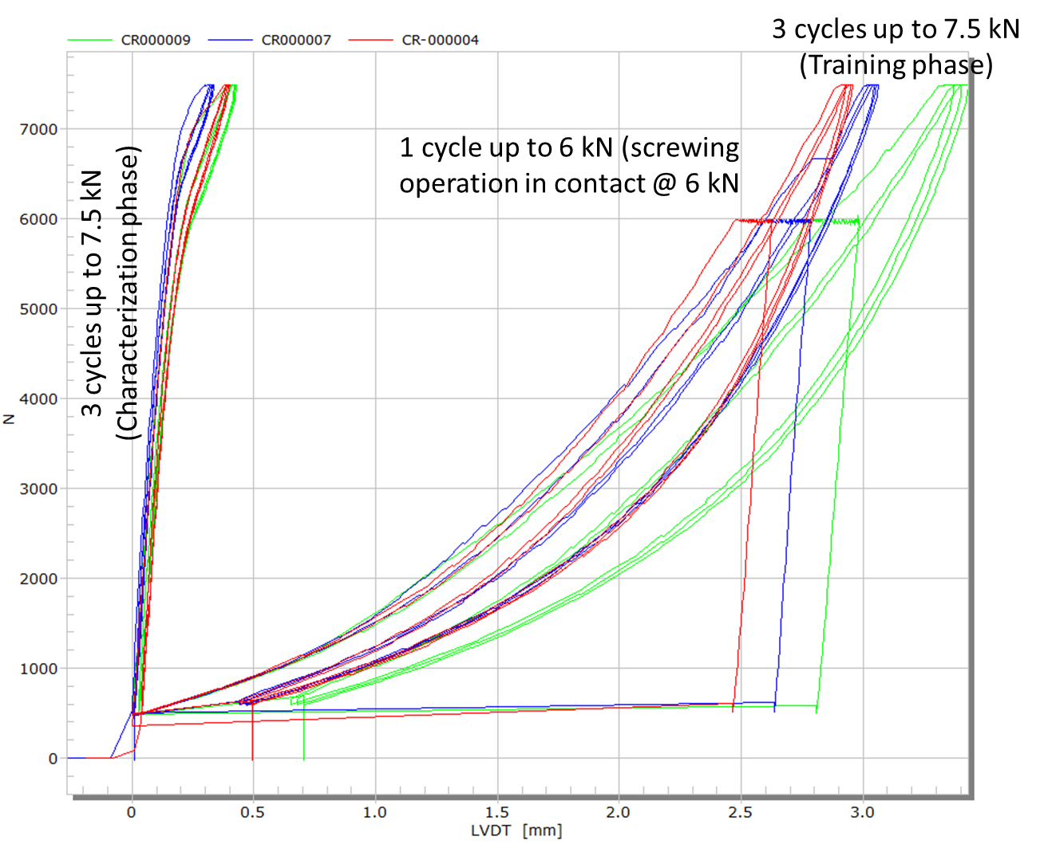
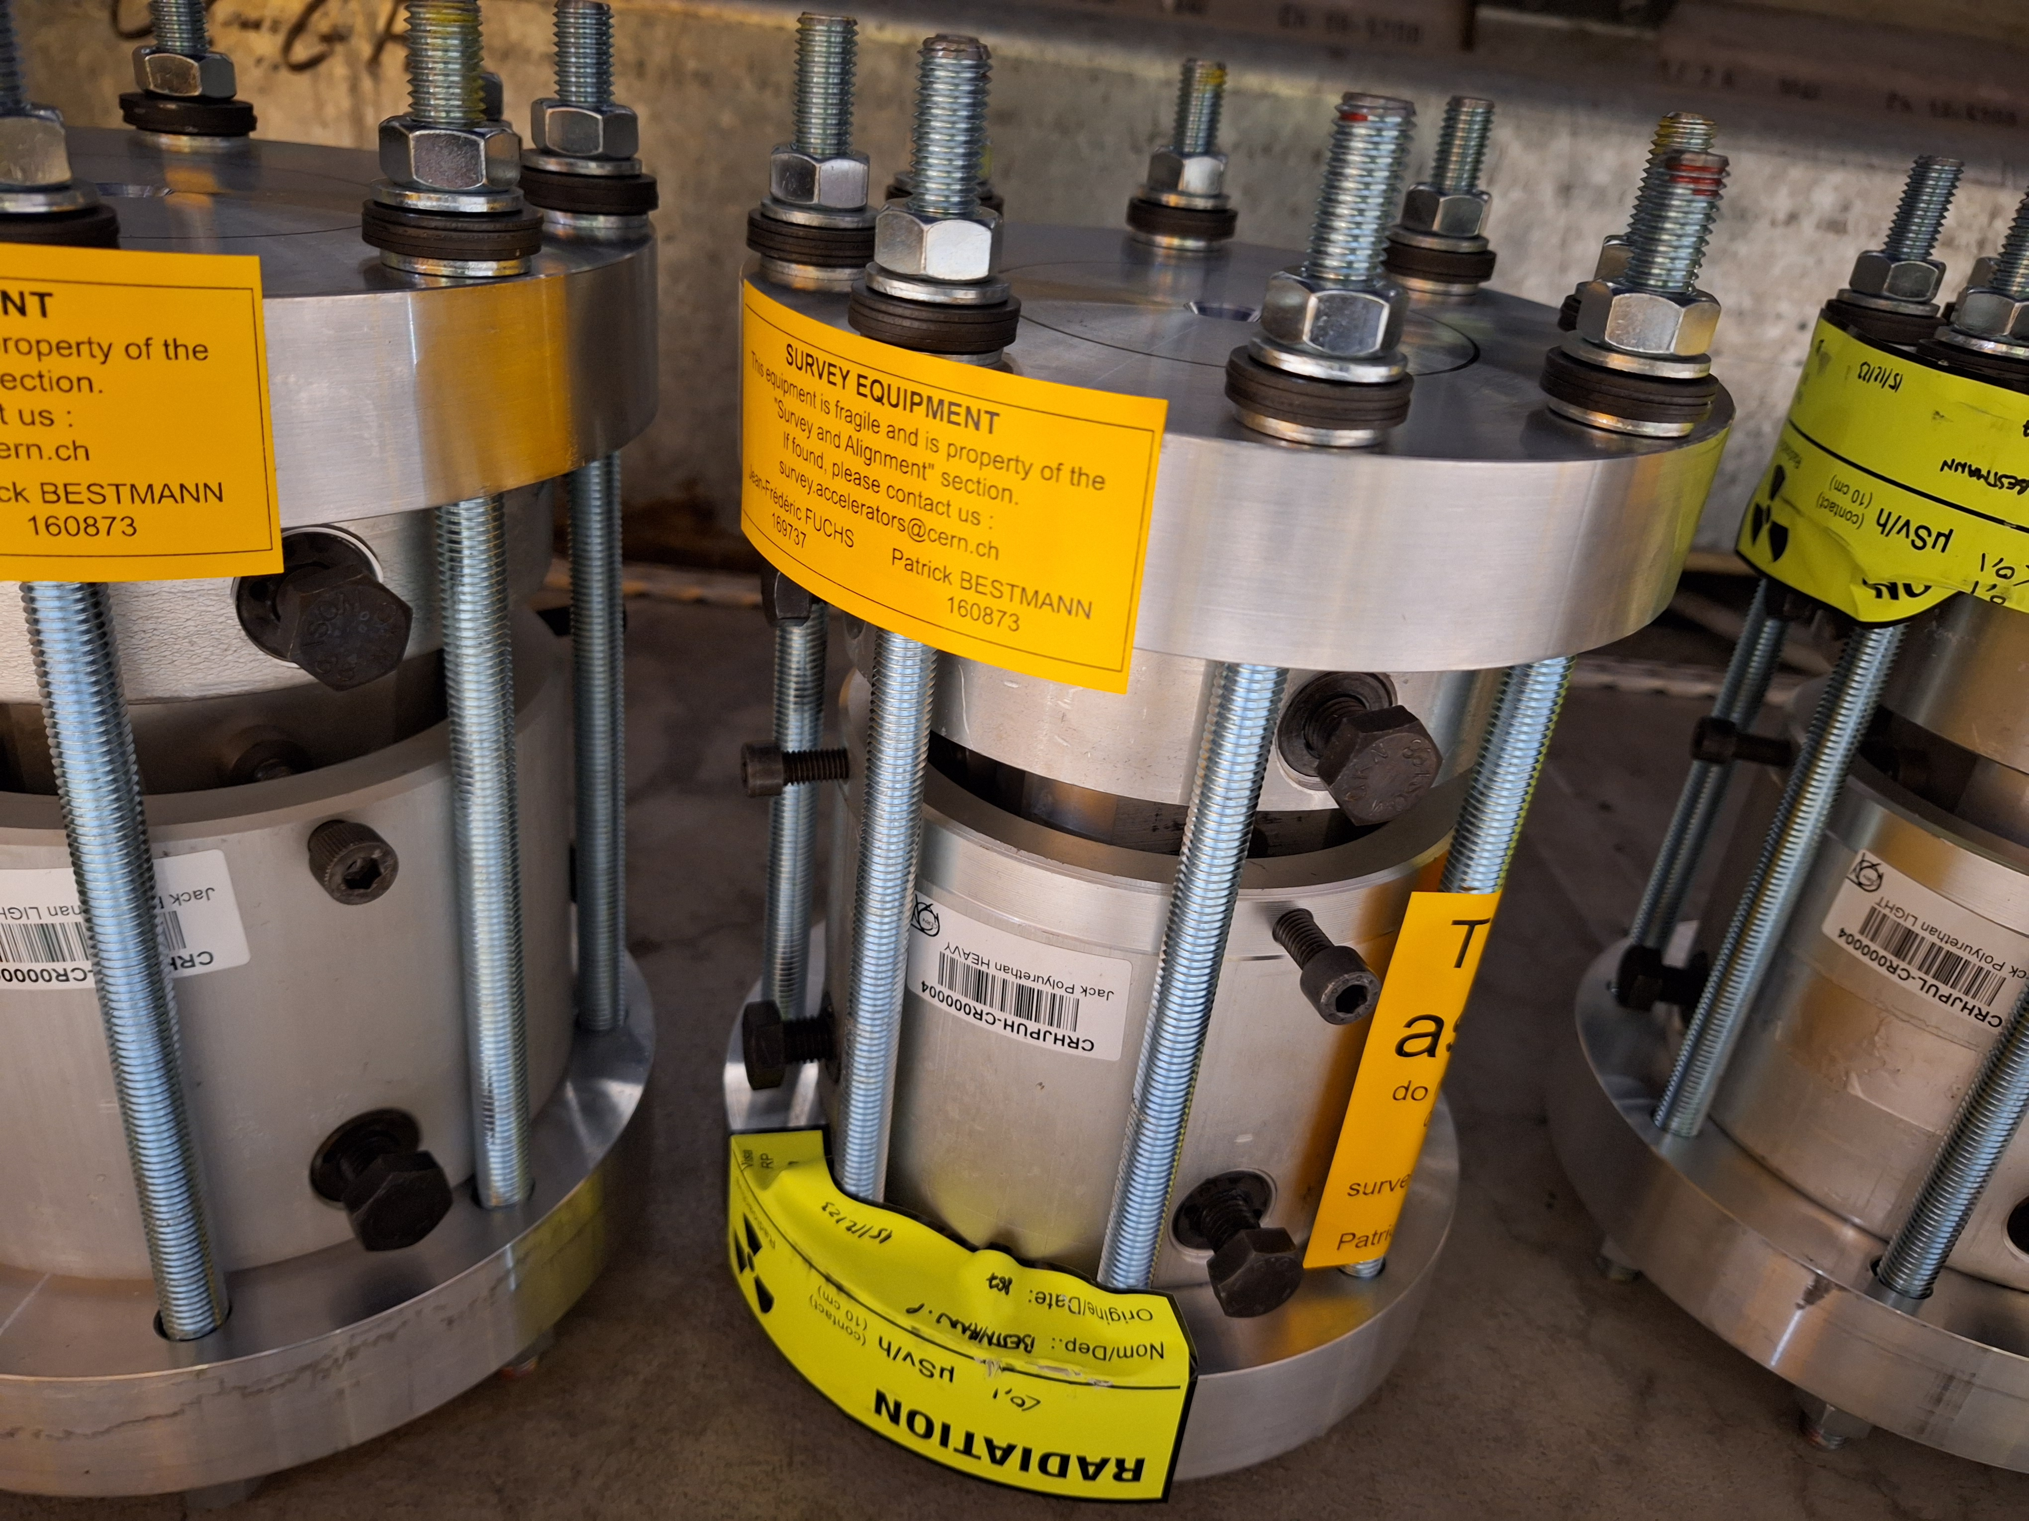
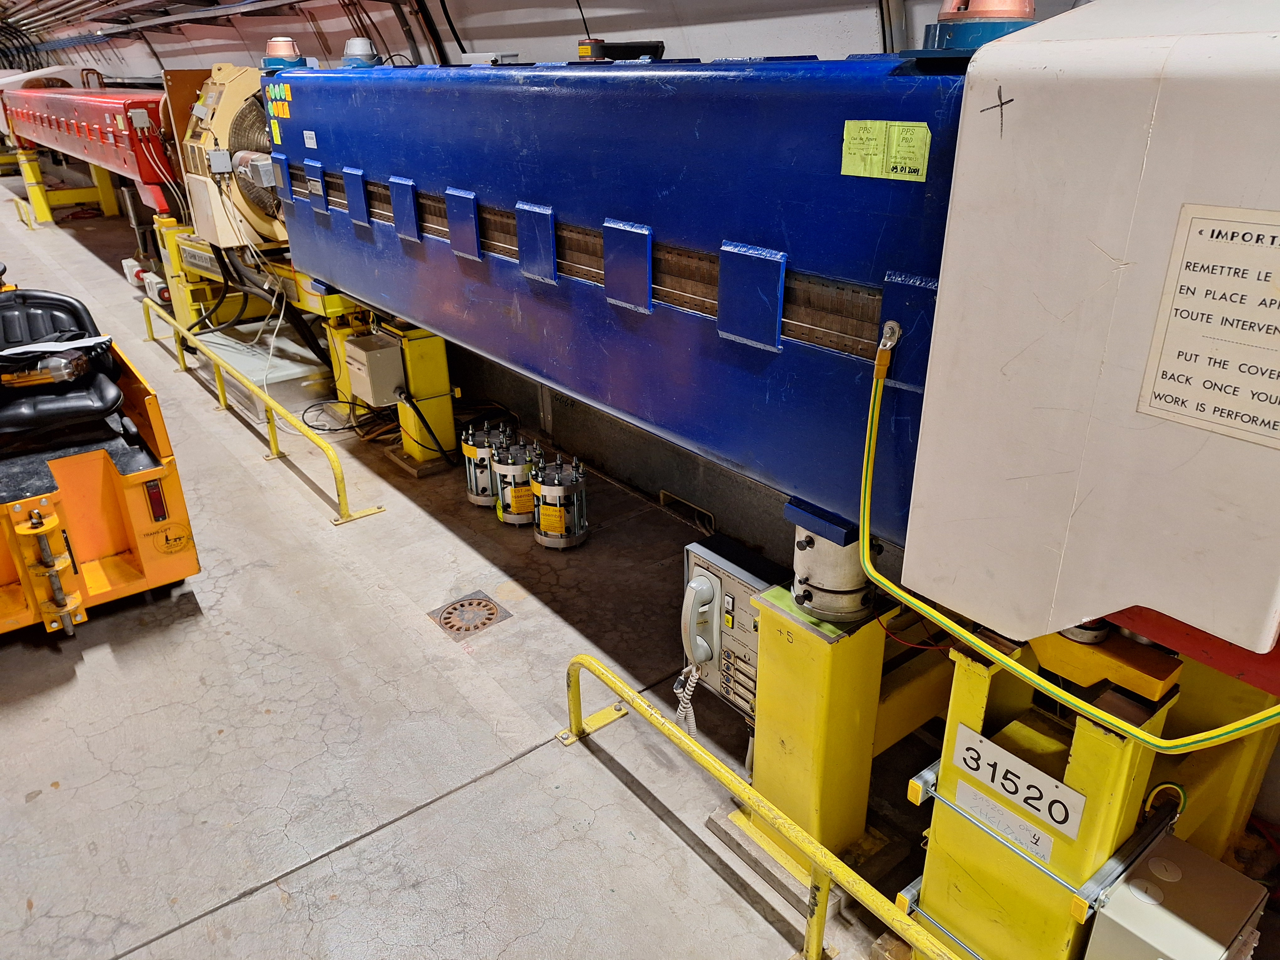
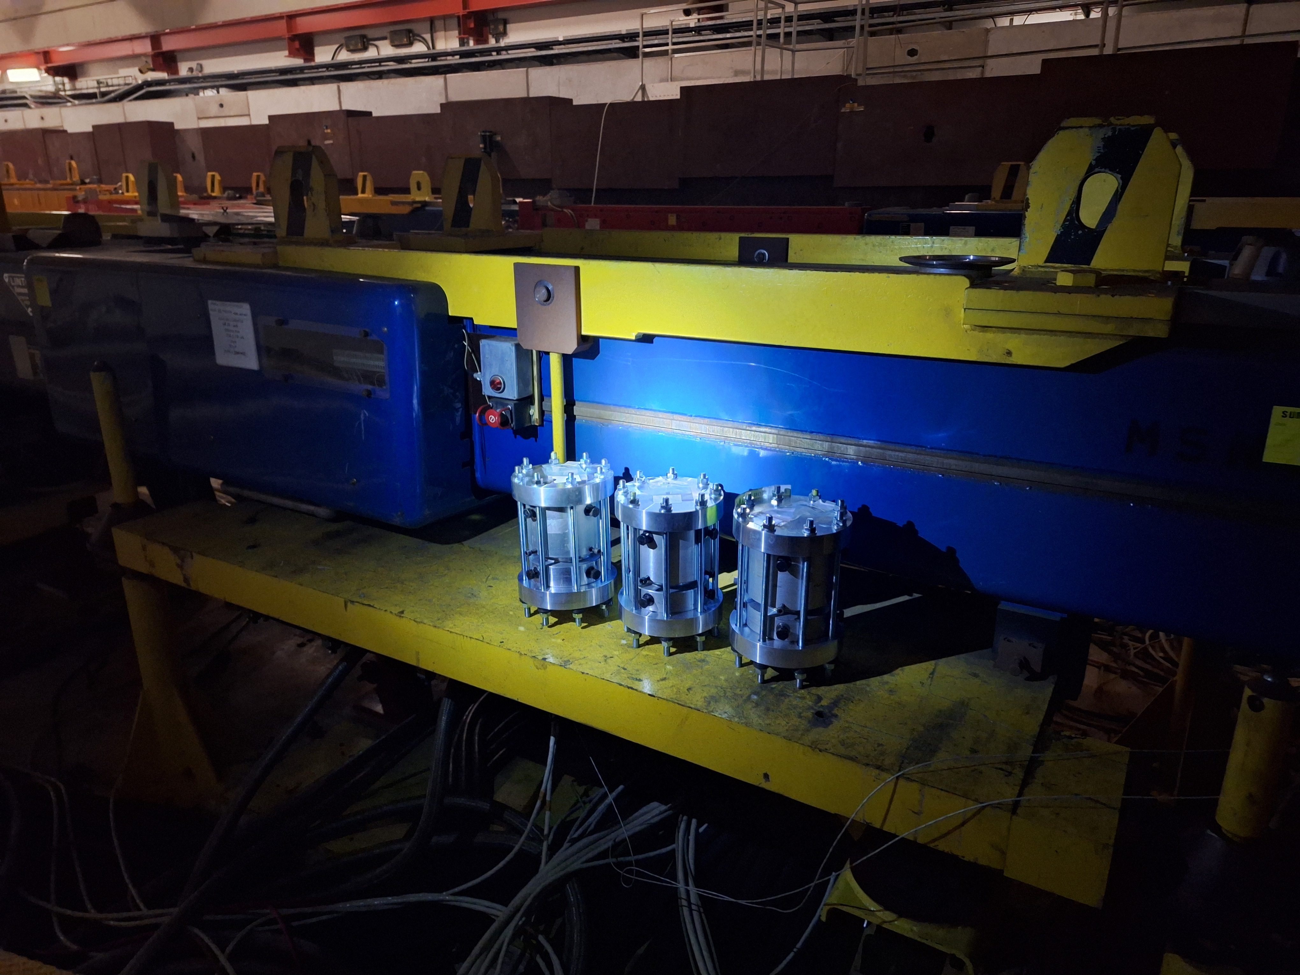
Latest news
SPS Test Jack assemblies tested and installed in the SPS and NA
  Equipped with RPL`s for Dose follow up

Slide 4
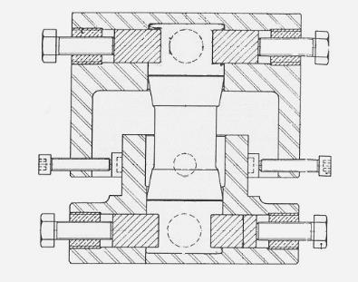
Latest news
New type of central column for SPS Jacks to be tested
  Replacing only central part
  With 2 spherical bearings
  Avoiding assymetric load on pads
Mechanical model and simulations
  Results of compression with DIC and model adjustments
  Different simulation software

Slide 5
Analysis of extracted jacks
Jacks from YETS23-24 analyzed
  Extraction position
  Mechanical conditions of jacks
  Optical state at extraction
  Hardness
  Chemical analysis

Slide 6
Chemical testing
  Swelling tests on 75ShA pads are in preparation
    CRHJPULP-CR000007 white translucide
    CRHJPULP-CR000008 slightly yellow
  News form the grease compatibility tests?
    First results
    Sample cutting from full pads

Slide 7
Transfert lines TI2, TI8 and TT41
  PU jacks have been installed in 2007
  Even if no apparanet sign of fatigue, compared to the SPS lifetime (2003-2018), they are at the end with a lifetime of 17 years and we are taking a risk!
  A preventive change during LS3 is mandatory
  500 magnets are concerned, evaluation of impact is ongoing

Slide 8
Important aspects
We need to reproduce the pad liquifaction to be sure of the reason!
  We need to test PG-65 and Lubrilog in the same test conditions to validate those!
Need to validate the radiation influence on the pads (hardening effect)
  This might lead to the observed breakdown in combination with assymetric load
We need to reproduce the mechanical failure in the lab! Tool in manufacturing
We need to produce a new test jack avoiding assymetric load!
We need to develop a consolidation plan from the YETS 2024/25 onwards
Practical aspects like tracing and procedures already in place
  Introduce this for all other lines

Slide 9
Consolidation Plan
Technical specification to be done, urgently!
  Do we have all aspects at hand? What is missing?
Oldest jacks today certainly in the Nort Area, but stabilized mechanically until LS3
TT20 installation date is not known, but not in the past 15 years!
  Propose change in LS3 with realignment of the TT20 line
TI2, TI8 and TT41 dipoles are on PU jacks as well (installation in 2007/8)
  Propose change in LS3
Regular and staged replacement seems unavoidable, safe interval to be determined
Avoiding assymeric load will certainly reduce early breakage and failures
…..

Slide 10
Ongoing / upcoming Tests
  Molycote BBR2 compatibility test Roland ongoing
  Compression tests with DIC (on pads) Mickael done
  Tensile tests (depending on samples) Mickael upcoming
  Creep tests (depending on samples) Mickael upcoming
  Swelling Tests (on pads) Benoit ongoing
  Compression Tests on Test Stands Michael done
  Radiation Test nTOF (pad+grease PG65/BBR2) Sonia ongoing

