Slide 1
DRD4 Working group 1
SiPM meeting

Slide 2
SiPM overview
Big disclaimer:
  I was short of time, and I used mostly material that I had on hand from my group
  The message should not be very different for other SiPMs
Outline:
  Gain and breakdown
  Electrical circuit
  Photon detection efficiency
  Dark noise, after-pulsing and cross-talk
  Timing resolution
  Radiation damage

Slide 3
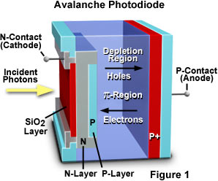
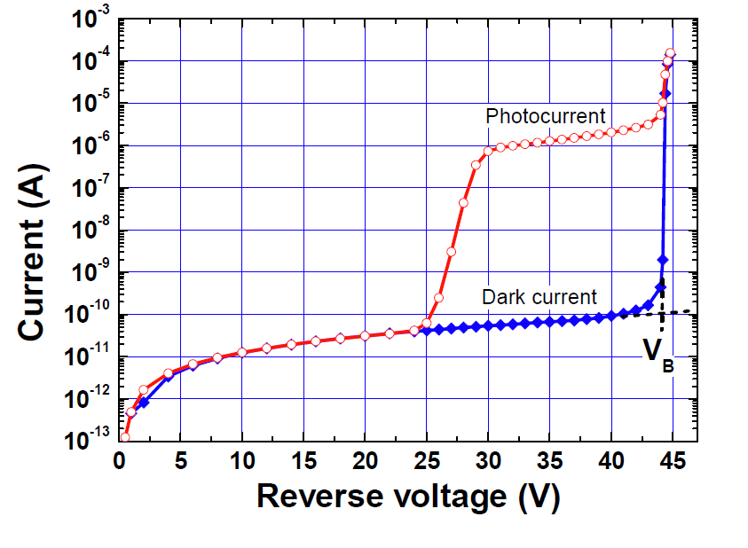
Single Photon Avalanche Detector
Avalanche photo-diode operated above breakdown
  Runaway avalanche due to impact ionization
with quenching circuit
  Passive (resistor)
  Active (transistor + quenching detection)
Passive
Active
(avalanche detection)

Slide 4
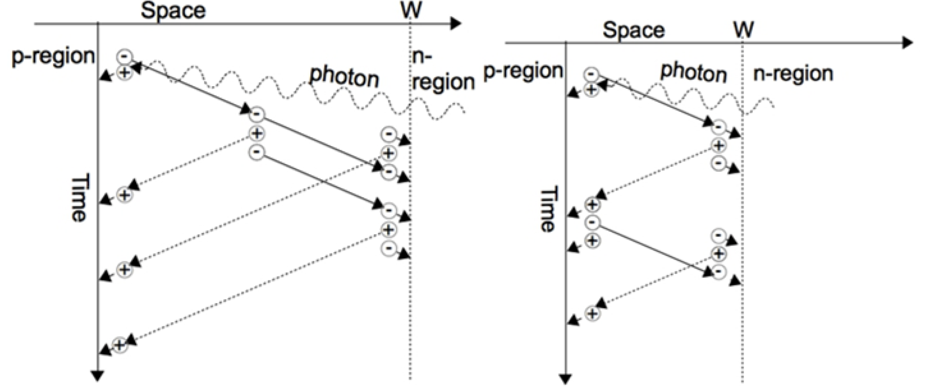
SiPM breakdown and gain
Limited avalanche
Only one type of carrier multiplies
Breakdown
  Once breakdown starts it self-sustains unless quenched
Quenching and gain
  Diode fully discharges. Charge is diode capacitance times over-voltage
  Peak current is set by quenching resistor
https://www.intechopen.com/chapters/49261
Breakdown avalanche
Both type of carriers multiplies
(with different probabilities)

Slide 5
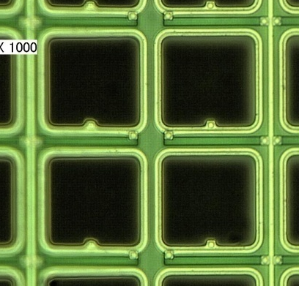
SPAD equivalent electrical circuit
Quenching
resistor
C_{quench}
R_{quench}
C_{quench}
R_{quench}
C_{quench}
R_{quench}
C_{quench}
R_{quench}
Aluminum lines
C_{line}
i_{avalanche}
C_{pixel}
i_{avalanche}
C_{pixel}
i_{avalanche}
C_{pixel}
i_{avalanche}
C_{pixel}
Diode
Parameters for T2K MPPC (… many years ago)
C_{pixel} = 90 fF
R_{quench} = 150 kΩ
C_{quench} ~ 4 fF (parasitic)
C_{line} ~ 10 pF (parasitic)
I_{avalanche} = (V_{operation} – V_{breakdown}) / R_{quench} ~ 5-10 μA
Q_{avalanche} = (V_{operation} – V_{breakdown}) C_{pixel} ~ 90-140 fC

Slide 6
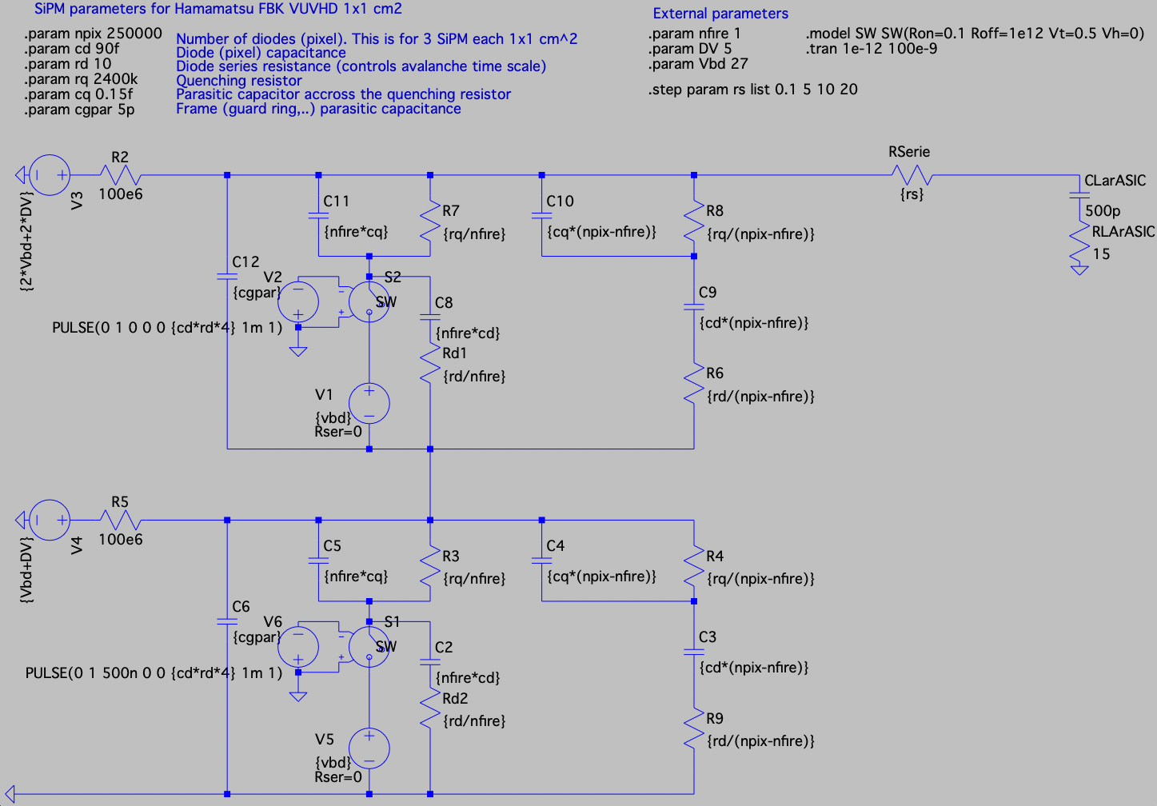
SPICE models as information repository?
Example of a system level model
For nEXO 3 parallel SiPM + 2 series with LArASIC
SiPM parameters
SPAD capacitance
SPAD resistance (time scale of avalanche)
Quenching resistance
Parasitic quenching capacitance
Other parasitic capacitance and resistance

Slide 7
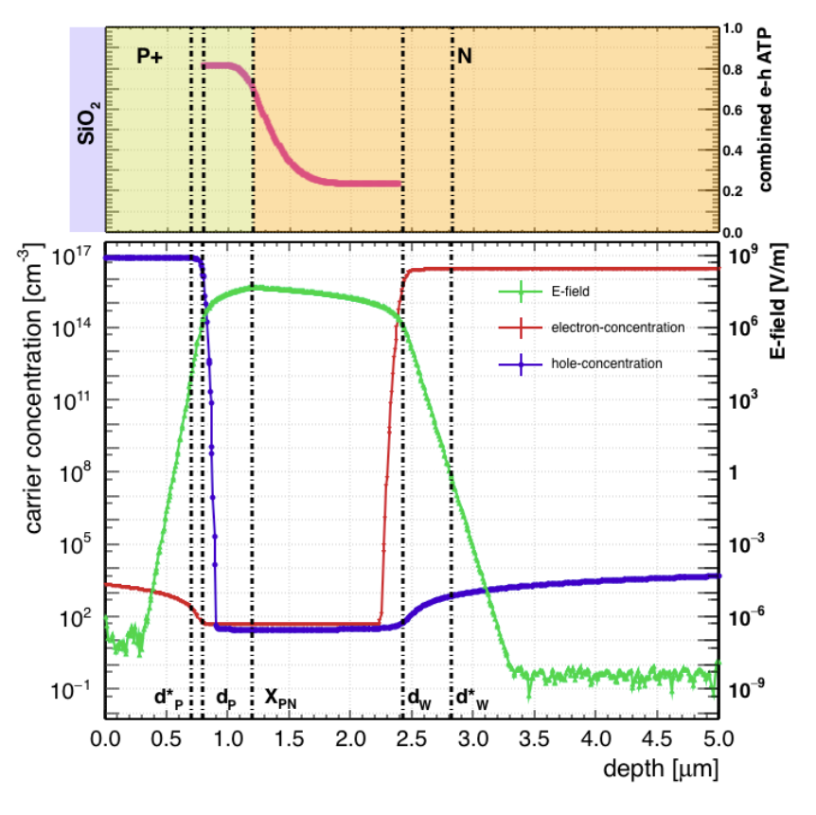
Understanding efficiency
… in p on n
G. Gallina et al., "Characterization of SiPM Avalanche Triggering Probabilities," in IEEE Transactions on Electron Devices, vol. 66, no. 10, pp. 4228-4234, Oct. 2019,
Fill factor FF
  Straightforward except at non-normal incidence
Transmittance (angle and WL)
Absorption depth (angle* and WL)
  Angle* after refraction (straighten a lot)
  Too close to surface -> lost
  In p region -> seed is an electron
  In n region -> seed is a hole (less effective)
  Beyond n region -> lost for new SiPM generation (avoid delayed cross-talk)
Avalanche triggering (seed type and over-voltage)

Slide 8
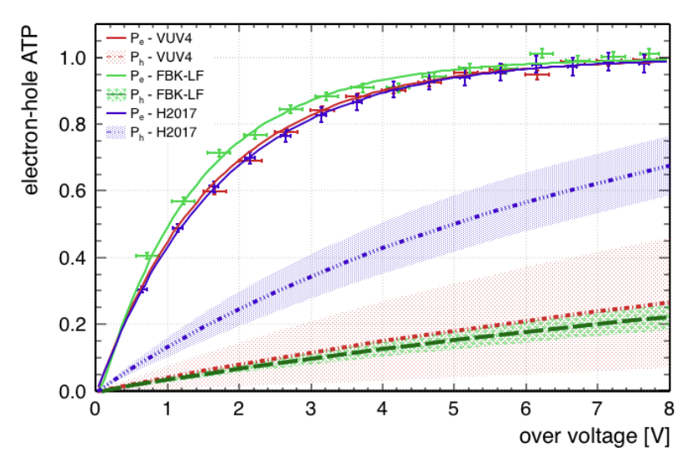
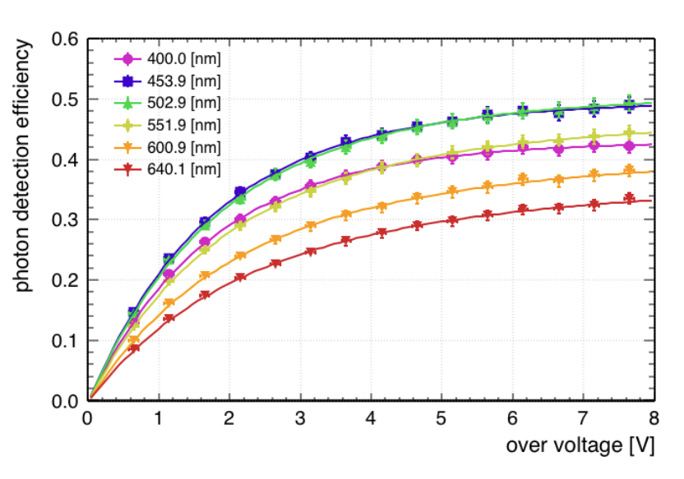
Quantitative modeling
G. Gallina et al., "Characterization of SiPM Avalanche Triggering Probabilities," in IEEE Transactions on Electron Devices, vol. 66, no. 10, pp. 4228-4234, Oct. 2019,
Free parameters are 3 geometric: surface depth, p-n junction depth, depleted region depth
And the rest is the probability that an electron or hole trigger an avalanche
Data from EPFL group

Slide 9
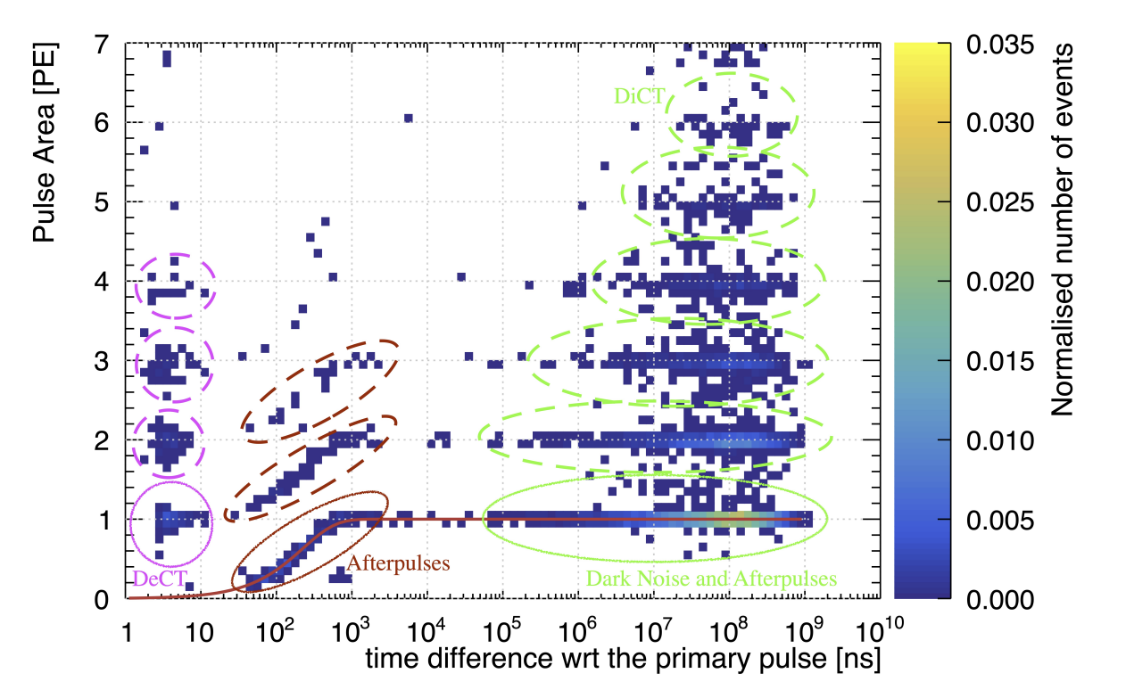
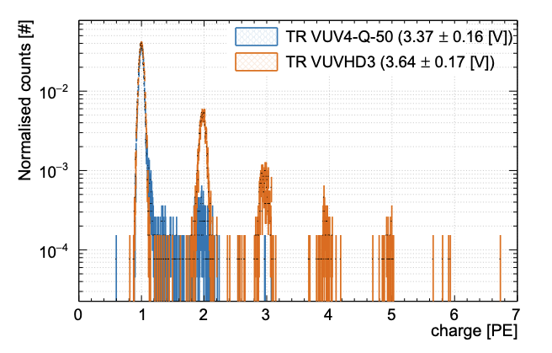
SiPM nuisance
The highly misleading finger plot
Yes, the gain fluctuation for a single avalanche is small
No, the charge fluctuation for 1 photon is not that small
There are “many” excess avalanches
Statistics of excess is not so obvious
My favorite figure…
Charge due to a single thermal carrier seed
Gallina, G., Guan, Y., Retiere, F. et al. Performance of novel VUV-sensitive Silicon Photo-Multipliers for nEXO. Eur. Phys. J. C 82, 1125 (2022)

Slide 10
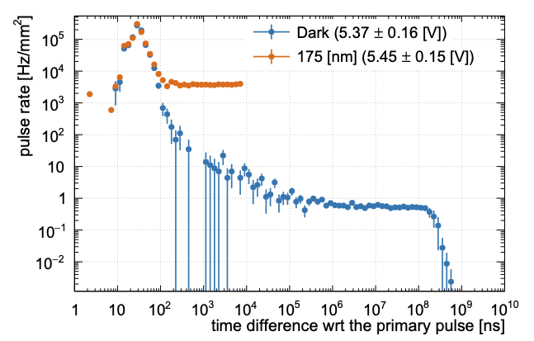
After-pulsing and dark noise
Separate dark noise and after-pulsing by building time difference
  + unshadowing if possible…
Best to measure efficiency with a pulsed light source
  If not available can be measured like dark noise
After-pulsing has decreased dramatically in last decade
  No longer dominant
Detected photon rate
After-pulsing
Dark noise rate
Gallina, G., Guan, Y., Retiere, F. et al. Performance of novel VUV-sensitive Silicon Photo-Multipliers for nEXO. Eur. Phys. J. C 82, 1125 (2022)

Slide 11
Note on efficiency measurement
Absolute efficiency is hard to measure with good precision
  Systematic errors are all too common
Important to have redundancy, i.e. several setup measuring the same thing

Slide 12
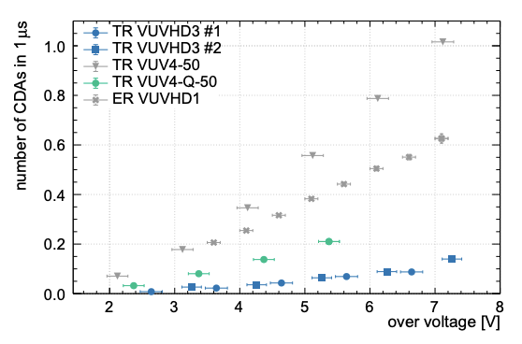
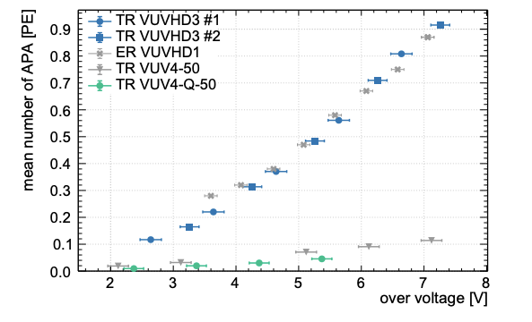
Optical cross-talk
Delayed correlated avalanche
aka after-pulsing (delayed xt is gone)
Prompt correlated avalanche
aka direct cross-talk
FBK VUV-HD3 is without metallic trenches
Hamamatsu VUV4 has W trenches

Slide 13
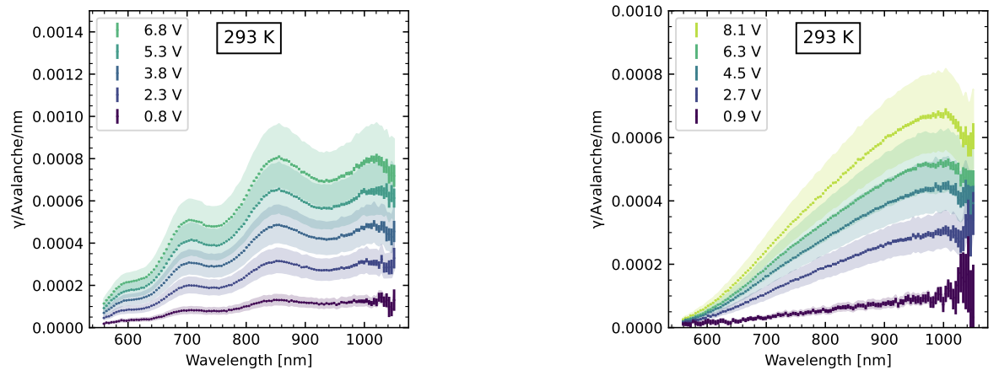
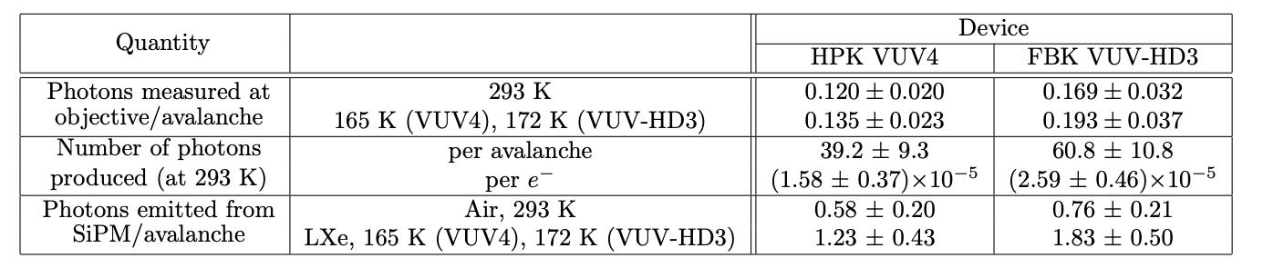
Optical cross-talk from SiPM light emission
The next issue is external cross-talk
Hamamatsu VUV4
FBK VUV-HD3
https://arxiv.org/abs/2402.09634

Slide 14
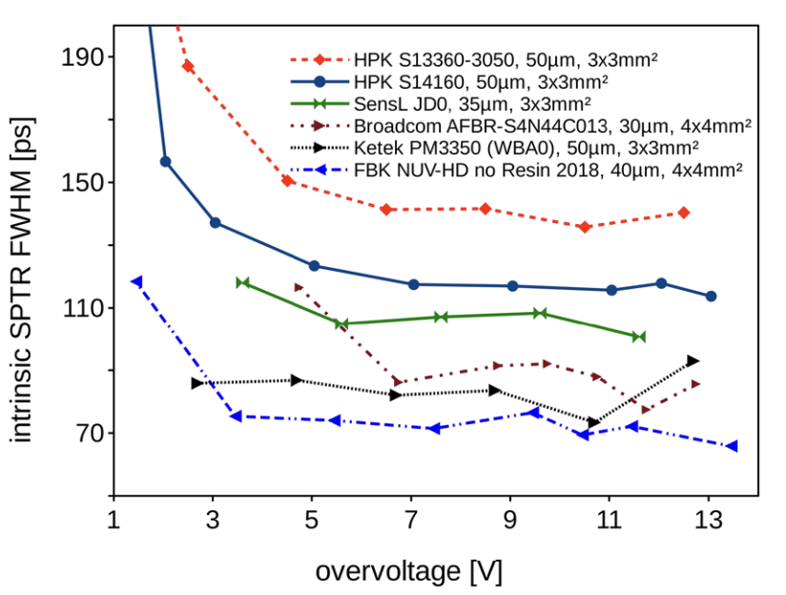
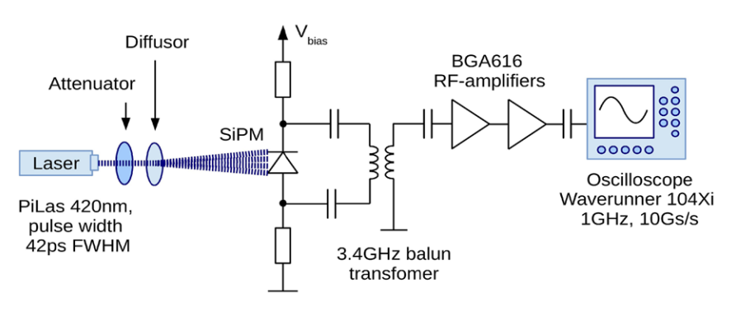
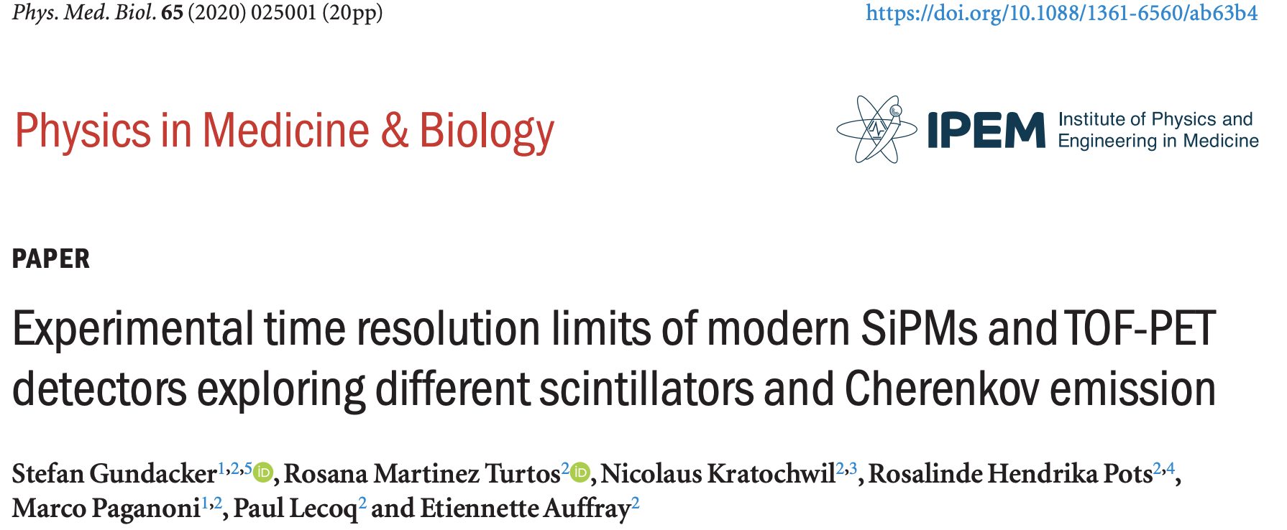
Single Photon timing resolution
Hard to measure well
  Need to select single photon
  Need excellent signal to noise
Benchmark is critical
  Reference papers are needed

Slide 15
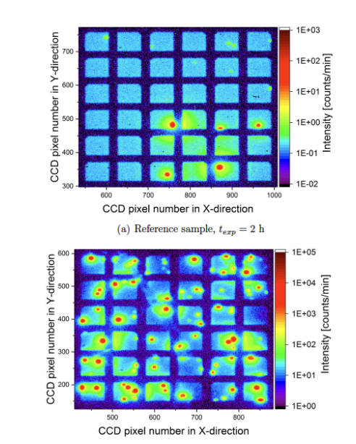
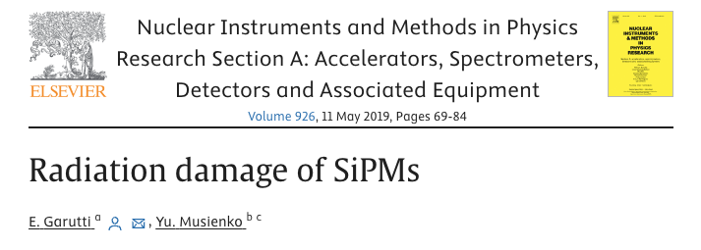
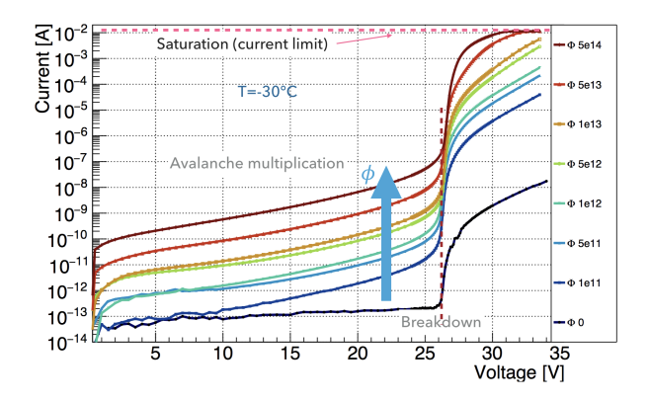
Radiation damage: major increase in dark current (pre and post breakdown)
Before irradiation
After irradiation

Slide 16
End of the introduction

Slide 17
List of talks in city alphabetical order
Bologna (Italy) – INFN/University –
Bucharest (Romania) - University
Ferrara (Italy) – INFN/University
Genova (Italy) – INFN/University
Lausanne (Switzerland) – EPFL
Melbourne (Australia) – Monash University
Perugia (Italy) – INFN/University
Trento (Italy) - FBK
Vancouver (Canada) – TRIUMF
Wuppertal (Germany) - Univeristy

