Slide 2
Technical Galleries Consolidation Program
TG-CONS Schedule

Slide 3
Agenda
Program status
PLAN
Review of works by Group
Key-take aways

Slide 4
Program Status - DASHBOARD
LS3 activities
Gallery | Drinking water | Firefighting network | Compressed air | Heating pipes | Decabling | Doors, metal frames, roofs, ladders, false floors | Asbestos , led diagnostics | Drain check | Scans | 3D model Integration
835 north | Done | Done | Done | Done | Done | Done | Done | Done | Done | Done
835 south | Done | Done | Done | Done | Done | Done | Done | Done | Done | Done
825 part 4.1 | Done | Done | Done | Done | Done | Partially | Done | Done | Done | Done
825 part 4.2 | Done | Done | Done | Ongoing | Done | Partially | Done | Done | Done | Done
825 part 3 | Ongoing | Ongoing | Ongoing | 2025 + 2026 | Done | Partially | Partially, 2025 + 2026 | TBC | Done | Done
825 part 2 | 2025 - 2027 | 2025 - 2027 | 2025 - 2027 | 2028 | Done | TBC | 2025 - 2028 | TBC | Done | 2024
825 part 1 | 2026 | 2026 | 2026 | 2029 | Done | TBC | 2026 + 2029 | TBC | Done | TBC
833 | 2026 | 2026 | 2026 | TBC | 2025 | TBC | 2026 | TBC | 2024 | 2025
826 | Done | N/A | Done | Ongoing | Done | TBC | Done | Done | Done | Done
827 | Done | N/A | Done | TBC | Done | TBC | Partially | Done | Done | Done
830 | Done | N/A | Done | TBC | Partially, 2024 | TBC | Partially | Done | Done | Partially
836 | Done | N/A | Done | Done | Done | TBC | Done | Done | Done | Done
180 | Done | Done | Done | TBC | Partially, 2024 | TBC | TBC | Done | Done | Partially
183 | Done | Done | Done | N/A | Partially, 2024 | TBC | TBC | Done | Done | Partially
829 | Done | Done | Done | TBC | TBC | TBC | Partially | Done | Done | TBC
831 + 832 | TBC | TBC | TBC | N/A | Done | TBC | TBC | Done | Done | TBC
837 | 2027 | 2027 | 2027 | Done | Done | Partially | TBC | TBC | Done | TBC
821 | 2027 | 2027 | 2027 | 2027 (TL4A) | Done | Partially | 2027 | TBC | Done | Ongoing
Notes:
Done/Partially (Green bold font) – final state of consolidation achieved
N/A – equipment is not present in the gallery
TBC – consolidation needed, no specific date/technical solution foreseen yet
YEAR – consolidation foreseen in the specified year
Partially (blue font) – some consolidation works were already done, more to come

Slide 5
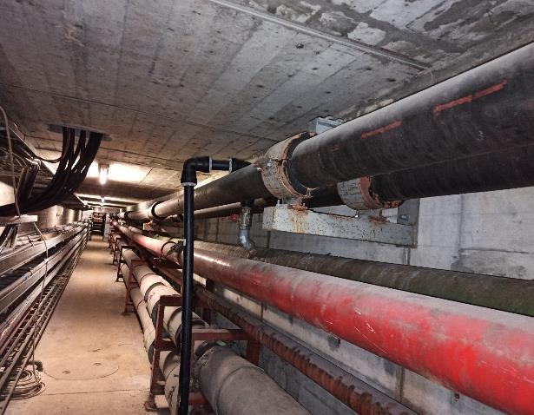
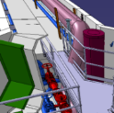
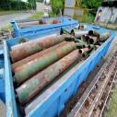
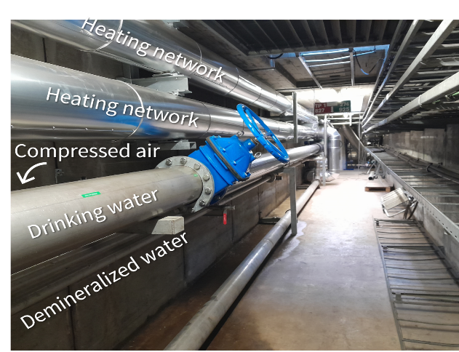
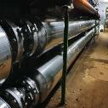
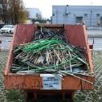
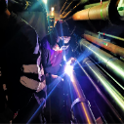
Program Status
Scanning, 3D models and integration of 5 km of galleries
276 tons of old piping and material removed
4.7 km of old piping replaced by 3.5 km of new piping
343 km of cables removed, 422 m³ of waste
2200 welds and 215 non-destructive tests

Slide 6
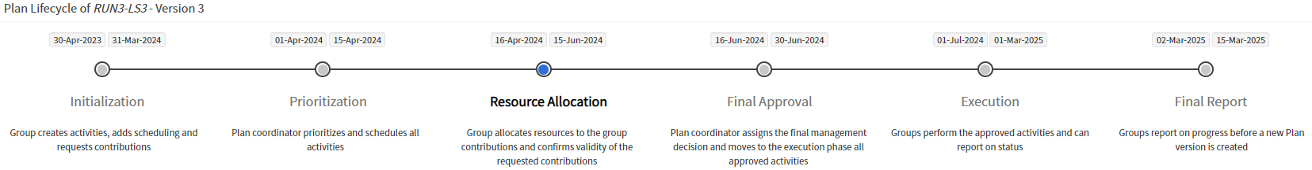
PLAN TOOL
RUN3
LS3

Slide 7
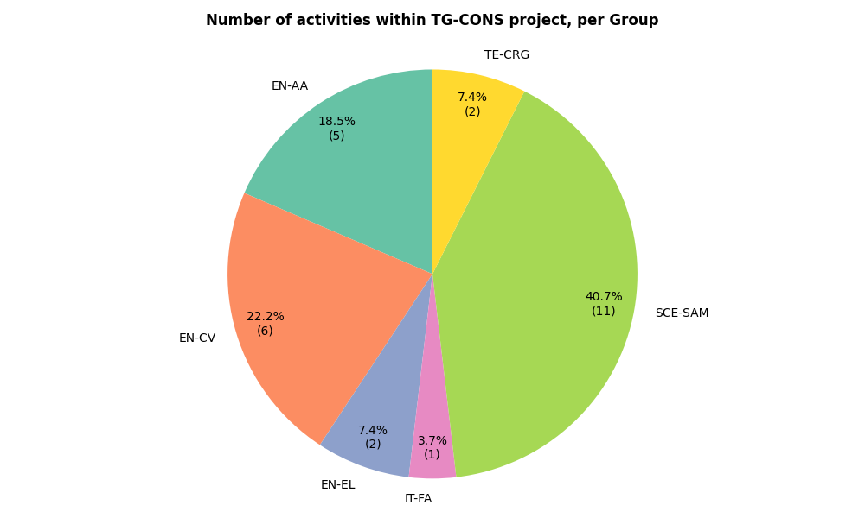
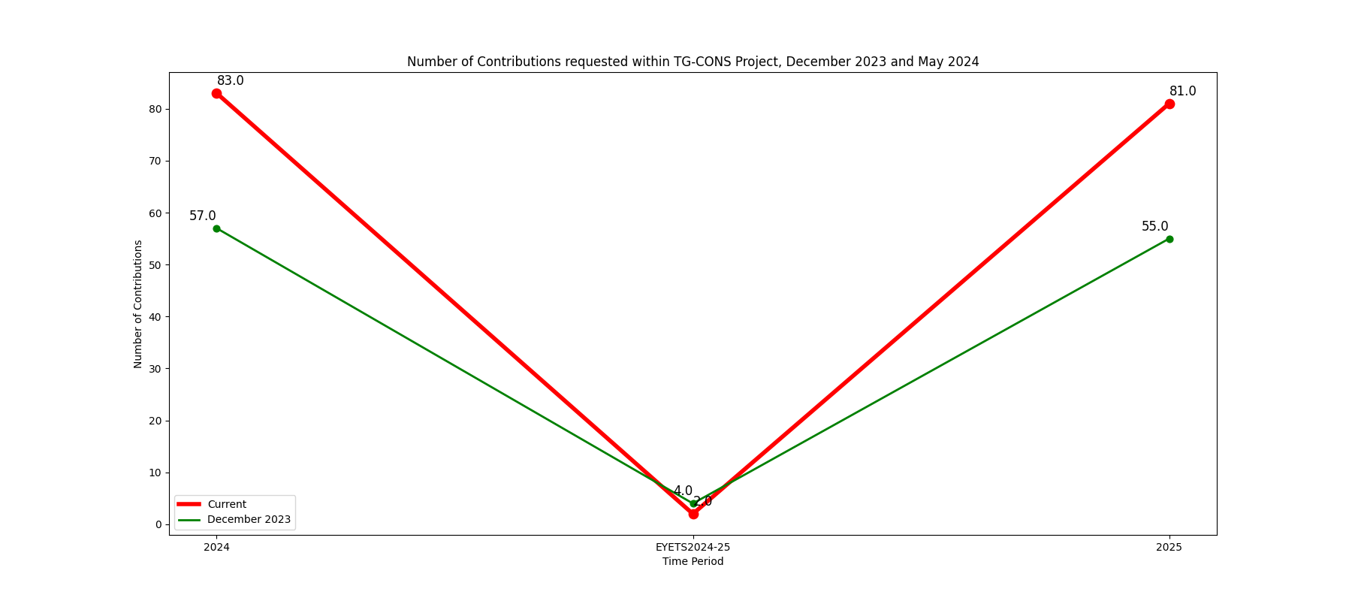
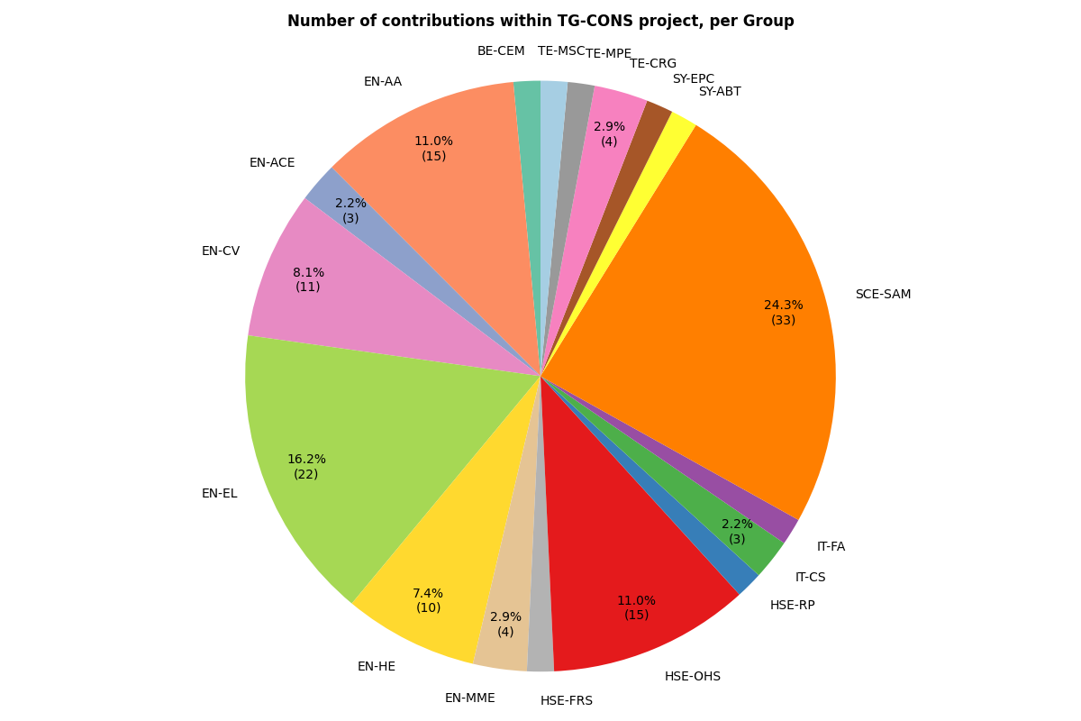
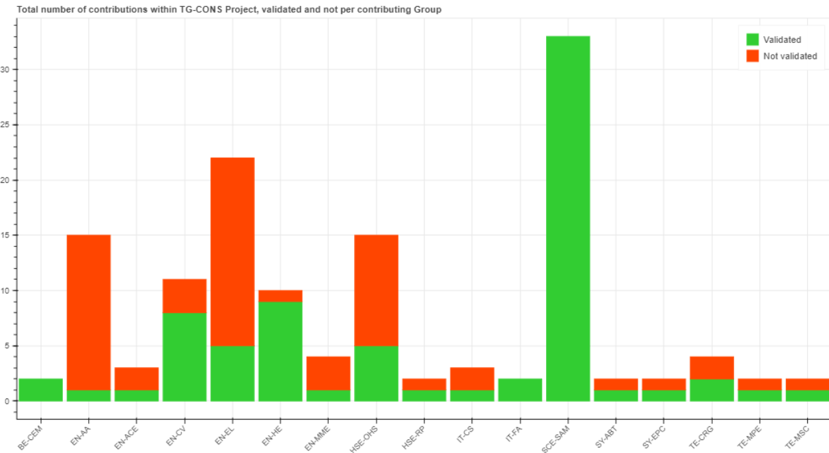
PLAN TOOL
Courtesy A. Borglund

Slide 8
Foreseen collaborations with other Groups
SCE-SAM
Civil engineering
Heating network
Drain systems
Normal/ emergency lighting
EN-CV
Water circuits: drinking, raw, firefighting, demineralised, chilled
Compressed air
Gas pipes (incl. He lines)
EN-EL
Cables: HV, LV, optical fibres, controls
Cable trays
Power supplies
Forecast expenditures by system/service

Slide 9
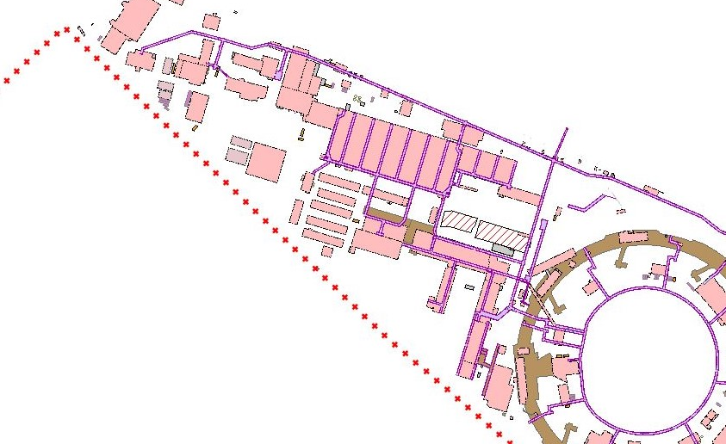
Heating pipes – accomplished & ongoing
2024
825
2023
2022
836
2023
835
826
2024
2023
Heating pipes
Status:
DONE/
ONGOING

Slide 10
Heating pipes – future works
2025
825
2025/26
825
2028
2029
821 (TL4A)
2027
Heating pipes
Status:
PLANNED

Slide 11
CA, EP, EInc – accomplished & ongoing
2023
825
2024
825
2022
2023
183
829
835
2022
2023
830
836
2023
826
2023
827
2023
Drinking Water + Compressed Air
Firefighting Water connections
Status:
DONE/
ONGOING
Notes:
Drinking water: 825, 829, 836, 835, 827, 830
Thanks to the firefighting network optimization, only 3 firefighting water connections are left in Meyrin West Area.

Slide 12
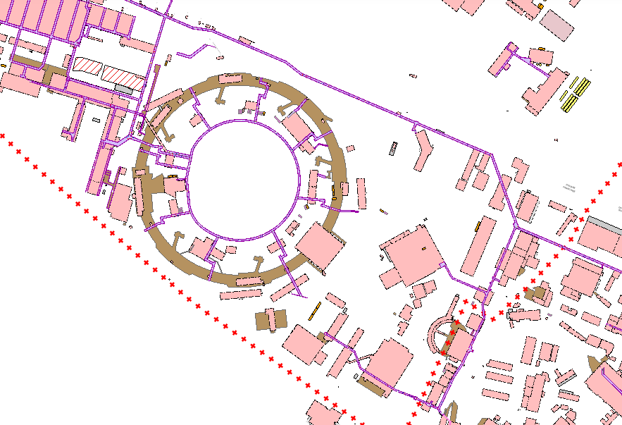
Future possibilities for EN-CV works
821
2025-27
821
821
825
837
821
821
2027-28
821
2026
821
Water tower
821
833
821
2025
833
2026
CV Networks (EP, AC, EI)
Buried pipes
Status:
PLANNED/
ONGOING STUDY
2025
833

Slide 13
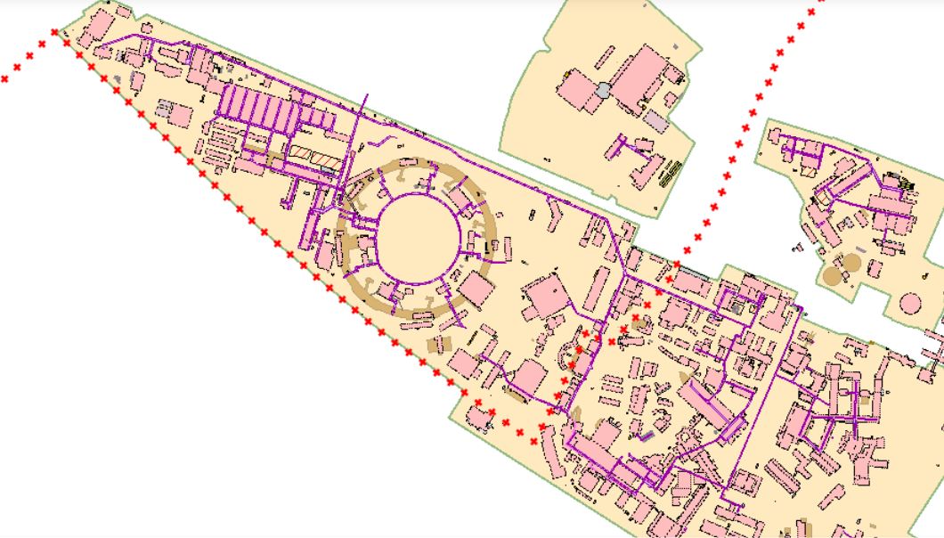
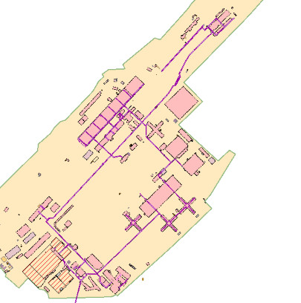
Decabling – accomplished
2023/24
822
2023
2022
2023
847
180
183
831
835
825
835
832
826
836
821
825
2022
837
827
2023
819
YETS 23/24
847
833
818
YETS 22/23
General decabling
Status:
DONE
Telecom cable removed

Slide 14
Decabling – future works
2024
183
180
2025
833
General decabling
Status:
PLANNED

Slide 15
Take Aways
TG-CONS is a long-term Program running until LS5, planned in 4 phases
Three main contributing groups: SCE-SAM, EN-CV and EN-EL
Re-engineering / Optimisation/ Priorization / Iso-functional replacement to some extent
LS3 activities will take place on the Meyrin site – central part (ISR up to gallery 833)
EN-EL has anticipated the cabling/decabling activities of phase 2 and will be free during LS3.
During LS3, all TG-CONS activities can be carried out in the shadow of higher priority activities and are not overly invasive
TG-CONS is a backup option for certain groups in the event of unforeseen circumstances/work stopped or blocked on other facilities

Slide 17
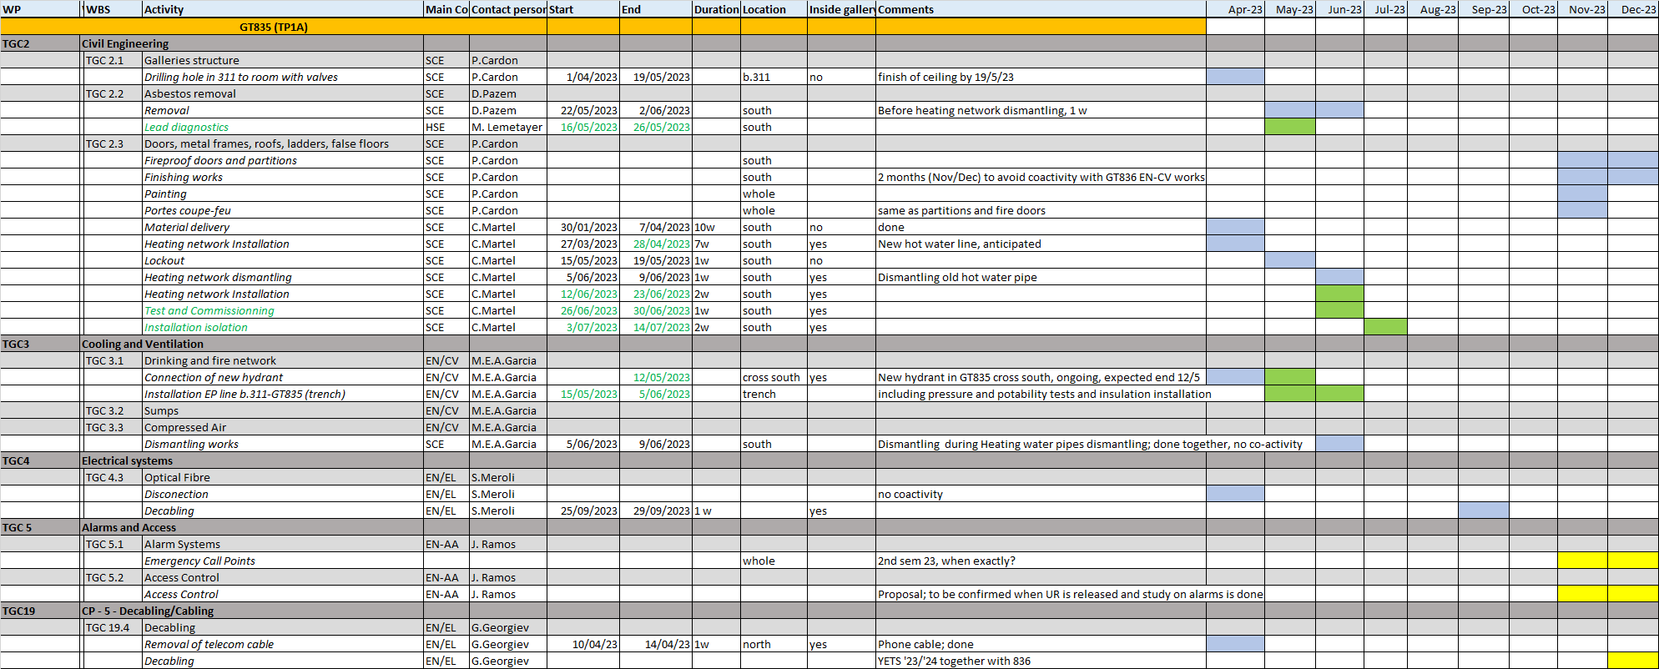
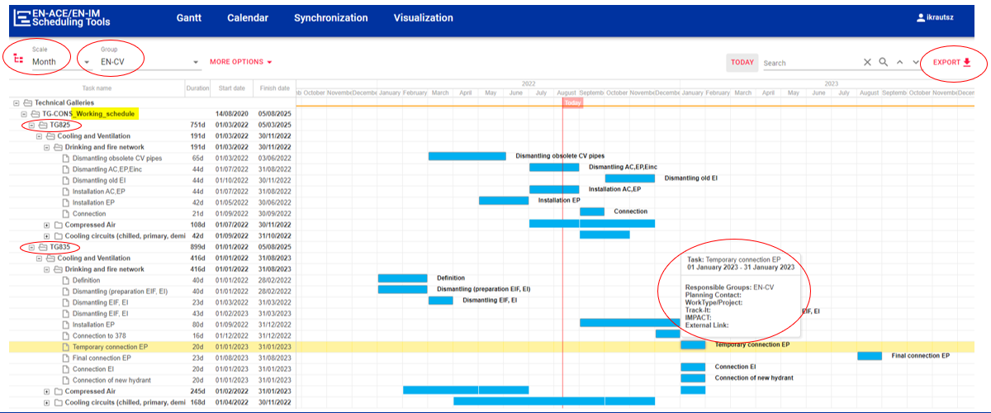
Schedule planning and monitoring
Detailed schedule
Gantt chart viewer
Link: EDMS 2705555
Link: EN-ACE scheduling tools online

