Slide 1
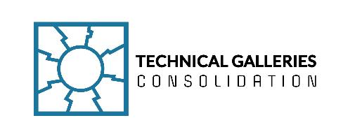
Technical Galleries Consolidation Program
Project Safety Challenges

Slide 2
Safety studies
Completed
Ongoing
Evacuation plan for Meyrin West Area (EDMS 2921024)
Gallery 827: access points and limits
CO2 and electromagnetic hazard in gallery 180 (EDMS 3072490)
Fire safety and access control in galleries under buildings 864, 865, 866 (ECR EDMS 3017204)
Removal of access point in b.274 (ECR EDMS 3000822)
Gallery 796: access points and fire safety (ECR EDMS 3017542)
Emergency and normal lights
Emergency Call Points (EDMS 2789563)

Slide 3
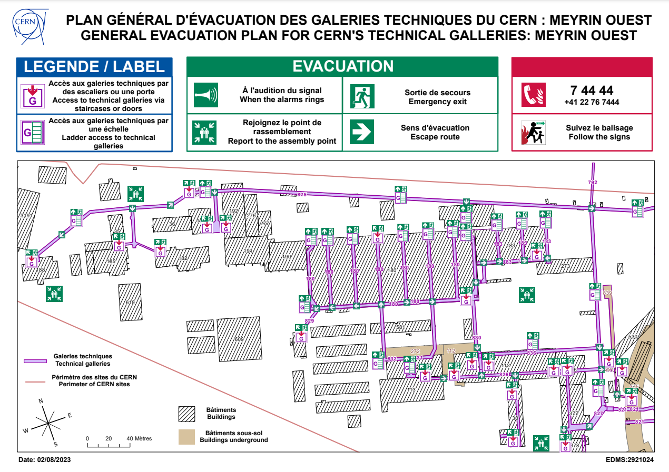
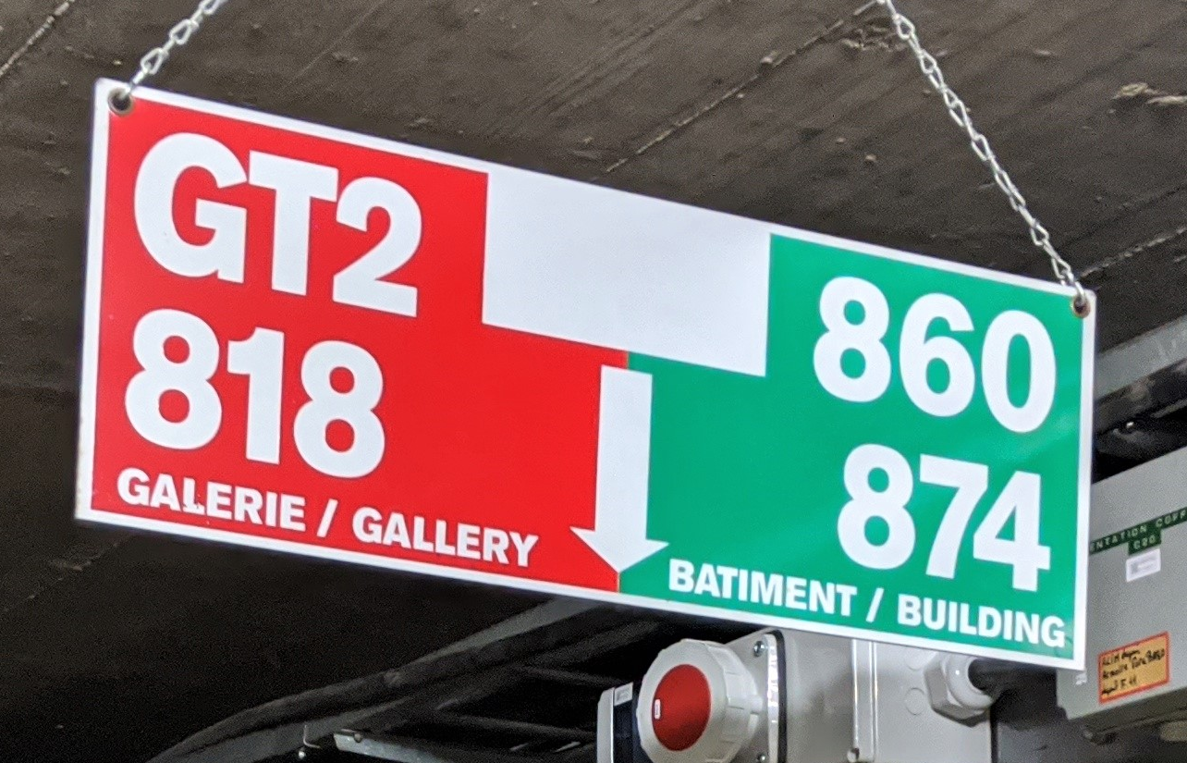
General evacuation plan for CERN’s technical galleries: Meyrin Ouest
EDMS 2921024
Location plates currently present in technical galleries
Notes:
Reminder: general evacuation plan to be provided to the contractors during VICs, closest evacuation routes and preferred access ways to be shown.

Slide 4
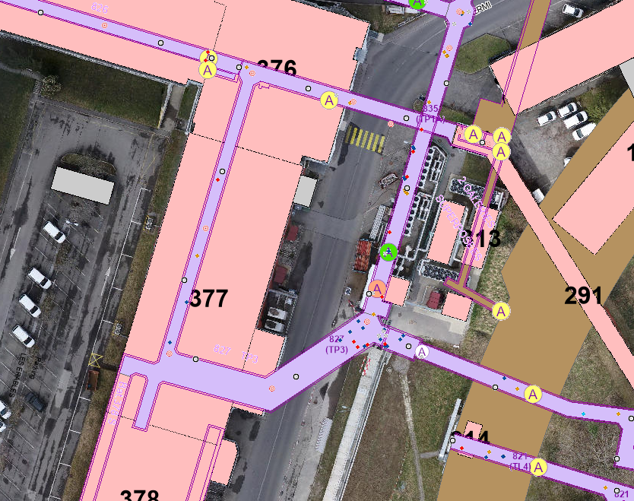
Gallery 827: access points and limits
Access point to be locked from outside, openable from inside (electronic key)
Fire partition to be installed, emergency exit both directions
Old doors to be removed
To be separated from 839 and marked as gallery in GIS
Doors to be equipped with alarm system (to register entrance to ISR storage in case of emergency escape from the gallery)
Limit of the gallery, fire partition to be installed

Slide 5
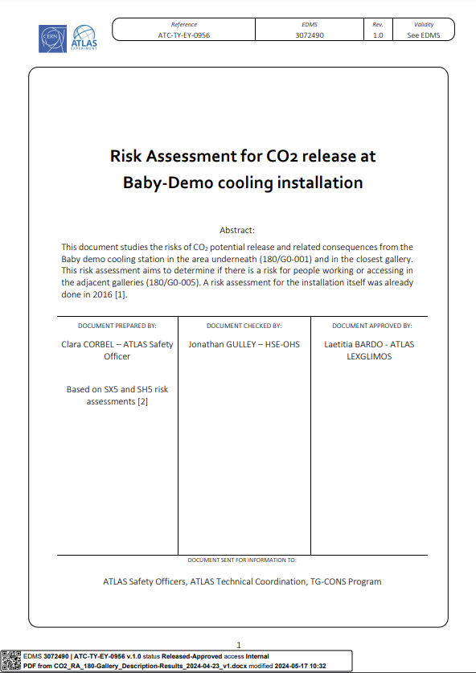
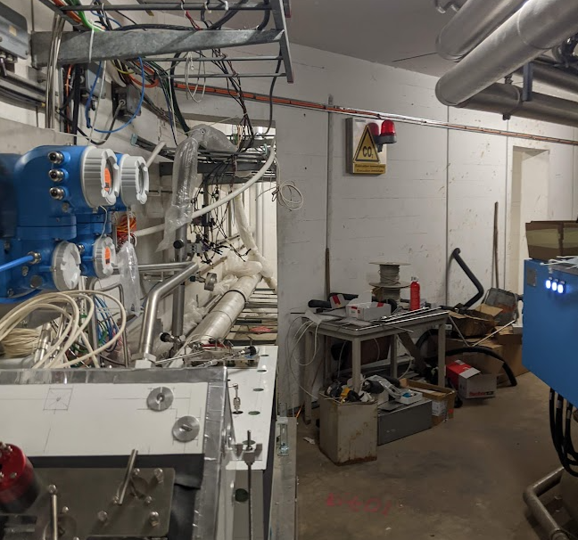
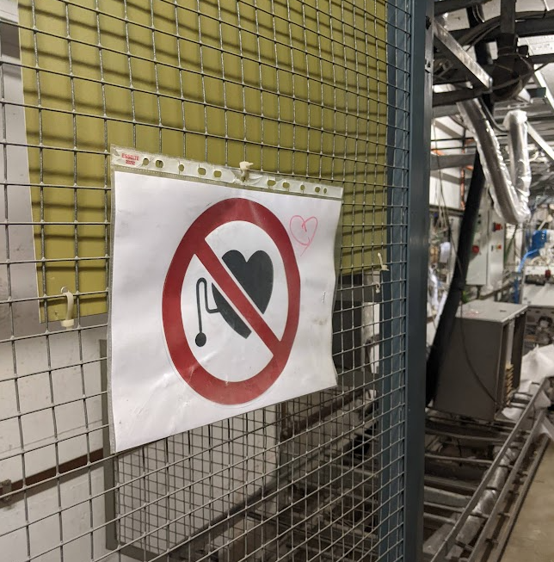
CO² and electromagnetic hazard in gallery 180
CO² - Risk Assessment - B180 Galleries under Baby demo
Electromagnetic hazard?
Result: no additional action needed – the existing safety measures were recognized as sufficient
EDMS 3072490
No hazard present in gallery 180 – confirmed by Herve Prin, Magnet Production Responsible
Obsolete warning signs were removed
Notes:
As can be seen from this example, it is important to keep paying attention to any potential impact on technical galleries caused by activities held in surface buildings. To approach more globally the need to monitor any risks propagated to the galleries, Sebastien Evrard will prepare a memorandum elaborating on this topic.

Slide 6
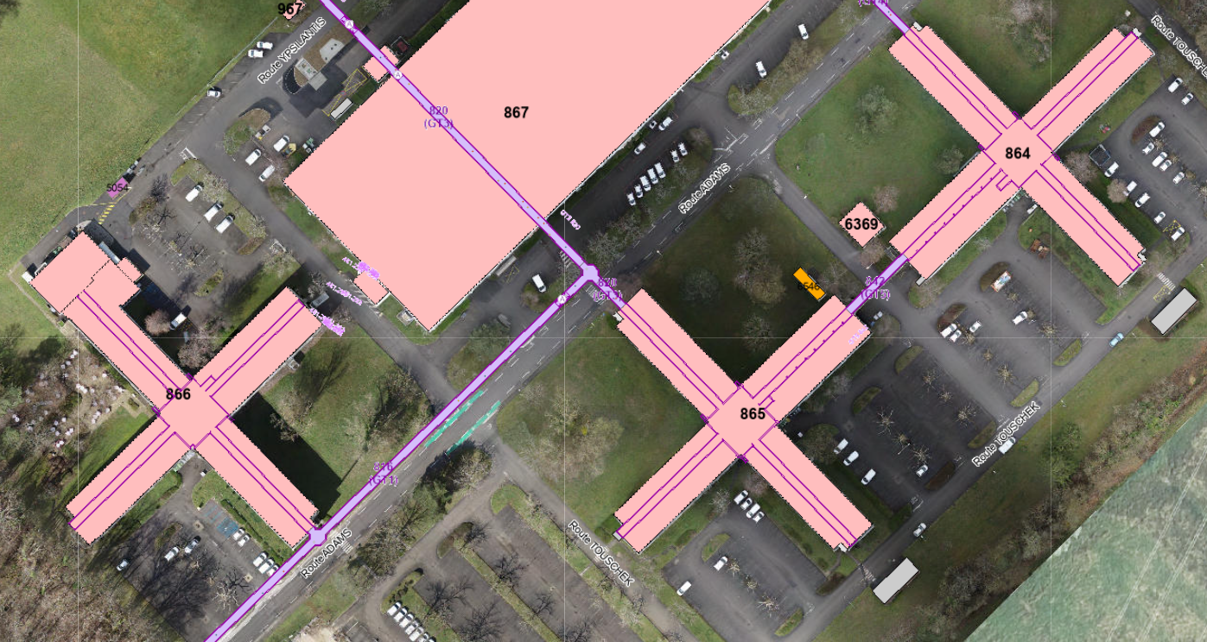
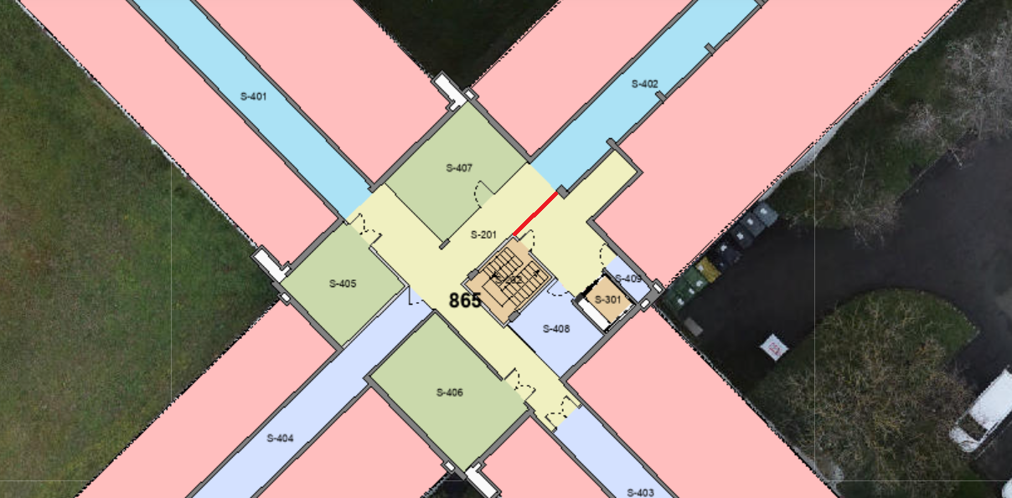
Fire safety and access control in galleries under buildings 864, 865, 866
Goal: improving fire safety and access control to technical galleries below buildings 864, 865, 866
Meetings among TG-CONS Team, EN-AA , EN-HE, HSE-OHS
  Buildings 864, 865, 866: new fire doors to be installed between building staircase and basement (864, 866 equipped with access control, marked with red triangles)
  Building 865 additionally: access control gate to be installed (marked with red line)
ECR: EDMS 3017204
Notes:
the current E120 lift doors are sufficient
New fire doors will be EI30

Slide 7
Ongoing studies
Emergency Call System
Emergency and normal lighting
Goal: To allow personnel to raise an alarm level-3 (IS37) in the event of an emergency and request assistance from the CERN emergency services by means of two-way voice communication
New! SRF on circuit integrity of Emergency Call Systems in Technical Galleries: EDMS 3021609
    New requirements on fire resistancy of cables
    Solution to be reviewed
URD (In Work): EDMS 2780563
Technical solution defined for emergency lighting by EN-EL (EDMS 3077752)
Normal lighting concept proposed by SCE-SAM

Slide 8
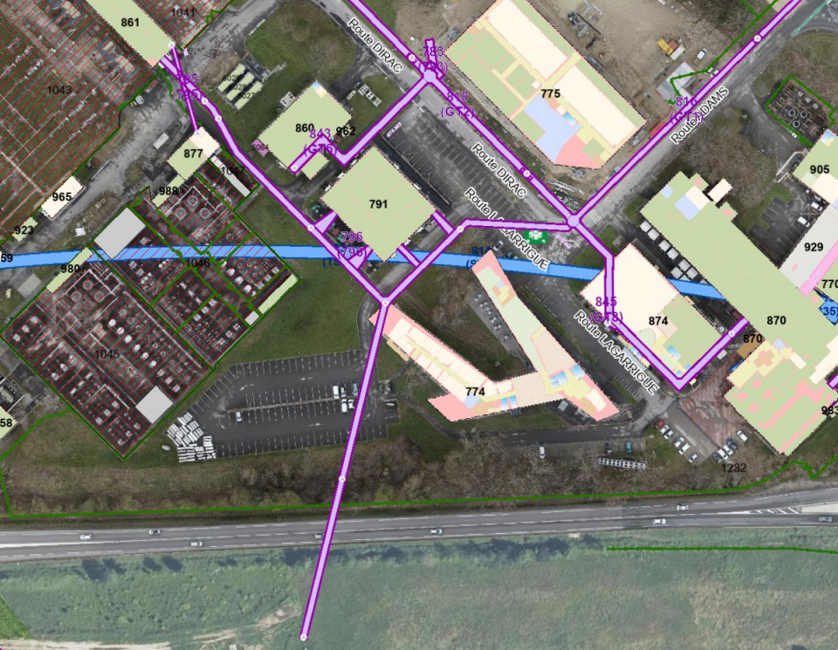
Gallery 796: access points and fire safety
- ongoing
New fire partition to be installed and access to be controlled
Openings between gallery 796 and basement of b.791 (BE91) to be closed
Passage blocked because of cable trays
Consolidate access points
Unblock drain pipes
ECR: EDMS 3017542 (In Work)

Slide 9
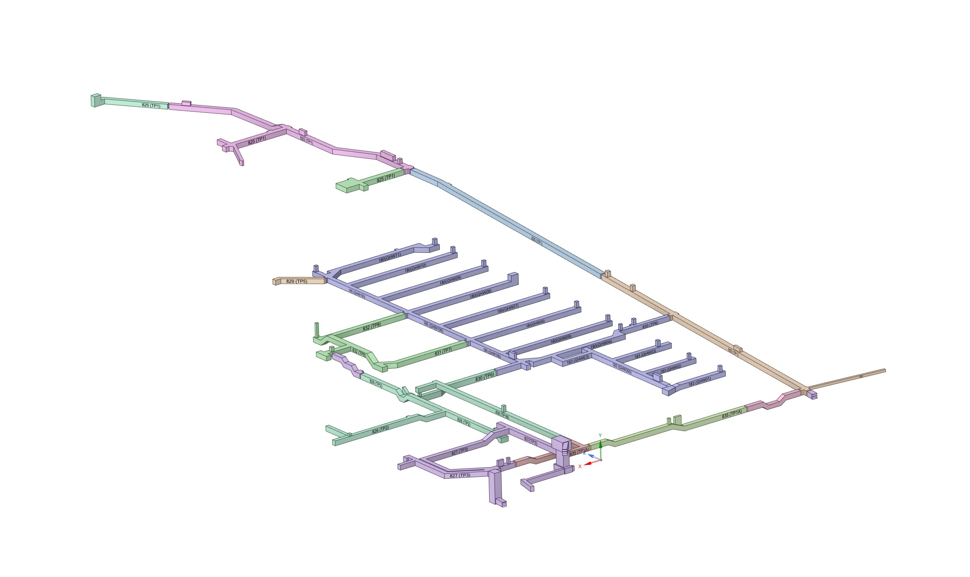
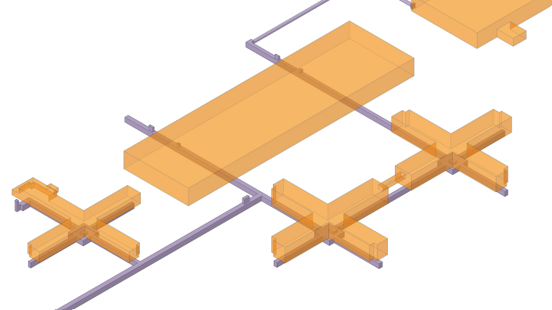
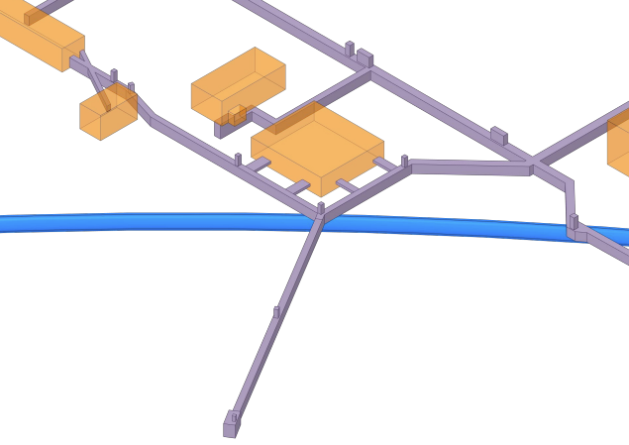
Fire partitions study - ongoing
Galleries under buildings 864, 865, 866, EDMS: 3017204
Meyrin West Area, EDMS: 2794867
12 new fire partitions/doors to be installed:
8 in Meyrin
4 in Prevessin
Gallery 796, EDMS: 3017542
Notes:
3 different studies

Slide 10
Safety systems combined – future state
Personnel access (hatch)
Material access
Fire partition
Call Point (36)
Gallery access through doors/staircase (14)
Main entrance (6)
Notes:
Holistyc approach to safety systems to assure their compatibility and coherent approach. Big amount of work is approaching.

Slide 11
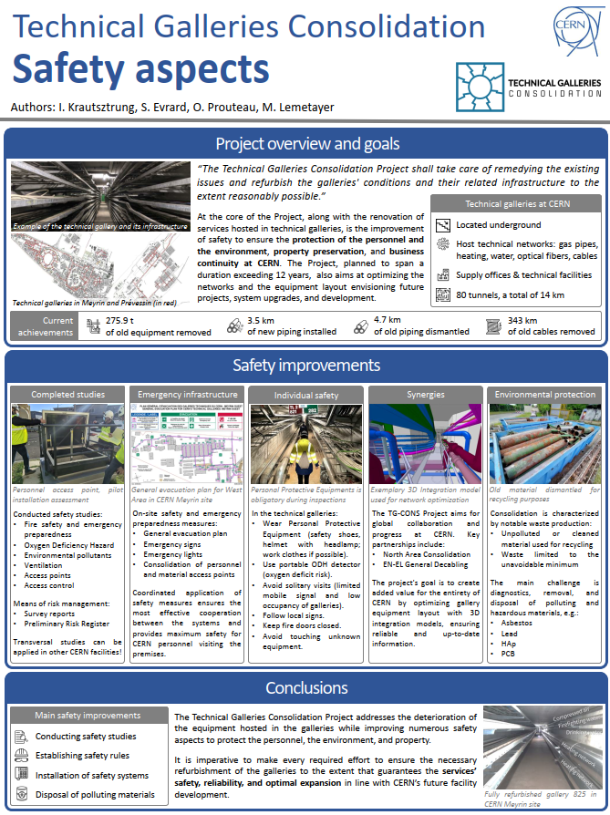
TG-CONS Safety aspects at International Technical Safety Forum
Dates: 10-14 June 2024
International forum, 2024 edition in Tokyo
Dedicated talk focused on safety aspects in the Technical Galleries Consolidation Program – remote
Poster session – on site

Slide 13
BACKUP slides

Slide 14
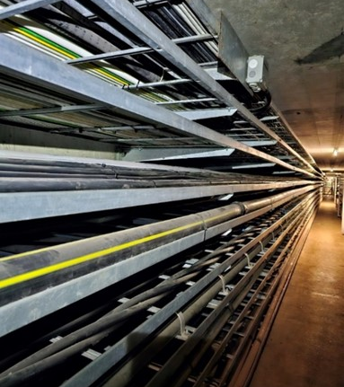

Consolidation of cable tray consoles in gallery 818
Cable tray supports found in bad condition in gallery 818
(issue might be also present in other galleries).
Cross-functional Working Group: TG-CONS, HSE-OHS, EN-EL
Goal: Find a proper response to the issue (solution, modus operandi)
Intervention done in YETS 23/24
Consolidation recommendations
Overloaded cable tray, EDMS: 2900780
SRF by HSE
Preliminary visit
Detailed inspection
Corrective intervention

Slide 15
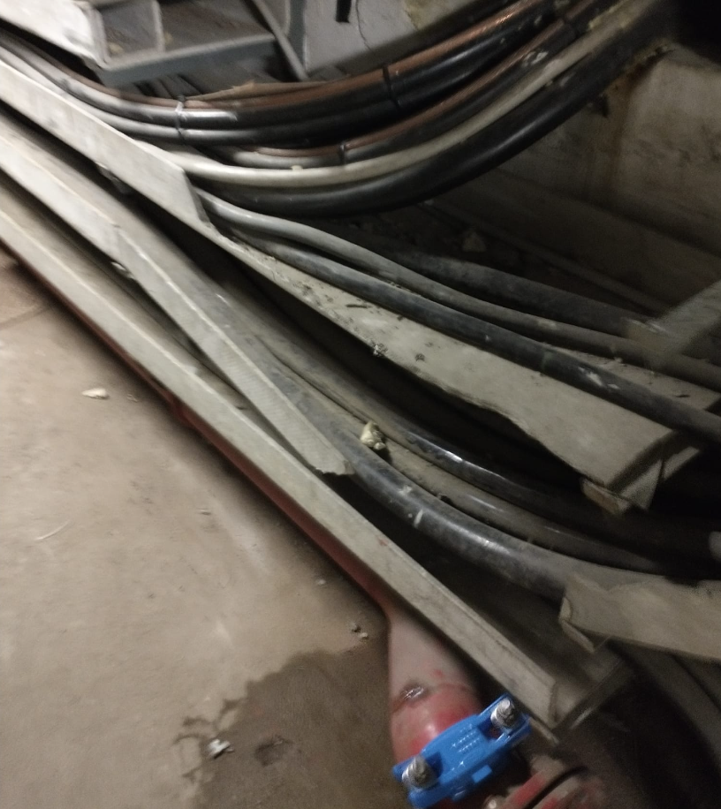
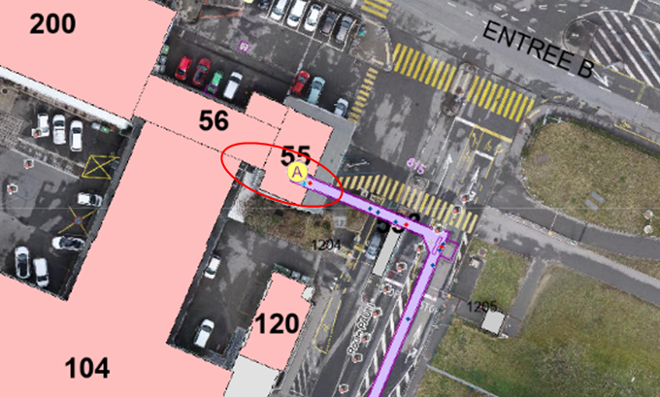
Removal of cable trays containing asbestos
Recurring and omnipresent issue
Special focus on the Swiss part of Meyrin
2 main hazards: asbestos, live cables – dual competencies needed
Cross-functional Working Group: TG-CONS, HSE-OHS, EN-EL, SCE-SAM
Pilot location chosen: gallery 815, under b.55
Contractor: TIA Suisse
Pilot intervention: postponed to YETS 24/25
Broken asbestos tray, EDMS: 2871752
Test exercise
Priorities
Survey
Pilot locations
Long-term plan

Slide 16

Support received from HSE
Reply to SRF relating to the program
HSE Representatives attending monthly Project meetings and Core Team meetings
Diagnostics needed before activities start
Superheated pipes (mechanical engineering) – validation of calculation for superheated pipes supports
Pressure tests after pipes installation
Safety and electrical inspections
(Level 3 Alarm testing and electrical inspections e.g., for Emergency Call System)
Safety support in matters of worksite safety

