Slide 1
Technical Galleries Consolidation Program
TG-CONS – SCE-SAM Heating network consolidation
Activities overview
Michela LAGIOIA
Gregoire GUILLOT
30/05/2024`

Slide 2
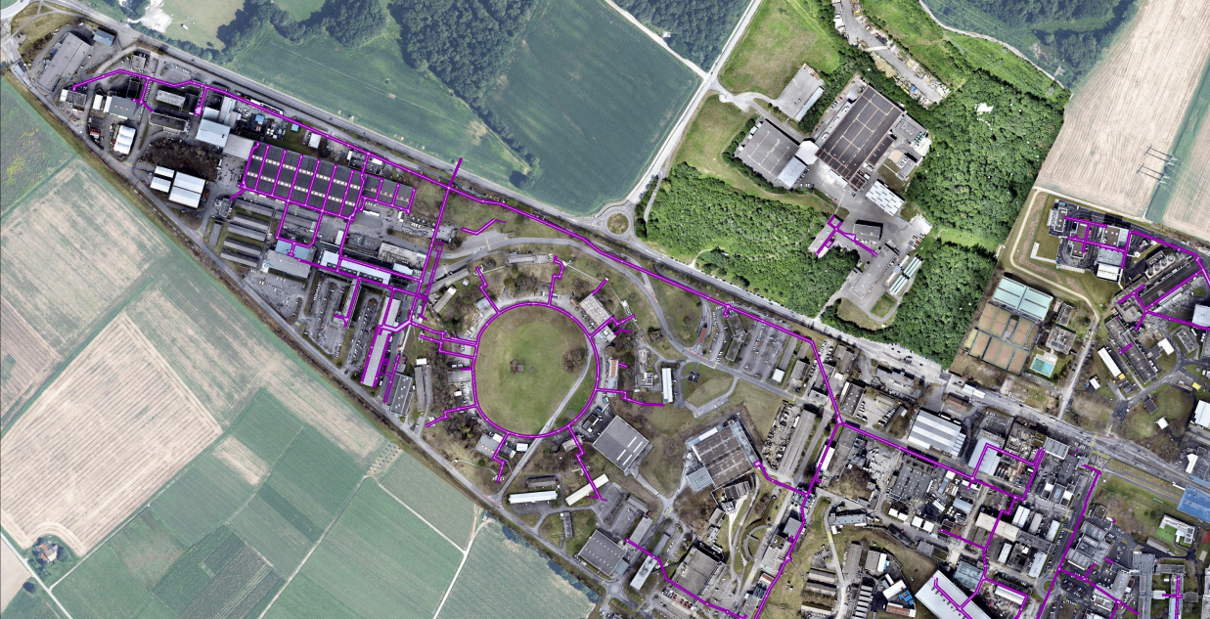

Overheated pipes – Past works
Gallery 825 – Part 4.1
835 North
Gallery 835 North – Pilot gallery in 2022
Gallery 835 South
Gallery 836
Gallery 825 Part 4.1
836
WORKSITE COMPLETED IN 2023 AND 100% INVOICED
835 South
ISR RING
RECENTLY RENOVATED

Slide 3
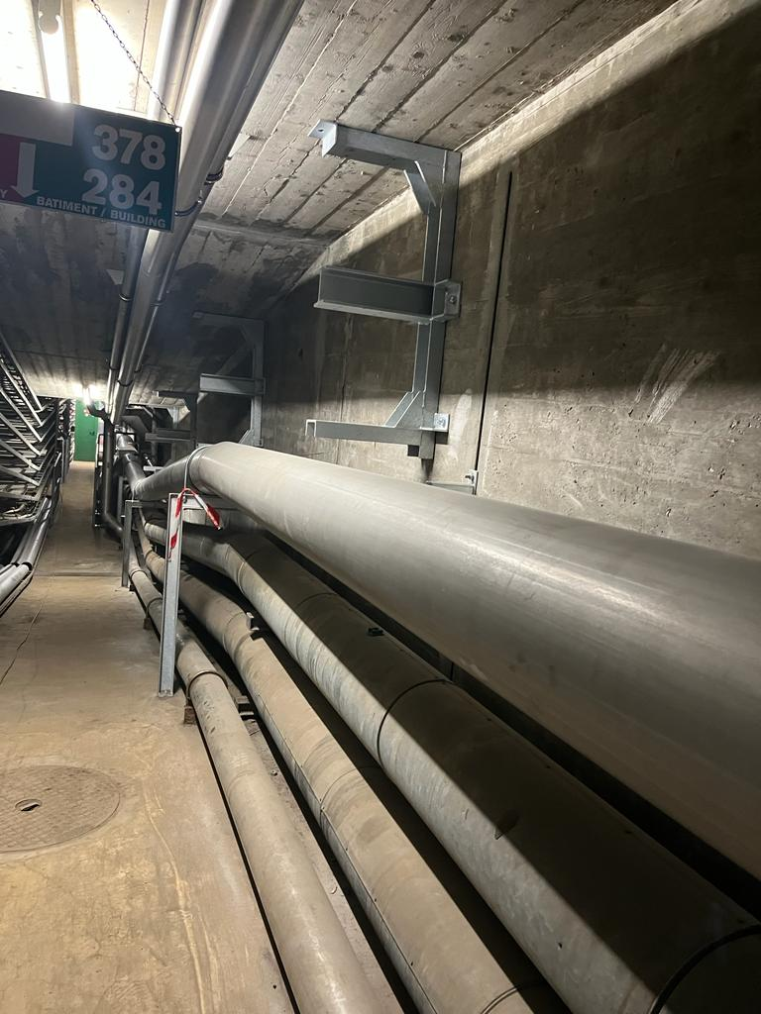
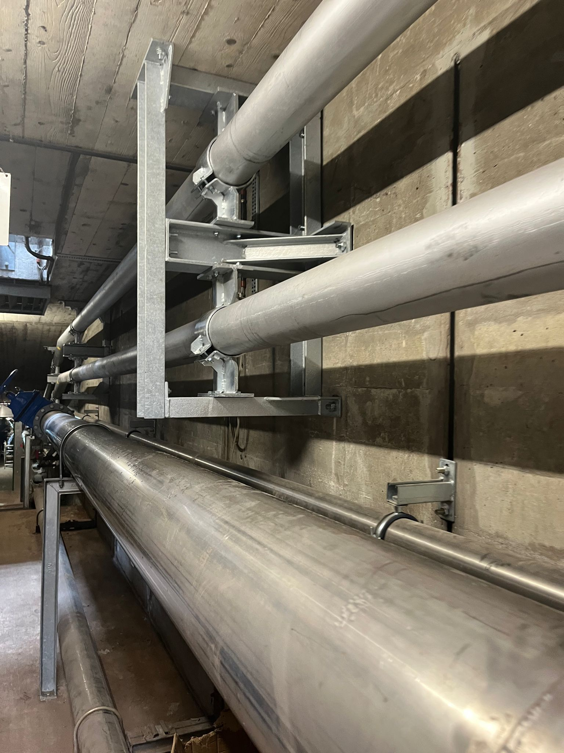
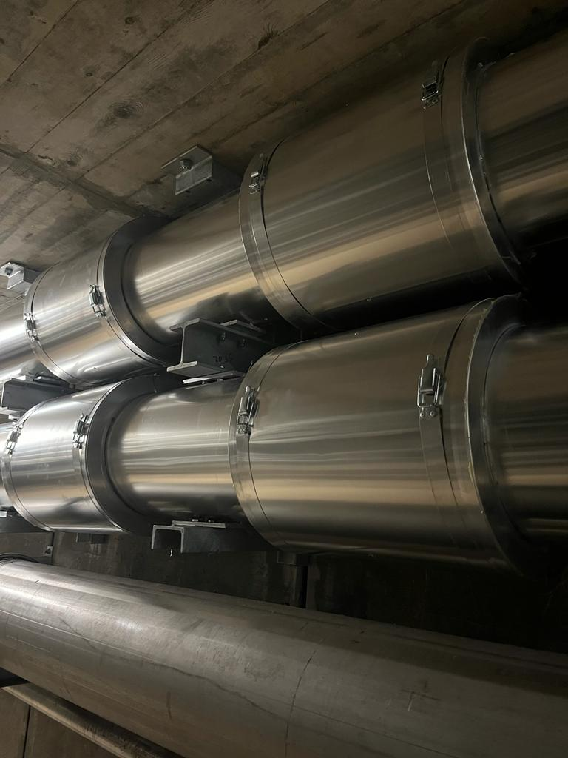
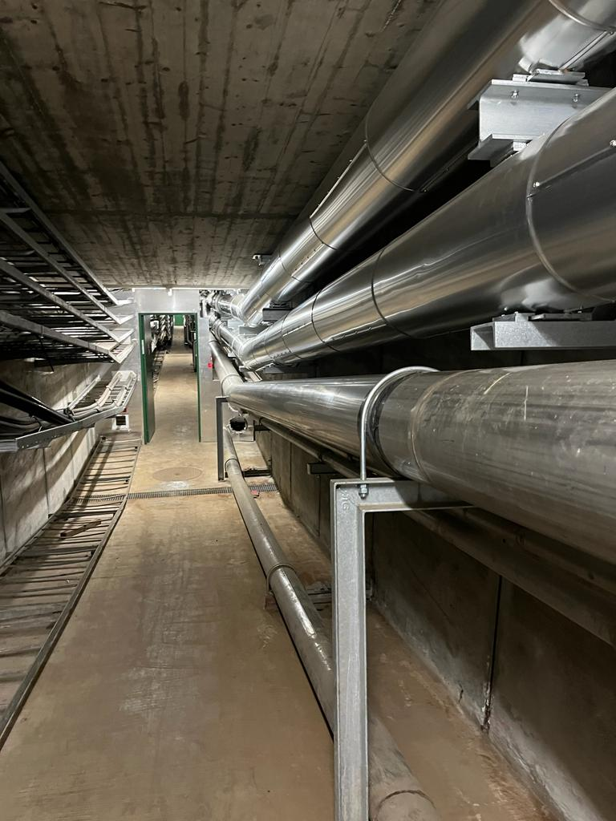
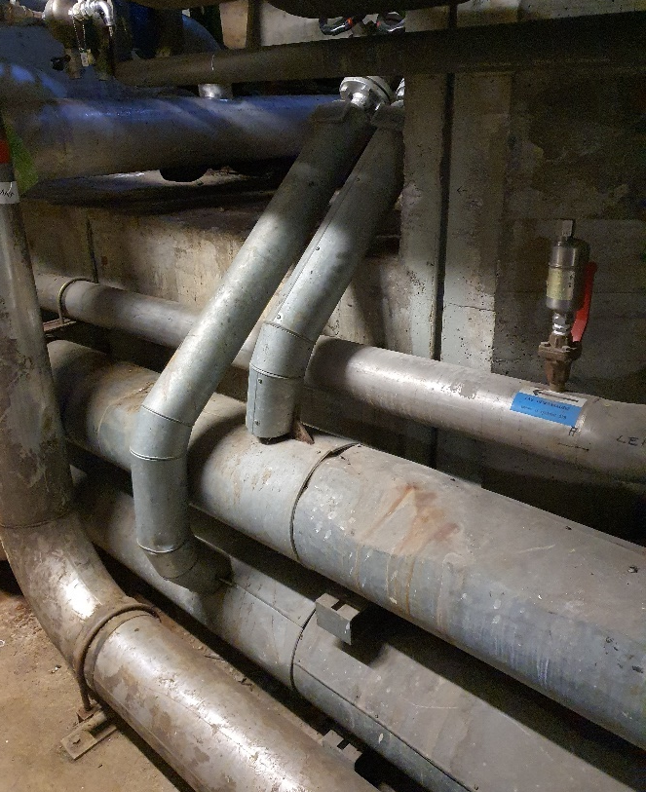


2023: Summary of the activities
ACTIONS IN EVERY GALLERY:
Asbestos removal campaign (SCE-CE)
Replacement of the pipes and insulation
Increase in the thickness of the insulation according to the current norms (SIA384-1 and Mopec 2018)
OLD CONFIGURATION
DISMANTLING
PIPE INSTALLATION
INSTALLATION OF INSULATION
SCHEDULE
Heating stop: 01/05/23
Start of the activity: 15/05/23
End of the activity: 01/11/23
Heating start: 23/10/23
~600 m
REPLACED PIPES
~24 tons
OF EVACUATED PIPES & SUPPORTS
~22 tons
OF INSTALLED PIPES & SUPPORTS
Notes:
PICTURES

Slide 4
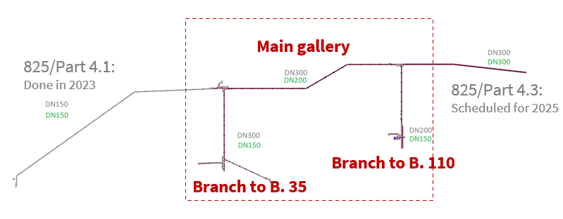
Heating pipes Current projects
Gallery 825 Part 4.2 – Summer 2024
From Building 35 to 110, branches included
Gallery 826 – Summer 2024
Gallery 825 Part 4.2
Gallery 826
De-classification from superheated water to heated water
New Technical Specifications:
- Nominal Pressure PN 16
- Design Temperature 99◦C
Notes:
FROM 125 C OF TEMP
PN 25 NOMINAL PRESSURE

Slide 5
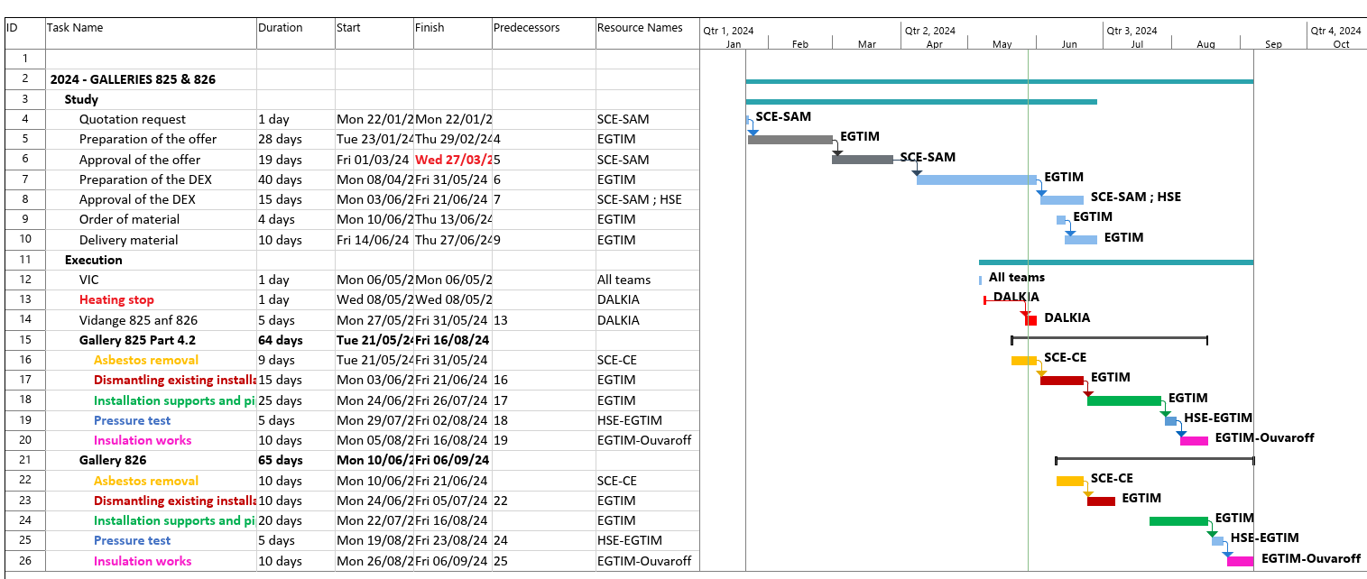

Heating pipes - Schedule 2024
Latest update:
Lockout ongoing
Insulation dismantling finished in 825.

Slide 6
FUTURE WORKS
Priority: to continue gallery 825, shadowing EN-CV
Budget constraints: the scope will be defined based on the budget availability of the project.
Collaboration with EN-CV.
825 Part 3 – Year 2025-2026
825 Part 2 – Year 2028-29
821 TL4A– 2027

