Slide 1
Secure Means of Communication
Status Report
Eva Sanchez-Corral, Jean Ramos, Henrik Nissen – EN-AA
TG-CONS Coordination Meeting #25 - 06.05.2024

Slide 2
HSE and Functional Requirements
Functional requirements (EDMS 2588546):
An alert system must be present every 200 m in the CERN accelerators tunnels
It must be suitable for operating in the wide range of environmental conditions that are present on CERN premises (underground, radioactive areas, etc) + technical galleries, surface hotels, cold room, PMRs, kinder garden…
The system shall trigger a level 3 alarm (according to IS37).
It must have the capability to deliver reliable two-way communications.
It must be able to operate in the event of a power failure for a given duration compatible with the premises’ emergency concept.
It shall provide an unambiguous geo-location.
Alert Systems - HSE requirements:
In response to EN-AA questions (EDMS 2894058, May 2023), response from HSE EDMS 3021609 (March 2024) - SRF on circuit integrity of Emergency Call Systems in Technical Galleries

Slide 3
EDMS 3021609 - Details
Question 1: Does the "Emergency Call System" for the Technical Galleries must ensure voice communication with the fire brigade in the event of a power failure and for how long at least?
Answer: The functionality of the emergency call system, including voice communication with the fire brigade, shall be guaranteed in case of power failure. This is important, for instance, if someone working in the technical galleries needs assistance soon after an incident that caused a power failure (e.g., short circuit). The minimum duration shall be 60 minutes.
Question 2: What are the characteristics that the cable trays for the system must meet, and in particular what is the fire resistance time required for these trays?
Question 3: Must the cables for voice communication and AL3 alarm transmission be fire-resistant and for how long at least?
Answer to 2 and 3: The fire resistance class of AL3 cable systems (the assembly of trays, supports, accessories, cables, etc.) shall be at least 60 minutes. Cabling installations do not need to be fire resistant if:
The circuit of the emergency call system is built in a loop, and functionality is maintained in case of failure at any location
Or all the following conditions are fulfilled:
The circuit is contained in a single fire compartment.
The galleries have two alternative exits, and no dead ends longer than 10 m.
The emergency call system has a fail-safe mode (i.e., triggers a level-3-alarm when a cable is cut, and CFRS can localise where the failure occurred).
Note: If voice transmission cable is present and is independent from AL3 cable, the above-mentioned fire resistance is not required for such cable as fire-degraded functionality of global system is covered by AL3 part.

Slide 4
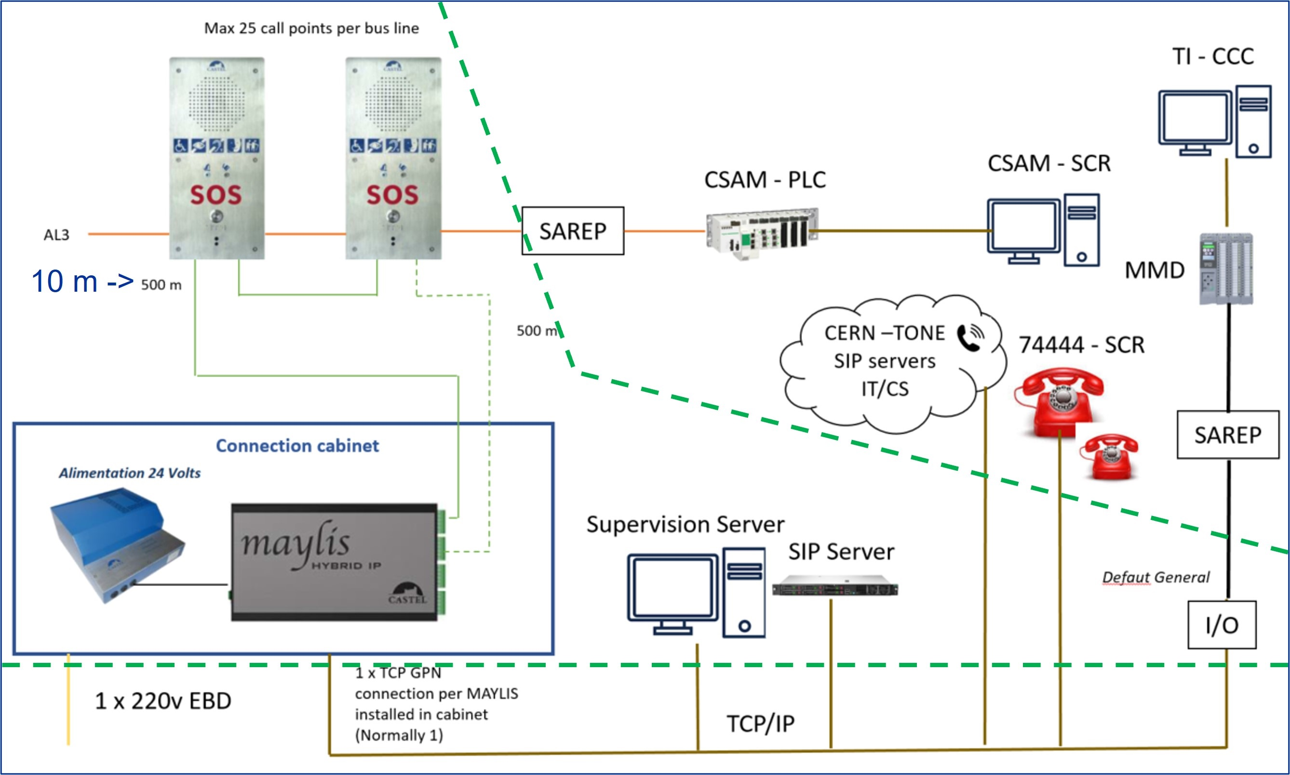
Technical Verification of the Technology
The technology was tested and validate in a test platform (in collaboration with IT-CS, 2Q2023):
Call points connected in a communication bus (RS485) to CERN TCP/IP infrastructure and interface with CERN telephony via SIP
10 m ->

Slide 5
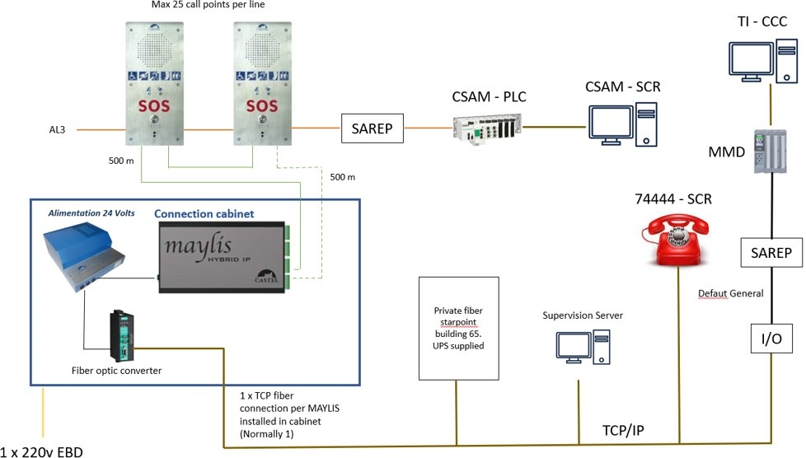
Network Architecture

Slide 6
Status Report
March 2024: The SRF is released, and it clarifies the requirements and specifications needed for Emergency Call Systems
March 2024: Technical meeting with IT-CS and HSE to evaluate impact of integrating new requirements as recommended by HSE
Evaluation of technical implementation and cost estimate to ensure requirements (on hold) :
  Secured power supply of all equipment is needed
  Replacing of general-purpose TCP/IP network initially considered by a dedicated secured optical fibre network
  Whole network layout and estimated quantity of call points to be carefully reviewed:
    Central secured Optical Fibre Starpoint in building 65?
  Optimisation of call points lines for the new Optical Fibre network architecture
  Request to TG-Cons project: A specific layout to positions of Emergency Call Points to review network architecture is needed.
Tender process for the purchase and supply of Emergency Call System equipment on hold until technical solution and total scope fully defined:
Discussions in progress with NA Cons since November 2023 to integrate all non-radioactive technical galleries attached to their project on the scope of the Technical Galleries Emergency Call System Project
System operation & maintenance responsibility listed but not defined nor approved

