Slide 1
EP-DT Group Meeting
Welcome/Bienvenue!
June 26, 2024
Burkhard Schmidt

Slide 2
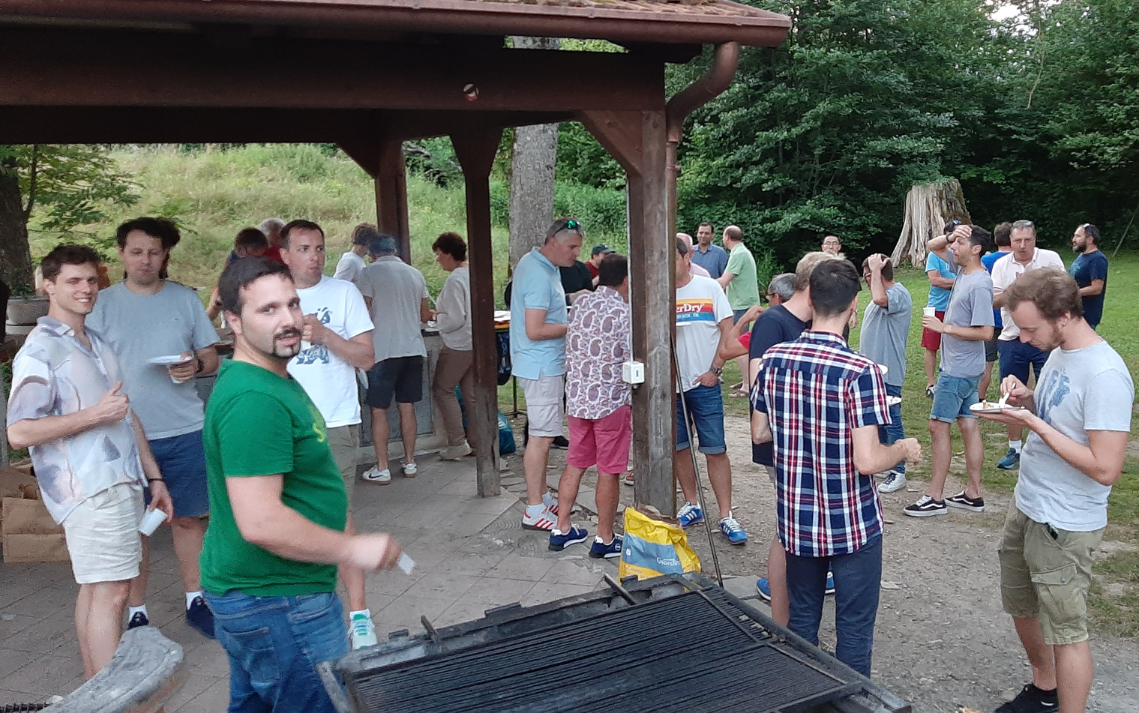
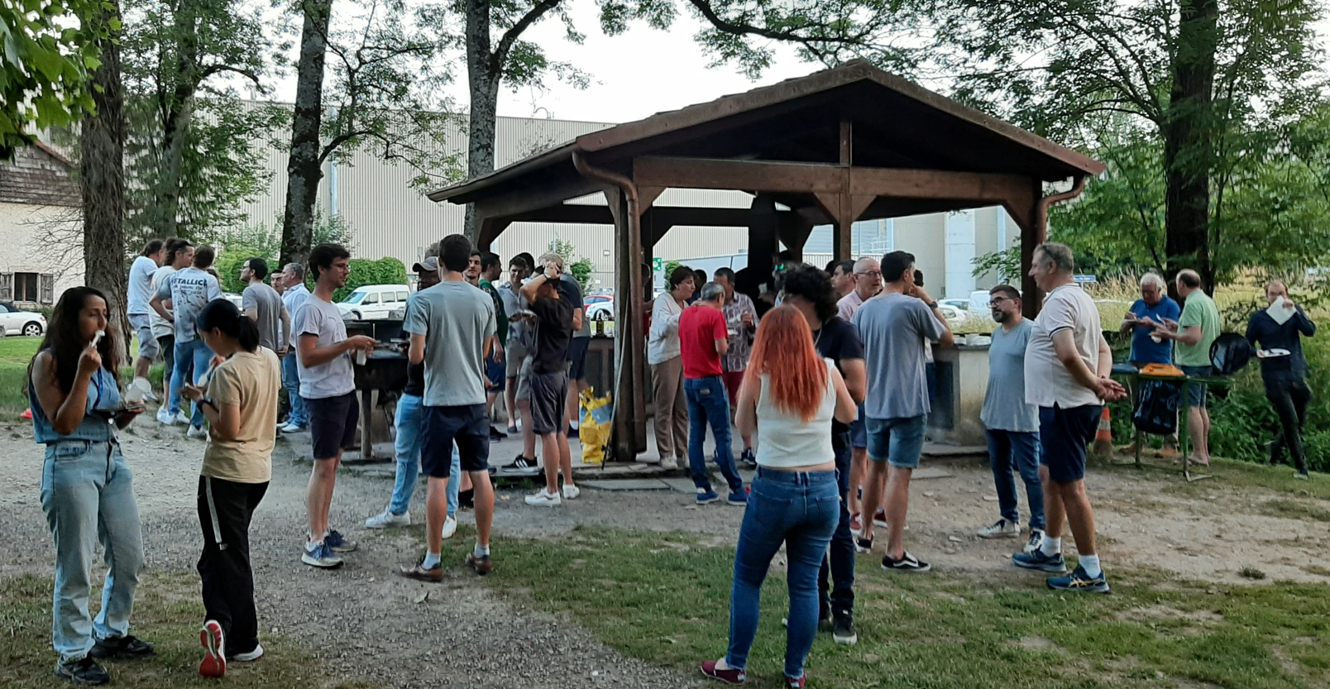
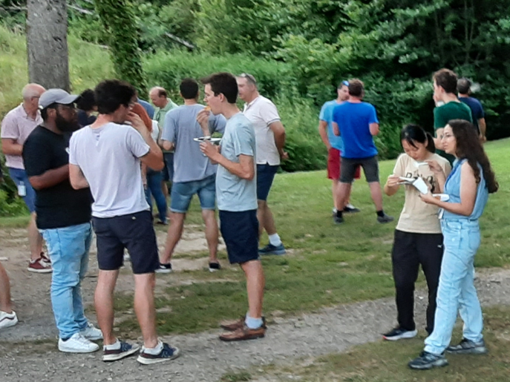
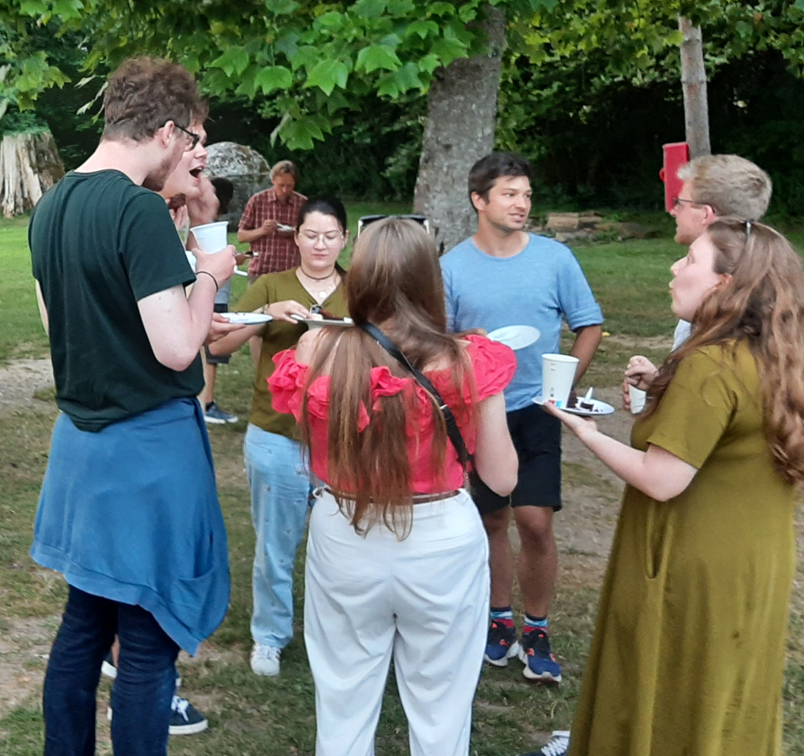
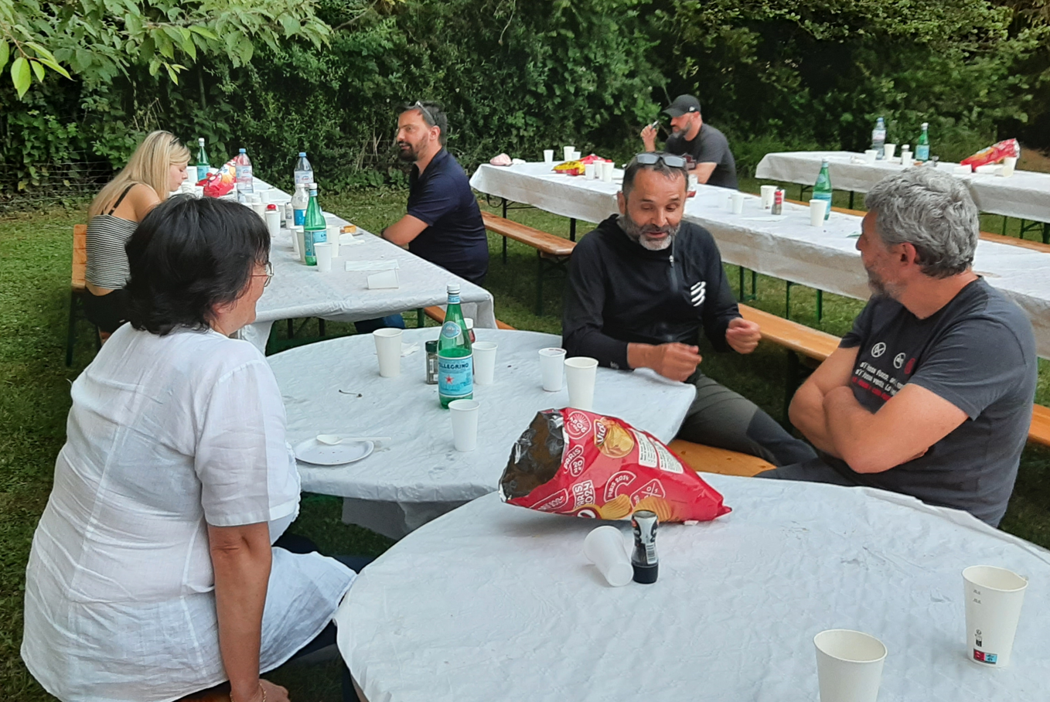
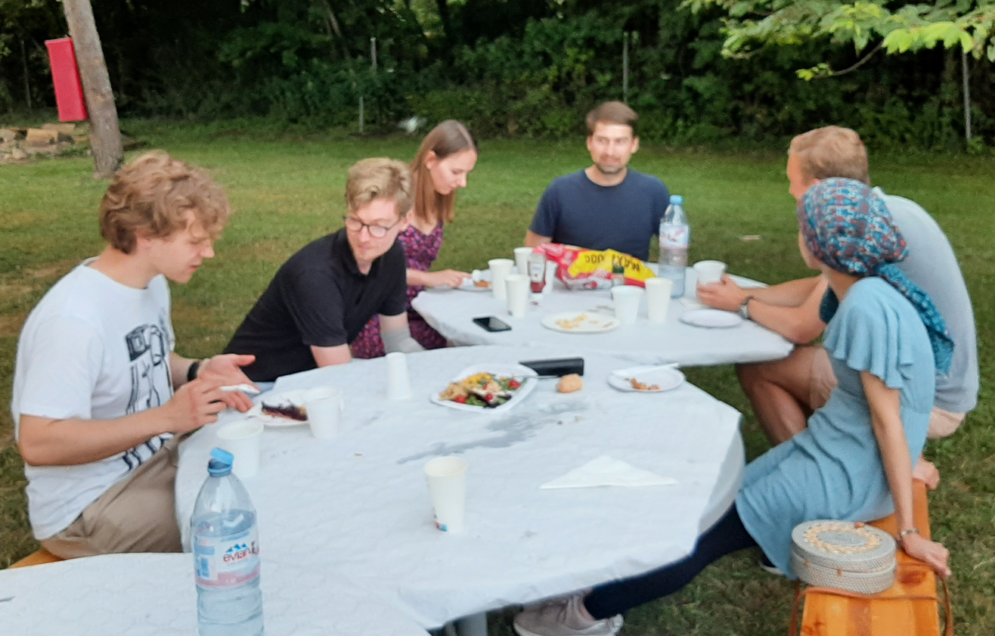
EP-DT Barbeque
Many thanks to all who contributed!

Slide 3

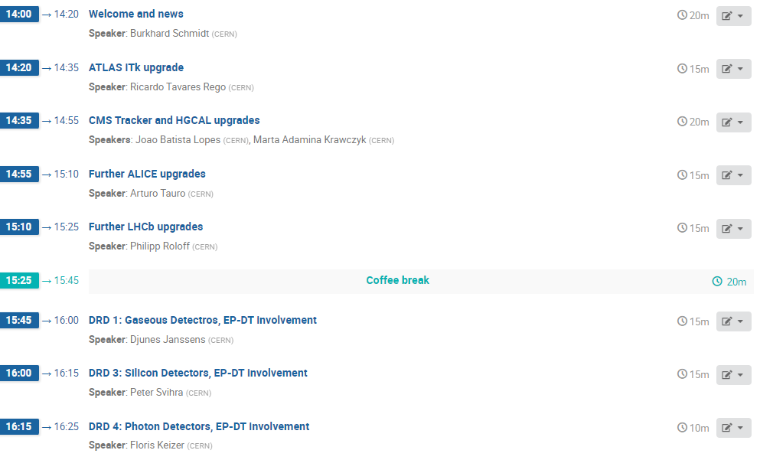

Slide 4
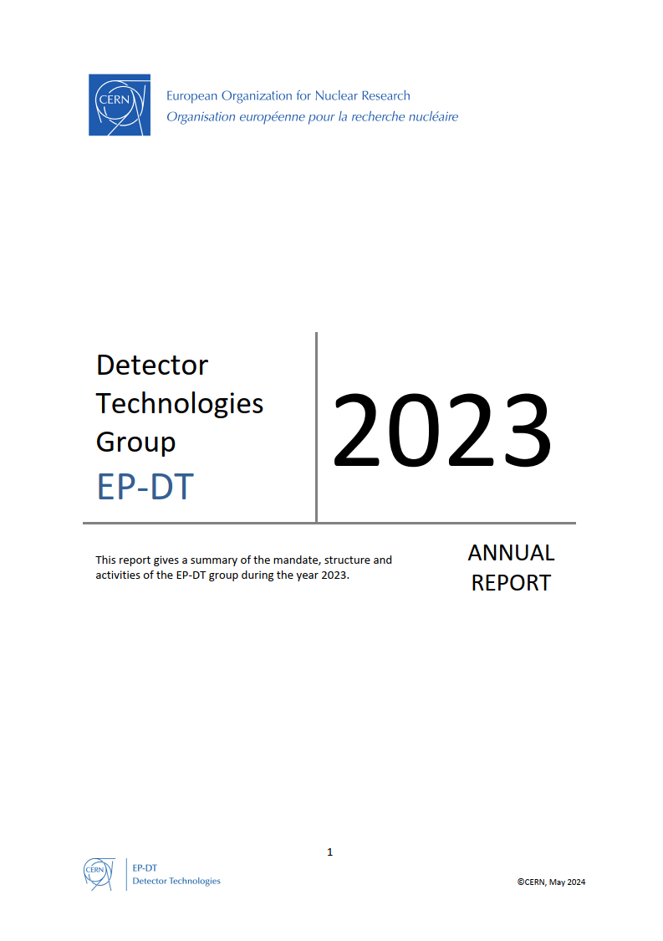
Outline
Overview of the EP-DT group composition
  Great challenges ahead of us
Activities of the group on projects not mentioned in the following presentations can be found in the EP-DT Annual Report
Things coming up
  Possible future projects: ALICE 3 and LHCb phase II upgrades
  News about building 140+
Concluding remarks

Slide 5
EP-DT Composition and Structure
Section | Persons
Technology &Physics (TP) SL: Thierry Gys | MPE: 13 MPA etc. 5
Detector Development (DD) SL: Petra Riedler | MPE: 20 MPA etc. 7
Fluidic Systems (FS) SL: Paolo Petagna | MPE: 31 MPA etc. 16
Detector Interface (DI) SL: Xavier Pons | MPE: 9 MPA etc. 4
Engineering Facilities (EF) SL: Hans Danielsson | MPE: 13 MPA etc. 1
Engineering Office (EO) SL: Andrea Catinaccio | MPE: 15 MPA etc. 3
Construction & Operations (CO) SL: Antti Onnela | MPE: 17 MPA etc. 0
Personnel | FTE 2024 (2023)
Staff | 88 (84)
Fellows /GRADs | 32 (31)
PJAS | 2 (3)
Doct. Students | 17 (20)
Tech. Students | 12 (11)
Trainees | 5 (9)
FSU PH-02 (S 302): FSU PH-40 (S 287): | 26 (16) 14 (16)
Contributing Retirees | 5 (6)
Total | 201 (196)
Comments:
The number of Staff members is increased slightly (Three 5-year LD positions for CO₂ cooling project)
  1 Staff members (included in the counting) is on long term sick-leave
Many Fellows, DOCT and TECH are affiliated to DT, but are only partially on DT quota.
The FSUs in the FS and EF sections are crucial to fulfil our mission (~20% of the workforce).

Slide 6
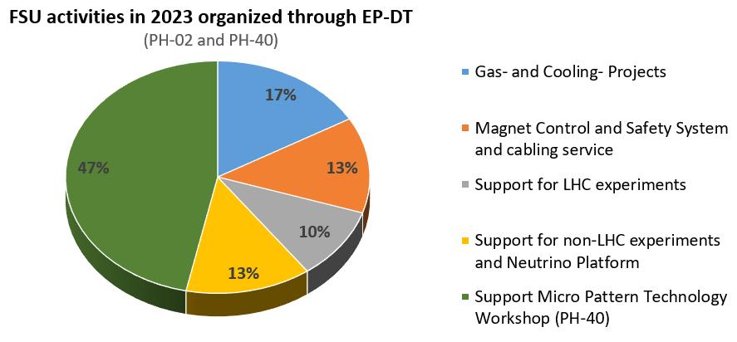
FSU Activities in EP-DT
Total of hours for 2023: ~55,000 hours (~30 FTE) for a cost of about 3 MCHF
The new FSU contracts are in place since July 2023 (MPT) resp. April 2024 (EP Tech. Support)
EP Technical Support merges the old DT contract (PH-02) and the CMS contract (PH-04 ).
The total FSU personal number is going up to 40.
FSUs are an important resource to respond to urgent needs of the experiments
For both new FSU contracts (S287, MPT Workshop, and S302, EP Technical Support), we work with the previous contractors and largely with the same personnel.

Slide 7
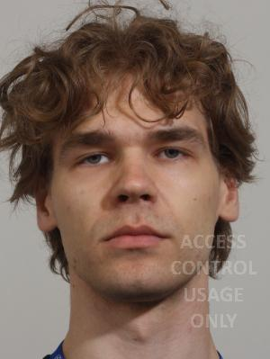
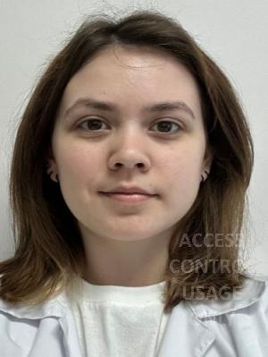
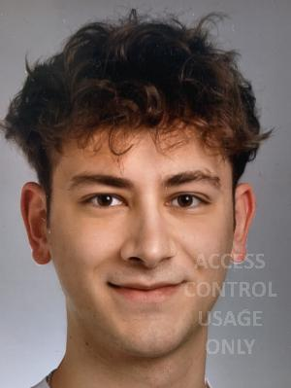
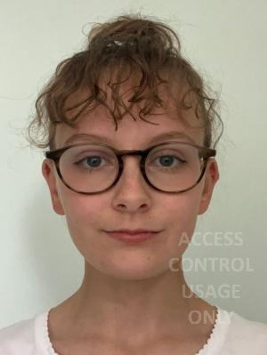
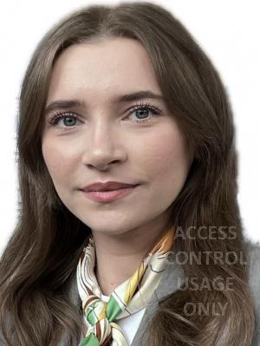
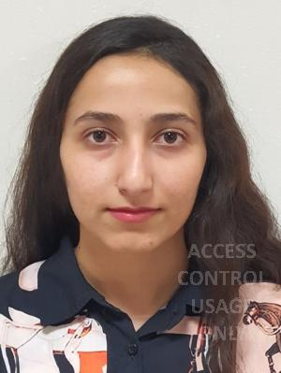
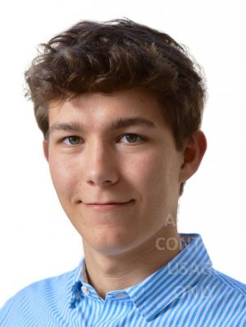
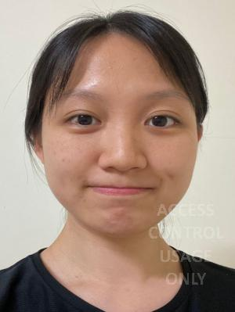
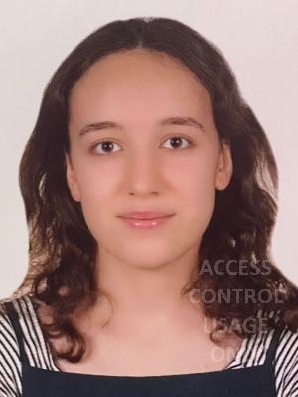
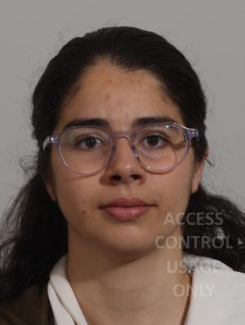
EP-DT Summer Students 2024 (1/2)
Antti
LUMPPIO
01.06 to 31.08
SV: E.OLIVERI/F.GARCIA
Natalya
GERASSYOVA
17.06. to 09.08
SV: L. DIEHL/O.K
Moritz
VOGT
10.06 to 06.09
SV: X. YANG
Zoe
RICHARDSON
24.06. to 23.08.
SV: L.SCHARENBERG
Margarita
BIVEINYTE
01.07 to 23.08
SV: V.KRAUS/M.WIEHE
Faezeh
GOGOUNANI
17.06 to 09.08
SV: D.JANSSENS
Andres
NAVARRO PEDREGAL
03.06 to 30.08
SV: G.RIGOLETTI/ P.V.
Hsuan-Chu
CHEN
10.06 to 09.08
SV: M.C.ARENA/D.G
Merve Sude
ALKAN
01.07 to 13.09
SV: A. LALE/P-SVIHRA
Maria Luisa
VELAZQUEZ FERNANDEZ
03.06 to 30.08
SV: M. LISOWSKA/F.BRUNBAUER
Welcome to EP-DT! We wish a very profitable time at CERN!
We have scheduled three sessions during the summer, in which you will have an opportunity to present your work: July 23, August 6 and August 20 (always AM)
  The aim is to have each time 4/5 presentations

Slide 8
EP-DT Summer Students 2024 (2/2)
Summer Students still to come:
Proposal for EP-DT Summer Student Presentations:
Maria
SOUSA
01.07. to 20.09
SV: J.WEICK/A.SHARMA
Thomas
LARRIVEE
01.07. to 23.08
SV: A. SHARMA
Milica
RAJCIC
01.07 to 16.09
SV: Y. OTARID
Pedro
SCARAZZATO
01.07 to 09.08
SV: Eraldo OLIVERI

Slide 9
EP-DT composition and age profile
Professionnal Categories in 201
6
Only minor changes in the Professional Categories over the past 8 years
About 70% of the group is on an IC contract, 30% on an LD contract, no change over the past years.
30% of the group will is above 55 and will retire in the coming years, this are 40% of the ICs.
In addition, only about 45% of the LDs can be retained.
In total 43% of the personnel will change. This is huge challenge to maintain the competencies we have.

Slide 10
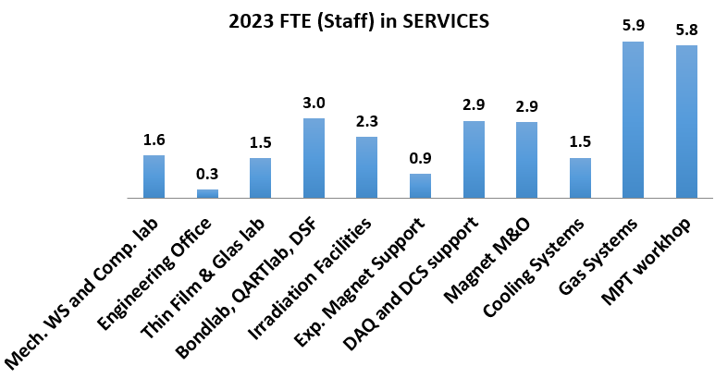
DT Staff involvement in Services
Pure Services have been reduced to a minimum in some areas (e.g. Mech. WS and Engineering Office); the resources are assigned to projects (mainly ATLAS and CMS trackers, and ALICE)
Some of the services are crucial for the world-wide detector physics community, e.g. the MPT workshop, the Irradiation Facilities, the Bond- QART-labs, the DSF, the magnetic field measurement service etc., the DQ and DCS support.
Some services are based on Service Level Agreements with the experiments

Slide 11
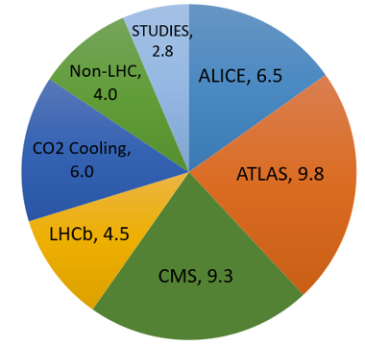
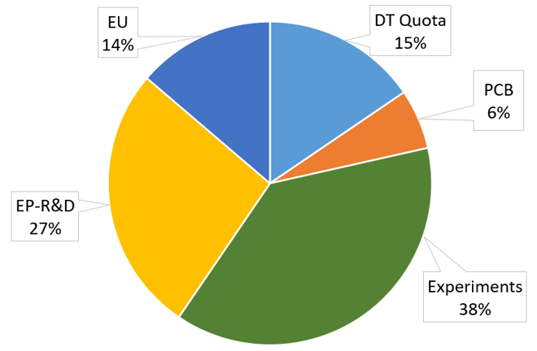
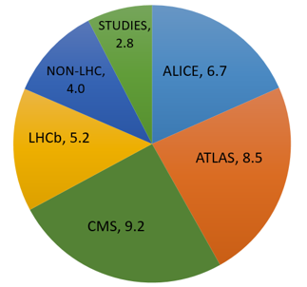
DT Staff and Fellows in Projects
Involvement of Staff and Fellows
In Projects
Funding Source of Fellows (w/o TTE)
Involvement in projects related to the upgrade of the LHC experiments is more than 85%.
The remaining 15% are shared between other experiments and project studies.
DT based Fellows (and Students) are mainly on non-DT resources
Very good collaboration with ATLAS, CMS, NA62 and NP for funding Fellows/Students
Fellows represent 50% of the resources for R&D
  Involvement of DT in the newly formed DRD collaborations will be shown after the break

Slide 12
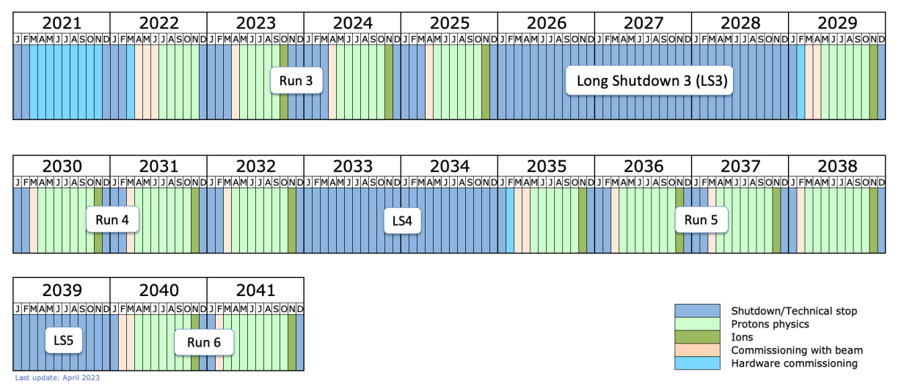
LHC / HL-LHC schedule
A confirmation / update of the schedule is expected for September 2024
As EP-DT group we are heavily involved in the Phase 2 upgrades of ATLAS and CMS and committed to complete our contributions according to the agreed WPs.
We contribute as well to R&D and operations for ALICE and LHCb, together with several non-LHC projects
For EP-DT it is fundamental to have new large projects for the 2030!

Slide 13
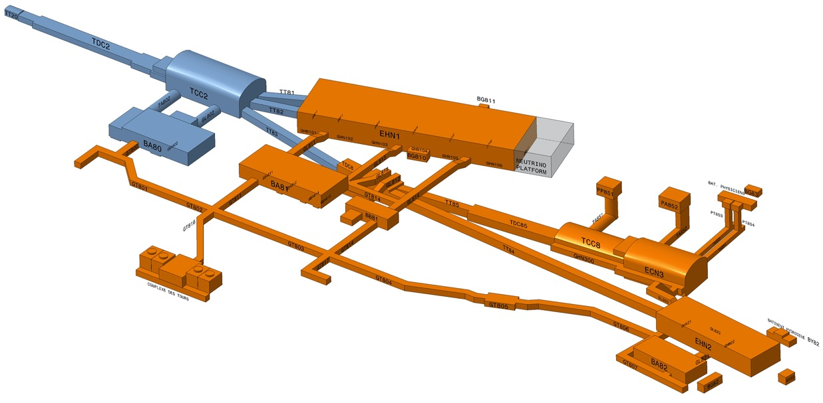
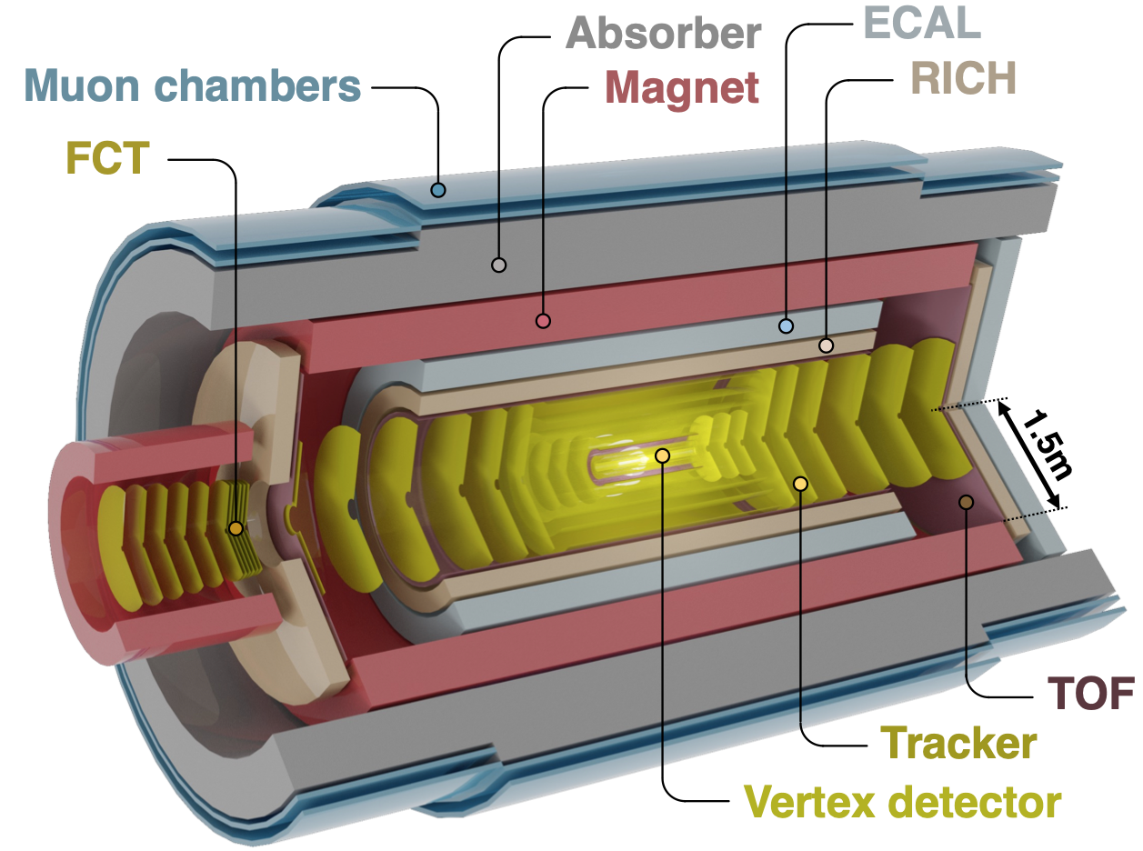
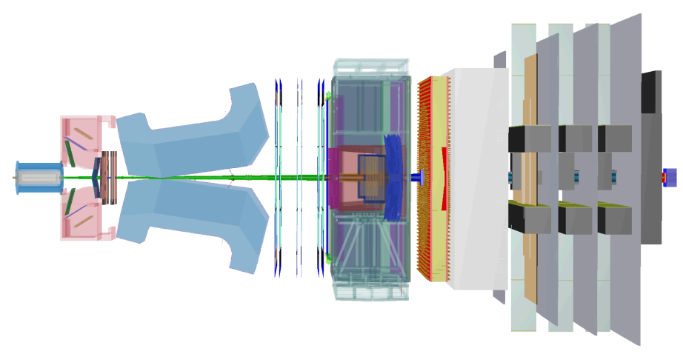
Possible Future Projects for EP-DT
A decision has been taken in March 2024 regarding the ECN3 beamline:
  The SHiP project has been selected
However, it has also been officially stated that:
CERN's contribution during the R&D and construction phases will be primarily focused on the muon spectrometer magnet and on the interfaces between the experimental area and the detector, as part of the host lab responsibility. … Given the emphasis on developing and constructing all detector components outside CERN except for the magnet, significant effort will be required from CERN in terms of coordination, design support, and integration. This is particularly important for the decay volume and the straw tracker.
High intensity beam line
The most promising projects for EP-DT for the 2030s are therefore the ALICE3 and LHCb phase II upgrades, currently undergoing a descoping exercise, aiming approval by the CERN Research Board in autumn 2024

Slide 14
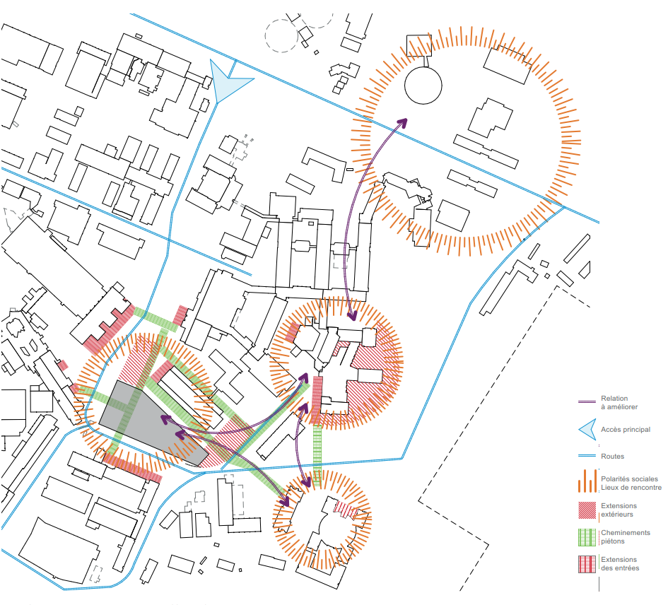
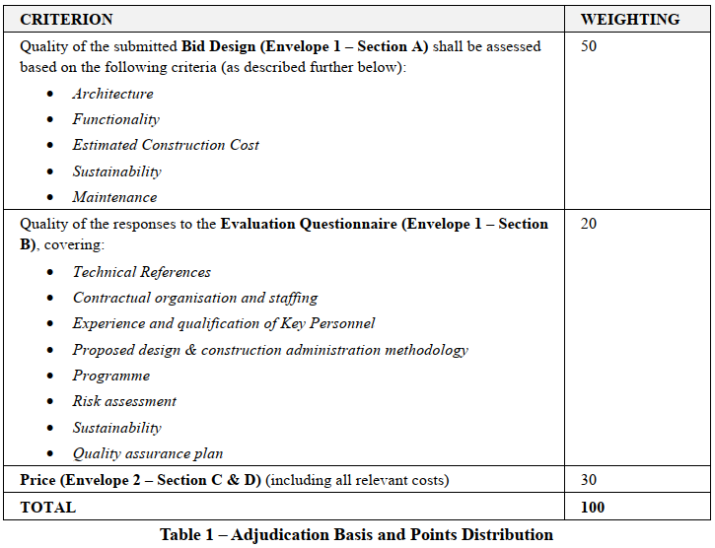
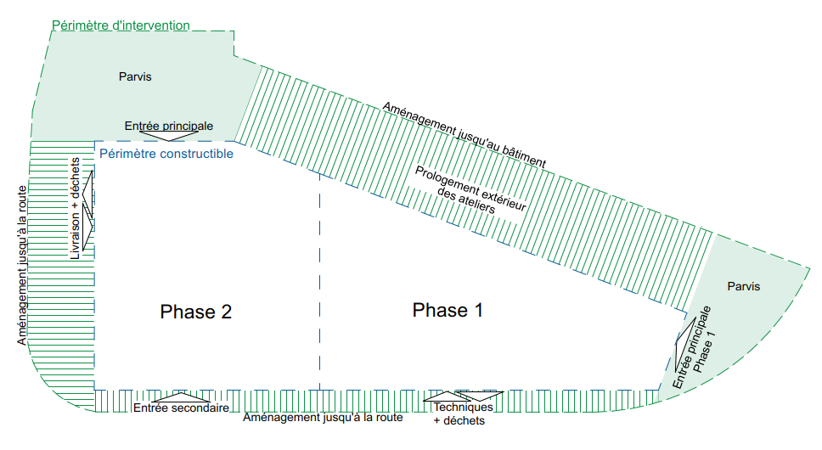
News about Building 140
General analysis of the Meyrin site has been carried out, leading to the conclusion that building 140 will be carried out in two phases:
  Phase 1: Facilities for EP-DT and office space for EP and the user community
  Phase 2: Offices, labs and meeting rooms for IR, HSE, Council Chamber
A Market Survey and an Invitation to Tender (IT-4827) have been carried out in 2023/2024.
Representatives of the users for building 140 have been involved in the IT process.
Eight bidders presented their proposed design of the building to an Evaluation Panel.
The process was successfully concluded in May 2024 and the contract with selected Consultant will start in September 2024, after the final decision is taken by the CERN Finance Committee.

Slide 15
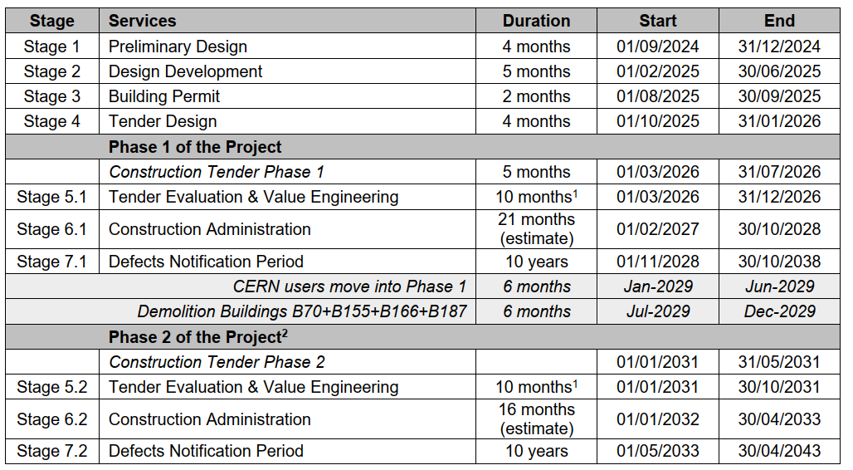
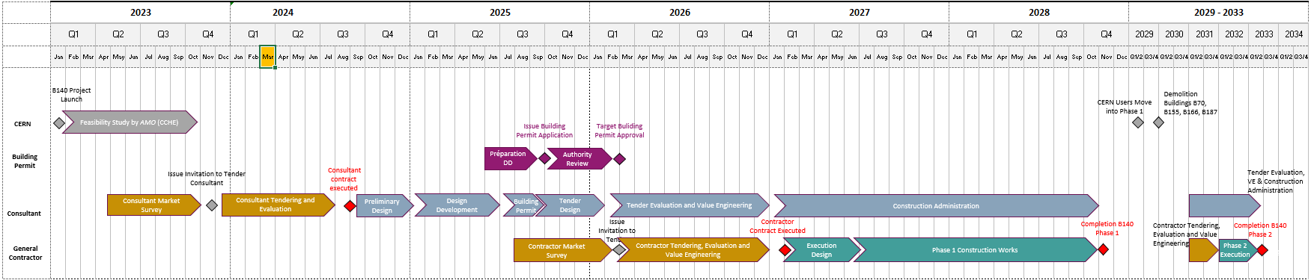
Consultant Programme
Official Start in Sept. 2024
Discussions between SCE project managers and EP-DT members about the Design of the DT part resumed yesterday.
Demolition of building 25 scheduled for Q2 2026
We have to reallocate about 30 colleagues in Q1 2026

Slide 16
Concluding remarks
We are living in very challenging times, from many viewpoints!
We are committed to support the CERN experiments with the resources available, which are very tight.
More volatile resources (TECH, DOCT, GRAE, FSUs etc.) are fundamental to fulfill our commitments for the Phase II upgrades of ATLAS and CMS.
The collaboration with the teams of the experiments is very good.
A decision about the LHC schedule is expected in September 2024.
Building 140 is another challenge, but progress has been finally very good over the past year
The age-profile of persons on ICs is a concern as 30% of the staff will retire before the end of the decade.
It is important to maintain the expertise and facilities of EP-DT and the various services we provide.
We have to ensure continuity of the competencies in the DT group!

