Slide 1
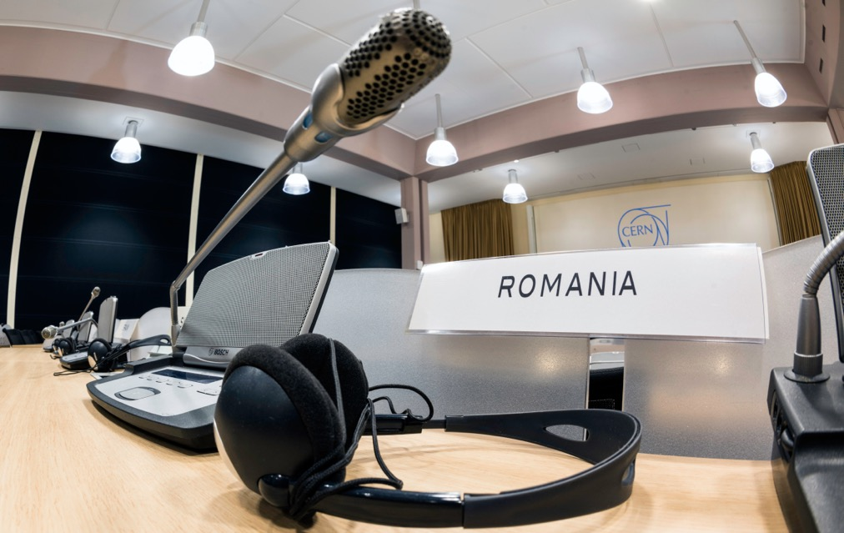
Romania @ CERN
Călin Alexa,
Fizica Particulelor Elementare, IFIN-HH

Slide 2
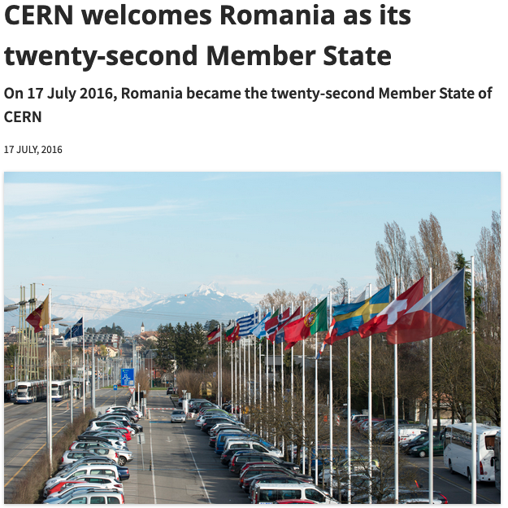
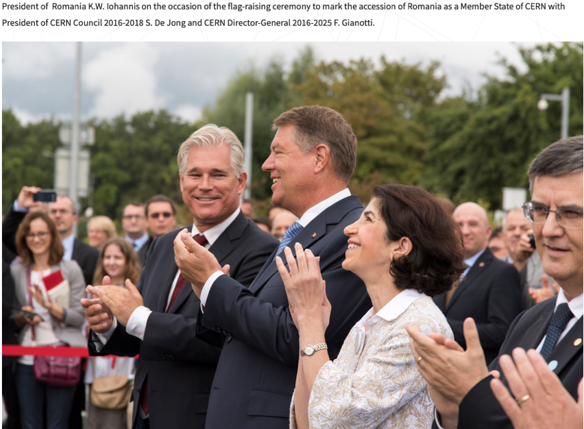
https://home.cern/news/news/cern/cern-welcomes-romania-its-twenty-second-member-state
17 July 2016

Slide 3

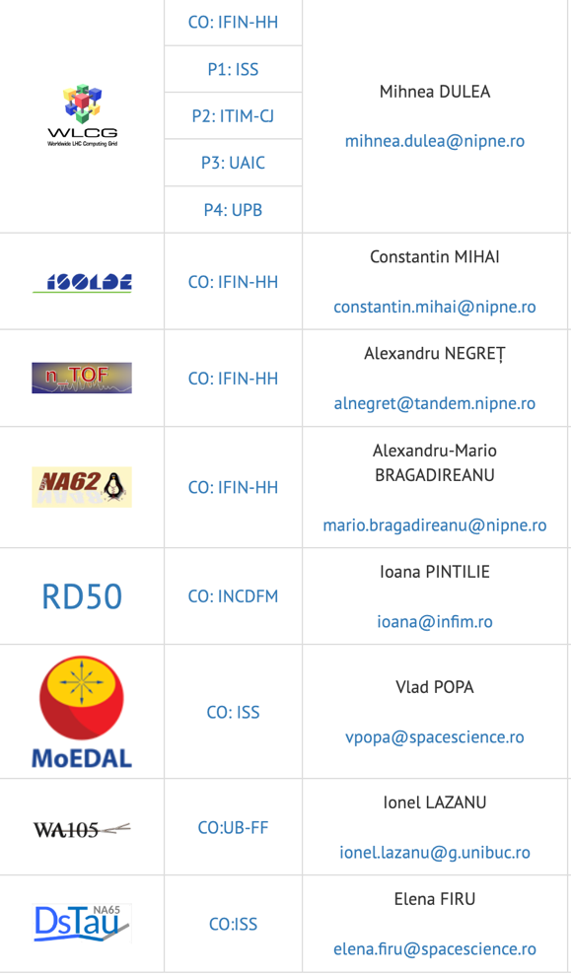
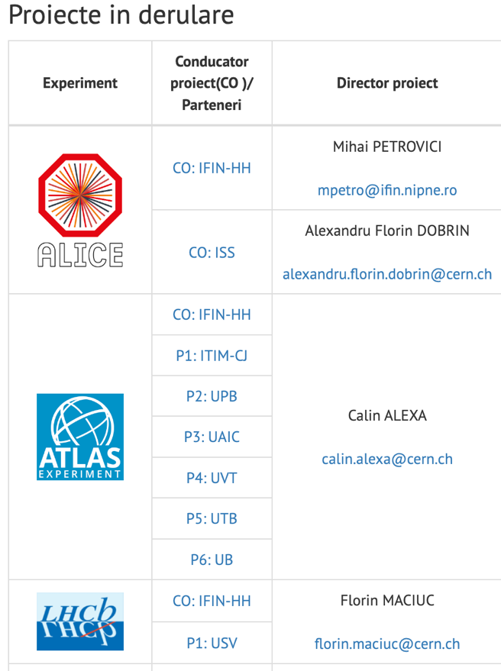
https://www.ifa-mg.ro/cern/programul-cern-ro.php
and
RD51

Slide 4
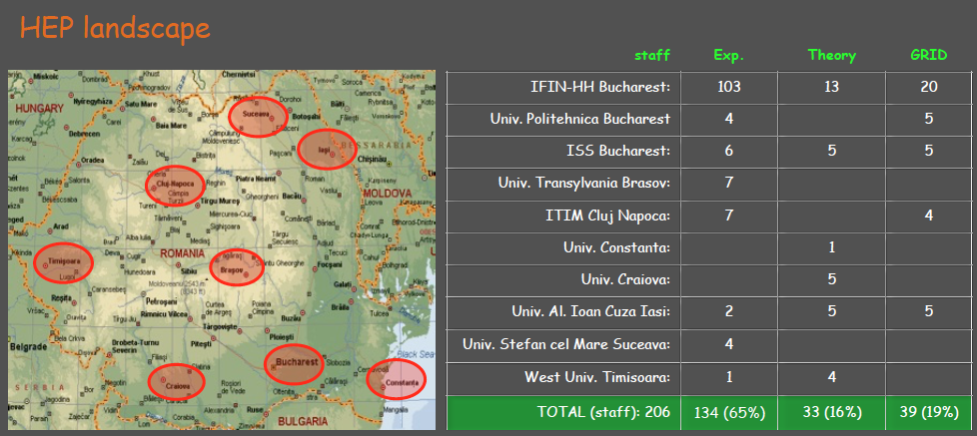
(2015)

Slide 6
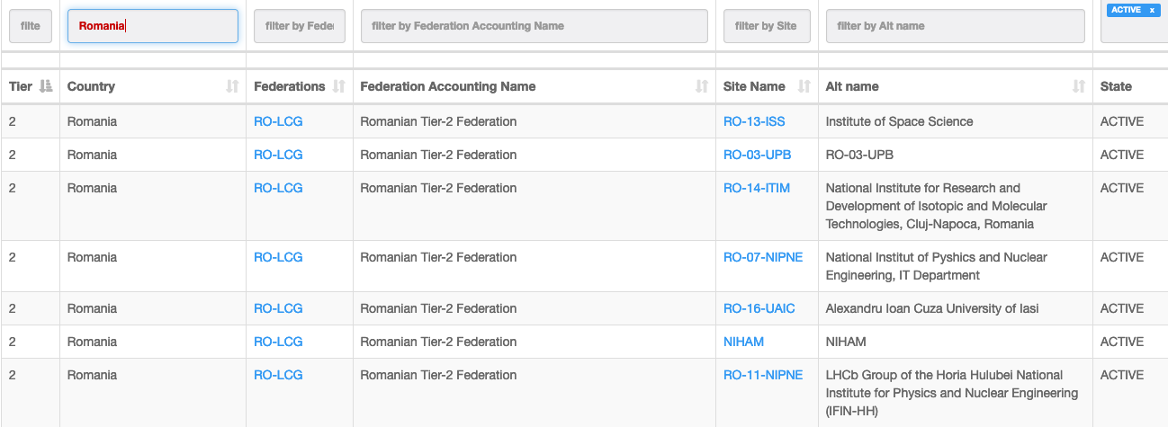

Slide 7
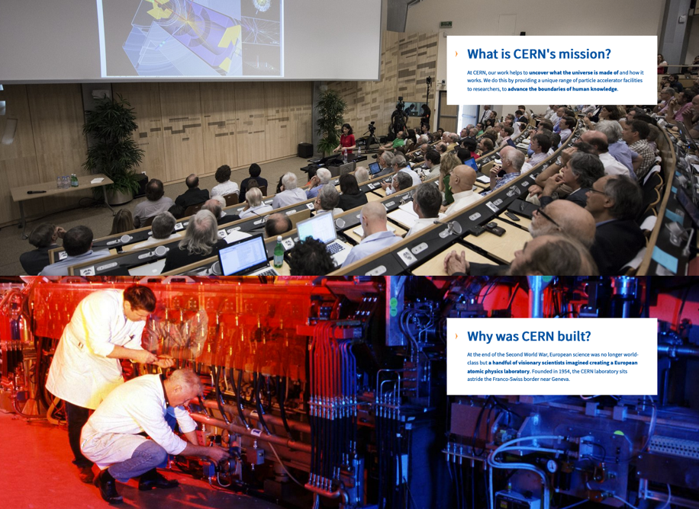
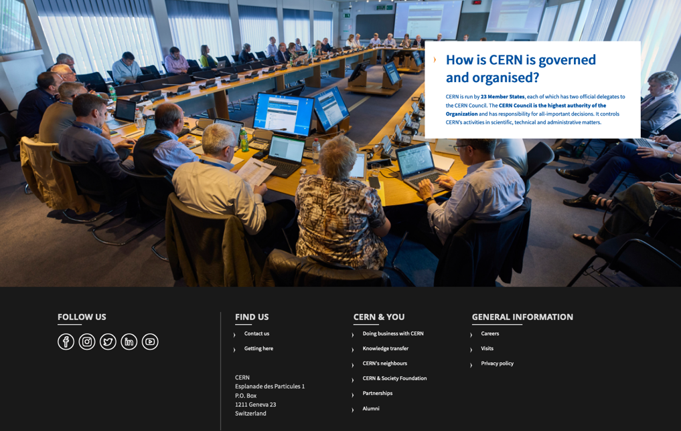
CERN (Conseil Européen pour la Recherche Nucléaire 1954)
este Laboratorul European pentru Fizica Particulelor.
https://home.cern/

Slide 8
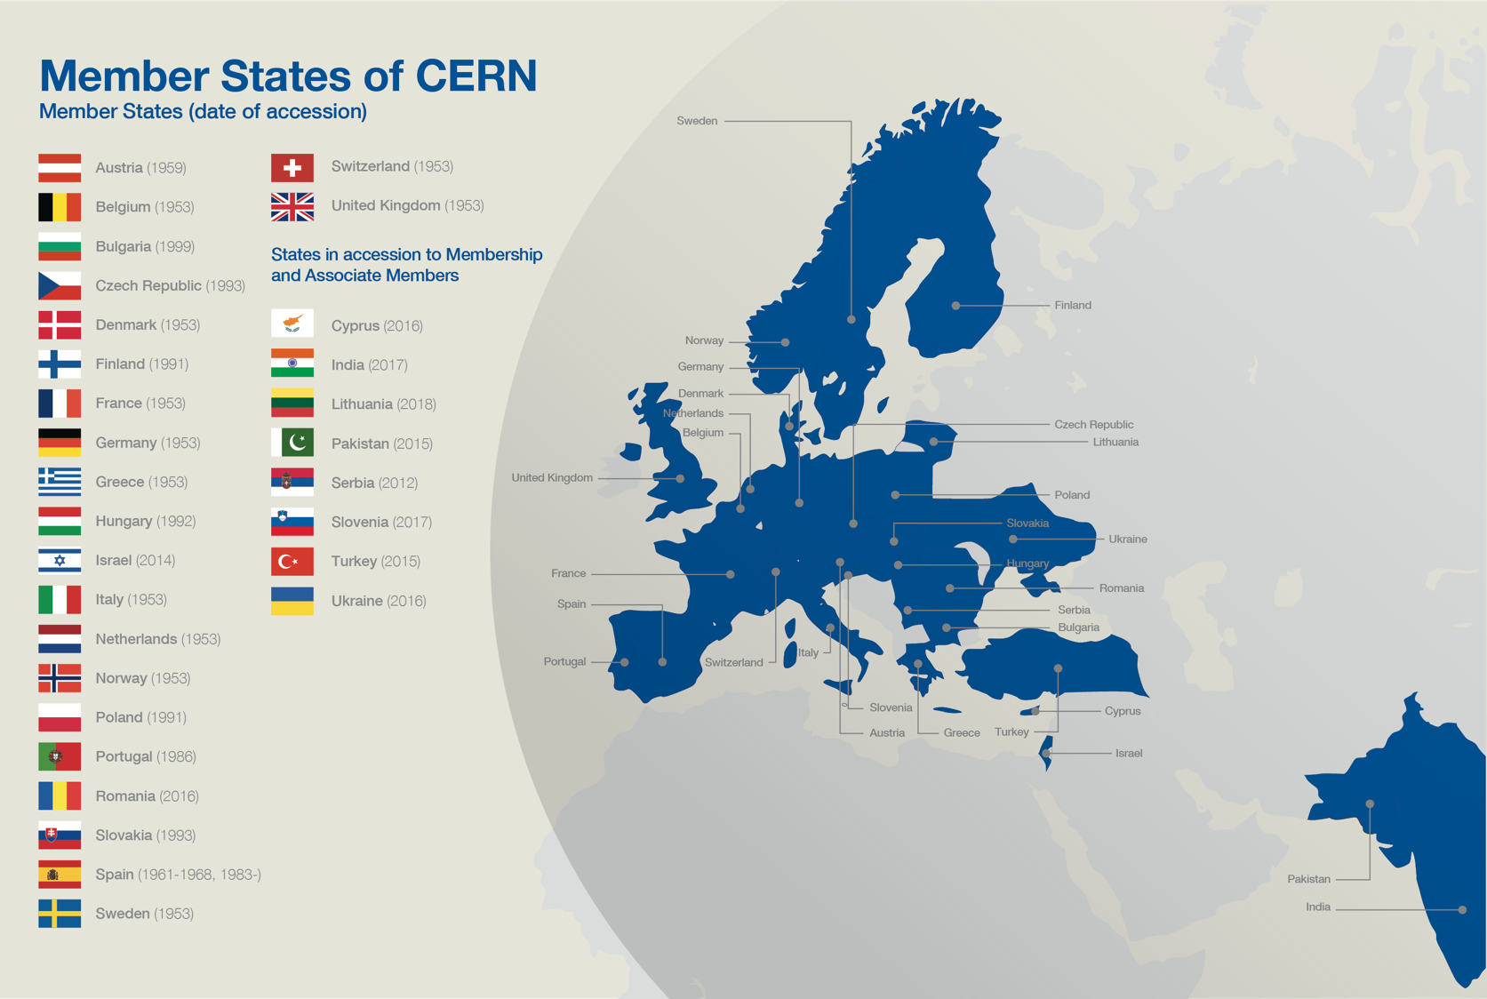
???

Slide 9
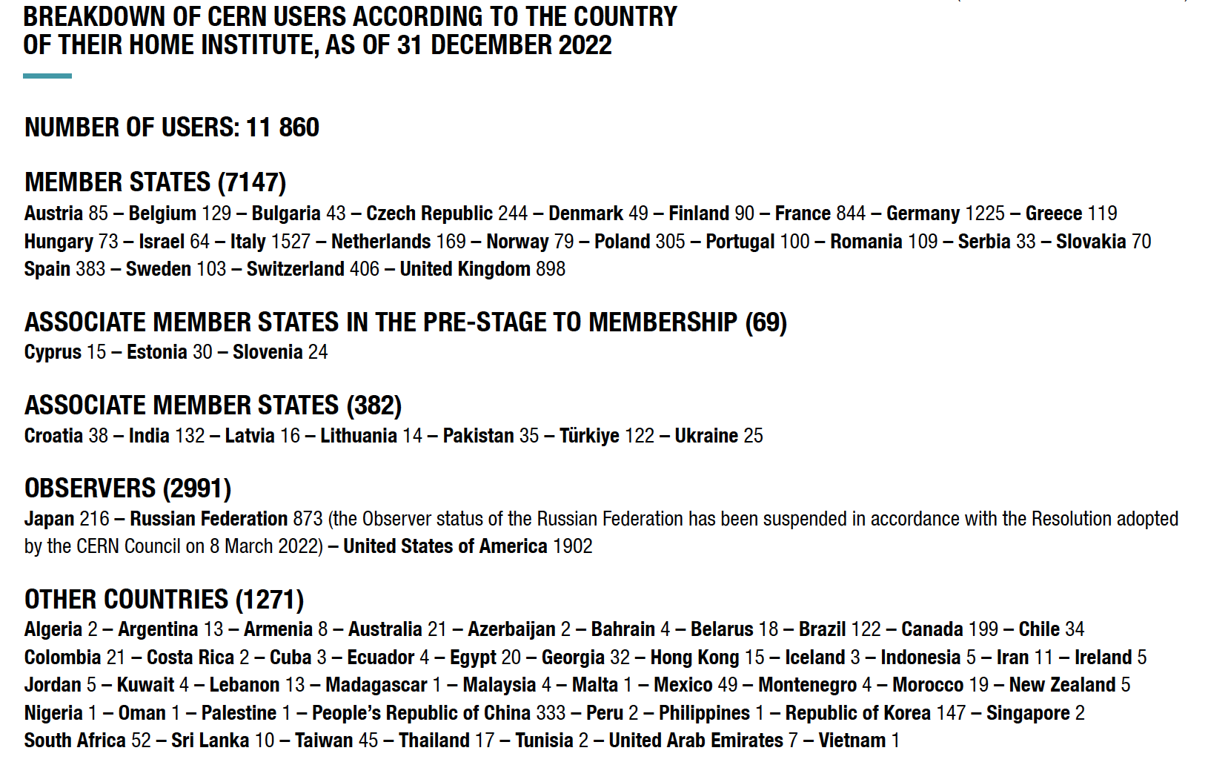

Slide 10
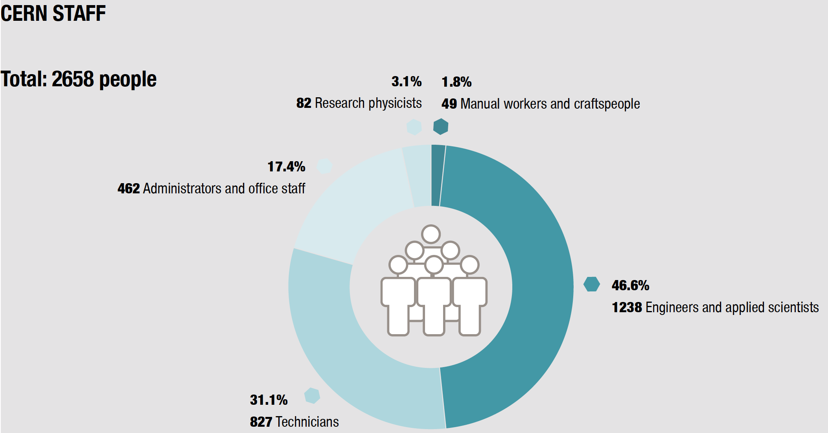
https://cds.cern.ch/record/2857560/files/CernAnnualReport_2022_EN.pdf

Slide 11
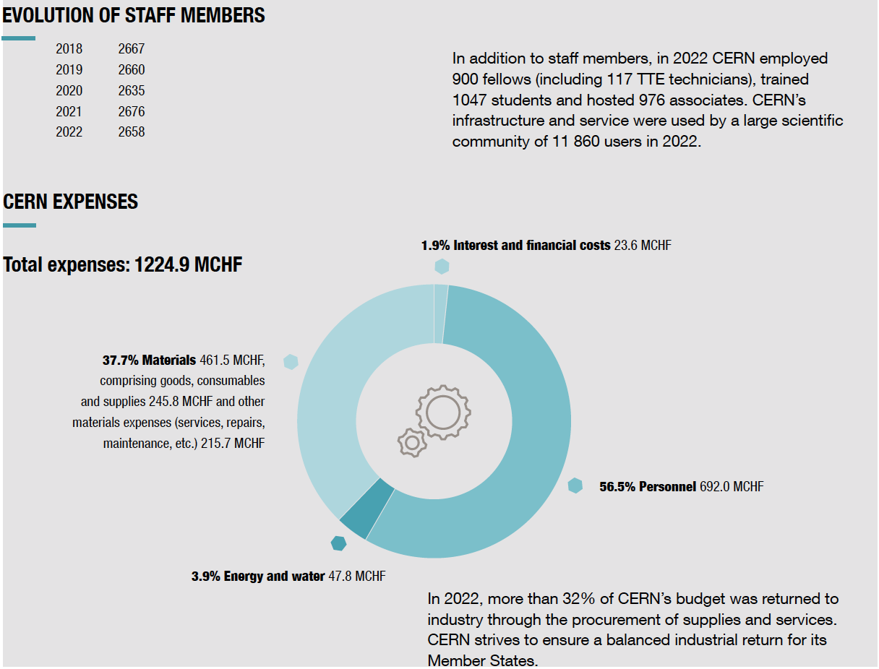

Slide 12
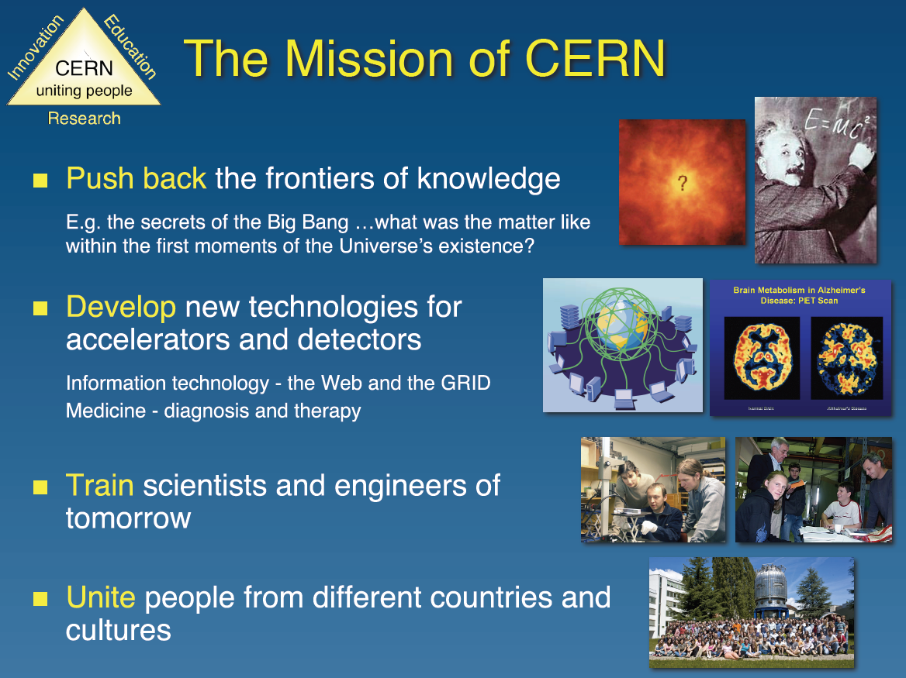

Slide 13
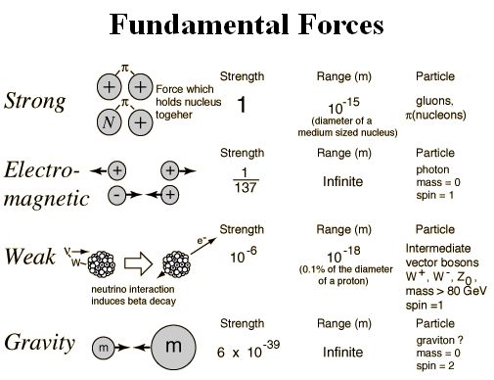
10⁻²² sec
10⁻¹⁵ sec
10⁻⁸ sec
10⁻² sec

Slide 14
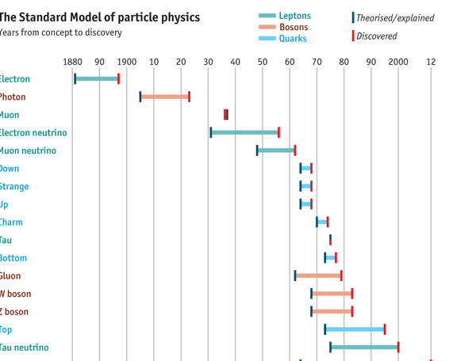

Slide 15
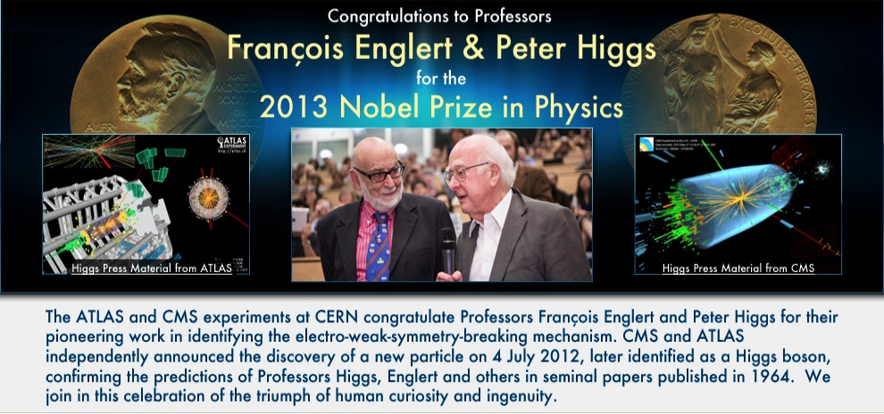
Higgs boson discovery was the culmination of the decades of dedicated and intense work by so many collaborators in designing, building and operating ATLAS, and in understanding and analysing the data. None of it would have been possible without the huge dedication also of the LHC accelerator team, the worldwide distributed computing teams, and the continuing support of the governments and funding agencies of the 38 countries home to our 177 member institutes.
We can all feel proud that our experimental observations demonstrated that the insights rewarded by the Nobel prize are realised in nature.

Slide 16

Animation of the reconstructed mass from Higgs candidate events in four-lepton decays.
https://cds.cern.ch/record/2230893

Slide 17

Animation of the reconstructed mass from Higgs candidate events in two-photon decays.

Slide 18
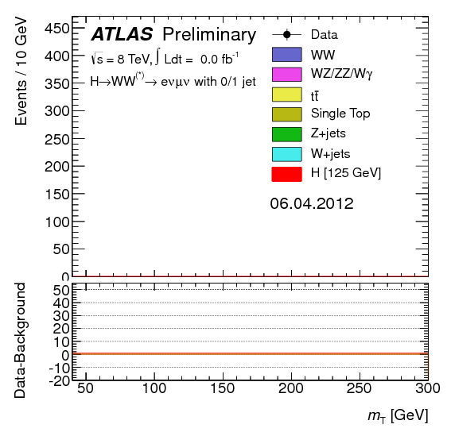
Animation of the reconstructed mass from Higgs candidate events in W-boson-pair decays.

Slide 19
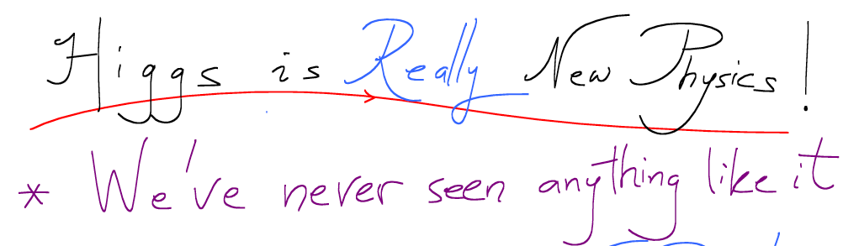
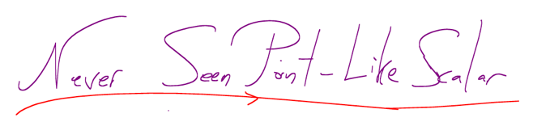

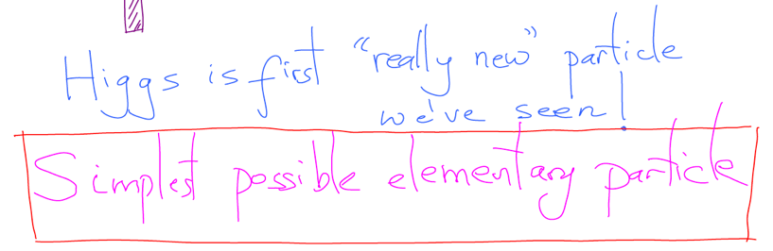
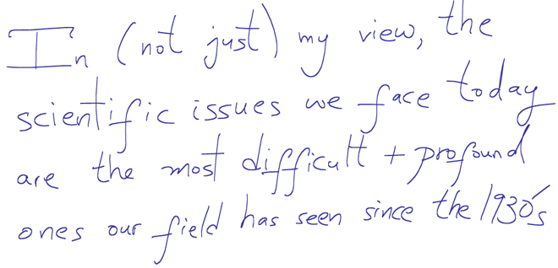
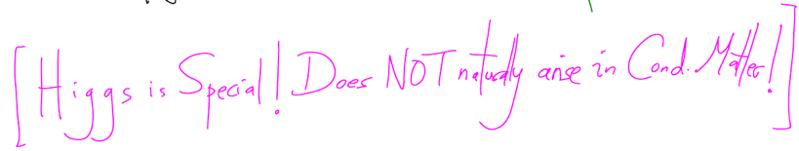
10th anniversary of the Higgs boson discovery
https://indico.cern.ch/event/1135177/timetable/?view=nicecompact
Prospects for the future - the Standard Model and beyond
Nima Arkani-Hamed (IAS)
https://indico.cern.ch/event/1135177/contributions/4788694/attachments/2474678/4246383/HiggsJul4CERN2022_NAH.pdf

Slide 20
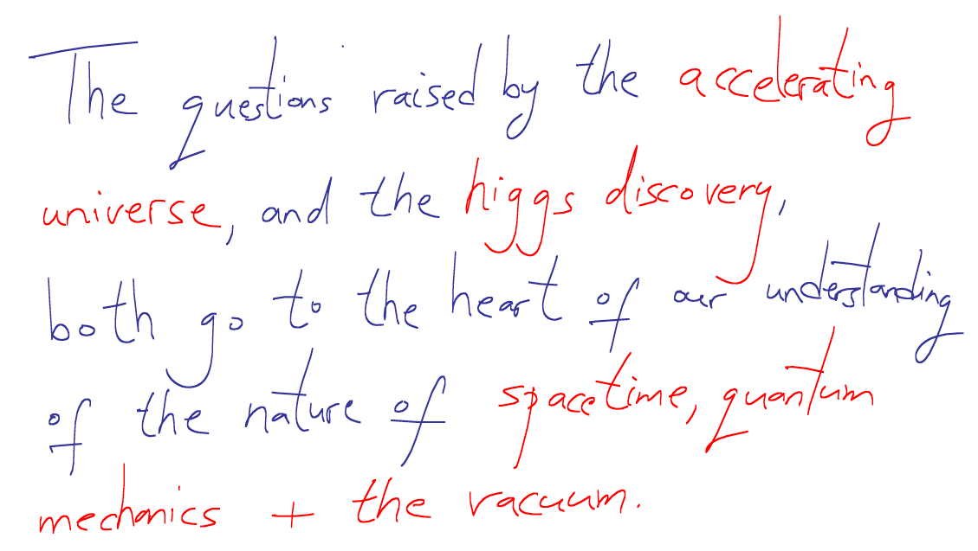
Prospects for the future - the Standard Model and beyond
Nima Arkani-Hamed (IAS)
https://indico.cern.ch/event/1135177/contributions/4788694/attachments/2474678/4246383/HiggsJul4CERN2022_NAH.pdf

Slide 21
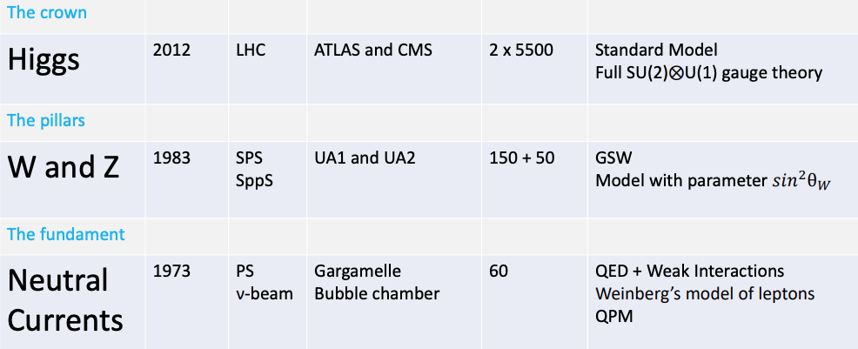

Slide 22
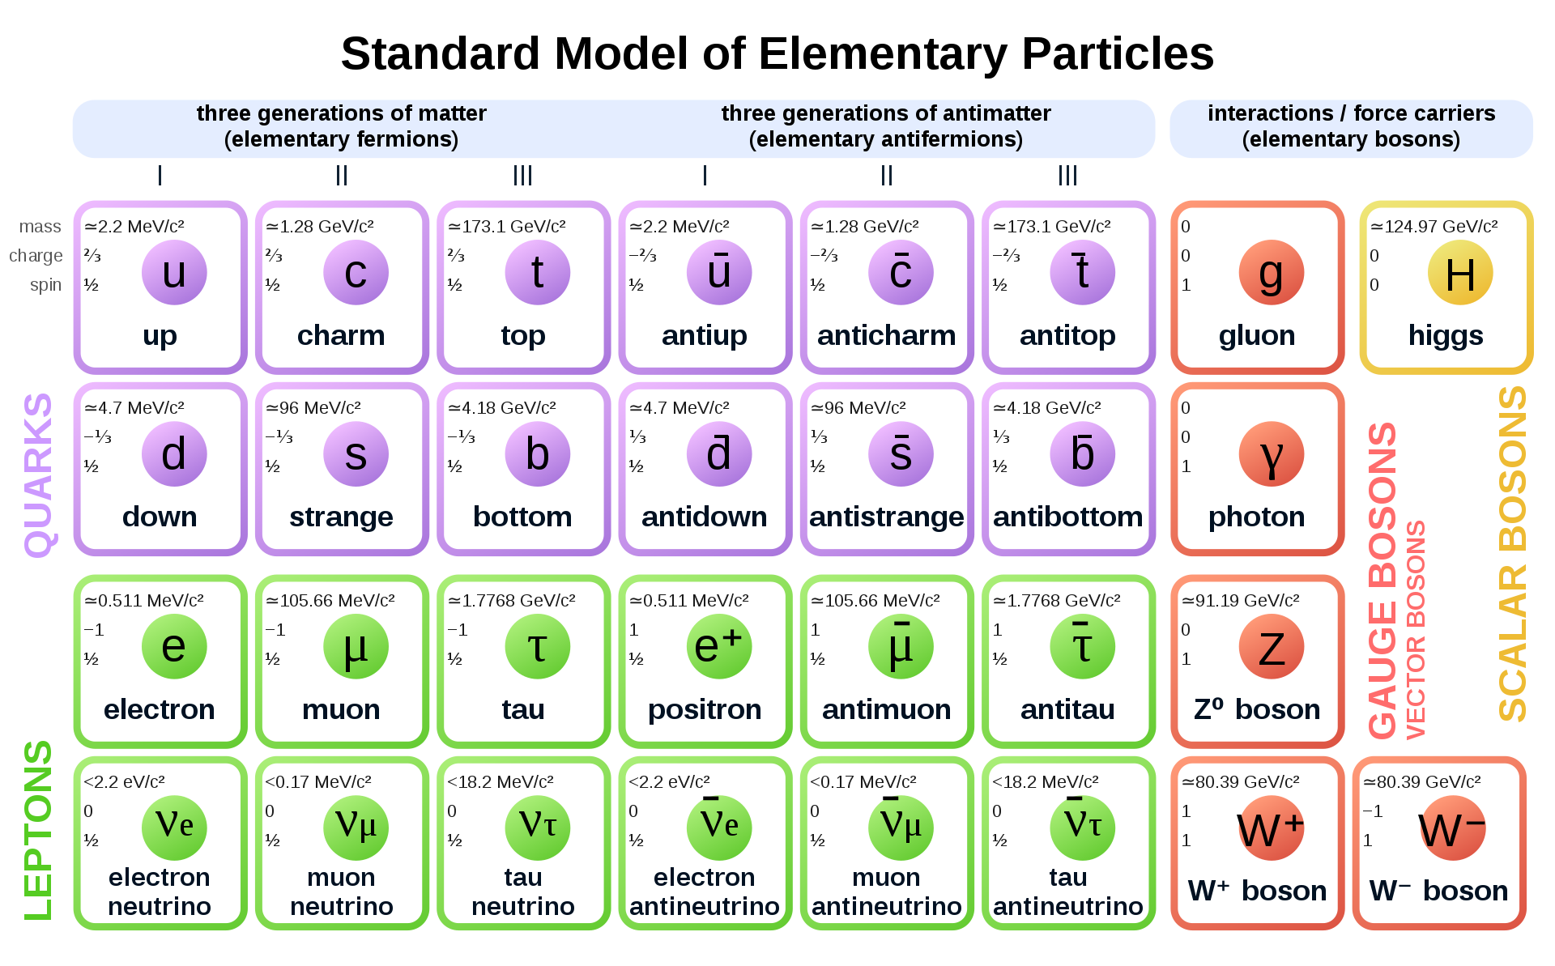

Slide 23

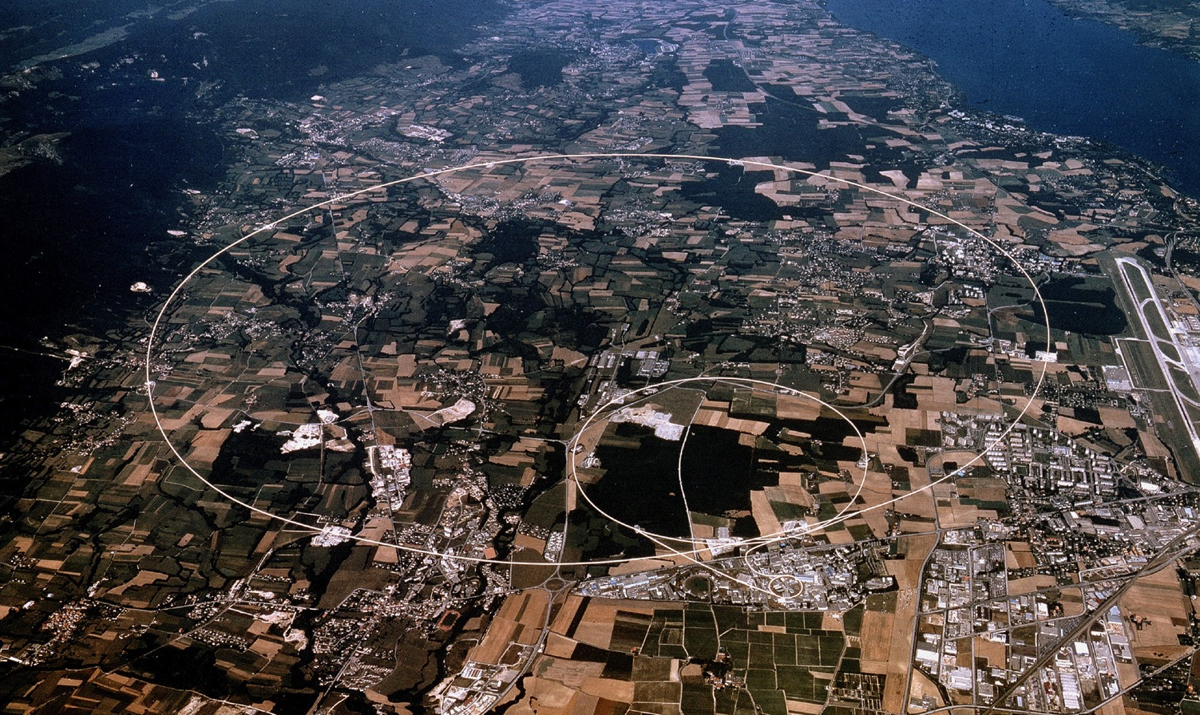
Accelerating Science and Innovation

Slide 24
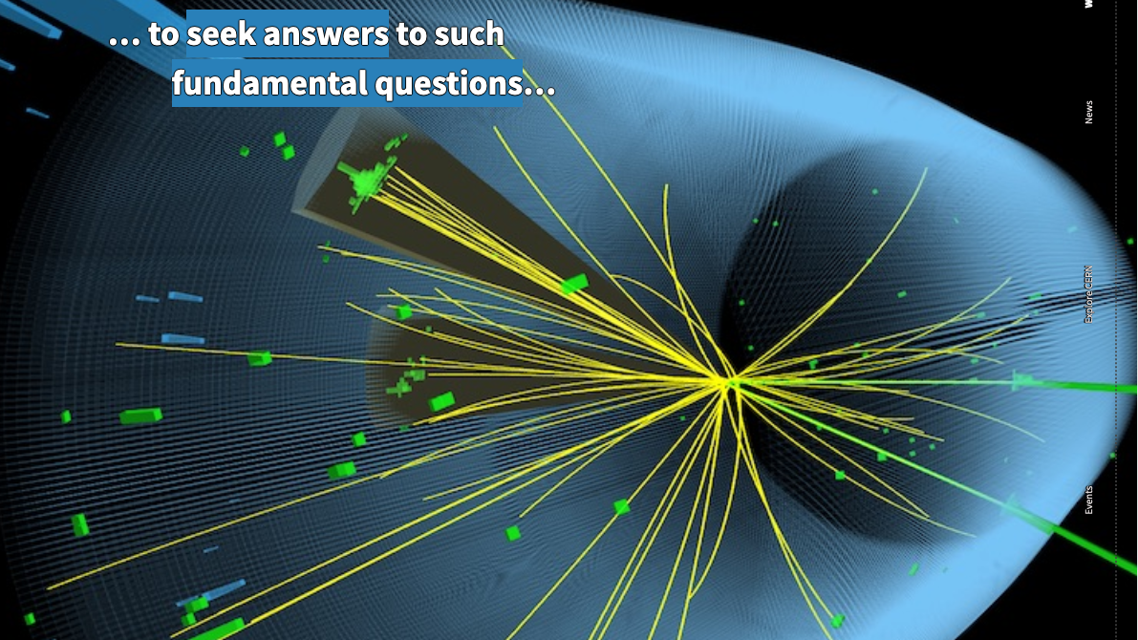

Slide 25
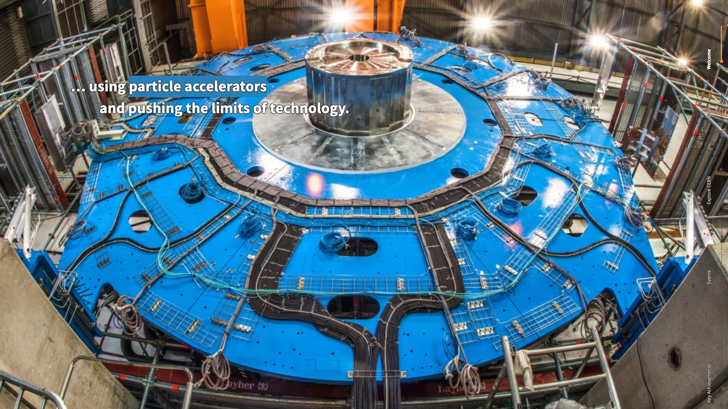

Slide 26
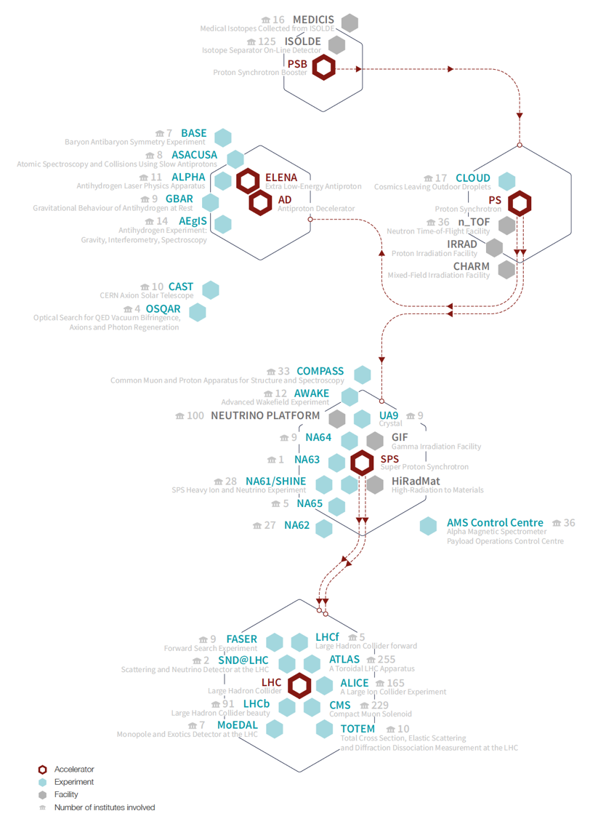

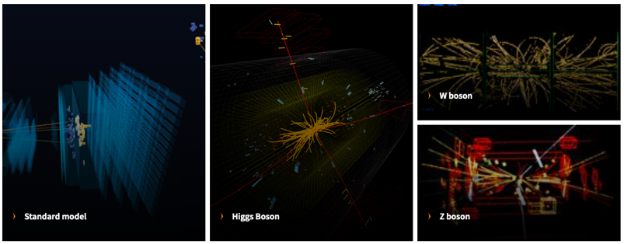
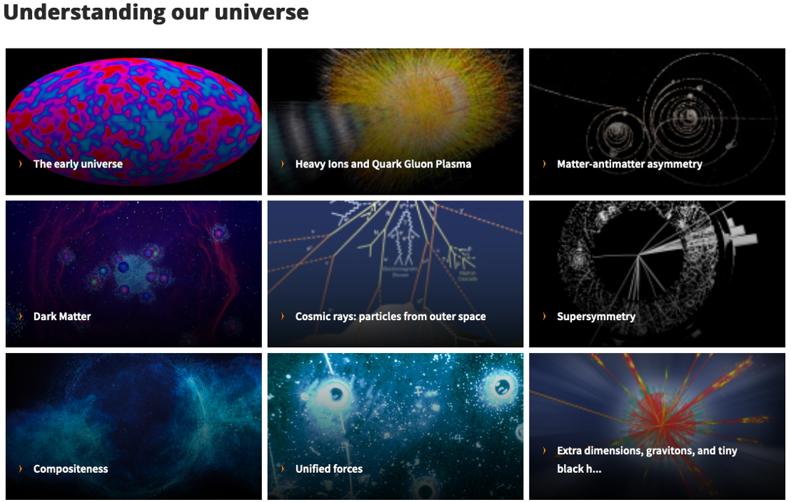
https://home.cern/science/physics

Slide 27
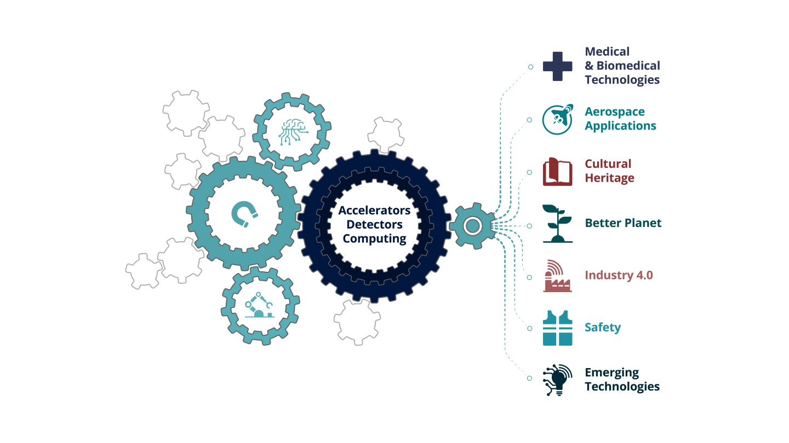
contribution to society: knowledge-transfer
https://home.cern/about/what-we-do/our-impact

Slide 28
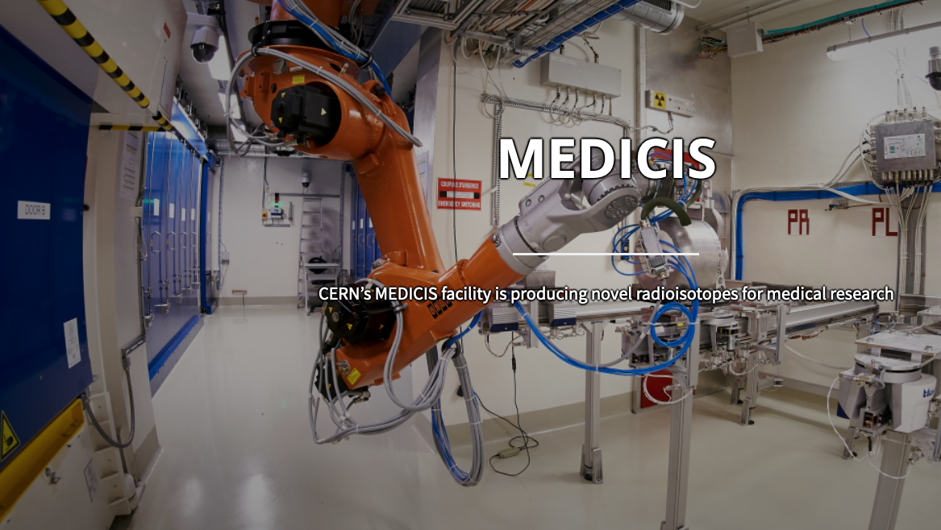
https://home.cern/science/experiments/medicis

Slide 29
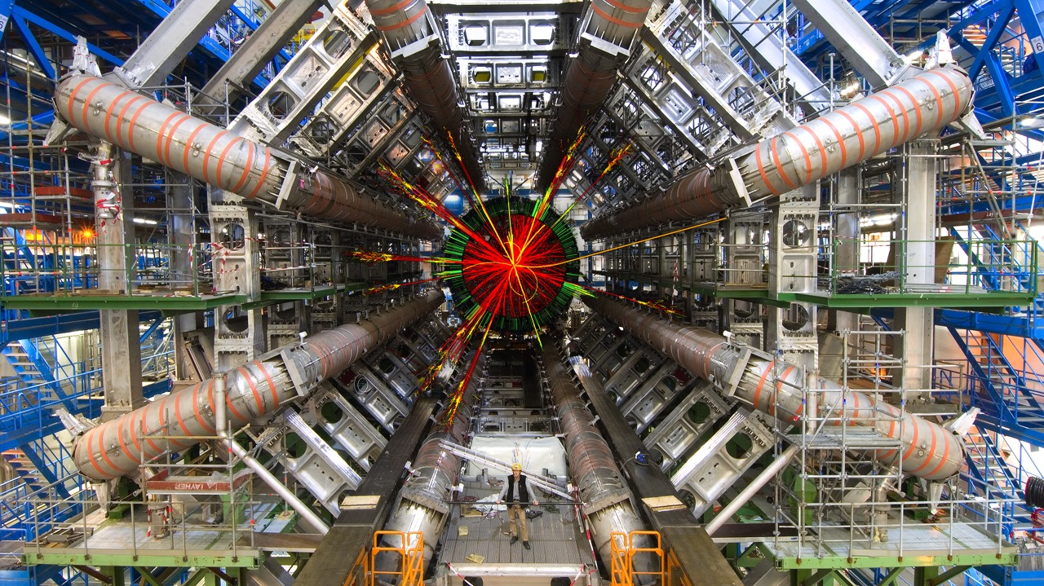

Slide 30
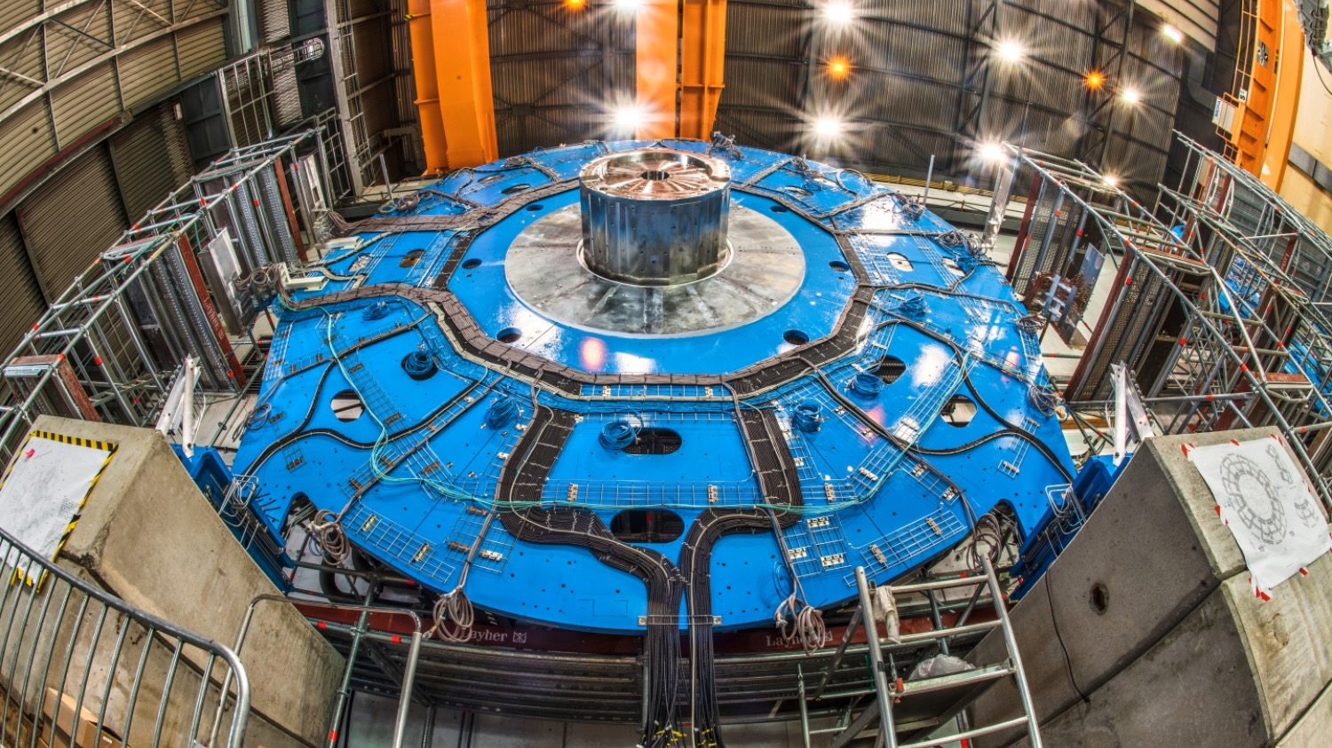
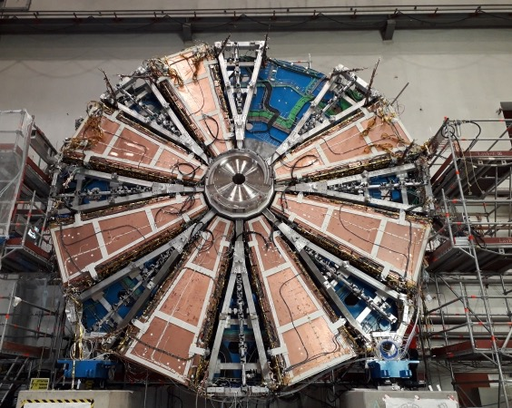

Slide 31
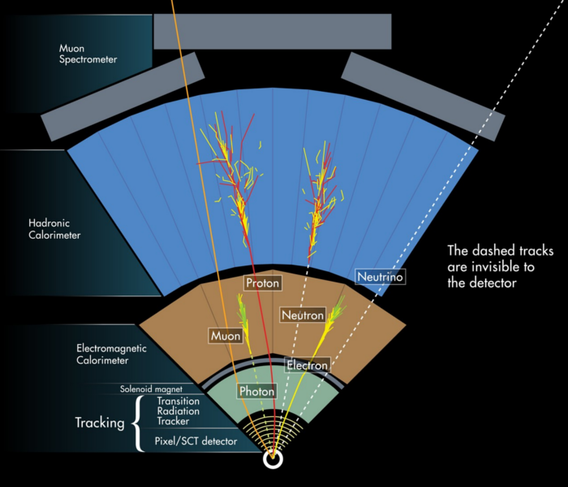

Slide 32

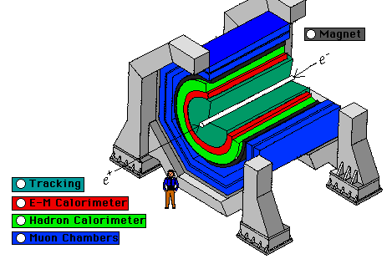
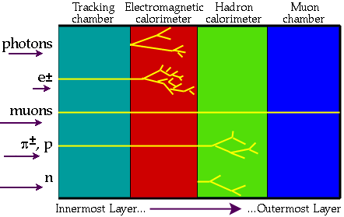

Slide 33
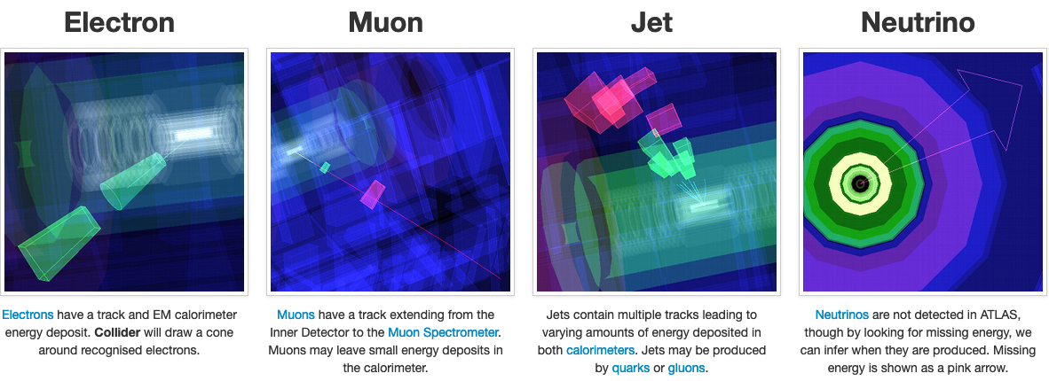

Slide 34
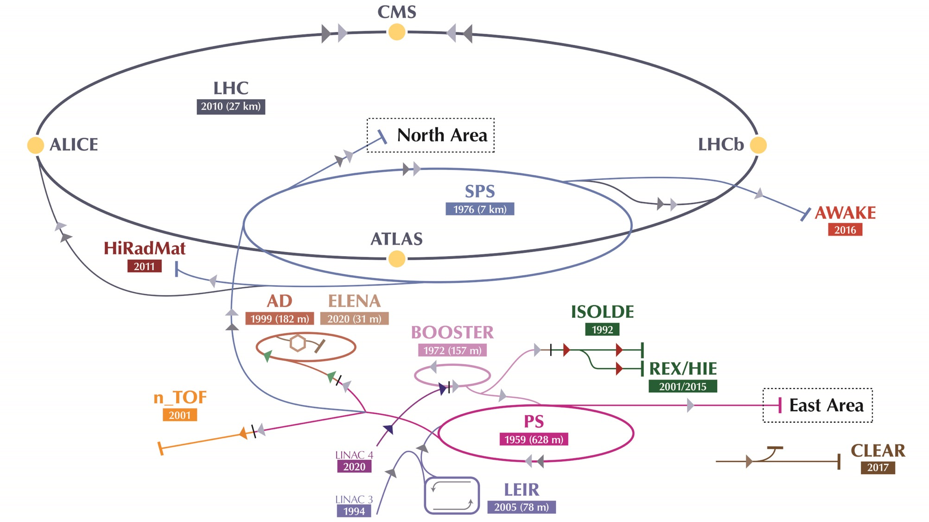

Slide 35
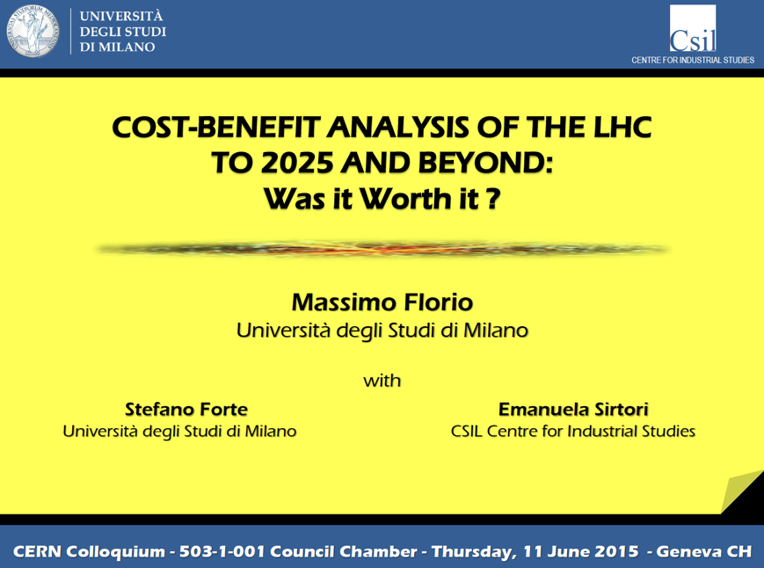
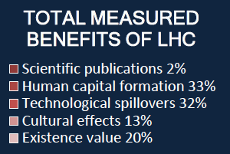
https://cds.cern.ch/record/2025538?ln=en

Slide 36

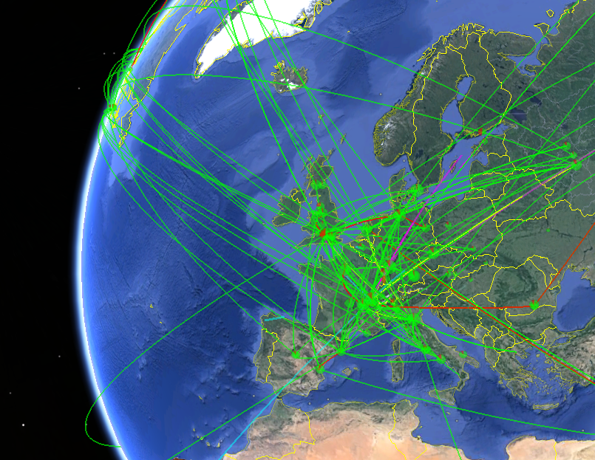
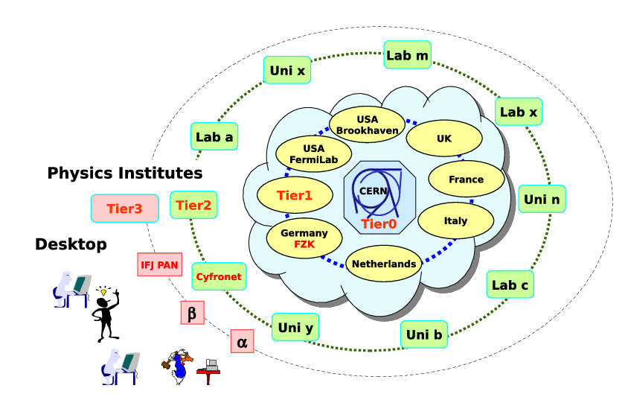
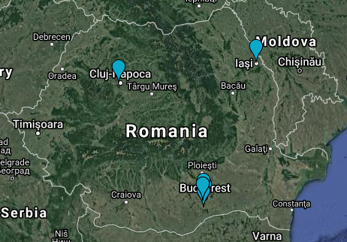
https://home.cern/science/computing/grid
900 000 computer cores
170 sites
42 countries
12 000 users
2 million tasks per day
60 GB/s

Slide 37
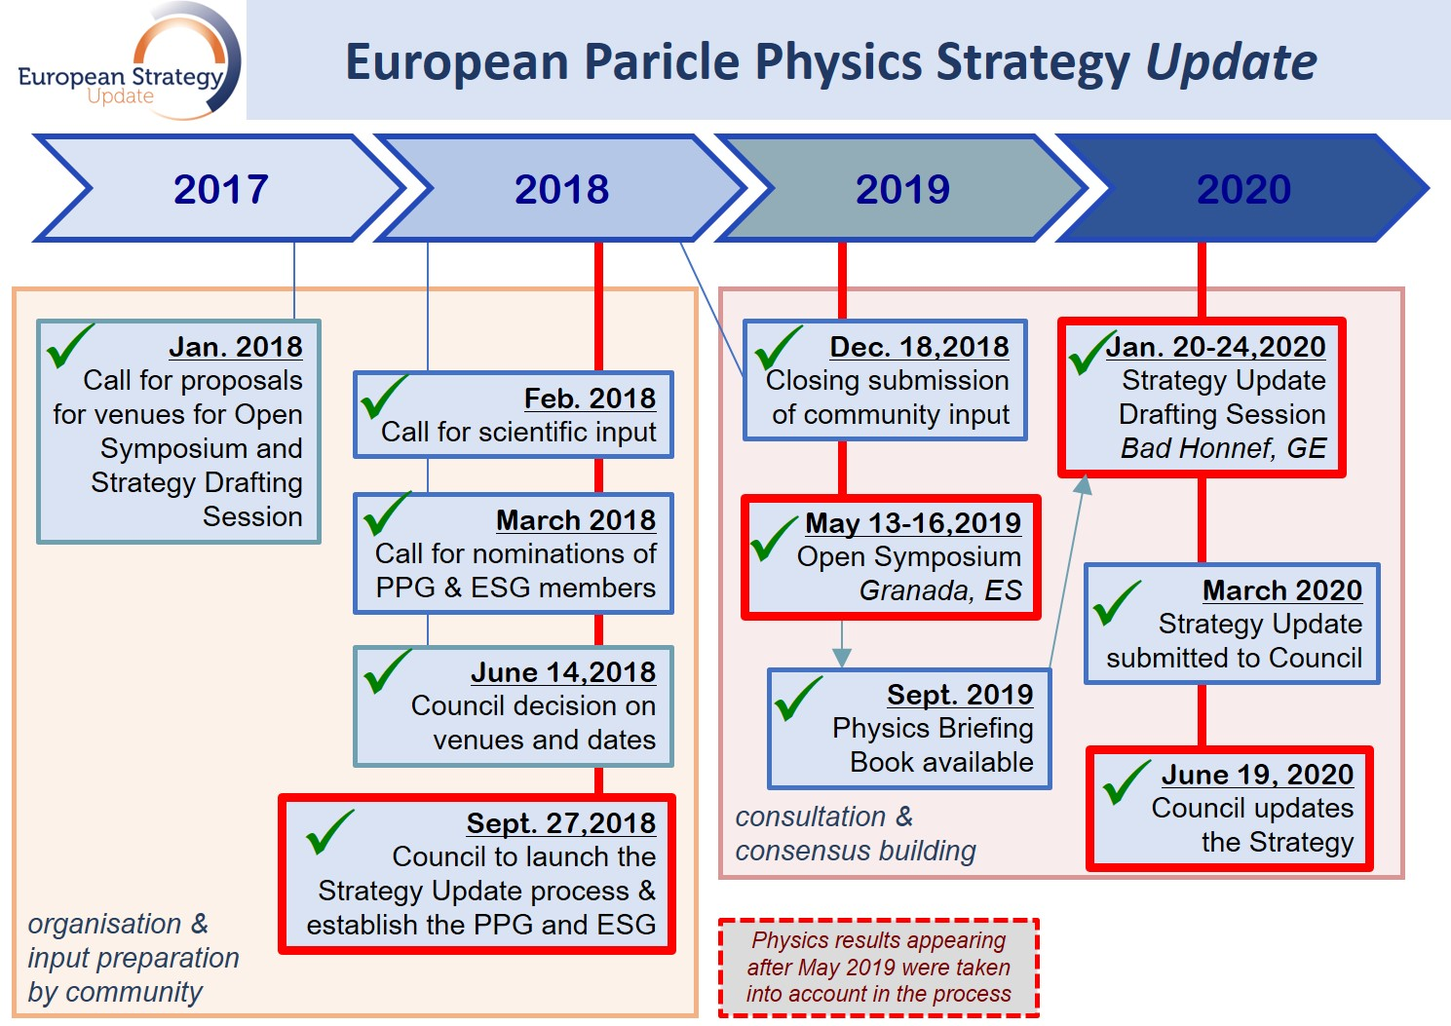

Slide 38
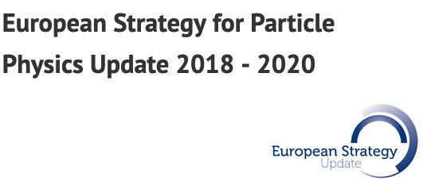
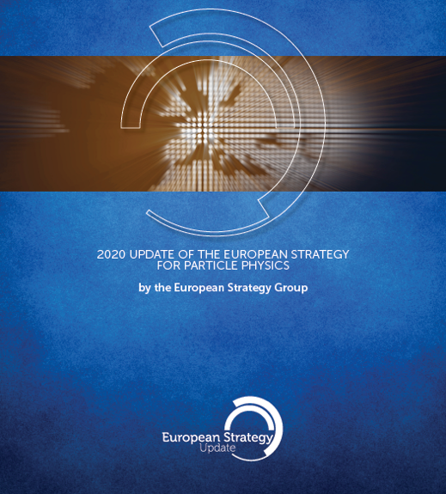


https://europeanstrategy.cern/european-strategy-for-particle-physics

Slide 39

Environmental and societal impact
D. Exploring the fundamental properties of nature inspires and excites. It is part of the duty of researchers to share the excitement of scientific achievements with all stakeholders and the public. The concepts of the Standard Model, a well-established theory for elementary particles, are an integral part of culture. Public engagement, education and communication in particle physics should continue to be recognised as important components of the scientific activity and receive adequate support. Particle physicists should work with the broad community of scientists to intensify engagement between scientific disciplines. The particle physics community should work with educators and relevant authorities to explore the adoption of basic knowledge of elementary particles and their interactions in the regular school curriculum.
https://physicsmasterclasses.org/

Slide 40



Slide 41

https://home.cern/about/what-we-do/inspire-educate

Slide 42



Slide 43

FCC Feasibility Study (2021 - 2025)

Slide 44


Slide 45


Slide 46


Slide 47



Slide 48



European Strategy for Particle Physics Update 2024-2026

Slide 49


Slide 50

Thank you !

