Slide 1
Ten Years of RF Operation with the TH628L Diacrode at LANSCE
J. T. M. Lyles, M.S. Barrueta, R. Bratton, T. W. Hall, G. Roybal, G. Sandoval
Accelerator Operations and Technology Division
13th CWRF Workshop
September 9, 2024
Work supported by the U.S. Department of Energy through the Los Alamos National Laboratory, operated by Triad National Security, LLC, for the National Nuclear Security Administration of U.S. Department of Energy (Contract No. 89233218CNA000001)

Slide 2
Outline
Drift Tube Linac RF
Motivation for Replacing RF Powerplant
New RF Power Amplifier Design
Prototype/Testing Facility
Some Engineering Challenges and Smoke
Commercial Production of Amplifiers
Installation of RF power systems at Linac
Operating Results
Tube Lifetime

Slide 3
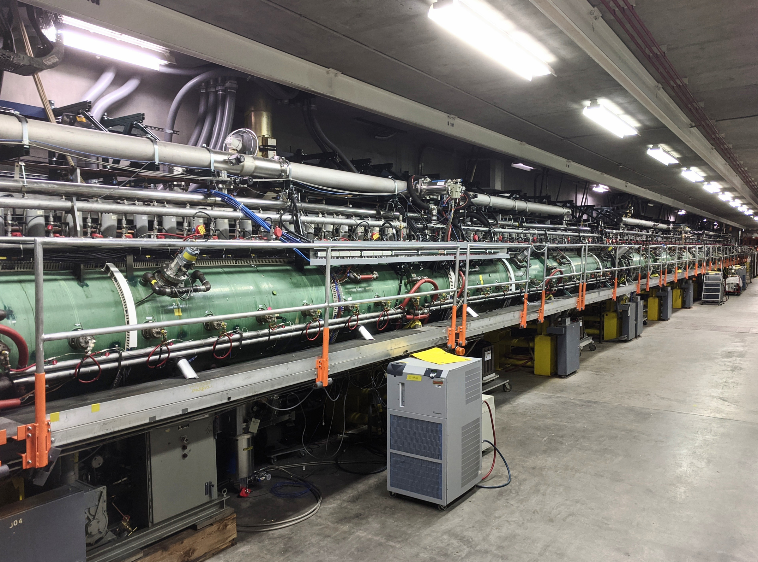
Room Temp DTL Uses Significant RF Power
Drift Tube Linac (DTL) occupies the first 60 meters of the 760 m copper linac, commissioned 1972
H- and Protons accelerated from 0.75 to 100 MeV in four cavities, then transferred to coupled-cavity linac for final acceleration to 800 MeV
DTL tanks 2-4 operate with 1 mS pulses of 201.25 MHz at 2 - 3 MW peak power and 120 Hz rep rate
DTL tank 1 (5 MeV) operates at 350 kW

Slide 4
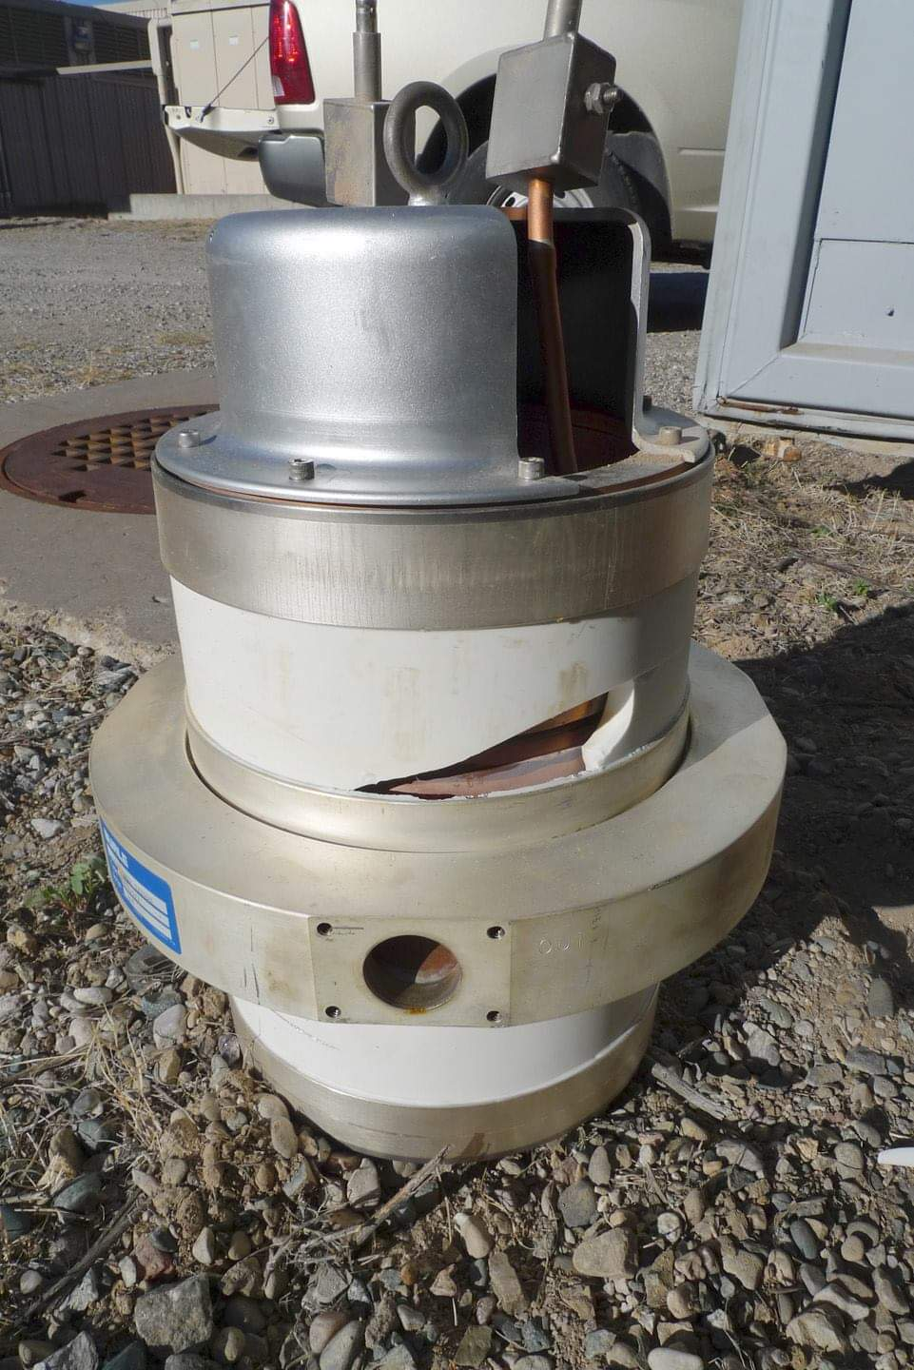
Motivation for Replacing RF Powerplant
Problems
Original triode final stage tube designed in 1958 at RCA. Company subsequently changed ownership twice, while staying in same factory but gradually loosing some process knowledge (the unwritten kind)
Around 2004, issues with new tubes resulted in shortened tube lifetime when operating at high average power at LANSCE ~ 340 kW. Required purchasing extra tubes each year for contingency, where rapid cathode emission degradation was occuring.
Manufacturer had no high power test bench, leaving us responsible for performing burn-in, RF/vacuum conditioning (weeks), and creating difficult warranty situation
In 2006, LANSCE reduced operation to 60 Hz due to increased tube failures and rapidly diminishing supply of high DF tubes. Some beam users lost up to 60% of available beam with lower rep rate
HV for anode was pulsed with a large tube-based modulator having 4 tubes

Slide 5
RF Amplifiers Considered to Meet Requirements
Device | Performance | Reliability | Commercial Supplier | Infrastructure
Klystron | Highest power gain Simple circuit Medium efficiency | “Typically” long life Least complex | Tube dev. required | Replace HV power sources. Physically long devices
Diacrode® | Lowest power gain Requires 2 stages Highest efficiency | Tetrode life in other systems was >40K hours, depending on power derating | Tube available, dev. amplifier circuit | Uses same HV and cooling, fitted space of original system
Solid State LDMOS | Med power gain Requires >2000 devices per station, medium efficiency | Unknown, but complexity leads to many failure points, requires extensive protection circuits | Dev. Required. Product lifetime may be short (~10 yr) | Replace power supplies, cooling. Enlarged building
“System Considerations for 201.25 MHz RF Systems for LANSCE”, Lyles, et. al., NAPAC’13

Slide 6
Replacement RF Power Source
Solution and Timetable
1994– Learned of novel vacuum tube in development at Thales. TH628 was developed for Ion Cyclotron Resonance Heating for fusion over 35-65 MHz (ITER), and 1 MW CW and 3 MW pulsed 200 MHz RF power was also being demonstrated. Tube was being considered for IFMIF (175 MHz), and IBA bought one for Rhodatron T1000 (~107 MHz) later. Tube was stable with DC HV applied and had double-ended geometry.
1998– We designed cold model of amplifier and bought an early tube. Convincing management did not yield $$ so progress was slow, kept as a ‘side job’ when time came available... But 2006 crisis with triode failures initiated start of planning for a project to be called LANSCE-R
2009- Multidisciplinary design team formed: 1 EE, 2 techs, 2 ME, mech designer. Solidworks, Superfish and CST Microwave Studio were some of our design tools
2010– Added two EE’s for controls, fast logic, power detectors, and for system wiring design, for new test facility and planning for RF gallery at linac.
2011– Prototype PA operating, testing with 1998 tube to 2.5 MW at 12% DF. Design changes added for better HOM suppression. Eventually several hundred drawings with formal change controls

Slide 7
Replacement RF Power Source
Solution and Timetable - Continued
2012- Minor change made to Diacrode® to meet French environmental protection regs, which resulted in derating the average power capability. Big impact on our system design as one tube per DTL tank was not satisfactory. Redesigned to power combine 2 x TH628L tubes for DTL tanks 2-4. Later it proved to be a wise decision
2012-13- Thales engineers transitioned TH628L to multiple tube production, and improved test bench for our requirements. They provided much guidance on amplifier construction as well. A few early tube failures happened at Thonon, lessons learned.
2013- First production amplifiers received from Continental Electronics in Texas with final assembly and testing at our test facility. Seven TH628L cavity amplifiers called FPA were tested
2014- Installation of the first complete system at DTL tank 2. Second and third installations accomplished in 2015 and 2016 winter outages as each was a complete demolition of the old systems and replacement requiring 4 months
2014- LANSCE returned to reliable 120 Hz operation, as we freed up spare triodes to use in the other two systems so that they could run at 12% DF
2021- Remaining RF system for DTL tank 1 installed using a single TH781 tetrode, delayed until after COVID19 peak. This system operates at 350 kW so was not causing as much down time.

Slide 8
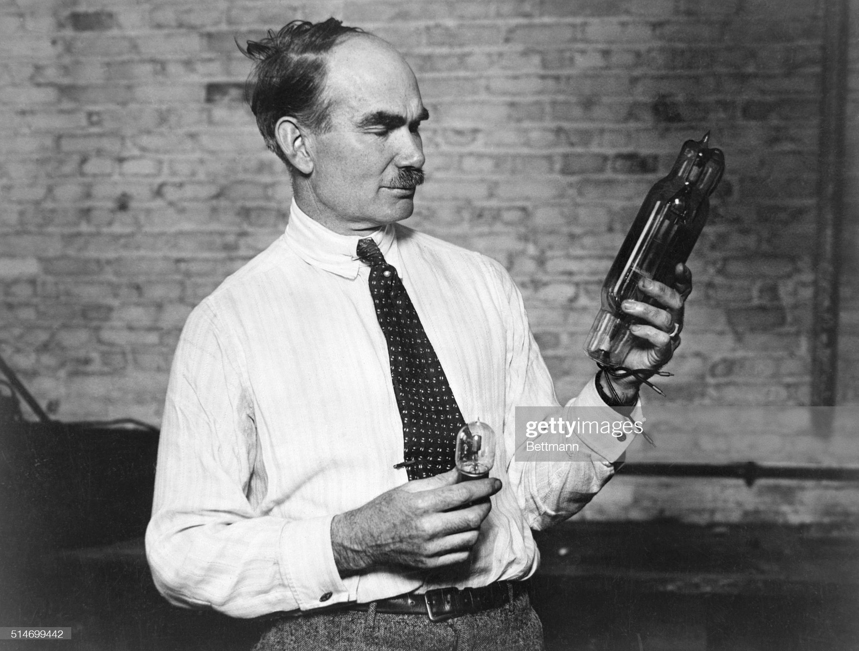
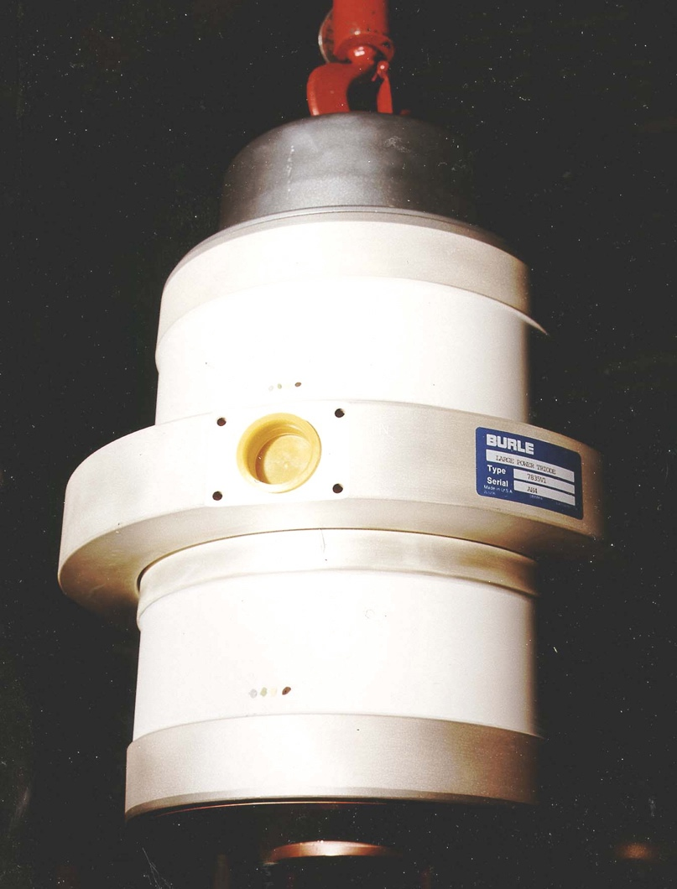
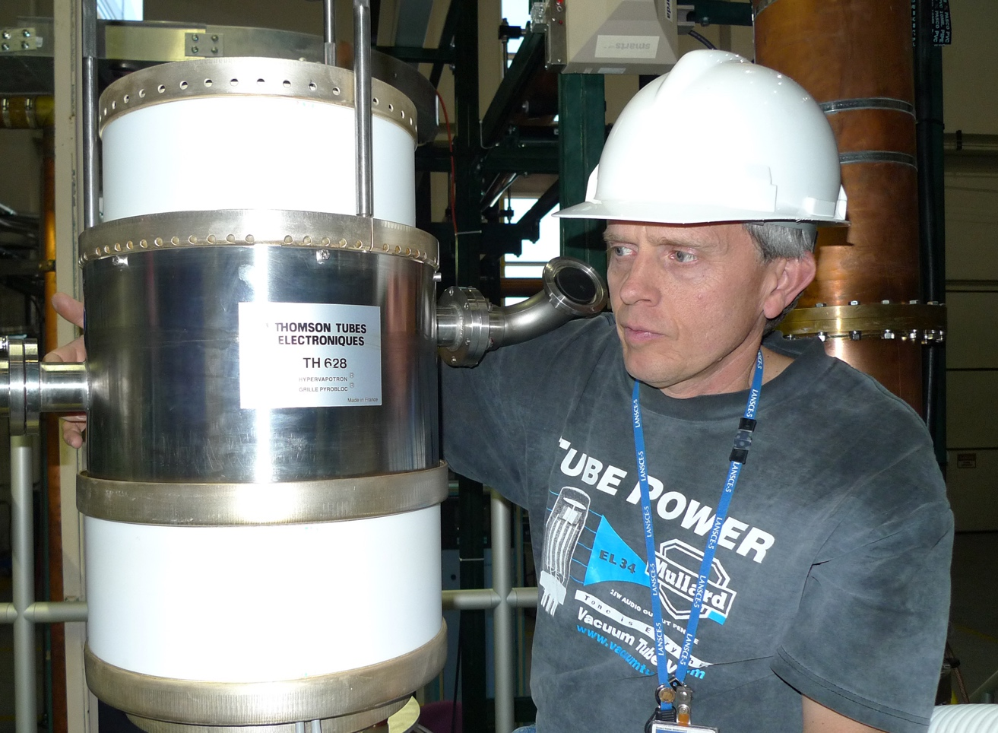
Lee DeForest over 100 years ago
Decades of Evolution
Of Power Grid Tubes
7835 Super Power Triode
TH628 Diacrode ® (1998 version)

Slide 9
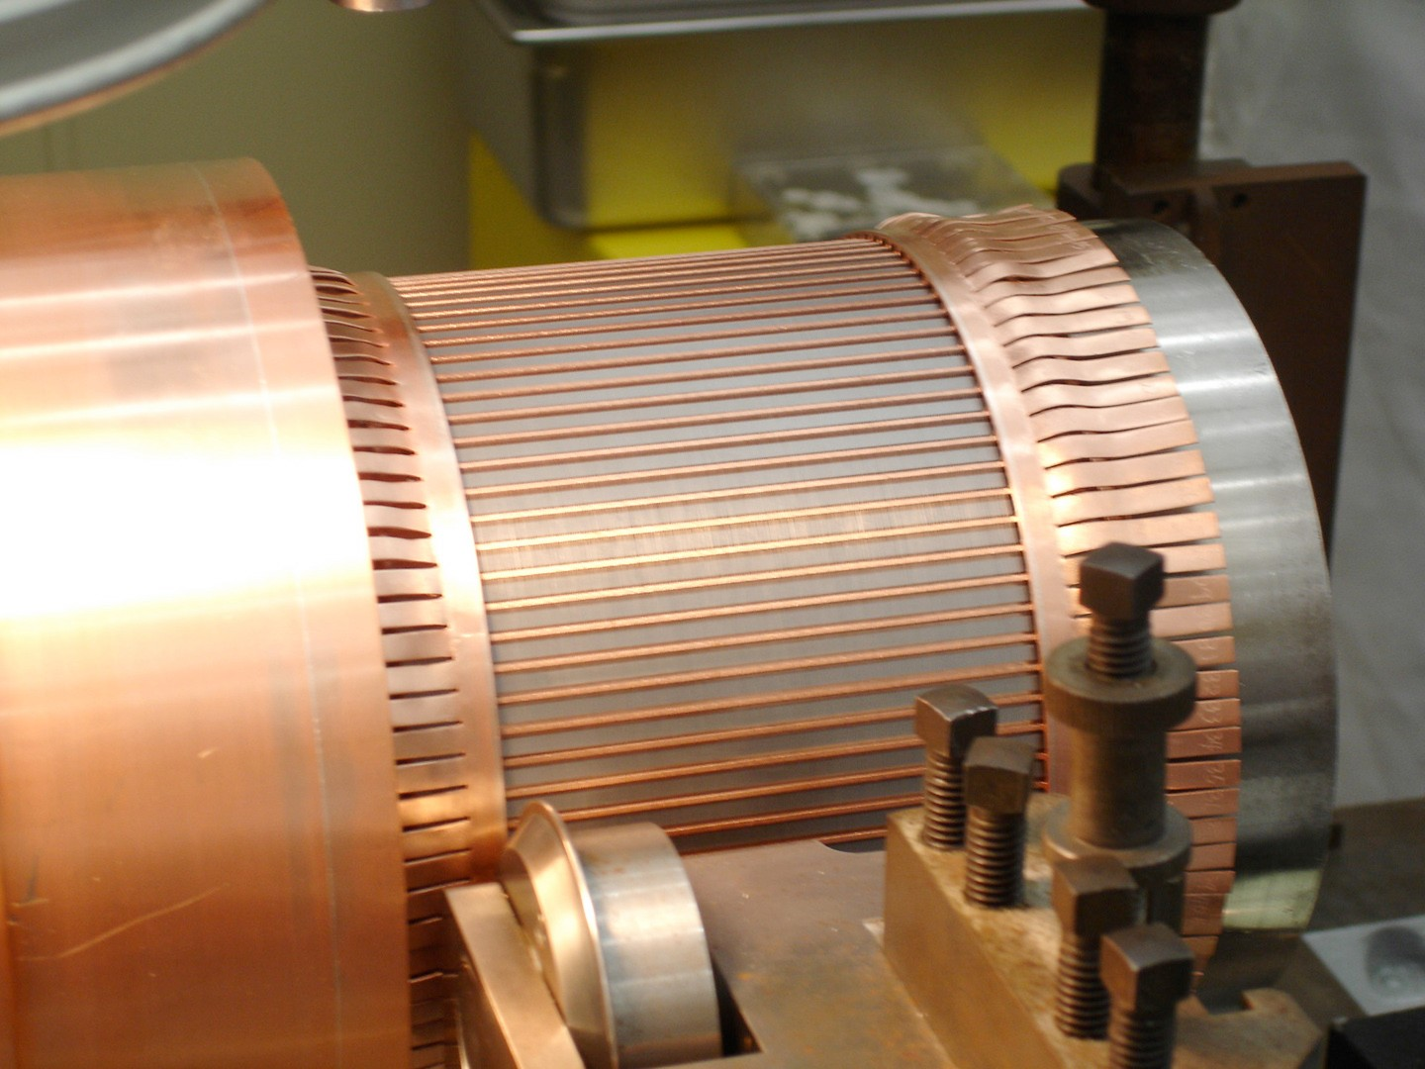
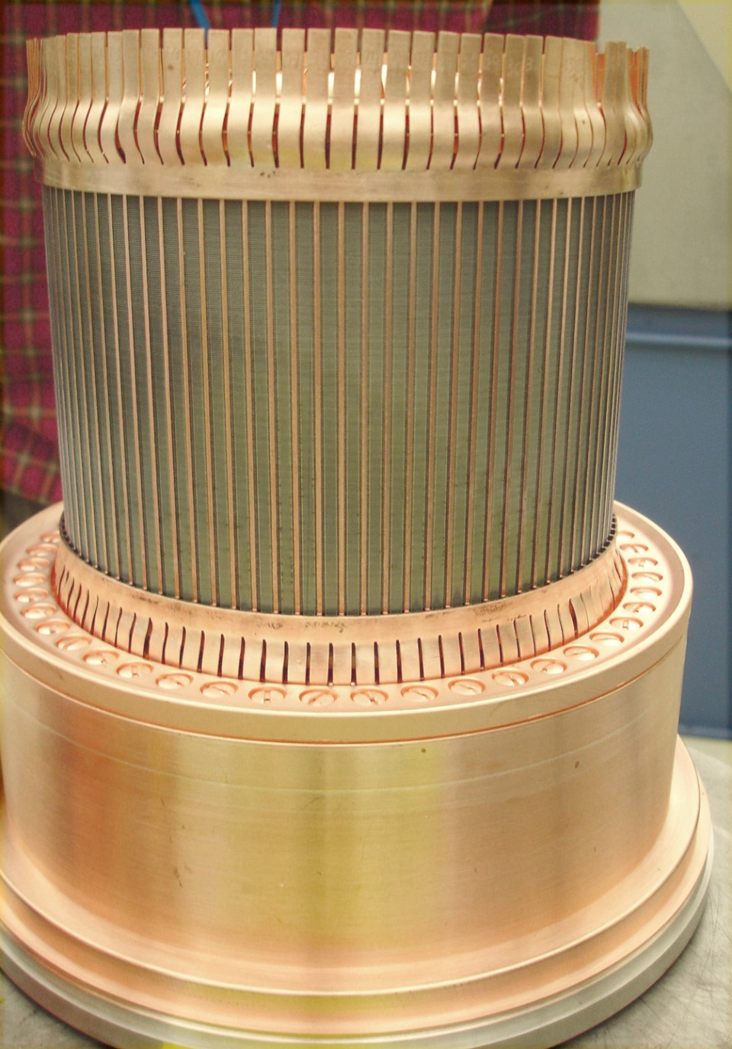
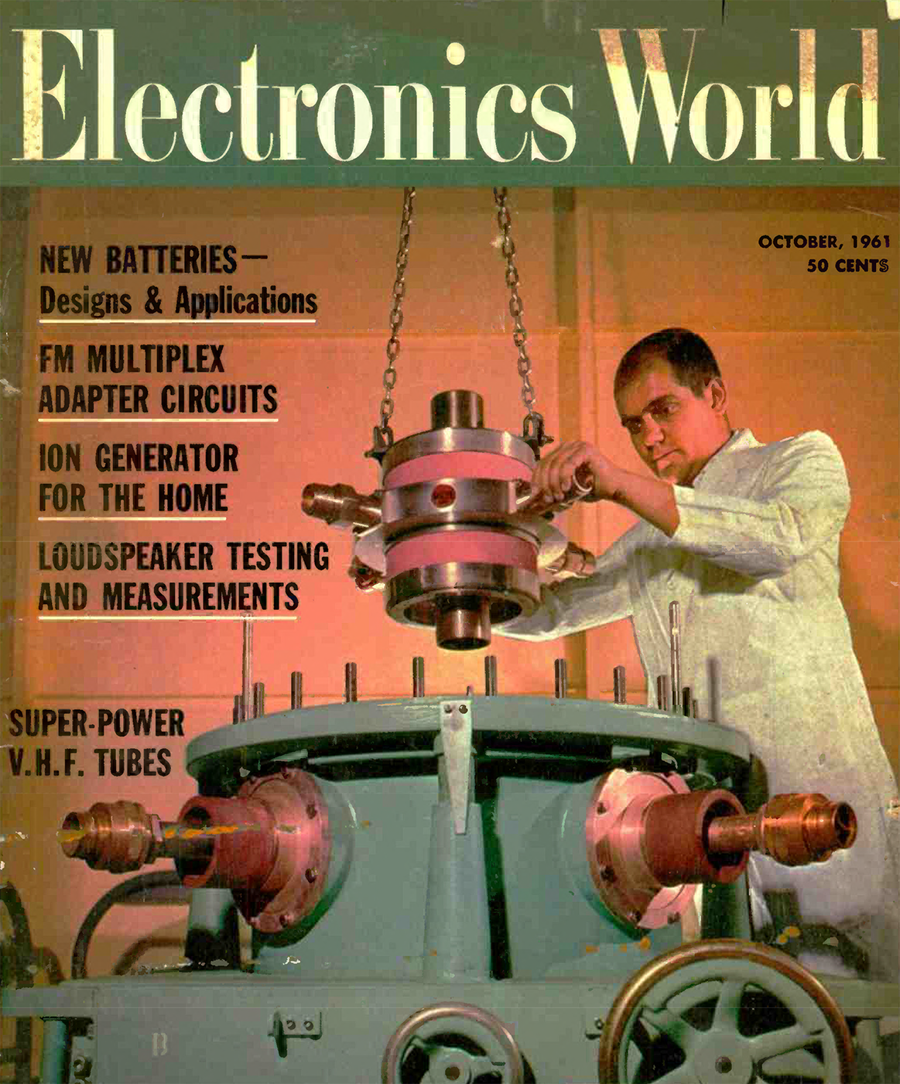
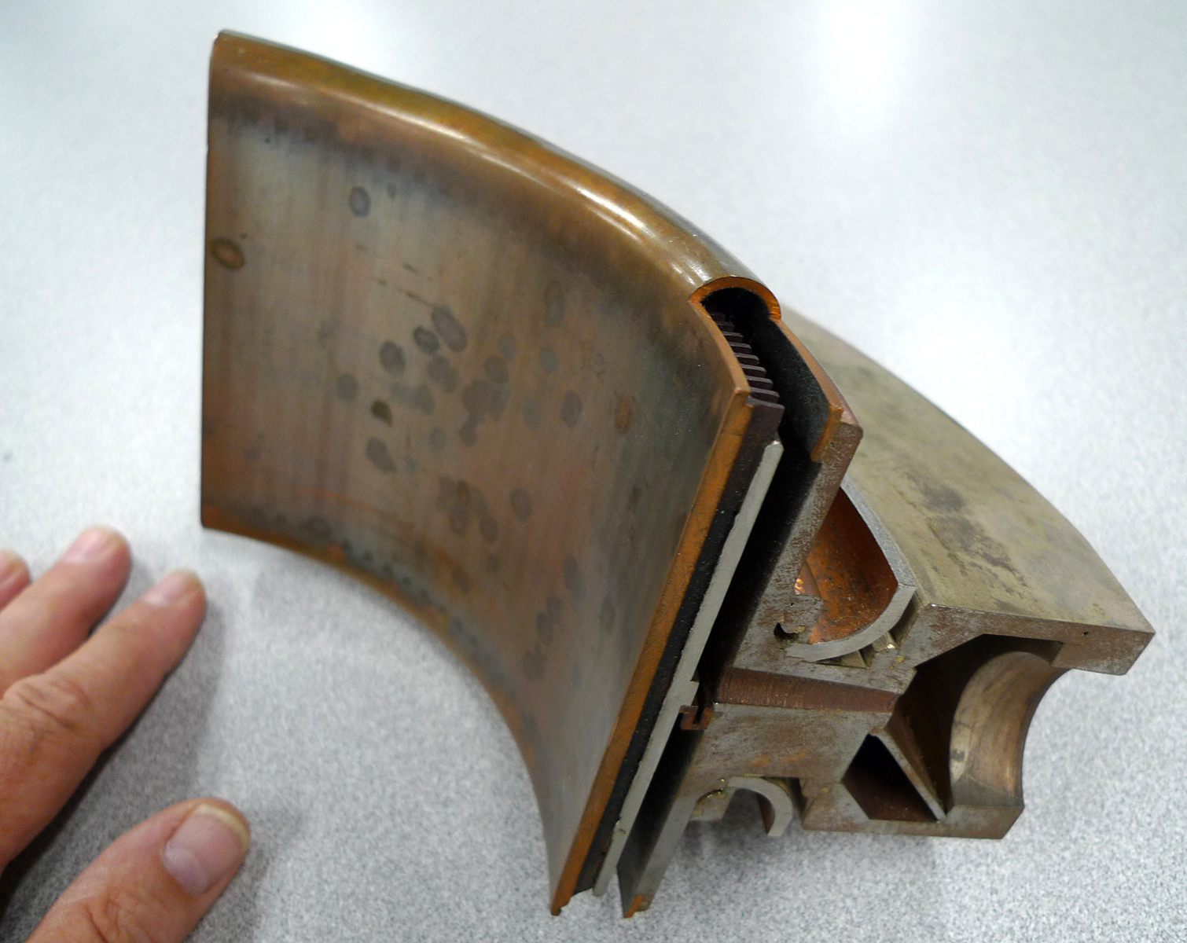
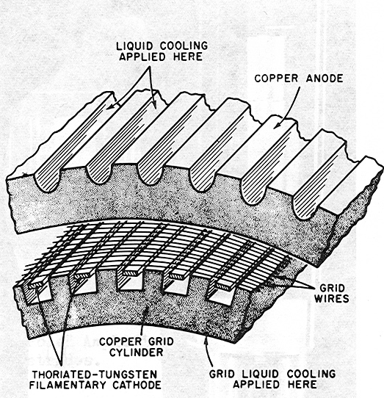
Internal Features of the RCA 7835 Triode

Slide 10
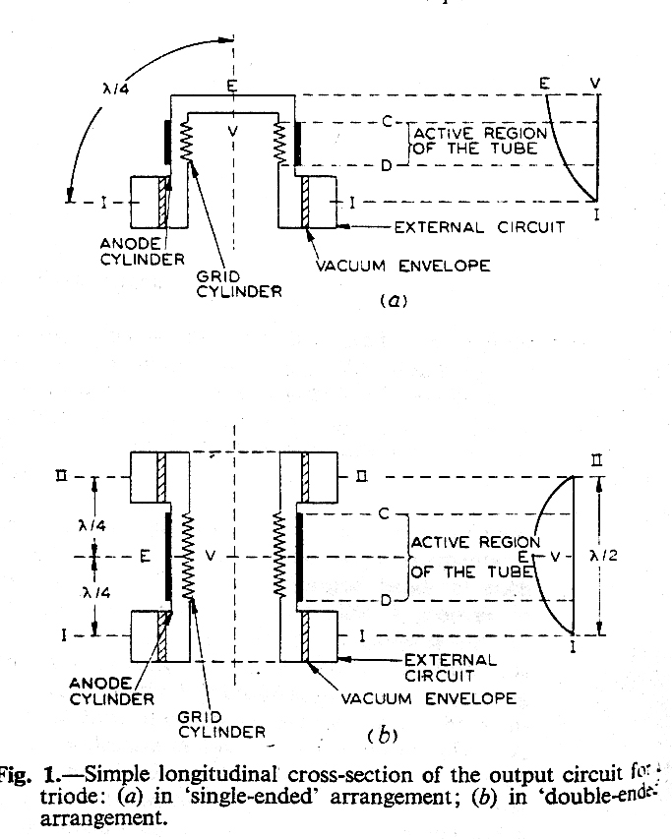
Double-Ended RF Circuit for RCA 7835 and Thales TH628L
Requires a “slave”circuit on one end of both the input and output terminals and a movable tuner on the opposite end of each. This maintains voltage antinode at center of the active region within the tube, making a λ/2 resonator
Conventional radial beam tetrodes are made like this.
Dead head horizontal space above beam region is capacitive
Megawatts of RF power at VHF → UHF by doubling height of active beam region, E_{max} is in center of beam region
“Advances in the Techniques and Applications of Very High Power Grid-Controlled Tubes”, Hoover, IEE paper 2752R, Nov. 1958

Slide 11
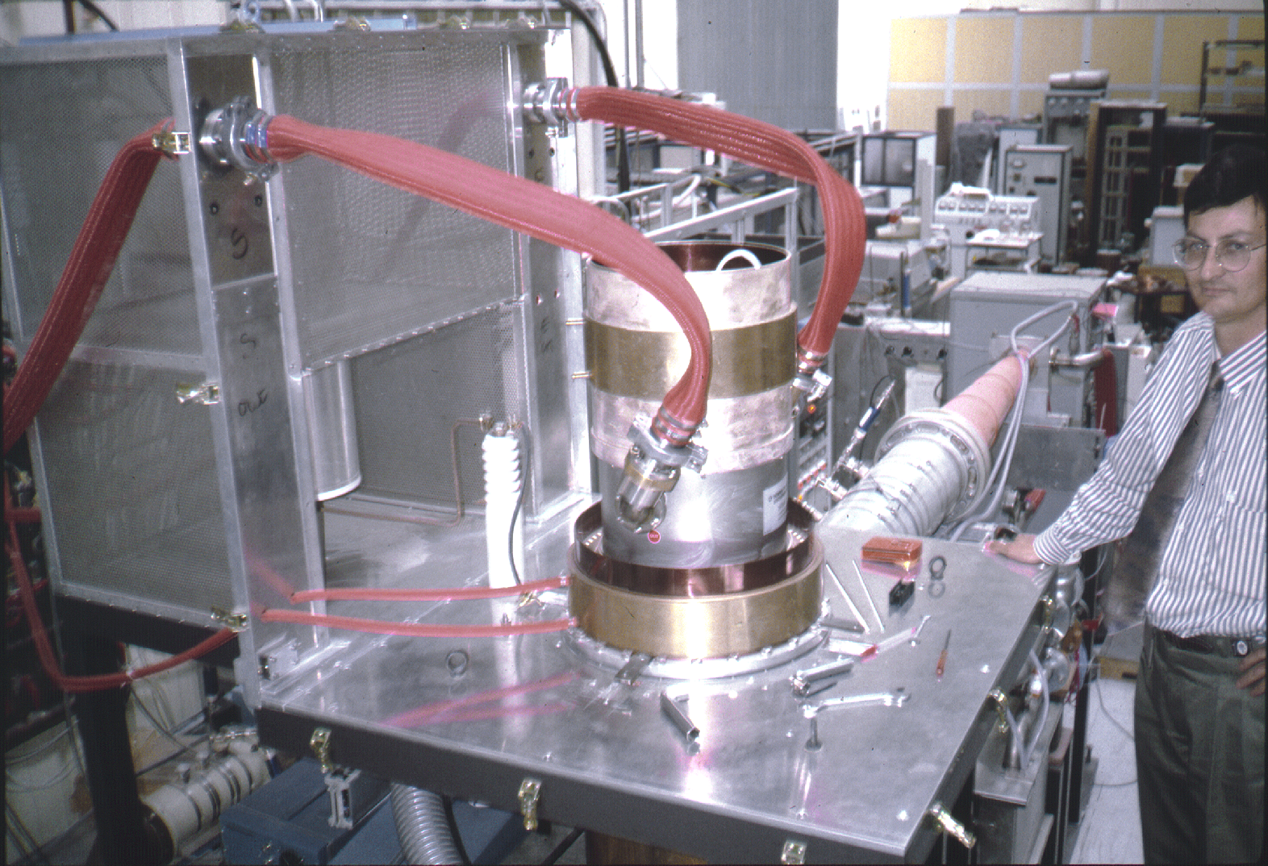
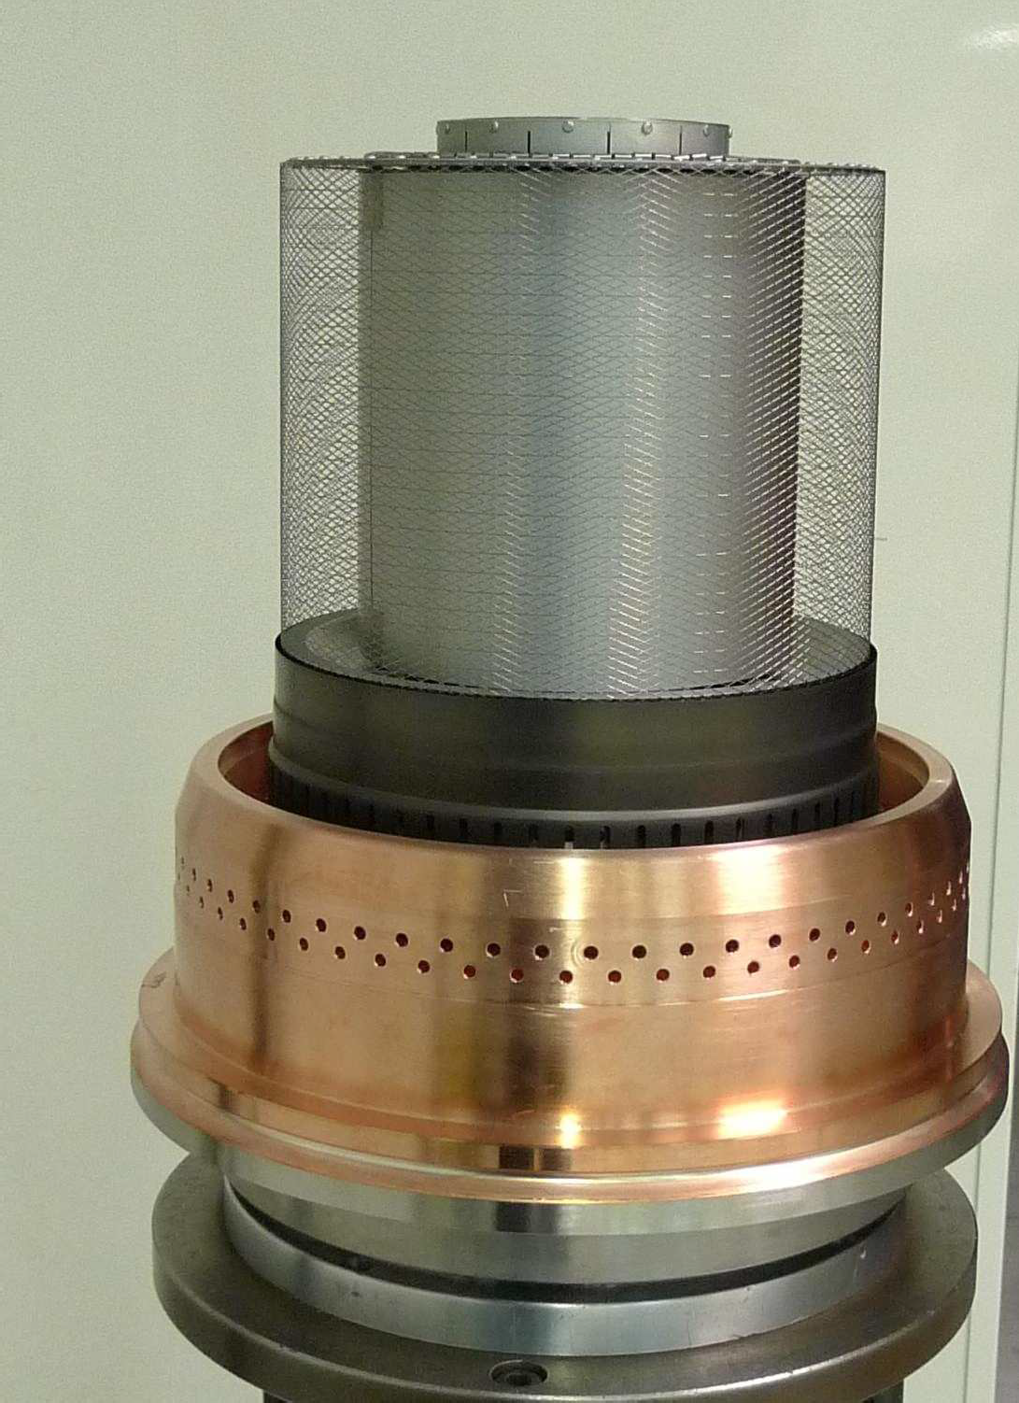
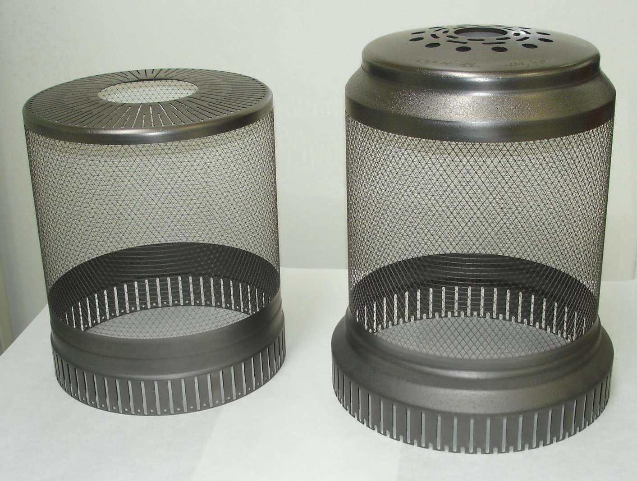
Thales Developed Substantial Innovations to
Make a Double-Ended Tetrode in 1993
D28 Prototype in 1994
Welded Mesh Heater
PG Control and Screen Grid
Pyrolytic graphite grids allows high temperature processing so no need for external appendage ion pump. Tubes have very few trips at first turn on.
Low secondary emission from PG and close G1-K spacing for increased power gain, yet stable mechanical properties adjacent to 1950K filament
Same double-ended resonator concept as RCA tube for 2 x power with twice active grid height
“A New Generation of Gridded Tubes for Higher Power and Frequencies”, Clerc, Ichac, Robert, PAC’97
“Diacrode TH628”, Robert, International Vacuum Electronics Conference, 2007
”TH628L Diacrode Status”, Grezaud, Boussaton, Robert, International Vacuum Electronics Conference, 2014

Slide 12
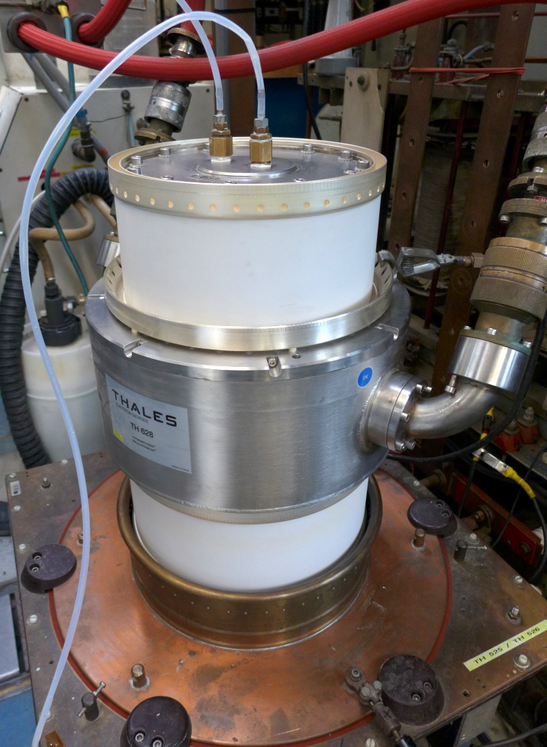
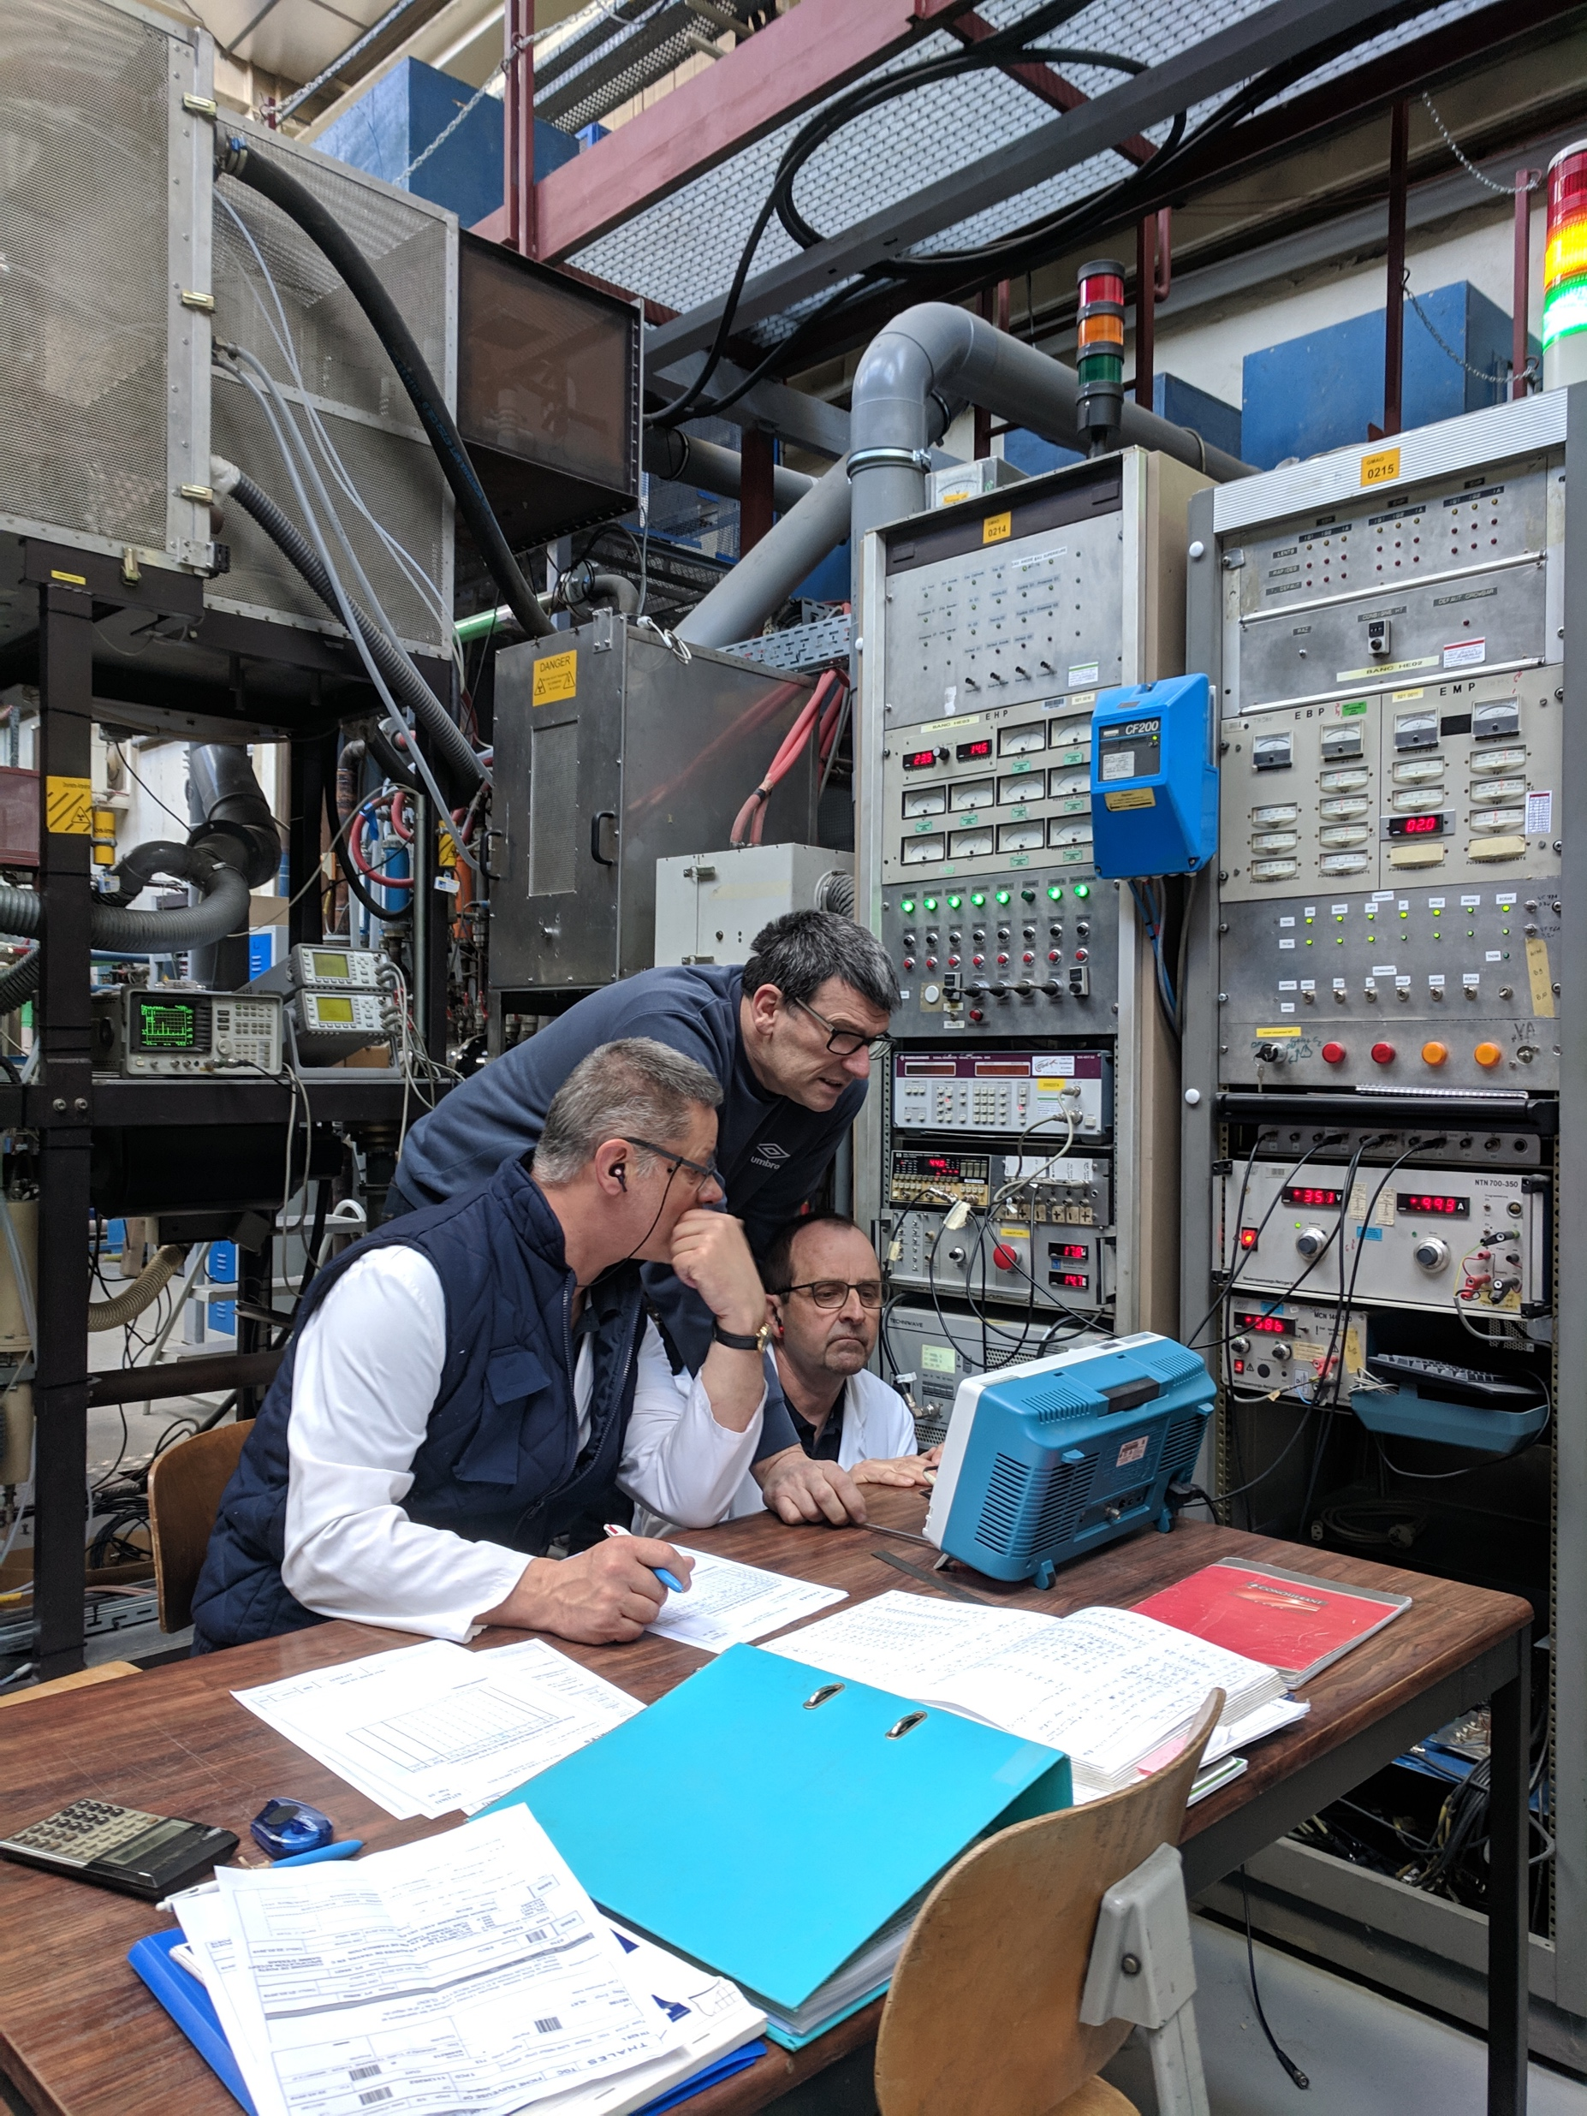
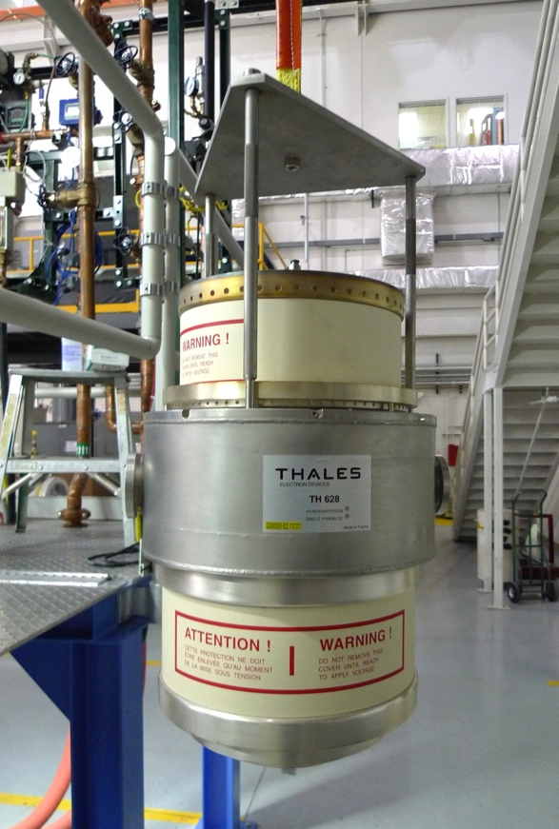
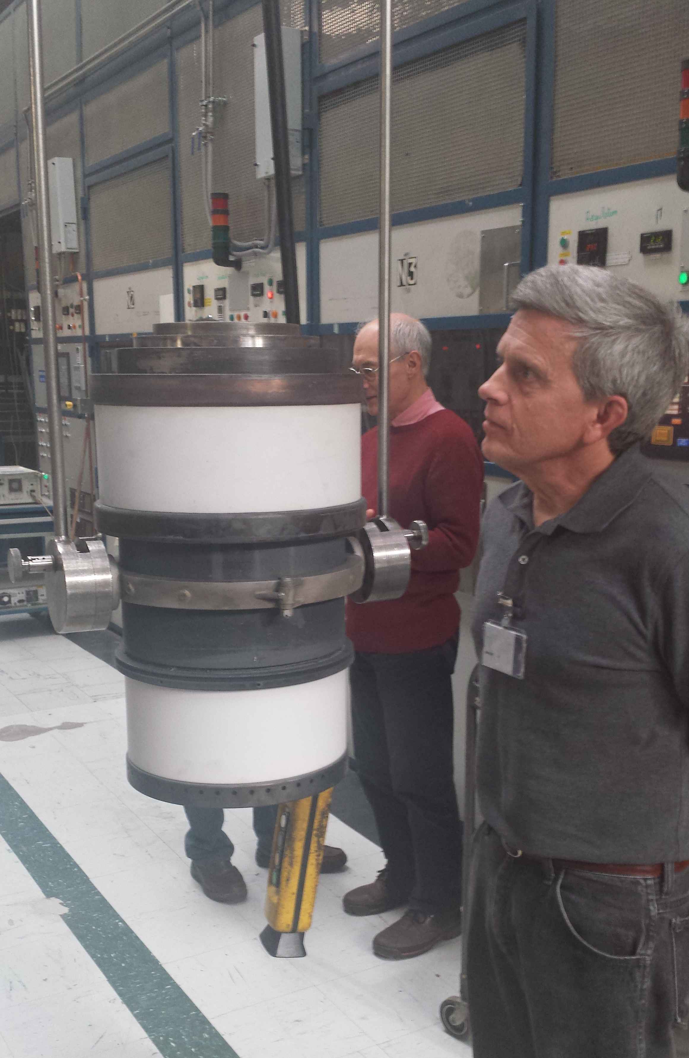
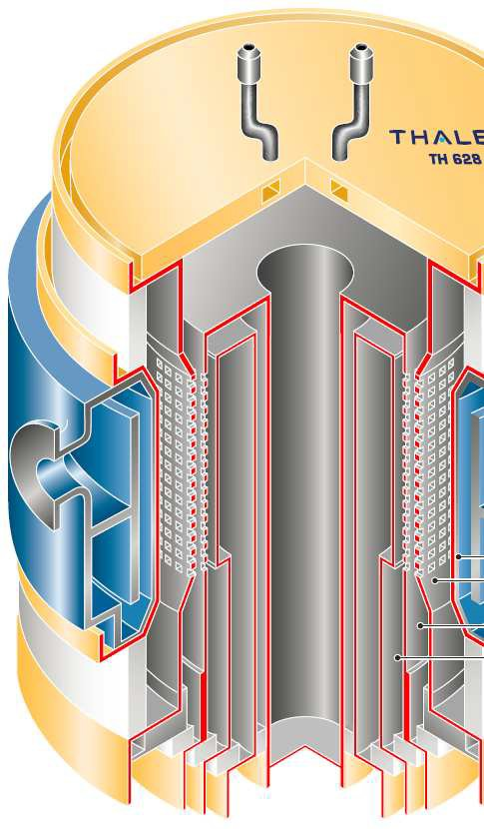
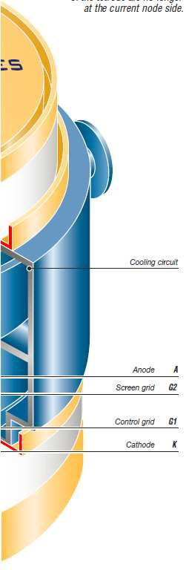
TH628L from Thonon to Los Alamos
After baking
1 MHz 1.6 MW CW
200 MHz 3 MWp
Installing at LANL

Slide 13
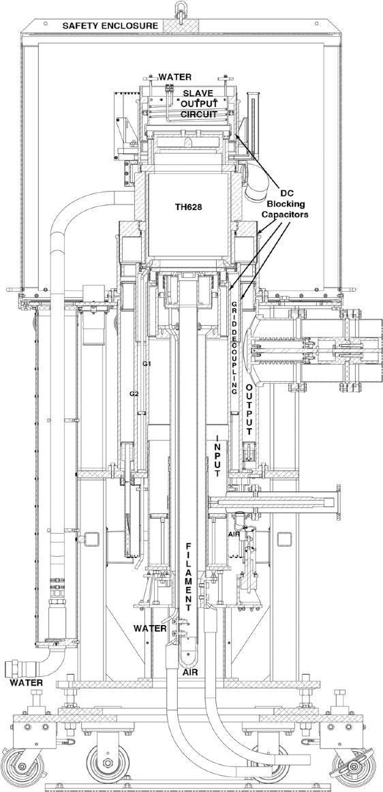
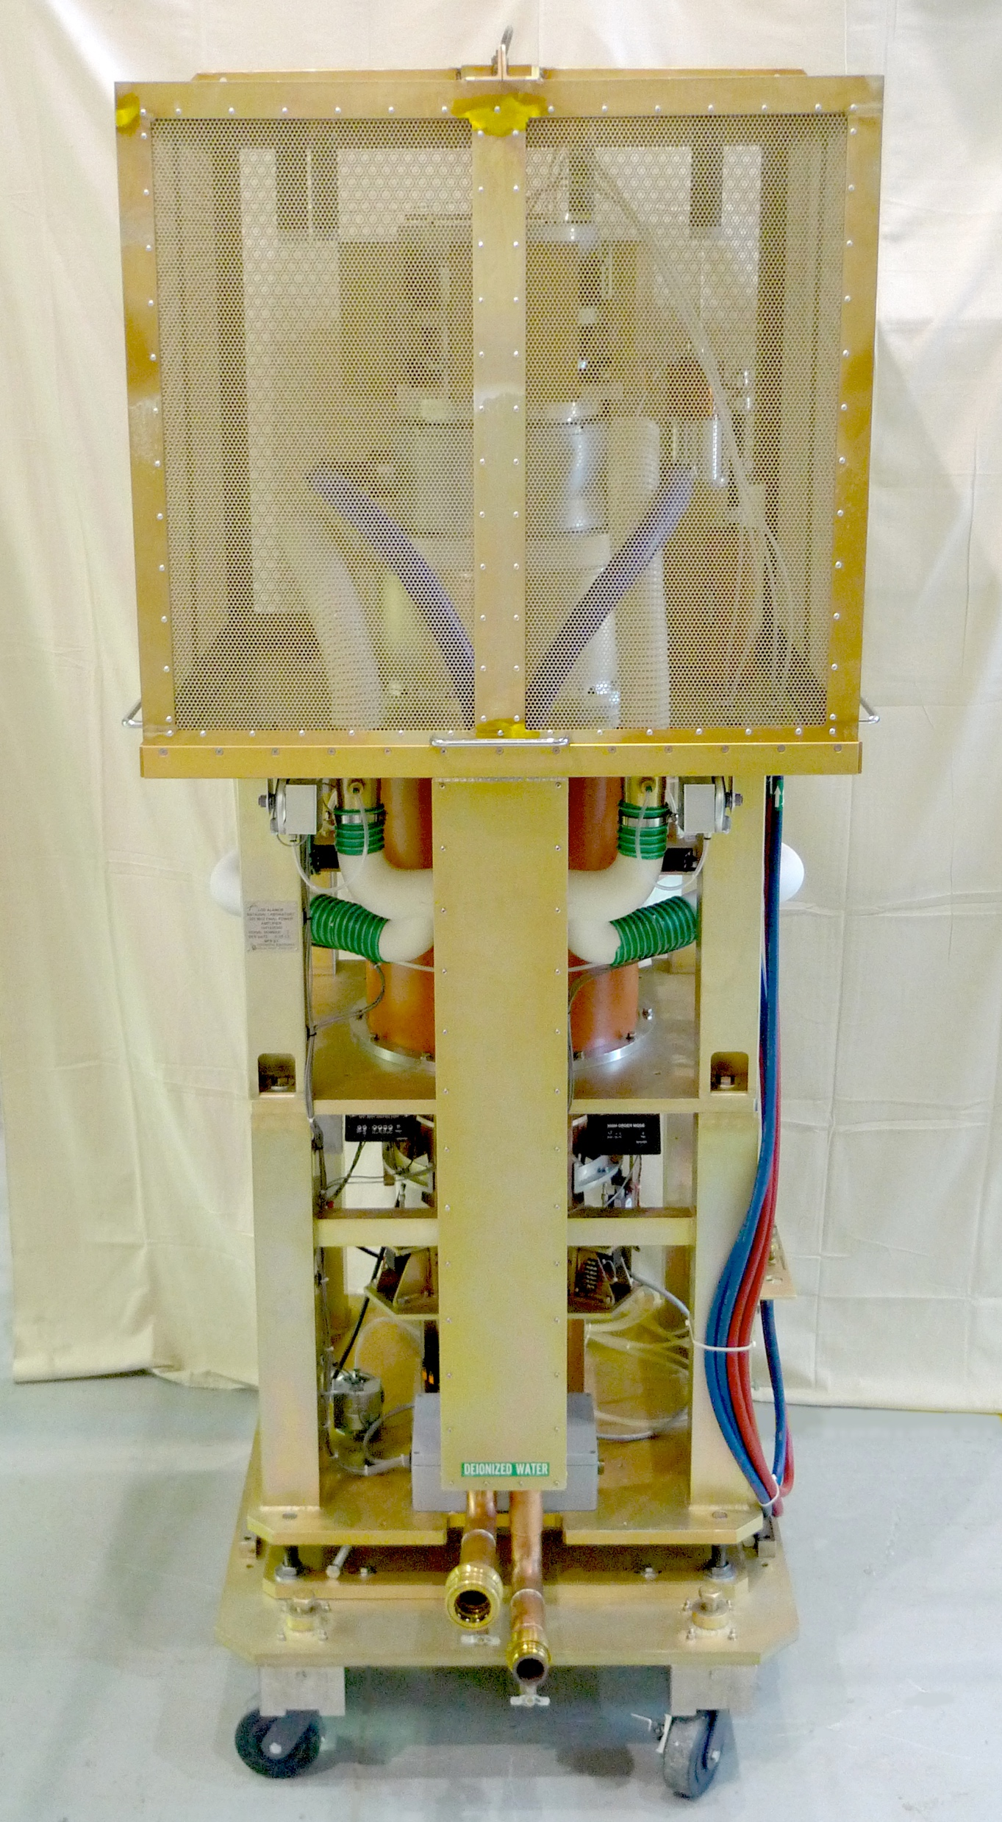
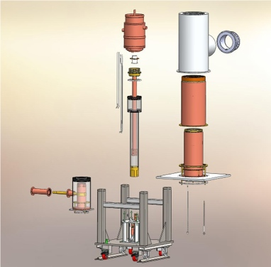
RF PA Designed, Prototyped, Tested and Commercialized
“Design of a New VHF Power Amplifier System for LANSCE”, Lyles, Chen, Archuletta, et al, IPAC’10
“RF Design and Operating Results for a New 201.25 MHz RF PA for LANSCE”, Lyles, Bultman, Chen, et al., PAC’11
“Mechanical Design and Fabrication of a New RF Power Amplifier for LANSCE”, Chen, Baca, Borden, et al., PAC’11

Slide 14
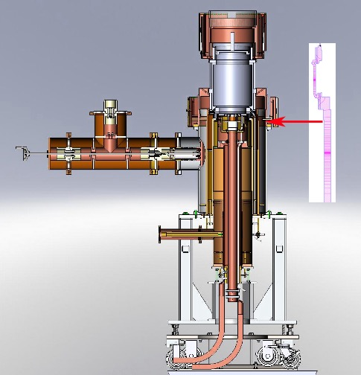
Cutaway View Showing Dual λ/2 E-Field Plotted
and Capacitive Power Coupler with Tuner Stub
Upper Slave Resonator Short
Anode
23 kV DC
TH628L
9-3/16 inch coaxial output
3-1/8 inch coaxial input
Filament Cables 18.4 VDC 980A

Slide 15
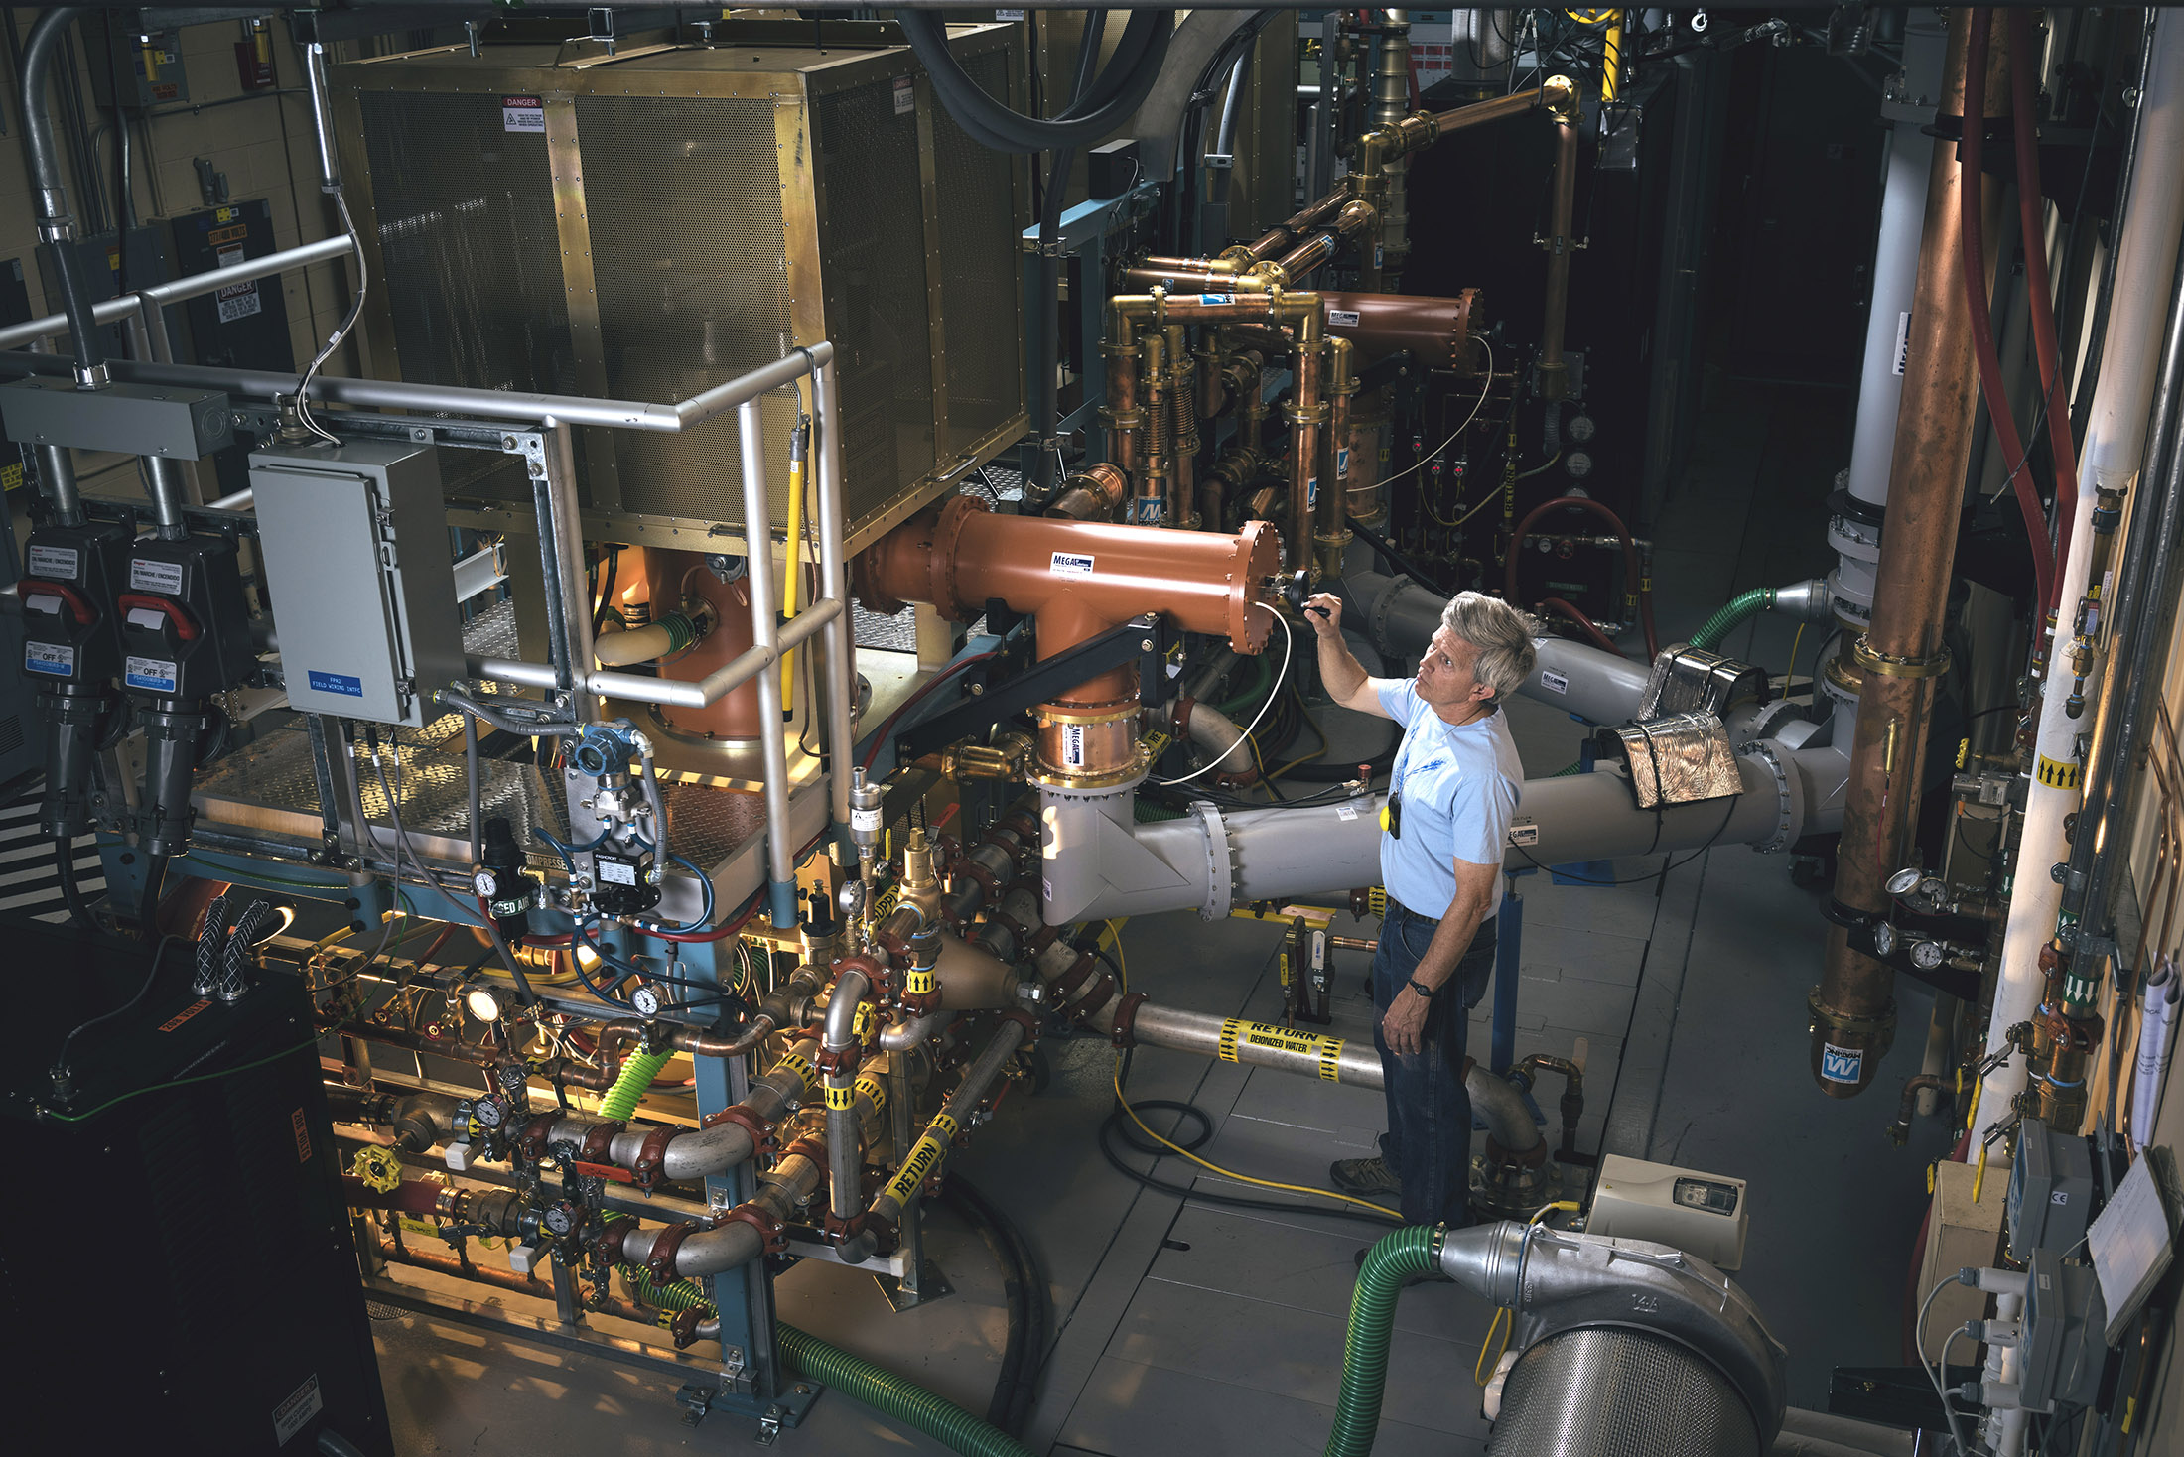
Power Coupling Adjusted While Operating

Slide 16
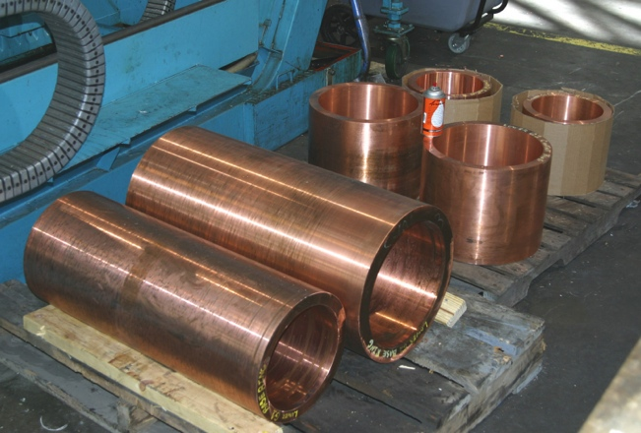
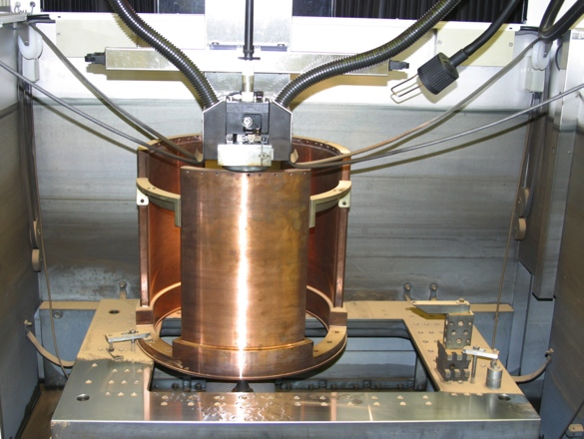
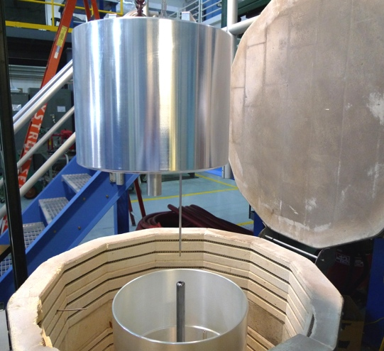
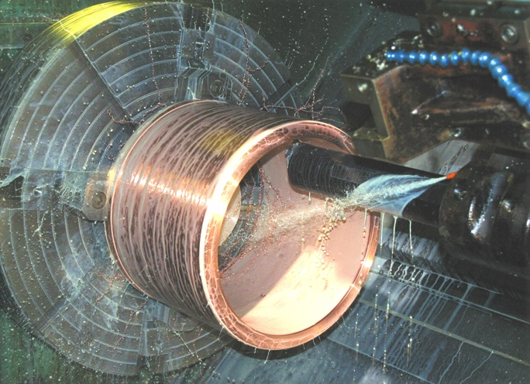
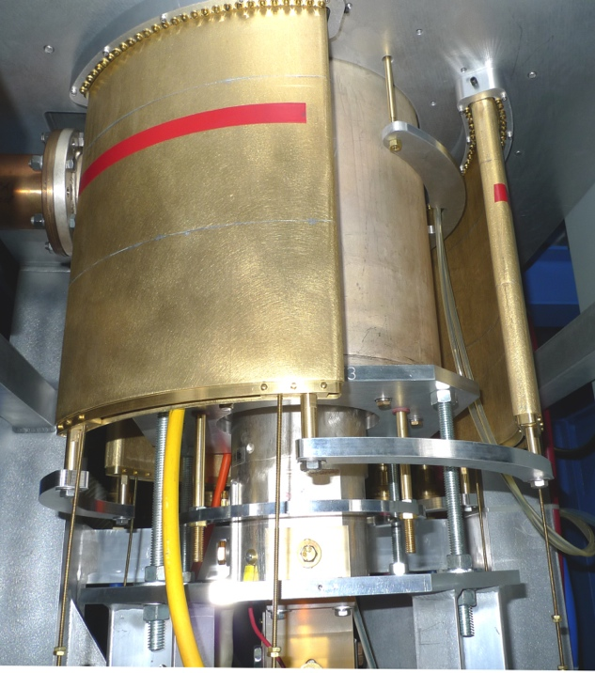
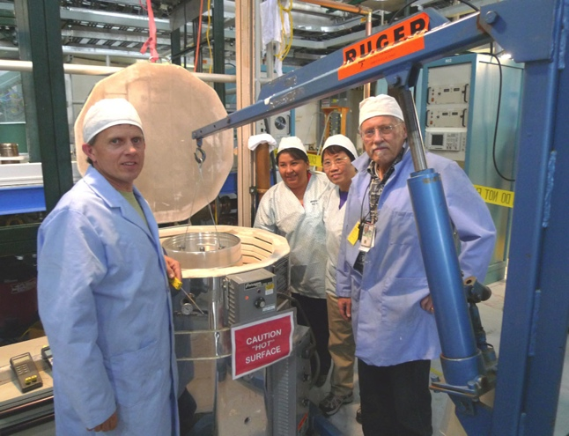
Prototype Fabricated at LANL
Machining of copper forgings
LANL prototype machine shop
Lower Waveguide HOM
Damper EDM and Test
Hot pressing of DC HV
blocking capacitors
Technology Commercialized at Continental Electronics Corp to Build 7 Amplifiers

Slide 17
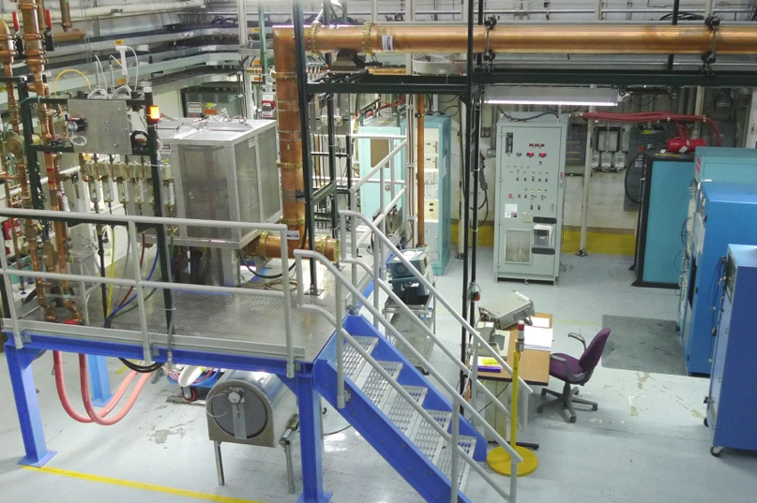
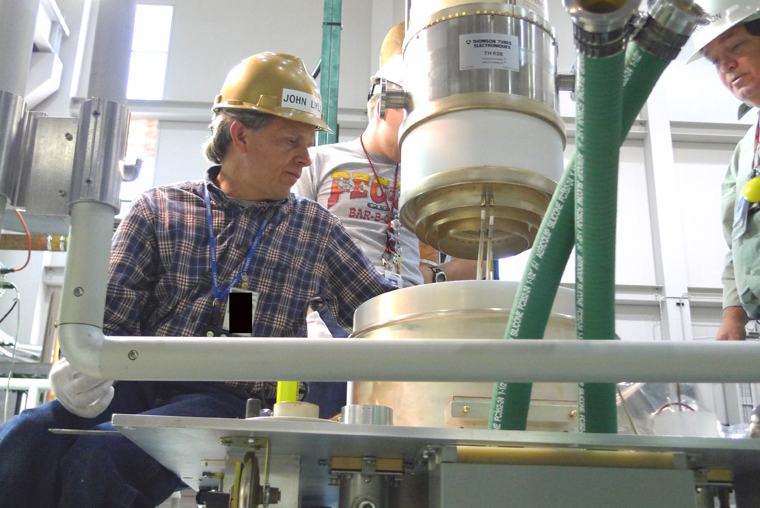
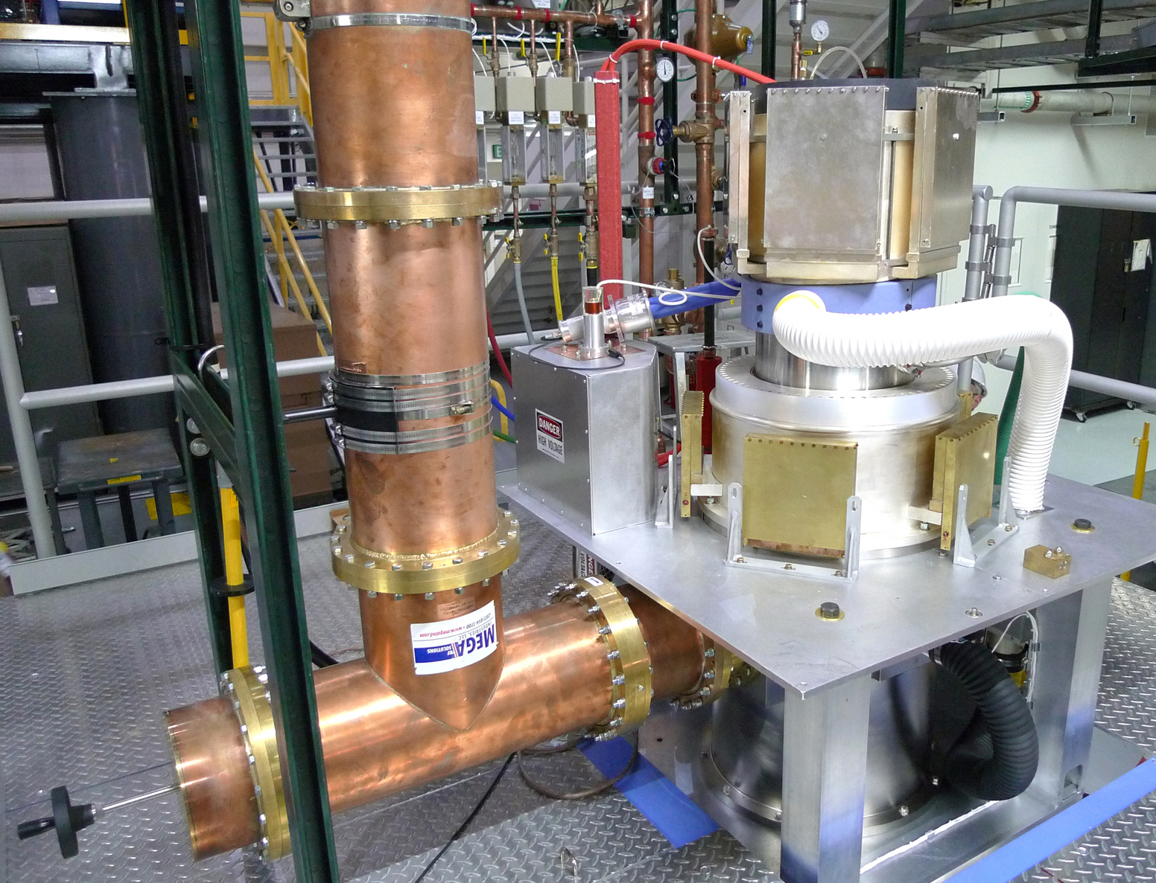
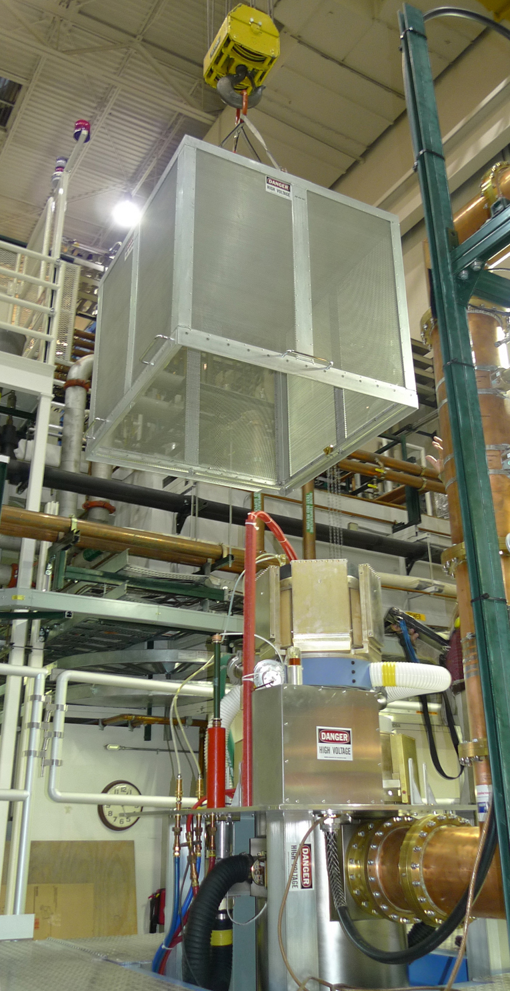
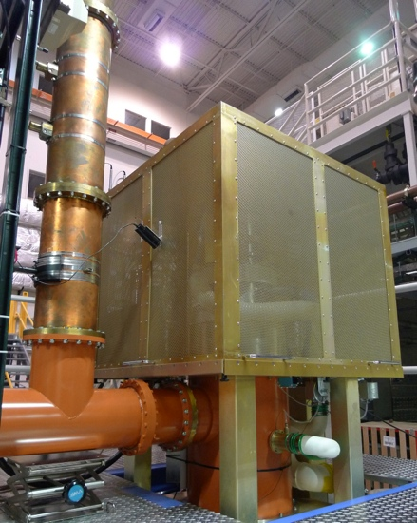
Test Facility Designed and Constructed
“Development of a High Power Test System for New Power Grid Tubes for 200 MHz”, Lyles, Davis, Torrez, 5th CWRF Workshop, 2008

Slide 18
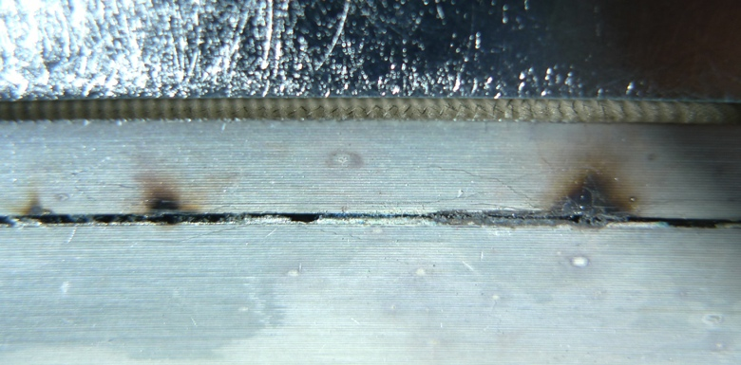
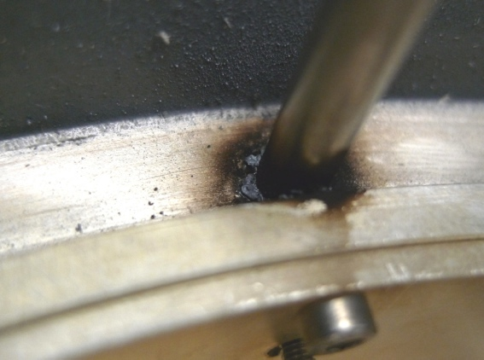
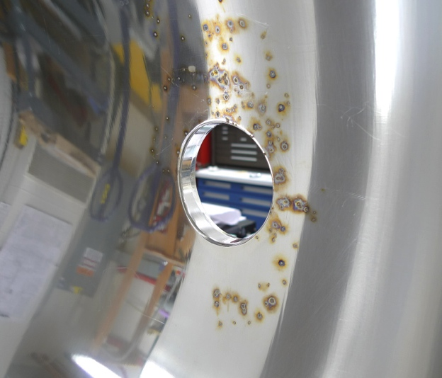
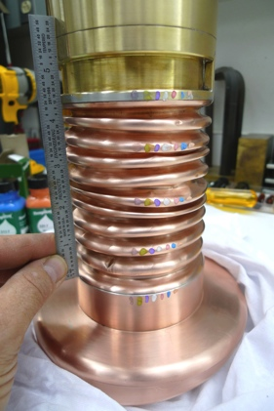
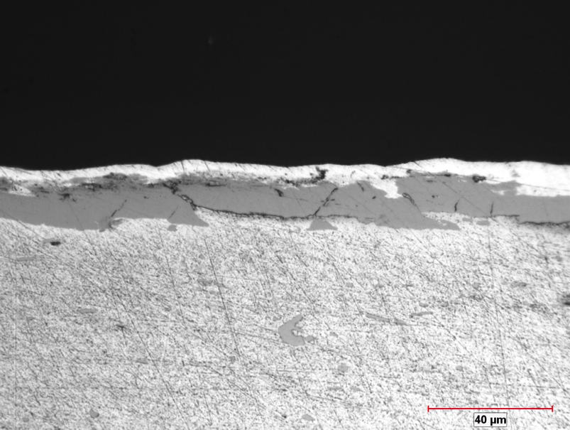
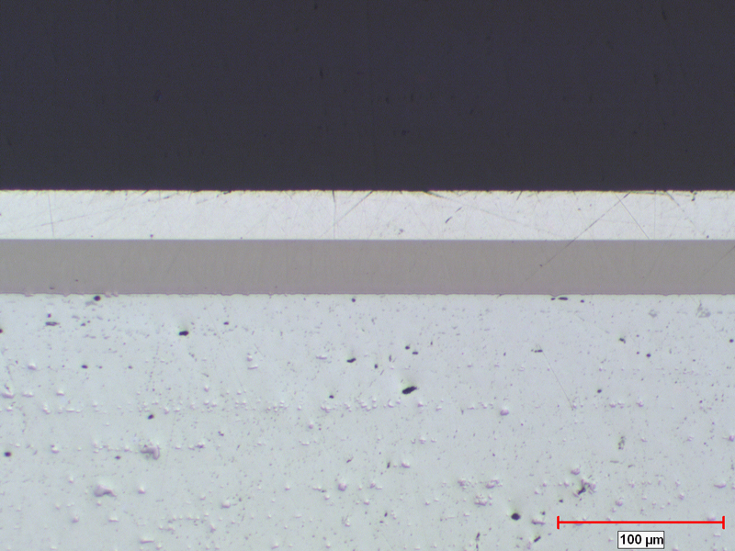
RF Engineering Challenges Were Overcome
Mistakes with High Power RF are Unforgiving!
Vendor A
Vendor B
Initial Prototype Cu
Bellows for OPC
Microscopy of Test Sections
Electroplated Ag/Ni/Al

Slide 19
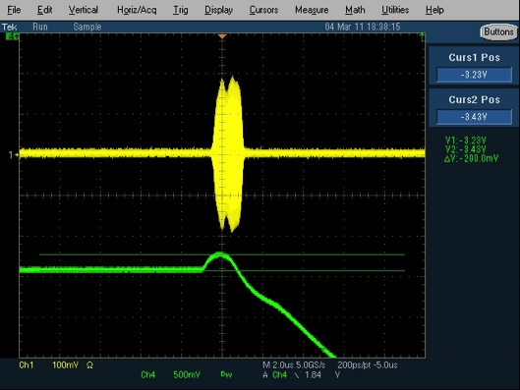
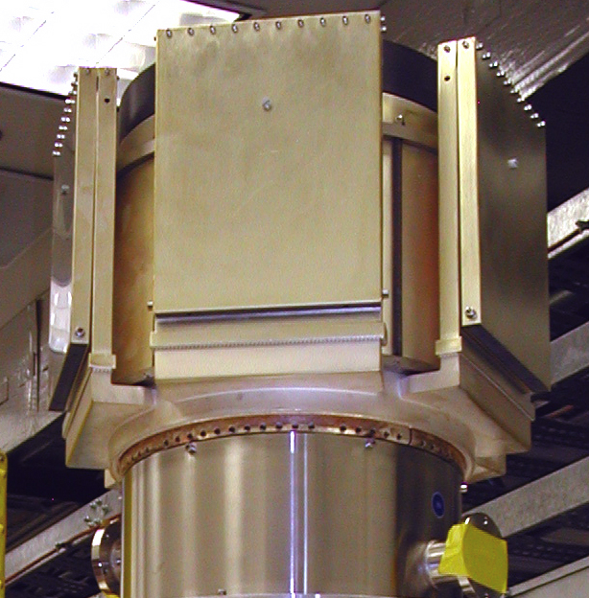
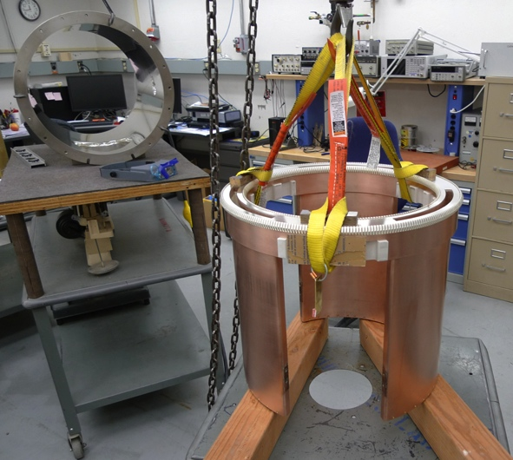
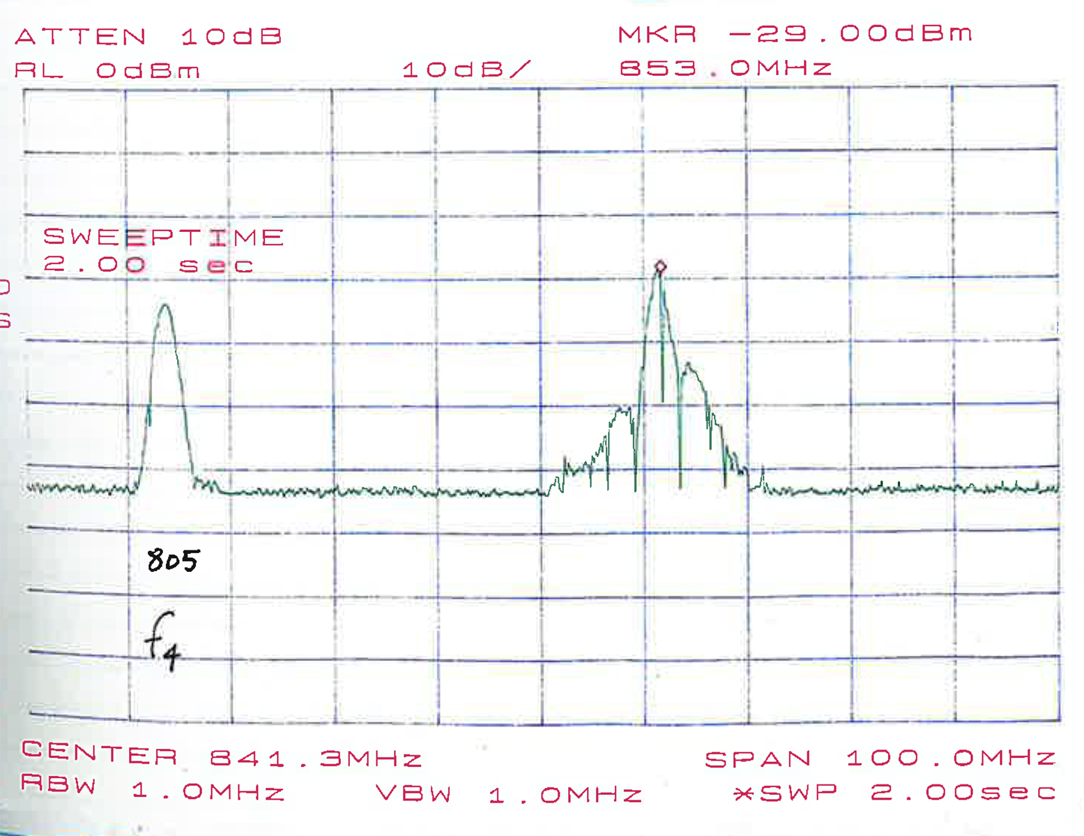
More RF Engineering Challenges/Fun
Modeling and
Experiments
Led to HOM
Damper WGs
Time and Frequency Domain
Measurements of Transient
TE₂₁ Mode at 853 MHz

Slide 20
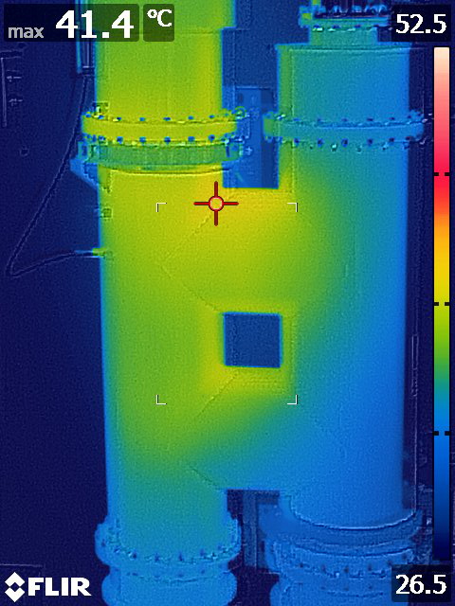
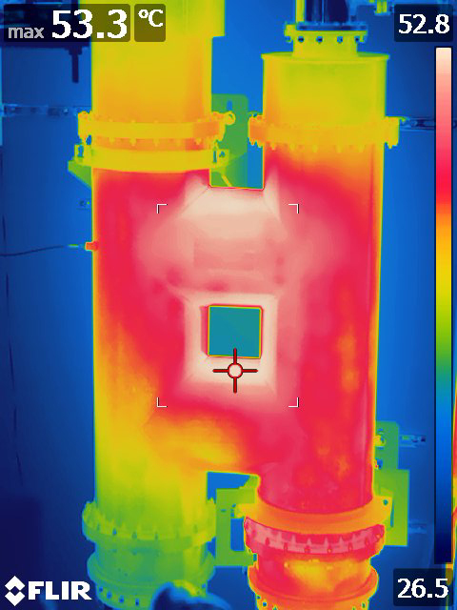
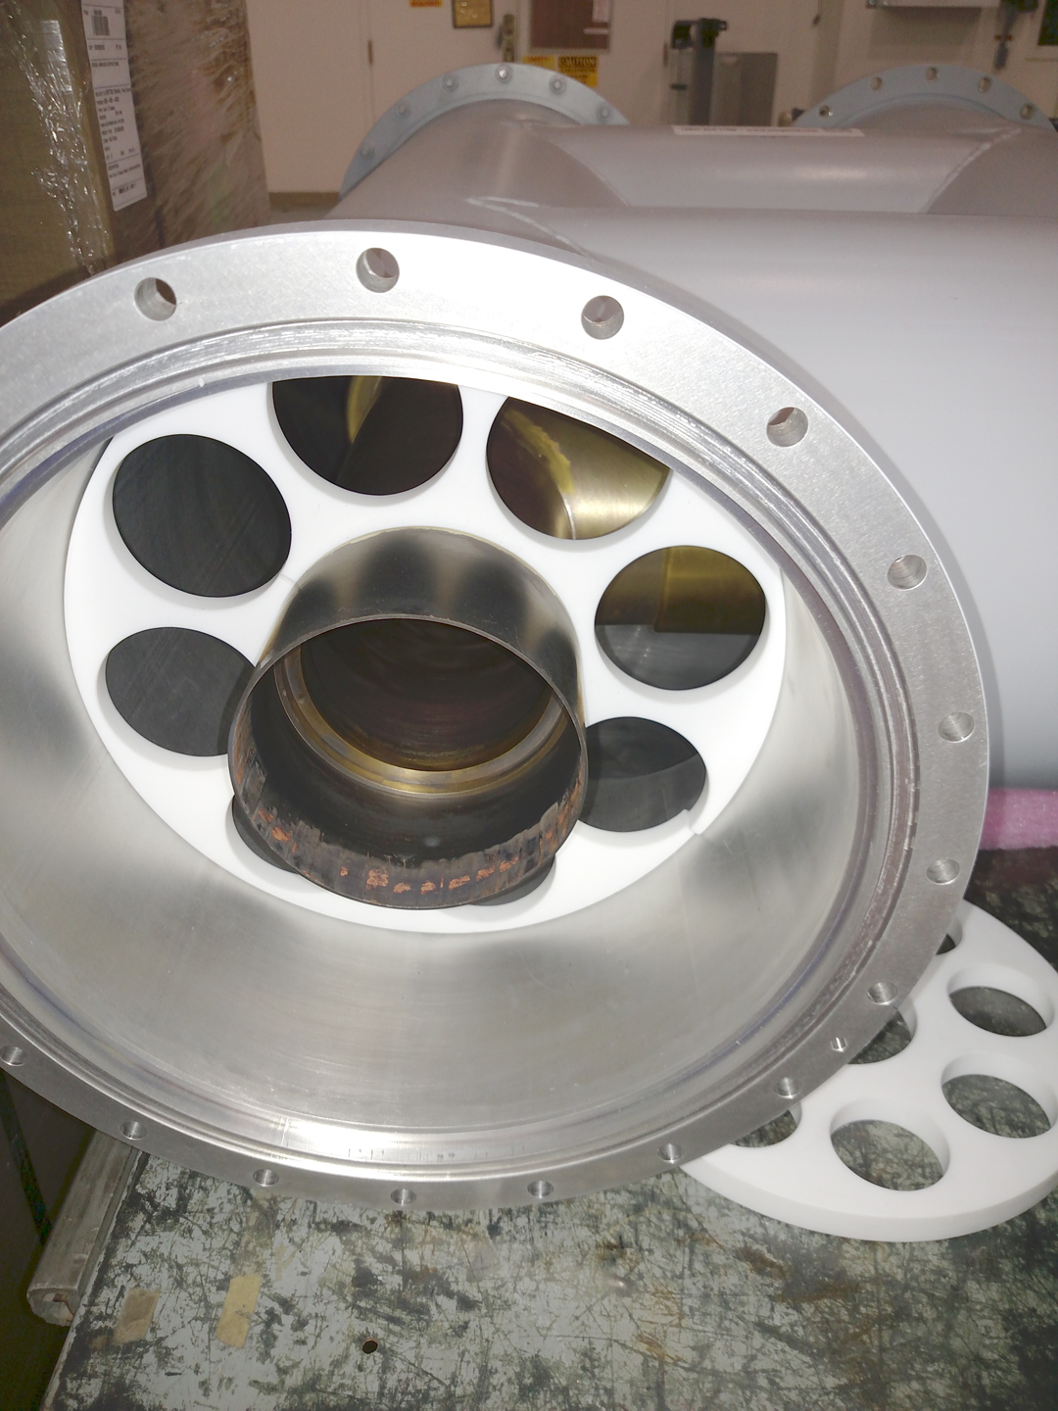
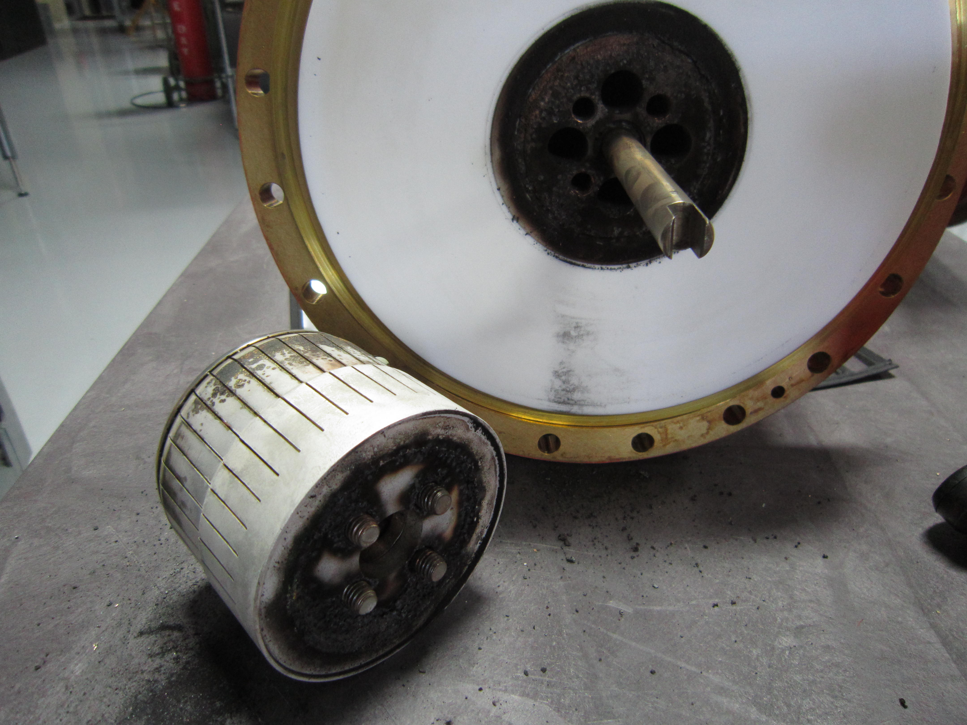

More Smoke
12 inch Diameter Coax Hybrid had Loose Bolt
Output Power Coupler on FPA had Loose Bolt

Slide 21



Production of Amplifiers in Dallas
s/n 06 and 7
Receipt of s/n 01
at LANL in 2013
Last Batch in 2015
“Prototype to Production Fabrication of a New RF Power Amplifier for LANSCE”, M. Troje, CWRF Workshop, 2014

Slide 22






Installation of One RF System / Year

Slide 23
Dual Amplifier RF System
Ugly Back Side (unless you are an RF engineer!)
Front Side (good for tours)

Slide 24

2014 Installation Team

Slide 25


Operating Results, 120 Hz
Operation into Dummy Load
29.4 kVDC, 153 Amps Pulsed
14.9 dB gain, 65.3% efficiency
23.9 kVDC, 122 Amps Pulsed
14.4 dB gain, 66.9% efficiency
Operation into DTL, 2 Tubes
Each Tube ~ 1 to 1.4 MW

Slide 26
Total Filament Operating Hours as of Aug. 28
TH781 Tetrode (IPA and M1 PA)
  M1 PA 21.3K hours
  M2 IPA 11.7K (replaced 2023 with 59.2K)
  M3 IPA 55.5K
  M4 IPA 56.6K
TH628L Diacrode (M2-M4, two tubes each)
  M2 FPA1 61.1K hours
  M2 FPA2 61.6K
  M3 FPA1 51.9K
  M3 FPA2 28.7K (replacement since 2020, thousands of DTL tank faults due to a cracked Cu liner)
  M4 FPA1 57K
  M4 FPA2 37.1K (replacement since 2021, G₂ Faults, probably carbonized ceramic inside)
7835 Triode (M2-M4, one tube), 76 tubes in 52 years
1 tube during 1980s with 45K hours
2 tubes in 1990s with 36 and 45.5K, rest were <18K
4 tubes 22K, 20.8K, 23.5K, 37.4K in first half of 2000 decade, rest were <20K hours
2006-2016, 1 tube>20K, 14 were shorter life, even at 6% DF

Slide 27
Summary of 10 Years Experience
By operating two TH628L in parallel at reduced output power, we have been able to also reduce filament power, extending tube life far beyond originally expected
Just beginning to see hints of cathode emission limiting on the initial fill power of pulses, in oldest tubes in module 2 (>60K hrs)
We monitor hot filament resistance as a way to track decarburization trend
Ramping filament cold to hot is known to cause F-G₂ shorts due to gradual sag
Standby mode allows idling filaments at 2% lower voltage when extended beam off (days)
We have purchased spare tubes on a regular schedule, and now have adequate inventory to replace all 6 tubes in the coming years as they age further
This has also helped maintain production yield as the factory refreshes knowledge and experience making this complex tube

Slide 28

Tom Yingst visits to see installed power amplifiers. He was on the team at RCA that developed the 7835 triode in 1958!

