Slide 1
Current Status and Future Plans of TPS High Power RF System
CWRF 2024
Z.-K. Liu, F.-T. Chung, S.-W. Chang, L.-J. Chen, F.-Y. Chang,
Y.-T. Li, C.-H. Huang, M.-S. Yeh, C.-H. Lo, M.-H. Chang,
M.-C. Lin, Chaoen Wang
2024/09/10
Notes:
Hello everybody, I am Chao-Hui Huang. Today, I represent the RF team of NSRRC to introduce the current status and future plans of the TPS high-power RF system.

Slide 2
Outline
Overview of TPS and its high power RF system
Operation status of TPS high power RF system
Future plan for TPS high power RF system
Summary
Notes:
Here is my outline: I will first introduce TPS and its RF system, then discuss the current operational status, outline the future upgrade plans, and finally, provide a summary.
報告大綱: TPS以及其高功率高頻系統的簡介、TPS高功率RF系統的運轉現況、TPS高功率RF系統的未來計畫，最後是summary。

Slide 3
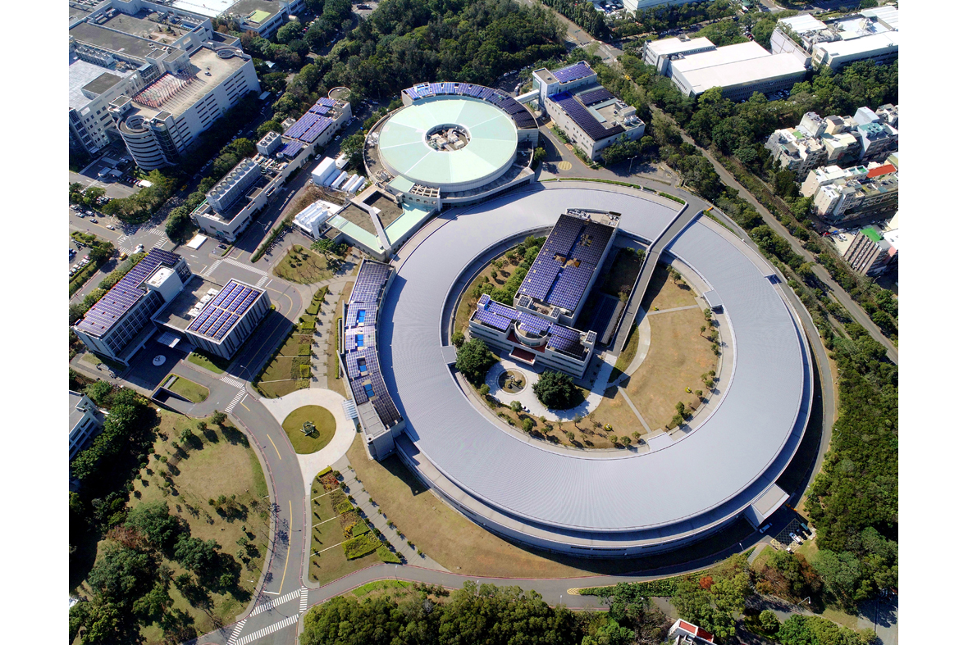
Two Light Sources in NSRRC
TLS Storage Ring (1.5 GeV)
25 beam lines
Open for user in 1993
Administration Building
Office & Lab
TPS Storage Ring (3.0 GeV)
Available for users in 2016
Phase I + Phase II: 16 beam lines
Phase III: 9 beam lines (~2026)
Notes:
This is a bird’s eye view of NSRRC. We have two light sources: the smaller one is the Taiwan Light Source (TLS), and the larger one is the Taiwan Photon Source (TPS). TLS has been in operation since 1993, with a beam energy of 1.5 GeV, supporting 25 beamlines. TPS, with a beam energy of 3 GeV, has been operational since 2016. During Phases 1 and 2, we constructed 16 beamlines. Currently, in Phase 3, we expect to complete 9 additional beamlines by 2026.
這是NSRRC的鳥瞰圖，在NSRRC共有兩個光源，一個是1.5 GeV的TLS(小環)，1993年開始開放給用戶。另一個是3 GeV電子能量的TPS(大環)，自2016年開始開放給用戶。目前TPS phase-1與phase-2的beam line有16條，phase-3的beam line有9條，預計在2026年會建造完成。

Slide 4
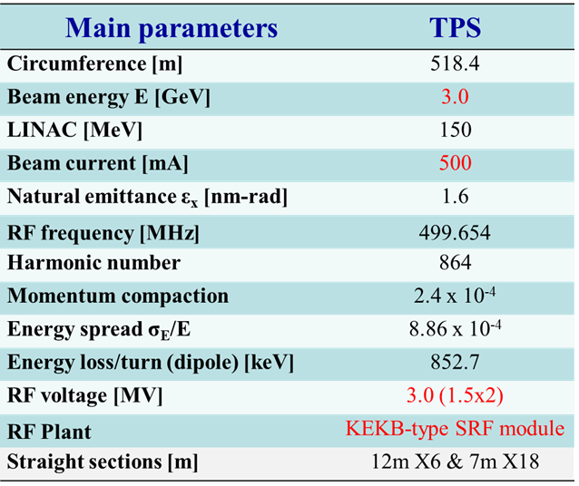
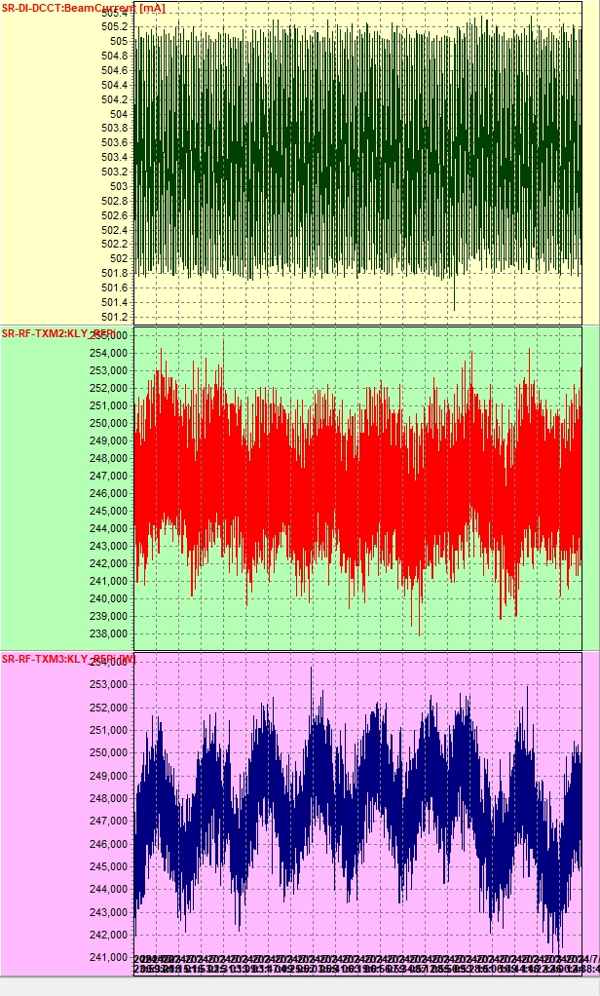
Machine Parameters for TPS
Beam current
500 mA top-up
Pf for SRF#2
~250 kW
Pf for SRF#3
~250 kW
Notes:
This table shows the machine parameters of TPS. The electron energy is 3 GeV, and the design current is 500 mA. There are two RF stations providing RF power, both using KEKB-type superconducting cavities. The RF voltage for each station operates at 1.5 MV. During user beam time, the current operates at 500 mA in top-up mode. The current record is shown here, with each station providing 250 kW.
這是TPS環的參數，電子能量3 GeV、設計電流為500 mA。共有兩座RF站，使用KEKB式的超導模組，RF voltage目前運轉在3.0 MV。在用戶時段運轉在500 mA 恆定電流模式(top-up mode)—右上圖，兩套RF系統各提供250 kW的輸出功率。

Slide 5
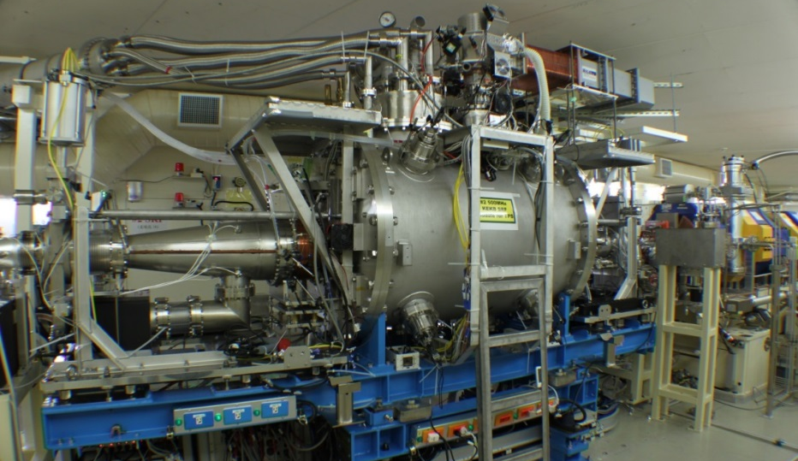
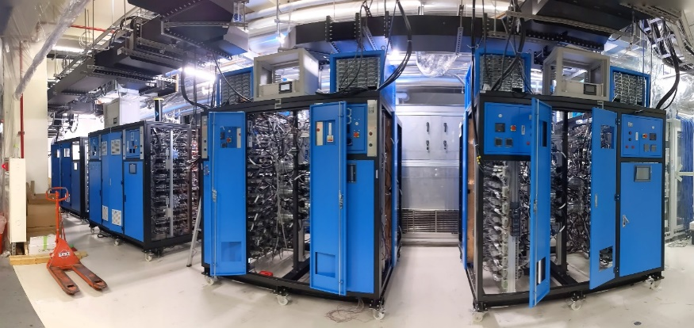
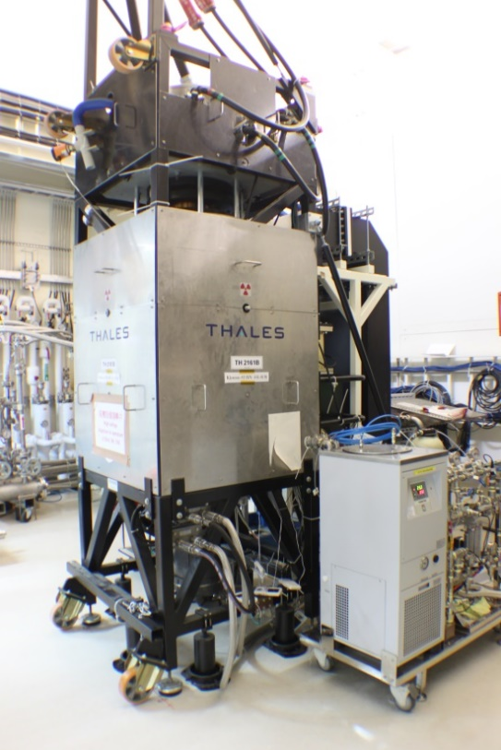
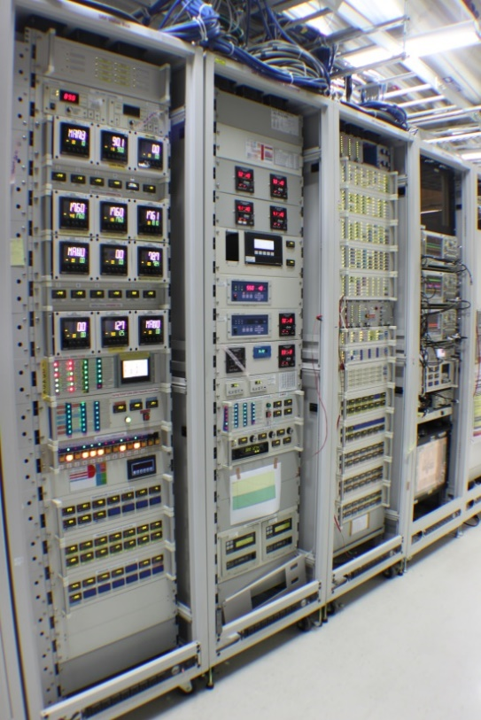
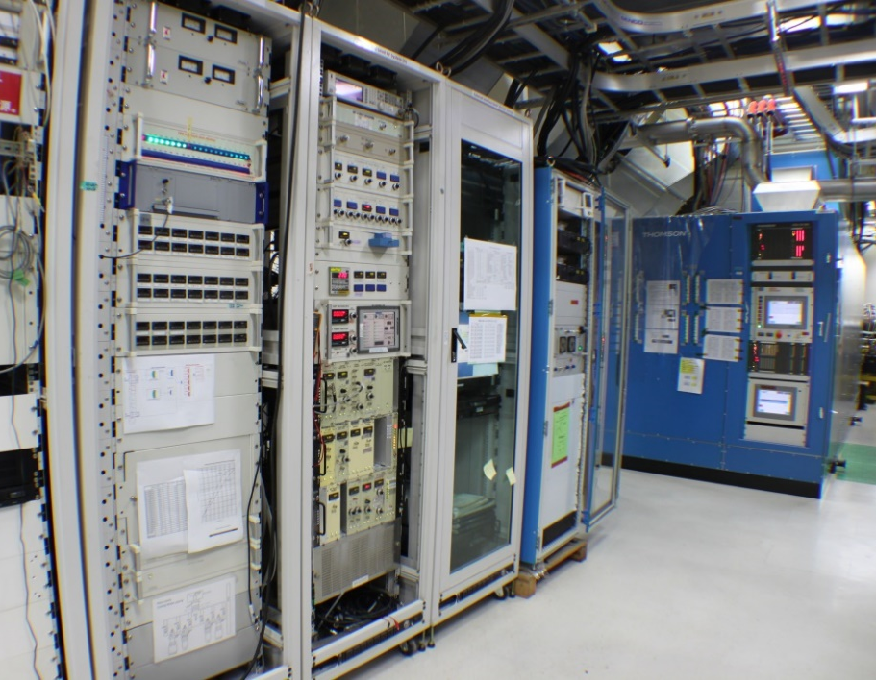
TPS RF System (Storage Ring)
300 kW SSPA
KEKB type SRF module
Two RF plants in operation
KEKB type SRF module
300 kW klystron transmitter & 300 kW SSPA transmitter
Analog & Digital LLRF
300 kW transmitter & LLRF
300 kW klystron
SRF electronics
Notes:
Currently, in the TPS storage ring, we have a 300 kW klystron-type transmitter, a 300 kW solid-state power amplifier (SSPA), analog low-level RF, digital low-level RF, and KEKB-type SRF modules. There are two RF stations, One RF station, equipped with a klystron, operates with digital low-level RF, while the other station uses an SSPA instead of a klystron and operates with analog low-level RF.
TPS的儲存環的高頻系統: 有兩個RF站，每個RF站有一座SRF module，配有一套300 kW klystron-type的transmitter。原本設計使用類比式LLRF，已開發數位式LLRF，其中一套以上線運轉。在其中一個RF站中有開發300 kW的SSPA。目前該站已切換為使用SSPA運轉。

Slide 6
Operation Status of TPS High Power Source
Notes:
Now, I will discuss the operational status of the TPS high-power RF system.

Slide 7
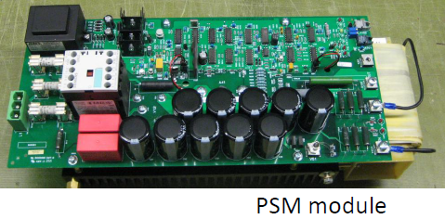
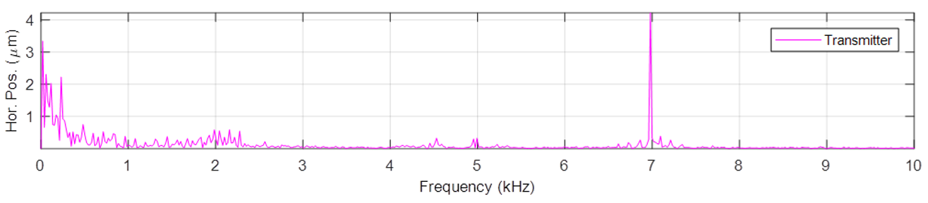
Klystron-type Transmitter
There are two transmitters with Thales klystron at TPS, the rated RF output power for one klystron is 300 kW.
Cathode voltage and cathode current are about 55 kV and 9 A, the DC to RF efficiency at 250 kW is about 50%.
PSM (pulse step modulation) type KSU (klystron supply unit). There are 86 800V PSM modules.
The rotation frequency of these PSM modules is
approximately 7 kHz. The electron beam
trajectory will be affected by this rotation.
300 kW klystron
Notes:
In the initial design of TPS, both stations used Thales klystrons with a rated RF output power of 300 kW each. We operated with a 55 kV cathode voltage and 9 A cathode current, achieving a DC-to-RF efficiency of about 50%. The klystron supply unit consists of 86 units of 800 V PSM modules. During operation, the rotation frequency is 7 kHz, which we found affects the electron trajectory. In the horizontal direction, there is a disturbance at the same frequency, though it does not impact users.
在TPS高頻系統設計中，兩個RF站都使用klystron型式的高頻發射機。我們使用300 kW Thales的klystron，運轉時的高壓約為55 kV，其cathode current約為9 A。在250 kW輸出時，其DC轉換成RF的效率約為50%。這系統使用PSM型式的supply unit(高壓電源供應器系統)，其中包含了86個PSM模組，每個模組的輸出電壓為800V。所需的高壓透過切換PSM模組產生，PSM rotation的頻率約為7kHz，這樣的切換所造成的雜訊會影響到電子束的軌道。下圖是單獨以klystron type transmitter運轉時的BPM(beam position monitor)頻譜，可以清楚看見在7kHz處有較強的擾動(現階段此頻率的擾動不影響用戶)。

Slide 8
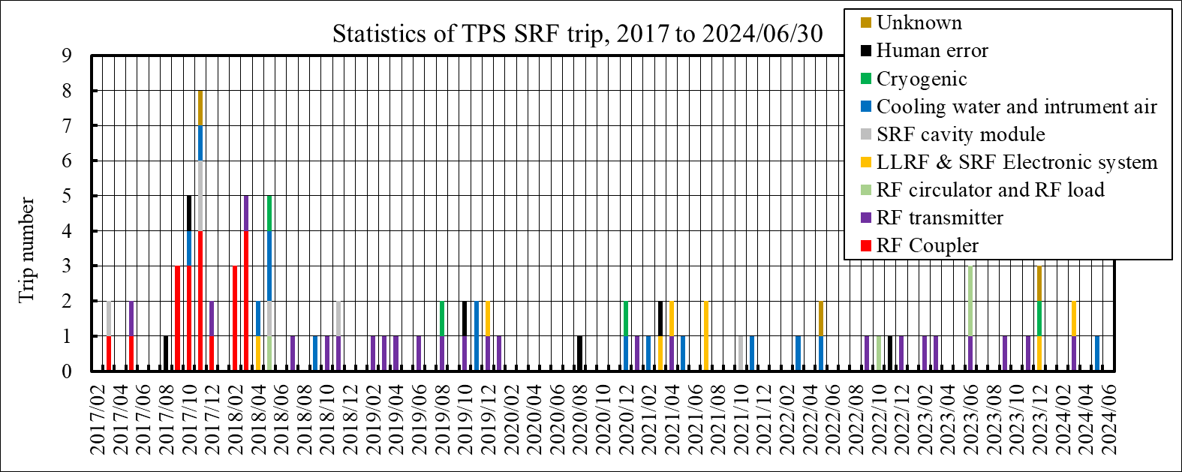
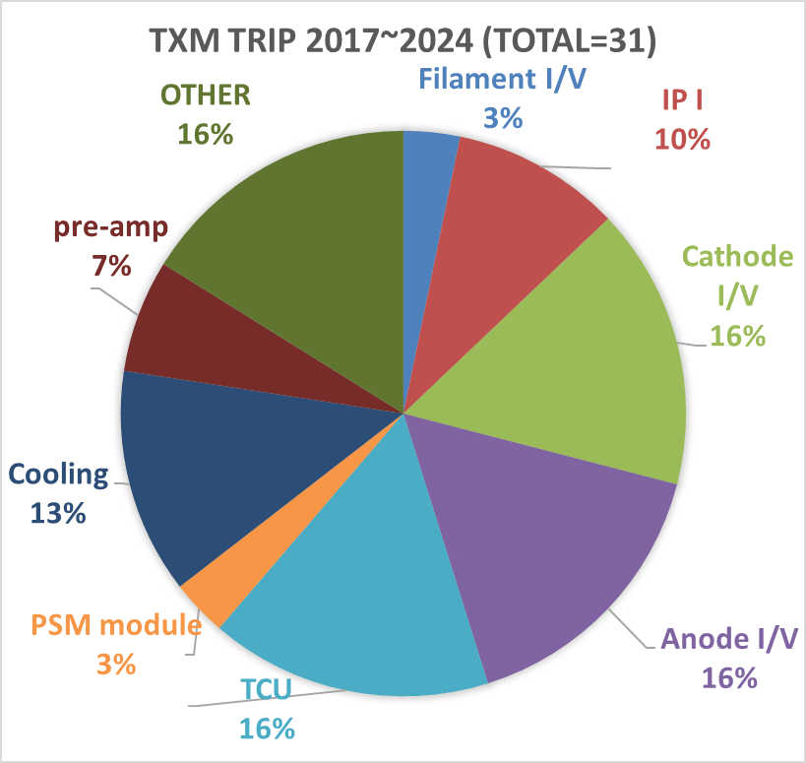
Klystron-type Transmitter
The left figure shows the statistics of TPS RF system failures from 2017 to June 2024 during user beam time. Excluding vacuum trip during the early operational phase, a significant proportion of the failures were related to the transmitters.
There were a total of 31 RF transmitter trips, including instances caused by excessive reflected power due to TCU anomalies. The causes of some failure incidents are still under investigation.
Notes:
Here are the statistics of TPS RF system failures from 2017 to June 2024 during user beam time. In the early stages, most failures were vacuum trips due to the RF coupler. After applying a bias to inhibit the multipactor effect, this issue has been resolved. Recently, failures have been related to the transmitters, such as reflection due to TCU anomalies, cooling water flow anomalies, pre-amplifier anomalies, etc. Trips due to high voltage are still under investigation.
左圖是自2017年起，在用戶時段因RF系統當機的統計，除了早期有大部分RF系統當機是因為RF coupler的真空事件引發之外(解決方式是在coupler處施加偏壓1200~1300 V，壓抑multipacting的發生)，其他部分中由高頻發射機造成的當機佔了很大的一部分。右圖是高頻發射機當機的各種原因比率，共有31次高頻發射機trip事件，其中包含了TCU異常導致的反射過高、水系統異常、pre-amplifier異常等，其中有部分與高壓相關的事件，其原因尚未釐清。

Slide 9
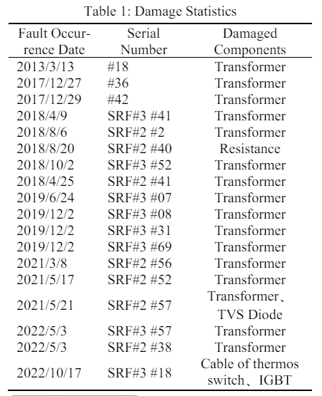
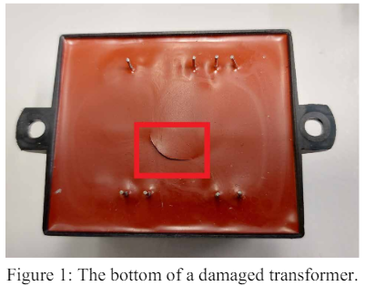
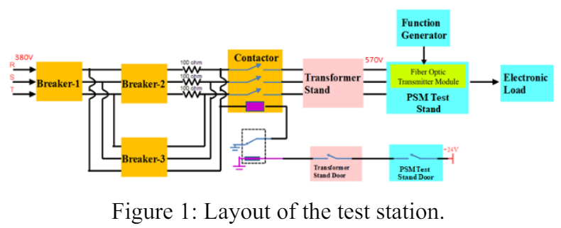
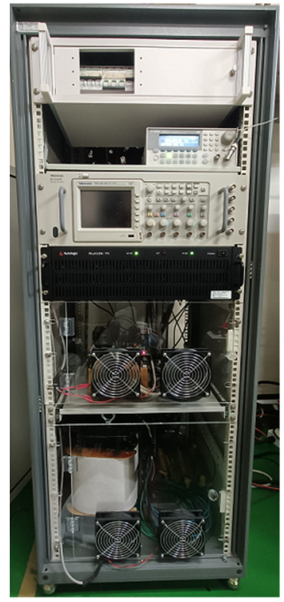
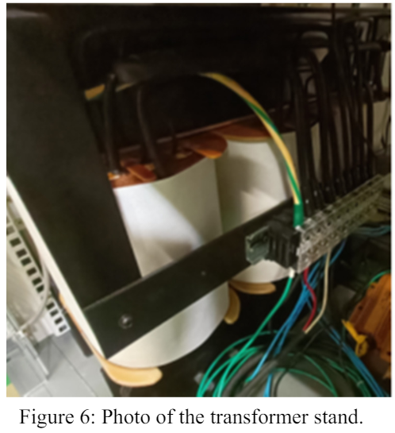
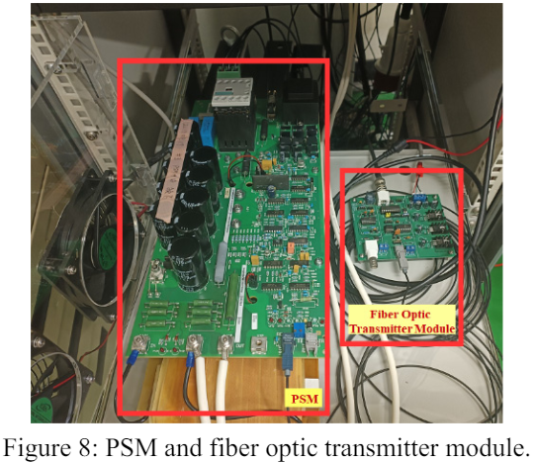
Developments (PSM Module & Test stand)
We developed a testing stand for the PSM module, which can be used for debugging and testing.
The primary cause of PSM module damage is transformer failure.
The fixed PSM module all work fine.
Notes:
During the development of the klystron system, we created a test stand for PSM modules. This stand converts AC input to the 570 V input voltage required by the PSM modules via a transformer. It also includes a circuit breaker, fiber optic modules, and interlocking protection systems. When PSM modules are damaged, they can be debugged and repaired using this test stand, and the repaired modules can also be tested on this platform. We have collected statistics on PSM module damage since operation began, and most failures have been due to transformer issues. After replacement, all repaired PSM modules have functioned properly.
在klystron系統的開發上，們開發了PSM模組的測試平台(右下圖片，右上為架構圖)，可將AC 輸入透過變壓器轉換成PSM模組所需的570V輸入電壓，此平台也包含circuit break、光纖模組與連鎖保護系統等。當PSM模組損壞時，可以透過此test stand進行除錯，修復完畢的模組也可在此平台進行測試。我們有統計自運轉以來的PSM模組損壞的狀況，絕大部分都是變壓器故障(中圖為一例)。而修復完的PSM模組換上運轉後都工作正常。

Slide 10
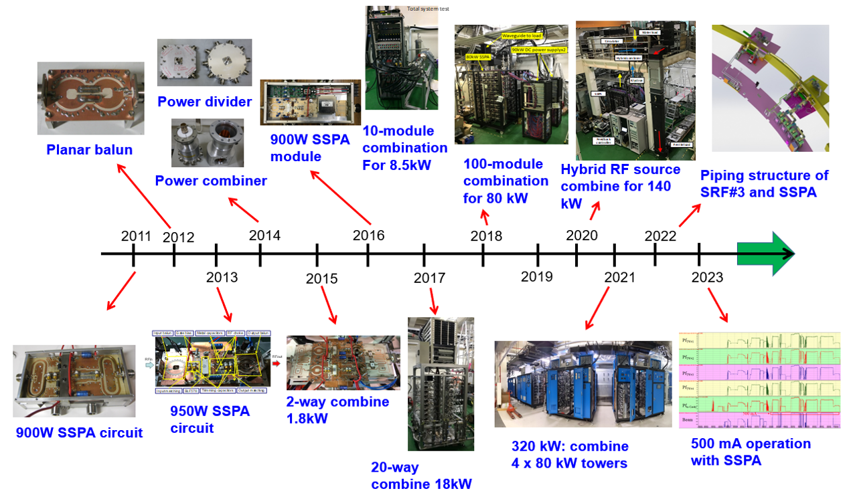
Solid State Power Amplifier development in NSRRC
Notes:
NSRRC began developing solid-state power amplifiers in 2011, working on components such as planar baluns, dividers, combiners, and RF towers. In 2016, we completed the first prototype of a 900 W SSPA module and began power combining. We progressively combined 10 modules, 20 modules, and eventually 100 modules. In 2018, we completed the prototype of an 80 kW RF tower composed of 100 SSPA modules. A hybrid RF source combination was achieved in 2020. We combined Klystron and SSPA RF power with a ratio of 1:1. By 2021, four towers had been built, and the piping structure was completed the following year. Finally, in 2023, the 300 kW SSPA system was used in TPS for normal operation at 500 mA.
這是NSRRC自主發展固態技術的歷程。NSRRC自2011起開始從固態晶片發展，包含balun與匹配電路等。在2013年完成950W輸出的電路板，之後陸續改善散熱問題與開發類比電路板，在2016完成原型的900W輸出的固態模組。2016年後開始逐步進行功率合併，先由10個模組合併到20個模組合併，並在2018於實驗室完成100個模組合併的80 kW 原型機。之後規劃在TPS建造300 kW固態transmitter，在2021年於TPS完成4座80 Kw tower的建造，並於2023年開始用於TPS常規運轉。

Slide 11
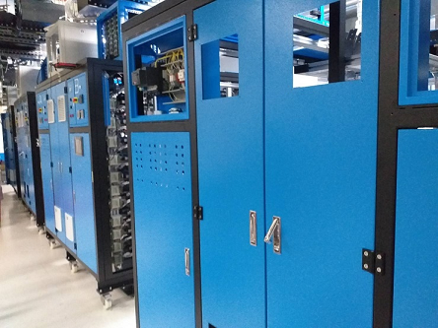
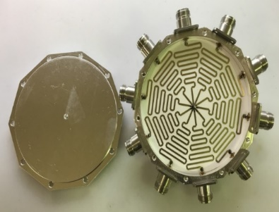
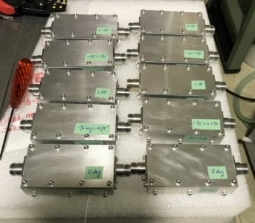
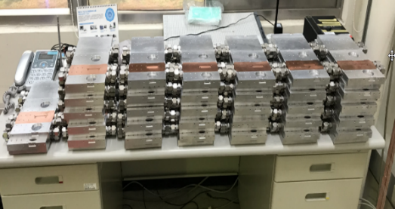
300 kW SSPA system in NSRRC
80 kW Tower
4 x 80 kW Towers
10 in 1 Tower
11 SSAP module in 1 group
Notes:
Here is the architecture of the 300 kW SSPA system at NSRRC. It includes four 80 kW RF towers. Each tower consists of 10 groups with 11 SSPA modules each. The driving power is provided by a two-stage power amplifier. The first stage consists of four commercial pre-amps, and the second stage has six SSPA modules. Driving power is fed into each group through a 10-way divider.
這為300 kW固態transmitter的架構圖，共包含4座80 kW的tower。每座tower由10路8.5 Kw的群組組成，每一個群組中包含了11個850 W的固態模組。為了有較好的redundancy，在pre-amplifier與drive amplifier的部分，分別由4個與6個固態放大起並聯所組成，在透過power divider分10路去驅動10個群組的放大器。

Slide 12
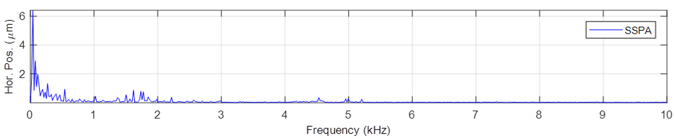
Operation Status of SSPA
Starting in August 2023, we replaced one klystron-type transmitter with an SSPA and used it for user operation, with an output power of 250 kW.
During nearly a year of operation, there was 1 beam trip caused by the SSPA, due to a water flow meter failure.
At an output of 250 kW, the overall AC to RF efficiency is approximately 50%.
Operating solely with the SSPA also showed better performance in terms of electron beam stability, with the 7 kHz disturbance disappearing.
Notes:
In August 2023, one klystron-type transmitter was replaced with a SSPA RF system for user beam time, providing an output power of 250 kW. Over a year of operation, there was only one beam trip in user beam time caused by the SSPA due to a water flow meter failure. The AC-to-RF efficiency is about 50% at 250 kW output power. Considering only the DC-to-RF efficiency of the four towers, it is 58%. The total loss, including the DC power supply, cable loss, and combining loss, is about 14%. The 7 kHz rotation frequency due to the PSM is not observed when operating solely with the SSPA.
自2023年8月開始，我們將一座klystron的高頻發射機替換成SSPA，投入TPS的常規運轉，提供250 Kw的輸出功率。在接近1年的運轉以來，在用戶時段發生了1次因SSPA導致的當機事件。該次當機原因為水流計故障。而在輸出250 Kw的功率下，SSPA整體的AC轉換RF的效率為50%，4座tower整體的DC轉換RF的效率約為58%。其他的損耗來自於DC power supply、功率合併以及cable的損耗。而在單獨使用SSPA運轉時(單套RF運轉)，電子束的穩定性也比較好，由BPM頻譜可見，7kHz的擾動已經消失。

Slide 13
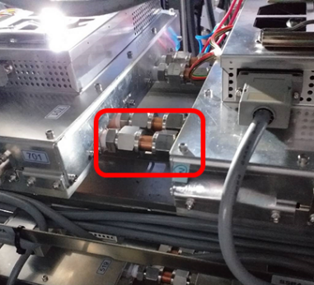
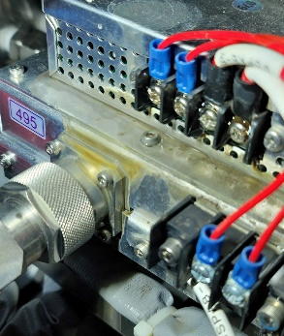
Operation Status of SSPA
In the past year of operation, a total of 12 modules have been damaged.
Five of these failures were caused by water leakage incidents.
The causes of the remaining 7 module failures are unknown; however, in 3 of these cases, an overload of DC current triggered a circuit breaker trip.
Water slowly seeped out from the cooling water pipes, accumulating in the catchment tray. When water accumulated excessively, it dripped onto the SSPA module.
Notes:
During a year of operation, 12 modules were damaged. Five of these failures were caused by water leakage incidents, and seven failures remain unexplained. Three of these failures triggered circuit breakers due to high DC current. Excluding the water leakage issue, the failure rate is about 1.5%, with an overall failure rate of 2.6%.
在一年的運轉期間，共損壞了12個模組(全部共116*4=464個模組)，占了2.6%。其中有5個模組是因漏水事件導致損壞(下圖)。因水路持續微露，滴水累積在盛水盤上沒有發現，等到水滿出盛水盤後，開始滴在模組上，導致模組故障(下圖右可見滴水的水痕)。另外有7個模組的實際故障原因尚不清楚，其中有3個模組曾發生DC current過高導致的circuit breaker跳脫。

Slide 14
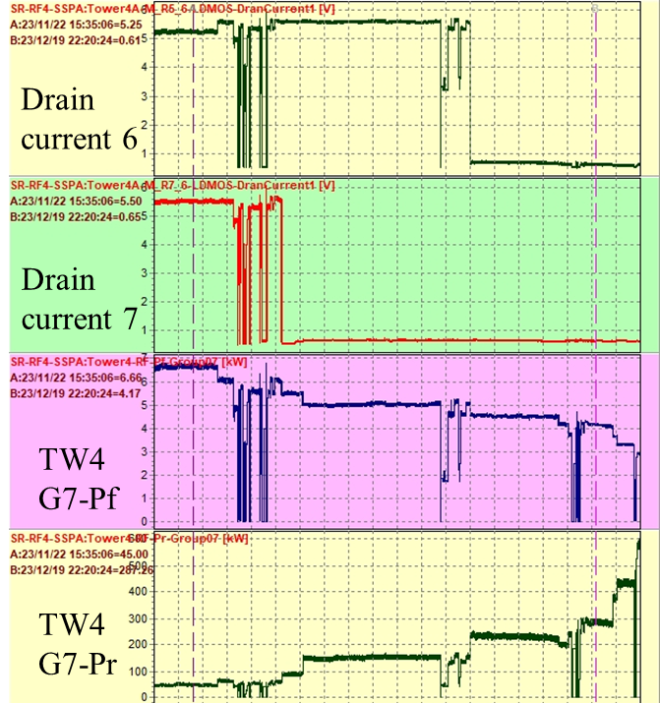
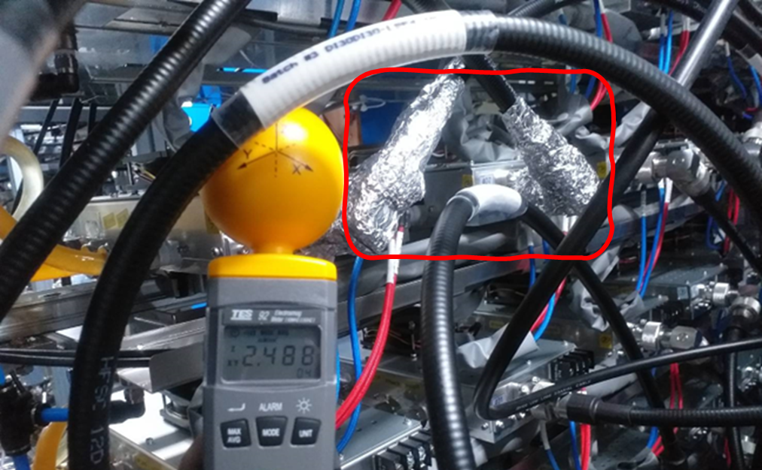
Operation Status of SSPA
During machine testing, the SSPA experienced 4 trips.
3 were due to abnormal water temperature and flow, and 1 was caused by excessive reflected power due to a water leakage incident.
The abnormal water temperature and flow may have been caused by RF leakage, as the RF were stronger near the affected temperature and flow sensors.
After enhancing the shielding, the measured RF levels have significantly decreased.
Each damaged module results in a decrease of ~600 W in output power and an increase of ~50-100 W in reflected power for one group.
Before shielding: overload at < 10 kW
After shielding: 2.5 mW/cm² at 80 kW
Notes:
During machine studies, there were four trips. Three were caused by anomalies in the water system, and one was due to excessive reflected power caused by a water leakage incident. The excessive reflection occurred because the water leakage led to SSPA failures one by one, eventually causing the reflected power in the group to exceed the threshold. The water system anomalies included temperature and flow problems. After investigation, we found that near the abnormal water meters, the RF power in the space was high. Enhancing shielding with aluminum foil reduced the RF power in the space, and the readings of the water meters returned to normal.
在機器測試期間，SSPA共發生了4次trips。有三次為水溫與水流異常，一次為漏水事件導致反射功率過高。在漏水事件中，每損壞一個模組，會讓該group的反射增加約50~100 W，在多個模組損壞後，該group的反射便超過interlock的設定值。水溫水流異常的原因可能是微波洩漏導致，異常的溫度計與流量計附近的微波較強，在加強shielding後，微波量測值已大幅降低。

Slide 15
Future Plan
Notes:
Let’s move on to feature plan.

Slide 16
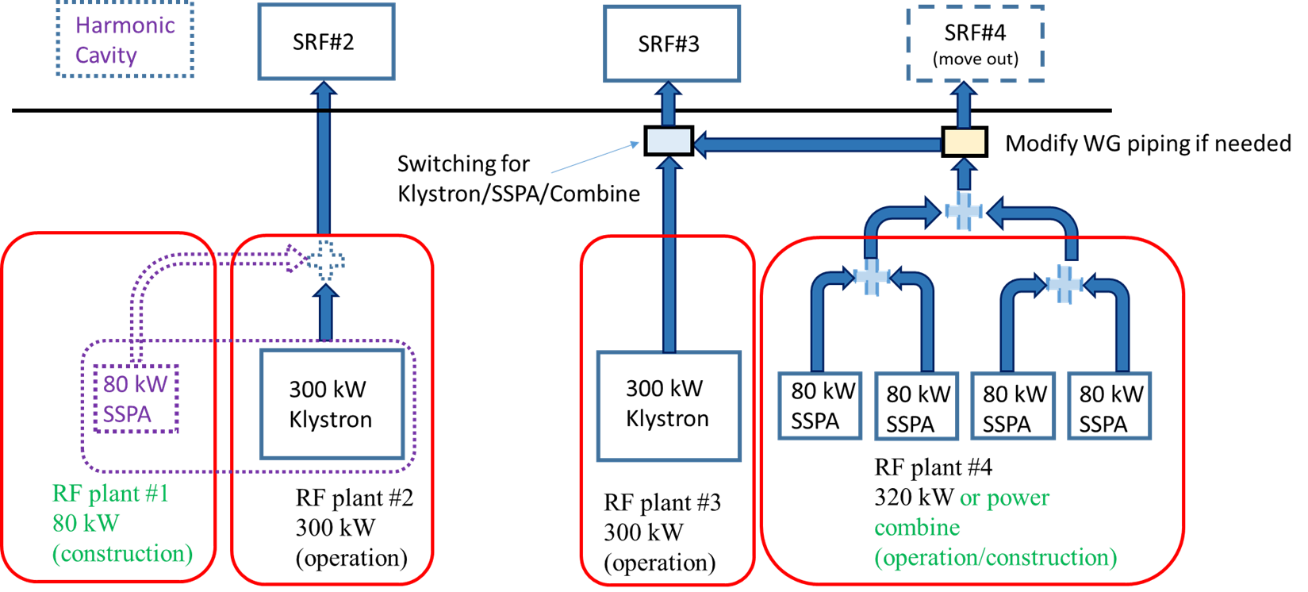
Power combination
Notes:
This is the diagram of the RF stations at TPS. There are two SRF cavities, with one backup cavity on standby if needed. As beamline construction continues, the RF power demand will exceed the capacity of the two 300 kW RF sources. We are planning power combination engineering. Currently, we are building an 80 kW RF tower named RF Plant #1. It will be combined with the klystron with a power ratio of 1:4. On the other side, a klystron will be combined with four 80 kW RF towers. Once completed, these RF stations will provide an additional 160 kW, 80 kW each. In this stage, Stations 3 and 4 can use waveguides to switch between the klystron, SSPA, or a hybrid mode.
這是目前TPS高頻站的架構圖，現階段共有2座超導模組投入運轉(SRF#4為備品，視需求未來可以使用3個RF站運轉，但目前不需要，故測試完畢後就移出tunnel)。因光束線持續增加，所需的RF功率增加，現有2套300 kW的RF source，在未來將無法滿足需求，所以我們規劃了功率合併的工程。目前將在RF station #1 增建80 kW固態tower(紫色虛線是建造中的設備)，將與RF station#2進行klystron : SSPA = 4:1的功率合併，在RF station#4已有SSPA系統，將與station #3的klystron進行功率合併。完工後可增加共160 kW的RF功率。現階段在station #3與#4之間，可以透過waveguide的切換，選擇使用klystron或是SSPA或是以功率合併方式運轉。

Slide 17
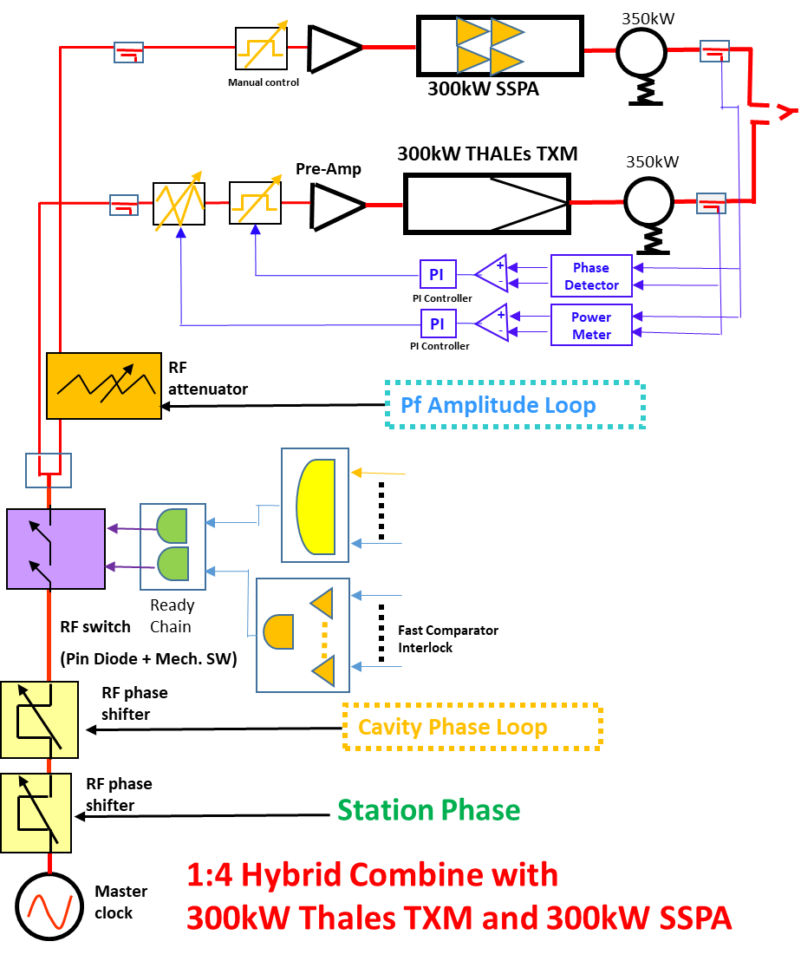
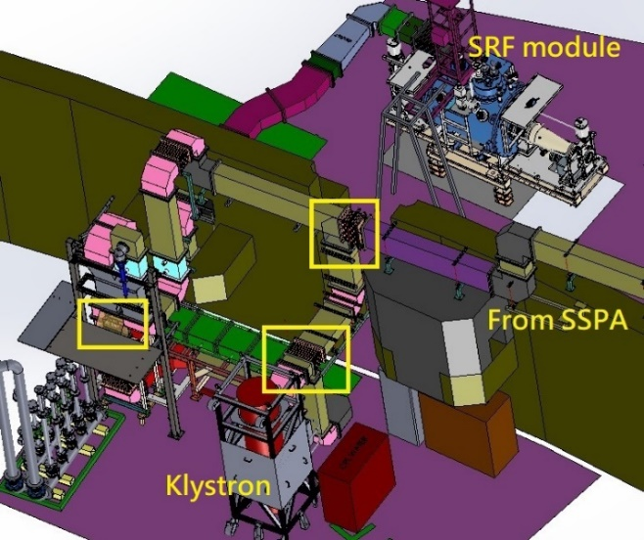
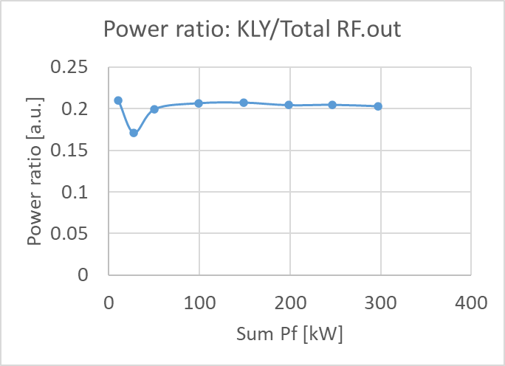
Power combination
Power ratio control loop and waveguide engineering diagram.
Preliminary high-power tests for power combining have been completed. The results show that this configuration can maintain a 1:4 ratio output at 300 kW..
Operation with two power combining systems is planned to begin in 2026.
Notes:
This is the control loop diagram. The Klystron is controlled according to the output of the SSPA. This plot shows that hybrid power can be maintained at a ratio of 1:4, providing up to 300 kW. As I mentioned in the last slide, we can switch the source type by adjusting the piping in the yellow box—choosing between Klystron, SSPA, or hybrid. We expect that by 2026, the system will operate in hybrid mode during normal operation.
我們在今年8月進行了klystron : SSPA = 1:4的功率合併測試，SSPA提供240 Kw輸出、klystron提供60 Kw輸出，共輸出300 kW。左圖為控制的架構圖，在主要的控制迴路之後，新增功率合併的控制迴路，控制SSPA與klystron在合併前的相位與振幅，維持功率比利為1:4；中間為waveguide piping的工程圖，藉由切換黃色框中的waveguide，可以進行RF source的切換。右圖為高功率測試的結果，顯示此架構可維持1:4的比例輸出300 kW。預計在2026年開始以兩套功率合併進行運轉。

Slide 18
Development of SSPA with new chips
The current SSPA modules use BLF578 chips, achieving a PAE of 61.5% at 900 W output. However, the BLF578 has been phased out.
Modules using the BLF978 chip have been developed, with a PAE of 67.6% at 900 W output.
Development of the modules with GaN chips will also begin in the future.
Notes:
The LDMOS in RF tower is BLF578 achieving the PAE of 61.5% at 800 W output. However, BLF578 has been phase out. We developed modules using BLF978P and the initial PAE is 68.8% at 900 W output. Next move is going to develop the GaN transistor in future.

Slide 19
Summary
The TPS high-power RF system has been briefly introduced: 2 RF stations are in operation, each providing up to 300 kW of output.
Operating status:
  Klystron: Operating well, but some trips related to high-voltage components have yet to be investigated.
  SSPA: Lower trip rate, minimal impact on beam stability, with room for efficiency improvement.
Future developments:
  The power combining of SSPA and klystron has been successfully tested in preliminary trials.
  Chip development: Trying to improve efficiency.
Notes:
So, we have briefly introduced the TPS high-power RF system. Two RF station are in operation and each provides 300 kW power. In operating status, Klystron work well but some trips high-voltage components are hard to figure out. SSPA also works well, has lower trip rate, minimal impact on beam stability, with room for efficiency improvement.

Slide 20
Thank you!
TPS issue: Zong-Kai, Liu (liu.zk@nsrrc.org.tw)
PSM issue: Yi-Da, Li (li.yd@nsrrc.org.tw)

