Slide 1
New Concepts for a High Power 805 MHz RF Amplifier for LANSCE Using Gallium Nitride Semiconductors
J. T. M. Lyles, M.S. Barrueta, J. T. Bradley III, E. N. Brown, M. C. Brown, J. L. Castellano, B. N. Comiskey, T. W. Hall, S. I. Kwon, M. S. Prokop, M. B. Rodriguez, P. J. Van Rooy, S. J. Russell, J. A. Valladares
Accelerator Operations and Technology Division
13th CWRF Workshop
September 10, 2024
Work supported by the U.S. Department of Energy through the Los Alamos National Laboratory, operated by Triad National Security, LLC, for the National Nuclear Security Administration of U.S. Department of Energy (Contract No. 89233218CNA000001). Research presented in this article was supported by the Laboratory Directed Research and Development program of Los Alamos National Laboratory under project number 20240723DI.

Slide 2
Outline
CCL RF System
Reliability Concerns with Vintage UHF Powerplant (RF and HV)
Long Term Klystron Concern – Alternatives?
Solid State Amplifier (SSA) Feasibility as a Long Term Source
Breakthru Technology is GaN on SiC
Combining
Amplitude Control
Next Steps

Slide 3
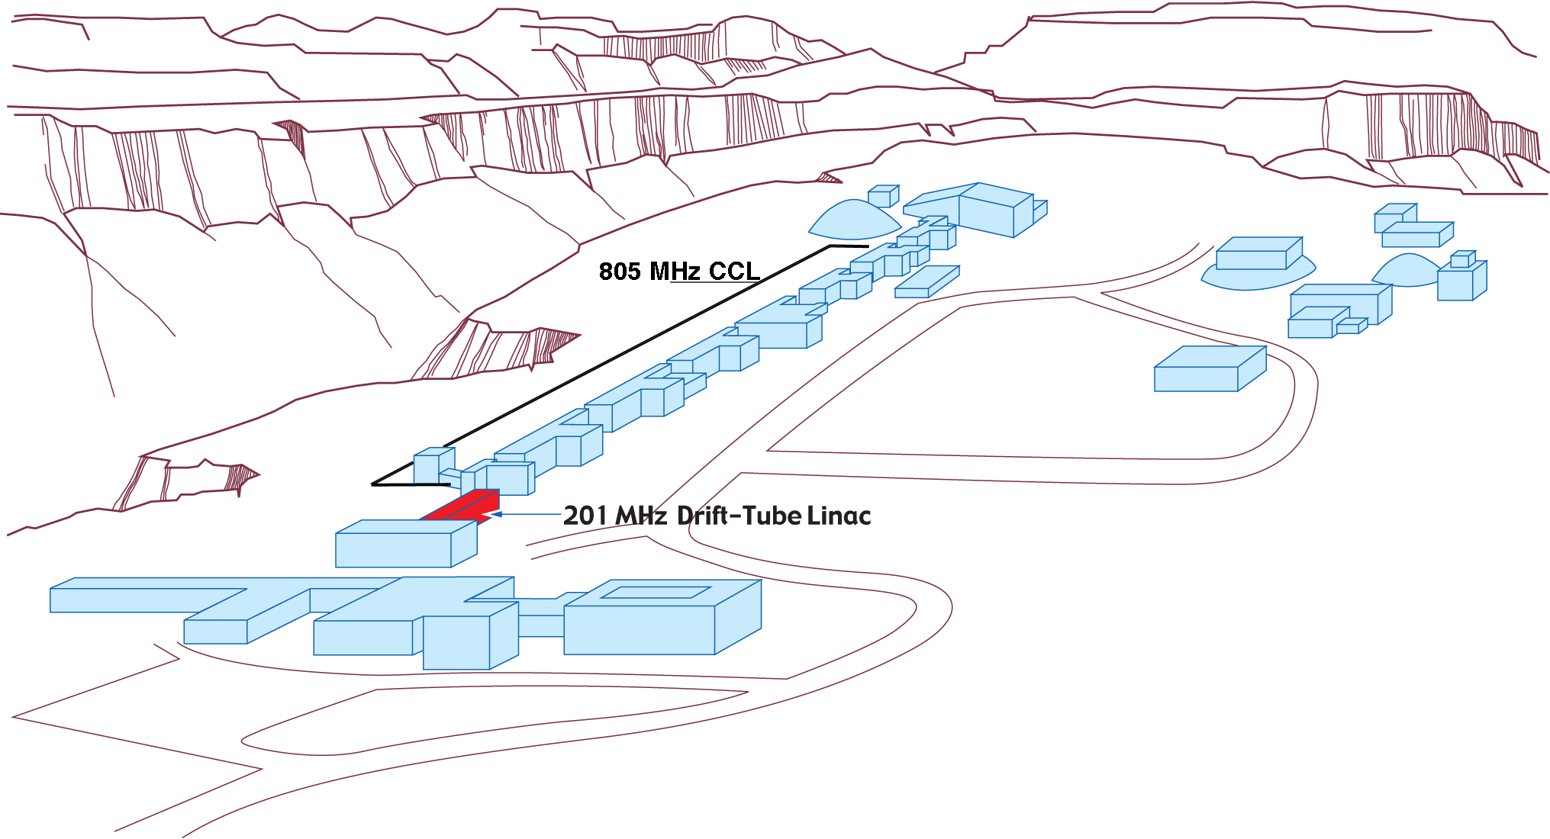
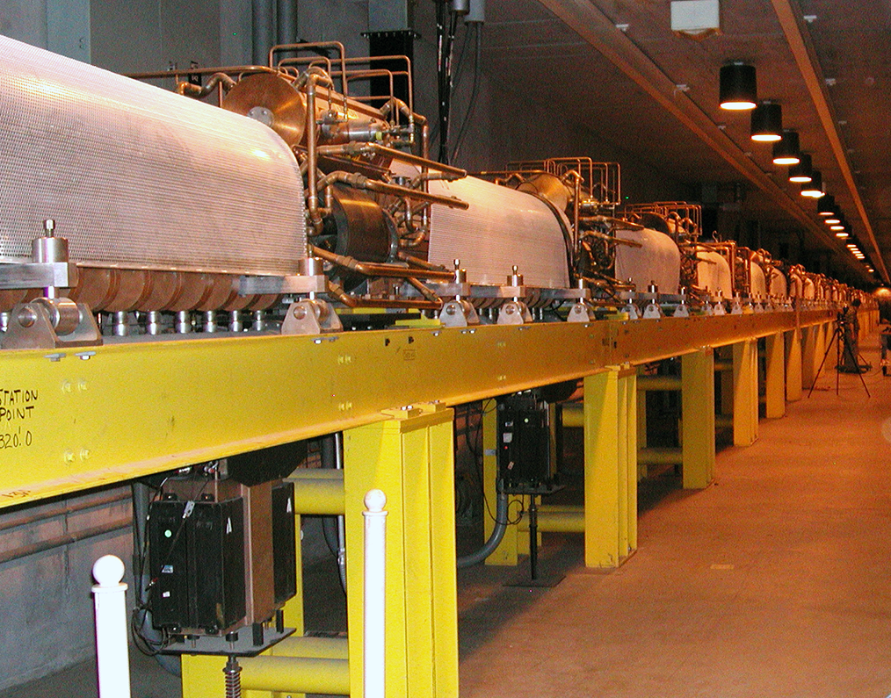
LANSCE Coupled Cavity Linac
Coupled-cavity linac is 727 m long, normal conducting copper, first one built and commissioned 1972 as LAMPF
H- accelerated from 100 MeV to 800 MeV, also protons in earlier years
Mandate to operate to 2050, for pRad, UCN, Neutron Scattering, ICE, WNR, IPF

Slide 4
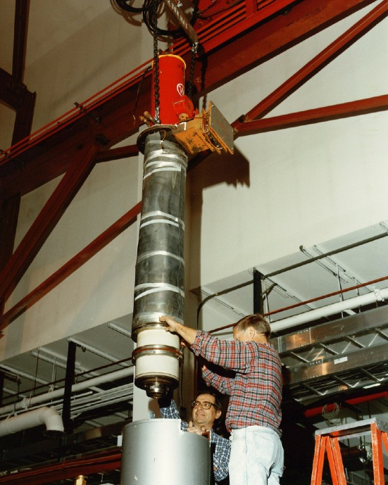
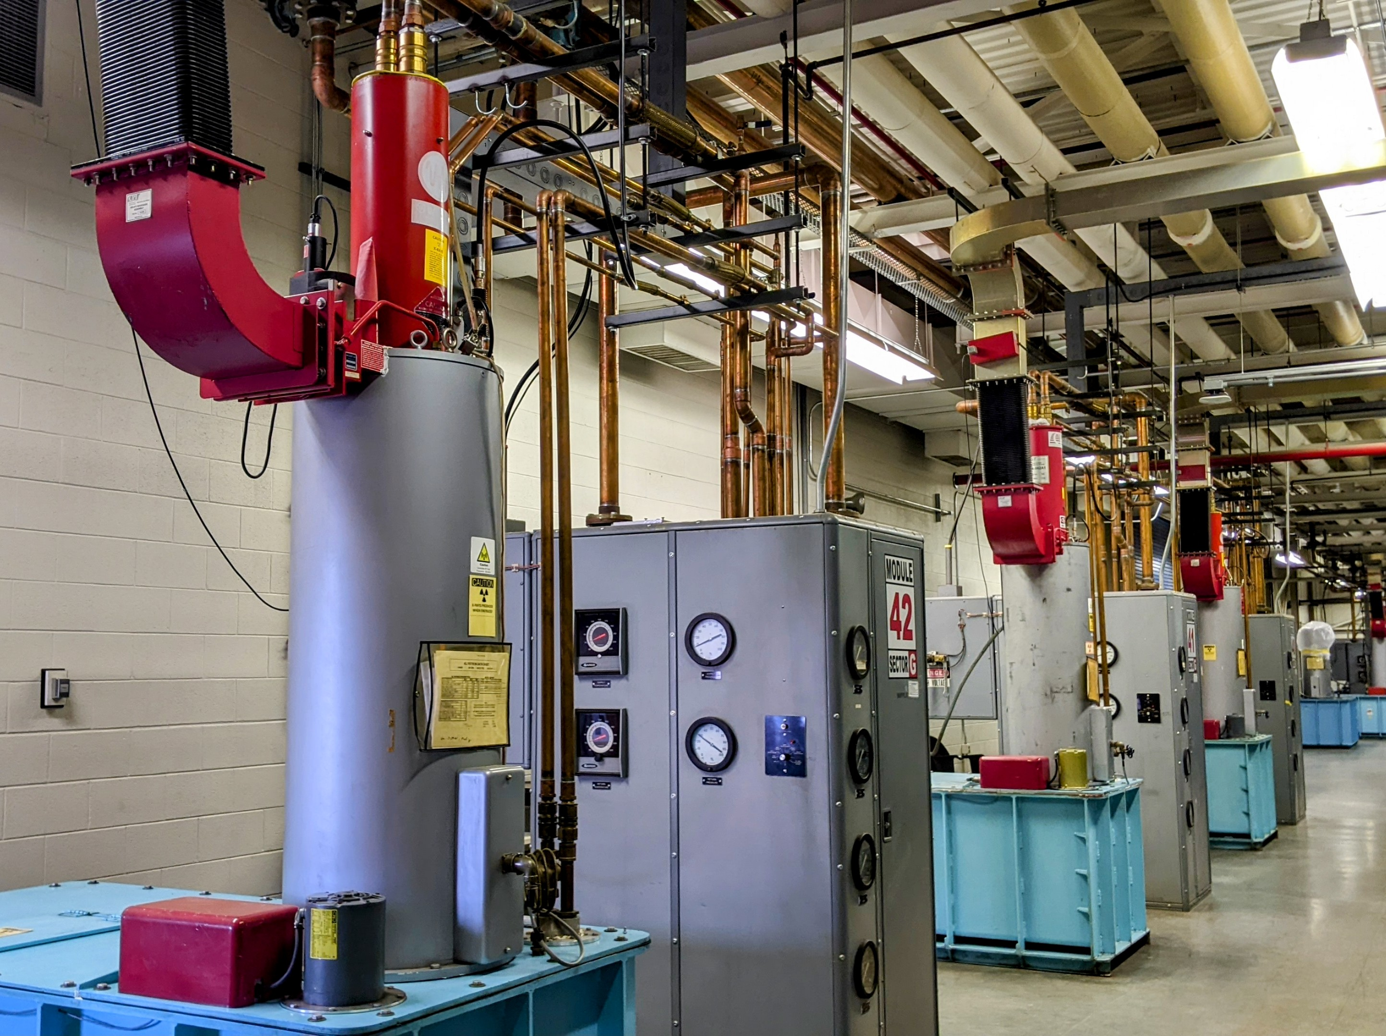
CCL High Power RF System
44 tubes, 1.25 MW peak, 805 MHz, 1 mS pulse, 120 Hz, 12% DF
Production of VA862A1 Klystrons needed for 25 more years
2010 tube run had increased early failures compared to 1980-90 tubes
“LANSCE CCL Klystron Reliability, Evaluation, and Path Forward”, Waghmare, Lyles, Bradley, 13th CWRF Workshop, 2024
“LANSCE 805 MHz Klystron Design and Performance”, Waghmare, Valladares, Linac’24, 2024

Slide 5
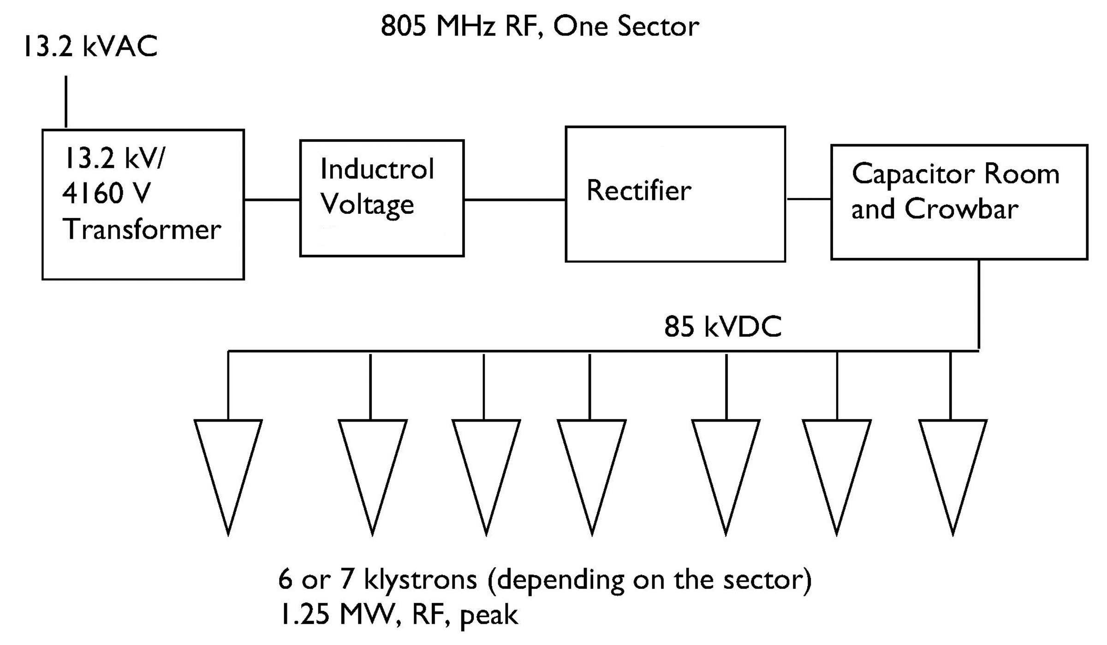
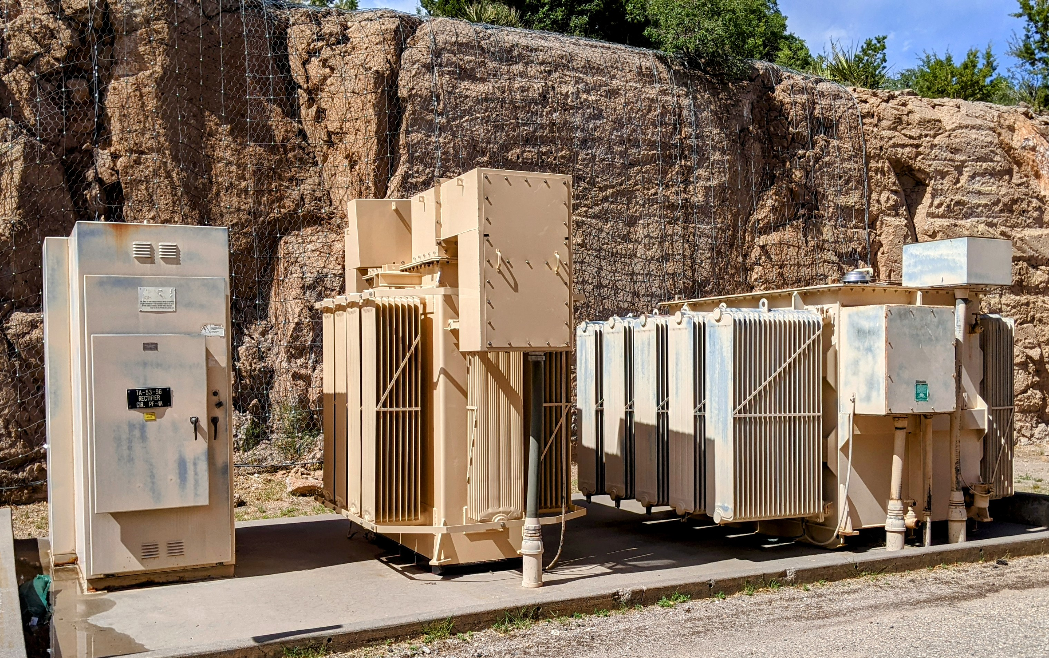
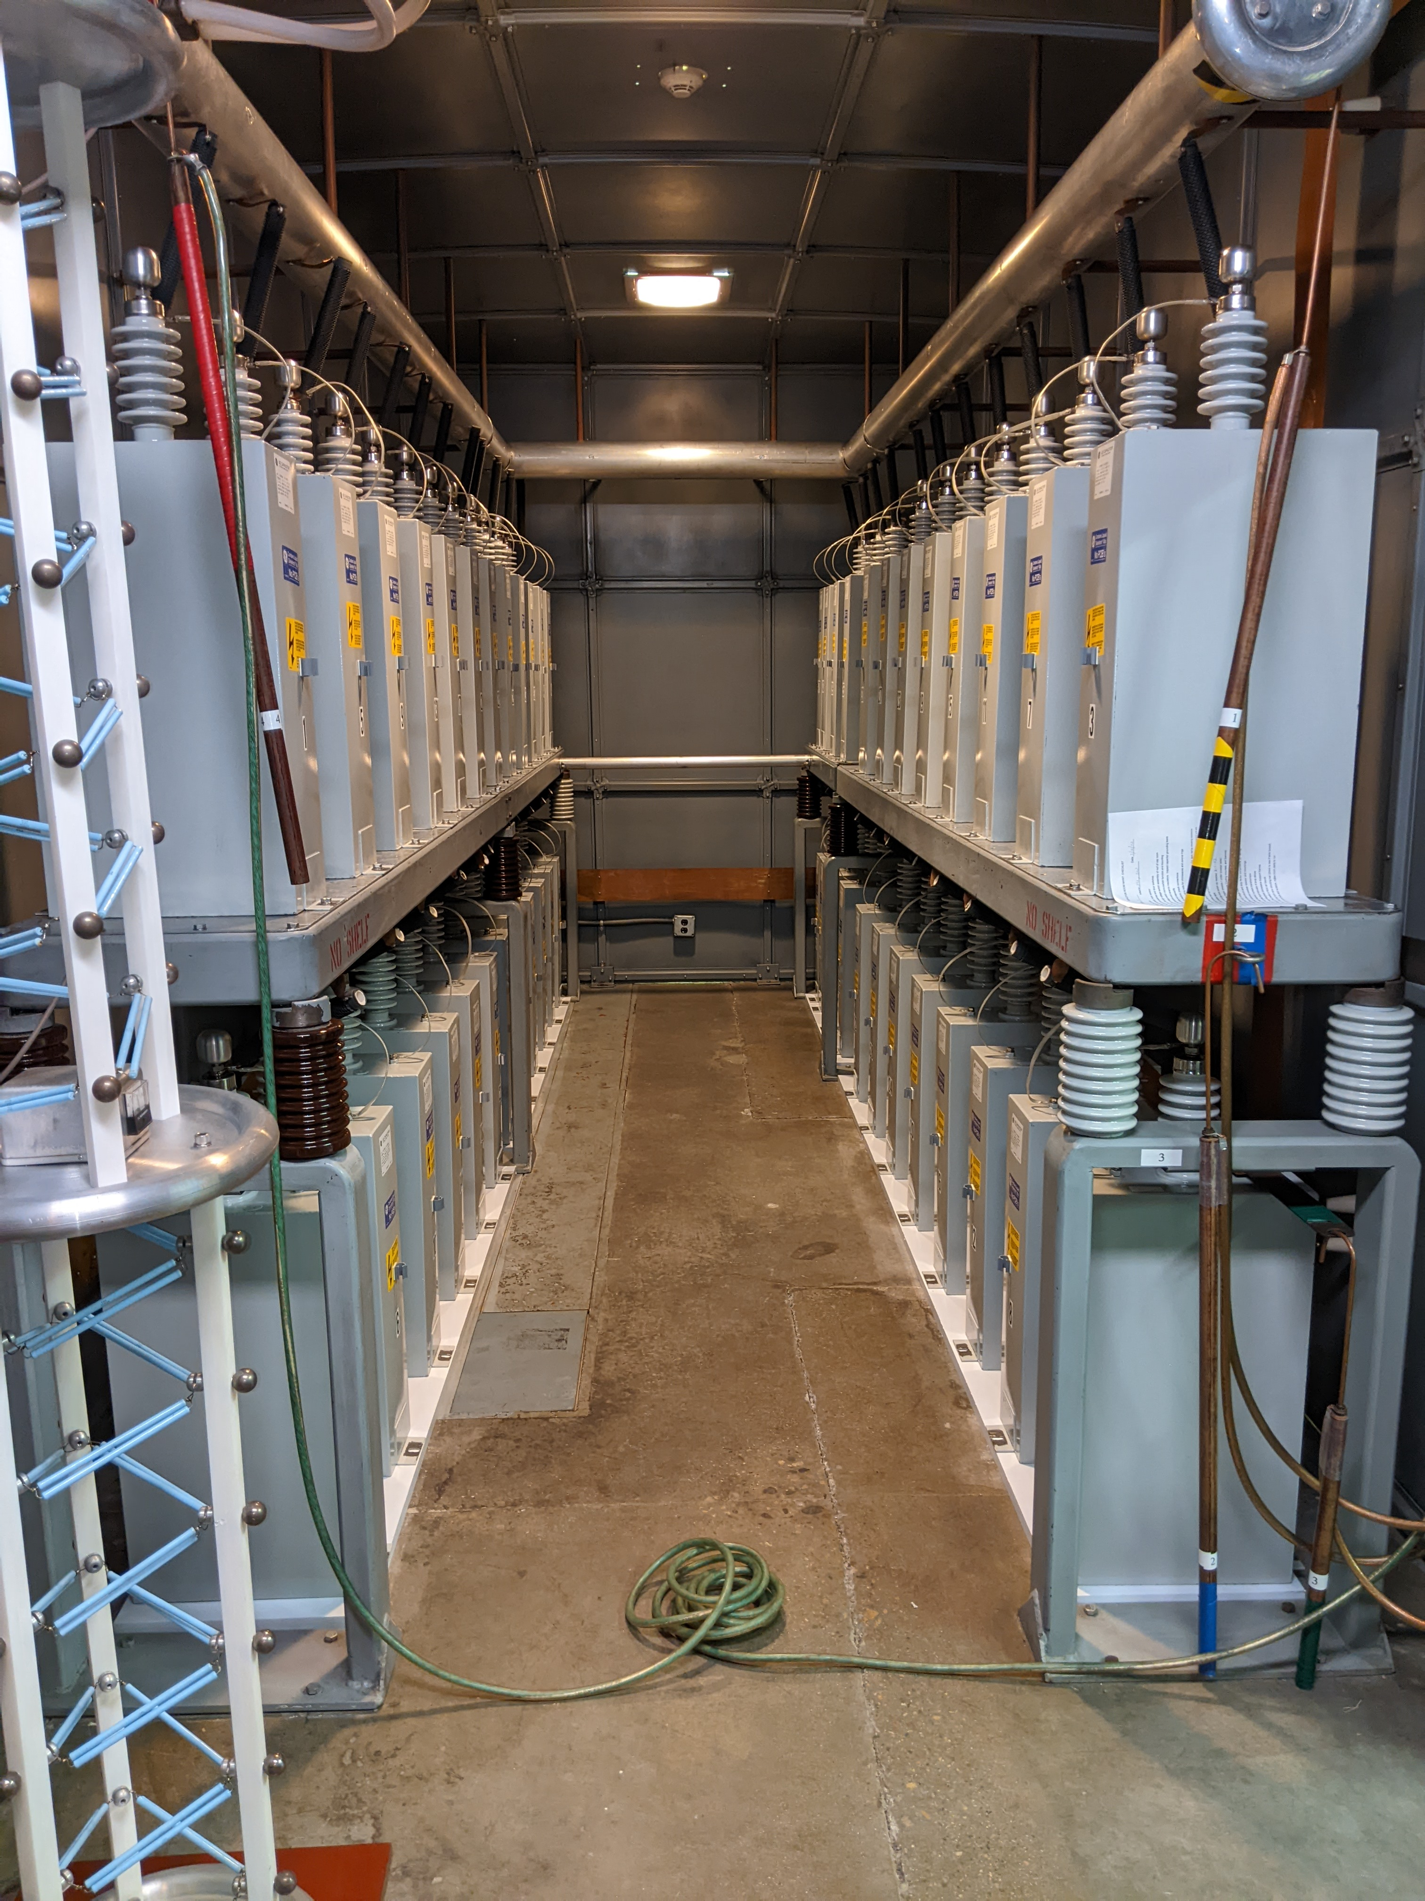
CCL RF HV System
Klystron beam voltage -85 kV DC
One mains charging supply plus 220 kJ capacitor bank and crowbar per 6 or 7 tubes
Power supply and AC regulator no longer made by GE, over 1 year to rebuild (by 3rd party). Some rebuilds have failed.

Slide 6
Alternative RF Amplifiers to Meet Requirements

Slide 7
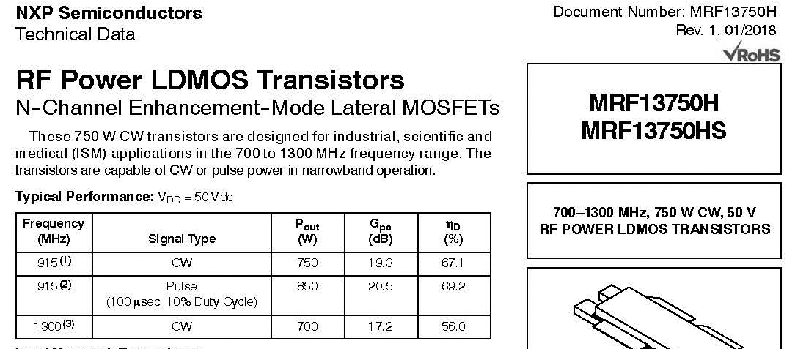

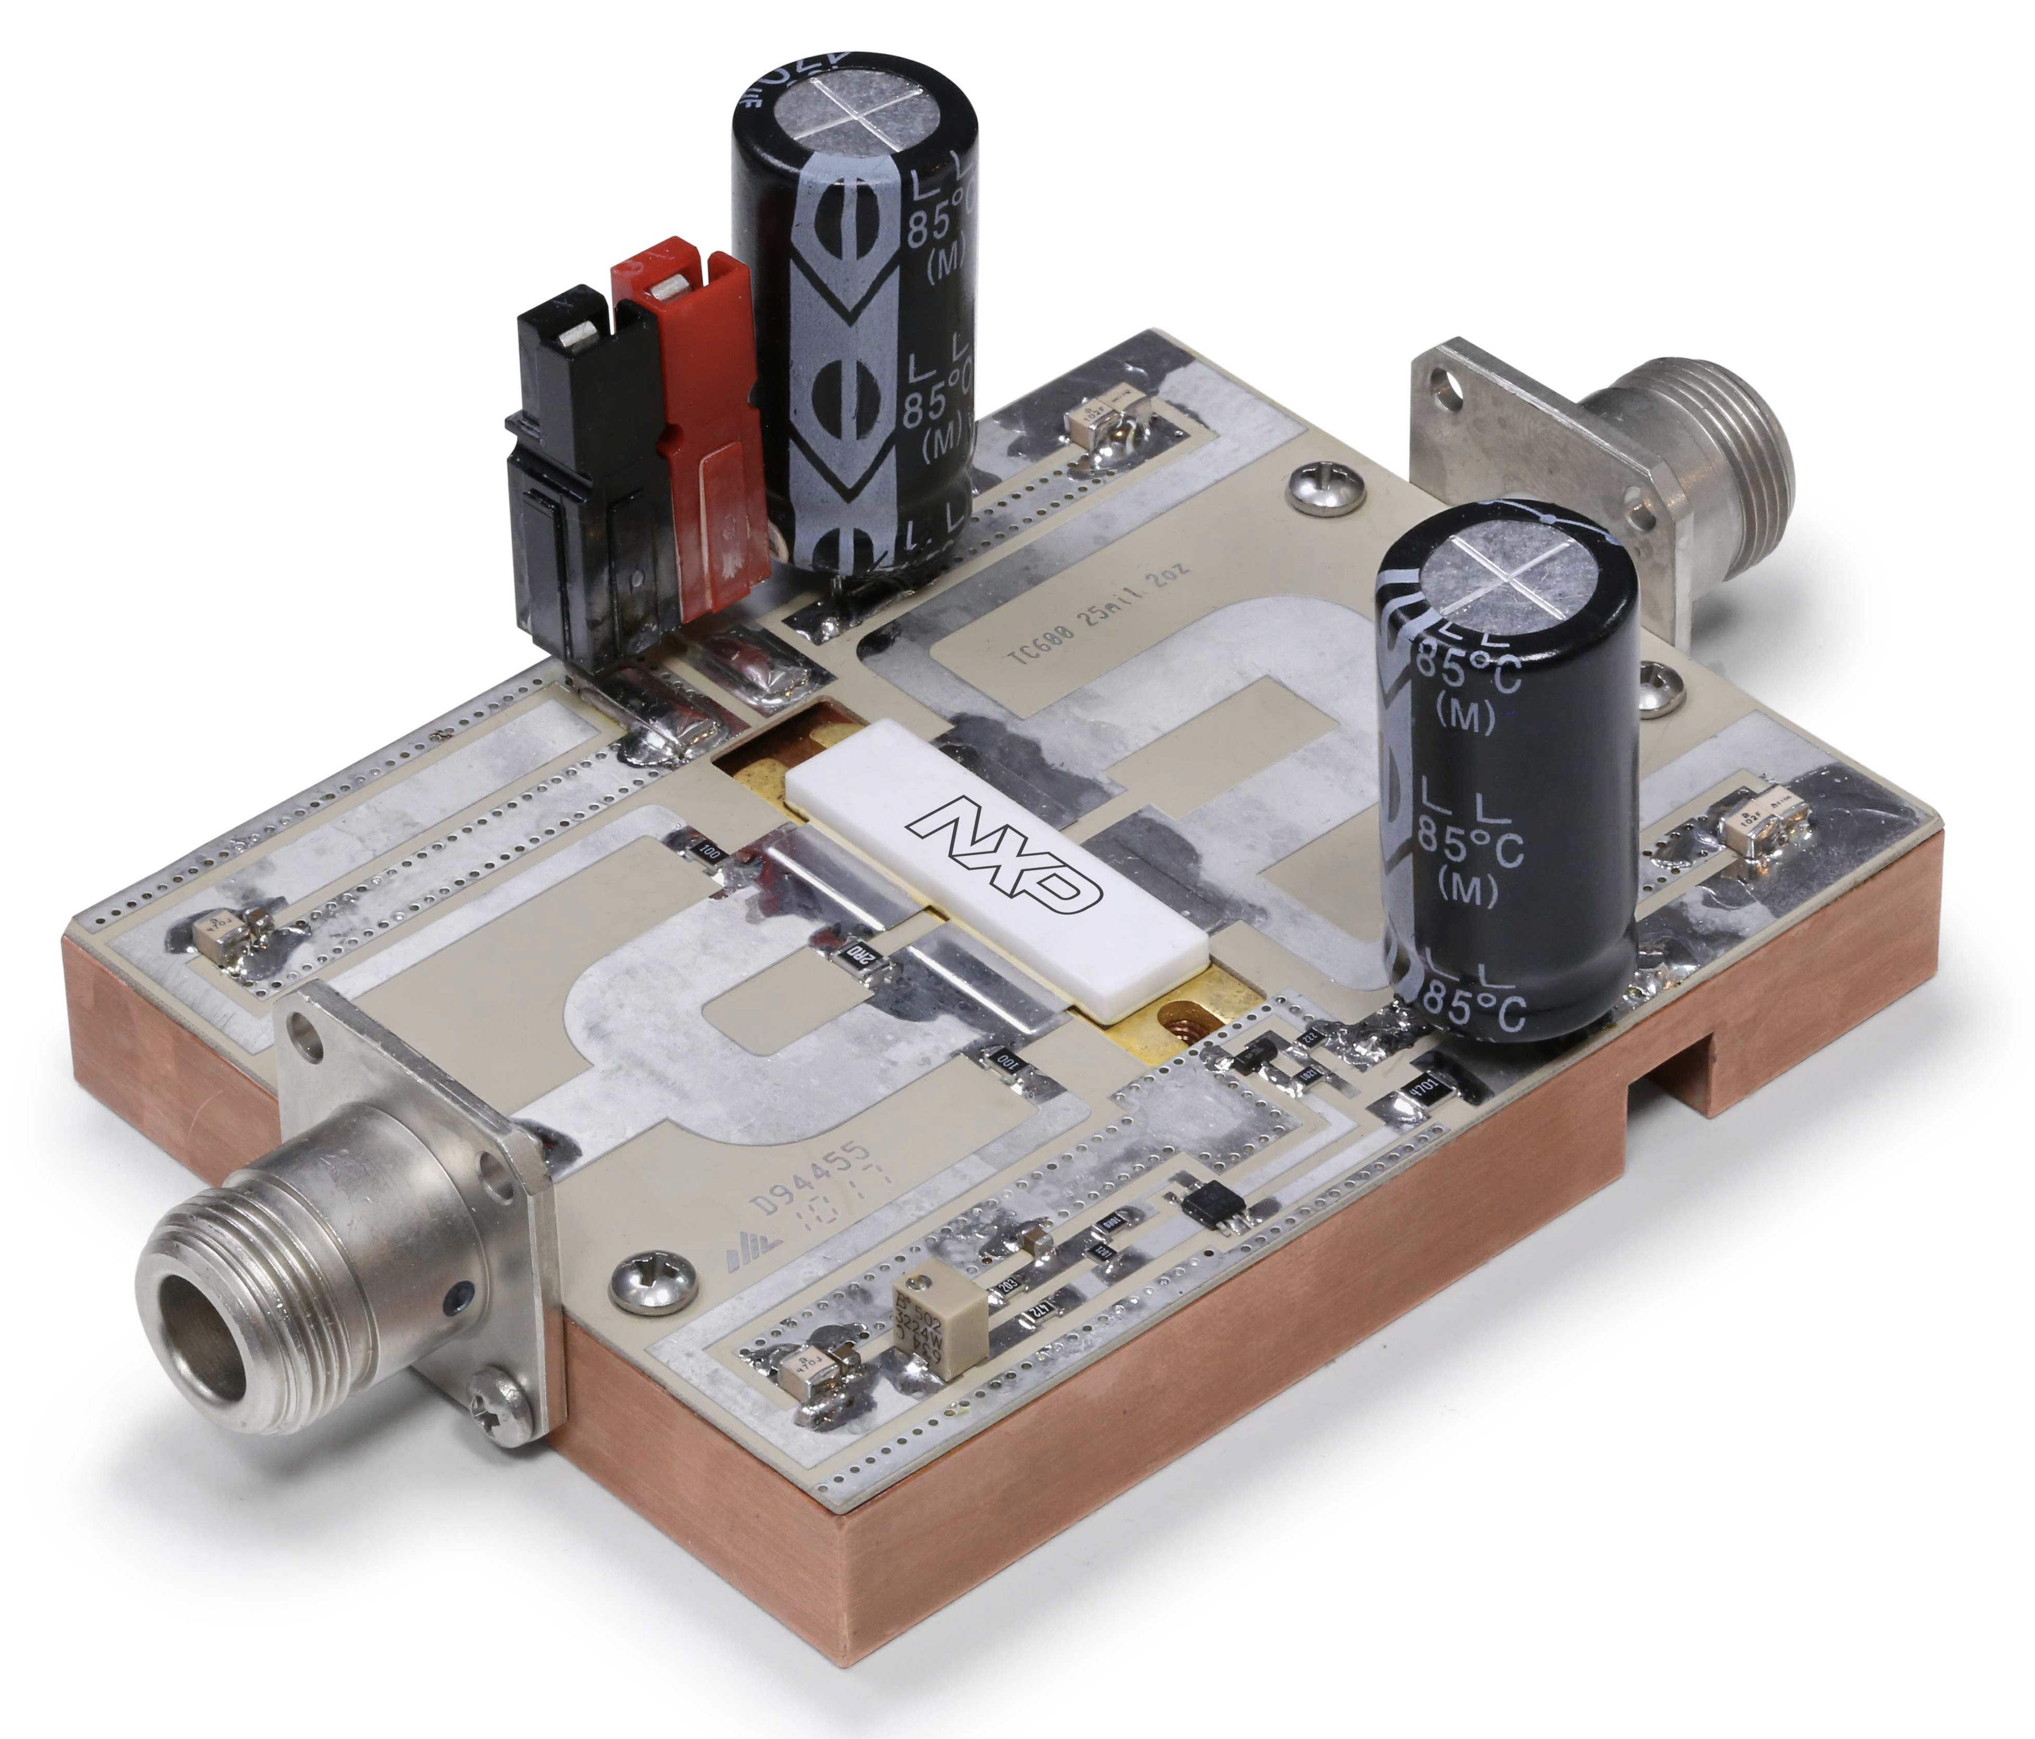
Examples of UHF LDMOS
Below 500 MHz LDMOS ~2 kW P_{sat}
Massive transistor structures used for higher power, have higher drain-source capacitance, 805 MHz power < 1 kW

Slide 8
LDMOS Product Lifecycle
Ampleon Product Longevity Overview
Type Number Launch Date Longevity Date Longevity Duration
ART150FE | 2020/12/04 | 2035/12/05 | 15 years
ART150PE | 2023/01/10 | 2038/01/10 | 15 years
ART150PEG | 2023/01/10 | 2038/01/10 | 15 years
ART1K6FH | 2020/09/15 | 2035/09/16 | 15 years
ART1K6FHG | 2022/03/18 | 2037/03/18 | 15 years
ART1K6FHS | 2022/03/18 | 2037/03/18 | 15 years
ART2K0FE | 2020/05/01 | 2035/05/02 | 15 years
ART2K0FEG | 2022/03/18 | 2037/03/18 | 15 years
ART2K0FES | 2022/03/18 | 2037/03/18 | 15 years
ART2K0PE | 2023/05/25 | 2038/05/25 | 15 years
ART2K0PEG | 2023/05/25 | 2038/05/25 | 15 years
ART2K0TFEG | 2023/06/06 | 2033/06/06 | 10 years
ART2K0TFES | 2023/06/06 | 2033/06/06 | 10 years
ART35FE | 2020/11/27 | 2035/11/28 | 15 years
ART450FE | 2023/06/23 | 2033/06/23 | 10 years
ART700FH | 2021/09/17 | 2036/09/17 | 15 years
ART700FHG | 2022/06/15 | 2037/06/15 | 15 years
ART700FHS | 2022/06/15 | 2037/06/15 | 15 years
ART800PE | 2023/09/19 | 2038/09/19 | 15 years

Slide 9
Beyond LDMOS
On Gallium Nitride:
“The energy gap of GaN is three times that of silicon, resulting in reduced performance degradation at high temperatures. Similarly, breakdown at a six-fold electric field and two-and-a-half-fold carrier saturation velocity enable much greater power densities, resulting in the same output power capability at a much higher impedance level.”
High Efficiency Power Amplifiers, Ericsson Review No. 3, 2006

Slide 10
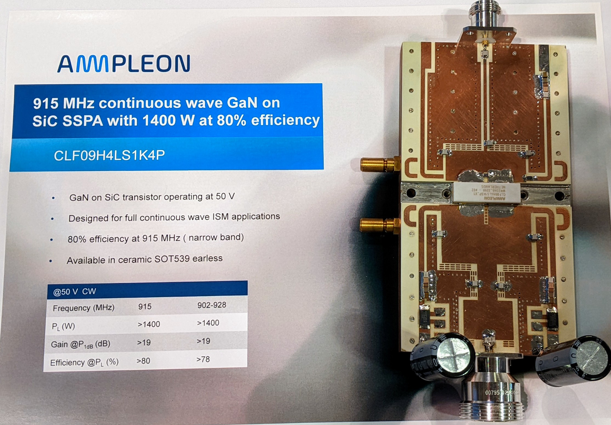
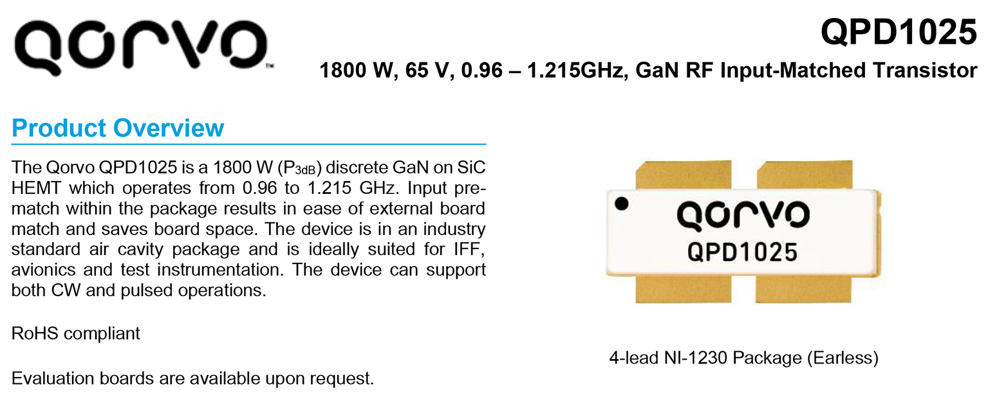
Examples of GaN Devices for L Band

Slide 11
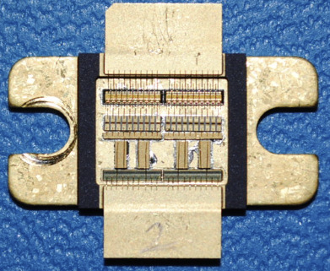
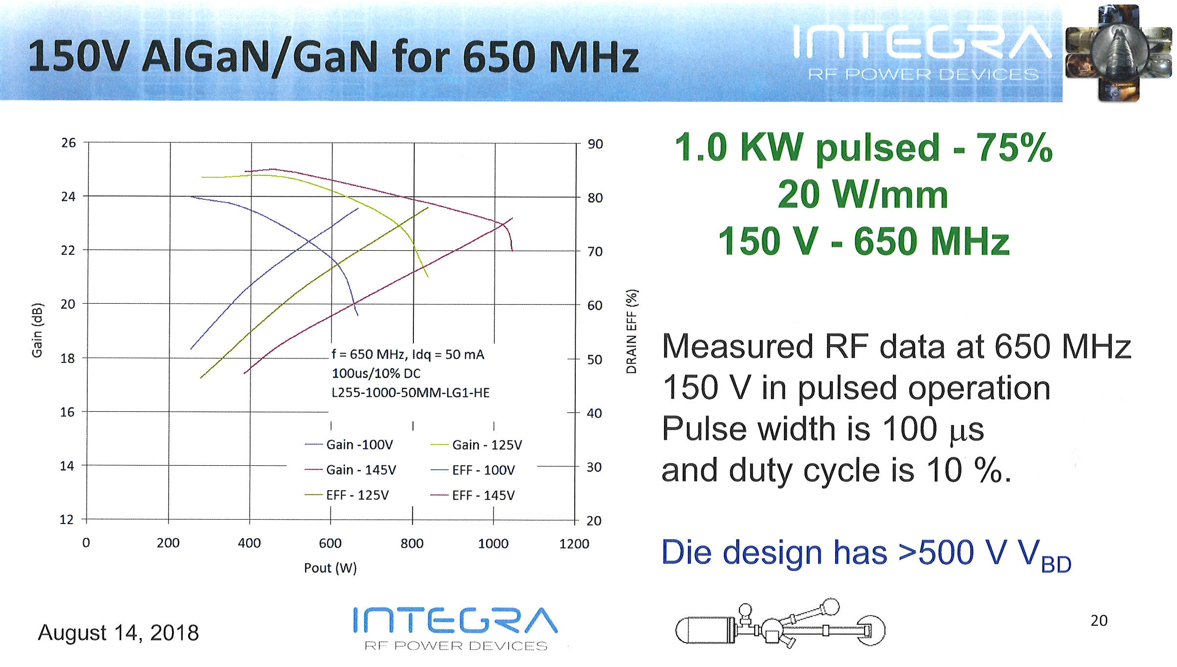

GaN with High Vds => Simple Matching due to Higher Impedance

Slide 12
GaN are Depletion Mode FETs
Require negative gate bias to pinch off channel to cutoff drain current
Less negative bias increases I_{q} to operating level
Zero bias with drain voltage applied can kill transistor
Disadvantage compared to LDMOS, needs bias controller

Slide 13
SSA Progress
Three year project funded by Laboratory Directed R&D to determine if SSA is feasible for megawatt-level pulsed PA
SSA should fit in space of a Klystron/HV modulator tank; need high power density
Engineering team formed from multiple groups, new SSA laboratory
Trade study of amplifying devices, accelerators using SSA, combining topologies
System simulations underway
Eight 3.6 kW SSA test boards acquired
Working with GaN transistor and combiner/circulator manufacturers
“2024 Overview of Solid-State RF Amplifiers for Accelerators”, Lyles, Internal Colloquim, LA-UR-24-22830

Slide 14
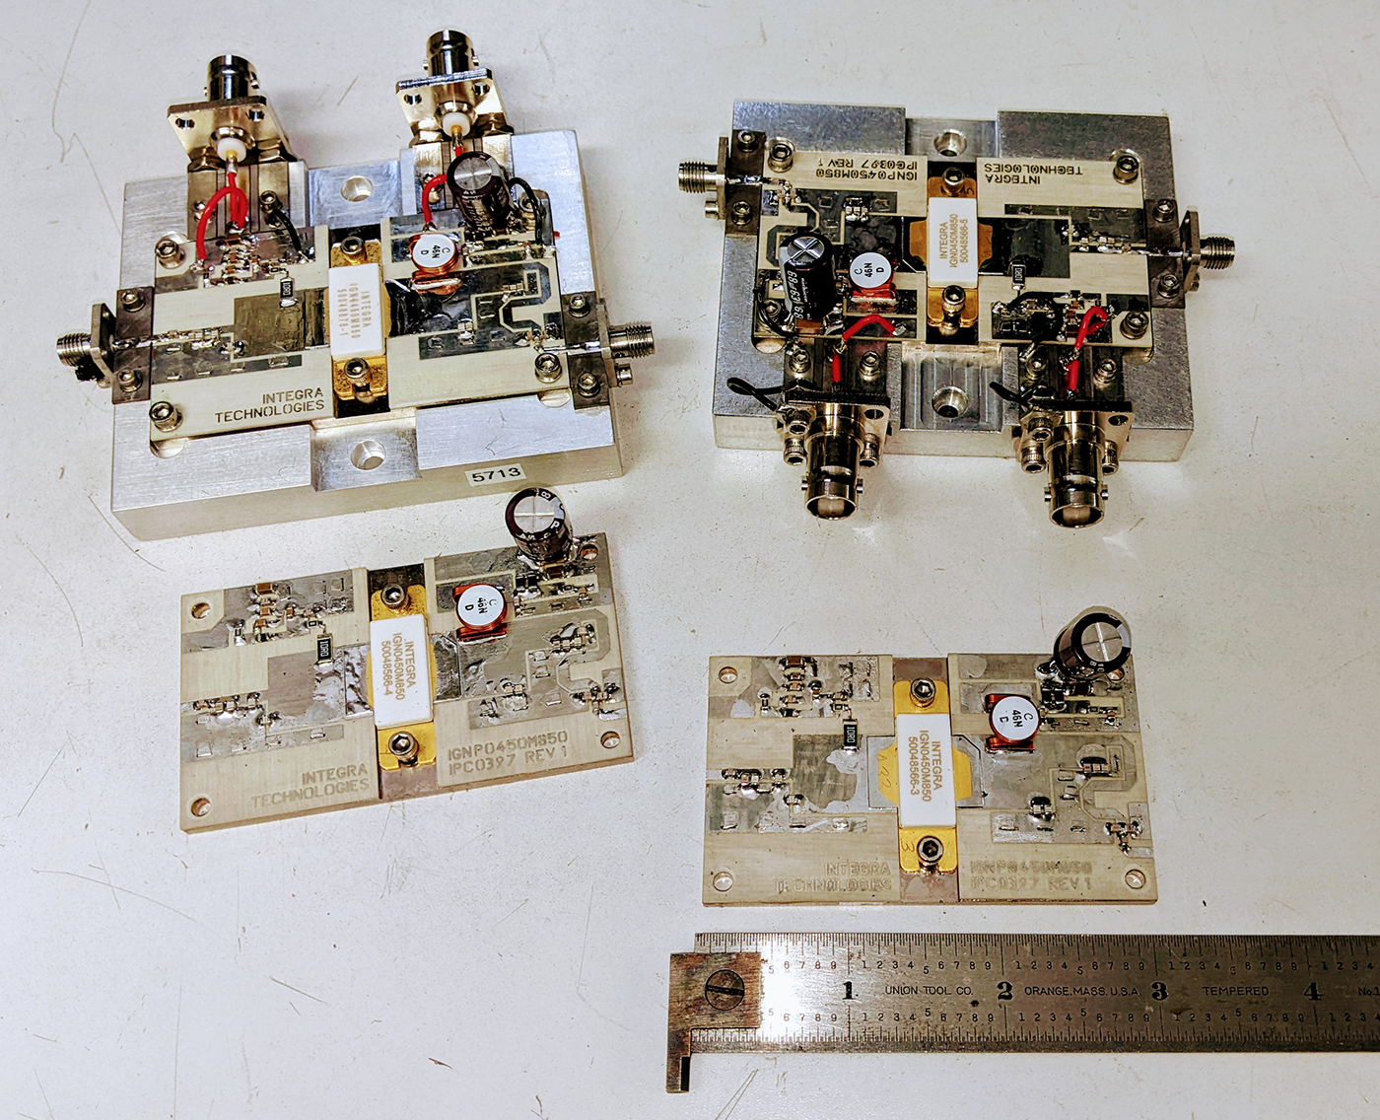
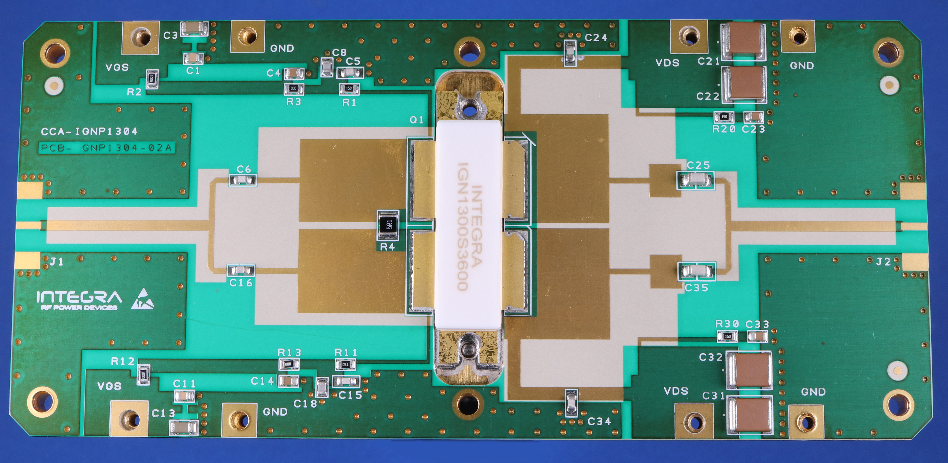
GaN on SiC RF Transistors
425 MHz GaN, 800 Watts, for another project in 2020
805 MHz GaN, 3.6 kW, 100 Volt Vds

Slide 15
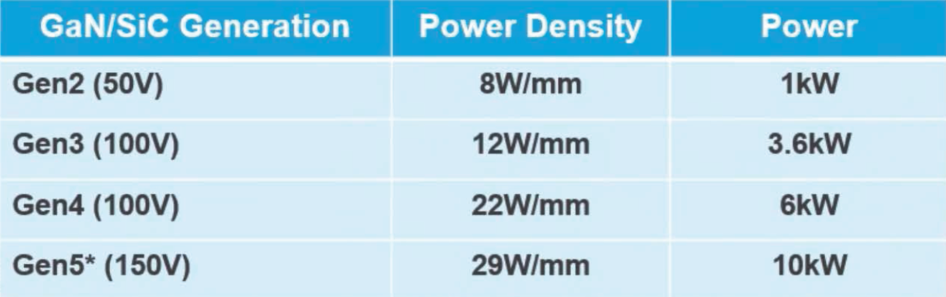
Integra Technologies GaN/SiC Architectures
Transistor for 805 MHz SSA is Gen4 where 5 kW P_{sat} device expected to operate at ~15W/mm power density for it’s gate periphery. Expected channel temp 170-185 deg C. (225 deg results in 1 x 10⁶ hour lifetime in GaN).

Slide 16
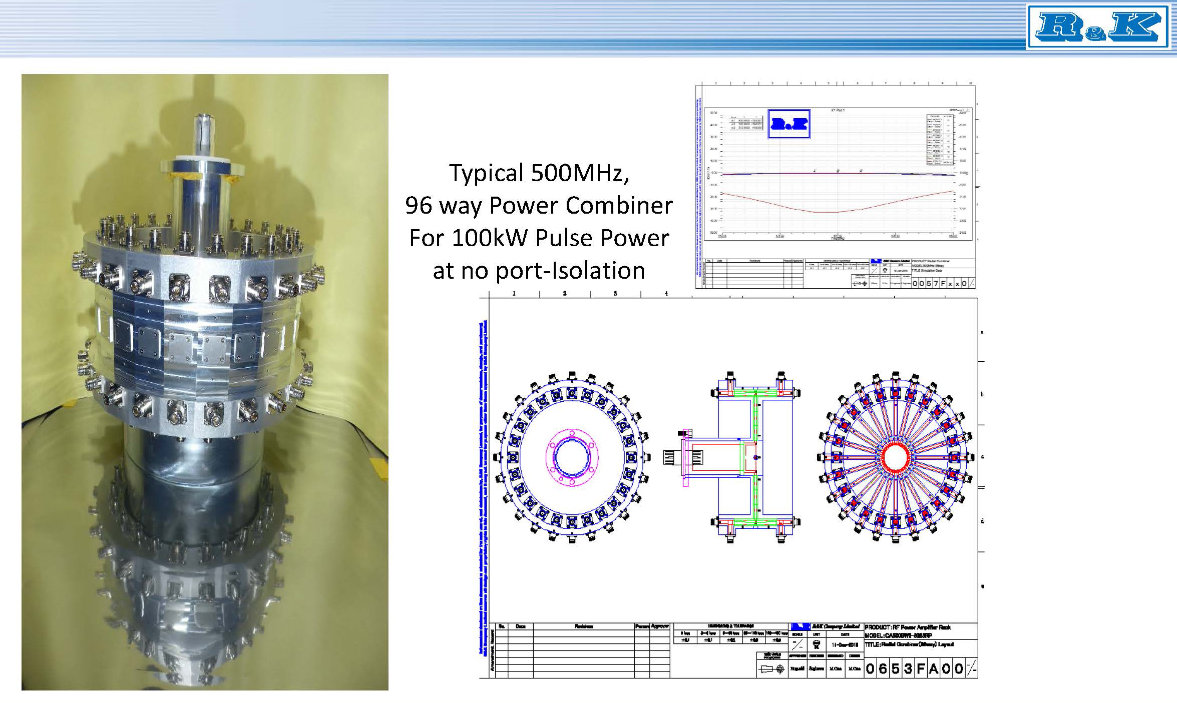
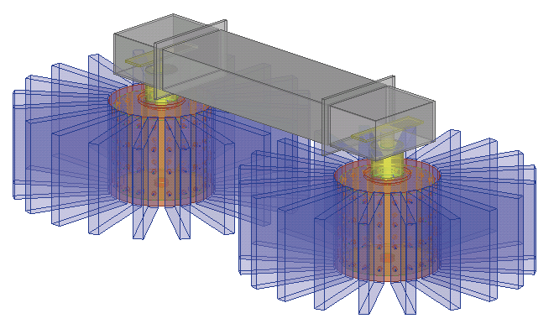
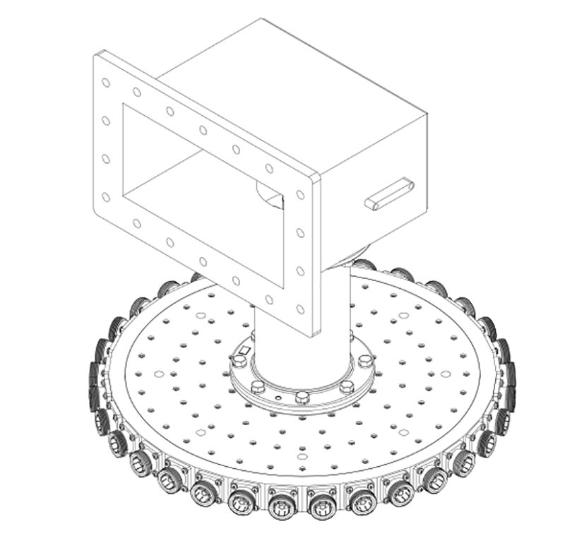
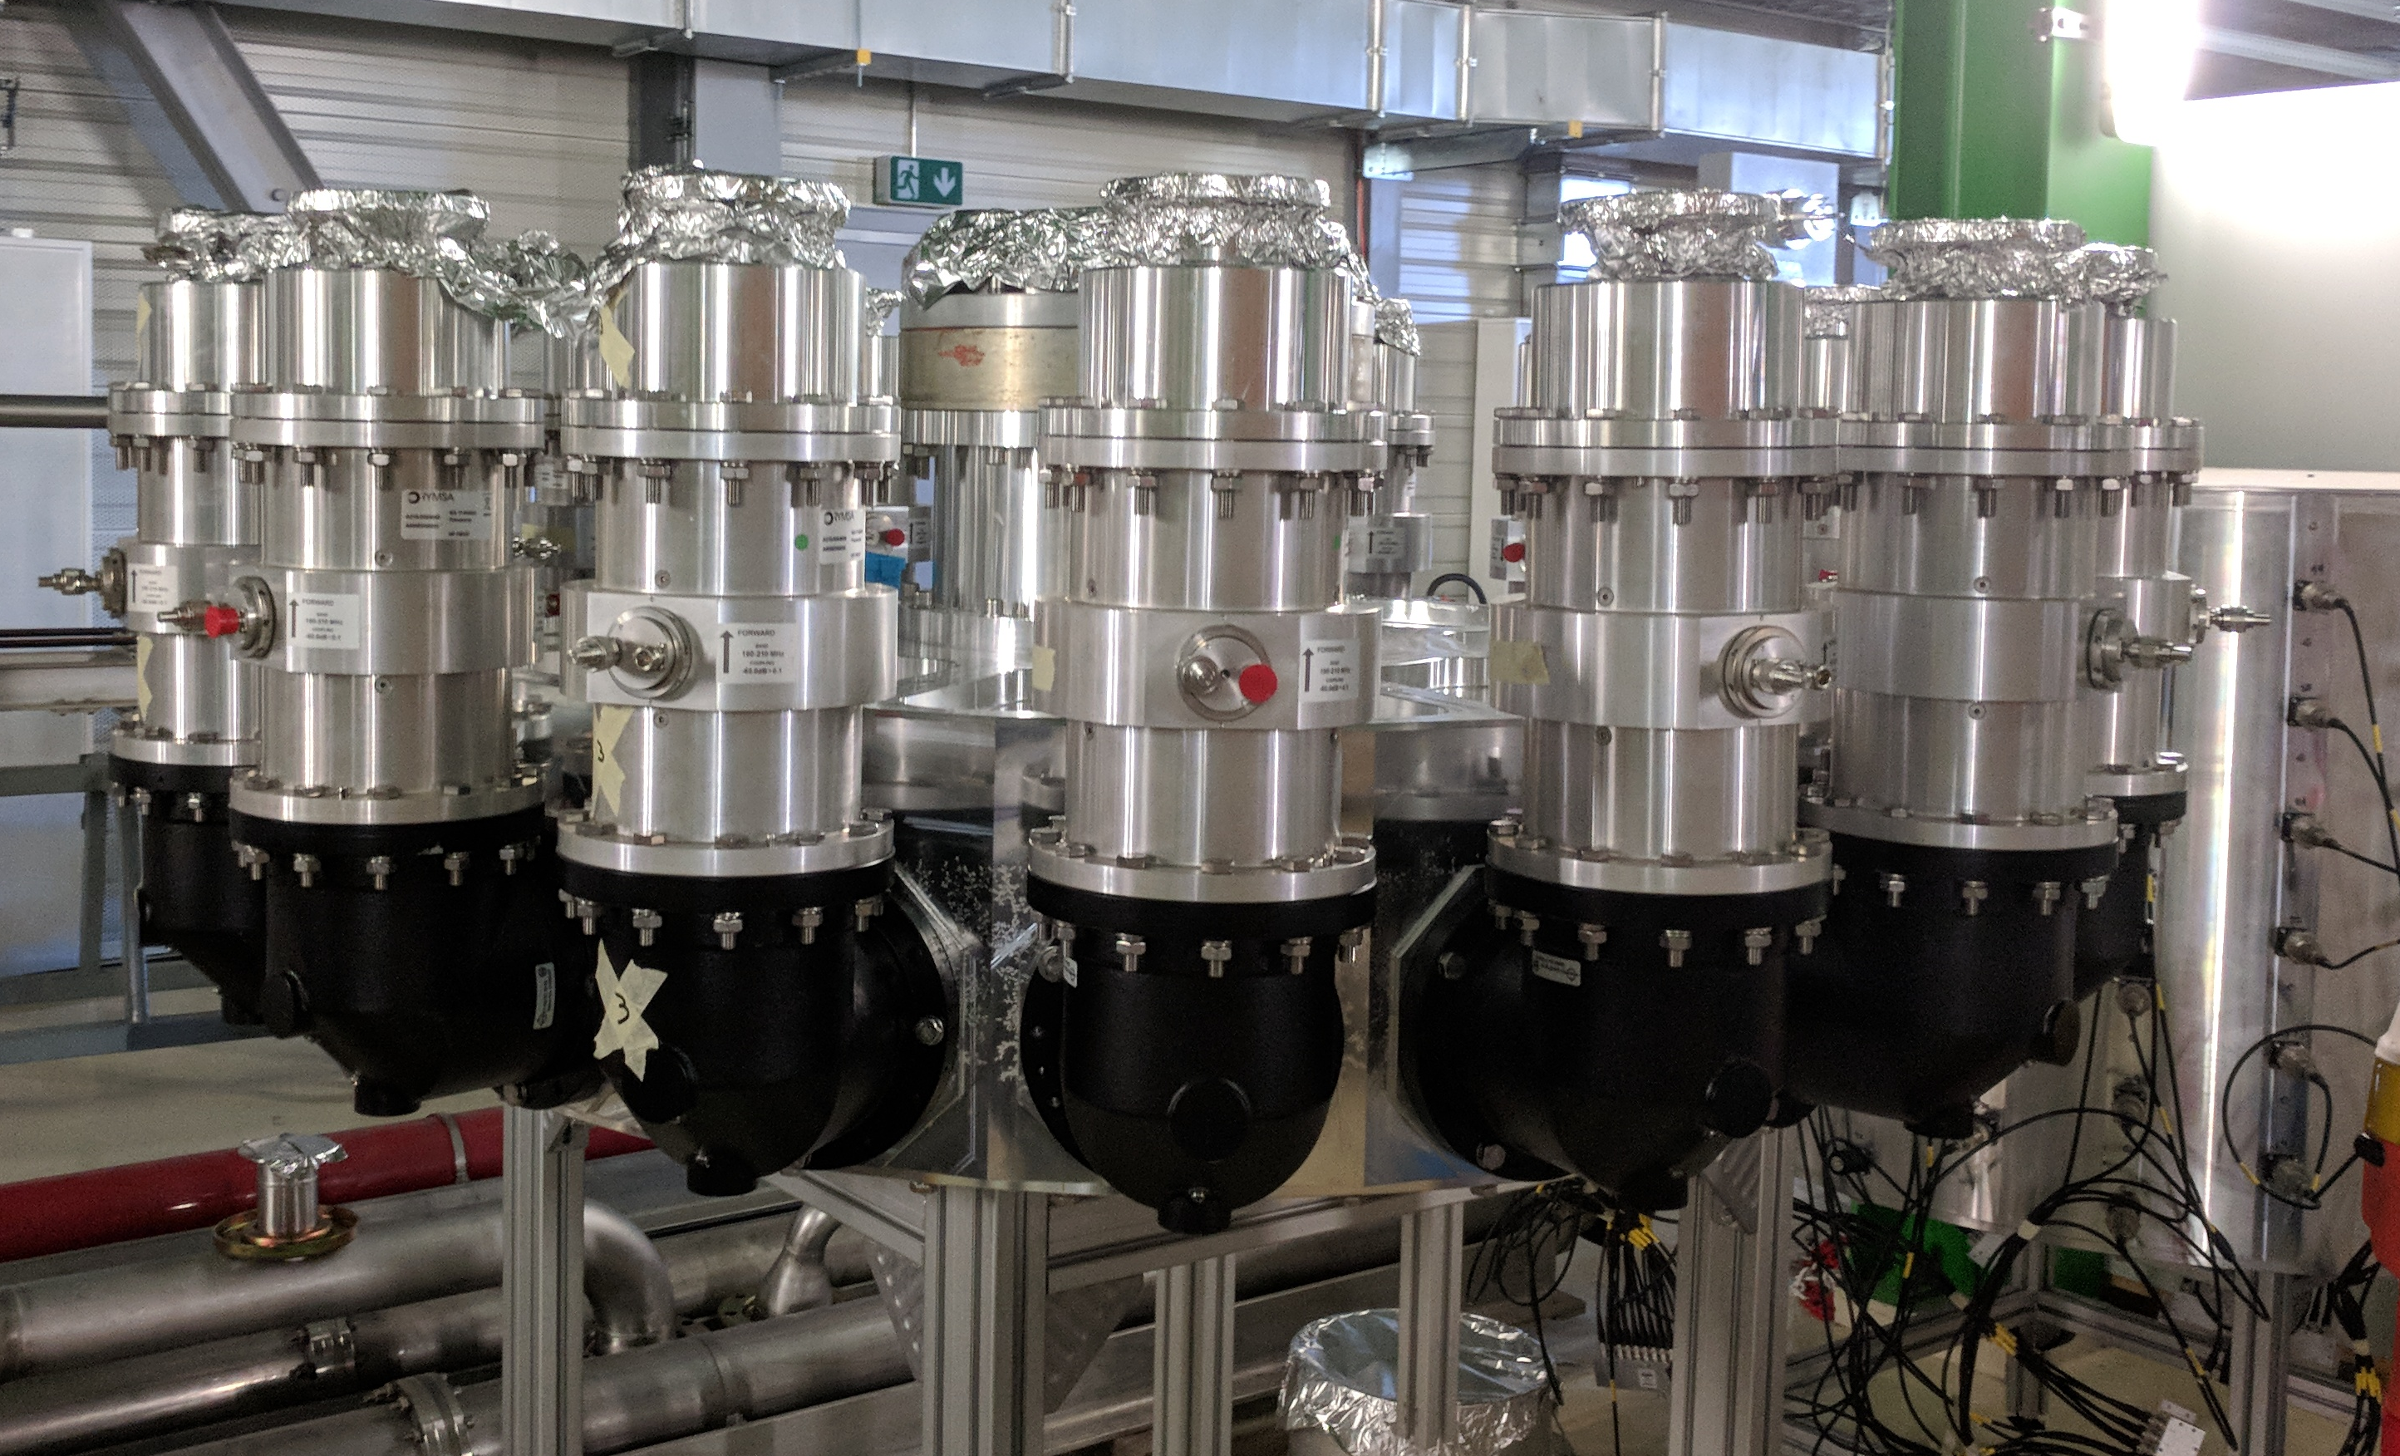
Some High Power Combiners
Proposed Spring 8 SSA
R&K Design
Werlatone Design
SPS 200 MHz 1.6 MW prototype

Slide 17
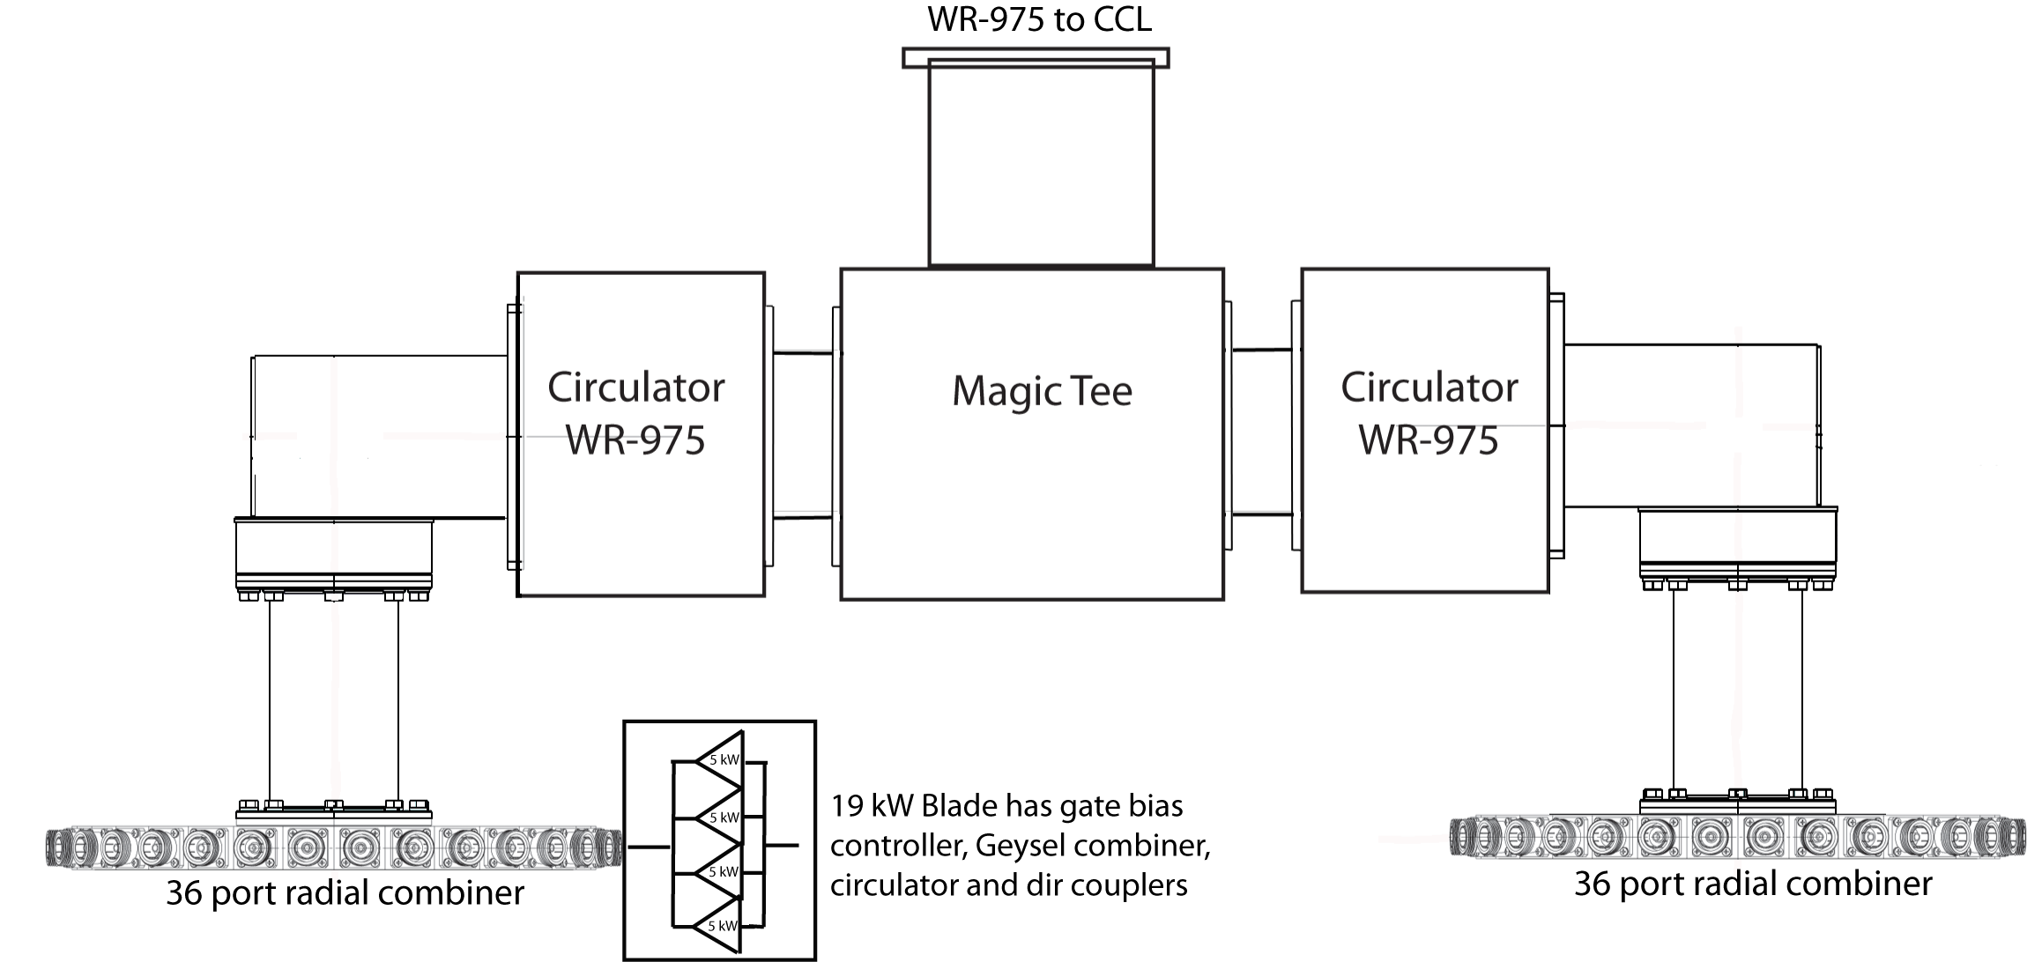
Present Baseline Design
Only output combining shown, 72 blades or pallets used plus driver architecture

Slide 18
Spreadsheet Analysis of Gain Distribution
Solid State Amplifier Configuration Planner |  |  |  |  | 3 stage (11 dB < gain < 19 dB)
 |  |  |  |  | Notes
Output Power from LLRF | 6.9 | Watts | 38.39 | dBm | 10-200 Watts
Number of Driver Modules | 2 |  |  |  | 2 drive modules for out-phasing
Driver Splitter Insertion Loss | 0.95 |  | -0.20 | dB
Driver Module input Power | 3.29 | Watts | 35.18 | dBm
Driver Module Gain | 63.10 |  | 18.00 | dB
Driver Module Power Rating | 5000 | Watts | 66.99 | dBm
Driver Output Power | 207.88 | Watts | 53.18 | dBm
Stage 2 Divider Ports | 1
Stage 2 Divider Insertion Loss | 0.93 |  | -0.30 | dB | includes 4-way in pallet
Stage 2 Driver Module input Power | 194.01 | Watts | 52.88 | dBm
Stage 2 Driver Gain | 63.10 |  | 18.00 | dB
Stage 2 Driver Output Rating | 20000 | Watts | 73.01 | dBm | 4 - amp pallet
Stage 2 Driver Output Power | 12241.06
Stage 3 Divider Ports | 38
Stage 3 Divider Insertion Loss | 0.93 |  | -0.30 | dB | includes 4-way in pallet
Stage 3 Driver Module input Power | 300.63 | Watts | 54.78 | dBm
Stage 3 Driver Gain | 63.10 |  | 18.00 | dB
Stage 3 Driver Output Rating | 20000 | Watts | 73.01 | dBm | 4 - amp pallet
Stage 3 Driver Output Power | 18968.61
Stage 4 Power Combiner Ports | 38
Stage 4 Power Combiner Insertion Loss | 0.98 |  | -0.10 | dB
Stage 4 Power Combiner Output Power | 704399.6
Final Combiner Ports | 2
Final Combiner Insertion Loss | 0.98 |  | -0.10 | dB
Final Output Power | 1408799.2
Input Divider | 76
Output Combiner | 76
Total Gain | 199526.23 |  | 53.00

Slide 19
GaN Thermal Measurement at Integra Technologies
Thermal measurement performed at worst case conditions
  This is for another transistor, not 805 MHz
  Worst case power dissipation of 1.87kW
  Flange temperature = 85°C
  Transient infrared detector used to capture peak temperature during RF pulse
This property of Class AB amplifiers can kill transistors during power rollback

Slide 20
Varying CCL power requirements at different locations
Turning down drive power is a concern for Class AB SSA devices
When conditioning a CCL cavity
Ramping up power slowly
During accelerator beam tuning
Normal uneven RF power distribution along linac from physics tune
Fast power fluctuation for beam loading
Need about 12 dB of output dynamic range for these situations

Slide 21
Techniques for Variable Power that Avoid High Drain P_{dissp}
Reduction of Vds below 100 V to keep high efficiency at lower power
  20% is safe but it cannot be fast with large power converters
  How would it be automatic?
Turning off pallets before combiner
  Must account for reverse power to other pallets
  Modeling is being done to understand which ones are best
  Difficult to remove RF driver power but can raise gate bias to disable output
Outphasing modulation for fast control, beam compensation

Slide 22
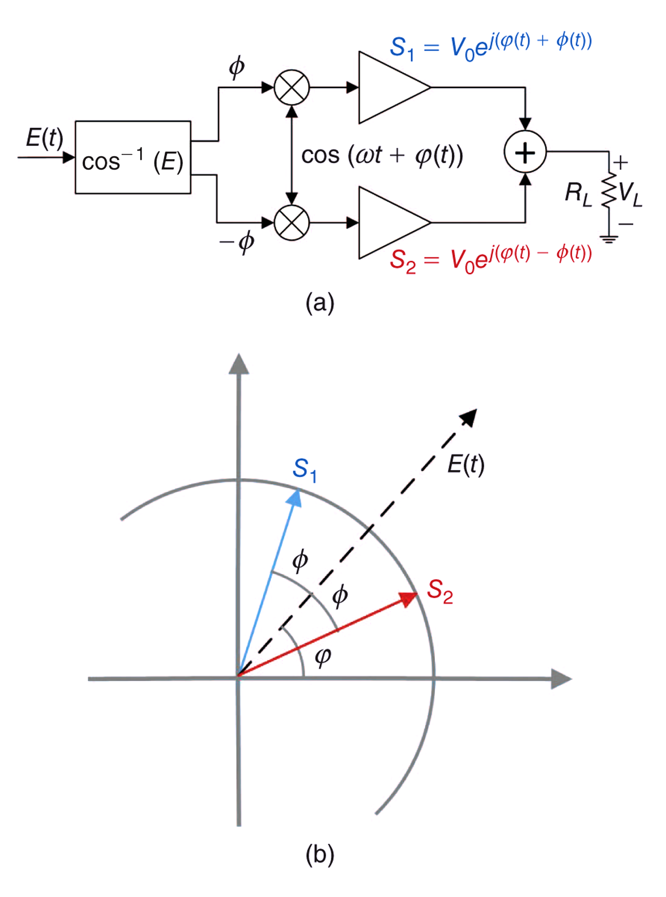
Outphasing Modulation
“Not Just a Phase”, Barton, IEEE Microwave Magazine, Feb. 2016
“High power outphasing modulation,” Chireix, Proc. IRE., vol. 23, no. 11, Nov. 1935

Slide 23
Outphasing Amplifier
  Outphasing amplifiers run at constant power at P_{sat}, highest efficiency
  A binary pair of PAs operate constant envelope -,driven hard, while phase modulation is applied to both input signals
  If one PA is +90 and other is -90 deg, combined output is zero power; If both PA are in-phase, then combined output is 2 times one PA
  The combined output is a linearly amplified replica of the desired input yet uses two nonlinear PAs
  The load impedance to each PA varies from 25 Ohms (when in phase) to infinity (when out of phase and zero combined output). Add circulators for each PA to isolate transistors from this wildly varying load.
  RCA commercialized outphasing in AM broadcast transmitters in 1954 using tubes
“The Circuit Development of the Ampliphase Broadcasting Transmitter”,Price, Proc IEE, 1954

Slide 24
Improved Efficiency Outphasing Amplifier
  We ran Matlab-Simulink comparisons of varying phases and amplitudes of the binary amplifier pair by +/-5% and +/-5 deg to understand effect on outphasing PA
  With circulators for each PA to isolate transistors we end up with an overall amplifier that is similar to a klystron, constantly delivering power to either RF or to the circulator loads.
  Techniques to reuse this wasted load power would raise system efficiency
    Convert RF load thermal heat to electricity, or rectify RF back to DC to the bus
“Efficiency of Outphasing RF Power Amplifying Systems”, Raab, IEEE Trans Communications, October ,1985
“A Power Re-Use Technique for Improved Efficiency of Outphasing Microwave Power Amplifiers”,Langridge et al., IEEE Trans MTT, August, 1999
“Analysis of Power Recycling Techniques for RF and Microwave Outphasing Microwave Power Amplifiers”,Zhang et al., IEEE Trans Circuits and Systems II, May, 2002

Slide 25
Outphasing with Regenerated Power

Slide 26
Planned Work in FY25-26
Development of long pulse GaN on SiC packaged transistor, 5 kW P_{sat}
  Wafer fab with mask to provide multiple devices with up to 4 wafers
  Packaged transistors qualified, tested, provided to LANL for testing
Refine SSA architecture, add ADS simulation with variation of passive parameters
Determine peak and avg power rating for connectors and cables on blades
Determine prime AC/DC power system architecture, stored energy location
Prototype 20-40 kW blades in lab using water-cooled plates and chiller
Develop commercialization plan
Scaled prototype to a hundreds of KW with WG circulators and magic tee

