Slide 1
Status and Upgrade plan of SPring-8 RF system
#8
T. Ohshima, T. Inagaki
on behalf of RF team of SPring-8
Notes:
My name is takashi ohshima coming from SPring-8. The title of my talk is status and upgrade plan of spring-8 rf system

Slide 2
Contents
Status of Current SPring-8
Upgrade plan of SPring-8
Trouble in High Power RF components during user operation
Notes:
Here shows contents of my talk
First topic is status of current spring-8

Slide 3
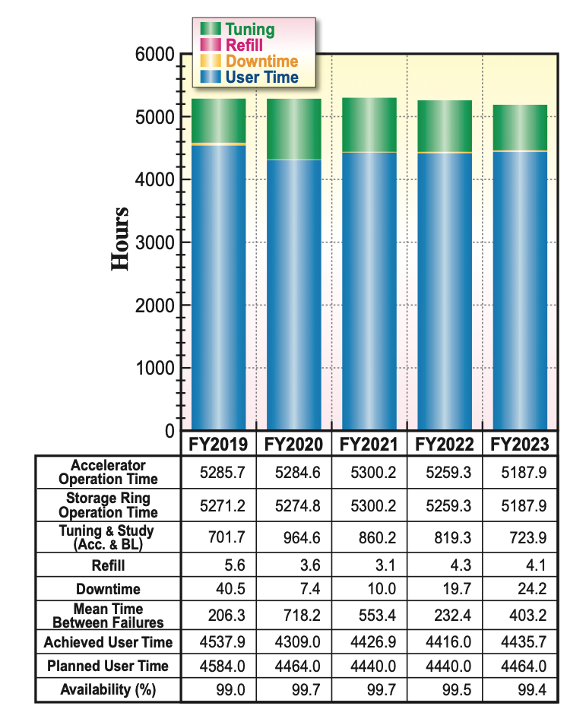
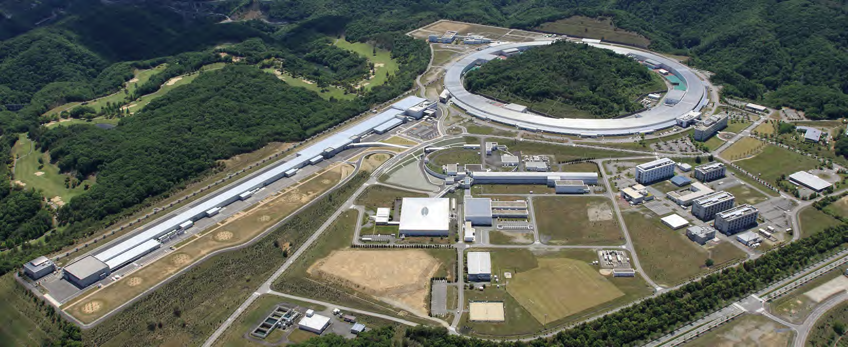
SPring-8: 3rd generation synchrotron radiation facility
 | SPring-8
Beam energy (GeV) | 8
Stored current (mA) | 100
Circumference (m) | 1435.95
# cells | 44 arc cells + 4 straights
Lattice | Double bend
Emittance (nmrad) | 2.4
# Beam Lines | 62
Four RF stations
SACLA
C
B
D
A
SPring-8
Notes:
SPring-8 is a 3rd generation synchrotron radiation facility aiming to provide hard X-ray to users. The beam energy is 8 GeV, the stored current 100 mA, the circumference 1.4km, there are 44 arc cells and 4 long straights along the ring. The lattice is the double band based achromat, which gives us the emittance of 2.4 nm.
Here is the operation statistics of recent years. The user time was more than 4.4 k hours per year. The resultant MTBF was more than 200 hours, and the availability was more than 99.5 %.. This ring has four rf stations to compensate the energy loss of the electron beam by the synchrotron radiation

Slide 4
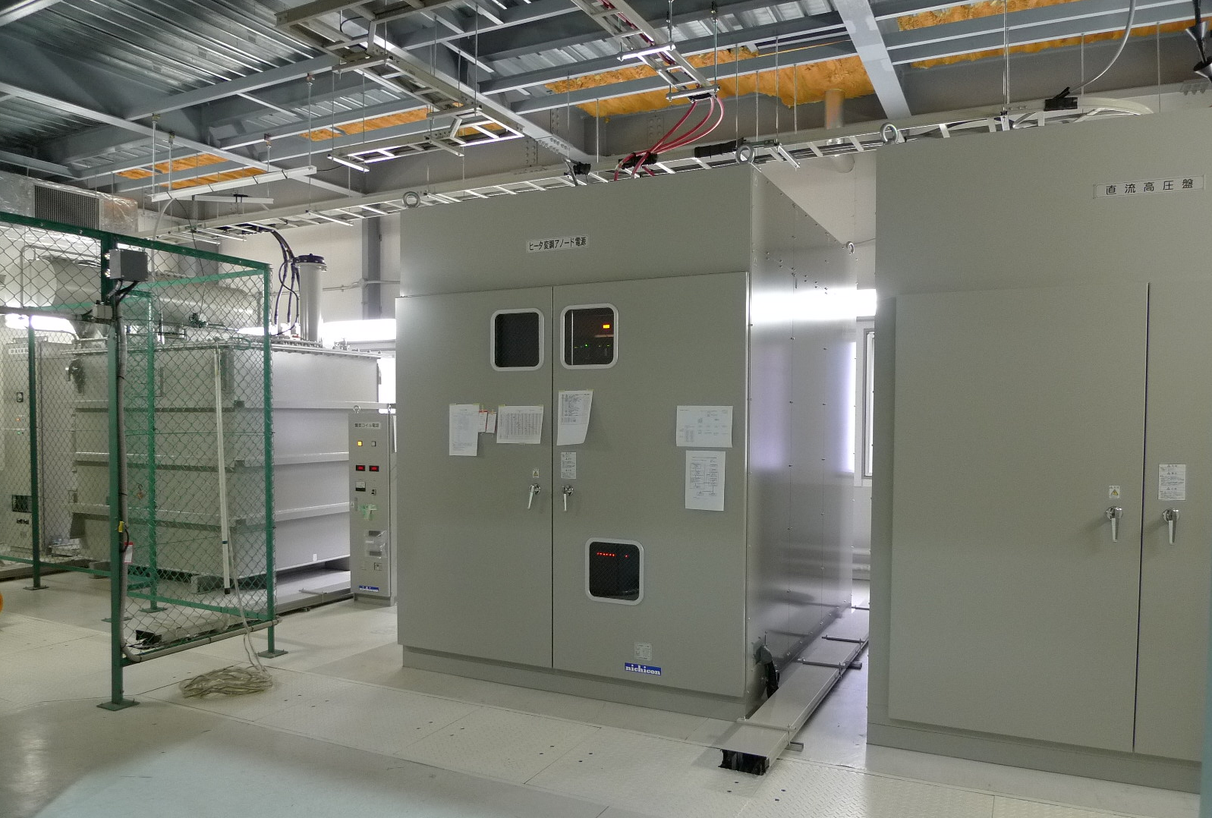
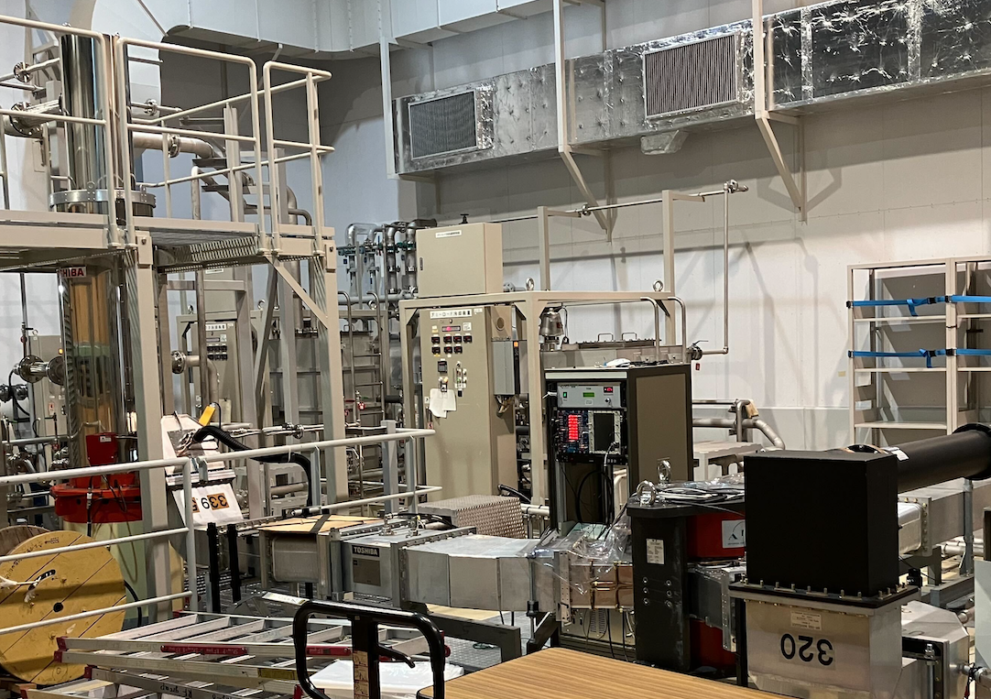
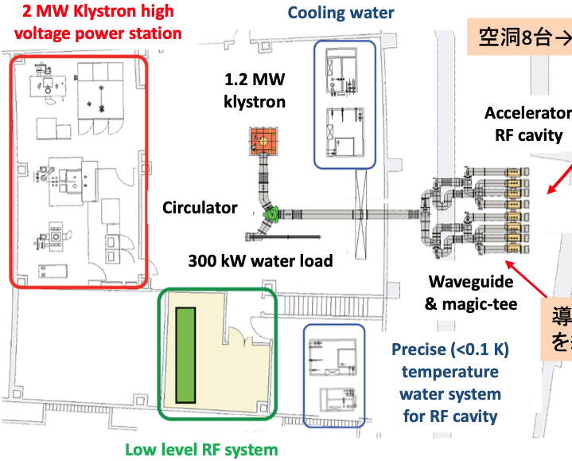
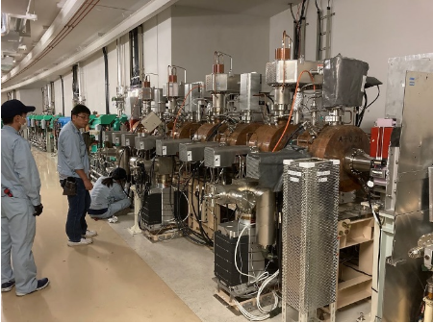
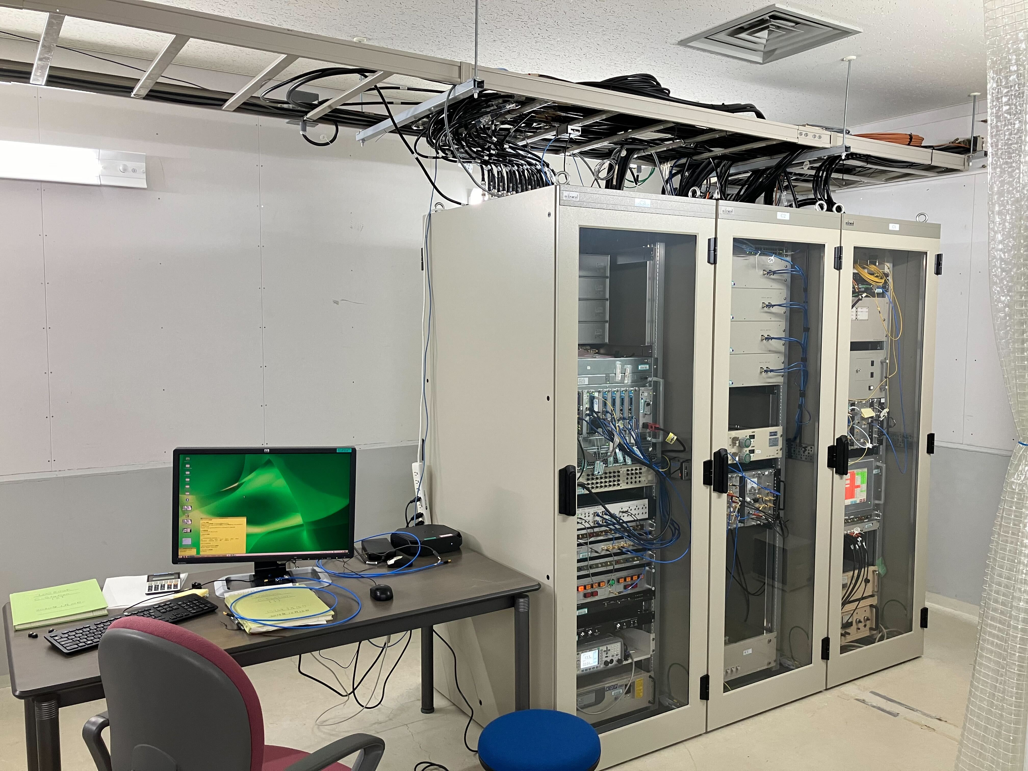
SPring-8 RF system
collector
>650 L/min
RF station:
0.5 MV x 8 bell-shaped cavities
= 4MV
4 MV x 4 RF stations = 16 MV
Use klystron
system for Collector
& dummy loads
Notes:
Each rf station has 8 bell shaped cavities and the accelerating voltage is 4 MV. Combining 4 stations, the accelerating voltage becomes 16 MV.
A 1.2 MW klystron is used to drive cavities. The rf power at usual user operation is about 700 kW.
The RF power is transmitted through circulator, magic-Ts, and fed to the cavities.
The temperature of the cavities are stabilized by a precise temperature-controlled water system.
The pickup signals are vector-summed at the LLRF module based on a MTCA.4 standard.

Slide 5
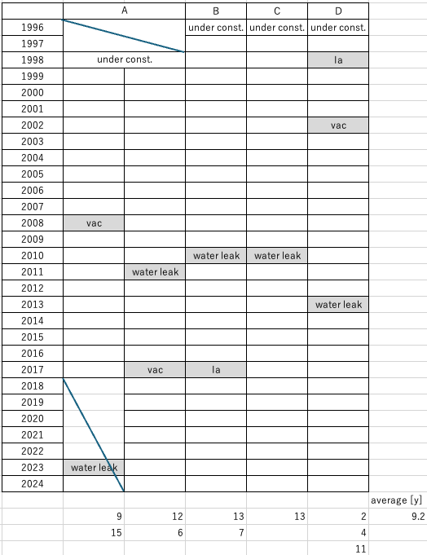
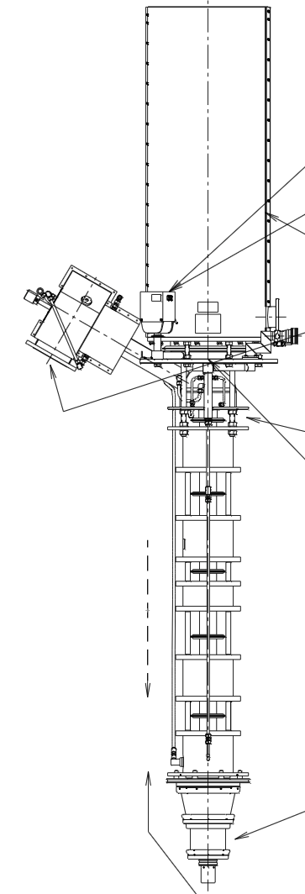
1.2 MW CW klystron fault history
4.3m
E3732 :
  Canon electron tubes & devices
  1.2 MW @ 508.58 MHz
RF/DC efficiency > 50%
  ex. 655kW / 80.2kV* 13.6A ~ 60%
During more than 27 years operation
9 klystrons were replaced
sources were
  water leakage from output coupler (5)
  bad vacuum of the tube (3)
  abnormal current at anode electrode (2)
1.2t
Notes:
This 1.2 MW klystron is provided from Canon electron tubes and devices.
The DC to RF efficiency is higher than 50 %.
Operation time of the tubes is over 27 yeas.
We experienced troubles such as water leakage from the output coupler, vacuum failure in the tube, abnormal current in anode electrode.
The averaged lifetime of the tube is over 9 year, which corresponds to 45k hours, which is relatively long lifetime.
The vacuum interlock threshold is set at 1E-4Pa

Slide 6
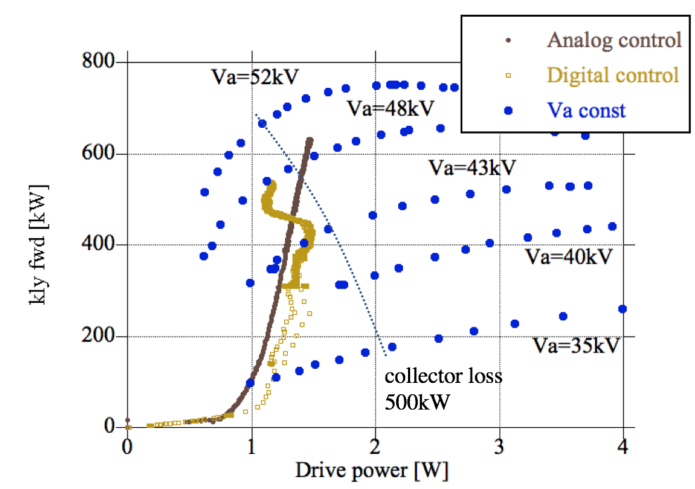
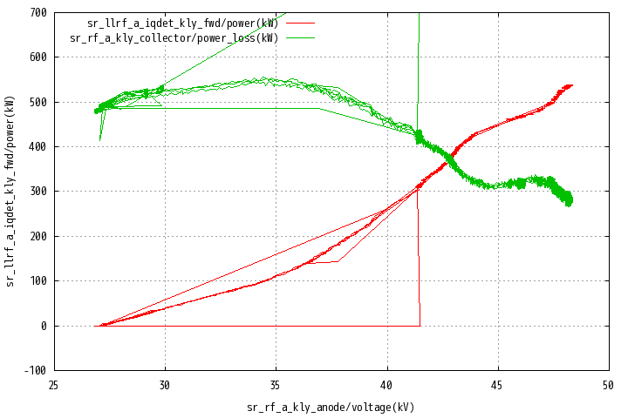
HV power supply for klystron
12 phase rectifier
RC smoothing circuit
Nominal cathode voltage : 80 kV
Anode voltage control according to a lookup table
  Va is determined by Pout
  Achieve high efficiency
Heater PS
collector loss
kly fwd , collector loss[kW]
Anode PS
AC6.6kV
Y
klystron
VCB
Δ
RF/(RF+Loss)
=520/(520+300)
~ 0.63
Δ
kly fwd
Anode voltage [kV]
Notes:
This figure shows a block diagram of a klystron HV power supply.
AC 6.6kV is stepped up by a transformer, rectified, smoothed by RC filter and fed to the cathode.
A cockloft type anode power supply is used.
This figure shows an input-output dependence at several anode voltages.
We use a lookup table to control the anode voltage according to the output power.
The DC to RF conversion efficiency under this operational condition is 0.63.

Slide 7
Contents
Status of Current SPring-8
Upgrade plan of SPring-8
Trouble in High Power RF during user operation
Notes:
next topic is upgrade plan of spring-8

Slide 8
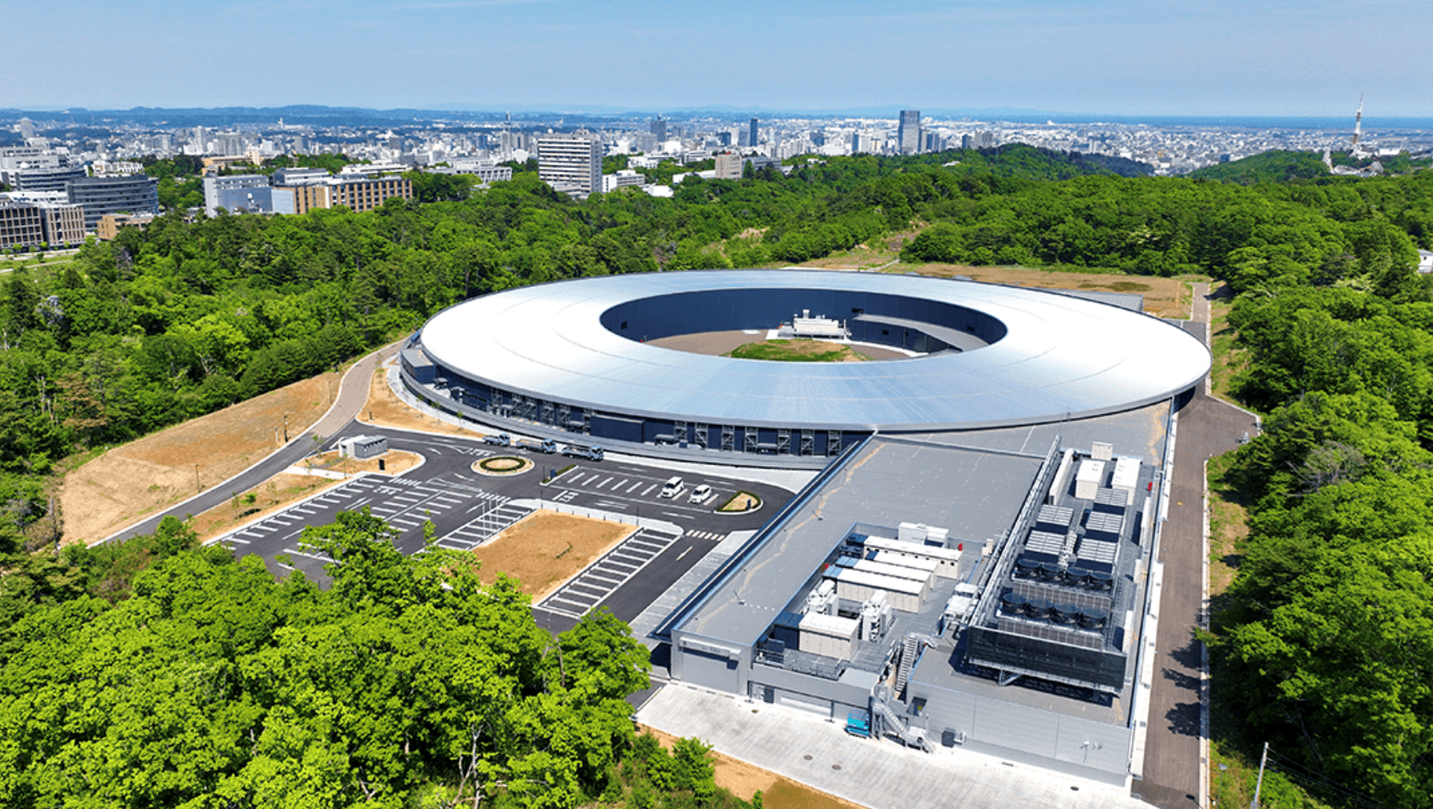
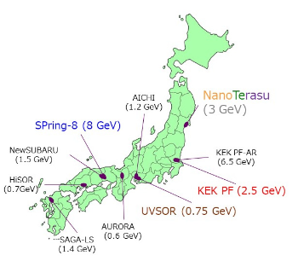
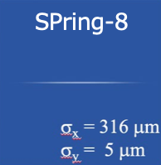
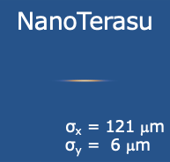
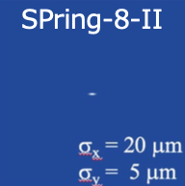
Upgrade plan of SPring-8 (SPring-8-II) and 3GeV project (NanoTerasu)
SPring-8 has been operated for > 27 years
*many devices nearly end of their lifespan
*difficult to procure spare modules
Reduction of power consumption is important
-> Upgrade program is in progress.
 | SPring-8 | NanoTerasu | SPring-8-II
Target | Hard X-ray | Soft X-ray | Hard X-ray
Emittance (nm.rad) | 2.4 | 1.1 | 0.05
Lattice | DBA | 4BA | 5BA
Energy (GeV) | 8 | 3 | 6
Stored Current (mA) | 100 | 400 | 200
Brilliance (ph/s/mm2/mrad2/0.1%b.w.) | 7x10²⁰ | 8x10²⁰ | 9x10²²
R&D for SPring-8-II
Back to SPring-8-II
New 3 GeV project
(FY2019 – 2023)
Parameter search for lattice
TM020 HOM dumped cavity
Rectangular ceramics RF window
New BPM system...
Dark time 1year in 2027
Start user time in 2029
starts user op. in 2024
with 200mA
Transfer
Feedback
Notes:
spring-8 has been operated for over 27 years. So many devices are nearing the end of their lifespan.
They may be due to capacity leakage of electrolytic capacitor, deterioration of motor bearing, clogged cooling pipes, and so on.
Also, it became difficult to procure spare modules.
Another important aspect is to reduce power consumption.
So, upgrade program of SPring-8 is in progress.
The emittance of the ring will be reduced from 2.4 nm rad to 50 pm rad at the new ring.
The lattice will be changed from double bend achromat to 5 bend achromat
The beam energy will be reduced from 8 GeV to 6 GeV
The current will be increased from 100 mA to 200 mA
We developed for example, parameter search procedure for the lattice, TM020 higher mode dumped cavity, rectangular ceramics window for the cavity, new beam position measurement system and so on.
Before applying the technologies to the SP8 upgrade ring, we were asked to help the construction of a new synchrotron radiation facility, nanoterasu in Tohoku region aiming to produce soft x-ray to users.
The beam energy is 3 GeV , the lattice is 4 bend achromat. This facility not only provide bright soft X-ray but will also support users during the dark time at the SP8 upgrade.
Construction of the new 3GeV ring in site started in 2019 and first beam was observed in 2023. User operation started in April this year. The beam current is 200 mA at present and will be increased to 400 mA near future.
Then the next step is to upgrade SPring-8.
Dark time is planned in 2027, and user operation will be started in 2029.

Slide 9
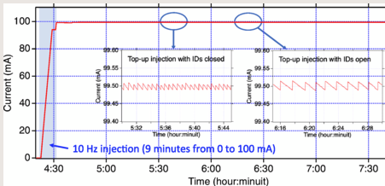
On-demand injection from SACLA to SR
The high-quality e-beam injection would be needed for SPring-8-II.
It is beneficial for reducing power consumption by shutting down the dedicated injector.
injection mode
*fill
*top-up : ~0.5min interval
depending on lifetime
SPring-8
8 GeV 100 mA
On demand
top-up injection
0.8 GeV SCSS+
Old 8 booster synchrotron
Dedicated injector complex
shut-down in 2021
Old 1 GeV linac
Switching
kicker
Compact dedicated linac
for independent operations
1 GeV linac
Pulse-by-pulse multi-energy
acceleration and switching
NewSUBARU
1-1.5 GeV SR
SACLA 8 GeV linac
[1] T. Hara et al., PRAB 24, 110702 (2021).
Notes:
The new low emittance ring requires also low emittance beam for injection.
The old dedicated injector can not satisfy the requirement.
We decided to inject the beam from the linac of SACLA, X-ray free electron laser facility.
It has a low emittance beam.
This injection scheme was applied prior to the construction of the new ring.
Because it is beneficial for reducing the power consumption by shutting down the old dedicated injector.
The maintenance cost is also reduced.
The challenge was a new timing synchronization system of two independent frequency source, SR bucket timing and FEL linac master trigger timing, without degrading the performance of XFEL operation.
We could overcome this problem and routinely used since 2020.
There are tow injection modes: fill-mode where accumulated current of the ring is increased from 0 mA to 100 mA. The linac is dedicated to the injection at this mode. The repetition is 10 Hz.
The opther is top-up mode where XFEL operation is carried out with on-demand injection. The injection ineterval depends on the lifetime of the ring and around 0.5 min. or several minutes.

Slide 10
RF Design Parameters
 | Present operation 100 mA 8 GeV |  | SP8II Typical operation 200 mA 6 GeV
RF frequency | 508.58 MHz |  | 508.764 MHz
Radiation loss | ~11.2 MeV/turn BM: 8.9 MeV ID: ~2.3 MeV |  | ~5.2 MeV/turn BM: 2.6 MeV DW: ~1.6 MeV (1.5Tx2) ID: ~1.0 MeV (0.6Tx34)
Total RF voltage | 16 MV |  | 7 MV
Number of cavities | 8x4 = 32 |  | 4x4 = 16
RF output power/station | ~680 kW |  | ~400 kW
Needed Voltage & Power are about half of current ring
# of cavities is halved
Notes:
This table shows RF parameters for the current ring and the upgraded ring. The upgraded ring requires approximately half the voltage and power of the current ring.
So, the number of the cavities is halved.

Slide 11
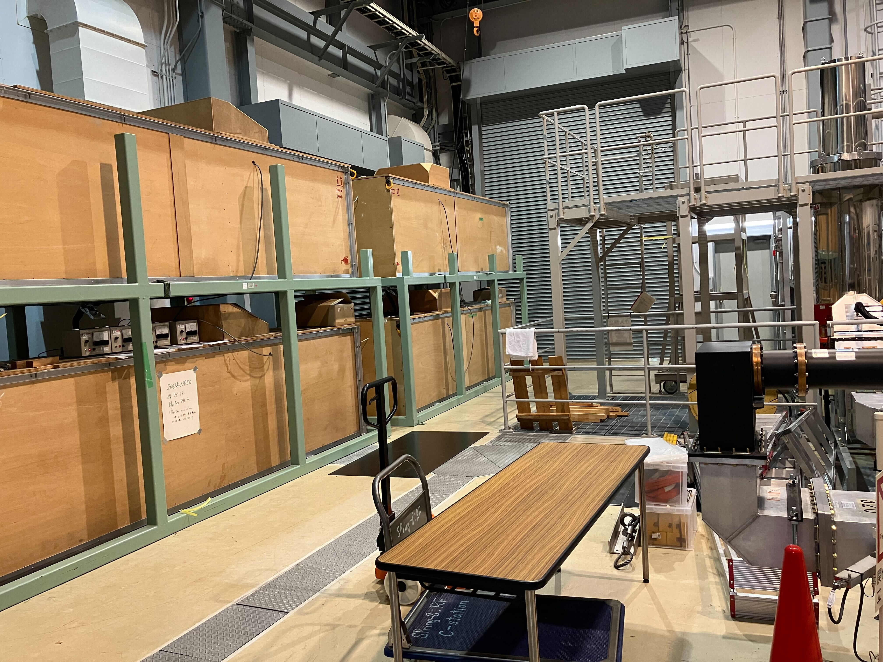
SPring-8-II Storage Ring RF System
Reduce construction cost
  RF frequency of new ring (+184 kHz) is within the bandwidth of current RF components
  Reuse existing RF components as much as possible
  -> klystron, HVPS, cavities, waveguides, LLRF,,,
Klystron
  power efficiency (RF/DC) > 50%
  lifetime > 90k hour ave.
  KEK and NanoTerasu also use this type of klystron
  E3732 can be purchased from Canon
  >4 spare klystrons in site
Klystron power supply: renewed in 2016 (C,D) and in 2017 (A,B)
LLRF : replaced in 2018 to MTCA.4 standard
Cavity
  bell-shaped cavity has basically low impedance to HOMs
  Counter measures to reduce impedance of TM011 under searching
Notes:
RF frequency of new ring (+184 kHz) is within the bandwidth of current RF components
to reduce the construction cost, we decided to reuse existing rf components as much as possible.
klystron has a rather high DC to RF efficiency, long lifetime, still available because SP8 and other facilities, KEK, nanoterasu use this type of klystron.
The high voltage power supplies were renewed in 2016 and 2017, so it can be reused
The LLRF system was renewed in 2018,
The bell-shaped cavity has basically low impedance to higher order modes.
The damping time of the new ring will be longer than that of current ring because the beam energy is reduced and stored current is increased.
The most harmful mode is TM011. We are searching countermeasure to this mode and already have some ideas.

Slide 12
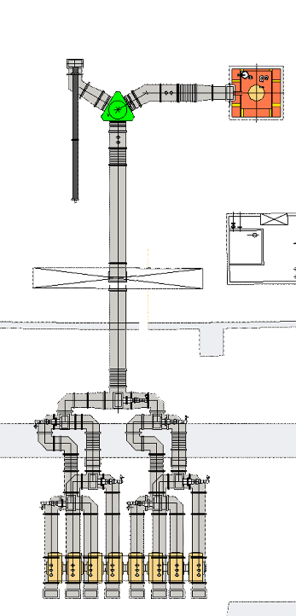
SPring-8-II Storage Ring RF System Diagram
Apr. 21, 2024, T. Inagaki
480 kW (200 mA)
220 kW (no beam)
509 MHz
1.2 MW
Klystron
6.6 kV
Max. 2 MVA
300 kW
Dummy load
DL
Max. 90 kV, 20 A
Klystron HV
power supply
Circulator
Master RF
509 MHz
Vector modulation
WR-1800
waveguide
Driver amp.
~10 W
DAC
Shield
ADC
Klystron FB
WR-1500
waveguide
MT
ADC
Magic Tee
Cavity FB
DL
ADC
MT
Ethernet
Phase shifter
MT
DL
Vector sum
Set value
DL
Low level RF system
Micro-TCA.4
Shield
Photon
absorber
117 kW (200 mA)
54 kW (no beam)
Interlock
RF OFF
EtherCAT
Tuner control
e⁻ beam
6 GeV
200 mA
500 kV
Bell-shaped
RF cavity
NEG+SIP
Frequency tuner
Notes:
This figure shows a block diagram of the RF connection at the upgraded ring. The number of the cavities will be halved.
New transition vacuum chambers, photon absorbers will be introduced.
Some waveguides will be renewed. The cooling piping will be renewed.

Slide 13
Contents
Status of Current SPring-8
Upgrade plan of SPring-8
Trouble in High Power RF components during user operation
Notes:
next topic is trouble in high power rf components we encountered

Slide 14
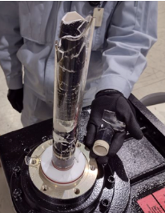
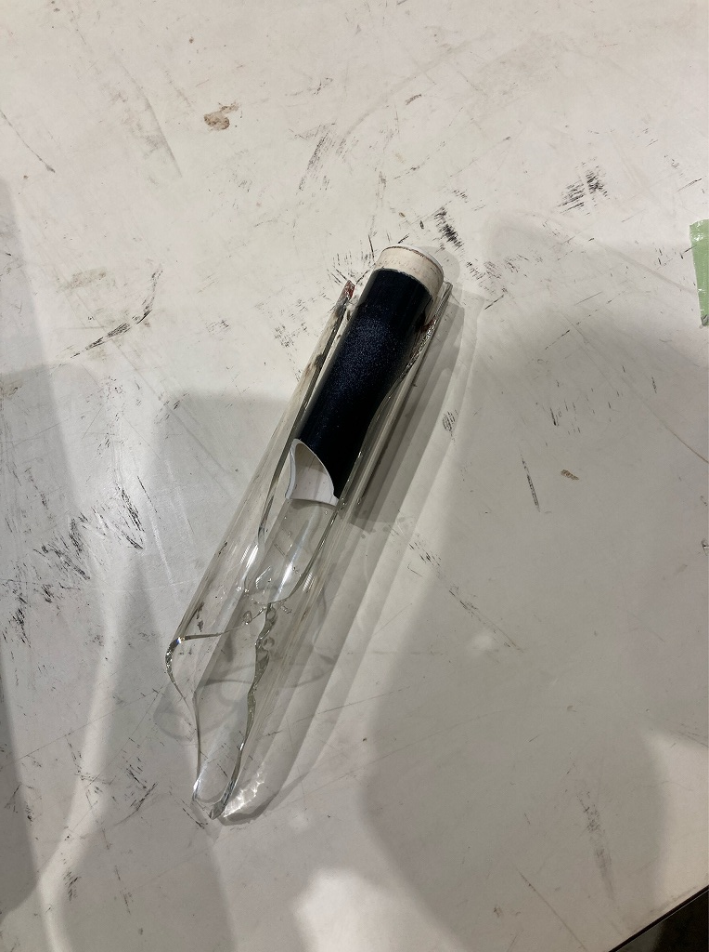
Trouble in High Power RF components
50kW dummy loads connected to magic-T were broken in Feb. 2024
Trigger of this failure was mis operation in timing-LLRF system
DL5
cav1
DL3
cav2
cav3
circ
DL6
DL2
cav4
DL7
kly
DL1
DL4
DL8
cav8
Dummy load of DL3 at B station
Notes:
50kW dummy loads connected to magic-T were broken in Feb. 2024.
Trigger of this failure was mis operation in timing-LLRF system.

Slide 15
Timing LLRF system of SPring-8
RF reference signal is generated from SMA100B signal generator
RF station
OE
IQ mod
SW
kly
EO
Local
Osc.
cavity pickup
Signal
generator
DAC
ADC
ADC
ADC
to SACLA
for beam inj.
ADC
clock
FPGA
(r,p) calc.
feedback cont.
cavity backward
ADC
ADC
ADC
ADC
clock
FPGA
(r,p) calc.
BWD interlock
Notes:
A block diagram of the timing and LLRF system is shown here.
The reference signal is transmitted to the RF stations through optical links.
The signal is IQ modulated and fed to the klystron. The amplified RF signal is fed into the cavities.
The signal is connected to a local oscillator which generates clock signal for the digitizer board.
This board contains DAC and ADC connected to an FPGA.
If the supply of the clock signal is stopped, there is a possibility of malfunction of FPGA process.

Slide 16
Trouble in signal generator
Signal generator had stopped outputting
Replace with spare
  Wrong frequency (nominal-40 kHz) was set !
OE
IQ mod
SW
kly
508.58MHz
X
EO
Local
Osc.
cavity pickup
Signal
generator
DAC
ADC
ADC
ADC
to SACLA
for beam inj.
ADC
clock
FPGA
(r,p) calc.
feedback cont.
replace with spare
ADC
ADC
ADC
ADC
clock
FPGA
(r,p) calc.
BWD interlock
Notes:
On 16th February, a stored beam was aborted. We found the signal generator used as a master oscillator had stopped outputting.
So, we replaced it with a spare unit.
But the wrong frequency was set on the unit.

Slide 17
Restart RF operation
Reboot MTCA.4 modules
  Reset FPGA, because clock fed to FPGA was stopped
Restart RF operation
Restart beam injection
  beam was not stored
  Wrong frequency set was found
OE
IQ mod
SW
kly
508.58MHz-40kHz
EO
Local
Osc.
cavity pickup
Signal
generator
DAC
ADC
ADC
ADC
to SACLA
for beam inj.
ADC
clock
FPGA
(r,p) calc.
feedback cont.
ADC
ADC
ADC
ADC
clock
FPGA
(r,p) calc.
BWD interlock
Notes:
After replacement of the signal generator, we rebooted the mtca modules. It was because the clock signal fed to the FPGA was stopped once.
We restarted the RF feeding to the cavities.
Then we started beam injection. But the beam was not stored. We found mis-setting of the frequency.

Slide 18
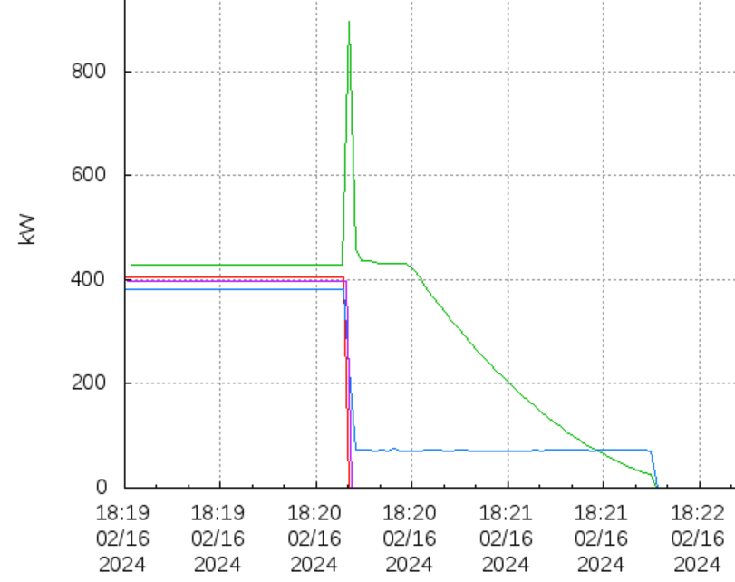
Frequency change during high power operation
Usually, frequency change is done with 10 Hz step to aimed value. It is to keep phase continuity.
40 kHz frequency sift was sent unintentionally
Cavity became detuned -> large reflection from cavity
Interlock worked at A and D stations to protect RF components
It did not work at B and C stations
  FPGA might not work properly because of sudden frequency jump
  High power operation with large reflection was continued for several tens' seconds.
+40 kHz frequency jump
B station
OE
IQ mod
SW
kly
EO
Local
Osc.
cavity pickup
Signal
generator
DAC
ADC
ADC
ADC
to SACLA
for beam inj.
ADC
C station
clock
FPGA
(r,p) calc.
feedback cont.
A, D station
508.58MHz-40kHz
ADC
ADC
ADC
ADC
508.58MHz+ 0kHz
clock
FPGA
(r,p) calc.
BWD interlock
Data of klystron power meter
Notes:
Usually, frequency change is done with 10 Hz step to aimed value.
40 kHz frequency sift was sent unintentionally.
The cavity was not tuned status for new frequency. This resulted in large reflections from the cavities.
Interlock system operated normally at A and D stations.
But it did not work at B and C stations.

Slide 19
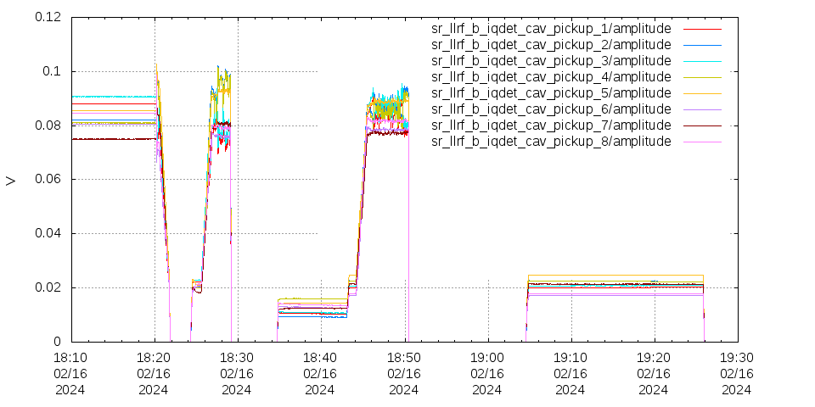
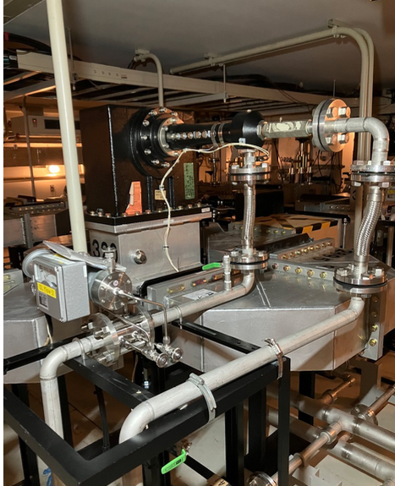
Water leak from dummy loads at B station
We didn’t aware of the trouble at dummy load at first.
Rebooted MTCA modules for A,B,C,D stations and restarted RF operation.
The amplitude of cavity pickup at B was unstable after a few minutes' operation at 4 MV.
Interlock of high temperature at dummy load observed -> stopped RF and checked. found water leak!
+40 kHz frequency jump
[MV] /0.63
Notes:
We didn’t aware of the trouble at dummy load at first.
We rebooted MTCA modules for A,B,C,D stations and restarted operation.
The amplitude of cavity pickup at B was unstable after a few minutes' operation at 4 MV.
Interlock of high temperature at dummy load occurred. We stopped RF operation and check the situation. We found water leak from dummy load!

Slide 20
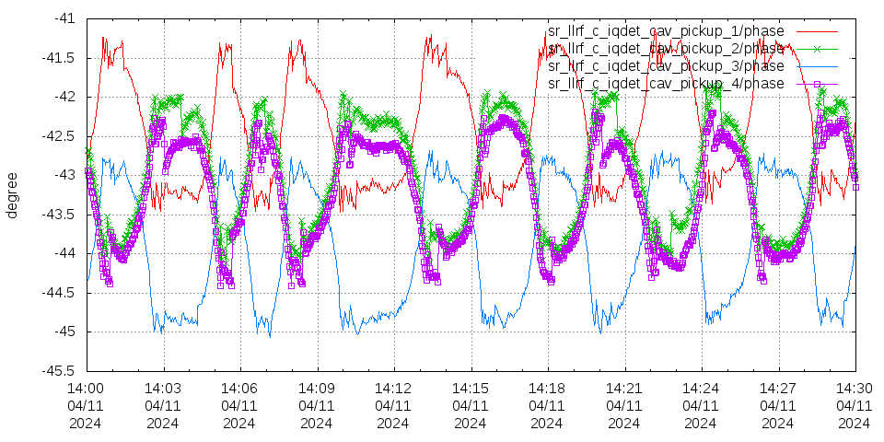
Some parameters at C station
Variation of a few degree in cavity phase was observed. (We did not aware until Apr.)
Phase of cav 1 and 3 (2 and 4) were changed in-phase.
Phase of each pair was changed to antiphase.
<- These phenomena occurred due to damaged dummy load attached to magic-T
1 degree
3 minutes
cavity 1 and 3
cavity 2 and 4
dummy load was replaced
with a spare at shutdown period
VSWR of damaged load was 5
(S11=-3.3 dB)
cavity phase
Notes:
Variationof a few degree in cavity pickup phase was observed. We did not aware until Apr.
Phase of cav 1 and 3 (2 and 4) were changed in-phase.
Phase of each pair were changed antiphase.
These phenomena was caused by broken dummy load attached to magic-T.
The dummy load was replaced with spare at shutdown period.
The removed load had VSWR of 5 (S11=-3.3 dB).

Slide 21

lesson learned from this trouble
You must turn off the high power to change important LLRF parameters.

Slide 22
Summary
SPring-8 has been stably operated since 1997
  Operation time > 5200 hr/year
  Mean Time Between Failure > 200 hr
  availability = achieved user time / planned user time > 99%
Upgrade program is in progress
  3GeV soft X-ray facility was newly built using SP8II technologies
    started its user operation in Apr. 2024
  SP8 will be renewed in 2027 and start user operation in 2029
  Reuse existing RF components as much as possible to reduce cost
50 kW dummy loads were broken
  Due to large reflected power from cavities at frequency jump of master oscillator
  Be careful not to change important LLRF parameters with High Power ON

