Slide 2
Status and operational readiness of the ESS RF Systems
PRESENTED BY Morten Jensen on behalf of the RF Group

Slide 3
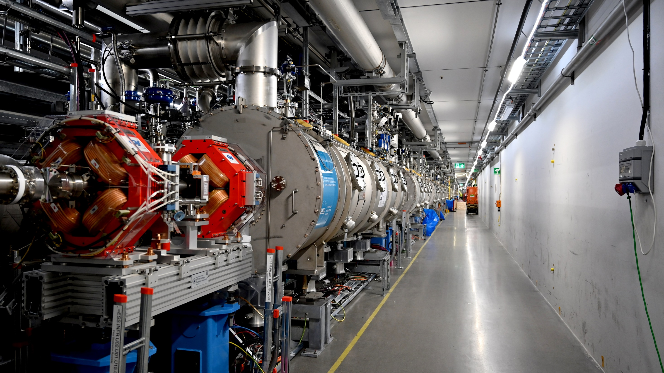

We will miss you Mats
Mats Lindroos passed away in May, after a long time of illness.
This fills us with deep sadness.
Mats was among the first to join the ESS initiative in 2009, bringing his expertise in accelerators together with an abiding passion for science to the service of the organisation and the many colleagues that he has led and worked with over the last 15 years.
Mats was relentlessly working for the ESS, a job that he embraced with his mind and his heart.
We owe him a lot and in particular to realise his dream.

Slide 4
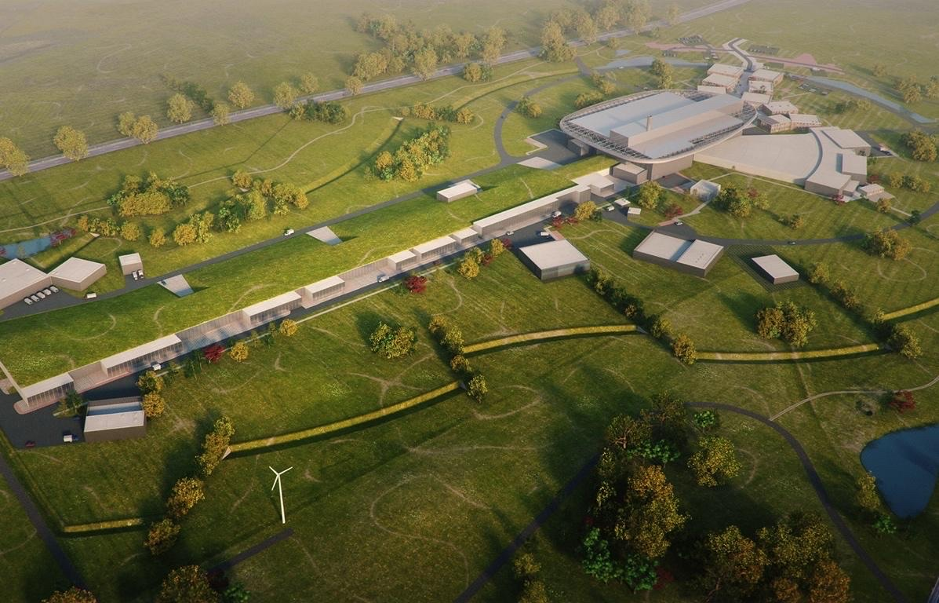
Content
ESS and RF Overview
Operational Experience
    Window Conditioning
    Warm Coupler Conditioning
    HP issues on TS2
    Update on new test stands

Slide 5
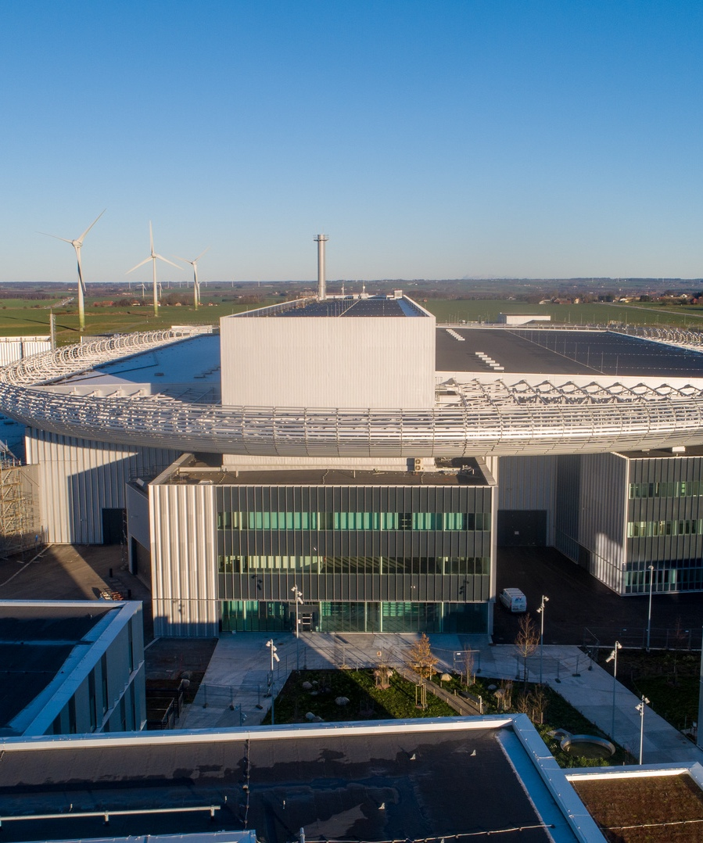
ESS and RF Overview

Slide 6
Accelerator Overview
 | RF Systems | High Power Technology | Peak RF Output Power | Average Beam power
RFQ | 1 | Klystrons | 3 MW
MEBT | 3 | SSPA | 30 kW
DTL | 5 | Klystrons | 3 MW
Spoke | 26 | Tetrodes | 400 kW
MB | 36 | Klystrons | 1.5 MW
HB (p1) | 20 | Klystrons | 1.5 MW | 2 MW
HB (p2) | 24 (later) | Klystrons | 1.5 MW | 3 MW*
HB (p3) | 40 (later) | Klystrons | 1.5 MW | 5 MW*
Key parameters:
Average Beam Power: 5 MW
Peak Beam Power: 125 MW
Beam pulse width: 2.86 ms
Beam energy: 2 GeV
Final Beam current: 62.5 mA peak
Repetition rate: 14 Hz
* Not yet funded
30 kW Solid State Amplifiers
Early Beam commissioning
1.5 MW Klystrons
Target
RFQ
HBL
6
ISrc
LEBT
MEBT
DTL
SPK
MBL
HEBT
Dump
2.4 m
4.6 m
3.8 m
39 m
56 m
77 m
179 m
75 keV
90 MeV
216 MeV
3.6 MeV
571 MeV
3 MW Klystrons
200 kW Tetrodes
2024-09-08
User mode (2 MW)
352 MHz
704 MHz

Slide 7
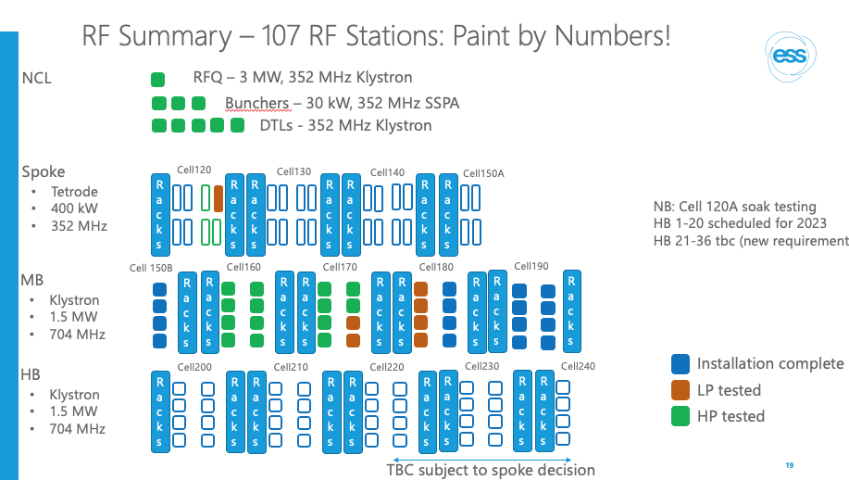
CWRF 2022
As reported previously:
NCL done
Spoke just starting
Approx 1/3rd MB done
HB not started

Slide 8
G02 – Status of RF Systems Aug 2024
Ready for Beam on Target (RBOT) Baseline
System used for window testing
#
Installation on-going
CELL 100/110
CELL 120
CELL 130
CELL 140
CELL 150A
RACKS
RACKS
B1
B2
B3
RACKS
RACKS
020-s1
010-s1
040-s1
030-s1
RACKS
RACKS
060-s1
050-s1
080-s1
070-s1
RACKS
RACKS
100-s1
090-s1
120-s1
110-s1
RACKS
RACKS
130-s1
RACKS
#
Installation complete ready for test
NCG + SPK
CPI klystron testing
352.21 MHz
#
Low Power Tested
K1
K2
K3
K4
K5
K6
020-s2
010-s2
040-s2
030-s2
060-s2
050-s2
080-s2
070-s2
100-s2
090-s2
120-s2
110-s2
130-s2
#
High Power Tested
M1
M2
M3
#
Special test
K1
K2
Cell 150 – MBL-010
MBL-020 Cell 160 – MBL-030
MBL-040 Cell 170 – MBL-050
MBL-060 Cell 180 – MBL-070
MBL-080 Cell 190 – MBL-090
TS2
4
RACKS
RACKS
1
4
RACKS
RACKS
1
4
RACKS
RACKS
1
4
RACKS
RACKS
1
4
RACKS
M2
1
4
1
4
1
4
1
4
1
MB
704.42 MHz
3
2
3
2
3
2
3
2
3
Thales klystron testing
2
3
2
3
2
3
2
3
2
M1
M2
M3
M4
M5
M6
M7
M8
M9
Canon klystron testing
NCL: Klystron@3 MW
Bunchers: SSPA@30 kW
SPK: Tetrodes@400 kW
MB: Klystron@1.5 MW
HB: Klystron@1.5 MW
HBL-010 Cell 200 – HBL-020
HBL-030 Cell 210 – HBL-040
HBL-050 Cell 220 – HBL-060
HBL-070 Cell 230 – HBL-080
HBL-090 Cell 240 – HBL-100
HBL-110 Cell 250
RACKS
1
4
RACKS
RACKS
1
4
RACKS
RACKS
1
4
RACKS
RACKS
1
4
RACKS
RACKS
1
4
RACKS
RACKS
1
RACKS
4
1
4
1
4
1
4
1
4
1
4
HB
704.42 MHz
2
3
2
3
2
3
2
3
2
3
2
3
2
3
2
3
2
3
2
3
2
3
M1
M2
M3
M4
M5
M6
M7
M8
M9
M10
M11
2024 2 MW Capable
Post BOT Scope 3 MW
ESS-4726471

Slide 9
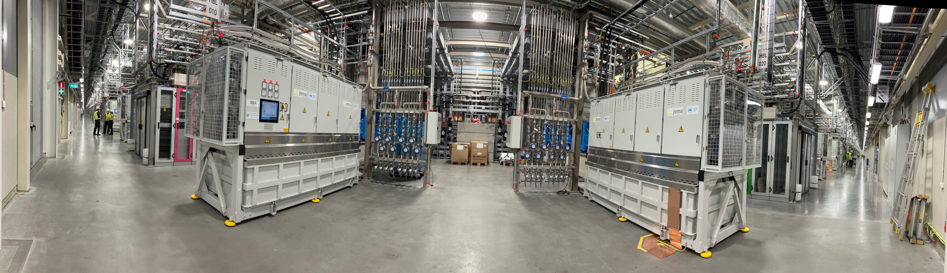
Total of 91 High power RF Systems, MO, and PRL incl all controls, interlock, aux and LLRF. Approximately 245 racks, > 21000 cables
180 degree view of Gallery

Slide 10
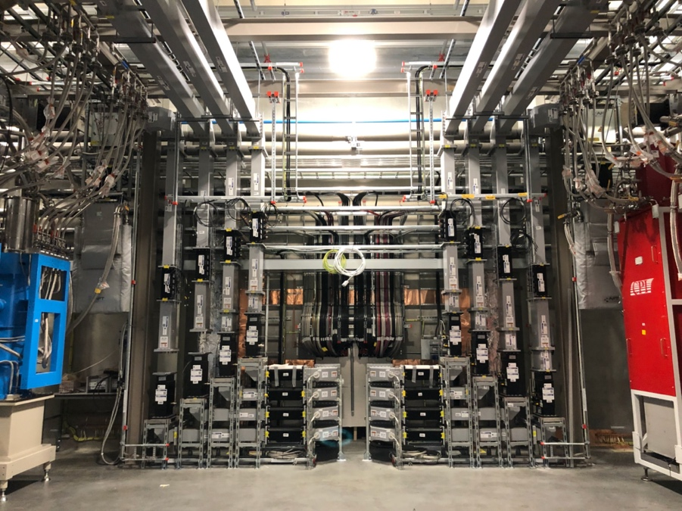
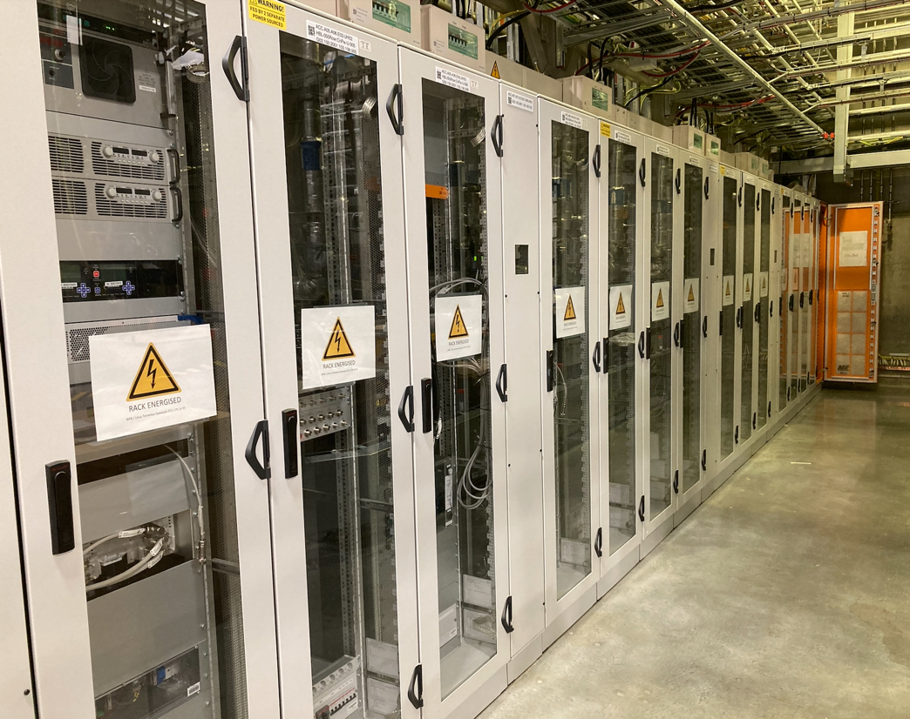
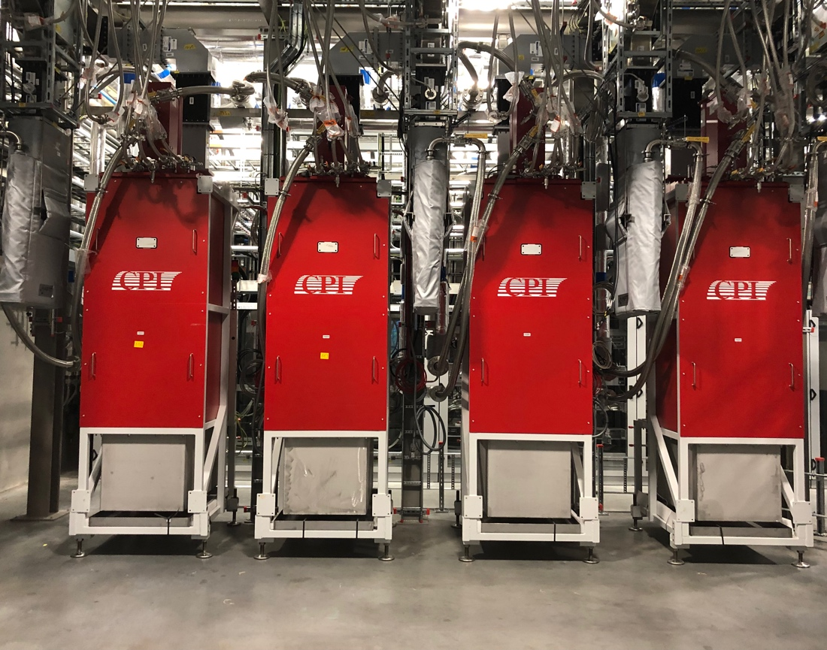
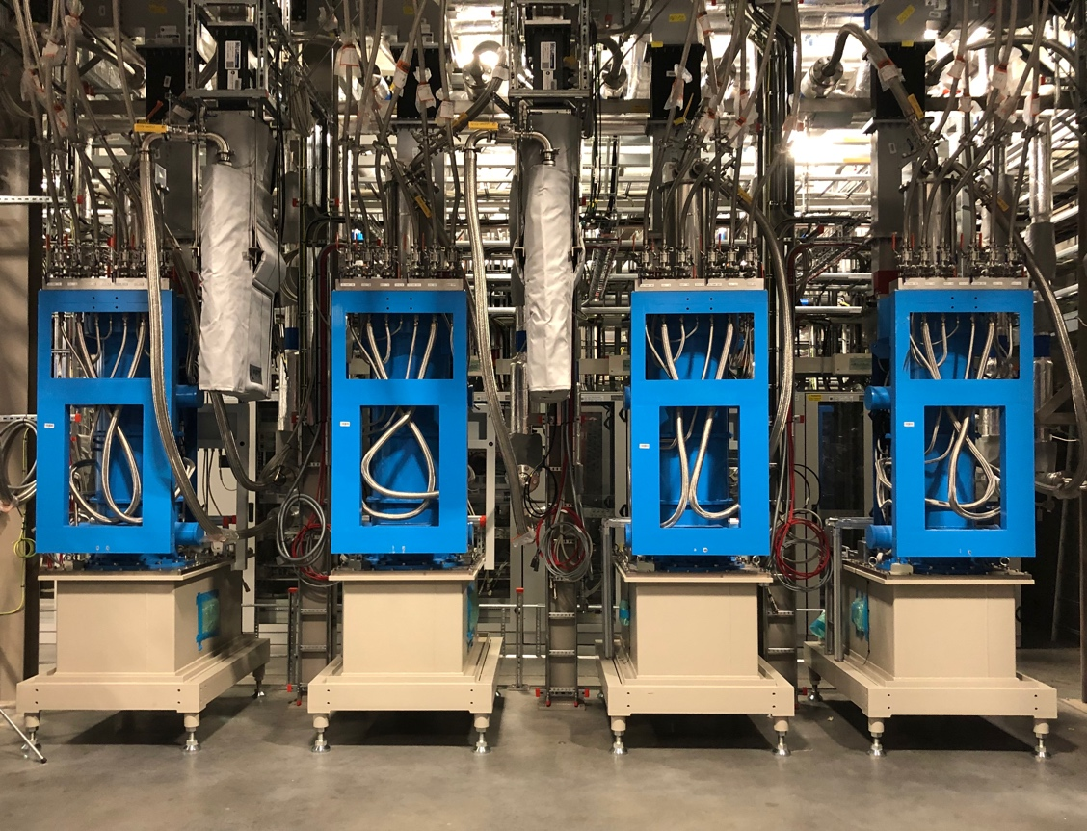
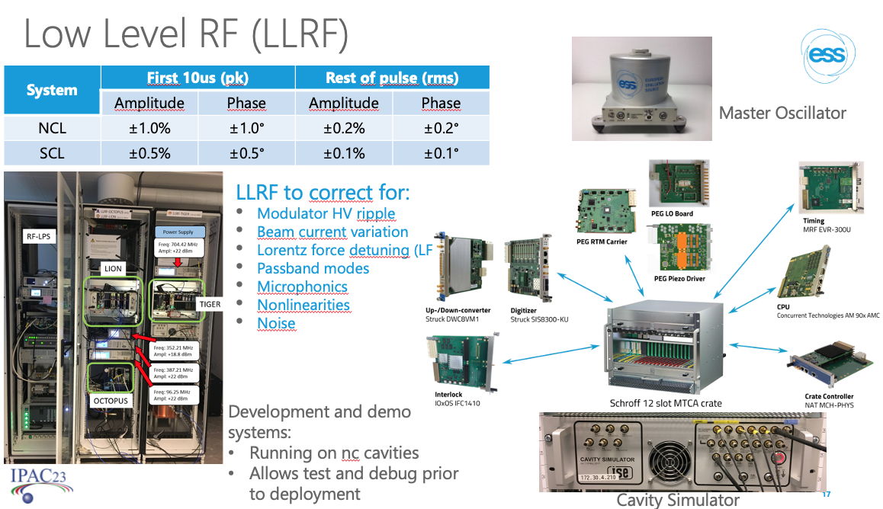
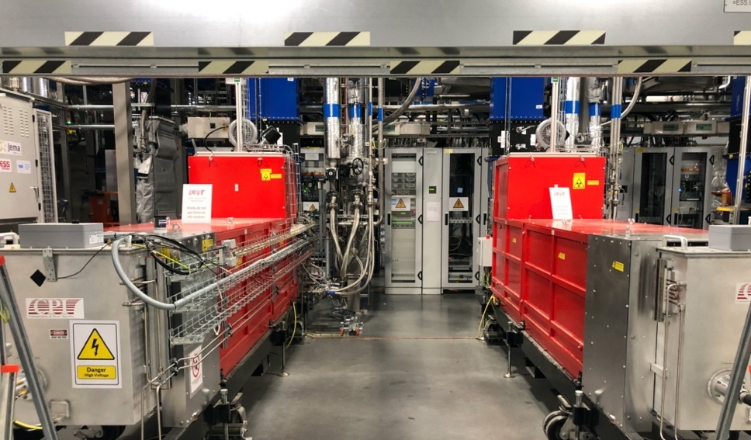
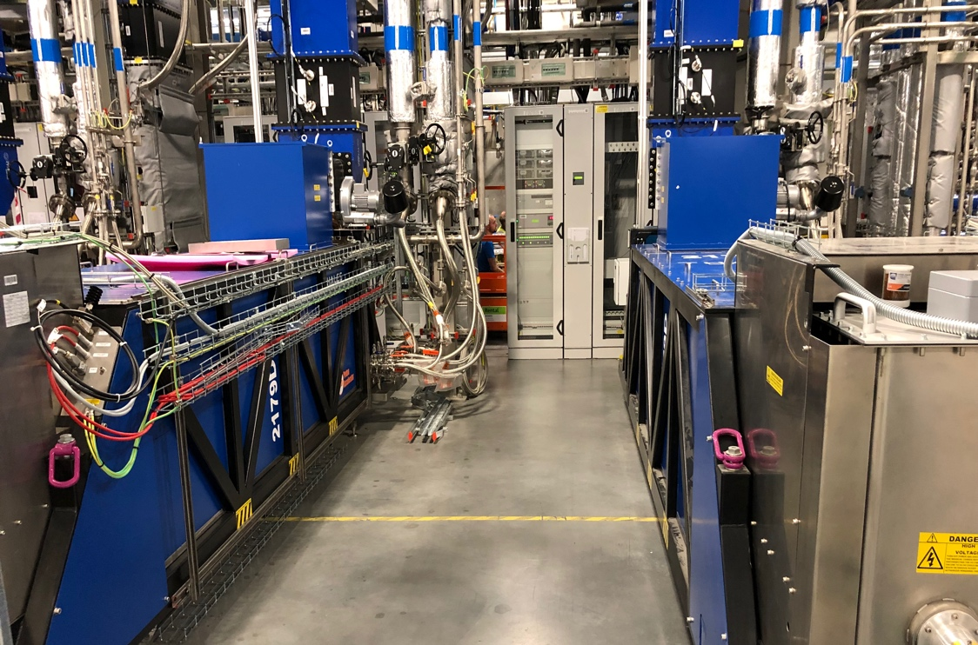
Huge Installation largely complete and tested
MB Klystrons
MB/HB Klystrons
MB/HB Klystrons
RFQ and DTL klystrons

Slide 11
Commissioning
Phase 1: 2 MWavg beam power on the target
To date we have run beam up to DLT 4
Next
Beam-on-Dump Feb 2025
Beam on target Autumn 2025
User Operation January 2028

Slide 12
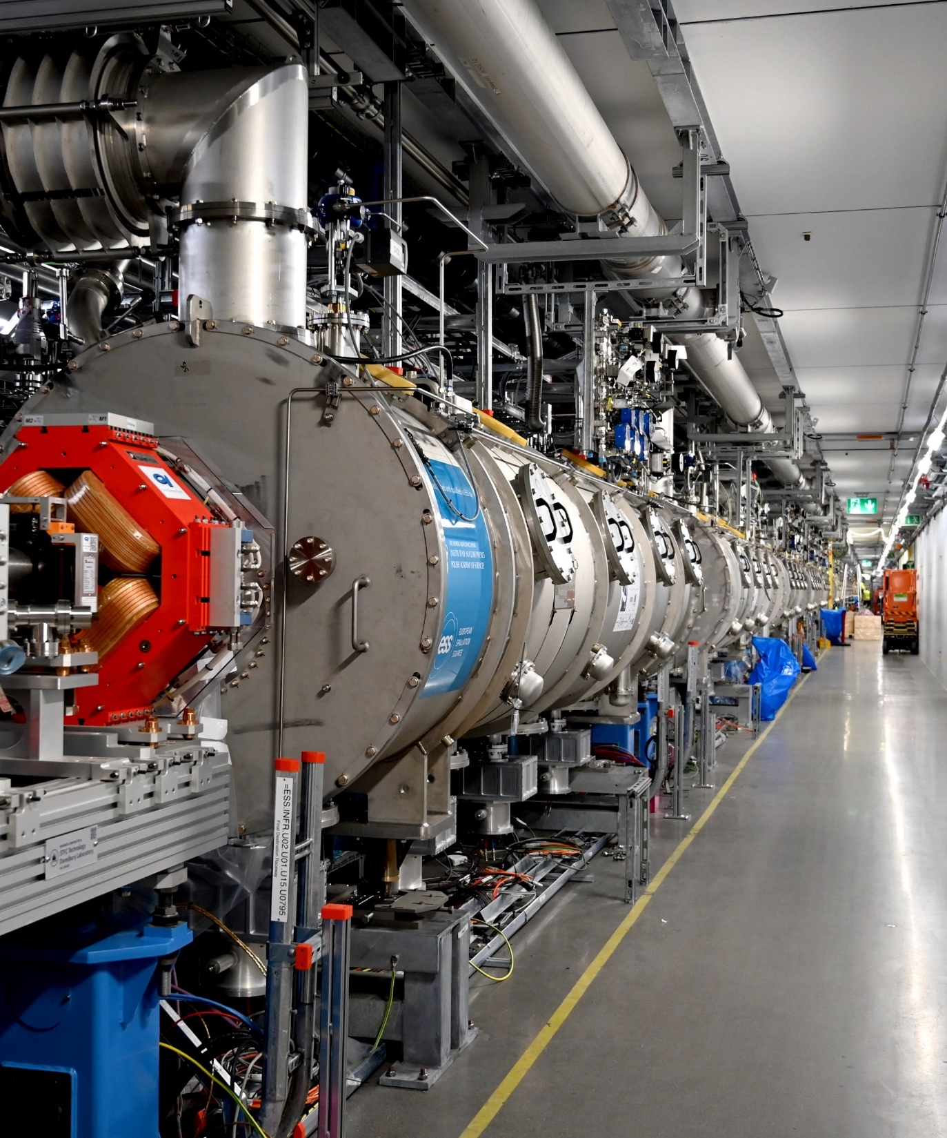
Operational Experience

Slide 13
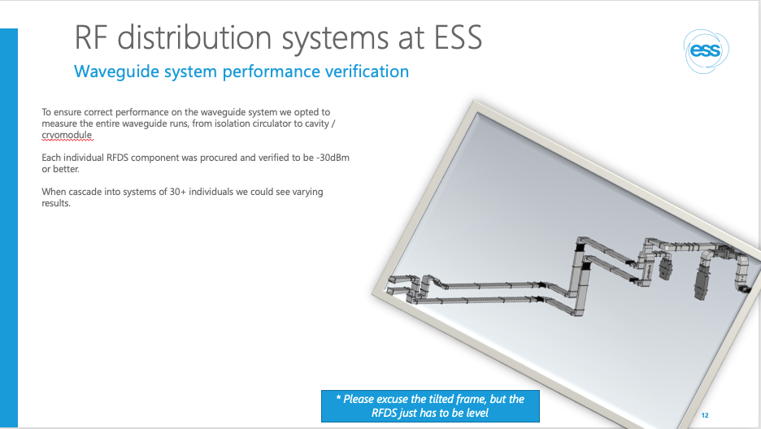
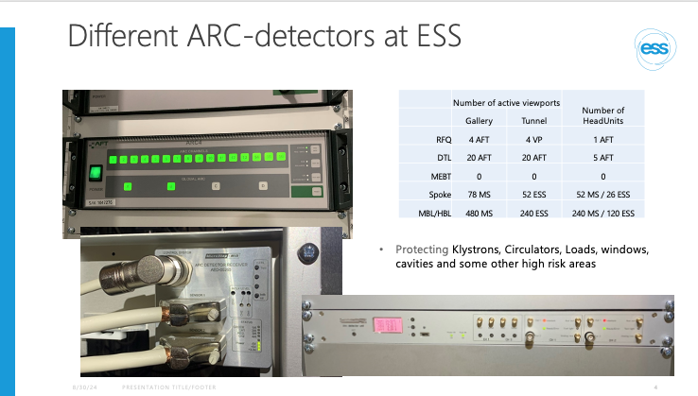
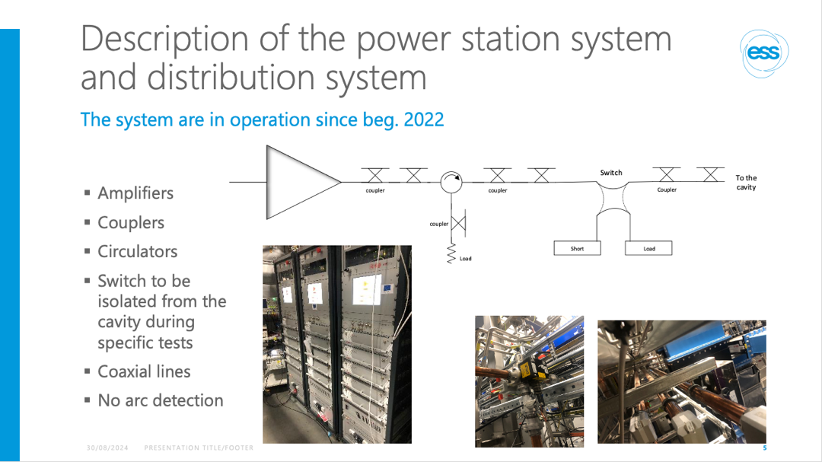
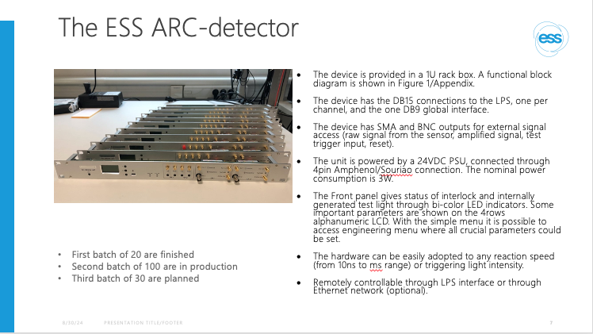
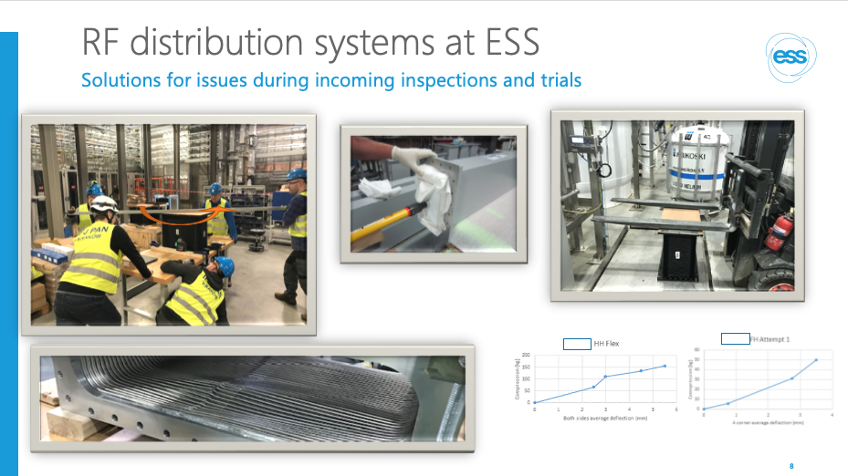
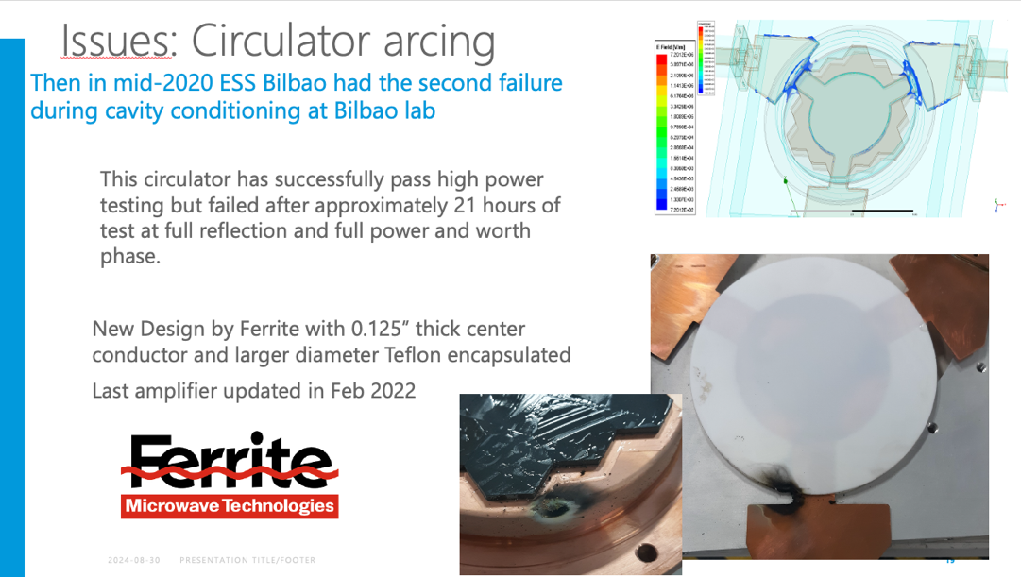
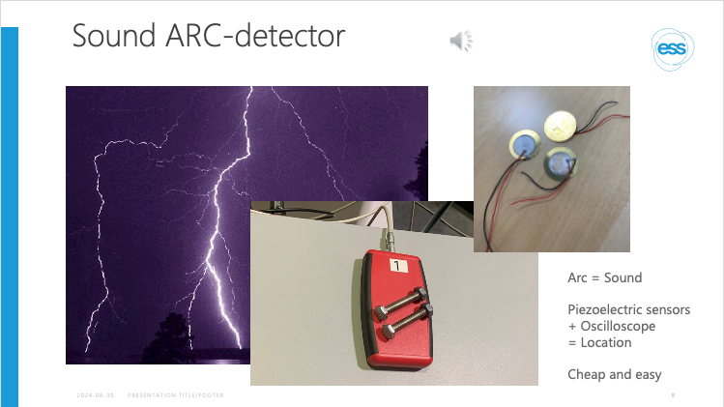
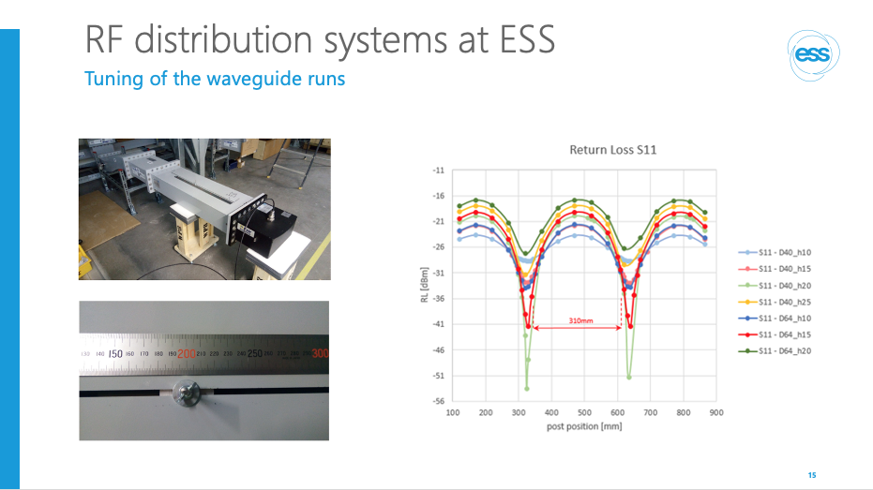
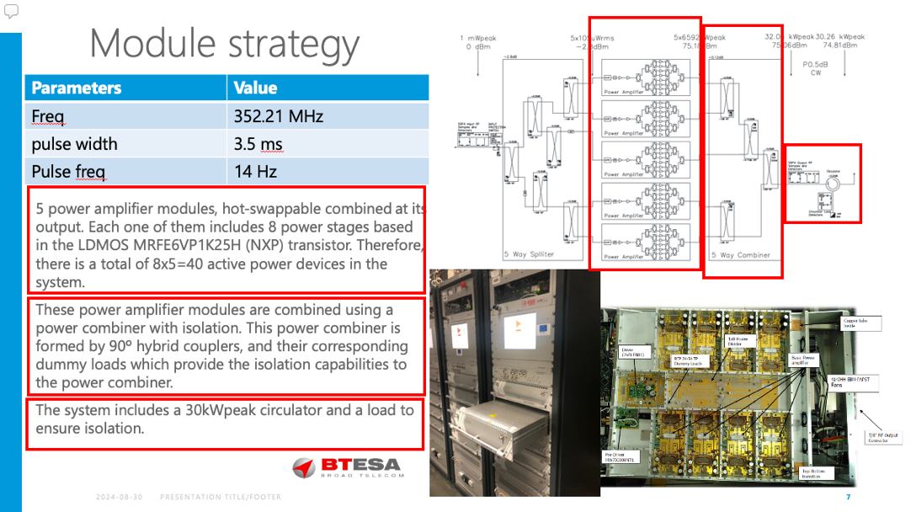
CWRF 2022
Please refer to the specific talks in 2022 for:
ESS arc-detector systems, development and experience
Tomas Olsson
RF distribution systems at ESS
Walther Borg
MEBT Installation, test, performances and operation at ESS
Bruno Lagoguez

Slide 14
Other ESS talks at CWRF 2024
Talk on High Power Loads: Walther Borg
Talk on high power klystron testing: Patrick Krämer
Talk on the 400 kW SSPA development: Dragos Dancila

Slide 15
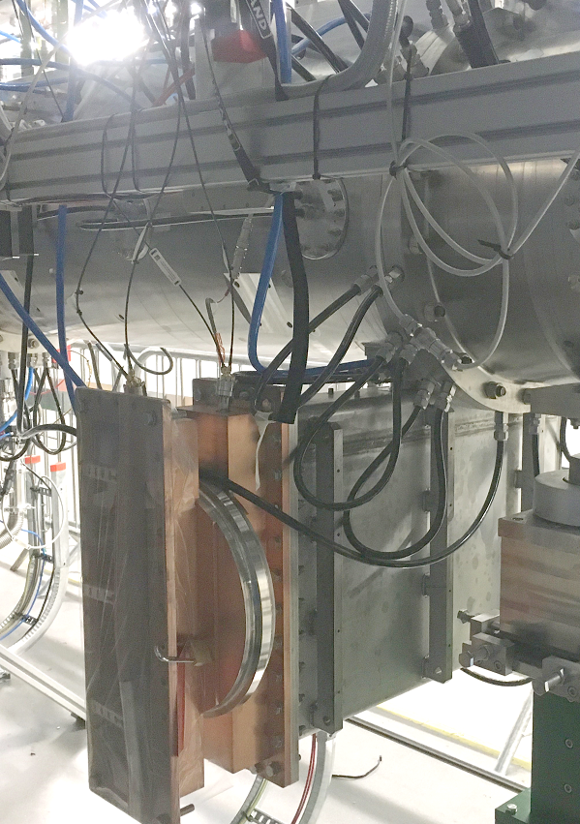
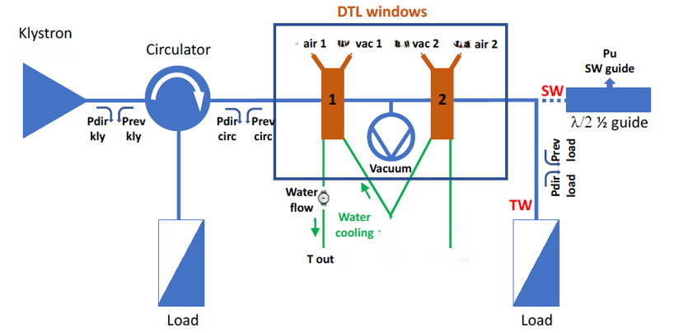
Window Conditioning
Windows for DTLs delivered by INFN to warm linac group.
Early operation of DTL2 and 4 showed issues with arcing and MP.
Inspection shows melting of the o-ring, multipacting and relatively high pressure.
Window test schematic
Window mounted below DTL Tank

Slide 16
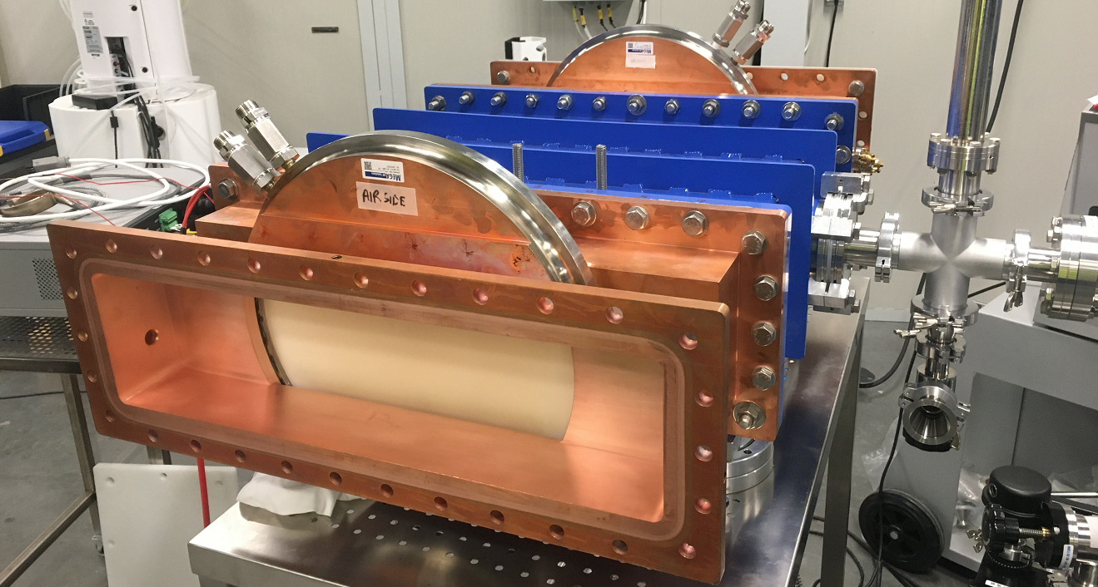
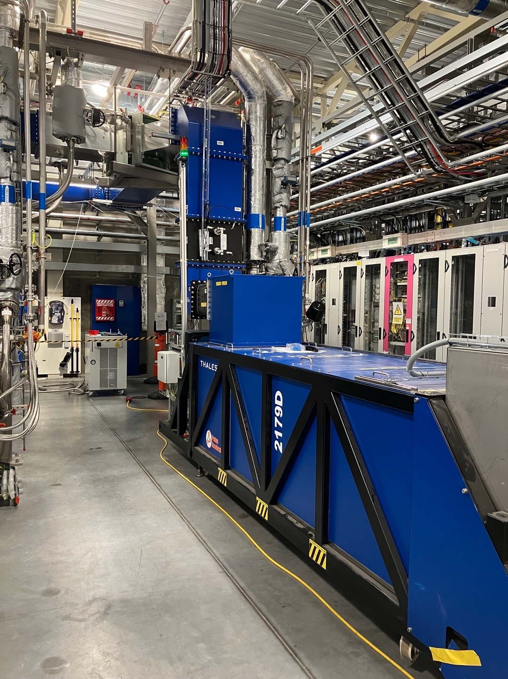
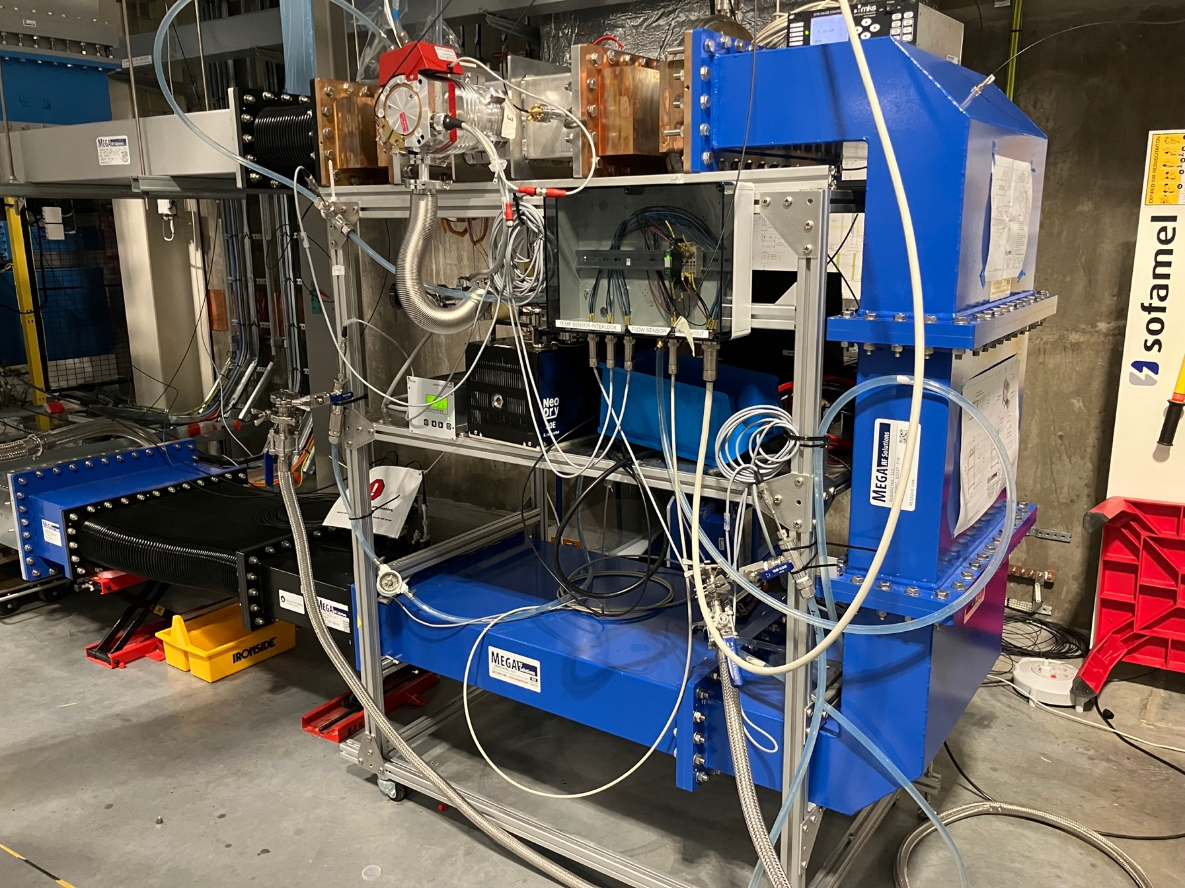
Window Conditioning
RF system for DTL 5 was reconfigured and a test stand was constructed
Back-to-back window assembly
DTL5 3 MW RF System

Slide 17
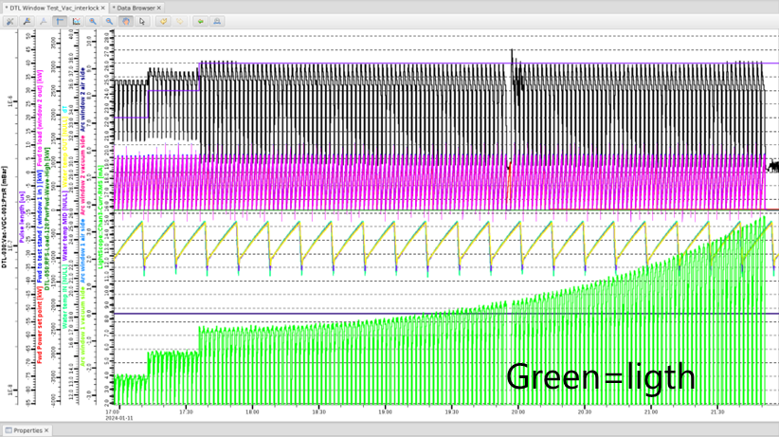
High-power tests @ ESS -1st phase
S/N 2056606 (report just one window test as example)
Large outgassing below 500 kW, light, vacuum and reverse power effects - Initially conditioned away.
But at 40us pulses the window started to worsen. Ramping 10-1000 kW @14Hz.
Two key technical issues:
Poor vacuum and melting of the o-ring
TIN coating most likely too thin
Pressure
Power
Ramp
Green = light
10 ‘good’ windows available for operation. More on order or being refurbished.
Courtesy of Francesco Grespan

Slide 18
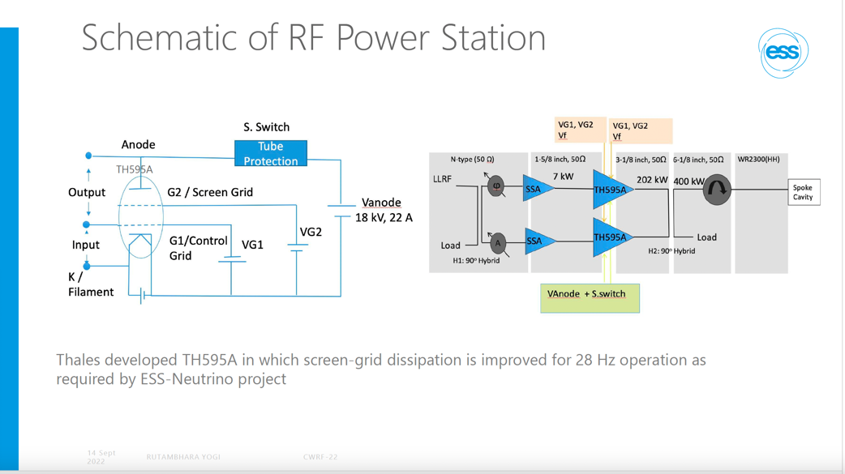
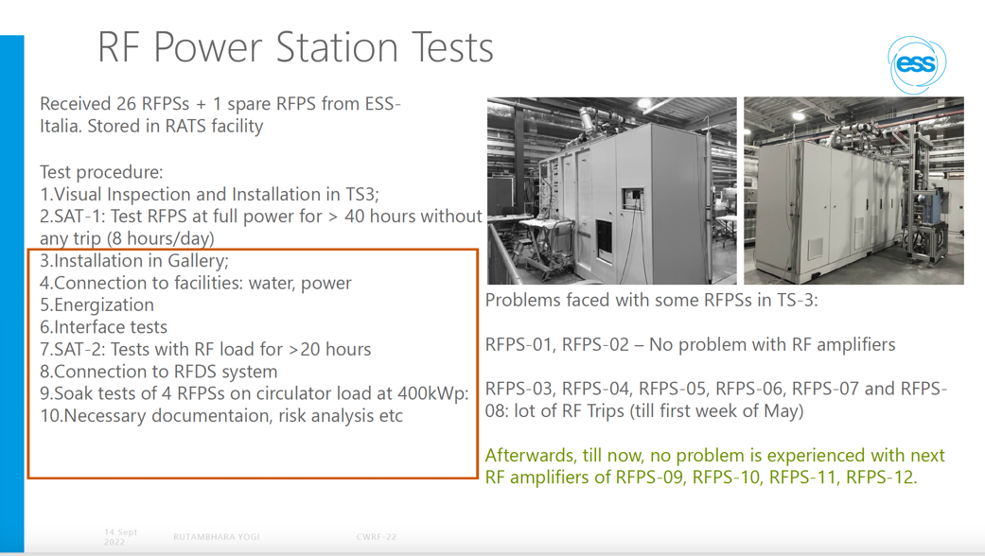
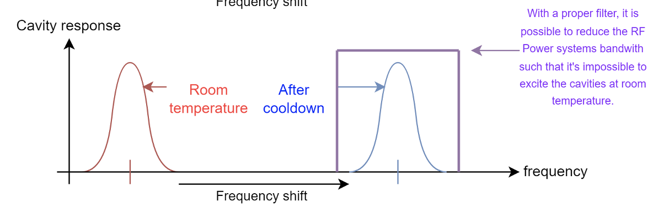
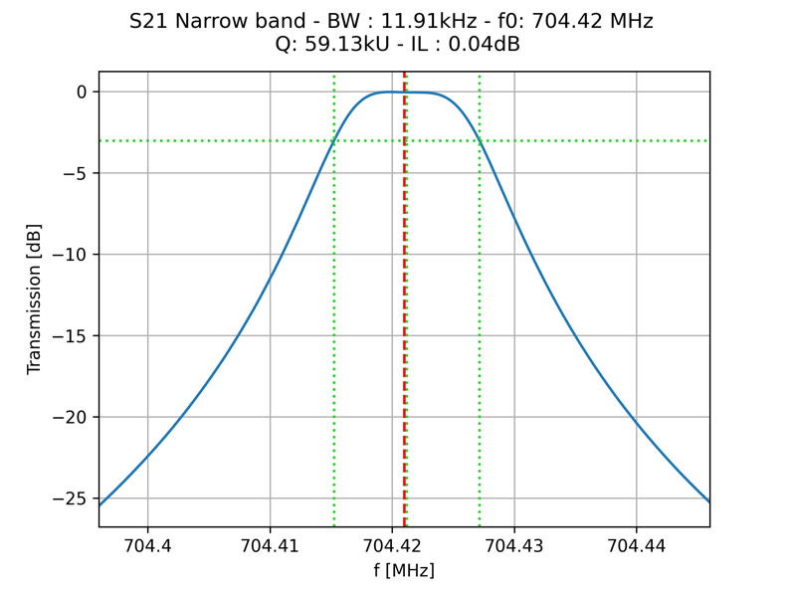
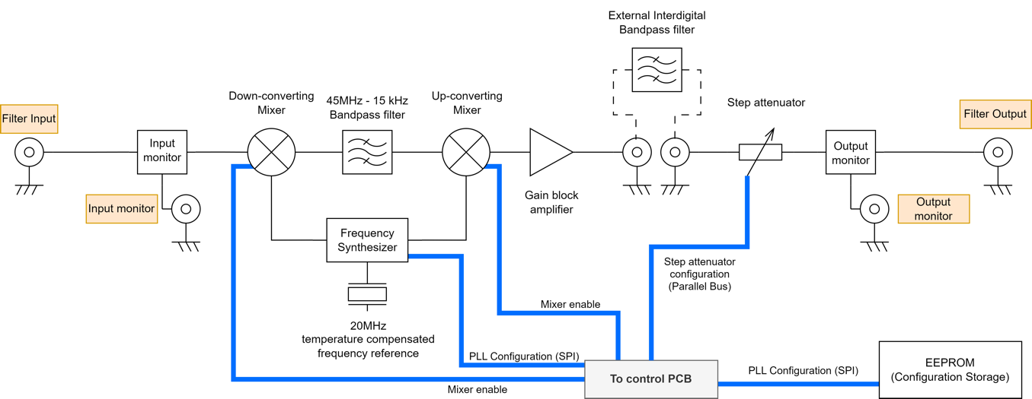
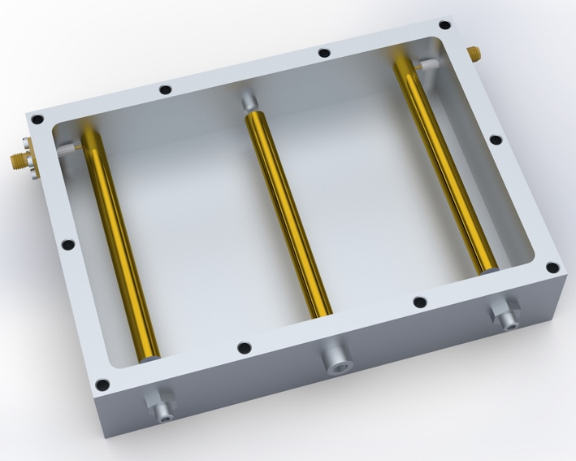
Warm Coupler Conditioning
For technical details of the Spoke Power stations
See CWRF 2022,
Radio Frequency RF Power Stations at ESS Rutambhara Yogi
Warm Coupler Conditioning (WCC) brought forward
Needs RF to the tunnel before Personal Safety System ready
Is it safe?
Cavity are naturally detuned
Ensure that the RF frequency does not match the cavity resonant frequency
Installation of narrow band pass at nominal frequency
Setup local monitoring and exclusion zone
Filter provides around 60 dB attenuation at warm cavity resonance

Slide 19
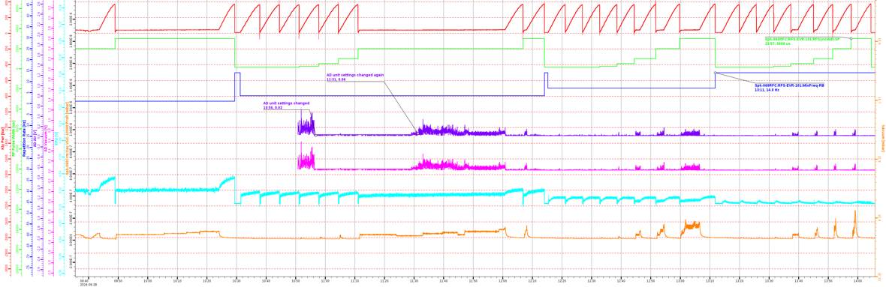
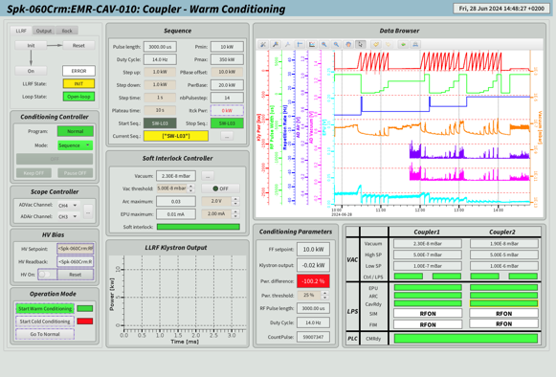
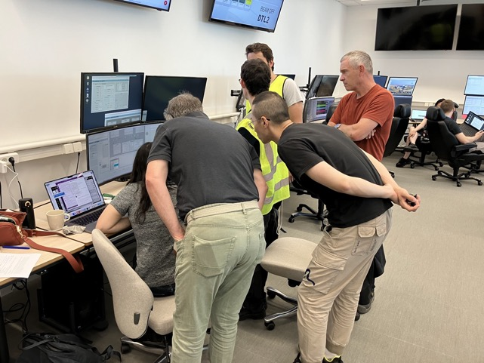
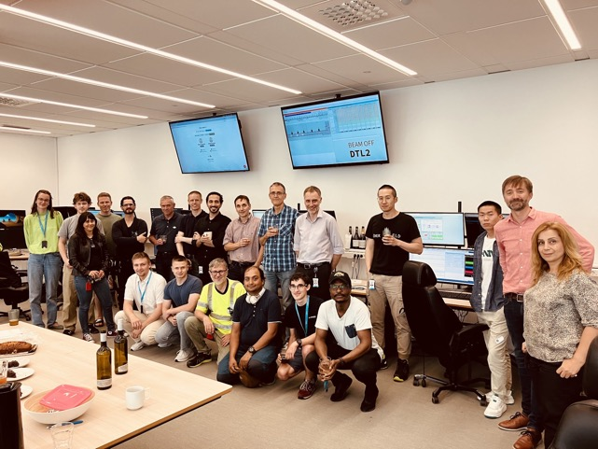
First WCC in open tunnel
It took months to make the safety case and have it approved
but finally the conditioning was quick.
All 26 spoke cavities conditioned and MB started
SRF/RF/LLRF/ICS/OPS/RP

Slide 20
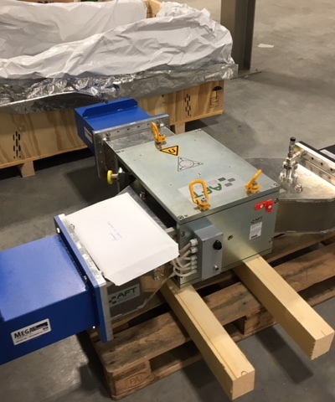
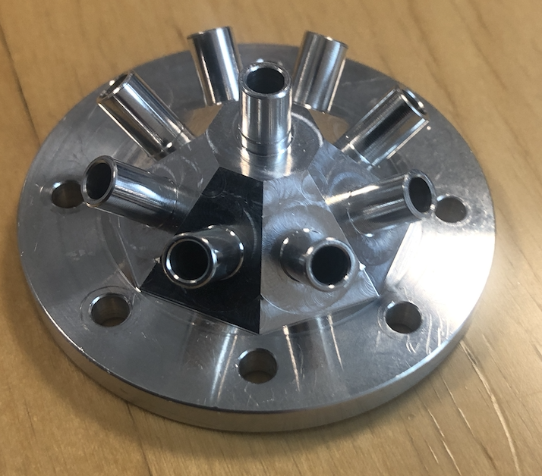
704 MHz circulator arcing
56 circulators circulators installed and operational on MB and HB
2 units on Test Stand 2
Circulators on MB started to suffer from occasional, apparently random arcing
Investigation started:
Multiple visual inspections – no obvious signs
Cleaning seemed to work – but not for long
Temperature dependence?
Humidity dependence – deliberately increased humidity
Where was the arc originating?
  Designed and built multiport viewer
  Added viewing port to taper
Circulators on TS2 had been operational for several years without incident, until
Sudden arcing on the circulator. Initially conditioned up and ran for weeks again
Then came back and did not recover.
New visual inspection

Slide 21
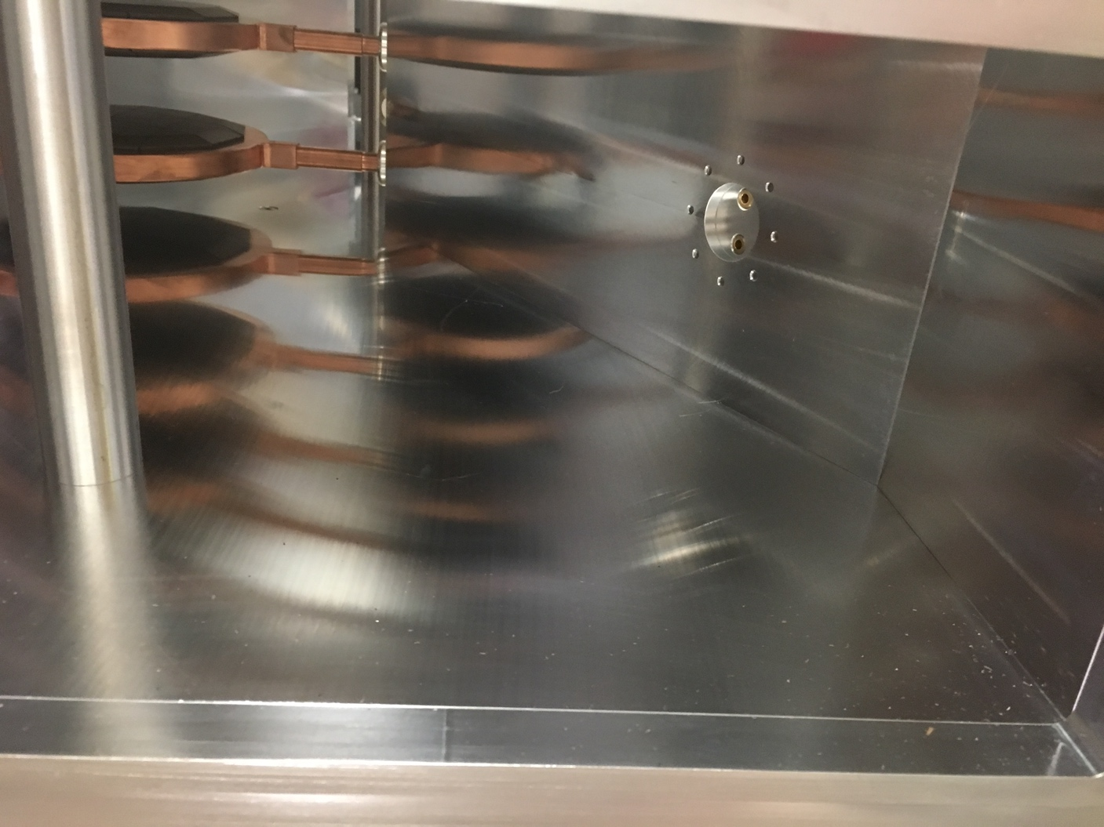
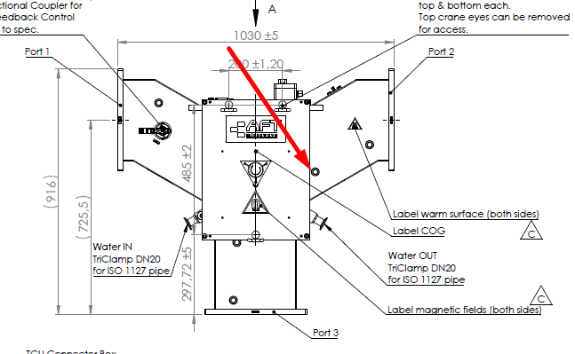
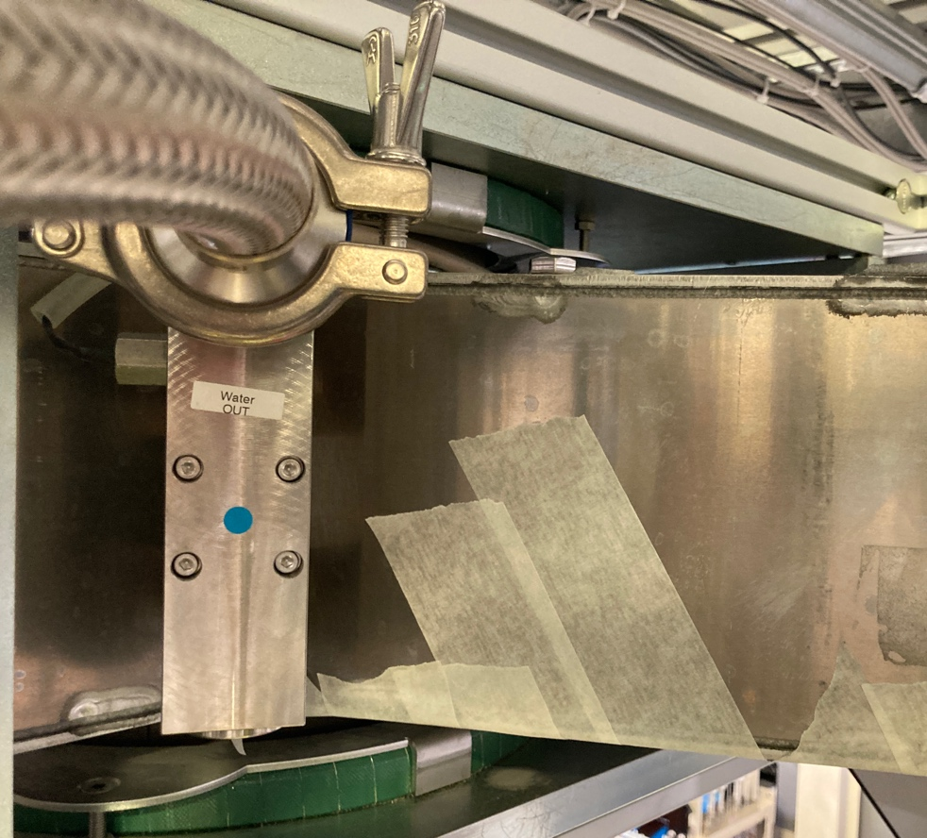
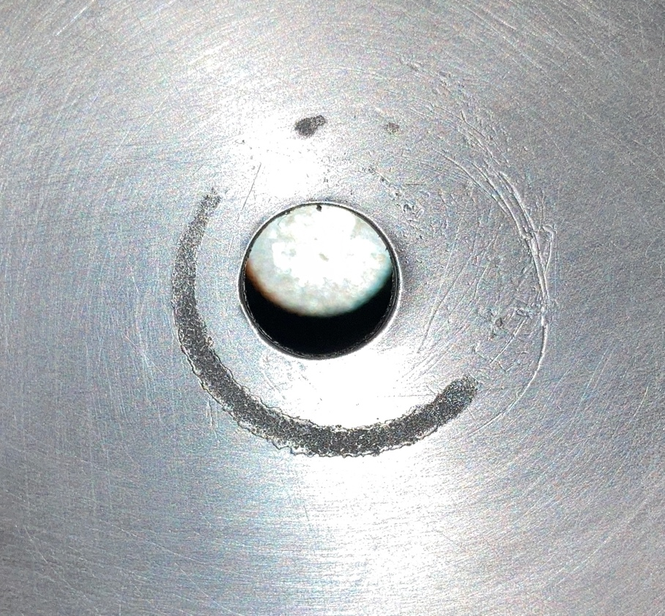
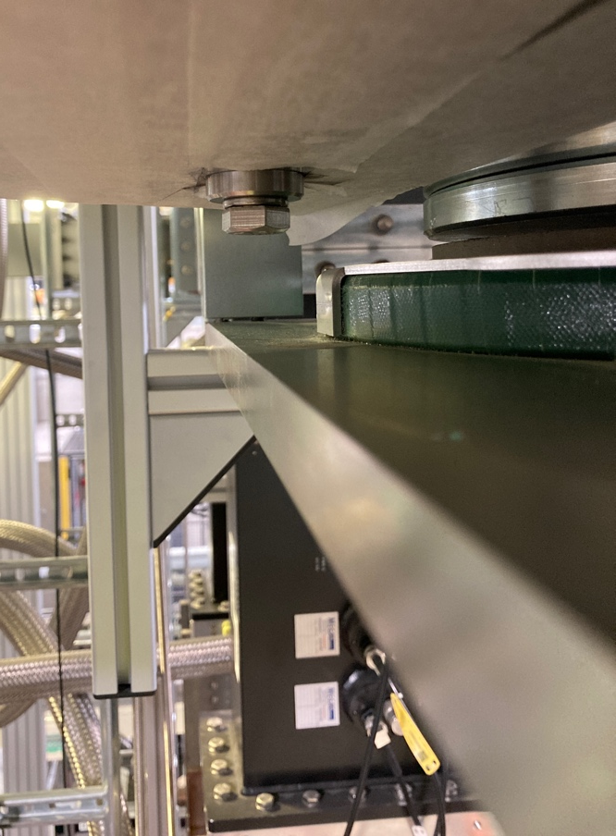
704 MHz circulator arcing
No obvious signs until small marks noticed on tuning post
Decision to remove post, but
bolts had gauled. Had to be cut.
Not possible to replace bolt due to poor access.
Finally machined new threaded hole post.

Slide 22
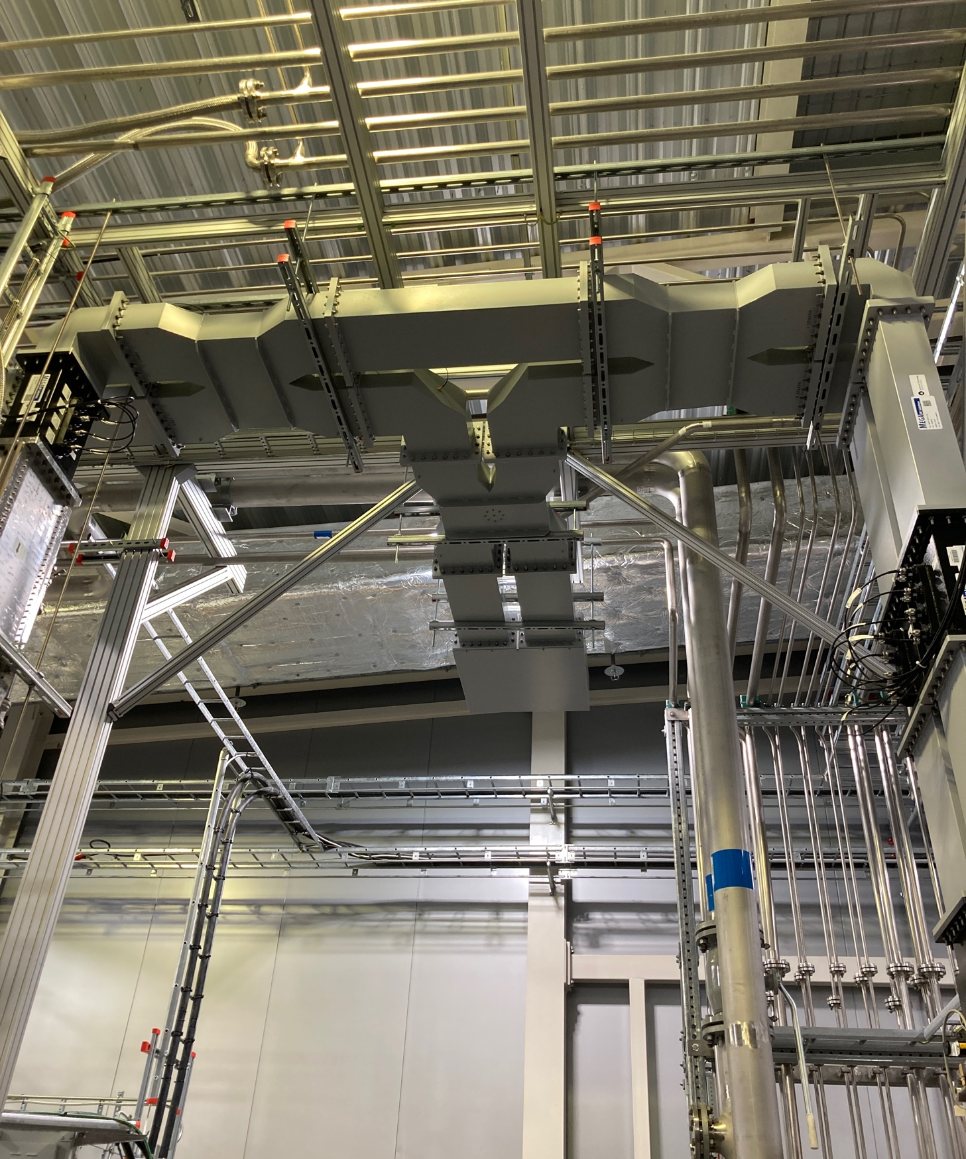
704 MHz circulator arcing
Immediately inspected other circulators on MB which were arcing.
Similar arcing noticed.
Re-tightened bolts on MB and HB systems with occasional arcing but many bolts have gauled.
New posts manufactured and ready for deployment.
Since intervention, no further arcing
Take care if you have similar devices

Slide 23
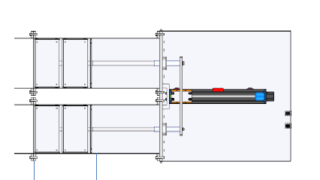
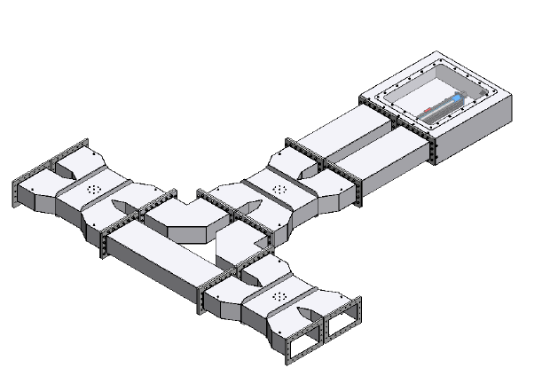
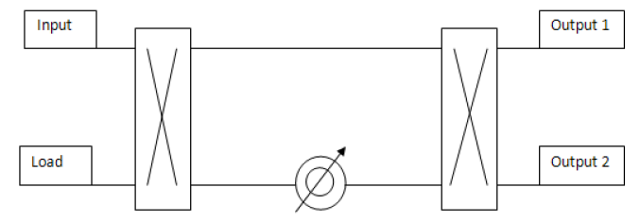
VPD – Variable Power Divider
However, when re-testing the circulator on TS2 noise heard from the Variable Power Divider and it one arm was getting warm!
No arc detection installed on the side branch.
Rated for 1.5 MW full reflection but typically operate at lower power
Designed to allow one input to be split into two outputs
Phase adjustment allows for any power split or option to supply either output.
Two units installed, but only one unit getting hot.
Power in
Power out

Slide 24
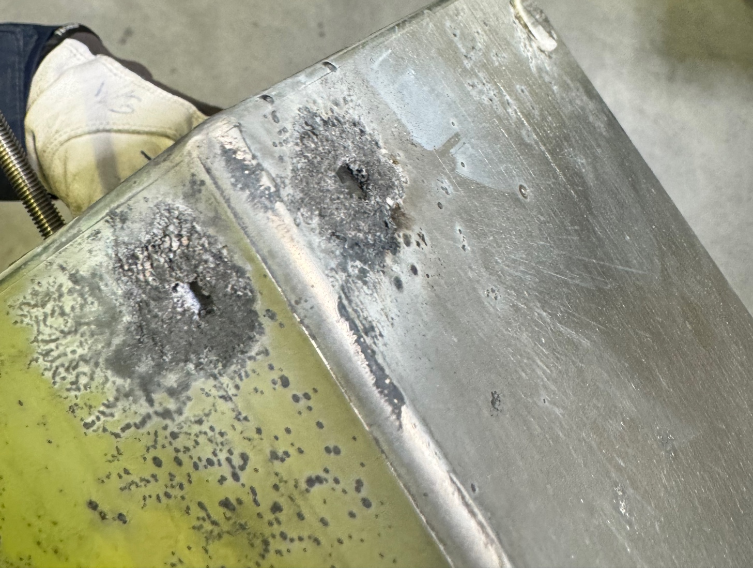




VPD
Arcs on the “buckets”
Spacers severely burnt

Slide 25



VPD
Waveguide severely burned
  Urgent clean up and damaged waveguide replaced with a ‘standard’ section of waveguide plus a new spacer
Installed additional arc detection
Damaged WG
5 mm spacer

Slide 26
New Test Stands
Soon future test places become limited:
TS2 in continuous use for cryomodule testing
Other systems needed for beam
Long term plan is to construct a full SRF facility including test benches for each type of RF system
Short term
  Testing and conditioning of:
  Klystrons
  RF windows and couplers
  RF loads
  Spares, upgrade procurements, technical issues

Slide 27




New ‘temporary’ Test Stands
352 MHz, 3 MW capable
704 MHz, 1.5 MW capable
Re-configurable with floor space.
Pre-installed klystron setup for rapid testing of new klystrons
S4: Canon
S1: CPI
S2 and 3: Thales

Slide 28

New Test Stands
Any Questions?
352 MHz, 3 MW capable
704 MHz, 1.5 MW capable
Re-configurable with floor space.
Pre-installed klystron setup for rapid testing of new klystrons
S4: Canon
S1: CPI
S2 and 3: Thales

