Slide 1
Status update and operational experience of the 200 MHz SSPA system for the CERN SPS
Sam Pitman on behalf of the entire SY-RF-AC section
09-12 September 2024 – Thirteenth CW and High Average Power RF Workshop

Slide 2
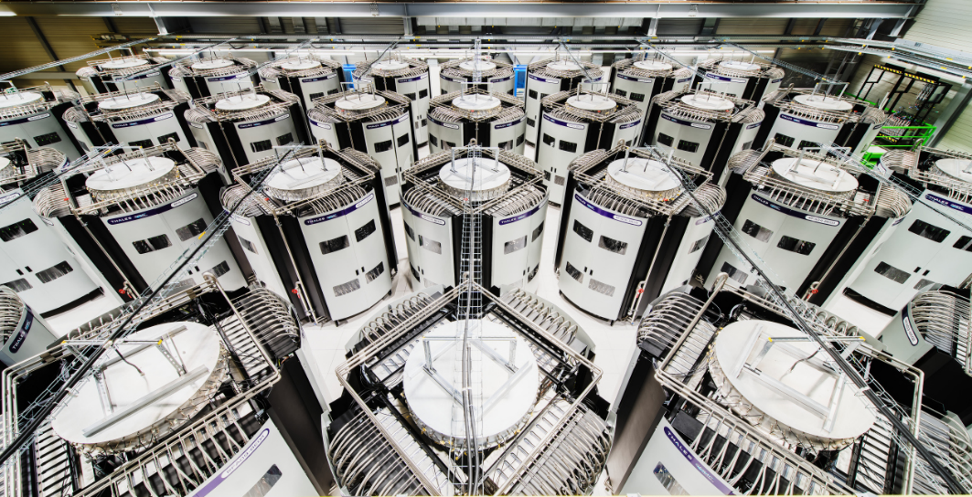
Contents
  Introduction
  Early Life Failures
  Notable Events
  Obsolescence
  Conclusions

Slide 3
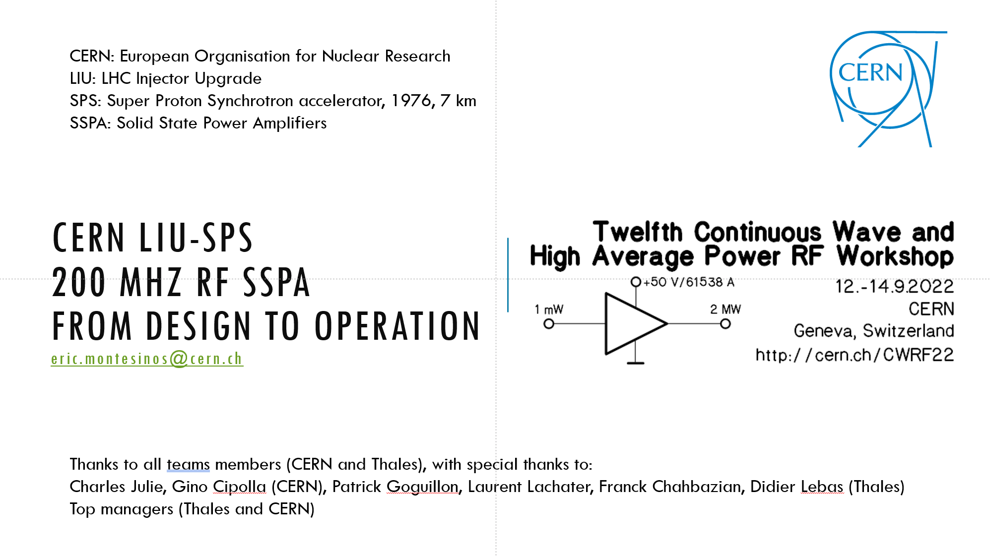
SPS – Super Proton Synchrotron
SPS – 1976 (7 km)
LHC Injector also North Area, AWAKE, and HiRadMat
SPS-LIU Project presented in 2022
High power RF for the SPS was upgraded for HL-LHC
Cavities were re-arranged in the tunnel
New SSPA system was installed to power two cavities

Slide 4
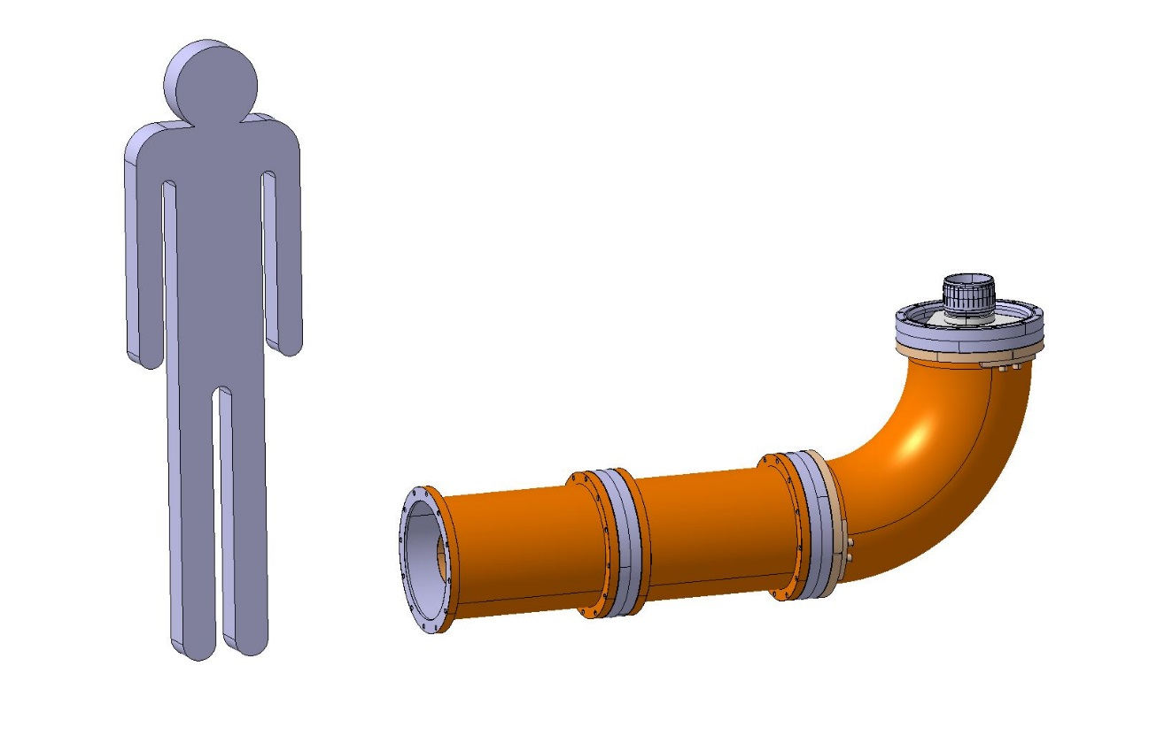
RF Cycles in the SPS
Average power limited to 750 kW due to 350 mm coaxial lines
1600 kW
This kind of cycling is a killer for the RF power amplifiers
750 kW
9.8 μs / 23.04 μs (43.4 kHz) or
2.75 μs / 5.76 μs (173.6 kHz)
10 kW
0
3.2
10.8
7.6
1.8
1.2
3.0
2.2
3.2
3.4
9.6
21.6 s
8.2 s
16.2 s
LHC
SHIP
FT

Slide 5
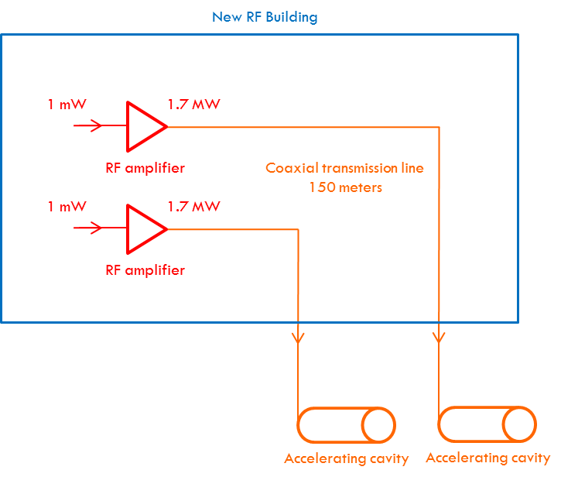
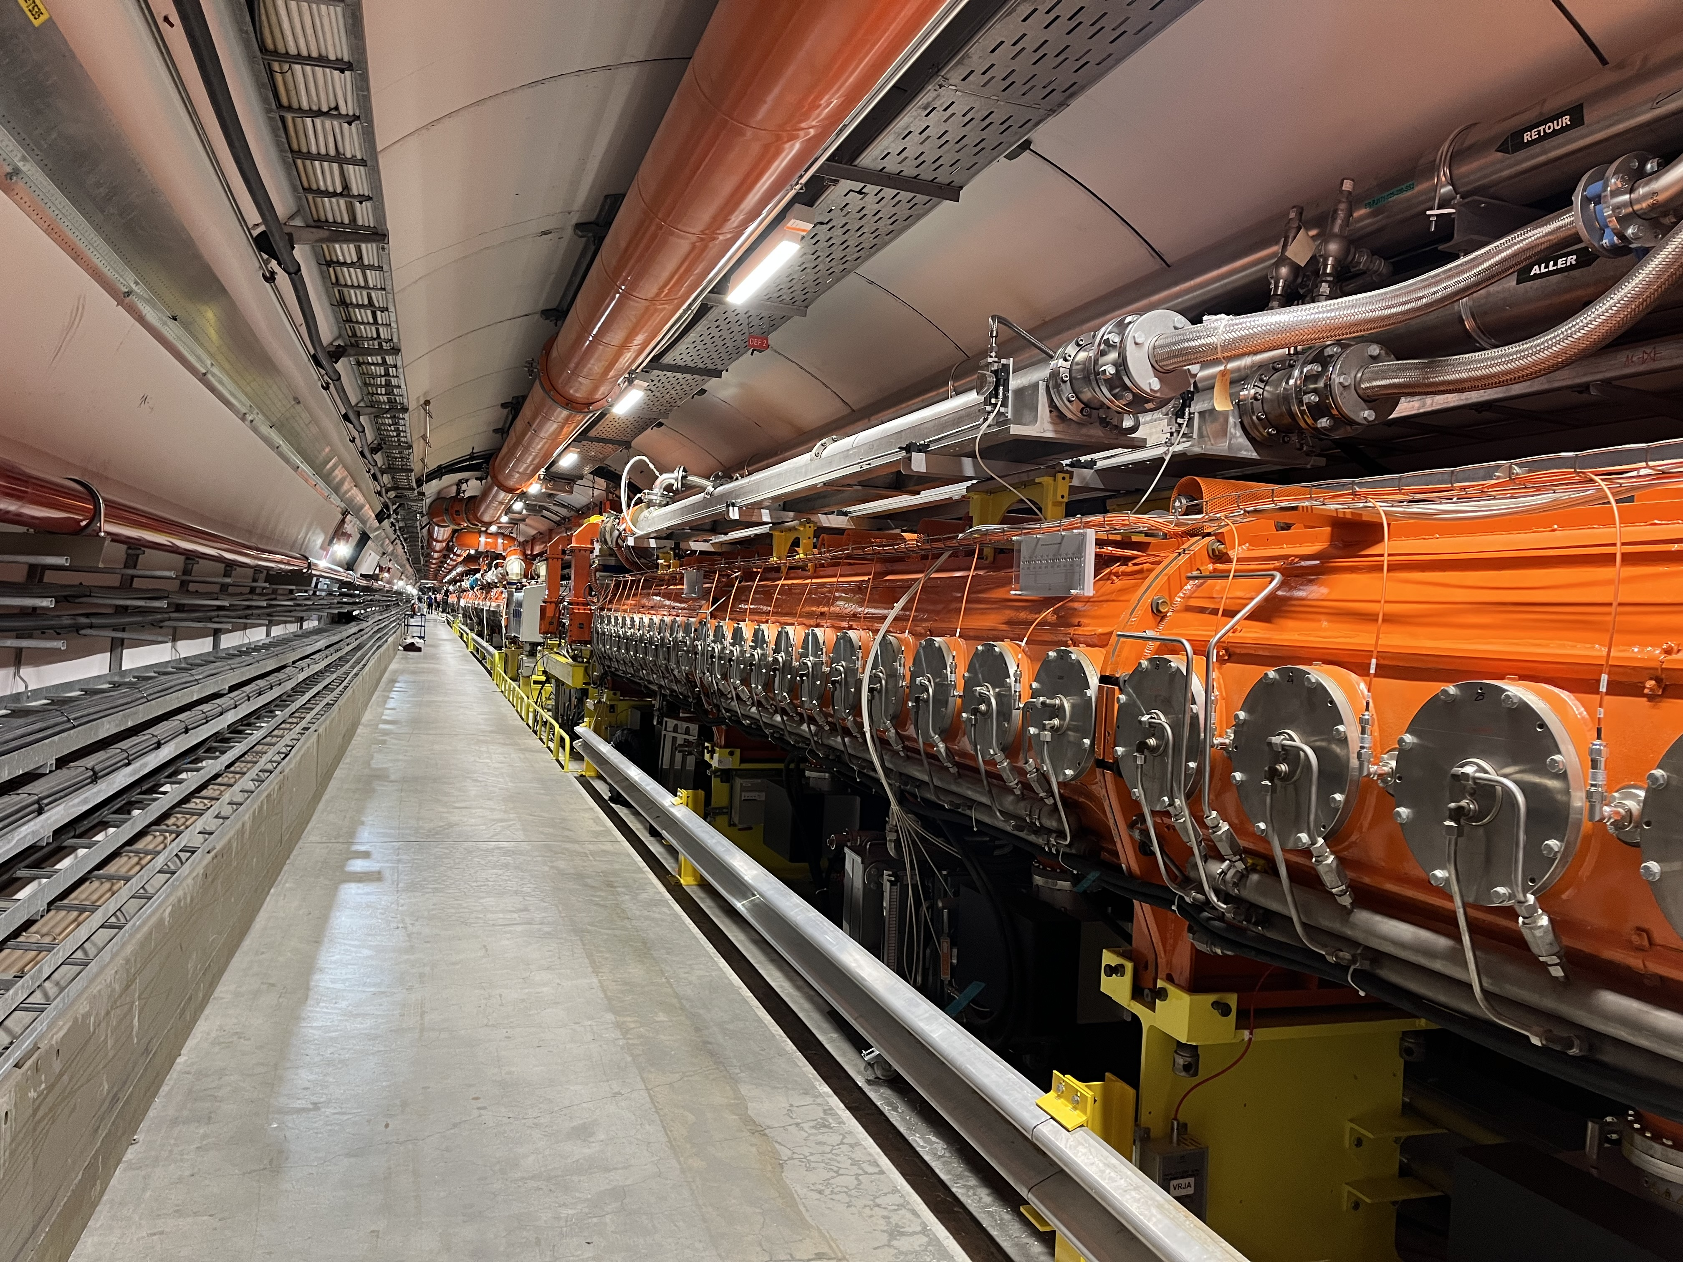
Layout
Above Ground
Tunnel

Slide 6
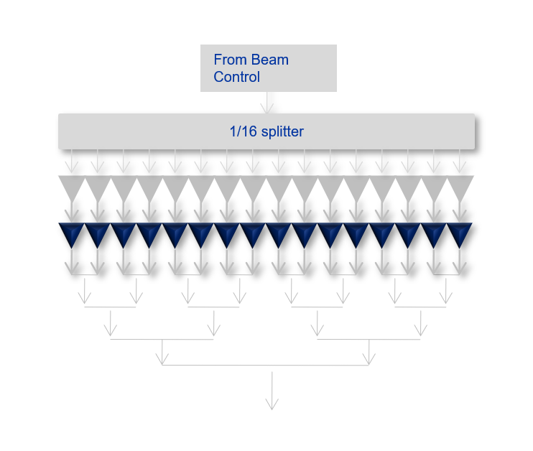
2x Transmitters
Transmitter Layout
One Transmitter is composed of
  16 x 160 kW RF amplifiers
One RF amplifier is composed of
  1:80 cavity splitter
  80 x 2 kW RF blocs (160 transistors)
  80:1 cavity combiner
In total
  Two transmitters
  32 RF amplifiers
  2560 RF blocs
  5120 transistors
From Beam Control
1/16 splitter
Cavity

Slide 7
Thales System Architecture
Thales Tower
80 * 2 kW modules
Relays to decouple broken modules
2 kW RF 01
Input distribution cavity
1 * 1 kW : 80 * 12 W
Note: Circulator free system
Pre-driver
LLRF
Hybrids
Output combining cavity
80 * 2 kW : 1 * 160 kW
2 kW RF 80

Slide 8
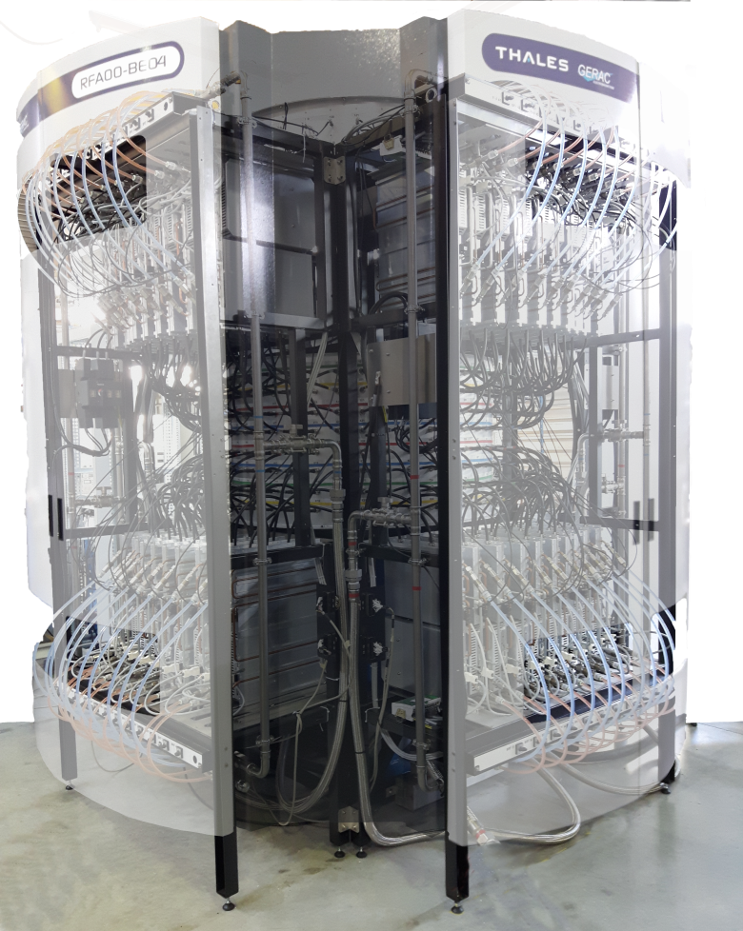
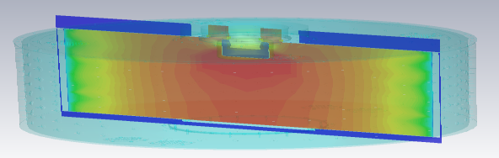
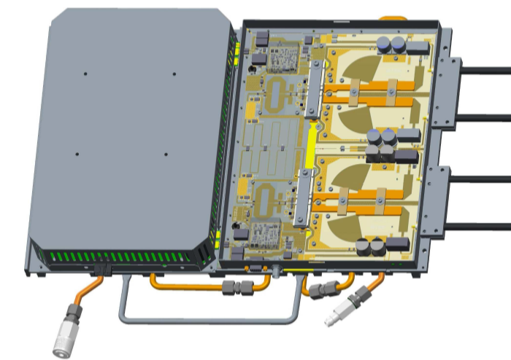
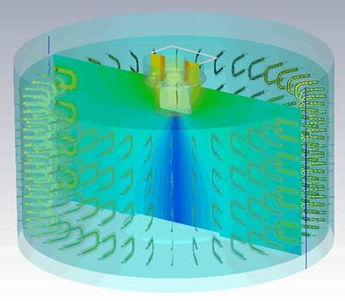
Thales System Architecture
1:80 cavity splitter
320:1 cavity combiner
80 x (2 x 1) kW
modules total

Slide 9
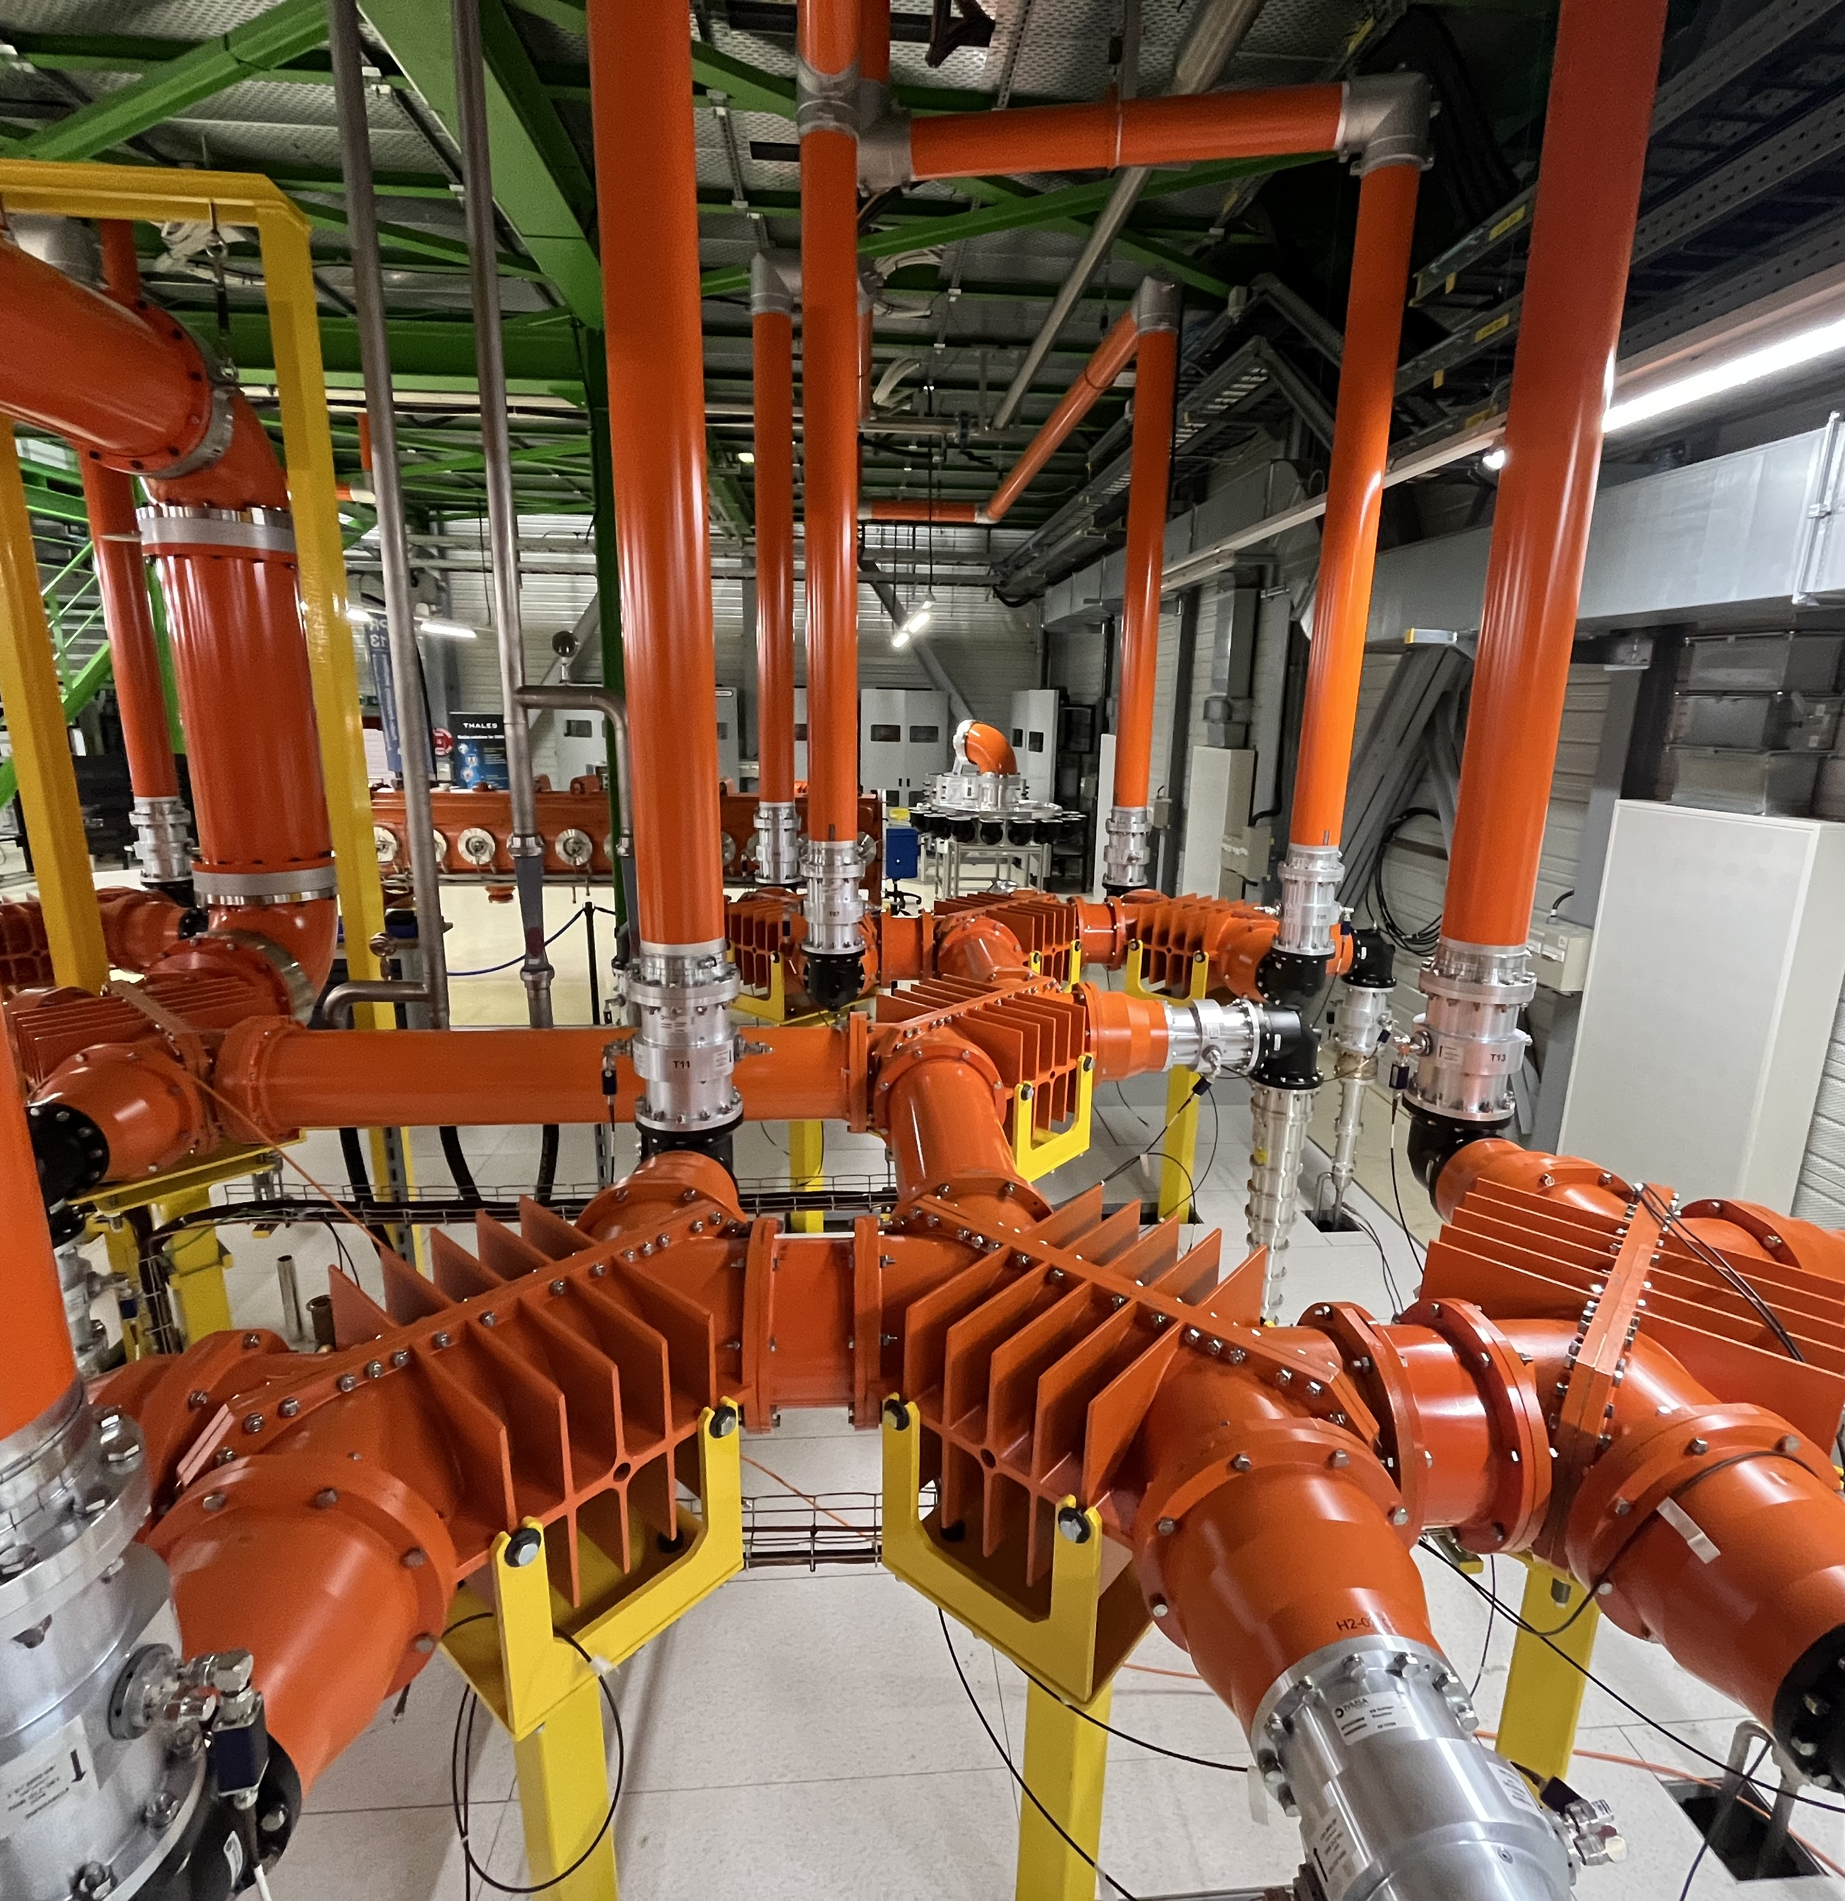
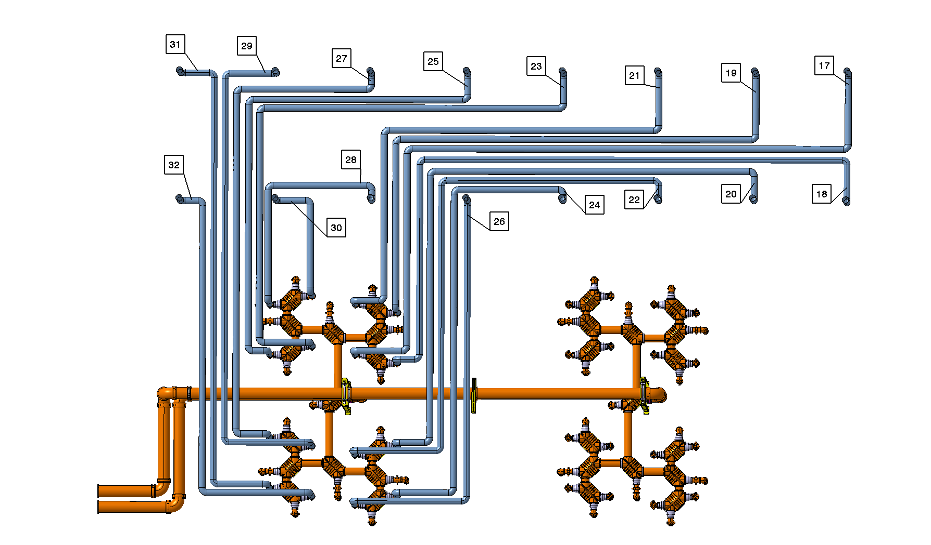
Hybrids
To Cavity
Notes:
90 degree quadrature hybrids
Directional couplers

Slide 10
Early life failures

Slide 11
Timeline of Transistor Failures
HOM Coupler burned Cav 3
Half towers not driven Cav 6
Broken Load on H1-04
Collars modification on Cav 3 & Cav 6
Collars modification & matching steps & new air-outlets on Cav 6
Cavity 6 Conditioning
Cavity 3&6 Conditioning & Scrubbing run
SPS Beam commissioning & scrubbing run polar loop instabilities
Cavity 6 Conditioning
Cavity 3 Conditioning
Scrubbing run
Ions to SPS & SFT_pro intensity between 2.7E+13eV to 3.3E+13eV
LIU parallel MD and LHC ions setting up flow monitoring all ok
AWAKE Beam water problems
MTEbeam nominal to SPS & LHC 25ns
SPS cold checkout
Notes:
Normal infantile mortality in first 18 months
Some towers have high failure rate and some low.
More failures seen during certain cycles such as AWAKE (High peak power AM)
Cavities exchange positions

Slide 12
Towers have different failure rates
Cavity 3
Cavity 6

Slide 13
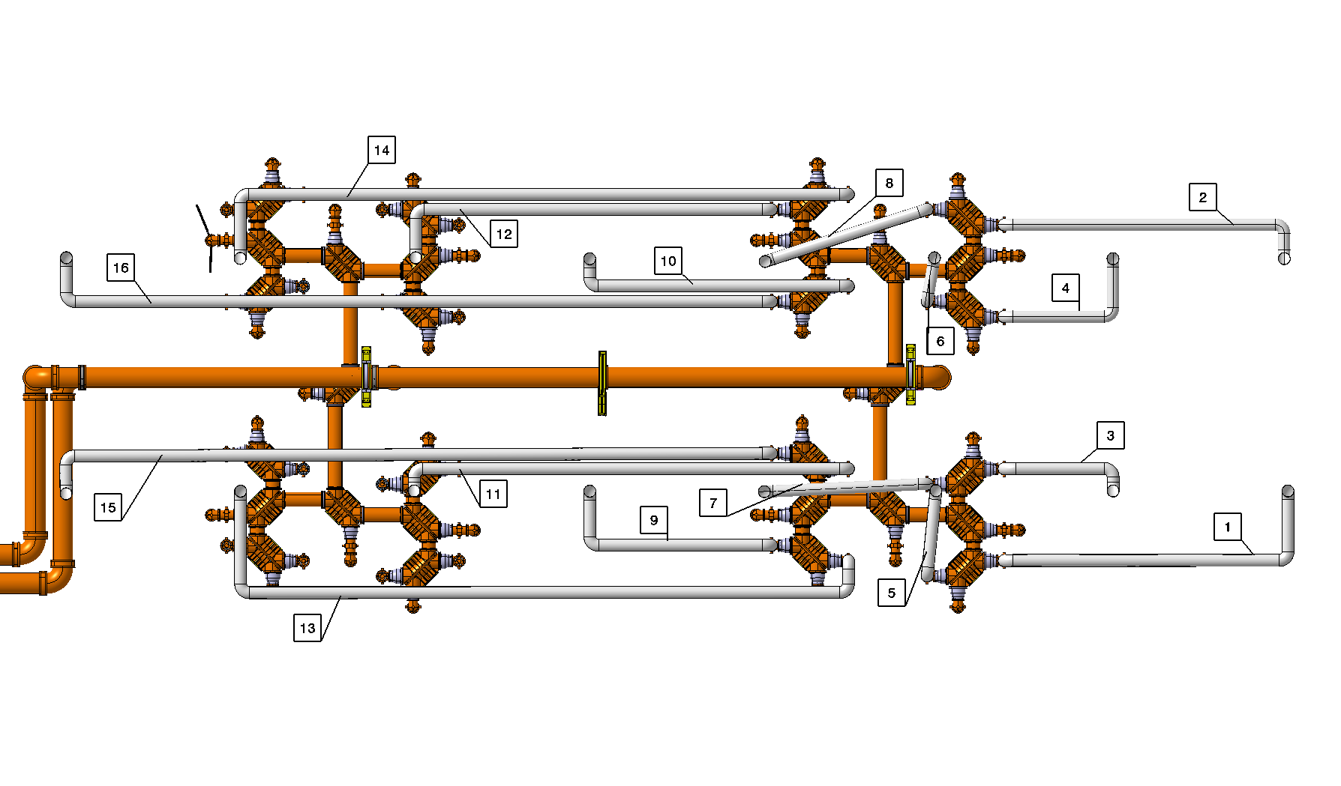
Difference in line length to hybrid
Cavity 3
Cavity 6

Slide 14
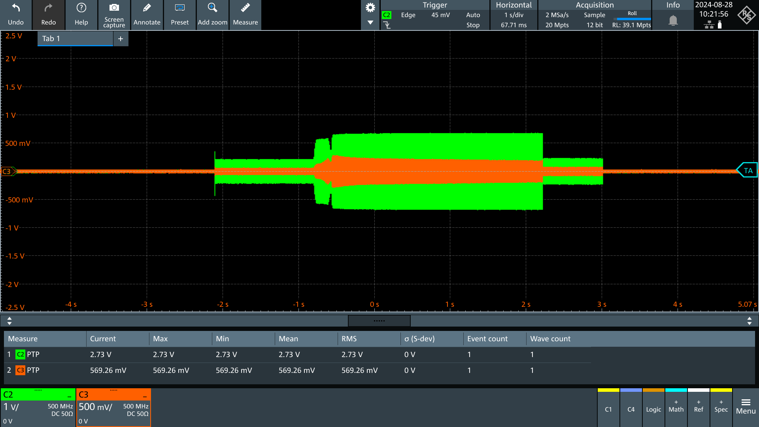
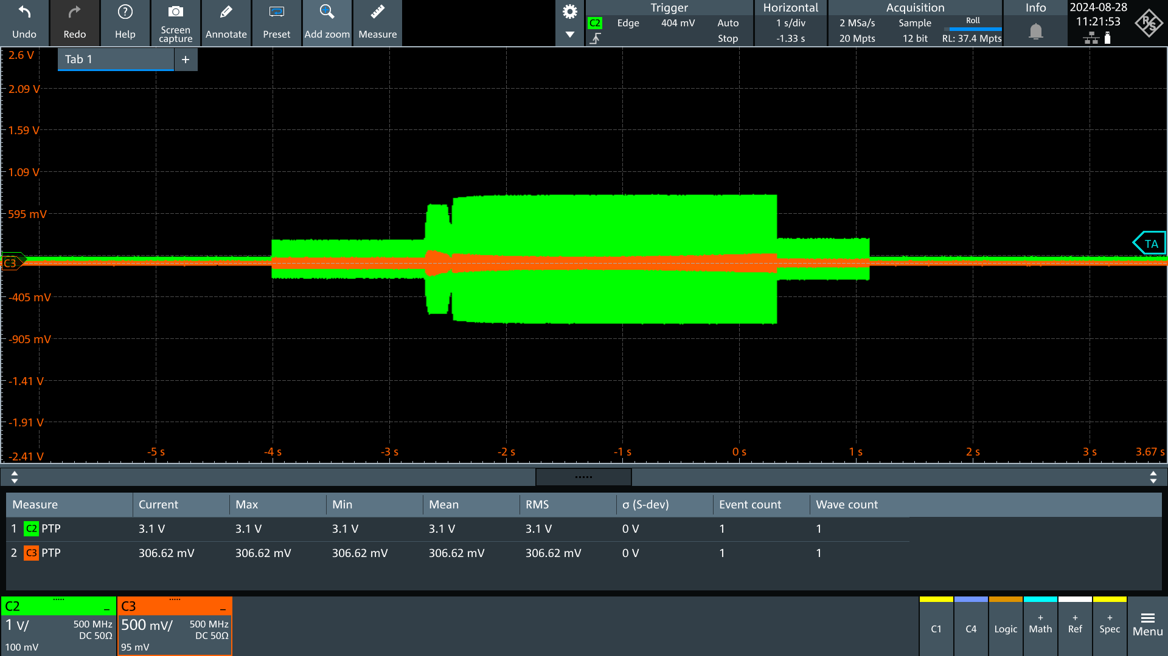
Reverse Power
Cavity 3 -14 dB
Forward power Reverse power
Cavity 6 -20dB
Notes:
Go deeper on the power levels in dB return loss – db
10dB – 10%
14dB – 4%
20dB – 1%

Slide 15
Notable Events

Slide 16
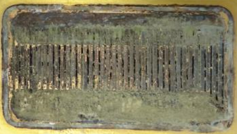
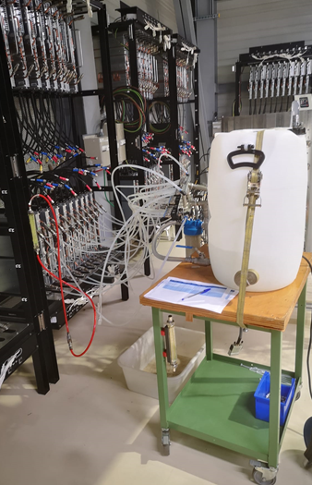
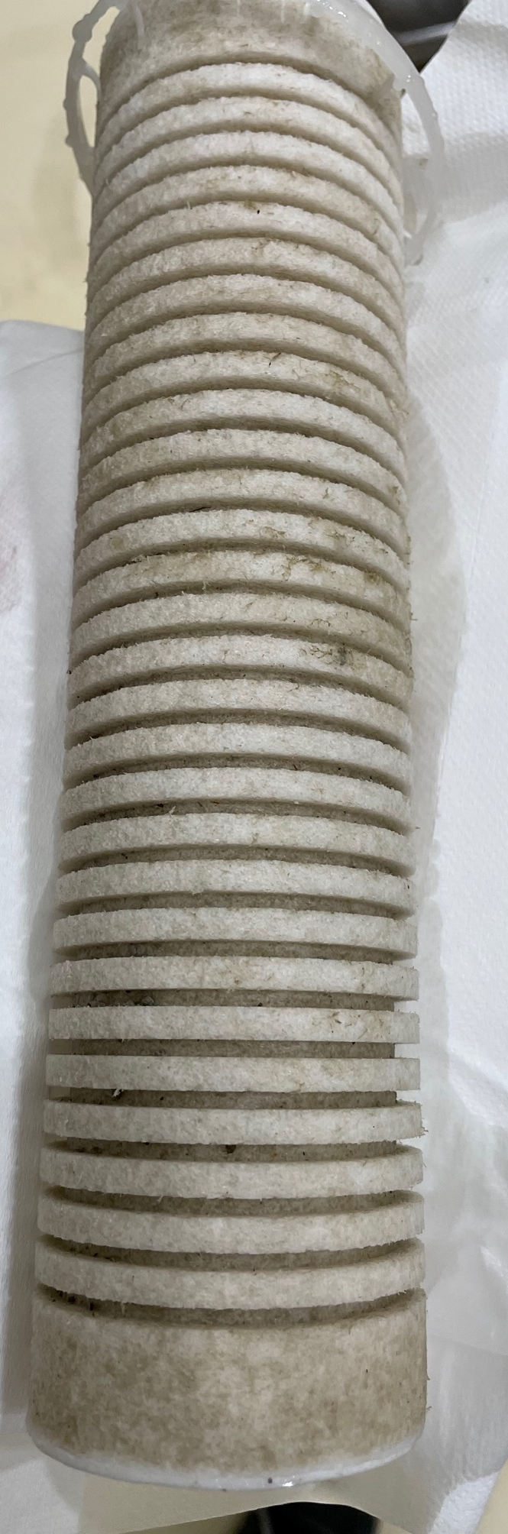
Thermal Paste
Thermal paste was introduced to the cooling system
This blocked the cooling channels of the transistors and caused overheating
System was flushed of impurities
Uncertain if there are still blockages causing problem
We still see burned transistors
Transistor Cooling Channels
Cleaning System Water Filter
Water Cleaning System

Slide 17
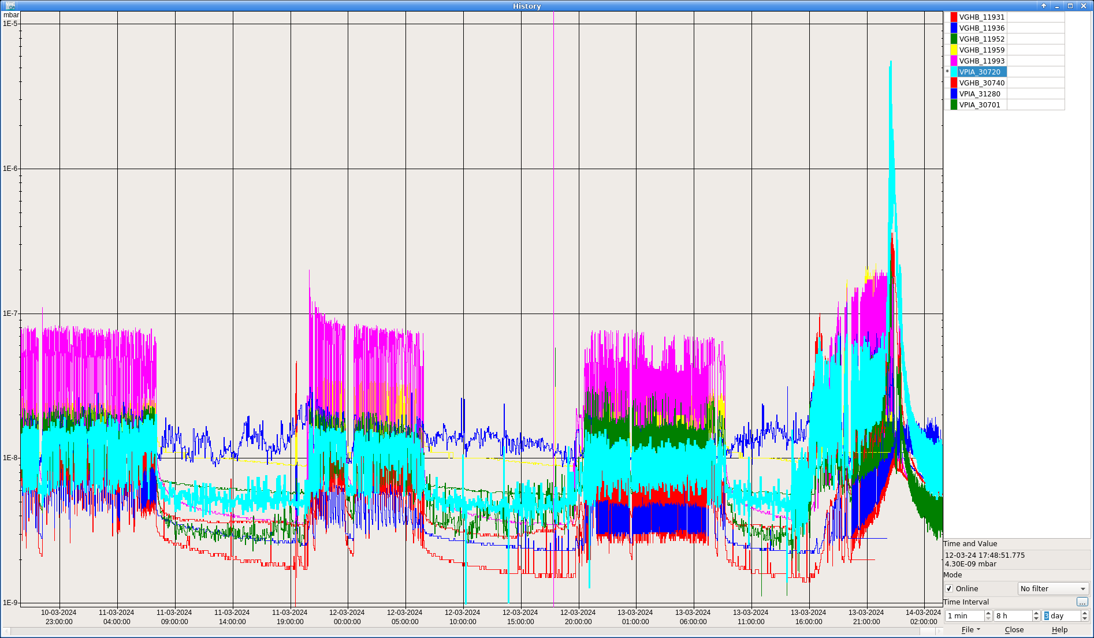
Scrubbing
Scrubbing run vacuum signals over 4 days
A scrubbing beam is a high intensity beam sent to clean the vacuum surfaces
14 Modules broken within 30 minutes on one cavity
30 broken in the event
Reflected Power?
Was cooling disturbed?
Notes:
Broadband Beam
The intention is to outgass
Peak is around 4e-6

Slide 18
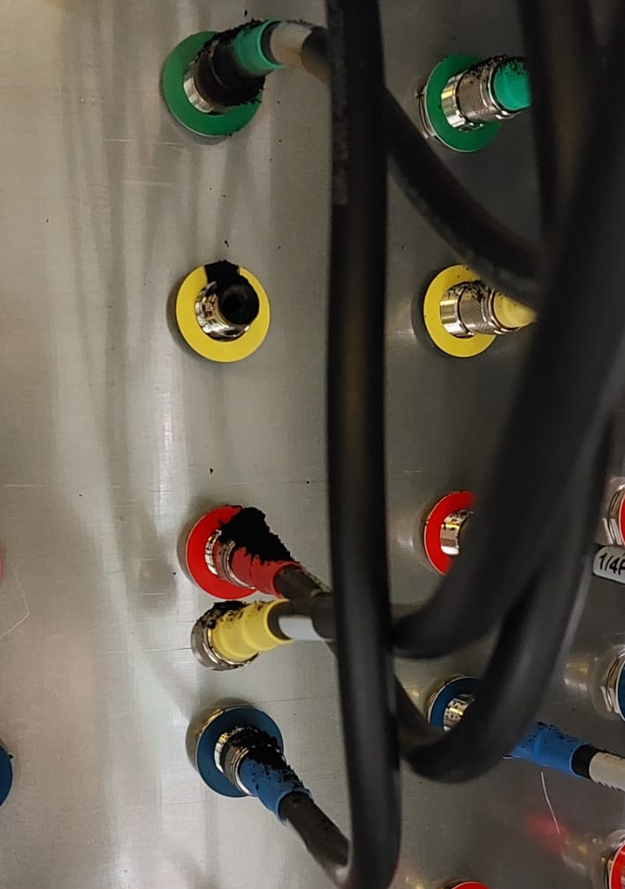
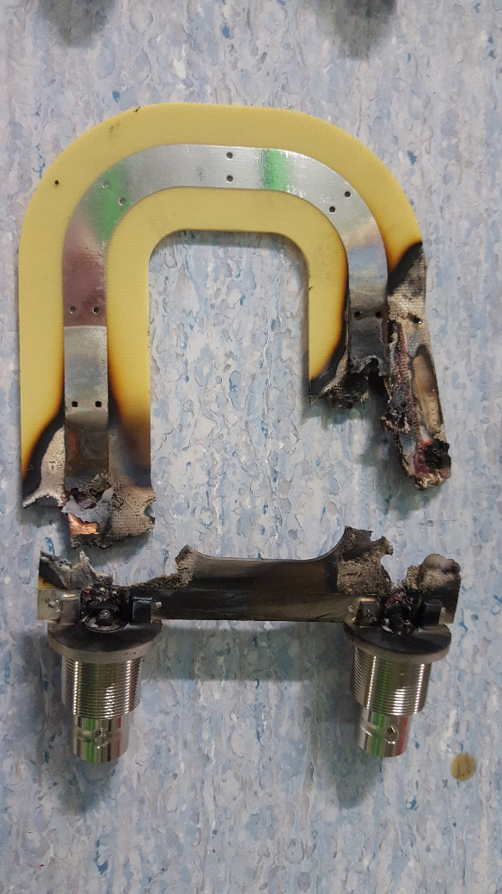
Bad connection
Connection from transistor to cavity combiner
C-type connector on 10240 connections
One was poorly connected
Up to 1kW can pass through these connections
Module broken as a result
Interlock is difficult to implement
Notes:
Human error

Slide 19

Technical stop event
A connection error lead to the LLRF signal being missing on one half of system
Some towers were full power and some zero
This was very unbalanced due to the integration
T26 first lost 13 modules
Then the load broke
Next the final load broke
Finally the signal was re-established to the other towers
Around 100 modules broken as a result of this event
30
21
28
19
25
23
17
18
27
29
20
22
31
24
32
26
Notes:
Interlocks were re-established afterwards

Slide 20
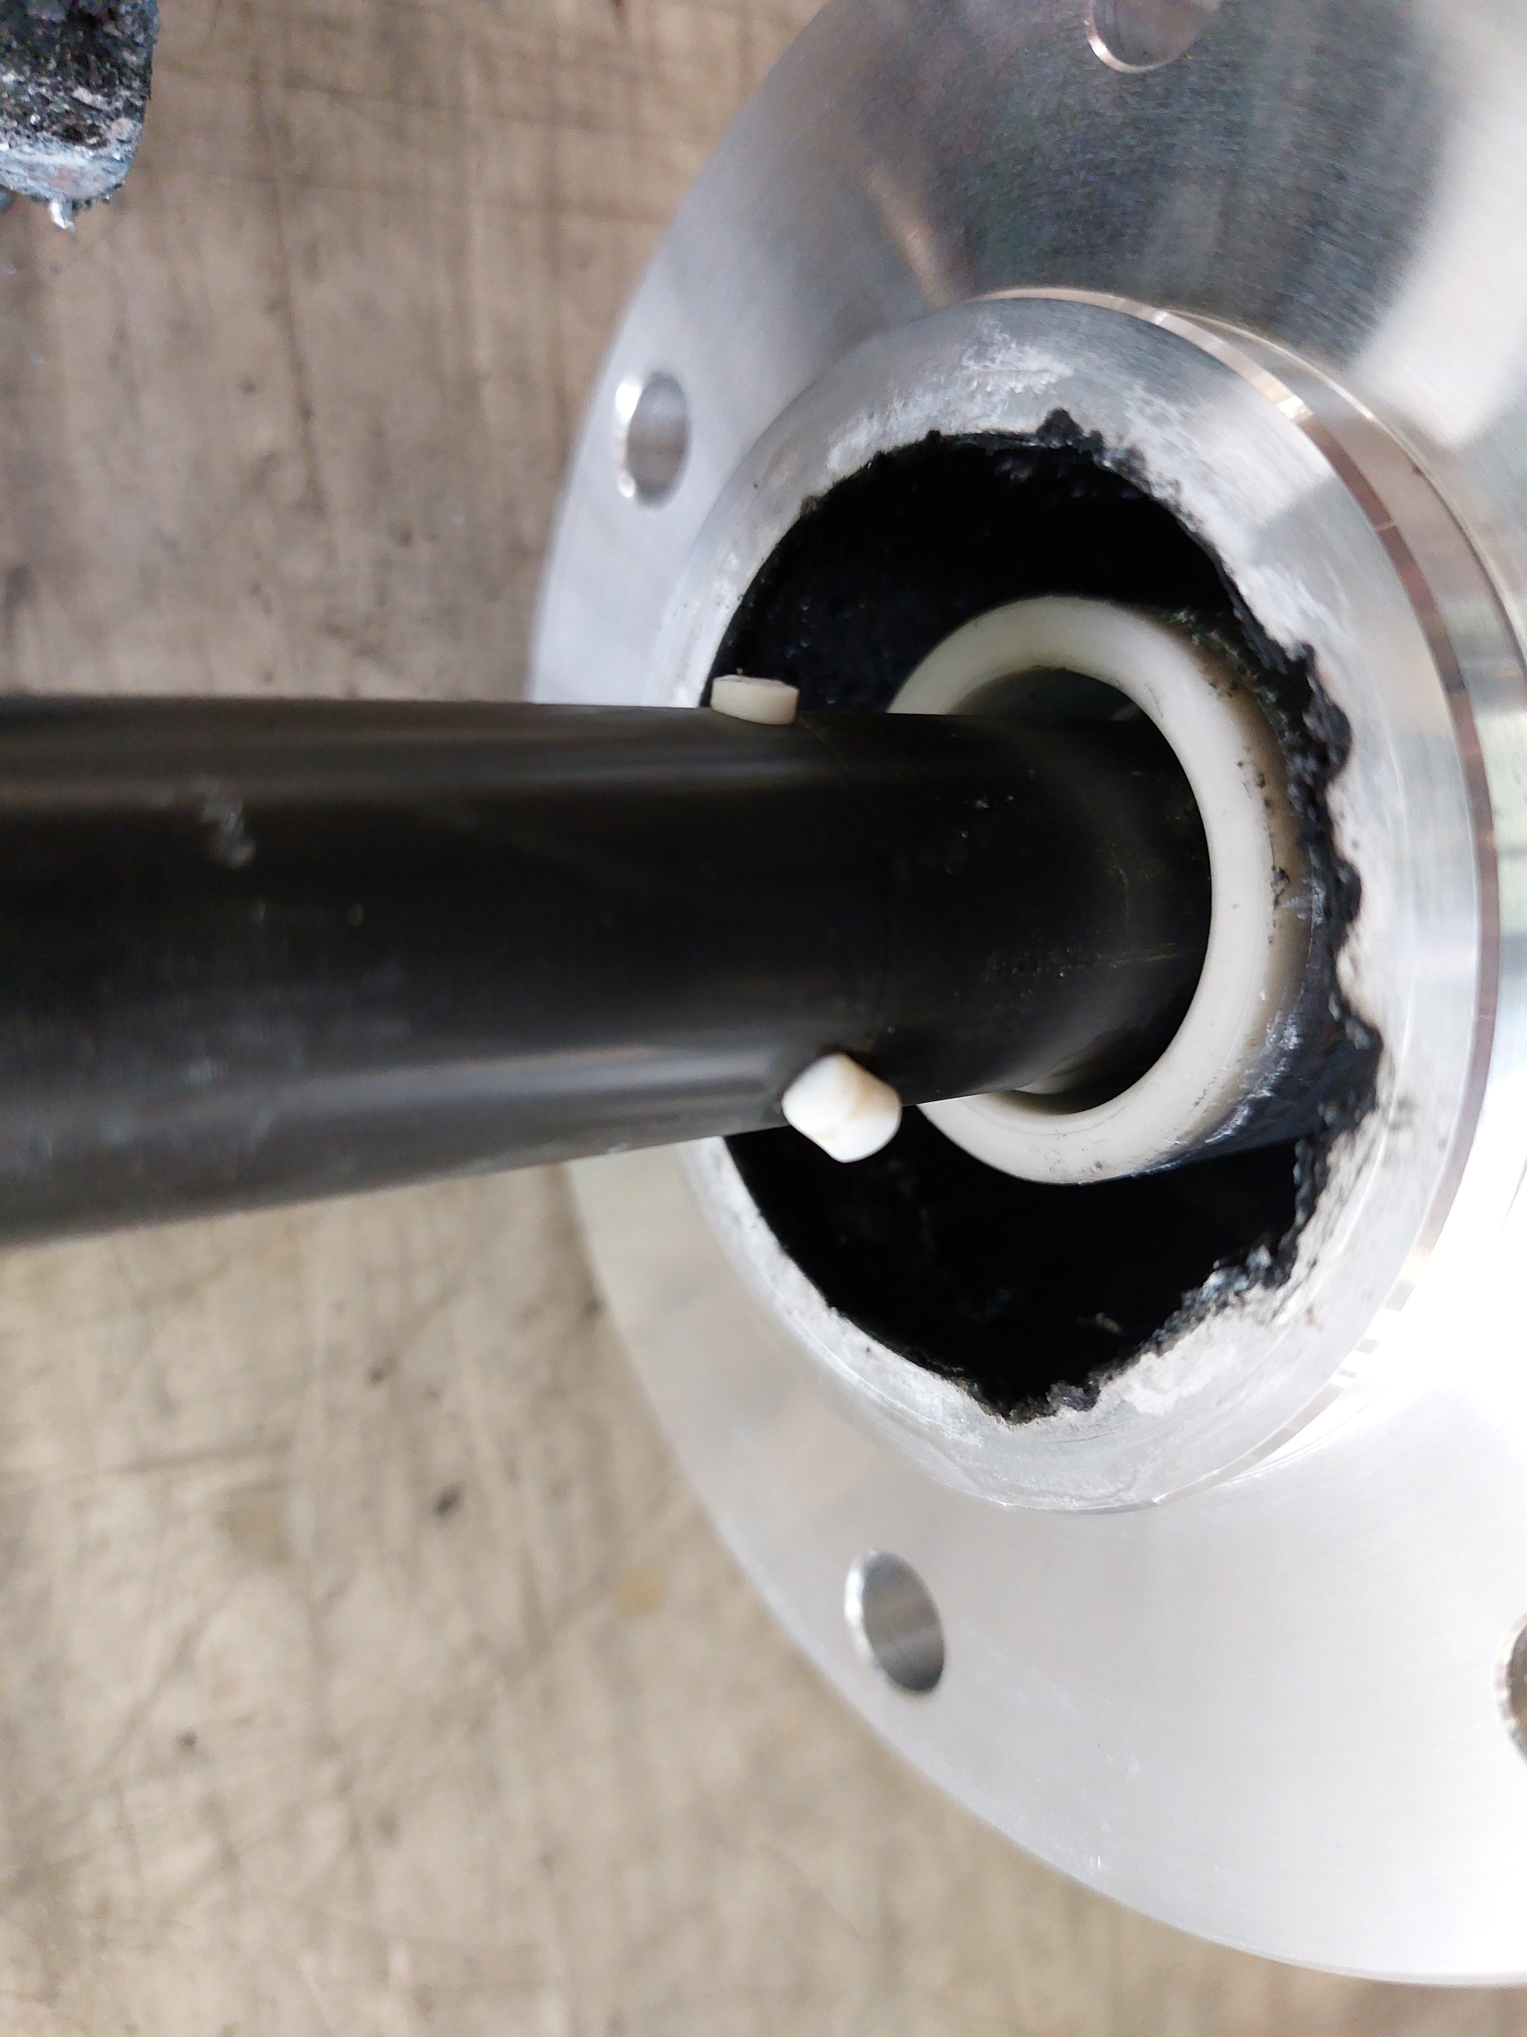
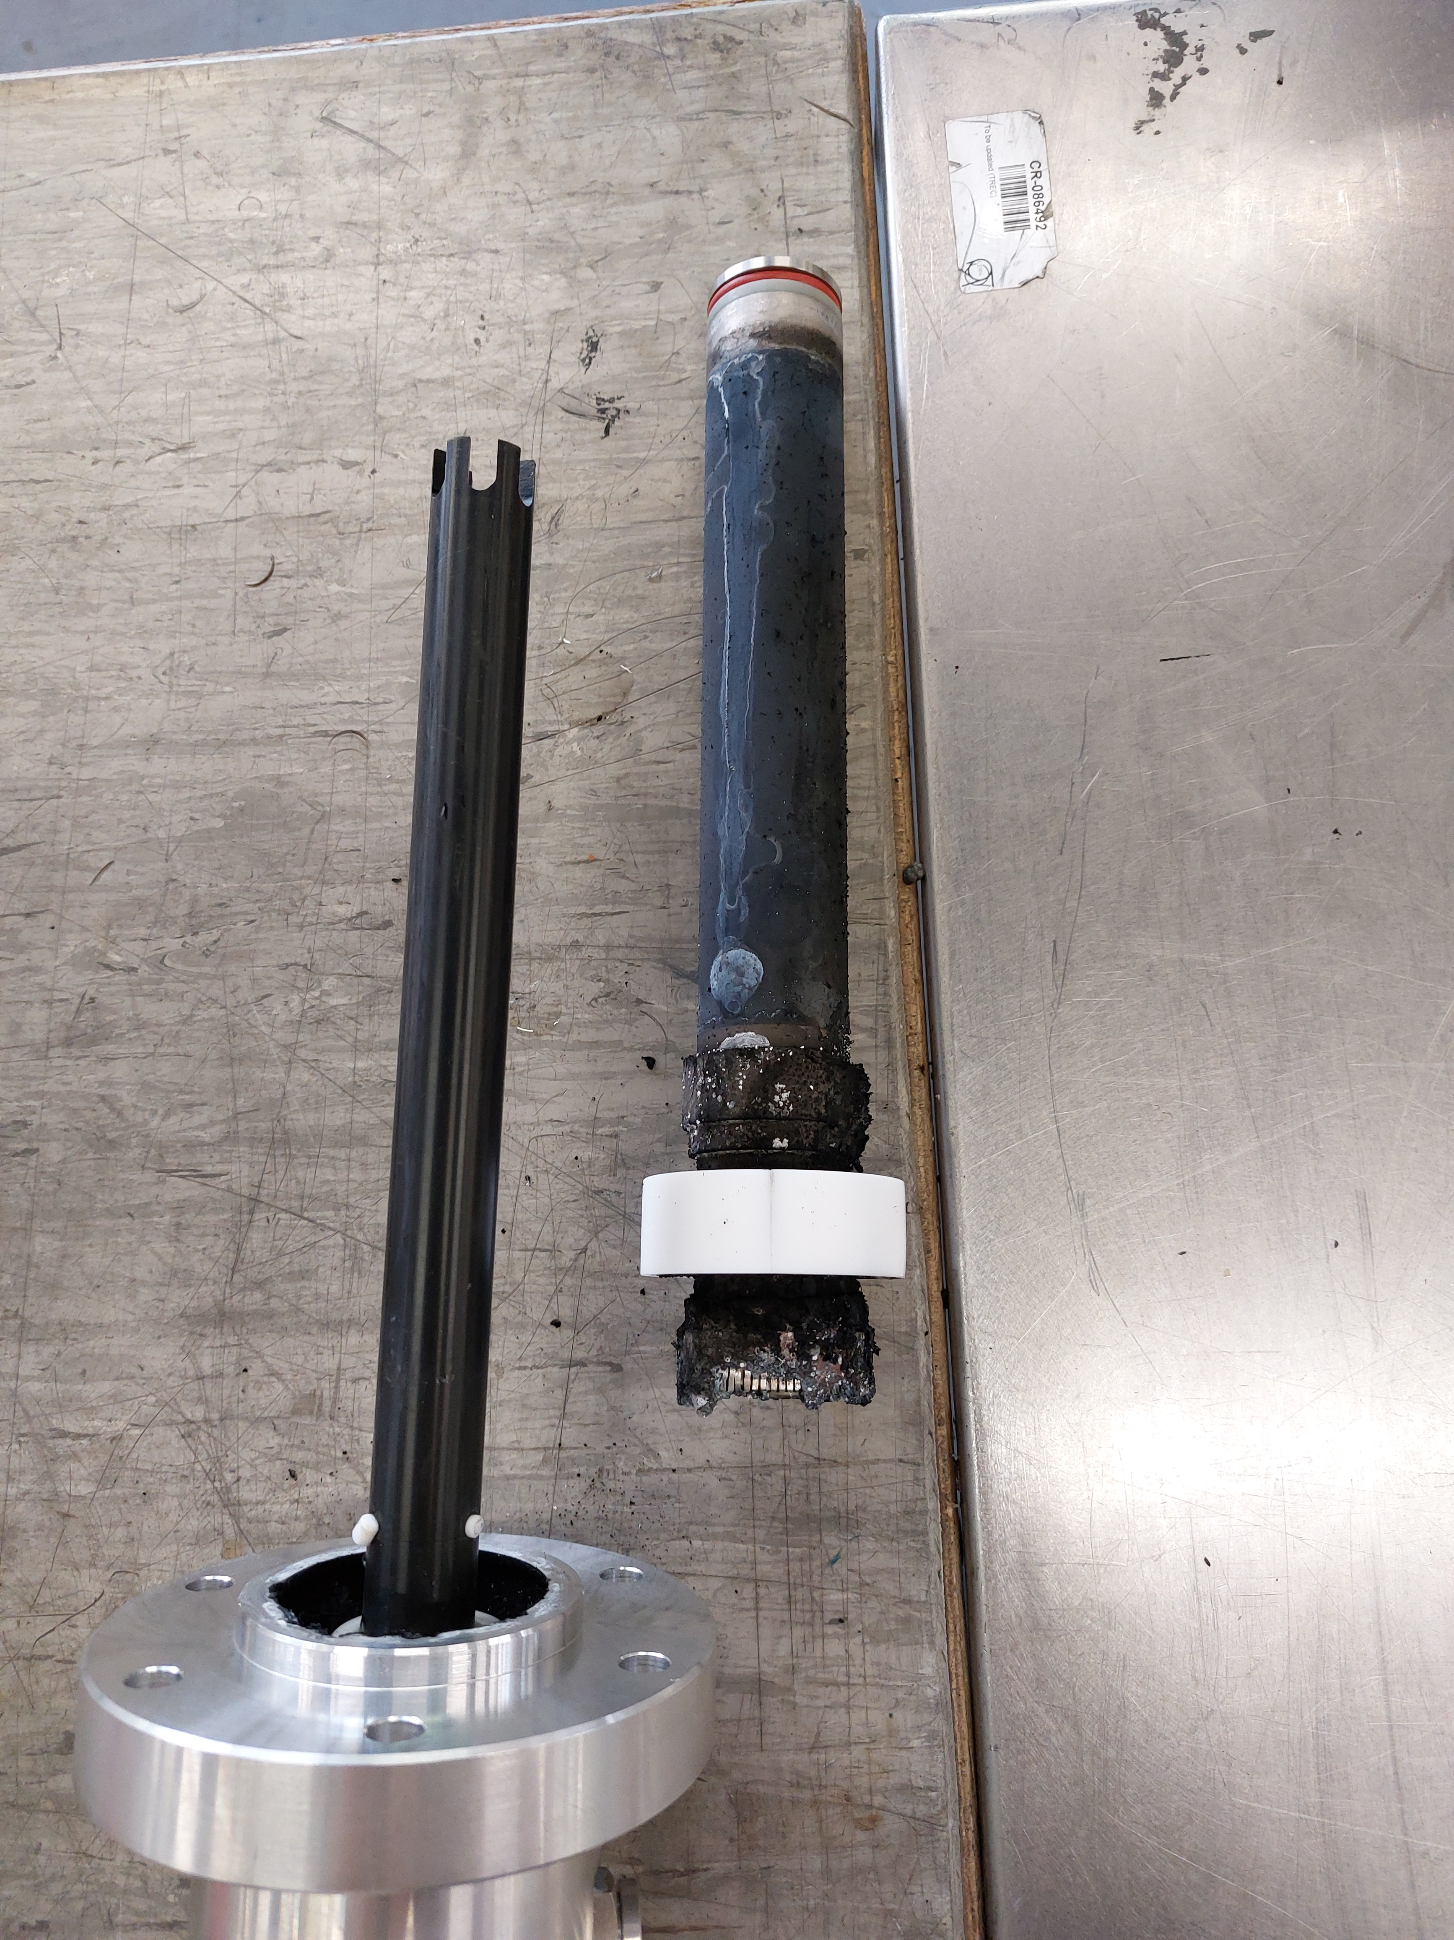
Broken load
A broken load has previously been discovered to result in many module failures
High failure rate on T14 even with very low power
Shares a hybrid with T12 (one of the most stable running at more than 10 times the power)
The high power load on the hybrid between the towers was seen to be leaking water
After removal it was dismantled to find it had been arcing
Not a single module lost on T14 since even after increasing the power*
Notes:
Remember the broken load from the history plot
**disclaimer about the modules.

Slide 21
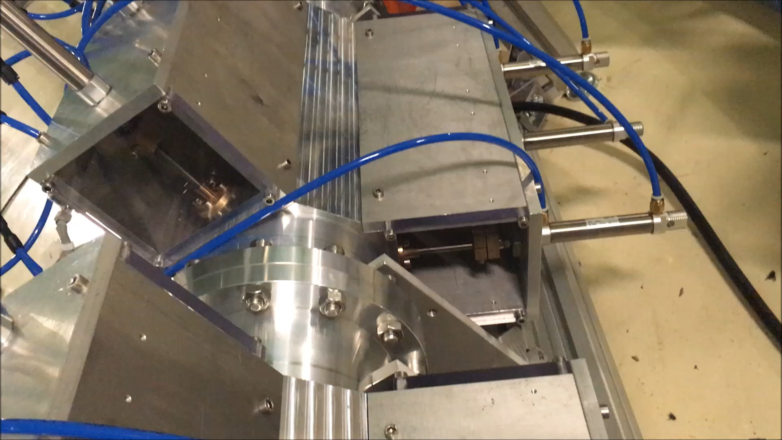
Short circuit test
6-1/8 line with 6 planes each with 3 fingers
every 5 seconds for one hour under various phase and power conditions
RF switch was off 100 ms after reverse was detected, in operation, it will be 1 ms maximum
Not having a circulator was THE challenge (I thought…)
It was fully successful, not a single module failed, the test was ok

Slide 22
Obsolescence
In 2015 NXP said plastic transistors were best for design
Beginning of 2022 last buy order warning within 6 months
When you move to transistors big science isn’t always the priority to suppliers
Obsolescence is a concern – do not count on suppliers to supply your project for its lifetime
When a design a system you must procure a lifetimes supply of transistors
Do transistors degrade on the shelf?

Slide 23
Ceramic transistors
We have procured a compatible ceramic transistor design
We have been testing them for some months in T12
No failures yet
When validated we aim to secure enough transistors for the future
Test bench is being recommissioned to do accelerated life tests with enhanced diagnostics
SSPA Module Test Bench

Slide 24
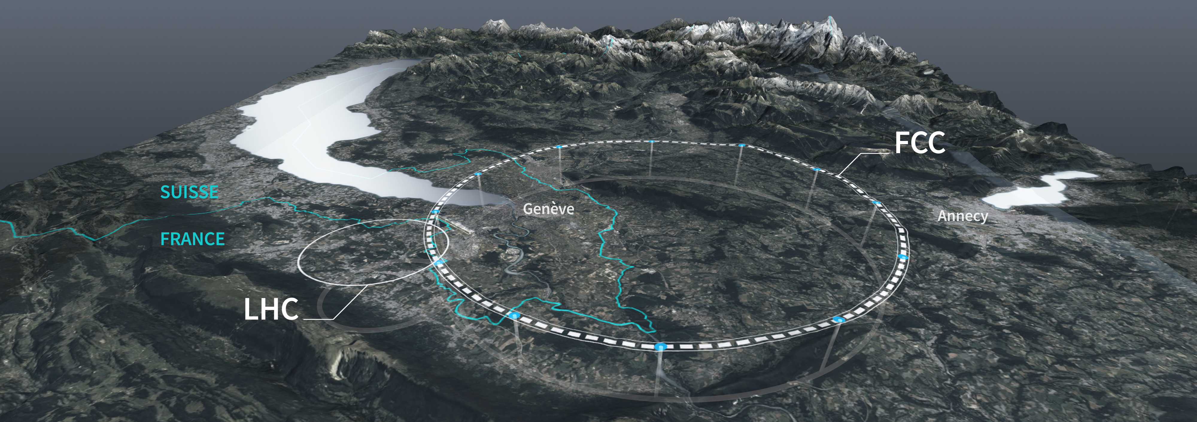
Conclusions
Conclusions
Interlocks – balance between stable operation and protecting system.
Despite all the problems we have had 99.9% availability
Although failure rate is high now, we are ironing out the problem
Once robustness is demonstrated Transistors can be considered for FCC

Slide 25
Questions
Thanks to all my colleagues and the meaningful collaborations who have contributed to this work.

