Slide 1
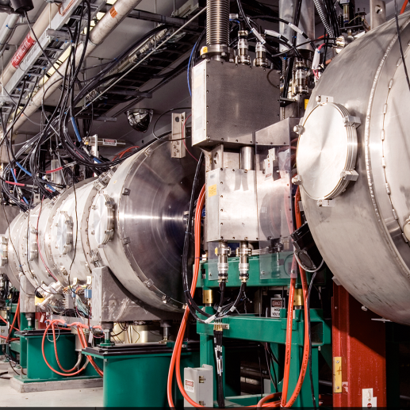
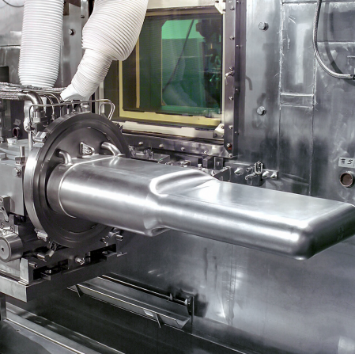
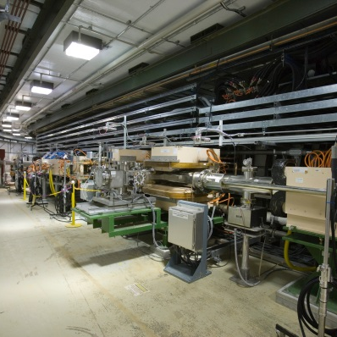

Spallation Neutron Source HPRF Sources – Past, Present, and Future
13th CWRF Workshop
John Moss

Slide 2
The Spallation Neutron Source relies heavily on klystrons – which are difficult to fabricate and operate – as its high-power RF source. Are there viable alternatives?
To help answer that question we will discuss:
Present SNS High-Power RF sources
A Brief Glimpse of the Past
Why klystrons?
Recent Experience with Klystrons
The Future of SNS High-Power RF Sources

Slide 3
Present: There are 131 distinct high power RF systems across the SNS complex.
At present there are 3 solid state, 4 tetrode, and 124 klystron-based RF sources used to accelerate an H- beam and accumulate protons
Ring RF Systems (4)
NC RF Systems:
DTL (6)
CCL (4)
SC RF Systems:
Medium Beta (33)
High Beta (76)
FE RF Systems:
Ion Source (2)
RFQ
MEBT (5)

Slide 4
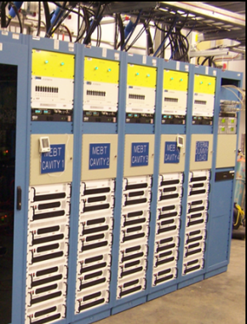
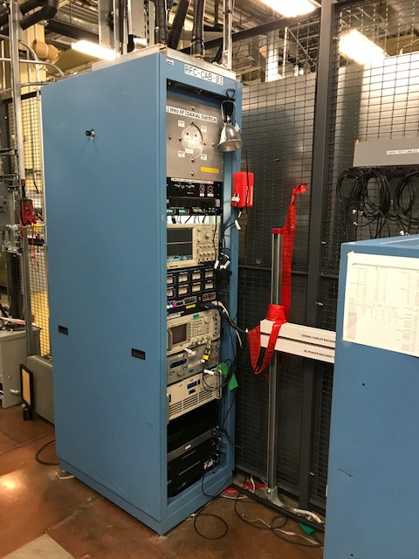
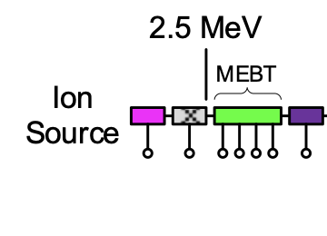
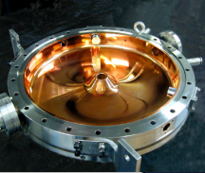
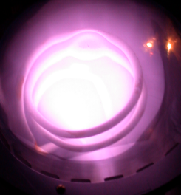
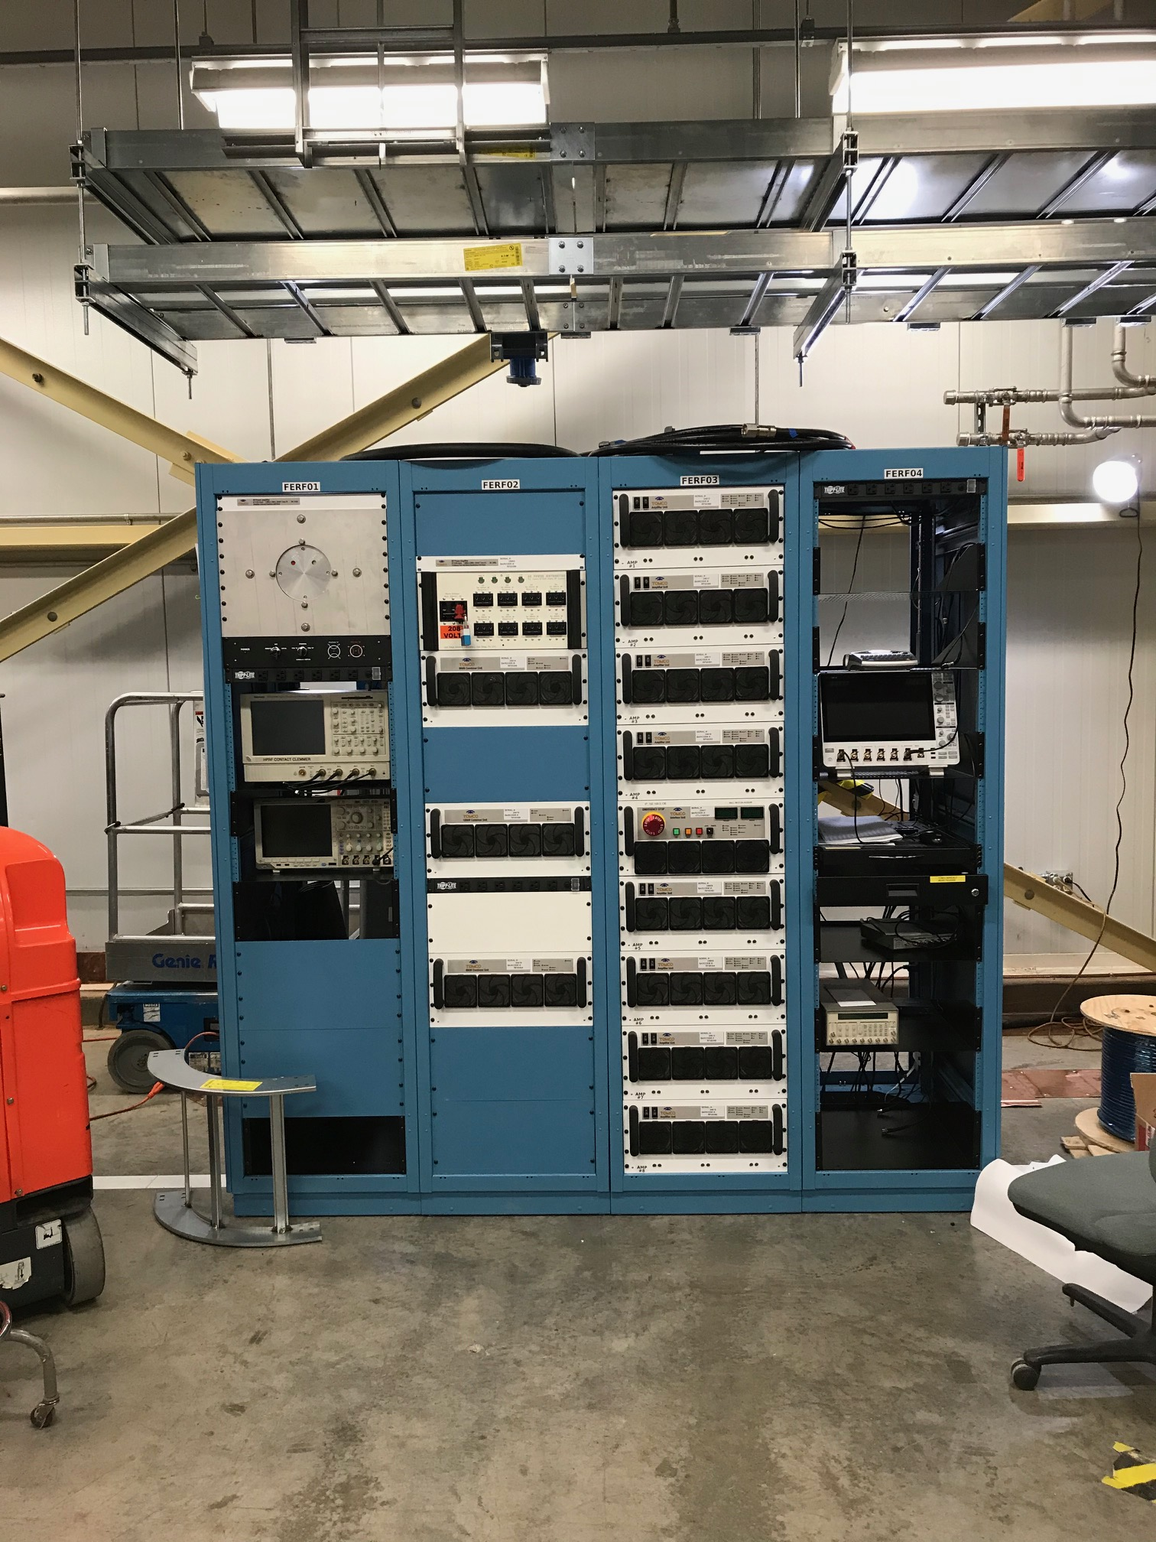
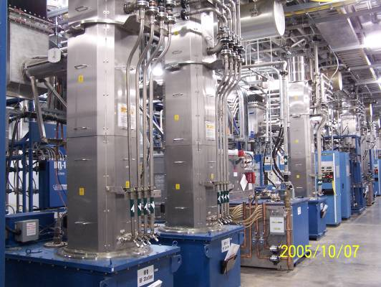
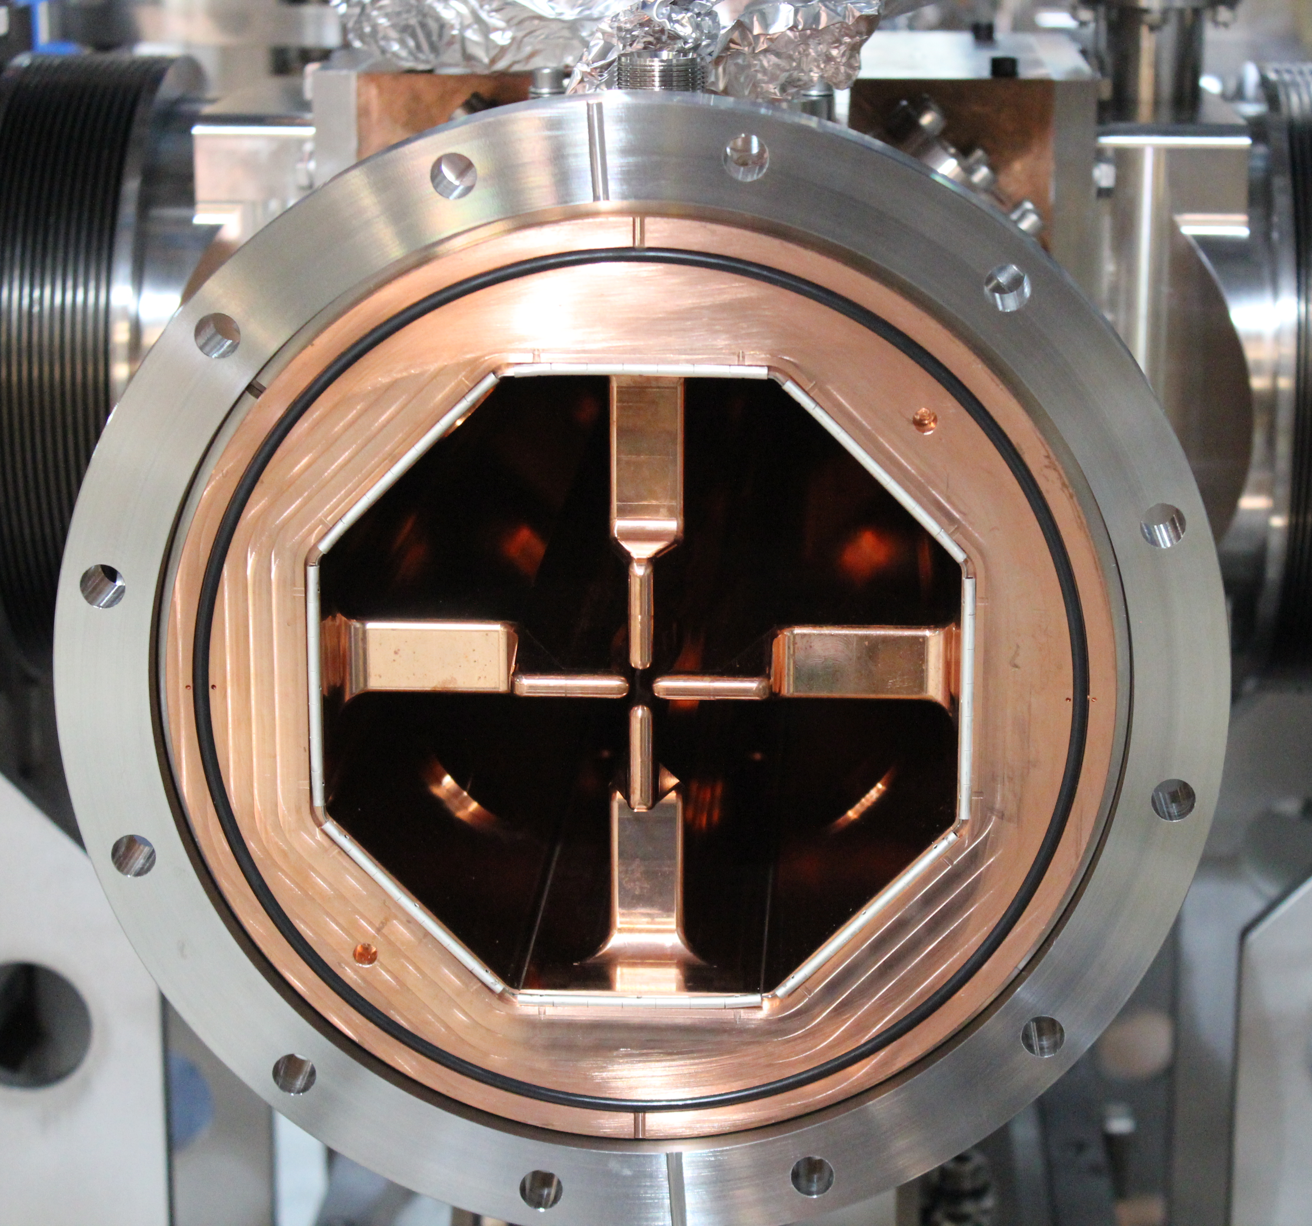
Present: There are eight high power RF sources for the front-end systems.
600W, 13MHz CW
20kW x 4 (+1), 402.5MHz Pulsed
.
2.5MW, 402.5MHz Pulsed
SOLID STATE
80kW, 2MHz Pulsed

Slide 5
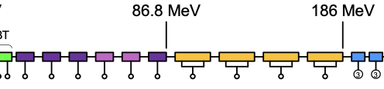
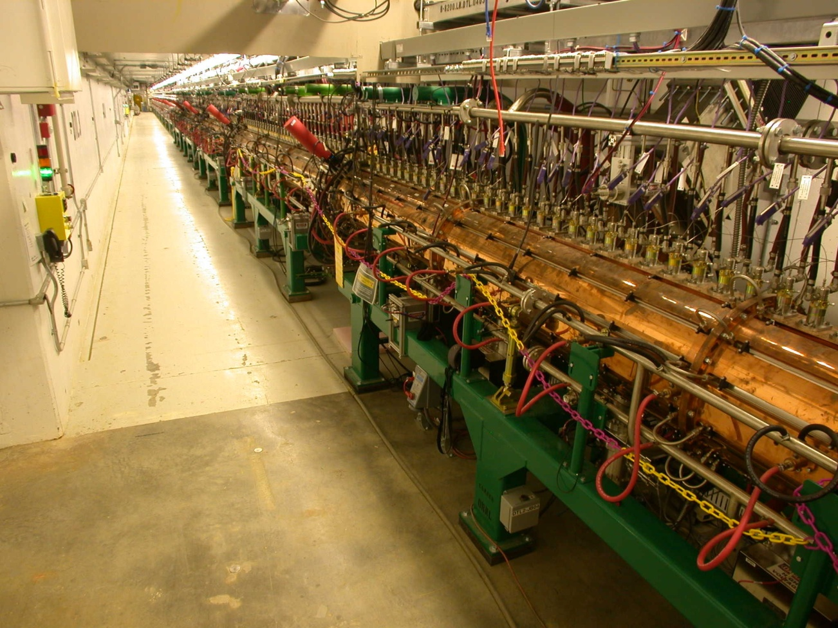
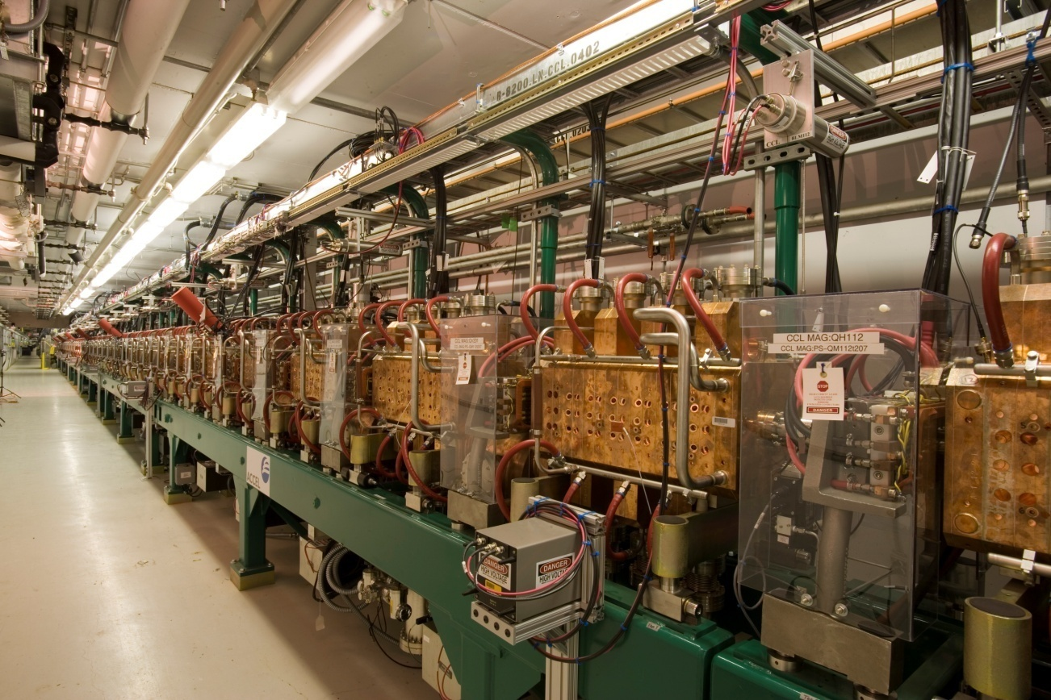
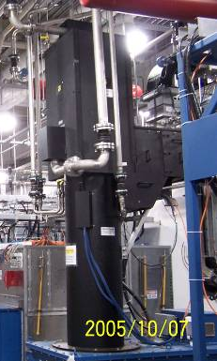
Present: The highest peak RF power levels at SNS are in the normal conducting Linac.
In the normal conducting linac, the beam energy is relatively low and there is only one klystron per system. This creates a bottleneck that is important to note – we cannot bypass any of the cavities in the event of a high-power RF source failure.
Six 2.5MW, 402.5MHz pulsed systems
Four 5MW, 805MHz pulsed systems
Frequency increase to 805MHz

Slide 6
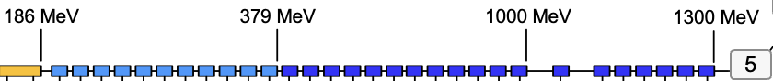
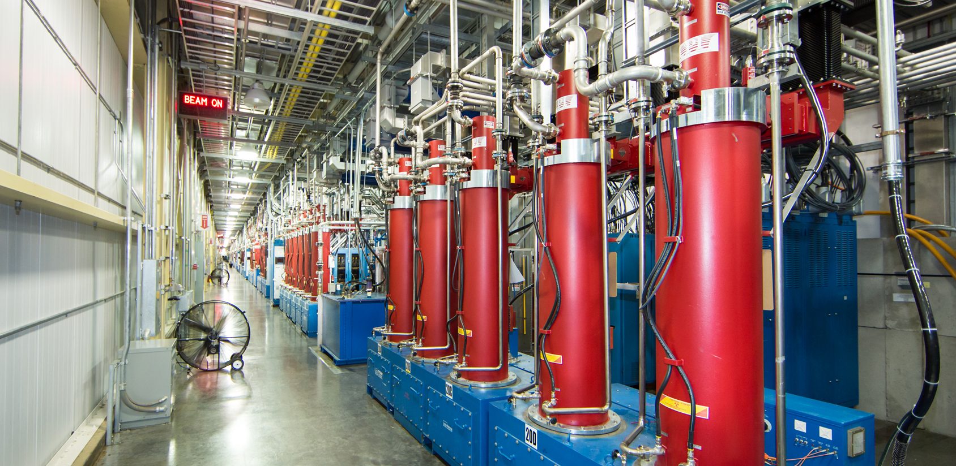
Present: The bulk of the high-power RF systems at SNS are in the superconducting linac – 109 of the 131.
The superconducting linac is more flexible. The beam energy is higher and there are 3 – 4 klystrons per cryomodule. Here, we can bypass up to 3 cavities (and the associated klystron) with no loss in energy.
Medium Beta - 33
550kW, 805MHz pulsed systems
High Beta - 76
550-700kW, 805MHz pulsed systems

Slide 7
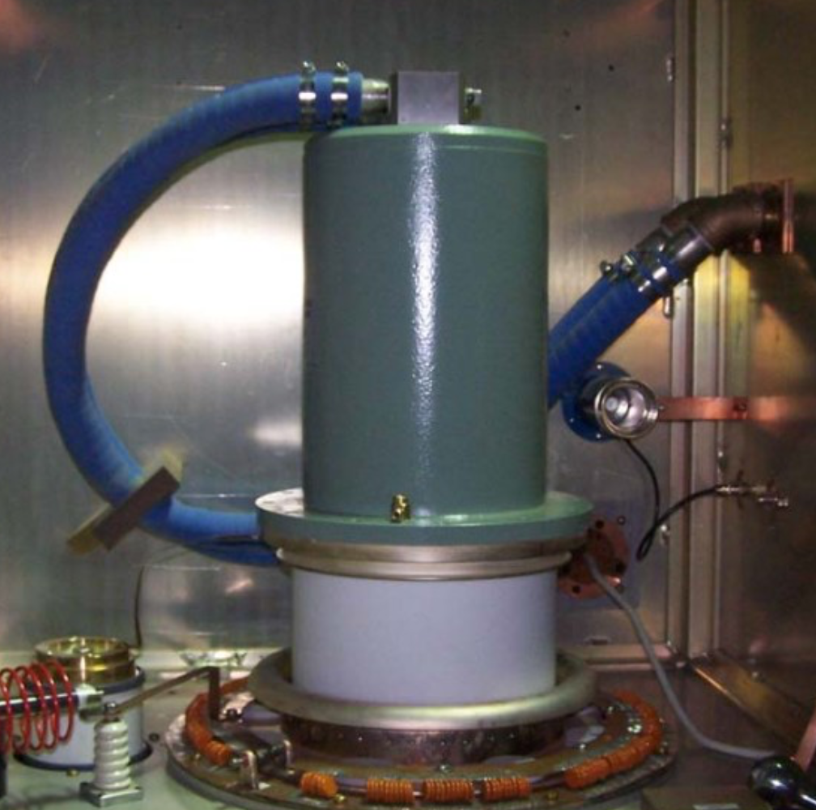
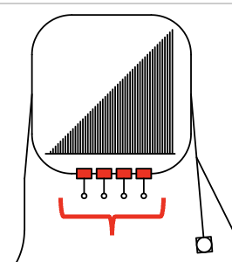
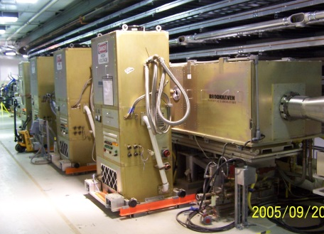
Present: The Ring high-power RF systems are used to counteract space charge as the protons are accumulated.
x4
2MHz – 2 500kW pulsed systems
1MHz – 2 500kW pulsed systems

Slide 8
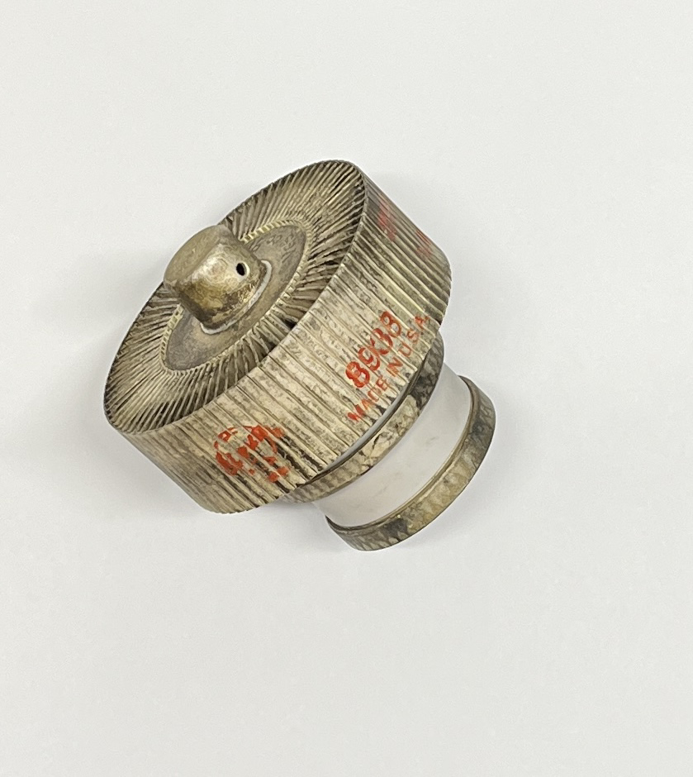
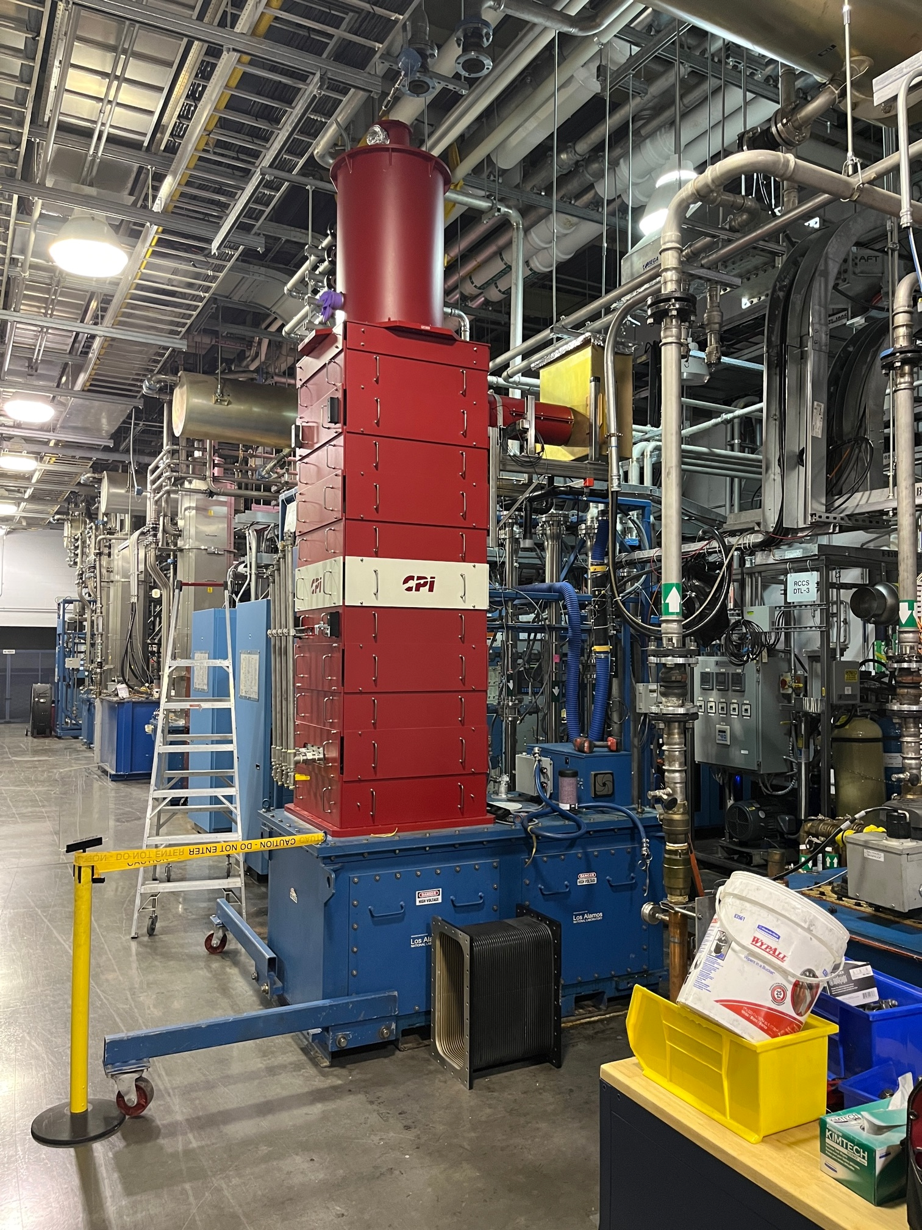
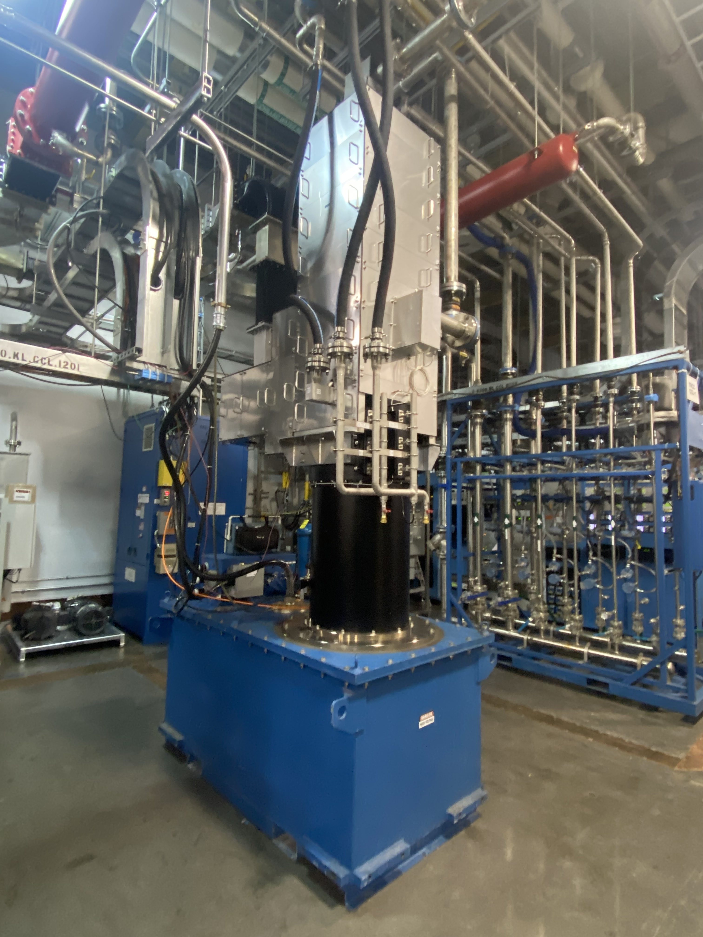
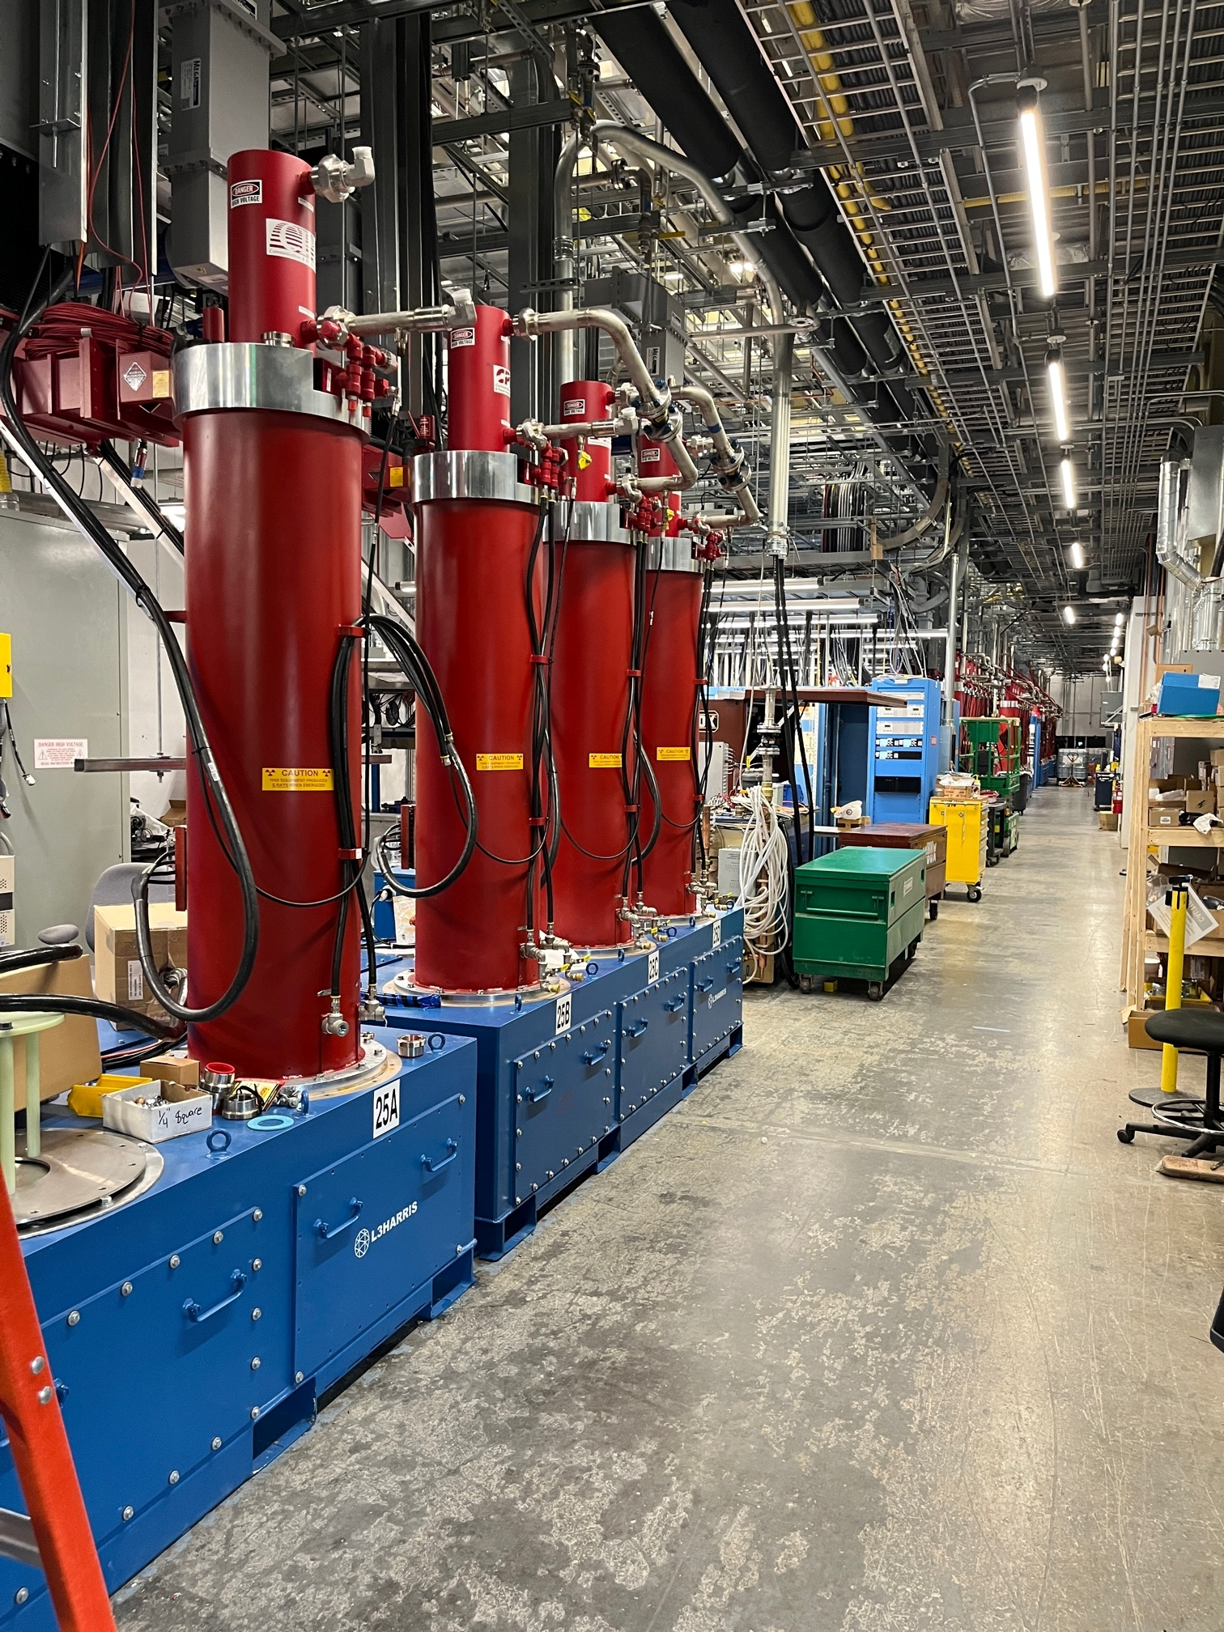
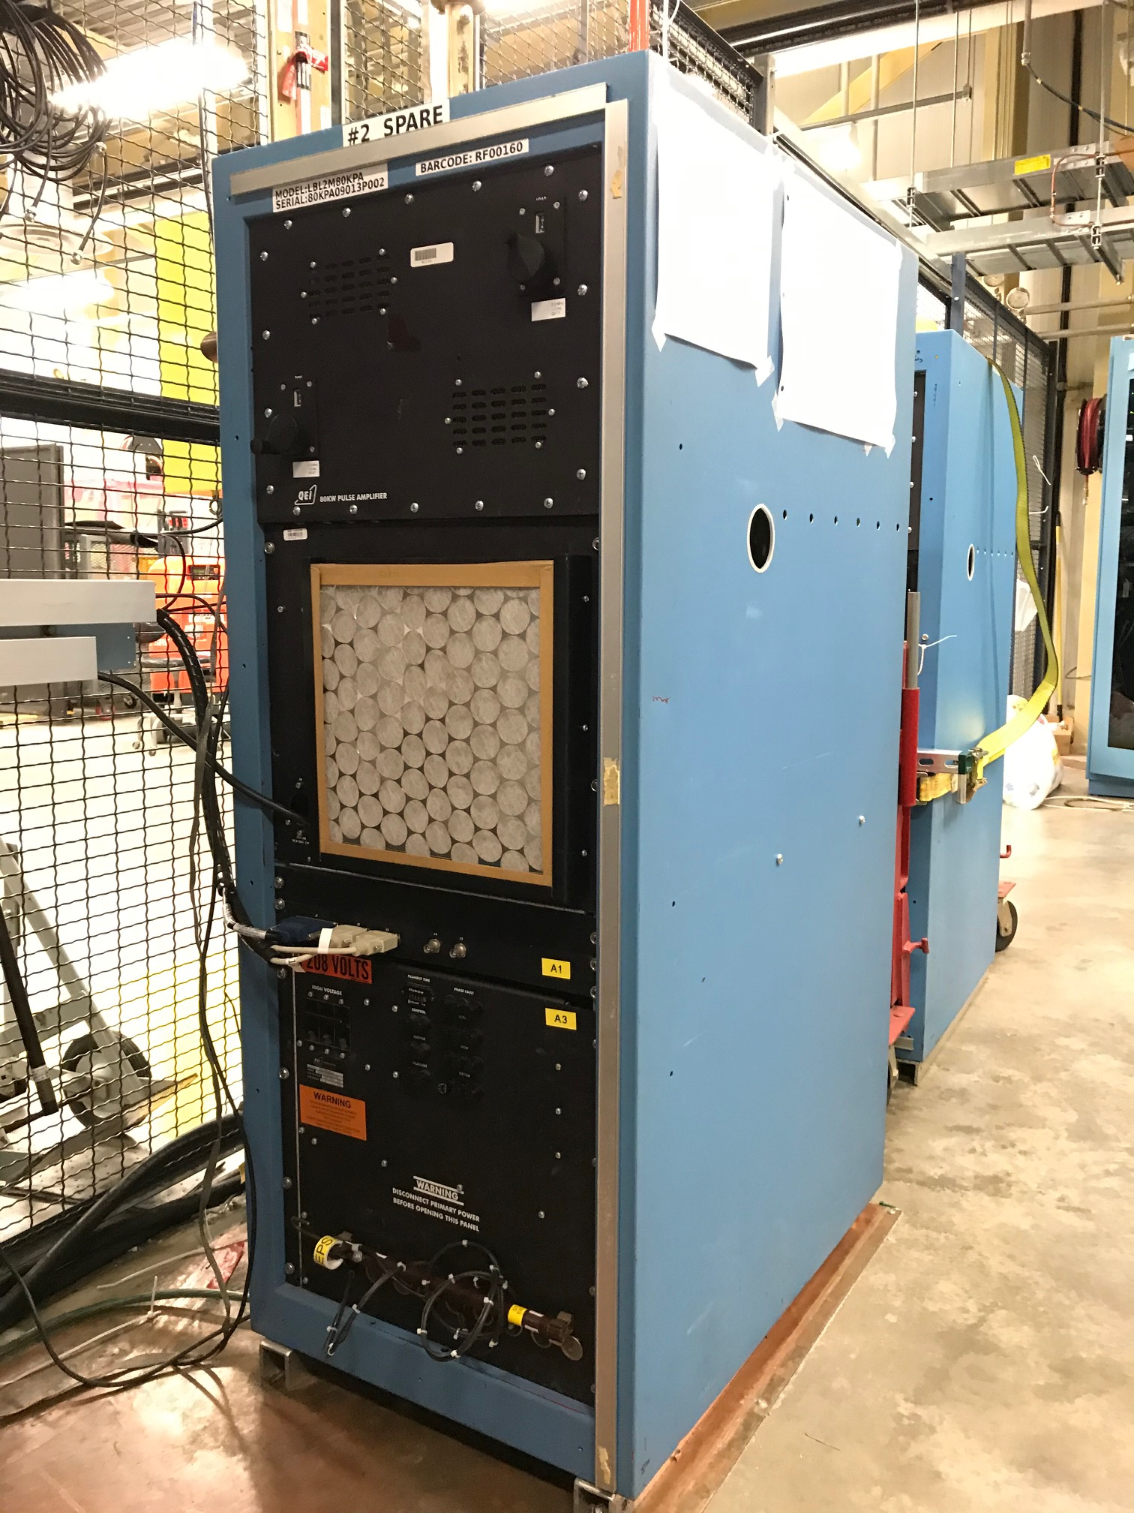
Glimpse of the Past: The SNS RF systems first started operation in the early 2000s.
RF sources in the front end have changed since the start…
…but the rest of the accelerator is essentially the same – vacuum-tube-based – and primarily klystrons.

Slide 9
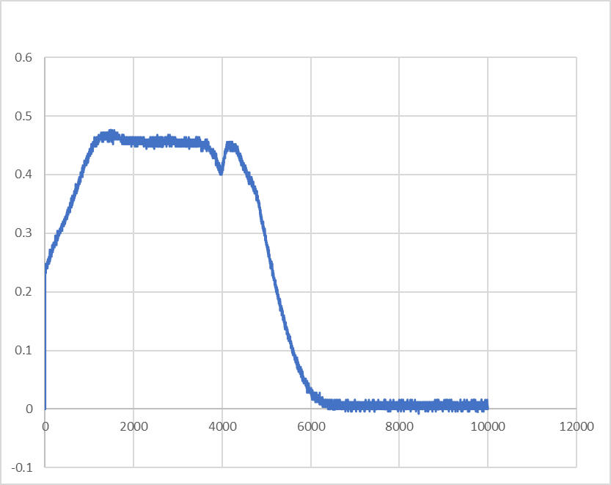
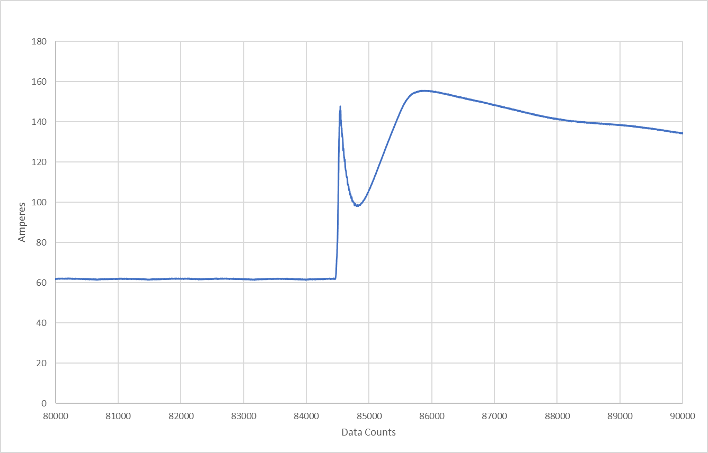
Glimpse of the Past: Historically, Klystrons are the single largest source of HPRF downtime, in terms of frequency.
Output RF Instabilities
Cathode Overcurrent

Slide 10
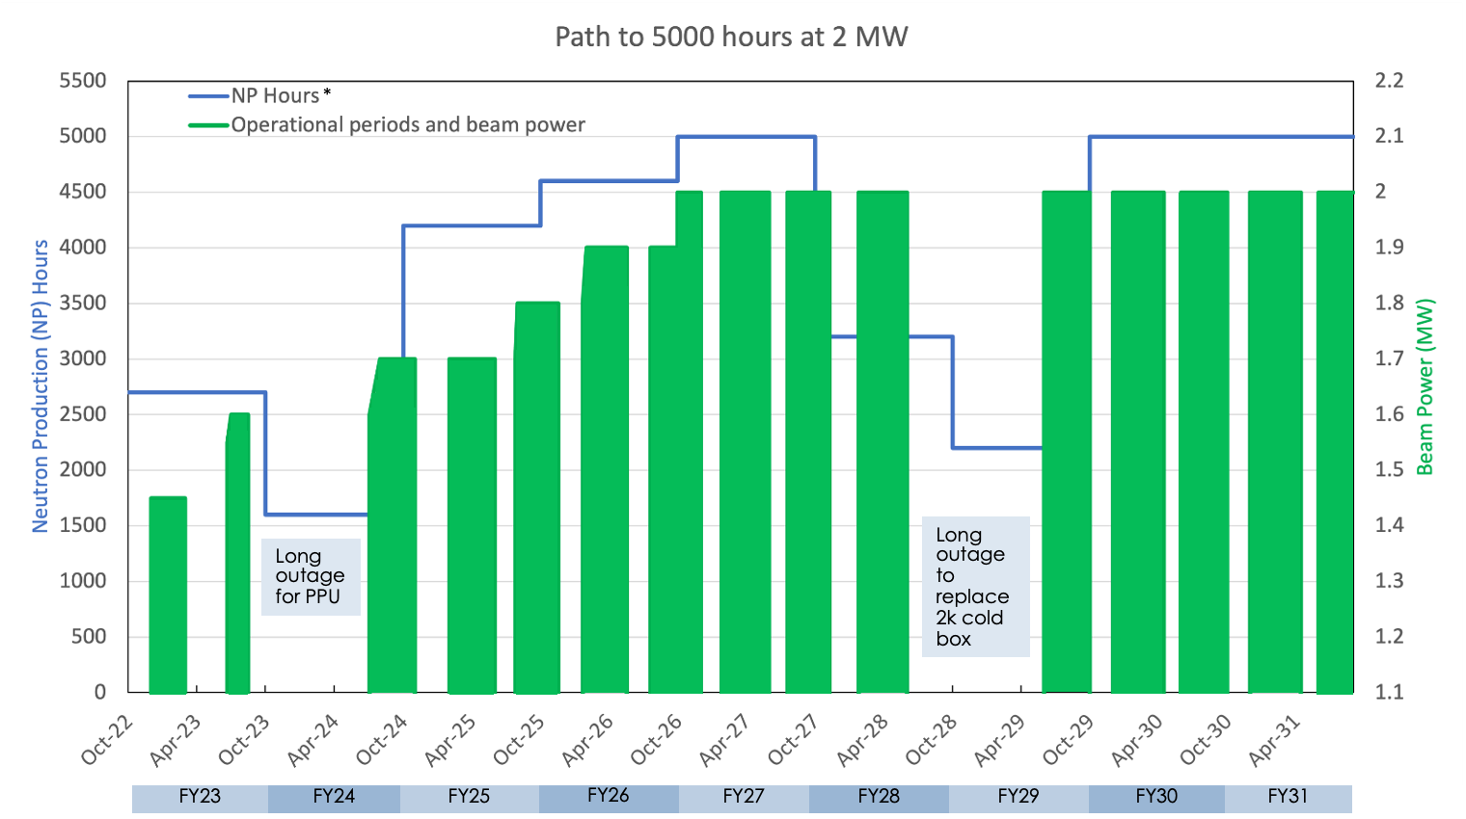
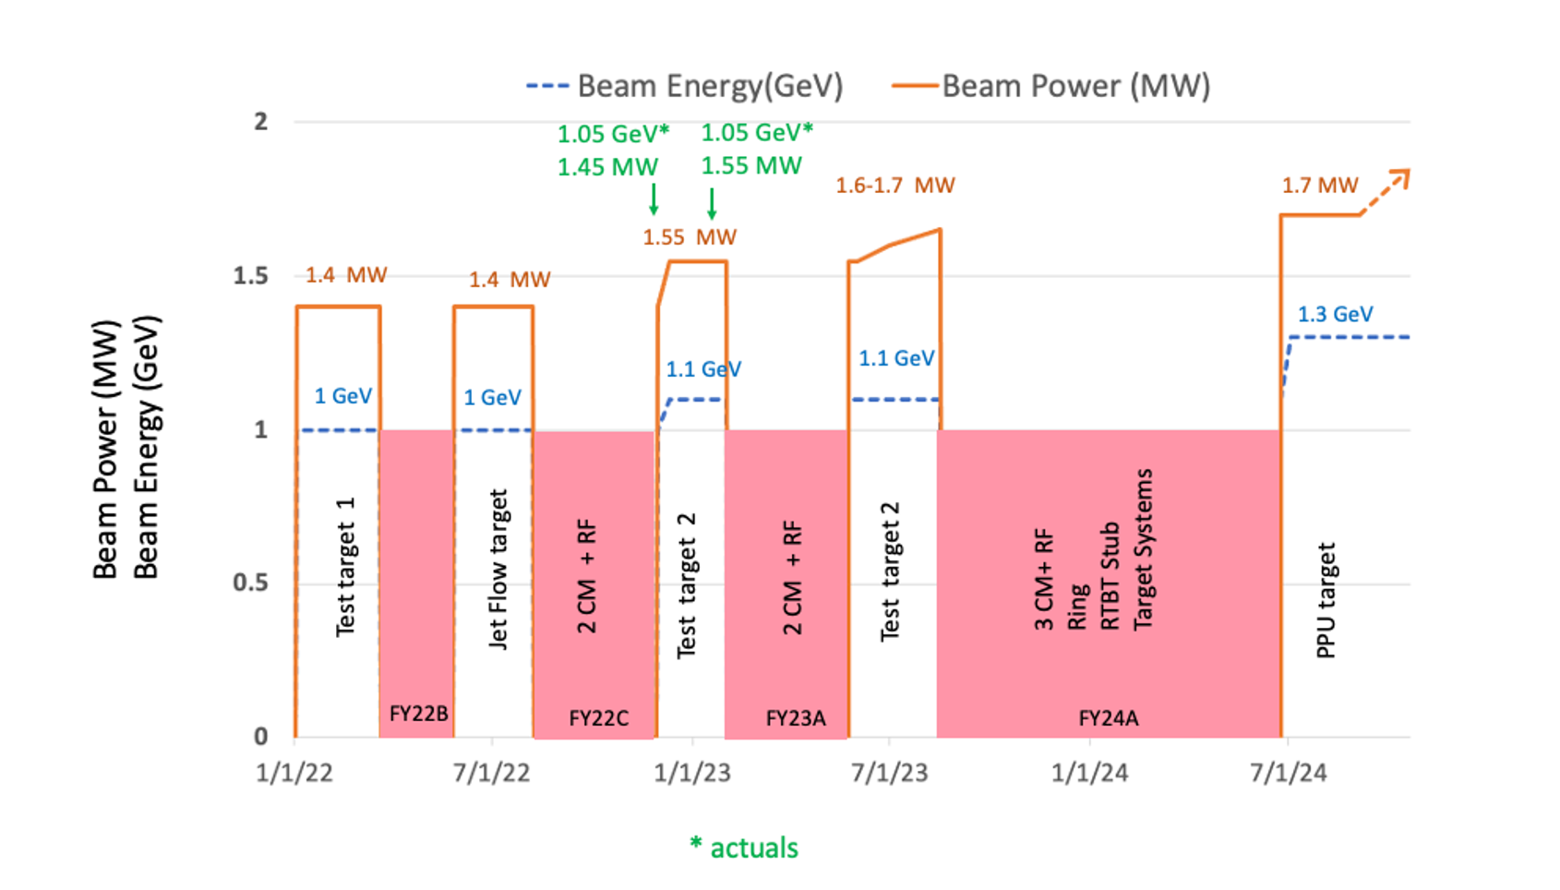
Why klystrons? Part of the answer is power levels.
SNS is only increasing in beam power, requiring more (~hundreds of kW, peak) high power RF with each step.
1.7MW today
2.0MW in 2026

Slide 11
Why klystrons? In short, infrastructure, age of our operating tubes, and spares.
In addition to the power levels, to move to a new high-power source would require major changes to infrastructure.
Linac Segment | In Operation | Spares (Untested)
RFQ/DTL | 7 | 1(+2)
CCL | 4 | 1
SCL | 109 | (39)
Longest operating klystrons in this segment have ~ 70,000 filament hours
Longest operating klystrons in these segments have ~ 100,000 filament hours
The spares situation also requires that we engage klystron vendors – which we have been doing since 2018. Remember the bottleneck in the NCL. Developing klystrons here is imperative!

Slide 12
Why klystrons? The near future of SNS relies on stable klystron sources – both in fabrication and operation.
770kW
Awarded contract in 2018. 3 of 3 klystrons delivered.
5MW
Awarded contract in 2018. 28 of klystrons delivered.
Awarded contract in 2018. 1 of 4 klystrons delivered.
3MW

Slide 13
Recent Experience: Fabrication of large klystrons has proven to be difficult...
Collector failed pressure test on the first article
High perveance on first article led to low peak output power
All 3 klystrons show persistent ”micro-discharge” on the cathode current. Micro-discharge prohibited operation on 2/3.
5MW
Vacuum leak discovered on first cavity during bakeout.
Persistent vacuum leaks on first cavity led to the redesign of the structural support.
Incorrect radius on first article cathode led to low perveance and low output power
3MW

Slide 14
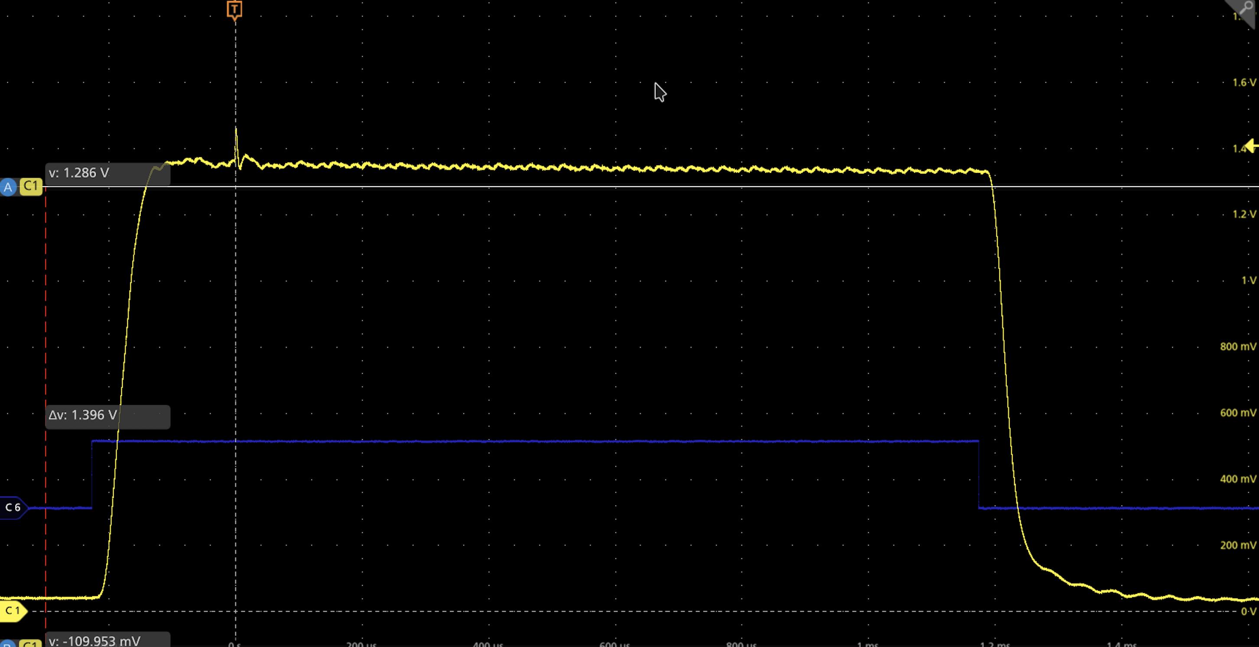
Recent Experience: …and stable operation…
5MW
Instantaneous 5A “spike” in klystron beam current
Cathode “micro-discharge” on 3/3 klystrons. Removed from operation in CCL-1 in August 2024 after significant vacuum degradation. Returning to vendor.

Slide 15
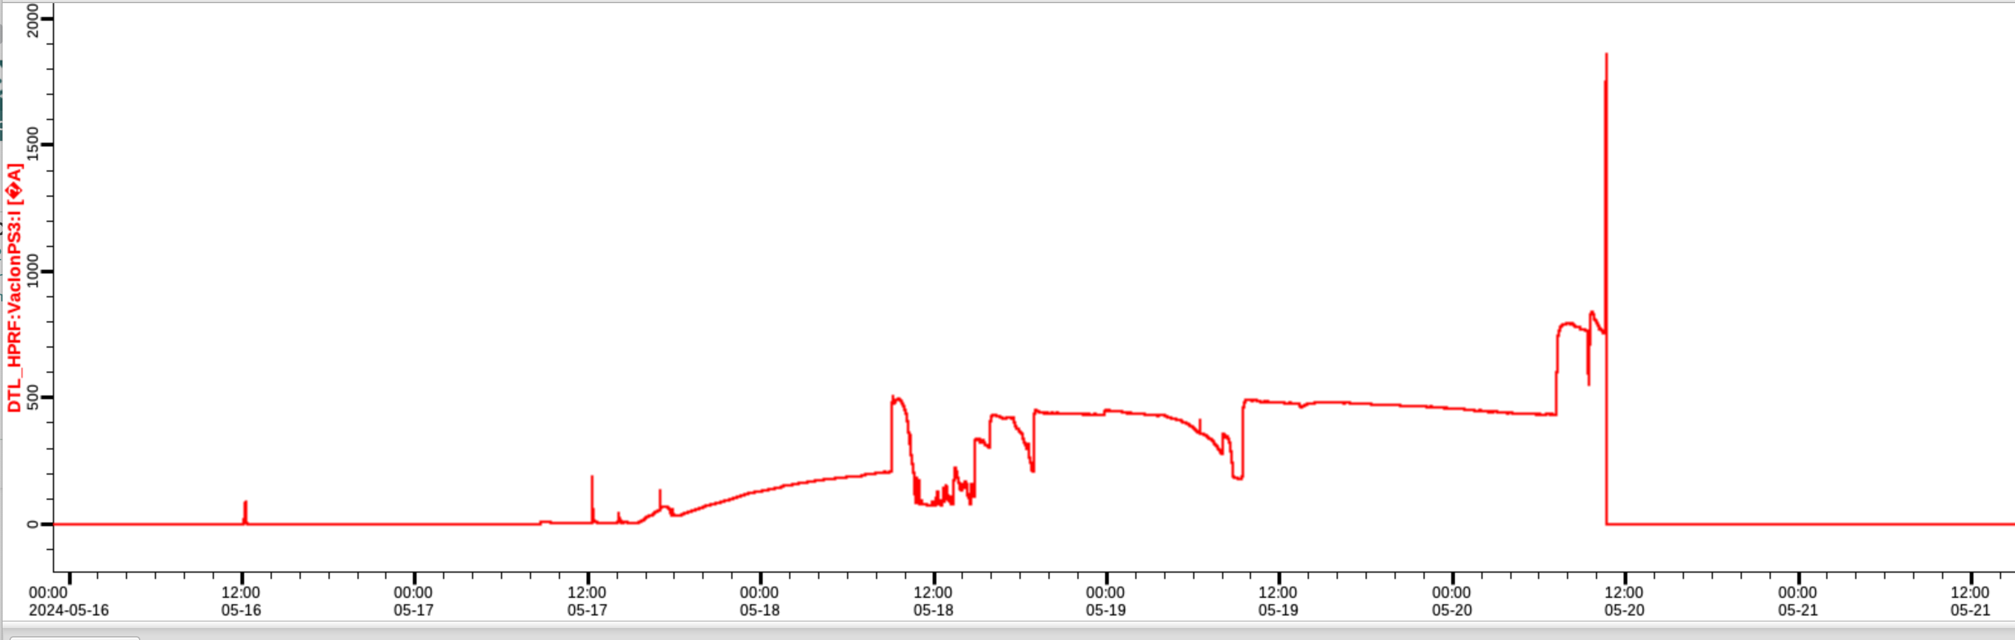
Recent Experience:... even more so.
3MW
Vacuum leak. Removed from DTL-3 in May 2024. Will be returned to vendor.

Slide 16
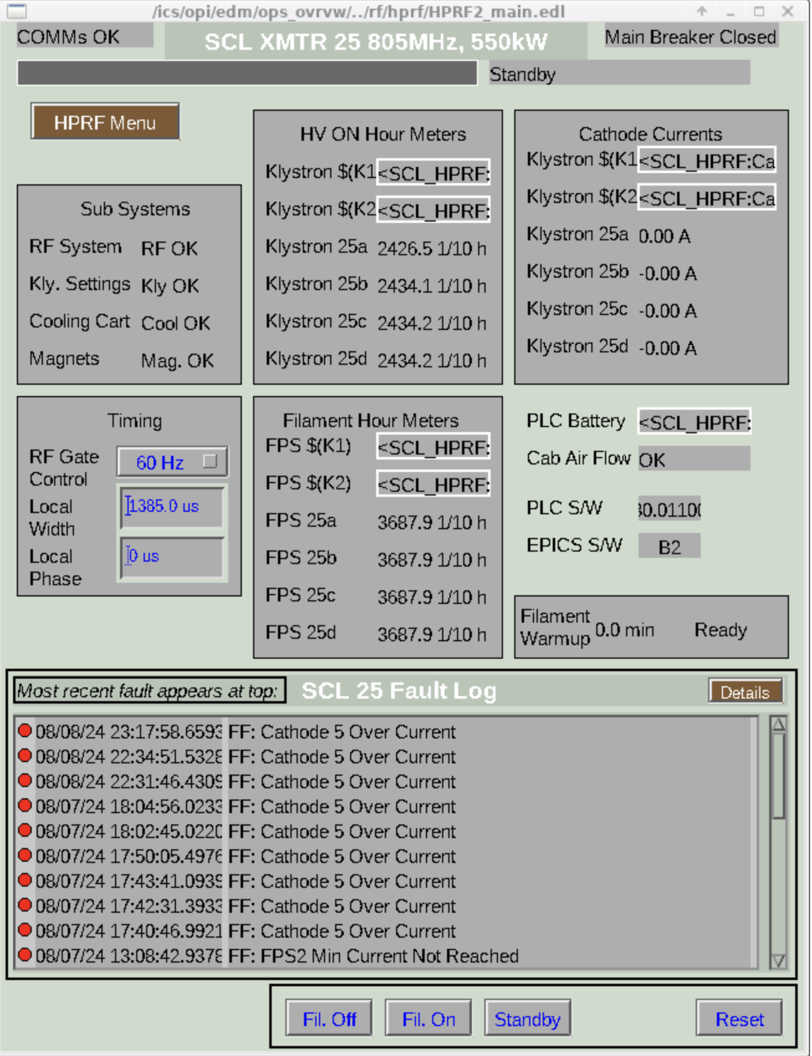
Recent Experience: Stable operation has even been elusive on the lower power tubes.
770kW
Removed 4 out of 28 klystrons from HV for repeated cathode arcing. Three returned to vendor.

Slide 17
Future: SNS relies on 124 tubes, but we are open to better sources or power delivery schemes. Other options?
?
Potential for solid-state in SCL and Ring
Potential for combining of lower power tubes for greater flexibility

Slide 18
Conclusion: The Spallation Neutron Source relies heavily on klystrons – which are difficult to fabricate and operate – as its high-power RF source. Are there viable alternatives?
?
There are viable alternatives long-term (10 years). Near term, SNS must continue to focus on the continued development of high-power klystrons for use in the normal conducting segments of our linac. As of today, we are > 6 years into that development.

Slide 19
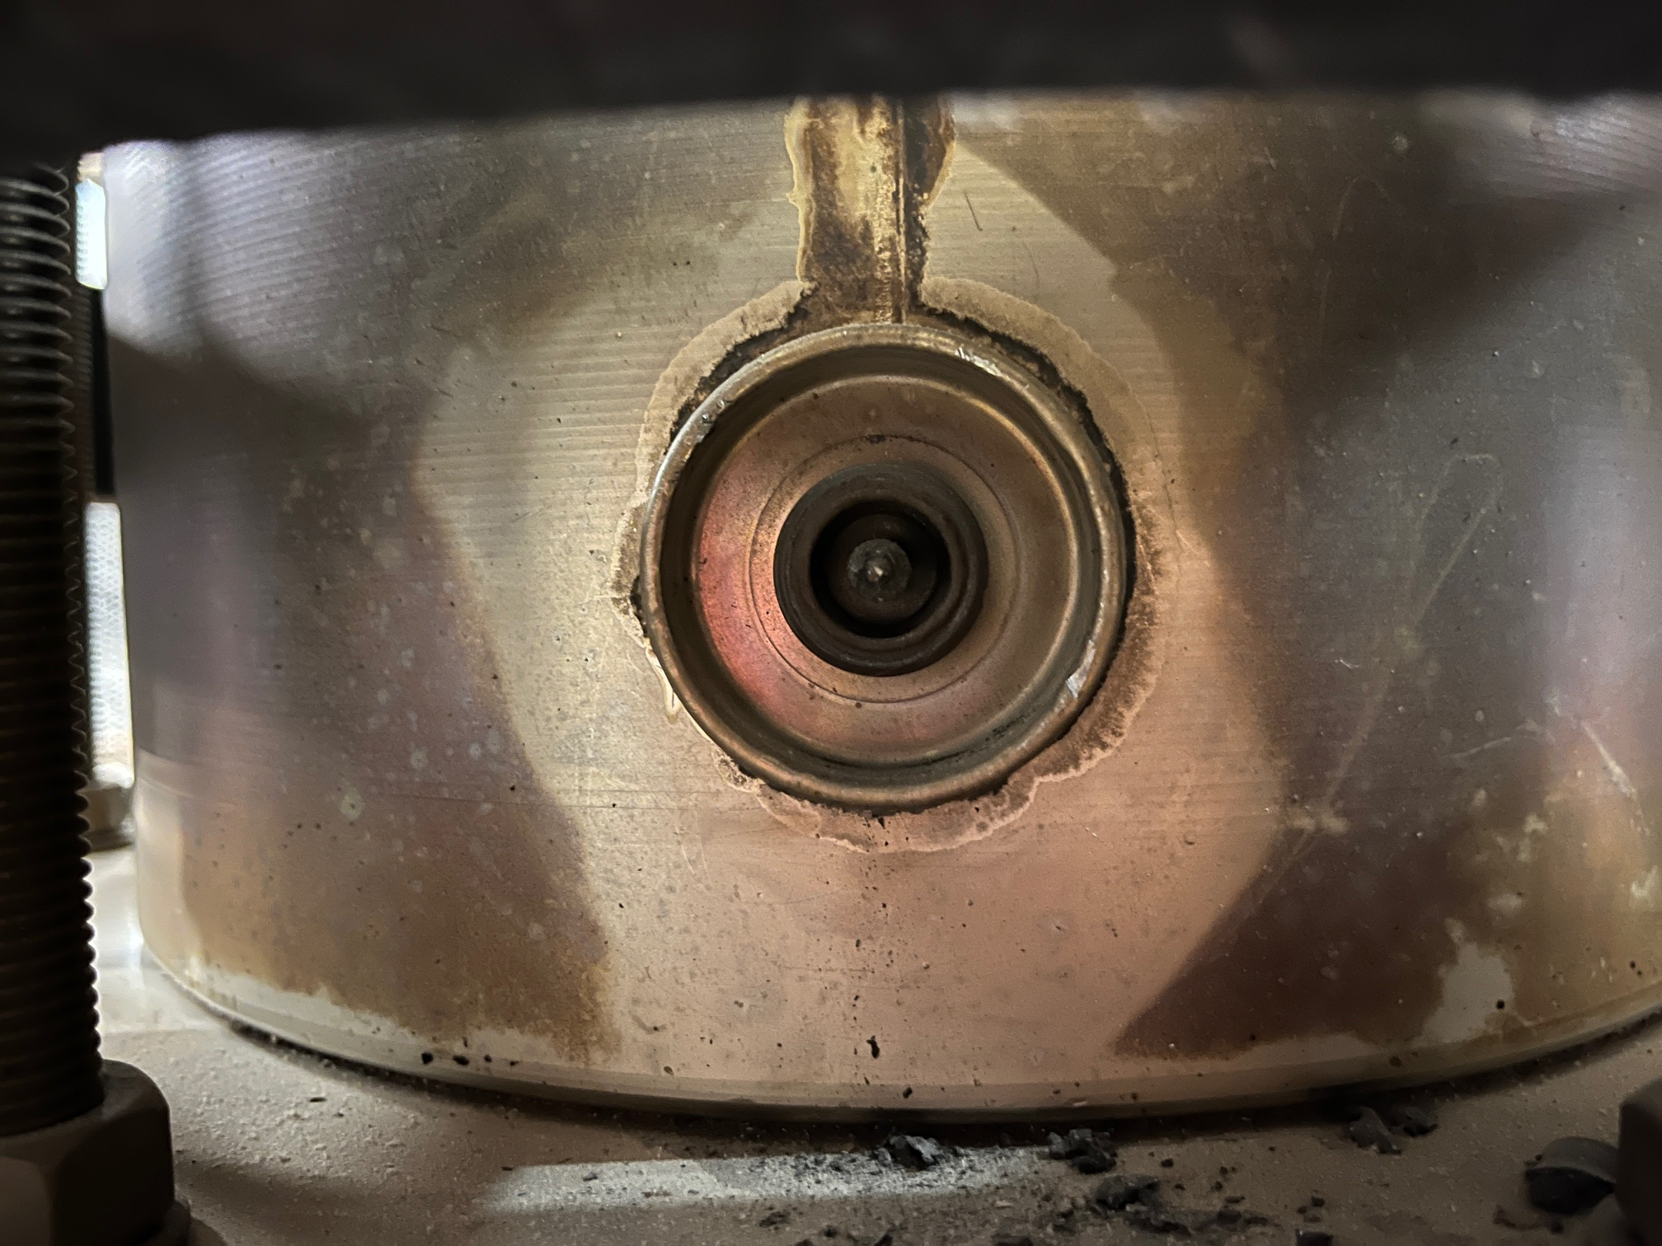
In keeping with CWRF tradition, here is a picture of a burned second cavity load connection on a 2.5MW klystron.

