Slide 1
Notes:
Slide 1: Company Logo Full Page
Before you start editing the slides of your talk change to the Master Slide view:
Microsoft Office :Menu: View > Slide Master;
Macintosh – View > Master > Slide Master
Edit the following items:
On the Slide Master (first master slide) – lower area
a) On the left Delete the text and write the title of the event/Conference, Location
b) On the right delete the text and write the name and surname of the speaker and the date (day, month , year)
Close Master View

Slide 2
130 kW - 500 MHz SSA
Commissioning and Operation in Elettra
Notes:
Slide 2: Title of the Presentation
Before you start editing the slides of your talk change to the Master Slide view:
Microsoft Office :Menu: View > Slide Master;
Macintosh – View > Master > Slide Master
Edit the following items:
On the Slide Master (first master slide) – lower area
a) On the left Delete the text and write the title of the event/Conference, Location
b) On the right delete the text and write the name and surname of the speaker and the date (day, month , year)
Close Master View
To start adding slides insert a new slide and select a Layout:
For Title & Subtitle
For text with bullet points
For Text
For Picture, graphs, visuals
Two columns
Blank

Slide 3
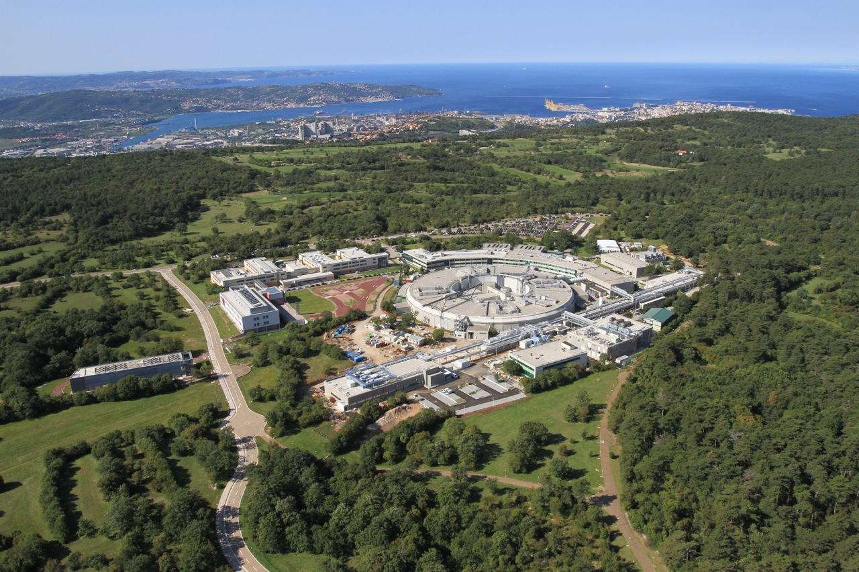

Elettra Sincrotrone - Trieste
Elettra: Third generation light source (DBA - 259.2 m) , open to external users since 1994 at 2.0 GeV ( 310 mA ) and 2.4 GeV ( 160 mA)
Elettra 2.0 project : S6BA-E with 12-fold symmetry operating mainly at 2.4 GeV (400 mA). It will open to external user in 2027
Elettra
EUROPE
FERMI
Seeded FEL (HGHG), 1.5 (1.8 ) GeV, 10 Hz (50 Hz) – First Lasing Dec.13, 2010
Open to external users since 2012 (FEL-1) (100-20 nm, 12 - 62 eV) and 2015 (FEL-2) (20- 4 nm, 62 - 320 eV)
Notes:
Slide 3 – (..) : Content of the presentation
Insert a new slide: Home > “New Slide” and choose a slide Layout:
For Title & Subtitle
For text with bullet points
For Text
For Picture, graphs, visuals
Two columns
Blank
If you want Copy & paste an element from the Clip Board to the particular slide:
1. Click on a box to mark it.
2. Position the mouse pointer on the box frame: Copy!
3. Click on the particular slide: Paste!
How you intend to use the elements is your choice.
You can combine the text block style with the background colour in different manner.

Slide 4
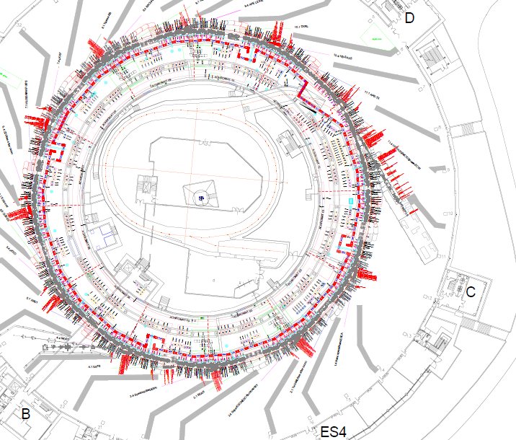
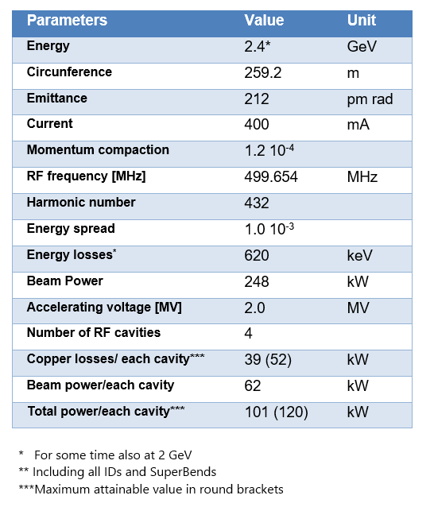
Elettra 2 parameters

Slide 5
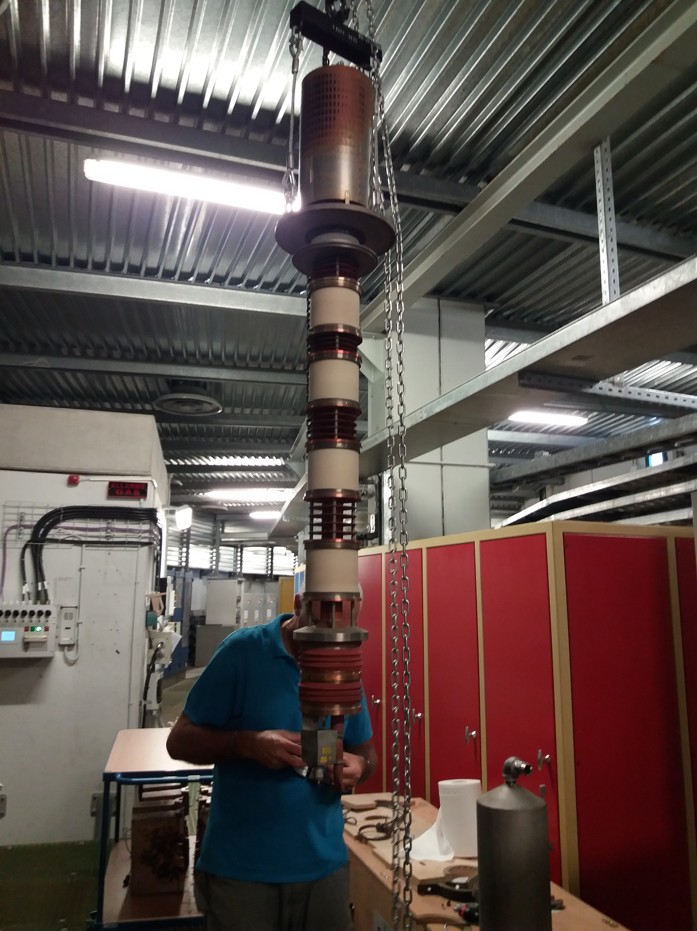
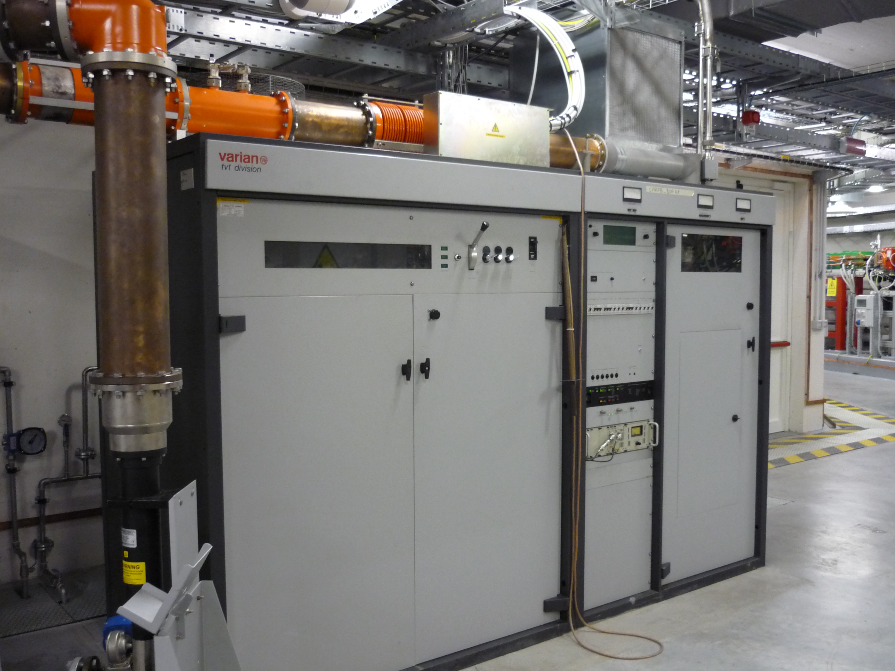
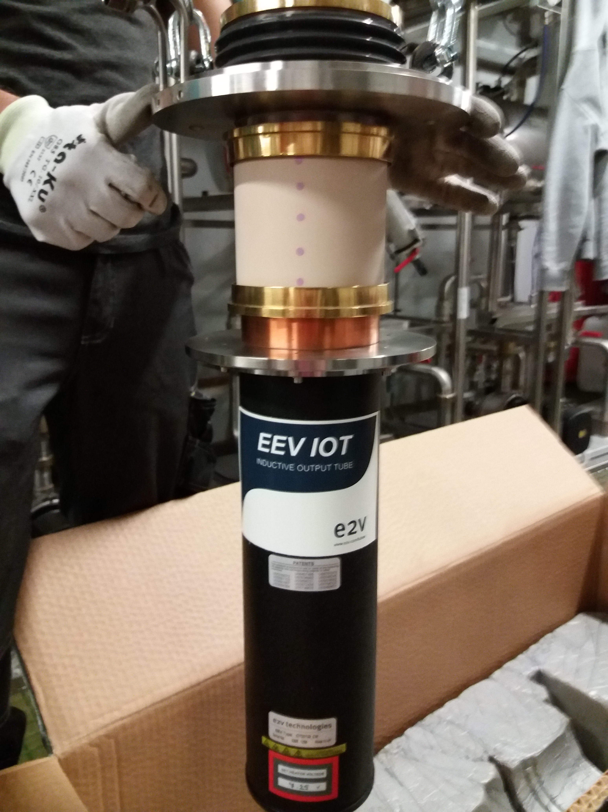
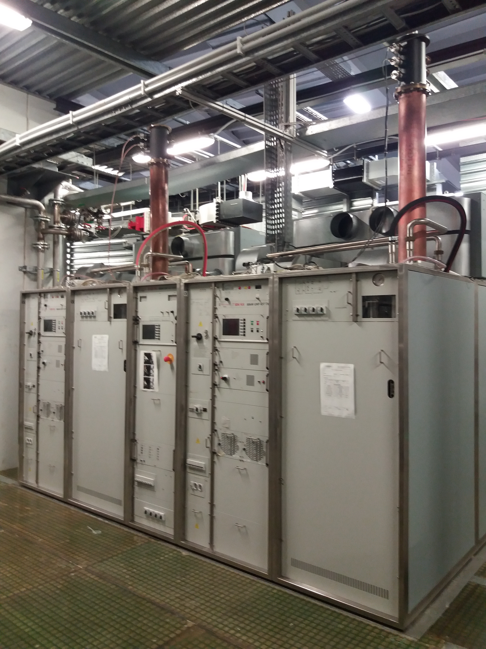
RF power for Elettra and Elettra 2.0
Four RF plants are operating at Elettra. The fours cavities were fed by independent amplifiers as follows:
3 amplifiers based on the 60 kW 500 MHz klystron E2V K3672 BCD, tube discontinued in 2012.
1 amplifier consisting of 2 transmitters combined together through a switchless WG combiner, each one based on 80 kW 500 MHz IOT E2V D2130 , tube discontinued in 2022.
The Elettra amplifiers RF power capability is well below the Elettra 2.0 need but the twin IOT one.
In 2018 the procurement of four identical turnkey 100 (130) kW 500 MHz solid state amplifiers operating at a single frequency (monotonic) and in continuous wave regime started. These transmitters are going to replace the klystron’s based amplifier for the storage ring and their installation must fit the Elettra’s scheduled operation calendar...”
80 kW+ 80 kW IOT twin amplifier, running since 2008
E2V K3672 BCD
60 kW Klystrons based amplifier,
running since 1993
E2V D2130

Slide 6
SSA Amplifier Roadmap
2019 June: 500 MHz 130 kW Solid State Amplifier - 4 units - contract awarded to Cryoelectra (Germany) machine model CRE-331M
2021 September: First machine FAT, remote session only.
2021 October: Installation, SAT and set into operation of the first machine
2022 October: Installation, SAT and set into operation of the second machine
2023 February: Installation, SAT and set into operation of the third machine
2023 August: Installation, SAT and set into operation of the fourth machine
2024 Jan- Dec: Firmware upgrade
Non Disclosure Agreement signed between Cryoelectra and Elettra at the contract signature.
Main contract lasted 4 years + 2 months. The contract was expected to run 3 years + the prospect for 1 year of storage for the last two machines.
The firmware upgrade contract is lasting one year due to Elettra scheduled hours of operations.
Together with first deliver Cryoelectra has given a spare RF module not foreseen in the contract.
The CRE 331M is designed by Cryoelectra with no flexible cable to combine the RF pallets output power.
They have implemented water cooled DC power supplies as per specs.
3 people from Cryoelectra come to Elettra for the first two installations, then only two people join us to install the last two machines.
The installations have been planned according to the Elettra scheduled operations.

Slide 7
SSA Specs
Item # | Parameters | Value | Unit
1. | Nominal operating frequency f_{N} (monotone) | 499.654 ± 2 | MHz
2. | Nominal RF output power P_{N} (rms) | 100 | kW
3. | Minimum RF output power P_{min} | 0 | kW
4. | Bandwidth (-1 dB) | > 0.5 | MHz
5. | Gain at P_{N} | ≥ 50 | dB
6. | Gain stability at P_{N} | < ± 0.2 | %
7. | RF drive, maximum | 30 | dBm
8. | Input return loss within the full input AM range | ≥ 18 | dB
9. | 1 dB compression point | > 80.3 | dBm
10. | AM to PM conversion, from P_{min} to P_{N} | < 10 | degrees
11. | Harmonic contents at P_{N} | < - 40 | dBc
12. | Spurious and sidebands levels in ± 10 MHz range at P_{N} | < -75 | dBc
13. | Phase and AM Noise at P_{N} : From 10 Hz to 100 Hz From 100 Hz to 1 kHz From 1 kHz to 10 kHz From 10 kHz to 100 kHz From 100 kHz to 1 MHz | < -70 < -80 < -90 < -100 < -110 | dBc/Hz
14. | VSWR at the output, maximum | 1.2:1
15. | Overall efficiency h₀ at P_{N} | ≥ 48 | %
16. | Overall average efficiency h_{A0} | ≥ 35 | %
17. | Input and output RF line impedance | 50 | ohm
18. | RF Drive input connector on the rack | N standard - female
19. | RF output line and standard | WR 1800 and Desy flange
130 kW achieved thanks to the contractual option and the availability of some extra budget
Agreed on 0 dBm for 130 kW output power
@ 130 kW CW Wall-Plug efficiency = 52%
Vdrain =44 VDC
ALL FOUR UNITS
MET the SPECS

Slide 8
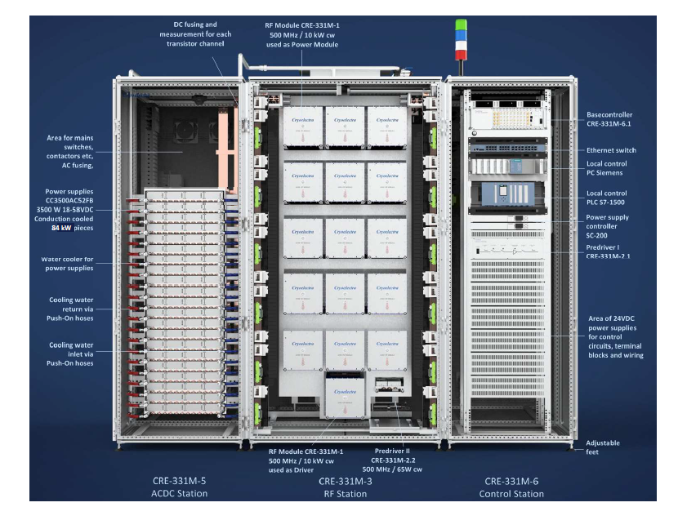
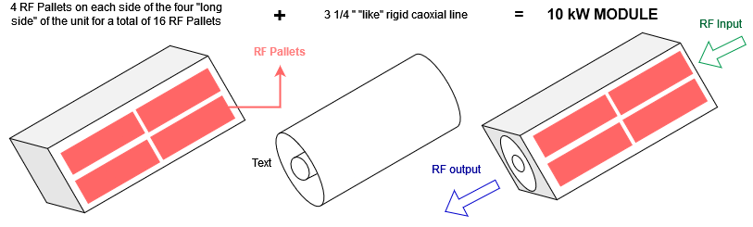
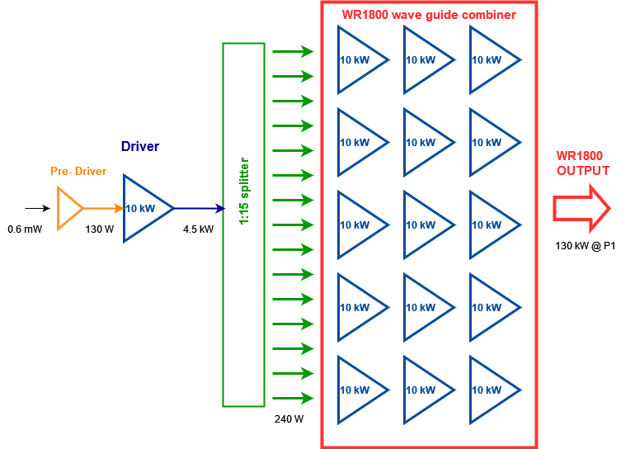
SSA Design
CRE 331M RF power transistor is the BLF578XR.
The basic pallet is made with one single transistor + circulator, RF pallet nominal power 600 W
The 10 kW “module”, is made by combining 16 pallets directly seated on the rigid 3 ¼'' coaxial line for their power combination. It has been tested up to 11 kW CW. To achieve 130 kW each modules delivers ~ 8.5 kW.
1 module is used as driver up to half of its power capability.
15 modules are directly seated on the wave guide for their output power combination.
84 power supply 3.5 kW 18-58 VDC feed in parallel the RF units.
During the contract Cryoelectra has developed its own PS controller allowing for the Vdrain swing along the whole DC rectifier range. All the machines have been upgraded to this new controller.
Graceful degradation: 100 kW with no troubles when 19 out of 240 transistors in OFF or 6 out of 84 PS in OFF

Slide 9
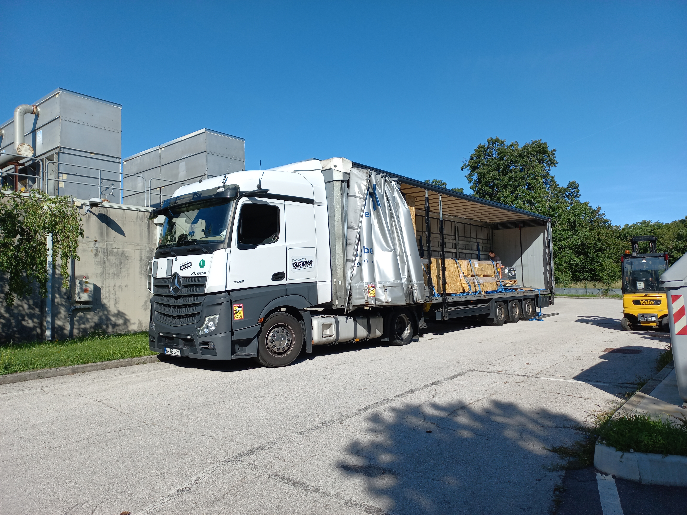
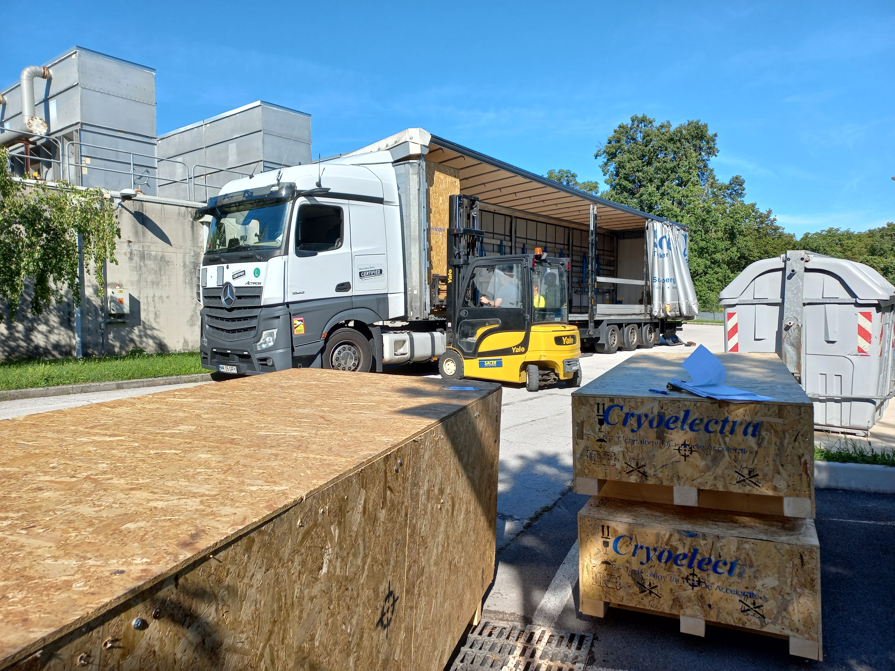
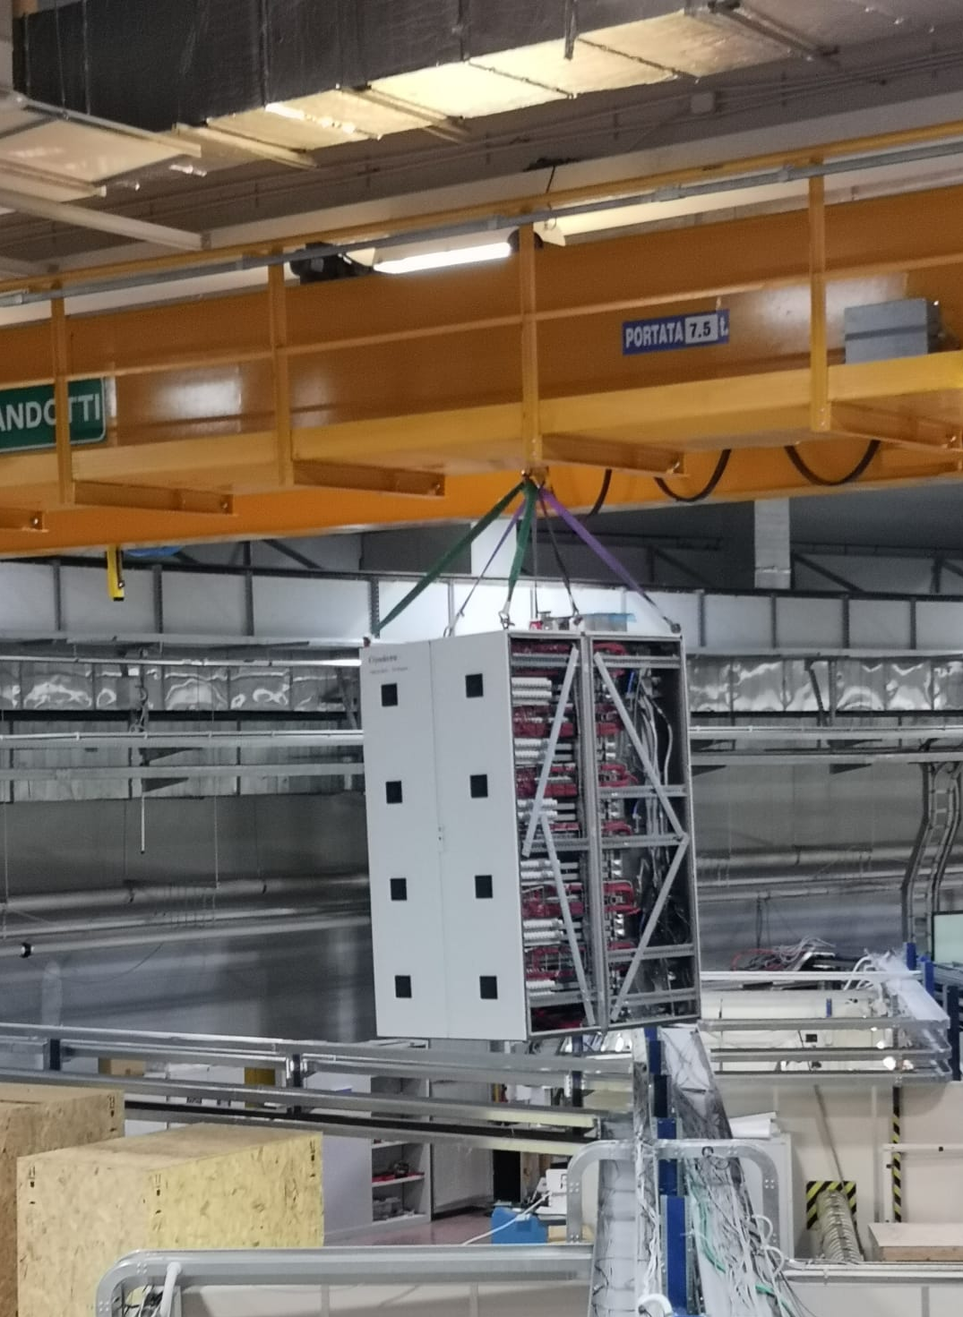
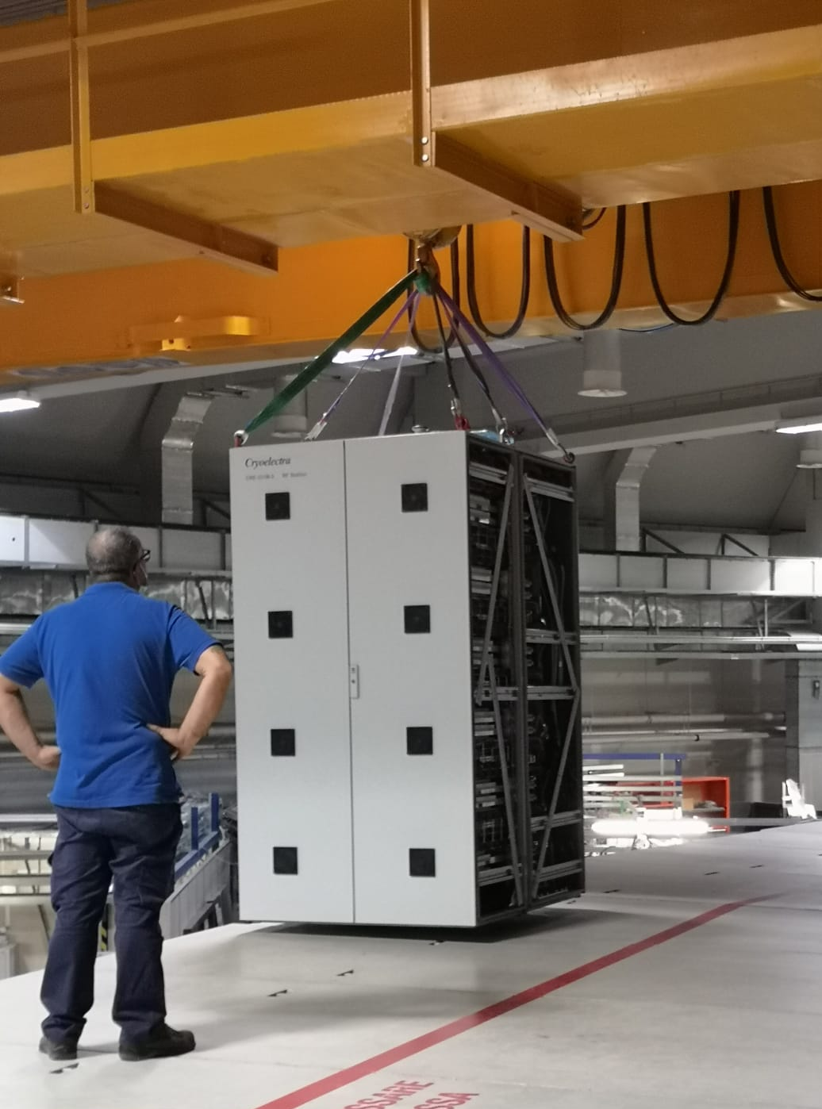
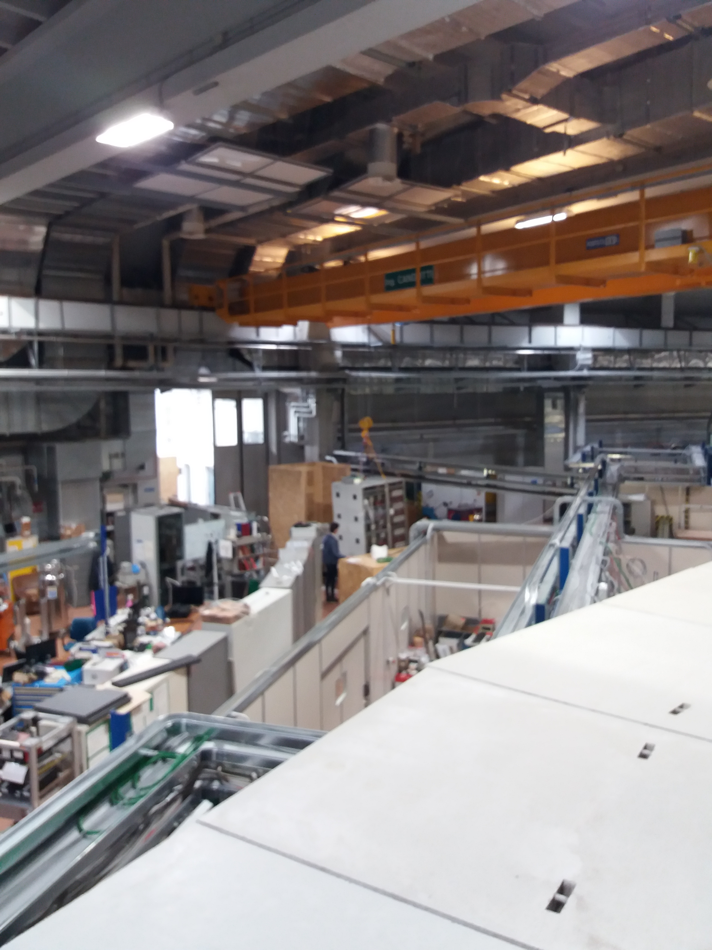
SSA Installation
The Elettra loading bay was crowded and the SSA was unloaded outdoor
As short as possible harness and rack’s feet removed in order to let the rack go beyond the tunnel roof

Slide 10
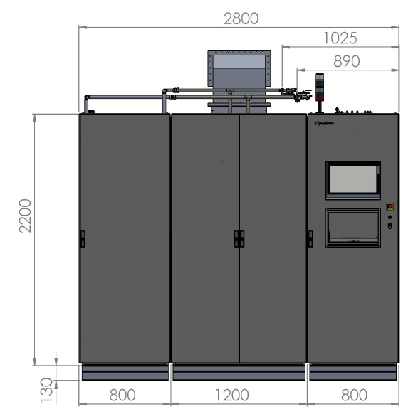
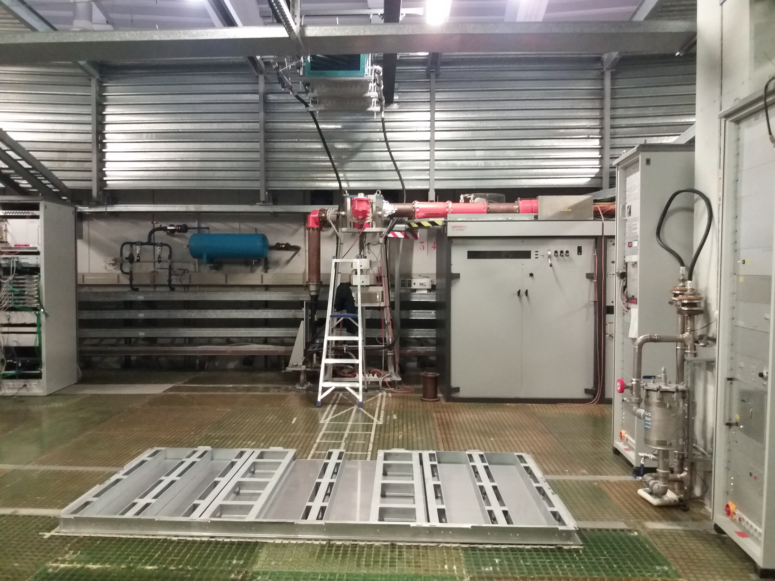
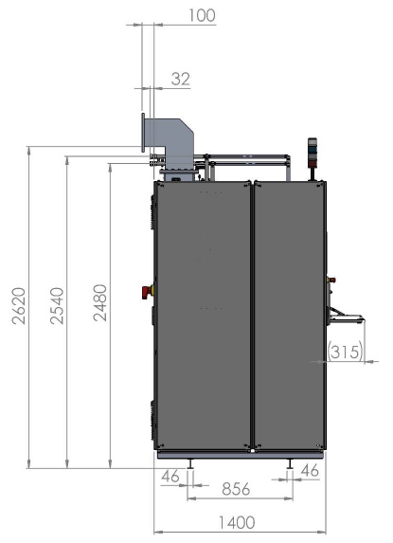
SSA Installation
The klystron amplifier is in background while the SSA basement is shown foreground.
SSA basement has been custom design and made for this specific service area since no crane is available at the installation area.
Only for the Elettra run the SSA is going to be connected to the rigid 6 1/8’’ coaxial line and the 80 kW circulator
SSA sizes in mm

Slide 11
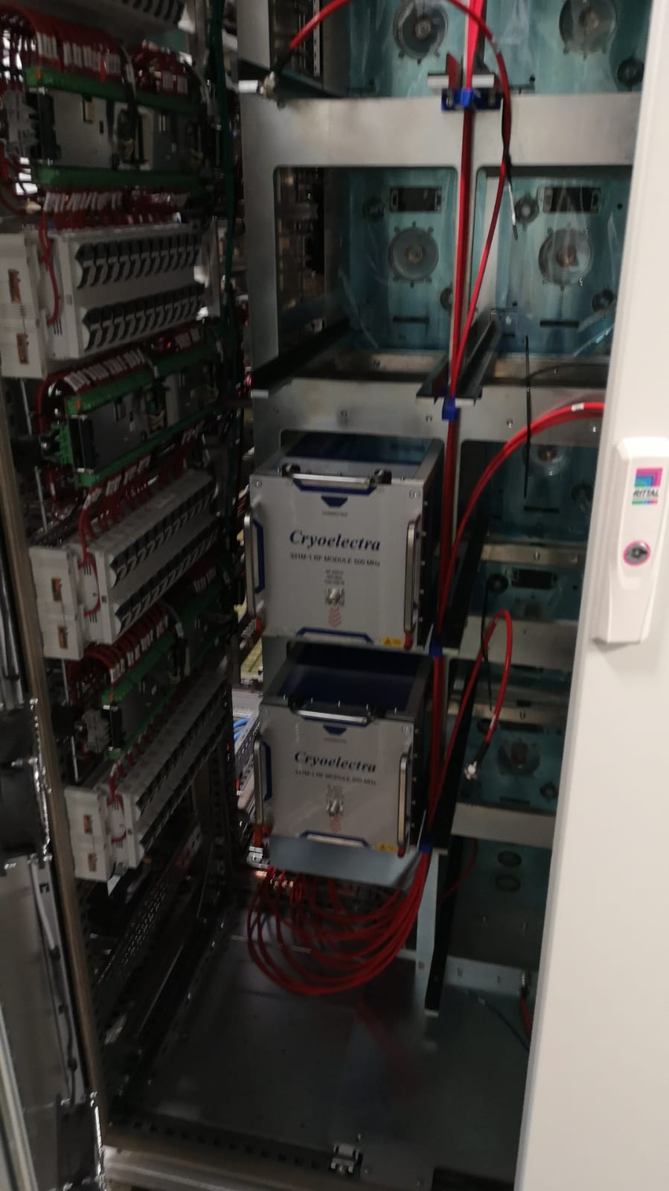
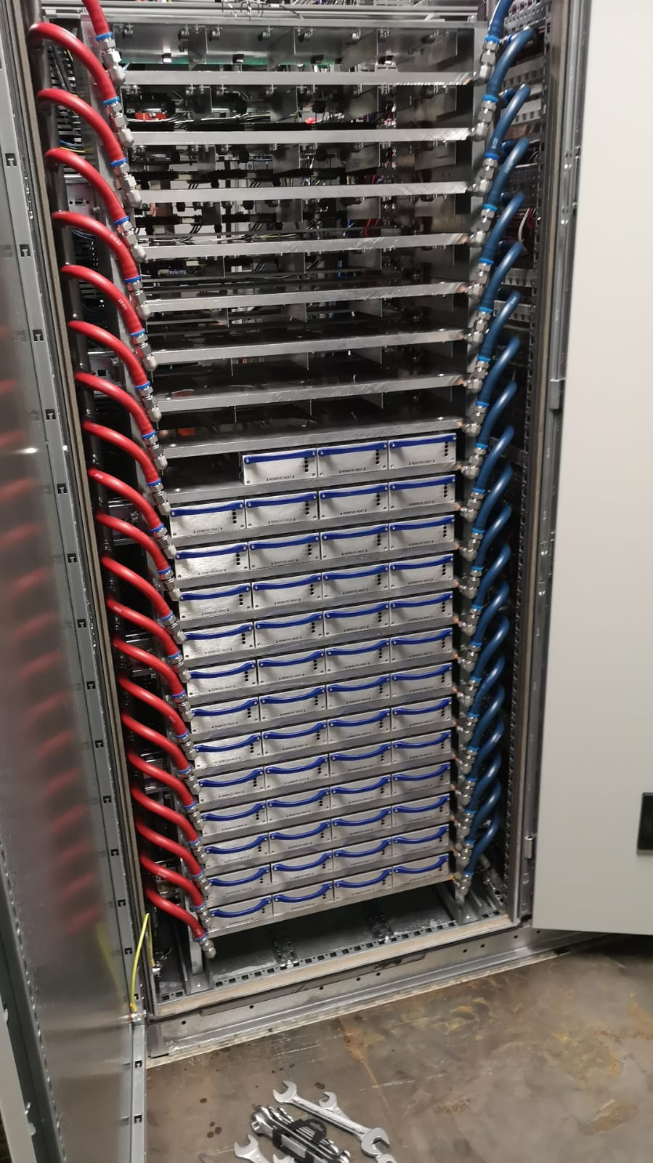
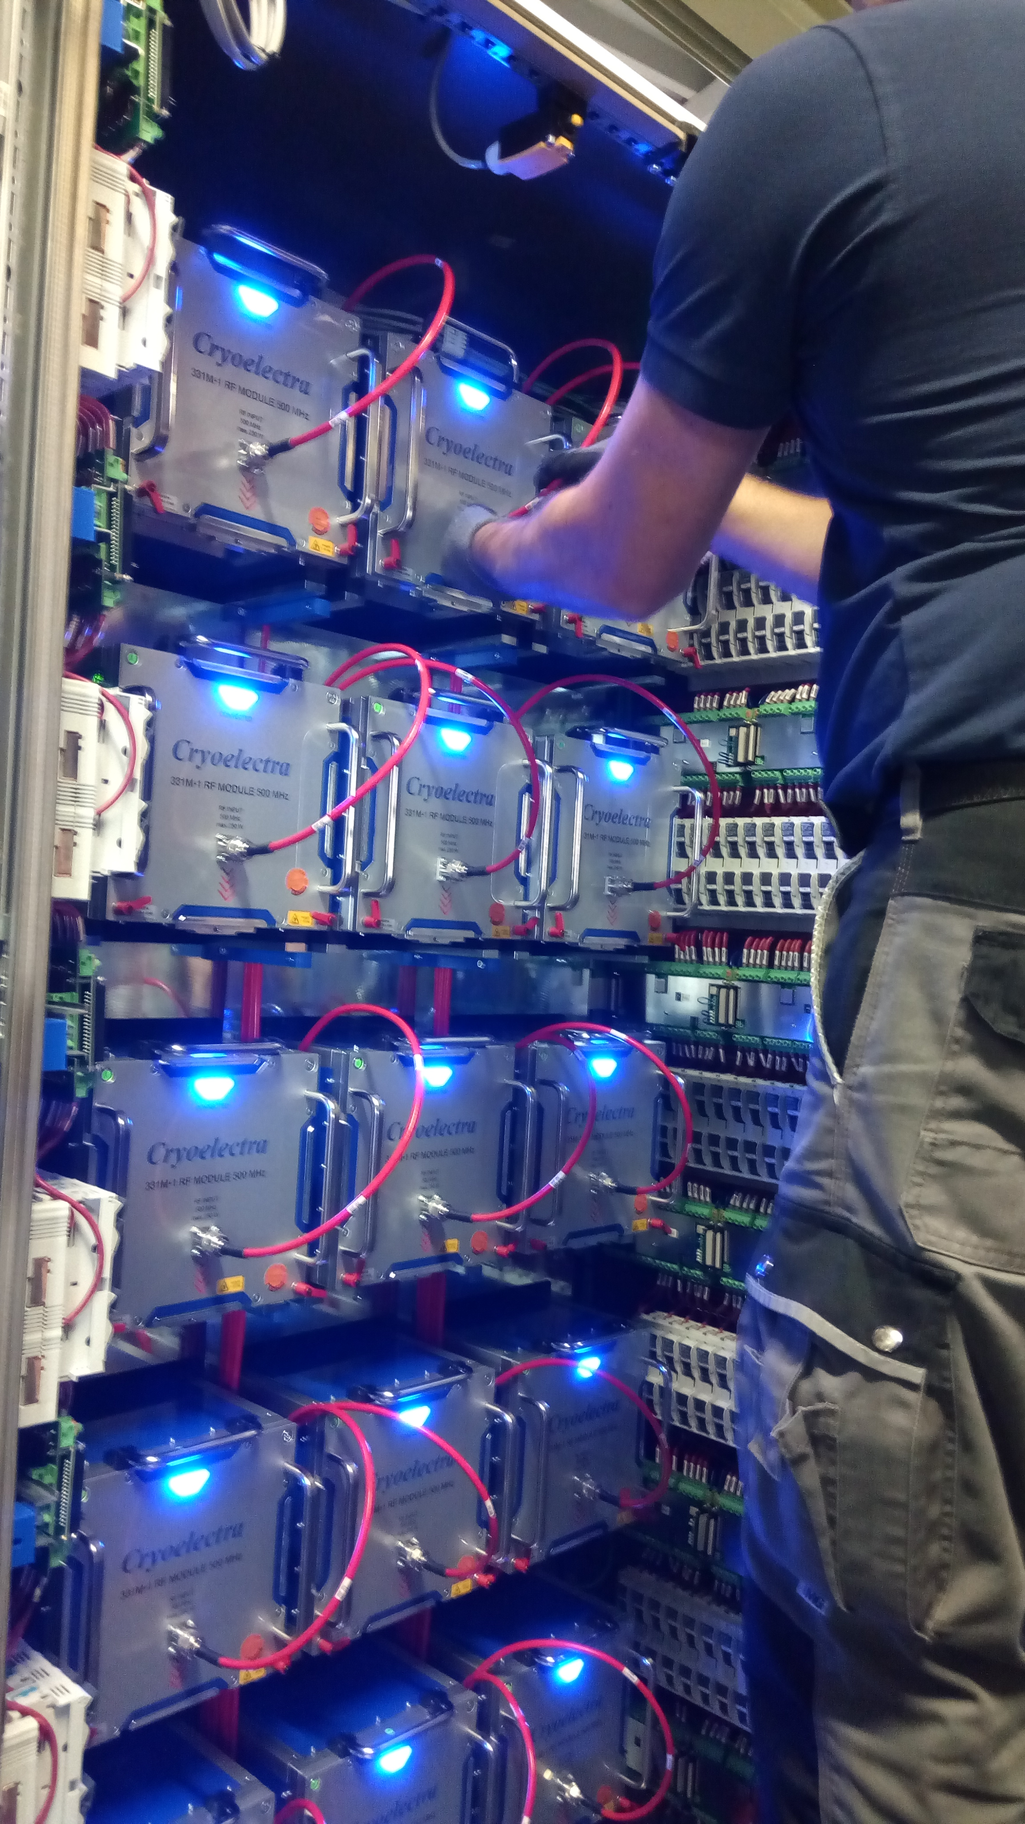
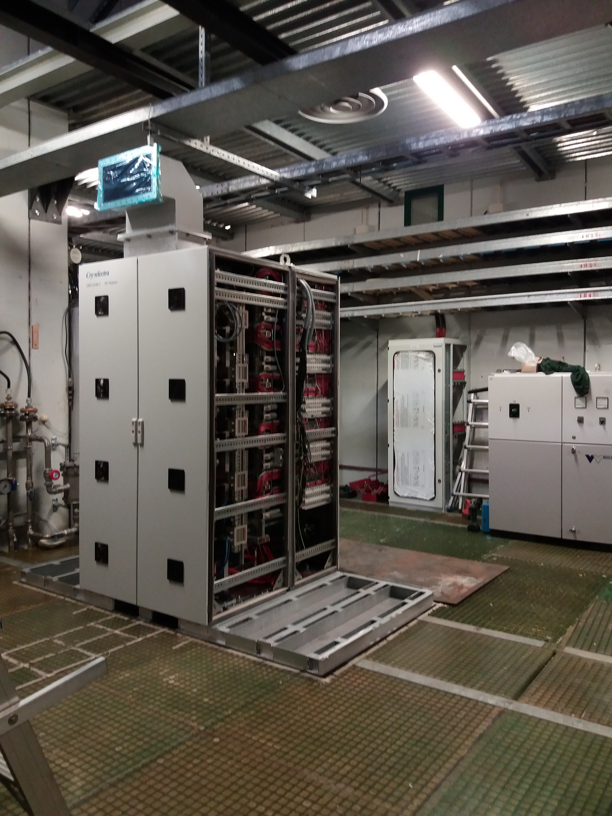
SSA Installation
For the shipment and installation SSA has been split in three emptied racks:
RF racks, the heavier one ~700 kg,
Power supply rack
Control rack
After the positioning and alignment of each rack the components have been installed and the cabling connected.
Starting on Monday, five working days were spent to handle, install, align and check the SSA. Next Monday the SSA was ready for the SAT, including connection towards mains, water cooling and 50 ohm matched load

Slide 12
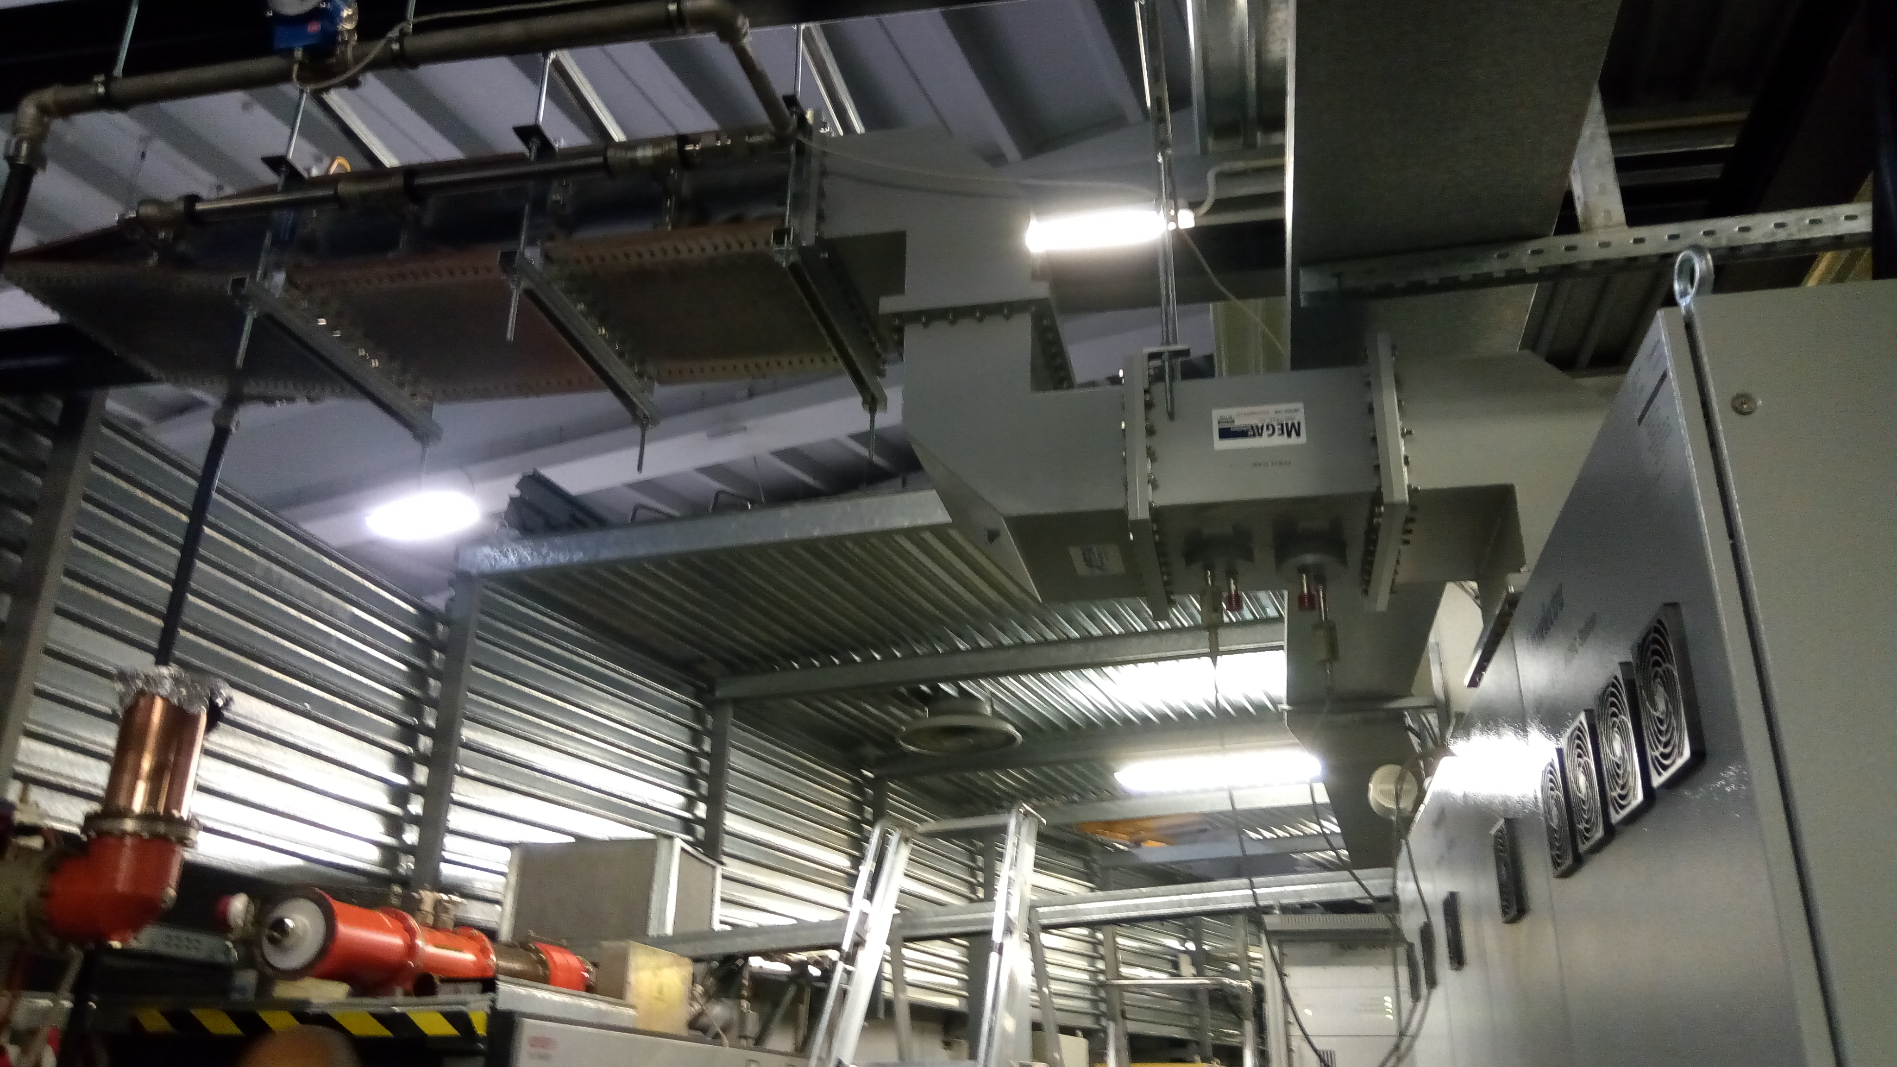
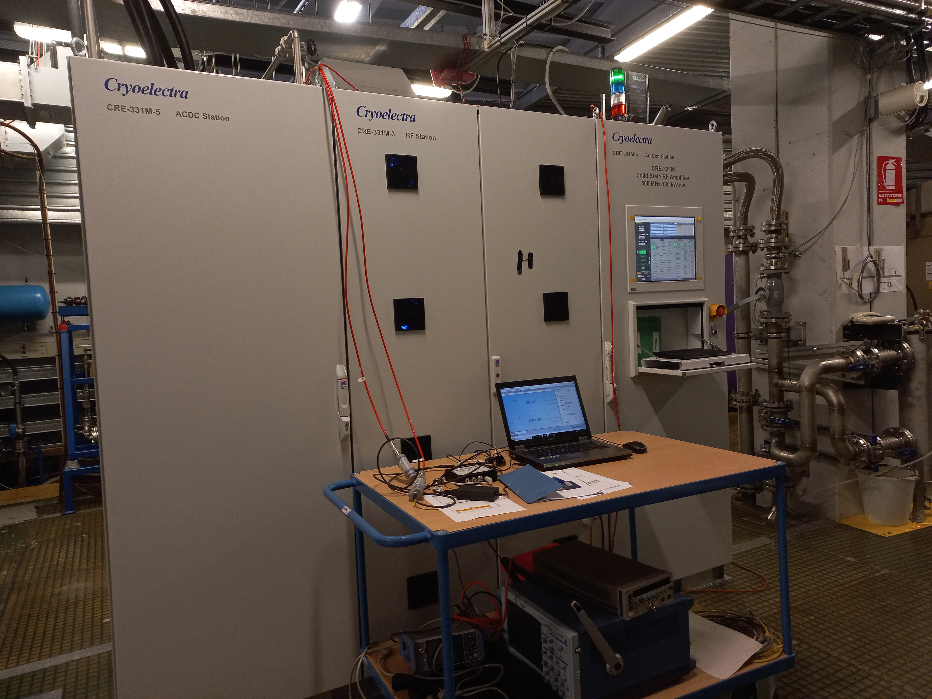
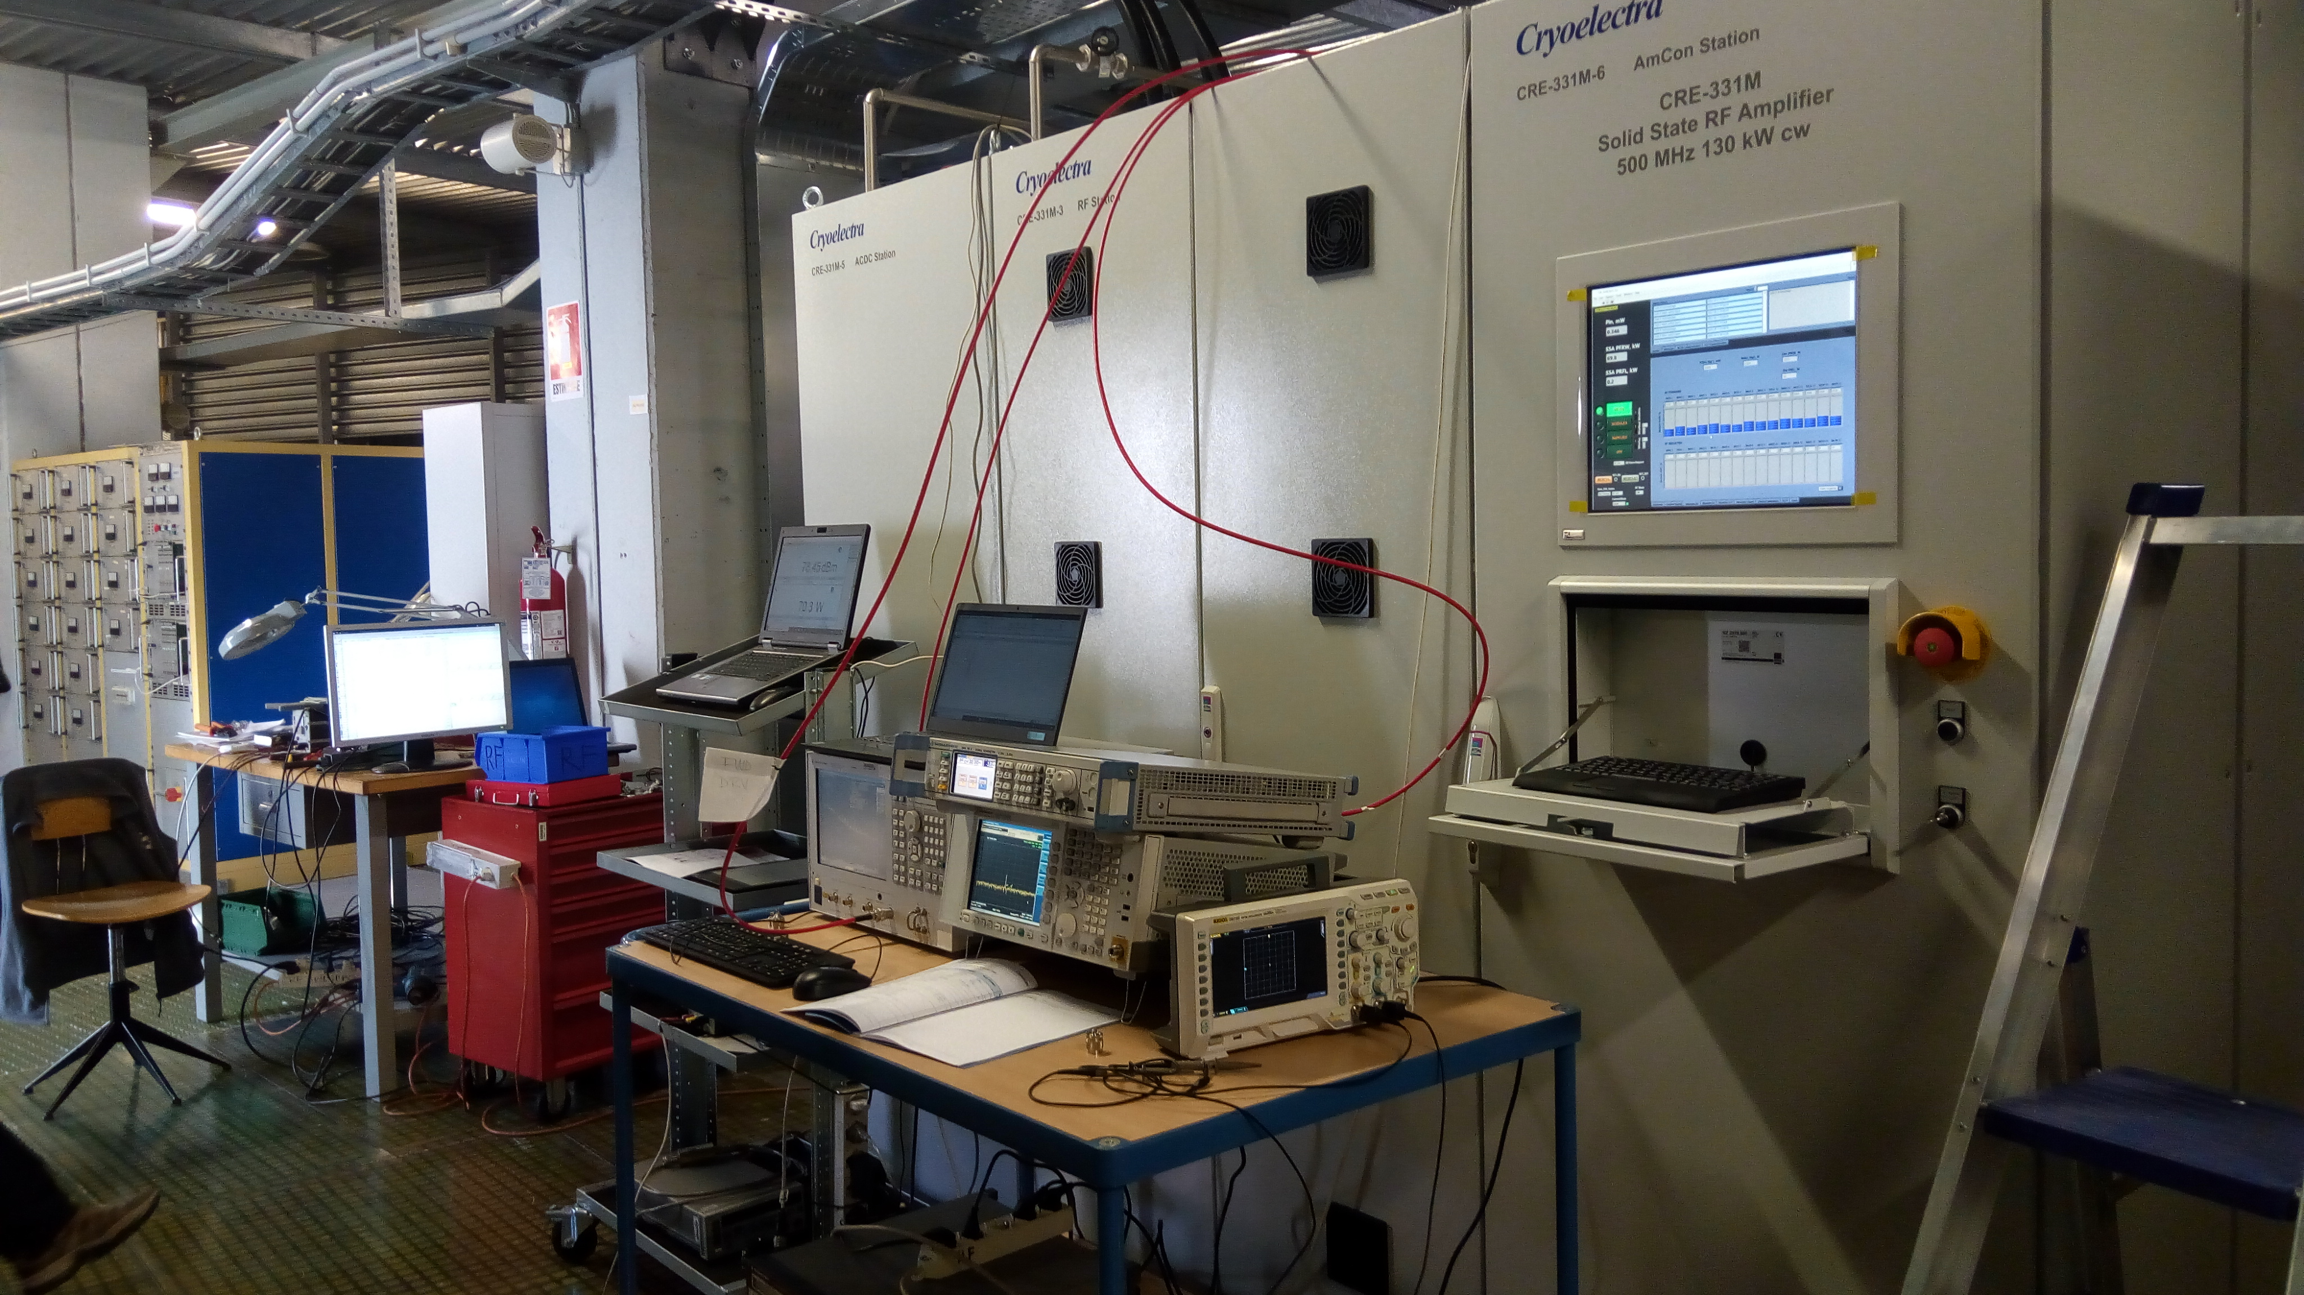
SSA Site Acceptance Test
SAT performed on a dedicated dummy load in 5 days:
All interlocks – internal and external
RF signal calibration check
RF parameters, gain , BW, PN and AM, harmonics, efficiency.
Long term tests 4 hours at 100 kW
  graceful degradation with 19 out of 240 transistors in off
  graceful degradation with 6 out of 84 PS in off : 100 kW
24 H non –stop @ 130 kW
Notes:
Slide 3 – (..) : Content of the presentation
Insert a new slide: Home > “New Slide” and choose a slide Layout:
For Title & Subtitle
For text with bullet points
For Text
For Picture, graphs, visuals
Two columns
Blank
If you want Copy & paste an element from the Clip Board to the particular slide:
1. Click on a box to mark it.
2. Position the mouse pointer on the box frame: Copy!
3. Click on the particular slide: Paste!
How you intend to use the elements is your choice.
You can combine the text block style with the background colour in different manner.

Slide 13
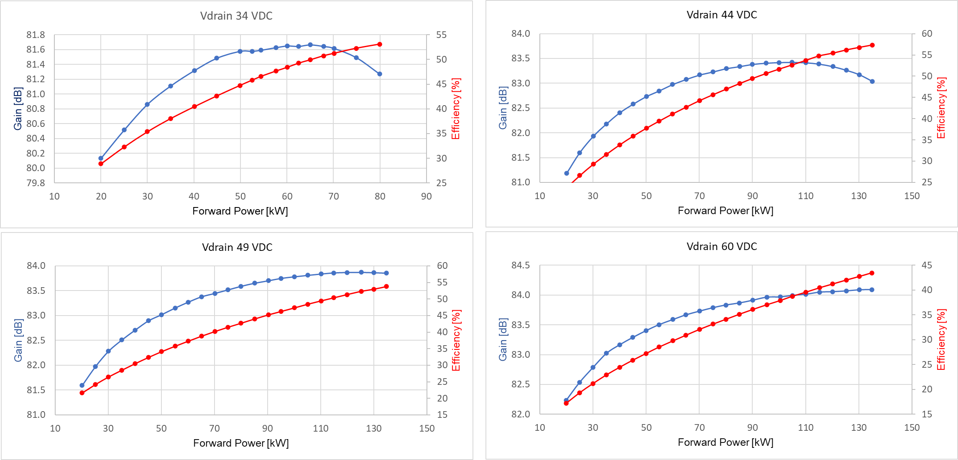
SSA efficiency
At a constant Vdrain = 44 VDC
Wall-plug efficiency @ 46 kW = 33 %
Wall-plug efficiency @ 100 kW = 48 %
Wall-plug efficiency @ 130 kW = 52 %
Notes:
Slide 3 – (..) : Content of the presentation
Insert a new slide: Home > “New Slide” and choose a slide Layout:
For Title & Subtitle
For text with bullet points
For Text
For Picture, graphs, visuals
Two columns
Blank
If you want Copy & paste an element from the Clip Board to the particular slide:
1. Click on a box to mark it.
2. Position the mouse pointer on the box frame: Copy!
3. Click on the particular slide: Paste!
How you intend to use the elements is your choice.
You can combine the text block style with the background colour in different manner.

Slide 14
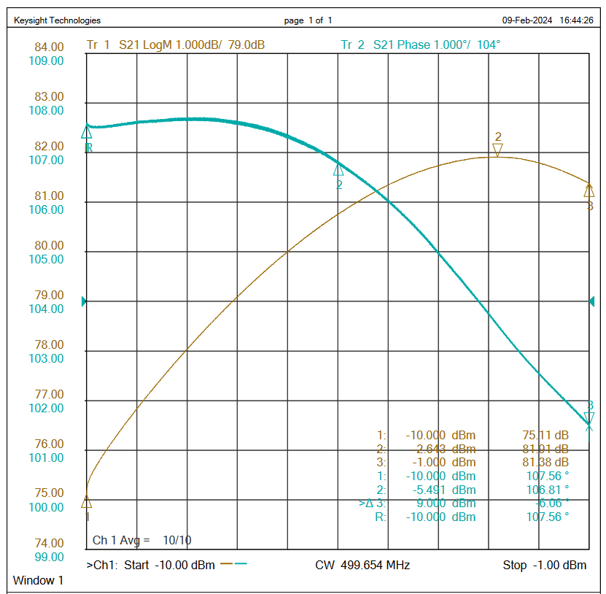
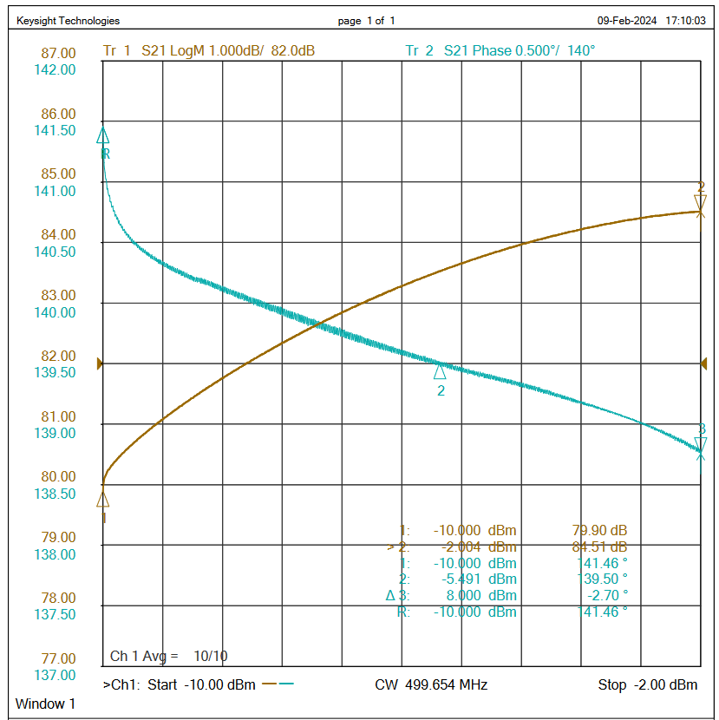
AM & PM to AM conversion
V_drain =34 VDC
RF drive Δ = 9 dB
Forward power from 2.5 kW to 80 kW
Phase shift = 6 degrees
V_drain =54 VDC
RF drive Δ = 8 dB
Forward power from 7 kW to 130 kW
Phase shift = 2.7 degrees
Notes:
Slide 3 – (..) : Content of the presentation
Insert a new slide: Home > “New Slide” and choose a slide Layout:
For Title & Subtitle
For text with bullet points
For Text
For Picture, graphs, visuals
Two columns
Blank
If you want Copy & paste an element from the Clip Board to the particular slide:
1. Click on a box to mark it.
2. Position the mouse pointer on the box frame: Copy!
3. Click on the particular slide: Paste!
How you intend to use the elements is your choice.
You can combine the text block style with the background colour in different manner.

Slide 15
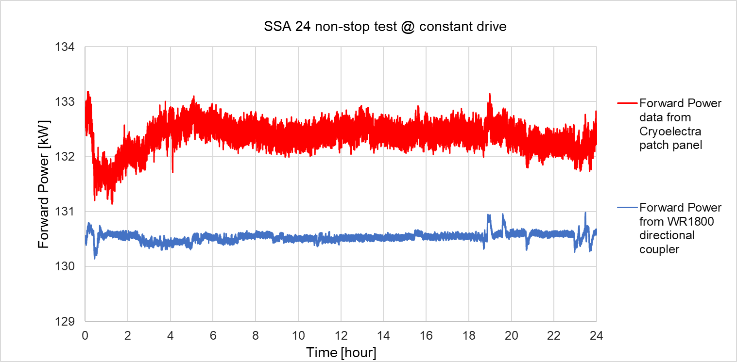
Long term test
Plot shows the averaged RF power data sampled each 10 sec for two different directional couplers. R&S NRP-Z81 power meters, 0.05 dB accuracy and precision.
Data log started after 20 minutes warm up at 04:30 p.m.
WR1800 RF power data min to max range = 1.05 kW – i.e. < 1.0%
Patch panel RF power data min to max range = 2.75 kW - i. e. < 2.0%
Cooling water inlet temperature = 23.7 ±0.3 °C:
  RF rack cooling flow 225 l/min; Δ Τemp = 7.0 ±0.3 °C → Heat dissipated in cooling water ~ 110 kW
  PS rack cooling flow 61 l/min; Δ Τemp = 3.5 ±0.3 °C → Heat dissipated in cooling water ~ 15 kW
  DC Power Supplies @ 44 V , total current drained is 90% of the total capacity ~ 5600 A
Notes:
Slide 3 – (..) : Content of the presentation
Insert a new slide: Home > “New Slide” and choose a slide Layout:
For Title & Subtitle
For text with bullet points
For Text
For Picture, graphs, visuals
Two columns
Blank
If you want Copy & paste an element from the Clip Board to the particular slide:
1. Click on a box to mark it.
2. Position the mouse pointer on the box frame: Copy!
3. Click on the particular slide: Paste!
How you intend to use the elements is your choice.
You can combine the text block style with the background colour in different manner.

Slide 16
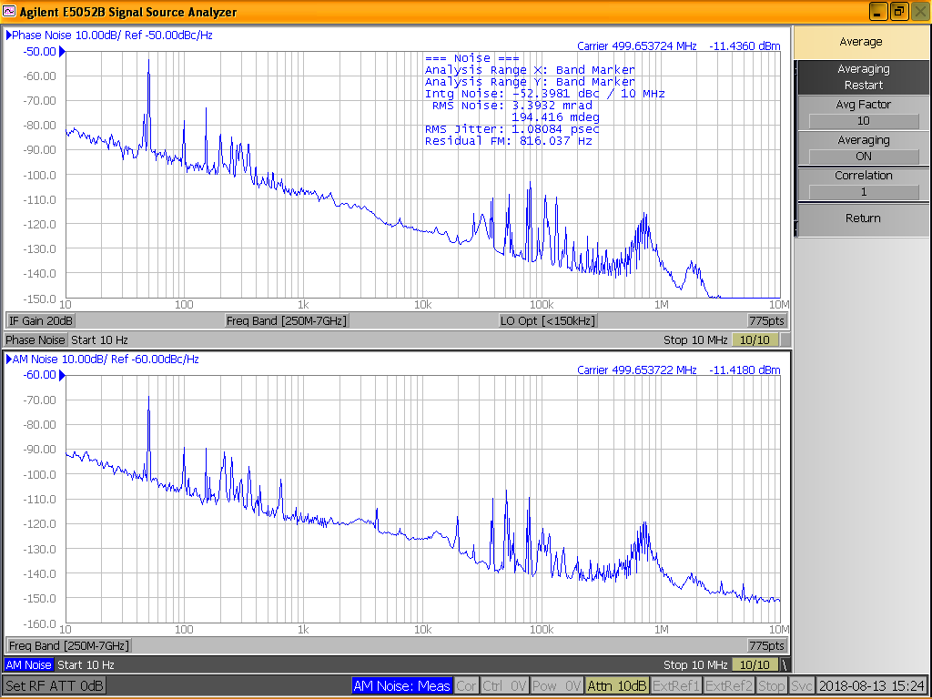
IOT based Amplifier PN and AM noise
Phase Noise and Amplitude Modulation around the carrier frequency of the amplifier show the amplification quality of the machine.
PN and AM of the IOT based Amplifier. Peaks at -60 dBc - 50 Hz are clearly visible
Notes:
Slide 3 – (..) : Content of the presentation
Insert a new slide: Home > “New Slide” and choose a slide Layout:
For Title & Subtitle
For text with bullet points
For Text
For Picture, graphs, visuals
Two columns
Blank
If you want Copy & paste an element from the Clip Board to the particular slide:
1. Click on a box to mark it.
2. Position the mouse pointer on the box frame: Copy!
3. Click on the particular slide: Paste!
How you intend to use the elements is your choice.
You can combine the text block style with the background colour in different manner.

Slide 17
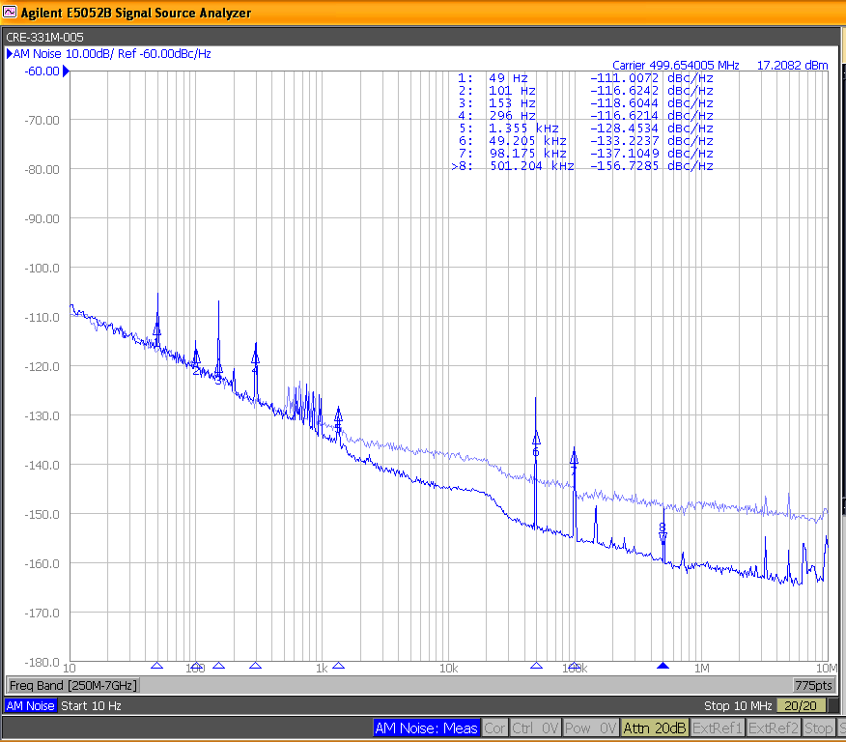
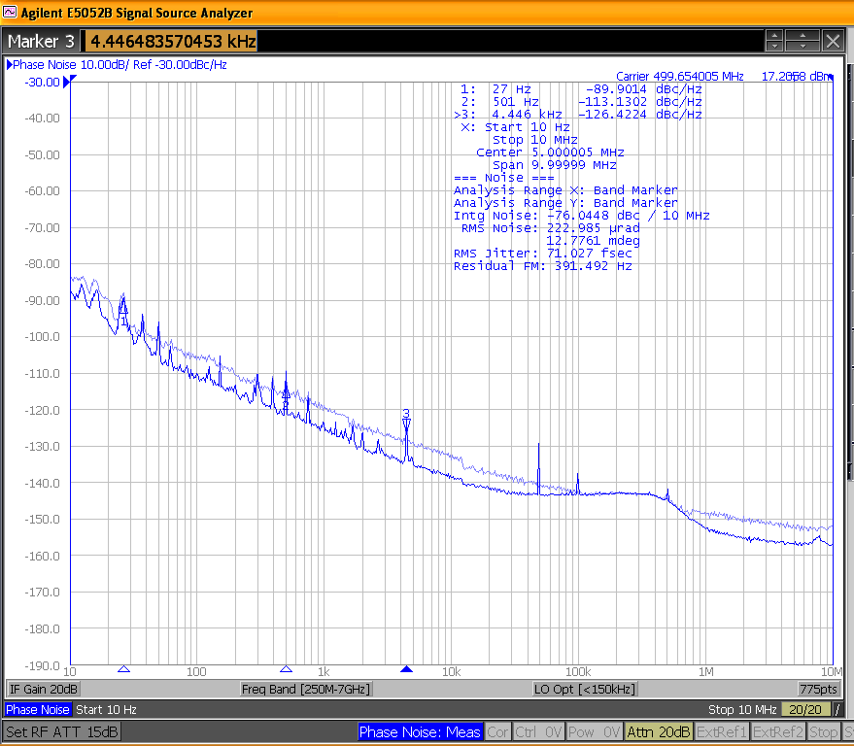
PN and AM noise of the SSA
SSA amplitude modulation and phase noise at 130 kW of output power’ Light blue curve is the RF driver noise.
Notes:
Slide 3 – (..) : Content of the presentation
Insert a new slide: Home > “New Slide” and choose a slide Layout:
For Title & Subtitle
For text with bullet points
For Text
For Picture, graphs, visuals
Two columns
Blank
If you want Copy & paste an element from the Clip Board to the particular slide:
1. Click on a box to mark it.
2. Position the mouse pointer on the box frame: Copy!
3. Click on the particular slide: Paste!
How you intend to use the elements is your choice.
You can combine the text block style with the background colour in different manner.

Slide 18
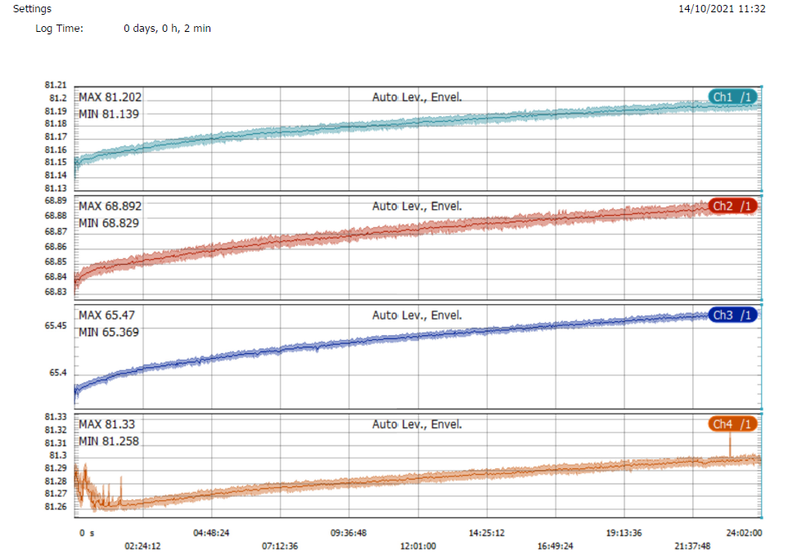
Early failures and anomalies
During the SAT and set into operation of 4 machines we had the following inconvenience:
Total RF power data from the patch panel N connector had some glitches at start up ( 1st machine only).
1 fuses from the electrical distribution of the PLC found broken ( 1st machine only).
1 transistor out of 240 broken on the 2nd machine only. Cryoelectra had already given Elettra a spare module for free since the first installation.
1 power supply of the embedded Siemens computer went broken, replaced at once ( 3rd machine only).
1 DC Power Supply failure out of 84, replaced for free ( 2nd machine only).
24 hours test of the 4th machine stopped due to the new PS controller. Software fixed and test OK.
RF power data log during the first machine SAT.
Channel data are as follows:
Ch 1 is the total SSA RF forward power data from WR1800 directional coupler
CH 2: Module forward power from SSA patch panel
CH3 : Driver forward power from SSA patch panel
CH4: Total RF forward power data from SSA patch panel
Notes:
Slide 3 – (..) : Content of the presentation
Insert a new slide: Home > “New Slide” and choose a slide Layout:
For Title & Subtitle
For text with bullet points
For Text
For Picture, graphs, visuals
Two columns
Blank
If you want Copy & paste an element from the Clip Board to the particular slide:
1. Click on a box to mark it.
2. Position the mouse pointer on the box frame: Copy!
3. Click on the particular slide: Paste!
How you intend to use the elements is your choice.
You can combine the text block style with the background colour in different manner.

Slide 19
SAT outcome
All the SATs were great.
Lot’s of expertise and efforts have been made to optimize the RF combination and minimize the losses.
The time between the contract signature and the delivery of the fist machine was wisely used.
The SSAs are well designed. They have redundancy. They are made with qualified components and conservative design. A robust machine follows.
The failures that occurred during SAT were no real failure at all.
The first 3 machine had a off the shelf power supply controller. This was limiting the drain voltage range from 42 to 48 V DC. This feature already meets the specs but the supplier has developed a in-house design controller having the full VDC range 33 to 60 VDC.
The supplier propose to install it on the last machine. After some optimization the new controller is now working on all the four SSA. Elettra is working at low RF power and the new controller gives an energy saving of 26 % (170 kW).
What went wrong?: 2/3 of the modules of the 4th machine had a shower thanks to the Elettra people. These modules have been left dry for 24 hours and re-installed but one that has been sent back to Cryoelectra. Their warranty is lost but they are working well.
Notes:
Slide 3 – (..) : Content of the presentation
Insert a new slide: Home > “New Slide” and choose a slide Layout:
For Title & Subtitle
For text with bullet points
For Text
For Picture, graphs, visuals
Two columns
Blank
If you want Copy & paste an element from the Clip Board to the particular slide:
1. Click on a box to mark it.
2. Position the mouse pointer on the box frame: Copy!
3. Click on the particular slide: Paste!
How you intend to use the elements is your choice.
You can combine the text block style with the background colour in different manner.

Slide 20
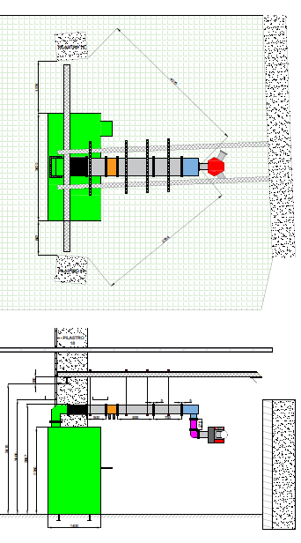
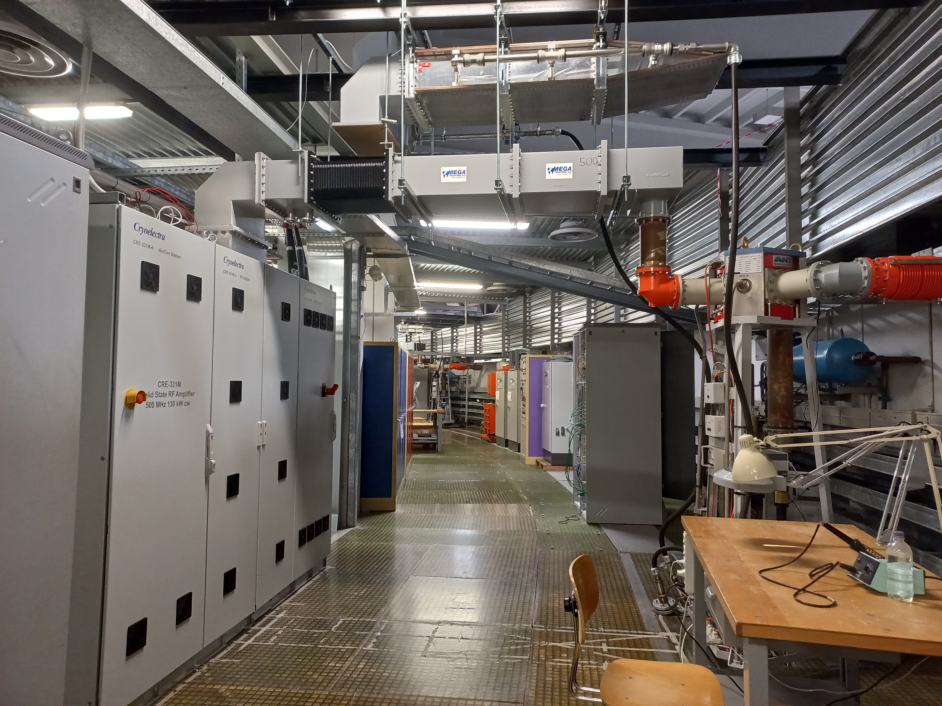
SSA set into operation
The 3 weeks length SSA installation performed during the shut-down had to be fully transparent for the Elettra beam user. The simpler RF power run set have been arranged for this very reason.
The SSA RF output has been connected to the existing 80 kW circulator by means of a WR1800 to 6 1/8’’ adapter. The 6 1/8’’ rigid coaxial line and the cooling capability does not allow us to raise the output power level above 70 kW for 3 out of 4 RF plants.
Notes:
Slide 3 – (..) : Content of the presentation
Insert a new slide: Home > “New Slide” and choose a slide Layout:
For Title & Subtitle
For text with bullet points
For Text
For Picture, graphs, visuals
Two columns
Blank
If you want Copy & paste an element from the Clip Board to the particular slide:
1. Click on a box to mark it.
2. Position the mouse pointer on the box frame: Copy!
3. Click on the particular slide: Paste!
How you intend to use the elements is your choice.
You can combine the text block style with the background colour in different manner.

Slide 21
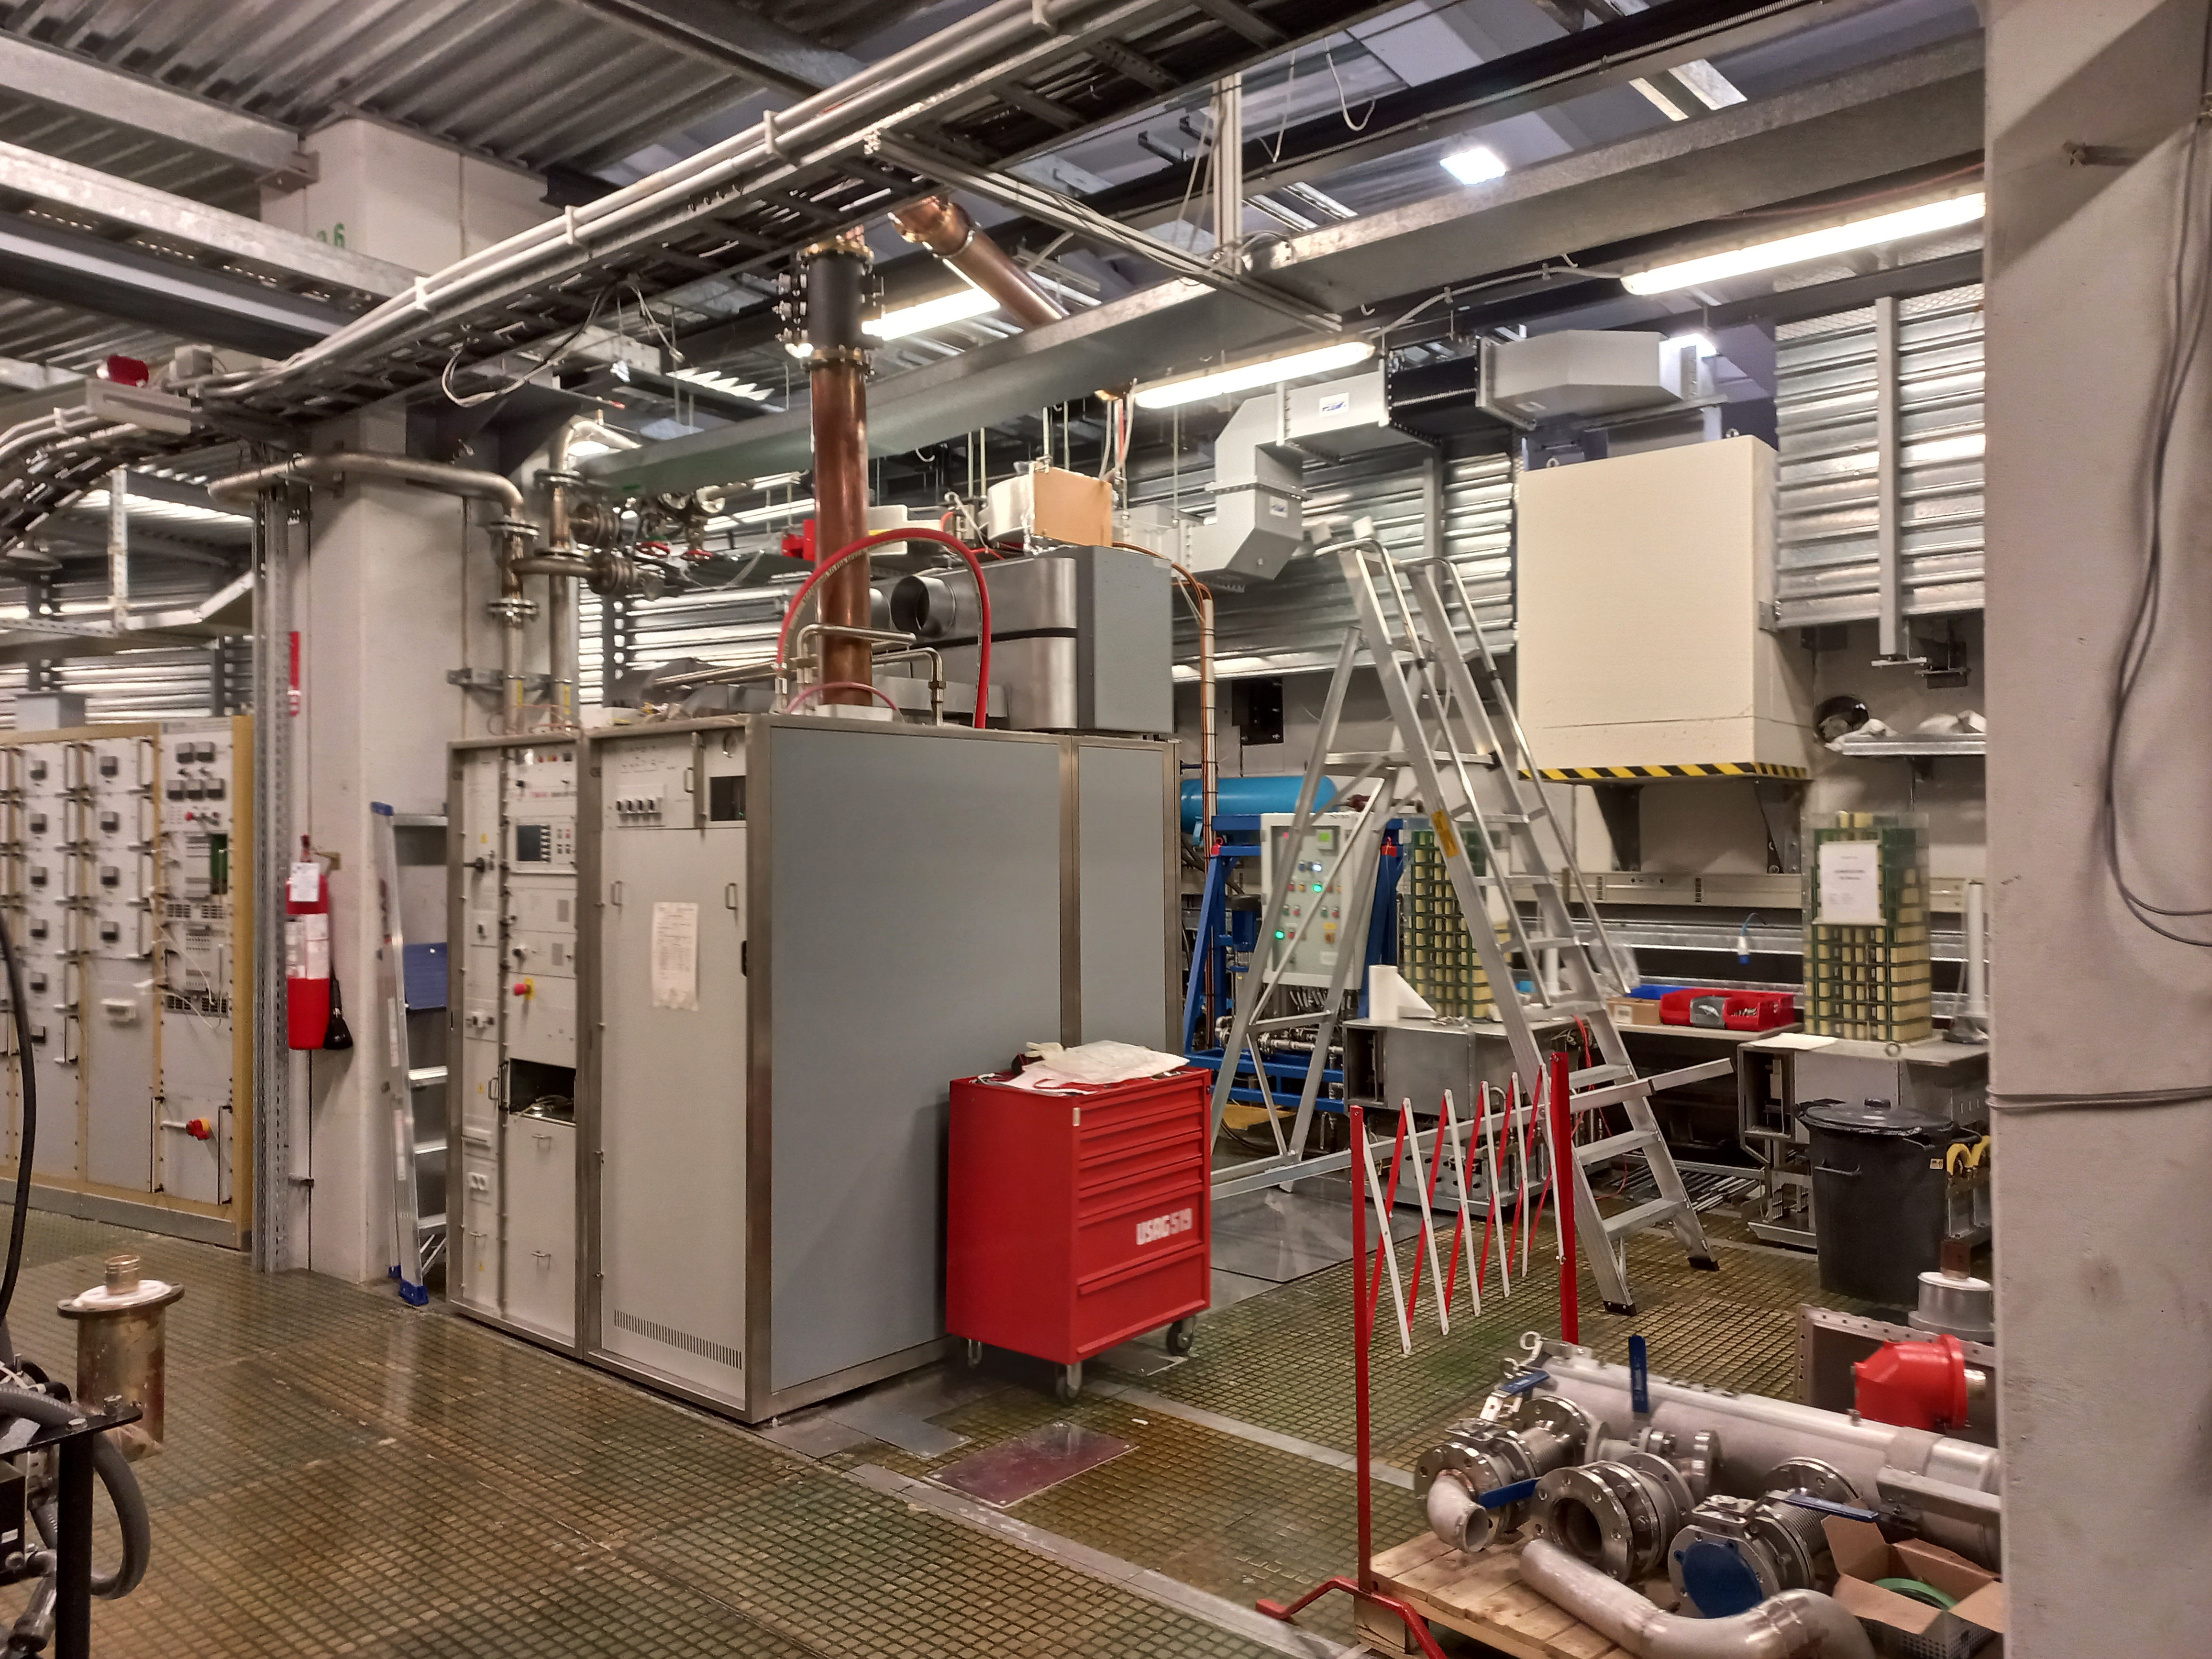
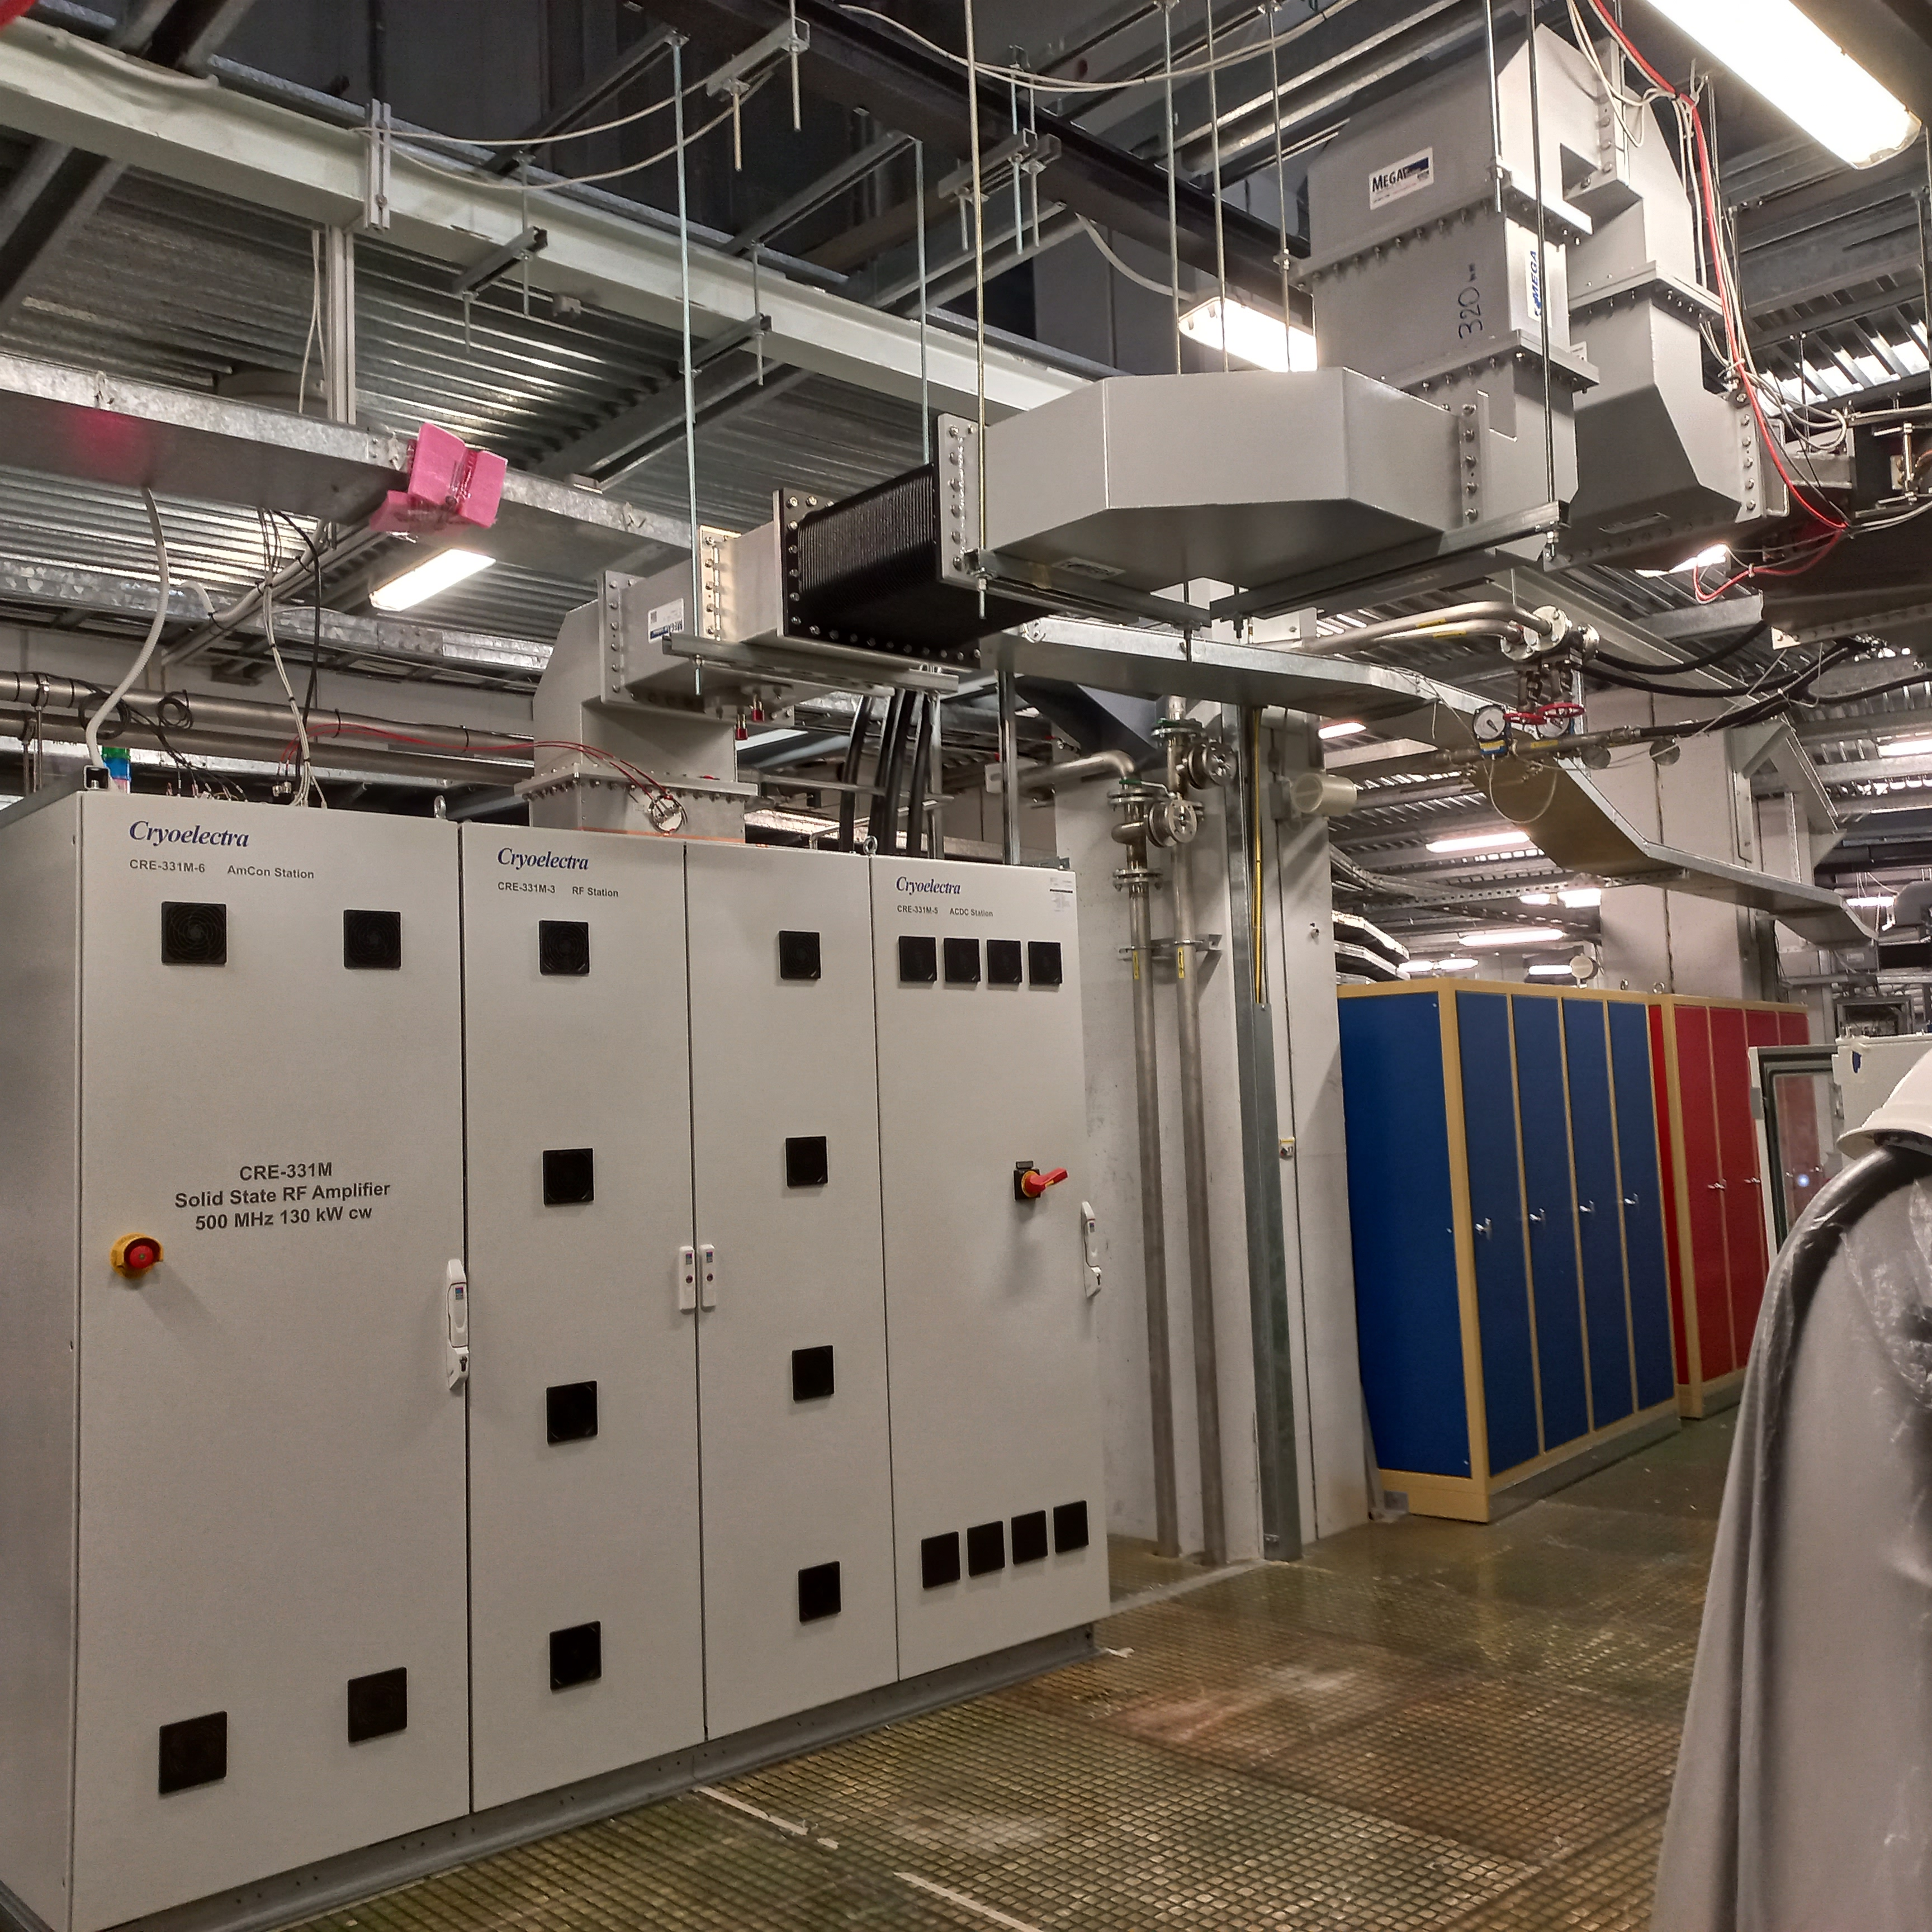
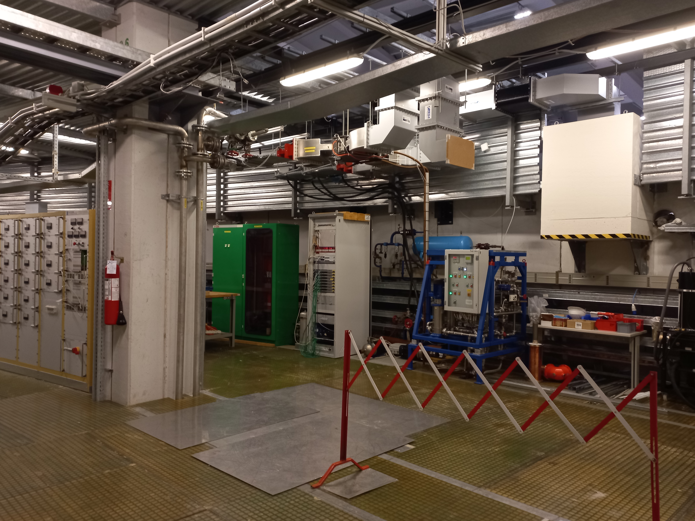
SSA set into operation
The IOT twin transmitter was the last t obe replaced. This installation needed more arrangement: first we split the two transmitters and use only one transmitter for a full Elettra run. Next shut down the second IOT transmitter was removed and eventually the SSA was installed. To match the existing WR1800 run a “fancy” WG run have been installed.
Notes:
Slide 3 – (..) : Content of the presentation
Insert a new slide: Home > “New Slide” and choose a slide Layout:
For Title & Subtitle
For text with bullet points
For Text
For Picture, graphs, visuals
Two columns
Blank
If you want Copy & paste an element from the Clip Board to the particular slide:
1. Click on a box to mark it.
2. Position the mouse pointer on the box frame: Copy!
3. Click on the particular slide: Paste!
How you intend to use the elements is your choice.
You can combine the text block style with the background colour in different manner.

Slide 22
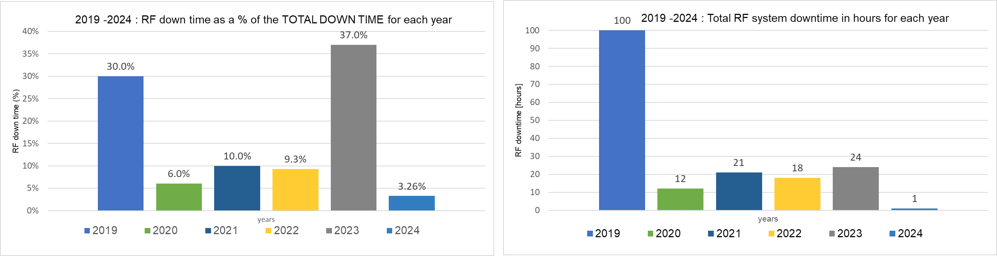
RF system and SSA Reliability
Elettra needs less RF power with respect to the coming Elettra 2.0 machine. Roughly 50- 60 kW /each SSA.
To date all the SSA hour of operation have been done at these power level but for the SAT week and one additional 5 days non-stop run at 130 kW on the 50 ohm loads done last February before the final acceptance.
2% of the
scheduled
beam time
0.75% of the
scheduled
beam time
2nd SSA
2nd SSA
3rd SSA
1st SSA
4th SSA
3rd SSA
1st SSA
4th SSA
SSAs SAT and set into operation was smooth but their reliability during the Elettra operation could not taken for granted.

Slide 23
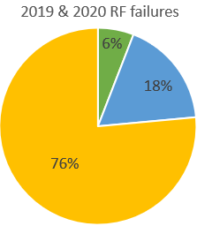
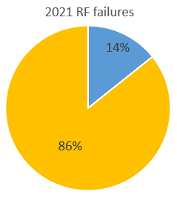
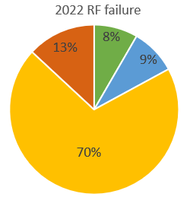
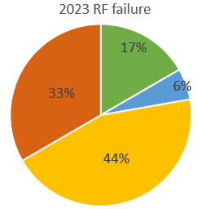
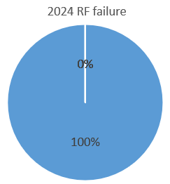

RF system and SSA Reliability
Any failure on one RF system out of four means beam losses and user downtime.
The main sources of RF system’s failure are spread over old electronic tube amplifiers, SSA amplifiers, circulator arcs and cavity vacuum trip:
Before SSA installation:
2019 Many severe hardware failures:
last spare klystron was replaced
one 188 kVA transformer replaced
both IOTs replaced
2020 RF downtime improved
2021 RF downtime improved
Still large number of electronic tube failures!
Klystron and IOT based
amplifiers
SSA amplifiers
Circulator ARC
Cavity vacuum trip
1 out of 4 SSA in operation from OCT. 2021
After SSA installation:
3 failures on SSA , totalling 13% of the total number of failures
  2 trips on s/n 01
  1 trips on s/n 03
2023 7 failures on SSA always on
  7 trips on s/n 03
2024 no failure, only 2 circulator arcs for a total of 1 hour of downtime
2 out of 4 SSA in operation from OCT. 2022
4 out of 4 SSA in operation from AUG. 2023

Slide 24
SSA Reliability
To date 9 SSA failures occurred during the Elettra operation:
  CRE-331M- 01 2 failures due to the 3 phases relay left with the minimum selectable time delay. Raised to 1s and no further troubles. All next SSA relays have been at once set.
  No more failures after this one.
  CRE-331M- 03 7 failures as follows:
  1 failure due to the local computer Windows update. Elettra fault keeping open
  some Ethernet connection.
  6 failures due to spurious “module connection”, “water leak” and “temperature sensor” interlocks.
  CRE-331M- 04 0 failure.
  CRE-331M- 05 0 failure but some interlocks were by-passed pending the CRE-331M-03 troubleshooting. Interlock’s by-pass done in full agreement with Cryoelectra.
We got more “annoyance” than real hardware SSA failures but the impact has been significant being in run-time. The beam was lost to the user. On the contrary the electronic tube amplifier’s failures were only hardware ones and time consuming to be solved.
During run-time the “reset & start” ASAP procedure is often applied and his is not the best way to debug issues.
On top of this the SSA test during the shut-down time was restricted due to the electricity budget and the radioprotection safety constraints.
Cryoelectra provided the highest availability and collaboration to the troubleshooting.
Together we learned how to better operate the machine.

Slide 25
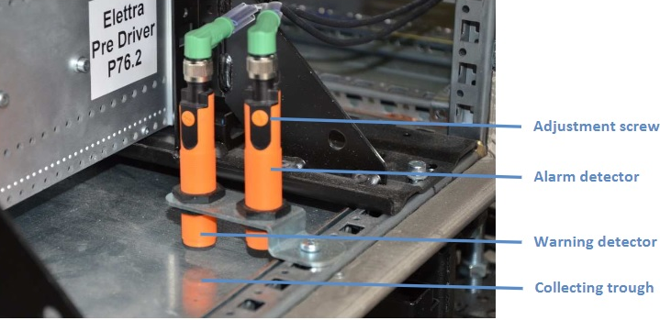
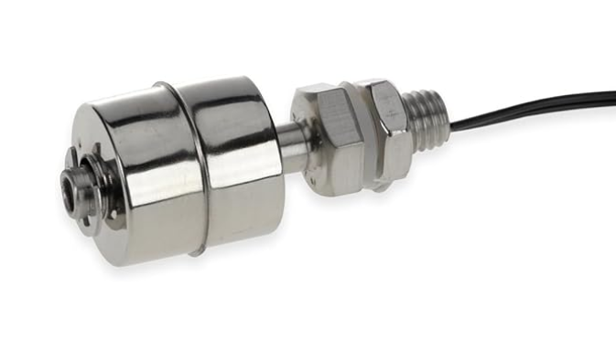
SSA issues solution
All the trips were due to false positive interlock.
Some EM leakage > 100 V/m ( even 3 times larger) was detected in the RF rack.
The EM leakage could affect the inductive and capacitive sensors deployed for the “module connect” and “water leak” interlocks.
Solution:
“Module connect” interlock passivated during the SSA operation (new firmware)
“Water leakage” capacitive sensors replaced with mechanical float switch (hardware changes)
Capacitive Sensors
Float switch
It seems that simpler procedure and components are the best choice for this machines.
The interlock occurred only on CRE-331M-03 and CRE-331M-05 and the SSA upgrade was performed on all the SSAs.

Slide 26
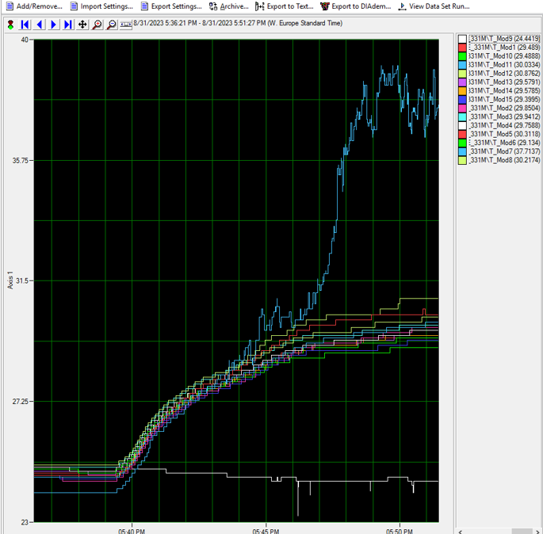
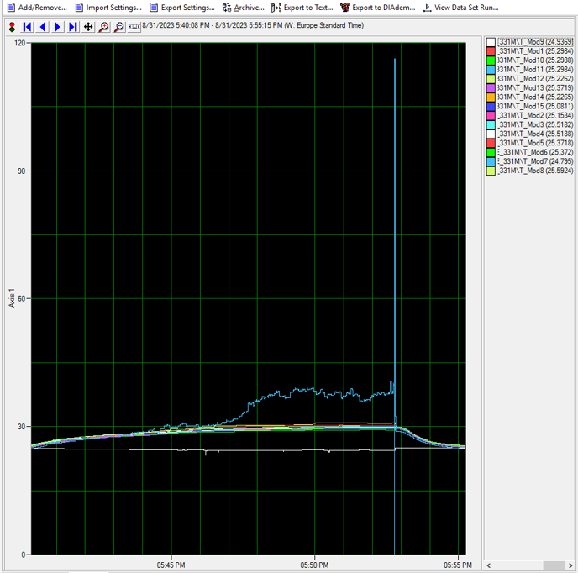
SSA issues mitigation
That’s the “temperature sensor” interlock could be affected by some EM leakage but also by the proper mechanical connection of the Module towards the waveguide combiner.
The 16 temperature sensors data log shows a initial drift of one temperature ( Module7 – light blue trace). Module data – transistors current and voltage , output and reflected power - are fine but suddenly the temperature departs beyond the interlock threshold and the SSA stops.
The temperature data acquisition filtering has been increased but the proper coupling between the module and the wave guide can be the keystone.

Slide 27
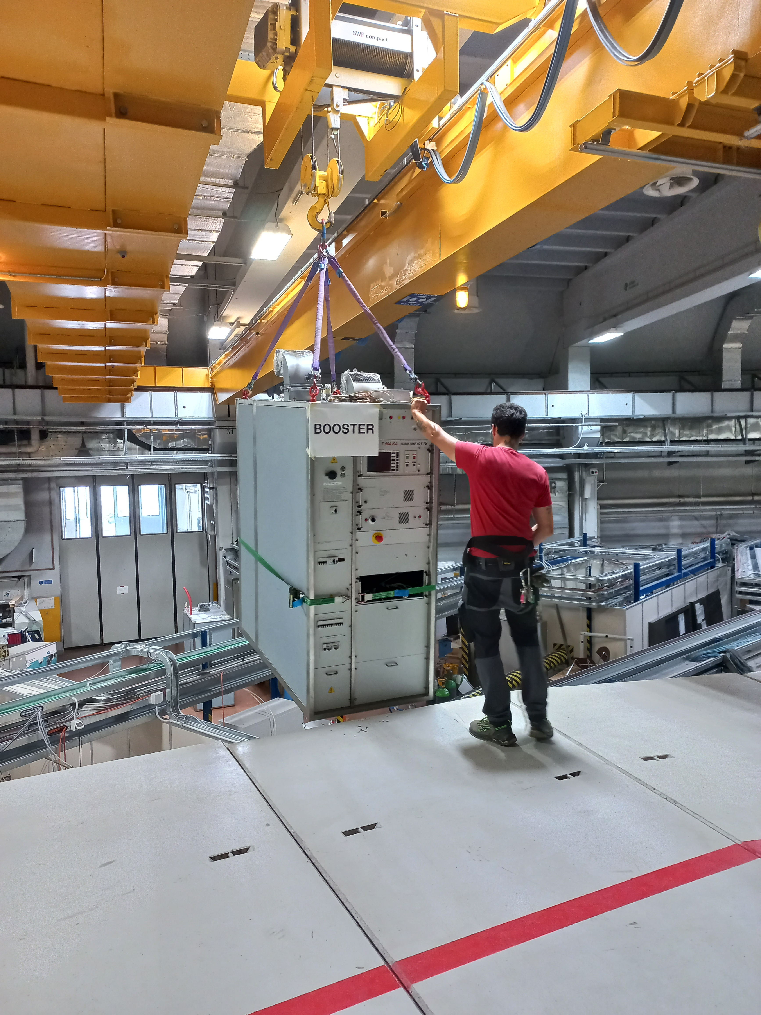
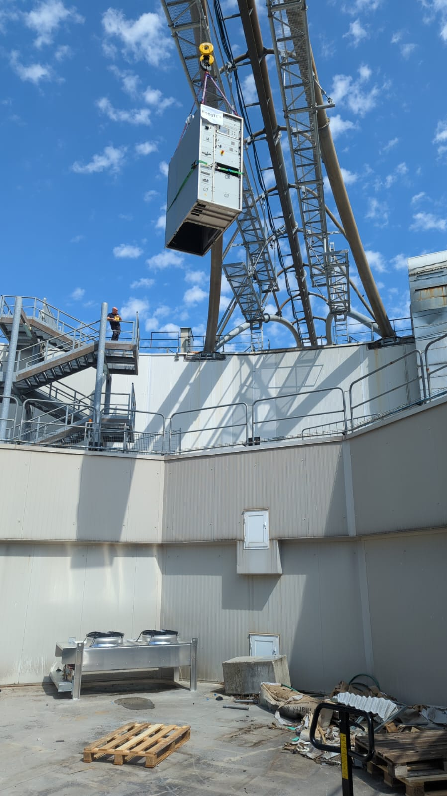


Recycling
One IOT based transmitter together with the last 80 kW IOT tube has been moved to the booster RF plant.
In 2018 a new 500 MHz - 18 kW SSA has been set into operation for the single RF plant of the booster ( peak RF power need ~ 14 kW).
After the storage ring SSA revamp it has been agreed to recyle the “not-so-old” IOT based transmitter in the Booster.
For the Booster RF system:
some redundancy in terms of RF power availability
the accelerating booster cavity voltage can be raised up to achieve the “emittance swop” injection, an undoubted plus in view of the Elettra 2.0 project.

Slide 28


WR1800 WG Run
Elettra 2.0 RF system foresees only wave guide run to feed the accelerating cavity.
Since the SSA installation is over, the WG is now we are going installing the WG run
However for radioprotection safety issue the 6 1/8’’ coaxial line run can’t be removed till the Elettra end of operation

Slide 29
Conclusion
In the framework of the Elettra 2.0 project four turn-key 130 kW 500 MHz cw SSAs amplifiers were purchased and set already into operation on the Elettra storage ring.
The contract duration matched the foreseen one. An excellent cooperation is born between Elettra and the supplier.
The SSAs installation was fully transparent to the user. The installation, SAT and set into operation on the cavity of one SSA took three week as planned, no delay for the storage ring operation.
To date the total operating hours is close to 30000 hours but SSA are running at half of the nominal power level.
The in-house designed PS control allows a considerable savings of electricity consumption.
Several troubles occurred during the operation. Some of them were only mishandling and were easily solved. Others were due to some RF leakage non negligible for sophisticated electronic equipment. Mechanical actuators better fit such environment.
After fixing these troubles no failure occurred in 2024 run.

Slide 30

Notes:
Last Slide 1: Thanks to the audience

Slide 31
Notes:
Last Slide 2: Aerial Photo of Elettra

