Slide 1
Installation Of New Solid-State Amplifiers For CEBAF’s Pass 5 Extraction Cavities
Mark Wissmann, Curt Hovater, Larry Farrish, Rick Nelson, Mike Spata,Young-Min Shin
May, 2024

Slide 2
Outline
A Brief CEBAF Separator History
  • Three Energy Changes
  • RF Separator Changes
Operational Challenges Along The Way
• Power limit of components, cables & cavities
• Single HVPS for all four IOTs
  • Vector Sum Control
  • Cavity to Cavity Phasing
  Rationale For Switching
  • DC Power Supply
  • Easier Phasing
  • Quick Recovery

Slide 3
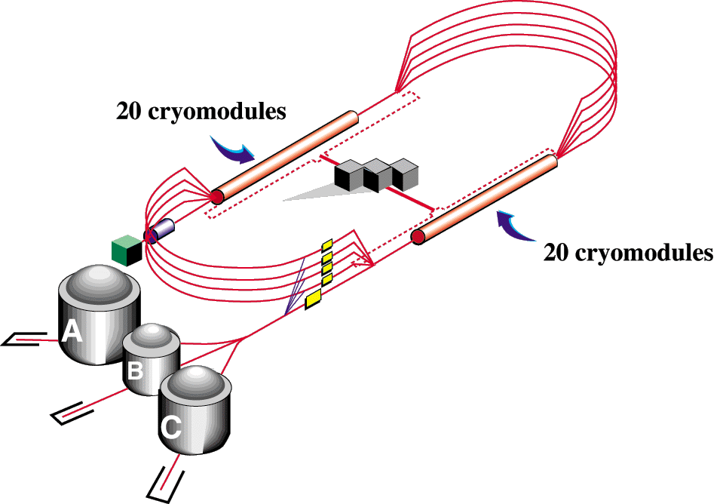
Two Beam Energy Upgrades
  • Originally designed as a 4 GeV Accelerator
Two 0.5 GeV linacs
  • Operating up to 6 GeV 2004 – 2012
  • 2014 Started Operations with 12 GeV Beam

Slide 4
CEBAF Extraction History
• 1998 - Delivery of 4 GeV Beam simultaneously to three experimental Halls
• 2004 to Spring of 2012 delivered up to 6 GeV electron beam to three Halls
simultaneously
- 2004 investigation of using Inductive Output Tubes (IOTs) started
- 2008 replaced 1 kW SSAs with IOTs to amplify 499 MHz to cavities
• 2014 to present – simultaneously up to 11 GeV to halls A, B, & C
and 12 GeV to Hall D
- converted and tuned Pass 5’s IOT from 499 to 750 MHz

Slide 5
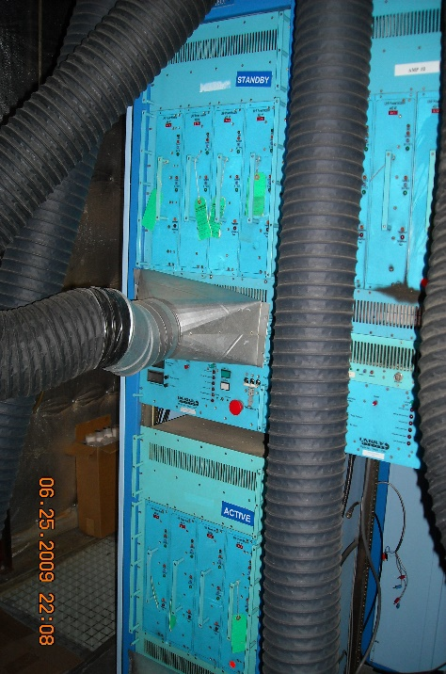
4 - 6 GeV Separator Cavity Power Source
RF Separators
Septa Magnets
SSA AMPS PASS 1 – 5 Horizontal
Pass 1
YAs YBs
Pass 2
Pass 3
Hall A
Pass 4
Pass 5
Hall B
Lambertson
Hall C
1kW design – Combined 2 to operate Pass 2
Configuration until ~2004
2004 – 2008 replaced SSAs with Inductive Output Tubes (IOT)
- Transistors became obsolete
- Reliability problems with increased power requirements
- Future 12 Gev power requirements (>10000 kW)

Slide 6
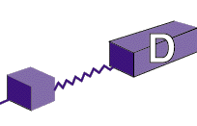
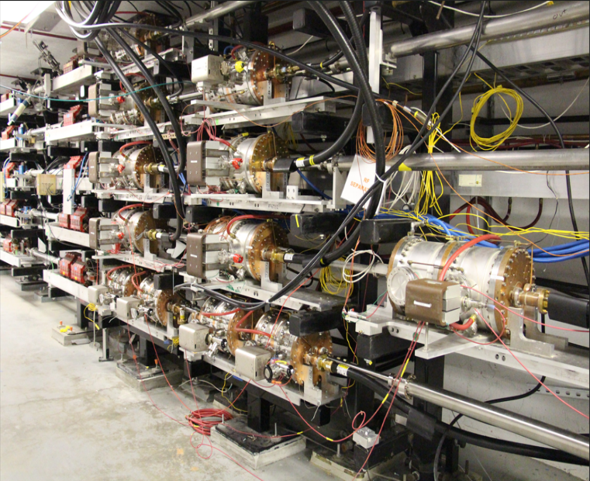
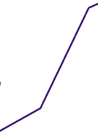
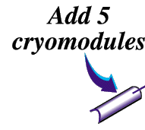


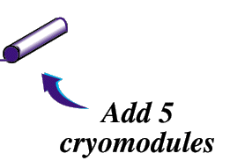
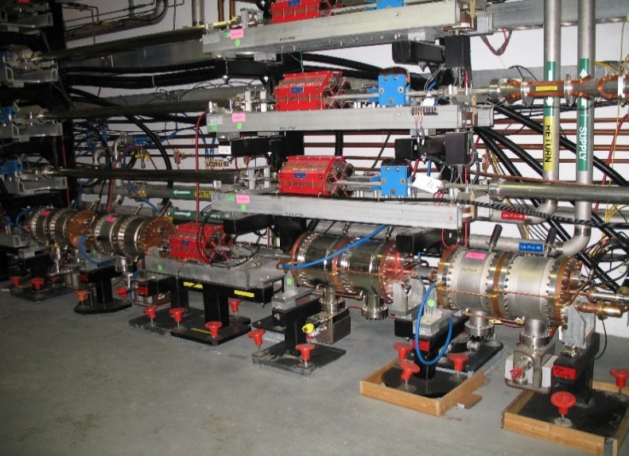
20012 – 2014 CEBAF 12 GeV UPGRADE
Added 4 750 MHz Horizontal Cavities
Two 1.1 GeV linacs
CHL-2
Added 4, 499 MHz Vertical Cavities

Slide 7
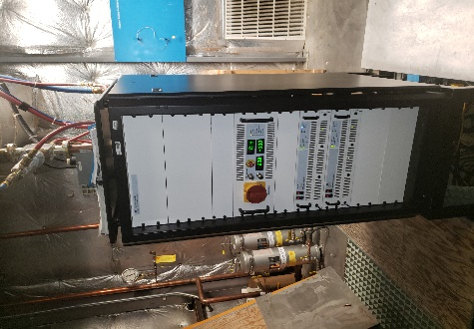
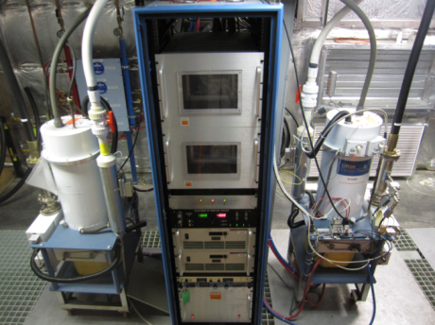
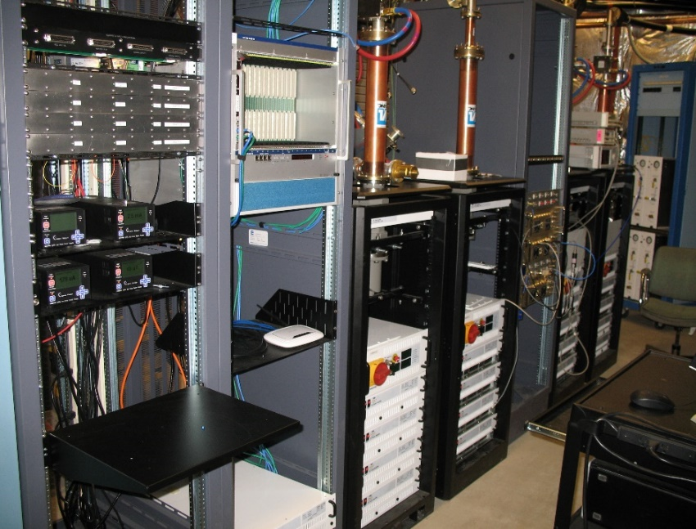
12 GeV Separator Cavity Power Sources
RF Separators
Septa Magnets
Pass 1
YAs YBs
Pass 2
499 MHz Cavities
Pass 3
Pass 4
Hall A
Pass 5
Hall B
750 MHz Cavities
499 MHz Cavities
Lambertson
Hall C
Hall D
10 kW SSAs Pass 5 Vertical
IOT Amps Pass 2-5 Horizontal
SSA Pass 1

Slide 8
Power and Energy
Energy Pass 1 (GeV) | RF Power Pass 1 | Energy Pass 2 (GeV) | RF Power(W) Pass 2 w/ One Cavity | Less power needed for Pass 1 (dB)
0.86 | 141 | 1.66 | 525 | -5.71
1.16 | 256 | 2.26 | 973 | -5.79
2.24 | 956 | 4.42 | 3720 | -5.90
6 GeV Energy/Power
12 GeV Energy/Power

Slide 9
RF Power Requirements
12 GeV Extraction: RF Power Requirements (x’ = 200 mrad) Calculated
Pass | Number of Cavities | Energy (MeV) | Power per Cavity (W)
1 | 1 | 2281 | 991
2 | 2 | 4441 | 939
3 | 2 | 6601 | 2074
4 | 3 | 8760 | 1624
5 | 4 | 10920 | 1420
Actual
Power Per Cavity (W)
850
1230
2800
2100
2000

Slide 10
Operational Challenges
1. Power limit of components, cables & cavities
2. Single HVPS for all four IOTs
  3. Vector Sum Control
  4. Cavity to Cavity Phasing

Slide 11
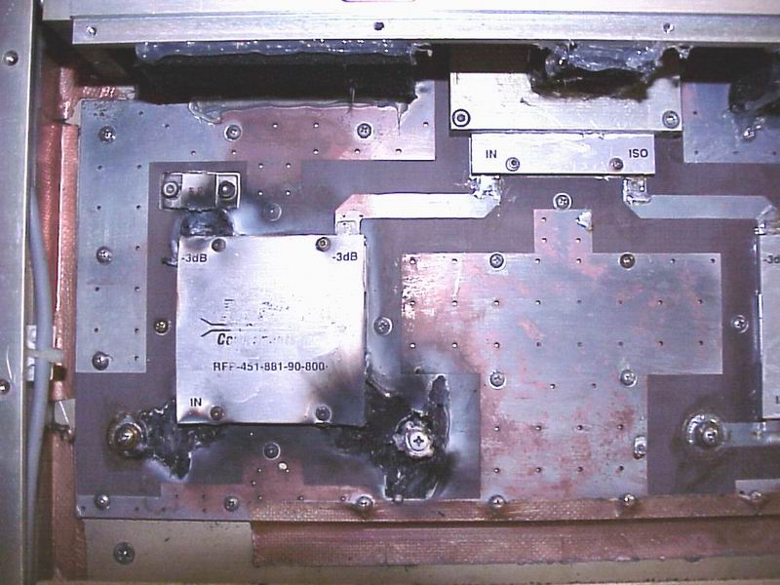
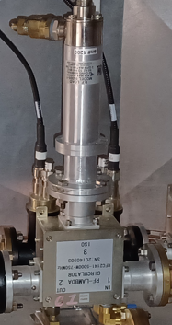
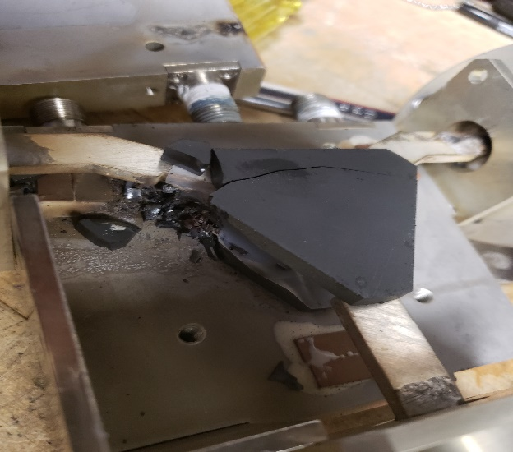
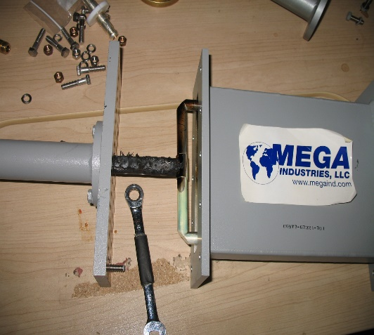
Op Challenge #1: Power Limit of Components, Cables & Cavities
• 1st SSAs – 1 kW
• Phase Shifters, Circulators, Couplers – 5 kW
• Cavities: 499 MHz – 5 kW, 750 MHz – 3 kW
1 kW SSAs
Circulator
Phase Shifter

Slide 12
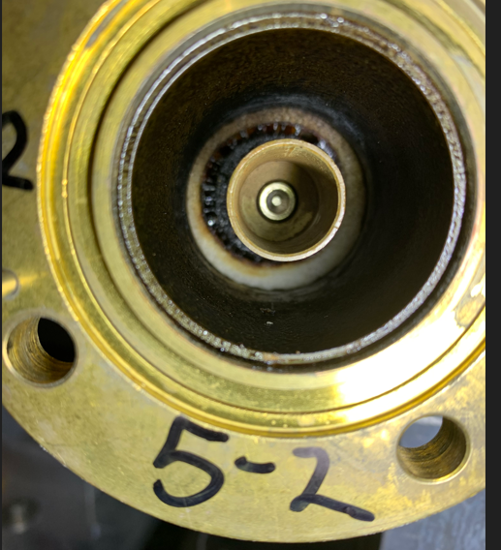
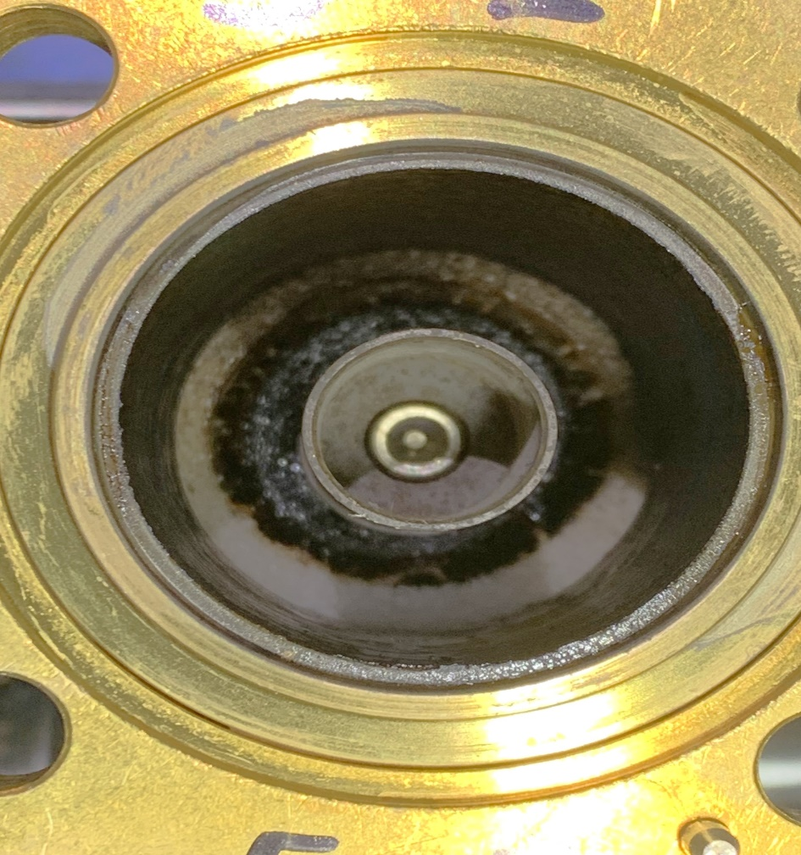

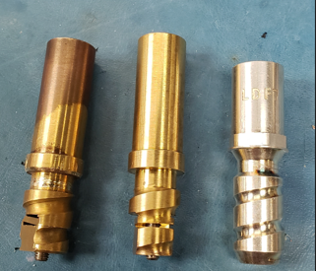
Cable Burns

Slide 13
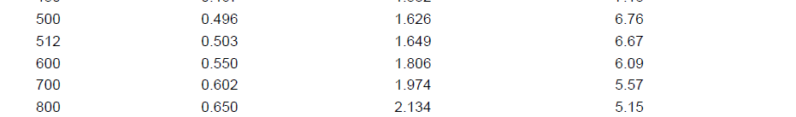
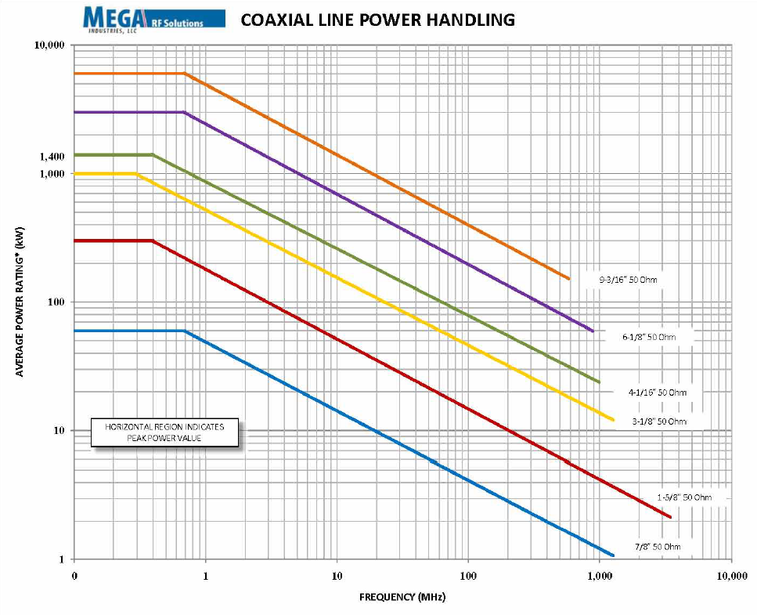
Cables – LDF7 & Rigid Line Power Specs

Slide 14
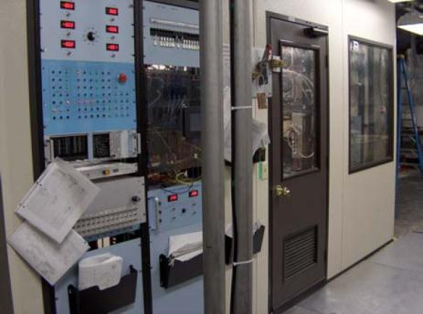
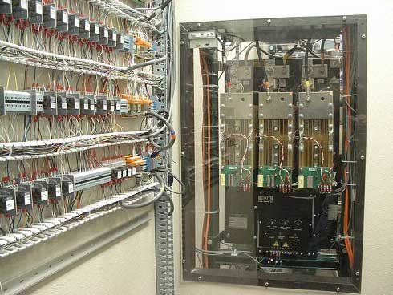
Op Challenge #2: Single HVPS
One HVPS powers all four IOTs – If it goes down, Beam Separation from Passes 2-5 down

Slide 15
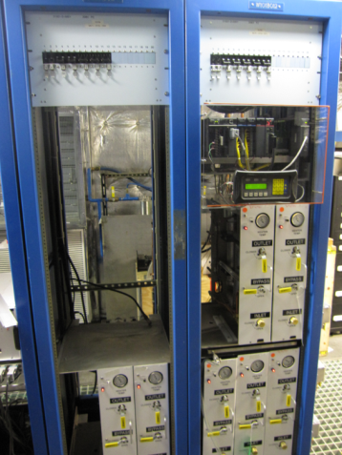
Op Challenge #3 Vector Sum & Resonance Control
Resonance control system to maintain cavity frequency
Requires one heater module per cavity
Mixing valve and Cavity Resonance Monitor
RF Amplifier
LLRF
Controls
Coupler
Forward Power
Splitter
Reflected Power
LCW
Supply
Phase
Shifters
Transmitted
Power
Heater
Cavity Resonance Monitor
Circulators
Mixing
Valve
LCW
Supply
Cavity
Cavity
Cavity
Resonance Control System
Heater Modules
Combiner
Transmitted Power

Slide 16
#3 Vector Sum Control
• One SSA (IOT) to four Cavities (Pass 5) to one FCC
• All cavity’s gradients vector summed together
• FCC (LLRF Controls) maintains this gradient
• Maintain all four cavities on resonance
RF Amplifier
LLRF
Controls
Coupler
Forward Power
Splitter
Reflected Power
LCW
Supply
Phase
Shifters
Transmitted
Power
Heater
Cavity Resonance Monitor
Circulators
Mixing
Valve
LCW
Supply
Cavity
Cavity
Cavity
Combiner
Transmitted Power

Slide 17
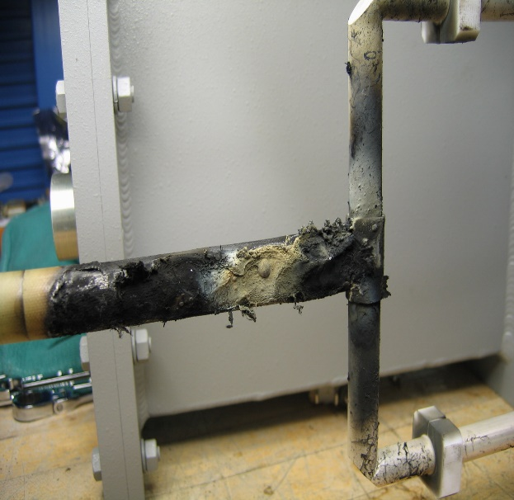
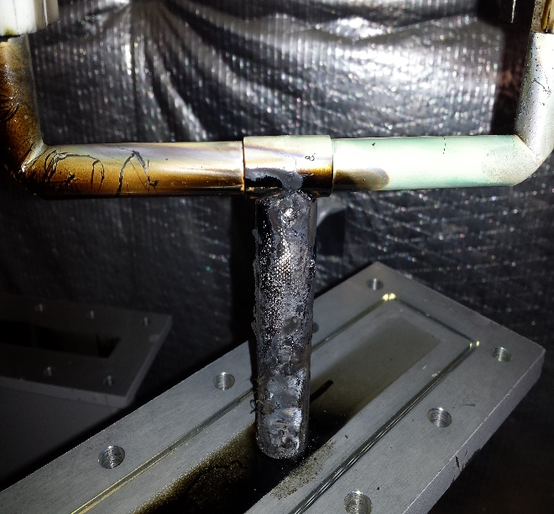
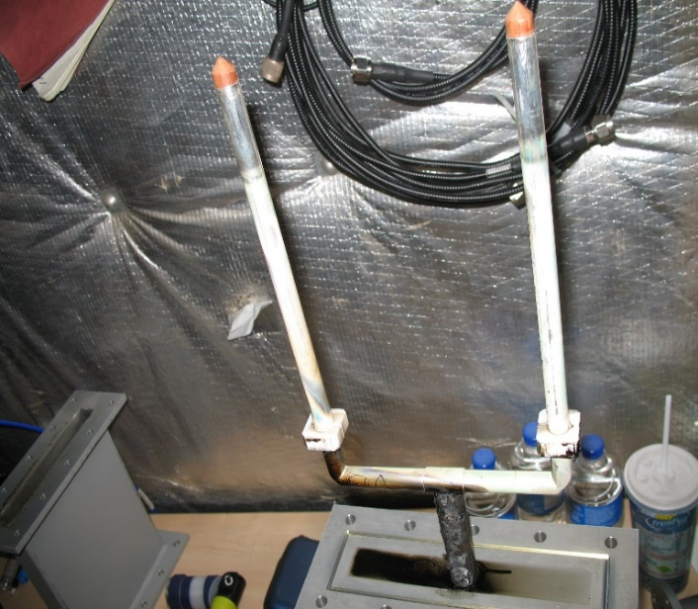
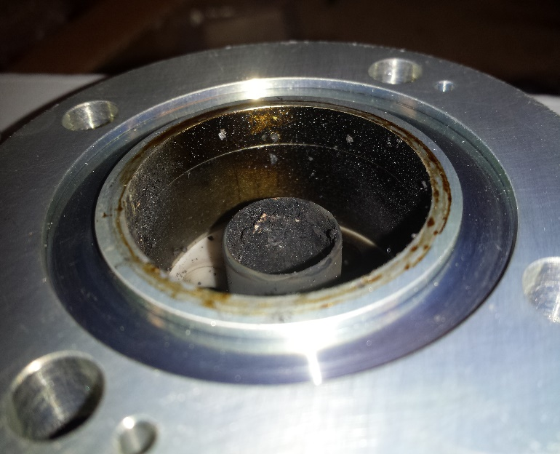
Op Challenge #4: Cavity to Cavity Phasing
RF Separators
Septa Magnets
Pass 1
YAs YBs
Pass 2
499 MHz Cavities
Pass 3
Pass 4
Hall A
Pass 5
Hall B
750 MHz Cavities
499 MHz Cavities
Lambertson
Hall C
Hall D

Slide 18
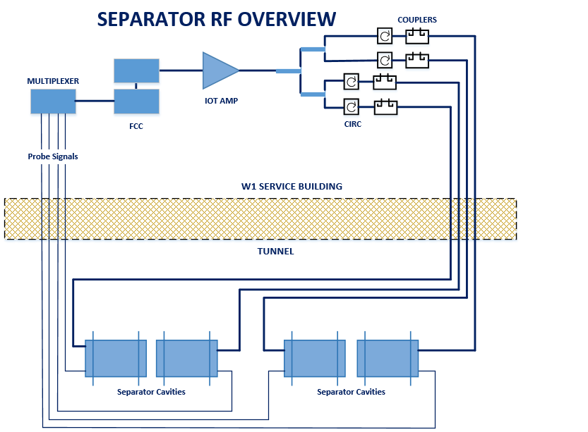
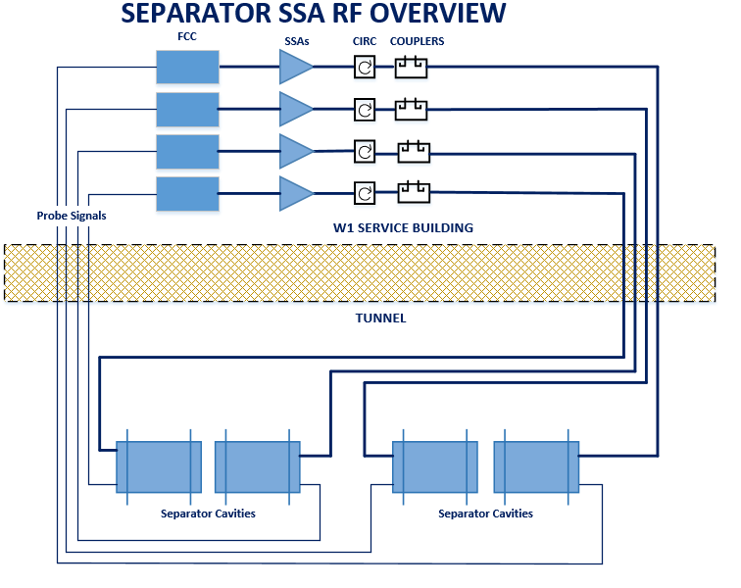
Pass 5: Old vs New
• One SSA to four Cavities (Pass 5) to one FCC vs One SSA for each cavity
• All cavity’s gradients vector summed vs Independent control each cavity’s gradient
• Cavity phasing mechanically vs cavity phasing from the FCC (LLRF Controls)

Slide 19
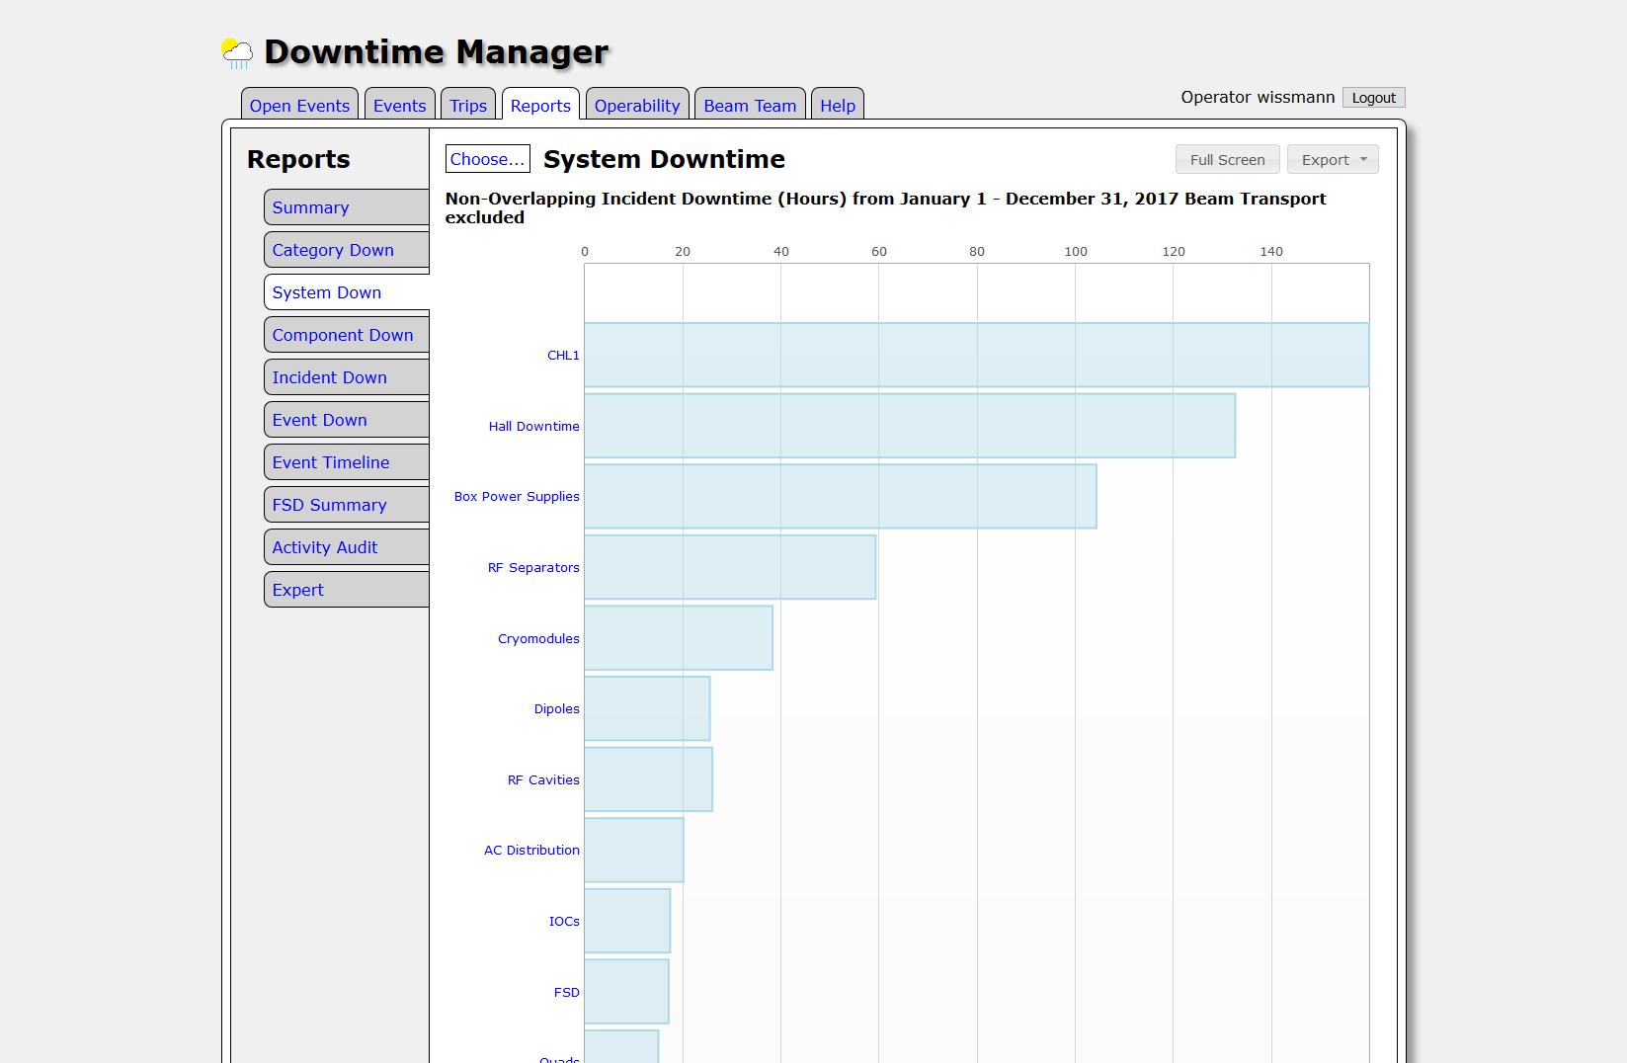

Slide 20
2019 Downtime Stats
Hours of Separator System Downtime By Month In 2019
Number of Separator System Failure Incidents In 2019
12
10.9
7
6
6
10
6
5
5
8
5
6
5.3
4
4.66
3
4
3.85
2
2
2.4
2
2
2.75
0
0
1
Feb
Apr
June
July
0
Mar
Aug
Sept
0
Feb
Mar
Apr
June
July
Aug
Sept
2019
2019

Slide 21
Rationale For New 750 MHz SSAs
  1. Reliability and power capabilities of SSAs are much improved so now viable.
  2. The 750 MHz cavities are more sensitive/responsive to resonance control. With each cavity powered through it’s own amplifier:
  • No longer one DC Power Supply for all amps
  • Now have individual Control of each cavity’s gradient vs vector sum method
  • Easier Phasing – cavity to cavity phasing done in each cavity’s FCC
  • Much Easier & Faster Recovery - <10 minutes vs >30 minutes/trip
Notes:
On the highlights slide you mentioned that this was done with ARRA funds. They may miss that or they may not remember at this point. Please add the “part of ARRA project” into the first bullet.
In first bullet you mention “high power testing”. In the 2nd bullet you say “rf measurements”. My brain assumed you were talking about high-power “rf measurements”. I suggest you add “low-power” in the 2nd bullet.

Slide 22
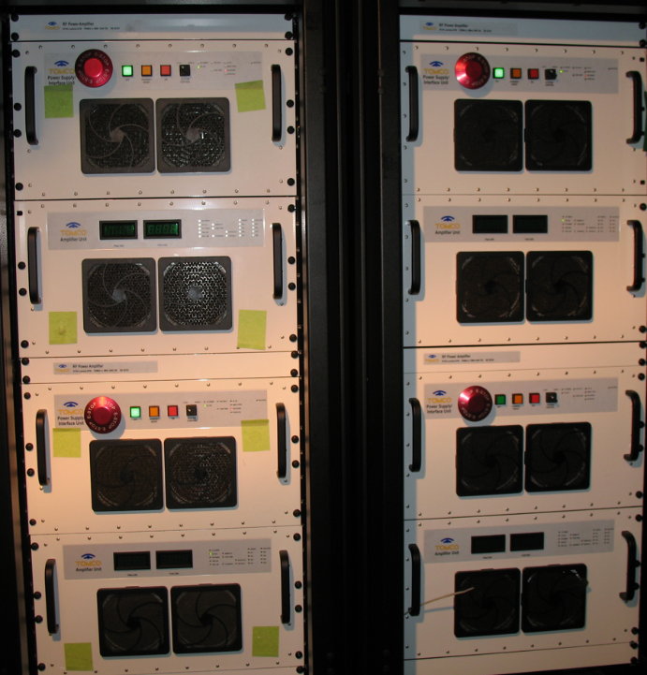
Planned Separator Cavity Power Sources 2025
RF Separators
Septa Magnets
Pass 1
YAs YBs
Pass 2
499 MHz Cavities
Pass 3
Pass 4
Hall A
Pass 5
Hall B
750 MHz Cavities
499 MHz Cavities
Lambertson
Hall C
SSA Pass 1
Hall D
SSAs PASS 5
SS AMPS For PASS 5 VERTICAL
IOT AMPS PASS 2 – 4 Horizontal

Slide 23
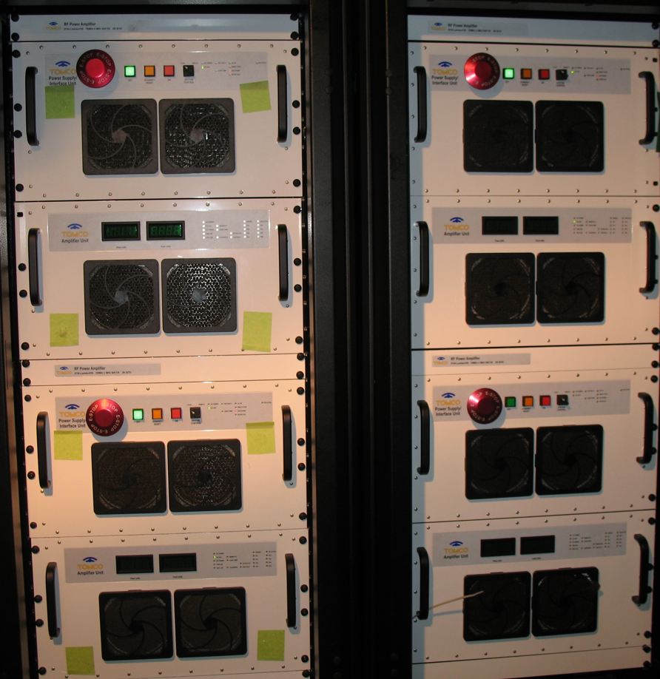
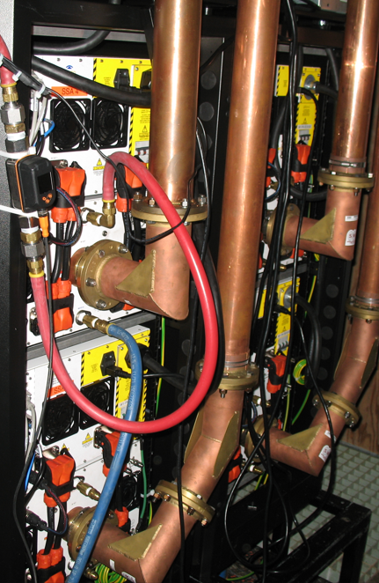
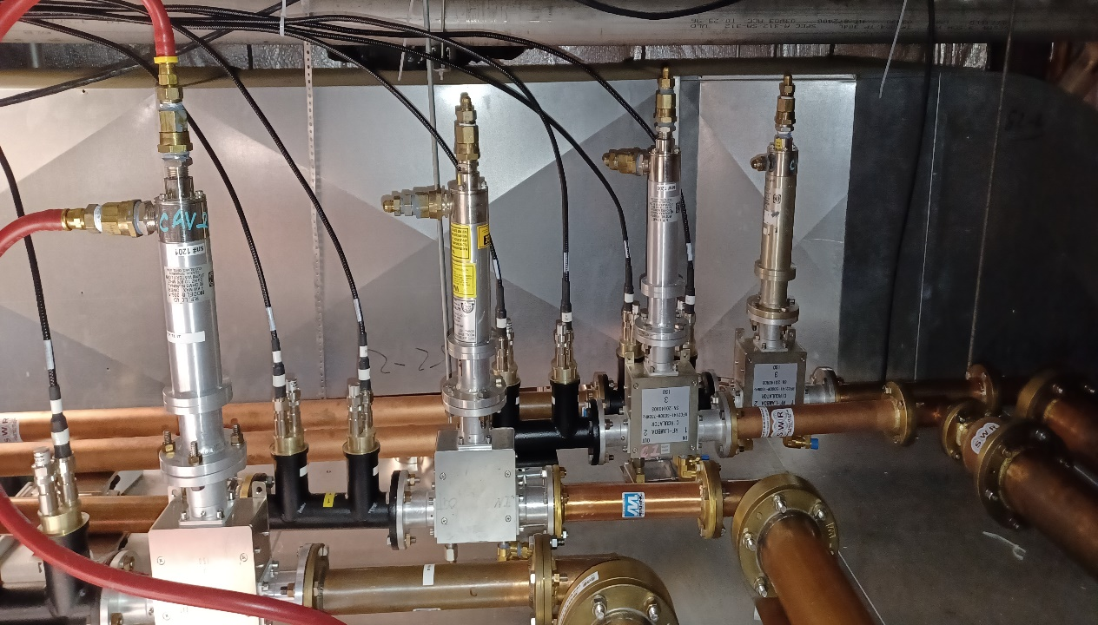
New SSAs & Components

Slide 24
Summary
  • IOTs will amplify 499 MHz RF to passes 2 through 4.
  • SSAs will amplify 499 MHz RF to pass 1 & 750 MHz to
  pass 5
  • Transistors to tubes back to transistors – Rick Nelson
  • The bottom line is expected reduction in accelerator down time.
  Thank You For Your Time

Slide 25
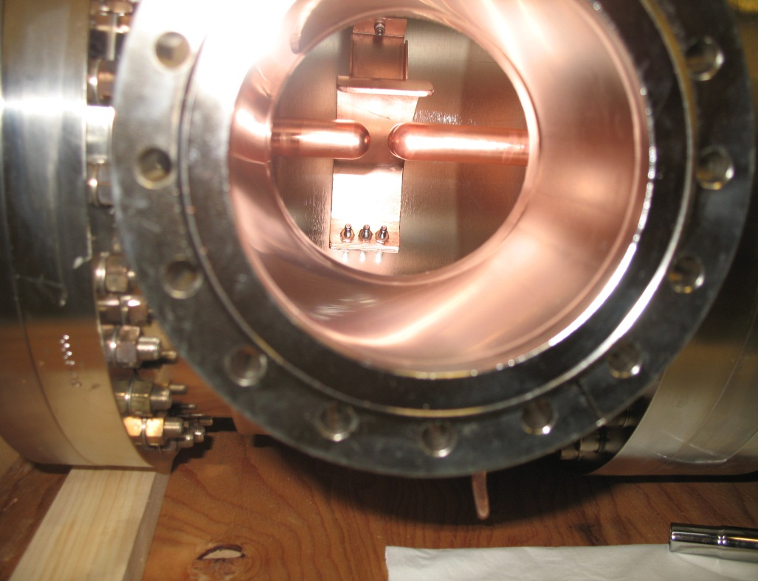
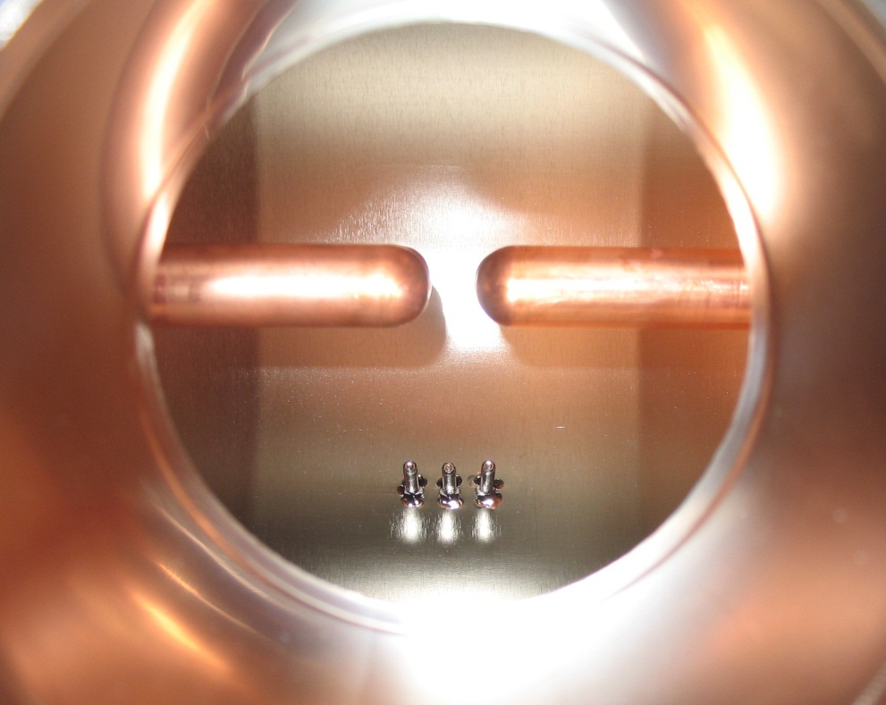
Inside A Separator Cavity
Tuning Plate and Rods
Close up of Tuner Plate Studs

Slide 26
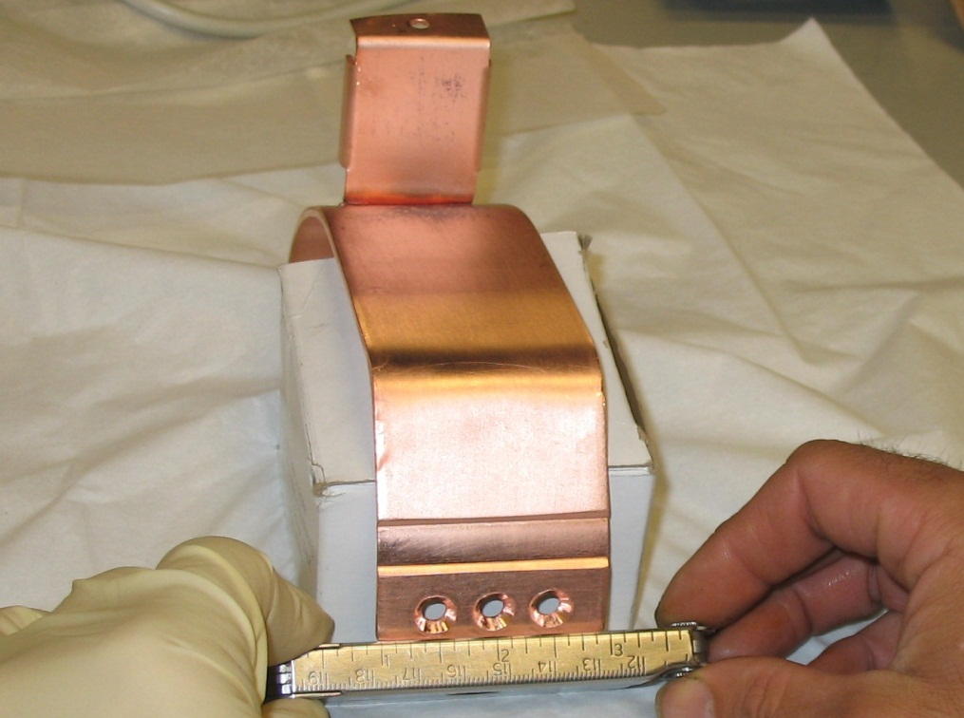
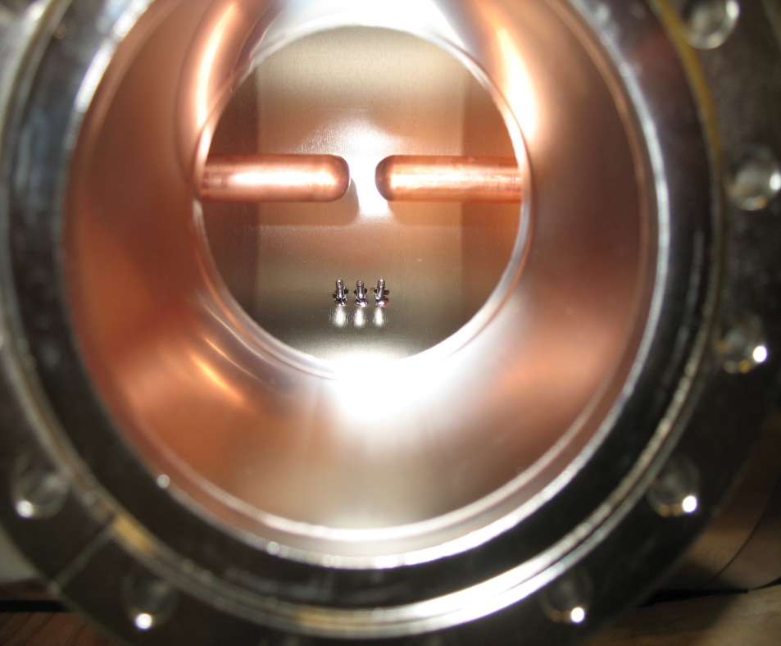
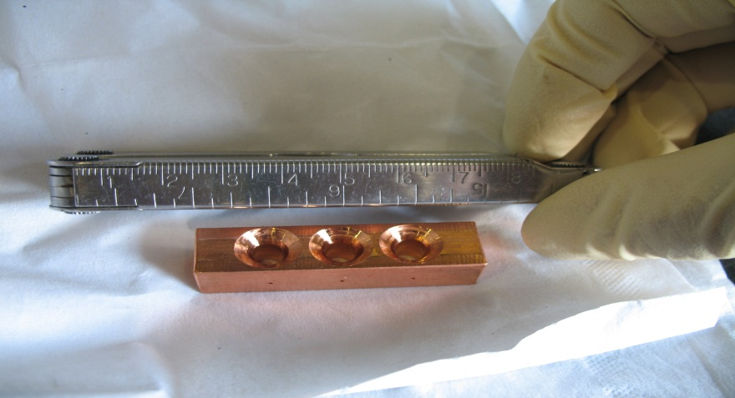
Inside A Separator Cavity
Tuning Plate Removed

Slide 27
IOT vs. Solid State Amp
Estimation of the costs Solid State Amp:
1 X 15kW @ 499MHz with 3 outputs = $115,000
Costs are for single unit – NEED 2 = $230,000
Or
4 x 10kW @ 499MHz with single output = $110,000
Costs are for single unit (NEED 4) = $230,000
Or
Estimation of the costs IOT Amp:
Hardware procurements = $325,000
Several support systems will need upgrading = 1.4 FTEs
Rick Nelson did pricing of IOTs earlier this year, had $325 k in procurements plus about 1.4 FTEs. That's for 2 IOT systems, fully separate from the existing systems. We had 60% rated efficiency for 10 kW. A single 50 kW supply wouldn't give us any margin in operating 2 IOTs, hence the dual HVPS and dual crowbars (55+55+16+16=142k alone).

Slide 28
Present IOT Amplifiers
Existing HV Deck
RF IOTs & Equipment Rack

Slide 29
Amplifier Power Requirement
Calculation:
Summary:
Number Of Cavities | Deflection (μrad) | Energy (MeV) | Shunt Impedance | PWR per Cavity(w)
4 | 260 | 11023 | 210 | 3260

Slide 30
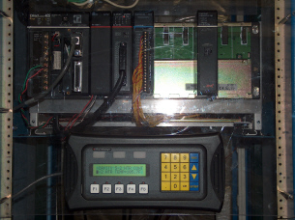
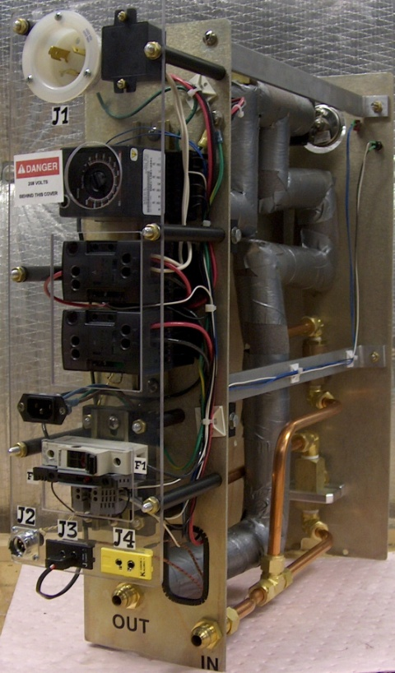
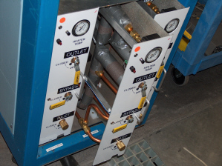
Resonance Control
Cavity Temp. vs. Frequency Response
PLC Controller
Heater Module
Heater System

Slide 31
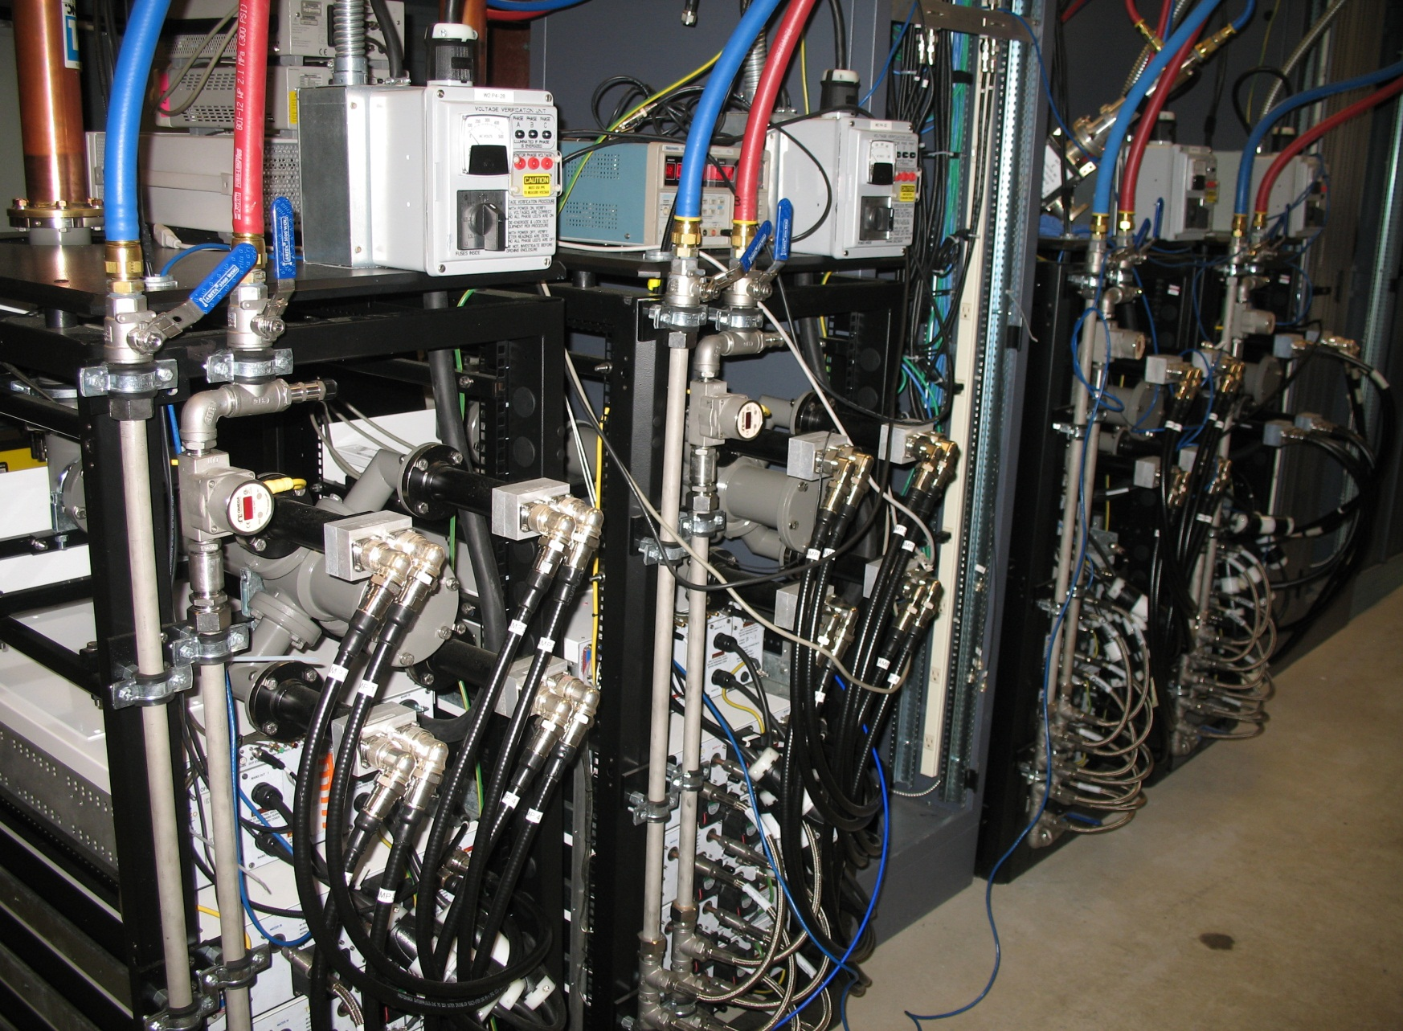

Slide 32
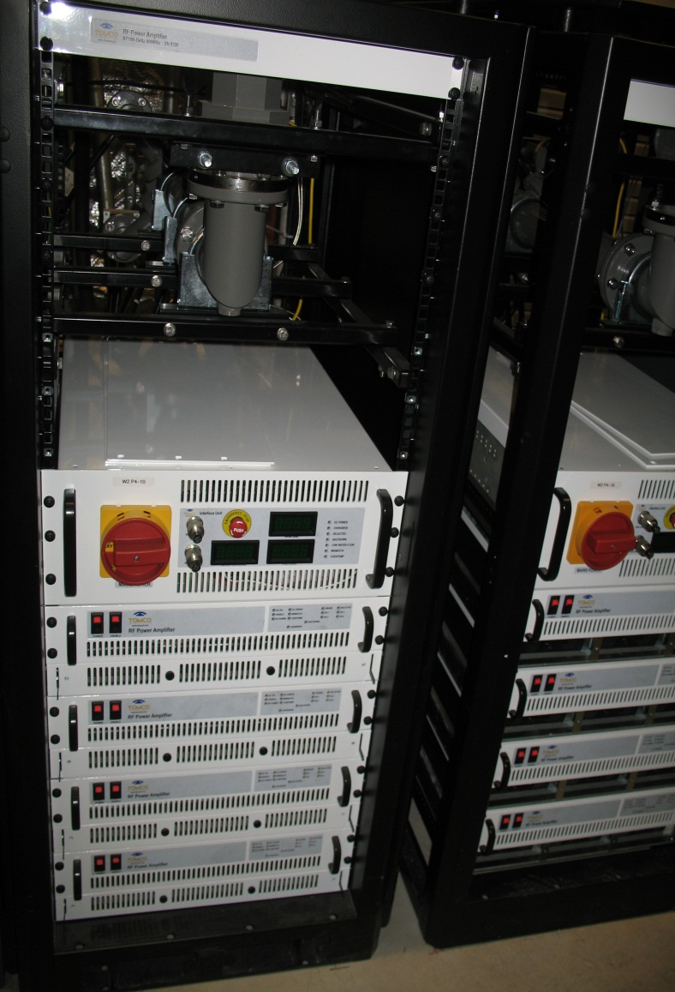
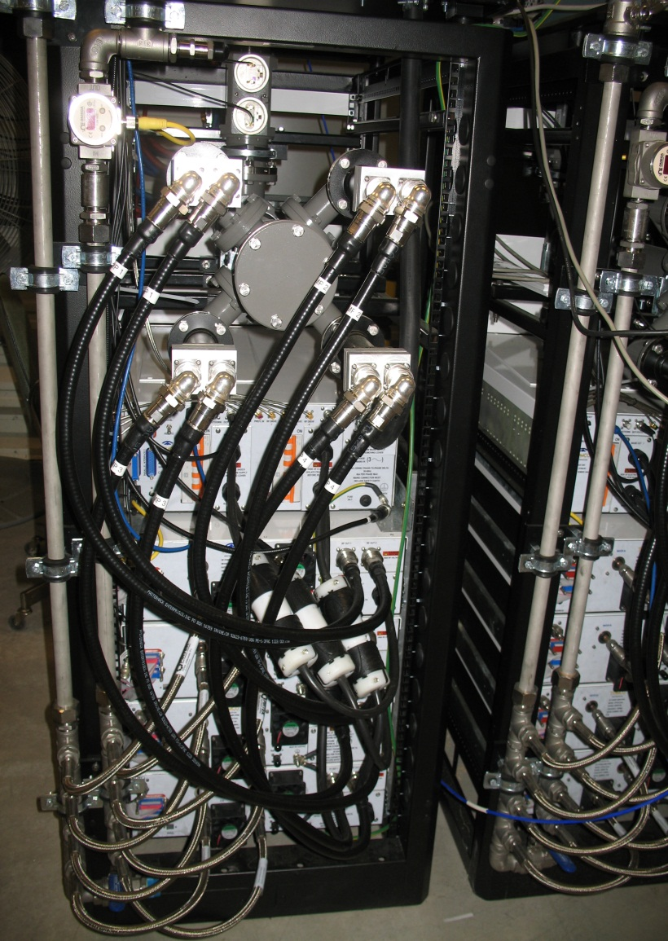
New TOMCO 10kW Solid State Amplifiers

Slide 33
Summary:
ΔHz/°C | TOTAL ΔHz | TOTAL ΔT(°C)
8000 | 165000 | ~21

Slide 34
Summary
Normal conducting solution requires 6 cavities
Cavity has been tested at the required power
Resonance Control System and RF Hardware match existing systems
New Solid State Amplifier instead of an IOT system
Ready to start procurement phase
Beneficial occupancy of building on 4/1/2013
Install cavities before the end of the LSD
Install hardware as soon as we get in building
Project complete by 4/1/2014
Questions?

