Slide 1
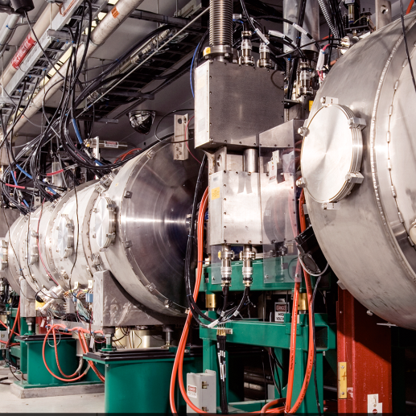
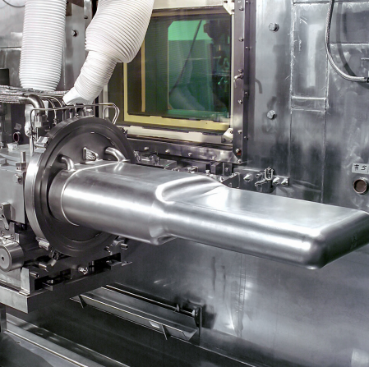
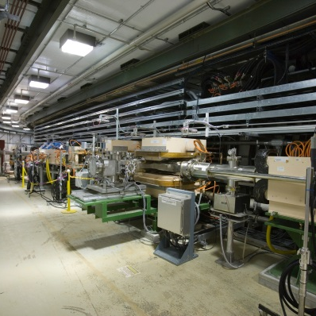

Enhanced RF Window Monitoring and Protection at the Spallation Neutron Source (SNS)
George Toby, Sang-ho Kim, Sung-Woo Lee, Haitao Ren, Timothy Miner, John Moss
tobygd@ornl.gov
CWRF 2024 - September 9–12, 2024

Slide 2
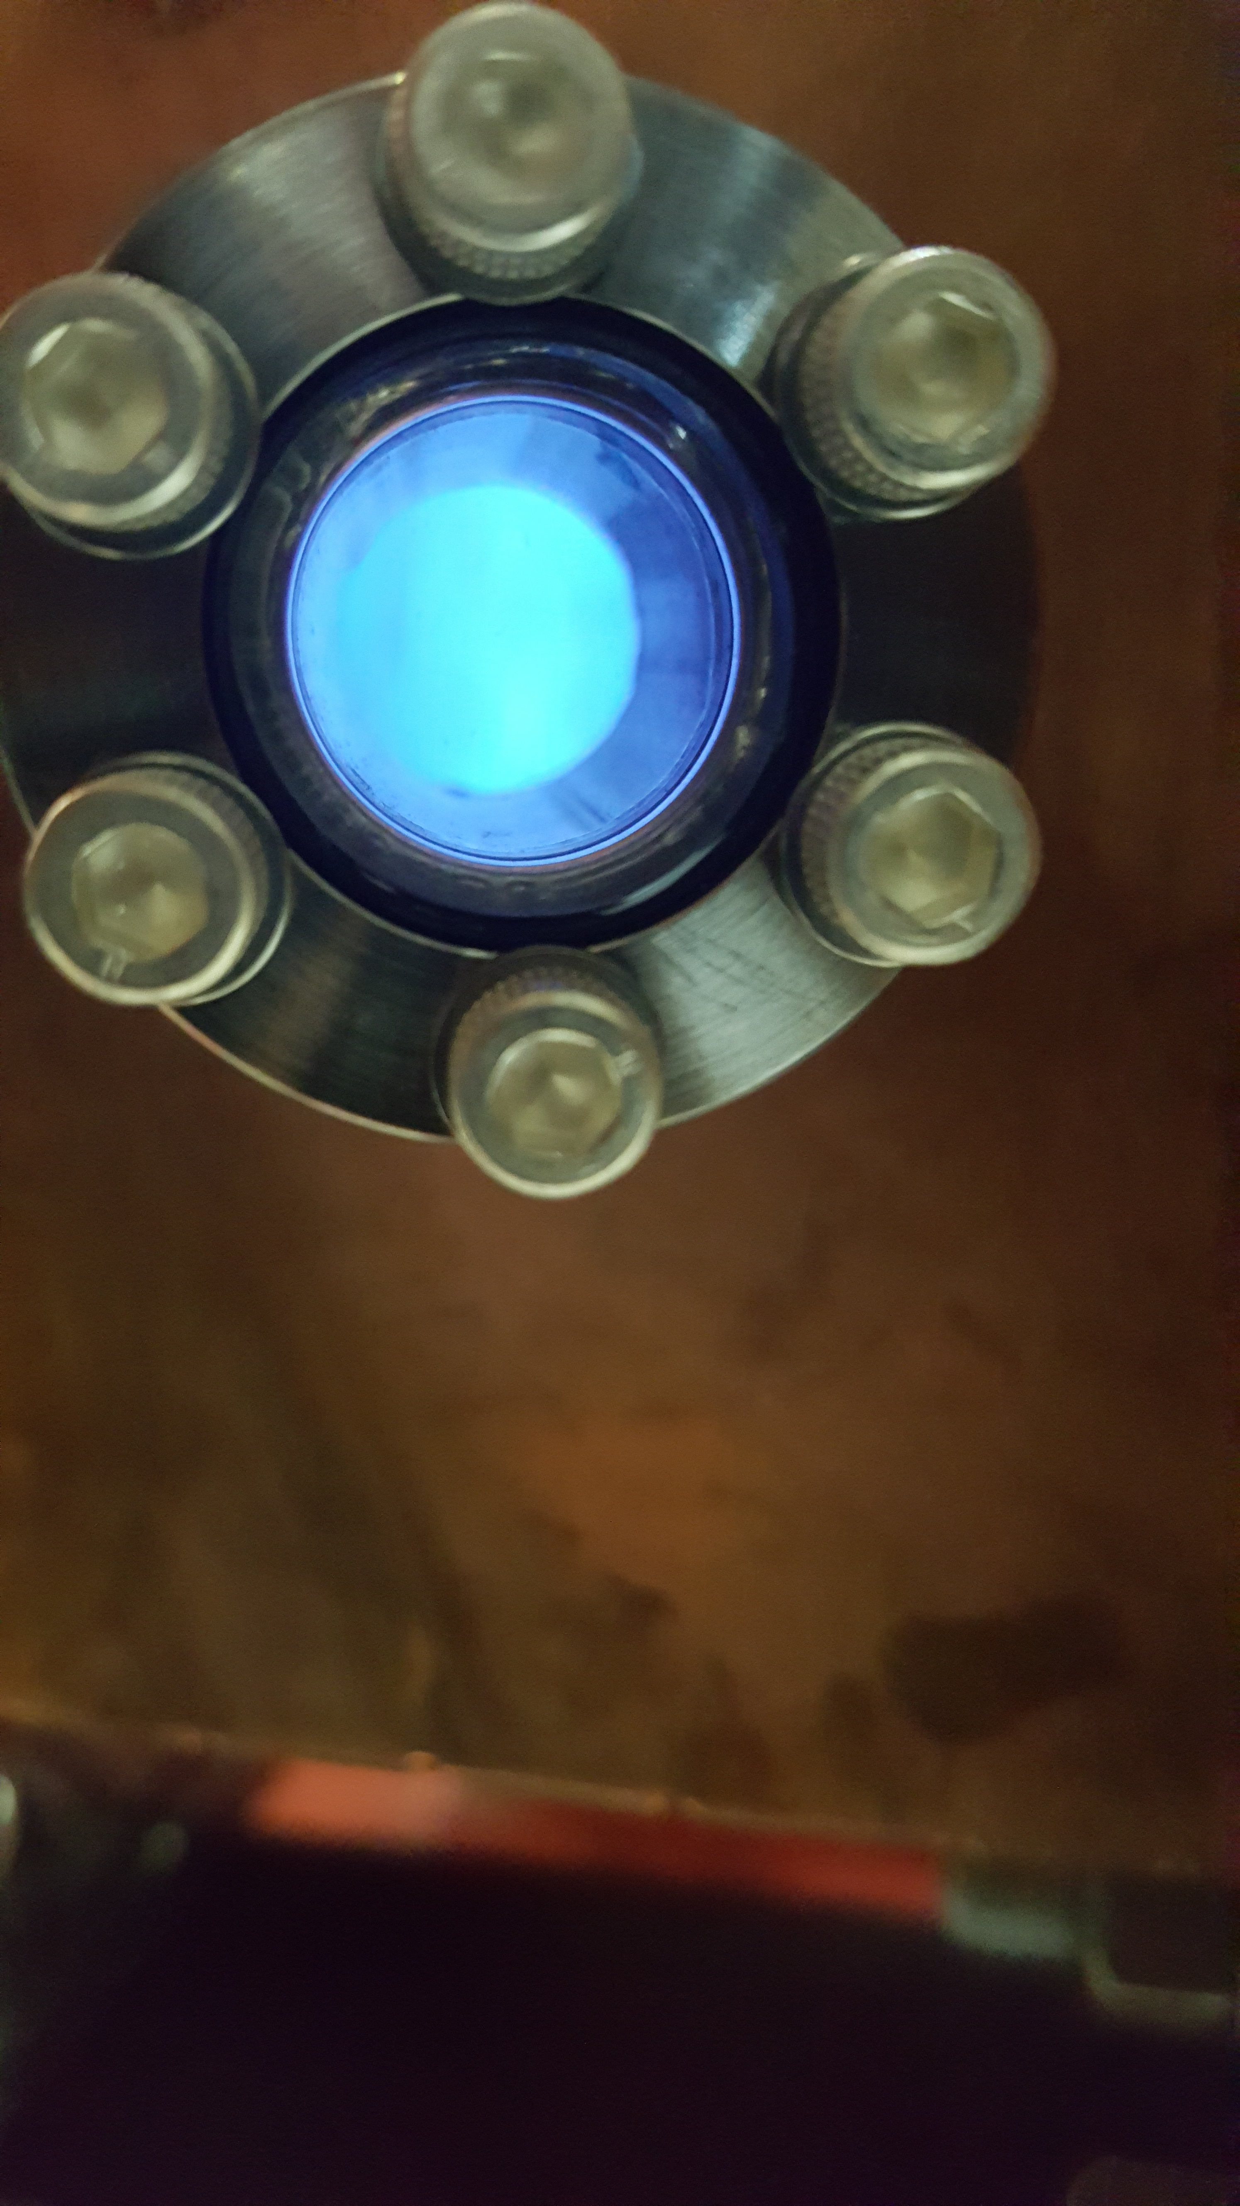
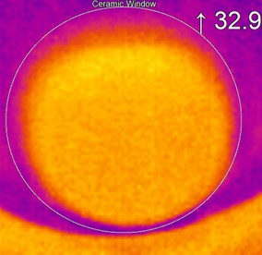
The SNS is implementing camera-based systems to enhance the reliability of the high-power RF vacuum windows.
Multipacting Project: Electron Glow Discharge Detection
Thermal Imaging Project: Ceramic Window

Slide 3
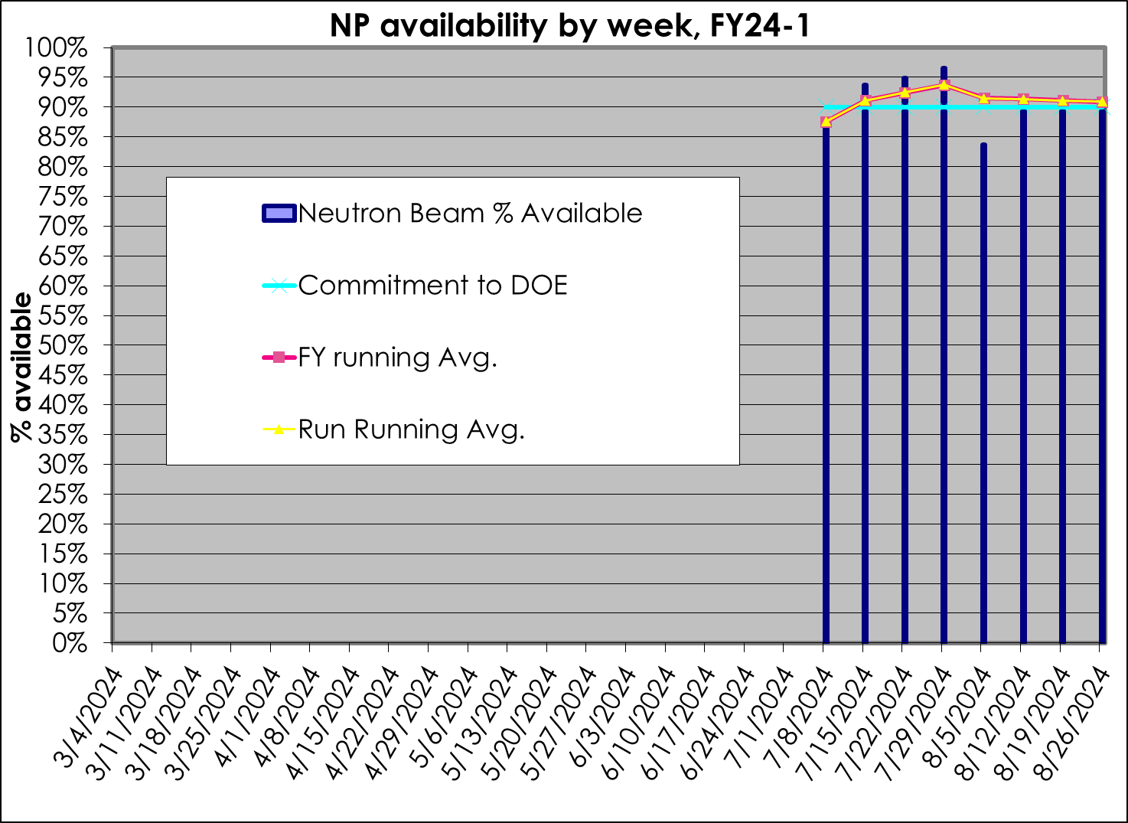
Efficient operation is a goal for the SNS
Reducing down time and improving reliability is critical for SNS operations
$30k to > $50k is the estimated cost per hour of down time
RF Vacuum window failures usually incur >8 hours per event

Slide 4
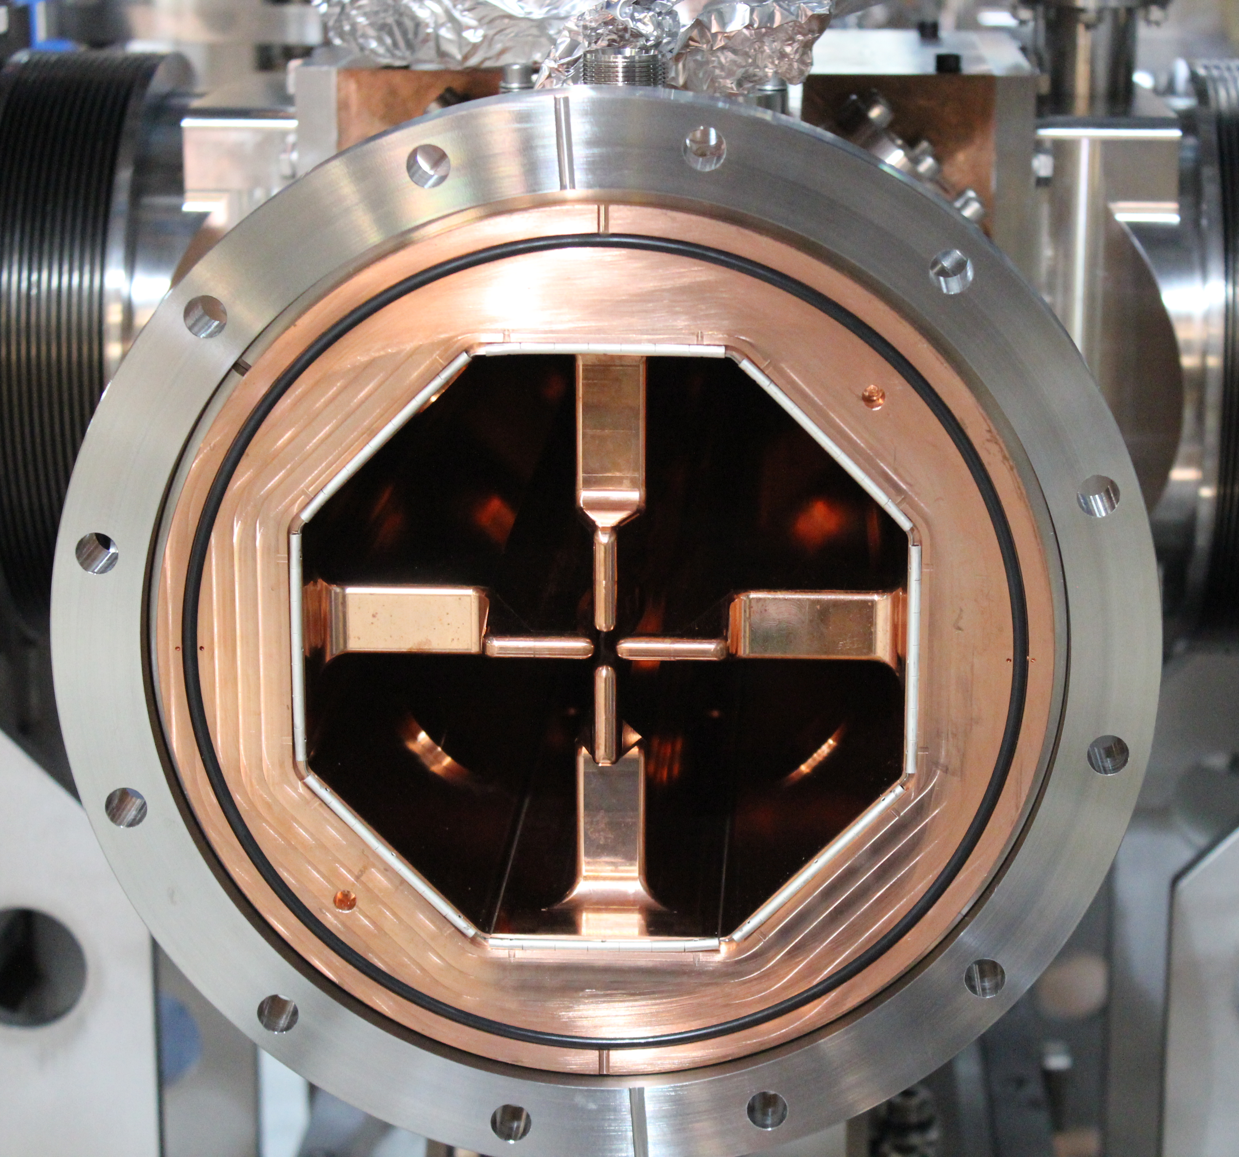
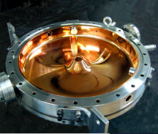
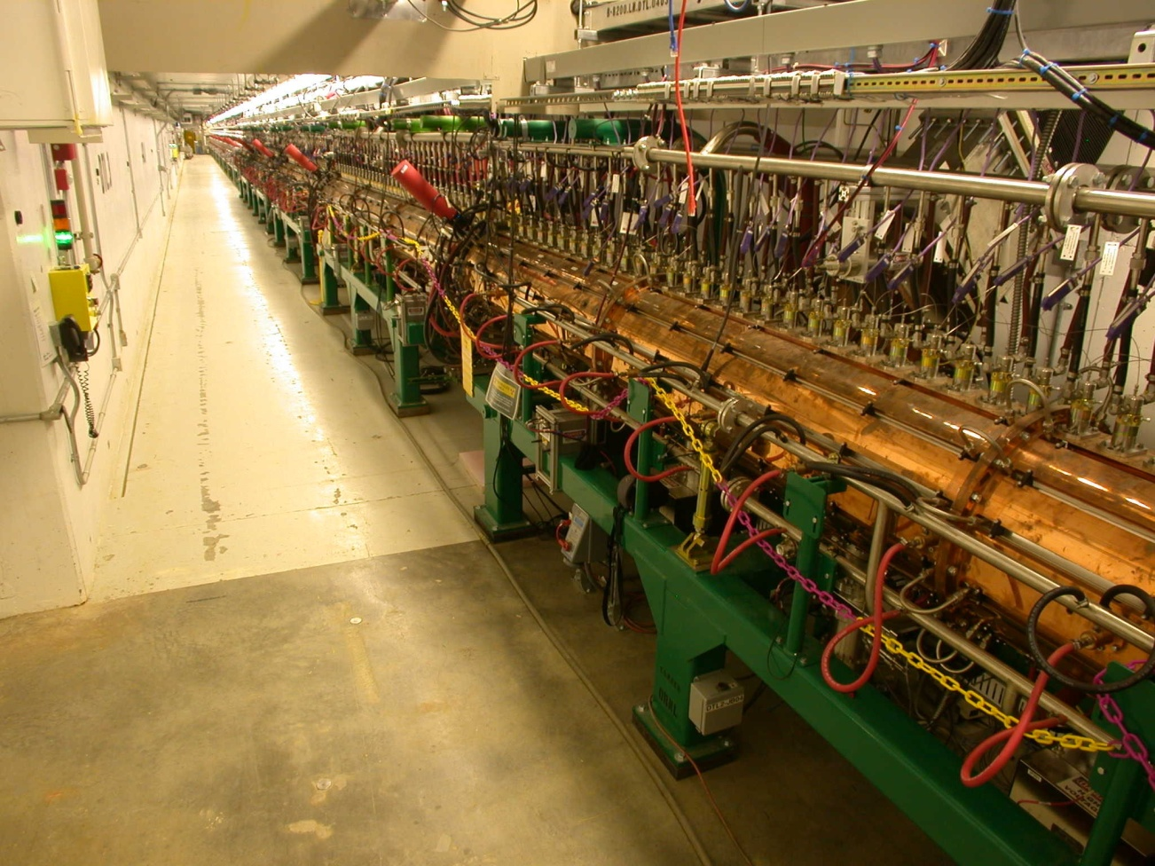
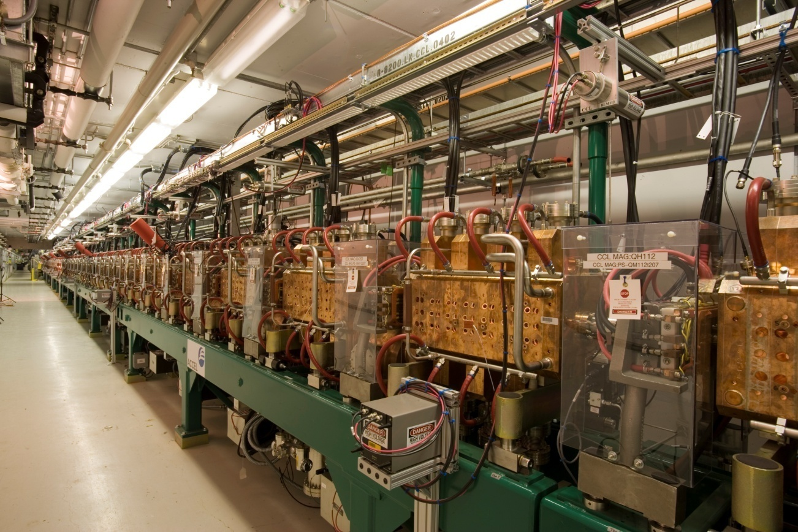
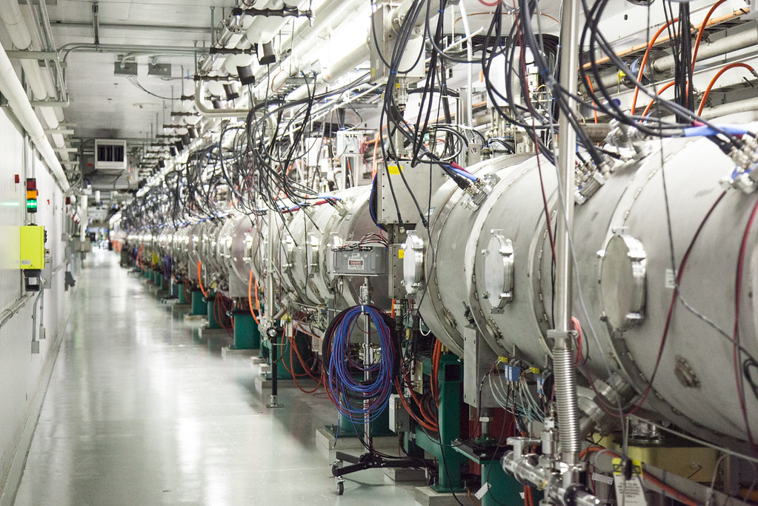
Overview: The SNS accelerator strings together resonant cavities ultimately creating a ~1.3 GeV proton beam
Radio-Frequency Quadrupole (RFQ)
Medium Energy Beam Transport (MEBT)
Coupled Cavity Linac (CCL)
Superconducting Linac (SCL)
Drift Tube Linac (DTL)
J. Galambos et al, June 2020, Proton Power Upgrade Final Design Report
S. Kim, June 2020, RAD LINAC Systems Group

Slide 5
Multipacting Project: Electron Glow Discharge Detection

Slide 6
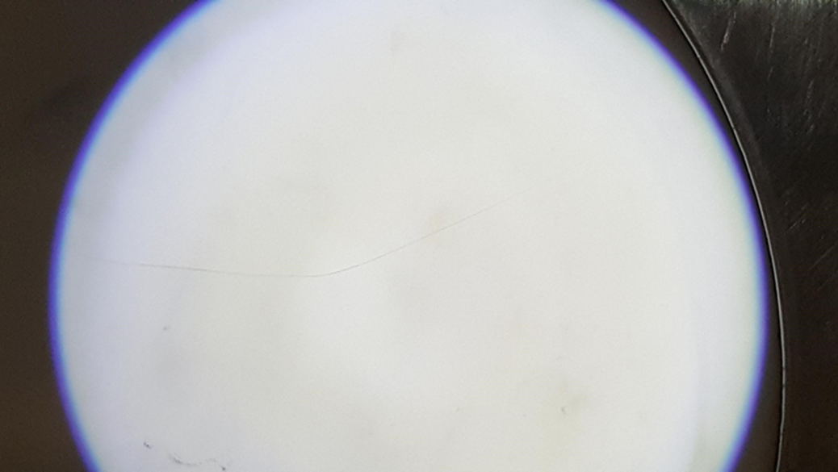
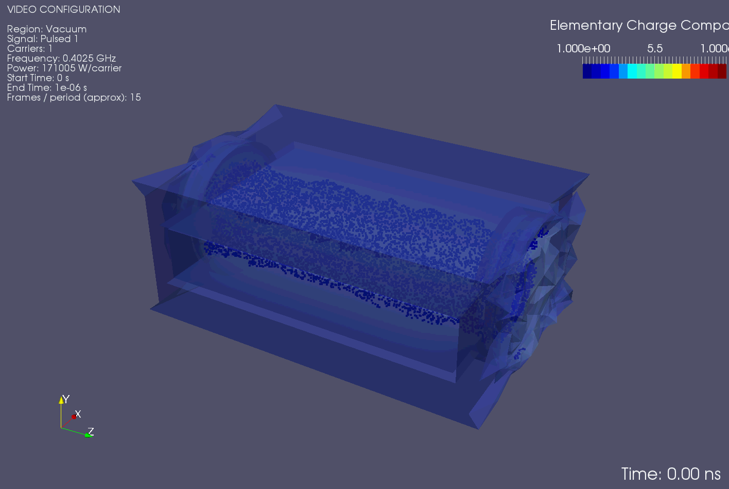
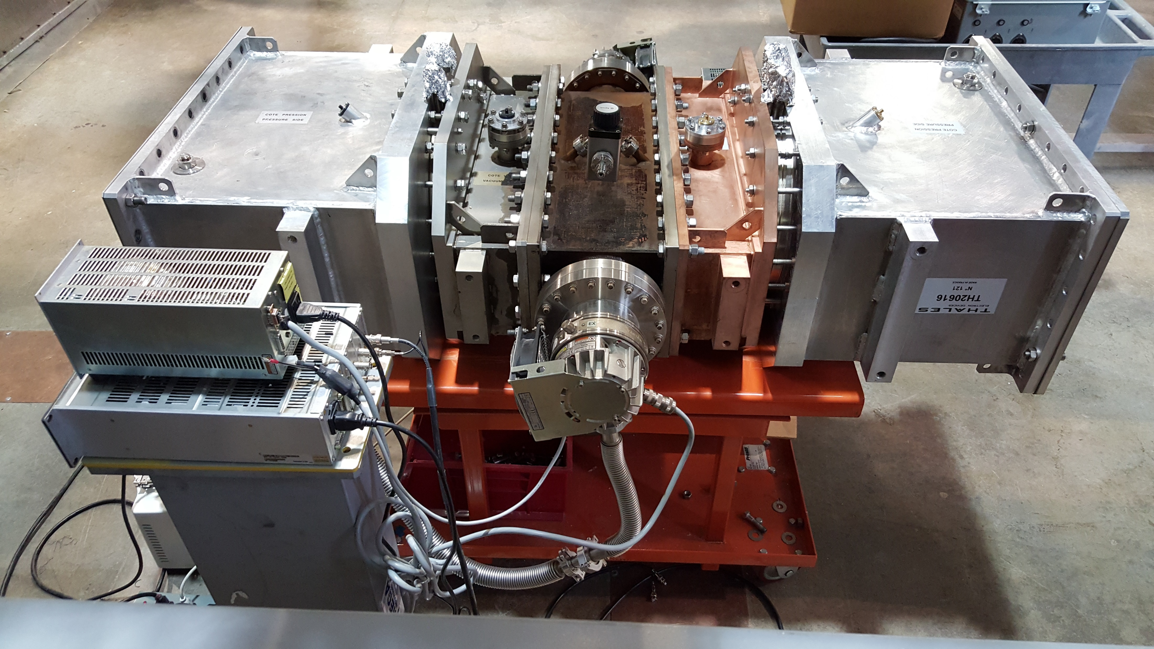
Multipacting is an RF phenomenon that needs to be addressed for improved accelerator reliability
Cracked ceramic from a failed DTL window (Apr 2015)
Material Processing, Ceramic Coating and Biasing are some of the best practices for multipacting suppression
Set of DTL Windows being prepared for RF Conditioning
Notes:
Multipacting:
Multipaction is a phenomenon where low energy electrons become resonant with an RF field resulting in an exponential multiplication of secondary electrons
Occurs in vacuum & reduces efficiency of the system
Can cause damage due to heating, repeated vacuum bursts and material degradation
Best Practices
Material Processing
Ceramic coating (TiN)
Biasing

Slide 7
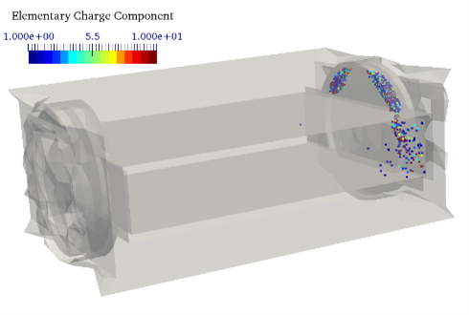
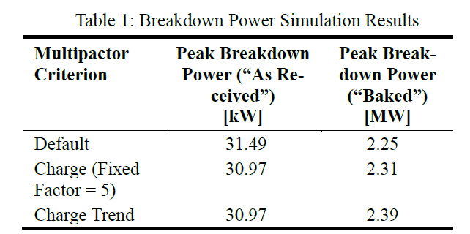
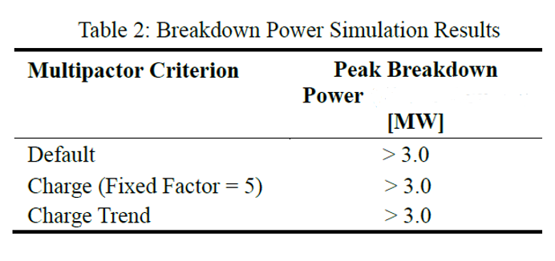
An ongoing research seeks to better understand and address multipacting in the DTL windows
The cavity matching section of the window appears to be prone to multipacting
Increased operational issues are likely for operation over 2.2 MW (Peak Power)
Potential Solutions: Coating copper surfaces, adding grooves & increasing baking temperature could eliminate the multipacting concerns for higher power operation
Spark3D Simulation Results – Area Prone to Multipacting
Spark3D Simulation Results – Operational SNS DTL Window
Spark3D Simulation Results – Copper coated with TiN
G. Toby et al, May 2023, Multipacting Analysis of the SNS Drift Tube Linac (DTL) RF Vacuum Window using Spark3D
https://www.3ds.com/products-services/simulia/products/spark3d/.
Notes:
Multipacting Research Ongoing
Several failures in the past
Potential solutions identified
Two papers published
Transitioning to the experimental phase

Slide 8
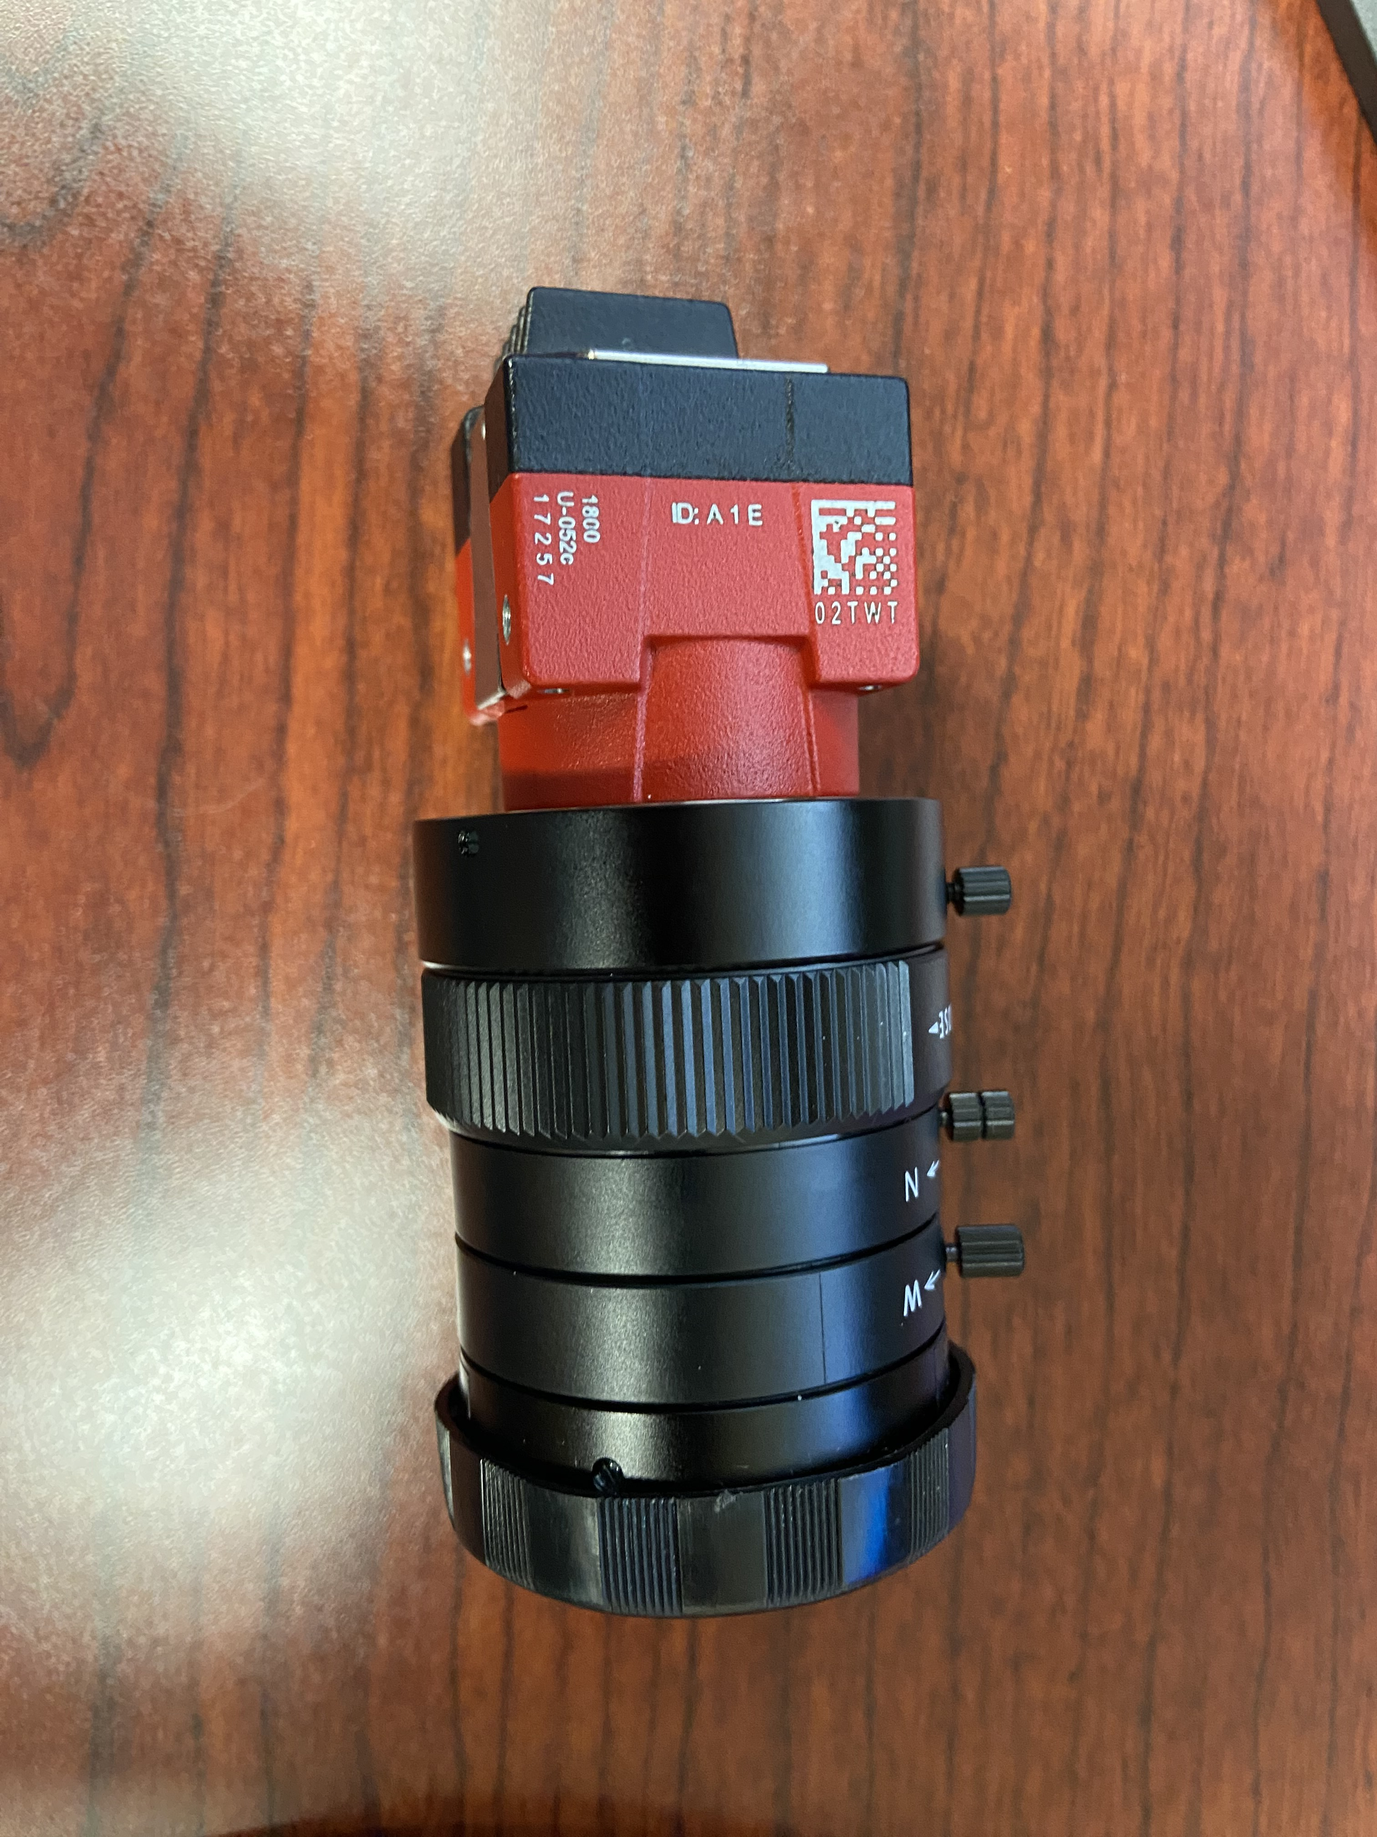
An experimental testing plan is being developed for verifying simulation results.
The experiment will check the effects of material processing on multipacting
The windows will be baked to 150ºC and 300ºC before RF conditioning
Cold Cathode Guage (CCG), Residual Gas Analyzer (RGA) and a High-Speed Camera will aid data analysis
The high-speed camera will be used to detect electron glow discharges sometimes associated with multipacting
Camera Selected: Alvium 1800 U-052C
Up to 691 frames per second
9µm X 9µm pixel size
-20ºC to 65ºC Operating temperature range
3.5”
Glow discharge from a prototype DTL Window testing (2017)

Slide 9
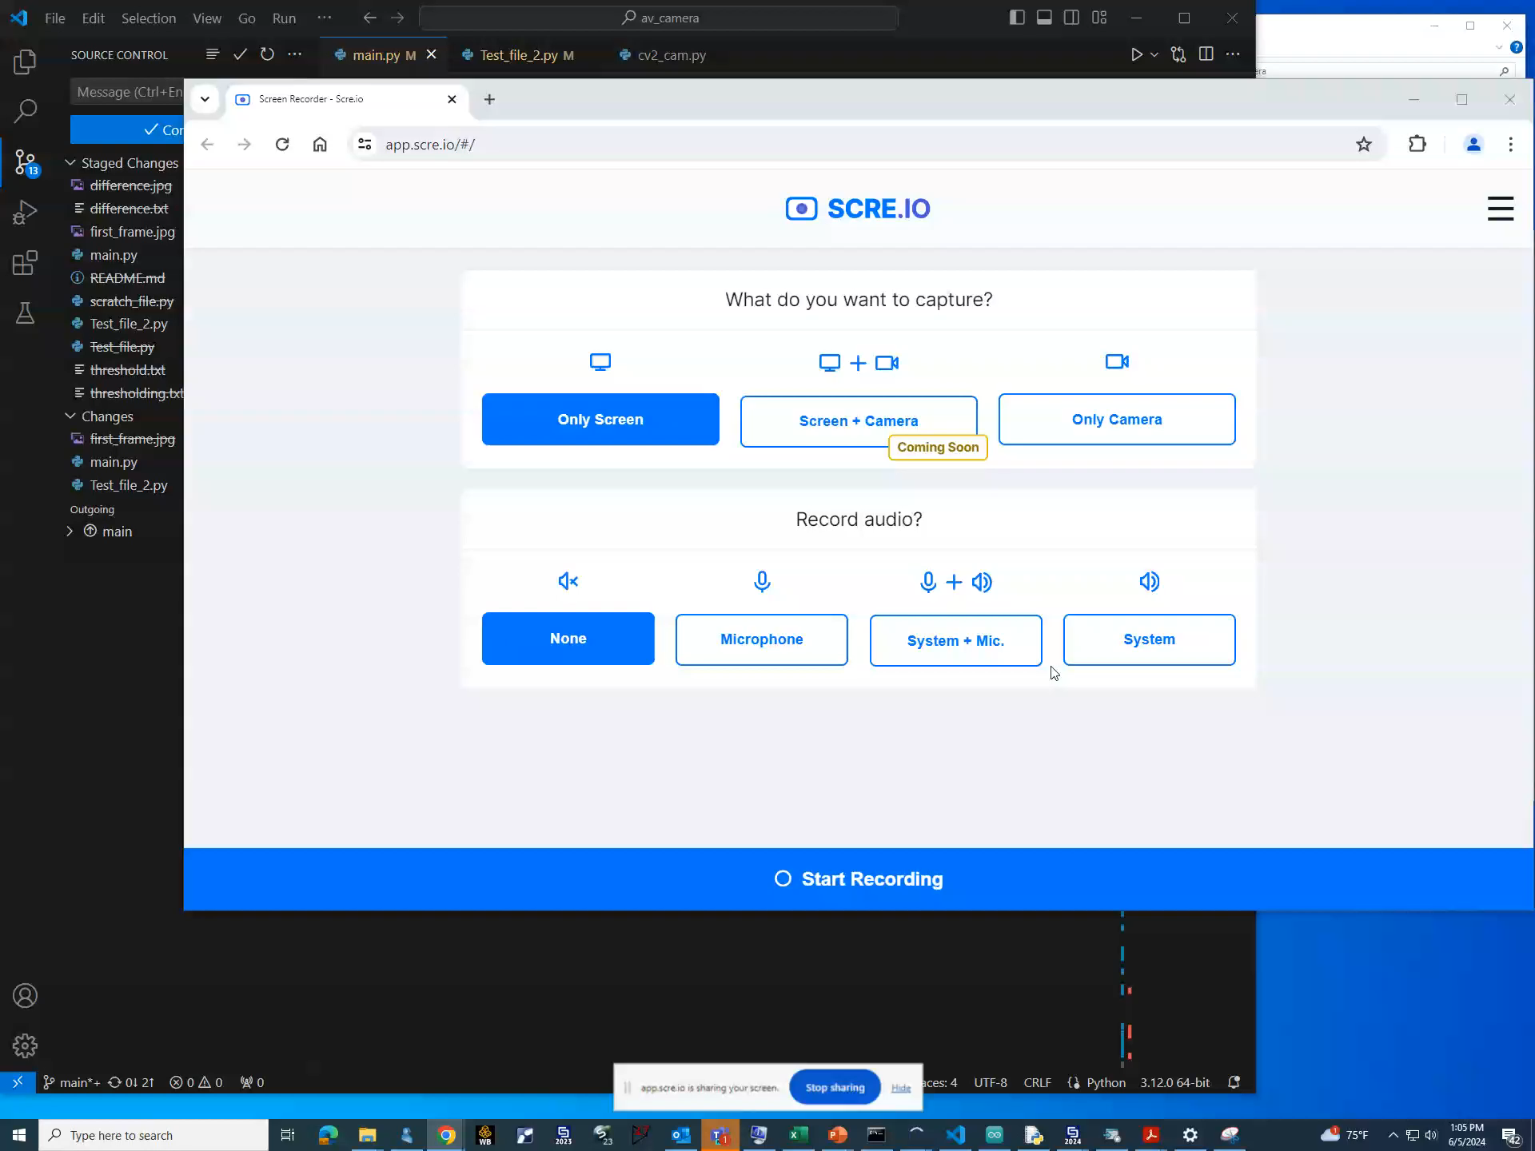
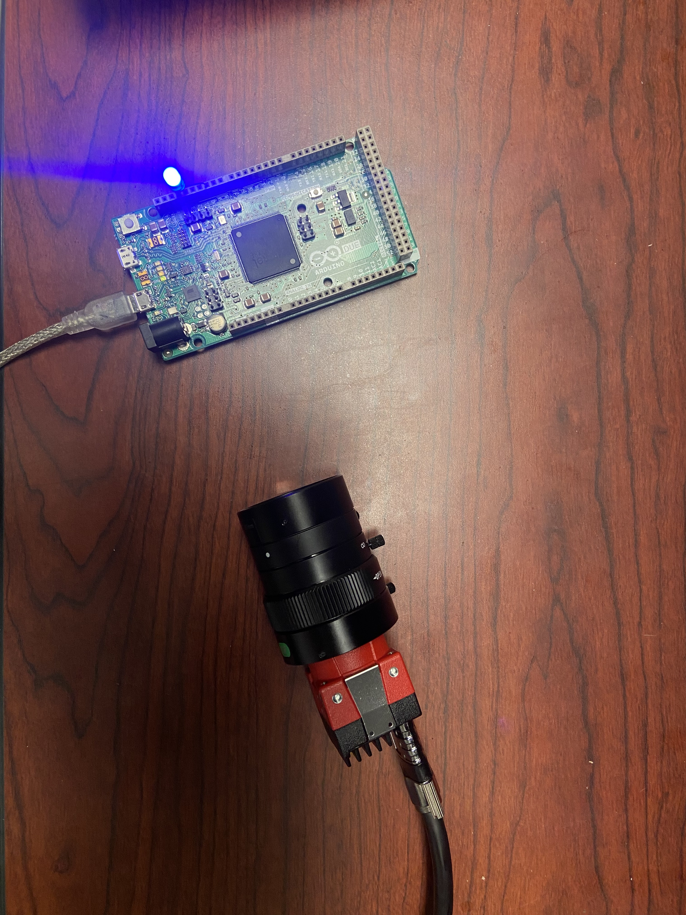

A python software system has been developed for detecting electron glow discharges
Test Setup (1 Second Capture)
Sample Capture
Notes:
Software Development Tasks:
Camera initialization
Image Acquisition – Background Frame
Frame streaming
Background subtraction (OpenCV)
Save or delete threshold
Image & Data saving
Full Software Testing & Bug Fixes
Frame rate verification
Drop frame rate determination/Shutter Lag

Slide 10
The latency/shutter lag of the camera was measured
Camera Capture Time | Program Recorded Time | Lag Time (mS)
10:04:21.322 | 10:04:21.521 | 0.199
10:04:21.546 | 10:04:21.605 | 0.059
10:04:21.576 | 10:04:21.645 | 0.069
10:04:21.472 | 10:04:21.685 | 0.213
10:04:21.636 | 10:04:21.732 | 0.096
Average |  | 0.127

Slide 11
Thermal Imaging Project: Ceramic Window

Slide 12
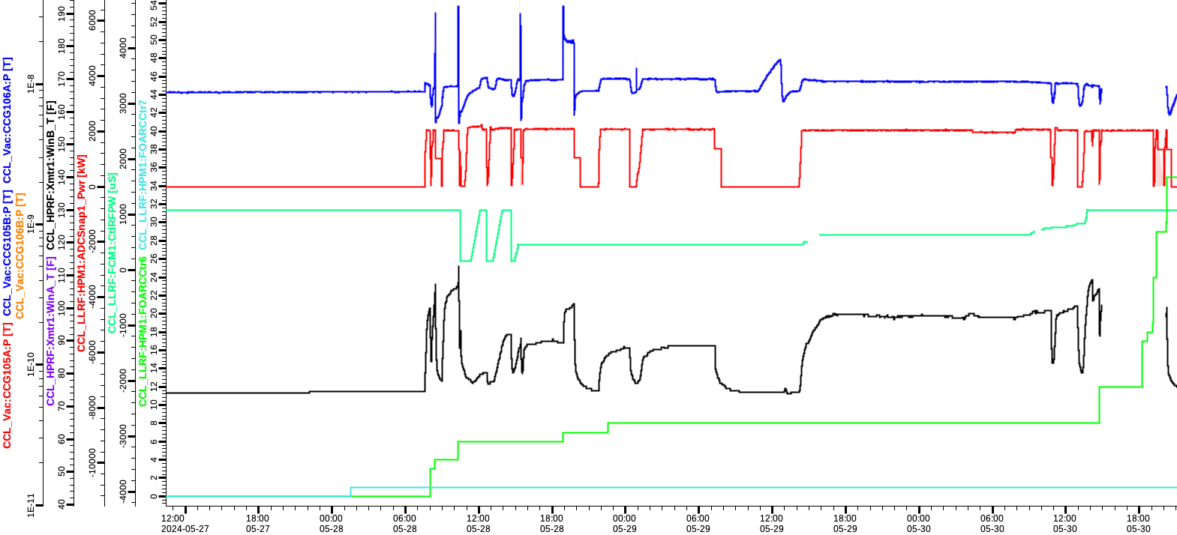
Real time thermal imaging of the ceramic windows is a necessary step for improved operations
May 28, 2024: CCL-1b Window
Coupler vacuum pressure
Forward power
Pulse width
Window Temp
Window (Air Side) arc counter
Window (Vacuum side) arc counter

Slide 13
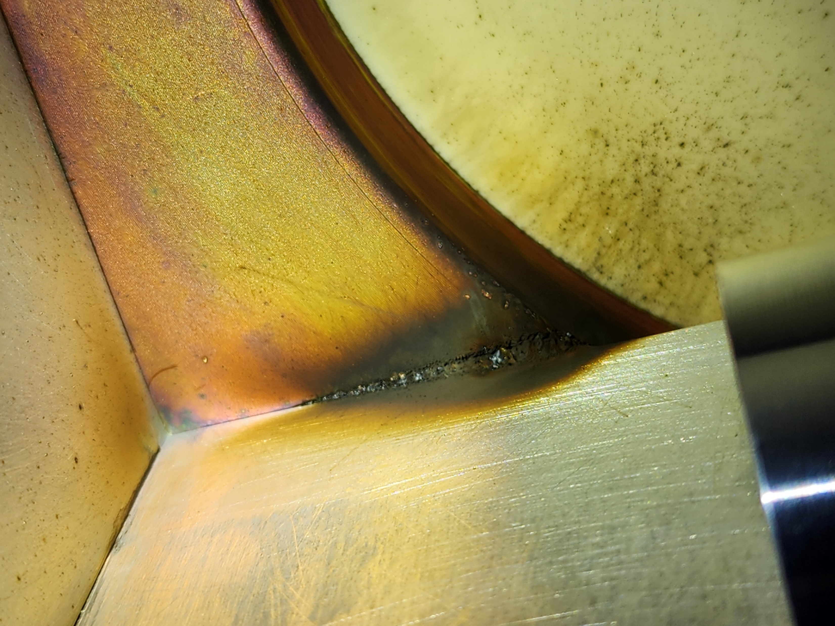
Real time thermal imaging of the ceramic windows is a necessary step for improved operations
Thermal imaging might have picked up the residue (2024)
Failed CCL Window (2024)

Slide 14
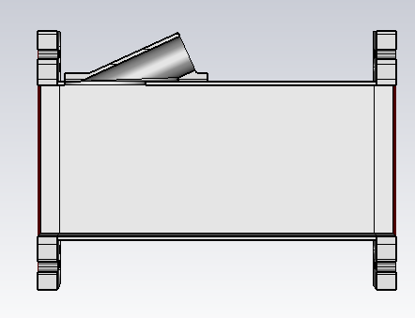
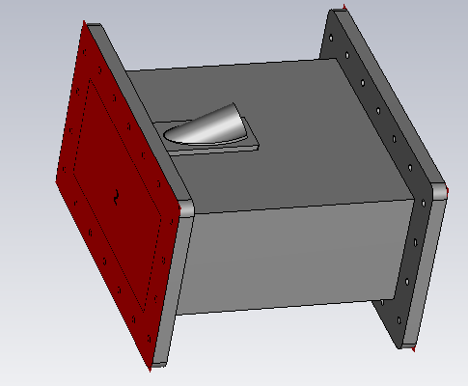
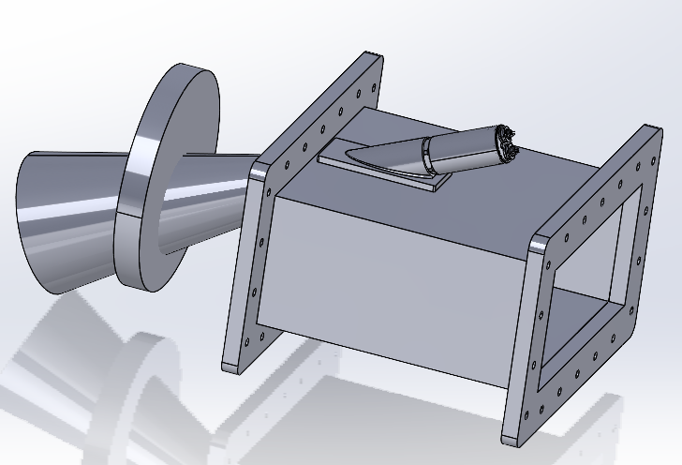
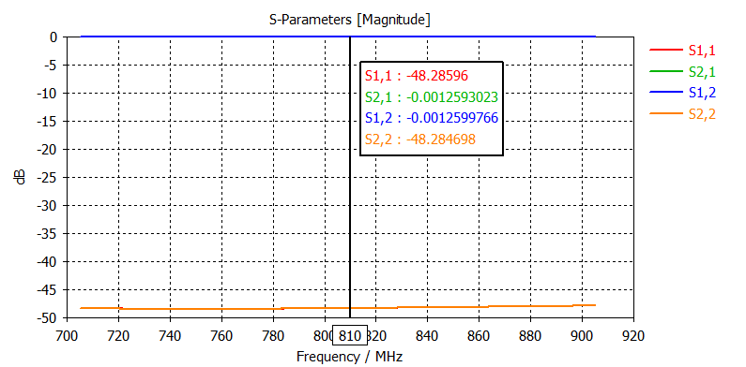
The design for the thermal imaging project has been completed
The camera was selected (Optris Xi-80) and a mount was designed
The camera is capable of tracking hotspots, average, minimum and maximum temperature
Simulation results showed negligible impact on RF propagation

Slide 15
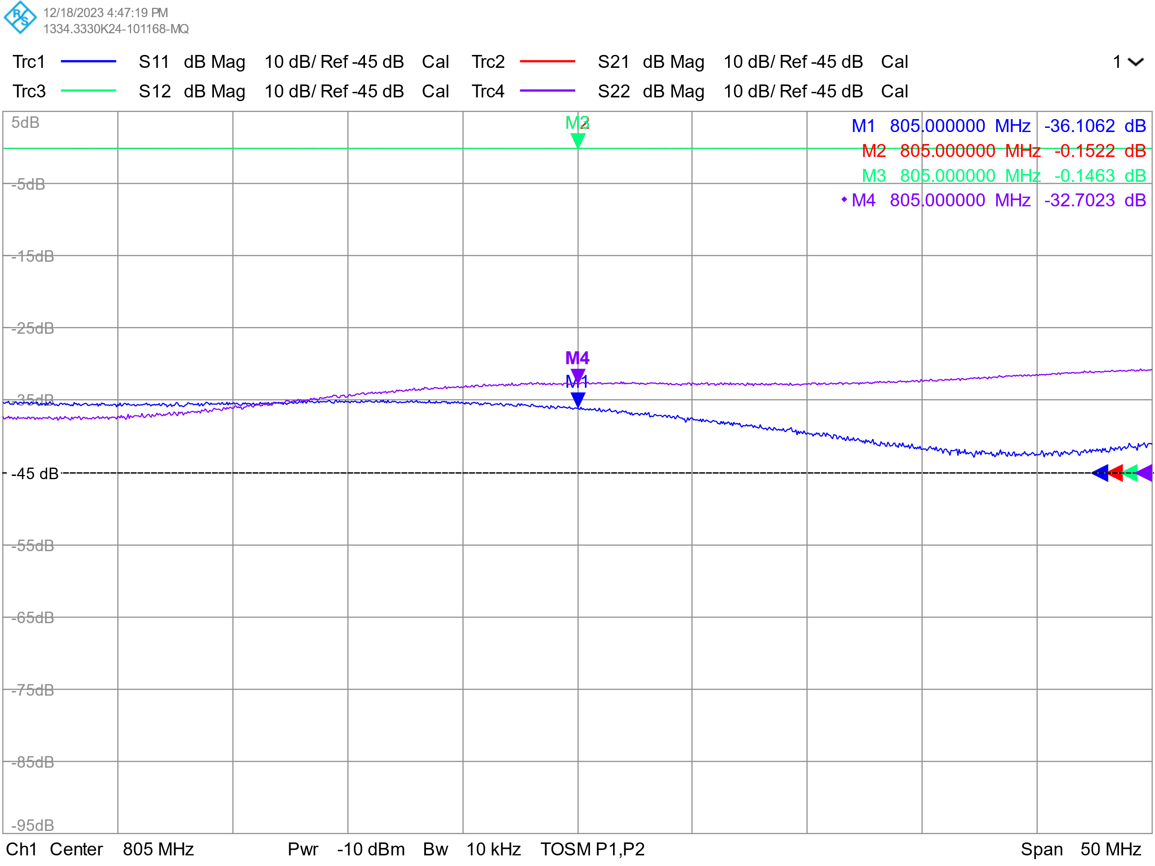
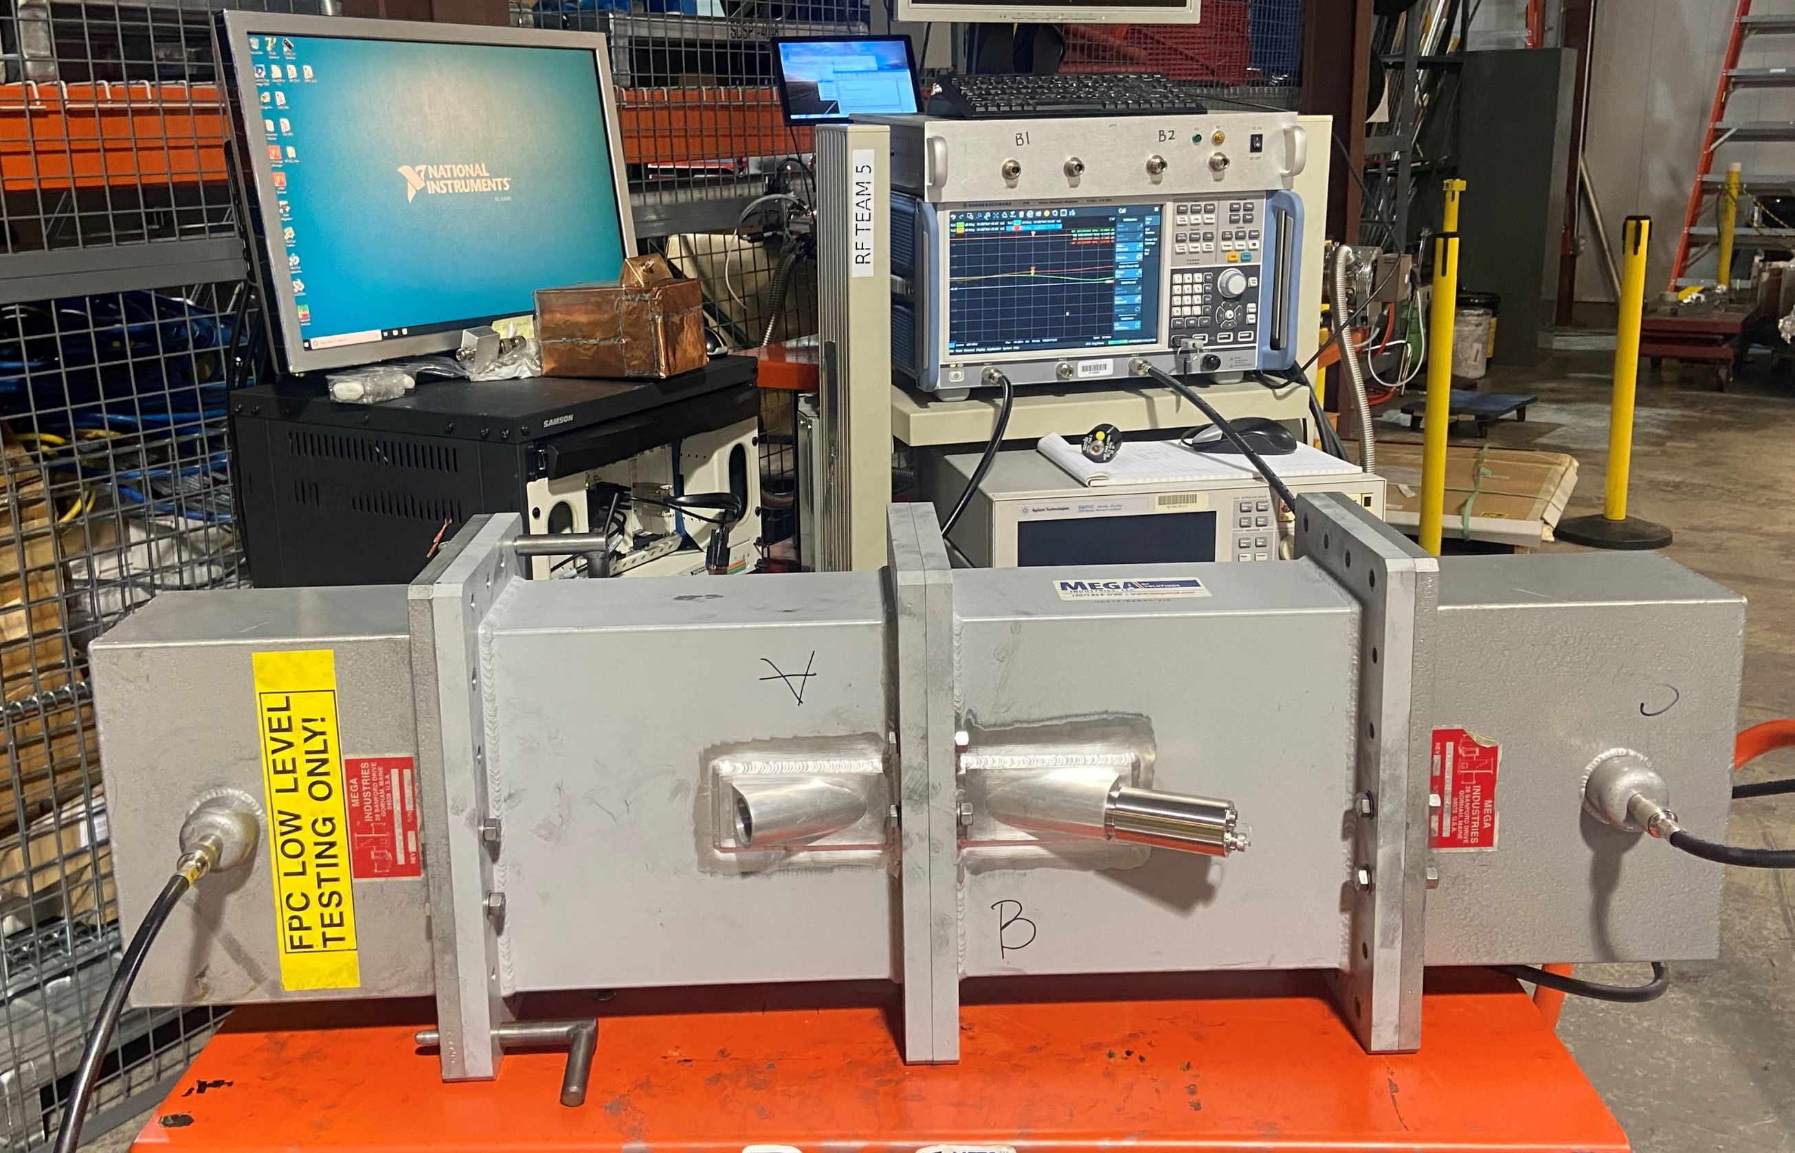
The design was fabricated, and transmission was verified
Measurement results were acceptable

Slide 16
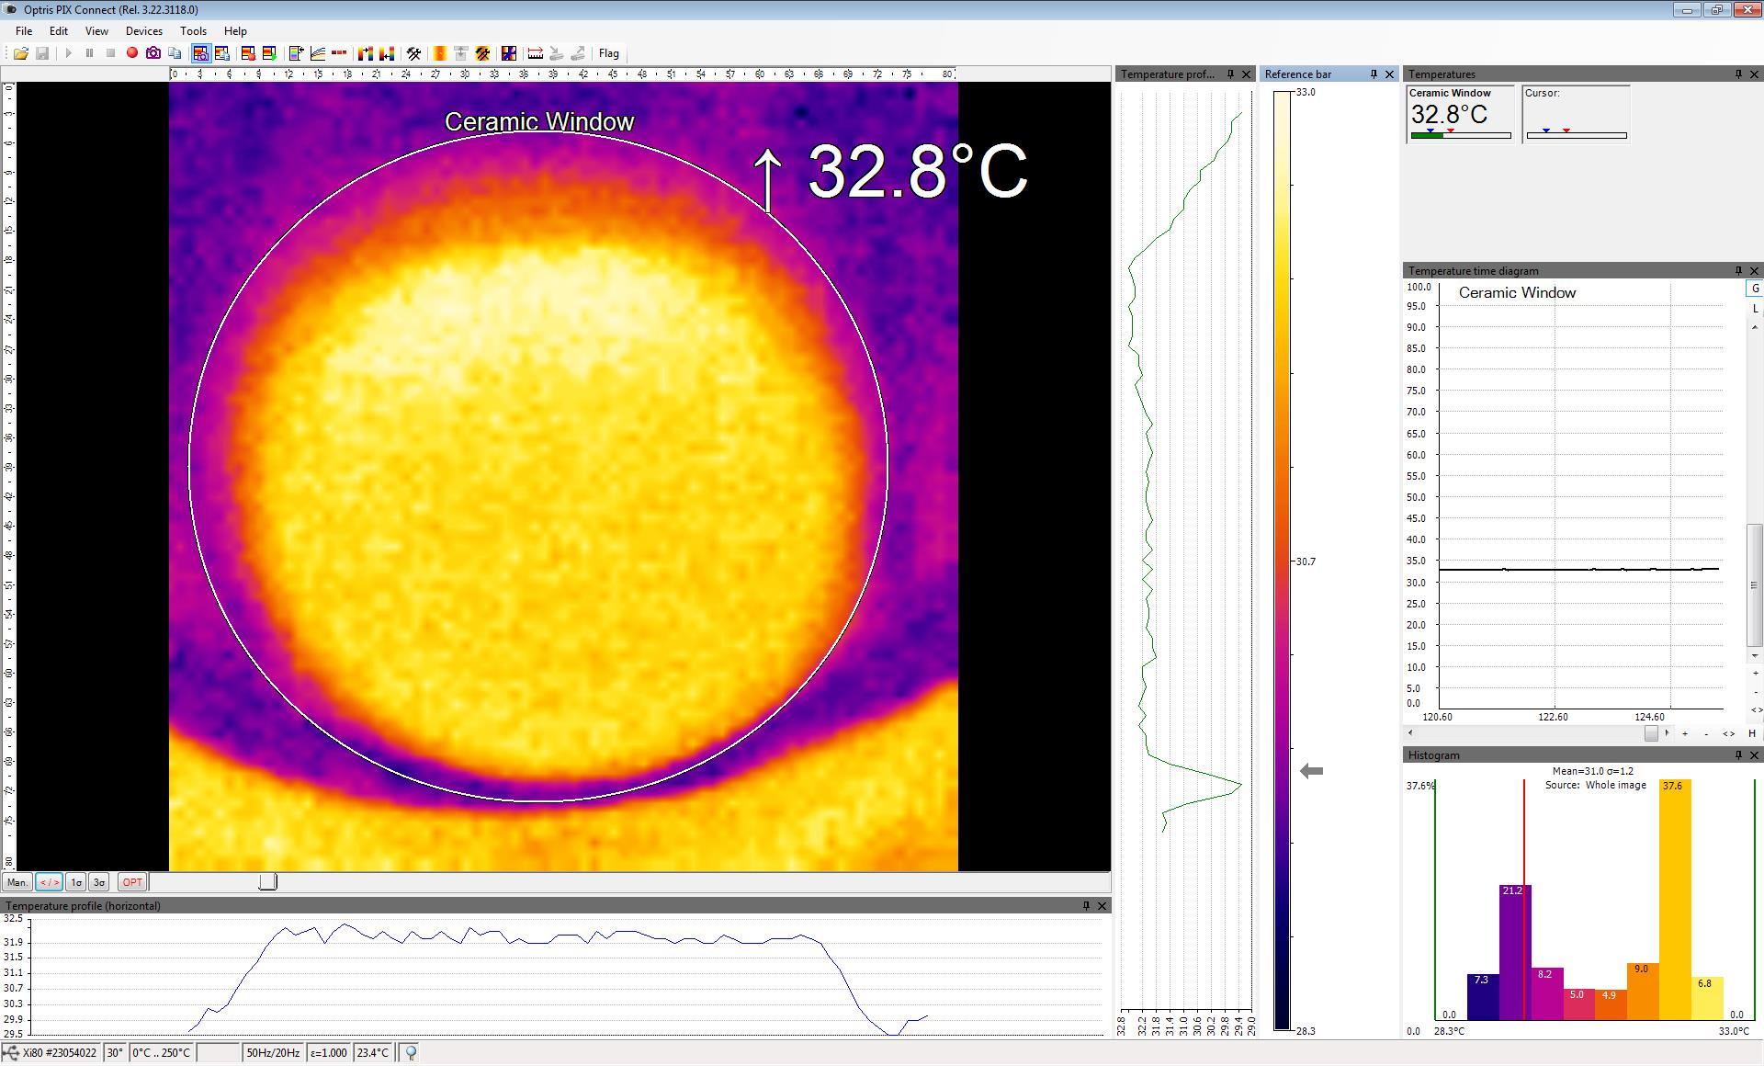
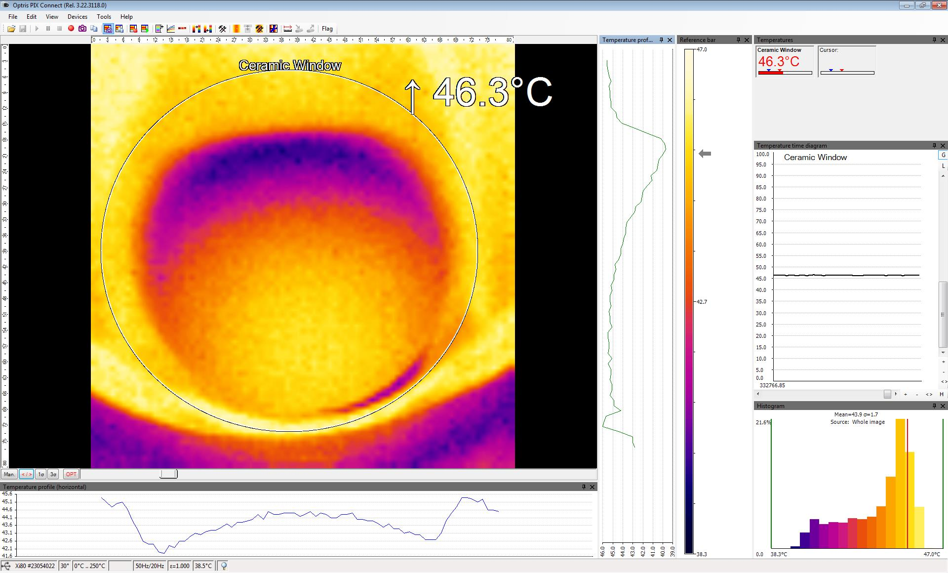
The thermal imaging system was tested at the maximum operating condition
Autoscaling needs to be turned off
Image selection option needs to be used to eliminate reflections
Ceramic Window
Reflections off mount
Before Conditioning
Thermal data at 60Hz, 1200µS, 2500kW

Slide 17
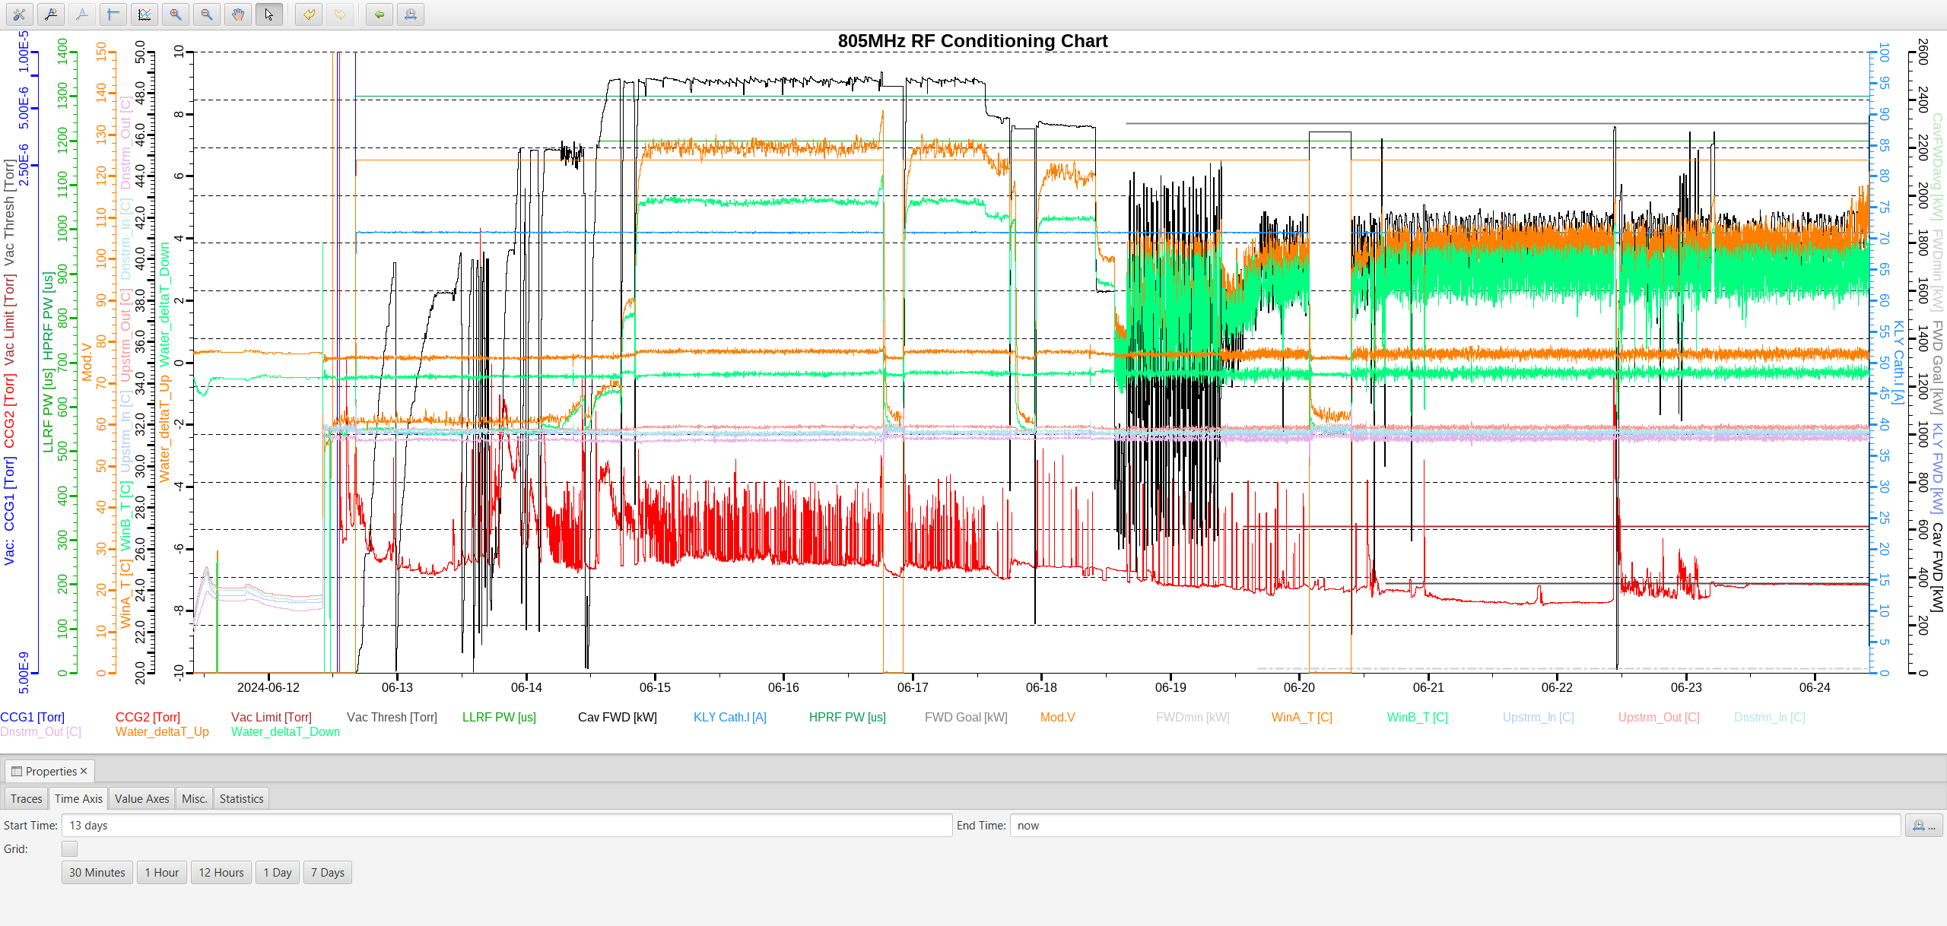
The thermal imaging system was tested at the maximum operating condition
Imaging Camera (WIN A)
Pyrometer (WIN B)

Slide 18
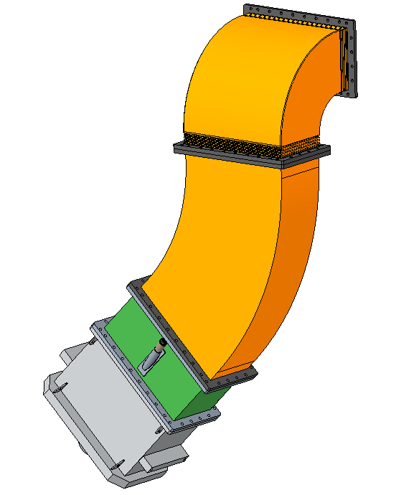
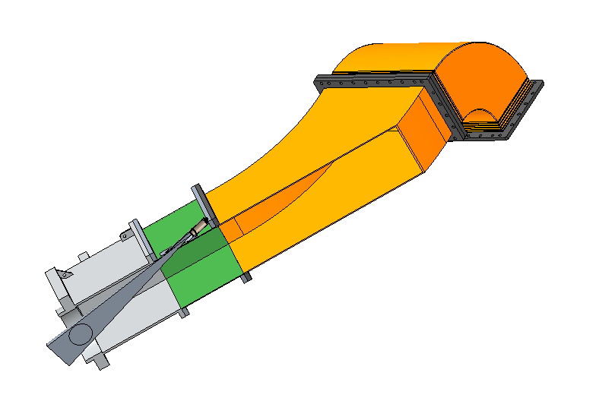
Steps are being taken to install the system in the DTL section during the upcoming outage
DTL Window
Models showing installation plan

Slide 19

In summary, two ongoing camera-based improvement projects seek to improve the reliability of SNS high power vacuum windows
The detection of electron glow discharges will aid the multipacting research project which aims to address multipacting issues.
Real time thermal imaging and data collection will improve operations and reduce downtime
Questions?

