Slide 1
RF Conditioning Operations and System Updates of the High-Power RF Test Facility in the Spallation Neutron Source
September 10, 2024 (CWRF workshop)
Sung-Woo Lee
On behalf of the RF Systems Group
Spallation Neutron Source

Slide 2
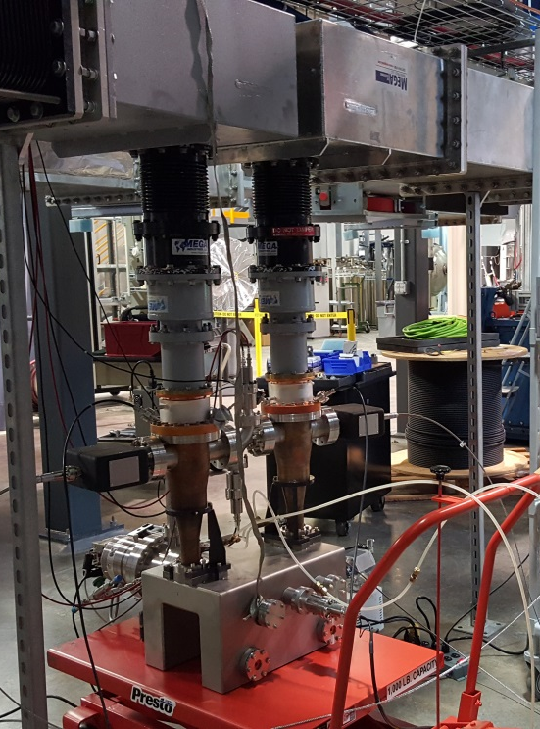
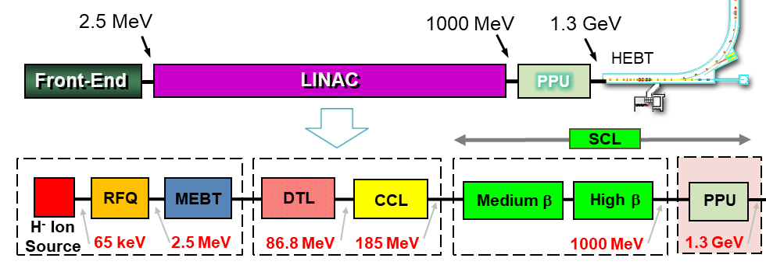
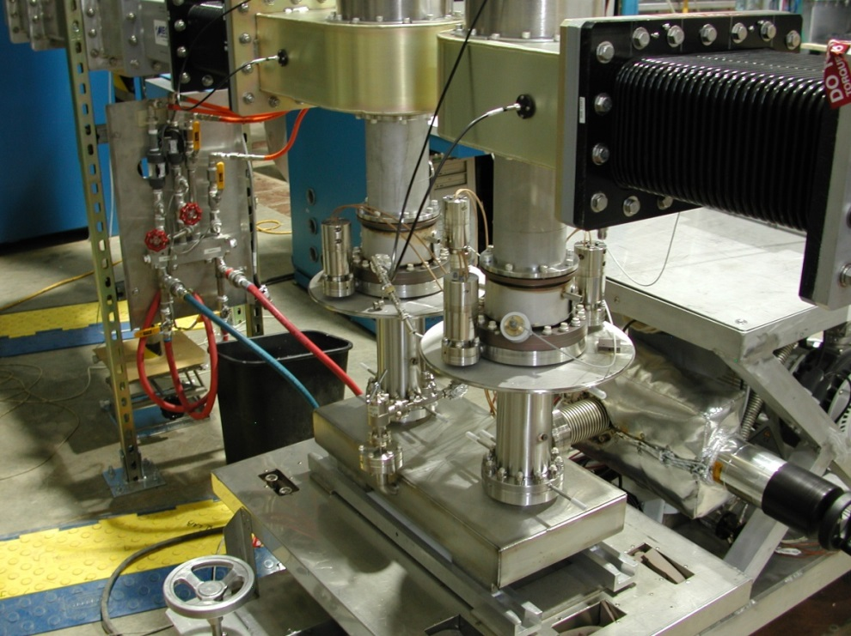
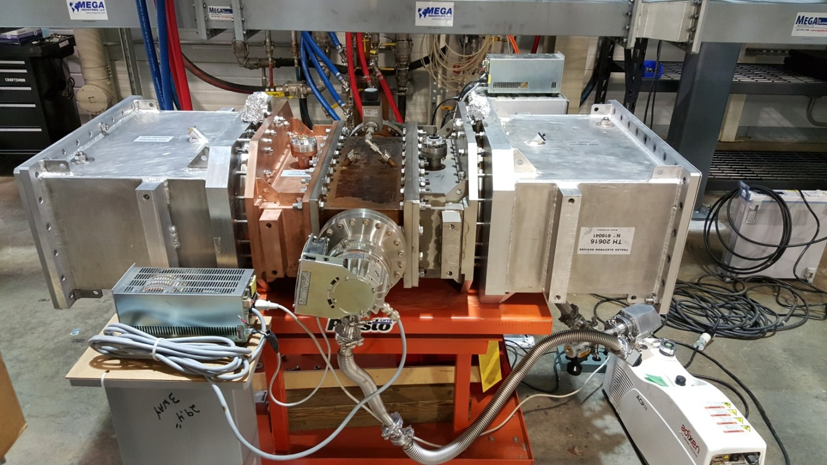
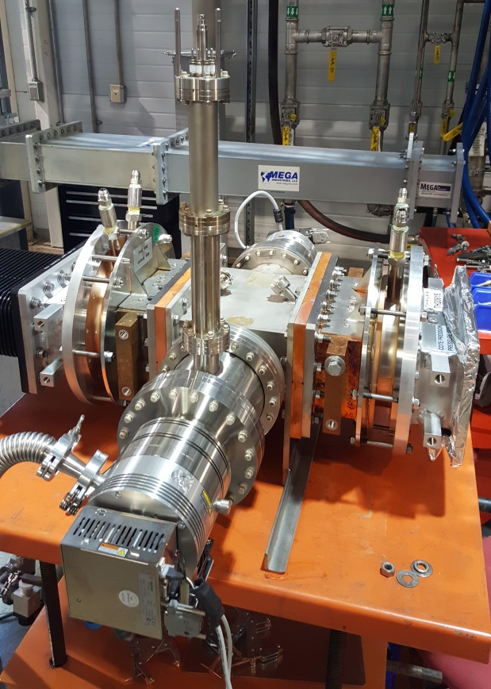
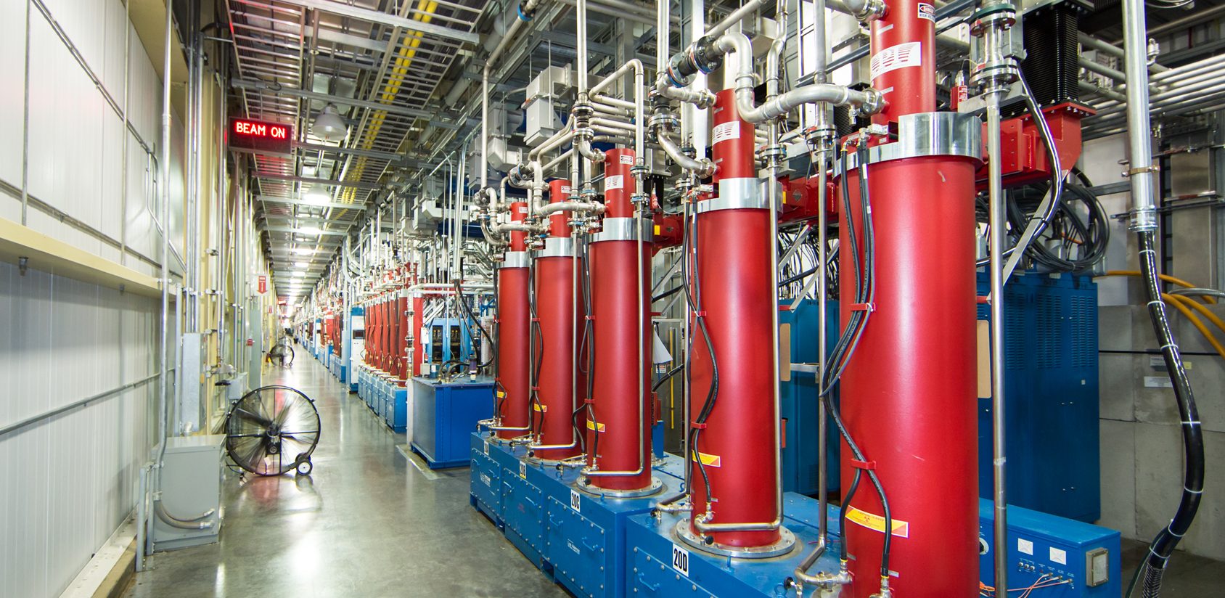
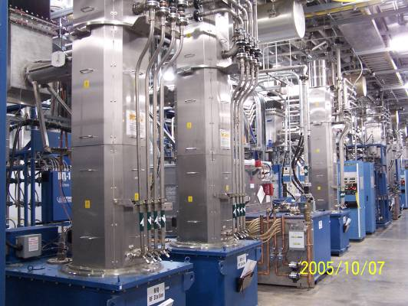
RF Test Facility (RFTF) is essential for testing and conditioning of RF windows, couplers and Klystrons in SNS Linac.
RFQ couplers
SCL couplers
DTL windows
CCL windows
Klystrons

Slide 3
RFTF was built with SNS Linac and extensively used for
RF conditioning during SNS Linac commissioning
High-Power RF conditioning
(RF Test Stands)
1. Vacuum monitoring:
CCGs and controllers, Pump Carts
2. Controls/Interlocks:
PLC(XMTRs, HVCM), VXI (LLRF-HPM), Arc Detectors
3. User Interfaces:
EPICS-OPIs, EDM screens
4. Control Software Program:
LabVIEW (JLAB) ➔ EPICS Sequencer
WR2100
402.5MHz
2.5MW_{peak}
Klystron
RFTF HVCM
(11MW 8%, 60Hz)
WR1150 => WR975
805MHz
5MW_{peak}
Klystron
Used for SCL FPCs (>60%), NCL windows/couplers during commissioning SNS
and High-Power RF testing of prototype RF devices of SNS and other partner Laboratories

Slide 4


RFTF has been updated and used for PPU project (1)
1. SNS HVCM Upgrade
HW/SW (2015)
WR1150 => WR975
2. LLRF, pulse timing systems separation
WR2100
402.5MHz
or
805 MHz
Sig. Gen.
RFTF HVCM
RFTF 805MHz
RFTF 402.5MHz
Sig. Gen.
402.5MHz
Beam Test Facility
(BTF)
RFAX HVCM
Sig. Gen.
805 MHz
BTF 402.5MHz
HPRF System Stability and Flexibility:
- HVCM upgrade in the SNS
- 2 Modulators can power 3 Klystrons
(BTF, RFTF 402.5/805 simultaneous run with less interruption)
RFTF RF system complete separation
402.5MHz and 805MHz system can run RF conditioning independently

Slide 5
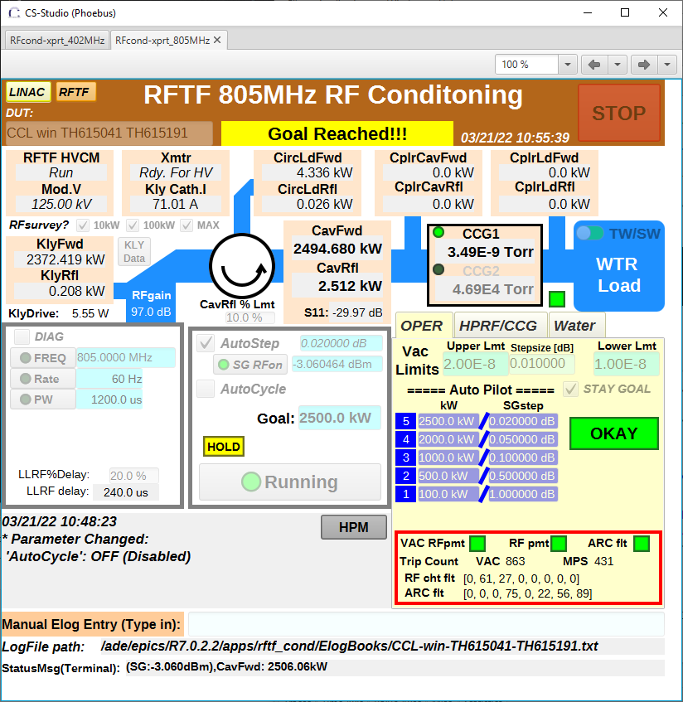


RFTF has been updated and used for PPU project (2)
3. RF Conditioning Software Upgrade
Python-EPICS RF conditioning scripts
(updated from EPICS sequencer program)
CSS-Phoebus for user interfaces
(updated from EDM screens)
Python-EPICS and CSS-Phoebus:
- Easier and flexible programming and maintenance
- Improved user interfaces and remote operation
EPICS EDM main RF conditioning control screen (EPICS sequencer program)
Latest CSS-Phoebus RF conditioning screen (Python-EPICS program run on Soft IOC)
4. RF Conditioning for RF spares and PPU project (2019 - )
SCL FPC RF conditioning
  (46 including all PPU couplers)
Klystron DC/RF conditioning
  (23 including PPU klystrons)
PPU WG circulators/WG water loads
Normal conducting Linac windows and couplers (RFQ/CCL/DTL)
System Upgrades in the RFTF:
Stable and enhanced RFTF sub-systems and conditioning program enabled executing the PPU progress and successful RF spare preparation

Slide 6
RF conditioning Process in the SNS RFTF
Assemble
Preparation of RF windows (couplers) Assembly
Baking the Conditioning Assembly
Installation in the RF Test Stand
High-Power RF Conditioning
Storage in the Front-End Vacuum Manifold
Inventory Update “Ready Spare”
Baking
Installation
HP Process
Storage
Inventory

Slide 7
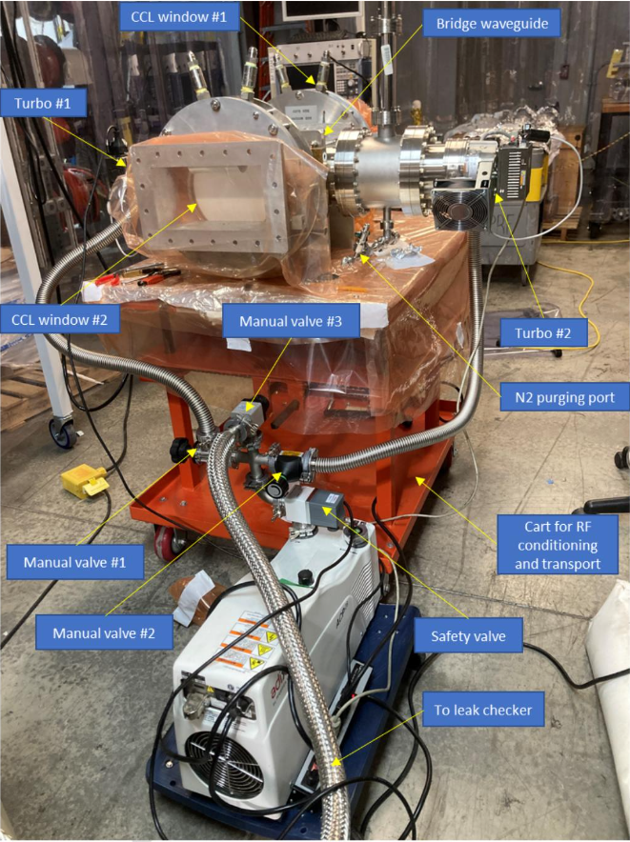
Preparation of RF windows (couplers) Assemblies
RF Conditioning Assembly Parts
  A pair of RF windows/couplers
  A bridge waveguide (BWG)/bridge cavity
  Vacuum turbo pump(s) with a roughing pump
  CCGs (cold cathode gauges)
  Arc detectors (vac, air sides each window)
  RGA (Residual Gas Analyzer)
  Conditioning Table (cart)
Assemble in the Clean Room (CCL windows)
  Ultrasonic clean BWG and vac gate valves
Vacuum leak test (1e-9 Torr L/s)
  Turbo pump(s) attached to the BWG with a rough pump
Low Power RF measurement
  Waveguide-N transitions and VNA
Assemble
Baking
Installation
HP Process
Storage
Inventory
SNS CCL window Conditioning Pair

Slide 8
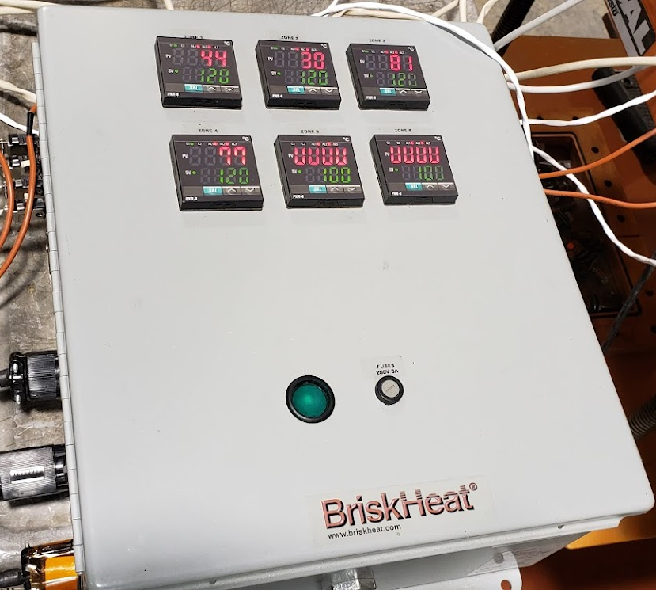
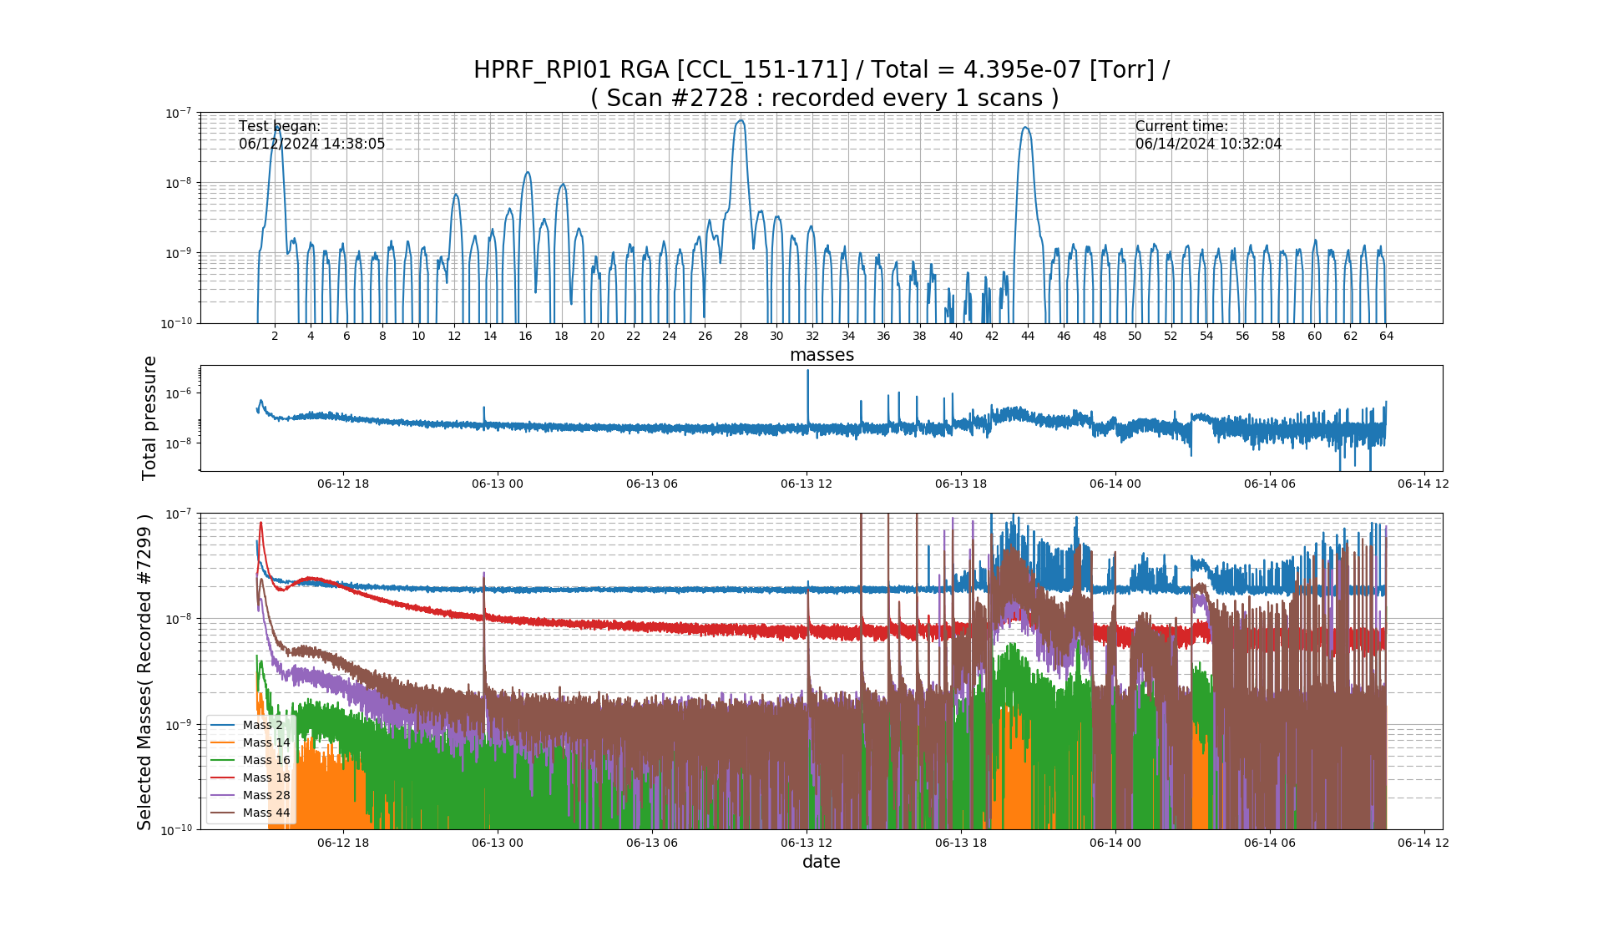
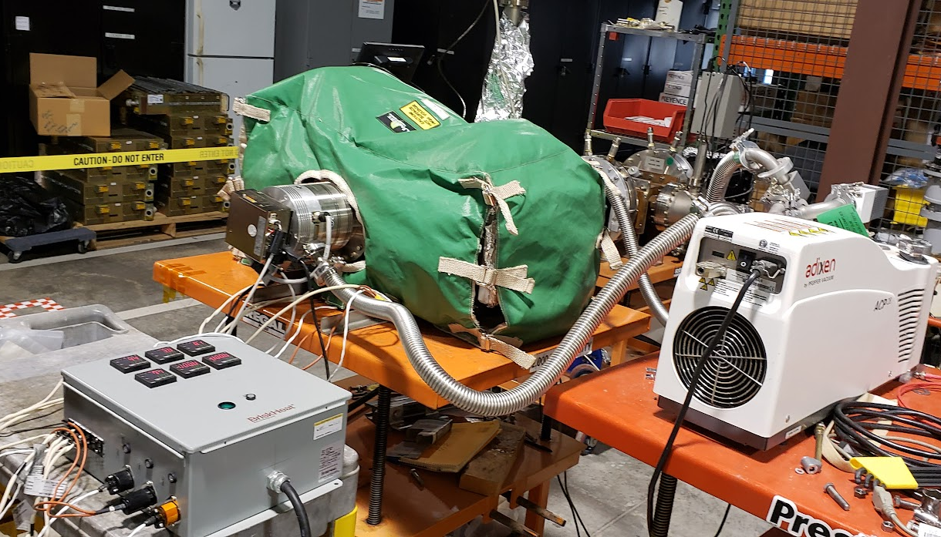
Baking the RF Conditioning Assemblies
Baking at 120 - 200°C for 3+ days under vac (1e-9 Torr)
  Temperature controller system
    6 Heat tapes and RTDs, Heat blanket
    Ramp ↗(12h), Baking (>72h), Ramp ↘ (12h)
  RGA monitoring
    Scan and record RGA data during baking and HPRF conditioning
Assemble
Baking
Installation
HP Process
Storage
Inventory
RGA scanning and data logging
Baking SNS CCL window Conditioning Assembly

Slide 9
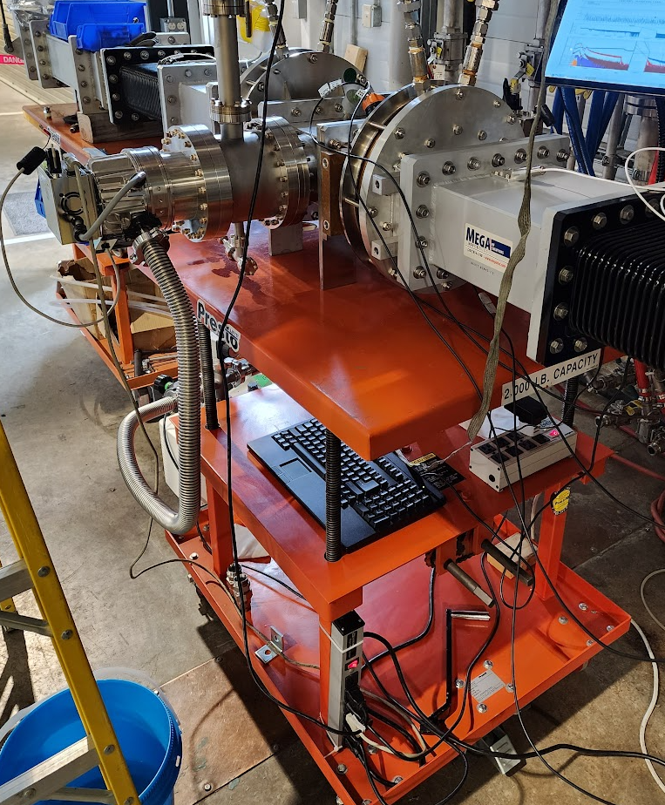
Installation in the High-Power RF Test Stands
Install the RF window/coupler assembly into the HPRF test stands
  WR2100 for 402.5 MHz system or WR1150 – WR975 for 805 MHz system
  Pulsed RF Operation (60Hz, 1.5ms, 2.5/5MW Traveling and Standing Wave)
  Protection by interlock system (HPM)
    RF power(HPM), Vacuum (CCGs), ARCs, Water Flow/Temp.
Assemble
Baking
Installation
HP Process
Storage
Inventory
* DC: directional couplers
(LLRF HPM: power reading)
CCL windows at RFTF 805MHz System

Slide 10
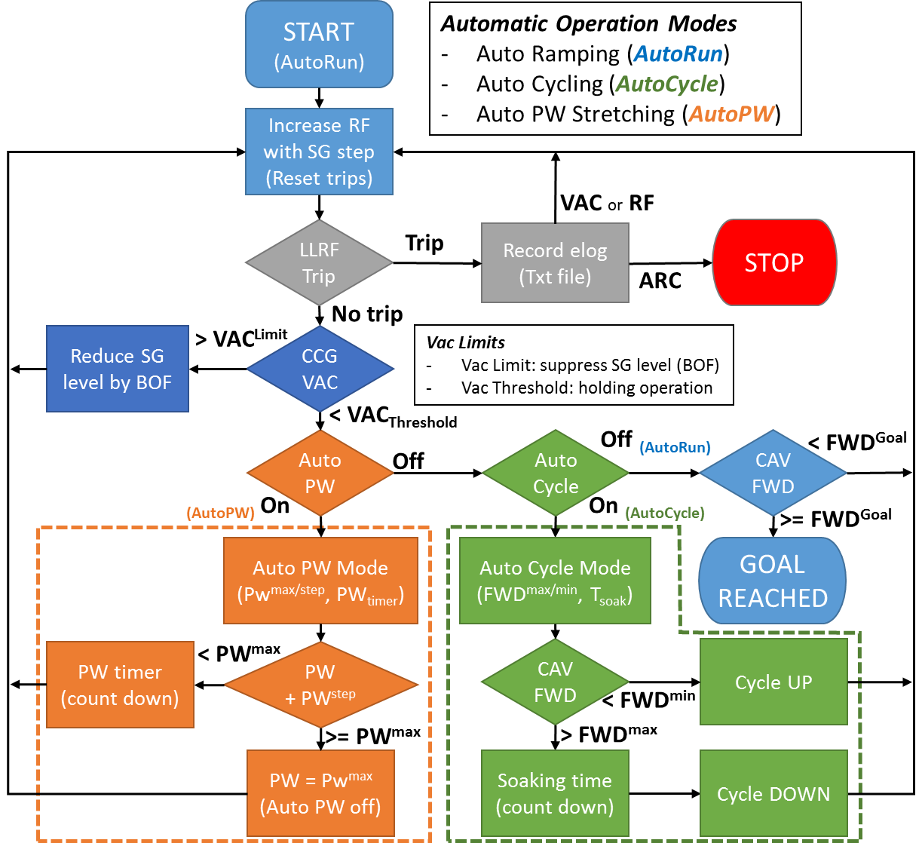
Python-EPICS program and Latest CSS software implemented for automatic monitoring and control during the HPRF process.
Python Epics and CSS-Phoebus
Assemble
Baking
Installation
HP Process
Storage
Inventory

Slide 11
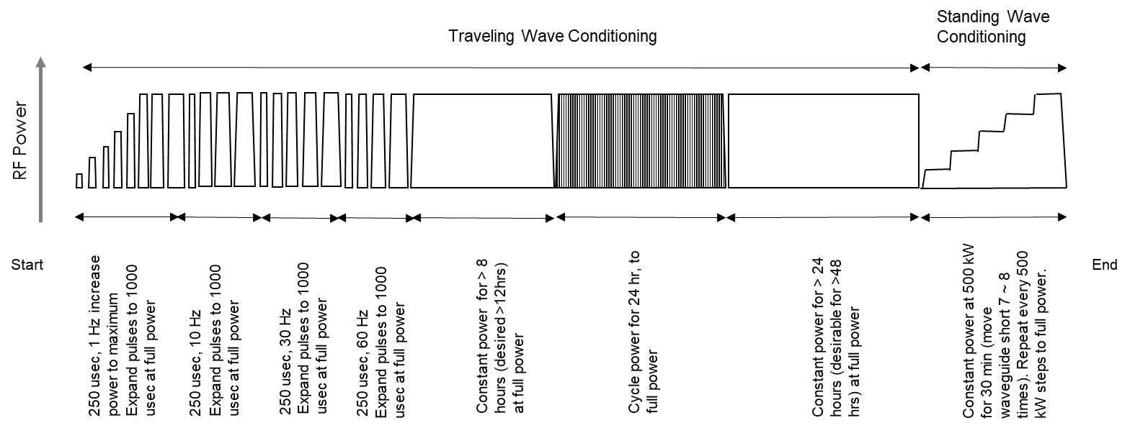
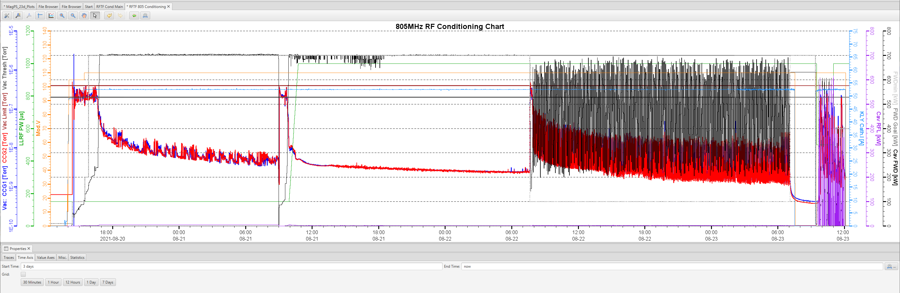
High Power RF conditioning Process
High Power RF processing (~2 weeks)
  Set to narrow pulse at low duty cycle
  Increase power slowly to maximum (Auto Run) and then increase pulse width to maximum (Auto PW) and duty cycle gradually
  Stay at full power continuously for a period of time (max power and full duty cycle)
  Repeat cycling user defined minimum to maximum power for a period of time (Auto Cycle)
  Use movable transmission line short for standing wave while increasing the power a step at a time (SCL couplers)
Assemble
Baking
Installation
HP Process
Storage
Inventory

Slide 12
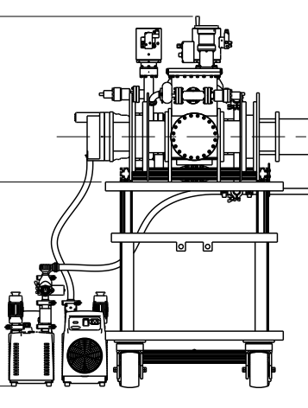
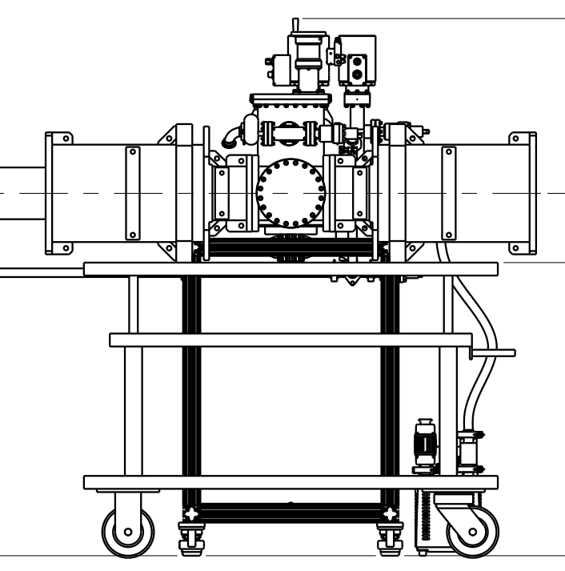
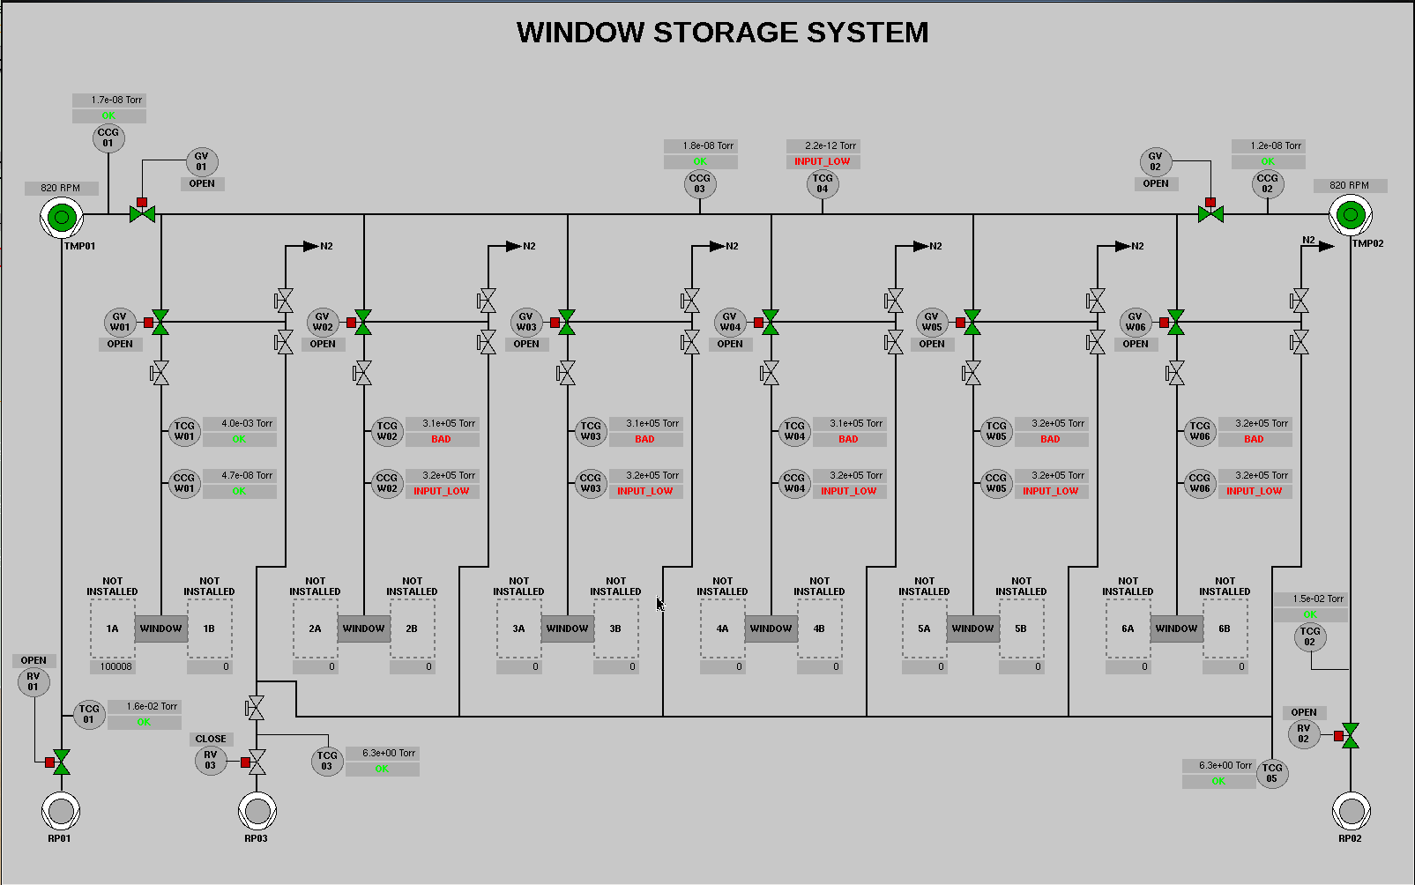
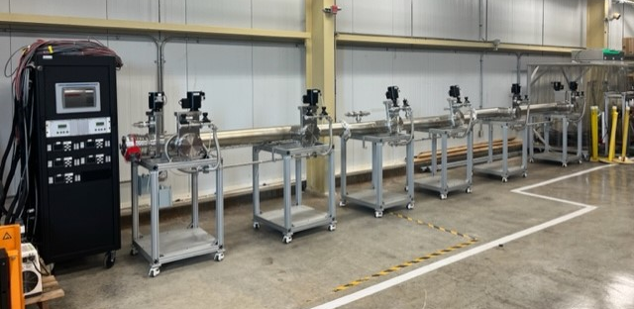
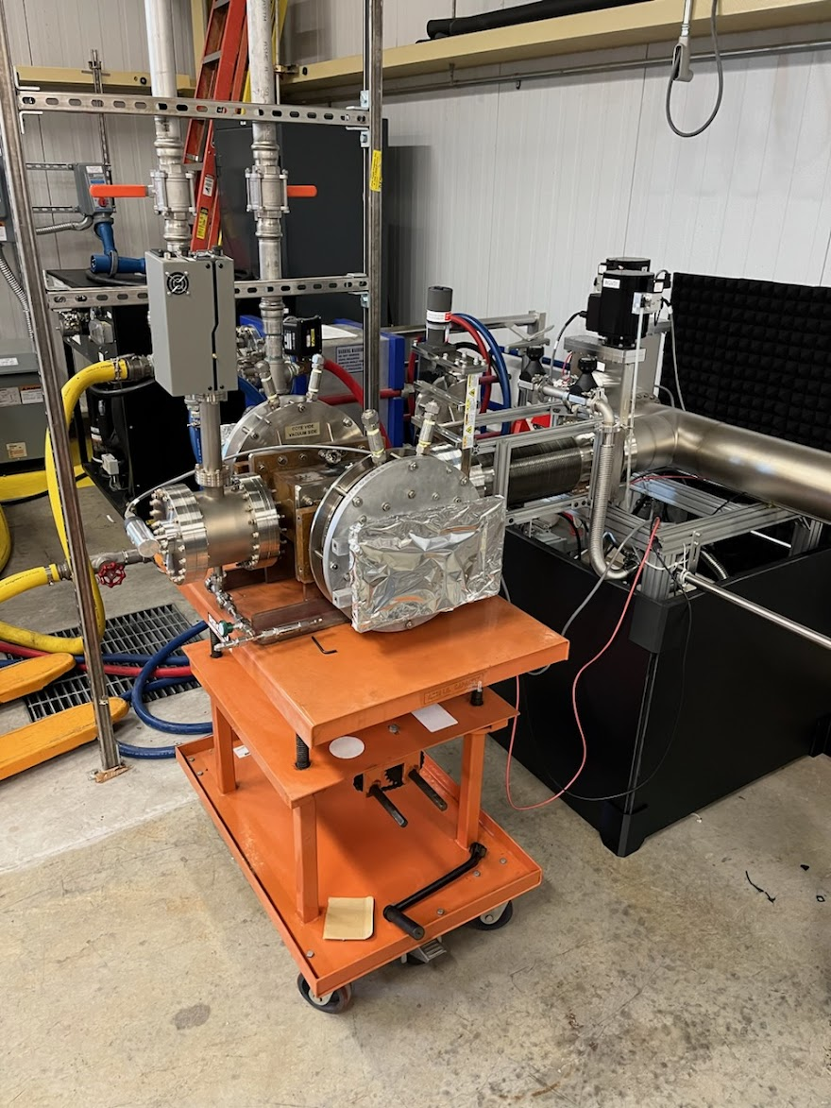
Vacuum Manifold System for Storage
Storage in noncontaminating environment (Vacuum or dry N₂)
Active pumping down is desirable for long term storage
Vacuum manifold for storage and monitoring the conditioned spare windows/couplers for SNS linac
Assemble
Baking
Installation
HP Process
Storage
Inventory

Slide 13
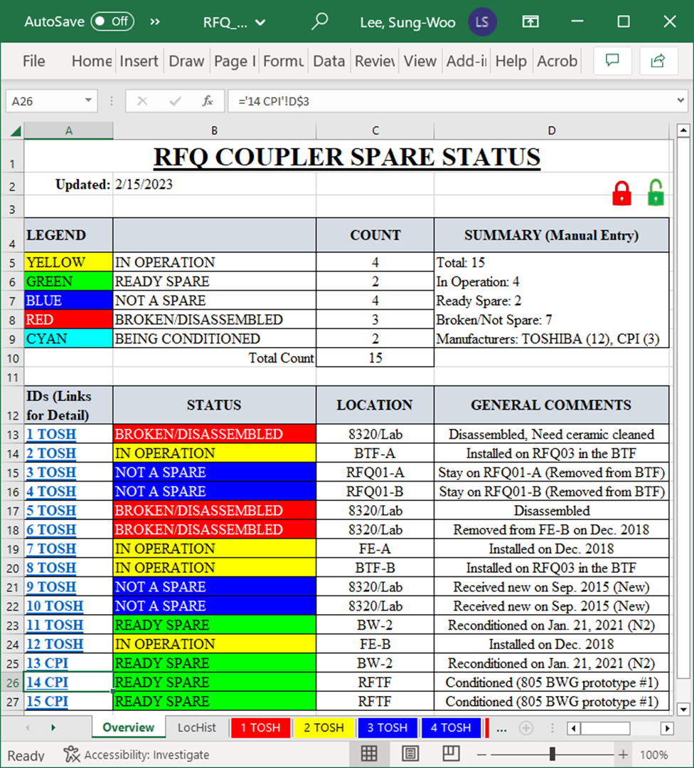
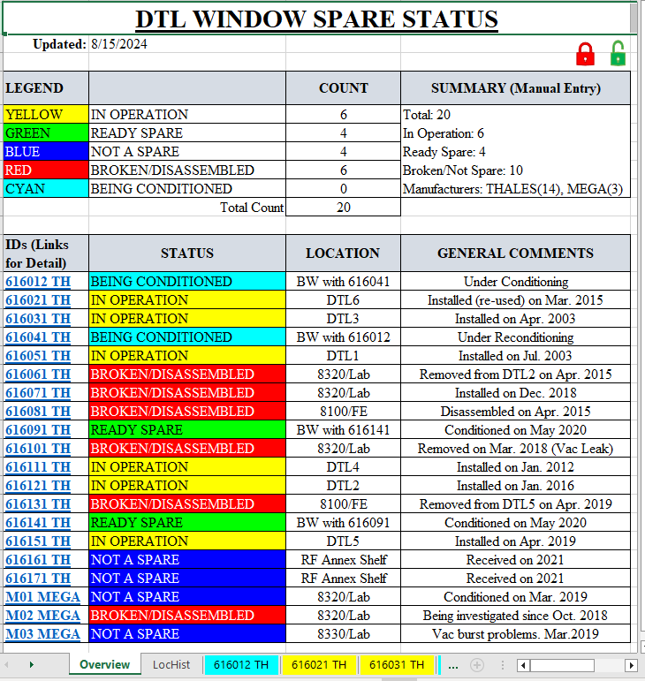
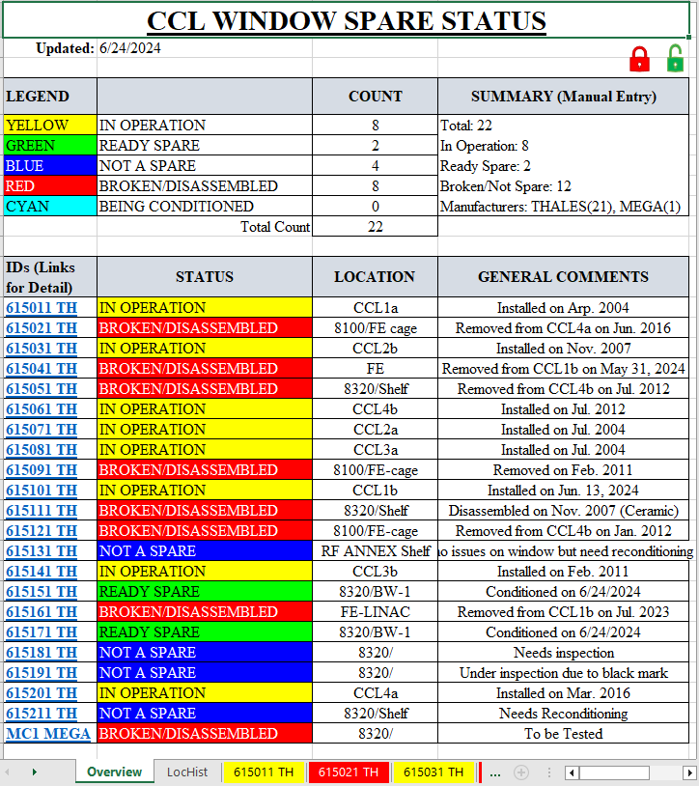
Storage and Inventory Control
“Ready Spares”: conditioned pair
  Document the conditioning process reports
  Status and locations of spare components
Assemble
Baking
Installation
HP Process
Storage
Inventory

Slide 14
Improvement and Test Plans (ongoing developments)
RF Window/Coupler Baking Station
  Development of a baking chamber for precise temperature control and ceramic protection from oxidation during baking of the window/coupler assemblies
Advanced Window Temperature monitoring camera system
  Implementing the camera system in the waveguide to monitor the ceramic surface temperature and glow
RF components/devices developments
  RF and Vacuum seals developments
  RF cavities and Bridge Waveguides developments
RF conditioning system and interfaces updates
  System hardware upgrades and updates
  Further RF conditioning process software enhancements

Slide 15
Summary
Radio Frequency Test Facility (RFTF) was built with SNS Linac
RFTF has been used for High Power RF system verifications and RF component conditioning during the SNS commissioning, operation, and the PPU projects
Systematic RF conditioning and spare preparations are crucial for reliable and stable neutron production operation in the SNS
Further developments in SNS RF components, RFTF system upgrades and the expansion of its capabilities are planned and ongoing

Slide 16
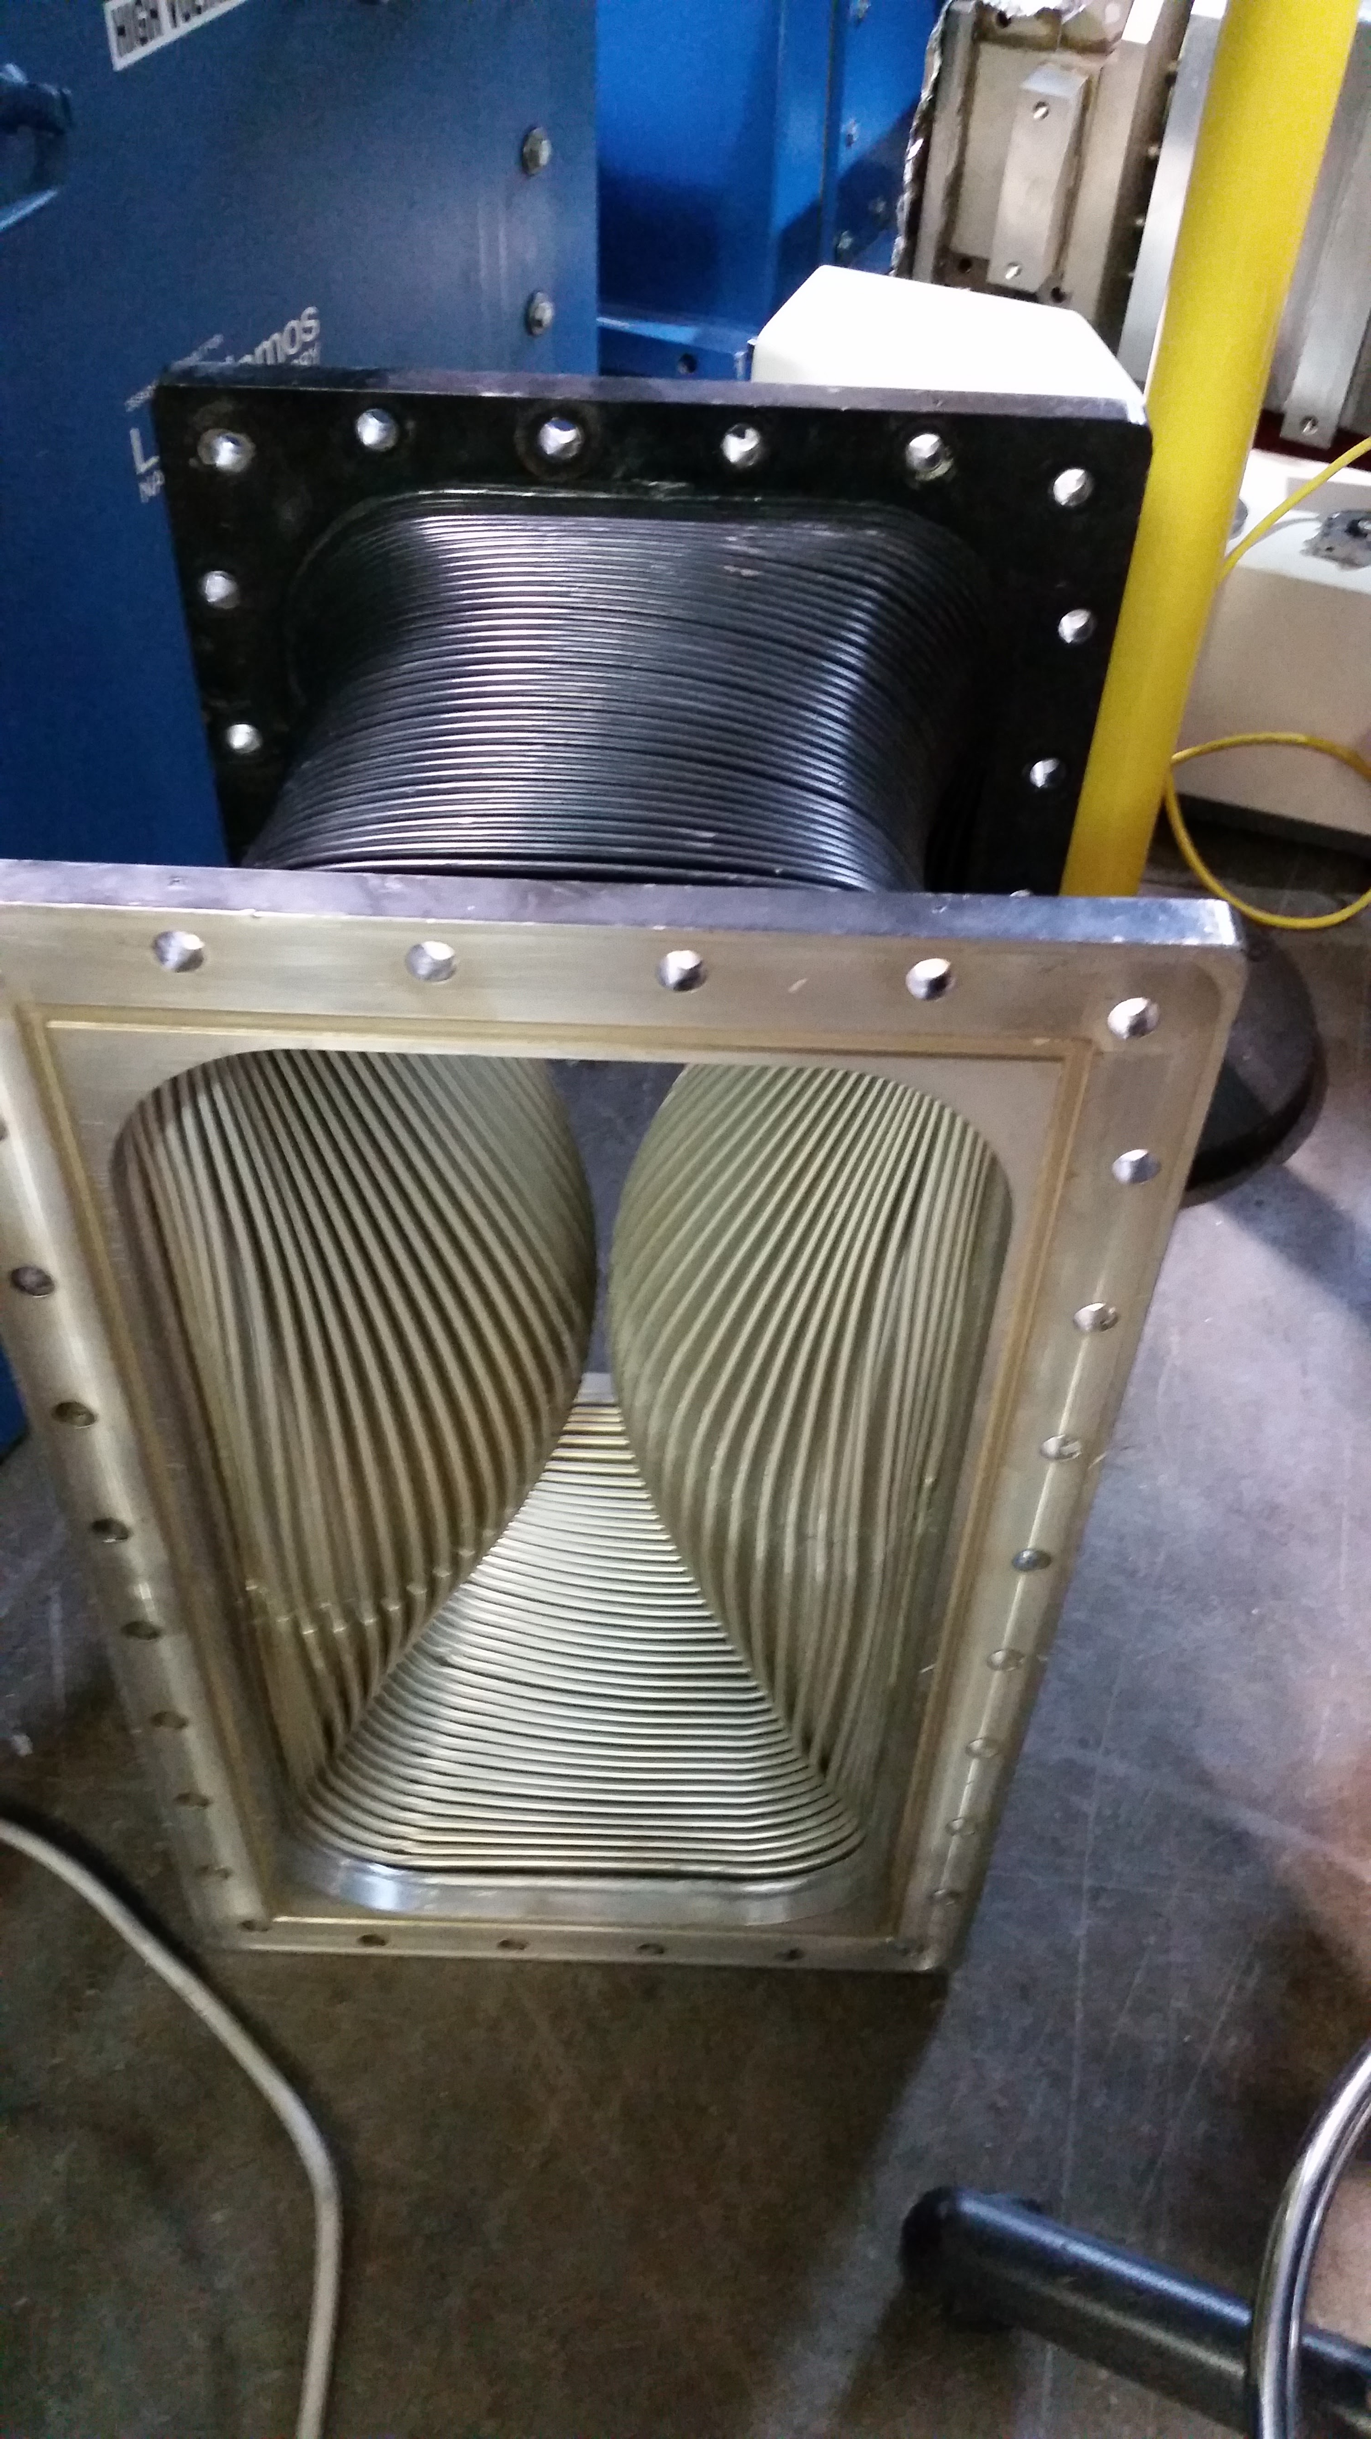
Thank you for your attention…
Failure of flex WR2100
during RF conditioning
prototype DTL window
Jan. 2017

