Slide 2
Klystron Commissioning Experience at ESS
13th CWRF Workshop
9-12 September 2024
PRESENTED BY Patrick Krämer
On behalf of the ESS RF group

Slide 3
Agenda
Klystron Commissioning Status
Two Examples of Difficulties Encountered during Commissioning
    Arcing in Coax-to-Waveguide Assembly of Canon Klystrons
    Transverse Fields in CPI Klystron Magnets
Summary & Outlook

Slide 4
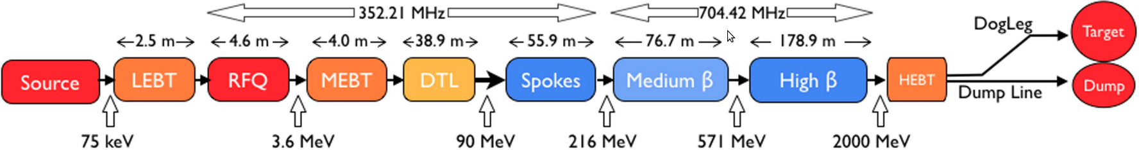
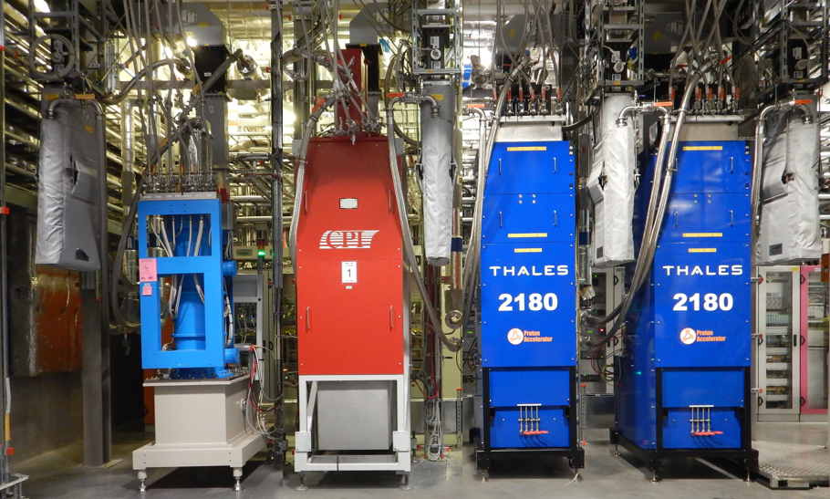
Klystron Commissioning Status
3MW klystrons
1.5MW klystrons
The klystron commissioning for the 2MW beam phase of ESS is complete
RFQ/ DTL: 5 + 2 spare
Medium-β: 36 klystrons
High-β: 20 klystrons
60+ klystrons installed & tested since 2021
Numerous problems: RF loads, X-rays, …
4 cavities per cryomodule

Slide 5
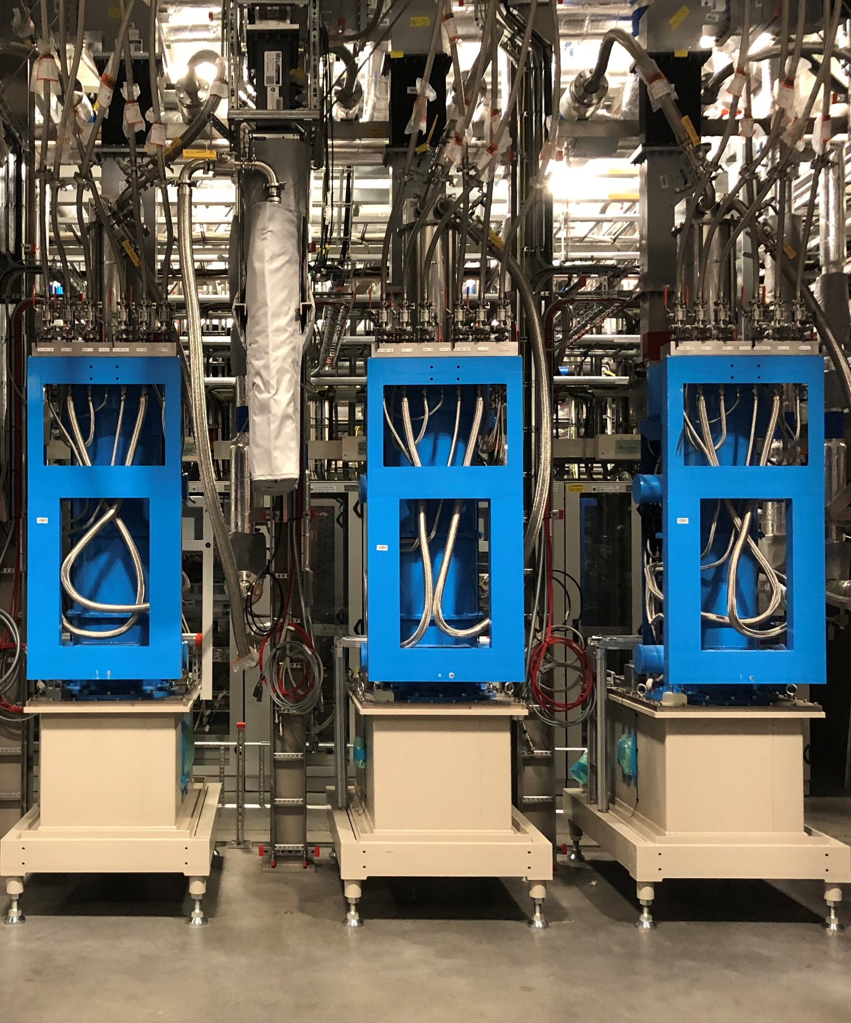
Canon Klystron Arcing

Slide 6
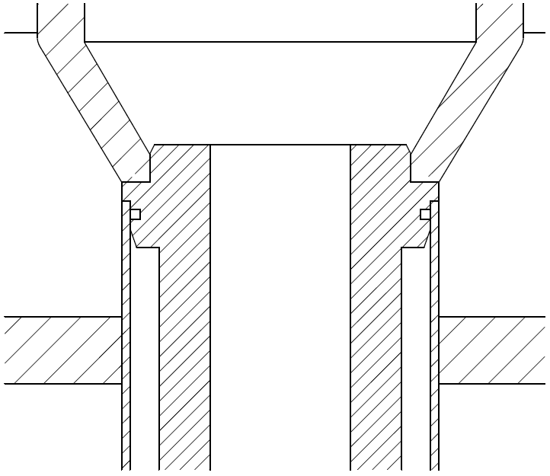
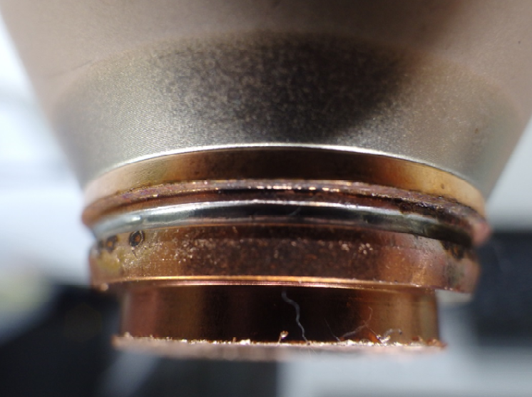
Canon Output-Coax Arcing at Factory
Canon reported RF discharges on two coax-to-waveguide output transitions in 2018
  Observed on SN6 & SN8 during FAT at >1MW
  Occurred at braze of inner sleeve of RF window
  Non-uniform flow of solder resulting in poor electrical contact (gaps 30-70µm)
  Complete replacement of output assemblies on these two tubes
(To T-bar)
brazing groove
silver brazing
(air side)
inner sleeve
ceramic window
(vacuum side)
inner rod
brazing groove
Inner sleeve
Inner rod
Courtesy Canon

Slide 7
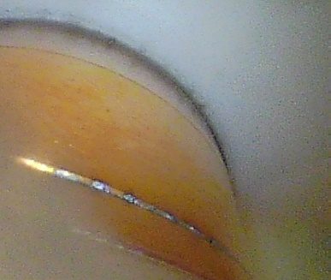
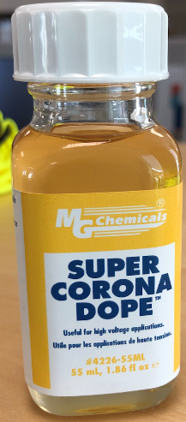
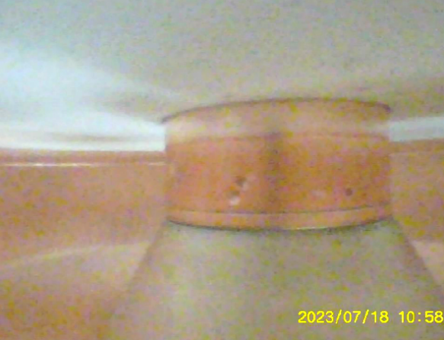
Canon Output-Coax Arcing at ESS
Same arcing observed in 2023 at ESS on SN3 & SN7 during soak testing (not during FAT & SAT)
Klystrons were then out of warranty
  Canon quote for repair was not considered
A number of options for in-house repair were discussed together with Canon
  Use of dielectric varnish for HV insulation
  Crimping tool (Canon)
  Low temperature solder (Canon)
Test on spare assembly at Canon; no high power test
Courtesy Canon

Slide 8
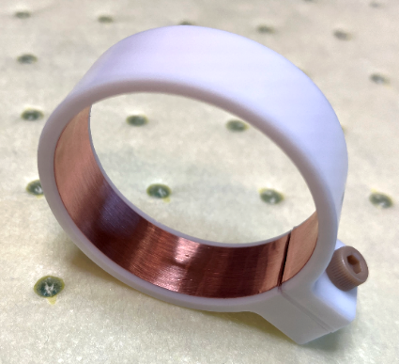
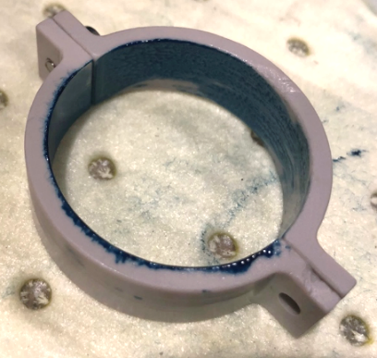
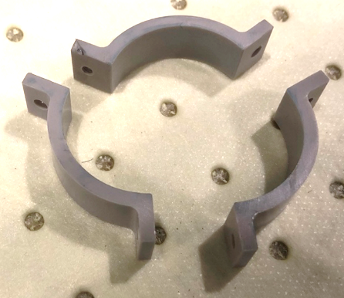
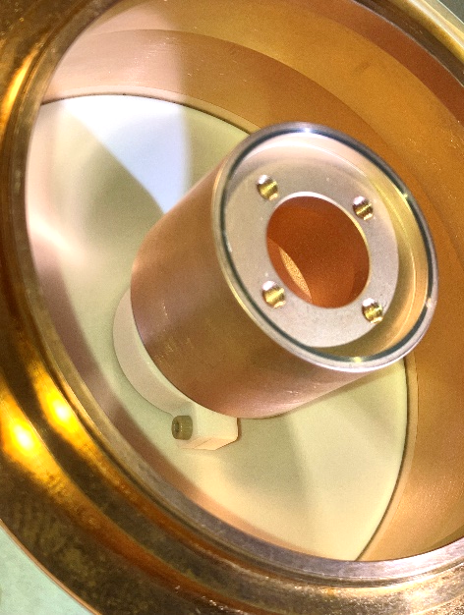
ESS Solution
Provide RF conduction path over the brazing gap with a clamped-on copper tape
Different clamps in PTFE & PEEK were manufactured and test fitted
E-field and RF-match simulations
Final solution:
  Single-opening PTFE clamp
  M3 PEEK screw
  50um Cu-tape glued to clamp
  No further arcing observed on SN3&7 during >150hrs of soak testing
E-field simulation courtesy Canon

Slide 9
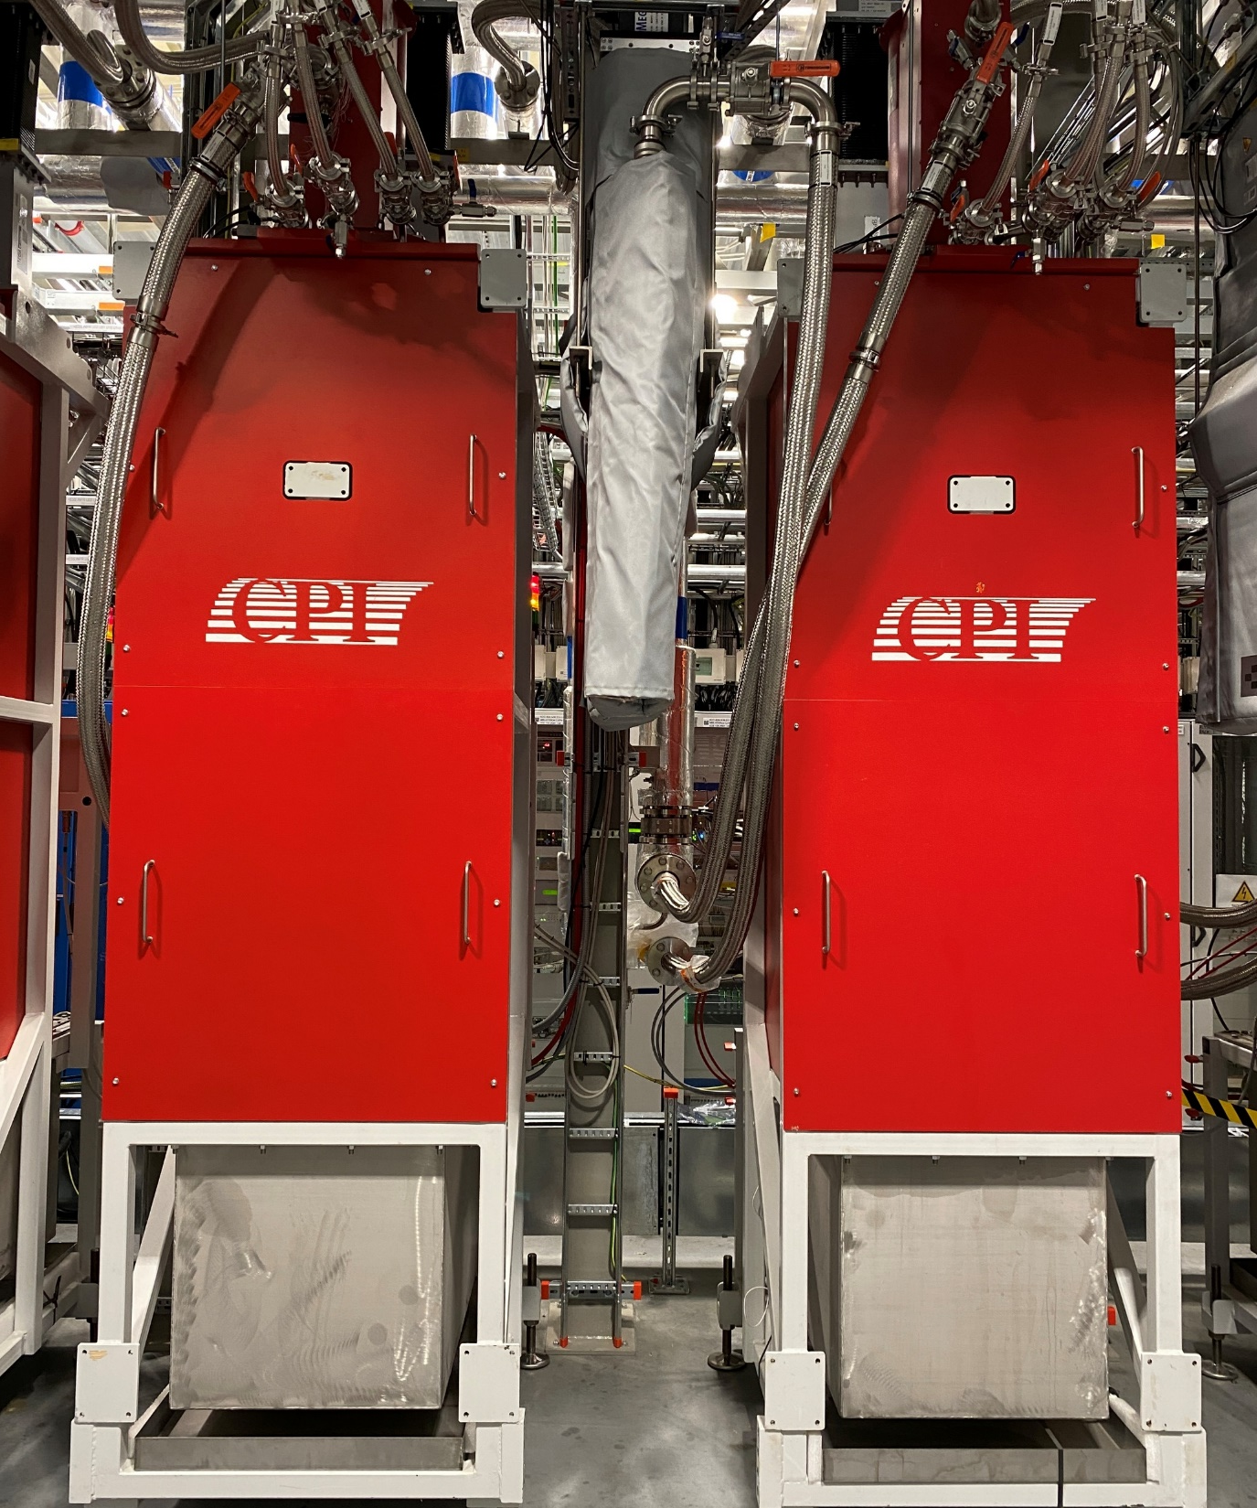
CPI Klystron Magnet Repair

Slide 10
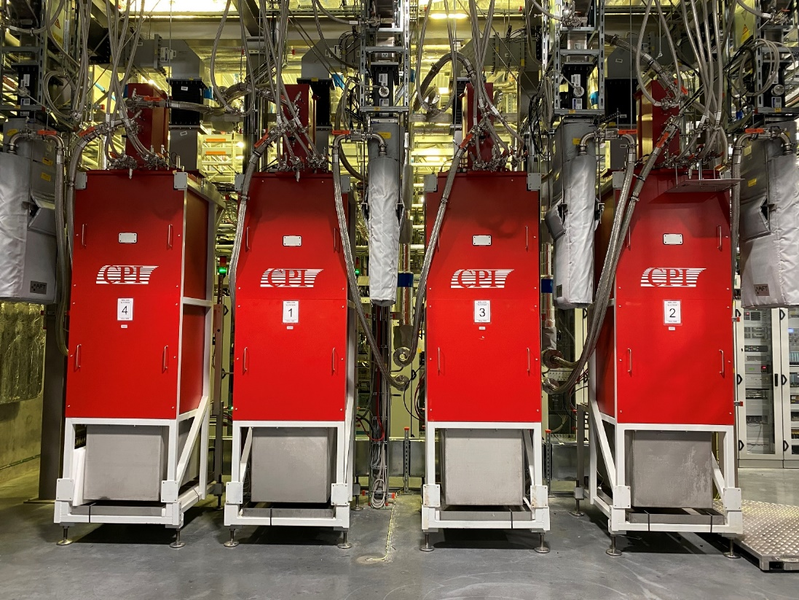
CPI 704MHz Klystron Procurement
18 procured in 2017 and delivered by 2020
CPI chose to have the magnet frame manufactured by Scanditronix AB in Sweden
  Tests at CPI in “golden magnet”
  Assembly of tube and magnet at ESS
9 pass Site Acceptance Test w/o any issues
9 fail SAT during DC conditioning
  Frequent high voltage arcing
  Loss of perveance
  High body dissipation

Slide 11
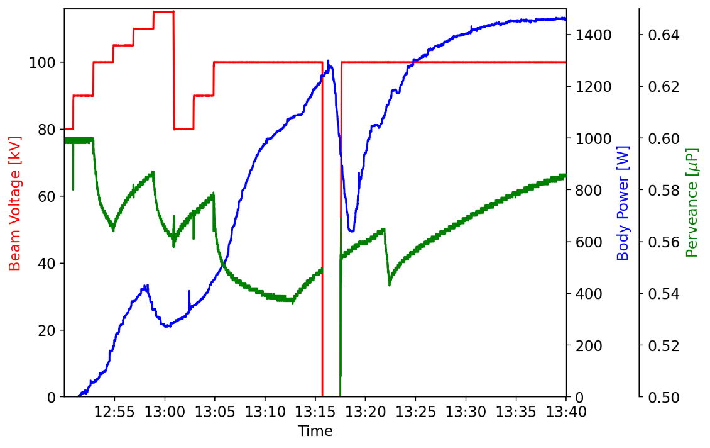
CPI 704MHz Klystron Procurement
18 procured in 2017 and delivered by 2020
CPI chose to have the magnet frame manufactured by Scanditronix AB in Sweden
  Tests at CPI in “golden magnet”
  Assembly of tube and magnet at ESS
9 pass Site Acceptance Test w/o any issues
9 fail SAT during DC conditioning
  Frequent high voltage arcing
  Loss of perveance
  High body dissipation
1.5kW at 2ms, 7Hz
(⅟4 of nominal duty)
HV conditioning
Loss of cathode emission

Slide 12
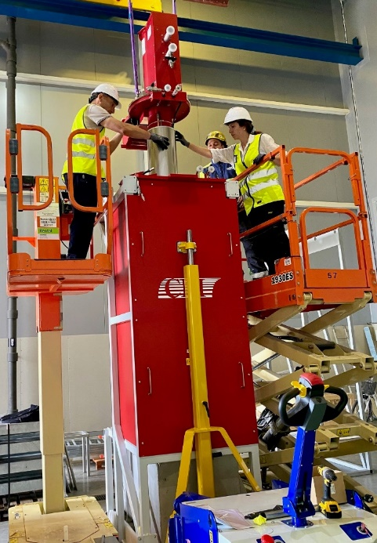
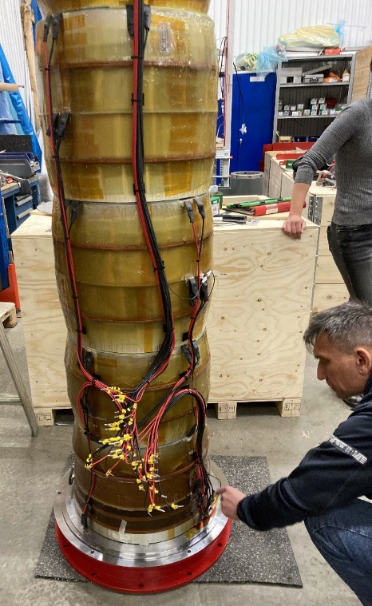
First Actions Taken
Consultations with manufacturers
Magnets were determined to be the root cause
  Swapping in tubes from working klystron sets
  Separating magnet from oil tank
The performance of 6 magnets could be recovered by adjusting coil currents and polarity
Detailed investigation of magnet pack stacking and alignment
3 of the 18 magnets remained unrecoverable (status after over a year of investigations)
magnet disassembly & inspection

Slide 13
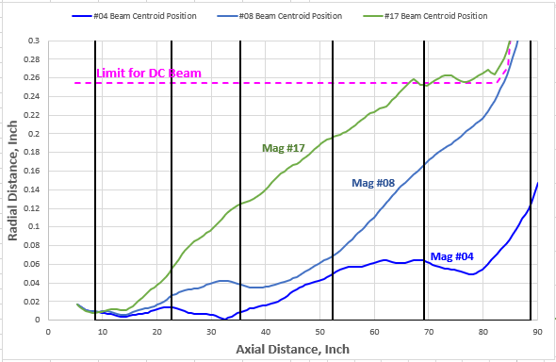
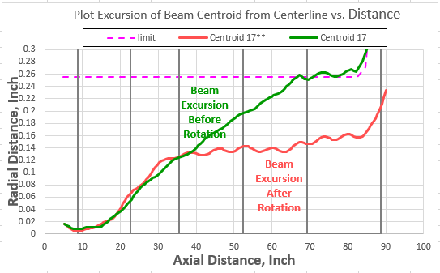
Magnet Repair
Magnetic field measurements at Scanditronix show transverse fields below 0.7% of longitudinal
Suspicion: Radial field steers the beam continuously off the tube axis
  Confirmed by particle tracking simulations at CPI
  Assumption: Rotating individual magnet packs by 180° will also reverse the transv. fields of this pack
Courtesy
B. Stockwell, CPI
Two magnets successfully repaired and performing with nominal parameters
Third magnet presently undergoing repair procedure
3 magnet packs rotated

Slide 14
Summary & Outlook

Slide 15
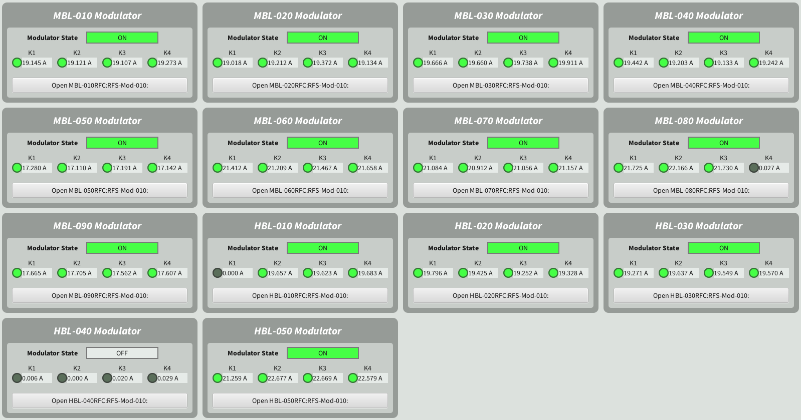
Summary & Outlook
Klystron commissioning for the 2MW-beam machine is complete (BOD Feb. 2025)
  60+ klystron SATs carried out over the last 3-4 years
  Many klystron sets needed to be un-/ reinstalled or even disassembled
Promising soak testing results for Medium-β and High-β klystrons
  Cooling water regulation improved
  Biggest causes for trips identified
  Building of klystron test stands to carry out SATs for spare klystrons

Slide 16
Thank you.
Acknowledgement
The ESS RF Group would like to thank Canon, CPI and Scanditronix for their technical advice and active support.

Slide 17
Backup

Slide 18
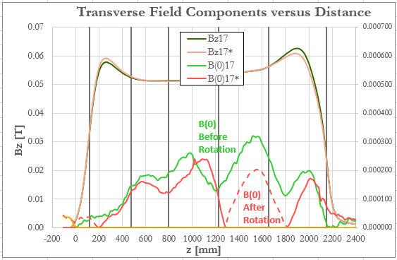
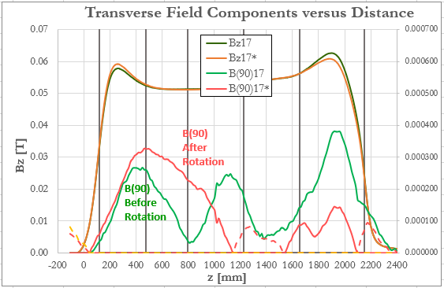
Magnet #17 Field Measurements
Magnetic field components before and after rotation of magnet packs 3 & 4
Rotation of magnet pack 1 was required in addition
Field measurements courtesy A. Ahl, Scanditronix AB

