Slide 1
THE INTERLOCK SYSTEMS FOR HIGH POWER RF SSA SYSTEMS AT ARGONNE APS AND ATLAS
Yong Luo
CWRF 2024
On Behalf of A. Goel, D. Horan, T. Madden,
A. Nassiri, B. Popovic, G. Trento
Not for further Distribution without Permission. If distributed beyond attendees the slides will need to be re-reviewed for copyrighted materials.

Slide 2
INTERLOCK SYSTEM
WAVEGUIDE SYSTEM: PRESENT WG AND WG after S36 SSA UPGRADE
RF DRIVE INTERLOCK CHAIN
MPS (MACHINE PROTECTION SYSTEM)
PSS (PERSONAL SAFETY SYSTEM)
PLC
PM (POWER MONITOR)
ATLAS ARIS (ATLAS RADIATION INTERLOCK SYSTEM) [SIMINAR AS APS ACIS]
SUMMARY
FUTURE WORK

Slide 3
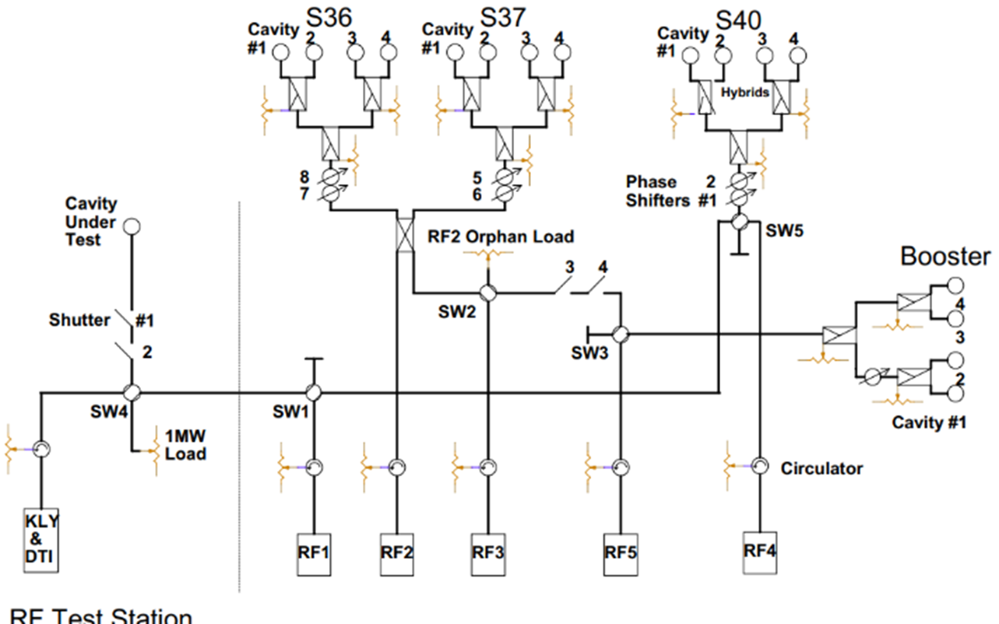
PRESENT WAVEGUIDE SYSTEM
3dB Hybrid and 50 Ohm Load
S38 was removed for Bunch Lengthening System (BLS)
RF Test Station

Slide 4
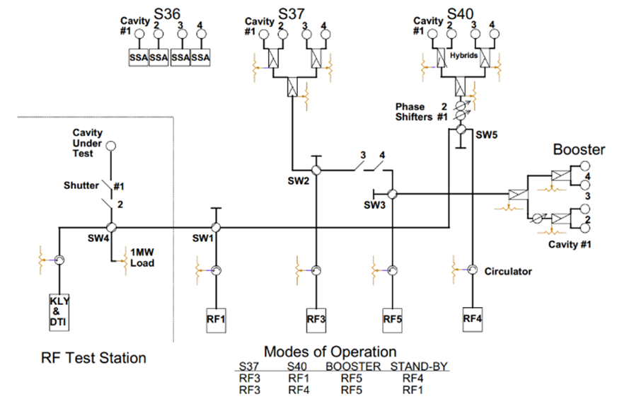
WAVEGUIDE SYSTEM after S36 SSA UPGRADE (HYBRID MODE)
Four R&K 160KW SSA for Sector 36
RF2 will be removed

Slide 5
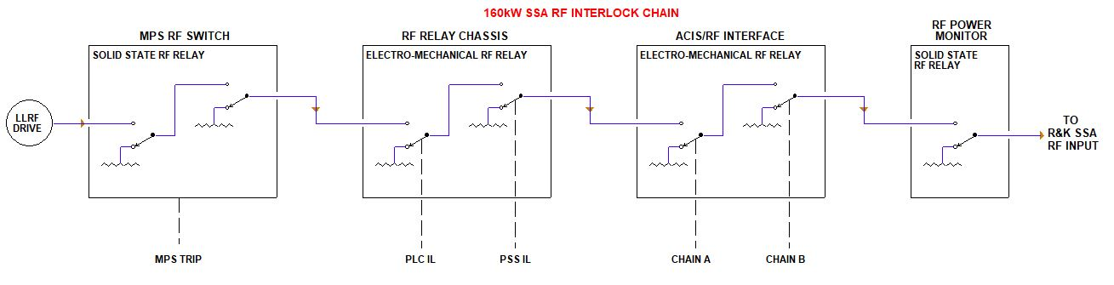
RF DRIVE INTERLOCK CHAIN
ACIS: Accelerator Control Interface System
RF drive will be muted when there is any interlock event detected/received by sub-systems
PSS
Besides the RF drive muting, SSAs will also be interlocked by putting them into Off (Standby) state when necessary

Slide 6
SR MPS SYSTEM – EXAMPLE (ONE CHANNEL/CAVITY)
TTL (MPS TRIP)
D-LLRF
Multiple Chassis
PSS Chassis and ACIS Relay Box:
D. Horan
PM: T. Madden and B. Popovic
RF Drive
Fiber to TTL Interface chassis W/ RF SSA SWs
PSS RF Relay
ACIS
PM
SSA 1
Primary MPS Fiber 1
Relay (On/Off),
Status Back from SSA Racks
SSA1 RACK A
SSA1 RACK B
Secondary MPS Fiber 1
Fiber to TTL Interface chassis W/ RF SSA Relays
P Forward after D.C.
Diode Detector Chassis
Copper to Fiber
Time Stamp
(Control System)
2 Fiber Outputs to each SR Sector (6 for 3 Sectors)
Each Cavity SSA System: 1 Time Stamp Output

Slide 7
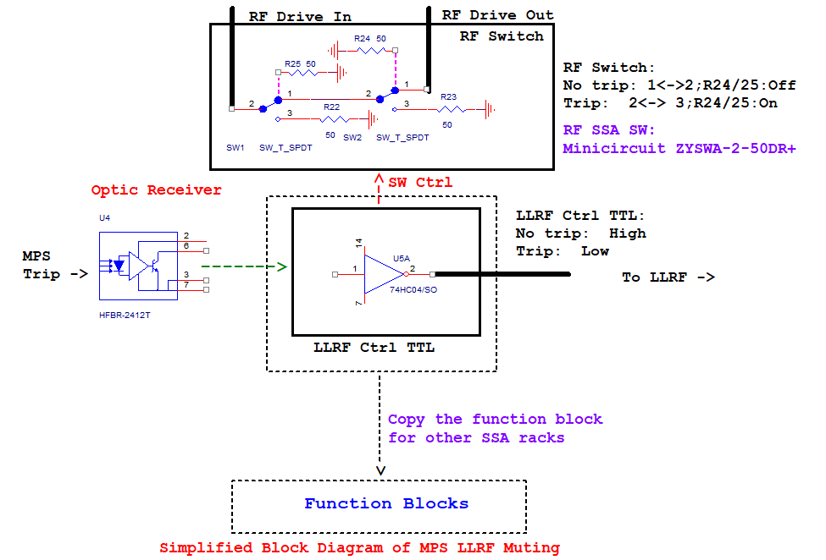
MPS RF MUTING SIMPLIFIED BLOCK DIAGRAM
The functions have been tested and verified.
DC power with redundance (not shown here)
Total 4 Channels
(4 cavities/sector)

Slide 8
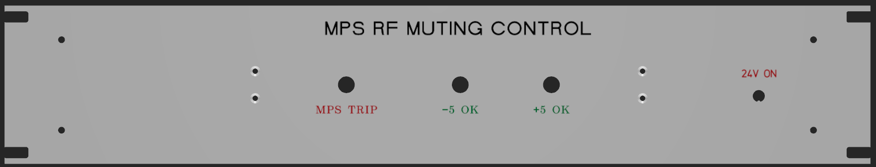
MPS RF MUTING FRONT PANEL
Front Panel
Green LEDs: DC Power
DC power switch
(24V DC from PLC)
PCB board mounting holes
Red LED: MPS Trip

Slide 9
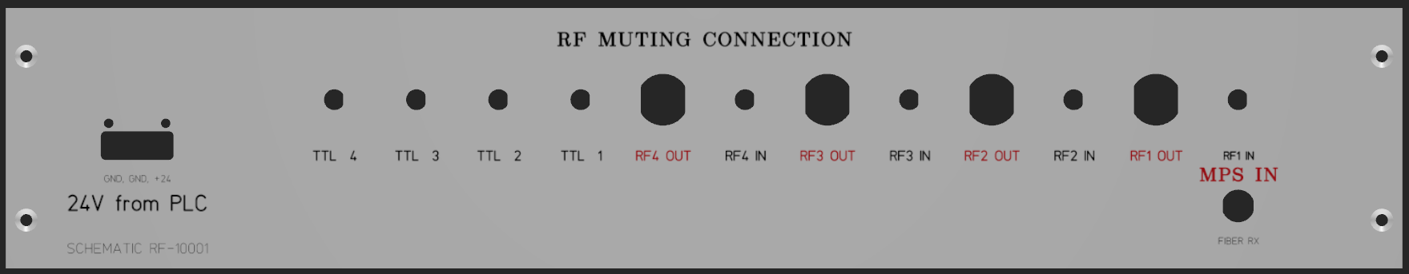
MPS RF MUTING BACK PANEL
Back Panel
24V DC from PLC
MPS Fiber Optical Signal In
DC Power Entry:
TB 3-Pin
4 SMA mounting holes for TTL signals to LLRF modules.
4 N mounting holes
4 SMA mounting holes

Slide 10
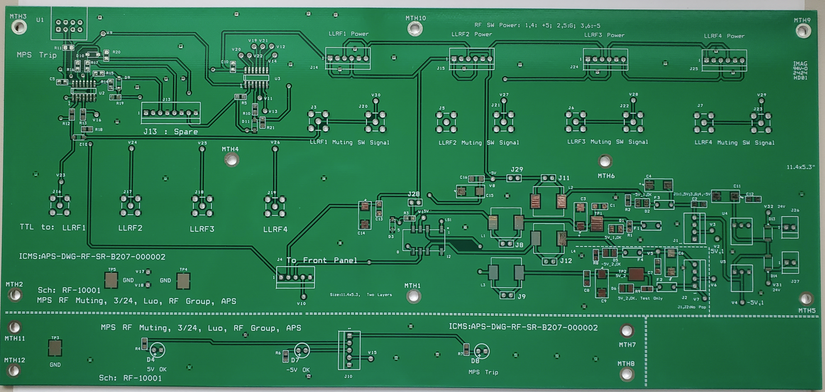
PCB BOARDS: MPS LLRF and RF MUTING PCB
Main bd
Front bd

Slide 11
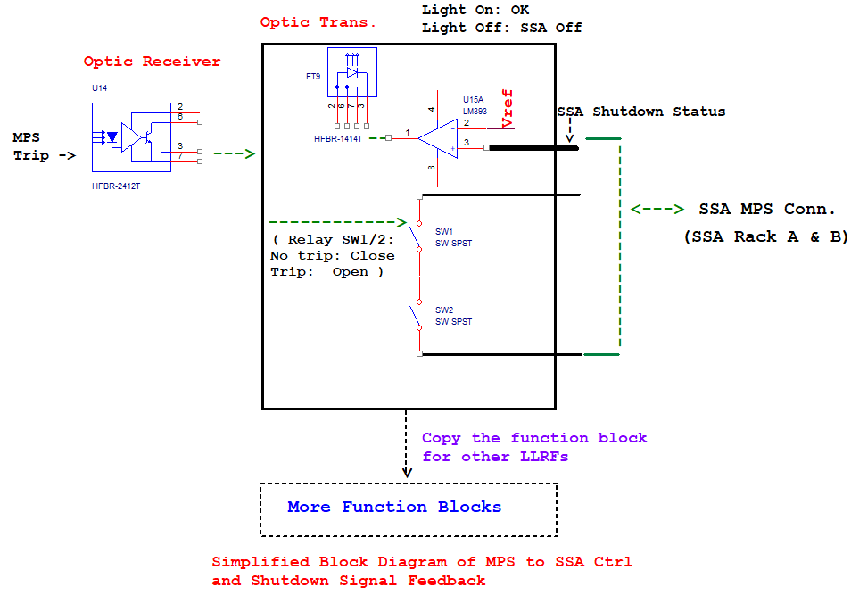
MPS SSA CONTROL SIMPLIFIED BLOCK DIAGRAM
SSA Status to PLC (newly added)
The functions have been tested and verified.
DC power with redundance (not shown here)
2 Switches in series for SSA ILK
Total 4 blocks
(4 racks/sector). Output status is A&B for specific SSA

Slide 12
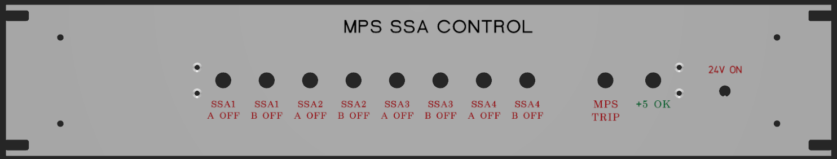
MPS SSA CTRL FRONT PANELS
Front Panel
DC power switch
(24V DC from PLC)
PCB board mounting holes
Green LEDs: DC Power
Red LED: MPS Trip or SSA Racks Off (Standby)

Slide 13
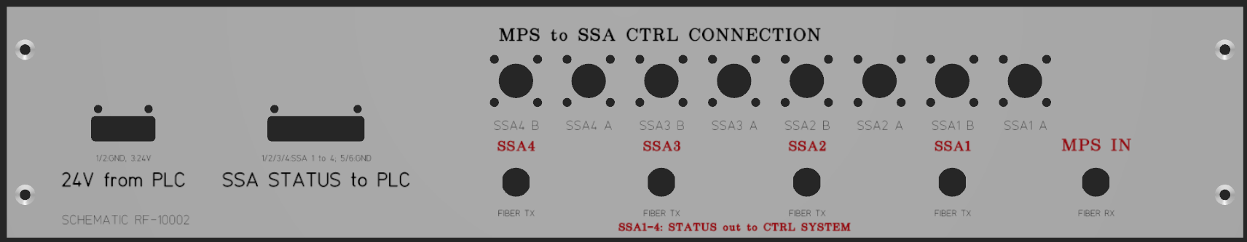
MPS SSA CTRL BACK PANELS
Back Panel
24V DC from PLC
MPS Fiber Optical Signal In
Recently added:
SSA Status to PLC, TB 6-Pin
Eight 4 Pin Military Connectors
(Relay Interlock, SSA Rack Status)
DC Power Entry:
TB 3-Pin
4 Fiber TX (Rack
Status) Out

Slide 14
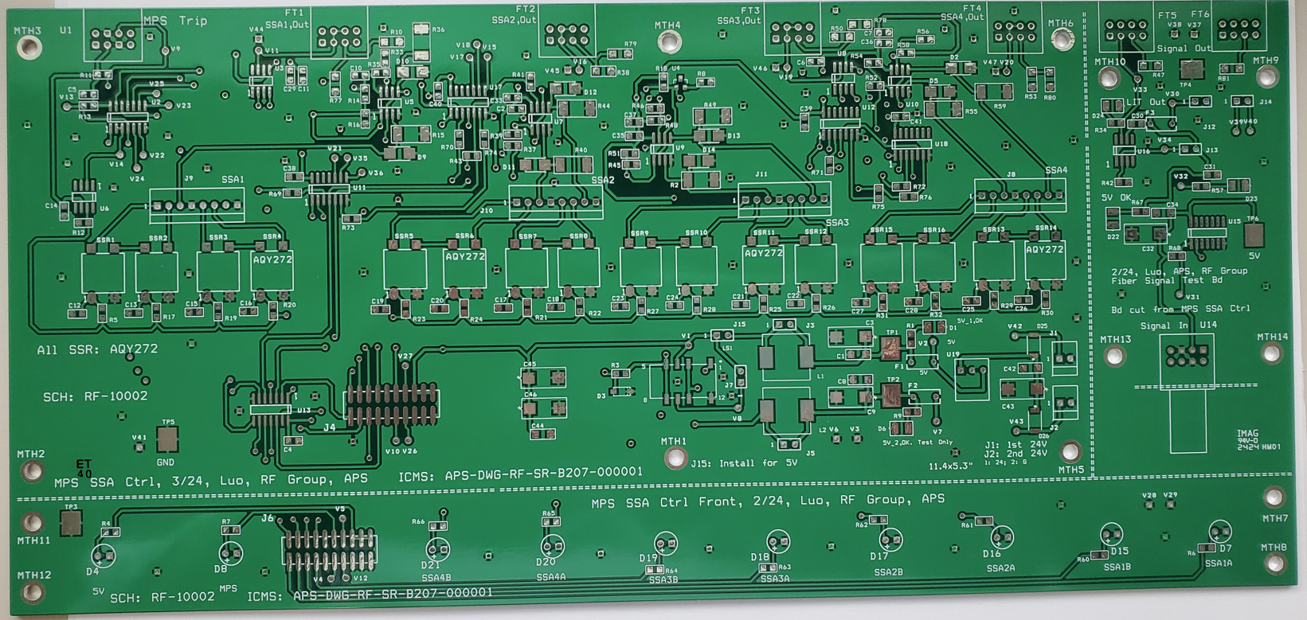
PCB BOARDS: MPS SSA CTRL PCB
Main bd
Test
bd
Front bd

Slide 15
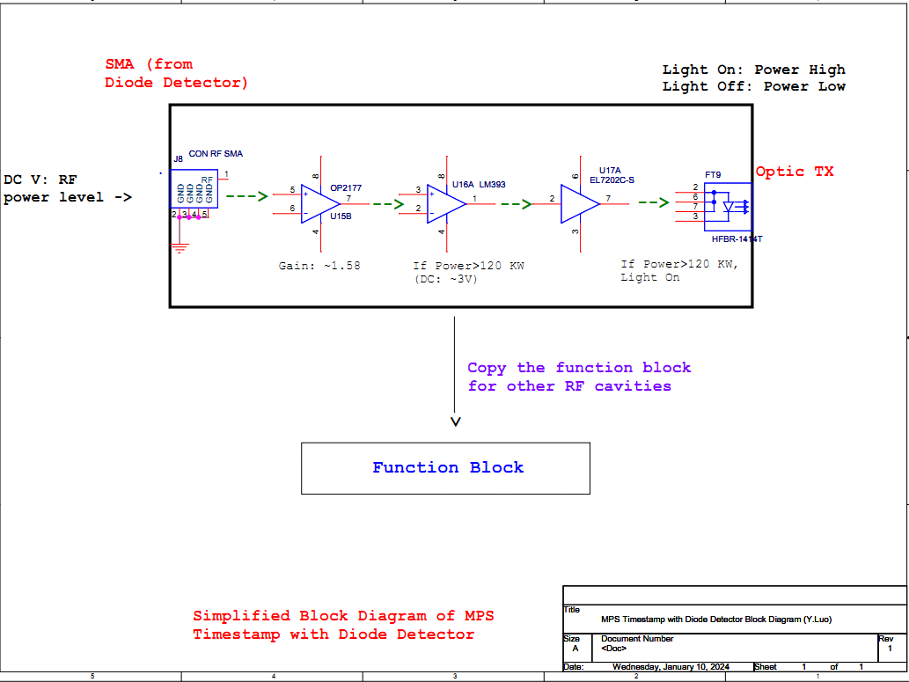
MPS DIODE DET. TIMESTAMP SIMPLIFIED BLOCK DIAGRAM
The functions have been tested and verified.
DC power with redundance (not shown here)!
-9 dBm: Diode Det. ~ 1.9 V
(120KW after 80 dB atten.->
1.2 mW, ~1 dBm. After 10 dB atten. -> -9 dBm)
Gain is adjustable (in a range) for different power level
Total 4 blocks
(4 Cavities/sector)

Slide 16
MPS DIODE DET. TIMESTAMP PANEL (Preliminary)
Proposed Back Panel: 1 U
Front Panel is not be needed. The plan is to use existing front panel of diode detector unit. Four Green LEDs will be added to the front panel for power status indication.
DC (from PLC) Power Entry:
TB 3-Pin
Optional: AC Power Entry:
Reuse Adi’s Power Entry Module
4 N Power Input.
1 N/Cavity
4 Fiber TX (RF Power
Timestamp) Out
2 D-sub 9 for Testing

Slide 17
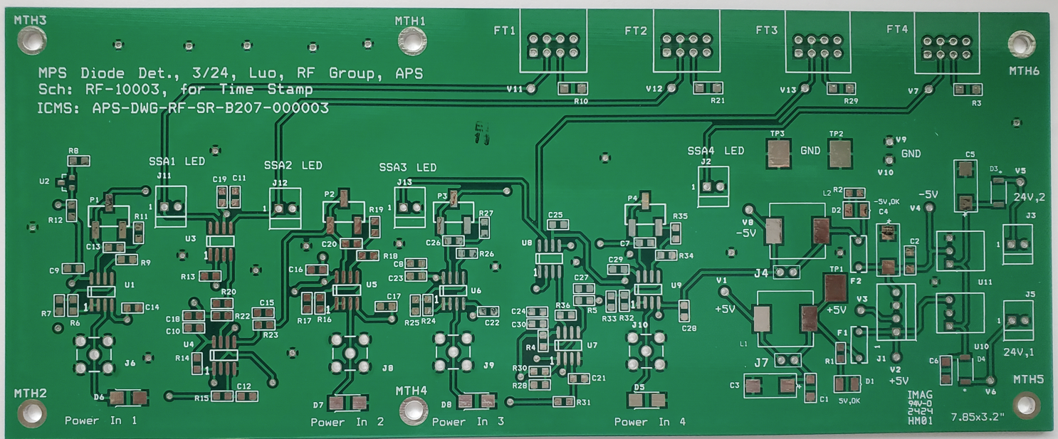
PCB BOARDS: MPS DIODE DET. TIMESTAMP PCB (MAIN BOARD)

Slide 18
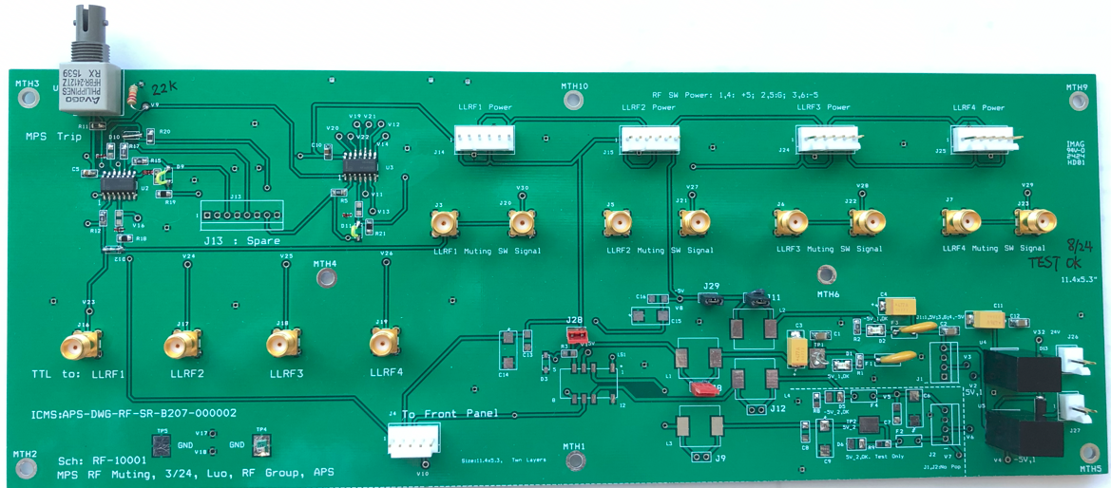
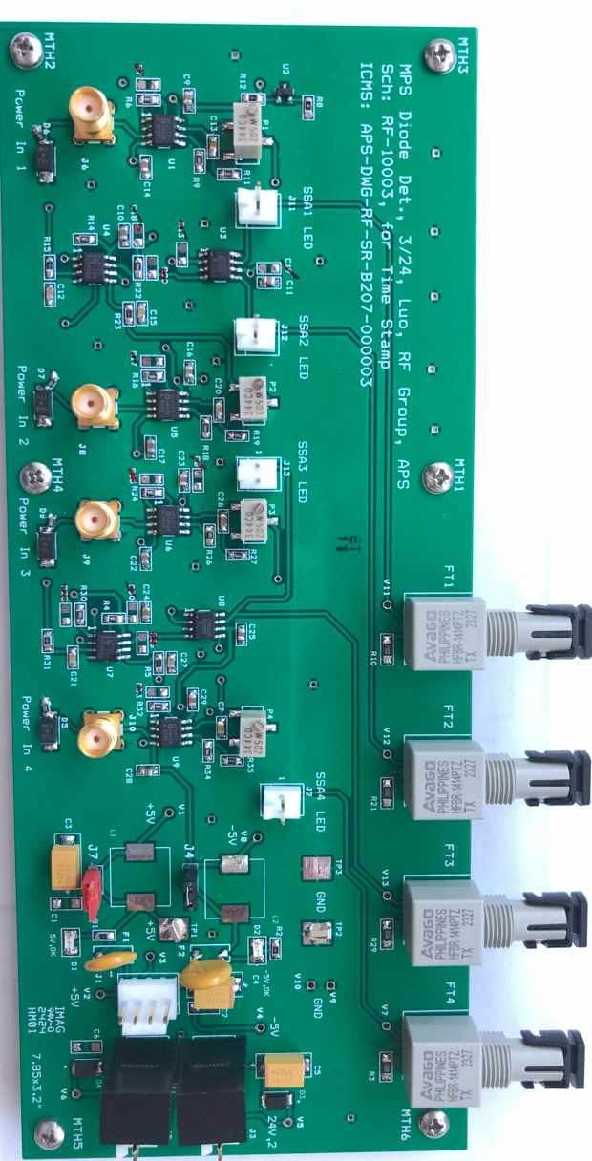
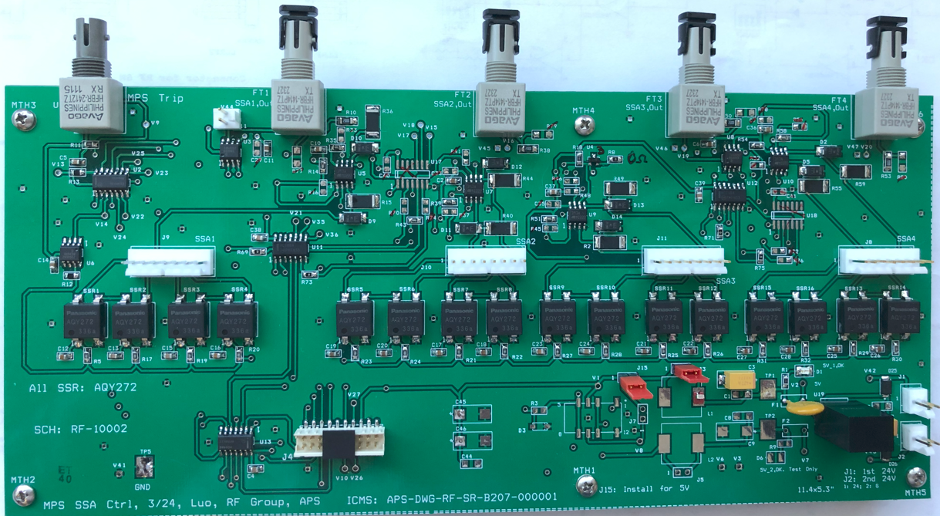
POPULATED PCB BOARDS
Major functions (All boards) have been bench tested and verified.
MPS RF Muting
RF Drive Signals to RF SWs Directly
MPS Time Stamp
Diode det. not shown here.
Front Boards not Shown
MPS SSA Control

Slide 19
PLC ARCHITECTURE (G. Trento)
36-1 System
36-2 System
36-3 System
36-4 System
TCU
RS-232
TCU
RS-232
TCU
RS-232
TCU
RS-232
36-1
SSA PLC
36-2
SSA PLC
36-3
SSA PLC
36-4
SSA PLC
EPICS
EPICS
EPICS
EPICS
Local
Network
36-1
HMI
36-2
HMI
36-3
HMI
36-4
HMI
SW1
SW2
SW3
SW4
Cavity Rack PLC
SW5
36-1
remote
36-2
remote
36-3
remote
36-4
remote
EPICS
TCU= circulator TCU
Mezzanine Rack
MEZZ
HMI
PLC contains µP
SSA – PLC Architecture with Cavity Isolation
SW1->5=Unmanaged Ethernet switch

Slide 20
PLC SIGNALS MONITORED/CONTROLLED (G. Trento)
S36-1
MAIN
RACK
PLC
Cavity &
Coupler Temps
S36
CAVITY
RACK
PLC
Waveguide
Pressure
Water Flow
& Temps
InfraRed
Temperatures
EPICS
EPICS
Circulator
TCU
Transformer
Qualitrol
36-1
HMI
Solenoid
Valves
MPS
Chassis
ACIS/RF
Chassis
HOM Switch
System
Same for 36-2,3,4
RF Relay
Chassis
Ion Gauge &
Pump Status
Power Monitor
Chassis
Blower Control
Chassis
SSA
PLC
PSS
Chassis
Tuner
Chassis

Slide 21
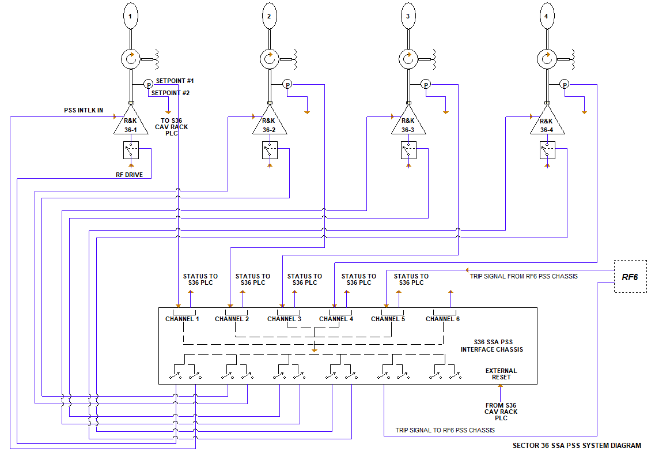
PSS BLOCK DIAGRAM (D. HORAN)
Pressure sensor signals are monitored by PSS and PLC.
RF drive is muted and SSA is interlocked when pressure is out of range.
Trip from and to RF6
(Interlock sum of other sectors)

Slide 22
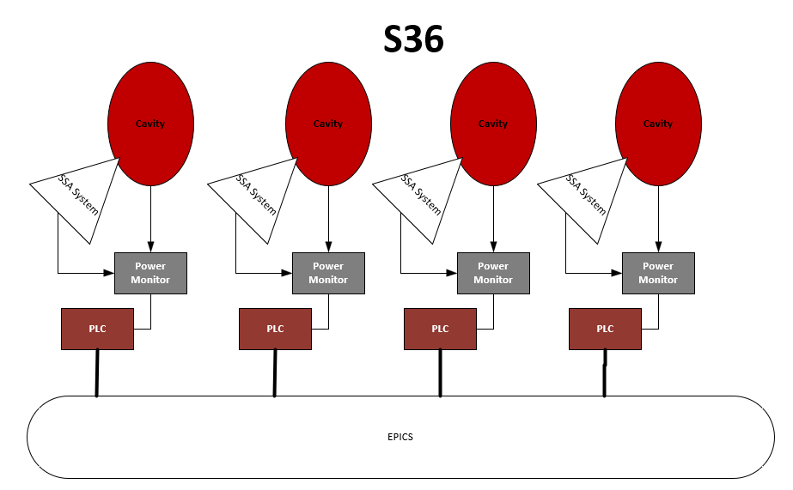
NEW POWER MONITOR DESIGN OVERVIEW (T. Madden, B. Popovic)
Single Power Monitor, one per cavity/SSA System
  No More Primary/Secondary PMs*
  Use the slightly modified circuits from the original design
    RF Diode
    IR Detector
    Arc Detector/RS422 Fault
    Ion Pump Fault
  New CPLD on Daughter Board
  Add EPICS interface
    Coming from CPLD to PLC then to EPICS
Communicate to each other via PLCs/EPICS
  Fault Reset to each PM, Fault Out from Each PM
*Unless you need more channels

Slide 23
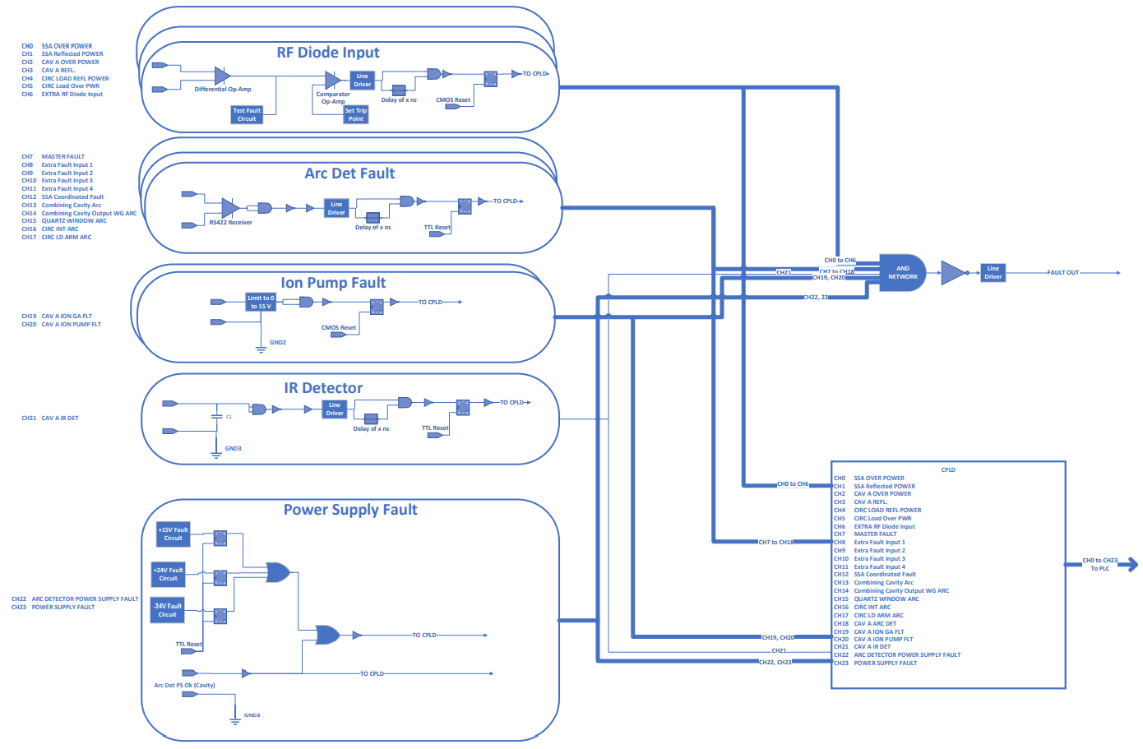
PM MAIN BD: SIMPLIFIED FUNCTION BLOCK DIAGRAM
RF SW Control

Slide 24
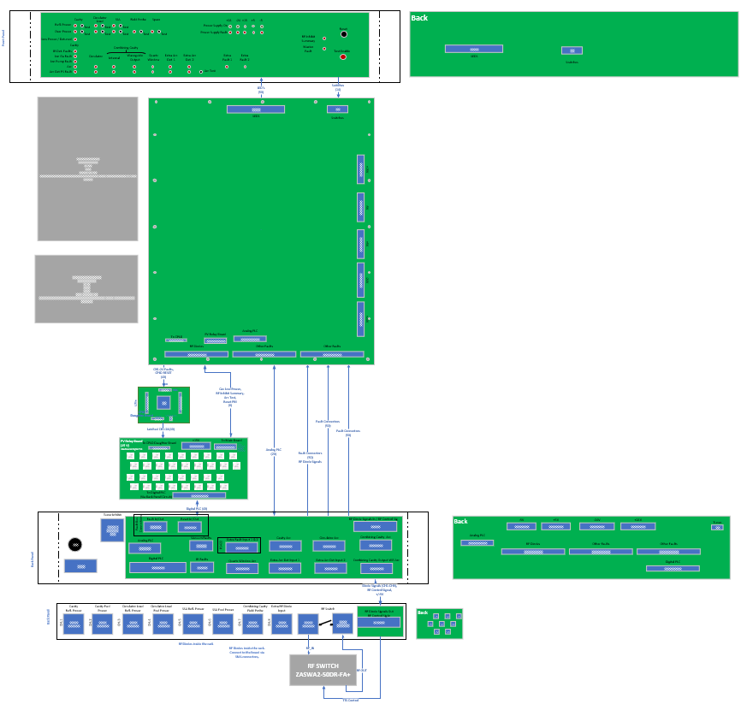
POWER MONITOR:
5+1* BOARDS
Front Panel: Both Sides Shown
PS
Front Panel Board
  LEDs showing fault status
  Switches to reset and test RF & Arc Det Faults
    I/O: Main Board
Mainboard
  Contains majority of PM circuitry
    I/O: Back & Front panel boards, PLC Interface Board
    Output: CPLD Board
CPLD Daughter Board
  Contains CPLD, which Latches the Faults
    Inputs: Main Board
    Outputs: PLC Interface Board
PLC Interface Board
  Provides 15 V signals and isolation for Digital PLC I/O
    Inputs: CPLD Board
    I/O: Main Board
Back Panel Board
  Connectors to PLC, Arc Detectors, RF Diode Unit etc.
    I/O: Main Board, PLC Interface Board
* RF Diode Detector Board in a Separate Chassis
Mainboard
PS
CPLD
PLC Interface
Back Panel : Both Sides Shown
RF Det.

Slide 25
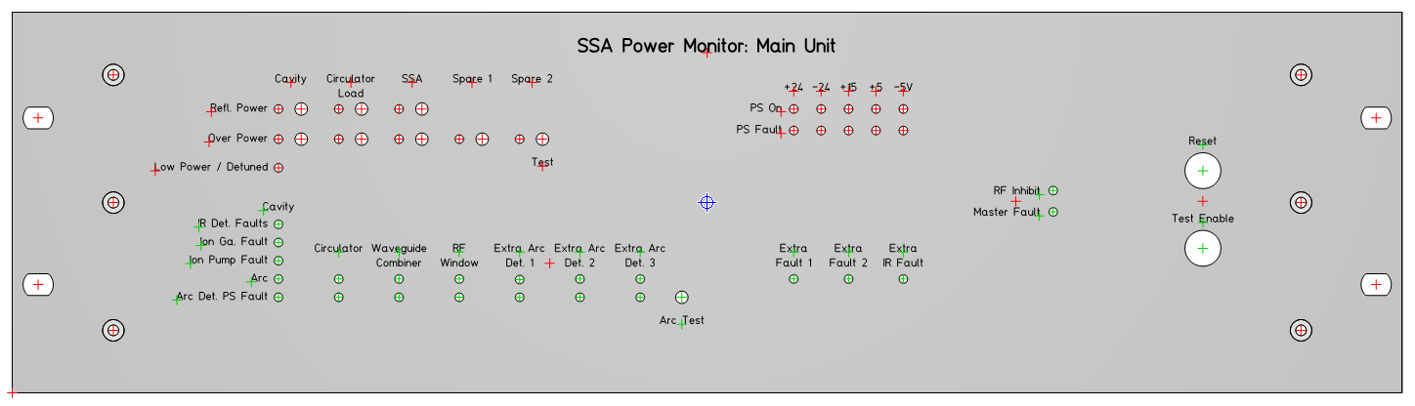
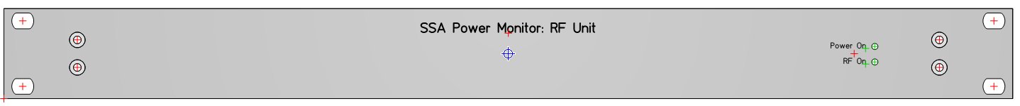
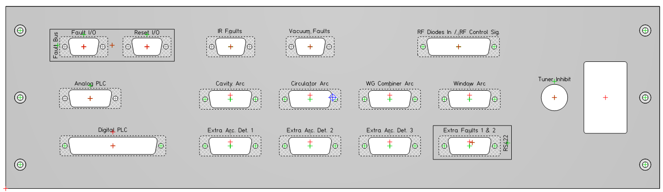
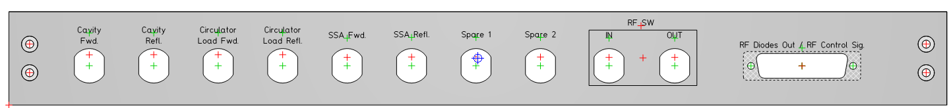
POWER MONITOR DESIGN: TWO RACKS
Front Panel Designs
3 RU Main Unit
  Contains the power monitor
  No RF inside this box
    Reduce noise
1 RU RF Box
  All detector diodes
    Outputs DC detector signals to the main unit
  RF SW
    Controlled by TTL signal from main unit
Back Panel Designs

Slide 26
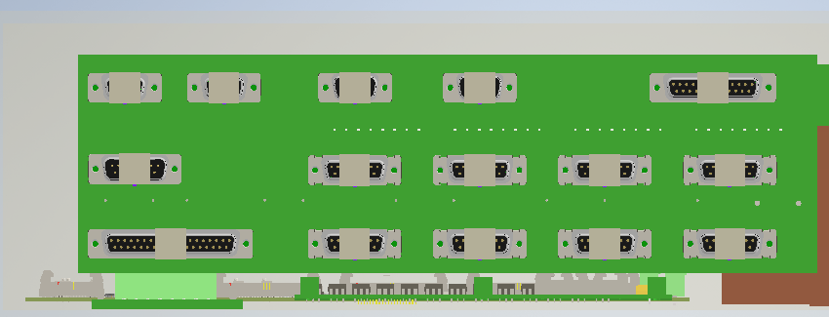
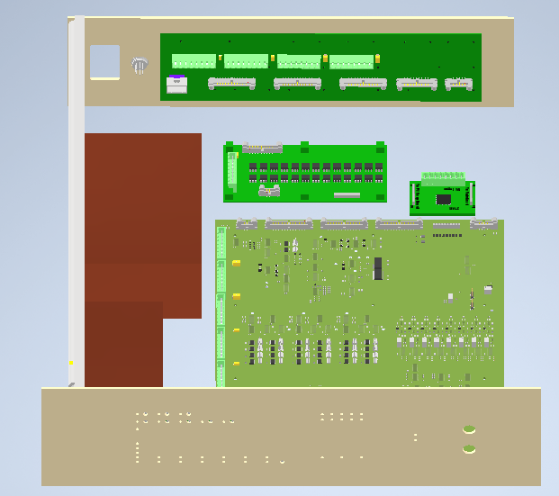
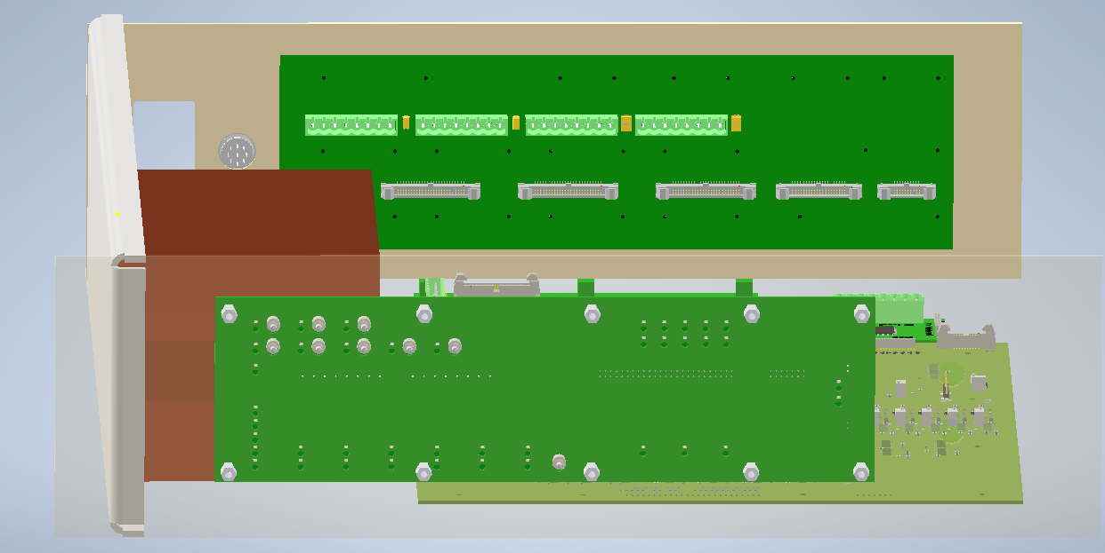
CAD DRAWING (ILLUSTRATION ONLY)

Slide 27
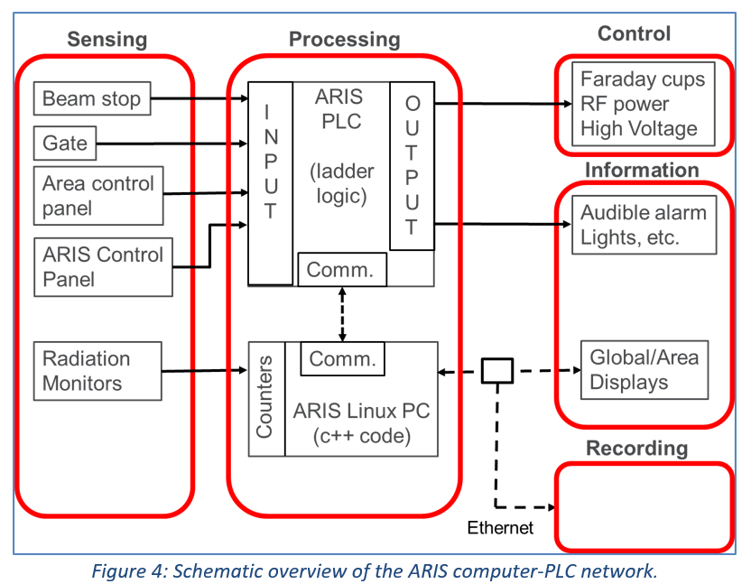
ATLAS ARIS 2 (SIMILAR AS APS ACIS)
Safety PLC Used
One Main Control: Watchdog Timer
ARIS 2: Newly Upgrade from ARIS
ARIS2:

Slide 28
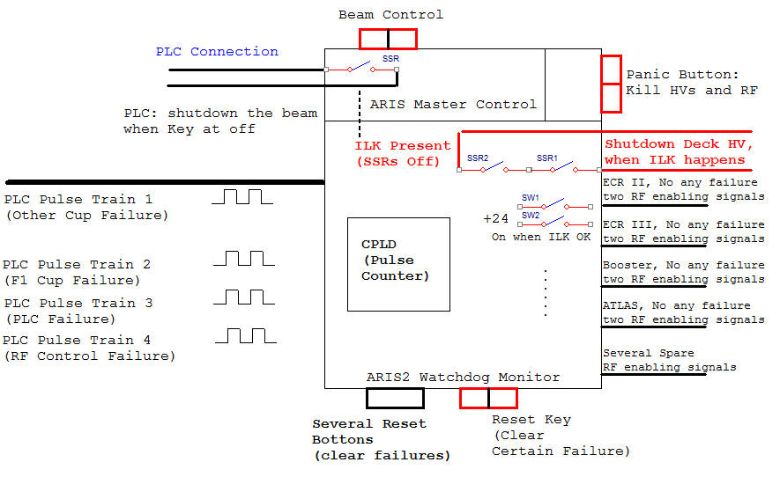
ATLAS ARIS 2 CONTROL/WATCHDOG TIMER-SIMPLE BLOCK DIAGRAM
Watchdog Timer Performs Critical Interlock Functions: Source Deck HV Off when ILK Present; Different Area SSAs Power Supplies Enabling/Disabling

Slide 29
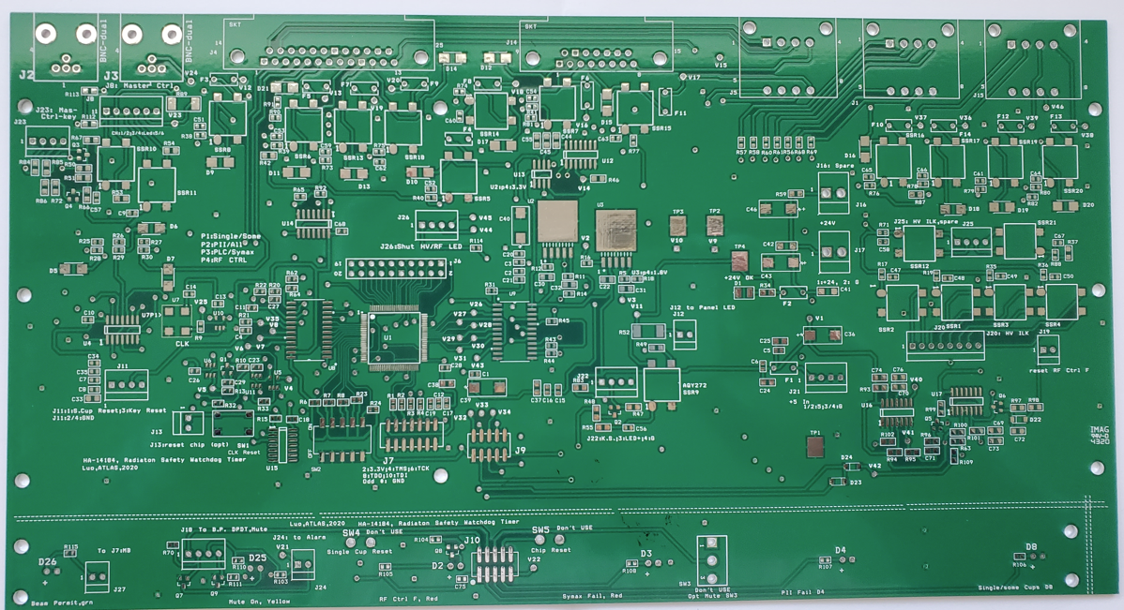
ATLAS ARIS 2 CONTROL/WATCHDOG TIMER-PCB BOARD
CPLD
Main bd
Front bd

Slide 30
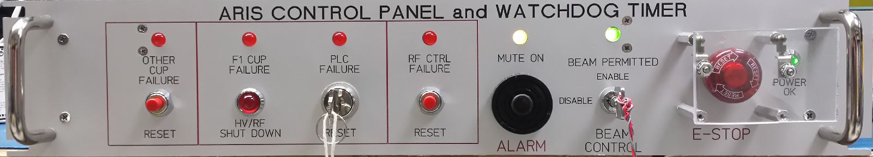
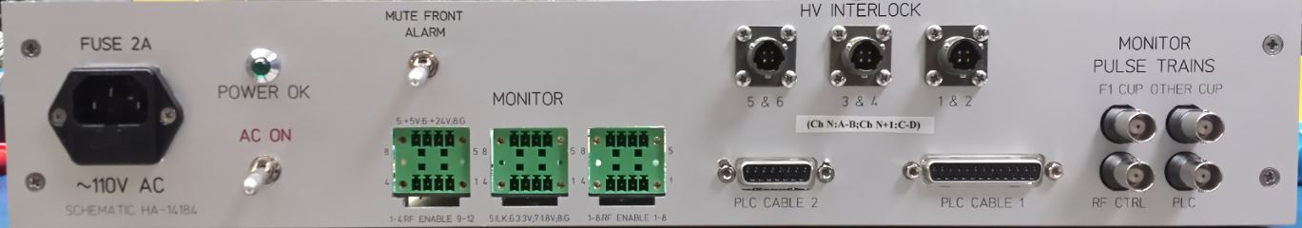
ATLAS ARIS 2 CONTROL/ WATCHDOG TIMER-PANELS
Panic Button (Covered)
Reset BUttons/Key
Beam Control Key
Mute @ Testing Only

Slide 31
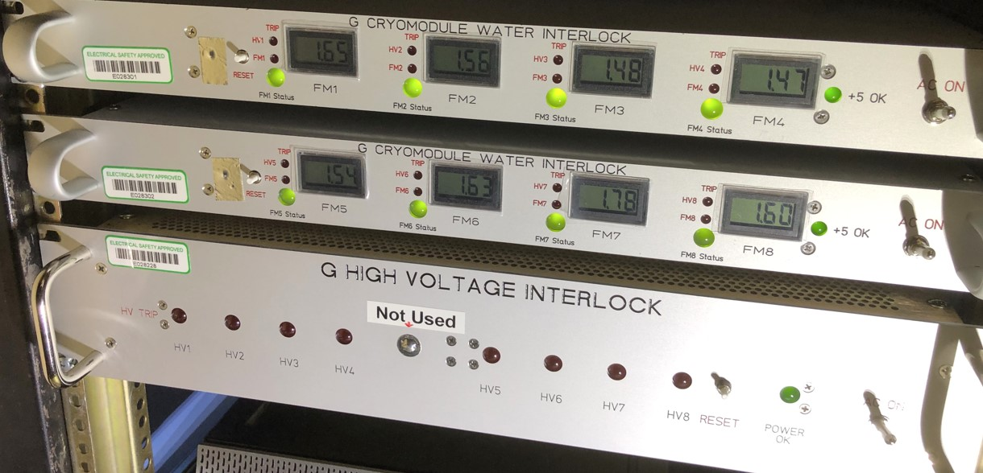
ATLAS OTHER INTERLOCK: EXAMPLE OF WATER AND HV ILK
Water ILK: Monitoring Flow, Trip when Low Flow
Those three chassis are used for G Cryomodule (a 109 MHz superconducting, low Beta (0.15) 8 cavities cryomodule)
HV ILK: Monitoring HV (thru HV Divider), Trip when Low HV value

Slide 32
SUMMARY
Majority Work of MPS: PCB, Panels, etc. ✓
Majority Work of PSS and ACIS Relay Box: Chassis (or Box) Assembly Ongoing. ✓
PLC: Hardware Assembly Done, Software Almost Done ✓
Majority Work of PM: PCB, Panels, etc. ✓
Work supported by the U.S. Department of Energy, Office of Science, under Contract No. DE-AC02-06CH11357.

Slide 33
FUTURE WORK (INTERLOCK SYSTEM)
Chassis and other Hardware Assembly of Some Systems.
Make and Run Cables Required including RF Cables.
Deployment and Test.
Test the Interlock Functions with the 1st SSA System SAT (Site Acceptance Test) around November, 2024.
Electronic Document Control Center (EDCC): All Documents Check In.
Other

