Slide 1
Commissioning
of the Linear IFMIF Prototype Accelerator
High-power CW RF system
presented by Kouki Hirosawa for LIPAc Team
National Institutes for Quantum Science and Technology (QST)
and the IFMIF/EVEDA project team

Slide 2
Author list
Kouki Hirosawa, Andrea De Franco, Naoya Kubo
National Institutes for Quantum Science and Technology (QST)
Ivan Moya, Francesco Scantamburlo¹⁾, Jean-Pierre Adam²⁾
Fusion for Energy (F4E)
¹⁾ and also Istituto Nazionale di Fisica Nucleare (INFN)
²⁾ and also Commissariat à l'énergie atomique et aux énergies alternatives (CEA)
Luis Gonzalez-Gallego
IFMIF-DONES España, EUROfusion
and IFMIF/EVEDA integrated project team
QST, F4E, IFMIF-DONES España, CEA, CIEMAT, INFN, and the IFMIF/EVEDA project team

Slide 3
Outline
LIPAc and its RF system Overview
Commissioning of the RF system
Topics from lower DC to CW in the LIPAc
Future plans for the improvements

Slide 4
Outline
LIPAc and its RF system Overview
Commissioning of the RF system
Topics from lower DC to CW in the LIPAc
Future plans for the improvements

Slide 5
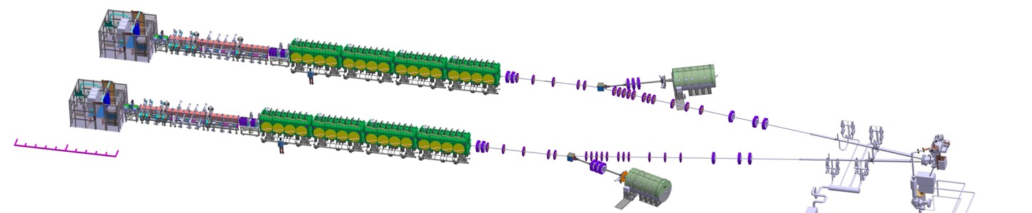





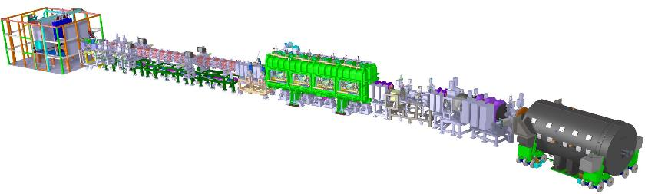
LIPAc Overview
LIPAc (the Linear IFMIF Prototype Accelerator) is the low energy part of the IFMIF accelerator.
  All essential components for the accelerator.
  Strong space charge force for the high current beam.
IFMIF accelerator
40 MeV, 125 mA, CW x 2 beamlines for Deuteron
Liquid Li target
Ion source
RFQ
Superconducting linac
Beam dump
E_{k} ~ 0.1 MeV
E_{k} ~ 5 MeV
E_{k} ~ 40 MeV
Injector
(Ion Source + LEBT)
CEA Saclay
LIPAc, operated by the EU-JA joint team
~9 MeV, 125 mA, short chopped pulse – CW
Mission and challenges of LIPAc
High Current: 9 MeV, 125 mA, Deuteron, high space charge
High Duty Cycle: – 100 % (CW)
The points of the RF-related system
Injector… high current, low emittance, CW
RFQ… the world’s most powerful, longest, CW
LLRF… Synchronized RF injection of 200 kW x8
SRF… the highest current for hadrons
RFQ
INFN Legnaro,F4E,QST
MEBT
CIEMAT Madrid
SRF Linac
CEA Saclay,
CIEMAT Madrid, F4E
HEBT
CIEMAT Madrid, F4E
Cryoplant
CEA Saclay, QST
Control System
QST,
CIEMAT Madrid,
CEA Saclay,
INFN Legnaro,
F4E
36 m
RF Power
CIEMAT Madrid,
CEA Saclay,
SCK Mol
Diagnostics
CEA Saclay
CIEMAT Madrid, INFN
Building Auxiliaries
System Installation
QST
Beam Dump
CIEMAT Madrid, F4E

Slide 6
LIPAc RF system
The LIPAc consists of three RF components:
  9.8m-long RFQ, working as one resonator for accelerating, bunching, and focusing
  5-gap IH resonator for re-bunching
  Superconducting half-wave resonator for accelerating (SRF)
SRF cavities
Re-bunchers
RFQ
To the Beam Dump
From the Injector
Solid-state
Amps
< 20kW
Tetrode
Amps
< 150kW
Tetrode
Amps
< 250kW
Beam Position Monitors
8 LLRF
Individual mode
2 LLRF
8 LLRF
Leader-follower mode
= Master-Slave control
White Rabbit
Clock synchronization

Slide 7
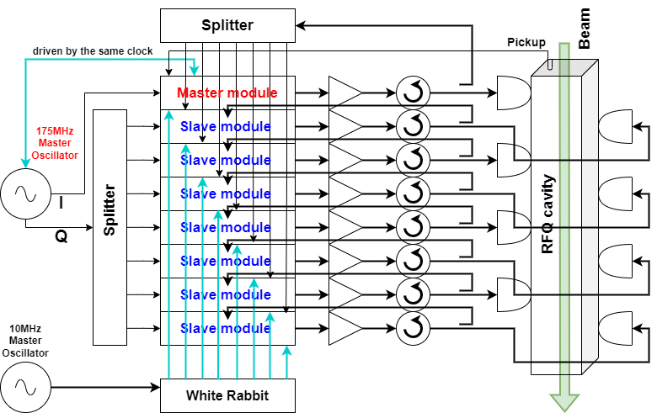
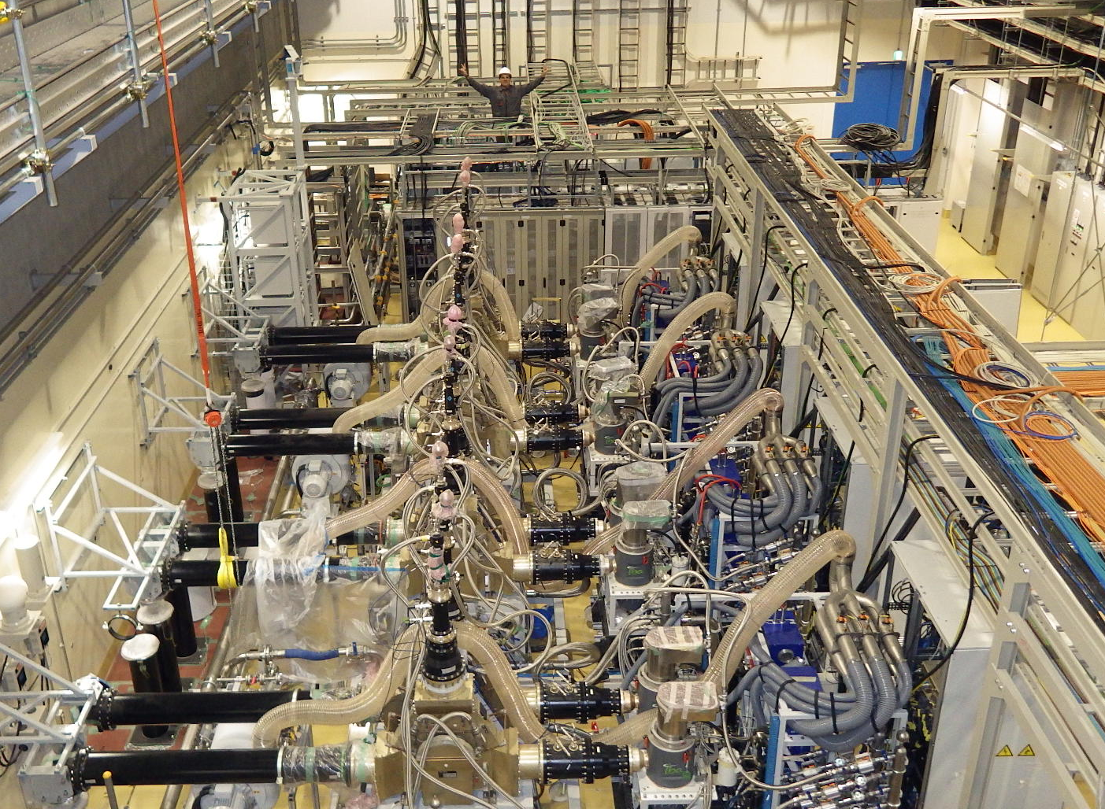
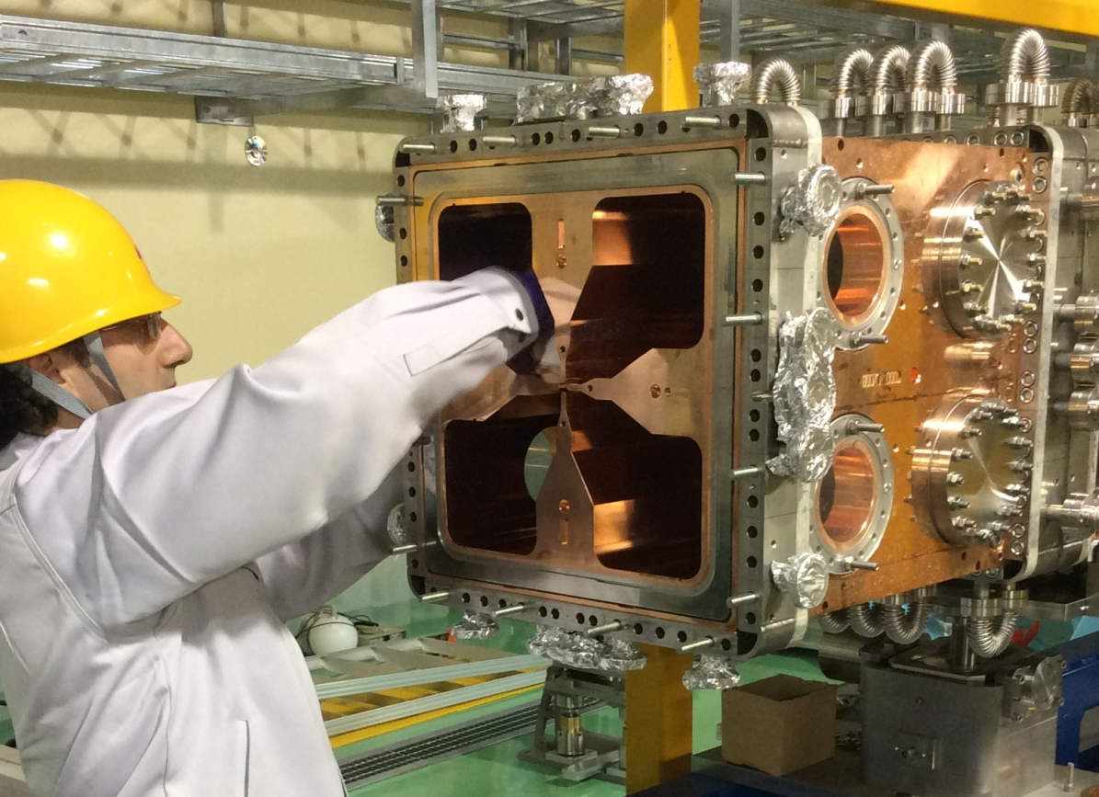
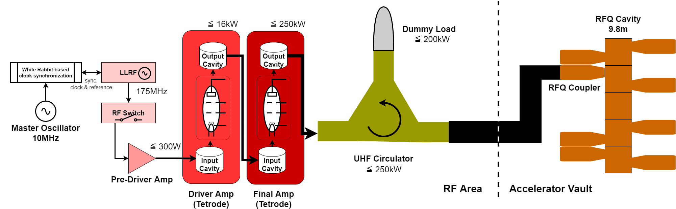
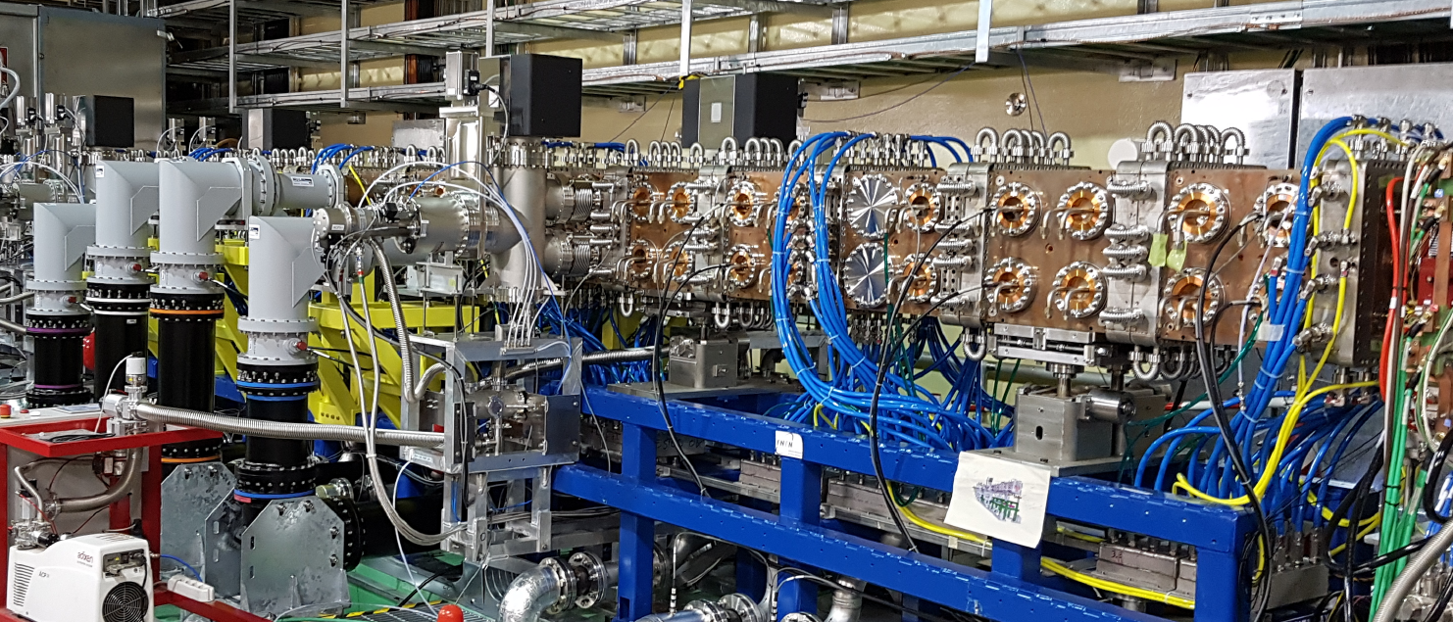
RFQ-RF system
Specification (the 4-vane RFQ, 9.8m as one resonator)
Energy: accelerating from 100 keV to 5 MeV
D⁺ current: 140mA input / 125 mA output
Frequency: 175 MHz
Wall loss : 560kW
Duty: a few 10us pulse / CW
8 chain RF control schematic
Composed of
18 x 0.54 m cells
For 1 amplification chain,
Cavity specification
Q₀ = 13100
R_{sh} = 201 kΩ
β_{L0} = 2.16
132kV vane voltage in nominal
TH561
TH781

Slide 8
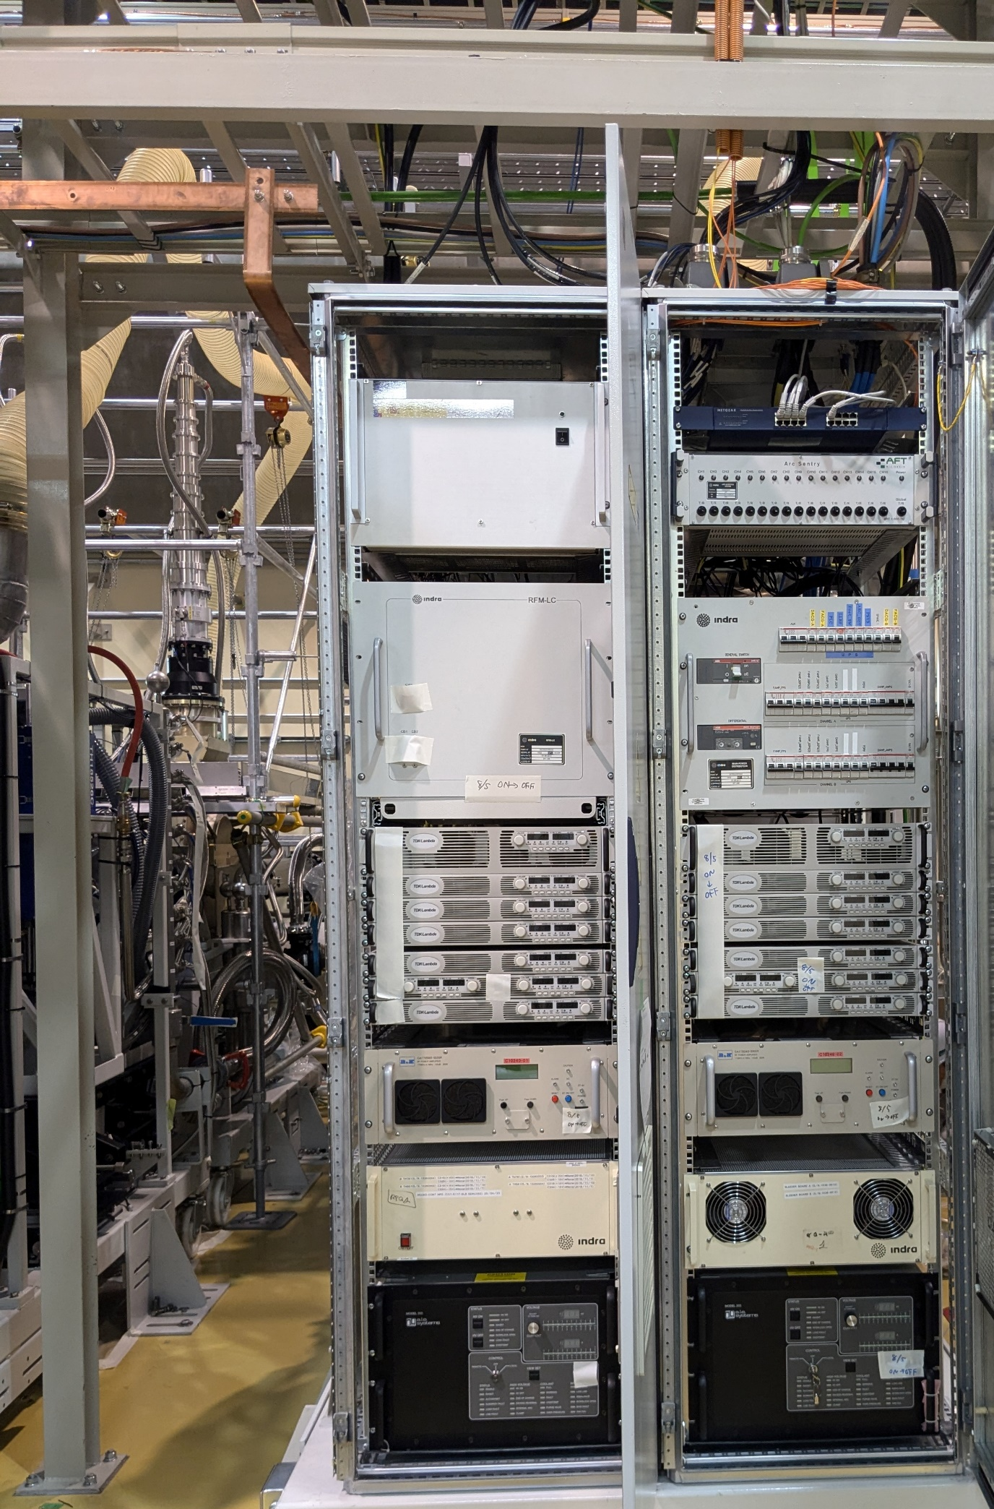
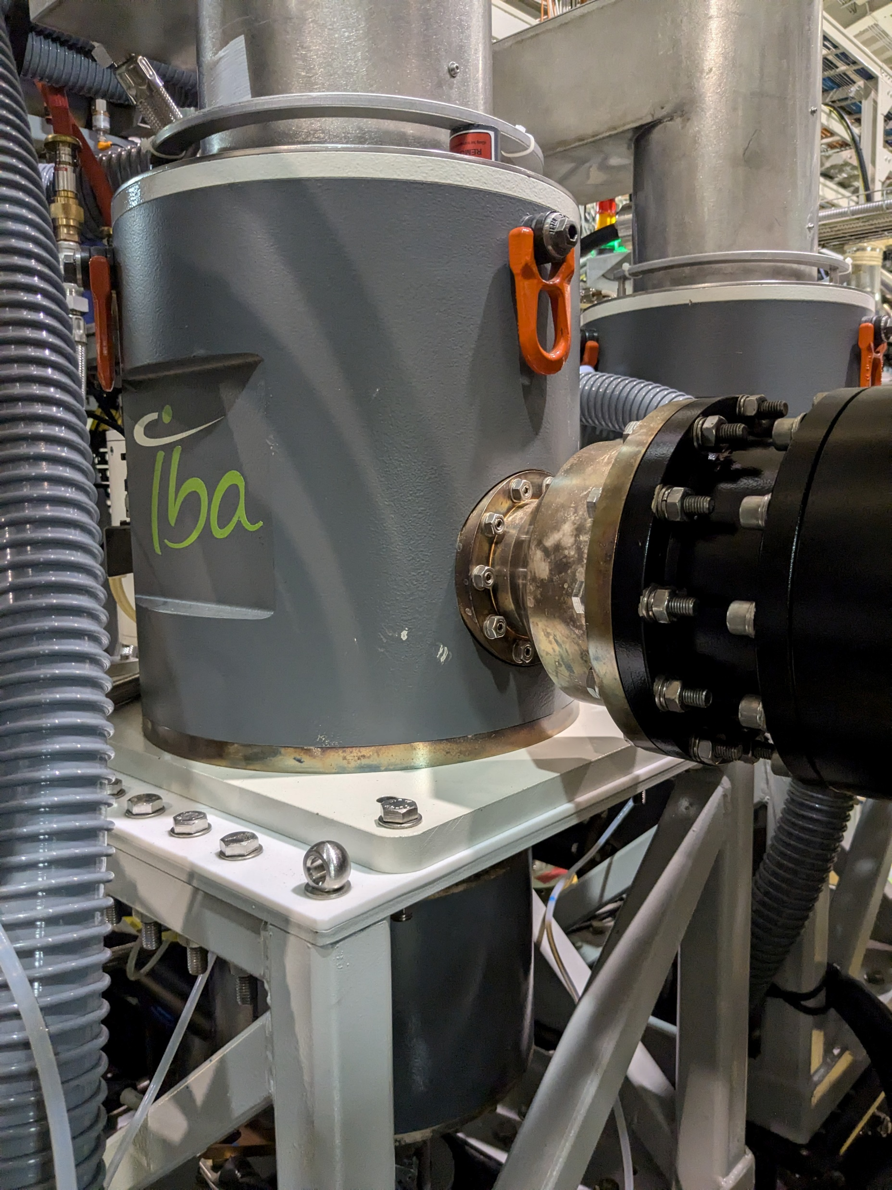
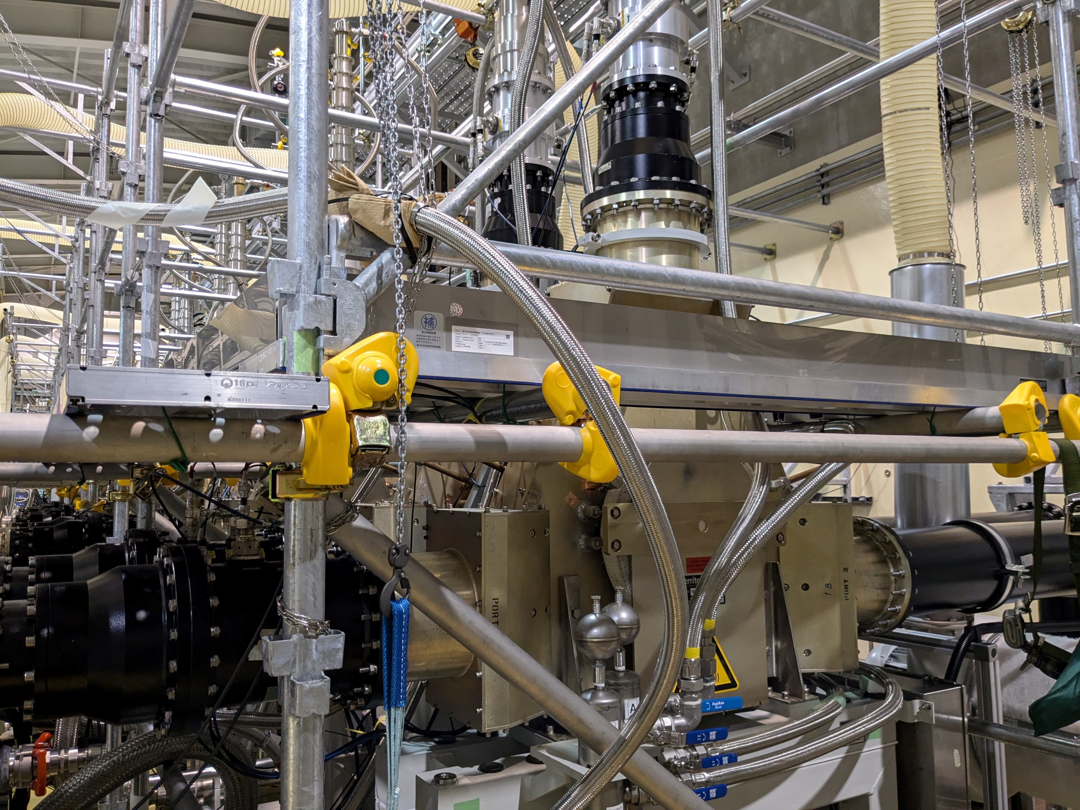
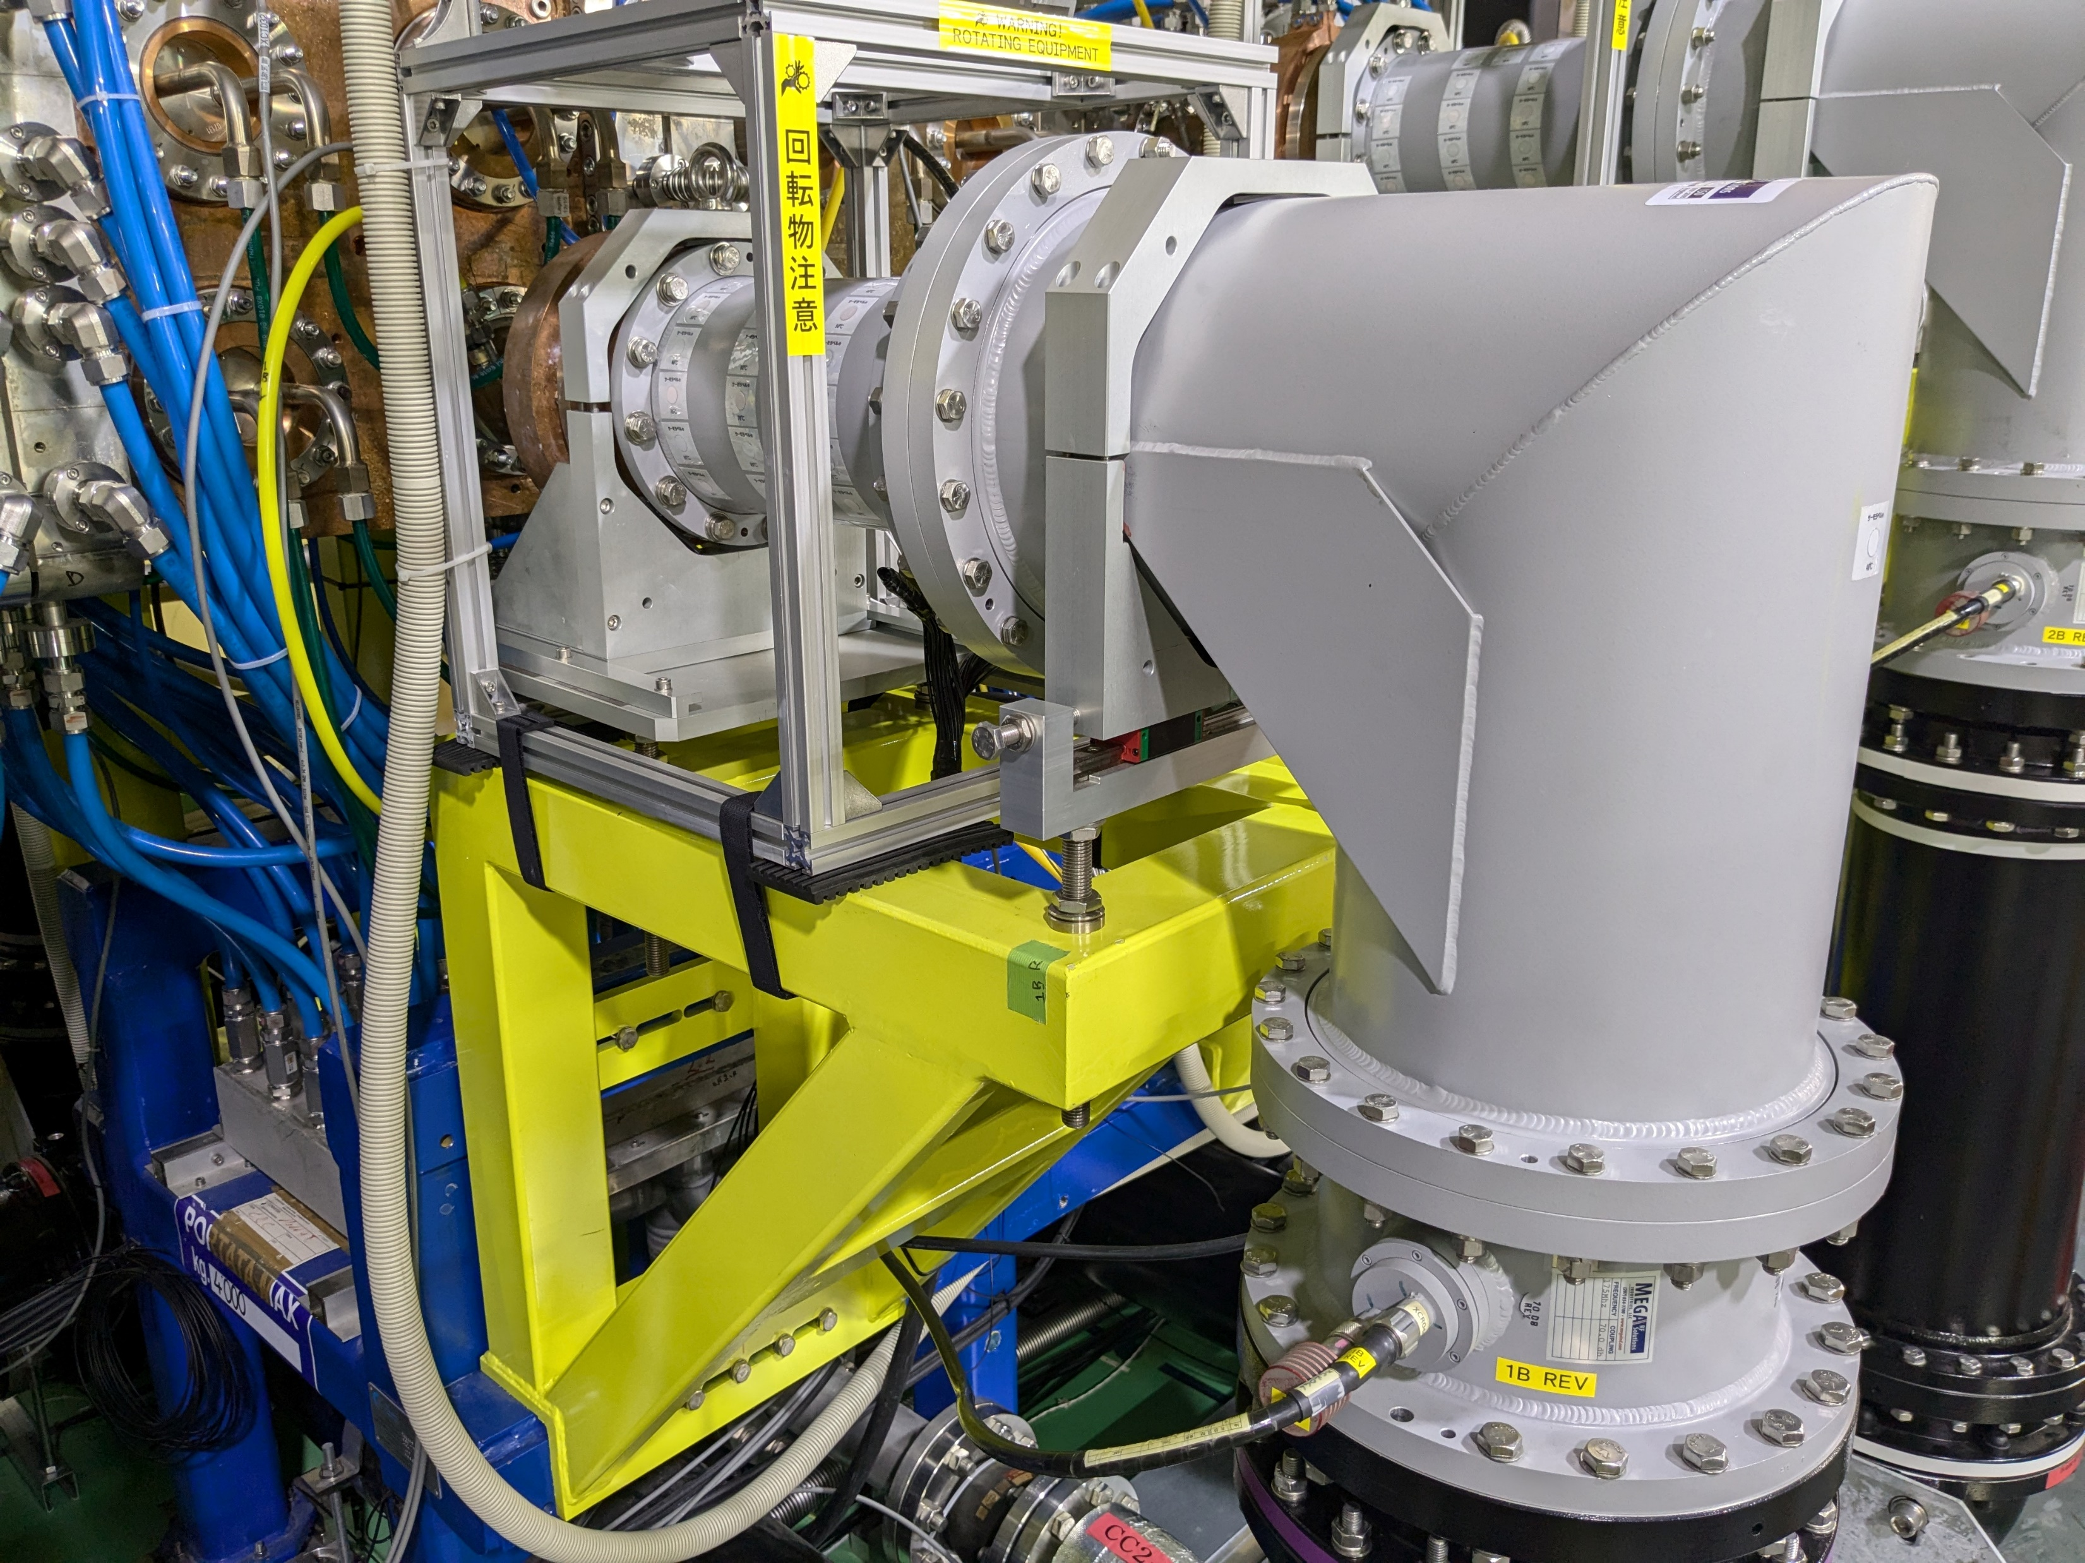
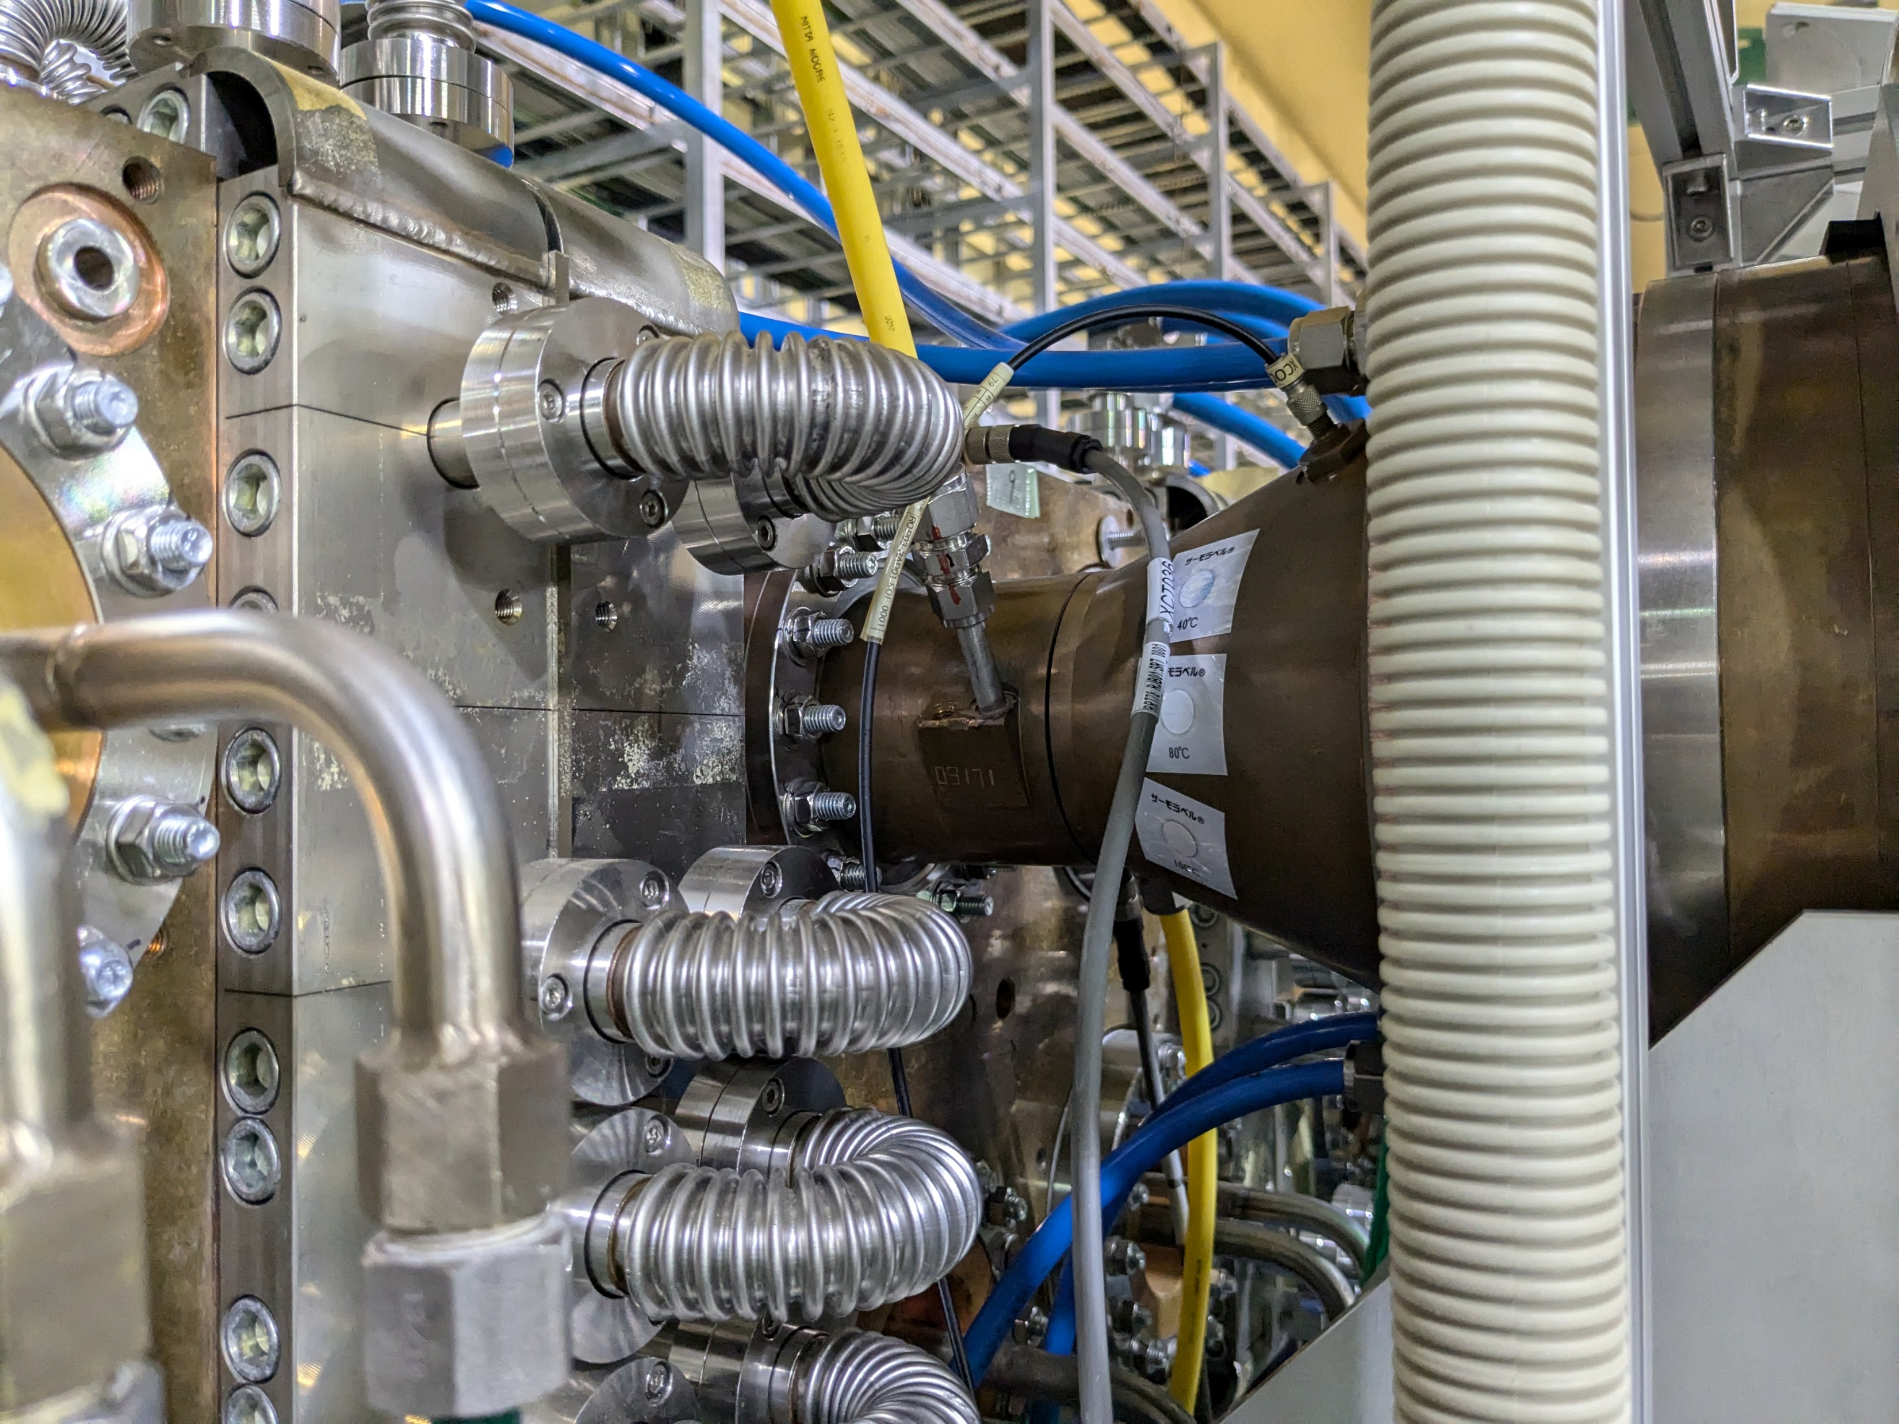
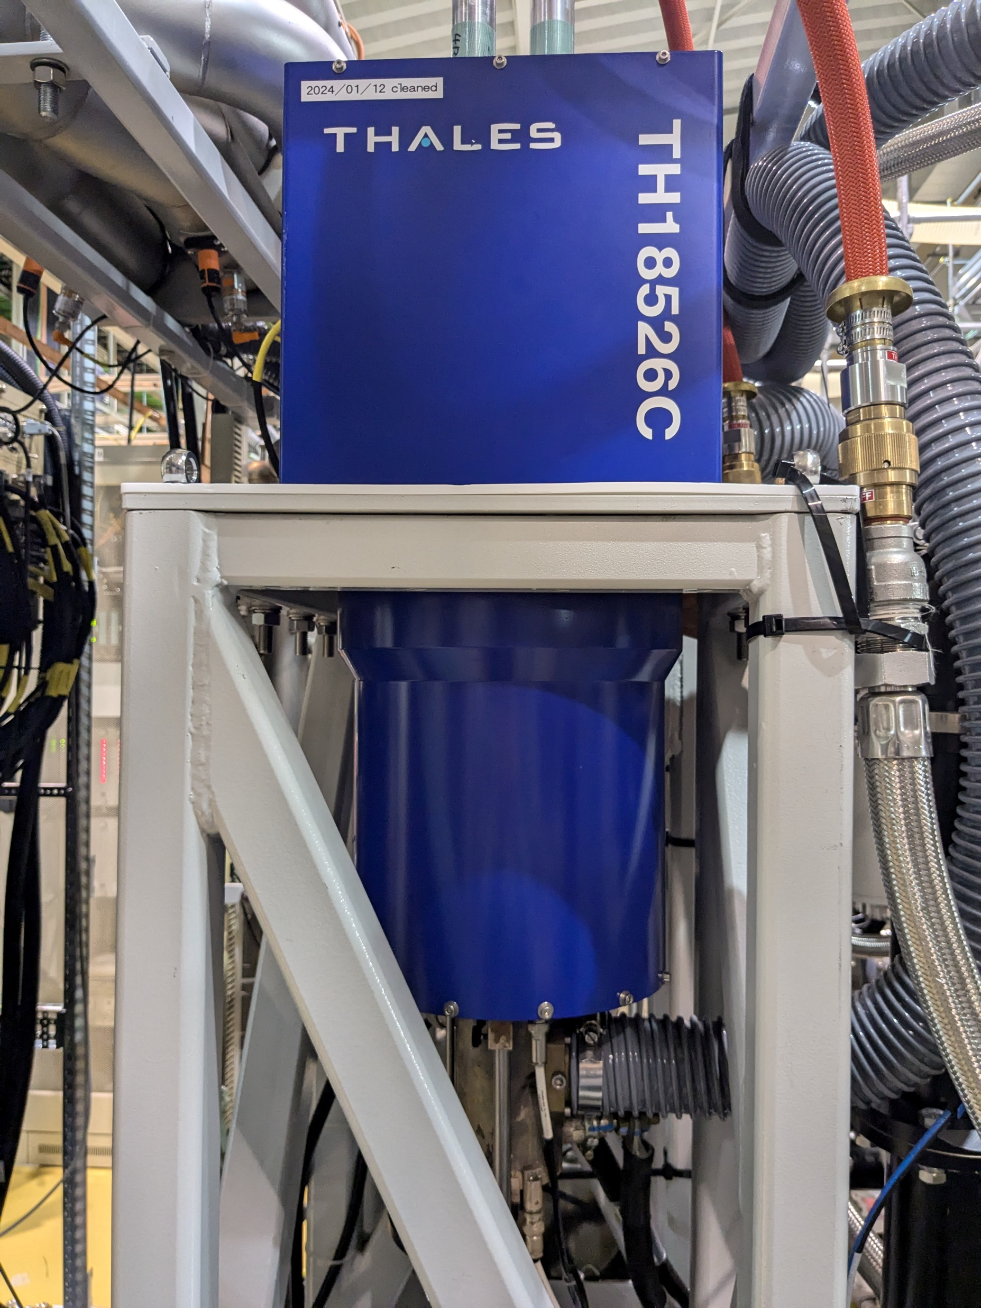
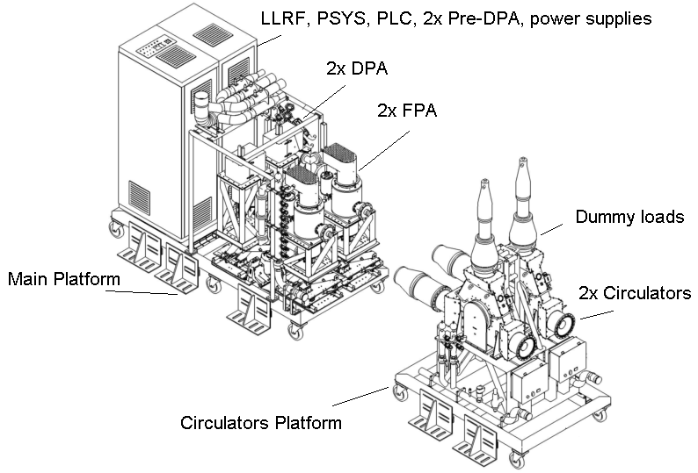
RFQ-RF system
Chain A
Chain B
LLRF
Arc det.
2nd tetrode
TH781 +
IBA cavity
Circulator
PLC
Connection: 9 3/16” coaxial WG
RF input coupler
Pre-Amp
1st tetrode
TH561 +
TH18526C
the 13th Continuous Wave and High Average Power RF Workshop, Knoxville, US

Slide 9
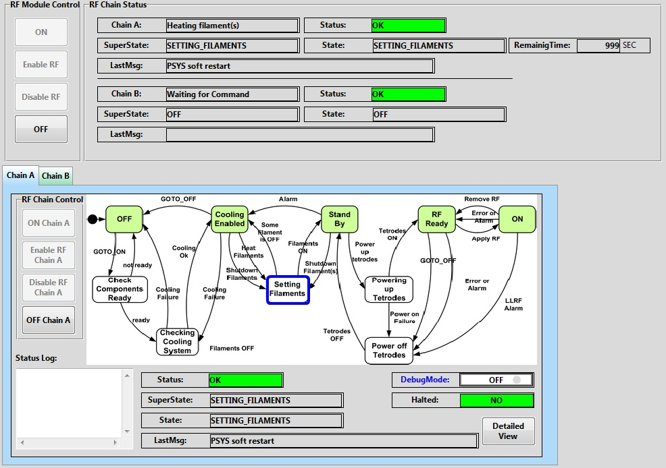
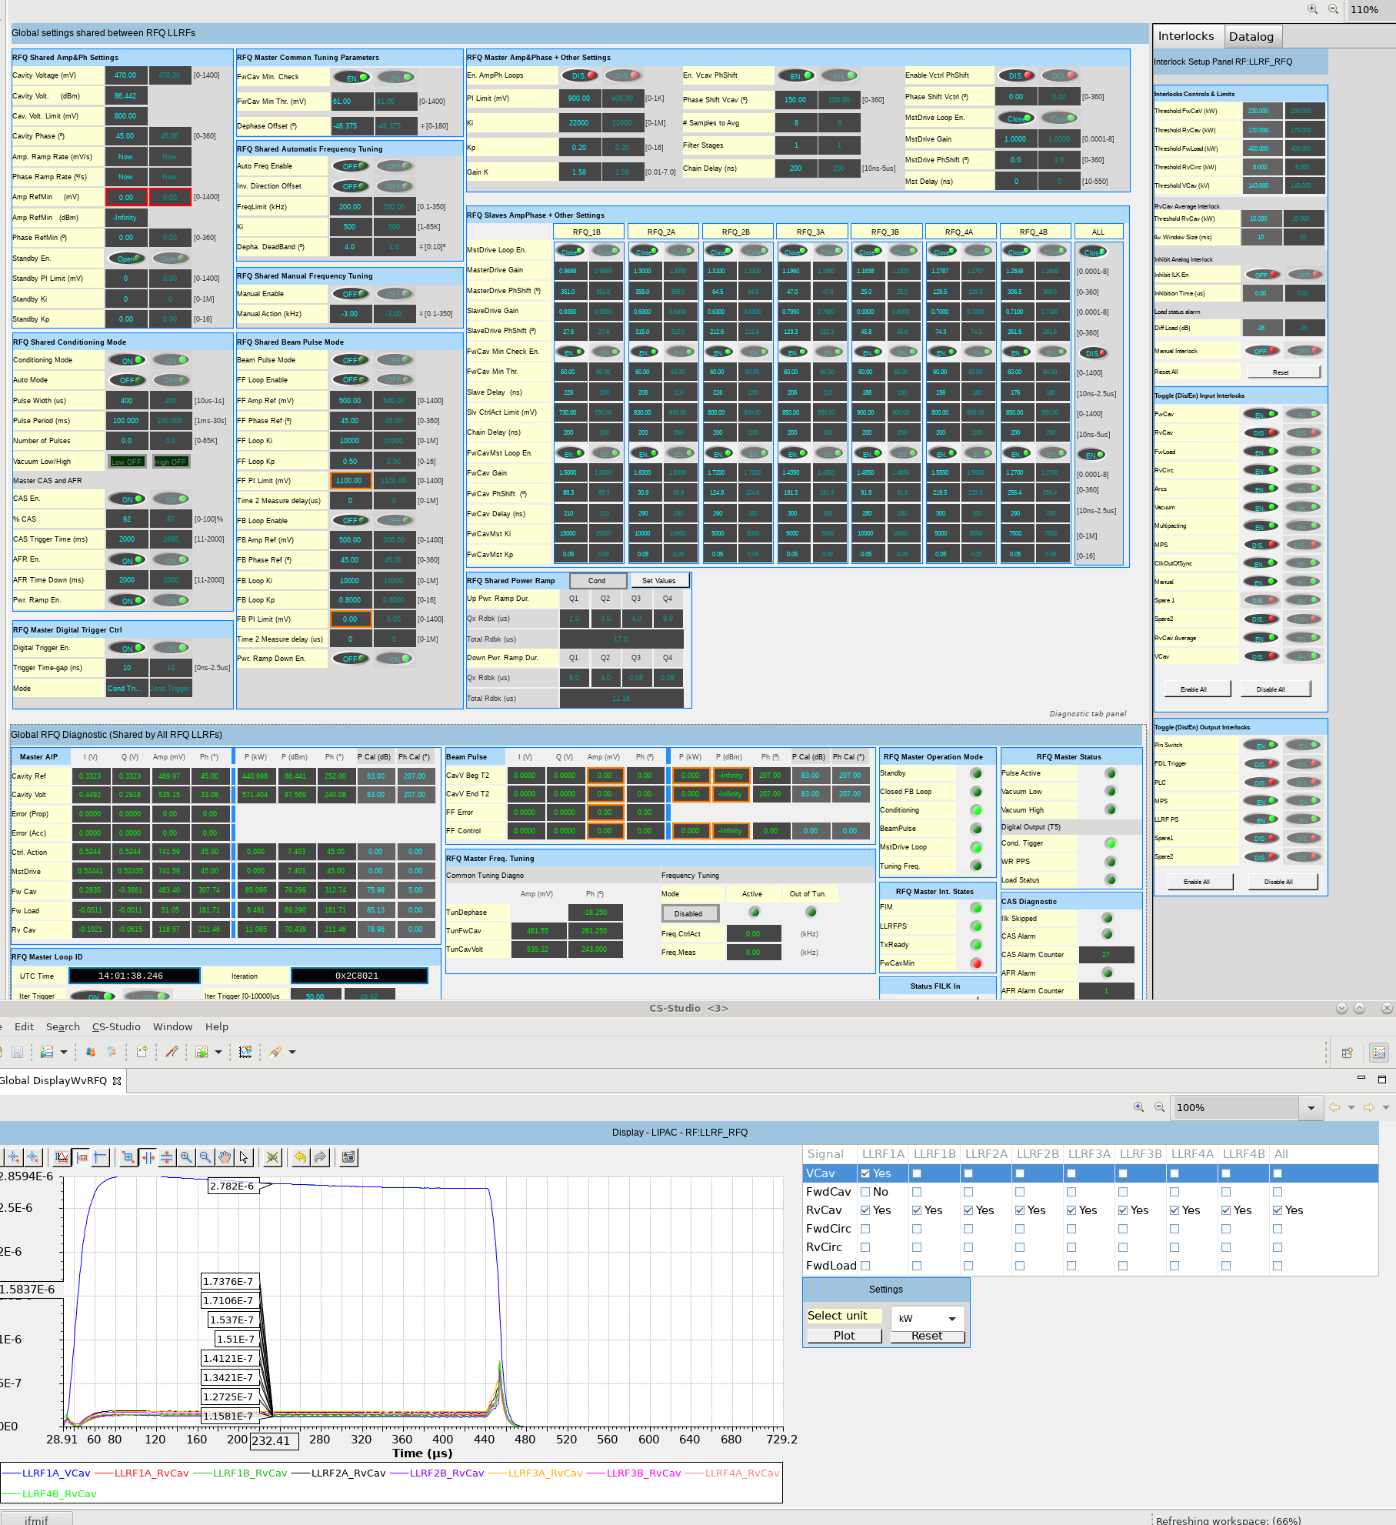
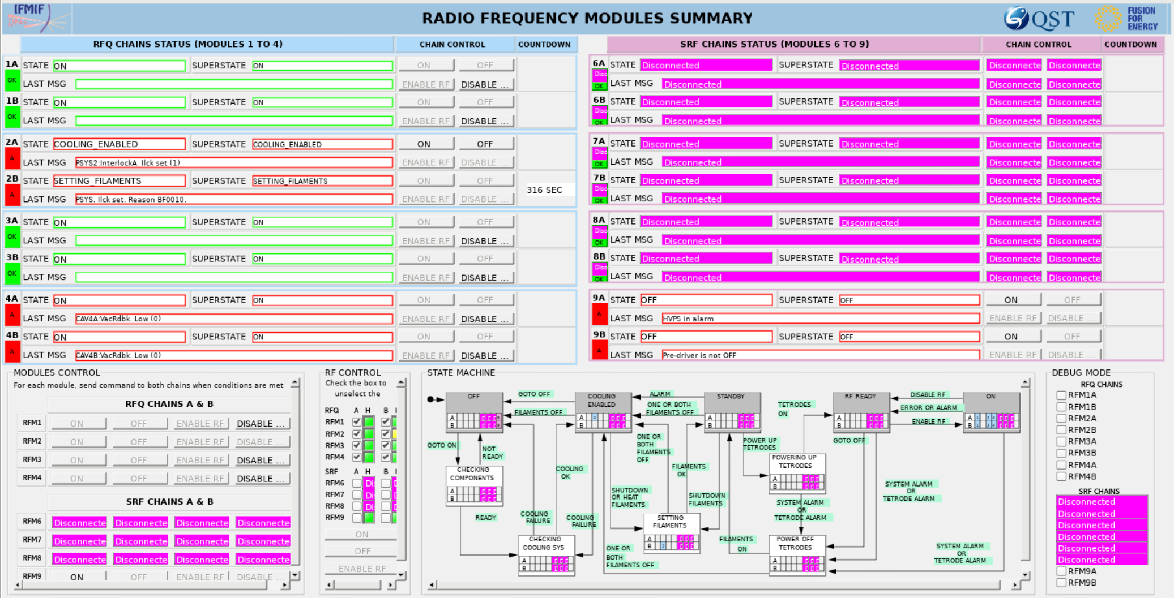
RF control system
RF Amps state machine for tetrodes
LLRF control panel
RF amps control panel
(EPICS IOC based)
Integrated control panel
LLRF control panel (Leader-follower mode)
Waveform viewer
(Direct sampling of 175MHz.)

Slide 10
Outline
LIPAc and its RF system Overview
Commissioning of the RF system
Topics from lower DC to CW in the LIPAc
Future plans for the improvements

Slide 11
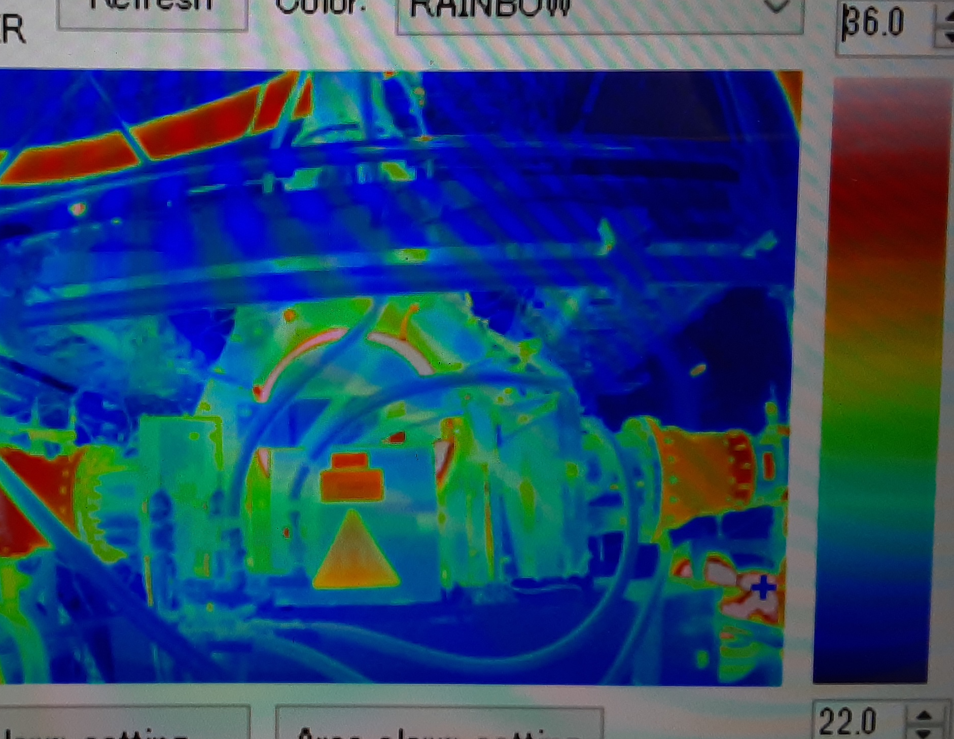
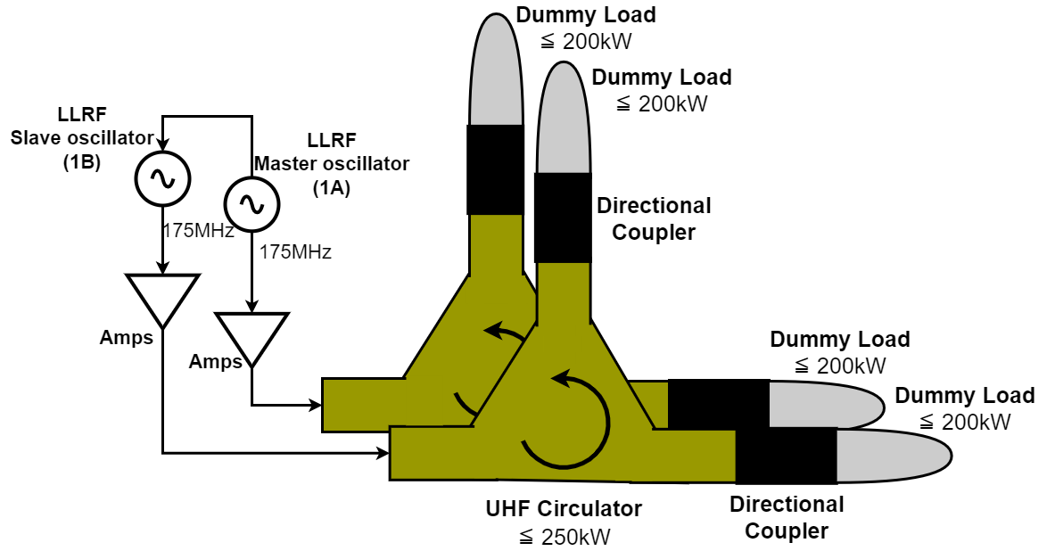
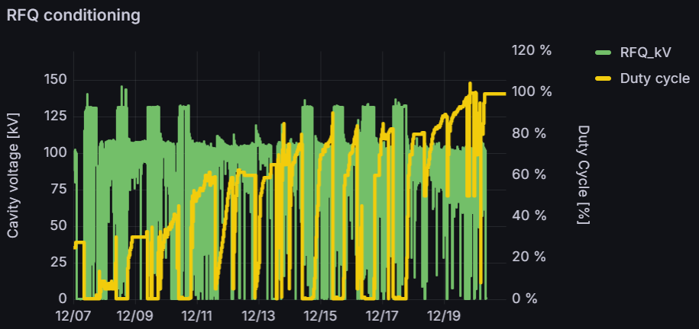
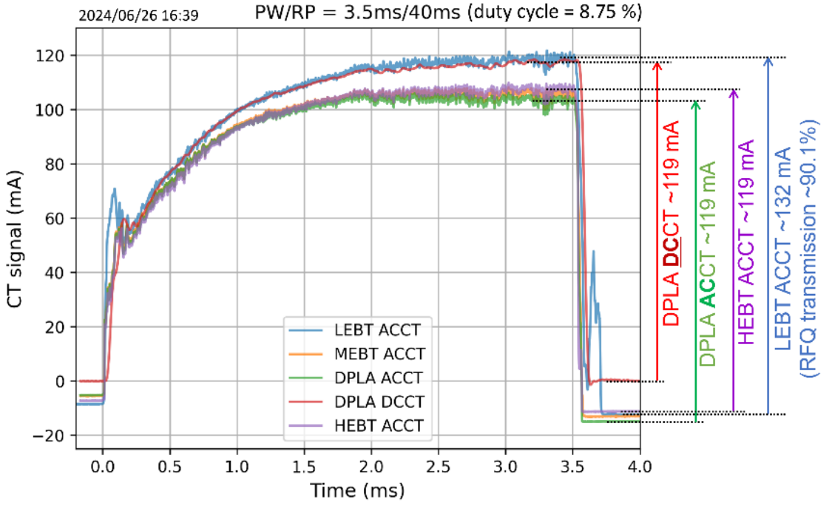
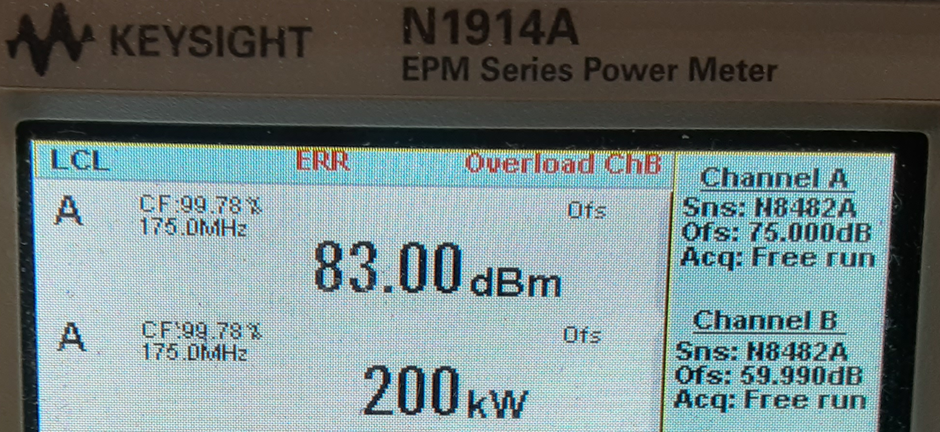
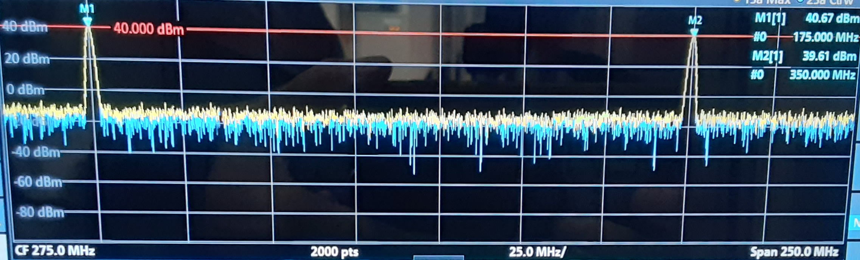

Commissioning plans
Commissioning of the system
For RF stations
For RFQ
For beam
132kV
106kV
Checked the system up to 200kW-CW.
Studied for the thermal cycles for high DC.
Reached to CW with 106kV (80%) voltage.
Two major issues to block increasing voltage.
To be restarted.
Reached to ~119 mA – 8.75% DC for 5 MeV.
Here!
Commissioning and installation plans in present
2020 | 2021 | 2022 | 2023 | 2024 | 2025 | 2026 | 2027-
Phase-B
Construction
Phase-B+
Construction
Phase-C, D
Major
Enhancement
CW Commissioning of the individual system
  > RF, RFQ, Injector
Beam study up to the beam dump (SRF → BT)
New RF input couplers for the RFQ
Superconducting cryomodule
LIPAc full design commissioning
New Injector
New RF Amp.
Connect to DONES
5 MeV 125 mA @RFQ exit, pulsed < 10% DC
9 MeV 125 mA @SRF exit, pulsed → CW

Slide 12
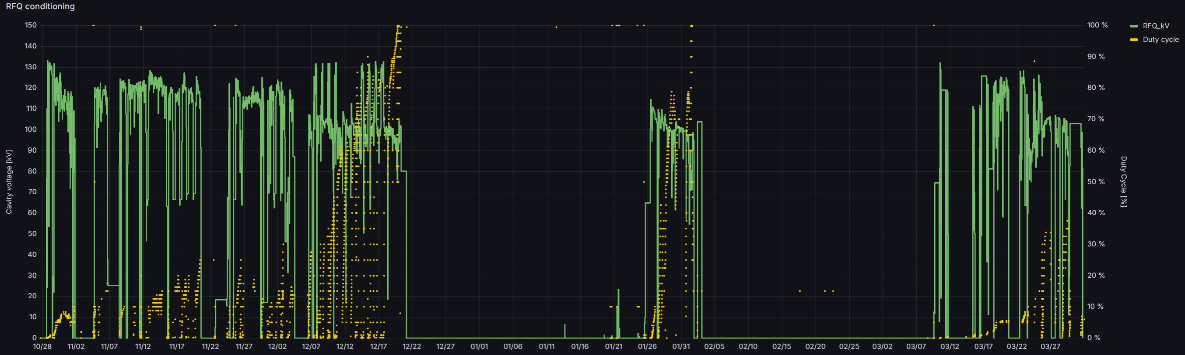
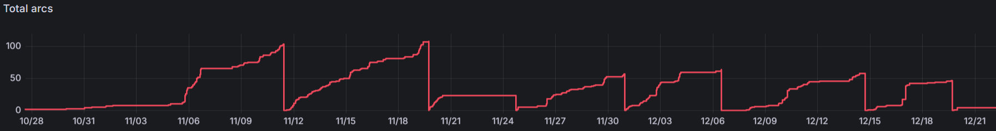
RF-RFQ commissioning
Progress of the conditioning. 24 Hours operation in this term.
Winter break
Maintenance
Plan: First voltage, next DC
10/28
11/07
11/17
11/27
12/07
12/17
12/27
1/6
1/16
1/26
2/5
2/15
2/15
3/7
3/17
3/27
[Date]
Strategy change
→ First DC, next voltage
CW @ 106kV!
(80% of nominal)
Circulator discharge
Conf. change
from 8 chain to 7 chain
RF coupler vacuum leak
Arc counter in the commissioning term

Slide 13
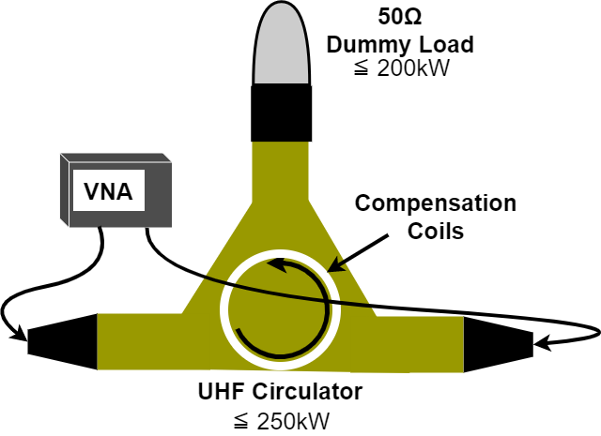
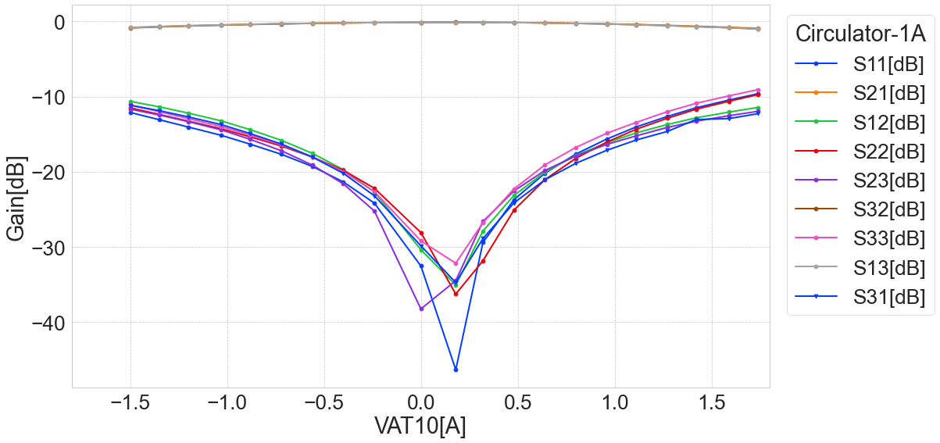
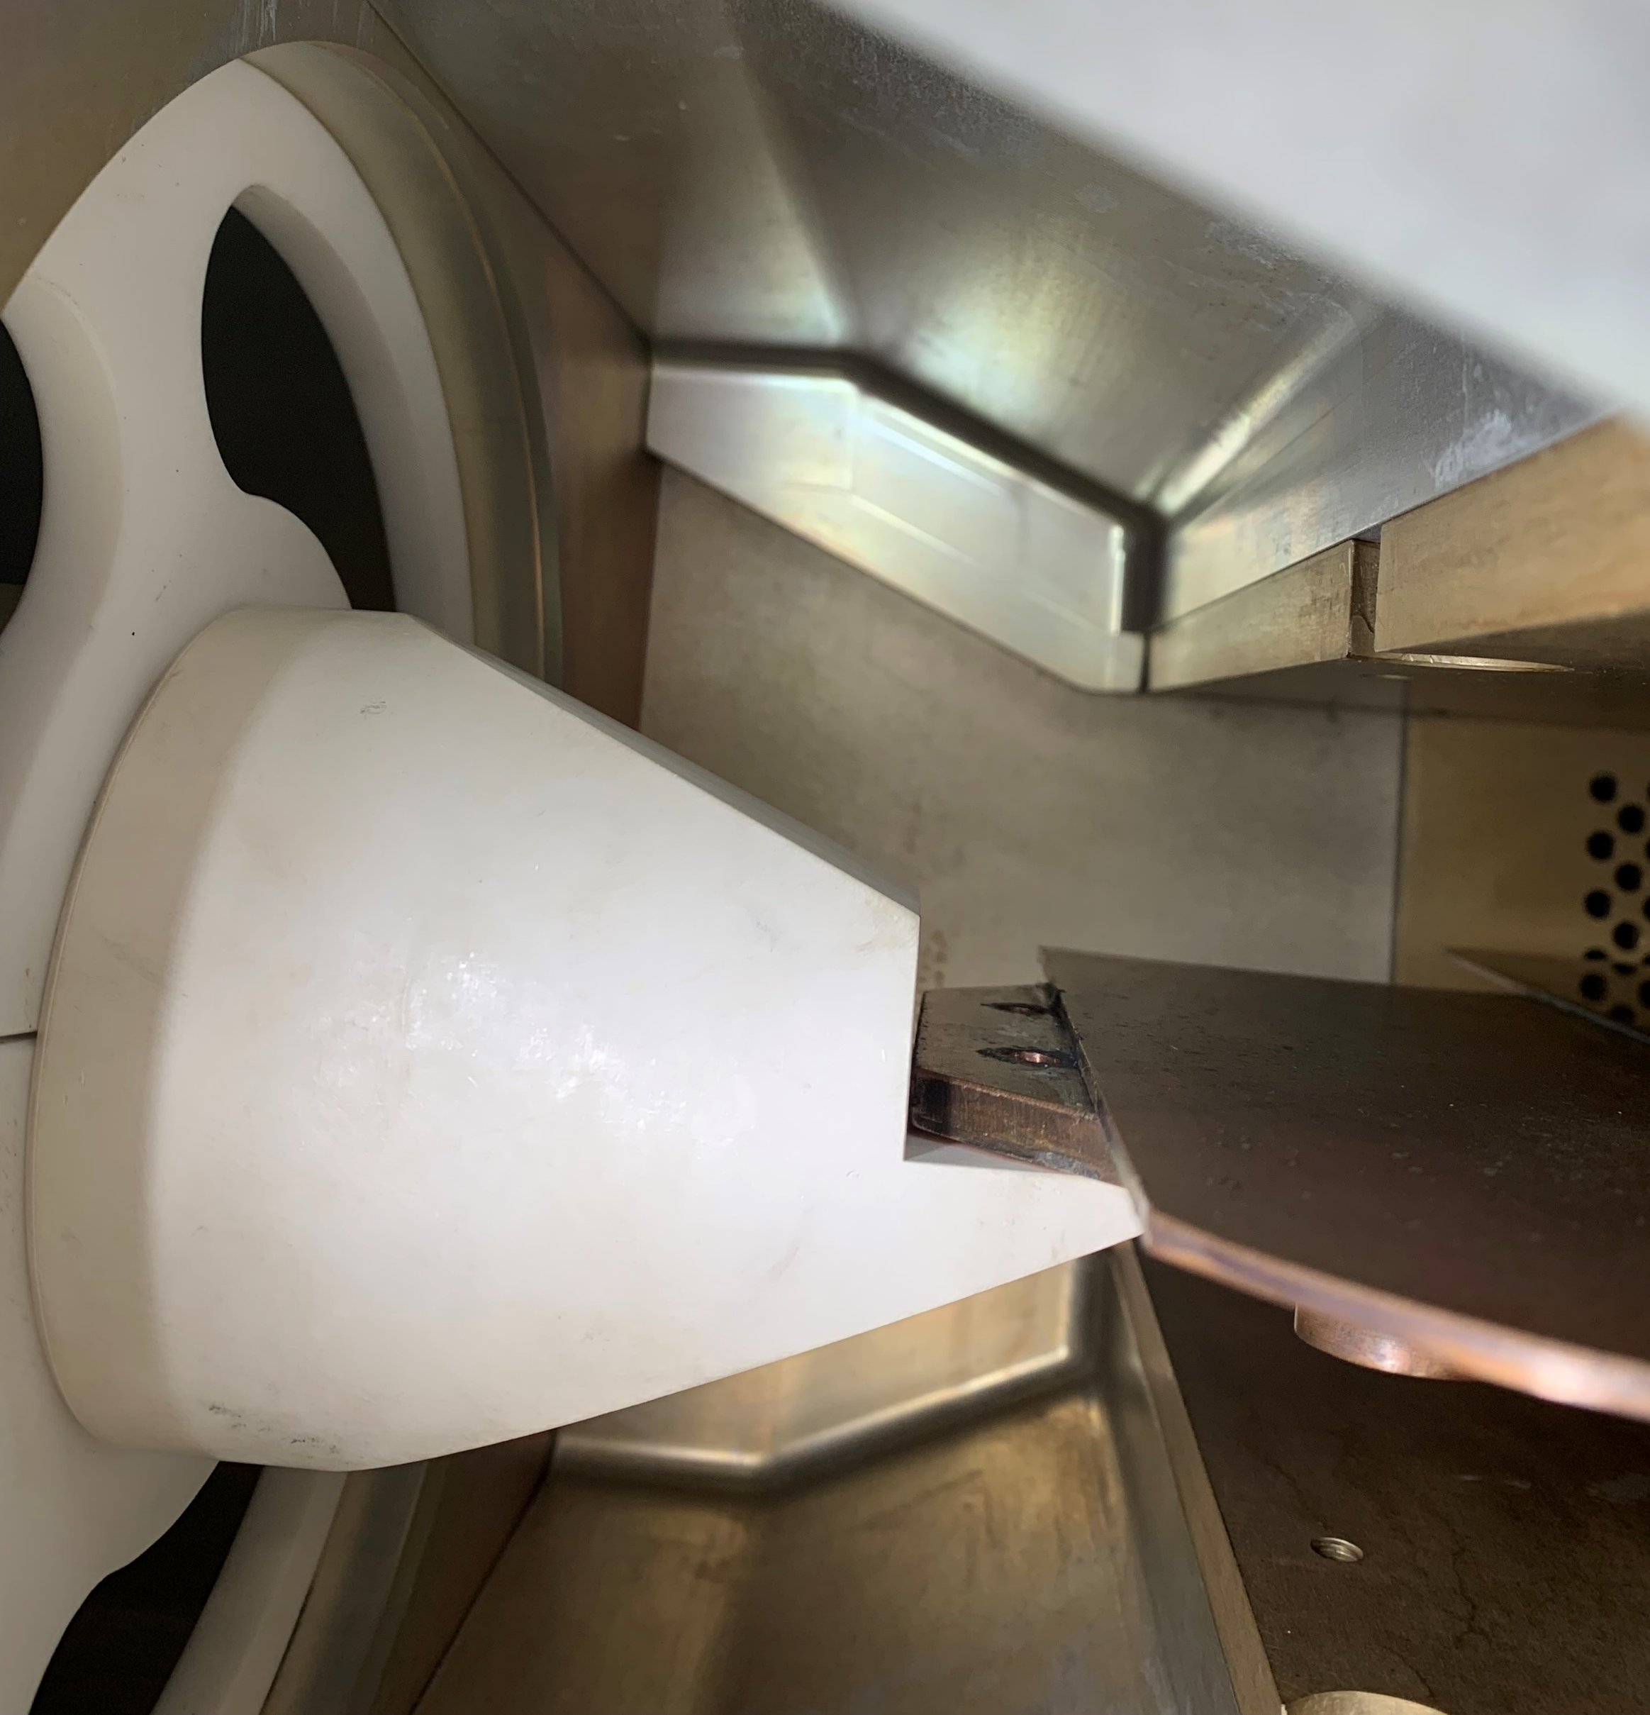
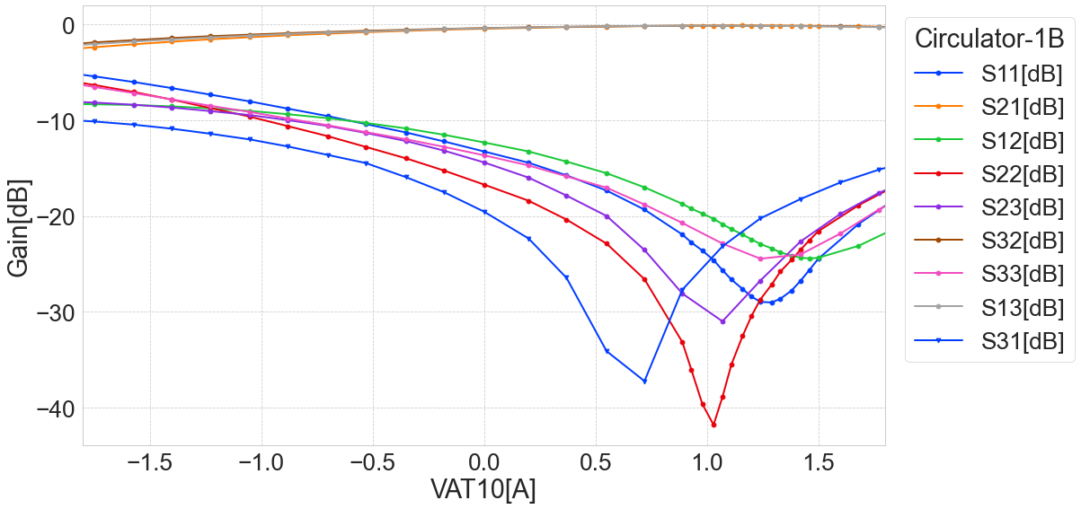
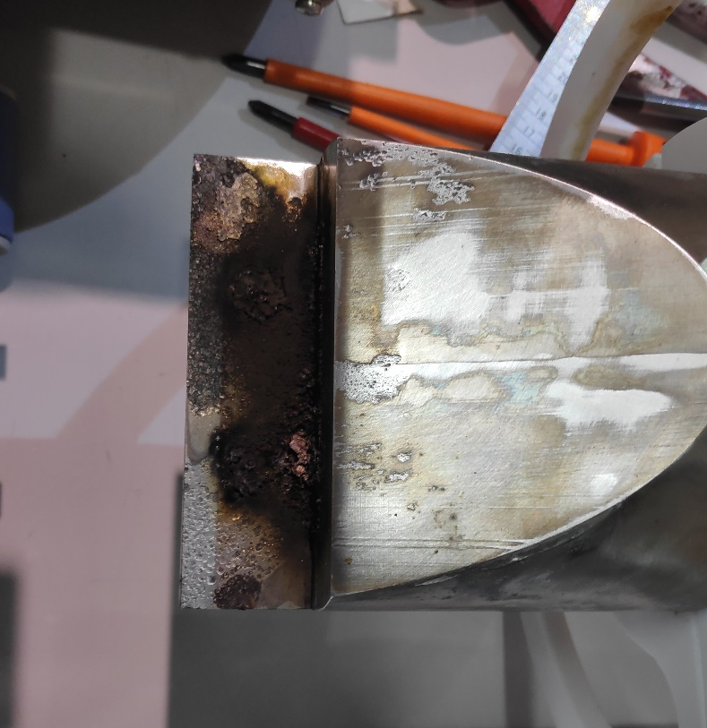
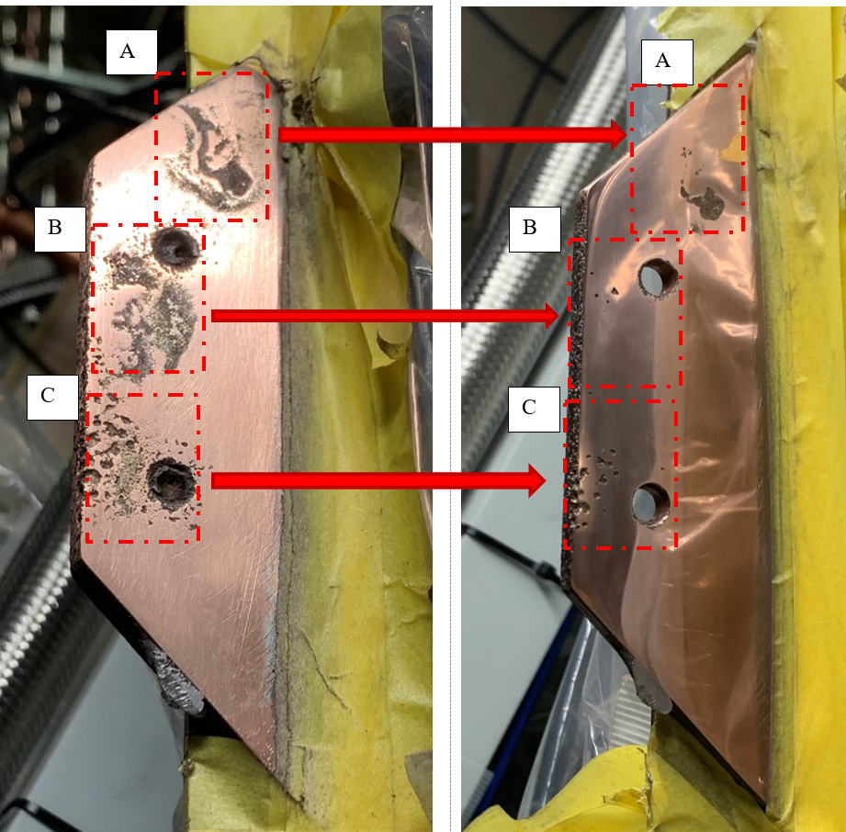
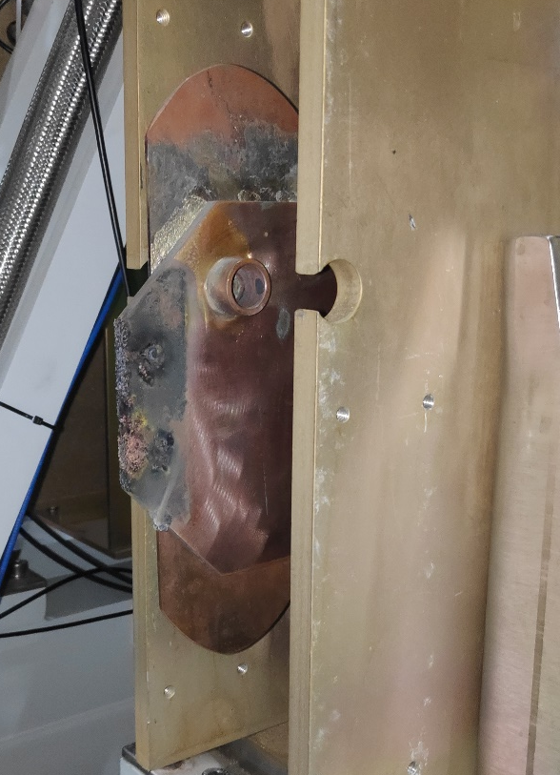
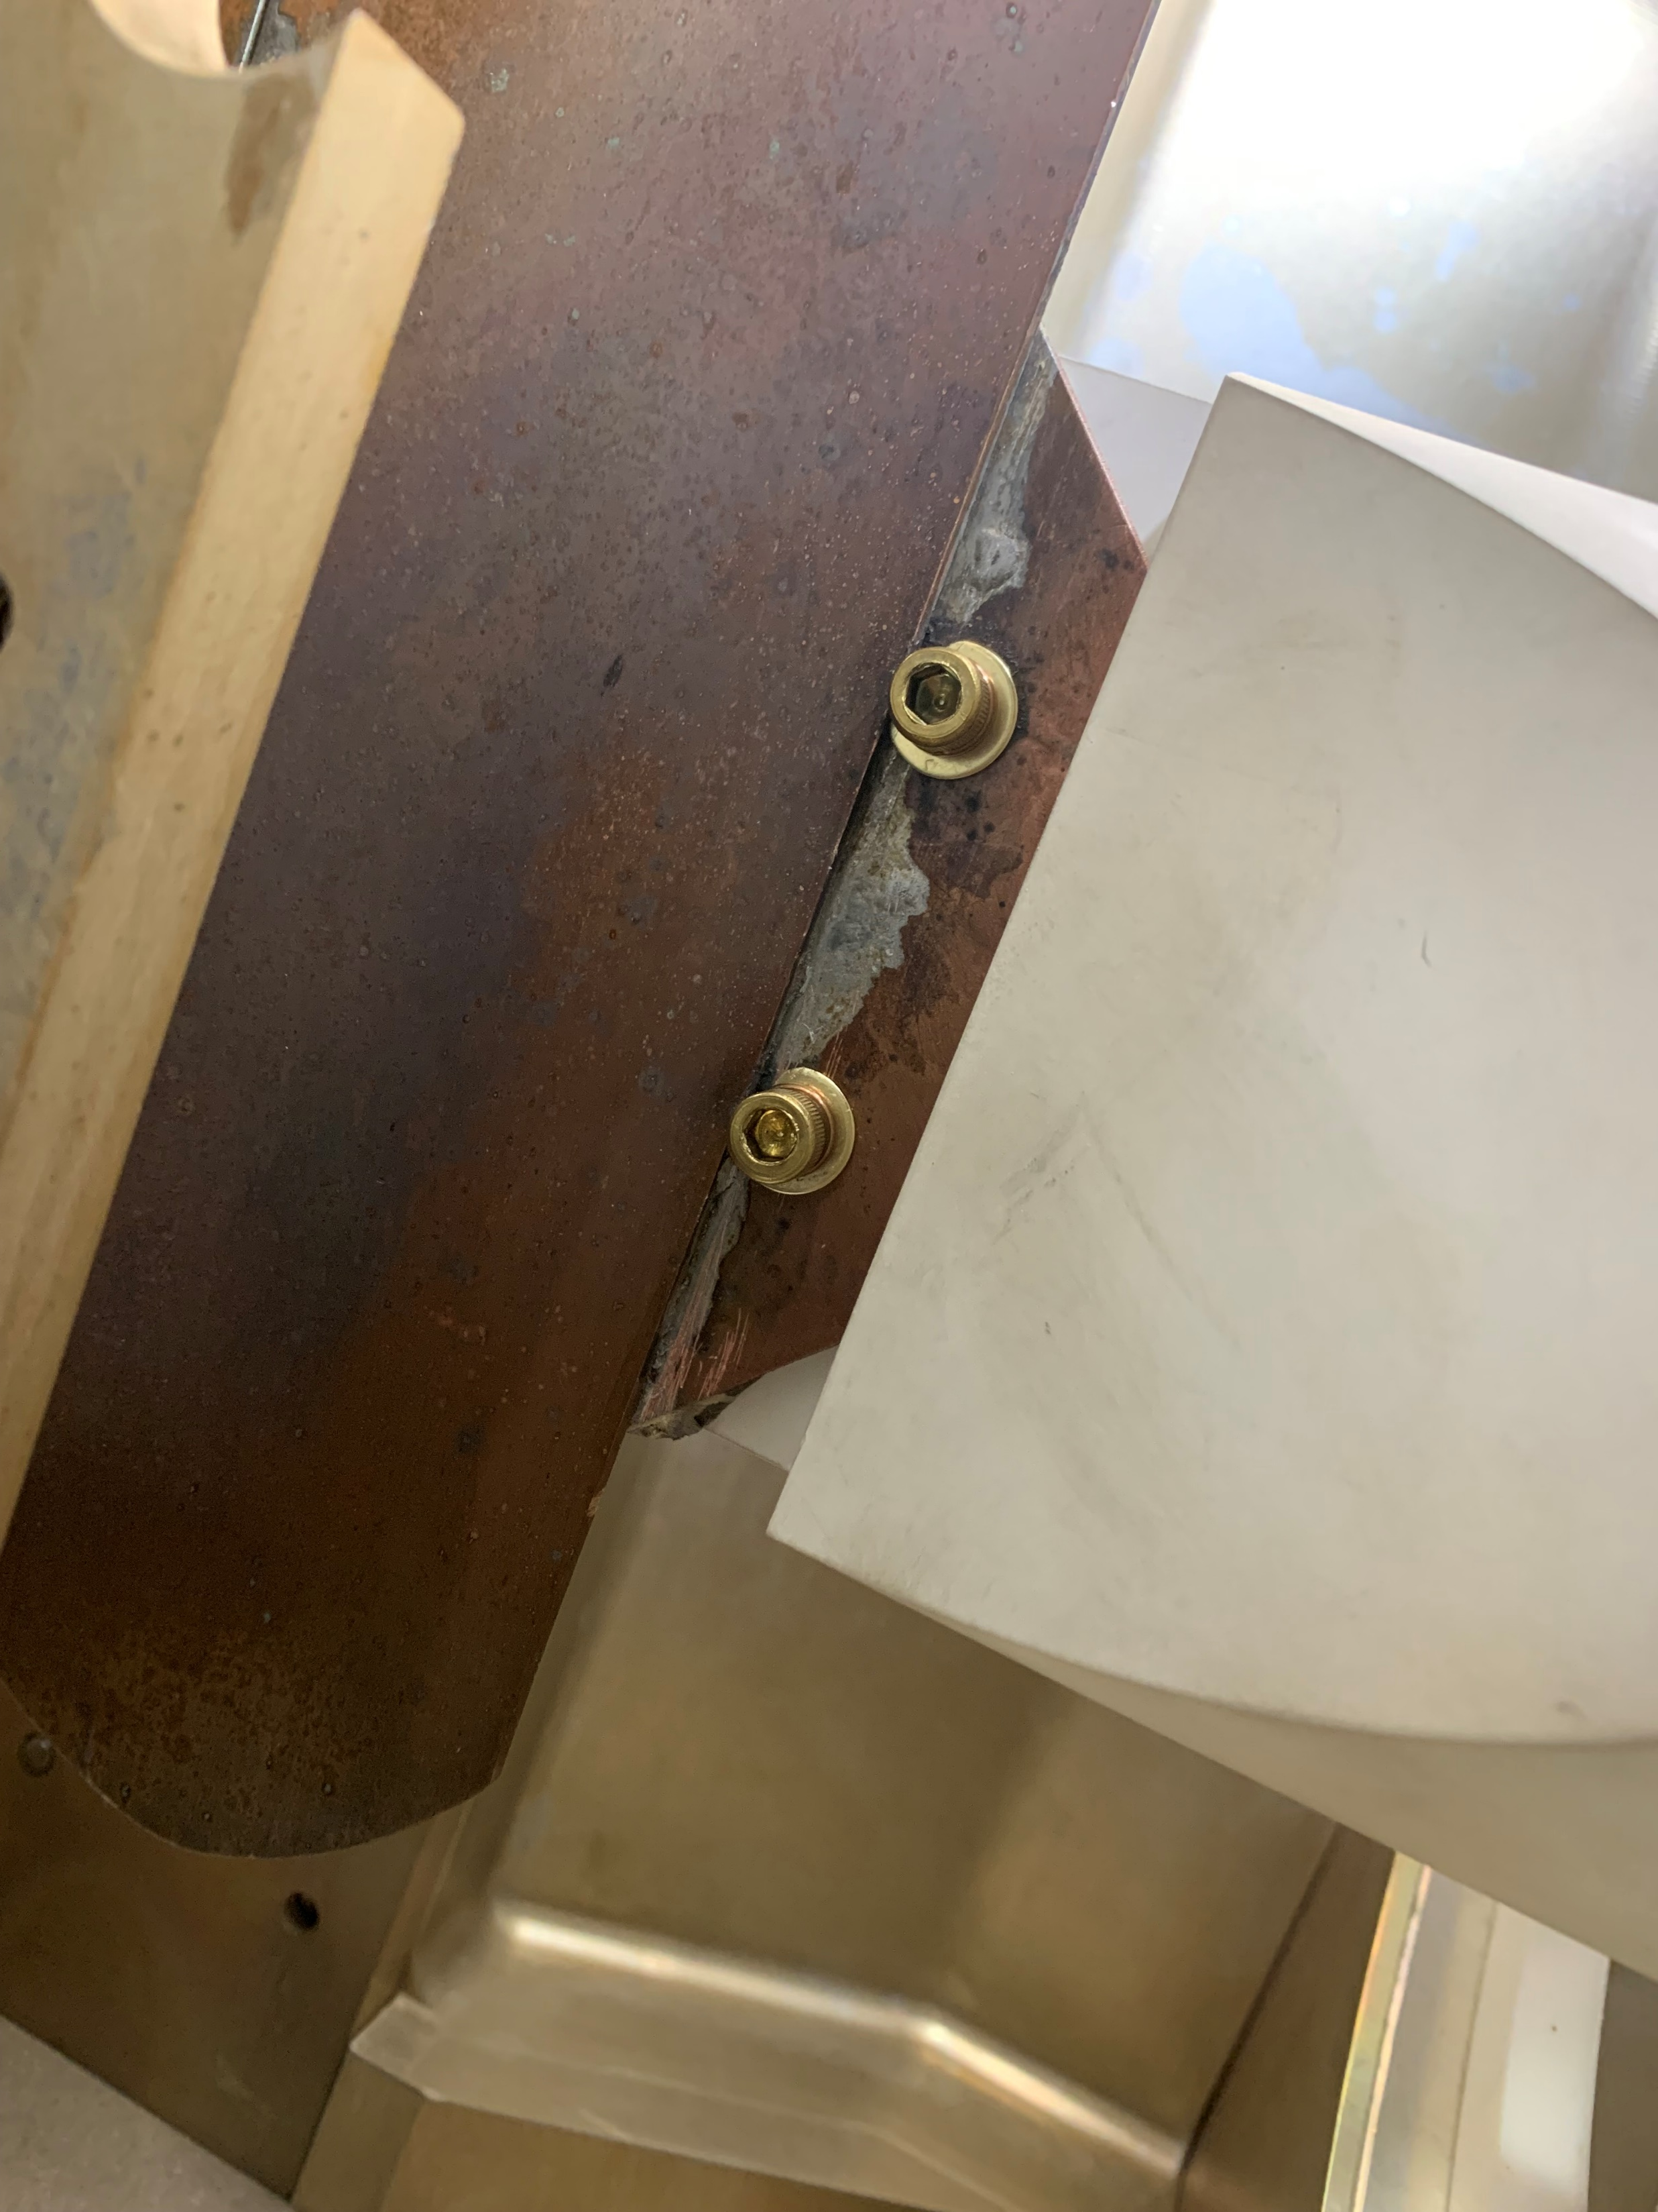
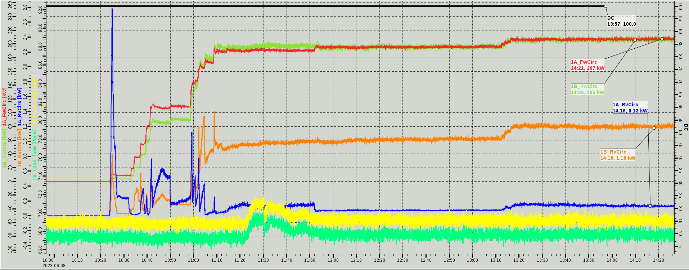
Challenges in the RFQ operation
Circulator trouble
Circulator challenges
Onsite VNA test
Burned transition of Coax. - Stripline
Cause: different thermal cycle of copper and stainless steel.
Repair: cleaned/replaced broken parts and screw material SUS → brass
Port-1
Circulator:1-A
repair
Circulator:1-B
Jan/2022
repair June/2022
High-Power test
Input power ~205kW
4 hour
Reflection 0.13kW(1A) 1.18kW(1B)
Factory check July/2022– March/2023
Water flow rate.

Slide 14
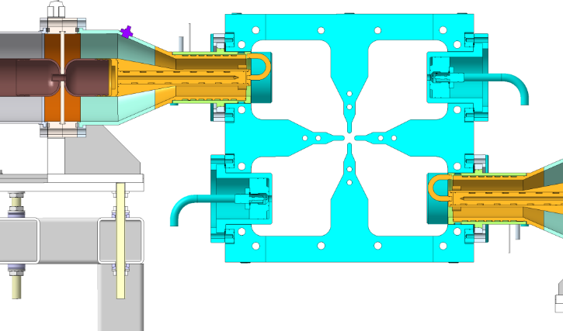
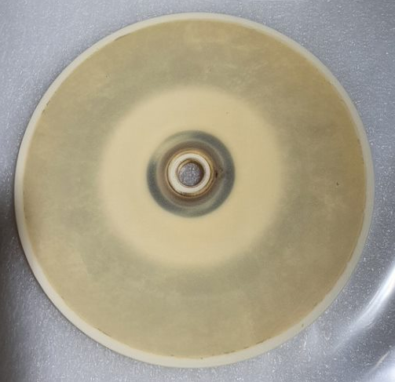
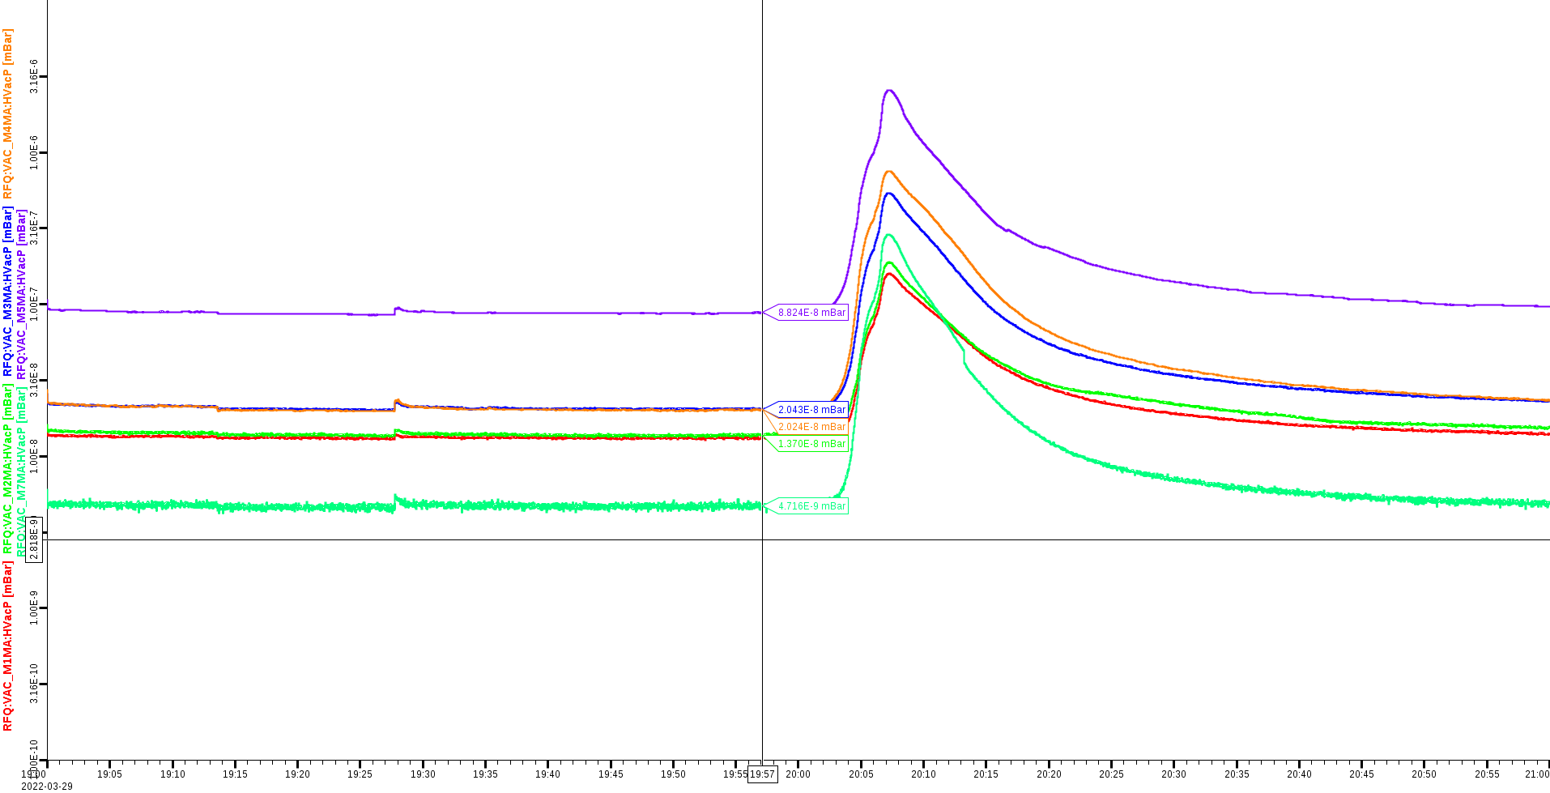
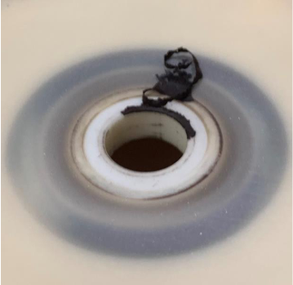
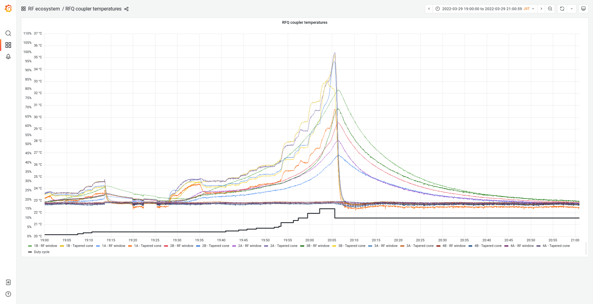
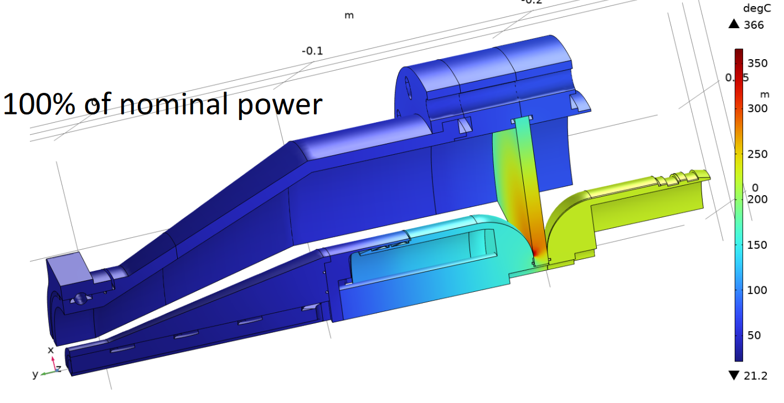
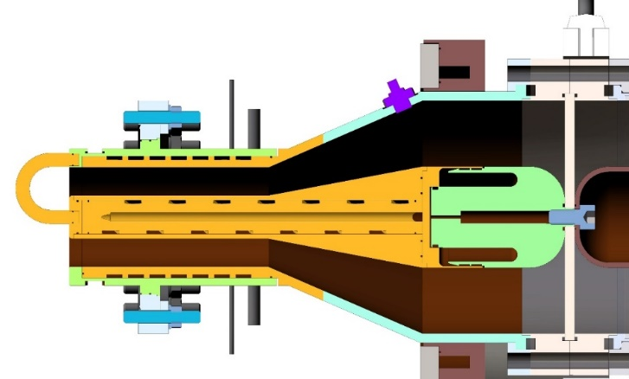
Challenges in the RFQ operation
RF input Coupler challenges
3 10⁻⁶
mBar
RFQ vacuum
RF interlock
10⁻⁸
mBar
45min
RFQ and coupler in section
36℃
Couplers surface Temperature
RF interlock
Melting Viton O-ring
To remove the ohmic losses, we modified units for cooling enhancement
3B
23℃
Just after the RF feeds stop, vacuum started to be deteriorated.
Vacuum response looks coming from the thermal deformation.
RF ON
RF OFF
Temperature was still increasing, but we observed the cause is multipactor.
→ Now we test the other RF coupler for the future operation.

Slide 15
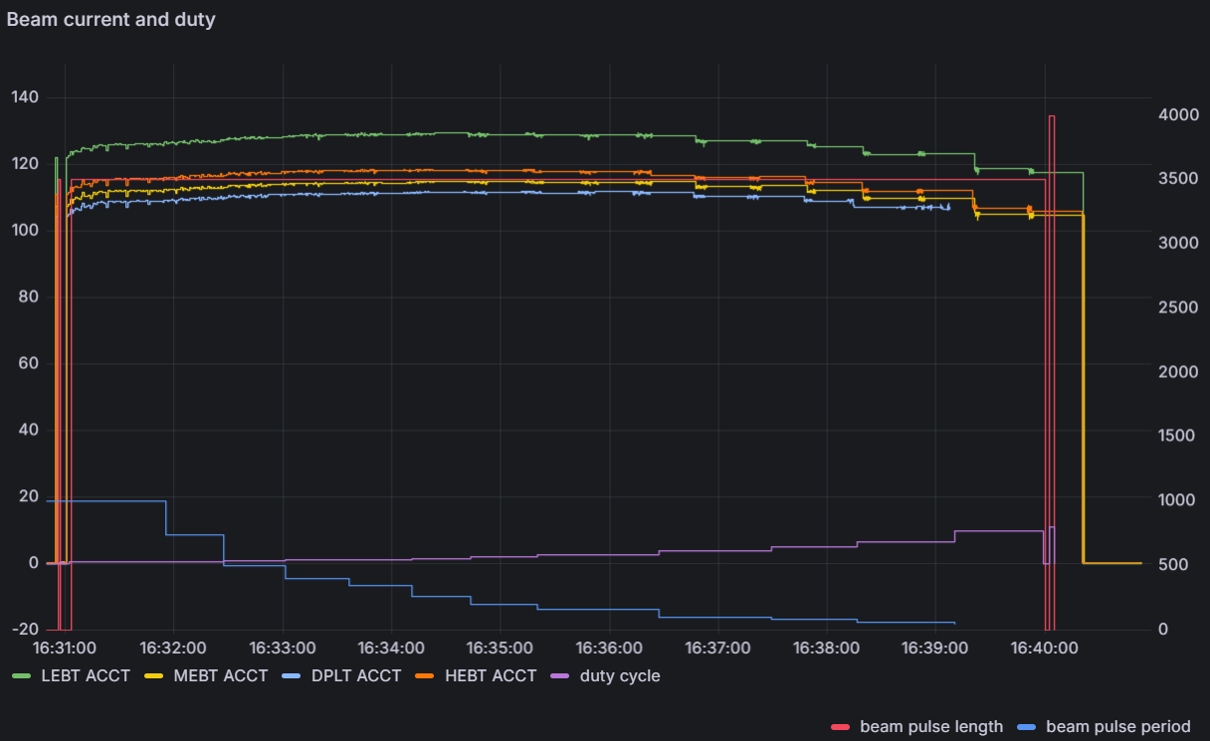


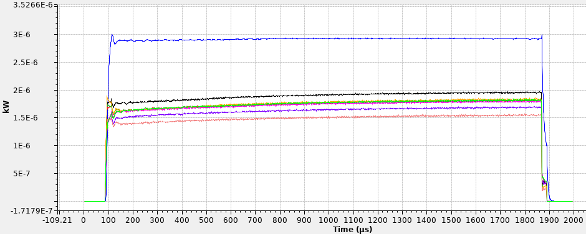
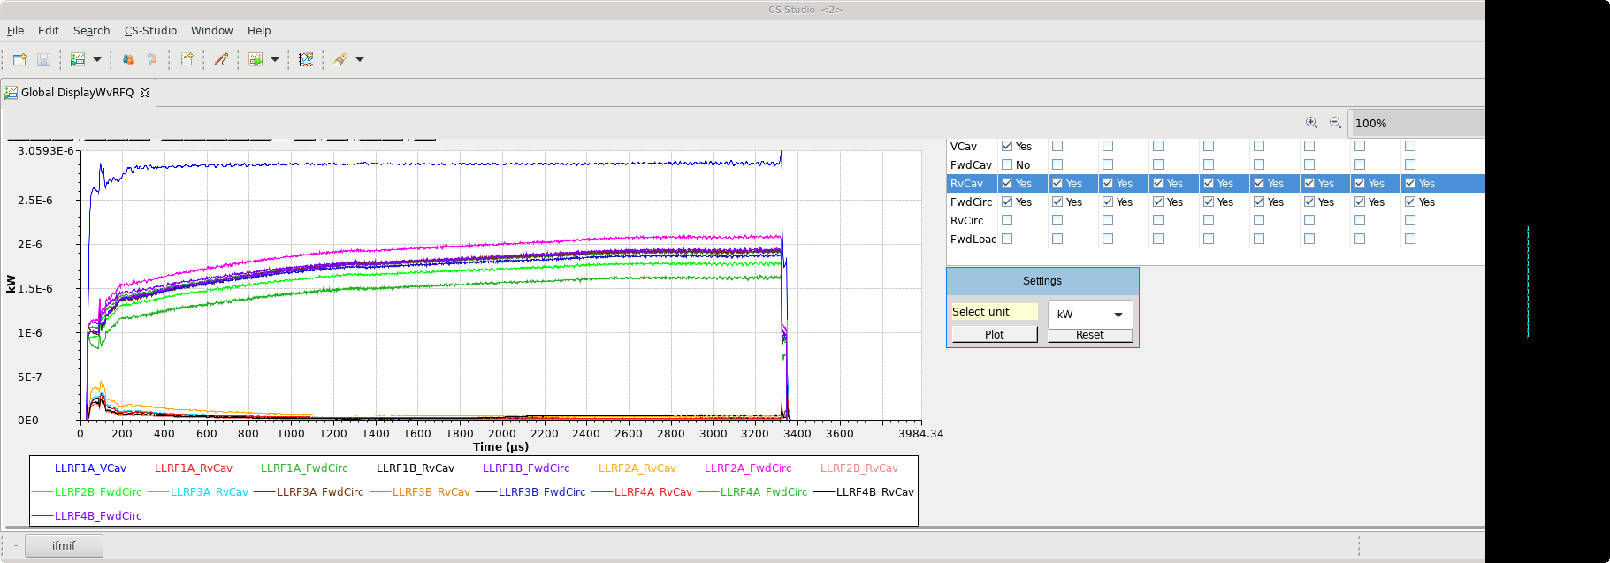
RF-Beam commissioning
Notes for RF control method
Short pulses < 3 ms → chopped beam operation
Fast ramp rate
  Requires feedforward tuning for beam loading transient.
  Dependency of the duty cycle in the transient shape.
Less fluctuation in the pulse head
  Less interlock due to the over voltage.
Long pulses > 3 ms → unchopped beam operation
Slow ramp rate
  Feedback control is enough to follow the slow transient.
More fluctuation in the pulse head
  Random jitter of beam head.
  Sometimes lack of beam pulse from our expectation.
Our reached DC in this beam campaign
Interlock triggered.
Reducing rep. rate for the same pulse length
~ 1 min
Less but sometimes miss shot happens
+ pulse by pulse beam current fluctuation
Duty 8.75%
One pulse shape of this part
Chopped beam
Raw beam
Rapid ramp up
Due to the fluctuation (better case)
Cavity volt.
Cavity volt.
Forwards
Forwards
We tested the behavior of the RF system until 8.75 % beam loading.
Reflections

Slide 16
Outline
LIPAc and its RF system Overview
Commissioning of the RF system
Topics from lower DC to CW in the LIPAc
Future plans for the improvements

Slide 17
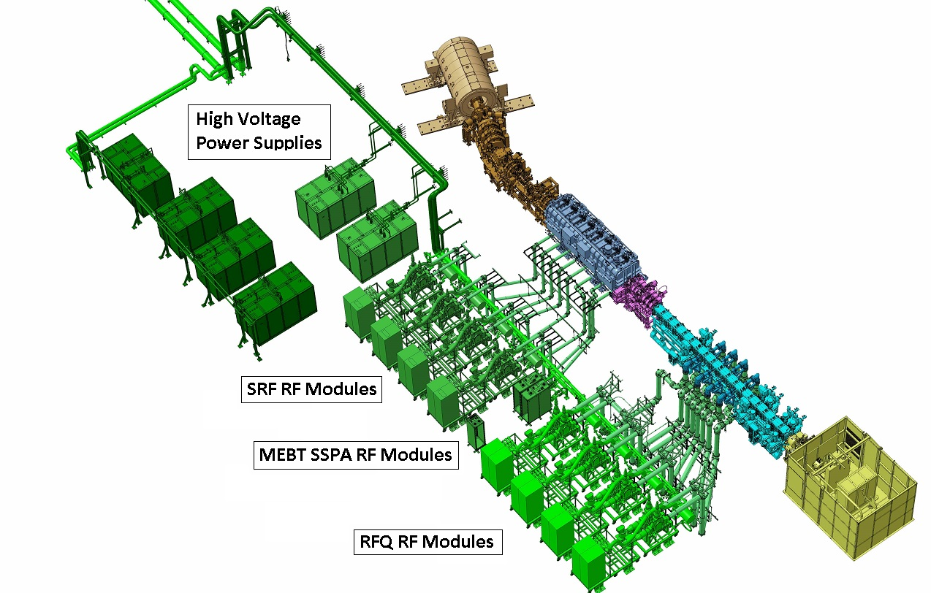
0. Challenges for the duty cycle change
Difference of the thermal cycle for each component
We assume the effect is negligible.
(condition is discontinuously → steady or quench)
Liquid Helium loop
Buncher cooling line
Relatively slow change compared with RFQ,
but tuner cannot follow stop & go for high DC.
RFQ cooling line
Outer cavity (wall) and 4-vanes are separated cooling line,
and inlet/outlet are separated into 3 sections.
Temp. is the active tuner of RFQ.
Resonance will go away if we lose RF/beam loading.
(∵ Temp. control loop has ~ 3 min. for one circulation.)
A quick/fast recovery system with multi-layers is required.
RF Amps/PSs cooling line
Interrupting !
+ injector’s behavior for beam
= Core challenging part
for our target CW operation!!
Effect of circulator thermal cycle
Compensation coil current driver has too slow response > 1 sec.

Slide 18
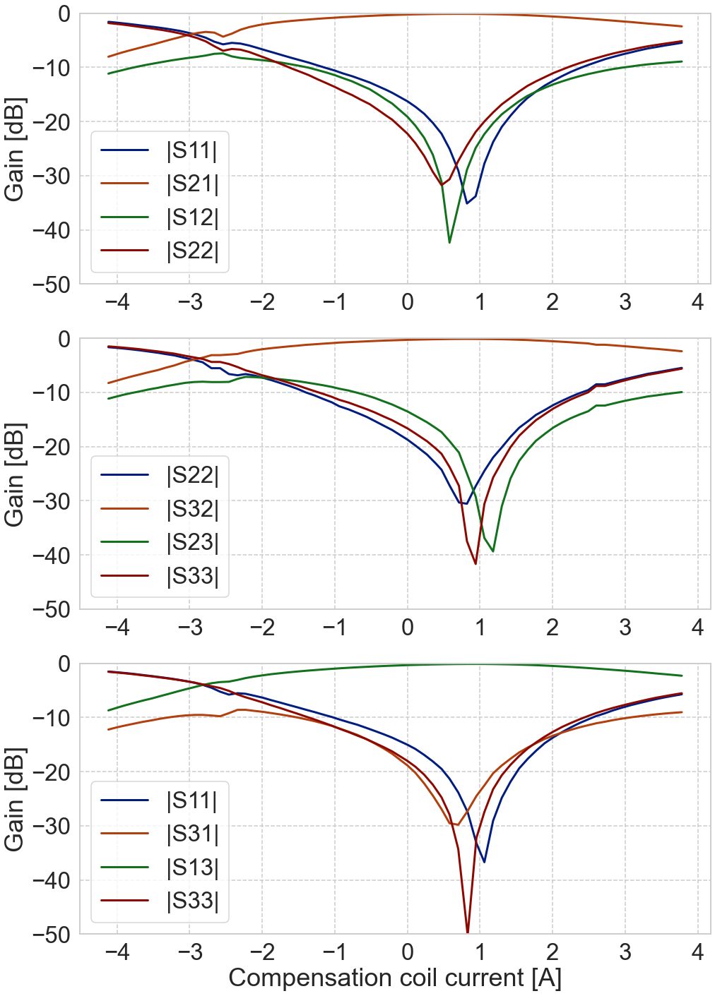


1. Challenges for the RF loading
Difference of the thermal / RF load cycles for each component
Isolated
S-parameters
$$∆Gain and ∆φ$$
Tetrode1
Tetrode2
LLRF
Circulator
(or ferrite temperature)
$∆Gain and ∆φ$ of $S_{11}$
Imagined case:
Thermal drift due to tetrodes → Leader-follower control (fast)
Thermal drift due to the circulator → circulator coil controller (slow)

Slide 19


1. Challenges for the RF loading
Due to High-power & high-DC
Difference of the thermal / RF load cycles for each component
LIPAc specific point
Isolation is not perfect
$∆Gain and ∆φ$ of $S_{21}$
Tetrode1
Tetrode2
Coupling with others
Depend on DC
Depend on DC
LLRF
Circulator
RFQ
$∆Gain and ∆φ$ of $S_{11}$
Practical case:
Thermal drift due to tetrodes and circulator → Leader-follower control (fast)
Thermal drift due to the circulator → circulator coil controller (should be faster)
Because of resonance mismatch, |S21|/|S11| will change.
S11 change affects 2nd tetrode output change.
S21 change affects RFQ input power balance change (coupler reflection changes).
  Coupled with other chains via the RFQ.
VNA result
of some circulator
Coil current for H_{ext} [A]
➔ Stabilization time of present conf. is not so quick.
A bit different characteristics in the RFQ high power operation.

Slide 20
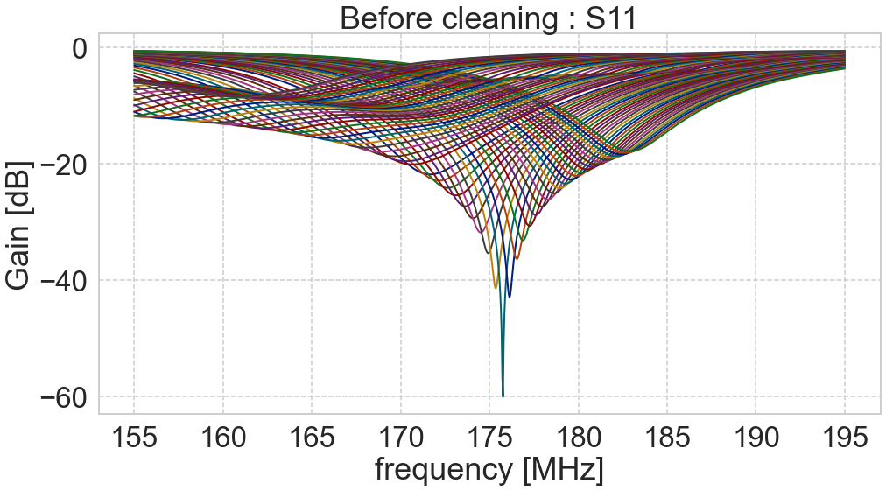
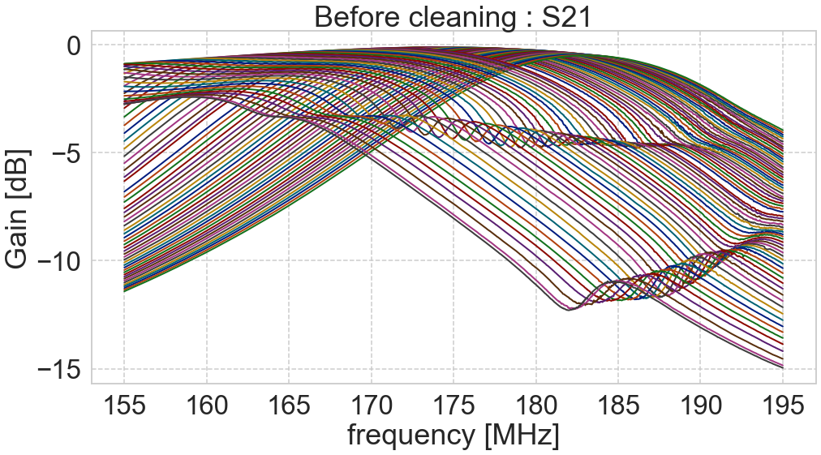
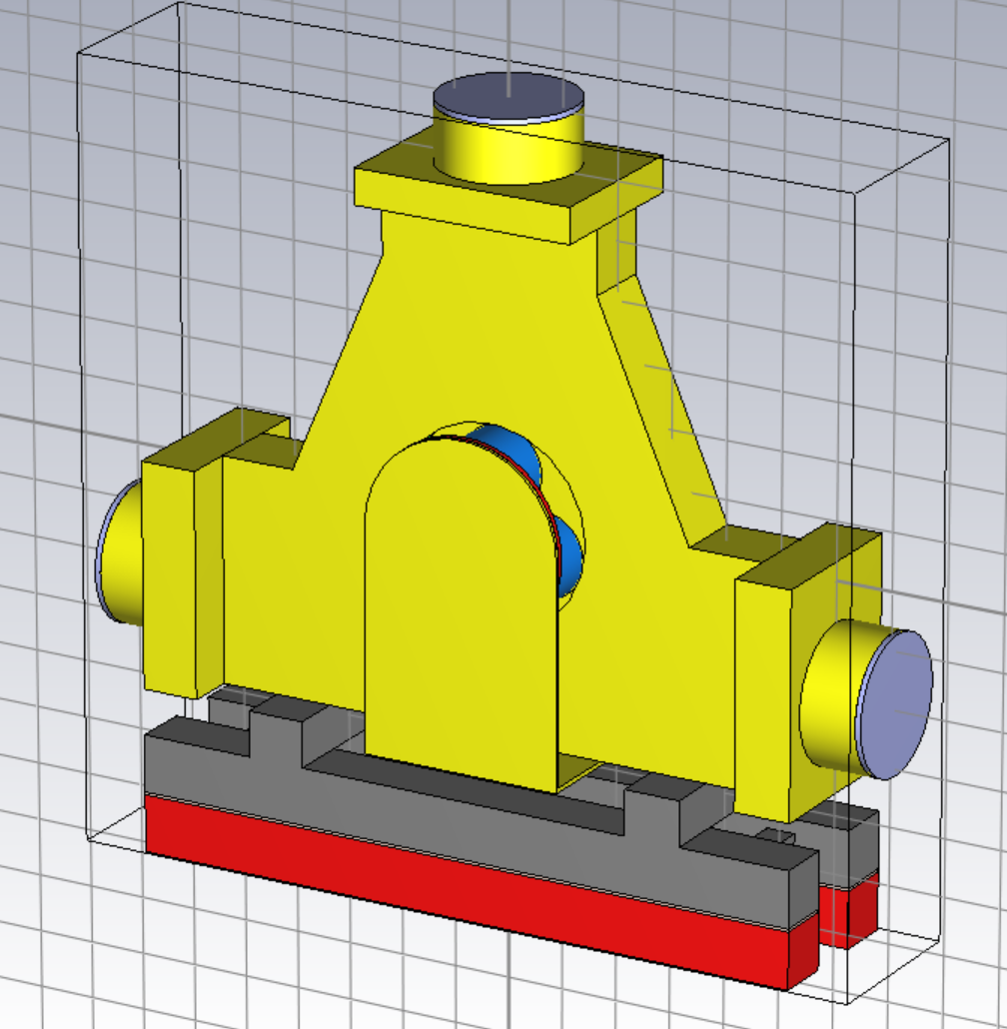

2. Circulator characteristics
Circulator S-param. response for H_{ext}
S11, S21 curves changed by external field
Measurement setup
VNA + calibrated cables + reducers
Water temperature ~[$26, 27]℃$
($174.7MHz<f_{opr}<175.3MHz$ in the LLRF)
S11
S21
SRF circ. 1
SRF circ. 2
SRF circ. 3
SRF circ. 4
External magnetic field response curves are not aligned for several chains.
→ If heating rate is quick (high DC case), how can we follow it effectively?
Working on this with CST sim.
Get all data for several units, or tune the unit to get certain acceptable range.

Slide 21





3. RF Couplers for multi-RF feeds
Tetrodes, circulators, and RF input couplers characteristics have non-negligible differences.
Leader-follower control can mitigate the effect in the amplification chain, but there is no tuning for RF input coupler and RFQ itself (with slow temperature control for resonance).
P_{reflection}
Rep. rate = 3.3 Hz
P_{reflection}
Rep. rate = 8.0 Hz
P_{reflection}
Rep. rate = 10.0 Hz
When duty cycle changed,
balance of the reflection moved.
Also for the transient in the pulse.
Coming from Thermal effect ?
Scenario 1:
Changing the plasma formation due to the multipactor effect in the coupler.
→ Under analysis by using CST, and testing the coupler by adding the external magnetic field
Affected by Fwd/Rev power
Control (calibration) point of slaves for feed powers.
→ Does RFQ-beam interaction drive the fluctuation of PSs?
Then, how about
Circulator compensation curves?
Existing power for standing waves in the line?
LLRF
Amps
Circ
→RF couplers should have the same cond. for any DC.

Slide 22






4. Challenges for the amps.
Noise environment of the measuring box for the anode electrode (protection system)
We are fighting to the fake/unnecessary interlock triggered here.
Causes are
Design of the circuit of the measuring part.
Noise environment of the module.
Especially for the second one, it looks related with the grounding / electrical condition of the building.
Test for remake PCBs
RF noise
Switching noise
Response speed for each power supply
Voltage applied to the anode electrode of the 1st tetrode
Our system is designed for the long pulse stability.
Short pulse or fast response is not good for the system.
→ Required rest time for the pulse operation > 4ms.
Spike noise
from the ground
RF start
RF stop
We struggled especially for the 1-2ms length.
(short pulse is sometimes required for startup, phasing, and destructive measurement.)
4ms

Slide 23


Ex. Difficulty for the on-site maintenance
International project team is also challenging point.
Especially,
Spare parts/unit procurement
Difference of the standard specification
Mismatch of the electrical environment (partially due to the law)
Most of components are developed in EU facilities as the in-kind contribution.
We always start from finding some agent in Japan.
→ Now the situation is improved. F4E procures some parts, that is difficult to get in Japan.
Based on the agreement, infrastructure is prepared by QST, Japan.
Each component manufactured or purchased in EU, JP, and sometime the US.
On-site team is the responsible of the machine integration.
→ We need to prepare numerous tools variation for the maintenance.
Signal of the electrodes of a tetrode
(1000:1 probes → oscilloscope)
Building had been constructed and electric line was configured based on the Japanese standard.
Modules are designed and developed for the EU standard and tested in the EU facilities.
→ Transitions or modifications are between them.
→ At least, modules could not work as expected without onsite treatments.
Noise check
Making tough and steady effort is only way to remove the noise!
RF noise on a cooling tube
(current probe → oscilloscope)

Slide 24
Outline
LIPAc and its RF system Overview
Commissioning of the RF system
Topics for the operation from lower DC to CW
Future plans and summary

Slide 25
Future plans/ideas for improvements
For the challenges to improve the isolation:
  Circulator resonances will be aligned.
  Circulator coil current driver will be replaced and LLRF will control the it.
For the unstable or noise in the RF electronics:
  Detecting the source of noise and seal/damp them.
  More analysis for the whole RF amplification circuit.
For the tetrode system stability including a part of above topics:
  The system will be replaced to the full solid-state amps. (under development.)
As other related actions:
  RFQ coupler will be replaced to the different type → now testing.
  Quick recovery system (linked to LIPAc MPS) → under discussion.
  Smart DC operation system → under discussion.

Slide 26
Summary
Our LIPAc team studies the RF system for high current and high DC, toward CW mode.
Markers in our footprints:
  Tetrodes amplifier chain for the nominal power > 200kW (RFQ) to the dummy load.
  8 feeds to the RFQ cavity, synchronized with the Leader-follower control under the WR protocol.
  RFQ-RF commissioning to the CW with 80% of the nominal vane voltage.
  Beam commissioning for the chopped and raw extracted beam pulse with 119 mA-8.75% DC.
Remaining challenges to be realized:
  Circulator analysis and optimization.
  Improve the stability of the amplification system including the noise environment.
  RFQ RF input coupler replacement and completing the RFQ commissioning.
  Superconducting LINAC commissioning.
  Beam study for higher DC > 10% and compensate/control the thermal effects.
  etc…
There are a lot of challenges on the way to the goal, but it is really exciting phase of the LIPAc !!

Slide 27

Thank you for your attention!
Backup slides
This work was undertaken under the Broader Approach Agreement between the European Atomic Energy Community and the Government of Japan.
The views and opinions expressed herein do not necessarily state or reflect those of the Parties to this Agreement.

Slide 28





Buncher-RF system
Specification (5-gap IH-type resonator)
Energy: 5 MeV (unchanged)
D⁺ current: 125 mA
Frequency: 175 MHz
Cavity pwr. : 6.6kW
Beam
Re-buncher
Cavity < 350kV
LLRF
Power
combiner
Power divider
Power
combiner
Solid-state amp.
< 300W
Power
combiner
PCL, Arc detector
LLRF
Pre-amp.
Solid-state amp.
< 2kW/module
Solid-state amp.
< 20kW in total
Solid-state amp.
Re-buncher cavity
One cubicle
Cavity specification
Q₀ = 11746
Cavity 1
R_{sh} = 6.655 MΩ
β_{L} = 1.217
Cavity 2
R_{sh} = 6.75 MΩ
β_{L} = 1.064
$E_{peak}=13.9$ MV/m
2nd cav.
1st cav.
1st cav.
LLRF
Pre-amp.
2nd cav.
Inside geometry of the cavity
from D. Gavela, I. Podadera, F. Toral, I. Moya, F. Scantamburlo,
“Validation of Two Re-Buncher Cavities under High Beam Loading for LIPAc”, proc of IPAC2021.

Slide 29





SRF-RF system
Specification (Nb Half-wave resonator)
Energy: accelerating from 5 MeV to 9 MeV
D⁺ current: 125 mA
Frequency: 175 MHz
Nominal voltage: E_{acc} = 4.5 MV/m
Oper. temp.: 4.4 K
Series of superconducting
half-wave resonators
solenoids
Beam
Cryomodule in section
Cavity specification
Q₀ = 5.0 × ${10}^{8}$
R_{sh}/ Q₀ ≤ 150 Ω
β_{L} = 7.7 × ${10}^{3}$
Cryomodule
150kW
150kW
The hardware model is the same as the RFQ’s one, but just voltage of the anode electrode is lower.
Picture after the string assembly
by superconducting cryomodule team !
Cryomodule installation in FY2024

