Slide 1














Overview of Tetrode-Based RF System for High-Power Plasma Heating Operation in the 4-9 MHz Range for the MPEX Project at ORNL
Confid
ential
Bodo Fritsche

Slide 2






A Heritage of Excellence
1937
1988
1993
2000
2006
2010
2012
2019
2012: The Ampegon Brand is established by financial investors out of Thomson Broadcast, as Technicolor restructures.
Opening of the Broadcast division at BBC.
BBC and Asea merge to new ABB Group
ABB Infocom sold to Thomson-CSF
Thomson-CSF is renamed to Thales, the Broadcast Division to Thales Broadcast & Multimedia
Thales Broadcast & Multimedia is sold to Thomson
Thomson is renamed to Technicolor and the Broadcast Division to Thomson Broadcast
2019: A new company, Ampegon Power Electronics, is founded by A&CT to take over the Ampegon Brand

Slide 3
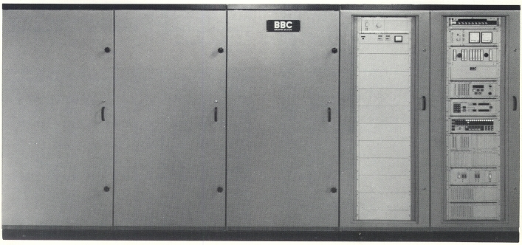
SKxx Transmitter Family
build since 1980’s
Naming convention:
SK51: 100kW
SK53: 300kW
SK55: 500kW
tube: CQK-650 (BBC)
Control system: TTL
First with push-pull tube based modulator,
later with Pulse Step Modulator (PSM)
1937
1988
1993
2000
2006
2010
2012
2019

Slide 4
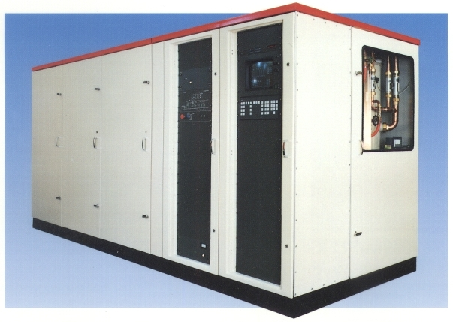
TSW2xxx Transmitter Family
build since 1990’s after ABB went to Thomson
Naming changed to:
TSW2100: 100kW
TSW2300: 300kW
TSW2500: 500kW
tube: TH-576
Control system: ECAM, later ECOS (computer based)
Capability for digital transmission (DRM)
1937
1988
1993
2000
2006
2010
2012
2019

Slide 5
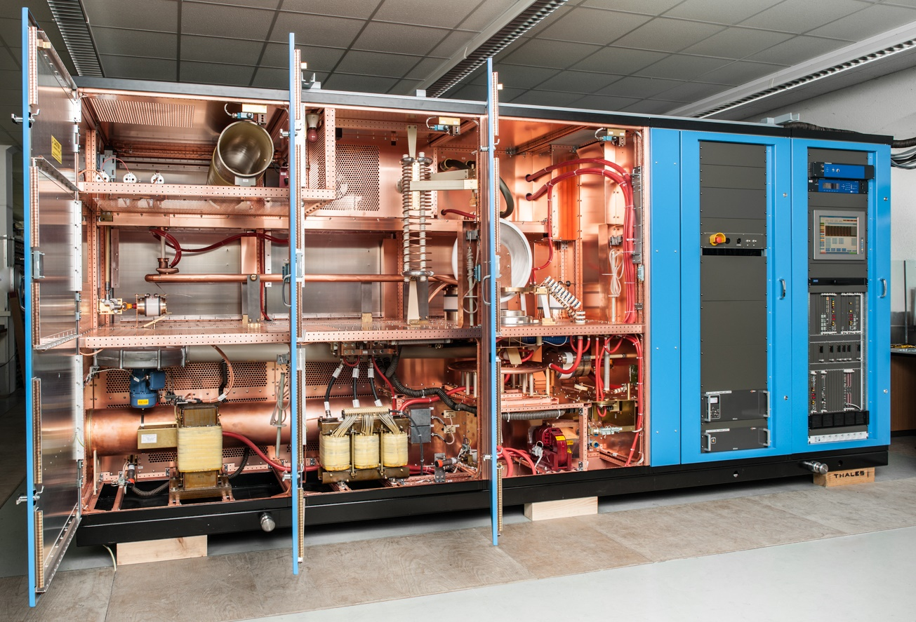
TSW2xxx Transmitter Family
RF network solid and reliable since the 80’s
Tube: TH-576 (500kW)
Tube: TH-588E (250kW and 300kW)
Control system: now UCS (based on FPGA & Linux)
>150 units sold worldwide
1937
1988
1993
2000
2006
2010
2012
2019
Time for something new?

Slide 6
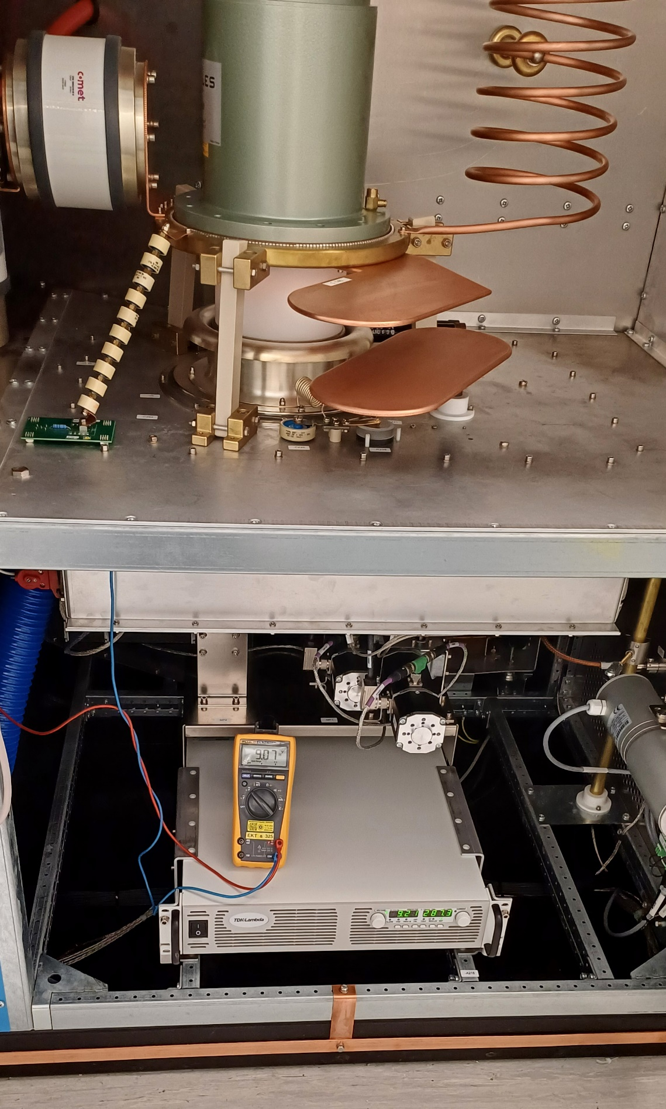
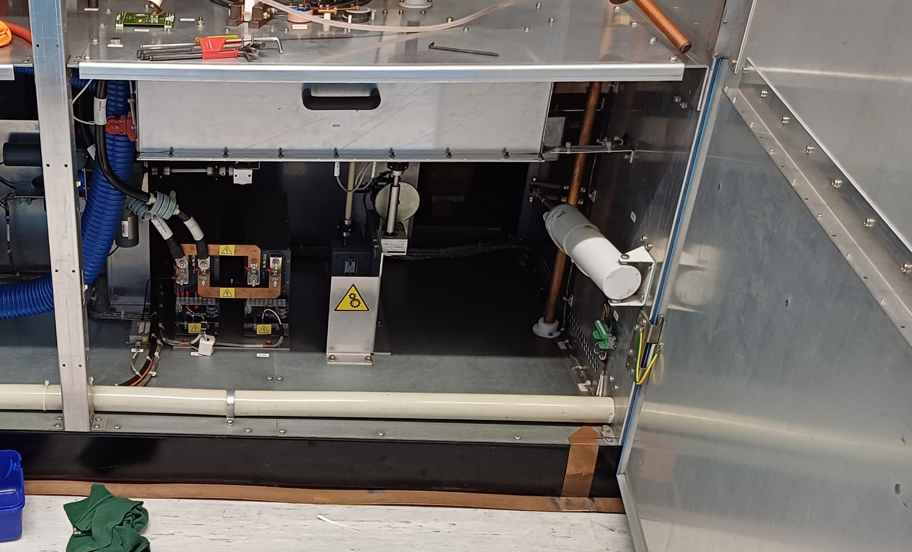
Difficult Improvements
Devices must work under severe conditions
“Good old solution” often the best
New components have problem with RF
control crashes
communication problems
items catching fire
1937
1988
1993
2000
2006
2010
2012
2019

Slide 7
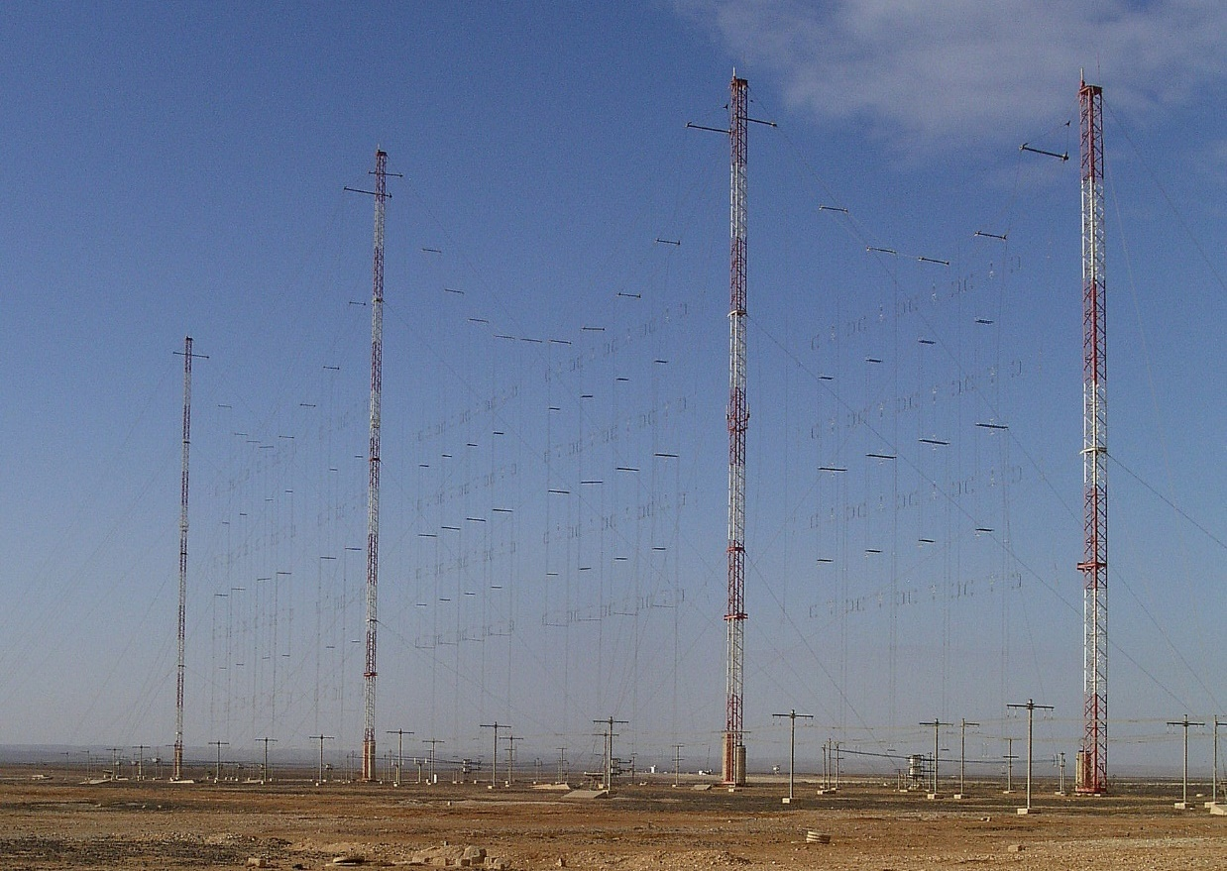
Why not solid state
Challenging issues to solve:
Combining 3.9…26.1MHz
Protection from lightning and arcing
Efficiency
Price
1937
1988
1993
2000
2006
2010
2012
2019

Slide 8
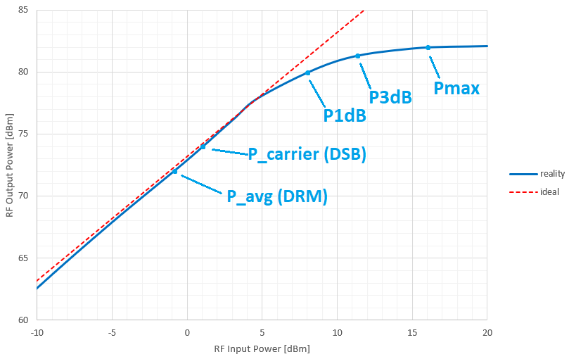
Why not solid state
DSB and DRM transmission require high peak power
LDMOS efficiency is good in P1dB… P3dB
To solve efficiency issue: drain-voltage modulation
2000
2006
2010
2012
2019

Slide 9
TSW2500 at ORNL

Slide 10
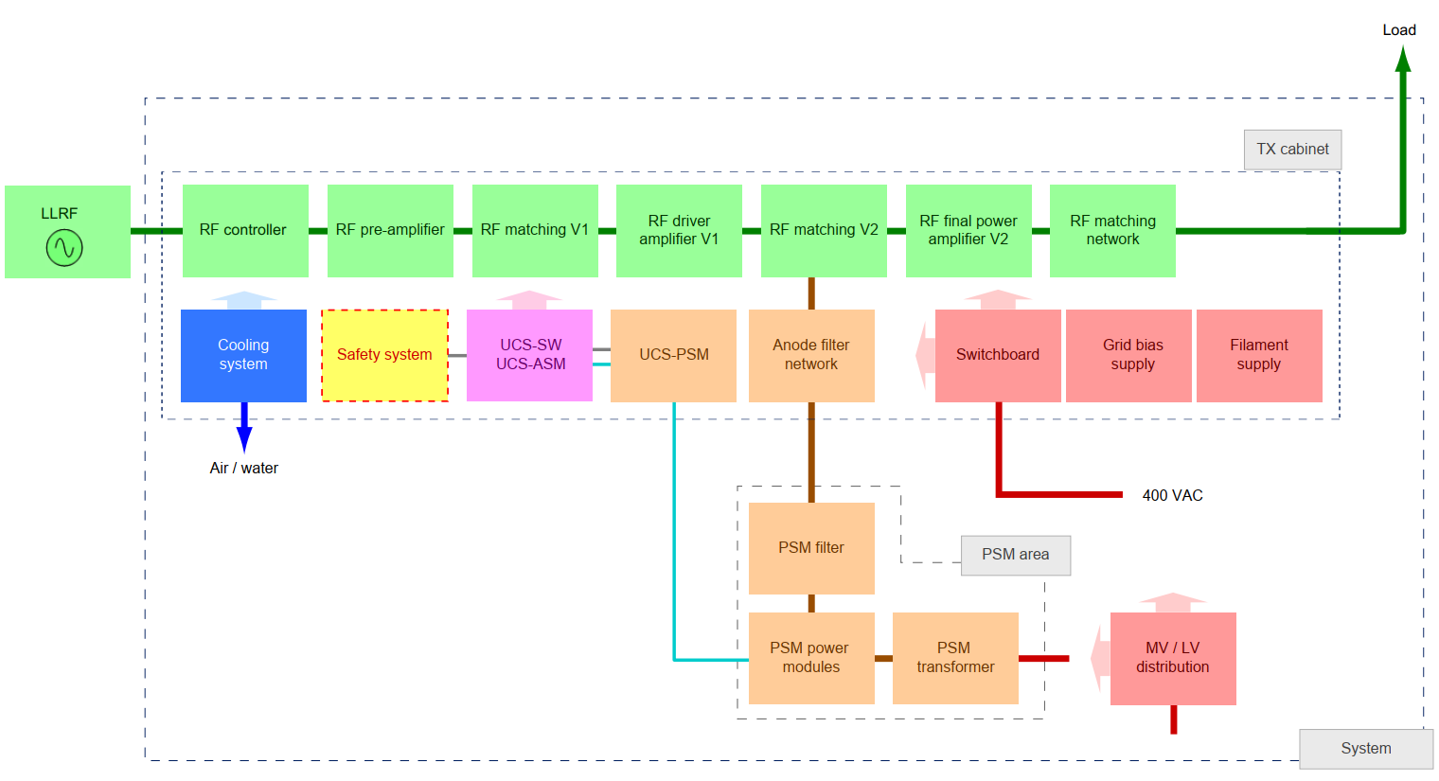
TSW2500 for ORNL
RF system (green)
PSM (orange)
UCS (pink)
Safety System (yellow)
Power supply (red)
Cooling system (blue)
1937
1988
1993
2000
2006
2010
2012
2019

Slide 11
TSW2500 for ORNL
1937
1988
1993
2000
2006
2010
2012
2019

Slide 12
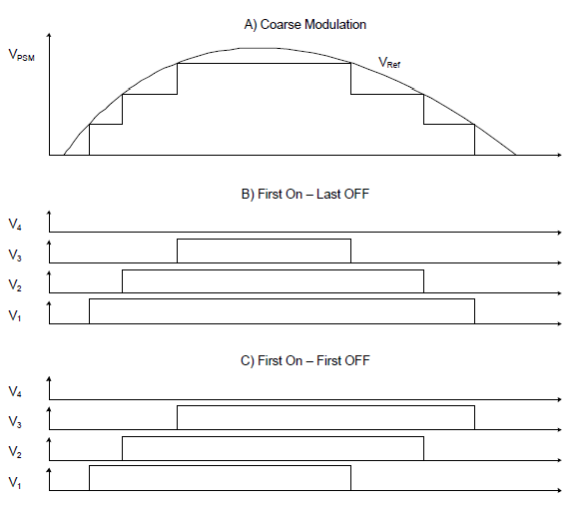
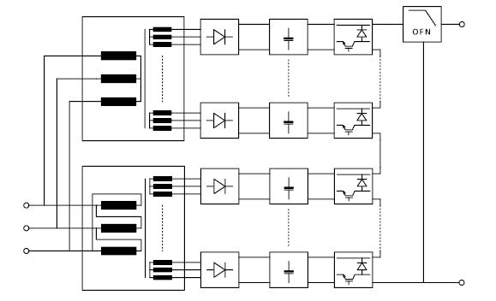
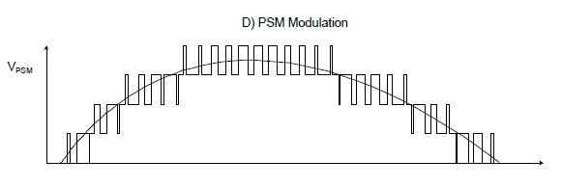
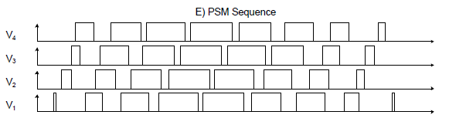
PSM Technology
Advantages:
High efficiency >97%
Flexible waveforms, CW output
Overshoot possible
Pulse ripple (module switching)
Limitations:

Slide 13
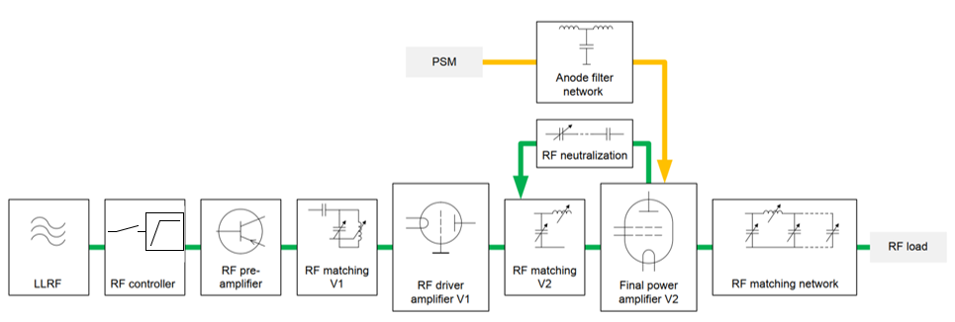
TSW2500 for ORNL
LLRF: supplied by ORNL
Pre-Amp: 1kW SSPA
V1: CTK-12
V2: TH-576
1937
1988
1993
2000
2006
2010
2012
2019

Slide 14
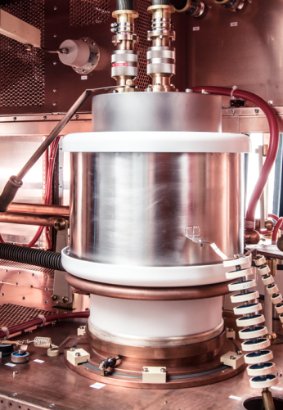
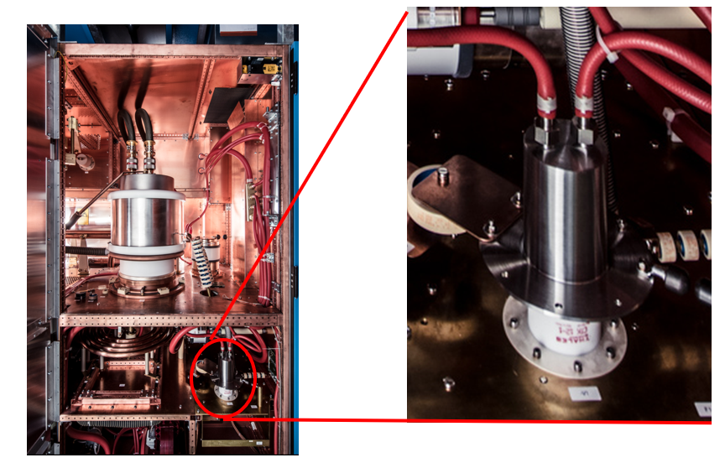
Tubes for TSW2500
1937
1988
1993
2000
2006
2010
2012
2019

Slide 15
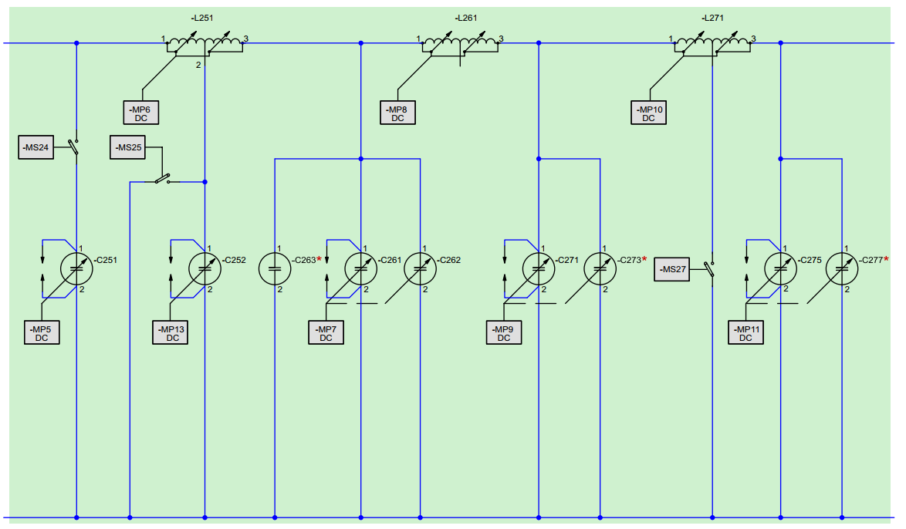
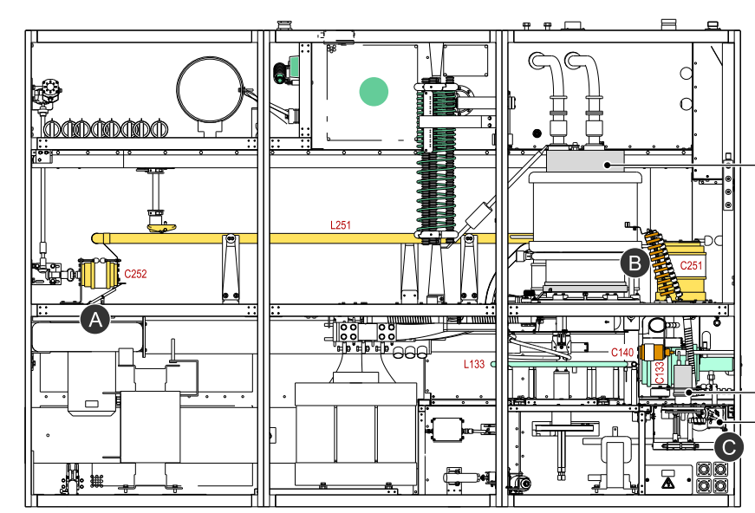
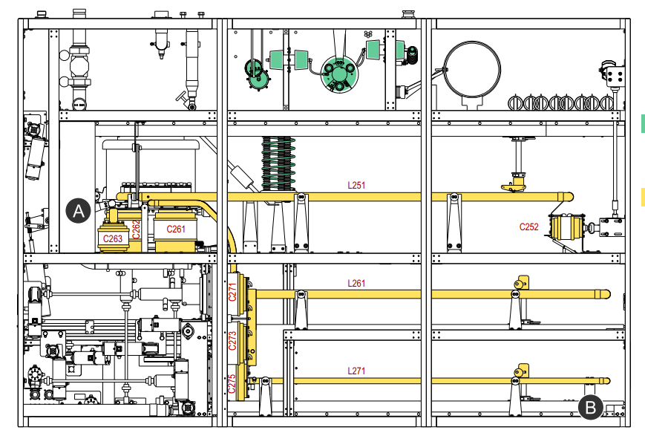
Matching Network TSW2500
1937
1988
1993
2000
2006
2010
2012
2019

Slide 16
TSW2500 for ORNL
1937
1988
1993
2000
2006
2010
2012
2019

Slide 17
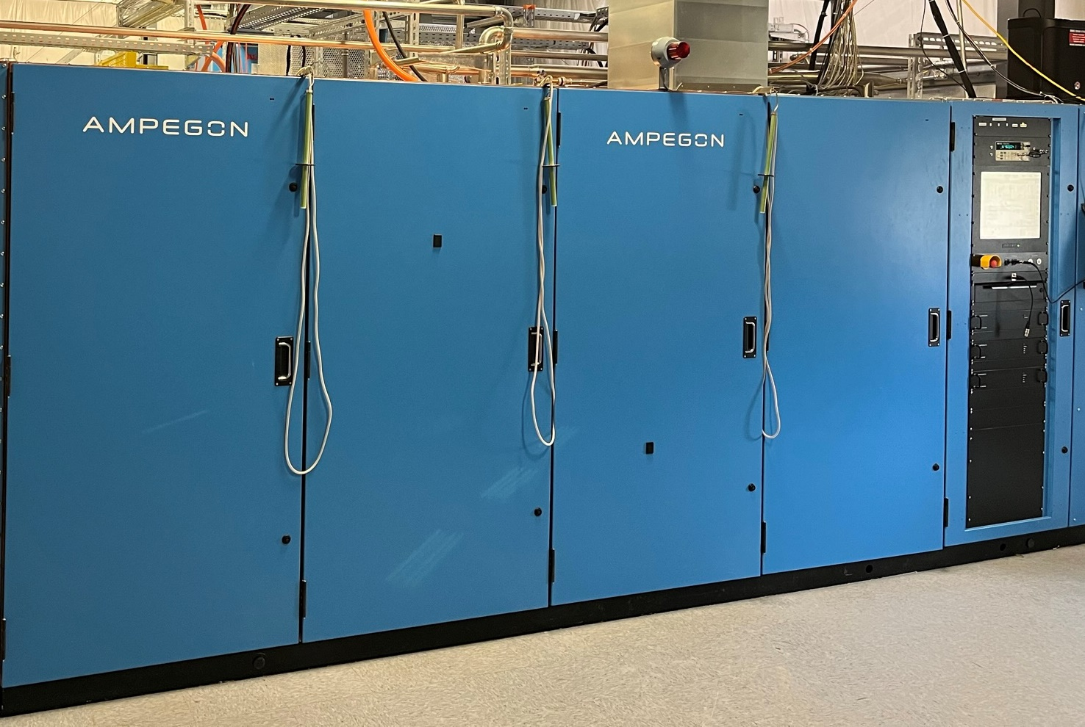
TSW2500 for ORNL
1937
1988
1993
2000
2006
2010
2012
2019

Slide 18
Thank you for your attention
Confid
ential
Bodo Fritsche

