Slide 1

Bead-Pull Measurement and Re-tuning of SNS RFQ02
13th Continuous Wave and High Average Power RF Workshop, Knoxville, 2024
Haitao Ren
On behalf of SNS RF Structure Team
Sep. 11, 2024

Slide 2
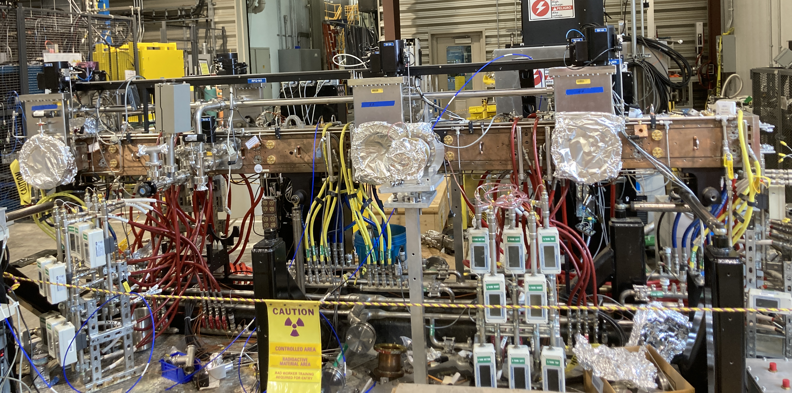
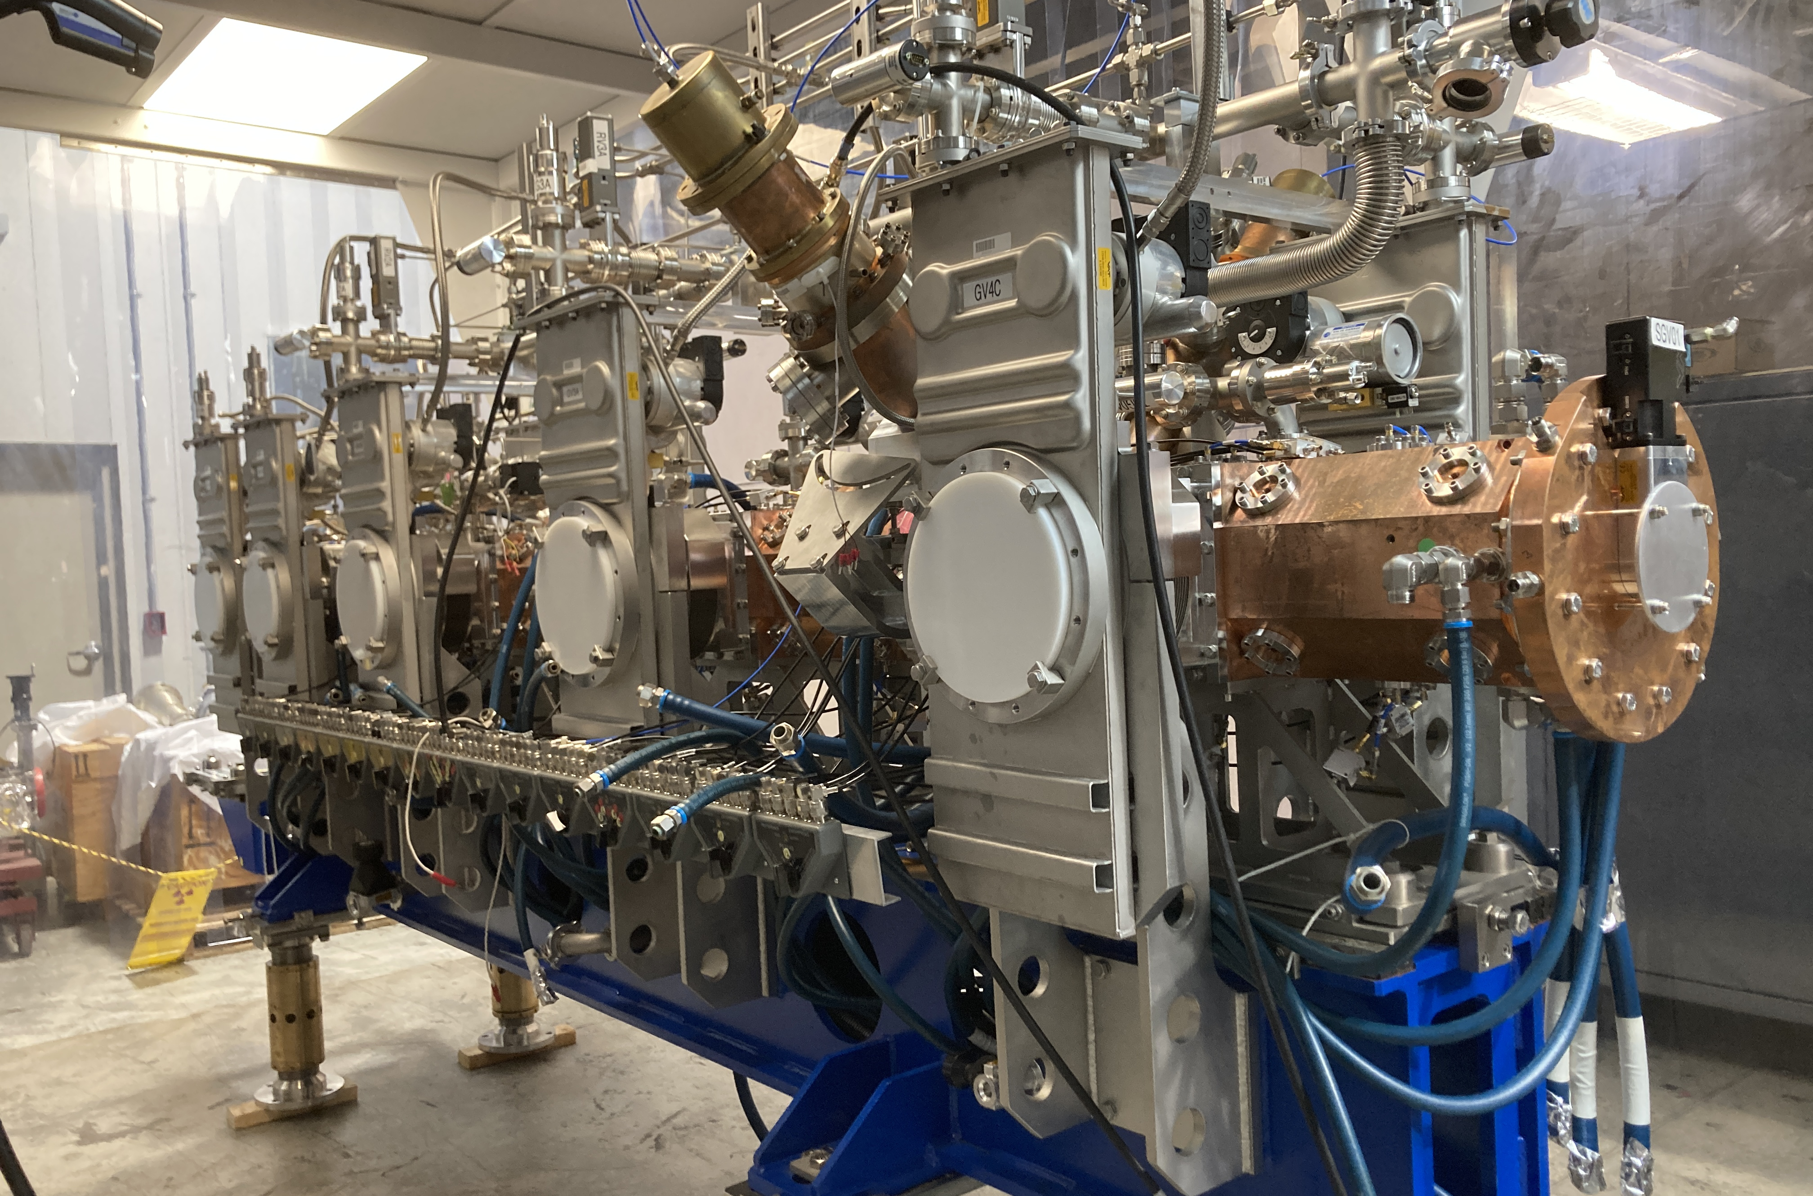
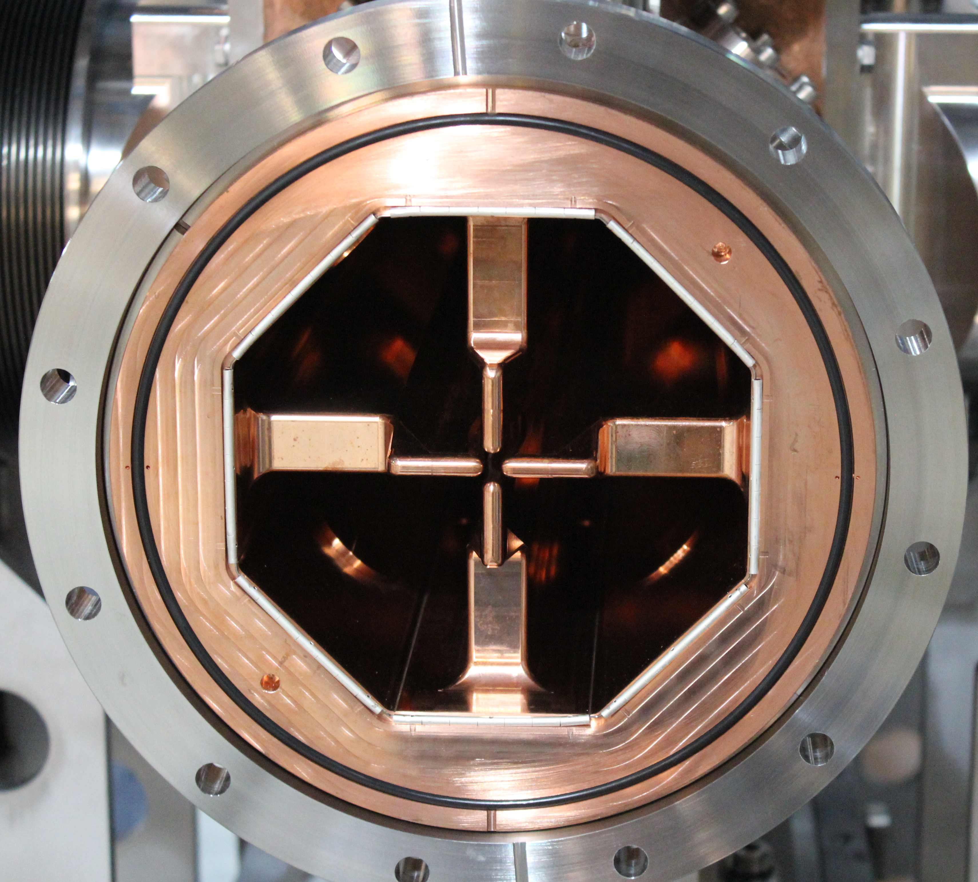
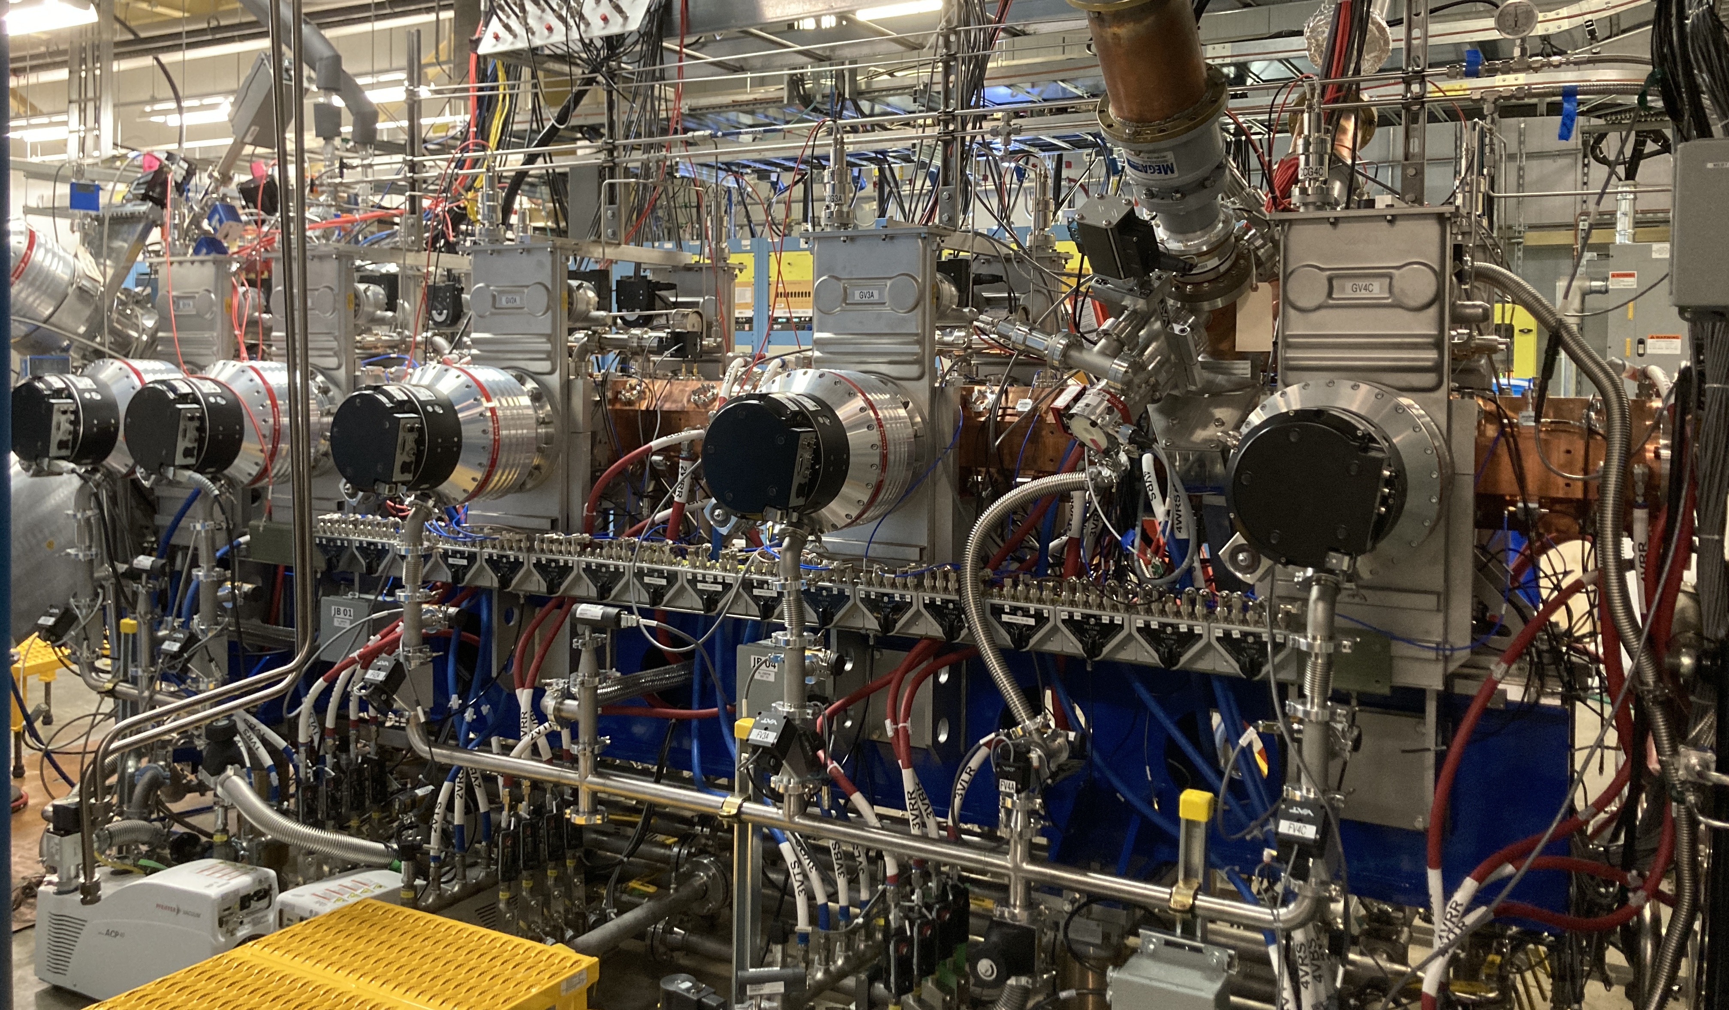
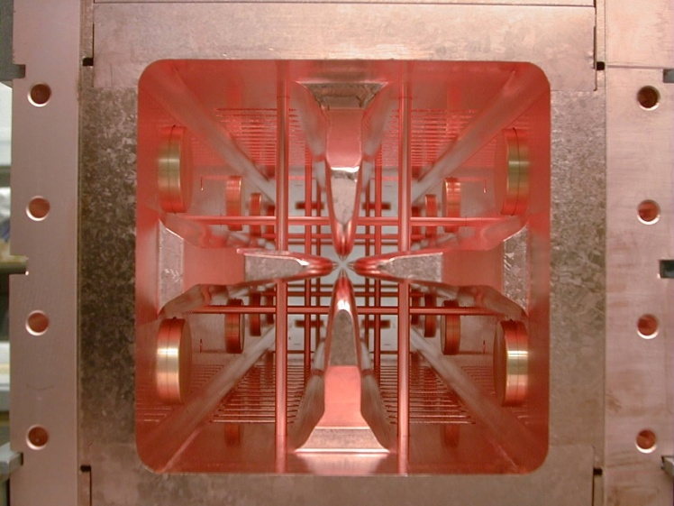
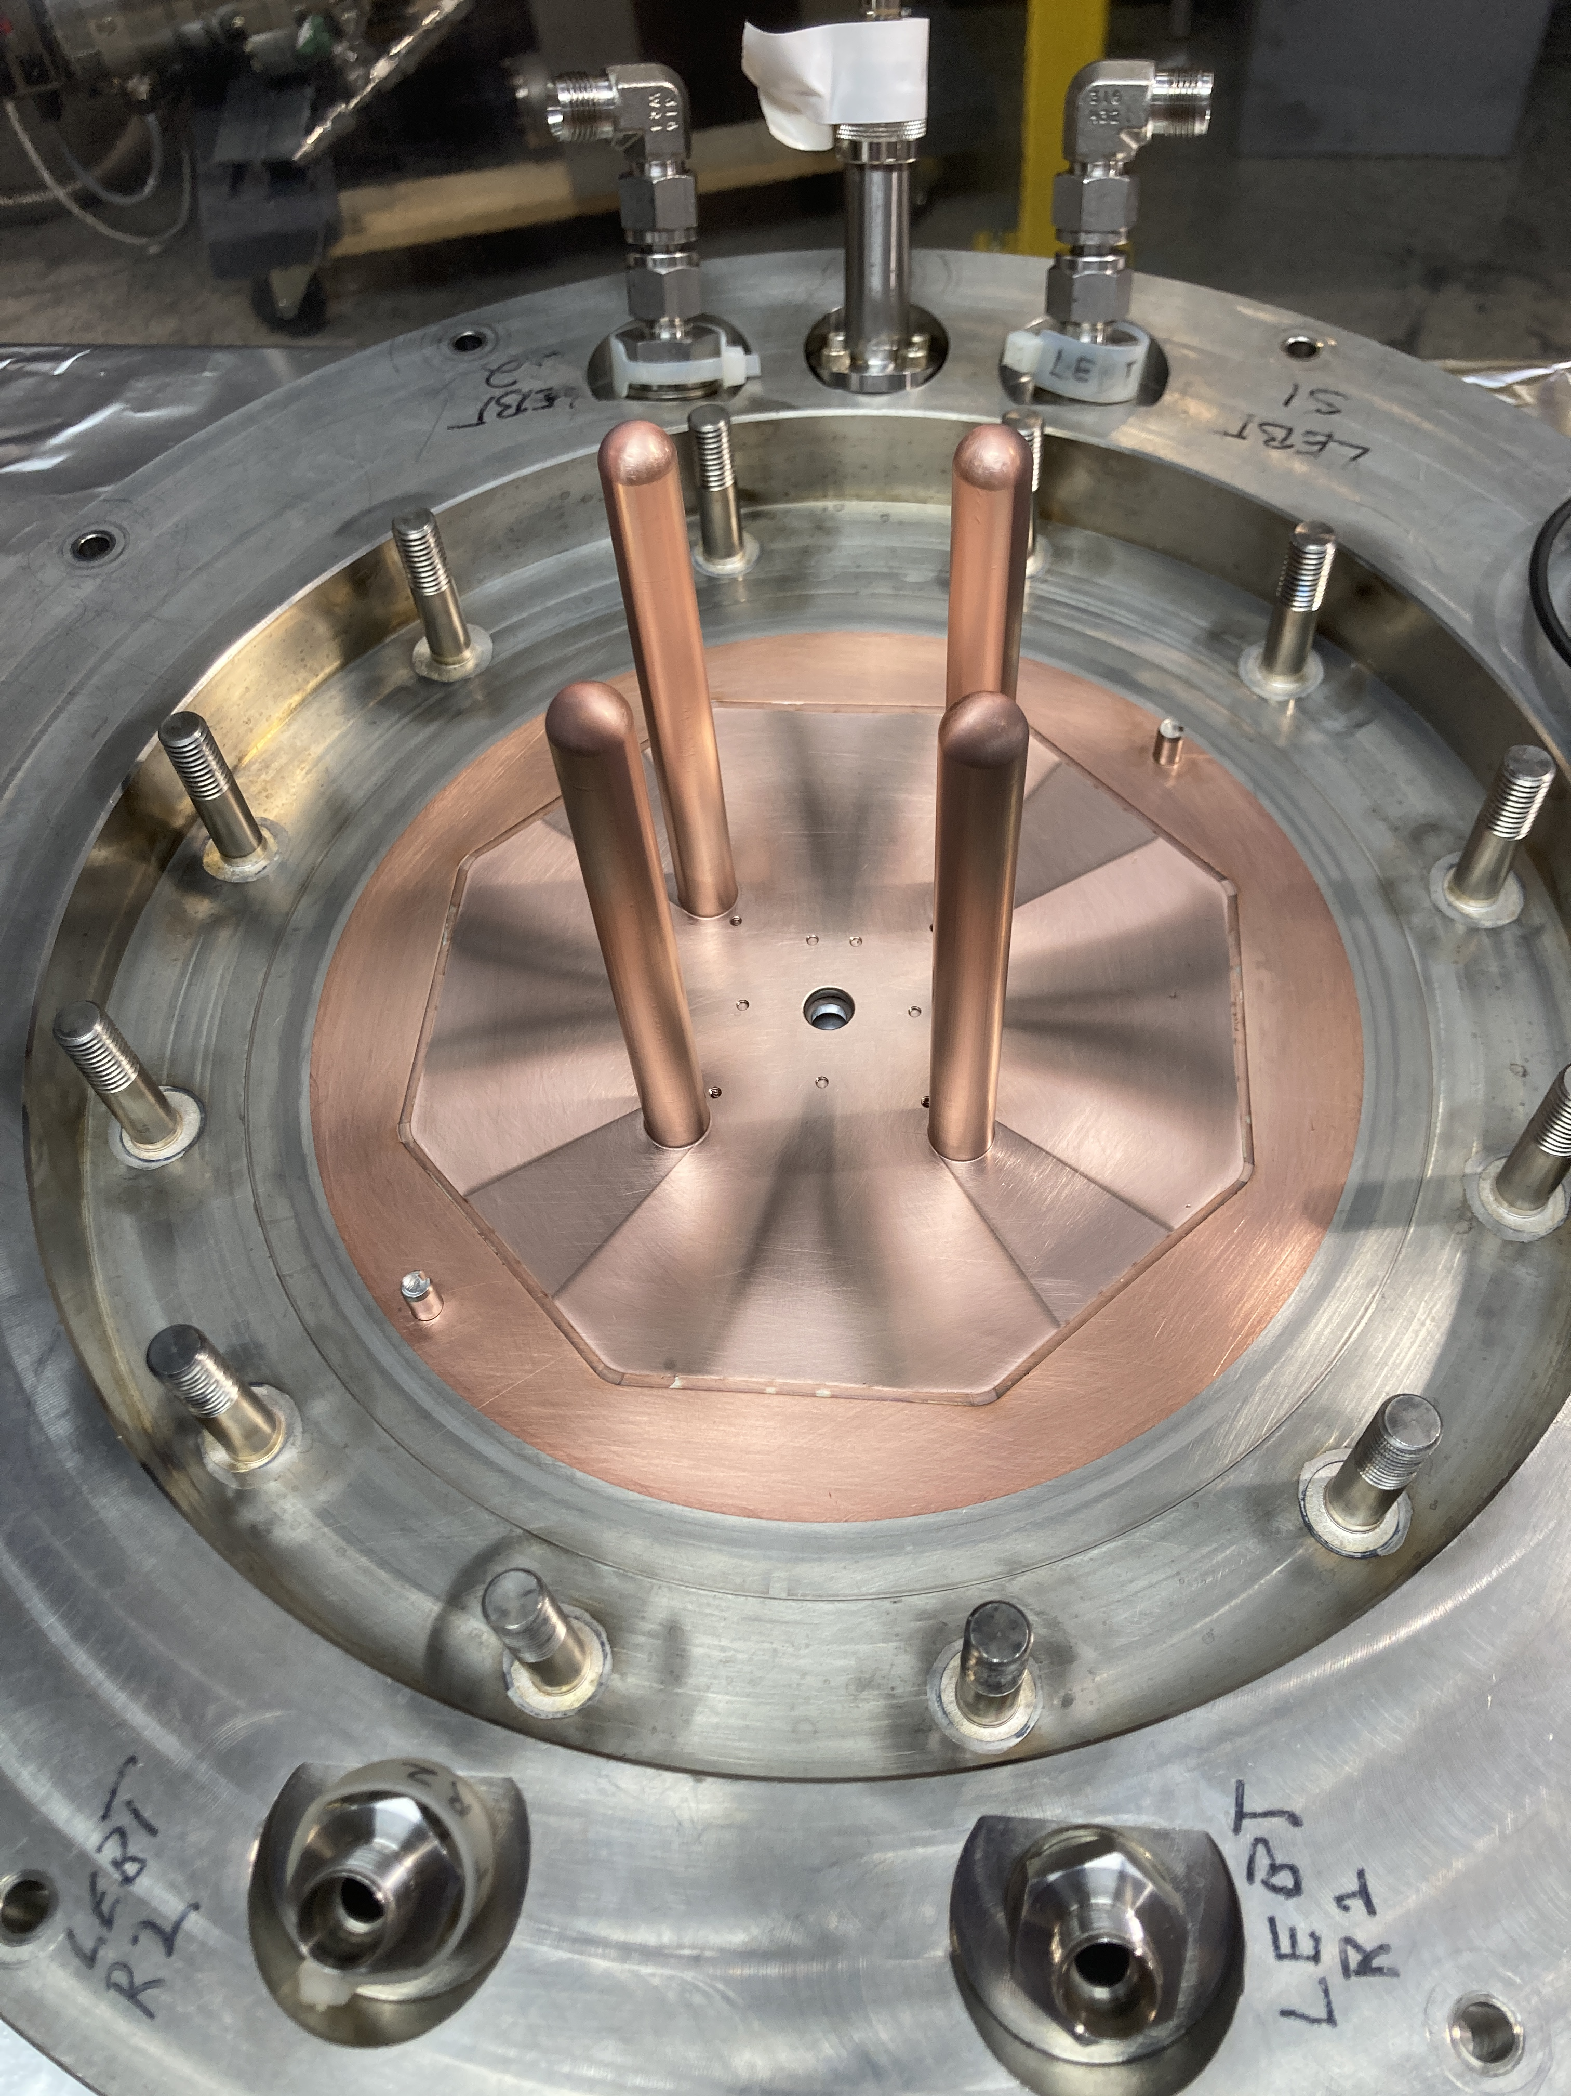
SNS RFQs
 | RFQ01 | RFQ02 | RFQ03
Operation begins | 2002 | 2018 | 2023
RF Frequency | 402.5 MHz | 402.5 MHz | 402.5 MHz
Length | 3.7 m 4 segments | 3.7 m 4 segments | 3.7 m 4 segments
Material | Glidcop + Copper | Copper | Copper
Design transmission | 90% | 90% | 90%
Beam dynamic design | Original design | Same as RFQ01 | Same as RFQ01
Vane-vane volt | 83 kV | 83 kV | 83 kV
Kilpatrick | 1.85 | 1.85 | 1.85
Dipole mode suppression | π-mode stabilizers | 4-rod stabilizers | 4-rod stabilizers
Coupler | 8 coaxial couplers (later 2 coaxial couplers) | 2 coaxial couplers | 2 coaxial couplers
Tuners | 80 fixed slug tuners | 64 fixed slug tuners | 64 fixed slug tuners
Vacuum pumping | 6 cryo-pumps | 6 cryo-pumps + 4 turbo pumps | 10 turbo pumps
10 turbo pumps

Slide 3
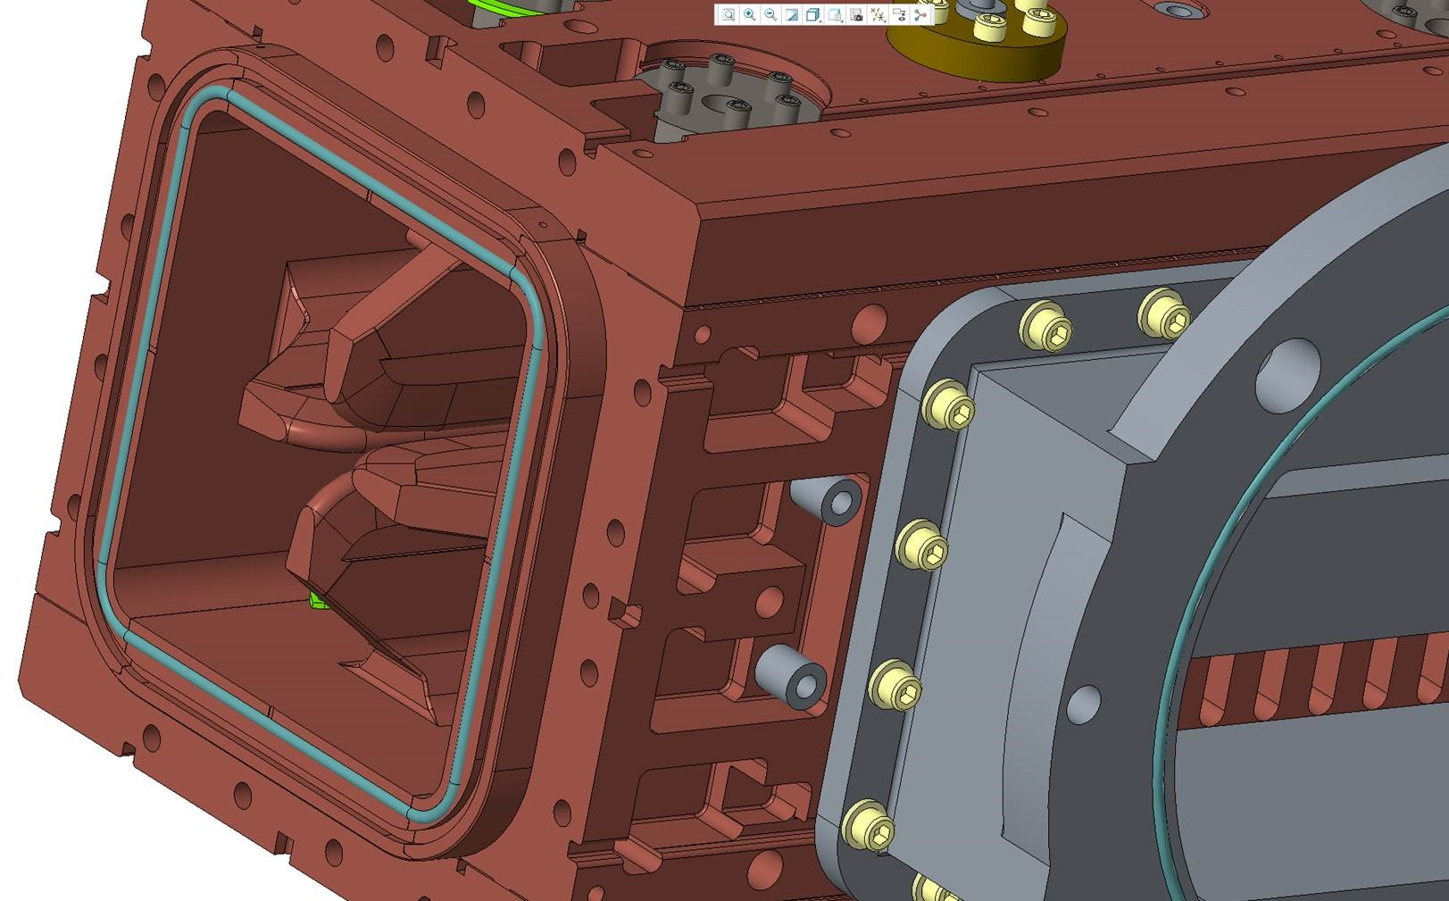
Original SNS RFQ01 (Berkeley RFQ)
RF frequency: 402.5 MHz
Design beam transmission: 90%
Peak surface field: 83 kV (1.85 Kilpatrick)
Dipole mode suppression: π-mode stabilizers
Resonance control: water temperature (two chillers: one for vanes and one for walls)
Glidcop/OFC braze joints

Slide 4
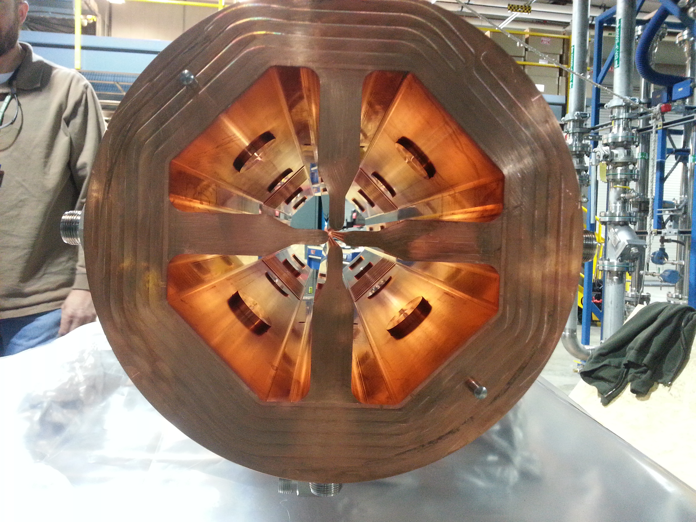
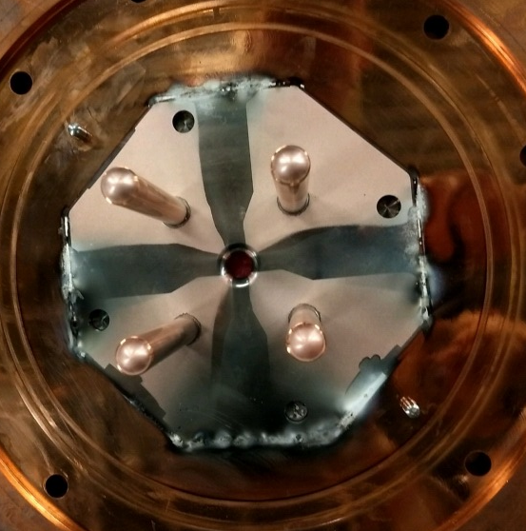
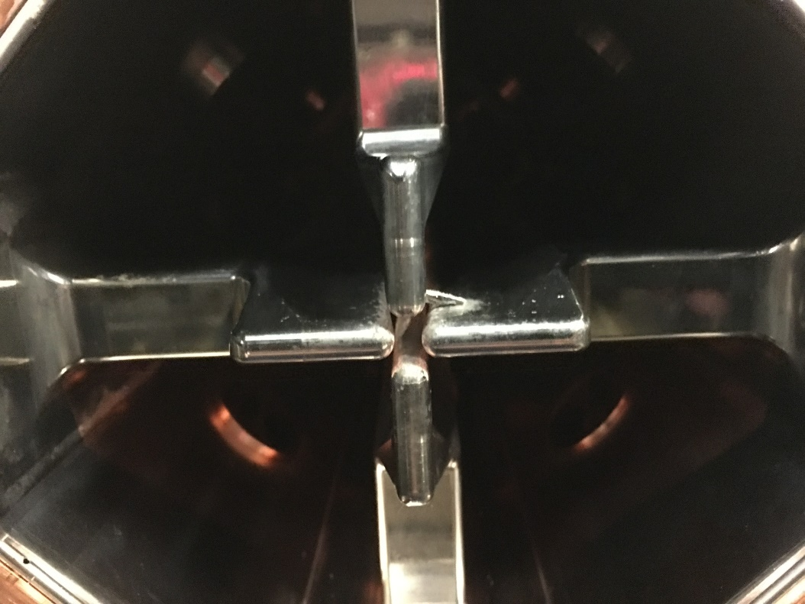
RFQ02 (manufactured by RI)
Same beam dynamics design
Same RF input (2 coaxial couplers)
Same resonance control scheme
Design changes
  Solid copper RF structure
  (vs. Glidcop/OFC brazing)
  Improved vacuum pumping
  Improved water cooling
  4 rods for dipole stabilizer
  (vs. π-mode stabilizers)
  RF seal scheme
Downstream end wall
Broken piece of C-seal

Slide 5
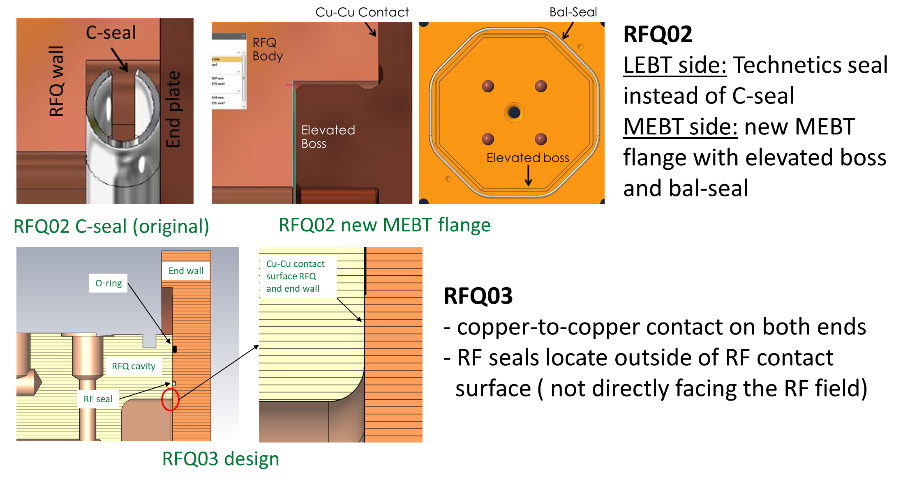
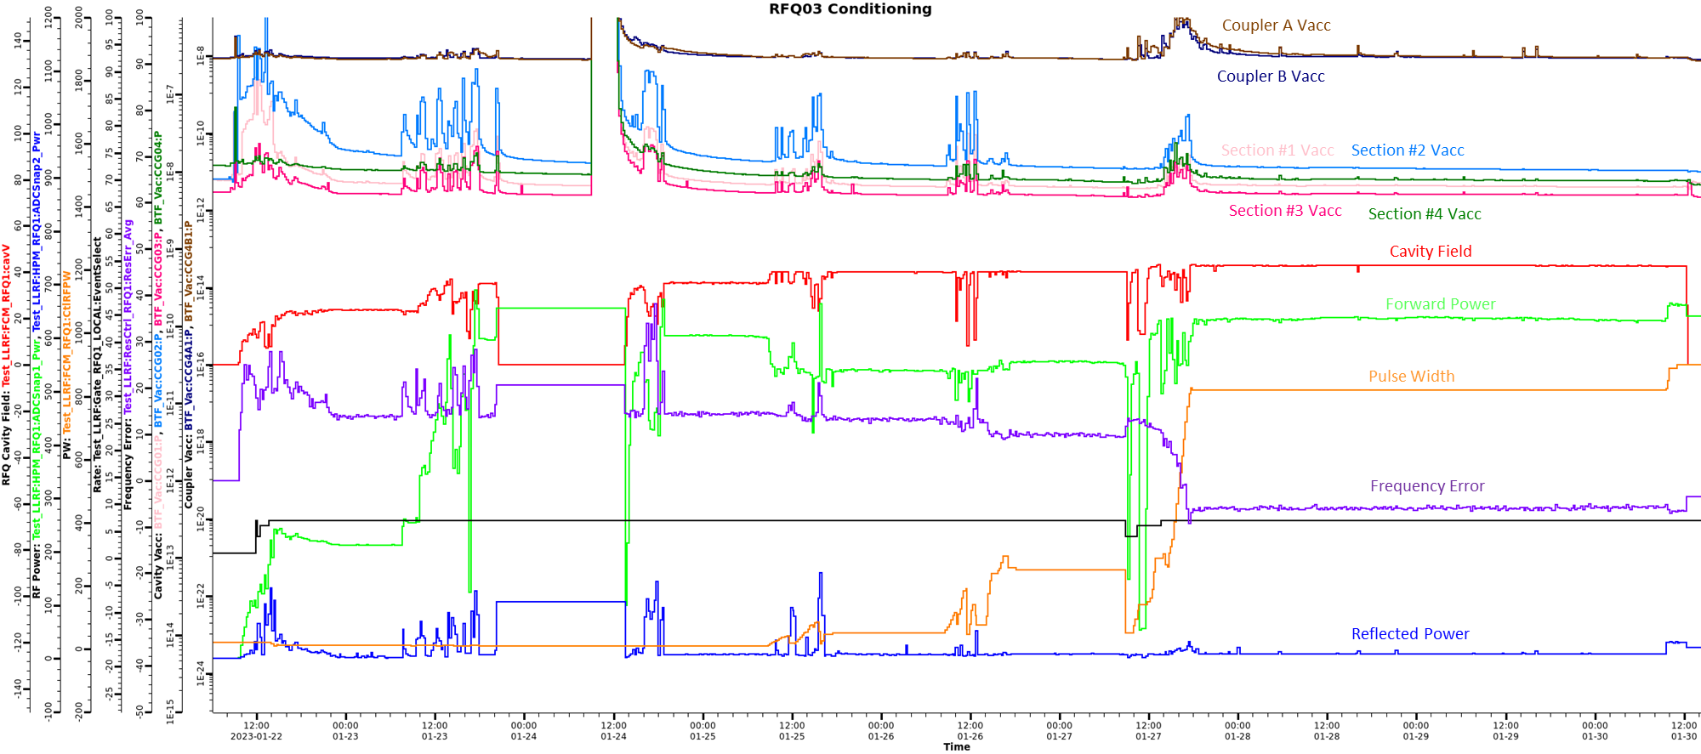
SNS New RFQ03 (manufactured by RI)
Design is the same as RFQ02 except RF seal
RFQ03 high power conditioning completed in Jan. 2023
SNS Front End with the New RFQ03 (April 2023)

Slide 6
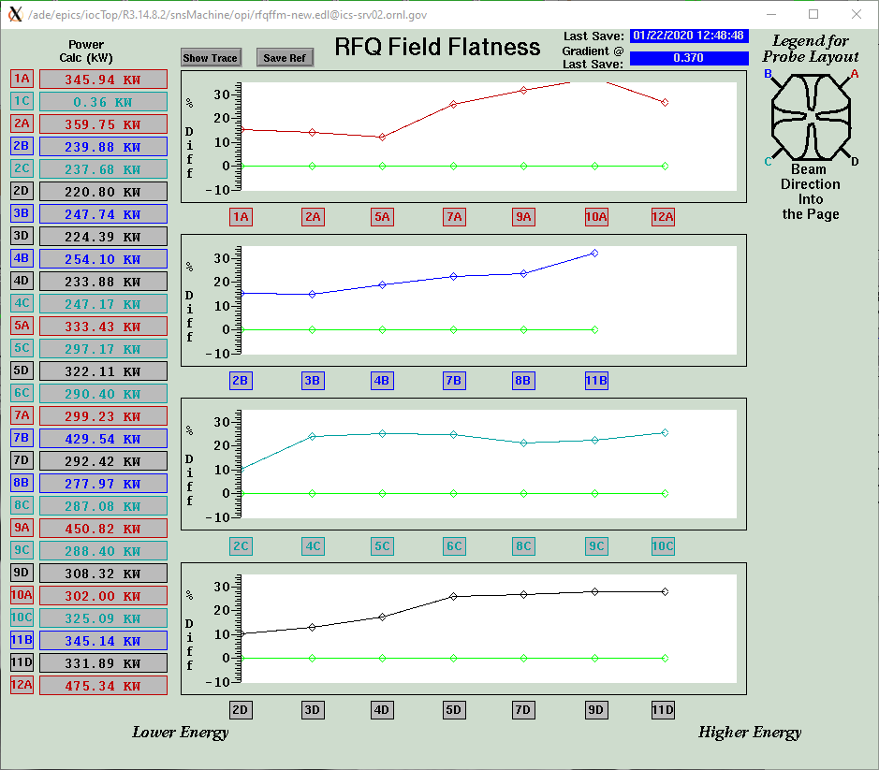
RFQ02 Needs Re-tuning
RFQ field tilt was noticed in early 2020
Measured Field
Required Field

Slide 7
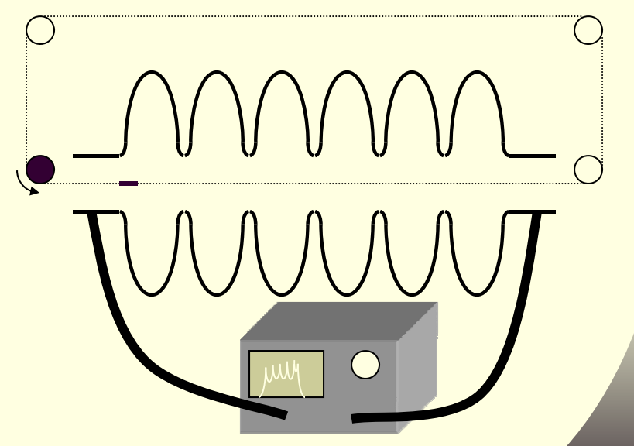
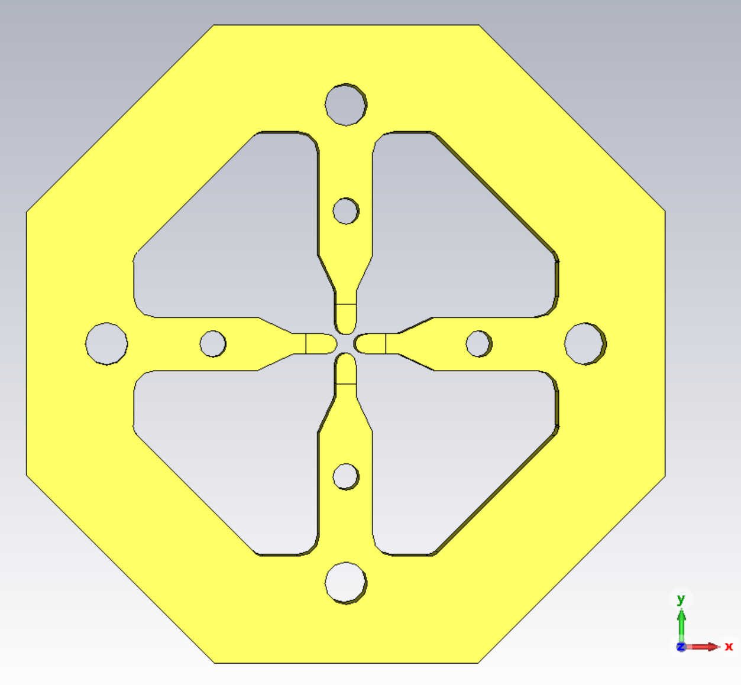


How Bead-pull Works
Small Perturbation Theory
  Relative magnetic field can be given by
$H_{0} \sim √tan∅$(z)
$∅$ (z) is bead-pull measured data
Bead-pull position
For Bead-pull measurement, RFQ H field is a function of the S21 phase

Slide 8
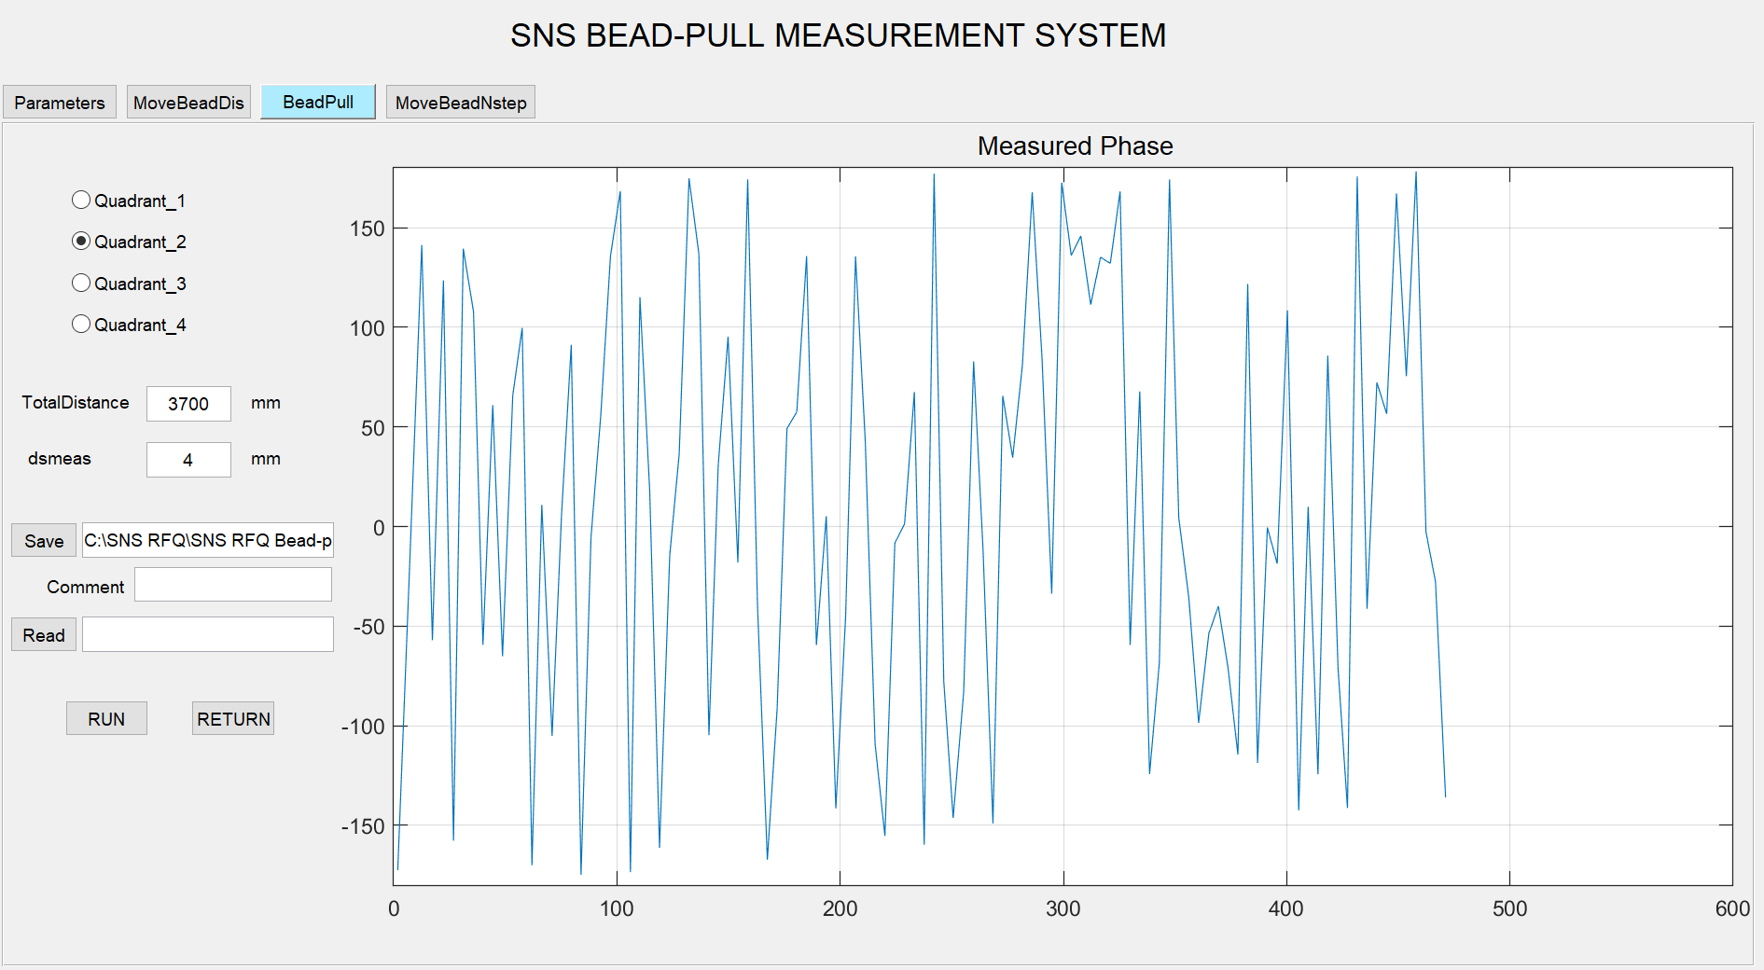
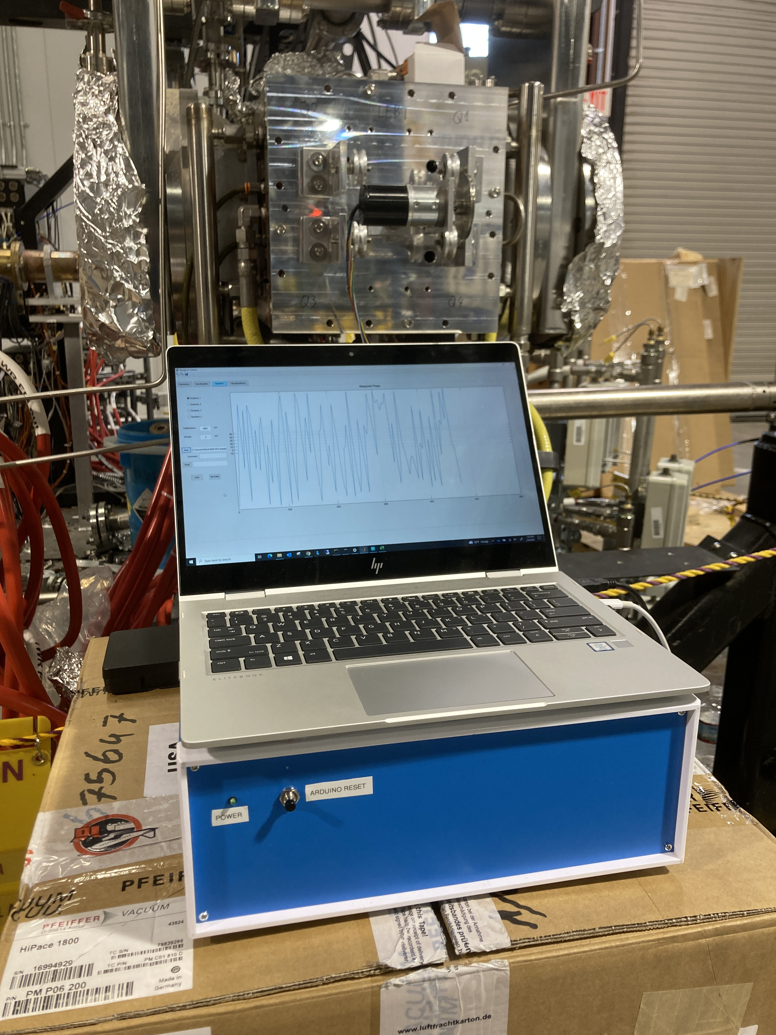
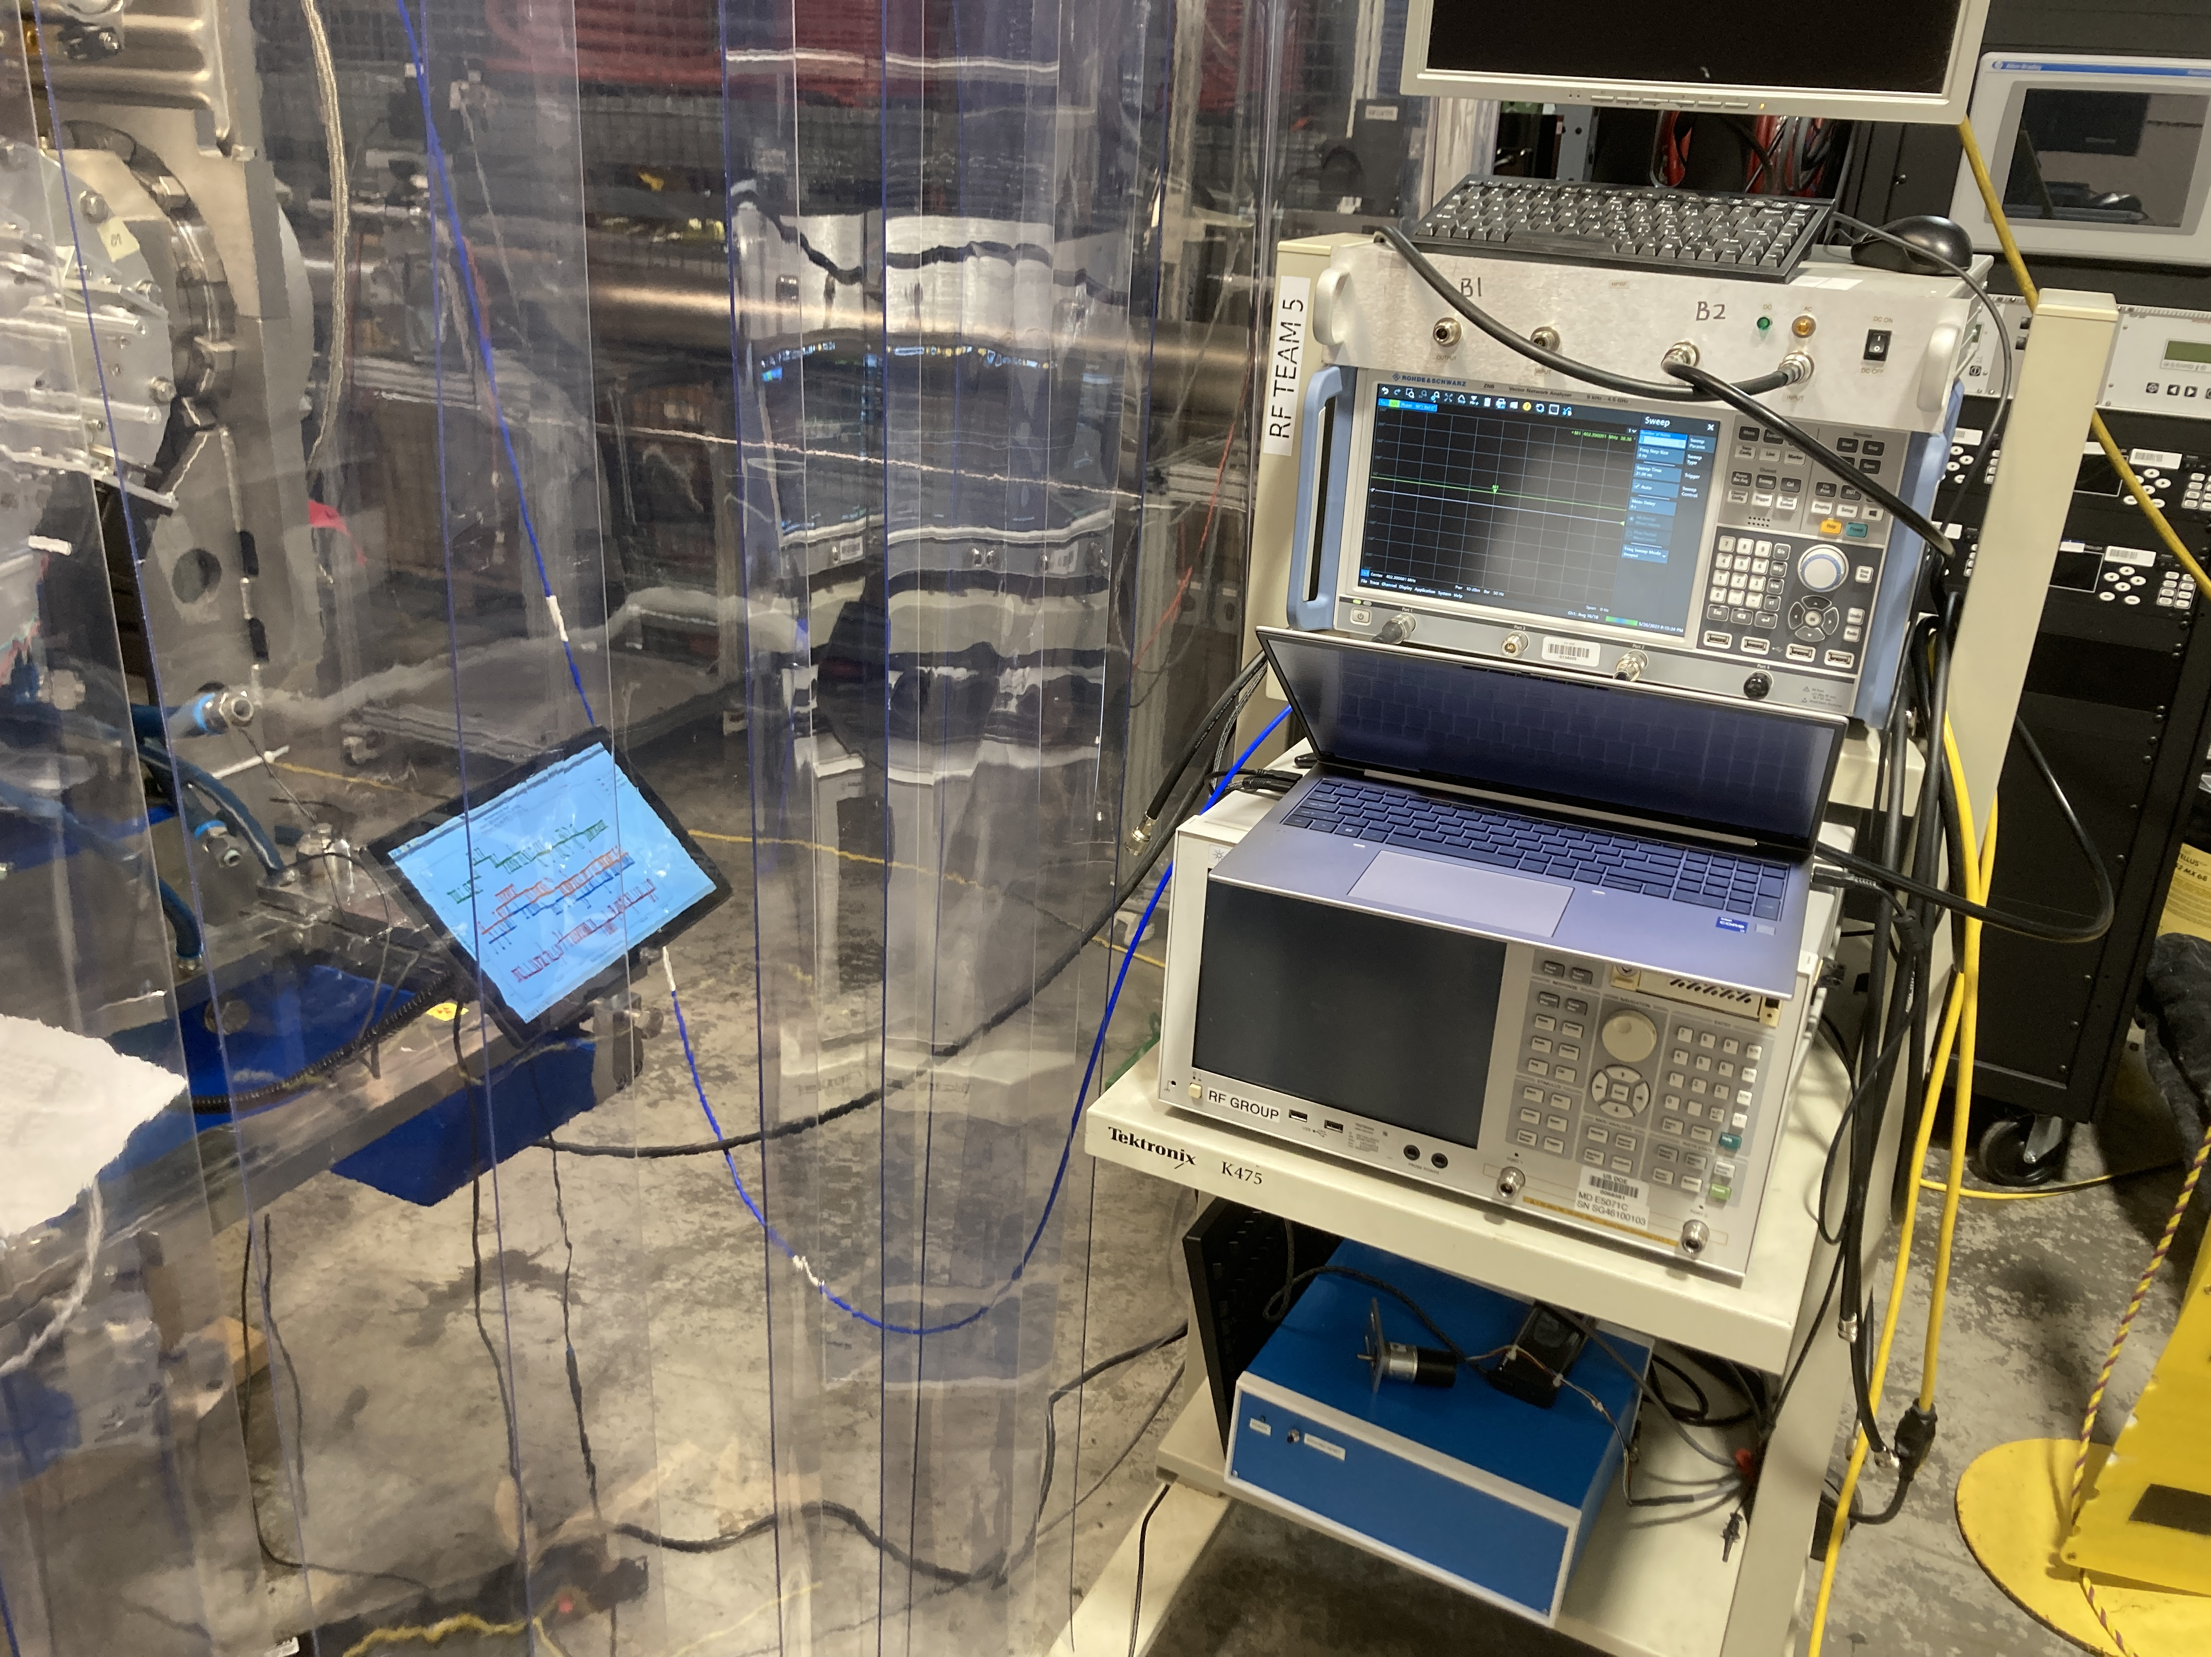
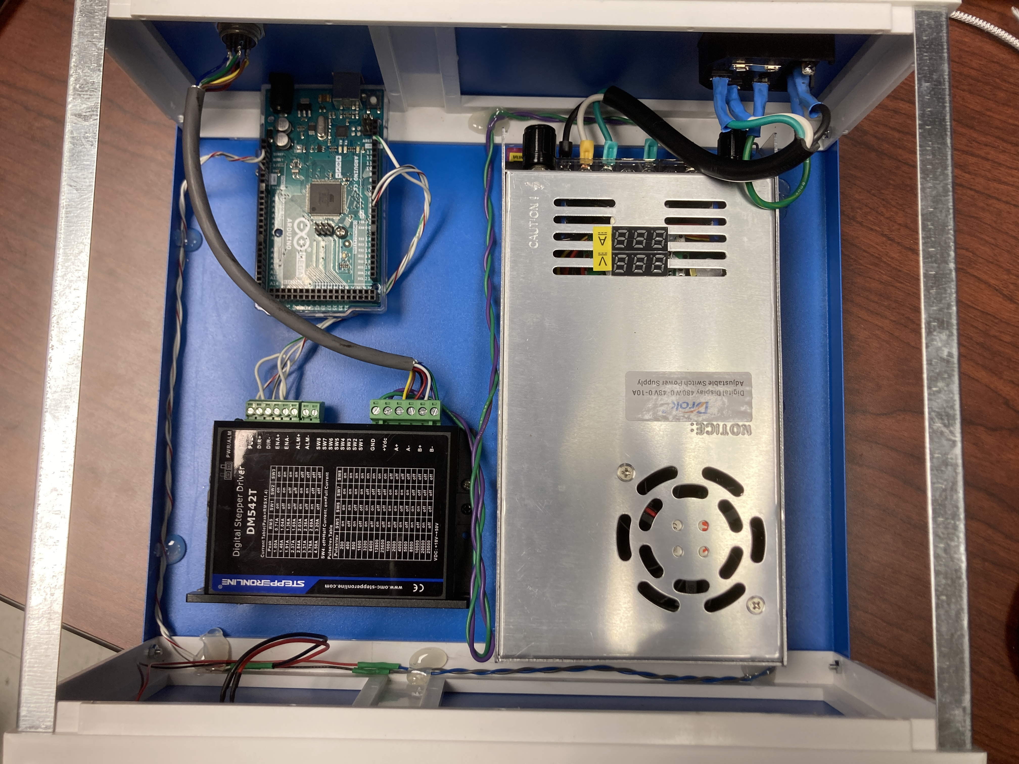
Bead-pull Setup
Bead-pull plate with motor and pulleys
Laptop with MATLAB control program
Control box with Arduino
Network Analyzer
RFQ02

Slide 9
RFQ Tuning Process
Untuned RFQ
Tune RFQ with Adjustable Tuners
CST Simulations
Quad field mode
Dipole field mode
Nonlinear check
Run Tuning Program with Measured Data
- Output: tuners depth
No, next iteration
Tuning Program
Algorithm
Excel tuning, or
Matlab tuning
RFQ tuned?
- Delta field <1%
- Delta F <50 KHz
Bead-pull Measurement
- Measured F
- Measured field profile
Yes
RFQ tuned with all slug tuners?
Cut and Install Slug Tuners
- Section by section, or
- Quadrant by quadrant
No
Yes
Tuning Complete

Slide 10
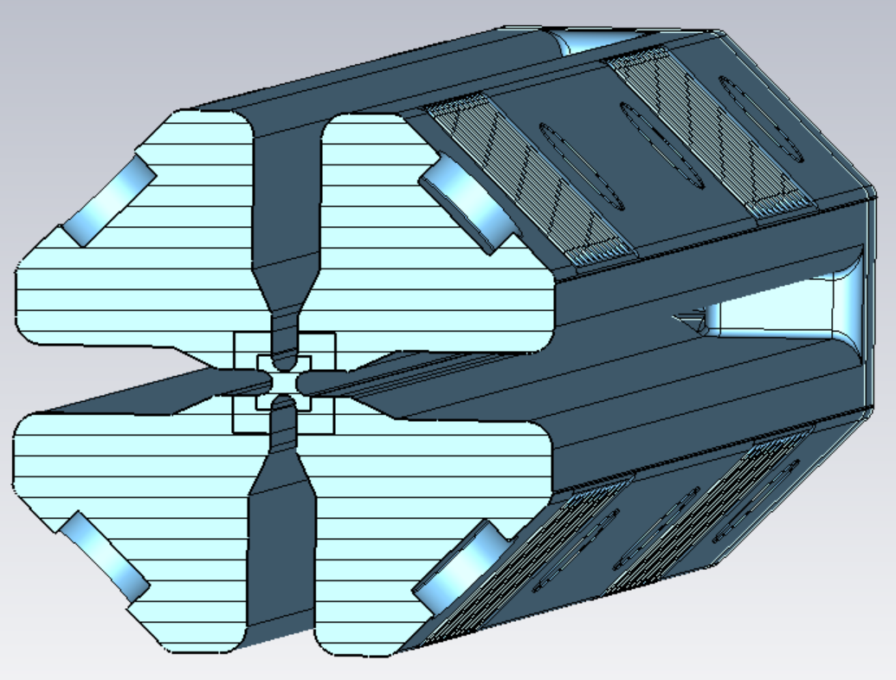
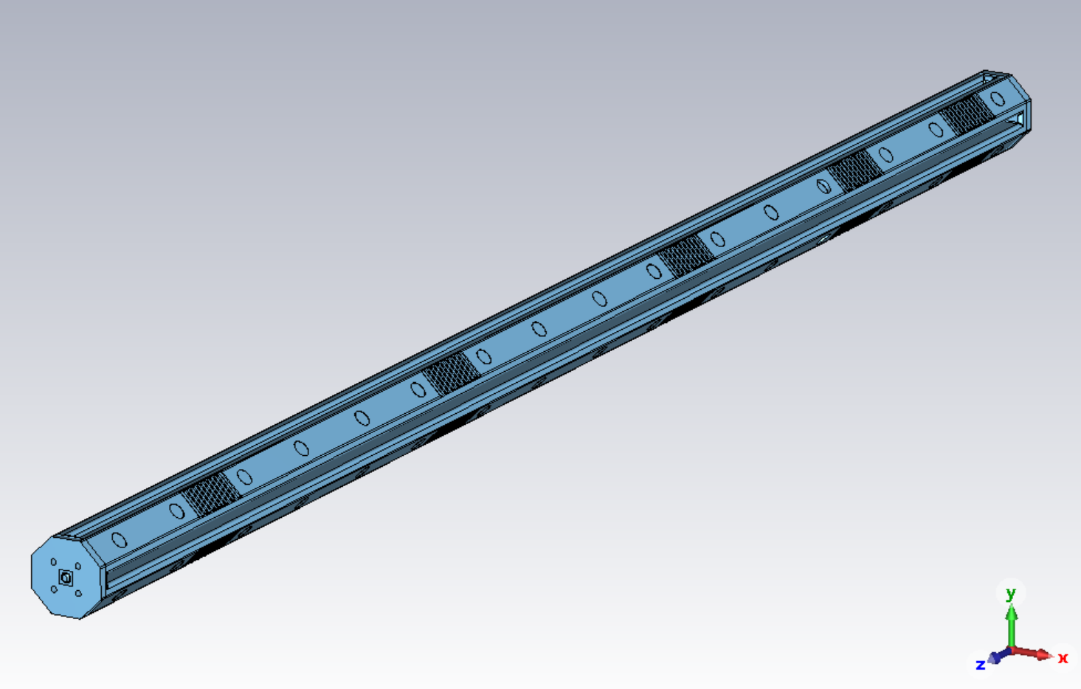
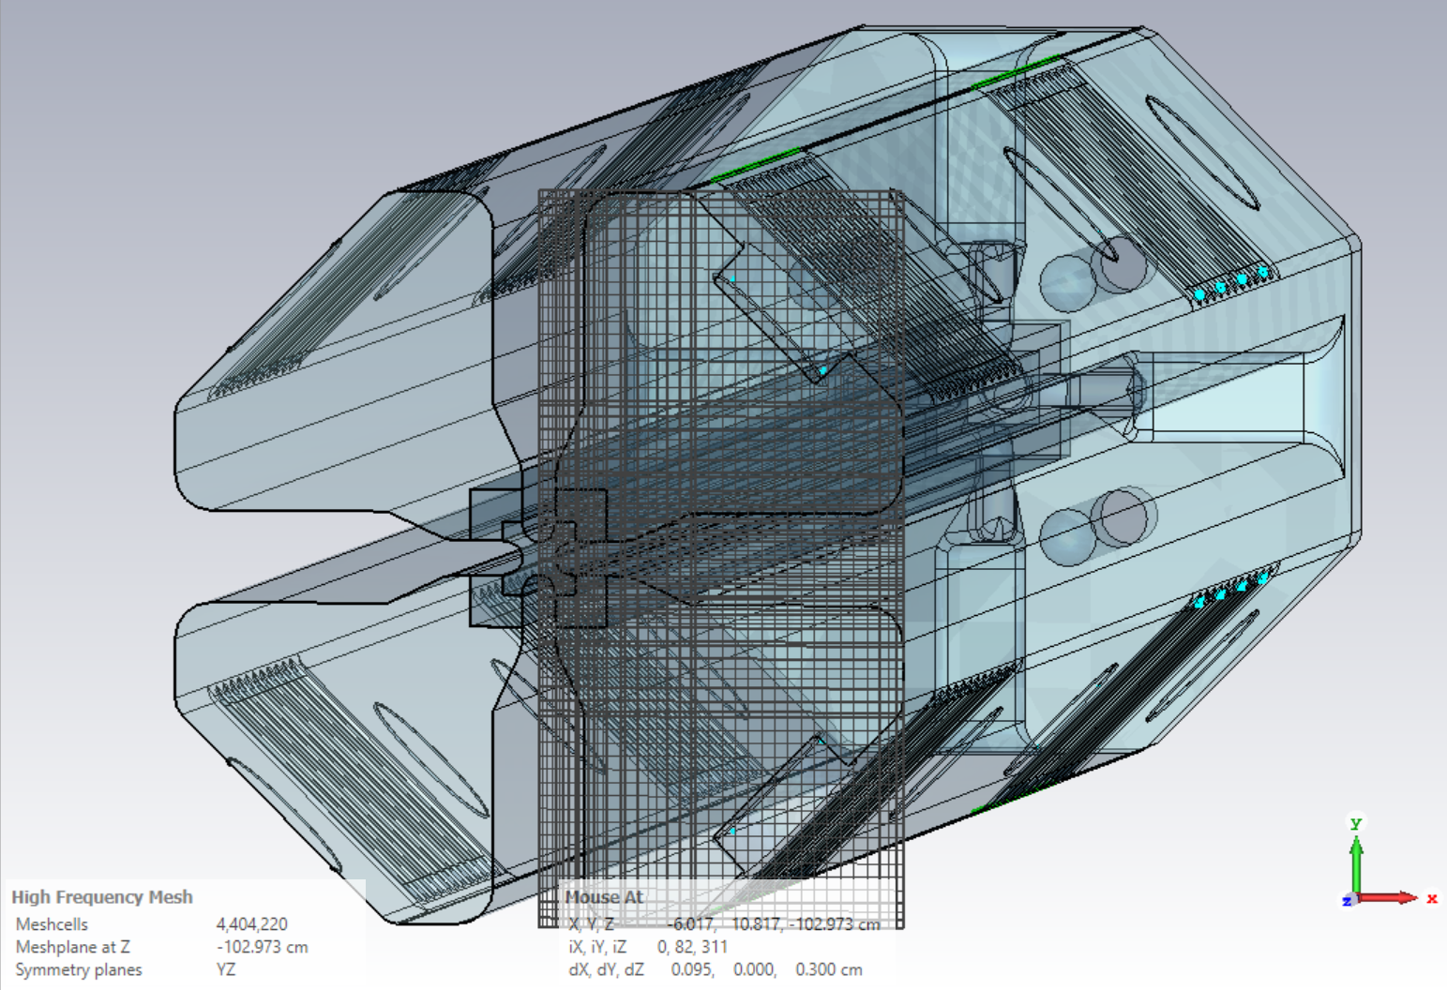
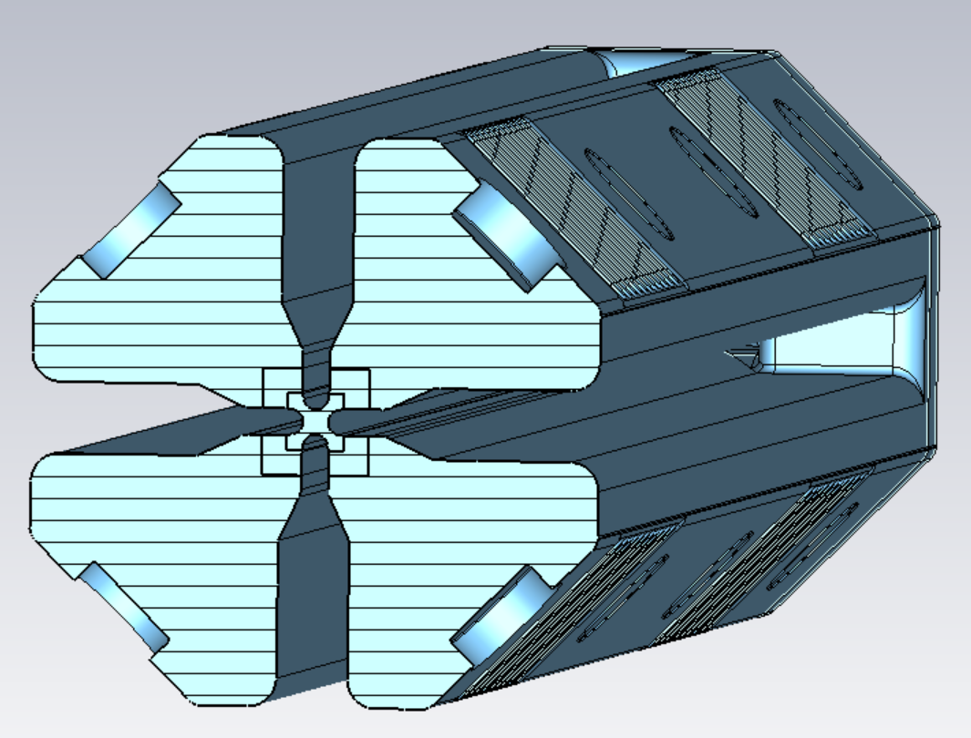
RFQ02 Model and Tuning Algorithm
4 tuners move in or out at the same time
Quad field simulation
L
L
CST simulations:
- Field response / tuner
- Frequency response / tuner
To minimize
- Delta Frequency
- Delta fields
Q4
Q1
Q3
Q2
Responses are scaled and added up for all tuners
Nonlinear responses to tuners are considered
L
L
2 tuners in Q1 and Q3 move towards the same direction
(1 in , 1 out)
Dipole field simulation
L
L+Δ
Q4
Q1
Q3
Q2
RFQ CST Model
L-Δ
L

Slide 11
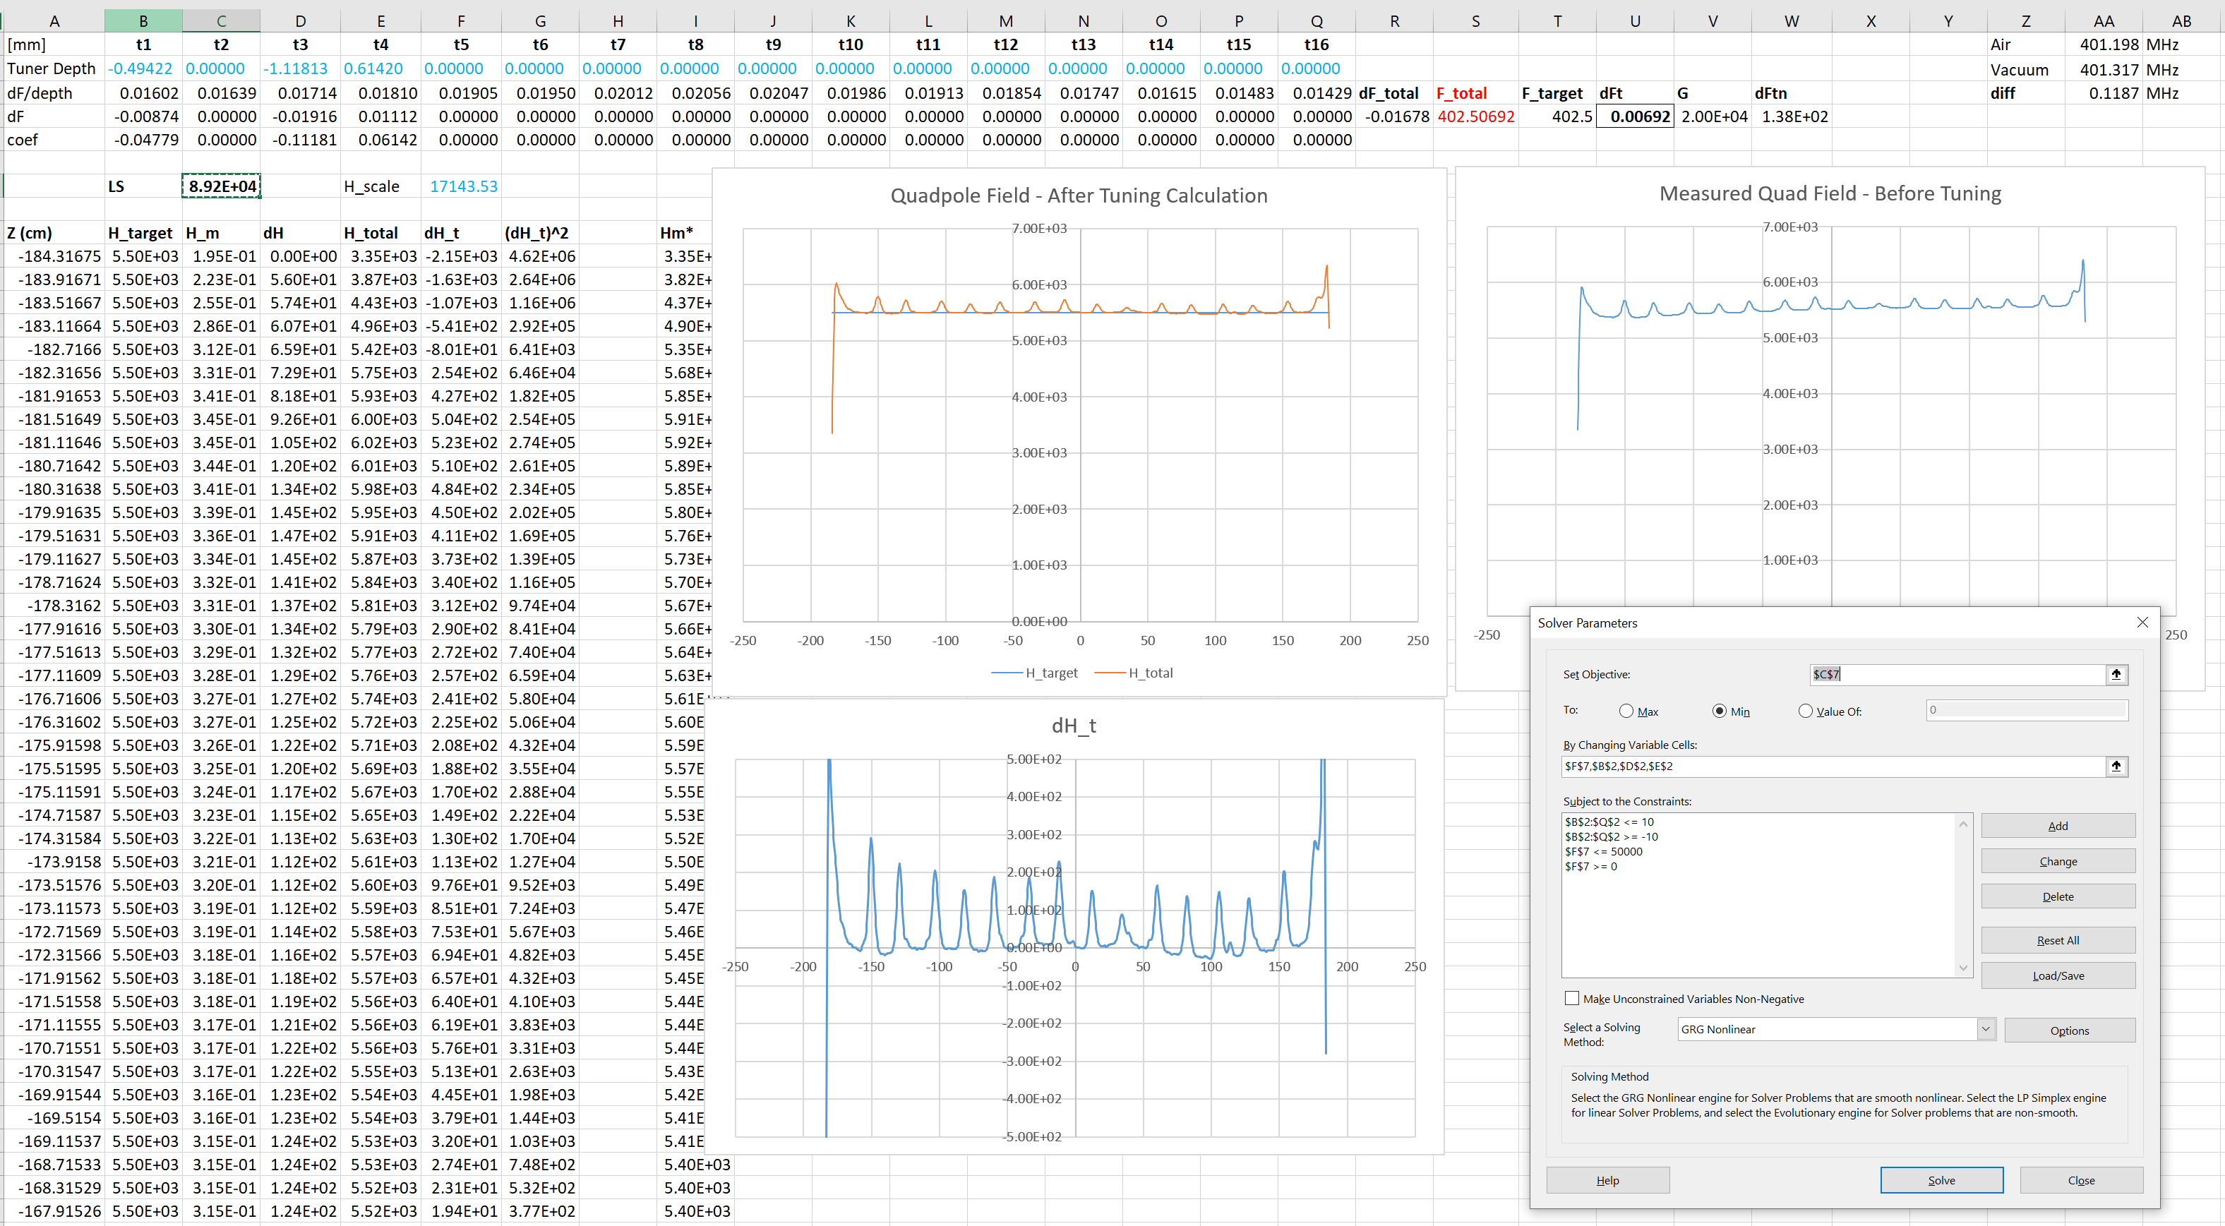
Tuning Program – Excel (Quad Field Tuning)
Tuned Frequency
H field after tuning
H field before tuning
Both Field & Frequency are tuned
Tune Quad field to flat
All 4 tuners (at the same longitudinal position Z) move in/out by same length together
Excel Solver
Field error after tuning

Slide 12
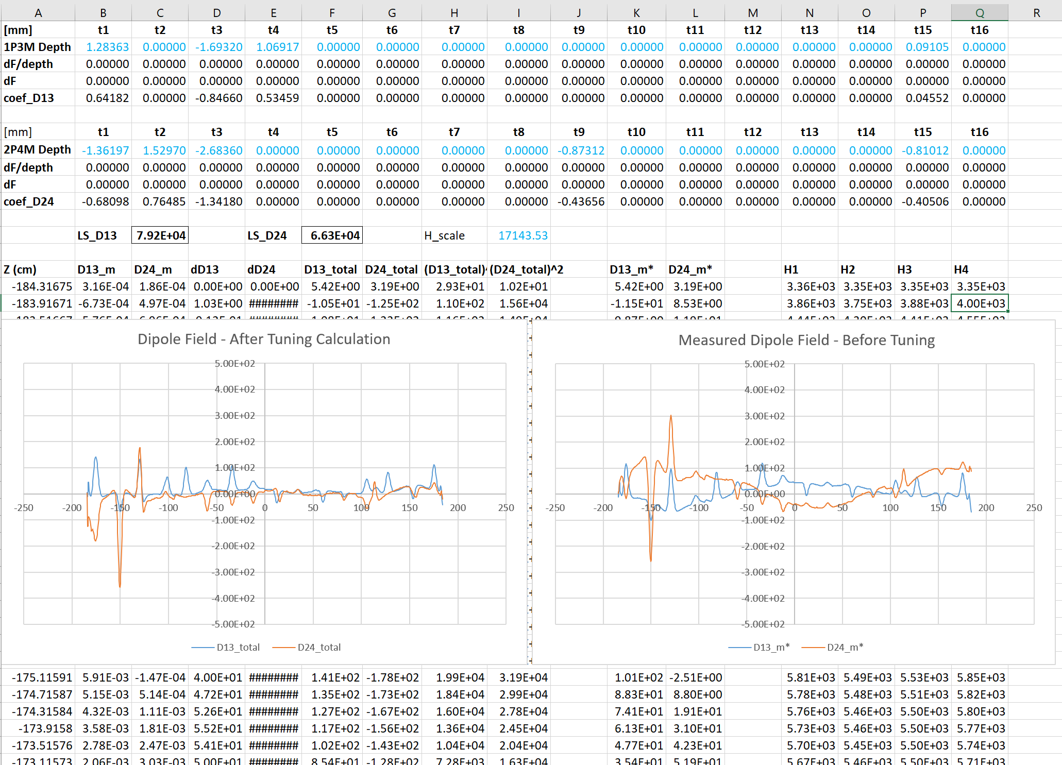
Tuning Program – Excel (Dipole Field Tuning)
Q4
Q1
Q3
Q2
Only field tuning, No Frequency tuning
Tune Dipole Field to zero
2 tuners in opposite quadrants
  - One moves in
  - One moves out by the same length
Dipole tuning almost no impact on the frequency and quad field profile!

Slide 13
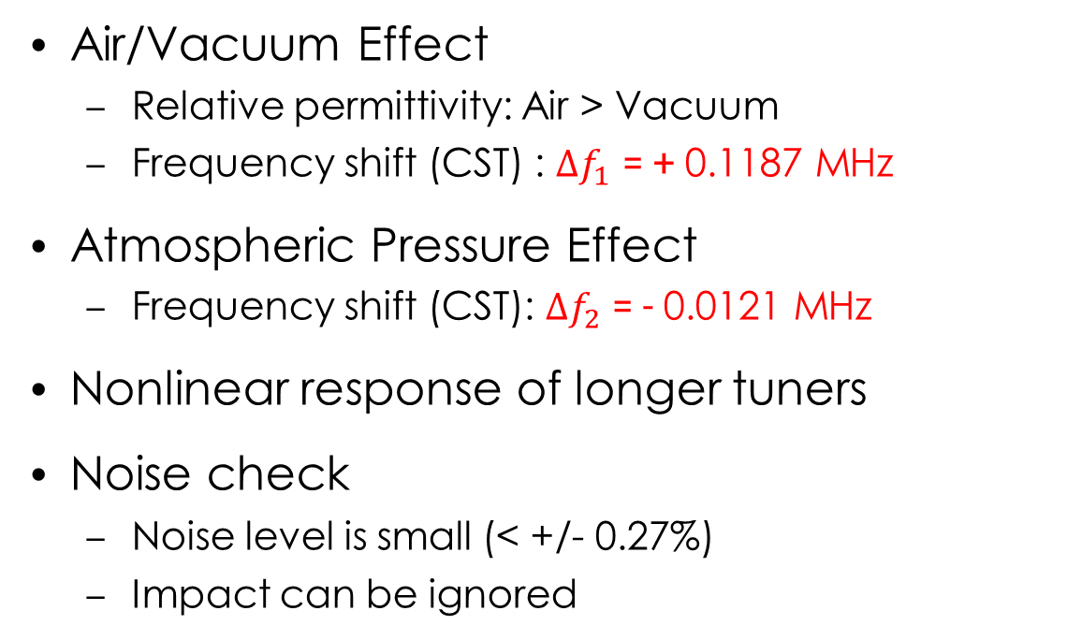
Tuning Program Improvements
Example: Tuner T1 nonlinear response
Air/Vacuum Effect
  Relative permittivity: Air > Vacuum
  Frequency shift (CST) : $∆f_{1}$ = + 0.1187 MHz
Atmospheric Pressure Effect
  Frequency shift (CST): $∆f_{2}$ = - 0.0121 MHz
Nonlinear response of longer tuners
Noise check
  Noise level is small (< +/- 0.27%)
  Impact can be ignored

Slide 14
Bead-pull Measurements – Before Tuning (Initial)
~2.5%
~7.0%
Target
~2.0%
~6.9%
Quad H = (H1 + H2 + H3 + H4)/4
D13 = (H1 - H3)/2; D14 = (H2 – H4)/2
Quad field tilt ~16.5% at entrance, ~9.0% at exit
Dipole field D24 ~7.0% (Max) and D13 ~2.5% (Max)
Target
~16.5%
~9.0%

Slide 15
Tuning Progress
Dipole field < 0.5%

Slide 16
Frequency Tuning
20 kHz

Slide 17
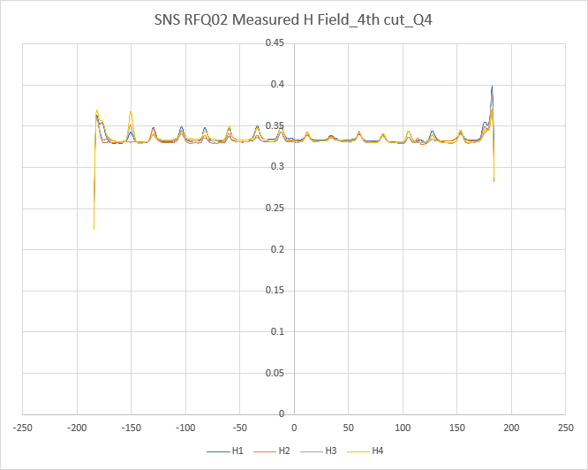
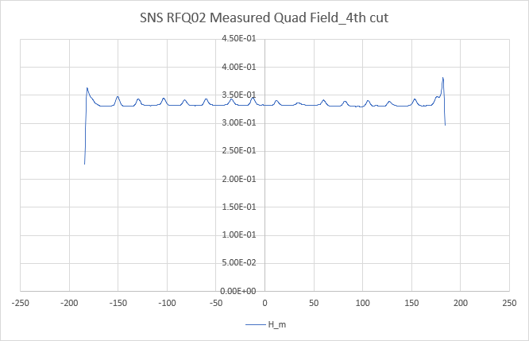
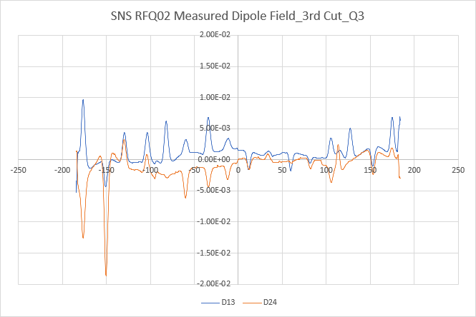
Final Measurement after 20 Slug Tuners Installed
Frequency: 402.395 MHz (Target 402.393 MHz)
  Measured F under vacuum: 402.525 MHz (7/27/2023)
Dipole field
  D13 (between Q1 and Q3) ~ 0.43% (Max)
  D24 (between Q2 and Q4) ~ 0.61% (Max)

Slide 18
Tuner Depth Changes
Module 1
Module 2
Module 3
Module 4
Module 1
Module 2
Module 3
Module 4
Q2
Q1
Q3
Q4
Module 1
Module 2
Module 3
Module 4
Module 1
Module 2
Module 3
Module 4
RFQ field tilt mainly caused by detuning in Module 1

Slide 19
Summary
Bead-pull system was developed for SNS RFQ
RFQ02 bead-pull retuning was successfully complete
Both field flatness and frequency met requirements after retuning
Thank you for your attention!
Questions or Comments?

