Slide 1
Opportunities for Electroweak Baryogenesis
Higgs off
Higgs on
Higgs off
Higgs on
Higgs off
Higgs on
Marcela Carena
Fermilab/Uchicago
9th LCTP Spring Symposium
University of Michigan, May 10, 2024

Slide 2
Outline
The Higgs field, the electroweak phase transition and the possible origin of the matter-antimatter asymmetry of the Universe
Electroweak Baryogenesis (EWBG) in the Standard Model?
  the electroweak phase transition in the early universe
  the need for new sources of CP violation
New models for electroweak baryogenesis
  a singlet extension of the Standard Model
  baryogenesis with dark CP violation
  implications for gravity waves, EDMs, LHC, and dark matter experiments
Outlook and future directions
Notes:
xand, I will then propose new ideas/new physics phenomena that will enable the EWBG mechanism and brielfy disucss its phenomenology
I will mention ongoing/future research directions at the end

Slide 3
Higgs questions to be addressed in HL-LHC
Are there Higgs cousins? What are their properties and impact on the Higgs behavior?
look for other Higgs-like particles
Is the Higgs self-interaction different from the one expected in the Standard Model?
→ look for di-Higgs production
Is the Higgs boson a composite of other particles?
→ look for evidence of new forces or new heavy fermions
Does the Higgs boson violate CP, the symmetry between matter and antimatter?
look for anomalies in Higgs boson decays
Is the Higgs boson a portal to dark matter, a dark sector and new forces?
→ look to see if Higgs bosons decay into something “invisible”
Is the fact that there is more matter than antimatter connected to the Higgs boson
via an early universe phase transition that broke the electroweak symmetry?
→ what we look for at the LHC/elsewhere depends on how/if such connection exists
Overarching mystery:
What was the mechanism behind electroweak symmetry breaking?

Slide 4
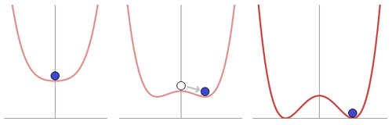
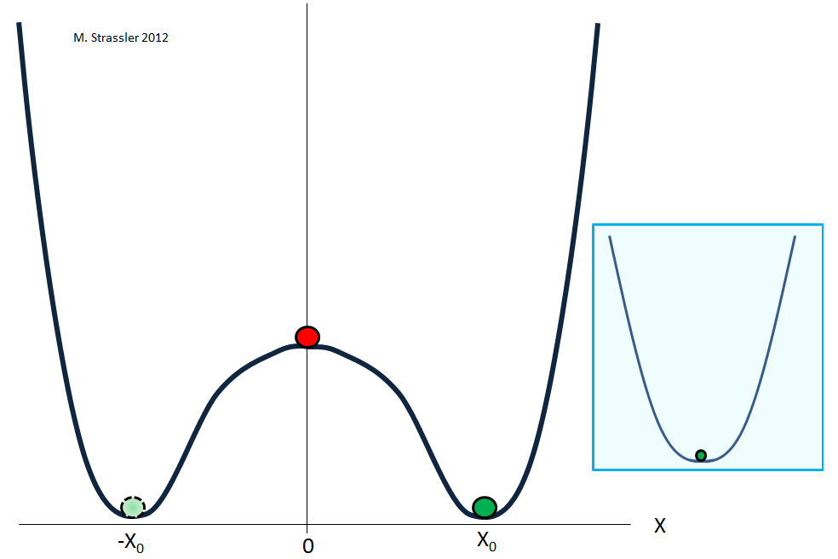
Electroweak Symmetry Breaking and the Phase Transition
We put by hand the condition for EWSB
There is no explanation for how the Higgs mass parameter and self-coupling are determined
What is behind the EWSB mechanism?
Radiative Breaking (like in Supersymmetry) or Compositeness
What was the history of the electroweak phase transition?
The Higgs discovery is strong evidence that the Higgs field turned on in the early moments of the Big Bang; the Electroweak Phase Transition took place
We need to understand its dynamics
Today I will focus on the possibility of generating the matter-antimatter asymmetry of the universe at the moment the Higgs turned on ➔ electroweak baryogenesis
Notes:
=========================================================
Its existence makes the SM by itself self consistent up to very high energies (it is challenging because does not tell us where the threshold for new physics might be
Calculability = consistency and perturbative
Apparent metastability is due to the fact that the higgs interacts with fermions (specially the top quark since it is the heavies one) and hence the potentila becomes unstable in field space
Its discovery also raises many questions:
What is encoded in the HIggs potential?
In the SM we fit the mass parameter to be negative, otherwise no EWSB, but why should we do that?
.Hoe..
What ..
Some basic things that we are uncomfortable about:
Metastability
scalar particle masses are not protected by any symmetry and induce quadratic dependence on large energy scales: quadratic divergences
Some big questions related to it
Other scalars, EWPT?
================
Important to know what you do not know
The lifetime of our vacuum ((the probablity that it tunnels to the true vacuum) is much larger that the age of the universe (10^10 years=age of the universe)
A false vacuum may only exist at a local minimum of energy and is therefore not stable, in contrast to a true vacuum, which exists at a global minimum and is stable. A false vacuum may be very long-lived, or metastable.
A true vacuum is a global minimum of energy, and coincides with a local vacuum. This configuration is stable.
The precise measurement and modeling of the Higgs will enrich both our understanding of its properties, and the opportunities to use it as a search and discovery tool
Without the Higgs boson, the calculability of the SM would have been spoiled. In particular, perturbative unitarity [5] would be lost at high energies since the longitudinal W/Z boson scattering amplitude would grow with the centre-of-mass energy. In addition, the radiative corrections to the gauge boson self-energies would exhibit dangerous logarithmic divergences that would be difficult to reconcile with EW precision data. With the discovery of the Higgs boson, the SM is a spontaneously broken gauge theory and, as such, it could a priori be consistently extrapolated well above the masses of the W and Z bosons. Hence, formally there is no need for new physics at the EW scale. However, as the SM Higgs boson is a scalar particle, at the quantum level it has sensitivity to possible new physics scales. Quite generally, the Higgs boson mass is affected by the presence of heavy particles and it receives quantum corrections which destabilise the weak scale barring a large fine-tuning of unrelated parameters. This is known as the Higgs naturalness or hierarchy problem [6]. It has been the prime argument for expecting new physics right at the TeV scale.

Slide 5


The Mystery of our Asymmetric Universe
Antimatter is governed by the same interactions as matter.
Observable Universe is mostly made of matter
Antimatter only seen in cosmic rays, radiative decays or is produced in the lab
Precision Cosmology: information on baryon abundance
Abundance of primordial elements
Predictions from Big Bang Nucleosynthesis
CMB
Matter
Antimatter
10,000,000,001
10,000,000,000
η
What generated the small observed baryon-antibaryon asymmetry ?
Initial condition, or generated during the evolution of the universe?

Slide 6

Sakharov conditions for baryogenesis
Baryon (or Lepton) number violation: if universe starts symmetric
C and CP violation: treat baryon/anti-baryon differently
(to remove antimatter)
Out-of-thermal equilibrium: suppress inverse processes
A number of mechanisms for baryogenesis have been proposed that satisfy all three Sakharov conditions
Electroweak Baryogenesis (EWBG), involving the Higgs field
Other alternatives: e.g. Leptogenesis, involving neutrinos, dark sector BG, etc
Can successful electroweak baryogenesis take place in the SM?
Discuss the process of generation of the baryon asymmetry at the EWPT, introducing all the elements we need to satisfy the Sakharov conditions
Consider the conditions to preserve such generated baryon asymmetry after it is produced at the electroweak phase transition
Investigate the particle content and specific properties of the SM and how they impact the possibility of EWBG

Slide 7
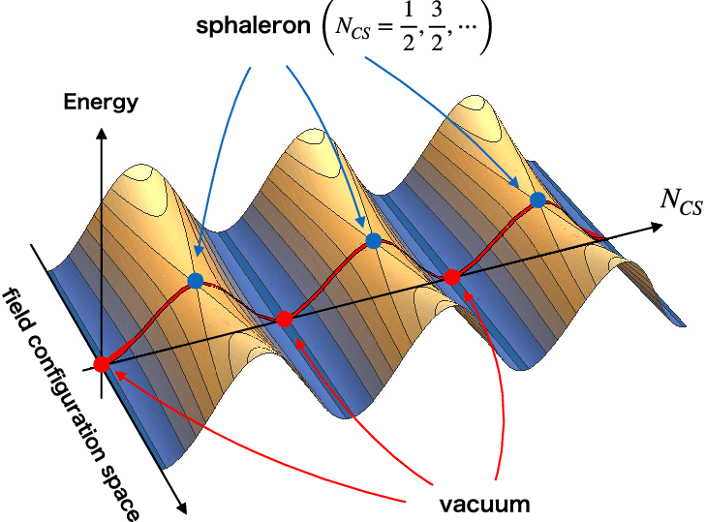
Sakharov Condition #1: breaking B and L conservation
After quantization, the SM conserves B-L, because B-L is tied to the SU(2)_{L} gauge symmetry of the weak interactions
B + L is not conserved in the Standard Model, because of a quantum anomaly
The anomaly is related to the existence of a winding number N_{CS} relating degenerate states of the SU(2)_{L} gauge fields separated by energy barriers
Creates a nonzero B and an equal nonzero L:
Such that
“sphalerons” (blue dots) are gauge + Higgs field configurations that approximate a transition that “goes over the hill” from one winding state to the next
At finite temperature, the sphaleron process occurs, with the usual Boltzmann factor:

Slide 8
Sakharov Condition #2: C and CP violation
CP violation occurs in the Standard Model from a complex “CKM” phase in the couplings of the Higgs field to quarks
This may also be true for leptons, but we need better data (DUNE experiment)
As a result of quark CP violation there are processes where (e.g.):
This can result in asymmetries between the number density of quarks & antiquarks
In the absence of C violation this also implies , which implies conservation of baryon number
As we shall see sphalerons will do the job of violating the C symmetry because they couple only to left-handed quarks and leptons

Slide 9
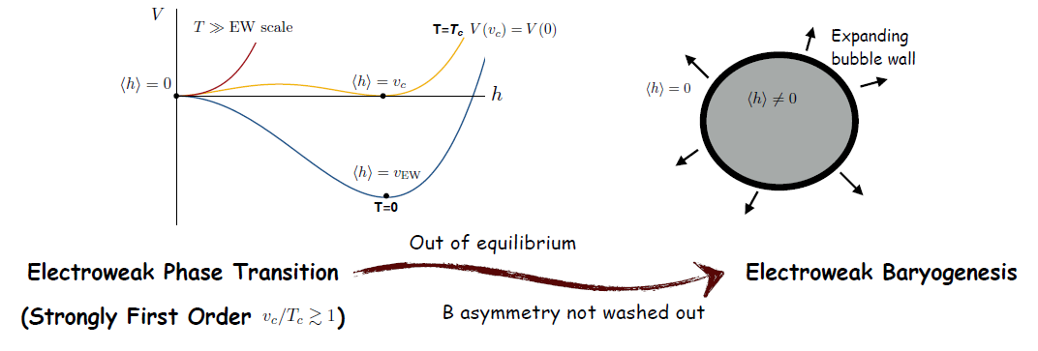
Sakharov Condition #3: Out of Equilibrium
Assume B = L = 0 at high temperatures (T>Tc)
In a first order electroweak phase transition, universe tunnels from <h> = 0 to <h> ≠ 0 vacuum via bubble nucleation.
Higgs off
Higgs on
Higgs off
Higgs
on
Higgs off
Higgs
on
Bubbles nucleate and expand in the presence of a plasma of SM particles
Bubble wall moves at near the speed of light, depending on the frictional force the plasma particles exert on it
Processes near the wall highly out of equilibrium
The CP violating dynamics that we need can occur at the bubble walls
Notes:
First order phase transitions proceed by bubble nucleation. A bubble of the new phase (the true vacuum) forms and then expands until the old phase (the false vacuum) disappears. A useful analogue is boiling water in which bubbles of steam form and expand as they rise to the surface
(During a first-order phase transition, the matter fields get trapped in a 'false vacuum' state from which they can only escape by nucleating bubbles of the new phase, that is, the 'true vacuum' state)
Free energy is given by the Bulk free energy per unit Volume (what we call the potential energy) and the surface free energy per unit area
Bubbles form just below TC when the inside energy is lower that the outside energy and can compensate for the positive surface energy (pin>pout) with p = -Veff ➔ Veff(v,T) < Veff (0, T), this occurs for Tn; (Tn < Tc)
The potential energy has a discontinuity because you have two solutions which minimize the potential energy and there is a gap between the two (➔first order phase transition)
Phase transitions can be either dramatic - first order - or smooth - second order:
First-order phase transitions (illustrated above and to the left) occur through the formation of bubbles of the new phase in the middle of the old phase; these bubbles then expand and collide until the old phase disappears completely and the phase transition is complete.
Second-order phase transitions, on the other hand, proceed smoothly. The old phase transforms itself into the new phase in a continuous manner.
Cline: The critical temperature Tc is defined to be the temperature at which the two minima are degenerate in the first order case, or the temperature at which V ′′(0) = 0 in the second order case.

Slide 10
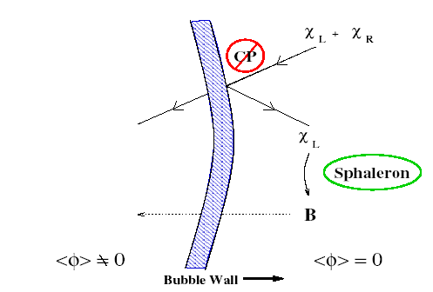
CPV effects and baryon number generation at the EWPT
Start with B = L = 0 at T >Tc
Due to CPV induced by Higgs-quark interactions, particle flow into the expanding
bubble wall creates a chiral asymmetry - an excess of antiquarks - just outside the
bubble
is faster than
leptons
antileptons
Unsuppressed sphaleron process will produce an excess of B and L, in equal quantities but just for the left handed chiral particles
an excess of quarks just outside the bubble
No Sphaleron effects
With Sphaleron effects
The Higgs boson discovery supports the occurrence of an EW phase transition
05-02-2024

Slide 11
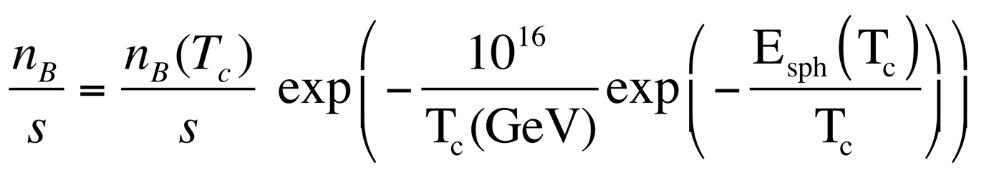
Baryon Asymmetry Preservation
For a short period, EW sphalerons work to generate the desired baryon asymmetry;
Then need to shut off quickly to prevent washout of the asymmetry
if n_{B} = 0 at T > Tc
Recall:
If Γ_{ΔB ≠ 0} ≲ H ~ T²/ M_{Pl}
<< 1 ➔ v(T_{c}) /T_{c} ~ 1
∕
>
B processes frozen
To preserve the baryon asymmetry demands a Strong First Order EWPT
Transition does not occur at T_{c}, but rather at T_{n} (bubble nucleation temp.) [T_{n} < T_{c}] We use semiclassical arguments to estimate the nucleation probability to be approx. one per Hubble time to determine T_{n} ; one requires S_{bounce}/T_{n} ~ 140

Slide 12
The failures of EW Baryogenesis in the Standard Model
All the ingredients to fulfil Sakharov’s conditions
Baryon number violation: Sphalerons
CP violation: CP violating phase in mixing of the three generations of quarks
Non-equilibrium: At the Electroweak Phase Transition
BUT
#1. Contribution from CP violation cannot catalyze enough of an asymmetry
CPV is proportional to the so-called Jarlskog’s invariant, that is proportional to the CKM mixing angles appearing in W boson interactions with the 3 generations of quarks
With δ the CPV phase
High order loop effects needed to generate a complex contribution to the top quark - Higgs interaction in the bubble wall
With
➔
Gavela, Hernandez, Orloff, Pene, Quimbay’94

Slide 13
The failure of EW Baryogenesis in the Standard Model
#2. With the measured 125 GeV Higgs mass, the EWPT is a crossover.
Need to consider the finite temperature Higgs potential:
Defining T_{c} and requiring that <φ(T_{c})> = v (T_{c}) is a minimum yields
v (T_{c}) / T_{c} ~ E_{SM} / λ
controls the strength of the phase transition
Since λ = m_{H}²/v²
To sufficiently suppress sphaleron processes in the true vacuum and prevent washout of the asymmetry
v(T_{c})/T_{c} > 1 ➔ m_{H} < 40 GeV
Kajantie, Laine, Rummukainen, Shaposhnikov ‘88

Slide 14
Electroweak Baryogenesis needs new phenomena
To provide new sources of CPV that catalyze enough of a chiral asymmetry to seed the observed baryon asymmetry via sphaleron processes
To render the EWPT strongly first order that allows to freeze sphaleron effects as the universe tunnels into the real vacuum
Many possible SM extensions, that require new particles/new forces at the electroweak scale - at the reach of existing and future experiments
Singlet extensions of the Standard Model
Two Higgs doublet Models
Supersymmetric models
MSSM: light stop scenario, ruled out by Higgs precision
NMSSM: through additional scalars with CP violation - an appealing possibility
Models with Dark CP violation
Models with heavy Fermions
SM effective theory with additional higher order operators
Models of EW symmetry non-restoration/delayed restoration
...

Slide 15
Simplest Case:
A singlet extension of the Standard Model

Slide 16


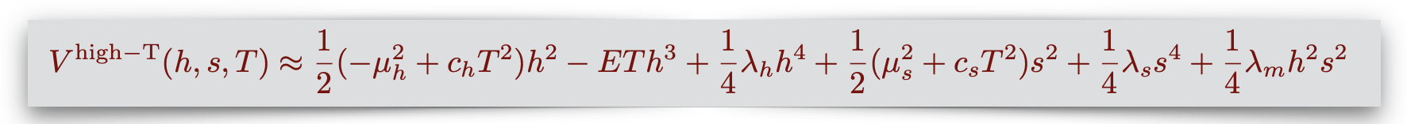
Enhancing the EWPT strength through a singlet scalar
Scalar couples to the Higgs and affects the tree level potential
We have separated out terms that explicitly break the Z₂ symmetry:
Explicit Z₂ breaking →
Z₂ - preserving (at T=0) →
Spontaneously Z₂ breaking →
Possible scenarios:
The last case follows naturally in scenarios where, e.g., the singlet is the Higgs-like boson of a complex scalar in the dark sector that spontaneously breaks a dark gauge symmetry
To determine phase transition patterns requires to compute temperature and quantum effects on the potential
Different thermal histories, with 1 or 2 step phase transitions and strong first order EWPT

Slide 17
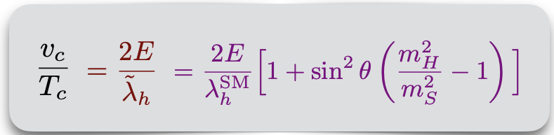
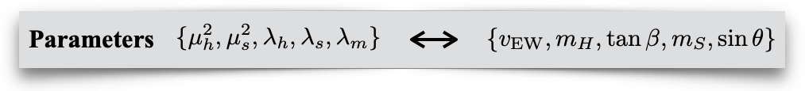
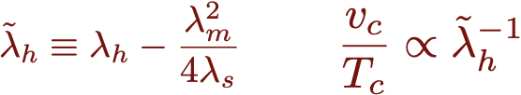
EWPT with Spontaneous Z₂ Breaking: a Strong 1st order EWPT
The electroweak phase transition strength – Spontaneous Z₂ breaking scenario
Sizeable quartic mixing coupling λ_{m} needed for a strong 1st order EWPT ➔ v (T_{c}) / T_{c} >1
Only 3 parameters after defining Higgs mass and v.e.v
λ_{m} proportional to sinθ (the h-s mixing parameter), and strongly constrained by Higgs precision measurements
a light singlet: m_{S} < 50 GeV is required
M.C, Z. Liu, Y. Wang, ‘19
If singlet sufficiently light, the Higgs can have exotic decay: H→SS
Also, v (T_{c}) / T_{c} >1 demands significant S-H couplings
➔ Hence, BR(h → SS) is bounded from below
Exotic Higgs decays are a potent probe of Singlet extensions with viable EWBG
Many ongoing searches at ATLAS and CMS for h → ss → 4b, 4μ, 4τ, 4γ, bbμμ, bbττ,…

Slide 18
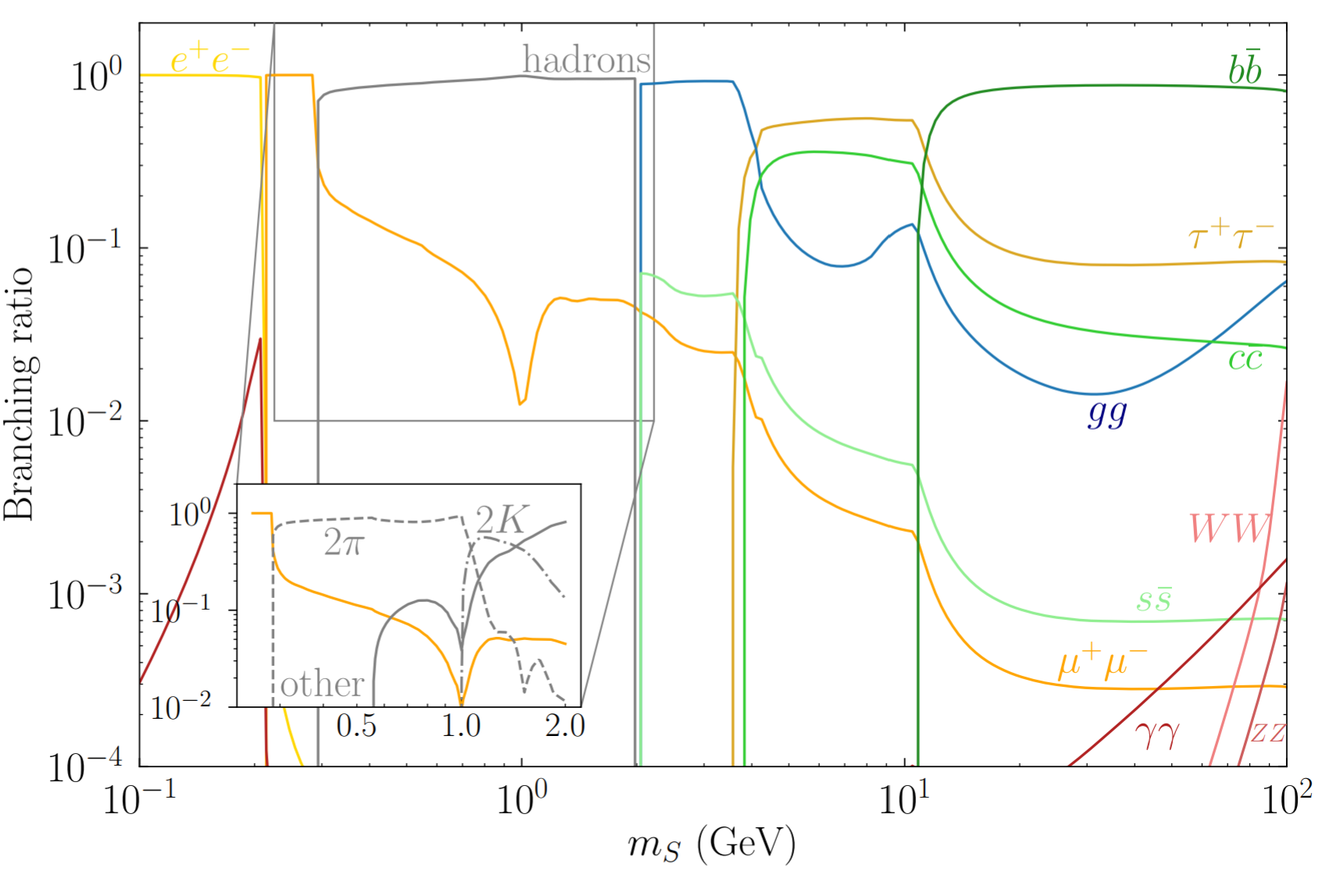
Probing Z₂-breaking Singlet Extensions via Exotic Higgs Decays
Current LHC data from global fit to Higgs couplings constrains
BR[H→ exotics] < 16%
H → SS can lead to many final states with S inheriting Higgs-like hierarchical BR’s via mixing
HL-LHC projected reach on Br(h → ss) from Br(h → ss → XXYY)
Strong 1st order EWPT
Bounds on exotic Higgs decays
m_{S}[GeV]
M.C., Tong Ou, Yikun Wang, et al, LHEP 2023 (2023)
Direct search and Higgs precision measurements can probe large regions of space compatible with a strong 1st order EWPT

Slide 19
Probing the Singlet Extension for EWBG via Gravitational Wave Signals
Motion of the bubble wall and energy budget
friction term
scalar + plasma dynamics
-Wall wants to expand (“pressure”), as the scalar field value changes
-Wall is pushed back by plasma (“friction”)
Sources of stochastic GWs power spectrum
collisions of bubbles
compression/sound waves of plasma
plasma turbulence
Case of interest for EWBG:
Bubbles that achieve a relativistic terminal velocity - sizable friction from the plasma
Vacuum energy release creates a sound shell and a turbulent flow in the plasma that source the GW

Slide 20
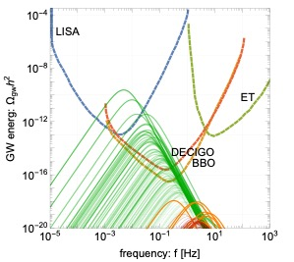
Probing the Singlet Extension for EWBG via Gravitational Wave Signals
The main parameters controlling the stochastic GW background power spectrum
.
Inverse time duration of the Phase transition β/H
M.C, Z. Liu, Y. Wang, ‘19
Wall velocity v_{w}
Strength of GW signature from the PT
Fitted from numerical simulations
Peak frequency set by the average bubble separation f_{peak} ~ O(β/v_{w})
subsonic velocity: v_{w} = 0.5
T* = T_{n} ~ 50 -100 GeV
More to come on bubble and GW dynamics: M.C., A. Ireland, T. Ou , Isaac Wang

Slide 21
Baryogenesis with Dark CP Violation:
A model with gauged lepton number
Marcela Carena | New Opportunities for Electroweak Baryogenesis

Slide 22
A new force in nature to transmit CP violation from a dark sector
Electroweak Baryogenesis demands new, sizeable CPV sources
Electric Dipole Moment (EDM) experiments set constrains on new sources of CVP
Electron EDM and the latest ACME/JILA experiment results →II
[In the SM d_{e} ~ 10⁻³⁹ e cm]
Weak scale CPV:
f
Problem: most models of electroweak baryogenesis require sinθ_{CPV} ≥ 10⁻²
Z₂ and EW Restoration

Slide 23
A new force in nature to transmit CP violation from a dark sector
Electroweak Baryogenesis demands new, sizeable CPV sources
Electric Dipole Moment (EDM) experiments set constrains on new sources of CVP
Electron EDM and the latest ACME/JILA experiment results →II
[In the SM d_{e} ~ 10⁻³⁹ e cm]
Weak scale CPV:
f
Problem: most models of electroweak baryogenesis require sinθ_{CPV} ≥ 10⁻²
Solution: new agent of CP violation is a SM gauge singlet, hence can only contribute to electron EDM through higher order quantum corrections
New Challenge: How to transfer CP violation in the early universe?
Through a new force that connects the dark sector to ours
Z₂ and EW Restoration
M.C., M. Quiros and Y. Zhang: Phys. Rev. Lett. 122 (2019) 20, 201802; Phys. Rev. D 101 (2020) 5, 055014

Slide 24
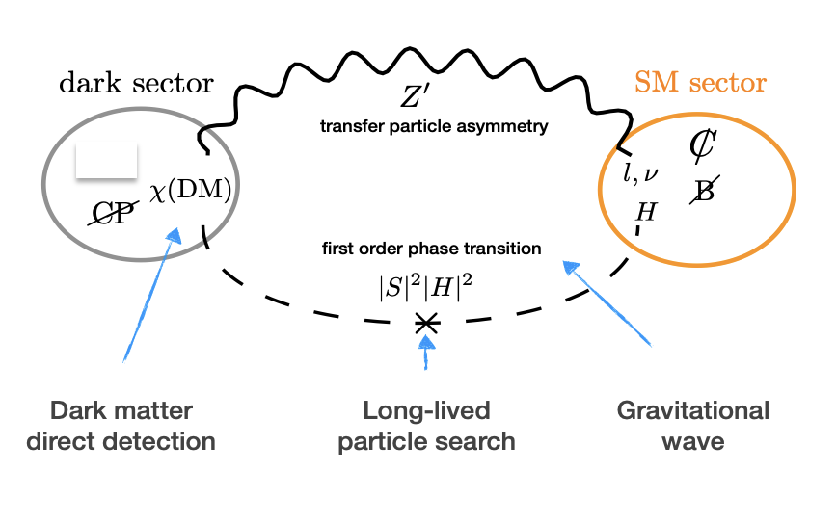
Dark CPV: a New mechanism for EW Baryogenesis
A new force: a U(1) gauged lepton number
New particles: Z’, S, χ (dark matter)
Higgs–Singlet portal to the dark sector
to source CP violation and induce a first order phase transition
Z’ portal to the dark sector
to transfer the CP violation to the SM sector
M.C., M. Quiros and Y. Zhang: Phys. Rev. Lett. 122 (2019) 20, 201802; Phys. Rev. D 101 (2020) 5, 055014

Slide 25
A new mechanism for electroweak baryogenesis:
Higgs–Singlet portal to the dark sector
to source CP violation and induce a first order phase transition
Z’ portal: to transfer the CP violation to the SM sector
A dark matter fermion χ talks to the Higgs boson via a new SM singlet scalar S
EW sphalerons cannot touch the CP asymmetries in the χ electroweak singlet
The new gauge boson Z’ couples to χ and SM leptons; Z’ transfers CPV to us and generates a lepton CP asymmetry at T_{n}
A varying mass m_{χ}, along the expanding bubble wall direction, together with the S vev, generates a CP asymmetry in the χ dark matter particles
The sphalerons, active outside the bubble wall create equal asymmetries in B and L number ➔ ΔN_{L} = ΔN_{B}
A new scalar-Higgs interaction, λ_{SH} |S|² |H|², can trigger strong first order EWPT
M.C., Y-Y. Li, T. Ou and Y. Wang, JHEP 02 (2023) 139

Slide 26
Dark CPV: The Higgs Portal to the Dark Sector
Sourcing CP Violation
MC, Quiros and Yue Zhang, PRD 101, 2020
The direct coupling between a SM gauge singlet fermion χ and the Higgs boson would be higher dimensional. To write a renormalizable theory introduce a new scalar S
Scalar S - also SM singlet - couples to dark fermion (DM)
In the presence of a relative phase between m₀ and y, a chiral charge asymmetry in χ particles can be generated
This requires m_{χ} to vary along the z direction, together with the S vev
A new EW phase transition
A new scalar-Higgs interaction,
λ_{SH}|S|²|H|², with λ_{SH} > 0,
can trigger strong first order EWPT
Z₂ and EW Restoration
Z₂ and EW NON- R
z is distance from bubble wall
Need at least to avoid CPV being redefined away
M.C., Y-Y. Li, T. Ou and Y. Wang, JHEP 02 (2023) 139

Slide 27
Dark CPV: The role of the Z’ Portal
EW sphalerons cannot touch the chiral charge asymmetries in χ because it is an SU(2) singlet — must transfer such CPV effect in other ways to the SM sector
Introduce a new U(1) gauge boson that couples to the dark fermions and SM leptons
If qχ_{L} ≠ qχ_{R} (required by anomaly cancellation), there is a net charge density, that generates a background for the Z’₀ component
(static electric potential analogue).
Δ
-Δ
α =0 component
Ζ’ couples to SM leptons
The Z’₀ background generates a chemical potential for them.
This in turn generates a Thermal Equilibrium Asymmetry in SM leptons

Slide 28
Dark CPV: Baryogenesis
Solving the corresponding Boltzman equation , considering sphaleron rate suppressed inside the bubble wall, one generates a lepton asymmetry Δn_{L}
Γ_{sph} unsuppressed outside the bubble but exponentially suppressed inside the bubble
Sphaleron processes generate equal asymmetries for B and L → Δn_{L} = Δn_{B}
➔ η_{Β} ≃ 0.9 10 ⁻¹⁰ as needed
Crucial Condition:
Non-vanishing lepton asymmetry depends on the EFT at EW scale having an anomalous lepton number, but a gauged U(1)_{l} should be anomaly free
SU(2)_{L} anomalons must decouple from thermal number density

Slide 29
Dark CPV and EWBG: Phenomenology
M.C., M. Quiros and Y. Zhang : Phys. Rev. Lett. 122 (2019) 20, 201802; Phys. Rev. D 101 (2020) 5, 055014
M.C., Y.Y Li, Ou and Wang, JHEP 02 (2023) 139
Model parameters in the scalar, Z’ and dark sectors need to accommodate to:
Strong 1st order EWPT, yield the observed baryon asymmetry and DM relic density
Fulfill experimental constraints / open new opportunities:
Predicts the existence of a new force carrier Z’, leptophilic ➔ Z’ searches.
Predicts very small EDM’s, but can be at reach in next round of experiments
Predicts a new Higgs portal scalar S, which could mainly decay into Z’ s.
The χ particle qualifies as a thermal DM candidate ➔ direct detection searches
Strong 1st order EWPT can generate stochastic gravitational wave signatures possibly observable at current/future GW detectors
Leading EDM arises at higher loops
naturally suppressed by one or two orders of magnitude below current limit for CPV sources of order one
Z₂ and EW Restoration

Slide 30
New forces and dark matter searches
Benchmark models for dark CP violation baryogenesis
generate the observed baryon asymmetry of the universe (BAU) at a strong first order electroweak phase transition
reproduce the observed dark matter relic density
Z’ mass and new force coupling strength
Direct Dark Matter detection
Z’ exchange dominant besides for
large m₀ (hence mχ ) and small g’²/m²_{Z’}
XENON1T
Z’ exchange only
BAU proportional to g’²/m²_{Z’}
XENON1T
Most relevant annihilation channel for relic density χχ→ ss,aa,sa ➔ λ-m₀ connection

Slide 31
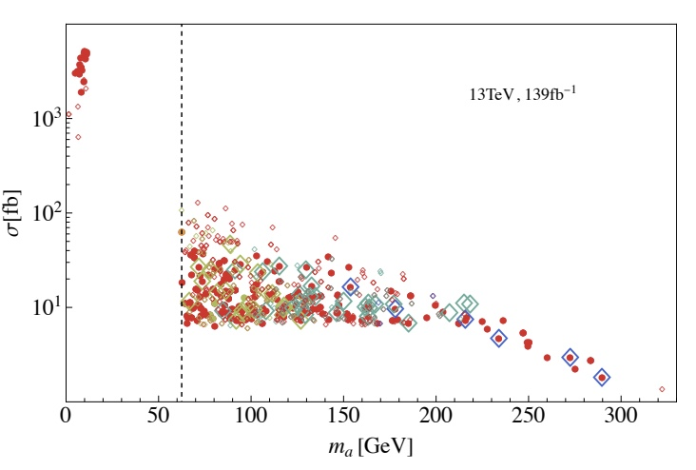
Signals of strong first order electroweak phase transition
Searches for long-lived scalars at the LHC
Z’ into SM leptons, with on/off shell Z’s
Solid circles pass both a and s search constraints, while open diamonds are excluded via prompt and long-lived searches, with current data
Gravitational wave signals
Total power spectrum: a linear combination of sound waves and MHD turbulence contributions
ma < (>) m_{h}/2 for dark (light) green curves.
The power-law integrated sensitivity prospective curves shown for comparison.
A first study, more exploration is ongoing

Slide 32
Outlook
Baryogenesis is one of the most compelling problems in particle physics and cosmology
Electroweak baryogenesis, while not the only possible solution, gives the opportunity to connect this fundamental problem to another one: the origin and cosmic history of electroweak symmetry breaking
Electroweak baryogenesis requires new phenomena at the electroweak scale, providing interesting targets for LHC experiments as well as gravity wave observations and EDM experiments
And as we have seen, there is the possibility to connect electroweak baryogenesis to features of the dark sector, with a target at direct dark matter detection experiments

Slide 33
Future directions and work in progress
Explore relations between EW phase transition parameters governing the sphaleron process and the strength of gravity wave signals.
First principles determination of bubble wall parameters.
Investigating EWBG for supersonic wall velocities
Resummation of large thermal corrections to multi-field effective potentials for accurate prediction of phase transitions and better determination of gravity wave signals.
Quantum simulation formalism applied to real-time wave packet evolution to compute transmission and reflection dynamics at the bubble wall.
M.C., A. Ireland, T. Ou, I. Wang
H Bahl, M.C., A. Ireland, C. Wagner, arXiv:2404.12439
M.C., Y-Y. Li, T. Ou, H. Singh

Slide 34
Extras
Notes:
The first Sakharov condition is that we have to violate conservation of Baryon and Lepton number.
B-L is conserved :When you chose the particle content of the SM to cancel EW gauge anomalies, you automatically cancel what would have been the anomaly in B-L.
Well in fact B and L are not conserved in the SM, because of a quantum anomaly that arise whne we quantized the theory
The anomaly is related to the existence of a winding number N_CS relating degenerate states of the SU(2)L gauge fields (the red dots)
Separated by energy barriers
The anomaly allows process that create a nonzero B and an equal nonzero L
The non-conservation of the B and L currents can be expressed in terms of SU(2)L gauge fields configurations related to the winding number as you see here.
The factor of 3 is because the anomaly acts on all three generations of quark/lepton doublets
Sphalerons (the blue dots) are static configurations with non-vanishing SU(2)L + Higgs field configurations that approximate going over the energy barrier to change the winding number
The sphaleron energy is related to the Higgs vev
At T = 0, Baryon number violating processes exponentially suppressed Gamma ~ exp (-2 pi/alphaWeak) ~ 10 ^(-120), (recall also a prefactor that goes to zero as quark masses vanish because it is proportional to fermion determinat)
Weak interactions: Transition amplitude exponentially small. ➔ No observable baryon number violating effects at T = 0
At temperatures above the EW phase transition, the Higgs vev vanishes and the sphaleron process is unsuppressed
This make sense because sphalerons are extended objects and they are heavy (mass ~ 10 TeV ),
at LHC you “could” make something heavy but not if it is a non-perturbative extended filed configuration, such as the sphaleron.
so we need to be at finite temperature and per sakarov conditions need to be out of equilibrium, so that may be a first order phase transiton
===================
For gauge theories, one finds violation of classically preserved symmetries due to the quantization process: Anomalies
For the chiral weak interactions, gauge symmetry preservation yields the non-conservation of baryon and lepton currents
When we quantize a QFT, anomalies arise in the process of regularization of divergences
When you chose the particle content of the SM to cancel EW gauge anomalies, you automatically cancel what would have been the anomaly in B-L.
The sphaleron is a static classical finite energy field configuration of the SU(2) gauge field and Higgs field that approximately represents the saddle point (easiest route) over the barrier between adjacent winding states.
Each winding state is essentially its own perturbative vacuum
The quantum tunneling can be computed semi-classically from instantons; the net effect is to lower the energy of vacuum from zero to some negative value.
The sphaleron is a static classical finite energy field configuration of the SU(2) gauge field and Higgs field that approximately represents the saddle point (easiest route) over the barrier between adjacent winding states.
Instantons: In the quantum theory the vacuum is a superposition of these winding states, combined with the effects of quantum tunneling between them
===========================
In the SM, Baryon Number is conserved at classical level but it becomes violated once we quantized the theory
For gauge theories, one finds violation of classically preserved symmetries due to the quantization process: Anomalies
For the chiral weak interactions, gauge symmetry preservation yields the non-conservation of baryon and lepton currents
Anomalous processes violate both baryon and lepton number, hence violate B+L, but they preserve B – L.
B and L violation can proceed via by the production of “sphalerons” Static configuration of the electroweak and Higgs fields that can convert quarks into antileptons and antiquarks into leptons
===================== form old version mine ===============
Anomalies arise in the process of regularization of divergences. Impossible to do it preserving gauge and B and L symmetries.
Instantons are minimal action configuration with non-vanishing values of the integral of the r.h.s
.
Sphaleron is a thing, because it has a profile in real space, it costs
Instanton configurations may be regarded as semi-classical amplitudes for tunneling effect between vacuum states with different baryon number. Is a spatial-temporal solution that goes from t-infinity to t infinity, the sphaleron is the static configuration at t=0
The sphaleron is a values of the Higgs and gauge boson fields. static configuration with non-vanishing
Its energy may be identified with the height of the barrier separating vacua with different baryon number
The quantity v is the Higgs vacuum expectation value, < H > = v.
This quantity provides an order parameter which distinguishes the electroweak symmetry preserving and violating phases
Noether Theorem: All fine technical points aside, Noether's theorem can be stated informally:
If a system has a continuous symmetry property, then there are corresponding quantities whose values are conserved in time.^{[7]}
A more sophisticated version of the theorem involving fields states that:
To every differentiable symmetry generated by local actions there corresponds a conserved current.
In the SM, Baryon Number is conserved at classical level but it becomes violated once we quantized the theory
For gauge theories, one finds violation of classically preserved symmetries due to the quantization process: Anomalies
For the chiral weak interactions, gauge symmetry preservation yields the non-conservation of baryon and lepton currents
Anomalous processes violate both baryon and lepton number, hence violate B+L, but they preserve B – L.
B and L violation can proceed via by the production of “sphalerons”
Static configuration of the electroweak and Higgs fields that can convert quarks into antileptons and antiquarks into leptons
The energy of the sphaleron is proportional to the Higgs vev
can be understood by looking at the vacuum of the theory, for simplicity just looking at the SU(2) gauge fields, the Higgs field, and their interactions with the quarks and leptons

Slide 35
EWPT with Spontaneous Z₂ Breaking: The full analysis
Tree-level Potential
Thermal potential
expanding the J_{B} and J_{F} functions
in terms of small α =m²/T²
One Loop Coleman-Weinberg potential and daisy resummation also considered

Slide 36
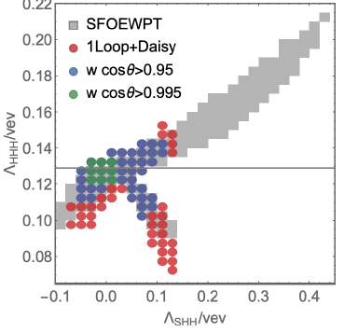
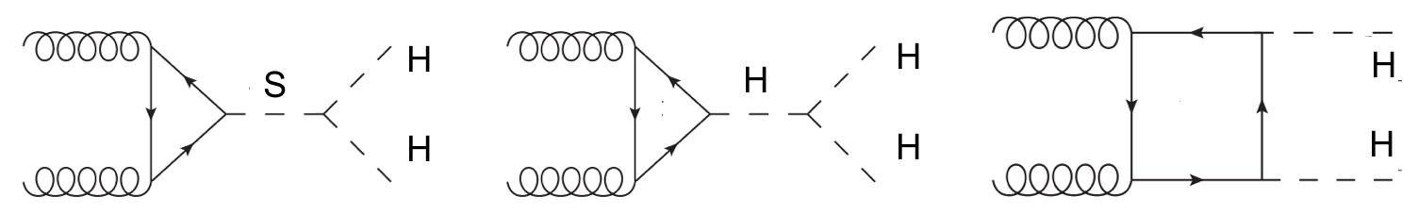
EWPT and Higgs Pair Production: Higgs Trilinear Coupling
Z₂ spontaneous Symmetry Breaking Scenario
M.C, Z. Liu, Y. Wang, ‘19
Beyond
HL-LHC reach, needs FCC-hh
H

Slide 37
Dark CPV: A new EW phase transition
M.C., Y-Y. Li, T. Ou and Y. Wang, JHEP 02 (2023) 139
Need at least to avoid CPV being redefined away.
In terms of h, a, s fields
with
and
a stationary point in the a direction at T=0 that facilitates a strong 1st order EWPT
Full one-loop potential: V₀ +V_{CW} + V_{CT} + V^{T}_{1-loop} and resummation of higher loop daisy diagrams to ensure validity of the analysis at T_{c} and T_{n}
Implement T= 0 boundary conditions: bounded from below, non tachyonic solutions, physical minimum at (v_{H},0,0) to be the global minimum
Careful study of finite temperature conditions to ensure a 1st order phase transition and not a cross over
X minimum
saddle point
maximum
Z₂ and EW Restoration
Z₂ and EW NON- R
stationary point,
maximum (minimum)

Slide 38
Dark CPV: Sourcing CP Violation
M.C., M. Quiros and Yue Zhang : Phys. Rev. Lett. 122 (2019) 20, 201802; Phys. Rev. D 101 (2020) 5, 055014
A direct coupling between a SM gauge singlet fermion χ and the Higgs boson would be higher dimensional.
To build a renormalizable theory introduce a new SM singlet composite scalar S
S couples to dark fermion (DM)
and contributes to its mass
During the EWPT, the phase of Mχ varying in the direction of the expanding bubble wall, derived from m₀ and the λ_{c} and S vev phases. This is the physical source of CP violation.
This induces a chiral asymmetry in the χ particles:
Z₂ and EW Restoration
Z₂ and EW NON- R

Slide 39
Extended Higgs sectors: a SUSY example
The Electroweak Phase Transition in the NMSSM

Slide 40


A SUSY example: the Next-to-Minimal Supersymmetric SM
A more extended Higgs sector: two Higgs doublets + a singlet
both charged under the EW gauge group
provides flexibility enhancing the PT strength
The NMSSM with the scalar potential
from Z3-NMSSM superpotential
Without loss of generality, we consider the 3-dim. field space
Higgs basis
The EW vacuum
After minimization conditions, replacing mass parameters by vev’s and suppress mixing of H^{NMS} and H^{S} with HSM to be consistent with Higgs 125 GeV phenomenology
Parameter space:

Slide 41
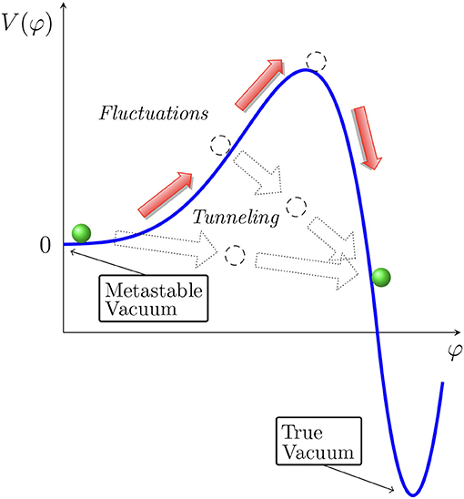
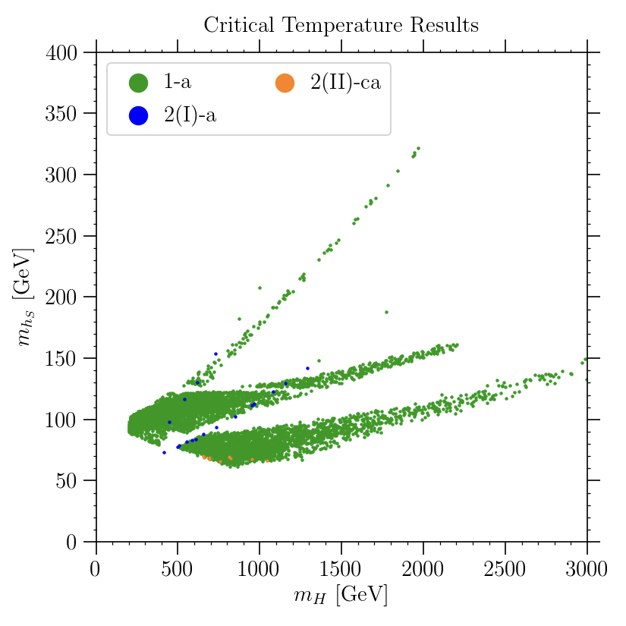
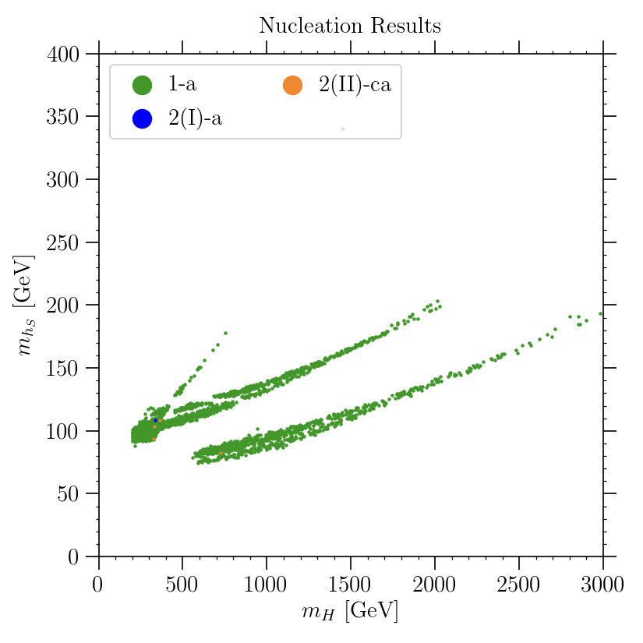
EWPT in the NMSSM - nucleation is more than critical
The vacuum structure gives little information about tunneling probability.
➔ the higher the barrier, and the larger the distance between the minima, the lower the nucleation probability
The bubble nucleation rate per unit volume:
requiring the nucleation probability to be approx. one per Hubble volume and Hubble time leads to the nucleation condition
M_{hs} [GeV]
M_{hs} [GeV]
T_{c} T_{n}
Baum, M.C, Shah, Wagner, Wang ‘19
vacuum structure
tunneling probability
M_{H} [GeV]
M_{H} [GeV]
Collider and Dark Matter opportunities
Strong EWPT consistent with light to heavy non-SM-like Higgs boson and a singlet
Despite light masses, these states are hard to probe at LHC ( best: H → h₁₂₅ + h_{S})
The most promising dark matter scenario is a bino-like lightest neutralino

