Slide 1
Workshop A3 Advancing Capacity Building OQI 30 May 2024 | online

Slide 2
Agenda
1.
Overview of OQI's Advancing Capacity Building Pillar and Objectives for Today
2.
Introduction Round
3.
Consortium Modalities
4.
Practical engagement with OQI
5.
Next Steps
Notes:
Our objectives this is why we want to work with you
This is how we are going to do thisConsortium Modalities - Practical engagement with OQI and the community

Slide 3
Overview of OQI's Advancing Capacity Building Pillar & Objectives for Today
1

Slide 4








OQI’s four pillars
A1 – Accelerating applications for humanity
Realising the full potential of quantum computing by accelerating the use cases geared towards achieving the SDGs, thanks to the combined forces of researchers and developers, entrepreneurs, the United Nations, and large NGOs.
A roadmap for the 3-year pilot structured around 4 key areas of activity.
A2 – Access for all
Providing global, inclusive and equitable access to a pool of public and private quantum computers and simulators available via the cloud
A3 – Advancing capacity building
Developing educational tools to enable everyone around the world to contribute to the development of quantum computing and make the most of the technology.
A4 – Activating multilateral governance for the SDGs
Providing a neutral forum to help shape multilateral governance of quantum computing for the SDGs
Notes:
We started with the workshops to socialize our vision; We are not an educational provider nor a research institution but an initiatives hosted at CERN as part of its Quantum Technology Initiative.
To establish OQI as a network of networks, within all four pillars, we have set together with the you, our community, 3 key objectives
Amplify activities initiated during the incubation
Generate first impactful results
Prepare the ground for the OQI to scale if needed to accomplish its mission at the end of the pilot phase

Slide 5


OQI A3 Focus – Advancing capacity building
Vision – OQI as a network of networks
Empower R&D-ers from target geographies to leverage quantum computing for challenges relevant to their own realities
Engage diplomats in the discussion and upskill
Shift the cursor, by enabling the global quantum community to rebalance the focus and resources toward quantum computing applications that both are beneficial to the SDGs and help to address global challenges
Mission: Developing educational tools to enable everyone around the world to contribute to the development of quantum computing and make the most of the technology
2 PRIORITY TARGET GROUPS
equip researchers and developers from underserved geographies to work on responsible quantum computing as well as diplomates to learn about it and its governance implications
foster collaboratively the formulation of quantum computing use cases for the SDGs
Notes:
Education is necessary for OQI to achieve its mission for 2 reasons:
Giving access to machines is not sufficient, we need to upskill people to be able to use them. Focus here is on the software/ algorithms part (NOT development of hardware)
The SDG-related use cases/ applications supported by OQI must be ideated / originate from those who are concerned by these challenges, incl. in developing countries. R&D-ers from these countries must be equipped to be able to submit such use cases
researchers, developers, and entrepreneurs of quantum underserved geographies
diplomats and more generally policy makers

Slide 6
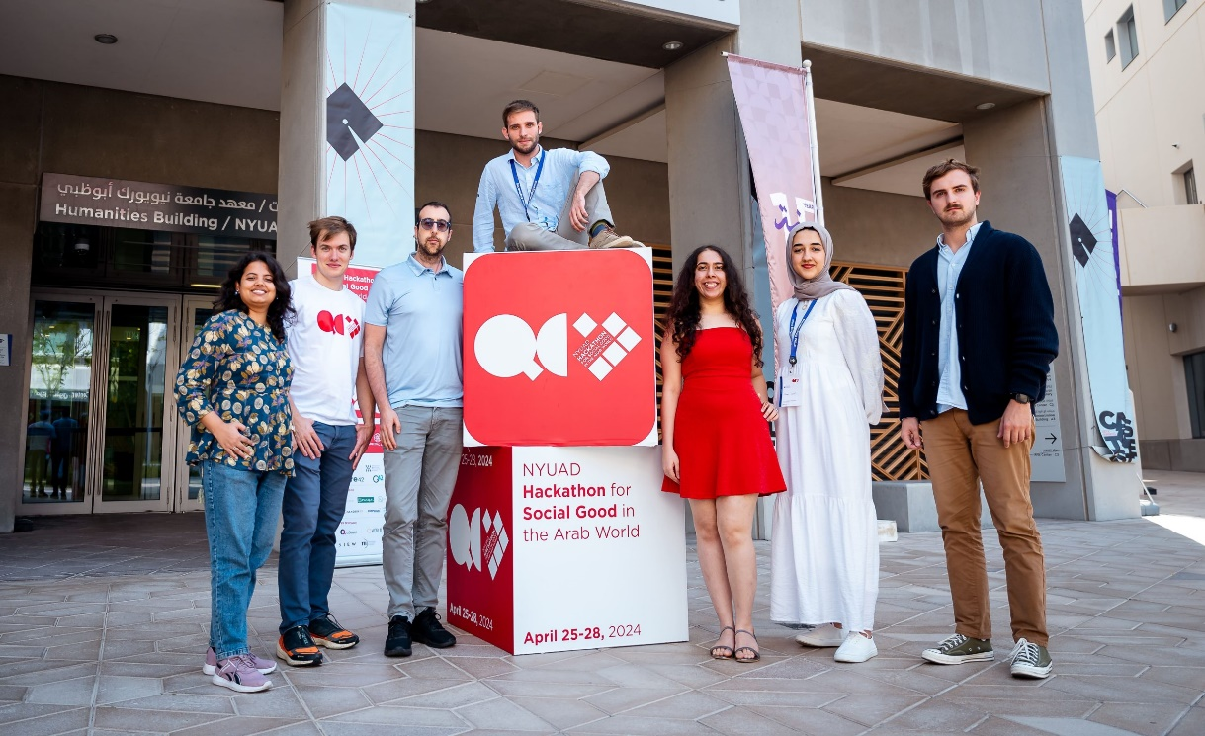
OQI A3 – Recent updates
NYUAD Hackathon for Social Good, 25-28 April 2024
OQI partnered for the second year:
Sponsored students from underserved geographies
Winning team invited to the GESDA Summit (October 9-11)
"Hackathon in a box"
In partnership with NYU, hackathon process currently being documented, with the plan to:
Make the toolbox available open-source on OQI website
Deploy it in underserved geographies in the future (target: Ghana in 2025)
Quantum diplomacy game
Currently being updated and collecting feedback:
Deployed in Kigali (INGSA, May)
Will be deployed in Geneva (Science Diplomacy Week, June 13)
Notes:
NTERNATIONAL NETWORK FOR GOVERNMENTAL SCIENCE ADVICE Conference at the beginning of May
INGSA and AIMS
QGasBusters protects critical infrastructure by instantly detecting pipeline anomalies, and optimally allocating emergency resources using Quantum Sensing & Machine Learning
The 12th edition of the annual event focused on tackling challenges and identifying solutions in line with the UN Sustainable Development Goals (SDGs) using cutting-edge quantum computing (QC) and artificial intelligence (AI).
QGasbusters won the first place for this year’s Hackathon, team QMarjan won the second place, and team aQua, and Aman tied for third place. They ranked the highest among 180 students from 50 countries,

Slide 7
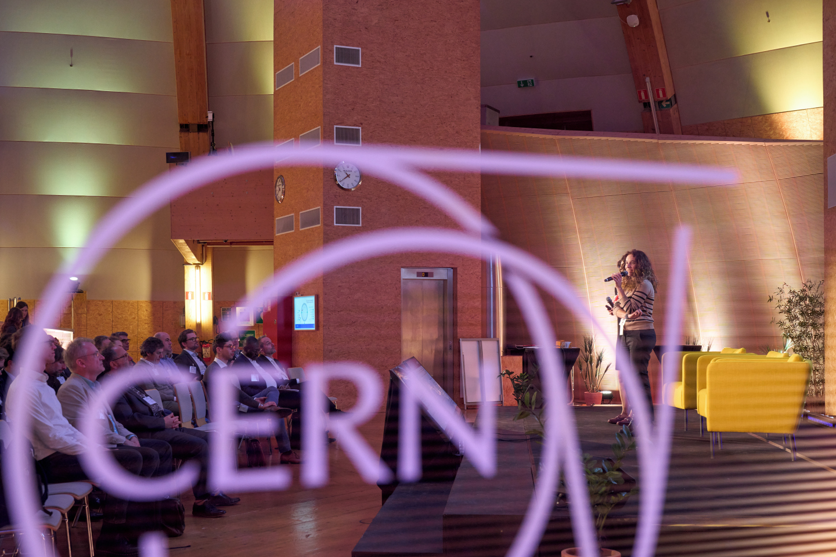
5th March workshop summary and objectives for today
Workshop focused on OQI’s role to advance capacity building, thus making the technology more inclusive and open, with a focus on SDGs
Discussions on the options of how educational providers and users can contribute to advance capacity building
Participants endorsed the idea of an educational consortium
Continued with individual follow-ups (ongoing; to discuss various activities for this pillar, build the Consortium
Objectives for today:​
Align on modus operandi for OQI Educational Consortium
Update on current OQI A3 activities
Discuss your feedback on opportunities to be addressed by the educational consortium

Slide 8

OQI A3 – Educational consortium’s focus
HOW?
Build and define best practices
Enable everyone around the world to contribute to the development of quantum computing and make the most of the technology
for developing of quantum computing use cases for the SDGs
Advance capacity building
Curate educational resources shared by OQI
for onboarding the participation of quantum underserved geographies
Collectively develop educational tools
Notes:
Build best practices for educational resources to foster use case development of quantum computing for SDGs
Inform and share educational content/approaches to foster the formulation of QC for SDGs
Enable alignment and coordination of like-minded educational programmes, initiatives
Validate tools developed and disseminated by OQI Educational Consortium (from a user and a provider perspective)

Slide 9
OQI A3 – Timeline 2024
Advancing Capacity Building
5 July 2024​
September 2024​
October 2024​
March 2025
Online Workshop
Online Workshop
In-person Workshop at GESDA Summit
Online Workshop (tbc)
Approach
Where your support is needed
Activate and support opportunities in underserved geographies
Disseminate OQI vetted resources and scale tools
Contribute to existing OQI Educational Consortium tools
Contribute to the co-creation of new tools
Build on experienced challenges and opportunities
Identify Top 3 priorities for consortium to deliver during OQI's pilot phase (by December 2026)
Build opportunities for collaboration to establish new set of best practices
Showcase how can QC be leveraged for impact projects
Notes:
Objectives to communicate
- We have developed tools: our focus the question: how to leverage QC for their own impact project? and diplomats: we are focused on the education
- Hackathon as one example for upskilling - we developed hackathon in a box to have a tool kit as a public good AND: we have done this again in Abu Dhabi, but we are preparing to rollout in 2025 in other locations
- QC use cases for SDGs and learn about responsible quantum computing
Working with partners who are already working with specific geographies and different mechanisms
Question: How can we activate satellites in underserved geographies?
Question: Where can OQI help in dissemination? Collaboration with implementers; how could we collaborate with ITCP et al on the role out of a hackathon in a box? How much would it cost to roll out a summer school that could be proposed to the consortium?
OQI Internship Program?
Upskilling Partnerships for educational content (in developing countries: ITU/UNESCO/UNICEF….), hackathon (NYUAD, AIMS, …
Use case Development: CERN school of computing? Series of lectures? (QC for computer scientists who have no training available in their own country); select 2-3 subject matters experts to trainin
At the same time, use the Science Diplomacy Students to the test game

Slide 10
2 Introduction Round

Slide 11

Introduction
Please share
Your name, affiliation, and where your institution is located
Your number 1 priority you would like to contribute to the consortium

Slide 12
3 Educational consortium modalities

Slide 13

Modalities for practical engagement
Role and Responsibilities
Working modalities
Be officially affiliated with OQI: either as official member or as partner of the OQI
Engage regularly and contribute actively to the consortium’s activities
Ensure that the OQI values are respected during the pilot phase and beyond:
Inclusivity, lobal scope
Openness
Focus on impact (SDGs and global challenges)
Independence (neutrality)
Collaboration
Expected time commitment: 1 – 1.5 h per month
6 – 8 h per year to participate in workshops (3 workshops per year, approx. 2 hours each)
3 h preparatory work per year for the above meetings
1 – 3 h individual ad-hoc consultations per year to challenge and increment the Consortium’s specific deliverables
The Consortium member can nominate a representative to follow the OQI pilot more closely
The OQI Coordination team co-creates with the participants of the educational consortium and provides the secretariate of the meetings
Sets time date and detailed agenda for meetings in advance
Shares necessary documents to keep the Consortium Members well informed
Communicates minutes of the meetings
Notes:
The Educational Consortium works with its members to build capacity to find, reuse, create and share Open (?) Educational Resources, create sustainable education models, and enable international collaboration and innovation

Slide 14
4 Practical engagement with OQI

Slide 15
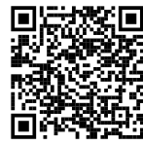
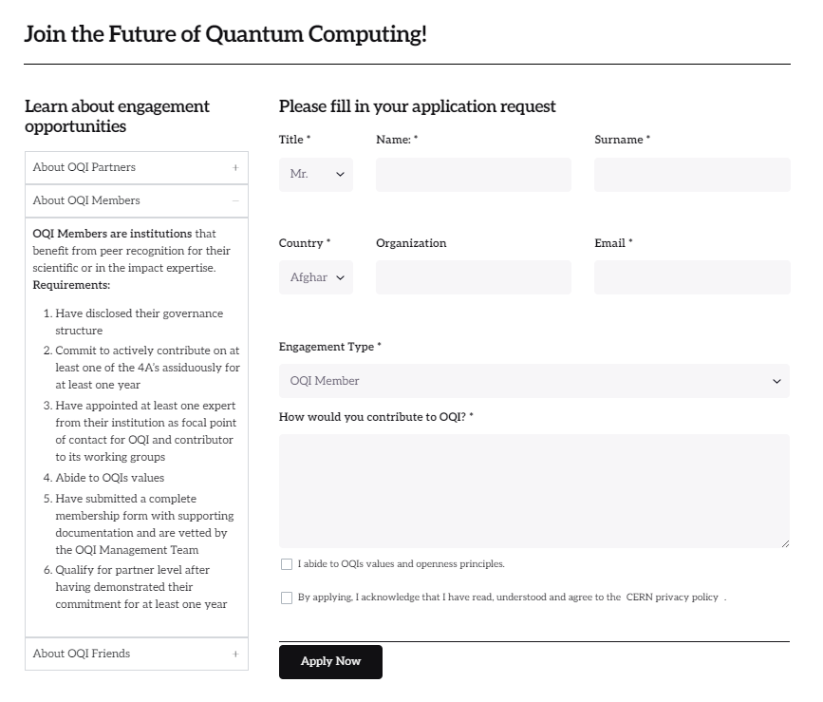
Engagement Request
1
Request to become an OQI member here:
2
Upon confirmation, your institution will be listed as OQI member and member of its Educational Consortium

Slide 16
Engagement Mechanisms
Tier | Objective | Eligibility Criteria
PARTNER | Co-shape and co-create OQI’s unique value proposition | OQI partners are institutions that benefit from peer recognition for their scientific or in the impact expertise. either have served as OQIs spearheading partners during its incubation phase or have consistently engaged resources to OQI’s work as OQI members for at least a year commit to co-shape the OQI’s unique value propositions for the three years of the pilot throughout the 4A’s are vetted by the OQI Advisory Committee abide to OQIs values and openness principles
MEMBER | Contribute continuously to at least one of OQI’s 4 A’s | OQI members are institutions that benefit from peer recognition for their scientific or in the impact expertise. have disclosed their governance structure commit to actively contribute on at least one of the 4A’s assiduously for at least one year have appointed at least one expert from their institution as focal point of contact for OQI and contributor to its working groups abide to OQIs values have submitted a complete membership form with supporting documentation and are vetted by the OQI Management Team qualify for partner level after having demonstrated their commitment for at least one year
FRIEND | Stay informed and be potentially solicited for consultations | OQI Friends are individuals (such as experts from the private or public sector, countries, citizens) who are committed to open science, inclusivity and CERN’s values and associate themselves with the OQI. Friends socialize the OQI in their communities.
New candidate partners/ members, submit your manifestation of interest on oqi.cern

Slide 17
Practical engagement
What is expected next
Become a member of OQI and appoint the primary contact of your institutions
Register for the Workshop on 5 July
Send OQI Coordination Team your flagship resources that are in line with OQI’s mission → upon review to be uploaded to OQI’s Educational Repository (Condition to participate in the upcoming workshop) – until 25 June 2024, EOB
Share with OQI Team the top priorities/challenges (3 max) you experience for the OQI’s three focus areas (developing use cases, for SDGs, onboarding participation of quantum underserved geographies) – until 25 June 2024, EOB
How you will co-shape A3
Build on experienced challenges and opportunities
Identify Top 3 priorities for consortium
Build opportunities for collaboration to establish new set of best practices
Showcase how can QC be leveraged for impact projects
Activate and support opportunities in underserved geographies
Disseminate OQI vetted resources and scale tools
Contribute to existing OQI Educational Consortium tools
Contribute to the co-creation of new tools
Notes:
Objectives to communicate
- We have developed tools: our focus the question: how to leverage QC for their own impact project? and diplomats: we are focused on the education
- Hackathon as one example for upskilling - we developed hackathon in a box to have a tool kit as a public good AND: we have done this again in Abu Dhabi, but we are preparing to rollout in 2025 in other locations
- QC use cases for SDGs and learn about responsible quantum computing
Working with partners who are already working with specific geographies and different mechanisms
Question: How can we activate satellites in underserved geographies?
Question: Where can OQI help in dissemination? Collaboration with implementers; how could we collaborate with ITCP et al on the role out of a hackathon in a box? How much would it cost to roll out a summer school that could be proposed to the consortium?
OQI Internship Program?
Upskilling Partnerships for educational content (in developing countries: ITU/UNESCO/UNICEF….), hackathon (NYUAD, AIMS, …
Use case Development: CERN school of computing? Series of lectures? (QC for computer scientists who have no training available in their own country); select 2-3 subject matters experts to trainin
At the same time, use the Science Diplomacy Students to the test game

Slide 18
5 Next Steps

Slide 19
Next Meetings
5 July 2024
Workshop #2 (Deep dive on Best practice opportunities) - online
Workshop #3 (Focus: Best practice opportunities) - online
Workshop #4 at GESDA Summit (Focus: Scaling efforts, input from Hackathon Winners) - hybrid
17 September 2024
09-11 October 2024

Slide 21
Participants/ Members of the Consortium
Finalize
Academia
AIMS
Diplomacy
Citizen
Impact
ICTP
University of Calgary
University of Geneva
NYUAD
NYU
Individual Permanent Missions at the UN
UNESCO
CERN/QTI
Quantum Delta
Perspectives of users and providers to be represented in the Consortium
Academic Community | Diplomatic Community | Impact Community | Citizen Community
University of Calgary | India | Quantum Basel? | Compagnia di San Paulo
AIMS | UNESCO | QAI Ventures | Unitary Fund
ICTP | Quantum Delta | Qbraid | XPRIZE?
NYUAD | CERN/QTI | Q-CTRL | Qworld
KIT? | OECD? | QURECA
IEEE Quantum Education? |  | QunaSys Inc
University of Geneva |  | IBM
 |  | Womanium
 |  | SandboxAQ
Notes:
Users of Educational Resources: Researchers, Associations,
Educational Providers: Industry, Diplomacy (International Organizations, NGOs), Academia

Slide 22
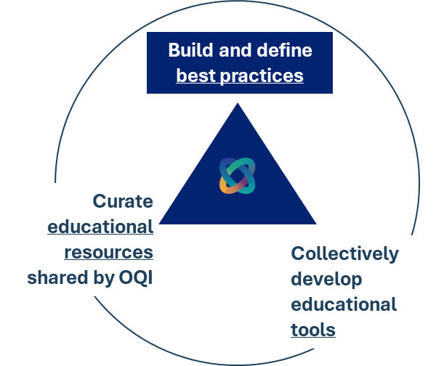
Our Proposal: The Consortium’s focus and its key activities
CAPACITY BUILDING FOCUS AREAS
developing of quantum computing use cases
for the SDGs
participation of quantum underserved geographies
what are the educational needs & related resources/tools (i.e. Training on quantum algorithms, training on quantum computing coding, etc. )
what are the best practices for use case development
what are the educational resources/tools to learn about the SDGs, impact, responsible computing principles and multilateral governance of quantum computing
what are the challenges to infuse these principles into QC (e.g. diversity of background)
what are the best practices for responsible quantum computing
what are the opportunities/ challenges faced by quantum underserved geographies that currently limits their active participation
what are the related tools/resources that could be deployed (e.g. access to QC, access to HPC, access to free training materials, language of tools access to mentors, access to internships, access to job opportunities, etc.)
what are the best practices for global reach and contextualization of tools/resources
CURRENT OQI TOOLS/ ACTIVITIES
Hackathon in a box
OQI repository of tools/resources
Quantum Diplomacy Game (Role Play)
Internship
KEY PARTNERS
Notes:
Developing quantum computing use case
what are the educational needs & related resources/tools (i.e. Training on quantum algorithms, training on quantum computing coding, etc)
what are the best practices for use case development (to be defined as this know-how is mostly at the industry/startup levels, although it could well become a new international standard)
For the SDGs
what are the responsible quantum computing best practices, what are the challenges to infuse these principles into QC (e.g. diversity of background)
what are the educational tools to learn about the SDGs, impact and responsible computing principles
Onboarding the participation of quantum underserved geographies
what are the global reach best practices
What are the challenges faced by underserved geographies that currently limits their active participation and related tools/resources that could be deployed (e.g. access to QC, access to HPC, access to free training materials, access to mentors, access to internships, access to job opportunities, etc.)
General CERN Center Summer School – dedicated to physics (100 students)
Open Lab – Programm for CERN member states/ and non-member states (lots from India, South America, Asia….) – quantum computing internships in the past, 2 months in the summer: tasks are side-task associated with a PhD or master-thesis, they are undergraduate level, quantum-algorithm tests, 2 branches: (30 students) – Christine Gonne… ) – June – September.
Funds (Open Lab: Industry Partners, or other departments of CERN, …)
Supervisors (People at CERN to accept to become mentors, …)
Lectures in Summer this year: 2 will be about quantum
This year, we could start the track? E.g. lecture on Ethics/ Responsible quantum computing/SDGs
Proposal: richer program for the year after
OQI funding a few internship within OpenLab
OQI summer school at CERN
2025: Getting a few projects in the OpenLab
CERN as a host of a OQI internship progamme
Lectures, projects, add SDG as special lecture, get the other summer students,
CERN/QTI offers to organize with OQI lectures for the summer school
Platforms where OQI can plug in at CERN – summer school, internship for summer pgramme students to work for a couple of months, connection with Prof in Spain (Santiago), Open Lab

Slide 23
Modalities for practical engagement
Role and Responsibilities
Working modalities
Be officially affiliated with OQI: either as official member or as partner of the OQI
Engage regularly and contribute actively to the consortium’s activities
Ensure that the OQI values are respected during the pilot phase and beyond:
Openness (equitable, inclusive access to quantum computing technology & knowledge)
Focus on impact (SDGs and global challenges)
Integrity, commitment, professionalism, creativity, and diversity
Advancement of science and the wide dissemination of knowledge by embracing and promoting practices making scientific research more open, collaborative, and responsive to societal changes
Expected time commitment: 1 – 1.5 h per month
6 – 8 h per year to participate in workshops (3 workshops per year, approx. 2 hours each)
3 h preparatory work per year for the above meetings
1 – 3 h individual ad-hoc consultations per year to challenge and increment the Consortium’s specific deliverables
The Consortium member can nominate a representative to follow the OQI pilot more closely
The OQI Coordination team co-creates with the participants of the educational consortium and provides the secretariate of the meetings
Sets time date and detailed agenda for meetings in advance
Shares necessary documents to keep the Consortium Members well informed
Communicates minutes of the meetings
Notes:
The Educational Consortium works with its members to build capacity to find, reuse, create and share Open (?) Educational Resources, create sustainable educationn models, and enable international collaboration and innovation
Openness (equitable, inclusive access to quantum computing technology & knowledge)
Focus on impact (SDGs and global challenges)
Integrity, commitment, professionalism, creativity, and diversity
Advancement of science and the wide dissemination of knowledge by embracing and promoting practices making scientific research more open, collaborative, and responsive to societal changes

Slide 24

NYUAD Hackathon for social good
Next steps:
Amplify hackathon in other regions (e.g. Africa, Latin America)
"Hackathon in a box“
Notes:
QGasBusters protects critical infrastructure by instantly detecting pipeline anomalies, and optimally allocating emergency resources using Quantum Sensing & Machine Learning
The 12th edition of the annual event focused on tackling challenges and identifying solutions in line with the UN Sustainable Development Goals (SDGs) using cutting-edge quantum computing (QC) and artificial intelligence (AI).
QGasbusters won the first place for this year’s Hackathon, team QMarjan won the second place, and team aQua, and Aman tied for third place. They ranked the highest among 180 students from 50 countries,

