Slide 1

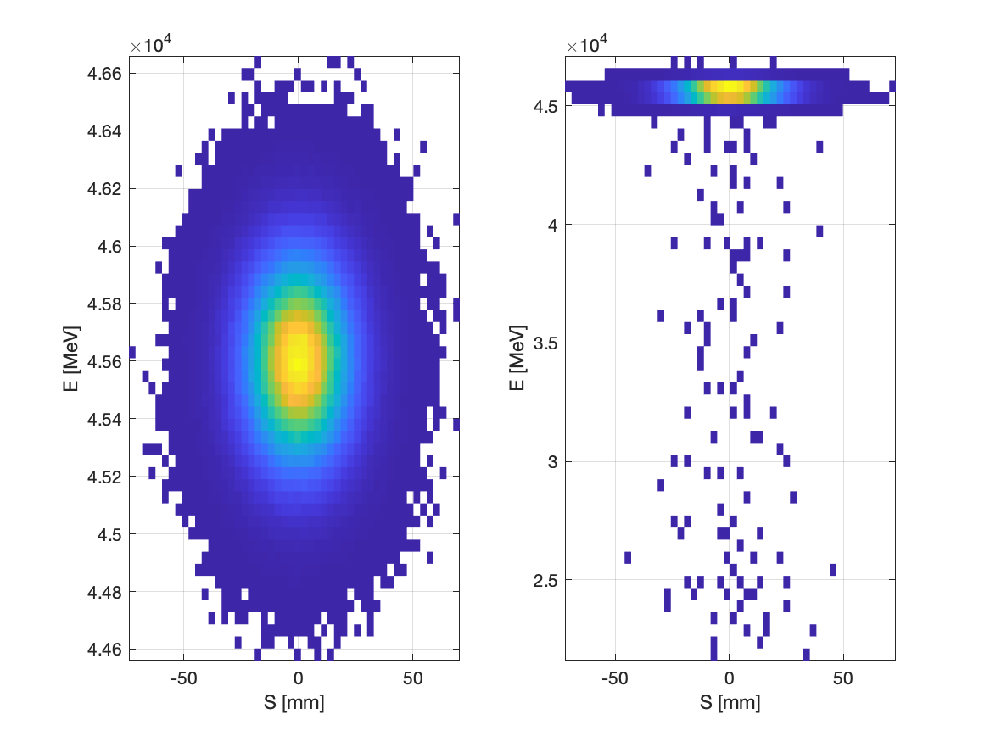
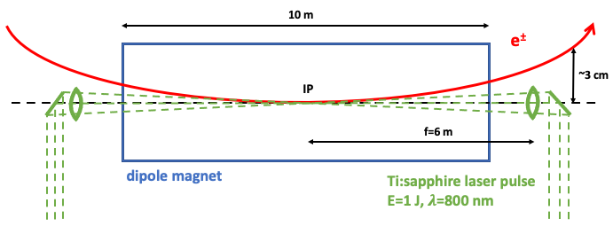
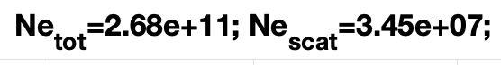
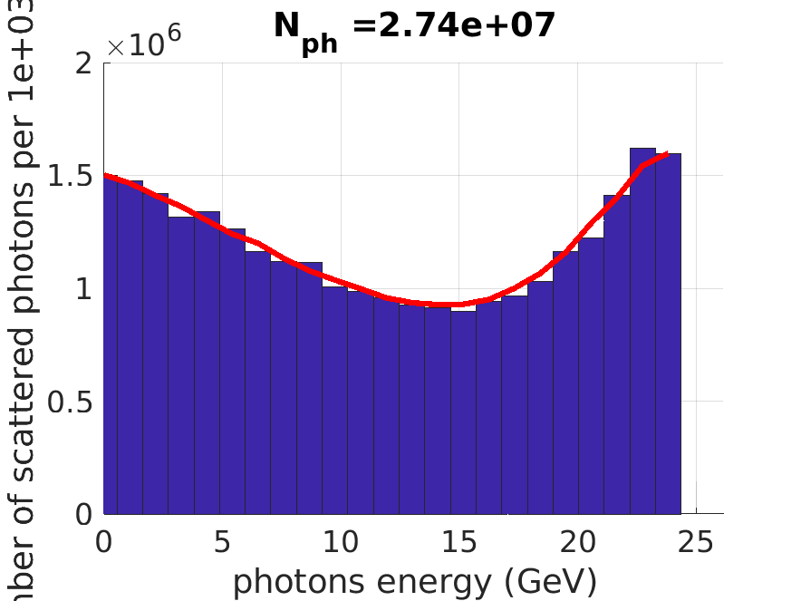
Diagnostics and bunch intensity control via Compton scattering
I. Drebot, S. Cialdi², INFN-Milano, [20133] Milano ²also at Universitá degli Studi, [20133], Milano, Italy
A. Abramov, M. Hofer, F. Zimmermann, CERN, [1211] Geneva, Switzerland
In the future circular electron-positron collider “FCC-ee”, the intensity of colliding bunches must be tightly controlled, with a maximum charge imbalance between collision partner bunches of less than 3–5%. Laser Compton back scattering could be used to adjust and fine-tune the bunch intensity.
Before collision
After collision
Sketch of the Compton collision inside a single 10 m long dipole.
To-Do: Find better position for Compton IP and optimise focusing parameters to increase efficiency of collision
Next step start simulation with polarisation for beam diagnostic

Slide 2
For these initial studies, based on the laser parameter mentioned above, the initial conservative assumption was made that the bunch undergoes laser interaction every 3rd turn, corresponding to a laser frequency of 1 kHz and assuming a pulse energy of 1 J.

Slide 3
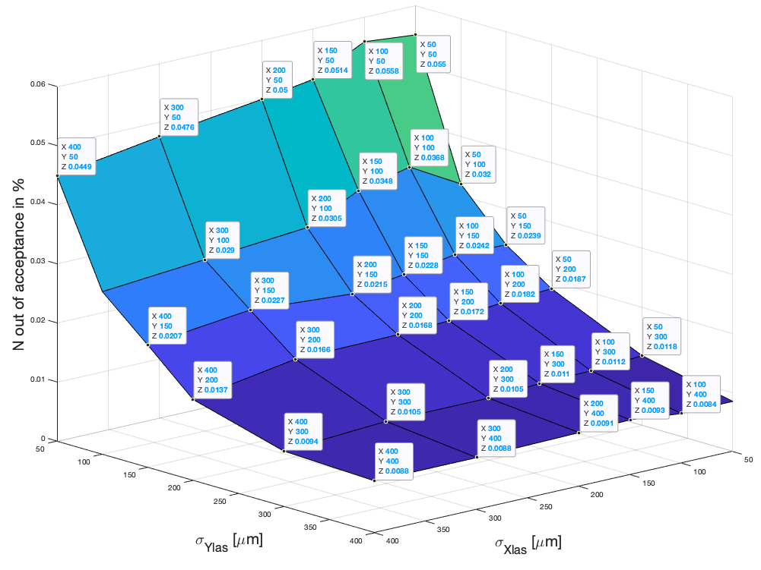
Varying laser focusing at IP

Slide 4
List ToDo:
Improve IP inside banding magnet
Find optimum between reducing bunch charge to exclude flip-flop instability and emittance groving
Study possibility to optimise energy distribution e⁻ e⁺ using dispersion inside bending magnet
Study possibility to reduce beam halo using Donuts-shaped laser beam
Study polarisation of scattered photons for diagnostic
Find application and users for 25 and 150 GeV photon beam 🖖

Slide 5
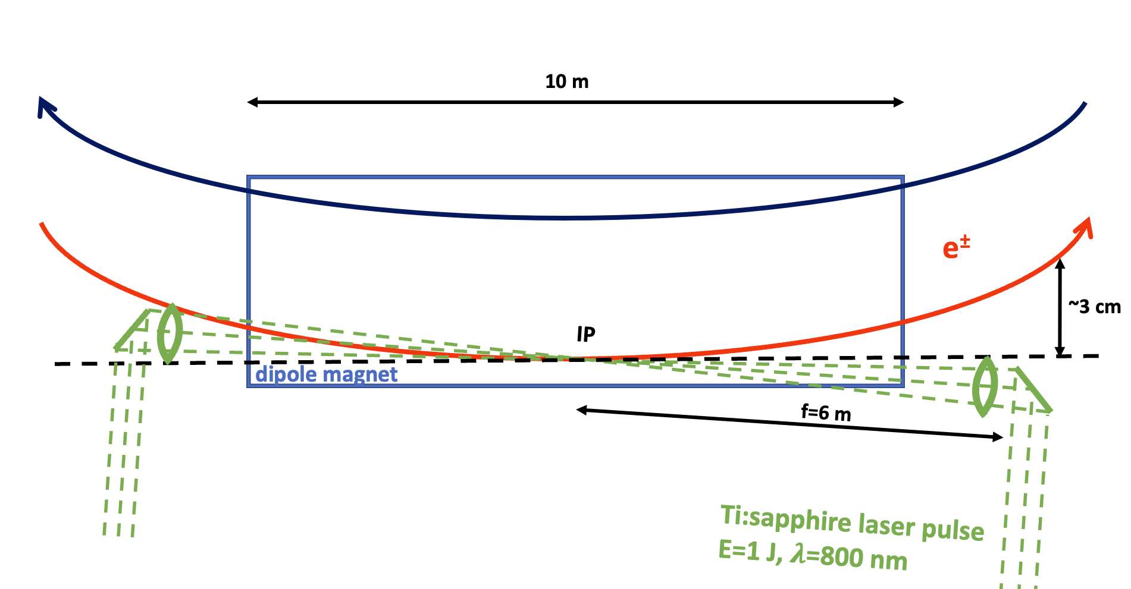

Slide 6
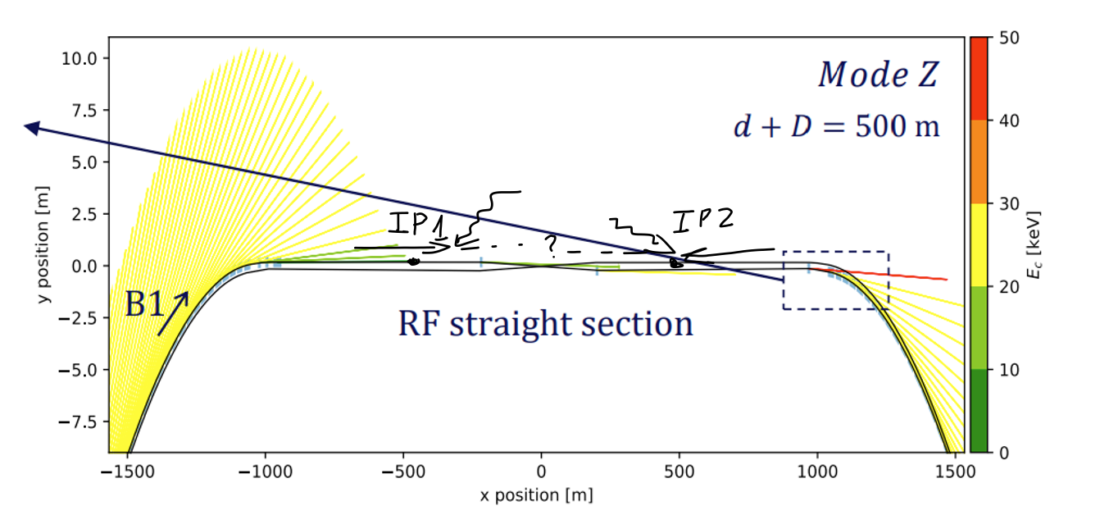

Slide 7
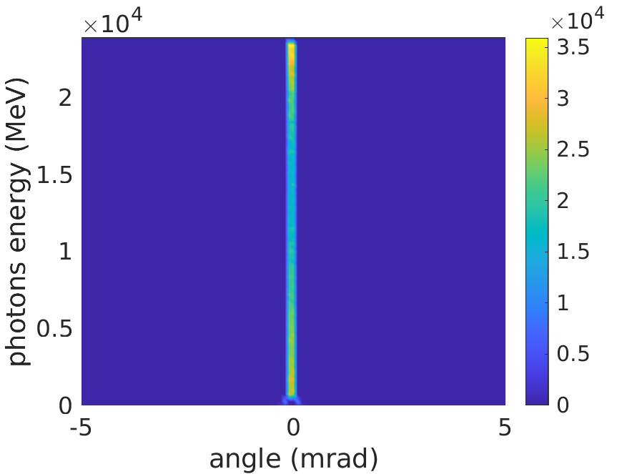
Beam from xsuit z

Slide 8
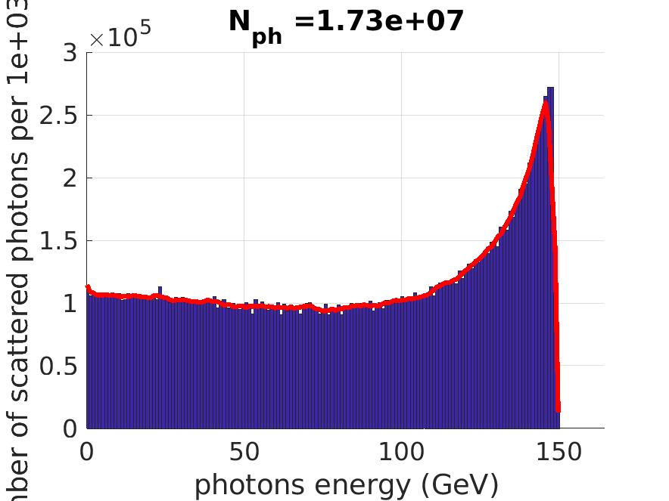
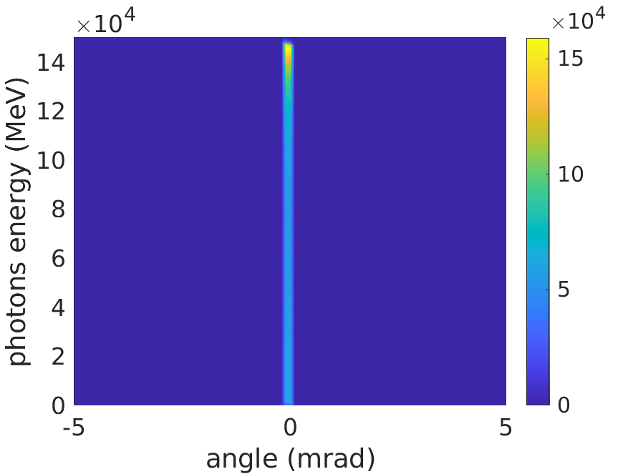
TT BAR

Slide 9
