Slide 1


Circular Electron Positron Collider
Beam polarization at CEPC
Zhe Duan
On behalf of the CEPC Polarization Working Group
Institute of High Energy Physics, CAS
18 Jun 2024, ECFA Meeting on e+e- to ZH angular measurements email: duanz@ihep.ac.cn

Slide 2
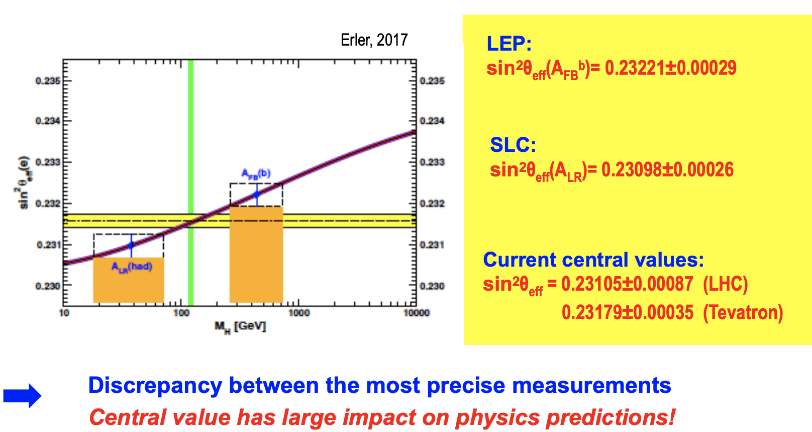
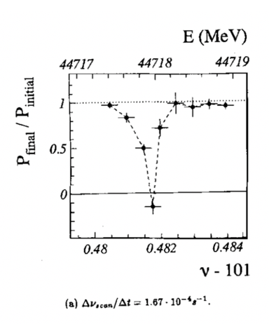
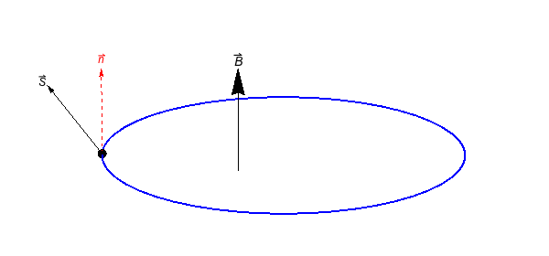
Motivation of CEPC polarized beam program
Vertical polarization for resonant depolarization
Essential for precision measurements of Z and W masses
> 5% ~ 10% polarization
Longitudinal polarization for colliding beams
Measurements of A_{FB} and A_{LR} @ Z-pole in the same experiment
Other benefits at W & Higgs energies, e.g. CP studies
> 50% polarization with a high luminosity
unpolarized e+/e-
IP/detector
polarized e- & unpolarized e+
IP/detector
polarimeter
depolarizer
L. Arnaudon, et al., Z. Phys. C 66, 45-62 (1995).
Summarized as a chapter in the Appendix of CEPC TDR.
G. Moortgat-Pick’s talk on CEPC Workshop EU @ Marseille, 2024 April

Slide 3
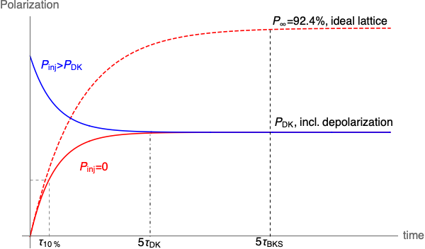
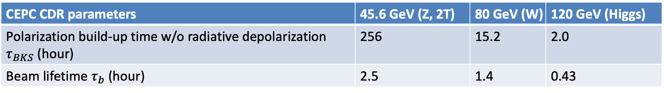
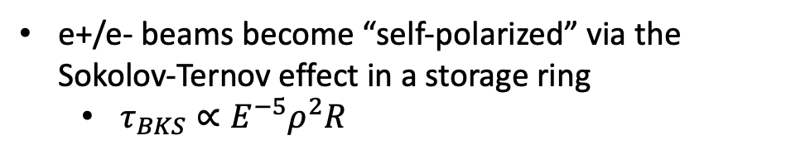
Self-polarization in the CEPC
e+/e- beams become “self-polarized” via the Sokolov-Ternov effect in a storage ring
  $τ_{BKS}∝E^{−5}ρ^{2}R$
Beam polarization build-up rate much slower than the beam decay rate @ Z
  Boosted with asymmetric wigglers in the Collider (FCC EPOL)
  Hard to achieve a high-level polarization
  In conflict with a high luminosity
CEPC CDR parameters | 45.6 GeV (Z, 2T) | 80 GeV (W) | 120 GeV (Higgs)
Polarization build-up time w/o radiative depolarization $τ_{BKS}$ (hour) | 256 | 15.2 | 2.0
Beam lifetime $τ_{b}$ (hour) | 2.5 | 1.4 | 0.43

Slide 4
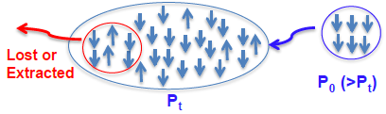
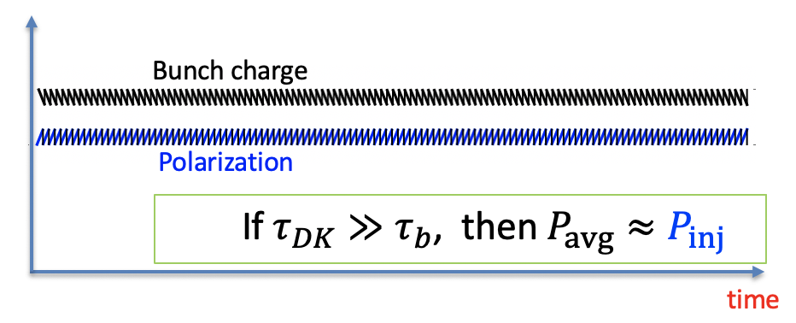
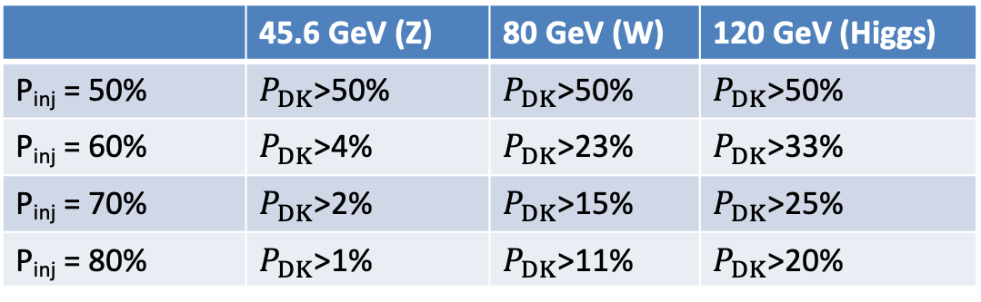
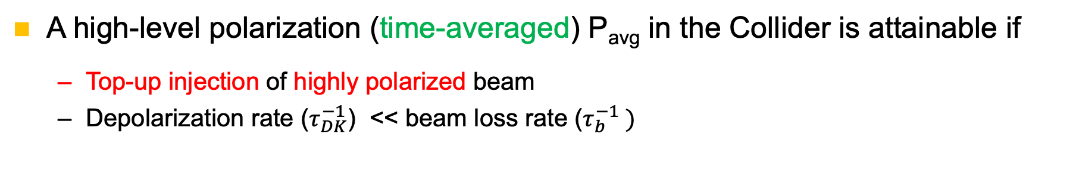
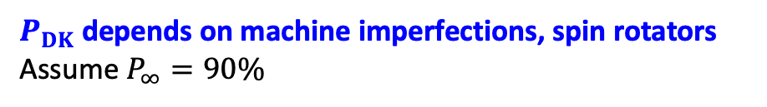

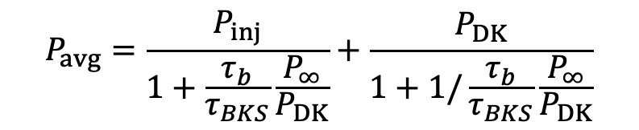

How to achieve a high-level polarization?
A high-level polarization (time-averaged) P_{avg} in the Collider is attainable if
  Top-up injection of highly polarized beam
  Depolarization rate ($τ_{DK}^{−1}$) << beam loss rate ($τ_{b}^{−1} )$
$$P_{avg}=\frac{P_{inj}}{1+\frac{τ_{b}}{τ_{BKS}}\frac{P_{∞}}{P_{DK}}}+\frac{P_{DK}}{1+1/\frac{τ_{b}}{τ_{BKS}}\frac{P_{∞}}{P_{DK}}}$$
$P_{DK}$depends on machine imperfections, spin rotators
Assume $P_{∞}=90\%$
Injected beam
P_{inj} > P_{DK}
$P_{avg}$> 50% requires a minimum value of $P_{DK}$
Sawtooth-shape evolution during top-up injection
 | 45.6 GeV (Z) | 80 GeV (W) | 120 GeV (Higgs)
P_{inj} = 50% | $P_{DK}$>50% | $P_{DK}$>50% | $P_{DK}$>50%
P_{inj} = 60% | $P_{DK}$>4% | $P_{DK}$>23% | $P_{DK}$>33%
P_{inj} = 70% | $P_{DK}$>2% | $P_{DK}$>15% | $P_{DK}$>25%
P_{inj} = 80% | $P_{DK}$>1% | $P_{DK}$>11% | $P_{DK}$>20%
$$\frac{|P_{inj}−P_{DK}|}{{(τ}_{b}+τ_{DK})/dt}$$
Amplitude of sawtooth ~

Slide 5
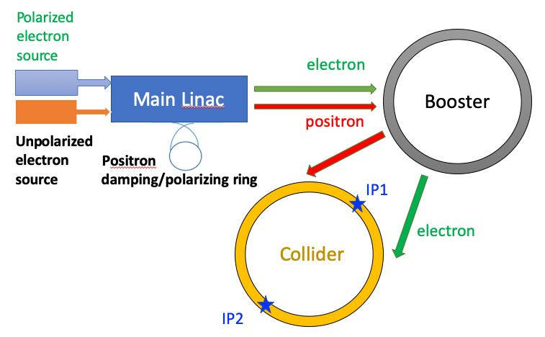
Polarized injector for CEPC
Polarized source
  Polarized electron source
    parameters less challenging than ILC, EIC
  Positron damping/polarizing ring
Linac & Transport lines
  spin direction matching @injection/extraction
  helicity adjustment after e+ damping/polarizing ring
Booster
  free from intrinsic spin resonances
T. Chen, Z. Duan, D. H. Ji, D. Wang, Phys. Rev. Accel. Beams, 26, 051003 (2023).

Slide 6
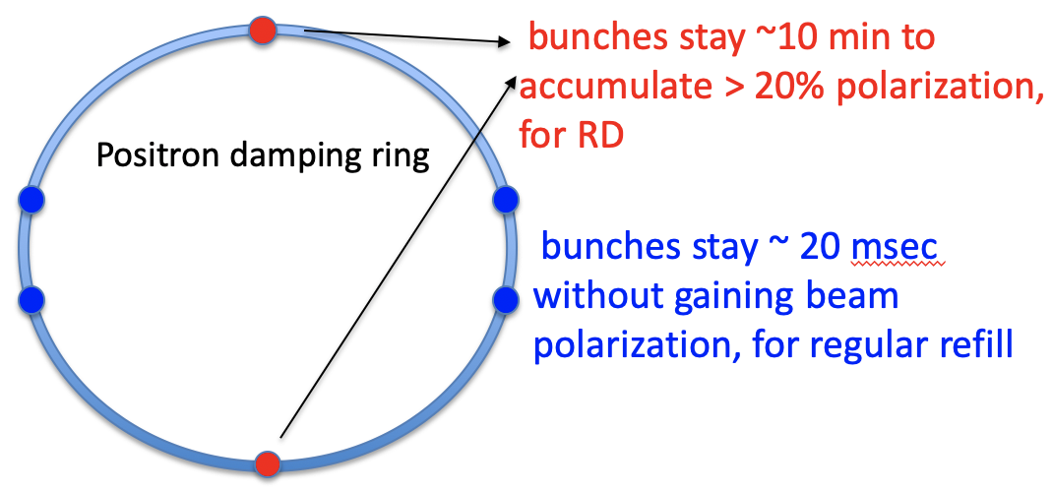
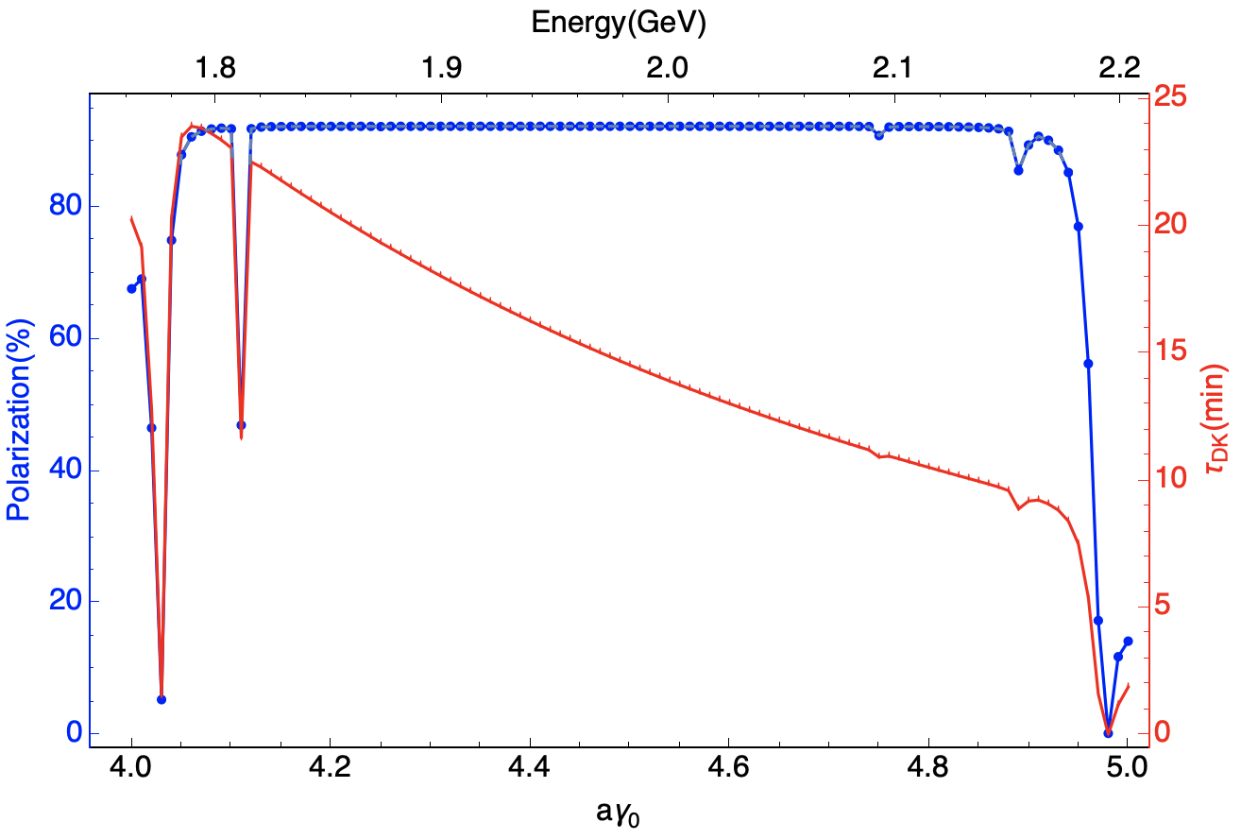
Positron damping/polarizing ring
Using the self-polarization to generate polarized e+ beams
  For Resonant depolarization (very promising)
    polarization build-up time ~ 14.5 min
    extracted beam polarization @ 10min ~ 44%
  For polarized colliding beams, more frequent top-up (under study)
    Higher energy and/or asymmetric wigglers
    More bunches
DR V4.0 | unpolarized e+ | polarized e+
Energy (Gev) | 1.983
Circumference (m) | 144.2
Number of trains | 2(4)
Number of bunches/trian | 1(2)
Total current (mA) | 12.4
Dipole strength B₀ (T) | 1.92
U₀ (kev/turn) | 397.9
Damping time x/y/z (ms) | 4.8/4.8/2.4
Momentum compaction | 0.0078
Storage time | 20 ms | 10 min
δ₀ (%) | 0.0917
ε₀ (mm.mrad) | 132
injection σ_{z} (mm) | 6
Extract σ_{z} (mm) | 6.7 | 6.6
ε_{inj} (mm.mrad) | 2500
ε_{ext x/y} (mm.mrad) | 133/13 | 132/13
δ_{inj} /δ_{ext} (%) | 0.18 /0.092
RF acceptance (%) | 1.85
Longitudinal tune | 0.025

Slide 7
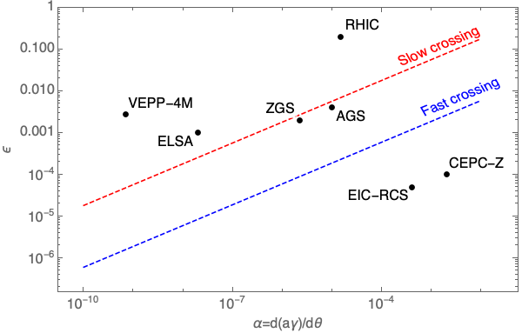
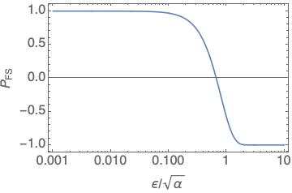
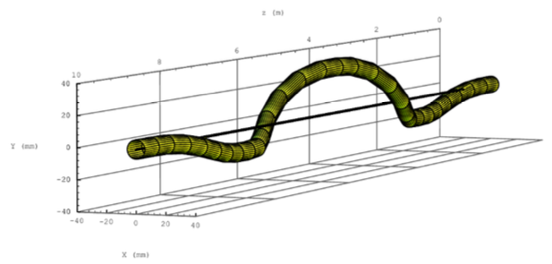
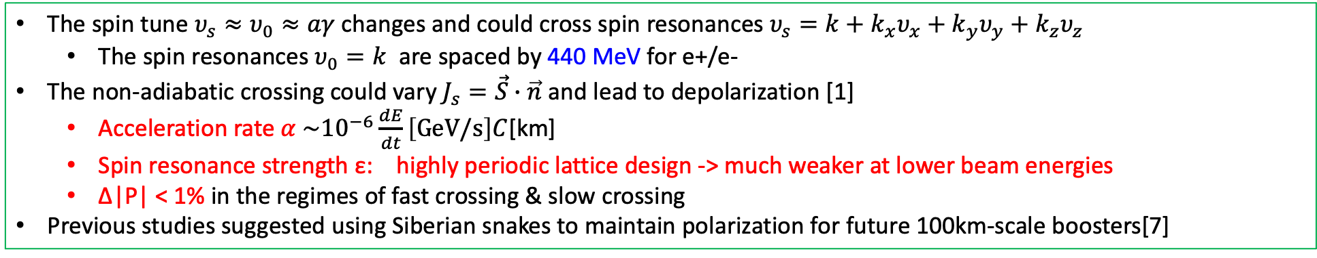
Depolarization in the booster
The spin tune $υ_{s}≈υ_{0}≈aγ$ changes and could cross spin resonances $υ_{s}=k+k_{x}υ_{x}+k_{y}υ_{y}+k_{z}υ_{z}$
  The spin resonances $υ_{0}=k$ are spaced by 440 MeV for e+/e-
The non-adiabatic crossing could vary $J_{s}=\vec{S}∙\vec{n}$ and lead to depolarization [1]
  Acceleration rate $α \sim {10}^{−6}\frac{dE}{dt}\left[GeV/s\right]C$[km]
  Spin resonance strength ε: highly periodic lattice design -> much weaker at lower beam energies
  Δ|P| < 1% in the regimes of fast crossing & slow crossing
Previous studies suggested using Siberian snakes to maintain polarization for future 100km-scale boosters[7]
Fast crossing
Slow crossing
Spin precession
Orbit motion in a helical snake @ RHIC
[1] Froissart and Stora, NIM 7, 297 (1960) [2] A. K. Barladyan, et al., PRAB 22, 112804, (2019)
[3] S. Nakamura, et al., NIM A 411, 93 (1998) [4] T. Khoe et al., Part. Accel. 6, 213 (1975)
[5] Configuration Manual: Polarized Proton Collider at RHIC, 2006 [6] V. Ranjbar, et al., PRAB 21, 111003 (2018)
[7] I. Koop et al., Phys. Part. Nucl. Lett. 13. 7 (2016); S. Nikitin, IJMPA 34, 1940004(2019); IJMPA 35, 2041001 (2020).
Data from Ref [2-6]

Slide 8
Depolarization effects: simulation vs. estimation
In the acceleration to Z & W
  The spin resonances are generally weak
  Polarization is mostly maintained
  Estimations agree fairly well with simulations
In the acceleration to H
  The spin resonances become stronger at higher energies
  Severe depolarization occurs
  Mitigation methods to be explored
Z-mode
W-mode
H-mode
This study supports injecting highly polarized beams into the collider rings as a very attractive solution, for applications @ Z & W.
Polarization transmission to Z, W and Higgs energies in Booster:
Z: over 99%, W: 77.5%~ 98%, Higgs: no better than 40%
[1] T. Chen, Z. Duan, D. H. Ji, D. Wang, Phys. Rev. Accel. Beams, 26, 051003 (2023).

Slide 9
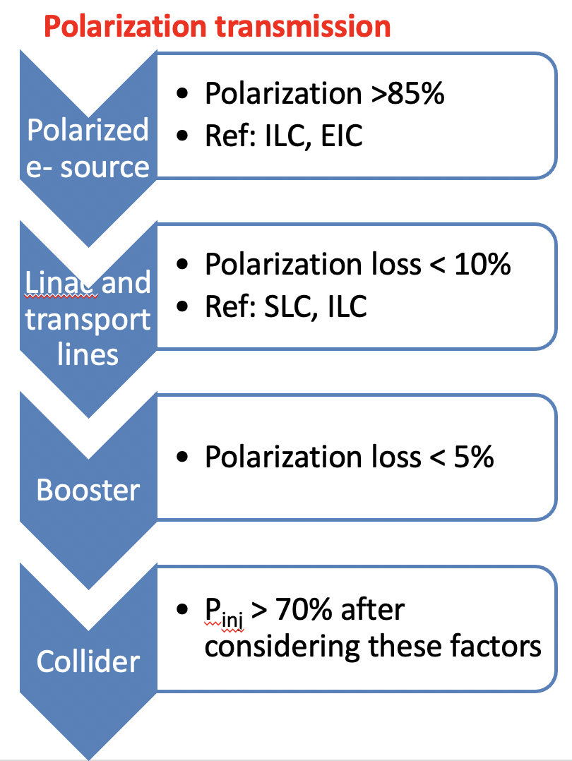
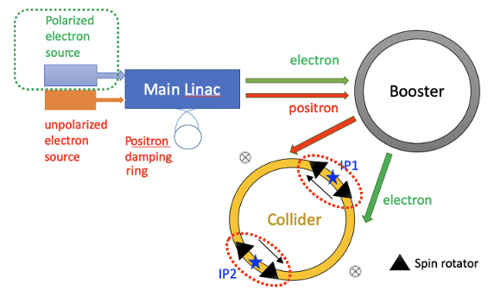
A high-level longitudinal polarization @ Z-pole
50%-70% longitudinal polarization for e- bunches is a reasonable goal
Over 70% injected e- beam polarization is possible.
Polarized e+ source is challenging for CEPC [1],
  self-polarization at a low energy e+ ring is possible, a tradeoff between the challenges & costs of the ring versus reduction injection rate & luminosity (need more study);
  polarization transmission efficiency is similar otherwise.
[1] P. Musumeci et al., Positron Sources for Future High Energy Physics Colliders, ArXiv:2204.13245 Phys. (2022).

Slide 10
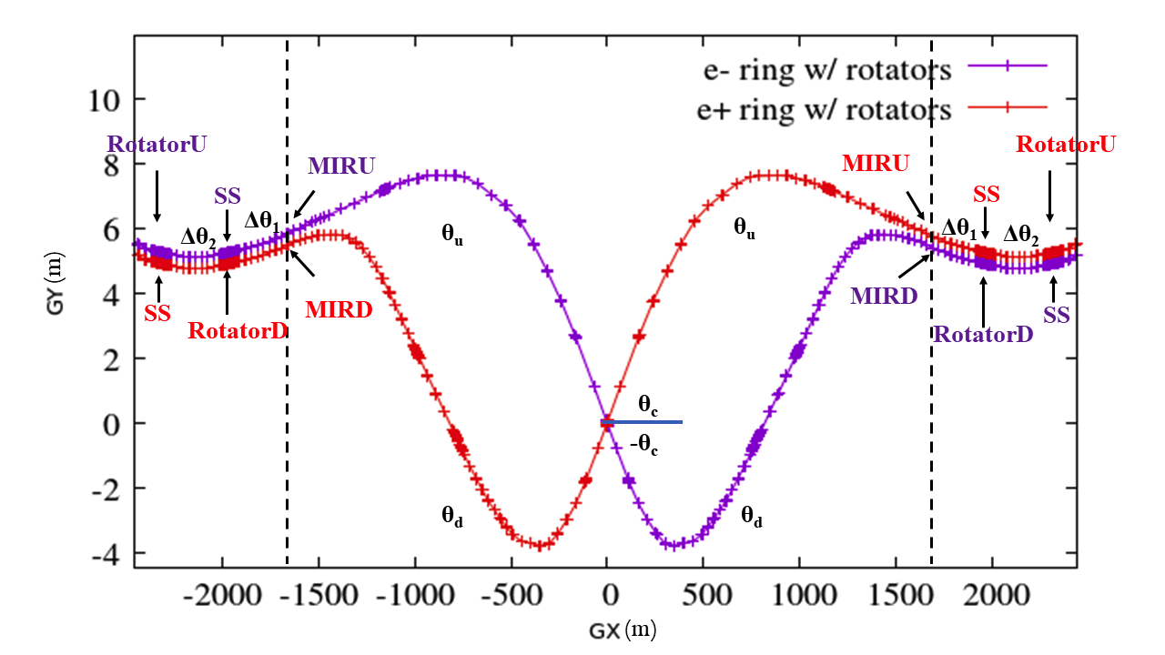
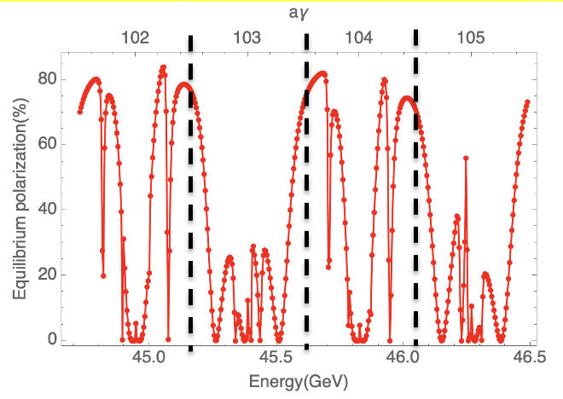
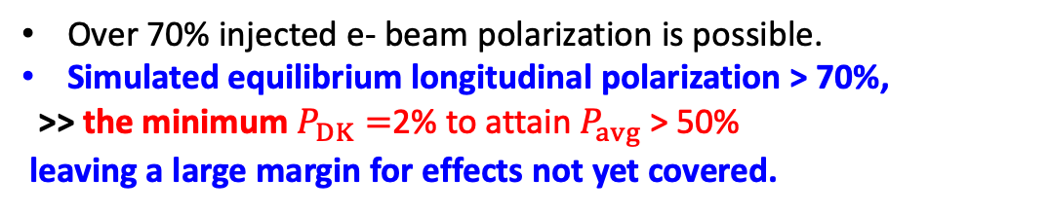
A high-level longitudinal polarization @ Z-pole
50%-70% longitudinal polarization for e- bunches is a reasonable goal
Implementation of the spin rotators adjacent to the IR
Over 70% injected e- beam polarization is possible.
Simulated equilibrium longitudinal polarization > 70%,
>> the minimum $P_{DK}=$2% to attain $P_{avg}$> 50%
leaving a large margin for effects not yet covered.
Simulated equilibrium polarization for an imperfect lattice w/ rotators after closed orbit correction

Slide 11
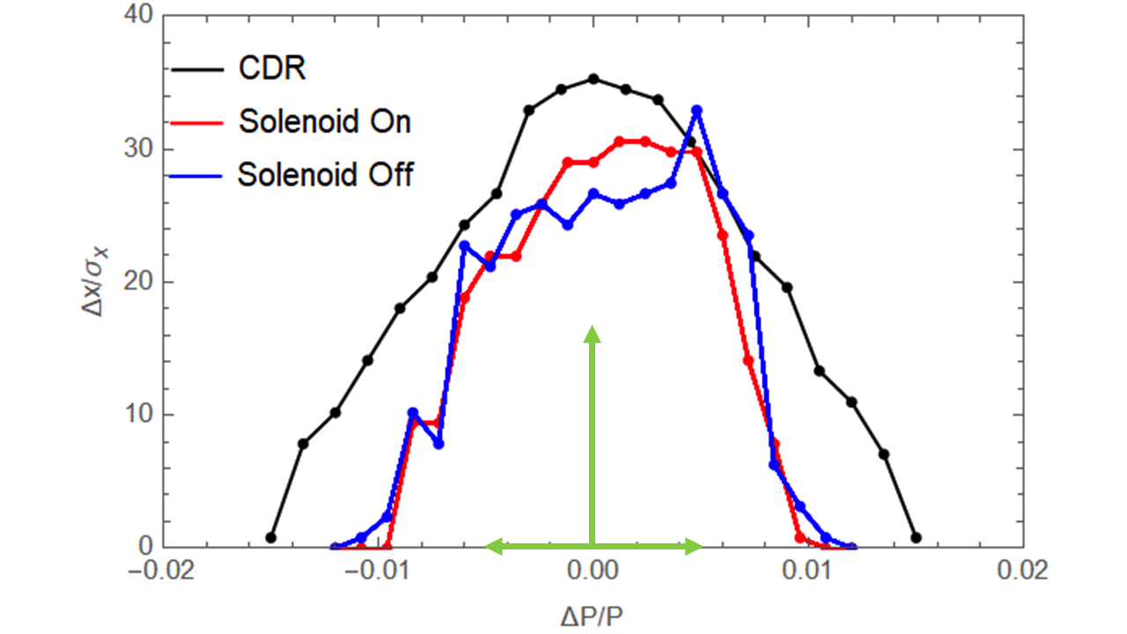
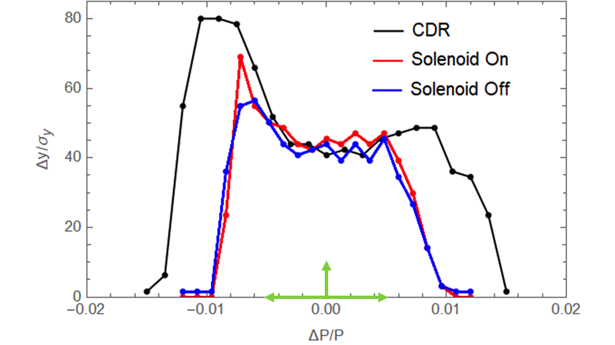
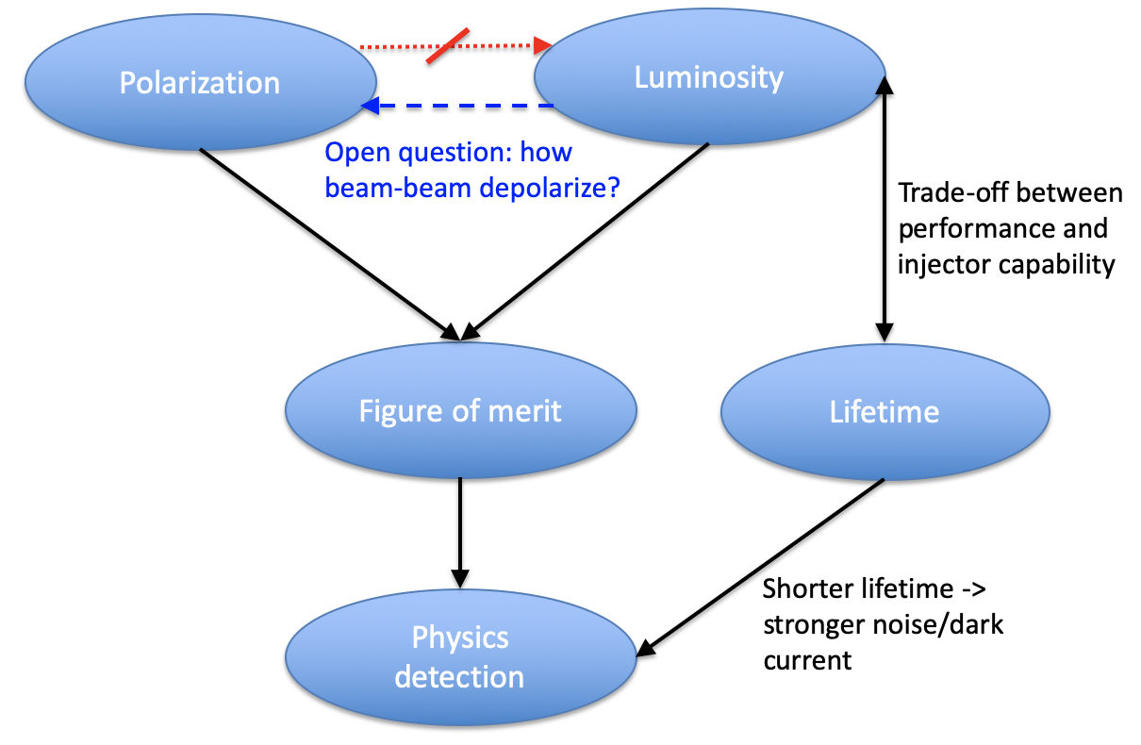
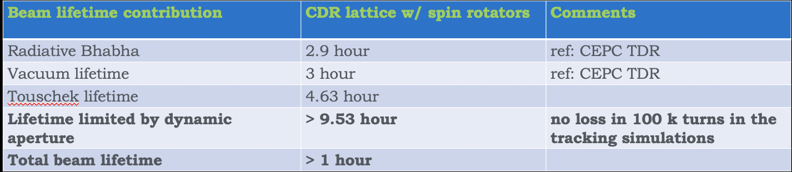
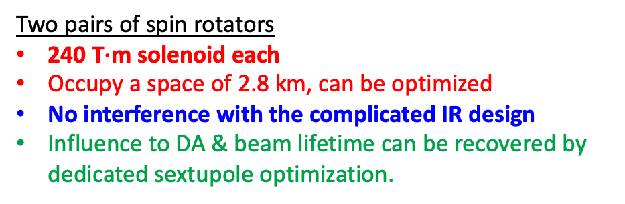
Polarization, luminosity and beam lifetime
It is possible to attain 50%-70% e- longitudinal polarization at the nominal luminosity and simultaneously with a decent lifetime @ Z-pole
Two pairs of spin rotators
240 T$∙$m solenoid each
Occupy a space of 2.8 km, can be optimized
No interference with the complicated IR design
Influence to DA & beam lifetime can be recovered by dedicated sextupole optimization.
Comparison of the dynamic aperture
Contributors to the beam lifetime
W. Xia et al., Investigation of spin rotators in CEPC at the Z-pole,
Radiat. Det. Tech. Meth. 6:490 (2022).

Slide 12
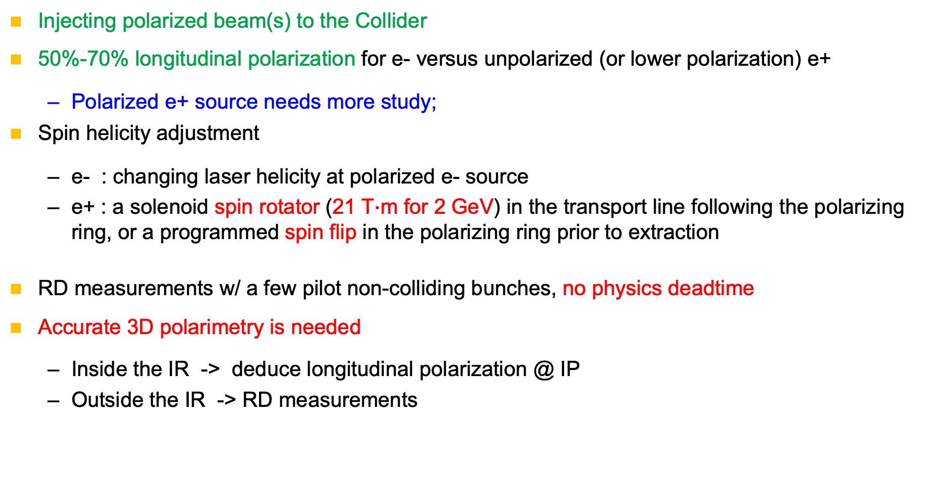
Prospects of Z-pole polarization for CEPC
Injecting polarized beam(s) to the Collider
50%-70% longitudinal polarization for e- versus unpolarized (or lower polarization) e+
  Polarized e+ source needs more study;
Spin helicity adjustment
  e- : changing laser helicity at polarized e- source
  e+ : a solenoid spin rotator (21 T$∙$m for 2 GeV) in the transport line following the polarizing ring, or a programmed spin flip in the polarizing ring prior to extraction
RD measurements w/ a few pilot non-colliding bunches, no physics deadtime
Accurate 3D polarimetry is needed
  Inside the IR -> deduce longitudinal polarization @ IP
  Outside the IR -> RD measurements

Slide 13
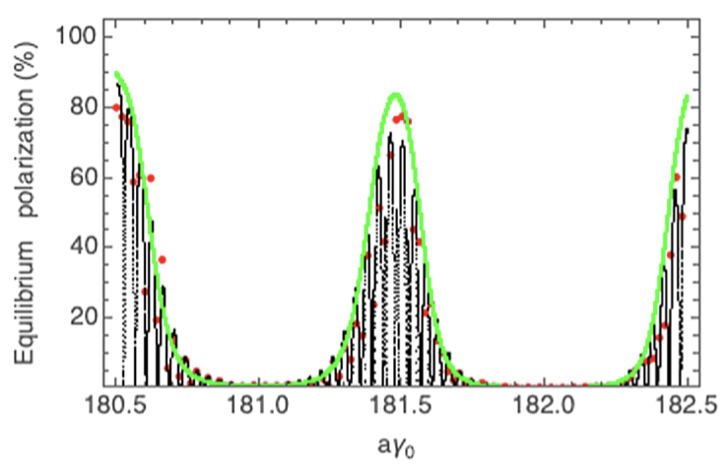
Longitudinal polarization at W?
A good chance for >50% e- longitudinal polarization at W
  Assume injected polarization > 60%, then P_{DK} needs to be above 23%
Interleaved solenoid + dipole spin rotators to cover a larger energy range (under study)
  solenoid strength scales ~ linearly with energy
Simulated equilibrium polarization of Collider at W
W. H. Xia, et al, Evaluation of radiative depolarization in the future circular electron-positron collider, Phys. Rev. Accel. Beams, 26, 091001, (2023).

Slide 14
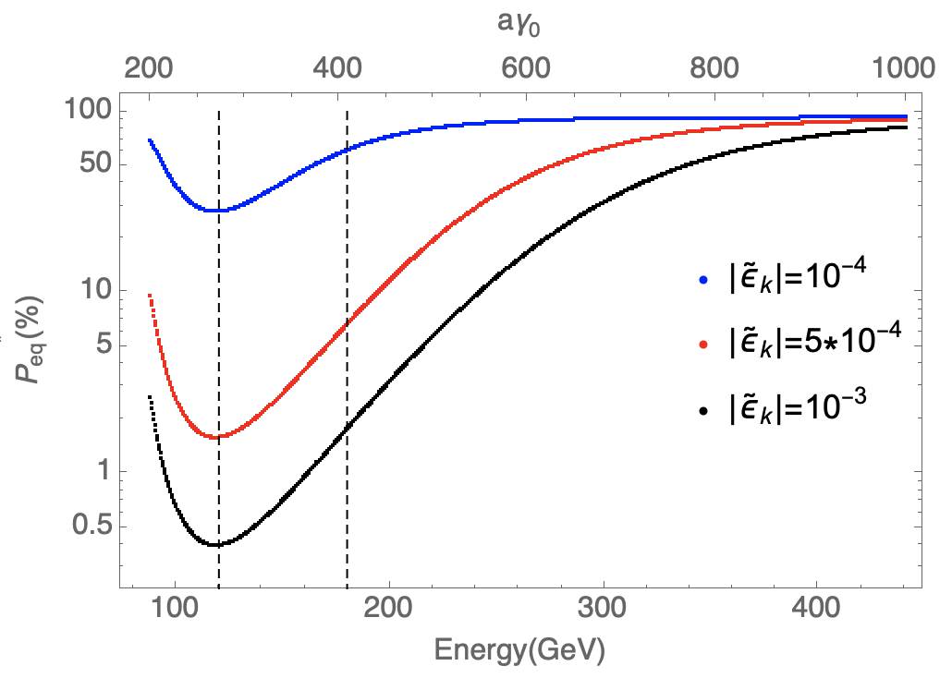
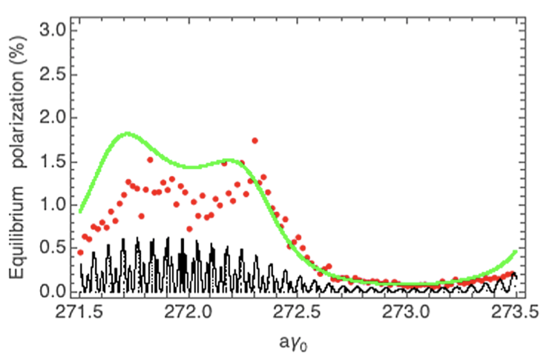
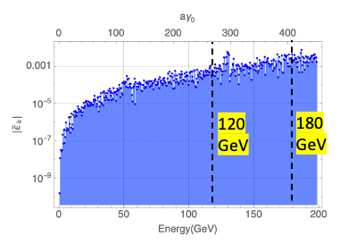
Useful polarization level at Higgs?
More challenging but possible at Higgs (Under study)
  Simulated injected polarization < 30% -> improvements in Booster lattice design & mitigation to machine imperfections
  Simulated equilibrium polarization ~ 1% -> mitigate depolarization by harmonic spin matching, cancellation of Sokolov-Ternov effect
Interleaved solenoid +dipole spin rotators to cover a larger energy range (under study)
Prediction of resonant spin diffusion theory at ultra-high energies
Simulated equilibrium polarization of Collider at Higgs
The key is to reduce the spin
resonance strength by a factor of 10
W. H. Xia, et al, Evaluation of radiative depolarization in the future circular electron-positron collider, Phys. Rev. Accel. Beams, 26, 091001, (2023).

Slide 15
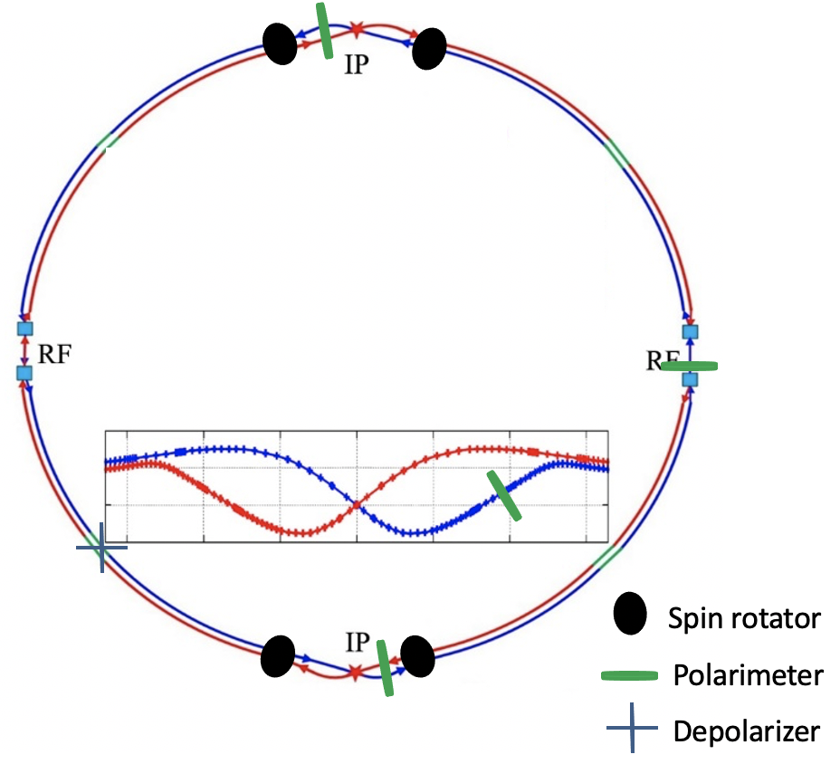
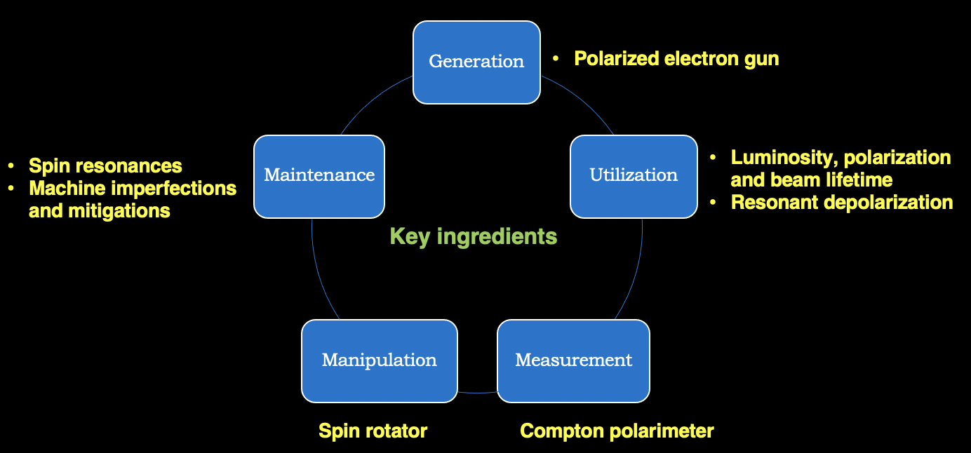
Polarization R&D plan in the CEPC EDR Phase
Implement the spin components in the post-TDR lattice designs
Study the polarization utilities at Higgs and W energies
Polarization-related key hardware R&D
Modify the PAPS photocathode DC gun to a Polarized Electron Source
RD @ BEPCII
R&D of high-field SC solenoids
A Compton polarimeter for BEPCII

Slide 16
Summary
Injecting polarized beams is promising for longitudinal polarization and RD measurements.
50%-70% longitudinally polarized e- versus unpolarized (or a lower polarization) e+ at Z with the nominal luminosity is a reasonable goal.
Further studies of polarized beams towards higher energies as well as related hardware R&D are planned for the CEPC EDR phase.
Physics motivations for polarized beams are warmly welcome.

Slide 17
Thank you for your attention!

Slide 18
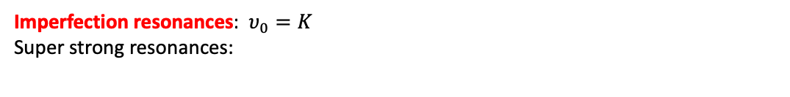
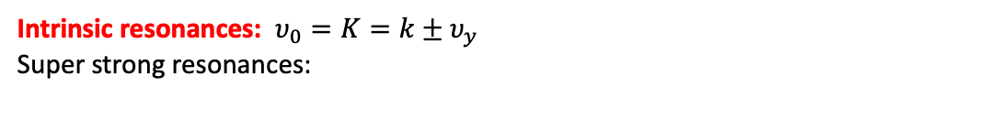
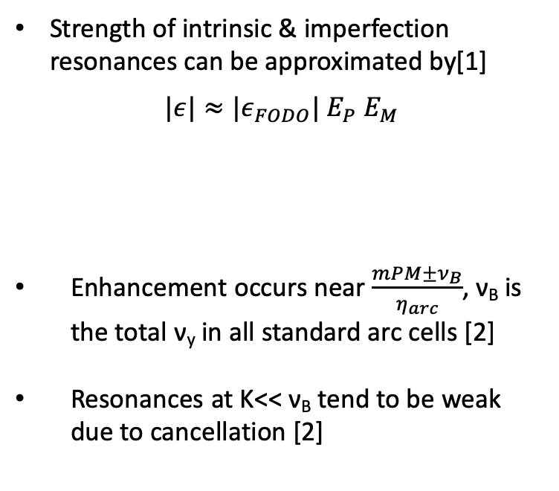
Spin resonance structure of a CEPC Booster lattice
Strength of intrinsic & imperfection resonances can be approximated by[1]
$$|ε|≈{|ε}_{FODO}| E_{P} E_{M}$$
Enhancement occurs near $\frac{mPM±ν_{B}}{η_{arc}}$, ν_{B} is the total ν_{y} in all standard arc cells [2]
Resonances at K<< ν_{B} tend to be weak due to cancellation [2]
Intrinsic resonances: $υ_{0}=K=k±υ_{y}$
Super strong resonances:
due to M identical FODOs in each arc
due to P superperiods
Imperfection resonances: $υ_{0}=K$
Super strong resonances:
[1] S. Y. Lee, Spin dynamics and snakes in synchrotrons (World Scientific, 1997).
[2] T. Chen, Z. Duan, D. H. Ji, D. Wang, Phys. Rev. Accel. Beams, 26, 051003 (2023).

Slide 19
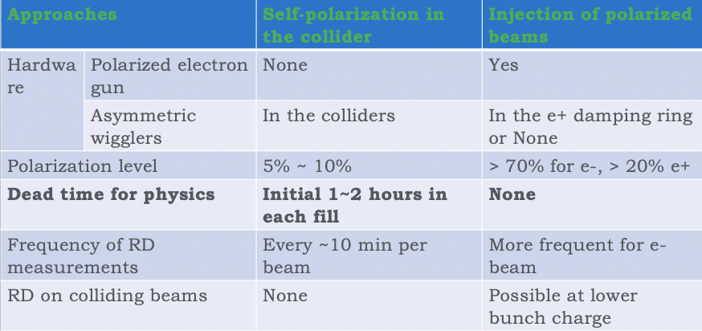
Resonant Depolarization at Z
It’s possible to inject > 20% polarized beams to enable RD measurements at Z-pole
  No dead time for physics, a few pilot bunches
  Polarized e+ source ? Dual-purpose damping/polarizing ring (could accommodate both e+/e- beams to gain sufficient polarization)
One typical design:
beam energy ~ 2 GeV, circumference ~ 150 m
polarization build-up time ~ 14.5 min
Extracted beam polarization @ 10min ~ 44%

Slide 20
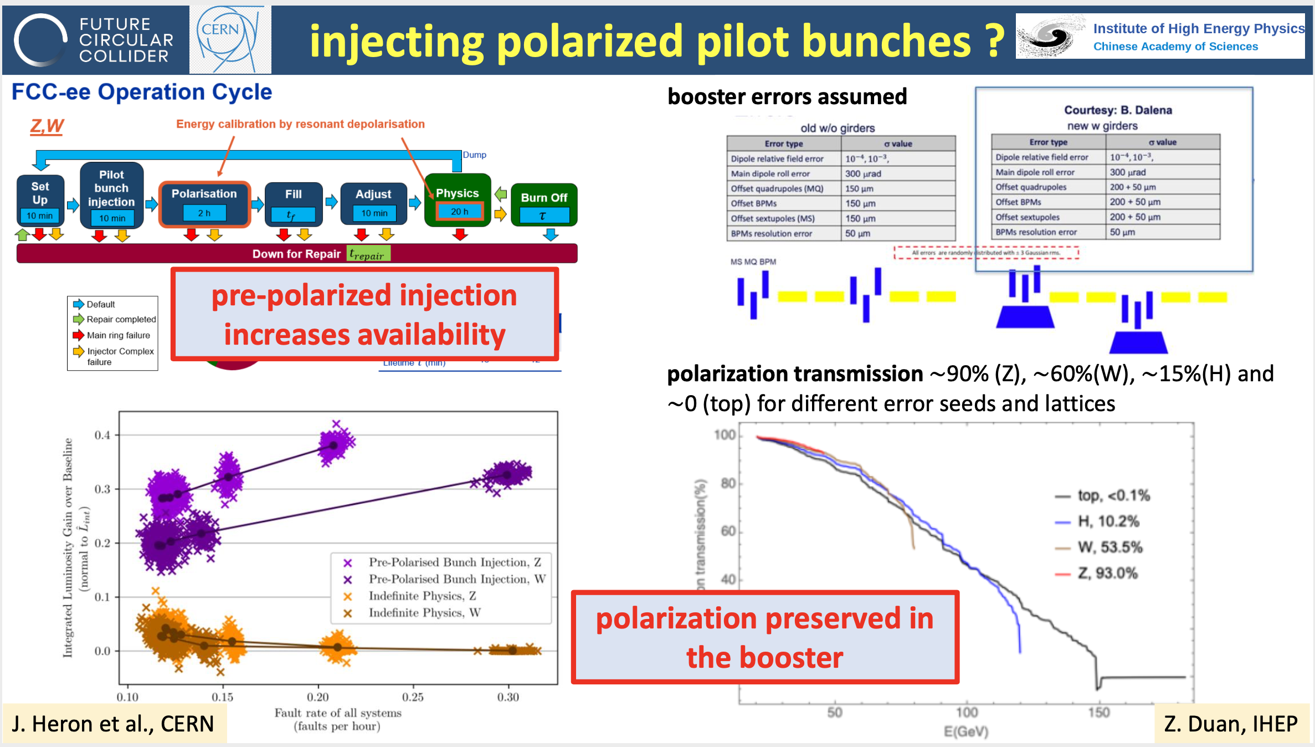
RD measurements: endorsed by recent FCC-ee studies
F. Zimmermann, FCC Accelerator Status, FCC Week 2024

