Slide 1






ALICE 3 RICH FEE preliminary module concept
Ciro Bermúdez Márquez, Daniel Durini, Julio Hernández, Tivadar Kiss, Flavio Loddo, José de Jesús Rangel, Jose M. Rocha-Perez, Sergio A. Rosales-Nunez, Miguel Velázquez de la Rosa
On behalf of the ALICE-3 RICH Group
ALICE 3 RICH preliminary FEE module concept, Oct. 2024

Slide 2
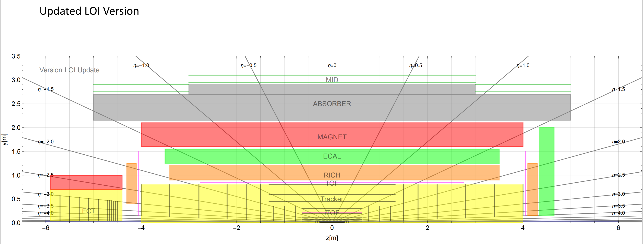
ALICE current system layout dimensions
ALICE 3 RICH preliminary FEE module concept, Oct. 2024

Slide 3
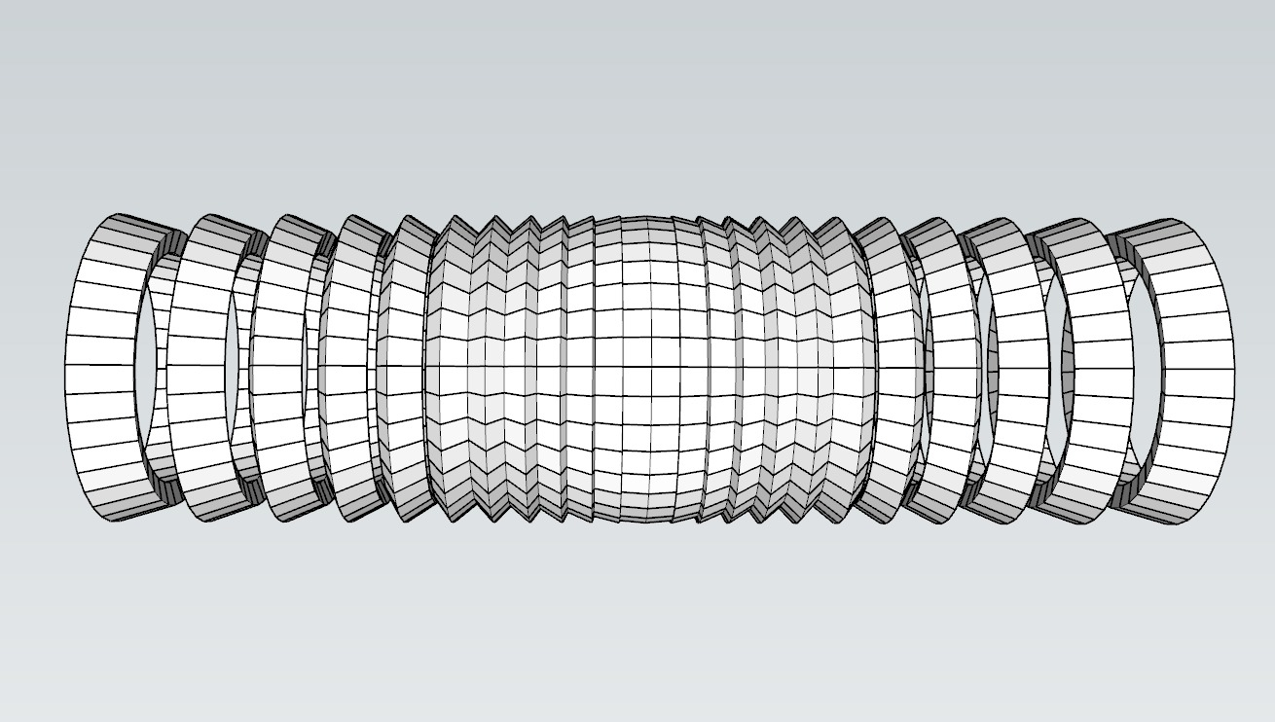
RICH barrel
Origin of heavy-ion collisions
Thermal isolation vessel
ALICE 3 RICH preliminary FEE module concept, Oct. 2024
7 m
TOTAL of 24 rings: each with 36 segments (with dimensions of 15 x 20 cm² perpendicular to the particle beam)
The first approach for front-end electronics proposed is modular, 4-side tileable, forming FEE “super-modules”, placed on and completely filling each of the 36 segments (with an approx. area of 15 x 20 cm²) per ring, each placed perpendicularly to the origin of heavy-ion collisions.

Slide 4
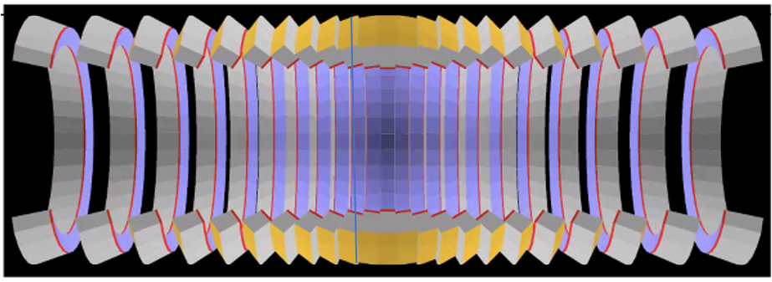
RICH proposed system layout
ALICE 3 RICH preliminary FEE module concept, Oct. 2024
7 m
Front-End Electronics (FEE) modules
TOTAL of 24 rings
Origin of heavy-ion collisions

Slide 5
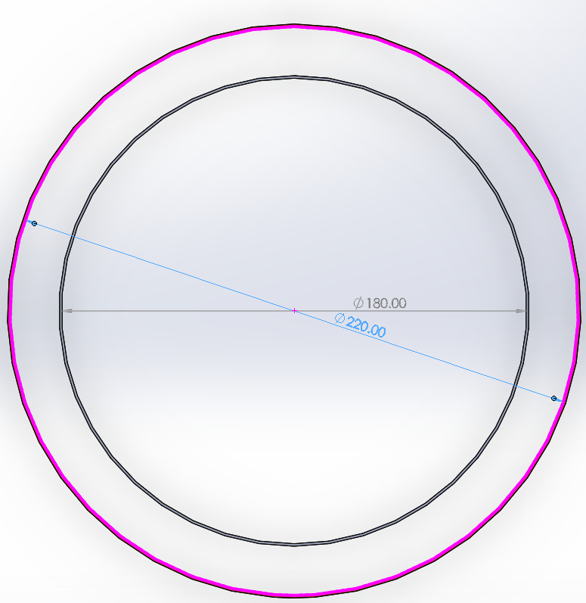
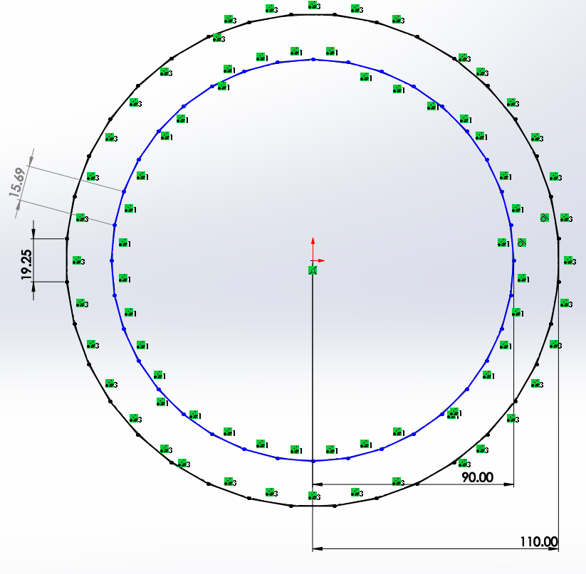
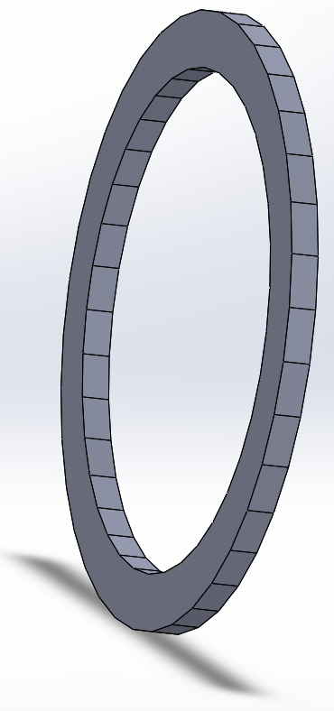
RICH Space Dimensions
Ring 0
ALICE 3 RICH preliminary FEE module concept, Oct. 2024
ø 240.00
120.00
Barrel dimensions: Radius 90 cm to 120 cm
Space in between: 30cm
The ring consists of 36 segments
Goal dimension specification for the 36 segments (super-modules) per ring: 15 x 20 cm²

Slide 6
RICH FEE Functional Diagram
2 cm
20 cm
8 cm
Cherenkov radiation
ALICE 3 RICH preliminary FEE module concept, Oct. 2024
Charged particle
20 cm
Cherenkov radiation
Charged particle
Cherenkov radiator
RICH air-gel Cherenkov radiator
SiPM-array
ALCOR array
VTRX + connectors
lpGBT array
15 cm
Connectors and passive electronics

Slide 7
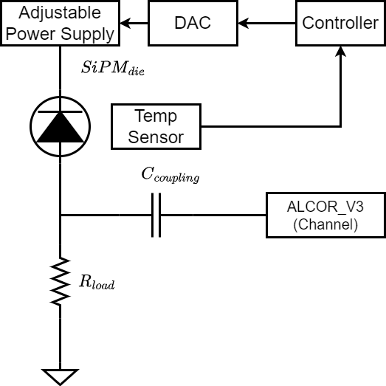
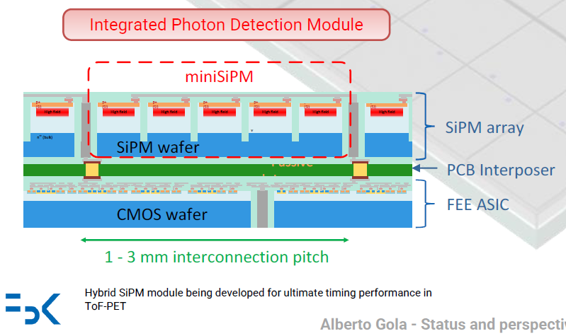
ALICE-3 RICH FEE: SiPM array
ALICE 3 RICH preliminary FEE module concept, Oct. 2024
Source: Alberto Gola, “Status and perspectives of SiPMs at FBK”, CERN, 2023
Fig. 2: SiPM die and ALCOR V3 general connection with temperature sensor.

Slide 8
ALICE-3 RICH FEE: Preliminary Assembly Proposal
The proposed modular assembly includes:
a SiPM-tile, which comprises an array of 8 x 8 SiPMs → 64 SiPM channels
a SiPM-module, constituted by 3 x 3 SiPM-tiles → 576 SiPM channels
a SiPM super-module made up of 3 x 4 SiPM-modules → 6,912 SiPM channels
16.67 mm
SiPM
SiPM
SiPM
SiPM
SiPM
SiPM
SiPM
SiPM
SiPM
SiPM
SiPM
SiPM
SiPM
SiPM
SiPM
SiPM
SiPM
SiPM
SiPM
SiPM
SiPM
SiPM
SiPM
SiPM
SiPM
SiPM
SiPM
SiPM
SiPM
SiPM
SiPM
SiPM
ALICE 3 RICH preliminary FEE module concept, Oct. 2024
16.67 mm
SiPM Super-module size must be equal area of each of the 36 segments of a RICH mechanical ring → 15 x 20 cm²
SiPM
SiPM
SiPM
SiPM
SiPM
SiPM
SiPM
SiPM
SiPM
SiPM
SiPM
SiPM
SiPM
SiPM
SiPM
SiPM
SiPM
SiPM
SiPM
SiPM
SiPM
SiPM
SiPM
SiPM
SiPM
SiPM
SiPM
SiPM
SiPM
SiPM
SiPM
SiPM
SiPM Tile → 64 SiPM channels
SiPM pitch ≤ 2.083 x 2.083 mm²

Slide 9
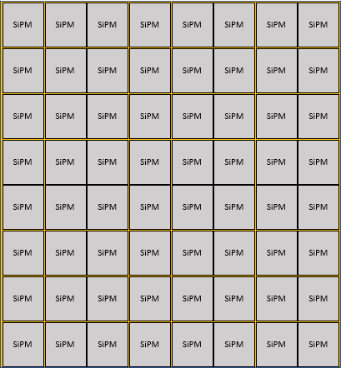
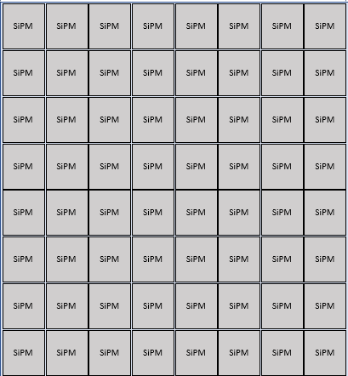
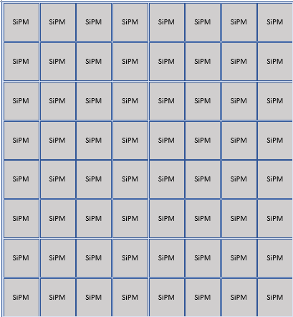
ALICE-3 RICH FEE: Preliminary Assembly Proposal
50 mm
Tile 1
Tile 2
Tile 3
Tile 4
Tile 5
Tile 6
50 mm
ALICE 3 RICH preliminary FEE module concept, Oct. 2024
Tile 7
Tile 8
Tile 9
SiPM-module, constituted by 3 x 3 SiPM-tiles → 576 SiPM channels

Slide 10
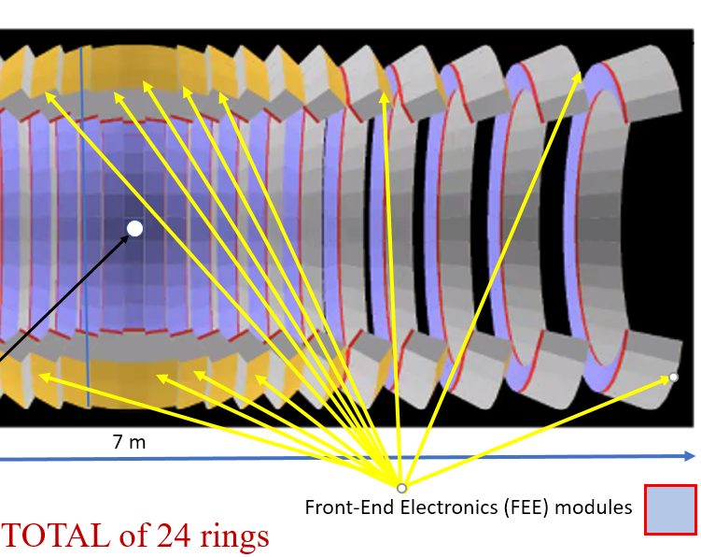
ALICE-3 RICH FEE: Preliminary Assembly Proposal
150 mm
Challenges:
The mandatory solution size requirement is 20 cm x 15 cm.
The maximum thickness of the solution is 30 mm.
The solutions must operate in a cryogenic environment of -40° C.
The solutions must operate in a high-radiation environment.
We have only preliminary information on the ALCOR specs.
Module 1
576 channels
Module 2
576 channels
Module 3
576 channels
Module 4
576 channels
Module 5
576 channels
Module 6
576 channels
200 mm
ALICE 3 RICH preliminary FEE module concept, Oct. 2024
SiPM super-module, constituted by 3 x 4 SiPM modules → 12 x 576 = 6,912 SiPM channels
Module 7
576 channels
Module 8
576 channels
Module 9
576 channels
Module 10
576 channels
Module 11
576 channels
Module 12
576 channels
Disclaimer: the total number my slightly change by
fine tuning the pitch of the sensors.

Slide 11
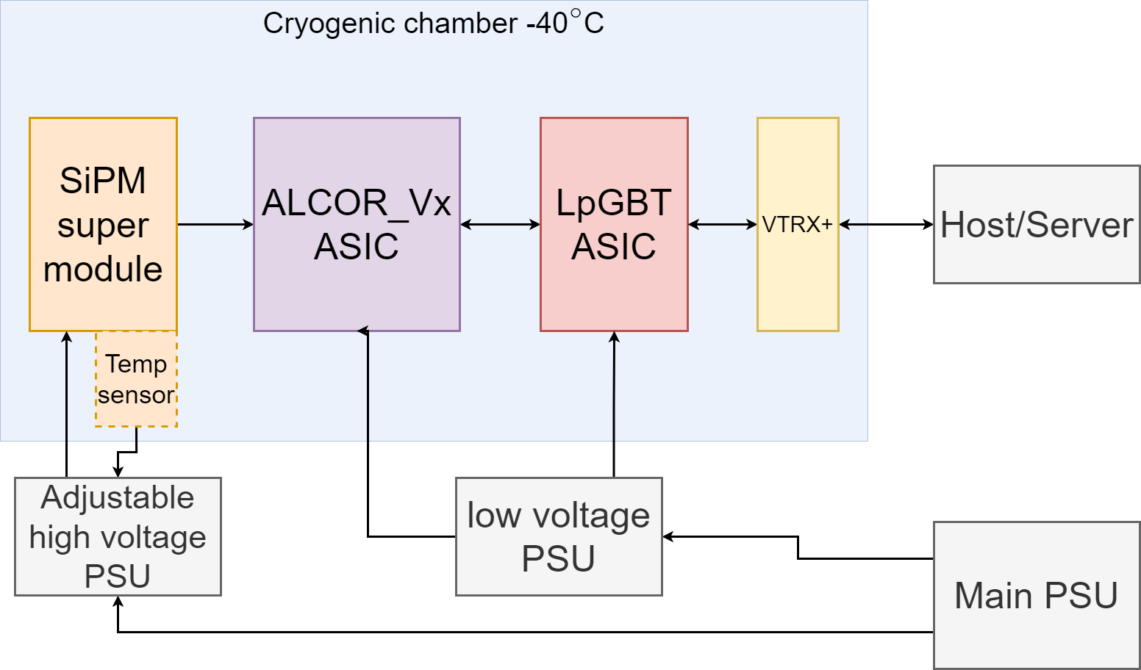
ALICE-3 RICH FEE: Preliminary Read-out Proposal Based on ALCOR ASICs
Read-out concept: direct read-out of the digitizer chip, e.g. an ALCOR, with lpGBT links
(No FPGAs are possible in this high radiation environment)
ALICE 3 RICH preliminary FEE module concept, Oct. 2024
  ALCORv3 / lpGBT digital interface:
  ALCOR v3
  64 analog channels
  8x data out: 640 Mb/s
  1x CLK_in: 320 MHz DDR
lpGBT ASIC
1 high speed output
up to 12x data in: 640 Mb/s
e-CLK outputs: 320 MHz (programmable)
Fig. 1: General block diagram of the ALICE3-RICH-FEE.

Slide 12
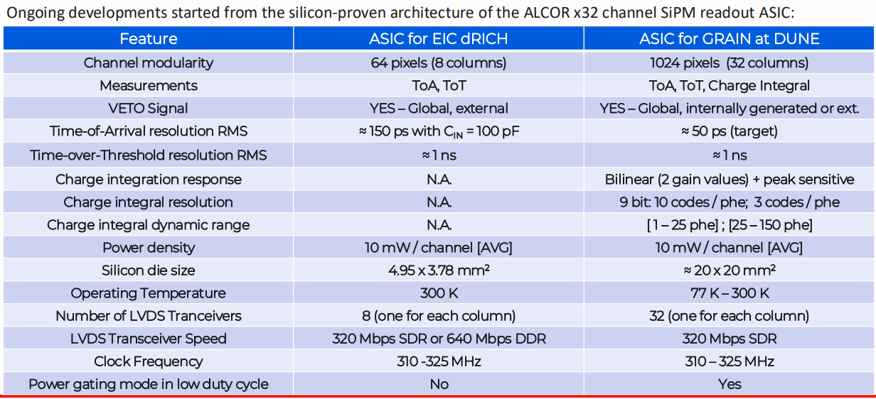
ALICE-3 RICH FEE: Preliminary Read-out Proposal Based on ALCOR ASICs
ALICE 3 RICH preliminary FEE module concept, Oct. 2024
See Valerio Pagliarino’s presentation „Perspectives for a RICH front-end based on the ALCOR architecture and possible synergies with other experiments”
5th ALICE UPGRADE WEEK in Kraków (7-11 October 2024): Overview · Indico (cern.ch)

Slide 13
ALICE-3 RICH FEE: Preliminary Read-out Proposal Based on ALCOR ASICs
We have investigated the following read-out schemes based on different present and future ALCOR ASICs:
Existing:
32-ch ALCOR_v2: not considered
Existing:
64-ch ALCOR_v3 with 320 Mb/s data lines
64-ch ALCOR_v3 with 640 Mb/s data lines
In development:
1024-ch ALCOR with 320 Mb/s data lines
1024-ch ALCOR with 320 Mb/s data lines
Using of additional ECON-D ASICs for ZS and data aggregation
ALICE 3 RICH preliminary FEE module concept, Oct. 2024

Slide 14
ALICE-3 RICH FEE: Preliminary Read-out Proposal Based on ALCOR ASICs
Study No.1: Read-out scheme based on
ALCOR_v3 with 640 Mb/s data lines
ALICE 3 RICH preliminary FEE module concept, Oct. 2024

Slide 15
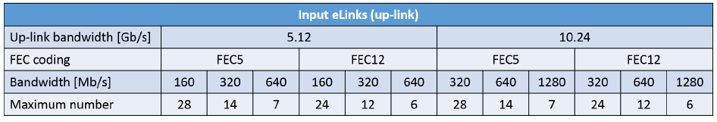
ALICE-3 RICH FEE: Preliminary Read-out Concept based on the ALCOR_v3 ASIC
How many FEE components do we need?
Total number of FE components foreseen…
We have 24 rings and 36 sectors, so we have 864 Supermodules
Components needed:
  ALCOR_v3: 864 x 108 = 93 312 pcs
  lpGBT ASIC: 864 x 72 = 62 208 pcs
  VTRX+ module: 864 x 18 = 15 552 pcs
Huge numbers of components, very high interconnection density
→ challenging implementation
1. Let’s see if it is possible… (next slides)
2. RICH is very much interested in new versions of ALCOR (or else)
to reduce the initial number of data lines
In a supermodule…
We have 6 912 SiPMs in a Suermodule…
ALCOR_v3 has 64 analog input channels
→ 108 ALCOR_v3 ASIC is needed in a Supermodule
1 ALCOR_v3 has 8 digital output lines running at 640 Mb/s.
Using the lpGBT in 10.24 Gb/s & FEC12 configuration,
12 input e-links are available at 640 Mb/s speed in an lpGBT ASIC to read out the ALCOR(s).
→ 72 lpGBT ASICs are required in a Supemodule
A VTRX+ optical transceiver module has 4 TX and 1 RX lines
→ 18 VTRX+ modules are need in a Supermodule
ALICE 3 RICH preliminary FEE module concept, Oct. 2024
6912 analog signals
+ VIN_DAC , GND
SPI (or I²C) control
SiPM
6 912 pcs
+
temp. sensor
64-ch
ALCOR v3 ASIC
108 pcs
DATA OUT
lpGBT
ASIC
72 pcs
VTRX+
optical modules
18 pcs
DAQ Common
Read-out Units
(Future CRU)
DAQ servers
high-
-speed
optical link
4 TX + 1 RX
640 Mb/s e-links
10 Gb/s
CLK, FCMD

Slide 16
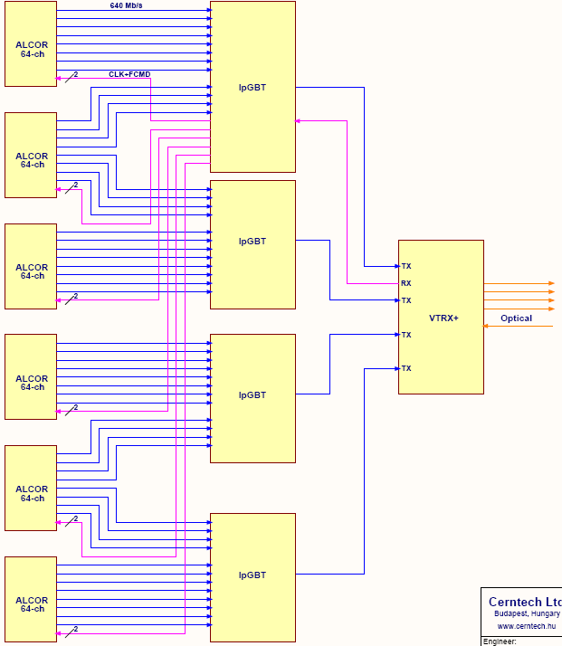

ALICE-3 RICH FEE: Read-out, Fast and Slow Control Segmentation (ALCOR_v3)
A VTRX+ optical module can handle 4 uplinks and 1 downlink
It is forwarded electrically to 1 lpGBT only → only 1 of the 4 lpGBT ASICs connected can receive downstream data.
This ‚master’ lpGBT ASIC has to do the Fast Control and configuration of the 6 ALCORs, as well as the Slow Control of that segment of the FEE.
What is behind 1 downlink?
  1x VTRX+ module (4x TX, 1x RX)
  4x lpGBT ASIC (1x ‚master’ + 3x ‚slave’)
  6x 64-ch ALCOR_v3 front-end ASIC
  384 SiPMs (analog channles)
This is the possible level of granularity for the fast-control and slow-control of the FEE.
ALICE 3 RICH preliminary FEE module concept, Oct. 2024

Slide 17
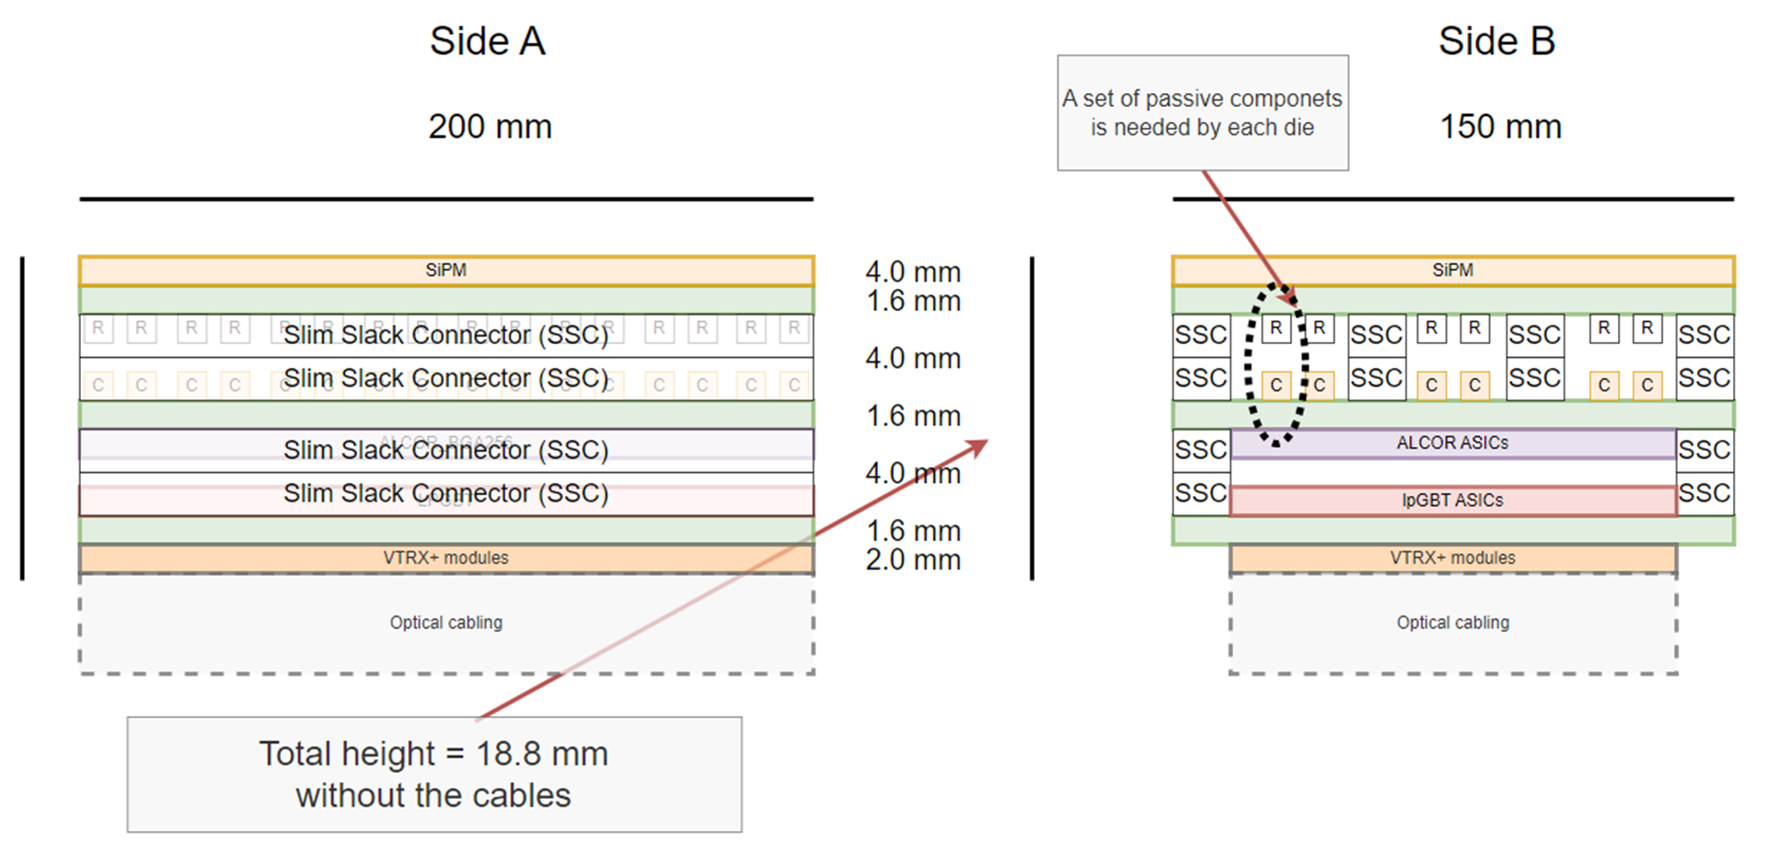
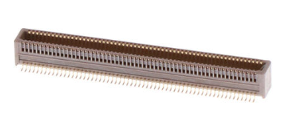
ALICE-3 RICH FEE: Stack of PCBs with board-to-board connectors
ALICE 3 RICH preliminary FEE module concept, Oct. 2024
Candidate connectors: Molex SlimStack (SSC)
0.4 mm pitch, 2 rows
max. circuits: 120 pins
stacking height: 4 mm
mating cycles: ~ 30

Slide 18
ALICE-3 RICH FEE: ALCOR_v3 with 640 Mb/s data lines
108 x ALCOR_v3 /board
ALCORs can be placed, but...
Connectors: 28x 120 pin, 0.4 mm
e.g. Molex SlimStack Connector (SSC)
  No. of connector pins needed between
  the SiPM PCB and the ALCOR PCB:
  - signals: ~ 6 912 !
  - GND: many! (up to thousands to avoid xtalk)
  - LV: hundreds!
  No. of connector pins available: ~ 6 720
  (issue no.1 - Looks to be a showstopper for this concept...)
No. of outgoing e-Links: 108 x 8 = 864
Power dissipation on this side
  P_{ALCOR} = 108x 64x 12 mW = 84 W /board, max
Is it routable?
Maybe... further study is needed if concept
is not dropped. Cross-talk, noise, etc.
20 cm
ALCOR_v3 Board
ALICE 3 RICH preliminary FEE module concept, Oct. 2024
15 cm
108 ALCOR_v3
in a matrix of 12 x 9
no trial placement has been done yet,
looks not to be possible…

Slide 19
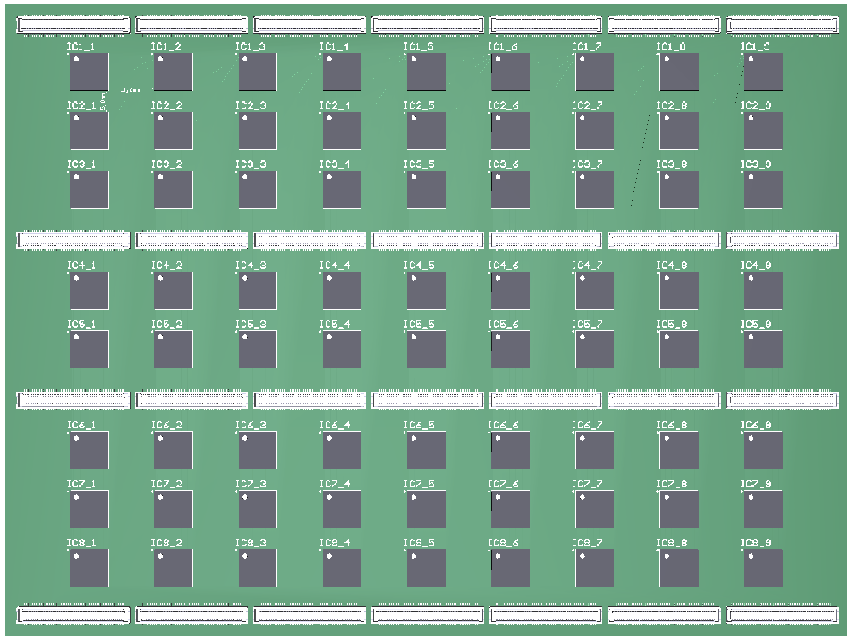
ALICE-3 RICH FEE: ALCOR_v3 with 640 Mb/s data lines
20 cm
72x lpGBT ASICs /board
Components can be placed, but:
No. of eLinks from the ALCOR board: ~ 864
  No. of connector pins needed between
  the ALCOR PCB and the lpGBT & VTRX+ PCB:
  - signals + GND: 3x 864 = 2 592 pins
  - LV delivery: hundreds (see later)
  No. of connector pins available: ~ 3 360
Power dissipation on this side
  P_{lpGBT} = 72x 0.5 W, max = 36 W /board, max
Is it routable?
Maybe on 16 layers... further study is needed if concept is not dropped.
ALICE 3 RICH preliminary FEE module concept, Oct. 2024
15 cm
TOP side

Slide 20
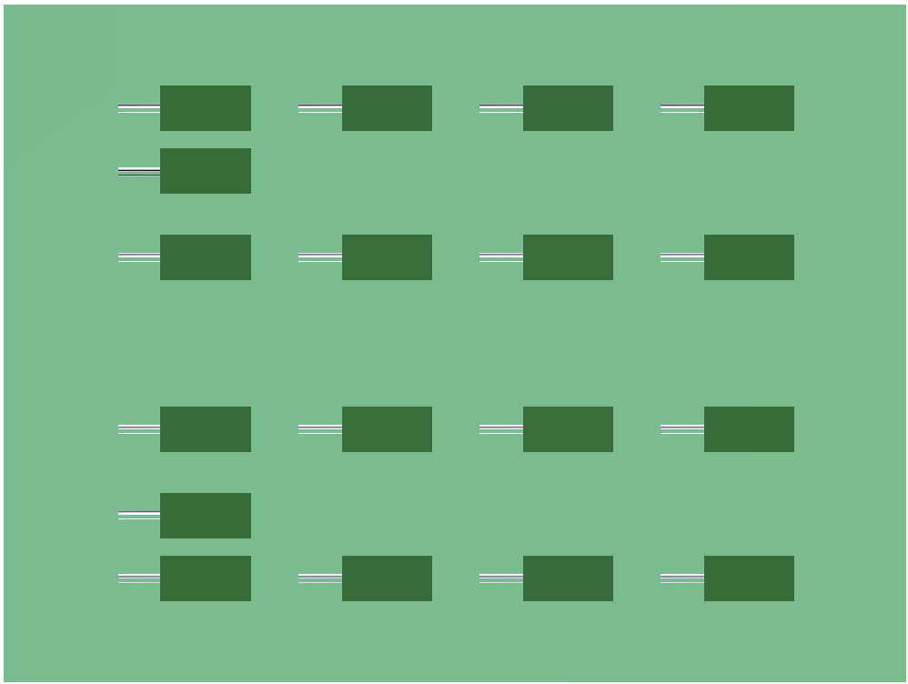
ALICE-3 RICH FEE: ALCOR_v3 with 640 Mb/s data lines
20 cm
18x VTRX+ modules /board
w/ long pigtail cables (up to 4 m! )
Components can be placed
10 Gb/s high-speed lines (90x) go to the
other side via carefully designed diff. vias
Power dissipation on this side
  P_{tot} = 18x 0.24 W, max = 4.3 W /board, max.
* * *
I_{LV} (lpGBT, 72 pcs) = 30 A, max @1.2V
(24 A, typ @1.2V)
I_{LV} (VTRX+, 18 pcs) = 1.6 A @ 2.5V
= 0.5 A @ 1.2V
P (lpGBT+VTRX+)_{tot, max} = 36+4.3 W = 41 W /board
T amb: -40 °C
ALICE 3 RICH preliminary FEE module concept, Oct. 2024
15 cm
BOTTOM side

Slide 21
ALICE-3 RICH FEE: LV Supply and Power Dissipation (ALCOR_v3_640 Mb/s)
LV Current Supply
Current consumption of the FEE components in each Supermodule…
I_{LV} (ALCOR_v3, 108 pcs) 10..12 mW /ch (ALCOR_v3)
= 70 A, max @1.2V
I_{LV} (lpGBT, 72 pcs) = 30 A, max @1.2V
I_{LV} (VTRX+, 18 pcs) = 1.6 A @ 2.5V
= 0.5 A @ 1.2V
The total 1.2V current consumption of each Supermodule
sums up to ~ 100 A
  - thick cables need space... no option
  - Local DC/DC conversion is a must
  - additional power board in the PCB stack will be needed
  - a single rad-hard „bPOL48V” DC/DC converter has an
  - I_{out, max} = ~ 10..15 A (w/ propoer cooling)
  - We would need a very high number of DC/DC converters
  in each Supermodule... (Issue No. 2a)
  - high density board-to-board connectors (e.g. this SlimStack connectors) can deliver 0.3..0.5A /pin → an additional hundreds of pins are needed for LV delivery (Issue No. 2b)
  - the even distribution of the current on hundreds of connector pins on multiple connectors can not be guaranteed...
This looks to be a showstopper with the present ALCOR_v3 ASIC and direct lpGBT read-out.
Power dissipation /cooling
Dissipation of the FEE components in a Supermodule…
P (ALCOR_v3, 108 pcs) = 84 W, max
P (lpGBT, 72 pcs) = 36 W, max (see previous slides)
P (VTRX+, 18 pcs) = 4.6 W, max (see previous slides)
120..130 W /Supermodule
* * *
In this scheme the total dissipation of the FEE compnents in the cryogenic vessel (I.e. all 864 Supermodules, 24 rings x 36 segments)
125 W x 864 = 110 kW, max.
Cooling down the cryogenic vessel to -40 °C while heating it with
110 kW is a challange, if feasible.
To be further evaluated... but the large FEE dissipation can also be a showstopper for this scenario with the ALCOR_v3.
ALICE 3 RICH preliminary FEE module concept, Oct. 2024

Slide 22
ALICE-3 RICH FEE: ASICs need and Cost estimations
FEE Components Cost (estimations)
ASIC components need:
  ALCOR_v3: 864 x 108 = 93 312 pcs ? CHF/ea = ?
  lpGBT ASIC: 864 x 72 = 62 208 pcs 25 CHF /ea = 1.56 MCHF
  VTRX+ module: 864 x 18 = 15 552 pcs 140 CHF /ea = 2.18 MCHF
  DC/DC: 864 x ?
Connectors
  Molex SSC 864 x 60 = 50k+ pcs < 2 CHF & 50K = < 0.1 MCHF
PCB (bare)
  est. 864 x 4 = 3 500 pcs ~ 300 CHF /ea = ~ 1 MCHF
ALICE 3 RICH preliminary FEE module concept, Oct. 2024
DAQ /Common Read-out Units (of that time):
lpGBT uplinks: ~ 62 000
CRUs with 48 inputs: ~ 1 300 ... also looks not acceptable...

Slide 23
ALICE-3 RICH FEE: Preliminary Read-out Proposal Based on ALCOR ASICs
Study No. 2: Read-out scheme based on
ALCOR_v3 with 320 Mb/s data lines
the same, but the number of lpGBT and VTRX+ components (and CRUs) can be halved...
ALICE 3 RICH preliminary FEE module concept, Oct. 2024

Slide 24
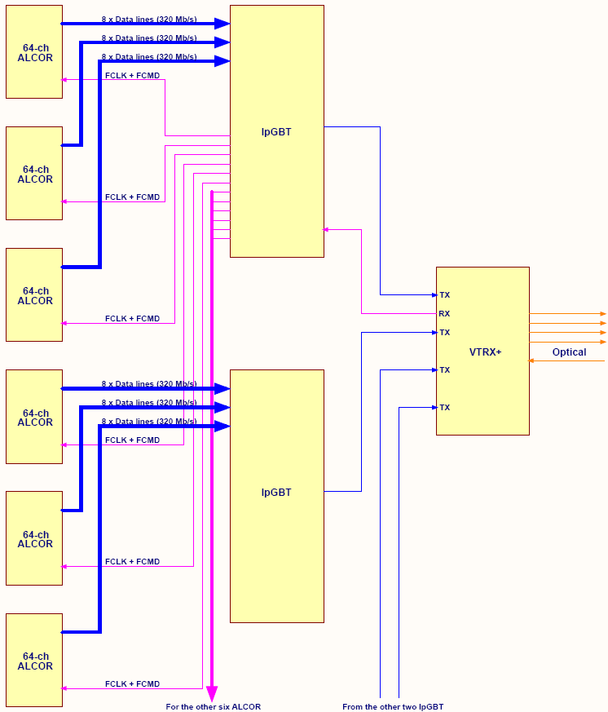
ALICE-3 RICH FEE: Read-out, Fast and Slow Control Segmentation (ALCOR_v3)
A VTRX+ optical module can handle 4 uplinks and 1 downlink
It is forwarded electrically to 1 lpGBT only → only 1 of the 4 lpGBT ASICs connected can receive downstream data.
This ‚master’ lpGBT ASIC has to do the Fast Control and configuration of the 6 ALCORs, as well as the Slow Control of that segment of the FEE.
What is behind 1 downlink?
  1x VTRX+ module (4x TX, 1x RX)
  4x lpGBT ASIC (1x ‚master’ + 3x ‚slave’)
  12x 64-ch ALCOR_v3 front-end ASIC
  768 SiPMs (analog channles)
This is the possible level of granularity for the fast-control and slow-control of the FEE.
ALICE 3 RICH preliminary FEE module concept, Oct. 2024

Slide 25
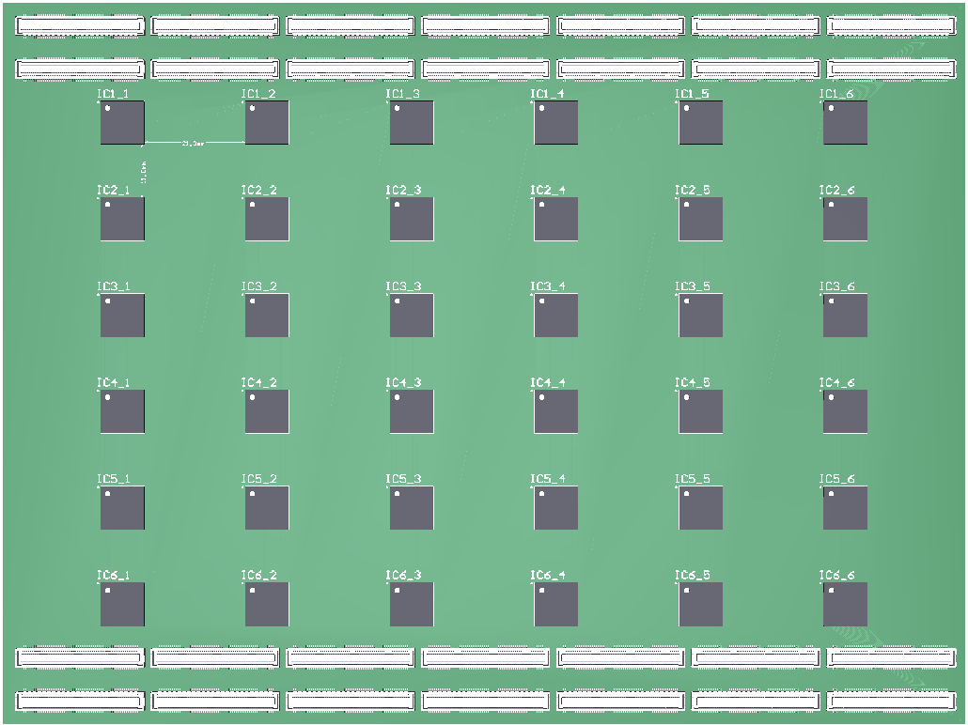
ALICE-3 RICH FEE: ALCOR_v3 with 320 Mb/s data lines
36x lpGBT ASICs /board
Components can be placed, but:
No. of eLinks: ~ 540
  No. of connector pins needed between the
  ALCOR PCB to the lpGBT PCB remains the same:
  - signals: ~ 6 912
  - GND: many (up to thousands)
  - LV hundreds
  No. of connector pins available: 3 360 or
  6 720, max, if we double the connectors
  (issue no.1)
Power dissipation on this side:
  P_{lpGBT} = 36x 0.5 W, max = 18 W /board, max
Is it routable?
Looks feasible...
ALICE 3 RICH preliminary FEE module concept, Oct. 2024
TOP side

Slide 26
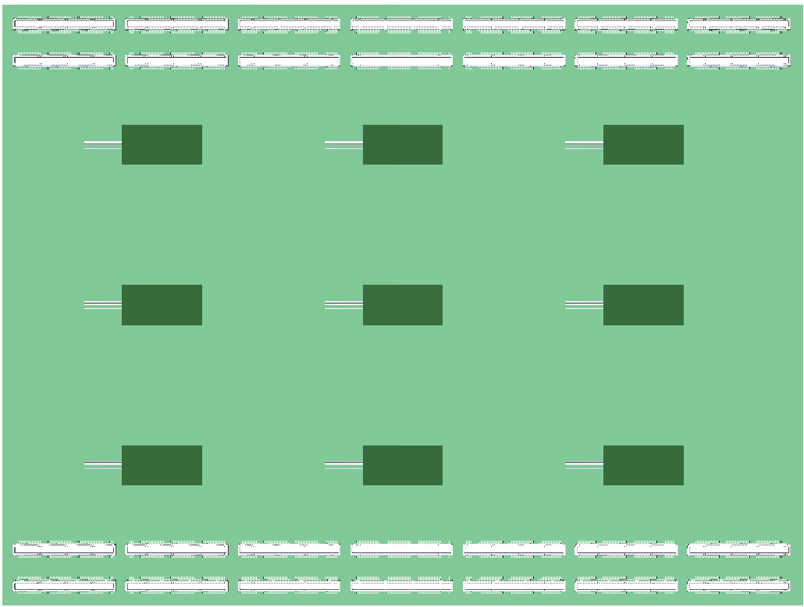
ALICE-3 RICH FEE: ALCOR_v3 with 320 Mb/s data lines
9x VTRX+ modules /board
w/ long pigtail cables (up to 4 m)
Components can be placed
10 Gb/s high-speed lines (45x) go to the
other side via carefully designed diff. vias
Power dissipation on this side:
  P_{tot} (VTRX+) = 9x 0.24 W, max = 2.2 W /board, max.
* * *
I_{LV} (lpGBT, 36 pcs) = 15 A, max @1.2V
(12 A, typ @1.2V)
I_{LV} (VTRX+, 18 pcs) = 0.8 A @ 2.5V
= 0.25 A @ 1.2V
P (lpGBT+VTRX+)_{tot, max} = 18+2.2 W = 21 W /board
T amb: -40 °C
ALICE 3 RICH preliminary FEE module concept, Oct. 2024
BOTTOM side

Slide 27
ALICE-3 RICH FEE: LV Supply and Power Dissipation (ALCOR_v3_320 Mb/s)
LV Current Supply
Current consumption of the FEE components in each Supermodule…
I_{LV} (ALCOR_v3, 108 pcs) 10..12 mW /ch (ALCOR_v3)
= 70 A, max @1.2V
I_{LV} (lpGBT, 36 pcs) = 15 A, max @1.2V
I_{LV} (VTRX+, 9 pcs) = 0.8 A @ 2.5V
= 0.25 A @ 1.2V
The total 1.2V current consumption of each Supermodule
sums up to ~ 85 A
  - Supplying 85 A instead of 100 A /Supermodule is still very demanding if feasible
  - We would need a very high number of DC/DC converters
  in each Supermodule... (Issue No. 2a)
  - high density board-to-board connectors (e.g. this SlimStack connectors) can deliver 0.3..0.5A /pin → an additional hundreds of pins are needed for LV delivery (Issue No. 2b)
  - the even distribution of the current on hundreds of connector pins on multiple connectors can not be guaranteed...
The high LV current need dominated by the ALCORs still looks to be a showstopper for this scenario with ALCOR_v3.
Power dissipation /cooling
Dissipation of the FEE components in a Supermodule…
P (ALCOR_v3, 108 pcs) = 84 W, max
P (lpGBT, 36 pcs) = 18 W, max (see previous slides)
P (VTRX+, 9 pcs) = 2.3 W, max (see previous slides)
100..110 W /Supermodule
* * *
In this scheme the total dissipation of the FEE compnents in the cryogenic vessel (I.e. all 864 Supermodules, 24 rings x 36 segments)
105 W x 864 = 91 kW, max.
Cooling down the cryogenic vessel to -40 °C while heating it with
90 kW is still a challange, if feasible. (Issue No. 3)
To be further evaluated... but the high dissipation dominated by the ALCORs can still be a showstopper for this scenario with ALCOR_v3.
ALICE 3 RICH preliminary FEE module concept, Oct. 2024

Slide 28
ALICE-3 RICH FEE: Conclusion with the ALCOR_v3 ASIC
Our conclusion:
For the RICH FEE, the present 64-ch ALCOR_v3 is not a feasible option
(neither with 640 Mb/s nor with 320 Mb/s data lines (e-links))
ALICE 3 RICH preliminary FEE module concept, Oct. 2024

Slide 29
ALICE-3 RICH FEE: Preliminary Read-out Proposal Based on an 1024-ch ALCOR
Study No. 3: Read-out scheme based on
1024-ch ALCOR with 320 Mb/s data lines
ALICE 3 RICH preliminary FEE module concept, Oct. 2024

Slide 30
ALICE-3 RICH FEE: Preliminary Read-out Proposal Based on an 1024-ch ALCOR
The new 1024-ch ALCOR
will have 32 output data lines that correspond to 32 columns with 32 pixels in each column
Unused columns can be disabled
Moreover, columns can be multiplexed to a lesser number of output lines, by a factor of powers of two
With 32 columns, the no. of the output lines can be 32, 16, 8, 4, 2, 1,
reducing the available bandwith for one column (or one pixel) proportionally
(for more details see Valerio’s presentation)
ALICE 3 RICH preliminary FEE module concept, Oct. 2024

Slide 31
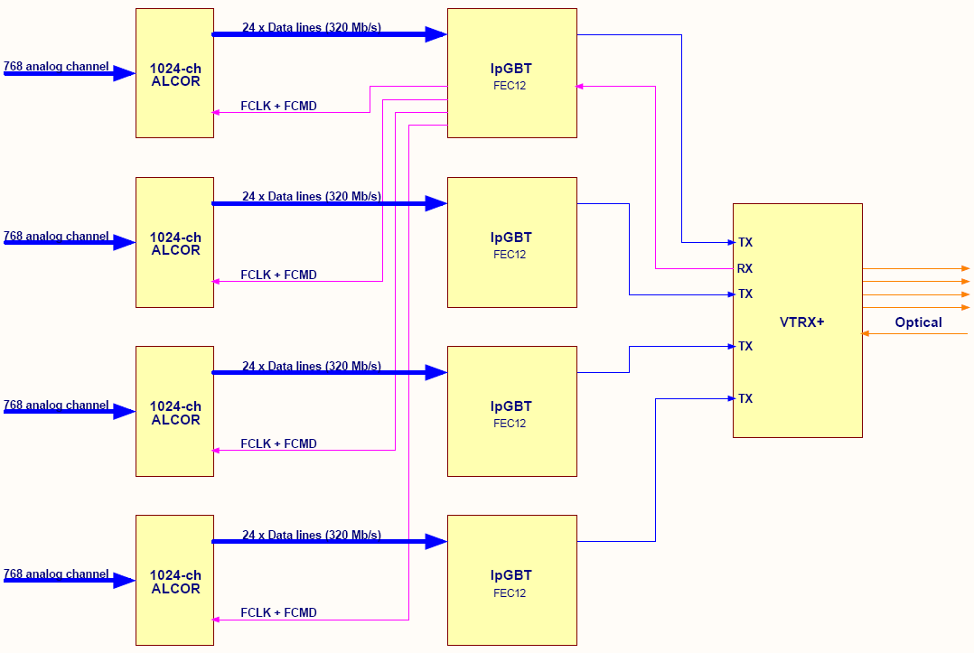
ALICE-3 RICH FEE: 1024-ch ALCOR and lpGBT with FEC12
x2
No. of components in a Supemodule:
With 24 data lines (and no multiplexing) the 1024-ch ALCOR
can handle 768 pixels
6 912 pixels / 768 = 9 ALCOR / Supermodule
Not a nice number because of the lpGBT/VTRX+ granularity of 4.
(With 8 ALCORs and FEC12 we can
have 6 144 pixels, max in a SM only)
ALICE 3 RICH preliminary FEE module concept, Oct. 2024
24 columns of an ALCOR is read out, 8 are disabled

Slide 32
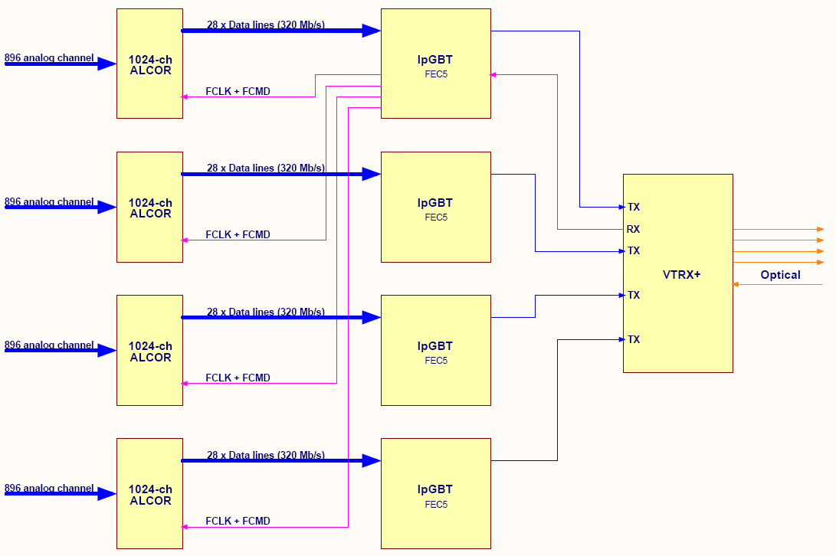
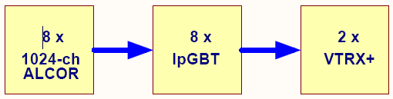
ALICE-3 RICH FEE: 1024-ch ALCOR and lpGBT with FEC5
No. of components in a Supemodule:
With 28 data lines (no multiplexing)
the 1024-ch ALCOR can handle
896 pixels
6 912 pixels / 896 = 7.7
➔ 8 ALCOR / Supermodule
This can be either:
- 7x 28 lines + 1x 20 lines, or
- 8x 27 lines
Reading-out 8 ALCORs, all with 28
data lines (lpGBT FEC5) we can have
7 168 pixels in a Supermodule
x2
ALICE 3 RICH preliminary FEE module concept, Oct. 2024
What is behind 1 downlink?
  1x VTRX+ (4x TX, 1x RX)
  4x lpGBT (1x ‚master’, 3x ‚slave’)
  4x 1024-ch ALCOR
  up to 3584 SiPMs (analog channles)
This is the possible level of granularity for the fast-control and slow-control of the FEE.
28 columns of an ALCOR is read out, 4 are disabled

Slide 33
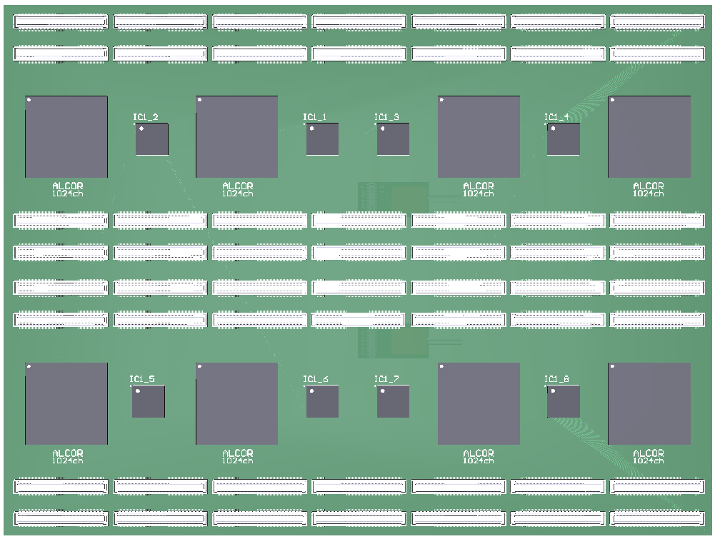
ALICE-3 RICH FEE: 1024-ch ALCORs and lpGBTs on the same board
8 ALCOR (1024-ch) + 8 lpGBT
could be placed on the same board
Components can be placed, but..
  No. of connector pins needed between the
  SiPM PCB and the (ALCOR + lpGBT) PCB remains the same:
  - analog signals: ~ 6 912
  - GND: many (up to thousands to avoid xtalk)
  Even with doubling the number of connectors the number of the available pins (~ 6 720) is not enough (issue no.1, still a showstopper...)
  No. of eLinks: ~ 224 (all PCB-internal)
Power dissipation on this side:
  P_{ALCOR} = 8x 10 W, max = 80 W /board, max
  P_{lpGBT} = 8x 0.5 W = 4 W /board, max
ALICE 3 RICH preliminary FEE module concept, Oct. 2024
TOP side

Slide 34
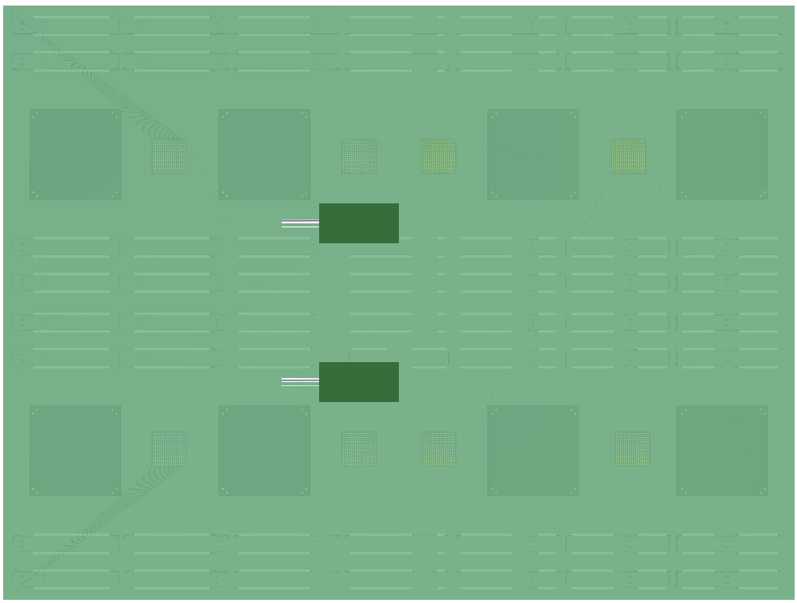
ALICE-3 RICH FEE: 1024-ch ALCORs and lpGBTs on the same board
2x VTRX+ modules /board
w/ long pigtail cables (up to 4 m)
Lot of space for overlappig cables, service electronics (e.g. including some of the DC/DC converters)
10 Gb/s high-speed lines (45x) go to the
other side via carefully designed diff. vias
Power dissipation on this side:
  P_{tot} (VTRX+) = 2x 0.24 W = 0.5 W, max: negligible
* * *
Current need & dissipation:
I_{LV} (ALCOR, 8 pcs) = 70 A, max @1.2V
I_{LV} (lpGBT+, 8 pcs) = 3.4 A @ 1.2V
P (lpGBT+VTRX+)_{tot, max} = 84 W+4 W = 88 W /board
T amb: -40 °C
ALICE 3 RICH preliminary FEE module concept, Oct. 2024
BOTTOM side

Slide 35
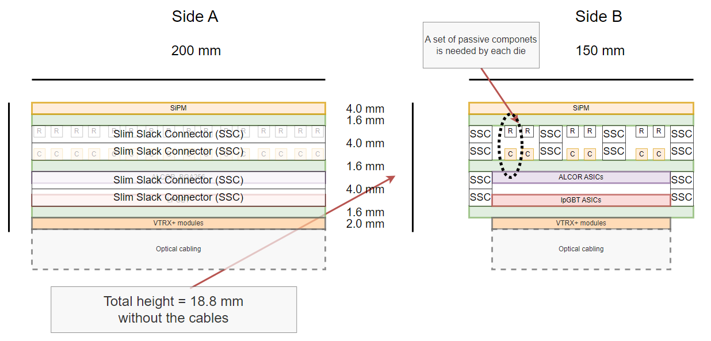
ALICE-3 RICH FEE: Most critical: the analog board-to-board connections
ALICE 3 RICH preliminary FEE module concept, Oct. 2024
critical parts
Not enough connector pins (SiPM – ALCOR boards)
Not enough board area (ALCOR Board)
Signal integrity issues (cross-talk, noise)

Slide 36
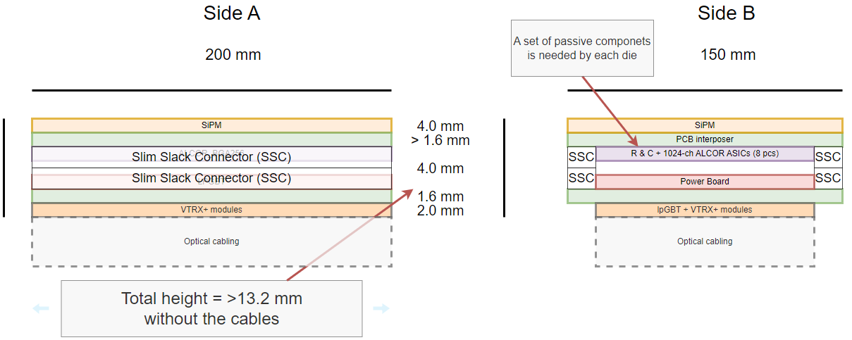
ALICE-3 RICH FEE: Eliminating the connectors…
ALICE 3 RICH preliminary FEE module concept, Oct. 2024
320 Mb/s digital lines only

Slide 37
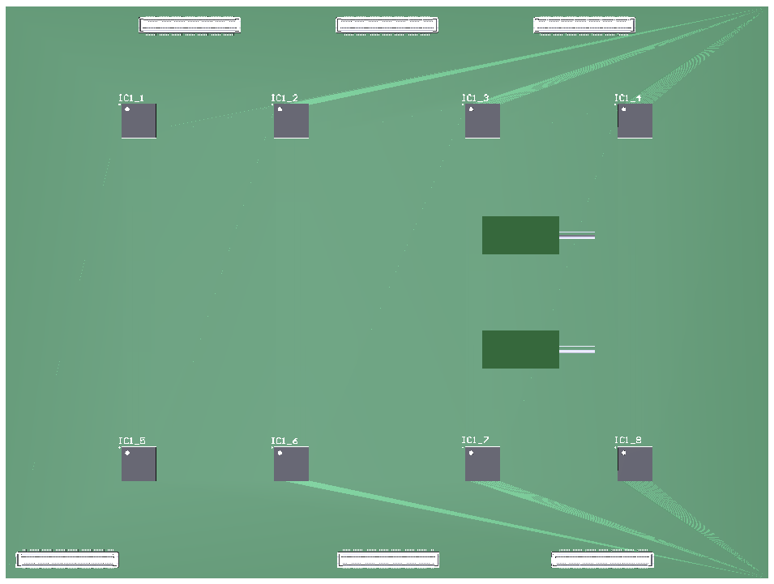
ALICE-3 RICH FEE: 1024-ch ALCORs on the bottom of the SIPM board...
The 1024-ch ALCORs moved to the bottom of the SiPM board….
8x lpGBT ASICs + 2x VTRX+ /board
Components placement is not a problem
Only digital lines (e-Links) go through the connectors.
No. of e-Links coming from the „SiPM+ALCOR” board: 8x 28 = 224, max.
  No. of connector pins needed between
  the „SiPM & ALCOR” and the „lpGBT & VTRX+” boards:
  - e-Link signals + GND: 3x 224 = 672
  - LV for the SiPM+ALCOR board: hundreds...
  No. of connector pins available: up to a few thousands... (see before)
  Power dissipation of the „lpGBT & VTRX+” board :
  P_{lpGBT} + P_{VTRX+} = < 5W /board
ALICE 3 RICH preliminary FEE module concept, Oct. 2024
TOP side

Slide 38
ALICE-3 RICH FEE: LV Supply and Power Dissipation with the 1024-ch ALCOR
LV Current Supply
Current consumption of the FEE components in each Supermodule…
I_{LV} (ALCOR_v3, 8 pcs) 10..12 mW /ch (1024-ch ALCOR)
= 70 A, max @1.2V (remains high!)
I_{LV} (lpGBT, 8 pcs) = 3.4 A, max @1.2V
I_{LV} (VTRX+, 2 pcs) = 0.18 A @ 2.5V
= 0.06 A @ 1.2V
The total 1.2V current consumption of each Supermodule
sums up to ~ 75 A
  - Supplying 75 A /Supermodule is still very demanding, if feasible
  - We would need a high number of DC/DC converters (e.g 6, min)
  in each Supermodule... (Issue No. 2a)
  - high density board-to-board connectors (e.g. this SlimStack connectors) can deliver 0.3..0.5A /pin → an additional hundreds of pins are needed for LV delivery (Issue No. 2b)
  - the even distribution of the current on hundreds of connector pins on multiple connectors can not be guaranteed...
The high LV current need dominated by the ALCORs are still challenging.
Power dissipation /cooling
Dissipation of the FEE components in a Supermodule…
P (1024-ch ALCOR, 8 pcs) = 84 W, max (remians high!)
P (lpGBT, 8 pcs) = 4 W, max (see previous slides)
P (VTRX+, 2 pcs) = 0.5 W, max (see previous slides)
85..90 W /Supermodule
* * *
In this scheme the total dissipation of the FEE compnents in the cryogenic vessel (I.e. all 864 Supermodules, 24 rings x 36 segments)
105 W x 864 = 78 kW, max.
Cooling down the cryogenic vessel to -40 °C while heating it with
78 kW is still a challange, if feasible. (Issue No. 3)
To be further evaluated... but the high dissipation dominated by the ALCORs can still be challenging.
ALICE 3 RICH preliminary FEE module concept, Oct. 2024
But Issue No. 1 (with the connectors) is solved at least, by omitting the connectors between the SiPMs and the ALCORs. (this eliminates >> 7000 signal pins there

Slide 39
ALICE-3 RICH FEE: ASICs need and cost estimations with 1024-ch ALCOR
FEE Components Cost (estimations)
ASIC components need:
  ALCOR_v3: 864 x 8 = 6 912 pcs ? CHF/ea = ?
  lpGBT ASIC: 864 x 8 = 6 912 pcs 25 CHF /ea = 173 kCHF
  VTRX+ module: 864 x 2 = 1 728 pcs 140 CHF /ea = 242 kCHF
  DC/DC: 864 x ?
Connectors
  Molex SSC 864 x 14 = 12k+ pcs < 2.5 CHF & 10K = < 50 kCHF
PCB (bare)
  est. 864 x 4 = 3 500 pcs ~ 300 CHF /ea = ~ 1 MCHF
Looks much better...
ALICE 3 RICH preliminary FEE module concept, Oct. 2024
DAQ /Common Read-out Units (of that time):
lpGBT uplinks: ~ 6 912
CRUs with 48 inputs: ~ 144 ... also looks more affordable...

Slide 40
ALICE-3 RICH FEE: Further considerations /1
1. Multiplexing columns of the 1024-ch ALCOR to their digital output lines
All 32 columns (all 1024 channels) would be available in ALCOR, but only 16, 8, 4, 2, or 1 output data lines would be used depending on the ‚occupancy’ of the data channels.
To make use of this (i.e. to spare with link components) this has to be decided in advance, design the PCBs accordingly, then it is frozen... → a safe decision has to be made.
With 1024 ALCOR channels available, only 7 ALCORs (instead of 8) would be needed in a Supermodule
(not a big reduction…)
The link components (lpGBT and VTRX+ ASICs, CRUs…) could be significantly reduced
(by a factor of 2, 4, 8, 16… etc, depending on the multiplexing factor)
  it can reduce cost, but
  it does not help in the challenge of LV power supply and dissipation of the FEE that are
  technically the more critical issues
ALICE 3 RICH preliminary FEE module concept, Oct. 2024

Slide 41
ALICE-3 RICH FEE: Further considerations /2
2. Using a rad-hard data concentrator ASIC (e.g. ECON-D)
ad-hard ASICs with e-Link inputs and e-Link outputs
By zero suppression it can reduce data volume and aggregate data of multiple input links to lesser number of output links (before the lpGBTs)
In ALICE, we will use ECON-D ASICs on the coming FoCal Pads read-out concentrator boards (Run 4), so we will get experience with them
They can help in reducing the number of the link components (e.g lpGBTs), but they themselves are additional components, designing the FE PCBs will not be easier…
ALICE 3 RICH preliminary FEE module concept, Oct. 2024

Slide 42
ALICE-3 RICH FEE: PCB Technology Required (Preliminary)
Challange level:
Routing-out of the differential signal pairs of the 0.5 mm pitch BGA ASICs (lpGBT, 1024-ch ALCOR)
is the determining factor in the required PCB technology
The following PCB parameters are foreseen:
  layer count
  ~ 16 layers (board thickness is not critical)
  track/clearence
      down to 60..70 um
      thinnest dielectric layer
  down to 60..70 um
  vias/microvias
  microvias: 0.25/0.12 mm (diameter/hole), or smaller...
Potential PCB manufacturers exist:
Exception PCB, Somacis, others...
ALICE 3 RICH preliminary FEE module concept, Oct. 2024

Slide 43
ALICE-3 RICH FEE: Summary and Take-away Message
The first concept is based on the
- array of 2x2 mm SiPMs
- the („already 2-years old”) 64-channel ALCOR_v3 digitizer ASIC,
- direct read-out with rad-hard lpGBT optical links
Newer verisons of ALCOR is foreseen with preliminary specifications
- 1024 input channels
- to be followed up and participate in the requirements specification
The feasibilty study of this concept based on the 1024-ch ALCOR, that consist of
- a conceptual design,
- simulations, and
- trial implememntations
has been started.
ALICE 3 RICH preliminary FEE module concept, Oct. 2024

