Slide 1
Muon ID Electronics: plastic scintillator option
October 10, 2024
Guillermo Tejeda, for the MID-Mexico electronics group

Slide 2
Outline
Introduction
FEC Design
Patch Panel Design
FEC Version 2
Organization
Summary

Slide 3
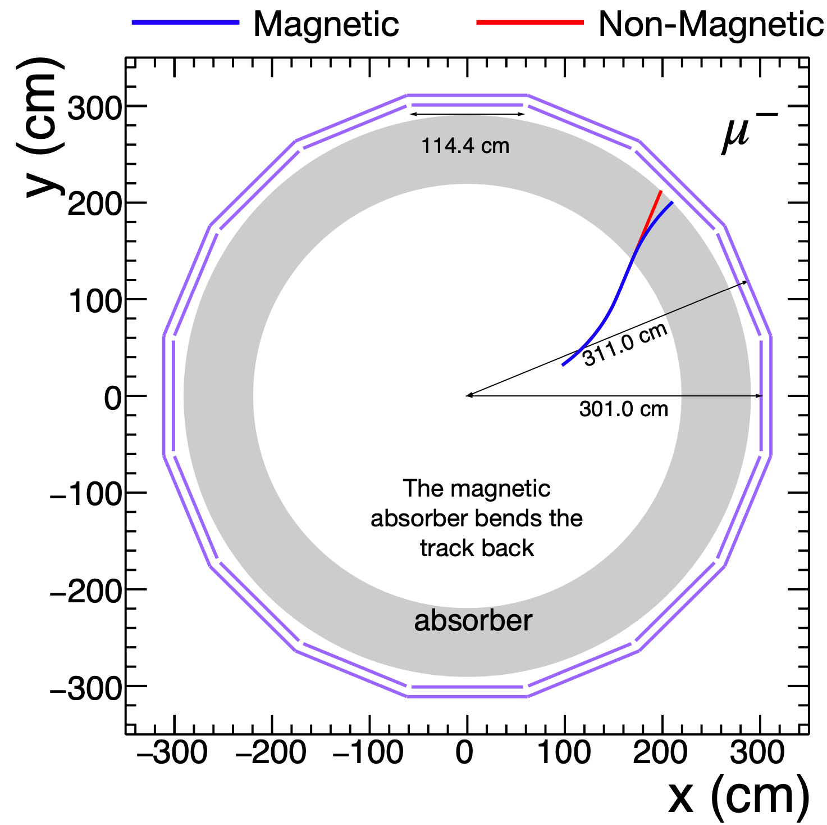
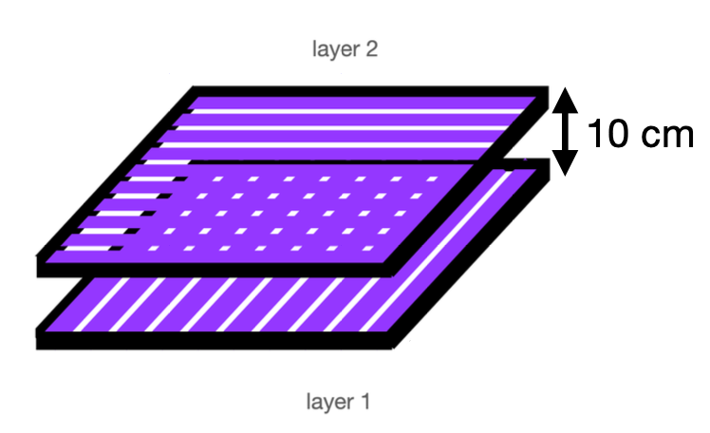
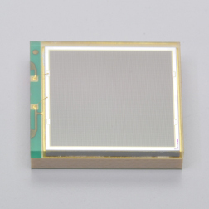
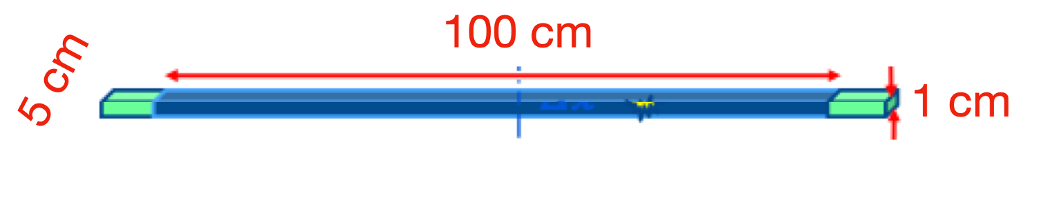
MuonID Detector
Plastic Scintillator Option
Assumptions:
  10 rings
  16 segments per ring
  1 chamber per segment
  40 channels per chamber

Slide 4
Channels Distribution (Option)
160 FECs in total
40 channels/FEC
Energy & Time measuremnt
Required 160 optical links
for all modules
10 m (10 rings)
MID Module
16 FEC per ring
FEC
. . .

Slide 5
MuonID FEC details
Clk_ext
1 FEC/Module 160 (10 spares) FEC in total
2 Erni connectors with 32 ch each
2 ASIC Petiroc 2A
1 FPGA Cyclone V
(non Rad-Hard 5cgtfd5c5f23c7n)
1 LpGBT + VtRx
(for communication and Slow control)
Power supply regulators zone
Petiroc 2A
Top
Clk
Control
Trigger
FPGA
Uplink
USB
Trigger
Downlink
Petiroc 2A
Bot
Control

Slide 6
FEC + Patch Panel (Version 1)
Spare SiPM
Bot SiPM
Top SiPM
1 ASIC Petiroc 2A
1 FPGA Cyclone III
(non Rad-Hard)
USB communication and debugging
32 Channels input
Charge and Time measurements
Channel by channel SiPM high voltage adjustment
6mW/channel power consumption
D_Out 1
Power Supply
Current – Voltage an temp sensor
DC-DC converters
ADC 1
Input 0-31
ASIC 1
FPGA 1
Petiroc 2A
Cyclone III
USB
LEDs
Digital I/Os
Power Supply + DC-DC converters

Slide 7
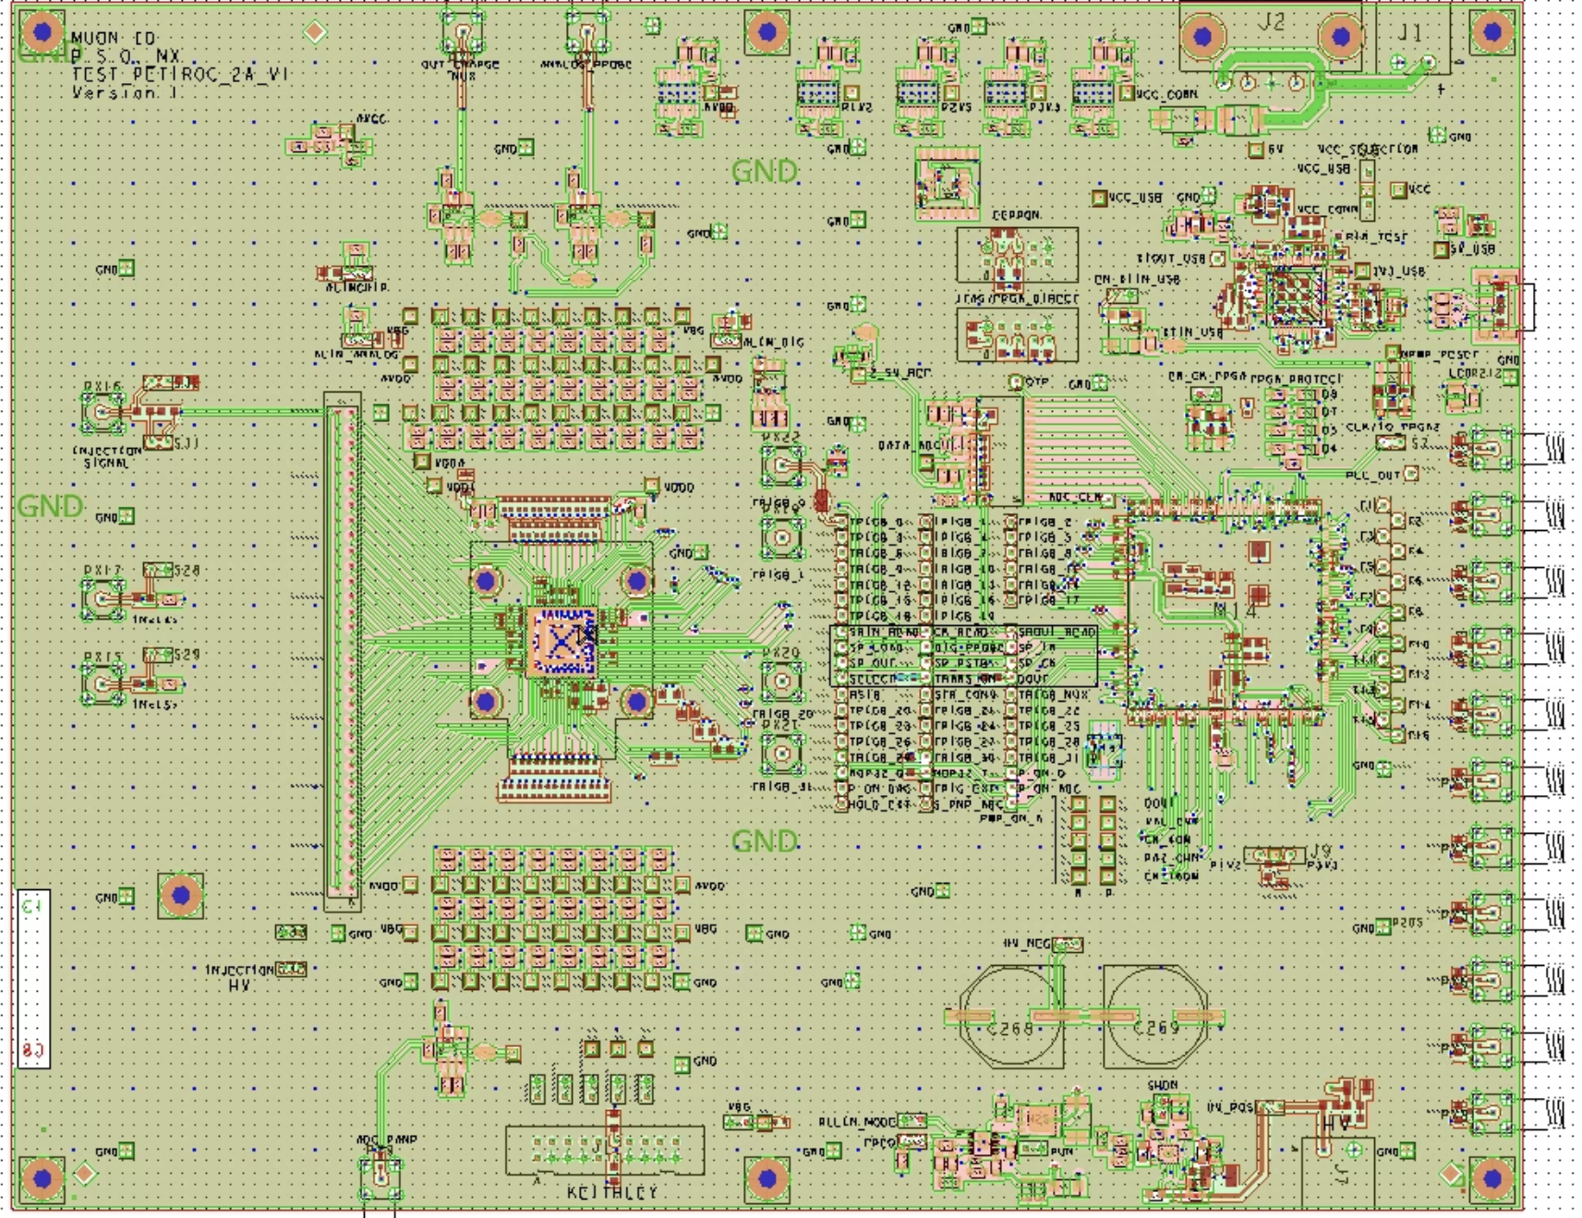
FEC
Final Design
25 x 20 cm
1 PETIROC 2A (32 Ch)
FPGA Cyclone
In production (PCBWay)
Many details
  Wrong gerber generation
  Extra ring around PCB
  No drill files
  No outline layer

Slide 8
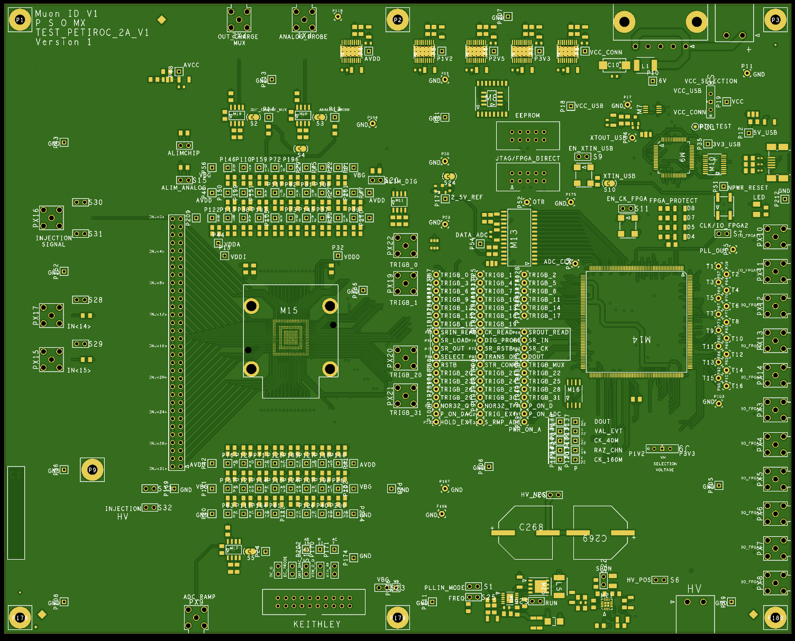
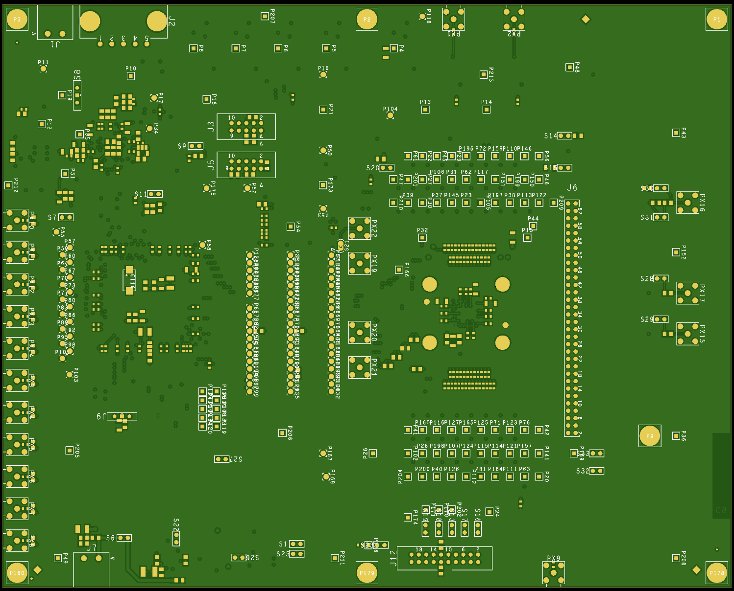
In production
Fabrication in progress after many issues

Slide 9
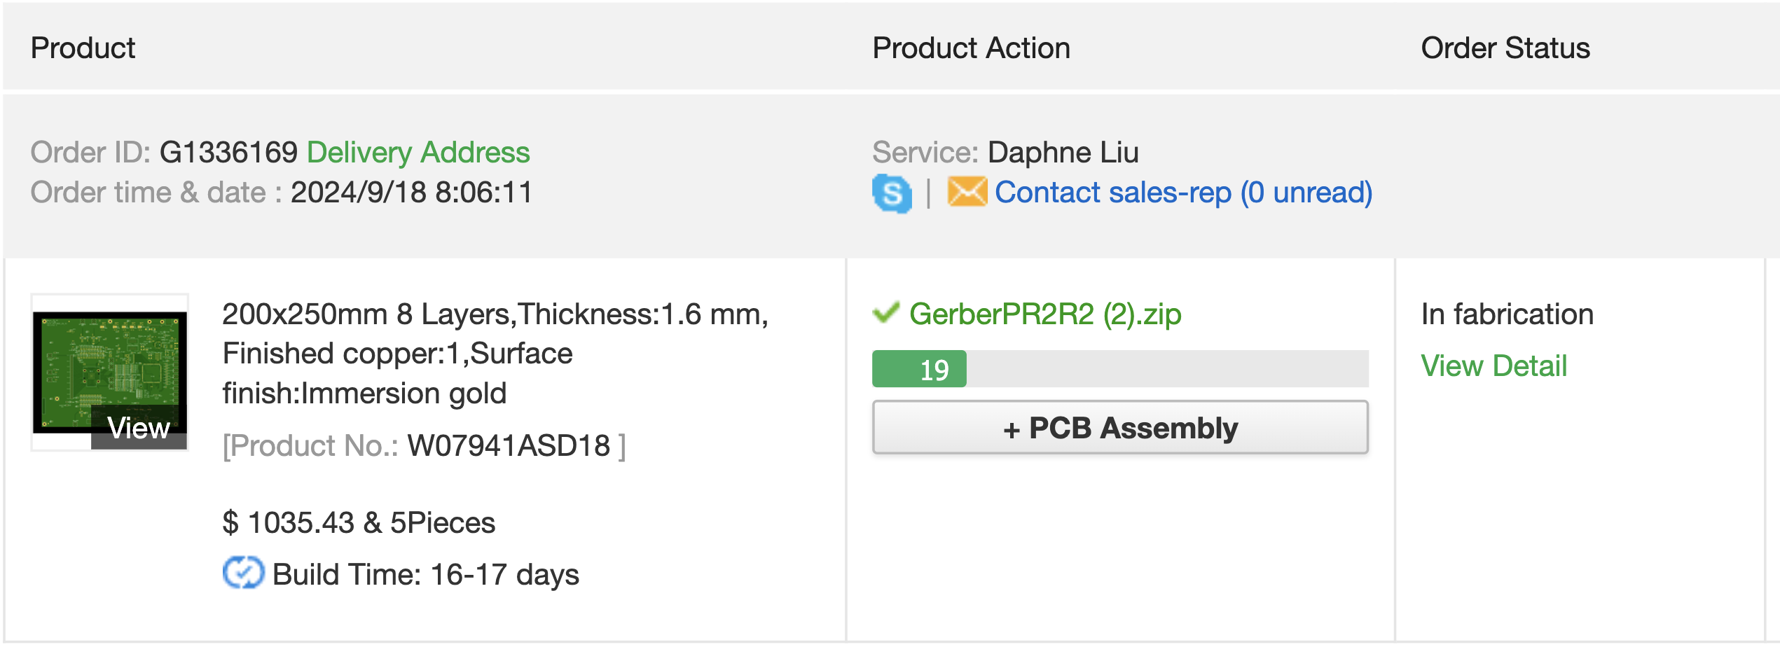
Fabrication Progress
54 % today

Slide 10
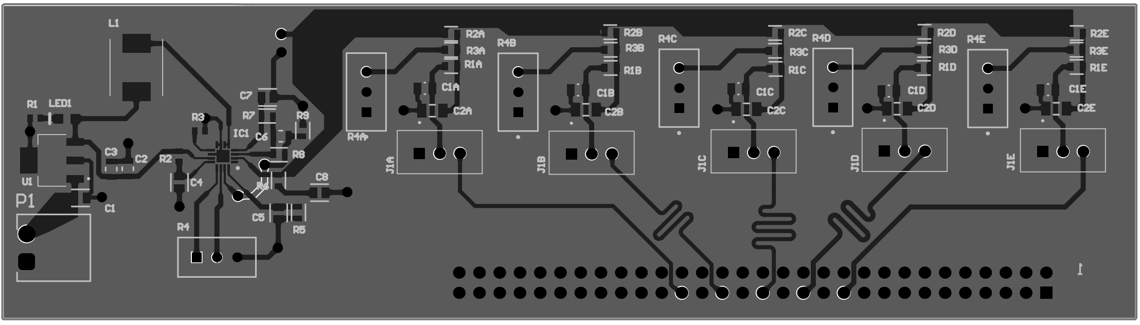
Patch Pannel (V1)
5 Channels PCB completed
Power regulator included in PP for 5 SiPM
To test Power regulator, noise and signal integrity

Slide 11
Patch Pannel (V2)
Board Connectors
50 Channels
Upgrade of the first patch pannel version
Schematic is in progress
Power Supply + DC-DC converters

Slide 12
User Interface
Compatible with Weeroc Test Board
Working on start procedure:
  Connnects USB cable
  Power up power supply
  Start Software
Slow Control:
  Load slow control parameters
  640 bits will be sent twice

Slide 13
Calibration:
  Calibrate the 6-bits DAC settings of each channel
Data Acquisition:
  Number of acquiisitions
  Trigger mode (under revision)
  Output file and format
Preparing technical documentation
  Manual FEC
  Manual Interface

Slide 14
FEC + Patch Panel
(Version 2)
Spare SiPM
Bot SiPM
Top SiPM
2 ASIC Petiroc 2A
1 FPGA Cyclone V
(non Rad-Hard 5cgtfd5c5f23c7n)
1 LpGBT + VtRx+ (for communication and Slow control)
USB communication for debugging
50 Channels input
Charge and Time measurements
Channel by channel SiPM high voltage adjustment
6mW/channel power consumption
Version 2 -> 2025
Current – Voltage an temp sensor
D_Out 1
Power Supply
Input 0-31
ASIC 1
DC-DC converters
Petiroc 2A
ADC 1
FPGA 1
Cyclone V
LpGBT
VtRx
Input 32-63
ASIC 2
Petiroc 2A
USB
LEDs
Digital I/Os
Power Supply + DC-DC converters

Slide 15
Time Line (FEC Version 1)
2024 | Mar | April | May | June | July | Aug | Sept | Oct | Nov | Dec
PCB Design
Firmware
User Interface
Patch Panel
Assembly
Test
Integration
FEC V1 will be tested in 2025 Beam Test with the Muon ID module

Slide 16
Radiation Tolerances
FEC located in a region with a “moderate” radiation dose estimated by simulations.
Not negligible for our FPGA. We are still investigating different ways for a save operation.
FEC will be tested under radiation sources to observe aging effects or SEU.

Slide 17
Firmware
Summary 1/2
FEC PCB
-Schematic and PCB Version 1 -> 100%
-Schematic Version 2 -> 20%
Slow control Register -> ok
Probe Register Parameters -> ok
Read Register for analogue Read Out -> ok
USB interface -> ok
ReadOut -> ok
Next steps:
  LpGBT (FPGA)
  Include second Petiroc
Patch Panel
-Version 1 -> 100 %
- Version 2 -> 20 %
PCB -> In production
User Interface
Testing USB port -> 80%

Slide 18
Summary 2/2
Waiting for cards to start with test
Development of the FEC Version 2
Development of the PP version 2
Development of the LpGBT communication protocol
Integration of the FEC V1 with a Muon ID Module

Slide 19
Muon ID Electronics Organization
Sinaloa
  Carlos Duarte Galvan
  Juan Manuel Mejia Camacho
  Cesar Regalado Elenes
  Juan Carlos Cabanillas
UNAM
  Enrique Patiño Salazar
  Saul Aguilar
Puebla
  Emigdio Jimenez Dominguez
  Yael Antonio Vazquez Beltrán
  Guillermo Tejeda Muñoz
  Luis A. Pérez Moreno
FEE
Grafic Interface
Bi weekly meeting for preparation of the electronics proposal and TDR
SiPM
FEC-PCB
FEC-Firmware
Communication protocols

Slide 20


Thank You for your attention

Slide 21
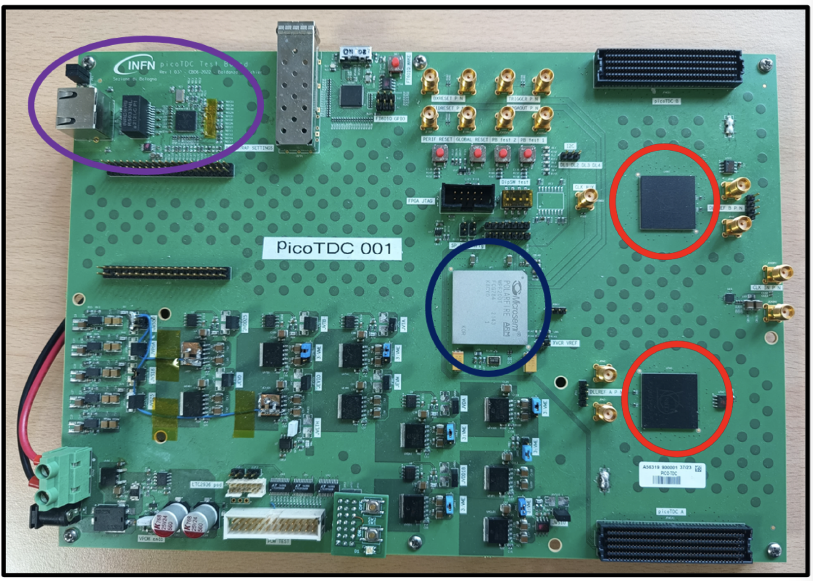
TOF design
PicoTDC board
PolarFire FPGA (blue)
2 PicoTDCs (red)
Ethernet connector subsystem (purple)

Slide 22
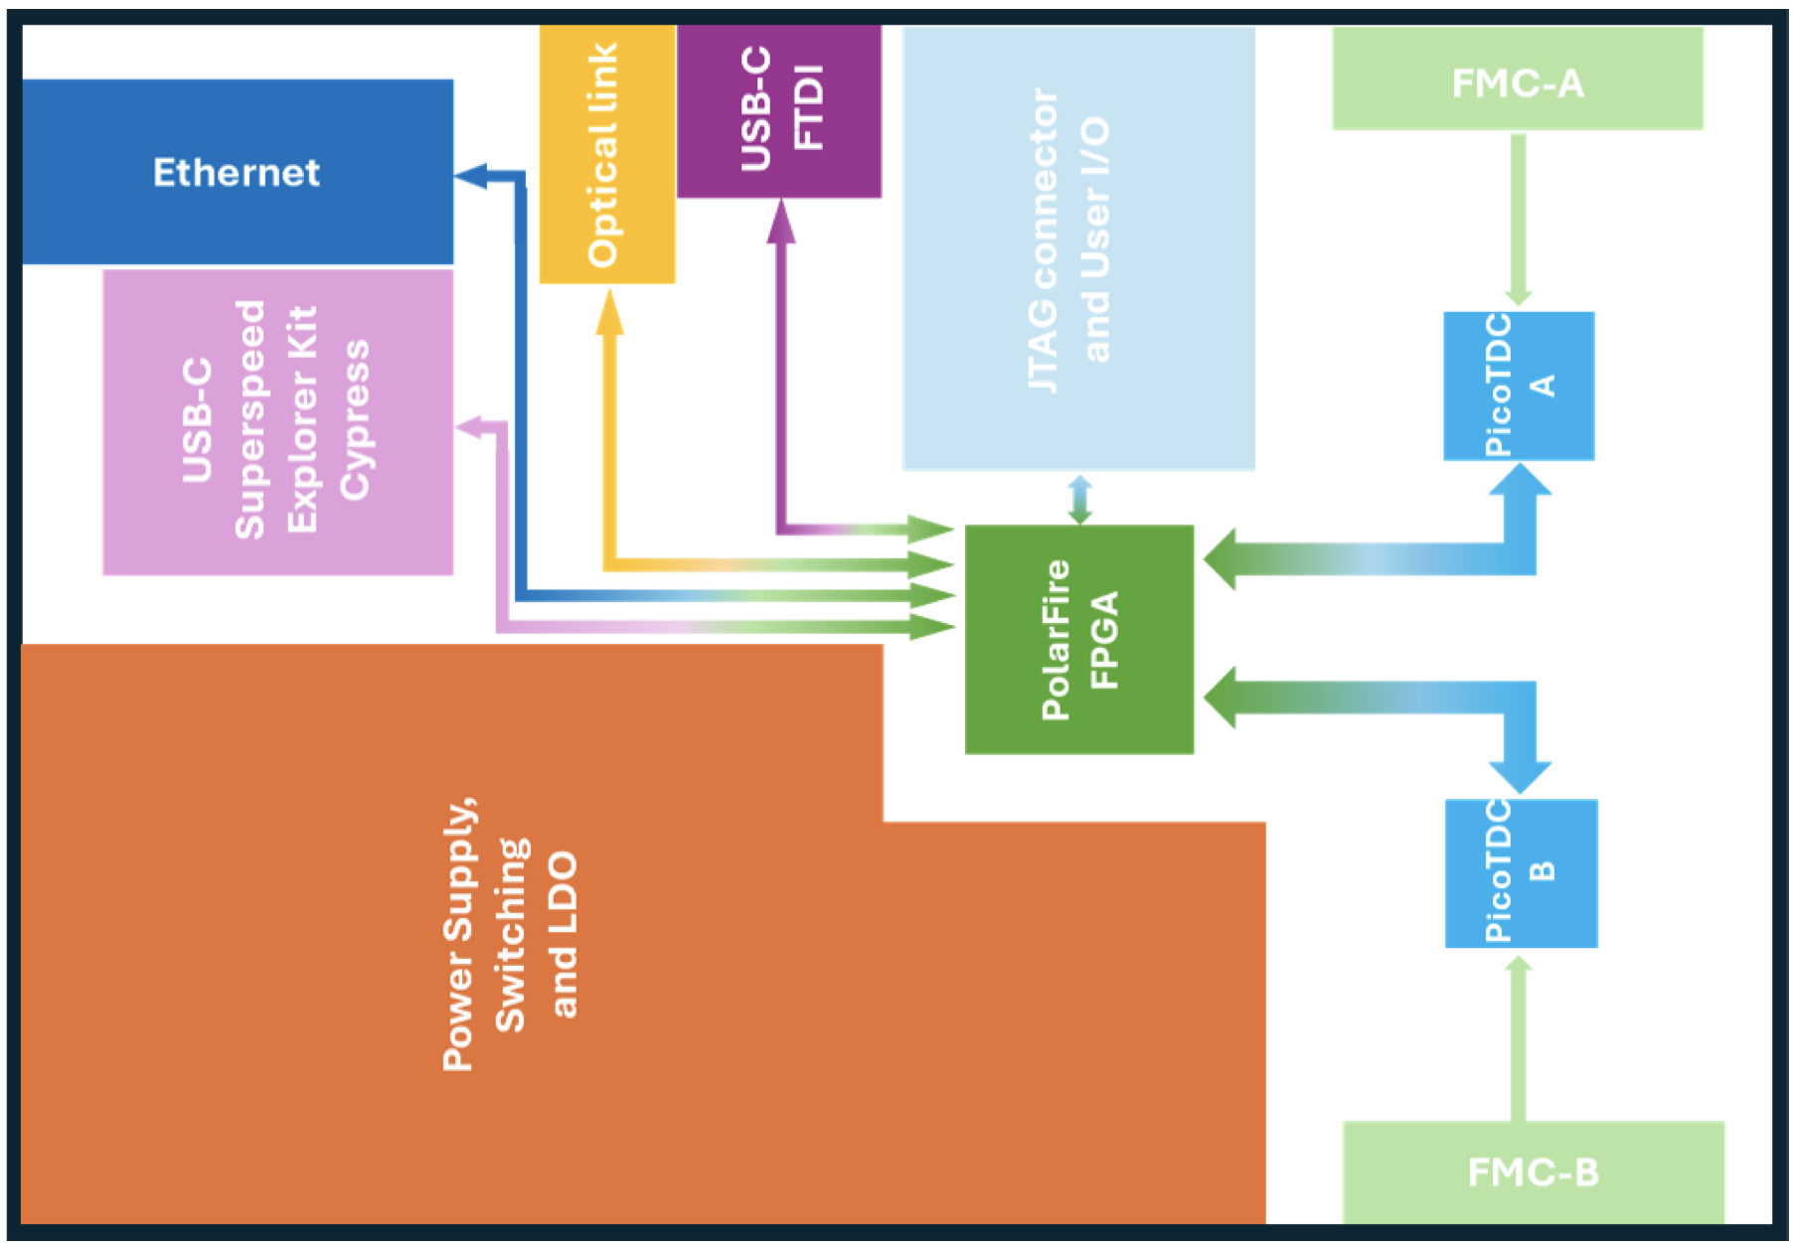
FPGA based design
PolarFire MPF200T FCG784E

Slide 23
Dose tolerances (from CMS)
TID (𝛾´s):
  FPGA Cyclone V (50Gy)
  Petiroc 2A (160Gy)
  Power Regulators (100Gy)
TNID (Neutrons):
  25e11 neq1MeV/cm²
Neutron flux:
  450e3 neq1MeV/cm²/s
SEU expected in FPGA
Expected fluence and dose (MID zone):

Slide 24
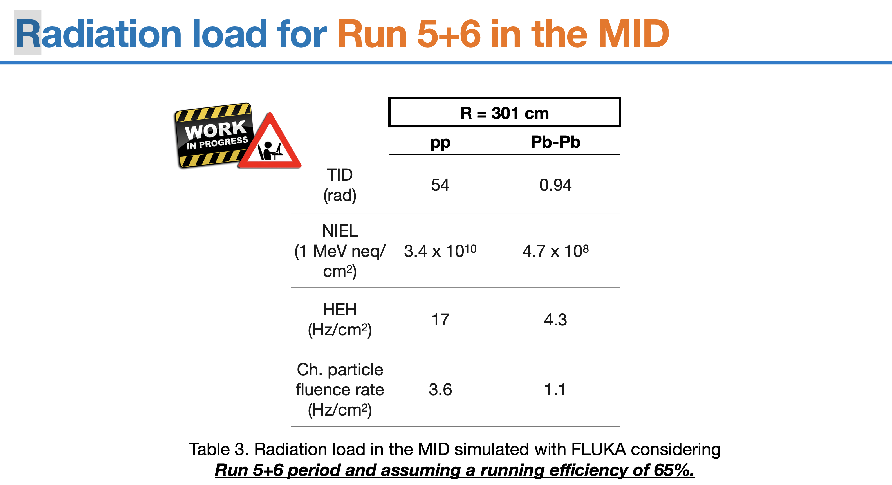

Slide 25
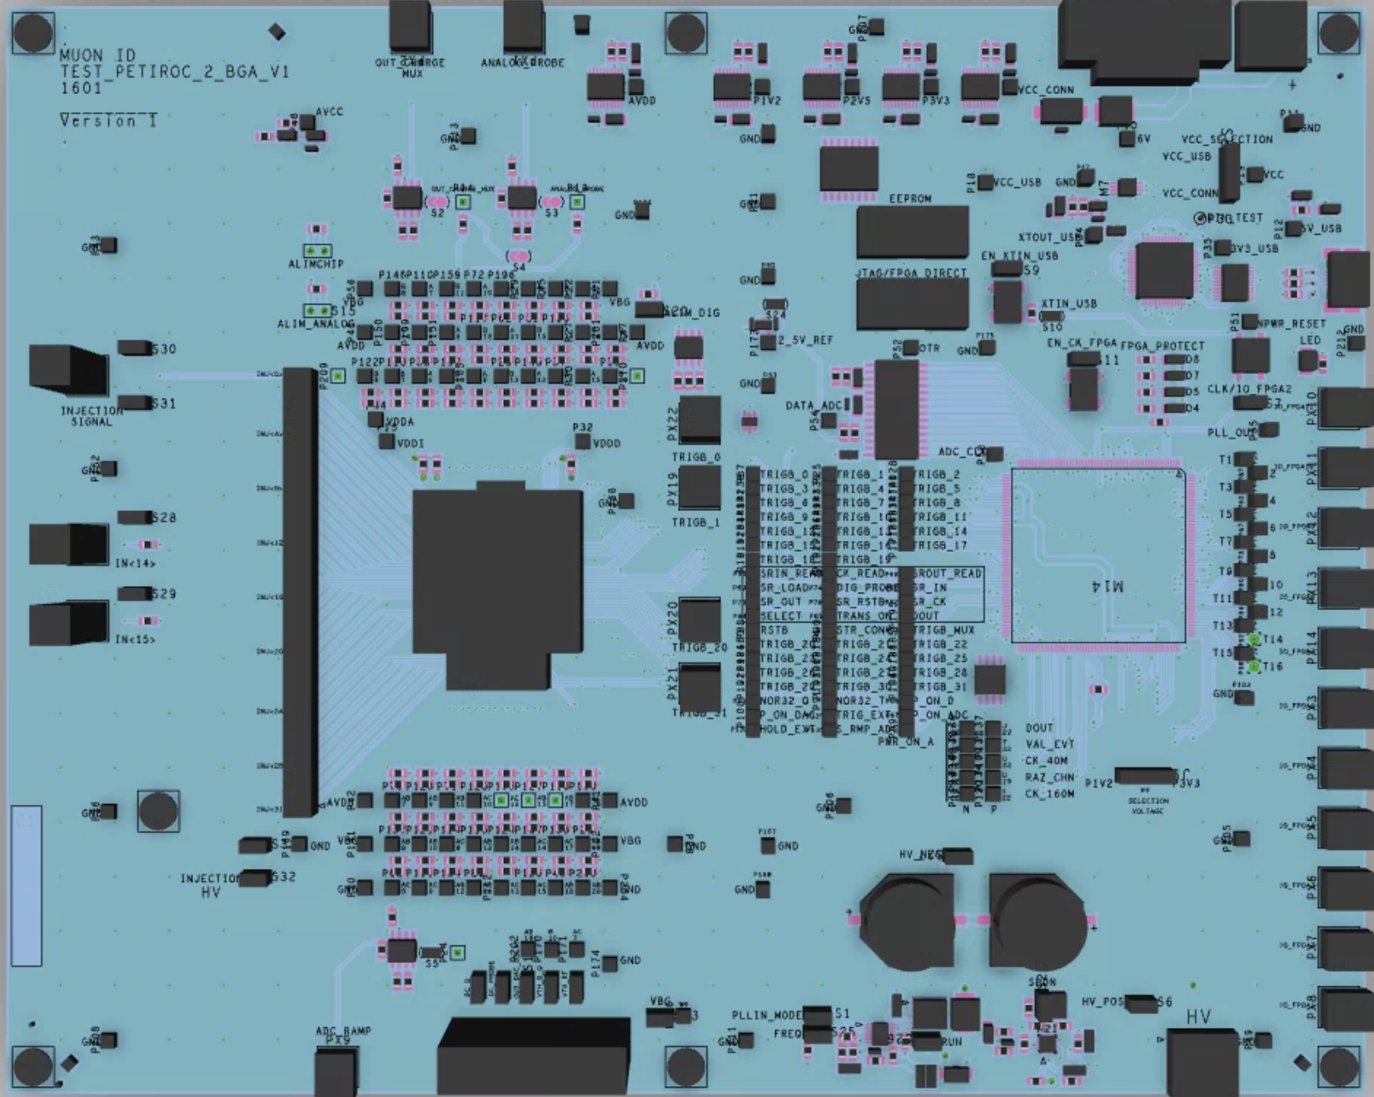
25 cm
-Design Rule Check (ok)
-Gerber Files
-8 layers
-32 Channels
-USB communication
-80% parts available
Recuerde que tiene que considerar una PCB para destrucción junto con un chip.
20 cm

Slide 26
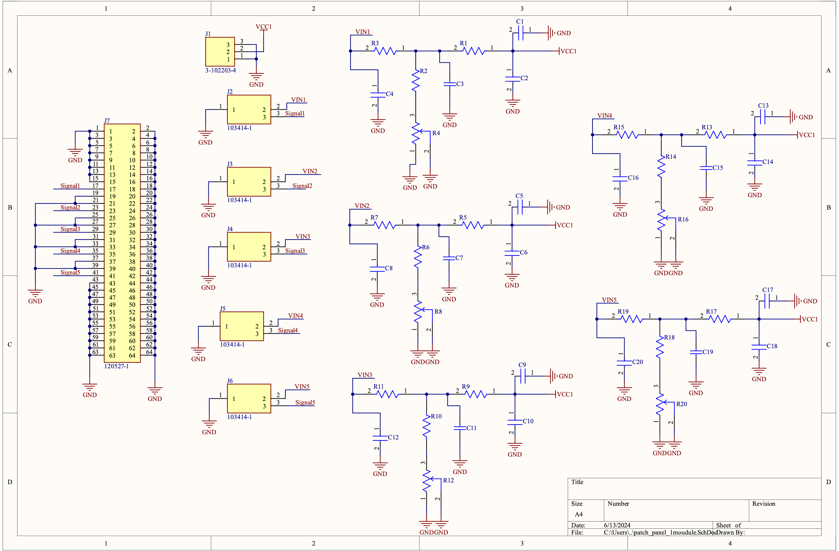
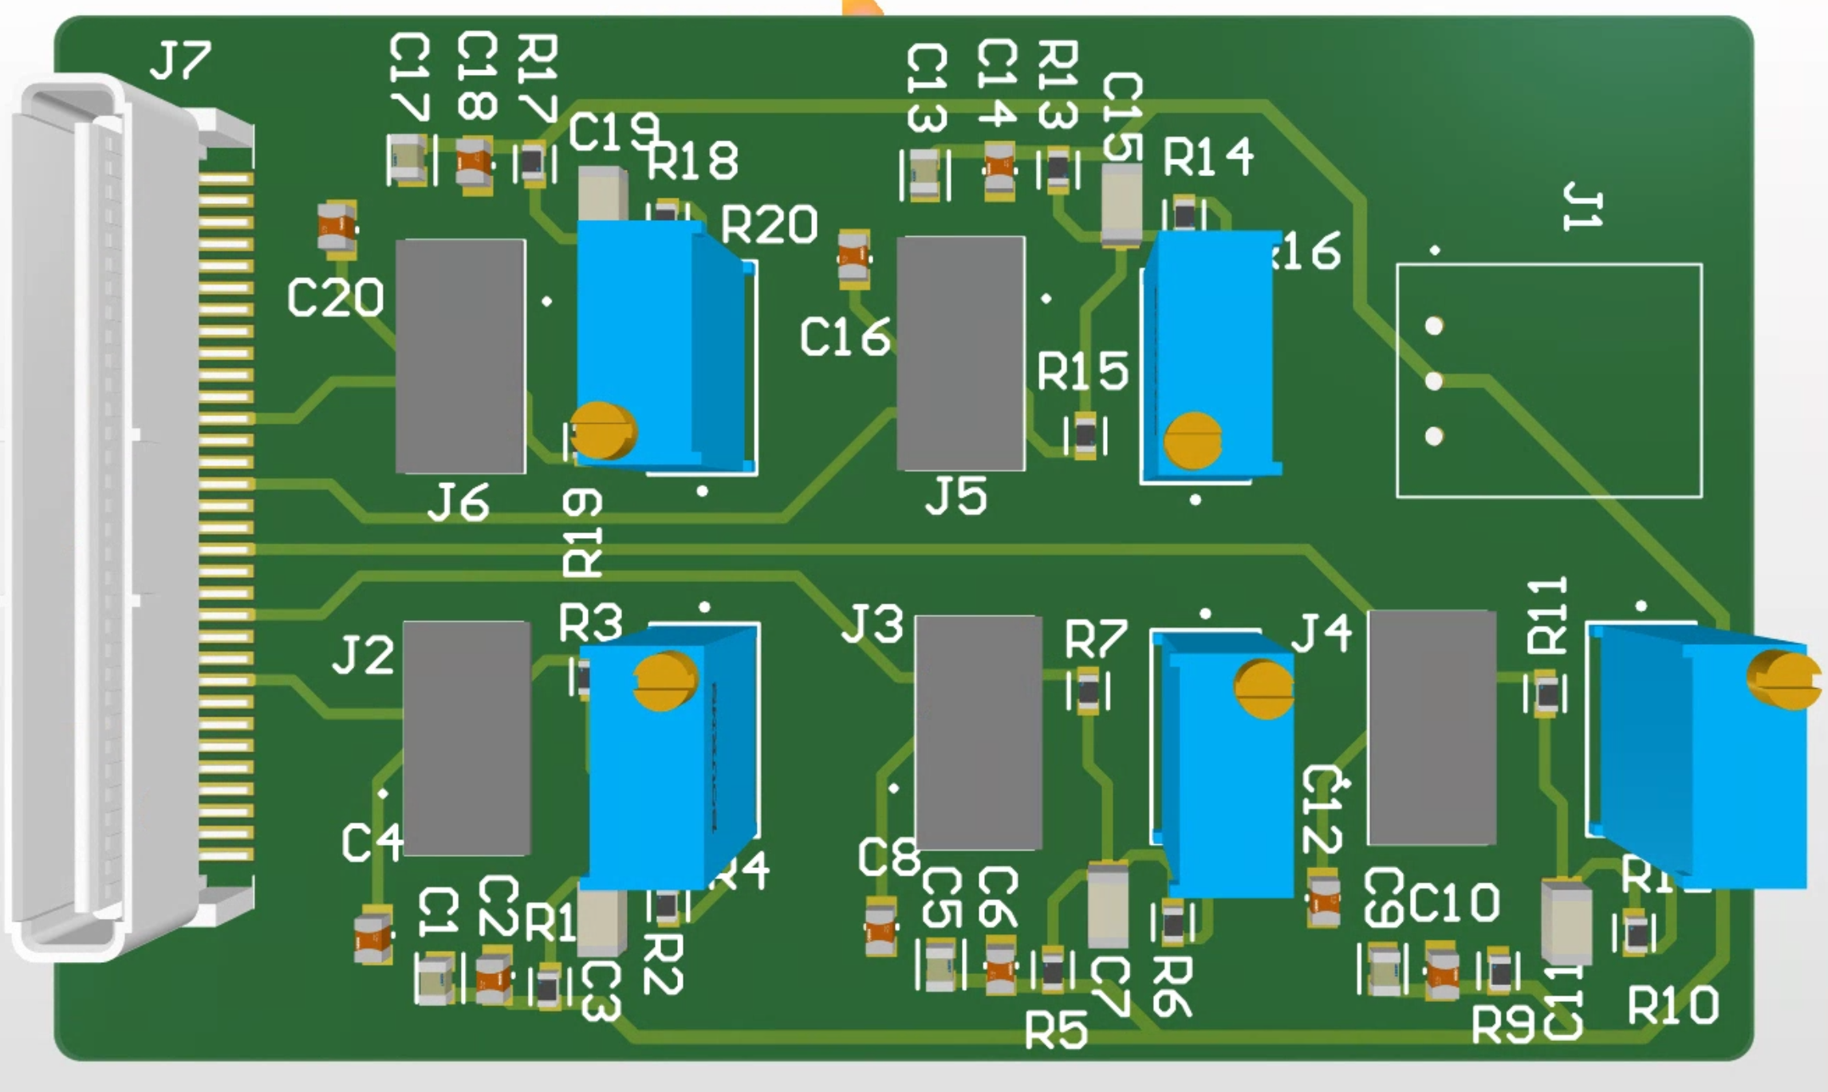
Patch-Panel Schematic Partial
First version to test:
Crostalk
Noise
Stability

Slide 27
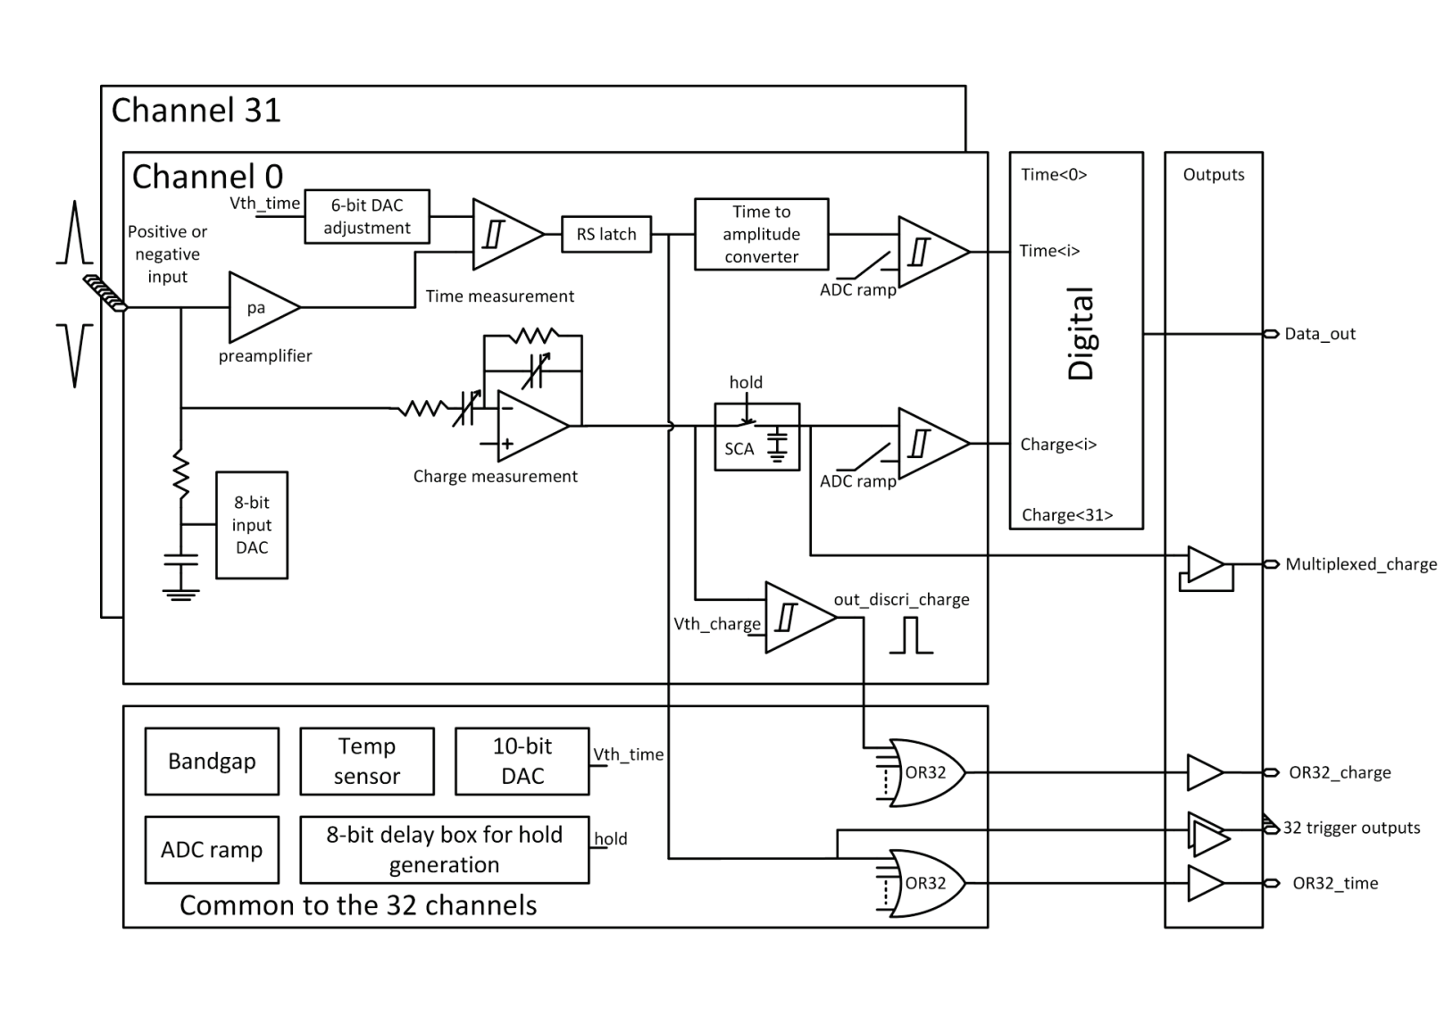
Petiroc 2A

Slide 28
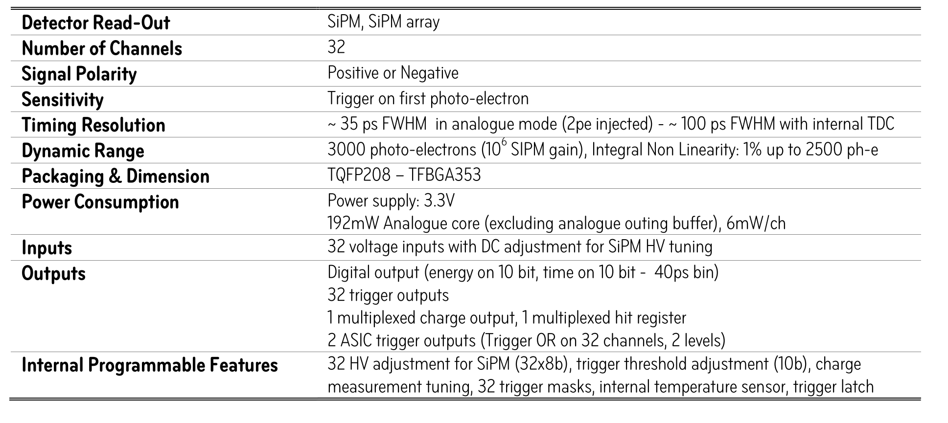
Specifications

