Slide 1
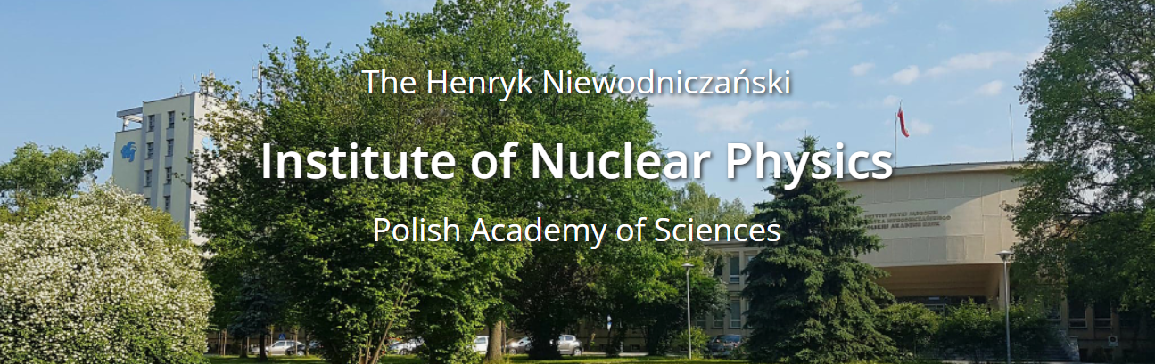

IFJ PAN in-kind contribution to the FoCal-E cooling system with respect to the quality assurance based on IFJ PAN projects experience
The Division of Scientific Equipment and Infrastructure Construction (DAI)

Slide 2
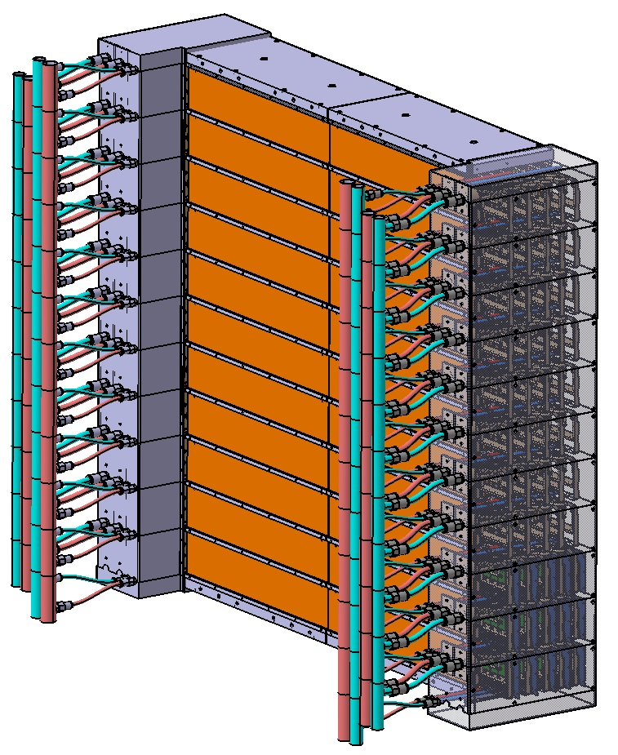
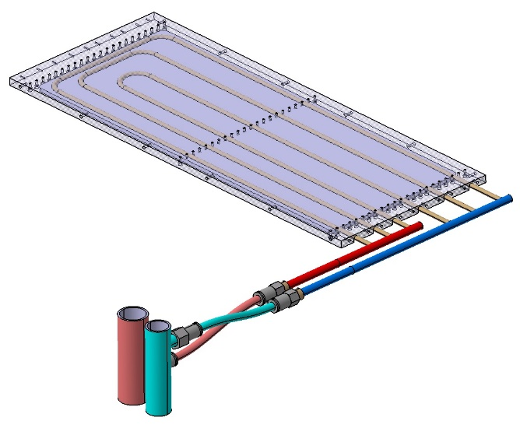
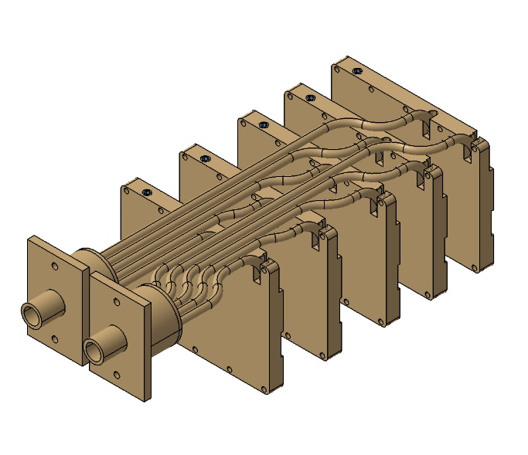
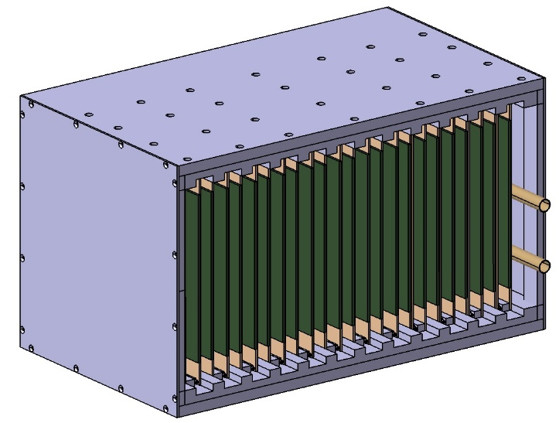
IFJ PAN – in-kind contribution to FOCAL
COOLING SYSTEM RESPONSIBILITY AND SCOPE OF WORK
FOCAL-E heat exchanger
DESIGN
PRODUCTION
TEST
DELIVERY
FOCAL model with
cooling system
READOUT UNIT
heat exchengers
EXTERNAL ELECTRONICS
heat exchangers

Slide 3
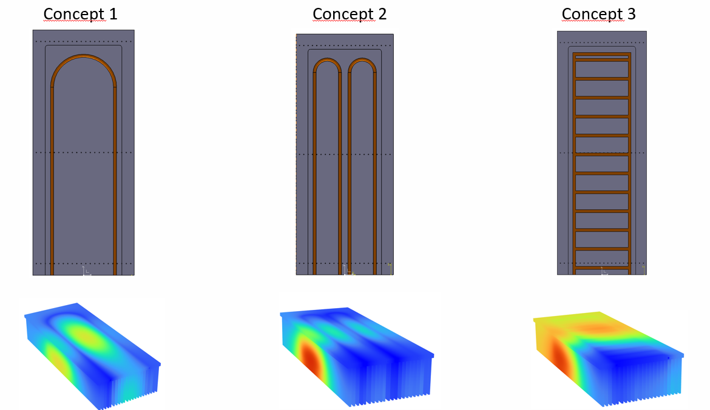
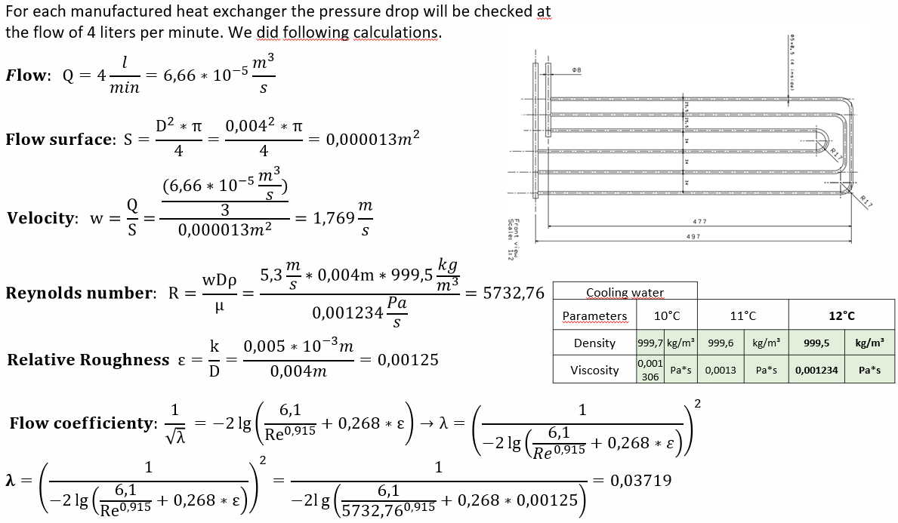
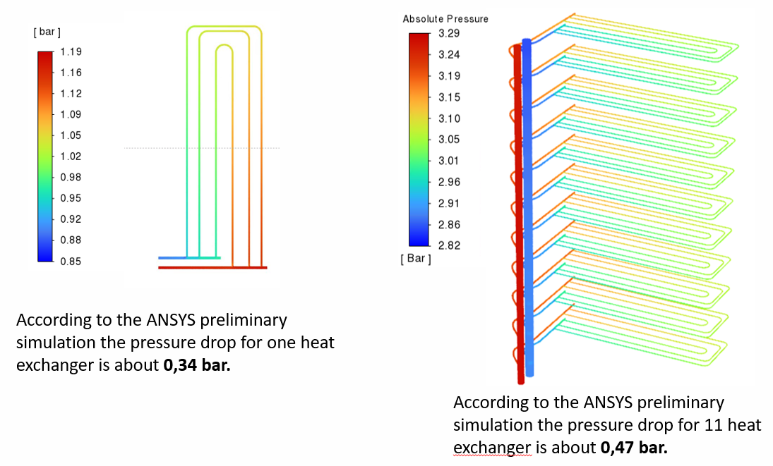
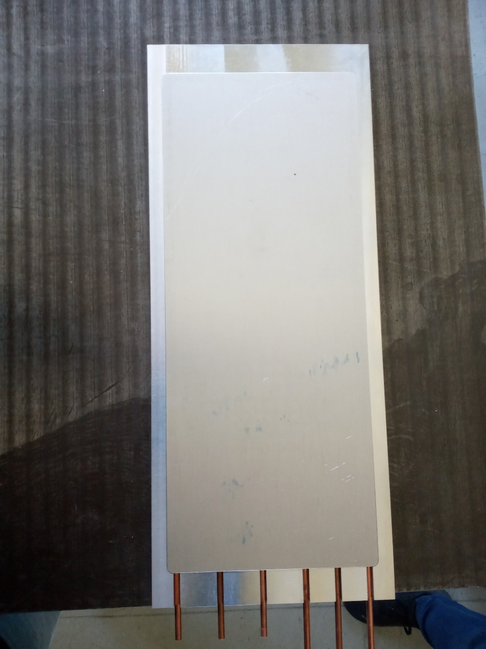
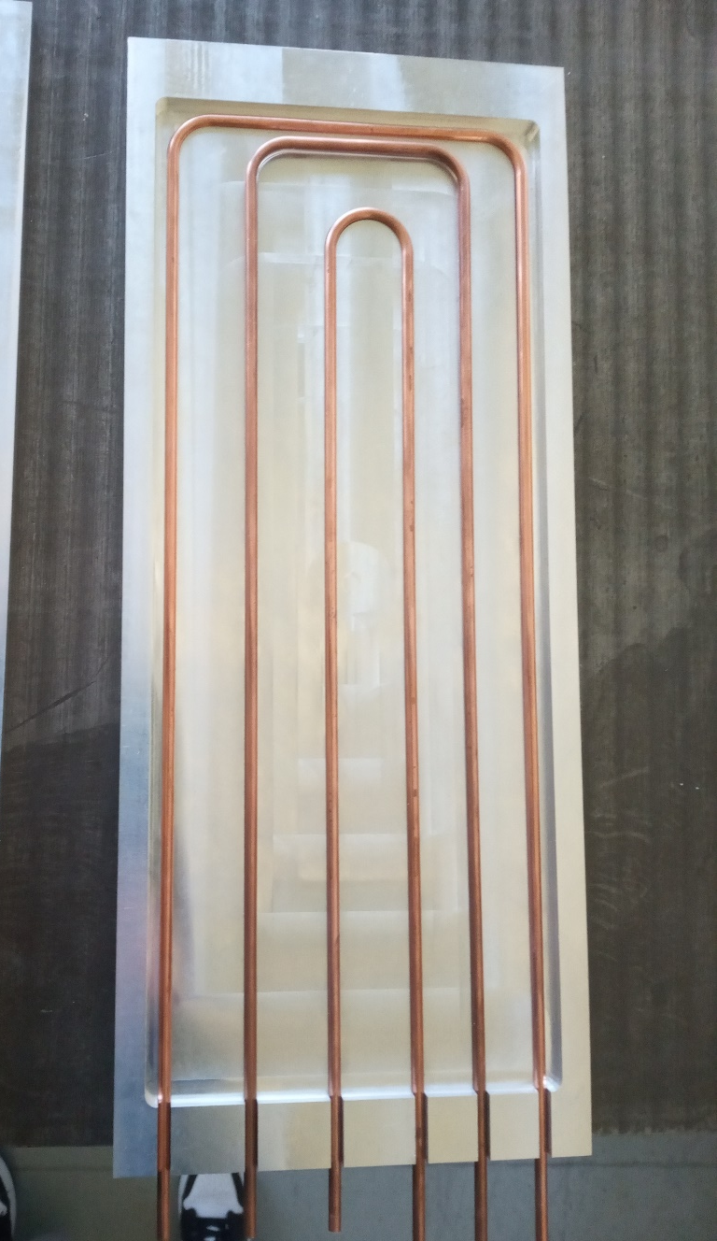
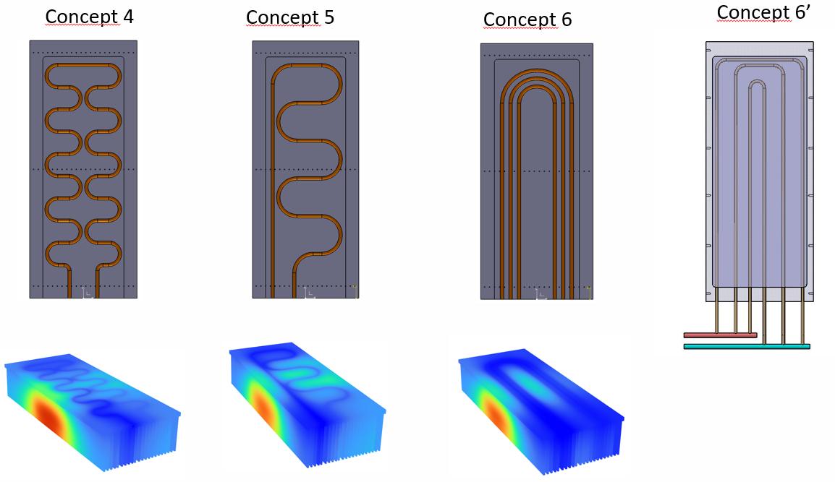
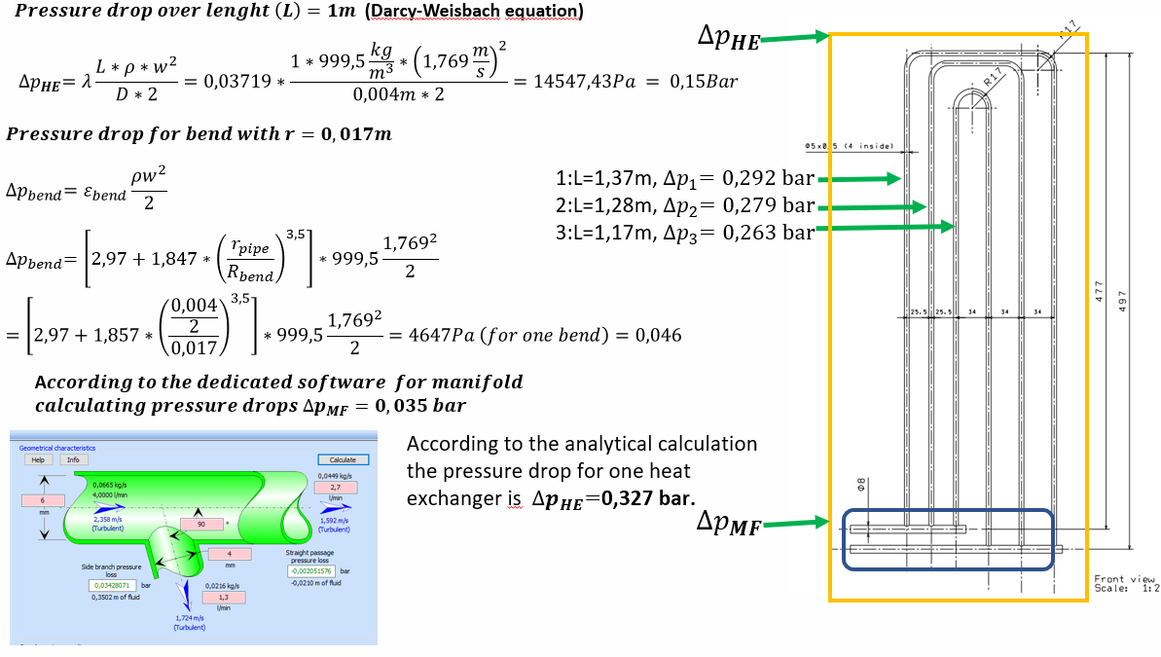
FOCAL-E CONCEPTUAL WORK

Slide 4
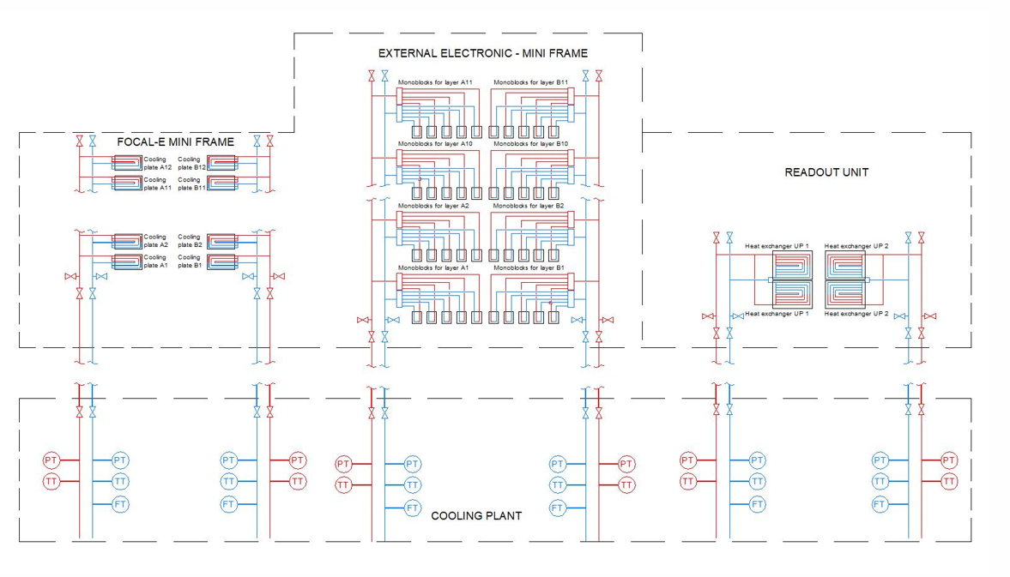
  PRELIMINARY P&ID DIAGRAM FOR FOCAL

Slide 5
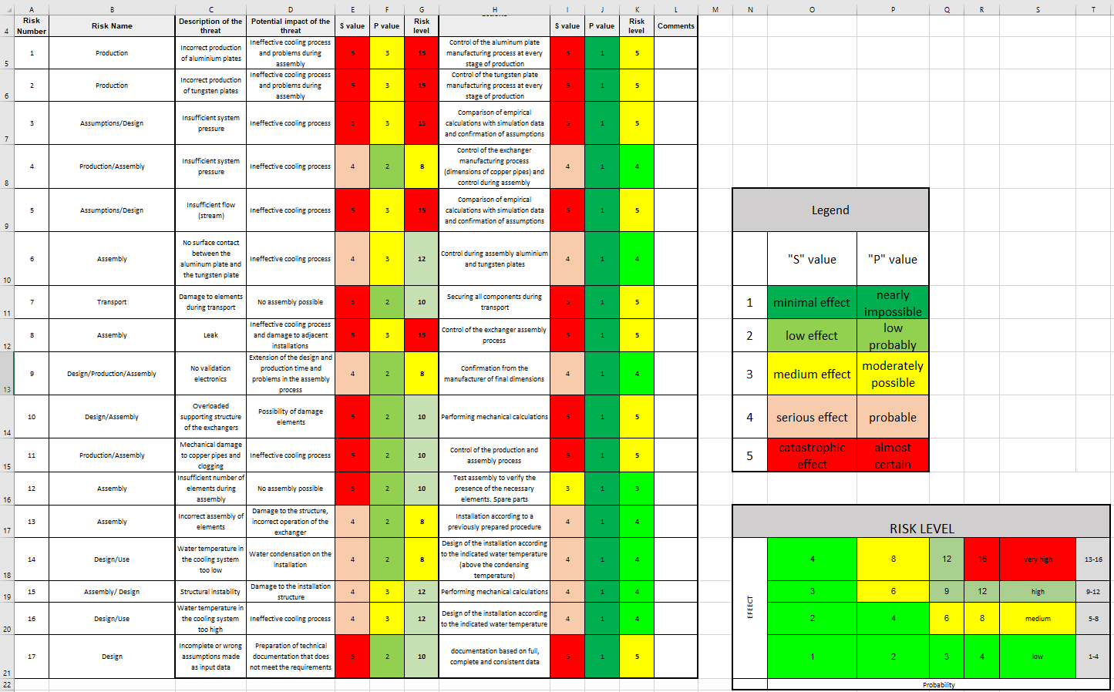
  PRELIMINARY RISK Analysis DIAGRAM FOR FOCAL

Slide 6

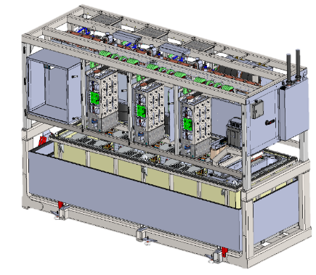
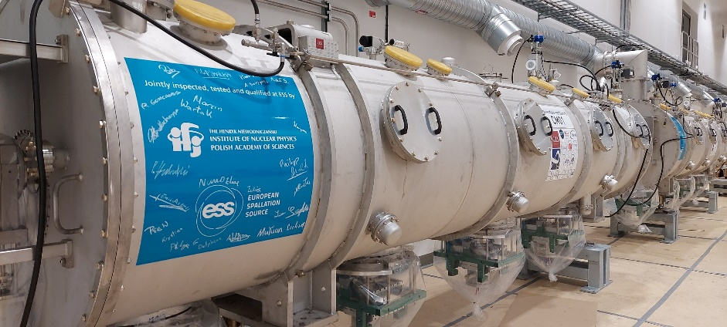
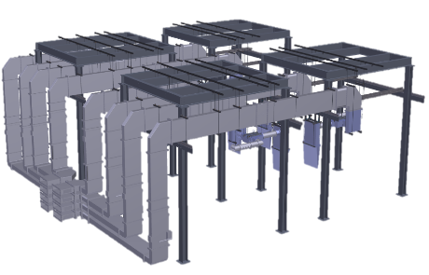
IFJ PAN in-kind contribution to ESS – Technical Annexes
SCHEDULE AIK 10.1-Cryomodule test
Reception of Cryomodule units
Preparation of Cryomodule units for the test bench
Installation on the test bench
Initial testing
Cool down
Heat load measurements
Warm up
Disconnection
Preparation for the tunnel
Participation in site activity coordination
Final review
SCHEDULE AIK 17.3 -PC Installation
Klystrons Modulators for RFQ and DTL
Klystron Modulators for Medium / High Beta
Magnet Power Converters
SCHEDULE AIK 8.6 -RF Installation
Stub installation
LLRF installation
LPS installation
Distribution system installation
High Power Amplifier installation
SCHEDULE AIK 8.8
CONTRIBUTION TO THE LOW AND HIGH-POWER TESTS OF RF EQUIPMENT AND TESTING AND INSTALLATION OF RFPS’S IN TS3 AND IN G02.
2017 - 2026
2022 - 2023

Slide 7

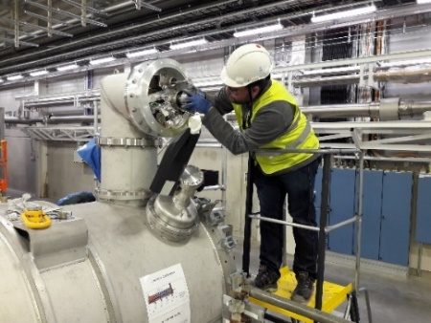
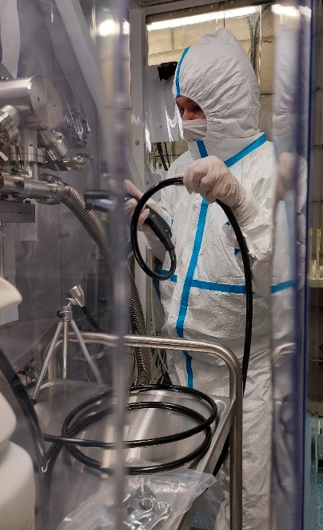
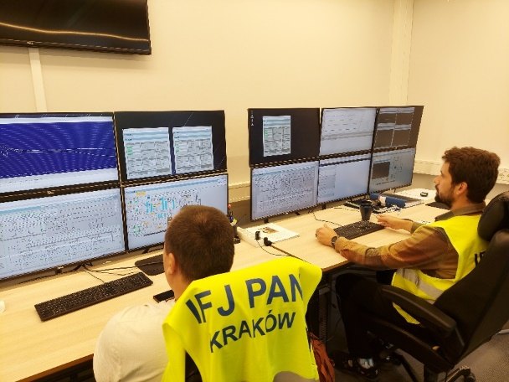
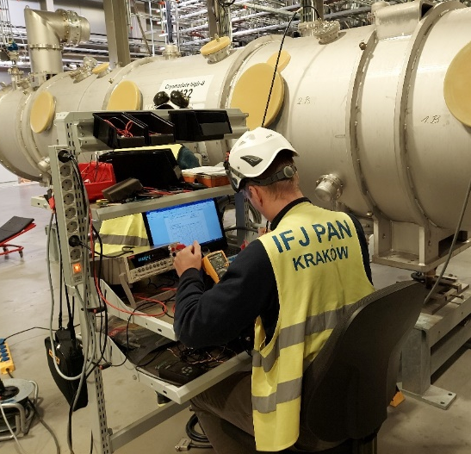
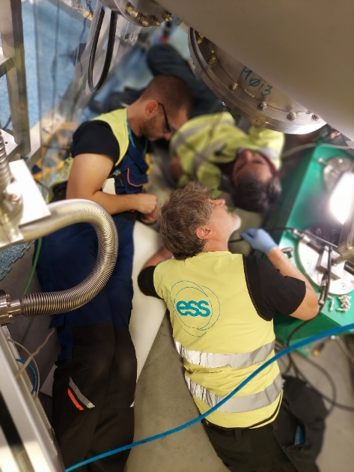
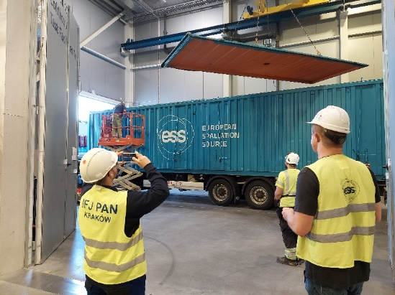
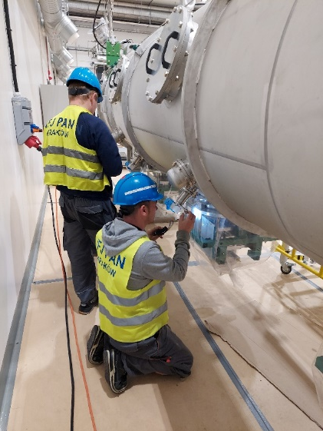
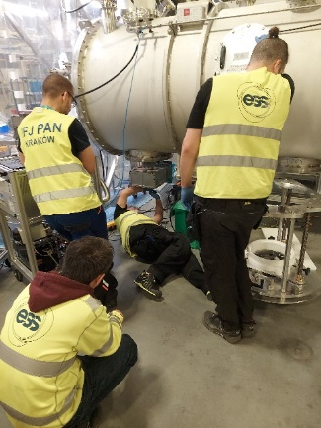
IFJ PAN (DAI) at ESS
permanently at ESS site 14 persons in total
VAC activities
Cryogenic experts,
Mechanical and electrical specialists,
RF engineers,
Vacuum specialists,
Skilled technicians,
MECH inspection
CRYO operations
ELE measurements
TECH work

Slide 8
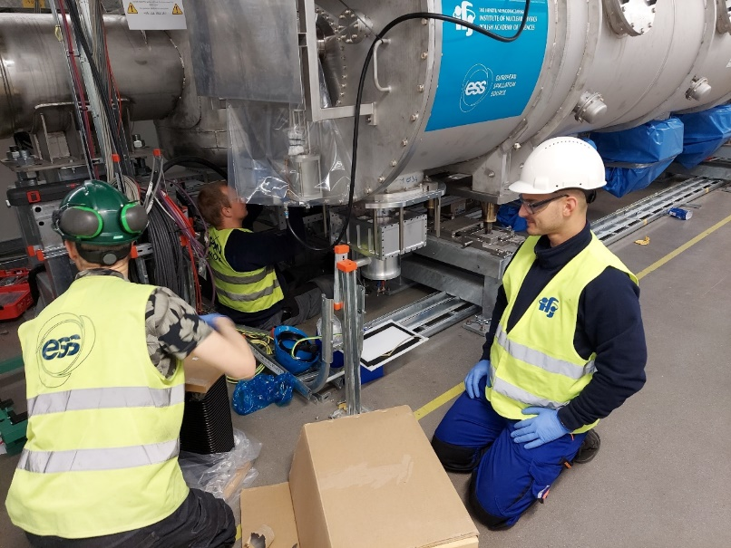
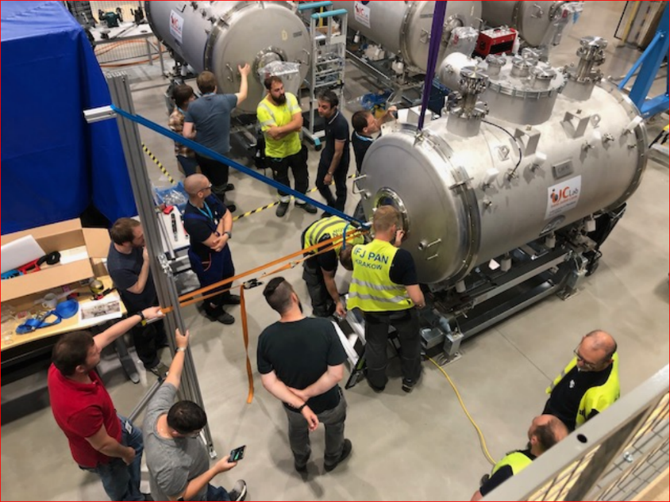
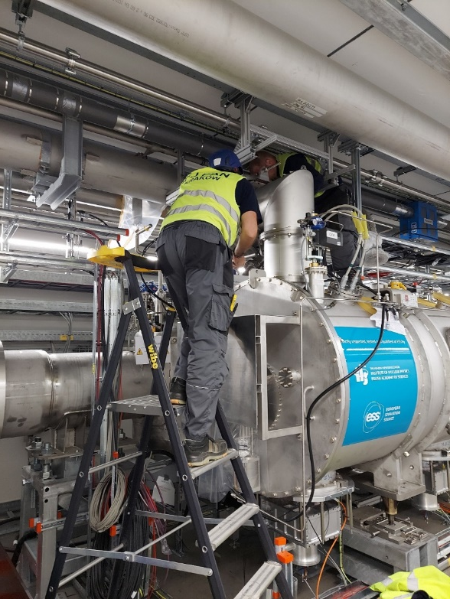
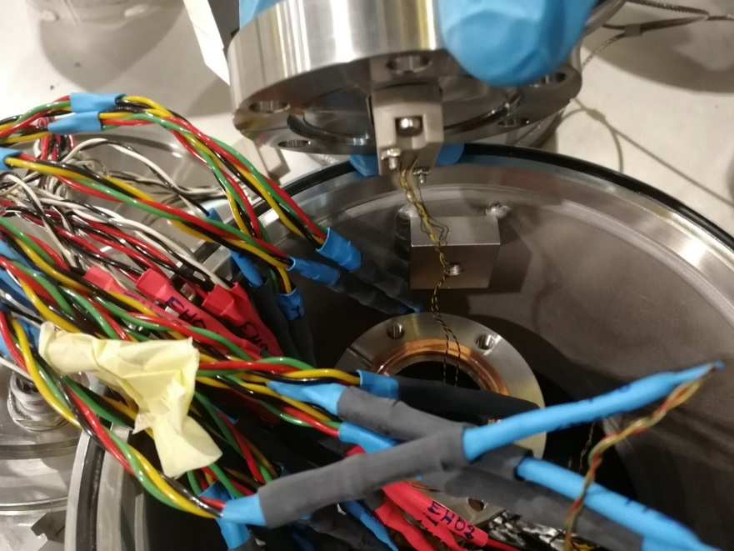
Supported activities at ESS side
IFJ PAN (DAI) at ESS
CM05 waveguides connection in the tunnel
Support with installation trial of elliptical CM05 & spoke CM02 in the tunel,
Support with SPOKE CM10 CTS motor replacing,
Replacing of the LG at all SPOKE CM’s,
Various leak tests for choosen SPOKE CM’s,
Support with MLI installation for ACCP-CTL interconnections,
And …
CTS motor repairing at SPOKE CM
CM05 Jumper connection in the tunel
level gauge replacing at SPOKE CM

Slide 9
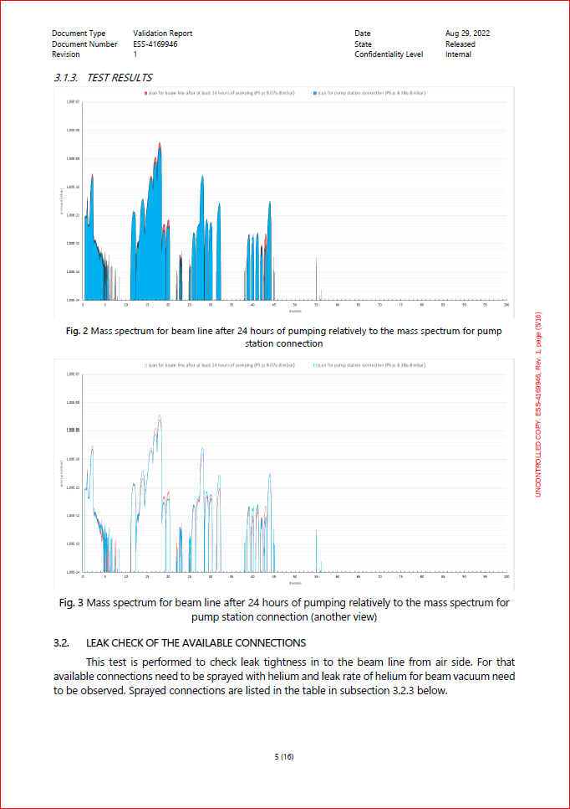
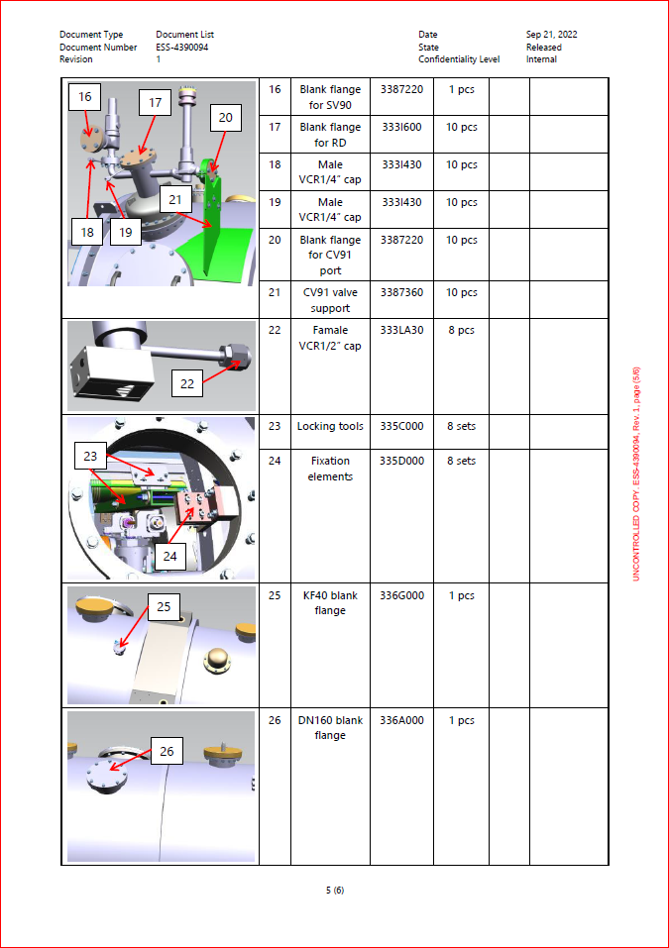
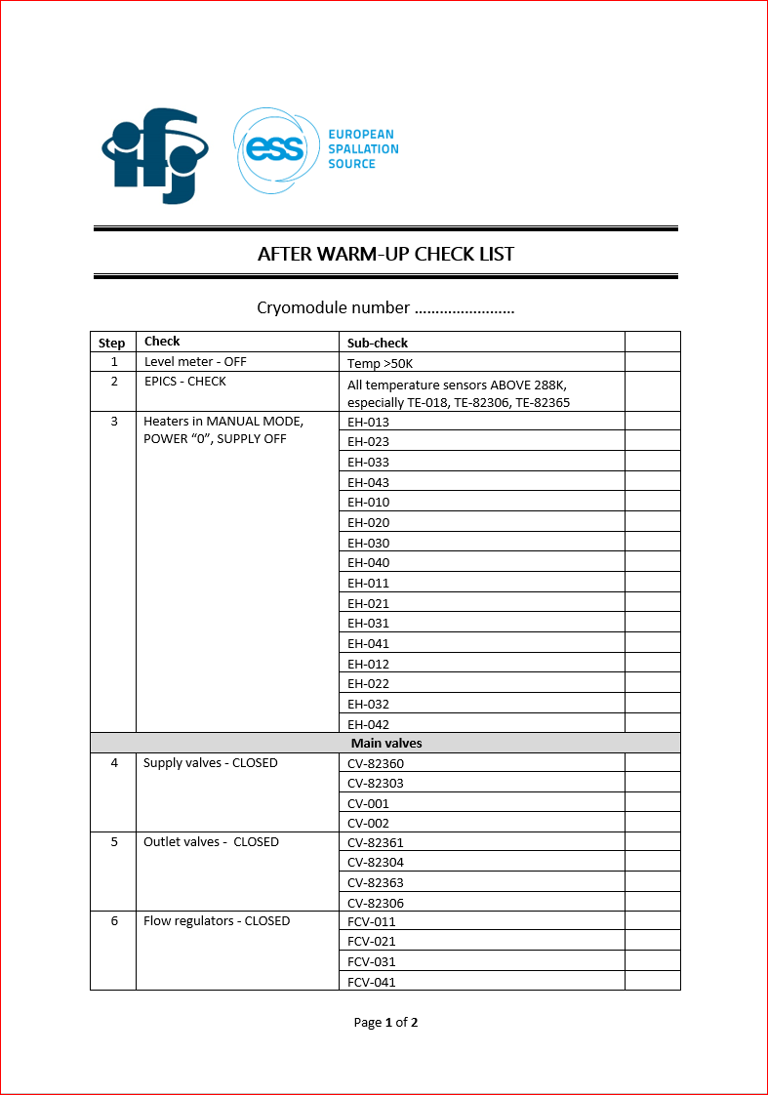
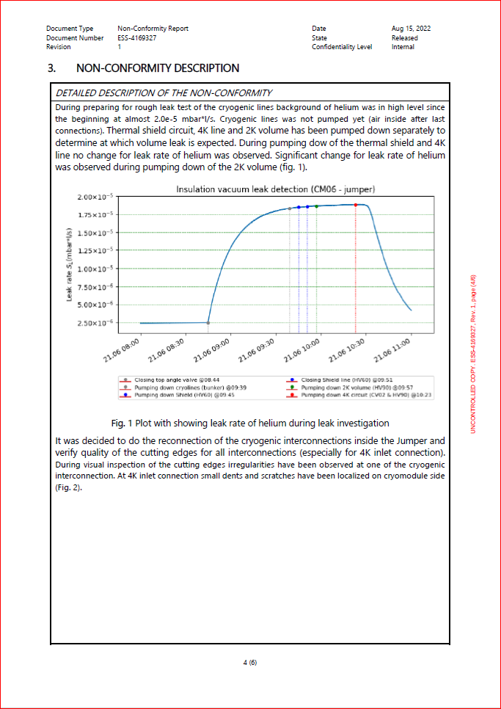
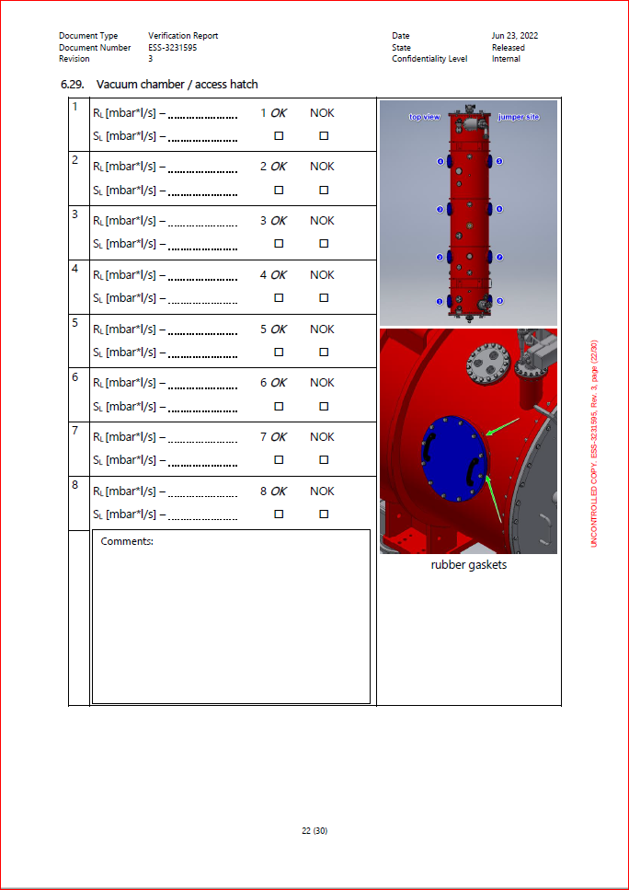
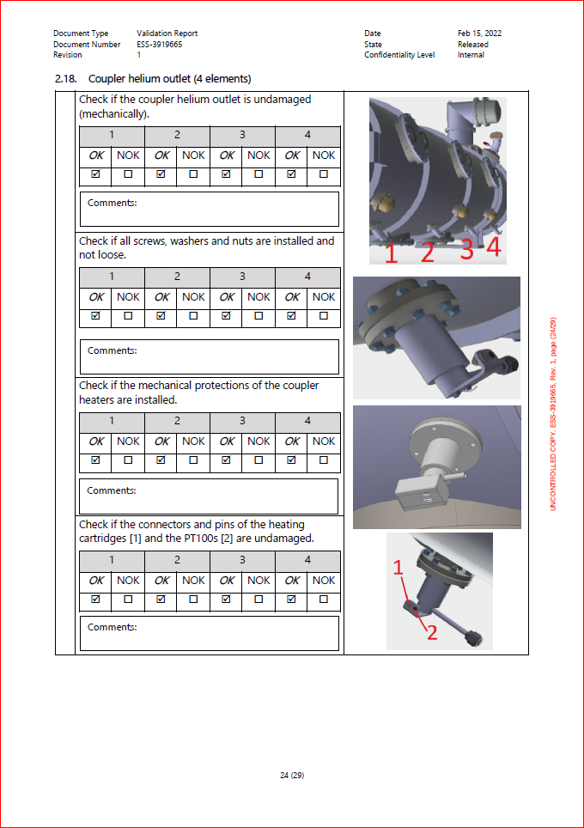
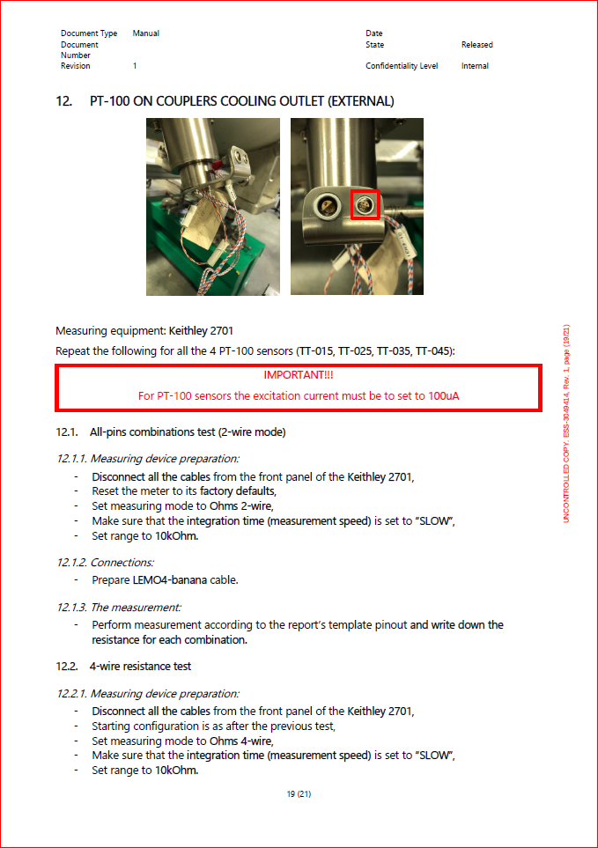
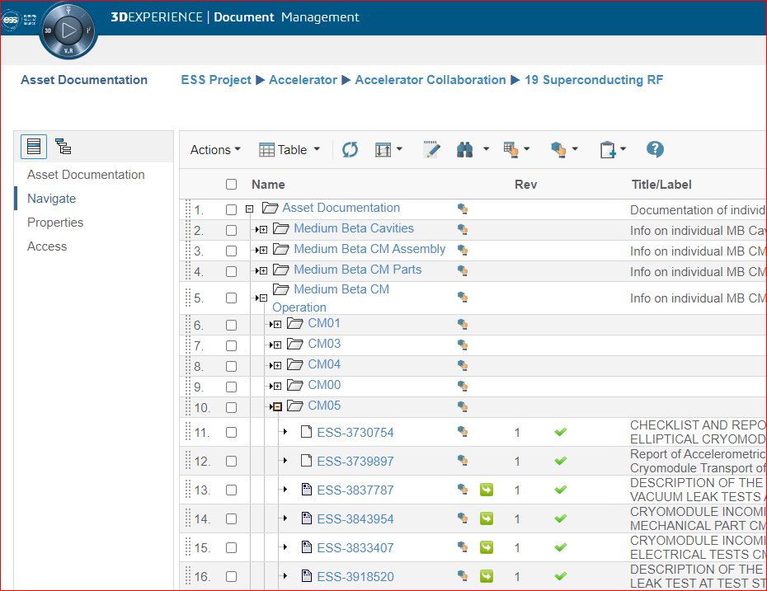
Documents:
IFJ PAN (DAI) at ESS
vacuum report
vacuum report
PIC check list
vacuum report
cryogenic check list
PIC check list
10 procedures
47 reports templates
15 check lists templates
13 NCR’s
NCR
vacuum procedure
vacuum procedure
vacuum procedure
mechanical report
electrical procedure
mechanical report
all documents in CHESS system

Slide 10

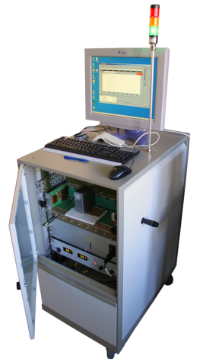
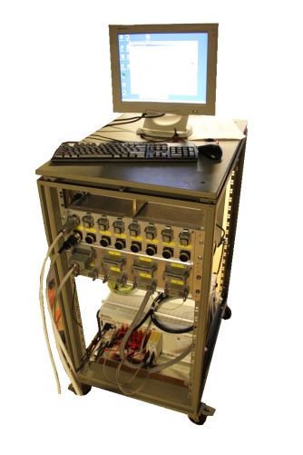
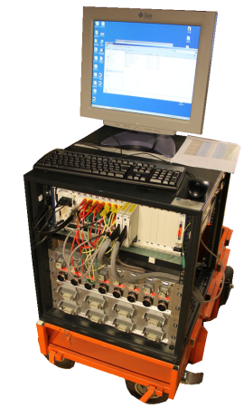
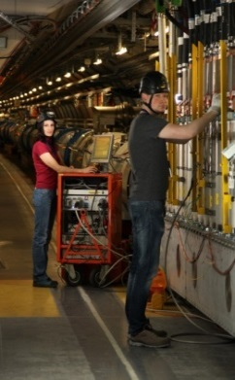
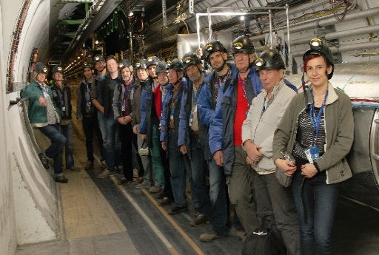
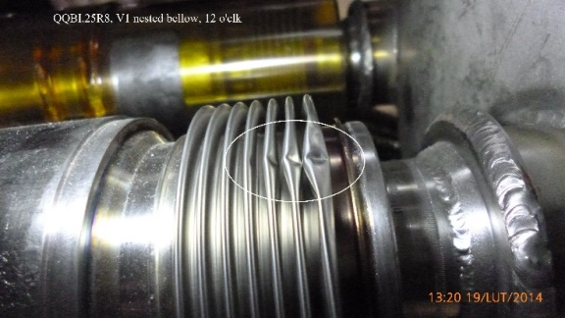

IFJ PAN (DAI) at LHC
LHC - construction, commissioning, consolidation
Sining of the agreement in 2005-2010 between IFJ PAN Director – prof. Marek Jeżabek and LHC Project Coordinator – dr. Lyndon Evans
Design and implementation of automatic measurement systems for testing superconducting LHC circuits
Quality Control of superconducting electrical circuits
Inspection of LHC superconducting magnet connections
Quality Control of superconducting electrical circuits
ELQA TEAM
LHC during Long Shutdown
New measurement systems
The work managing of the multinational team "Alpha-Omega"
Damage disclosed during QC– ICIT TEAM

Slide 11
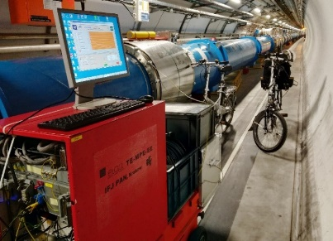
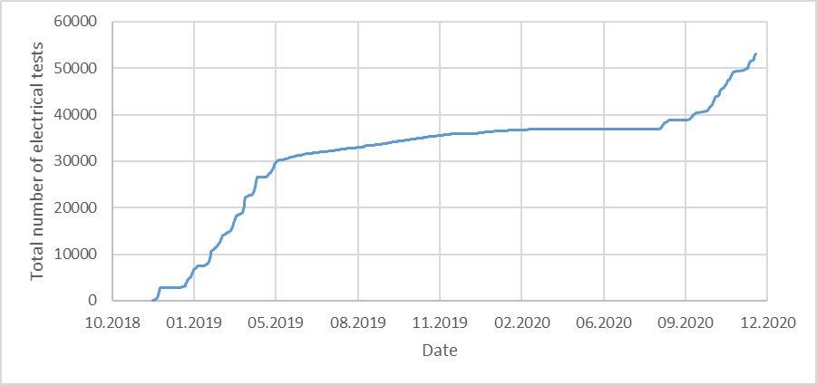
Measurements in the LHC during Long Shutdown 2
Standard measurements on more than 1600 LHC superconducting circuits and their instrumentation before and after warm-up of the LHC.
Software development, design and fabrication of four dedicated diode lead measurement systems.
Standard ELQA measurements in the LHC during Long Shutdown 2.
Up to 25 engineers and technicians from IFJ PAN on CERN site
Number of ELQA measurements performed by IFJ PAN personnel during LS2 until the end of 2020.

Slide 12
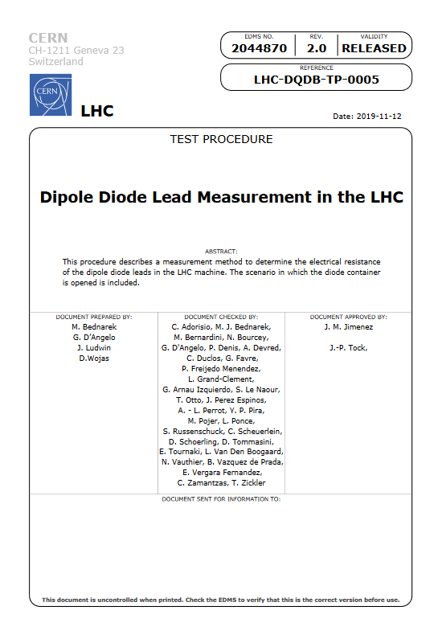
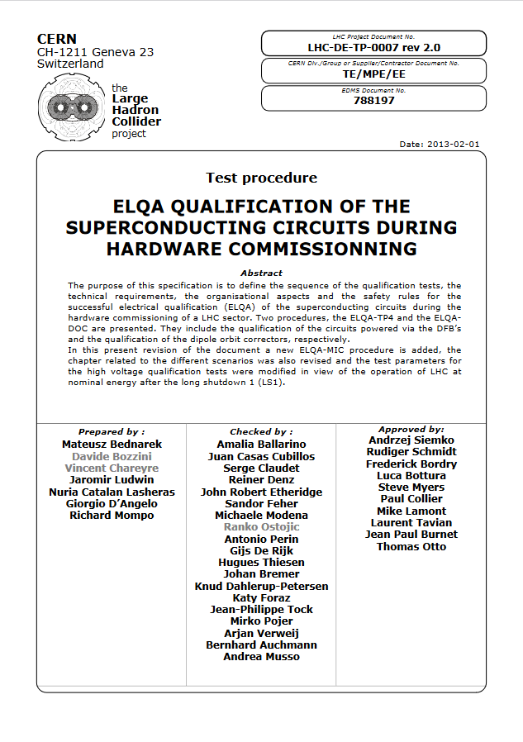
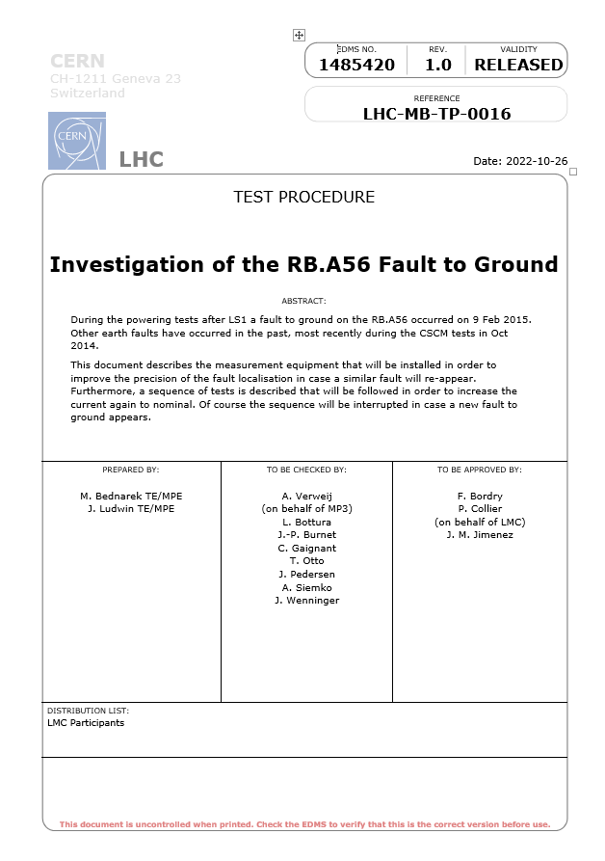
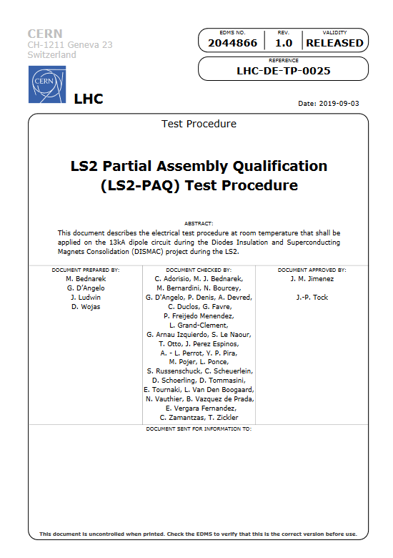
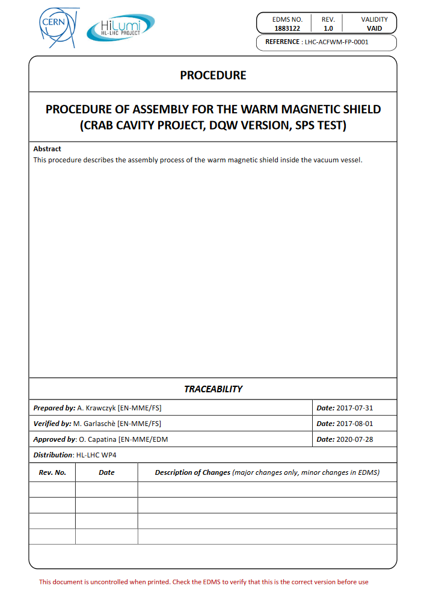
Procedures at CERN
Co-authorship of 10 procedures related to electrical quality assurance of LHC and HL-LHC superconducting circuits
Prototype crab cavity assembly procedure

Slide 13






IFJ PAN (DAI) at XFEL
Acceptance tests of superconducting components of the XFEL accelerator
IFJ PAN in-kind contribution to the XFEL 2010 – 2016
103 x
Current Lead
840 x
Cold magnet
Cavity
103 x
Cryomodule

Slide 14



Location: DESY campus at Hamburg
IFJ PAN Team met the logistic challenge in facility operating (equipped with) :
Two cryostats
Preparation area for cavities (6 Inserts)
Three test stands for cryomodules
Preparation areas for cryomodules(3x special support for survey check + additional 5 place for further incoming check.
Limited Storage areas for cavities and cryomodules
2 cryo operation(2 slots) available at the same time

Slide 15


TEST - What does it mean ?
Cavity test main flow diagram
Cryomodule test main flow diagram
TEST
The test program is realized according to the written procedures

Slide 16

TEST - What does it mean ?
Very time consuming and laborious

Slide 17
Number of FTEs over 6 years ~160
Number of people involved ~80 (~40 engineers)
In total were performed:
1214 tests for 813 series cavities performed
108 tests performed of 101 series cold magnets and current leads
107 tests for 100 series cryomodules

Slide 18






AMTF Hall - Cryomodule
Unloading of the cryomodule after transport
Cryomodule preparation area
Cryomodule test stand
Cryomodule test stand – module inside
Cryomodule test stand – front view

Slide 19








Preparation and assembling of cryomodules at AMTF hall
Main tasks:
Unload the cryomodule from the truck
Incoming checks
Load the cryomodule to the movable support
Assembling Cryomodule at the test stand
Connecting Cryomodule beam line to the test stand under clean room conditions
Leak check of beam line interconnections and mass spectroscopy of the beam line
Connecting of the waveguides
Connecting of all electrical cables
Connect of all cryomodule process pipes to the test stands
Leak check of cryomodule vessel (ISO-VAC)
Leak check of cryomodule cryogenic lines
Assembly and isolating thermal shields
Pumping down of isolation vacuum

Slide 20






AMTF Hall - Cavity
Vertical Cryostat
Radiation protection shielding
Cavity preparation area
Cavity storage area
Cavity incoming check area
Clean room

Slide 21








Preparation and assembling of cavities at AMTF hall
Main tasks:
Incoming checks
Assembling Cavity to the Insert
Connecting Cavity to the vacuum line (in cleanroom conditions)
Tuning of Fundamental Mode Rejection Filters of both HOM couplers + Cables connection
Leak check of the Cavity
Transport of the Insert to the cryostat + vacuum connection

Slide 22



XFEL Procedures
Number of created procedures:
~50 for Cryomodule (AMTF)
~19 for Cavity (AMTF)
~146 for Cryomodule (CMTB)
~21 for Cavity (HALL 3)

Slide 23




In November 2014 the major plan how to perform the test of the cryomodule with rate 1 per week (21 days test program) have been created
Test rate 1 module per week
Test rate 1.5 module per week

Slide 24



A small drop of our experience
Concluding
ESS
LUND
E-XFEL
DESY
W7X
IPP GREIFSWALD
SPIRAL 2
GANIL, CAEN
T2K, J-PARC
BELLE 2, KEK
IFJ PAN
KRAKÓW
CTA
Pierre Auger
FAIR
GSI DARMSTADT
LHC, ATLAS
CERN
ITER
CADARACHE
F4E
BARCELONA

Slide 25











GSI – Detector Motion System
T2K (ND280 detector upgrade)
ITK – ATLAS experiment
ITER RNC
PIERRE AUGER – Surface Scintillator Detector (SSD)

Slide 26

Lack of structures, lack of quality
Institute of Nuclear Physics Polish Academy of Sciences (IFJ-PAN)
in-kind contribution to the XFEL construction
Organizational structure of the IFJ-PAN Team at DESY
For Cavities and Cryomodules tests were involved around 50 persons at the same time:
AMTF Technical Coordinator
25 engineers
24 technicians
The work was organized on two shifts

Slide 27


Lack of structures, lack of quality
IFJ PAN Team at Lund (ESS)
Institute of Nuclear Physics Polish Academy of Sciences (IFJ PAN)
in-kind contribution to the ESS construction
Organizational structure of the IFJ-PAN Team at ESS
18 People involved
The work is organized on one shift
PERSONNEL:
GENERAL Coordinator: ………………………..
Technical Coordinator – ………………………
Work Unit Coordinator for Test Stand – …………………….
Work Unit Coordinator for RF&PC Installation - ………………..

Slide 28

Understanding of the Quality
Quality Assurance
Quality assurance can be defined as "part of quality management focused on providing confidence that quality requirements will be fulfilled." The confidence provided by quality assurance is twofold—internally to management and externally to customers, government agencies, regulators, certifiers, and third parties.
Quality Control
Quality control can be defined as "part of quality management focused on fulfilling quality requirements." While quality assurance relates to how a process is performed or how a product is made, quality control is more the inspection aspect of quality management.
QC focuses on the results of the work performed, whereas QA is concerned with the adequacy of the underlying processes, methodology, and standards in place to create the output.
Project Management Theory and Practice, Third Edition,2019
https://asq.org/quality-resources/quality-assurance-vs-control

Slide 29
Quality Relationships. ISO 9000 definitions from ISO 9000:2015: Quality management systems
Quality Control
Quality Assurance
Quality System
This standard describes the fundamental concepts and principles of quality management which are universally applicable to the following:
organizations seeking sustained success through the implementation of a quality management system;
customers seeking confidence in an organization’s ability to consistently provide products and services conforming to their requirements;
organizations seeking confidence in their supply chain that product and service requirements will be met;
organizations and interested parties seeking to improve communication through a common understanding of the vocabulary used in quality management;
organizations performing conformity assessments against the requirements of ISO 9001;
providers of training, assessment or advice in quality management;
developers of related standards.

Slide 30
E.W. Deming defines quality as the anticipated degree of homogeneity and reliability of a product at the lowest possible cost and adjusting it to the market requirements.
Quality means conformance to requirements. (Crosby, 1979)
Project Management Theory and Practice, Third Edition,2019
7 Principals of Quality
Customer focus
Leadership
Engagement of people
Process approach
Improvement
Evidence-based decision making
Relationship management
One American computer manufacturer was dissatisfied with one of its American suppliers. So he decided to try to cooperate with the Japanese. In the order, he wrote that he expected for every 10 000 no more than 4 defective products on average, which was in line with the US military standard 105D at that time. The Japanese took the order. Some time later the delivery of the equipment came, along with a letter that read: “We Japanese have a hard time for understanding the North American way of doing business. Four defective parts per 10 000 are delivered separately. We hope you are satisfied with this. "
Andrzej Blikle, Doktryna jakości (wydanie II turkusowe) ― rzecz o turkusowej samoorganizacji (16 września 2016)

Slide 31
QUALITY – fundamental Sensei
W. Shewhart
J. Bank
E. Skrzypek
J. Oakland
Ph. Crosby
G. Taguchi
J.M. Juran
W.E. Deming
K. Ishikawa
A.V. Feigenbaum
A.V. Feigenbaum
Quality in eight dimensions according to D.A. Garvina
practicality
singularity
utility
quality perception
durability
aesthetic
reliability
compliance with the requirements
G.F. Smith, The quality meaning, „Total Quality Management” 2003, Vol.3,

Slide 32
PDSA – Deming’s cycle
Adopt the change,
abandon it or run through
the cycle again.
Plan a change
or test aimed at
improvement.
Act
Plan
Study
Do
Carry out
the change or test
(preferably on a small scale).
Examine the
results. What did we
learn? What went wrong?
Deming modified Shewhart cycle and called new one → the Shewhart Cycle for Learning and Improvement
Deming described it as a flow diagram for learning and improvement of a product or a process.

Slide 33
Classification of quality management methods
- Failure mode and effects Analysis (FMEA)
– Quality function deployment (QFD)
– Projektowanie eksperymentów
– Metoda Taguchiego
– Single minute exchange of die
– Poka yoke
– Total productive maintenance
– Just in time
– Kanban
– 5xS
- Control card
- Pareto diagram
- Scatter correlation diagram
- Histogram
- Data analysis matrix
- Analytical sheet
- Statistical quality control
- Statistical controls process
- Process capability analysis
ENGINEERING
STATISTICAL
MANAGEMENT
- Kaizen
- Continuous improvement cycle(PDCA)
- Quality cost analysis
- Ishikawa diagram
- Relationship diagram
- Matrix diagram
- Decision tree
- Programming chart the decision process
- Benchmarking
- Quality planning
- Graphical presentation processes
- Flag method
- Process improvement cycle (DMAIC)
- SERVQUAL
- Quality wheels
- Quality audit meeting
- Empowerment
- Hoshin kanri
- Catchball
- Criteria quality awards (incl. W. E. Deming, M. Baldridge)
- EFQM excellence
- ISO 9004
- Management review
- Internal audit
ISSN 1898-6447, Zesz. Nauk. UEK, 2013; 910: 37–49

Slide 34

Quality Management Programs
TQM
Lean methodology
Zero Defect
Six Sigma
ISO 9000
Total Quality Management — TQM
The heart of the TQM philosophy is the prevention of problems and an emphasis on quality in the design and development of products and processes. A formal quality planning process is integral to the TQM philosophy.
Way to TQM
Six Sigma
Lean management
Project Management Theory and Practice, Third Edition,2019

Slide 35
Deming’s 14 Points for the Transformation of Management First presented in Dr. Deming’s seminal book, Out of the Crisis
85% of quality problems are due to system errors and only 15% can be attributed to employees.
Create constancy of purpose for improving products and services
Adopt the new philosophy
Cease dependence on inspection to achieve quality
End the practice of awarding business on price alone; instead, minimize total cost by working with a single supplier
Improve constantly and forever every process for planning, production, and service
Institute training on the job
Adopt and institute leadership
Drive out fear
Break down barriers between staff areas
Eliminate slogans, exhortations, and targets for the workforce
Eliminate numerical quotas for the workforce and numerical goals for management
Remove barriers that rob people of pride of workmanship, and eliminate the annual rating or merit system
Institute a vigorous program of education and self-improvement for everyone
Put everybody in the company to work accomplishing the transformation
https://deming.org/explore/fourteen-points/

Slide 36
Traditional quality assurance model
QUALITY
COSTS
TIME
The traditional relationship between quality and production time and cost
QUALITY
PROVIDER
COMPANY
PRODUCT
CUSTOMER
Andrzej Blikle, Doktryna jakości (wydanie II turkusowe) ― rzecz o turkusowej samoorganizacji (16 września 2016)

Slide 37
TQM quality assurance model
QUALITY
COSTS
TIME
The TQM’s relationship between quality and production time and cost
QUALITY
PROVIDER
COMPANY
PRODUCT
CUSTOMER
Andrzej Blikle, Doktryna jakości (wydanie II turkusowe) ― rzecz o turkusowej samoorganizacji (16 września 2016)

Slide 38
SEVEN DEADLY DISEASES OF MANAGEMENT
1. Lack of constancy of purpose to plan product and service that will have a market and keep the company in business and provide jobs. Lack of a set course of action is not like a runny nose or the flu. It is not a mild disease. It is a fatal disease and leads to the collapse of the company
2. Emphasis on short-term profits: short-term thinking (just the opposite from constancy of purpose to stay in business), fed by fear of unfriendly takeover, and by push from bankers and owners for dividends.
3. Evaluation of performance, merit rating, or annual review.
4. Mobility of management; job hopping.
5. Management by use only of visible figures, with little or no consideration of figures that are unknown or unknowable.
6. Excessive medical costs. As reported by Dr. Deming in Out of the Crisis (pages 97-98), executives shared with him that the cost of medical care for their employees was amongst their largest overall expenses, not to mention the cost of medical care embedded in the purchase price of what they purchased from their suppliers.
7. Excessive costs of liability, swelled by lawyers that work on contingency fees.
https://deming.org/explore/seven-deadly-diseases/

Slide 39

EFQM Model - European Foundation for Quality Management
„The EFQM Model not only remains relevant but continues to set the management agenda for any organisation
wanting a long term, sustainable future.” - EFQM Model Change Management Framework | EFQM
https://www.efqm.org/efqm-model

Slide 40
IFJ PAN in-kind contribution to……
daily / shifts report
Action plan - design and optimization
Act
Plan
DAI Quality system
team management
real communications
Study
Do
providing access to control data and relevant information
dedicated system for QC and QA support
daily meeting – briefing

Slide 41


Division of Scientific Equipment and Infrastructure Construction (DAI)
ON BEHALF of the TEAM:
Jacek Świerblewski
Jacek.Swierblewski@ifj.edu.pl
So that customers come back to you, not products! Quality is something that satisfies and even delights customers.
William Edwards Deming

