Slide 1
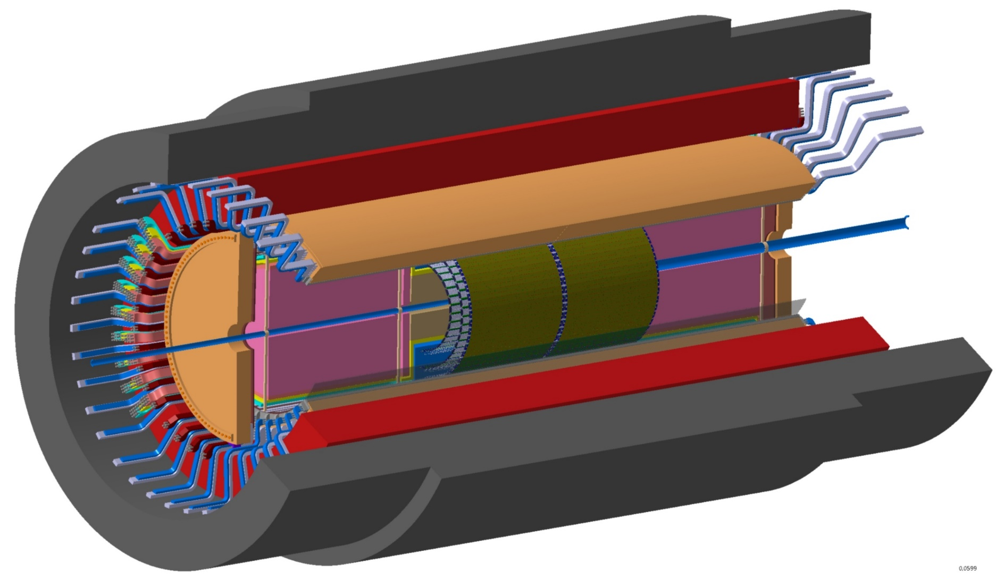
ALICE3 – Outer tracker status in Heidelberg
Update on mechanical design

Slide 2
OT barrel, layout and design status
Stave design and carbon spaceframe prototype
Summary, next steps

Slide 3
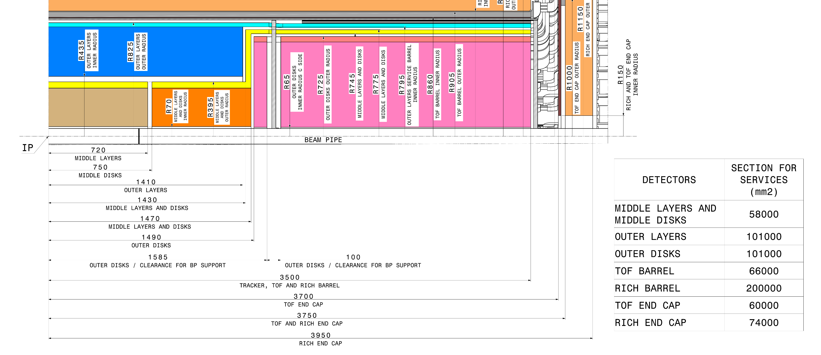
Layout and design of the OT Barrel – Geometrical constraints
Interface Control Drawing and Detector Volume
Detector Volume (half Barrel)
Length | 1410 mm
Inner Radius | 435 mm
Outer Radius | 825 mm
Service inner radius | 795 mm
Service outer radius | 825 mm
EDMS
ALICE General Layout | Project CERN-0000229560
CERNBOX
https://cernbox.cern.ch/s/kJ8ZyxV9KH63Kj7

Slide 4
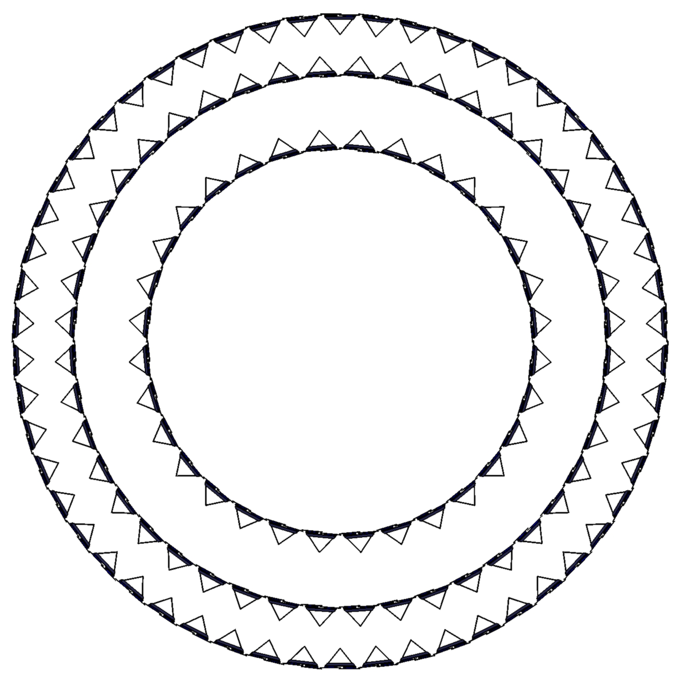
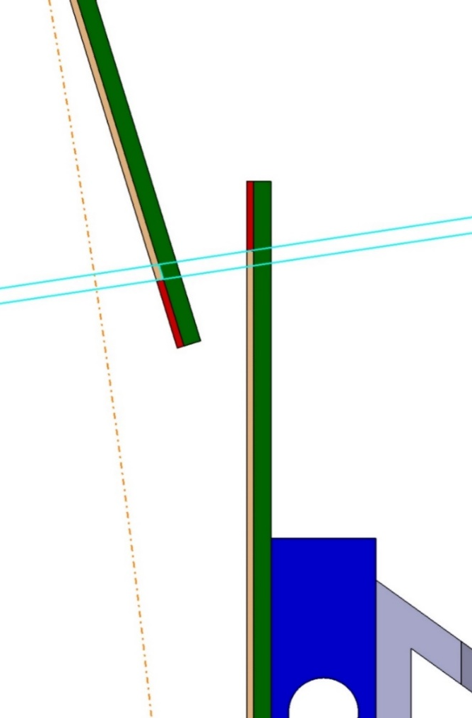
Layout and design of the OT Barrel
Layout Outer Tracker Layers
Flipped layer 10 at
800 mm to
reduce the outer radius
Exact numbers of staves
depends on overlap and
final radius
Layer Radius [mm] | Full barrel length [mm] | Overlap between staves [mm] | #Total space frames (full barrel length)
450 | 2640 | 0.766 | 64
650 | 2640 | 0.358 | 88
800 | 2640 | 0.082 | 108
 |  | Total | 260
Overlap of active area
between staves

Slide 5

Layout and design of the OT Barrel – Geometrical constraints
Interface Control Drawing and Detector Volume
Current CAD design implemented to check dimensions and compatibility
with the different detector volumes

Slide 6
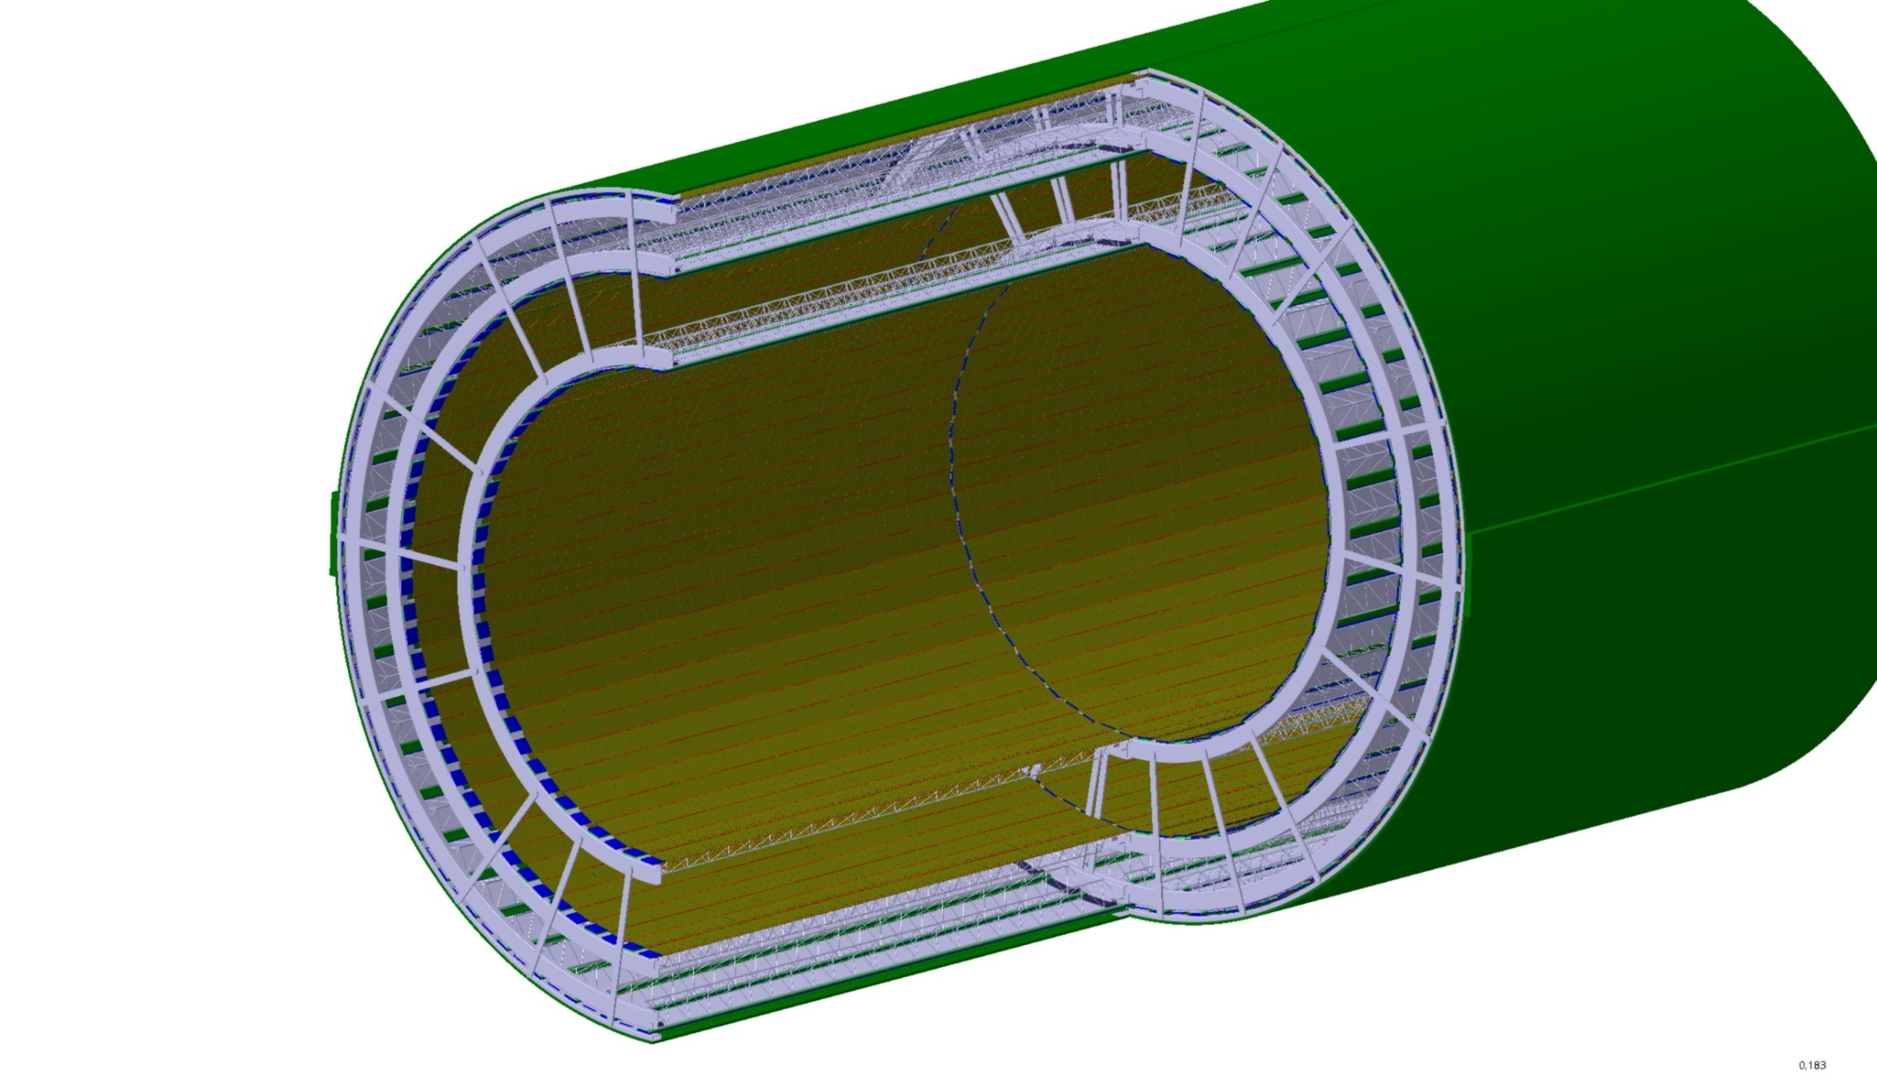
Layout and design of the OT Barrel – Half barrel
First rough 3D model to
show the modularity
Idea:
Each half layer can be assembled independently.
1 half barrel consists of 3 half layers
connected by rods.
Cylindrical shell connects
end and middle wheel.
Cylindrical shell
End wheel
Middle wheel
Connecting rods
Staves

Slide 7
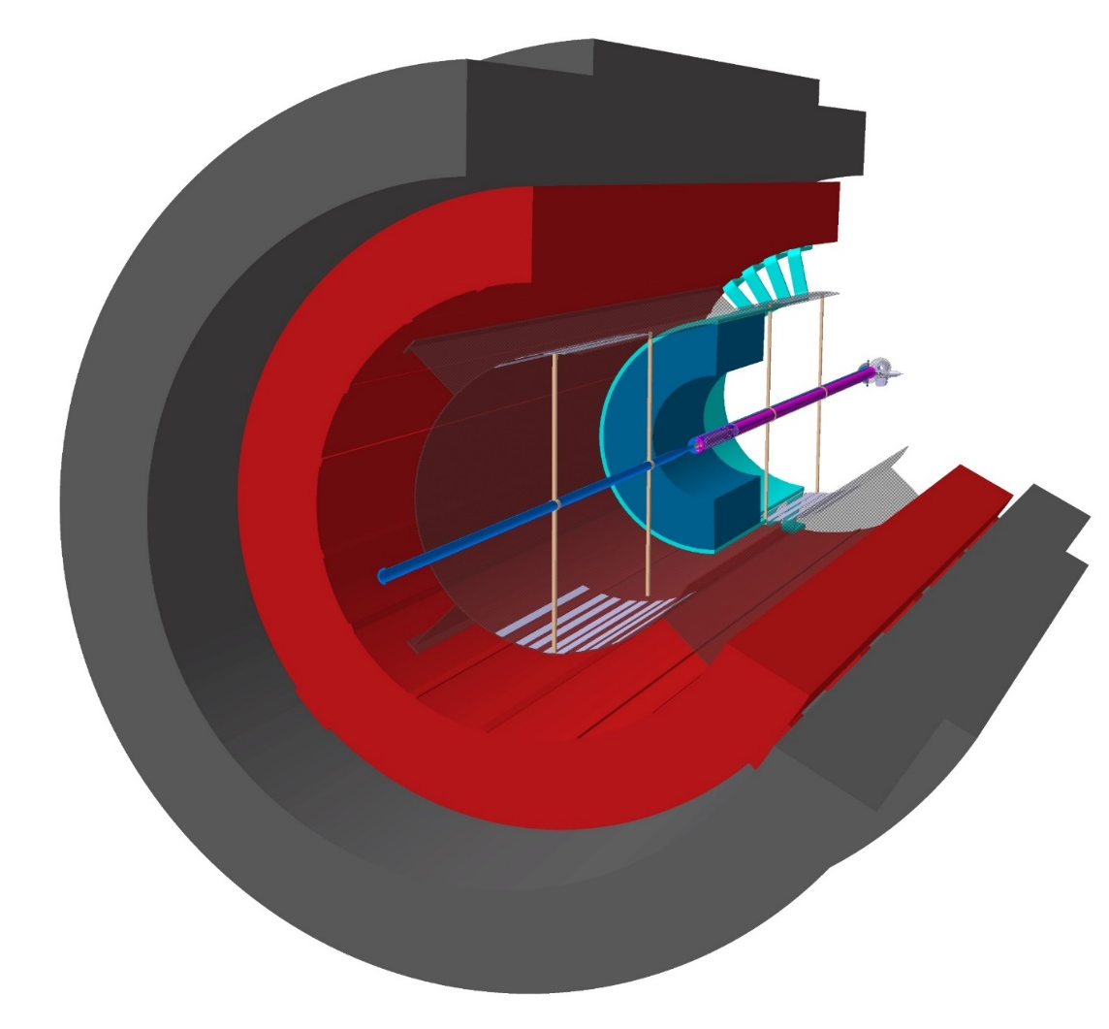
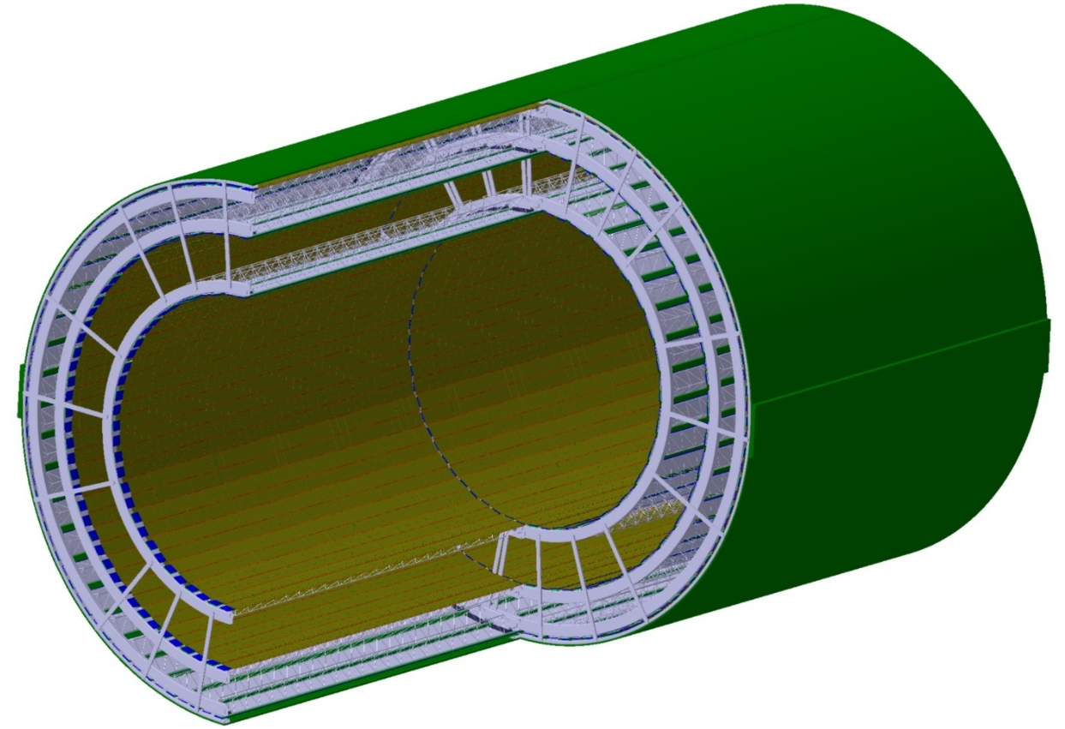
Layout and design of the OT Barrel – 3D Model
Outer Tracker CAD Model
Design Requirement:
Beam pipe supports require a separation of the OT barrel along the vertical axis for insertion/extraction the detector
-> OT is subdivided in 4 half barrels
More detailed designs of the
end and middle wheels
-> learn from existing designs
effort to minimize gap between the barrels
ALICE3 Interface Control Drawing and Detector Volumes
Current 3D model (Heidelberg and Frankfurt)

Slide 8
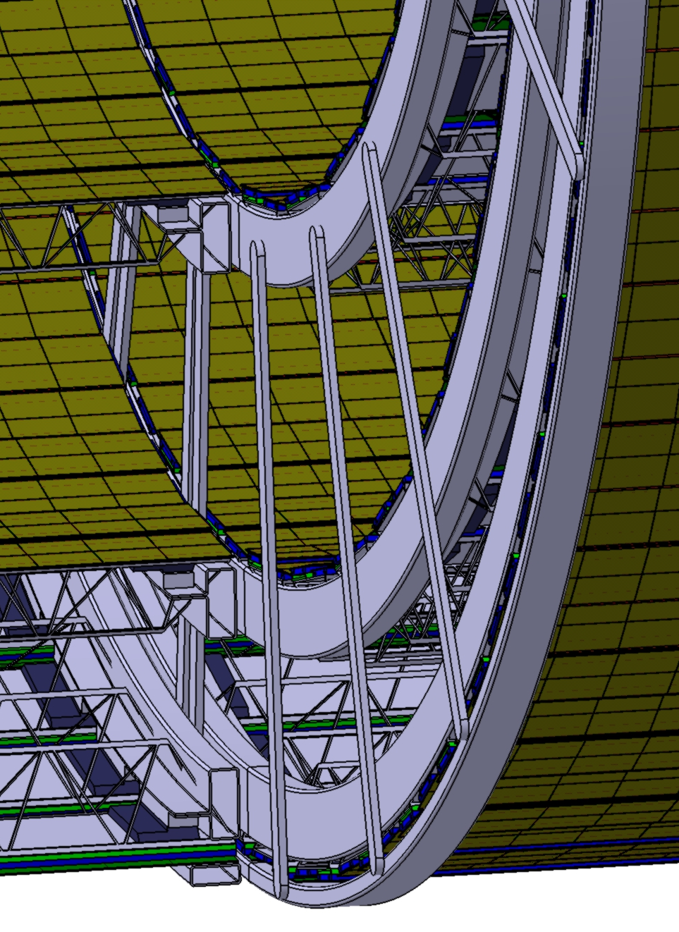
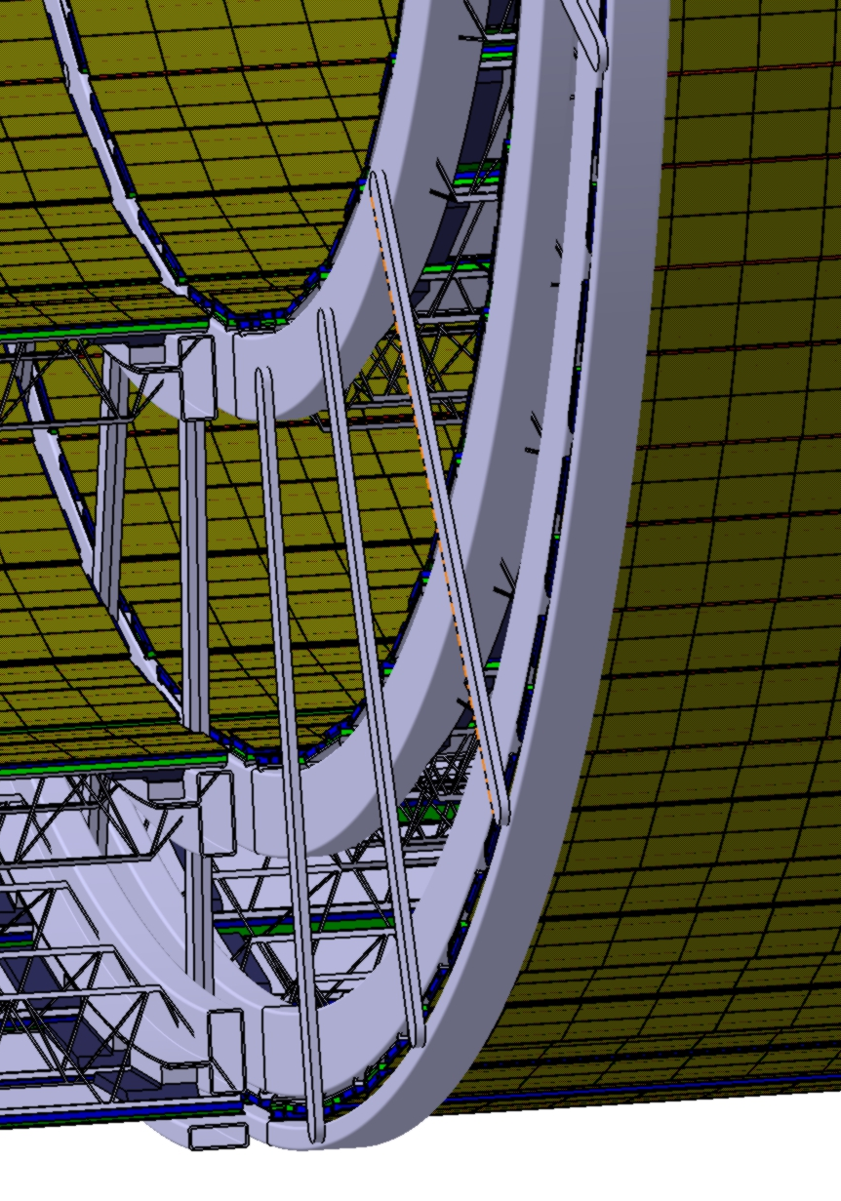
Layout and design of the OT Barrel – 3D Model
Gap between the Barrels
First Design:
Connecting rods of the middle weels at the same (azimuthal) position
-> Gap = 2 x Thickness of connecting rod
New design approach:
Displacement of face to face wheels in azimuthal direction
-> Gap = Thickness of connecting rod
Thickness of connecting rods?
-> Depends on Material and the requirements (e.g. stability, material budget)
-> currently 4mm + Clearance
-> can still be optimized

Slide 9
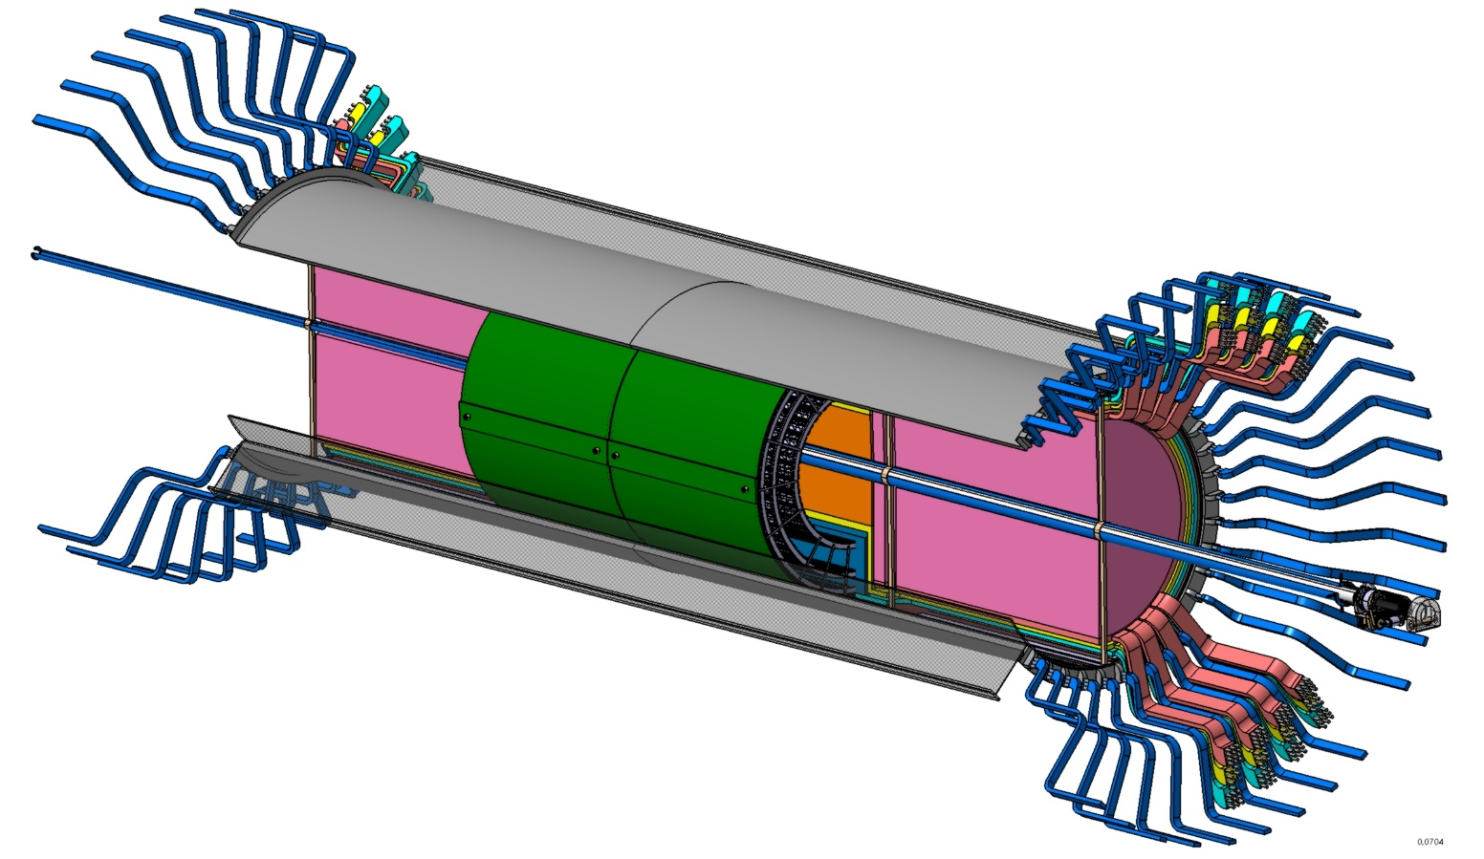

Layout and design of the OT Barrel
Further work packages and open questions
Interface to cage?
Mechanical interface for the
middle wheels in the cage?
Interface to other detectors
Integration of cooling system?
-> Details and progress on the cooling system will be presented in Laszlo’s talk
Still many “construction sites”

Slide 10
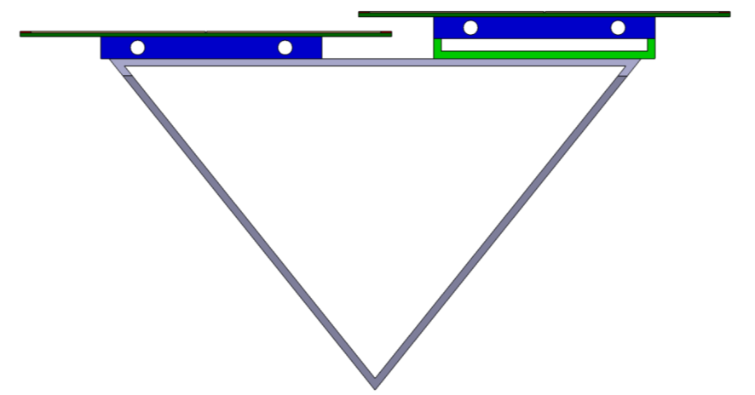
Stave design and carbon spaceframe prototype
Dead-zone
Dead-zone
coldplate
Coldplate
Design strongly
depends on
cooling concept
(liquid or gasoues)
Overlap
spacer
Cf-spaceframe

Slide 11
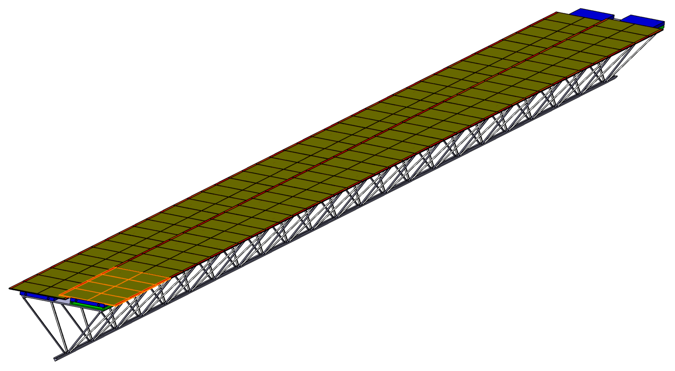
Stave design and carbon spaceframe prototype
Principal design similar to ITS2 - staves
Spaceframe
  CF structure, geometry similar to ITS2
Module:
  Consists of 8 chips, positioned in 2x4
  10 modules in one row
  20 modules on single spaceframe
Final design
depends on
cooling concept
Cooling options will be discussed in a following talk
(Laszlo Varga)
Cooling could be integrated in the spaceframe design

Slide 12
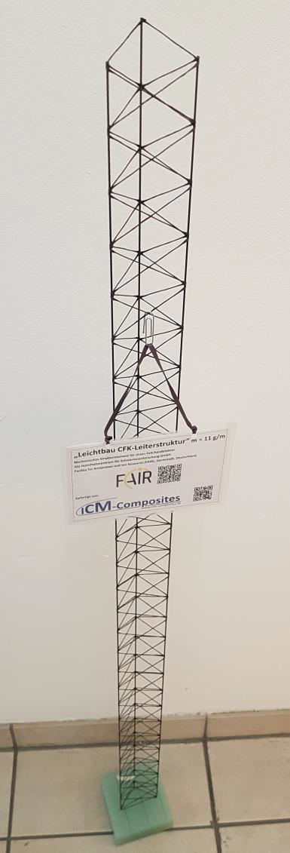
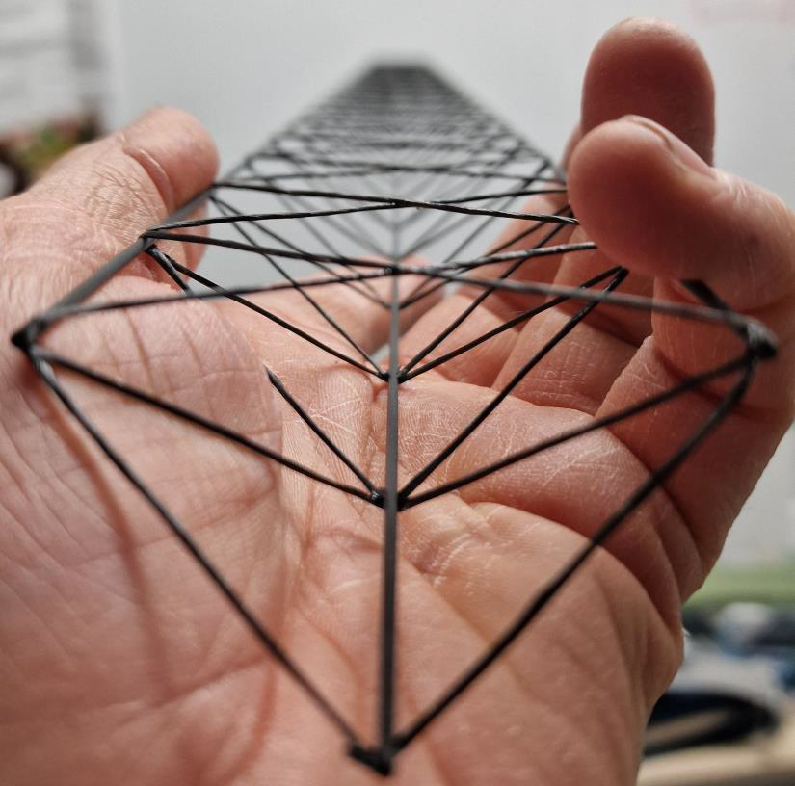
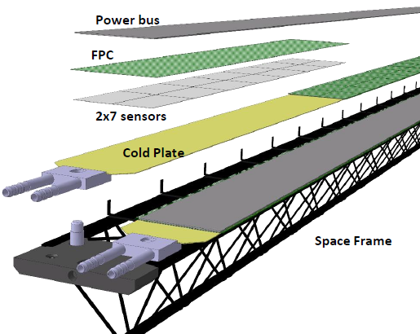
Stave design and carbon spaceframe prototype
First spaceframe prototype
Next design step:
Fixation of the sensor and cooling on the frame
  Close to ITS2 design?
  Other design approach
  in preparation
  -> modular design
  -> alternative way of spaceframe
  production
  for more detailed design work further input on module structure first needed (see Laszlo’s talk)

Slide 13
Stave design and carbon spaceframe prototype
First spaceframe prototype
Alternative industrialized manufacturing process discussed with ICM-Composites – woven carbon filament
around 3 carbon tubes as shown in the pictures below (other geometries possible).
Discussions with ICM
https://icm-composites.de/
Existing process of woven fibers can be adapted to
the ALICE3 OTR dimensions.
ICM offered to produce a first carbon spaceframe prototype similar to the existing design of the FAIR CBM STS detector project.
Adaption of existing tooling to ALICE3 OTR dimensions necessary. Easily possible with existing design. Need to extend the winding core to the length required for OTR stave.
The fabrication process is assumed to be much faster than
assembling and gluing the frame out of individual parts.

Slide 14
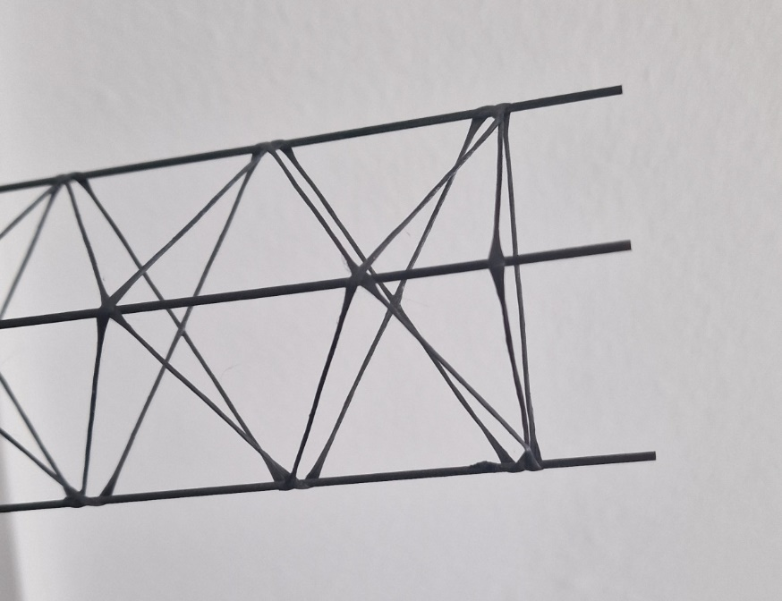
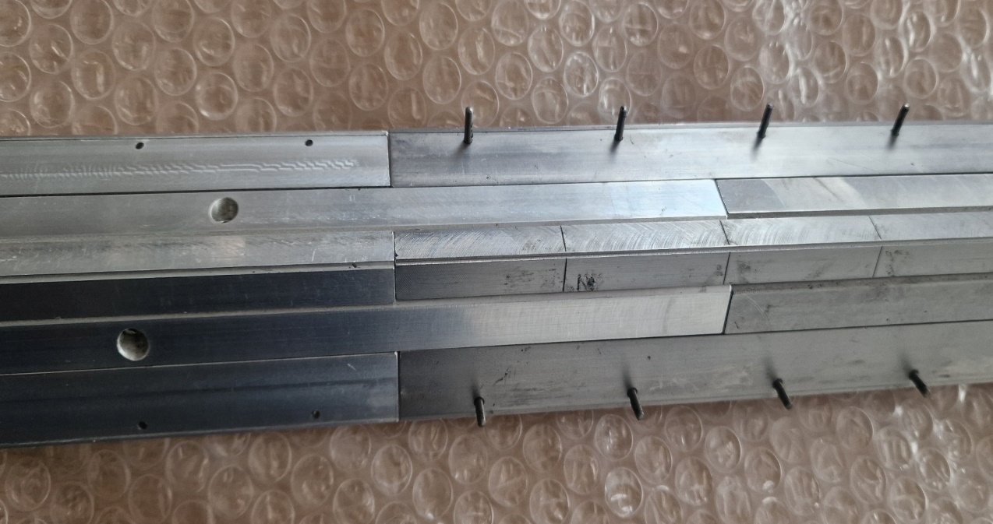

Stave design and carbon spaceframe prototype
First spaceframe prototype
Offer from ICM
https://icm-composites.de/
Production of 5 carbon spaceframes with the existing tooling slightly modified
(dimensions are almost the same)
Costs for 5 samples: 3.800 €
adaption of the existing tooling to the required length of 1285mm
Costs: 800€
Order was placed mid of July
awaiting prototypes 2nd half of October
Some delays due to workshop issues
Meeting with ICM and TUM colleagues on October 17.

Slide 15
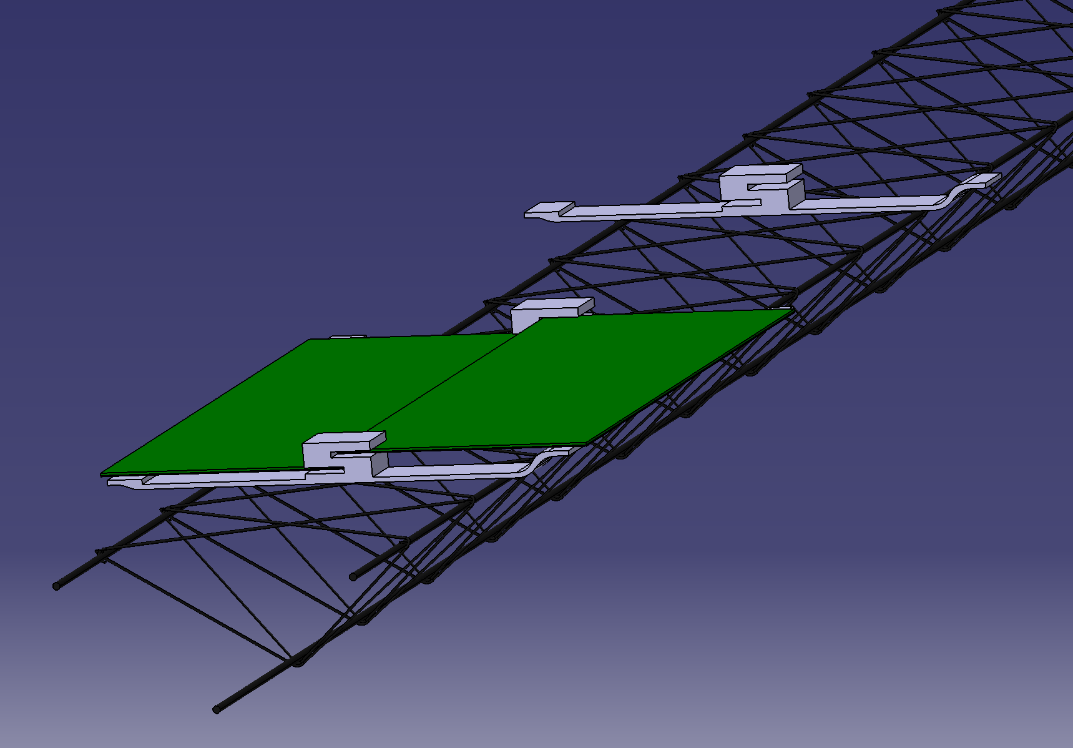
Stave design and carbon spaceframe prototype
Present idea of module fixation on spaceframe
Modules
Support brackets
being glued onto
the spaceframe
Spaceframe

Slide 16
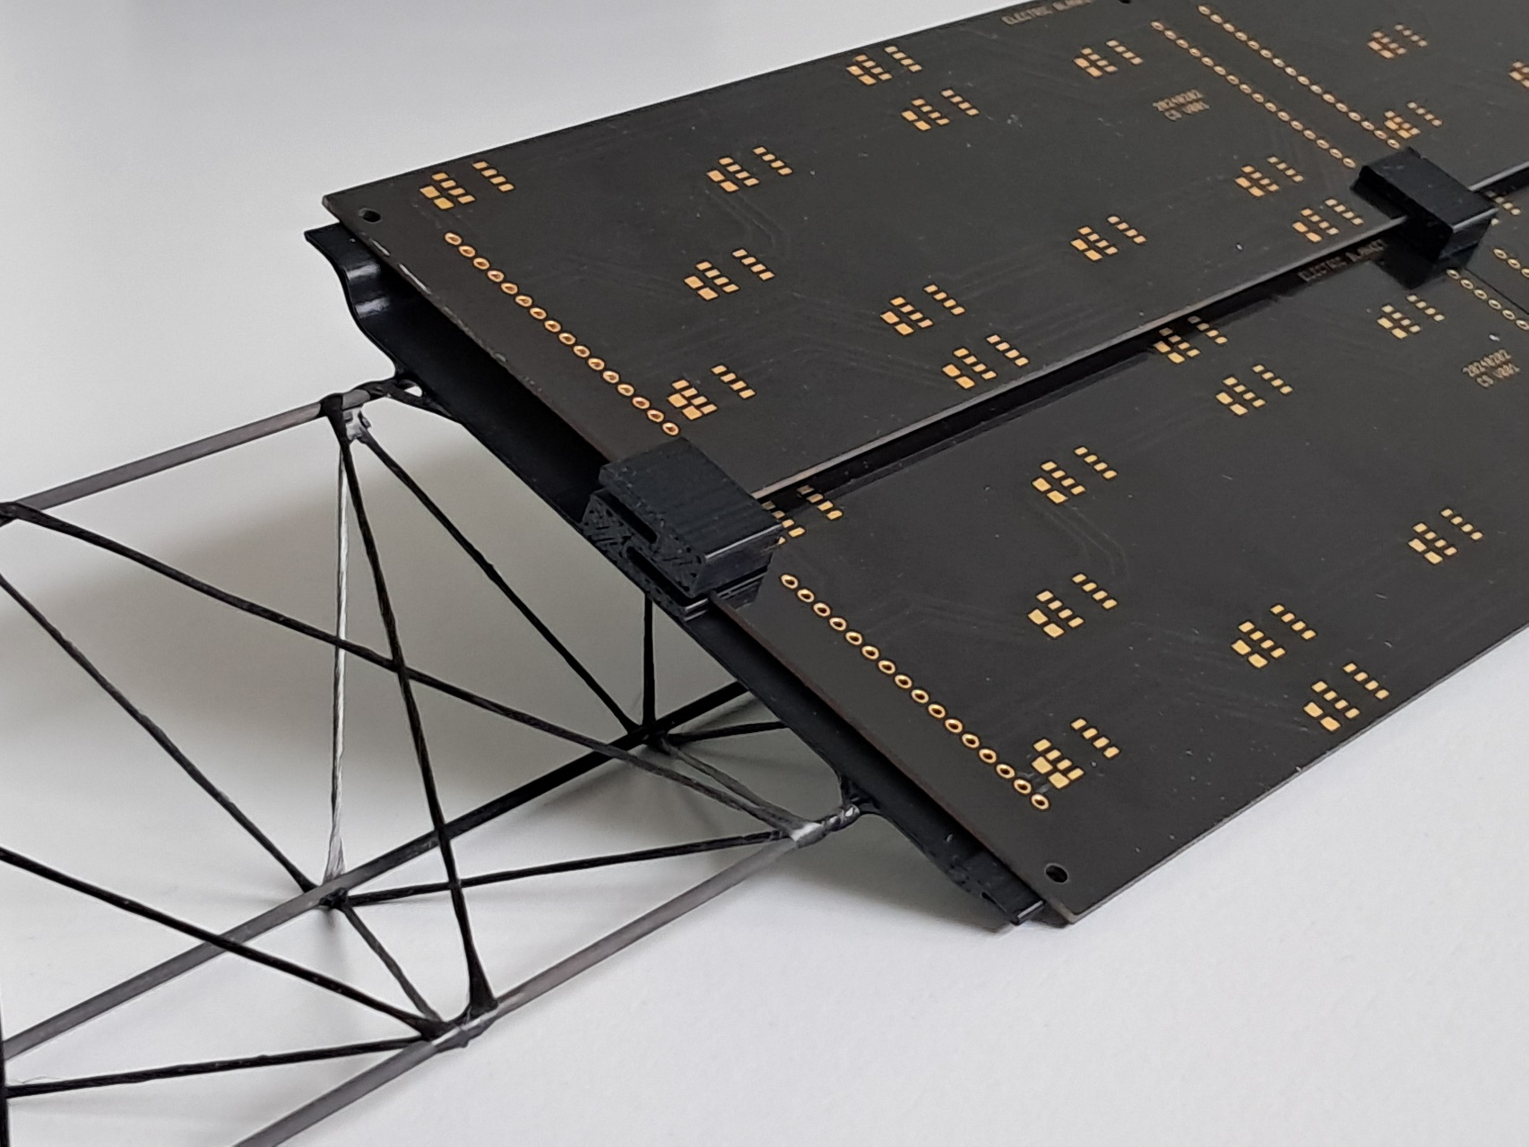
Stave design and carbon spaceframe prototype
Present idea of module fixation on spaceframe
support brackets
Brackets being glued
on to the spaceframe
Spaceframe
Dummy modules
for cooling tests
(TUM)

Slide 17
Summary
Schematic 3D model containing the layers and half barrels exists
  Design will be adapted based on further developments of OTR and surrounding detectors
  More detailed solutions (e.g. fixation of the staves, connection of the layers an barrels) will be developed
  First carbon spaceframe prototypes based on CBM STS design expected soon from ICM
  Mechanical studies und further cooling tests with ICM protos
Next steps
Continue design fixation of the sensor modules based on cooling/sensor input
Implement cooling system into spaceframe
Development of more detailed design of the detector barrel mechanics

Slide 18
Merçi beaucoup ☺

Slide 19
Backup

Slide 20
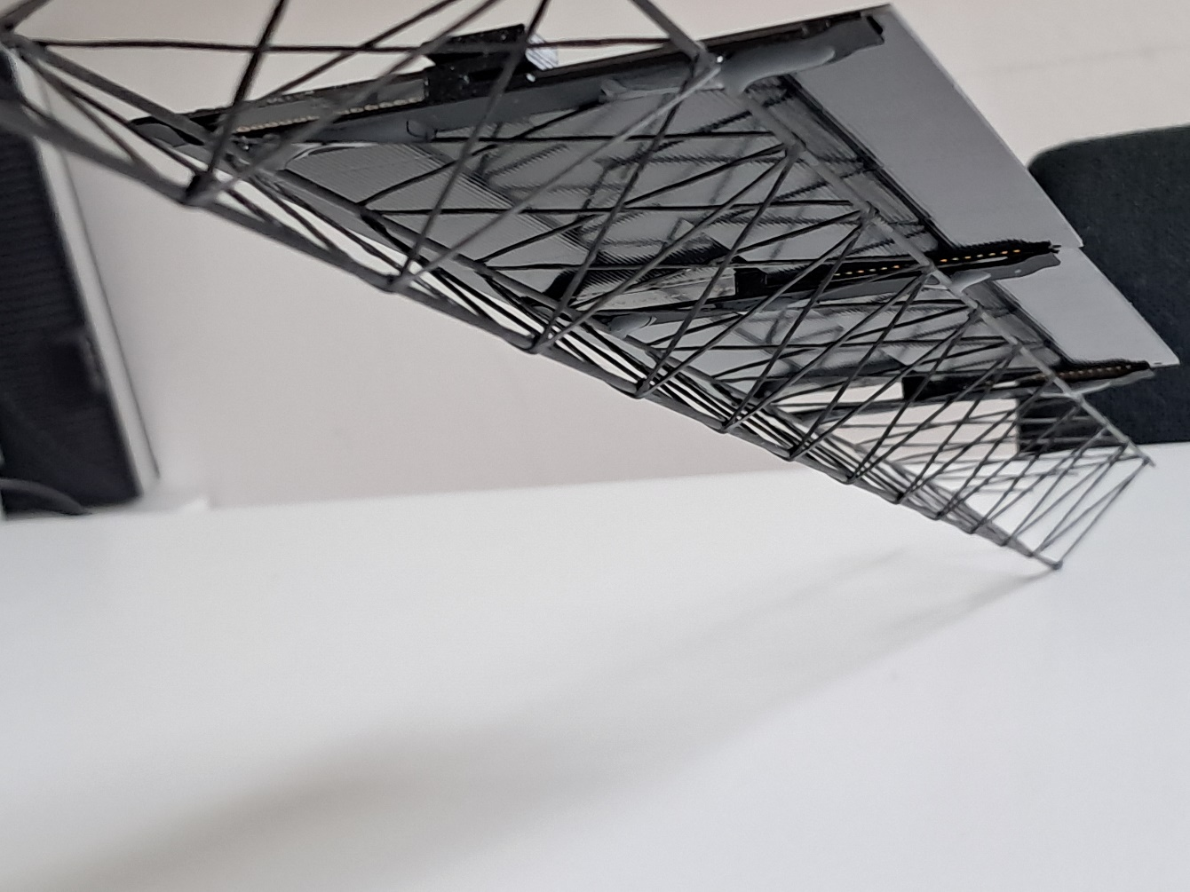
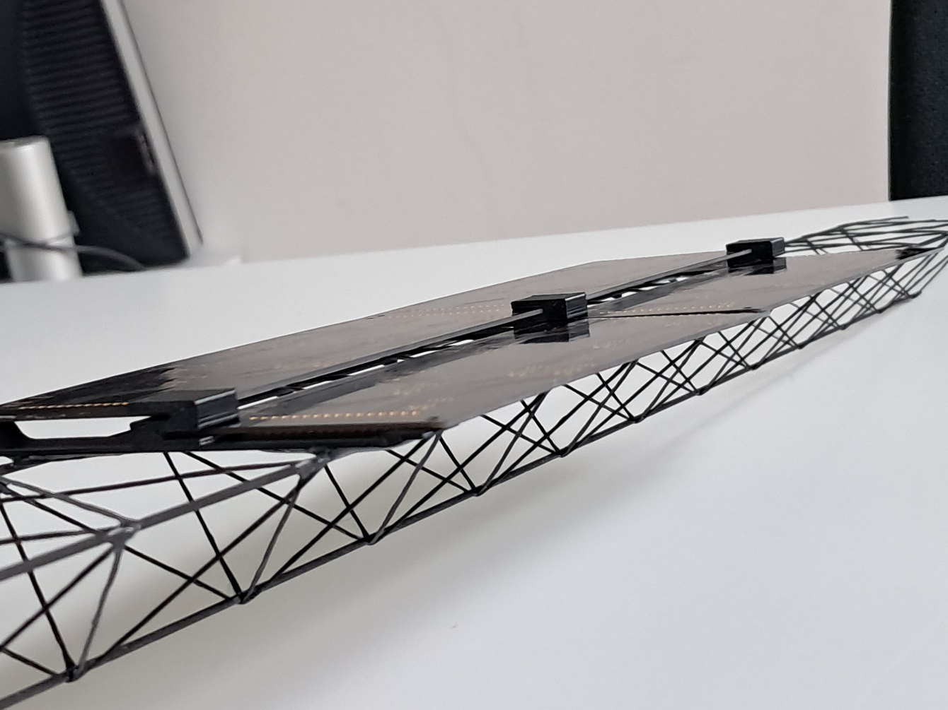
Backup slides

Slide 21
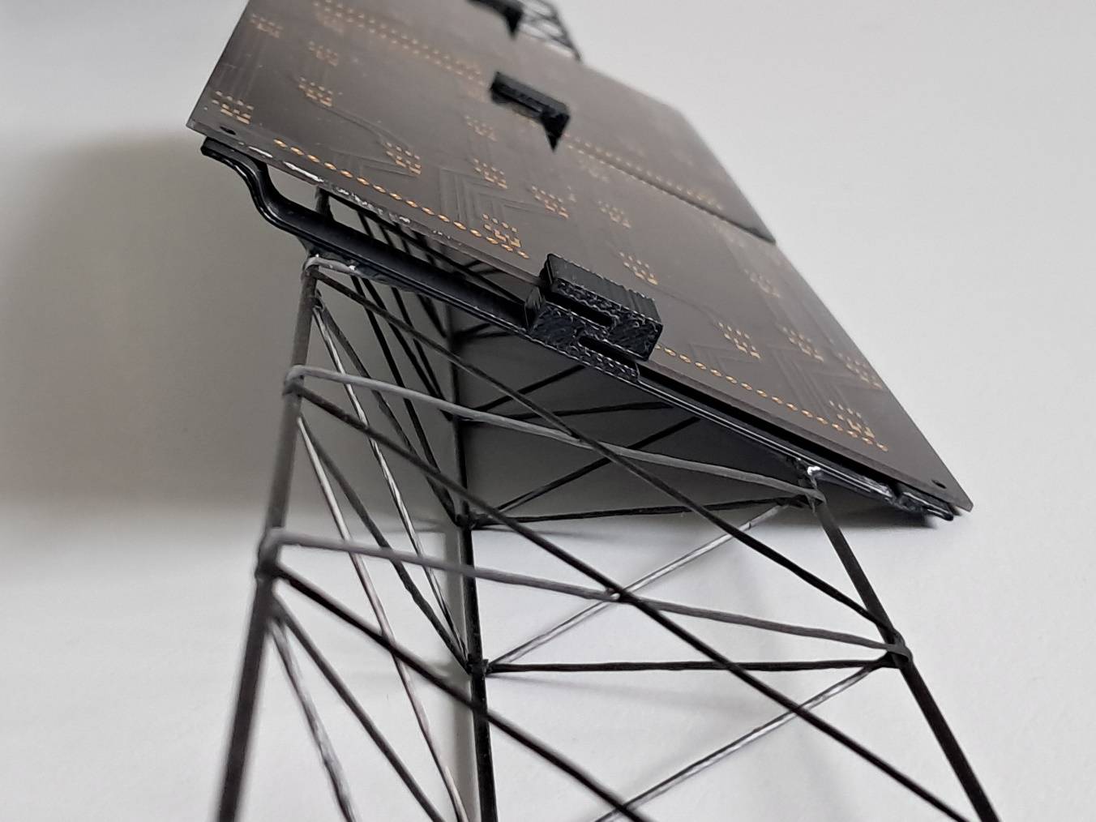
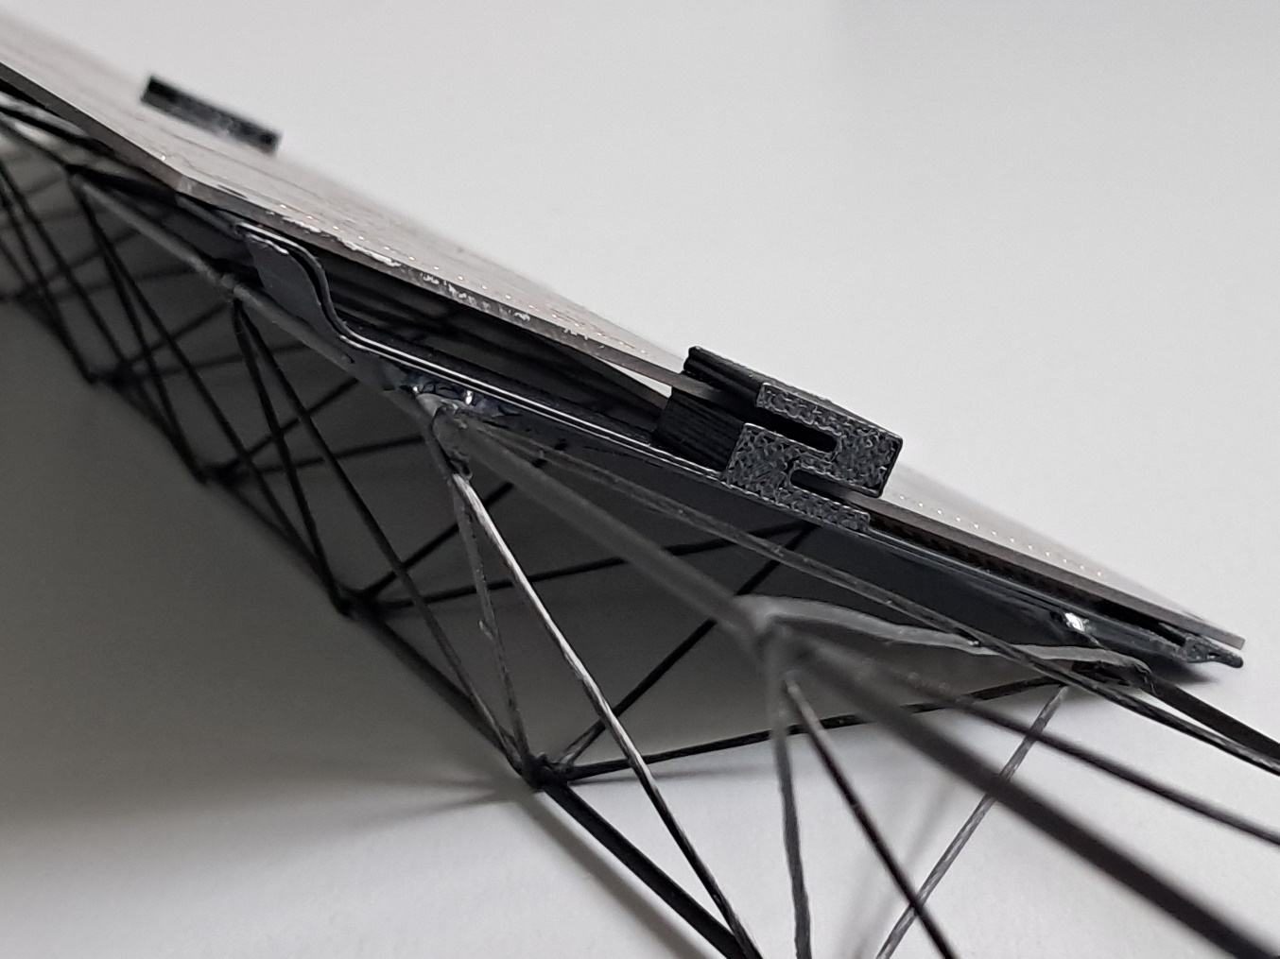
Backup slides

Slide 22
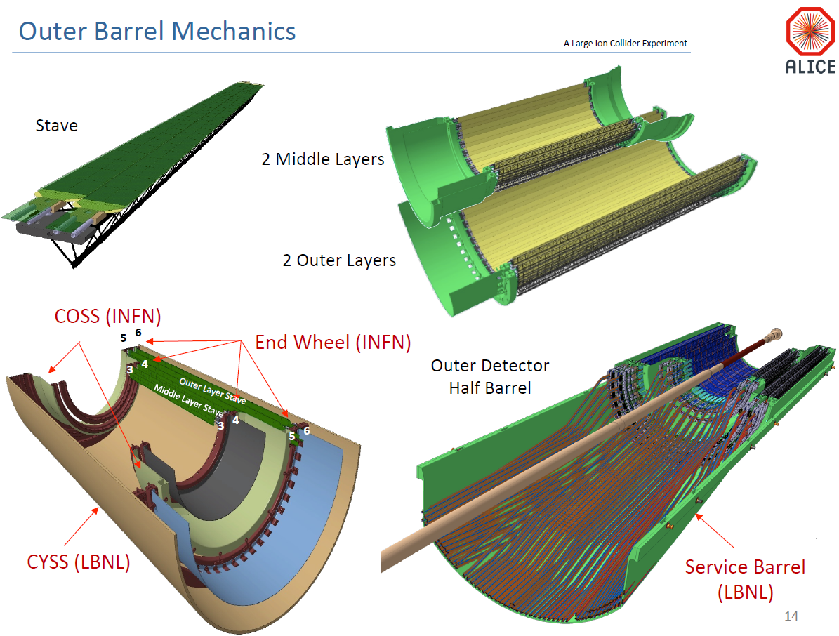
Design options for the mechanical support structure
Existing designs and solutions from ITS2 are prefered and should be implemented, if compatible to the ALICE3 requirements
Main components:
Stave
Half Layers
Half Barrels
Cylindrical Shell
Service Barrels
Difference to ITS:
Barrel is divided into two parts in beam direction
-> additional middle wheels
Vertical beam pipe support
ITS Upgrade Overview – Barrel Mechanics EDR – 20 July 2016

