Slide 1


Stress-Managed Asymmetric Common-Coils (SMACC)
D. Araujo, B. Auchmann, A. Brem, T. Michlmayr, C. Müller, A. Stampfli, J. Van den Eijnden
6th Common-Coils Joint Meeting – May 2024
Work supported by the Swiss State Secretariat for Education, Research and Innovation SERI.
This work was performed under the auspices and with support from the Swiss Accelerator Research and Technology (CHART) program

Slide 2
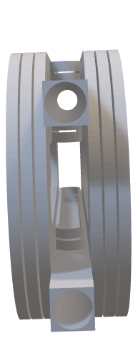
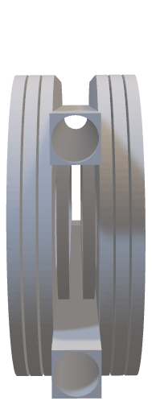
Motivation
In respect to standard common-coils magnet, we would like to:
deal with high Lorentz forces in a different way
simplify the common-coils architecture for accelerator magnets
have a full common coils architecture and reacting & winding
D. Araujo

Slide 3
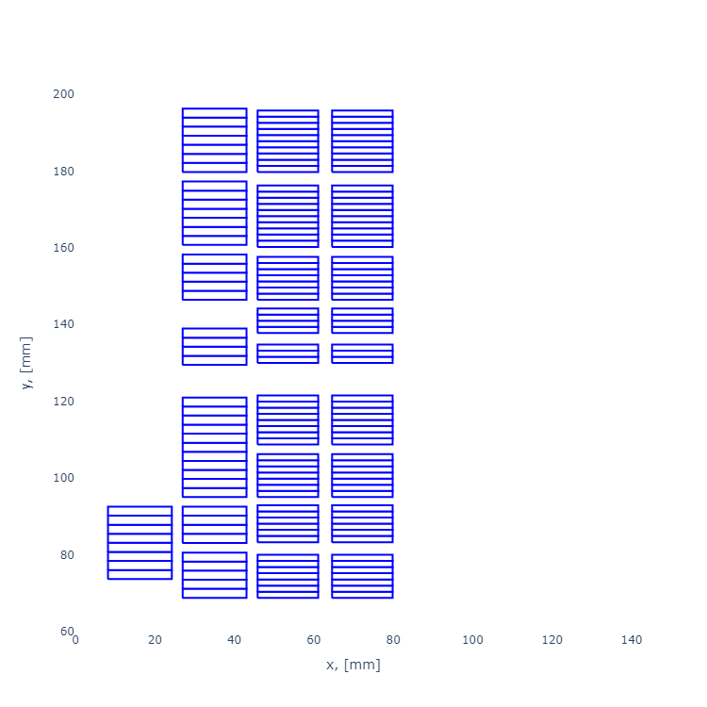
Stress-Managed Asymmetric Common-Coils (SMACC) –Nb₃Sn – hf_3
Layers | 1 | 2 | 3 | 4
Wire type | Nb₃Sn RRP® 162/169 | Nb₃Sn RRP® 162/169 | Nb₃Sn RRP® 78/91 | Nb₃Sn RRP® 60/91
N wire x dia in mm | 26 x 1.1 | 26 x 1.1 | 40 x 0.7 | 40 x 0.7
Cu/nCu | 0.9 | 0.9 | 1.2 | 1.8
Bare Cable dimensions in mm* | 15.77 x 2.06 | 15.77 x 2.06 | 14.94 x 1.3 | 14.94 x 1.3
Insulation thickness in mm | 0.155 | 0.155 | 0.155 | 0.155
Number of turns | 8 | 43 | 62 | 62
* Does not include Rutherford cable core
1 2 3 4
D. Araujo

Slide 4
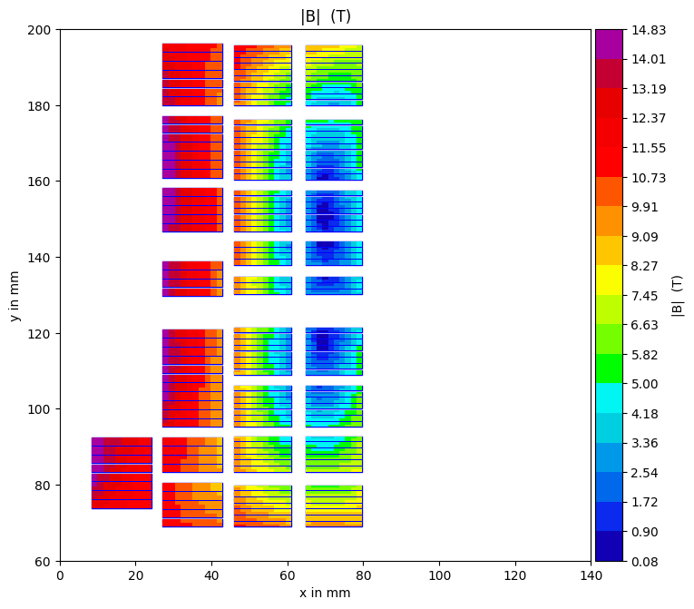
Stress-Managed Asymmetric Common-Coils (SMACC) – Nb₃Sn – hf_3
1 2 3 4
B₀ in T | E_{op} in MJ/m | T_{op} in K | % Margin | I_{op} in kA
14 | 2.94 | 4.22 | 9.8 | 14.77
Layer | B_{peak} in T | % Margin | J_{sc} in A/mm² | J_{cu} in A/mm² | J_{ov} * in A/mm²
1 | 14.83 | 9.80 | 1135.8 | 1261.2 | 389.5
2 | 14.81 | 9.91
3 | 11.24 | 11.68 | 2110.8 | 1759.0 | 605.7
4 | 9.78 | 13.98 | 2686.5 | 1492.5
* Including insulation area
D. Araujo

Slide 5
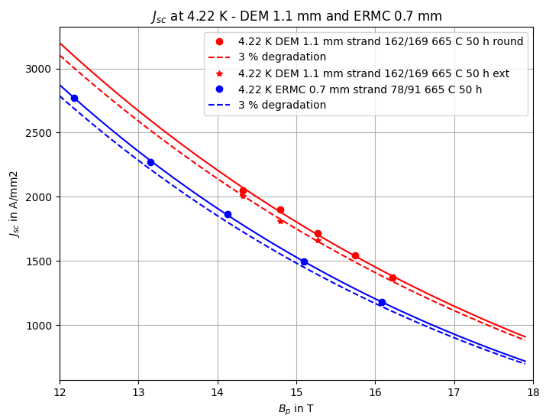
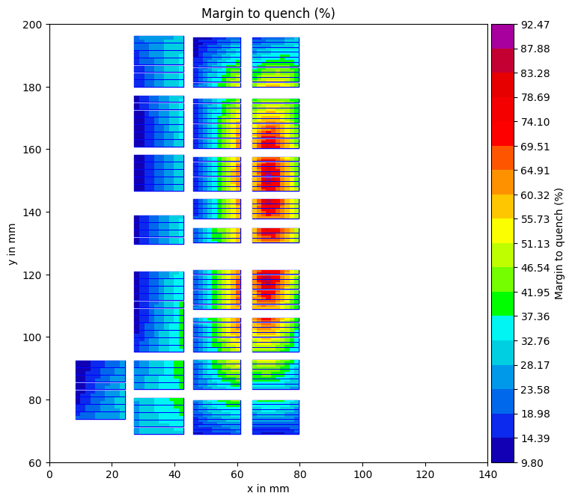
Stress-Managed Asymmetric Common-Coils (SMACC) – Nb₃Sn – hf_3 - 14 T
High-Field (1 and 2) and Low-Field (3 and 4) Jc fitting
The same Jc fitting is used for ERMC and DEM-0.7
D. Araujo

Slide 6
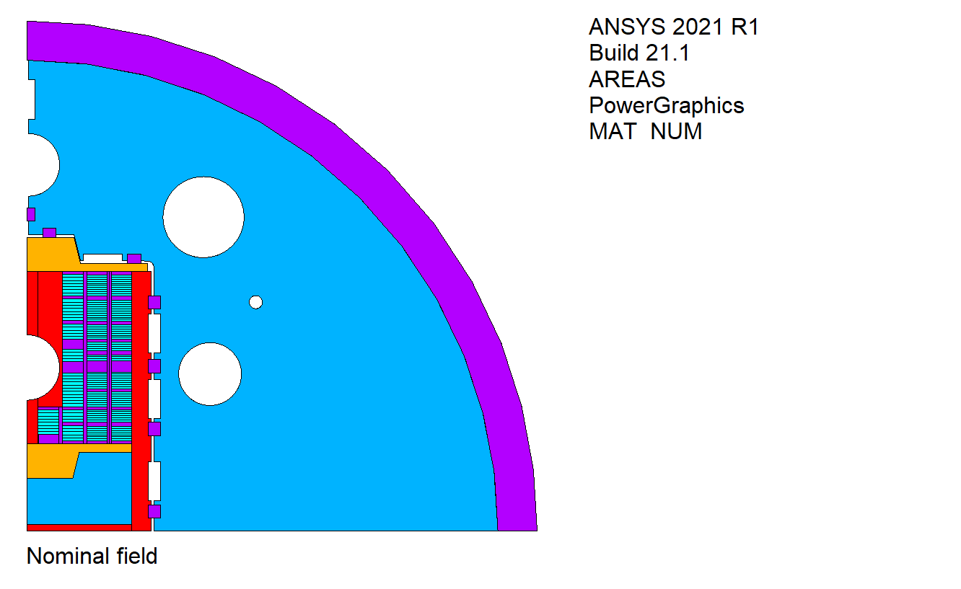
Stress-Managed Asymmetric Common-Coils (SMACC) - Cross-Section
The asymmetric common-coils magnet has an intra-beam distance of 250 mm, 50 mm bore, yoke diameter of 660 mm and 30 mm thick stainless-steel shell.
The magnet has 4 different types of coils (layer 1, layer 2, layer 3 and 4)
and 8 coils in total (for a double aperture magnet). The coils are placed
in the stress-management formers. The preload is transferred
towards the inner-most layers through the ribs.
The iron pole, combined with the asymmetric concept, helps on the
balance vertical force balance.
The magnet concept is based on bladder & keys technology for room
temperature preload.
D. Araujo

Slide 7
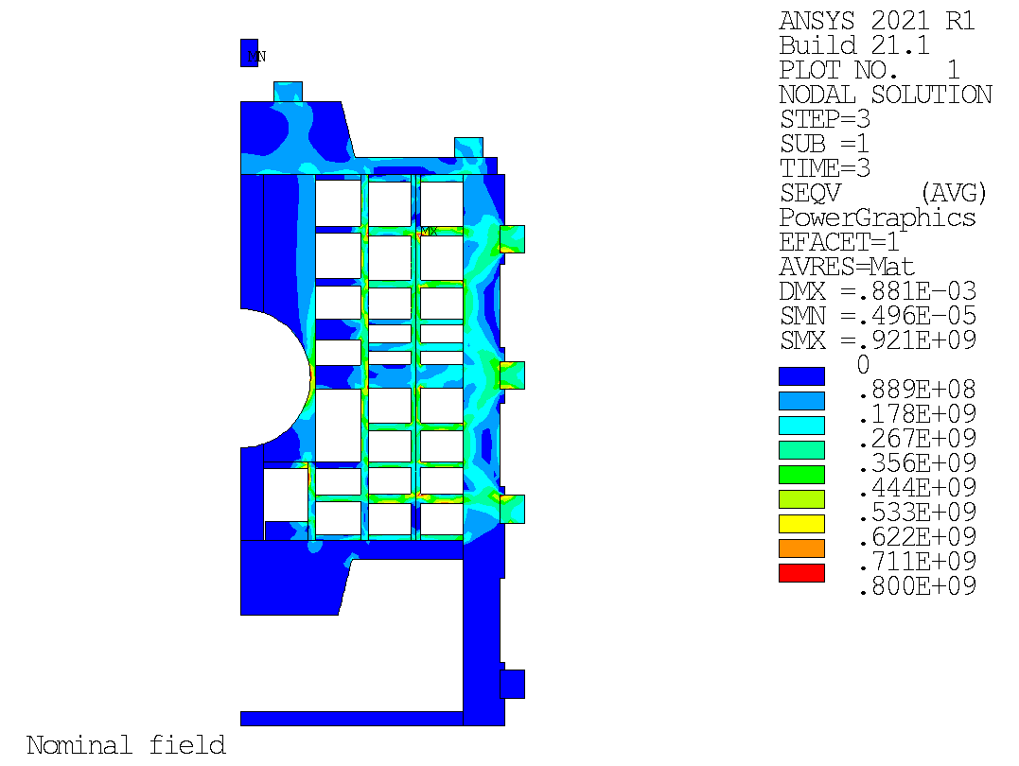
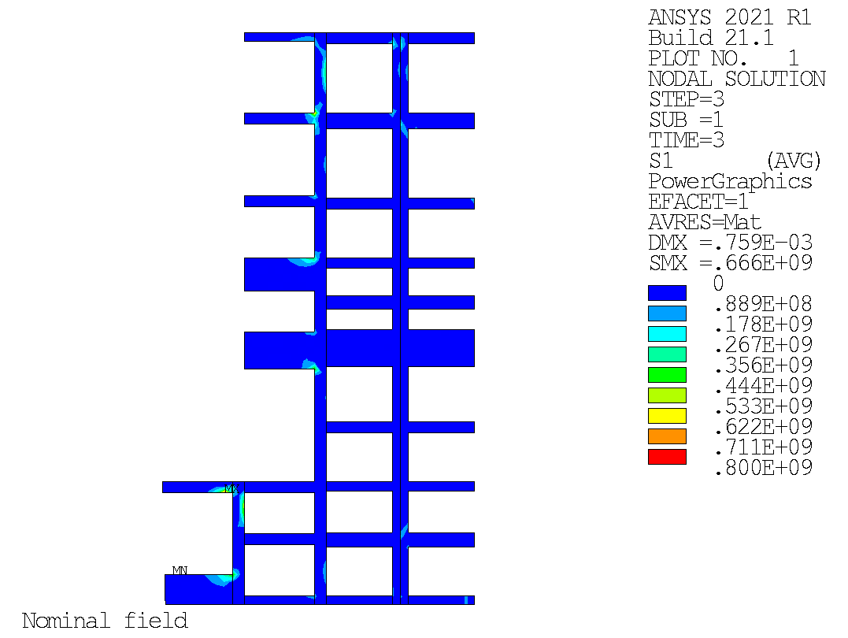
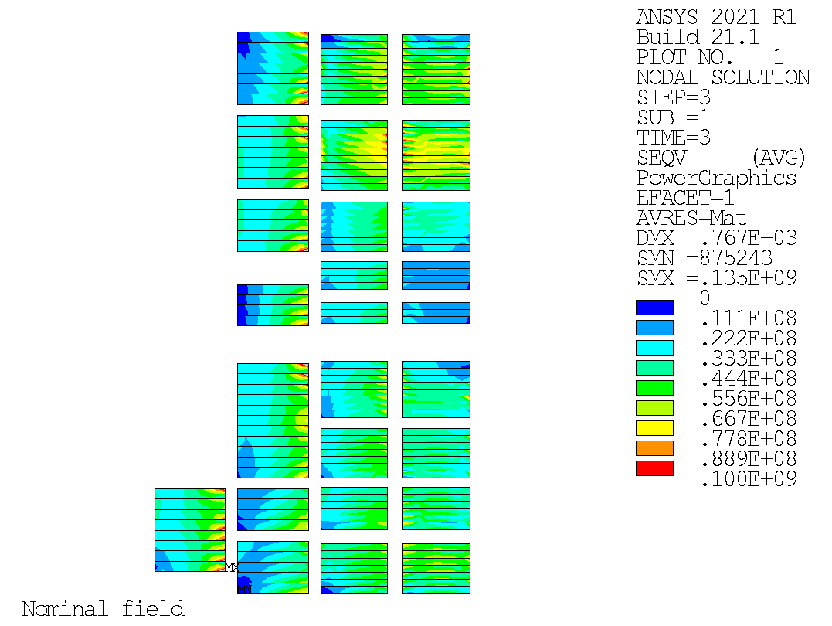
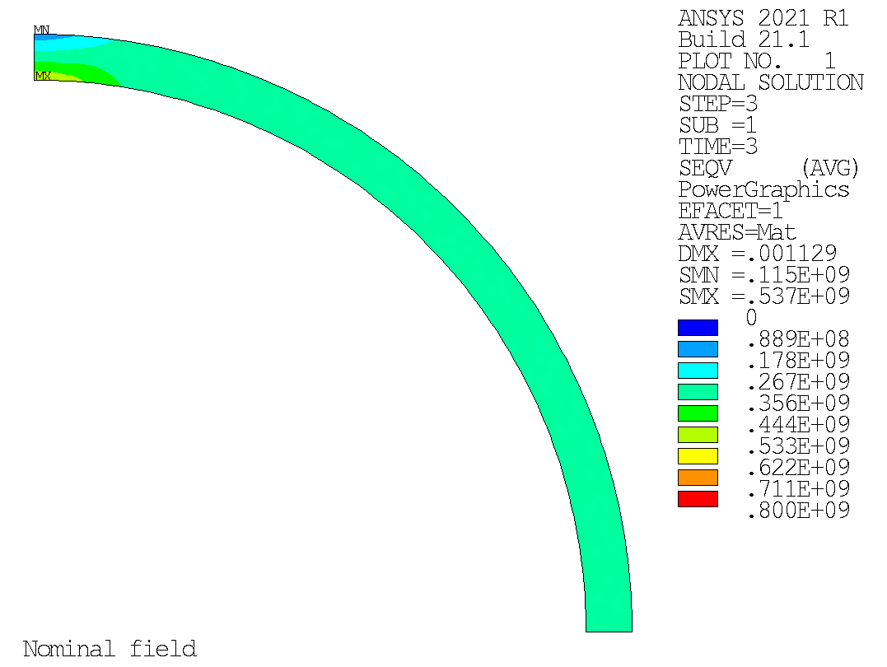
Mechanical Analysis
Von-Mises
S1
Von-Mises
Hoop Stress
D. Araujo

Slide 8
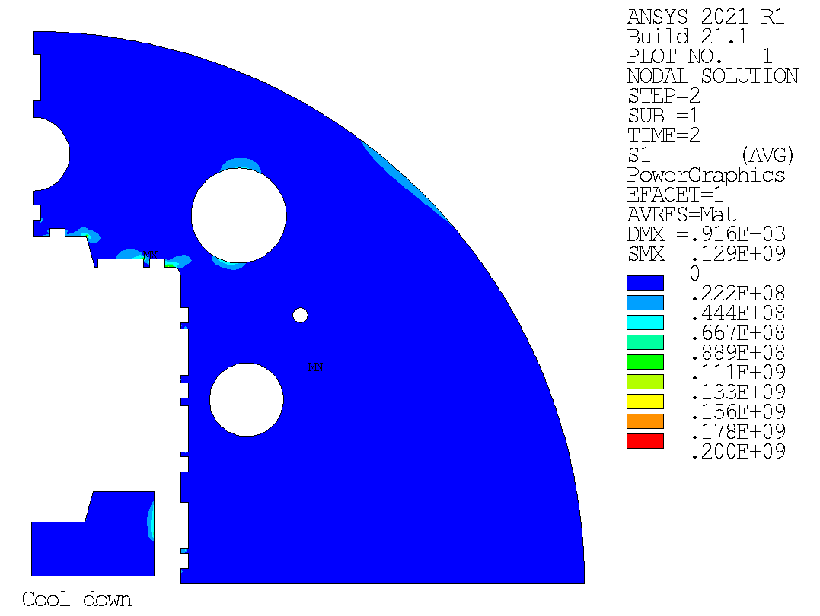
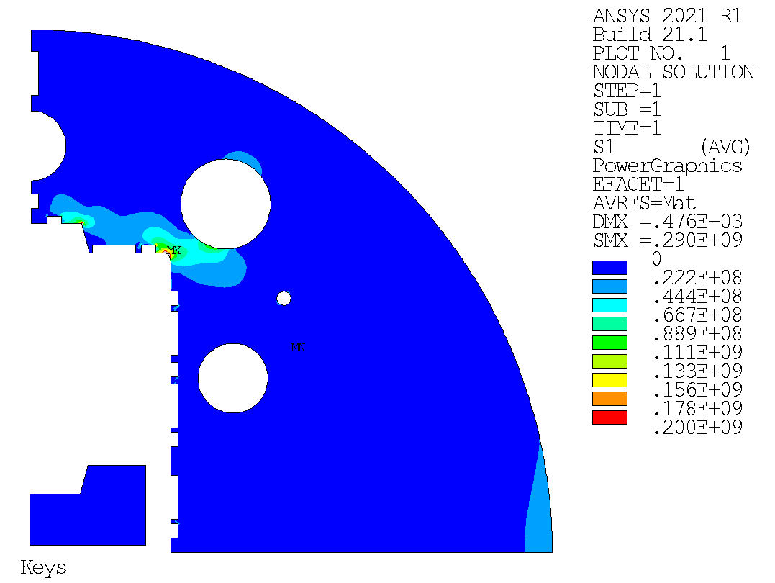
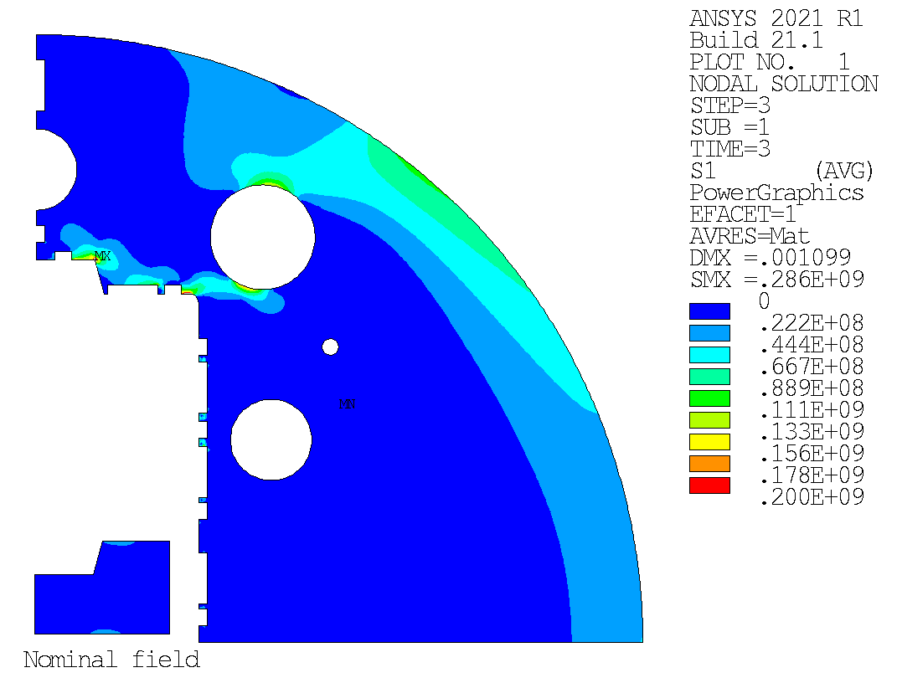
Mechanical Analysis
Maximum
principal stress
D. Araujo

Slide 9
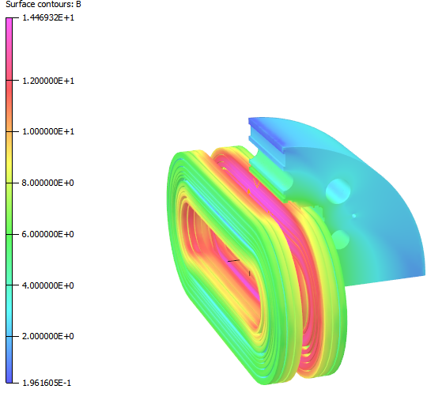
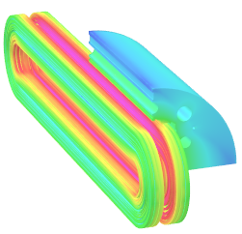
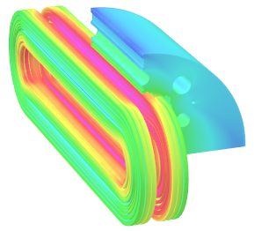
3D Magnetic Analysis – I_{op} = 14.77 kA
B₀ in T | B_{p} in T | L_{ss} in mm
13.81 | 14.47 | 500
B₀ in T | B_{p} in T | L_{ss} in mm
13.98 | 14.70 | 1000
B₀ in T | B_{p} in T | L_{ss} in mm
14.01 | 14.71 | 1500
2D without self-field | B₀ in T | B_{p} in T
14 | 14.00 | 14.56

Slide 10
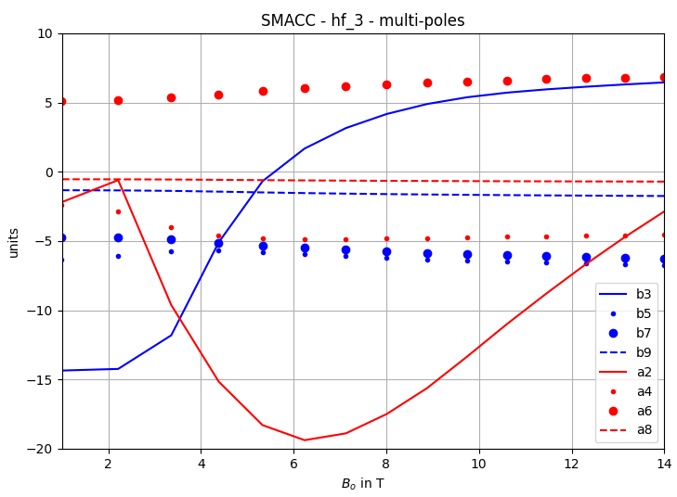
3D Magnetic Analysis – Multi-poles
Multi poles | 2D | L_{ss} = 500 mm | L_{ss} = 1000 mm | L_{ss} = 1500 mm
b3 | +6.45 | +5.84 | +6.29 | +6.36
b5 | -6.75 | -7.10 | -6.94 | -7.00
b7 | -6.25 | -6.45 | -6.30 | -6.38
b9 | -1.75 | -1.82 | -1.72 | -1.74
a2 | -2.87 | -16.95 | -5.86 | -4.58
a4 | -4.55 | -4.50 | -4.39 | -4.40
a6 | +6.85 | +6.91 | +6.82 | +6.83
a8 | -0.71 | -0.73 | -0.76 | -0.82
-14.08 | -2.99 | -1.71
2D

Slide 11
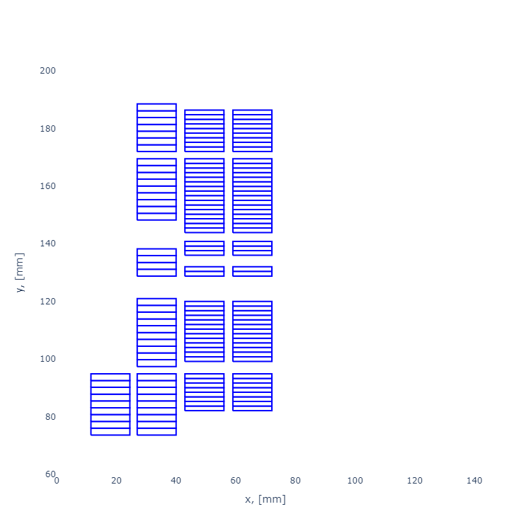
SMAAC 14 T and 13 T @ 4.5 K 9.5 – 10% margin
SMACC HF 3
SMACC LF 2

Slide 12
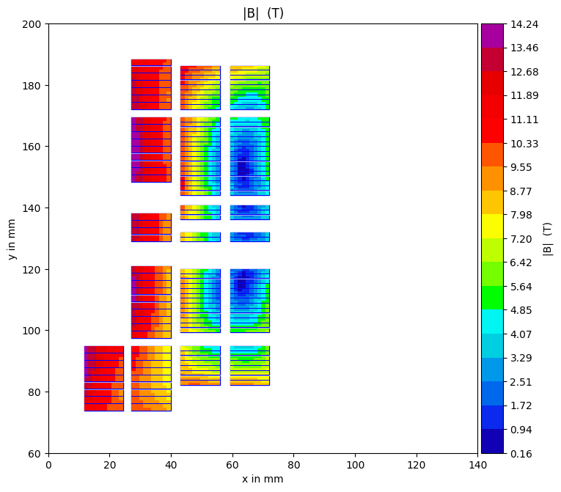
SMAAC 14 T and 13 T @ 4.5 K 9.5 – 10% margin
SMACC HF 3
SMACC LF 2

Slide 13
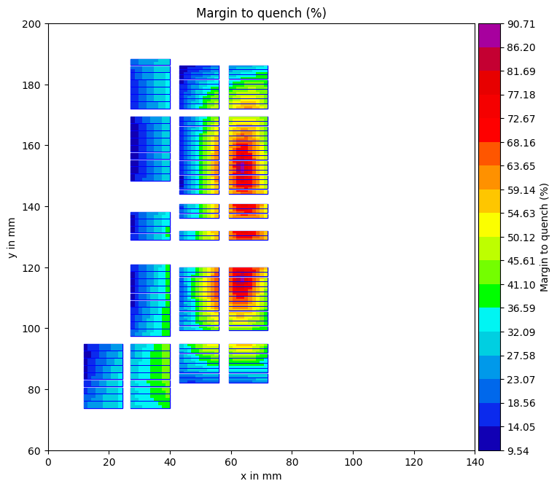
SMAAC 14 T and 13 T @ 4.5 K 9.5 – 9.8% margin
SMACC HF 3
SMACC LF 2

Slide 14
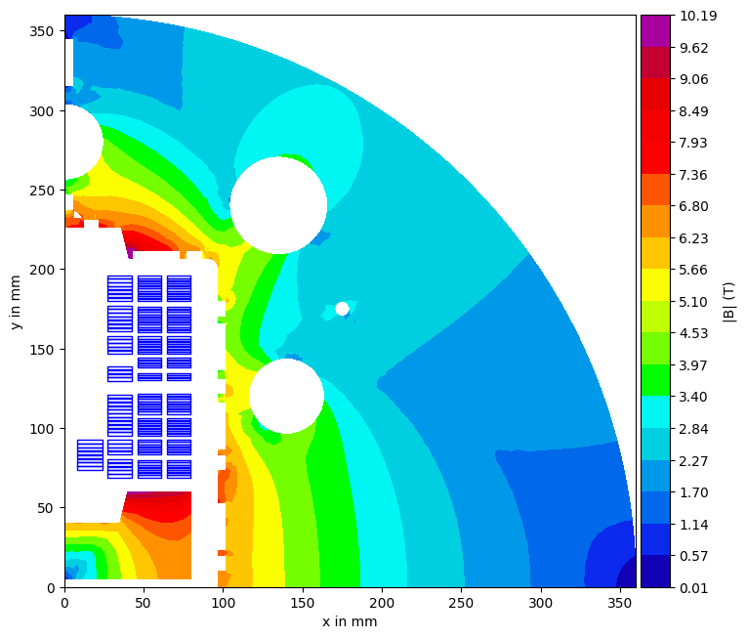
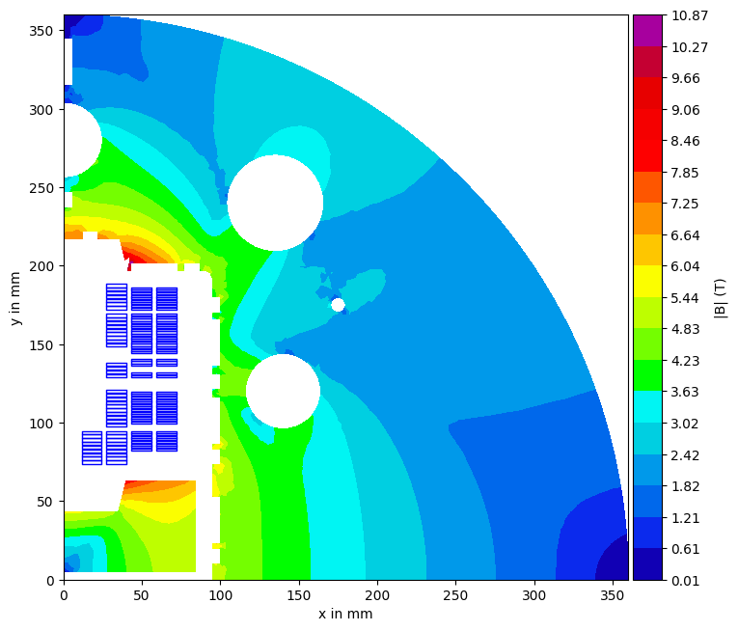
SMAAC 14 T and 13 T @ 4.5 K 9.5 – 10% margin
SMACC HF 3
SMACC LF 2
Re-use shell, rods, bladders, keys
re-machine yoke

Slide 16
Stress-Managed Asymmetric Common-Coils (SMACC) –Nb₃Sn – hf_3 - 14 T
Ribs and spar thickness were optimized for mechanics.
|B| including self-field
D. Araujo

Slide 17
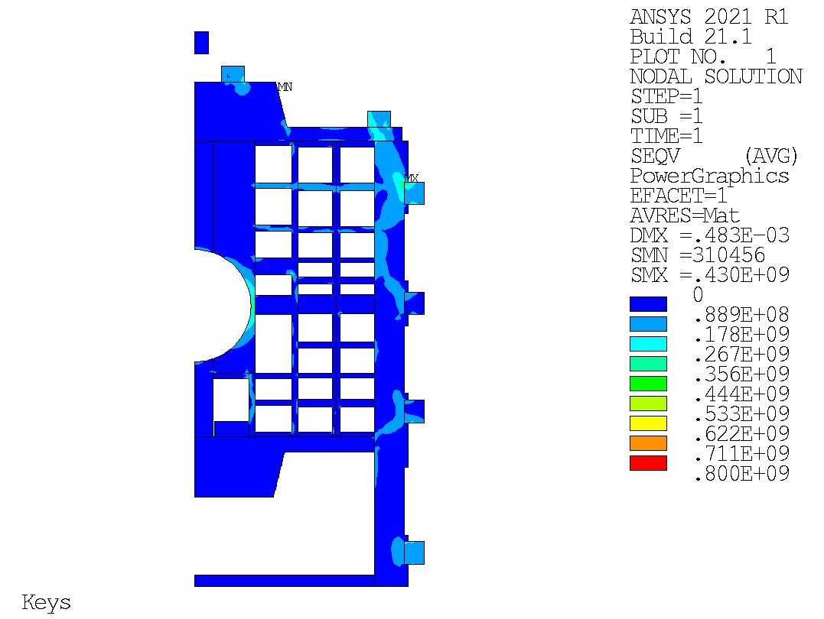
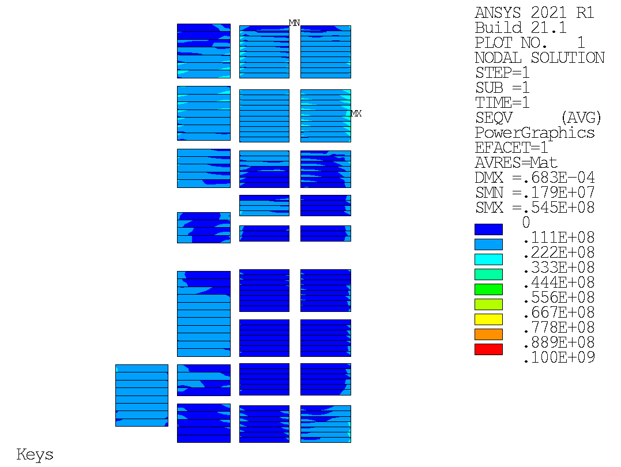
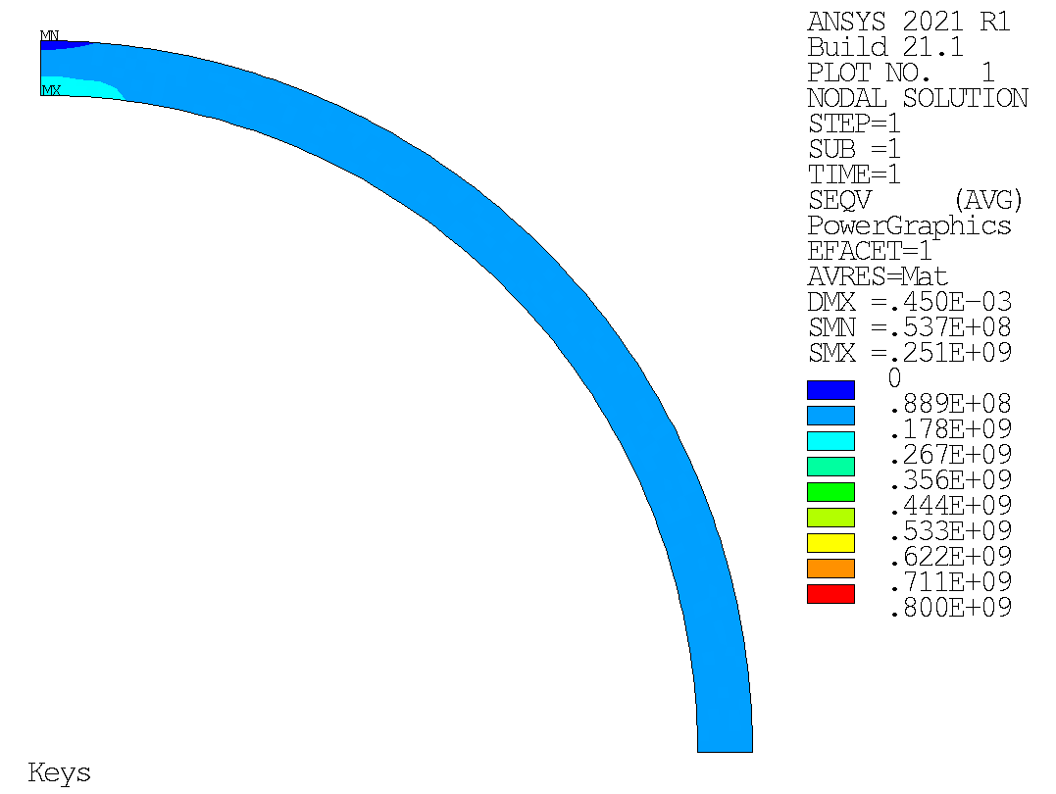
Mechanical Analysis
Von-Mises
Pre-load with 0.5 mm interference on the keys.
Von-Mises
Hoop Stress
D. Araujo

Slide 18
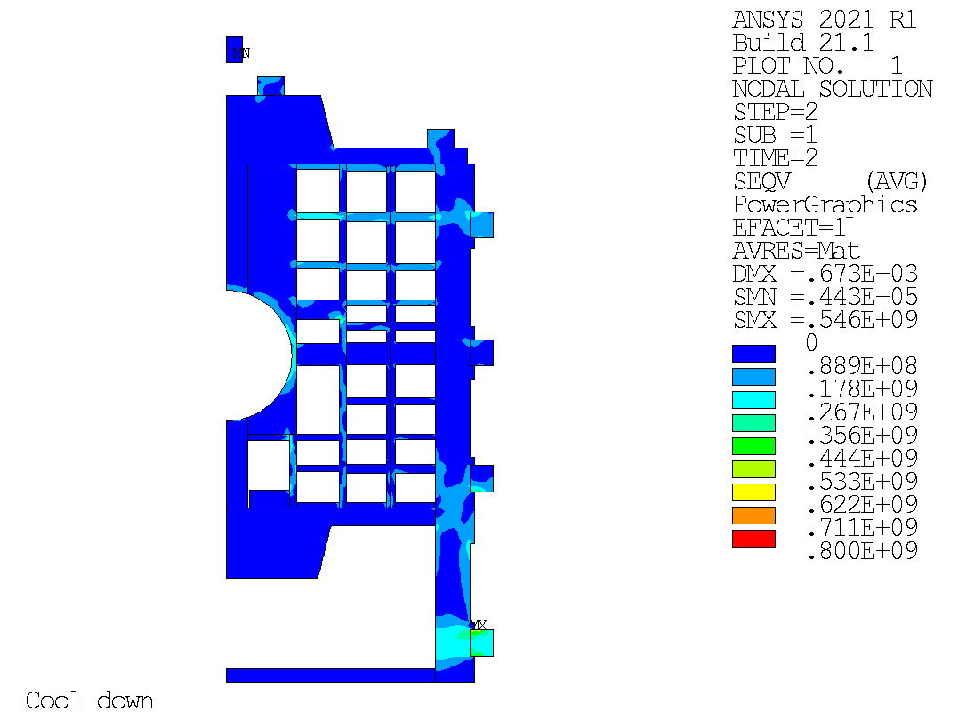
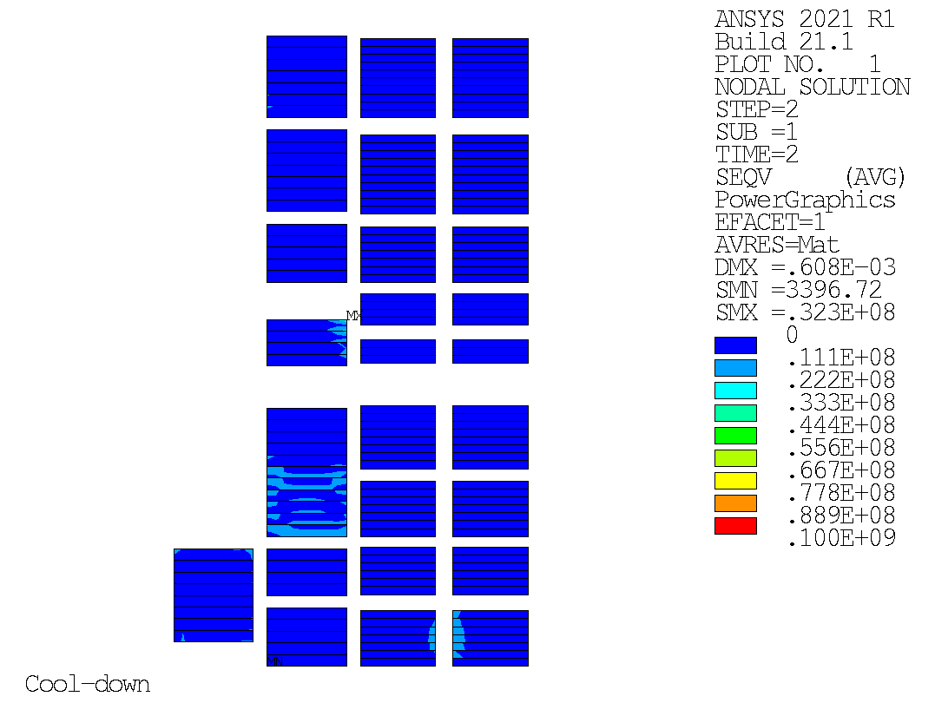
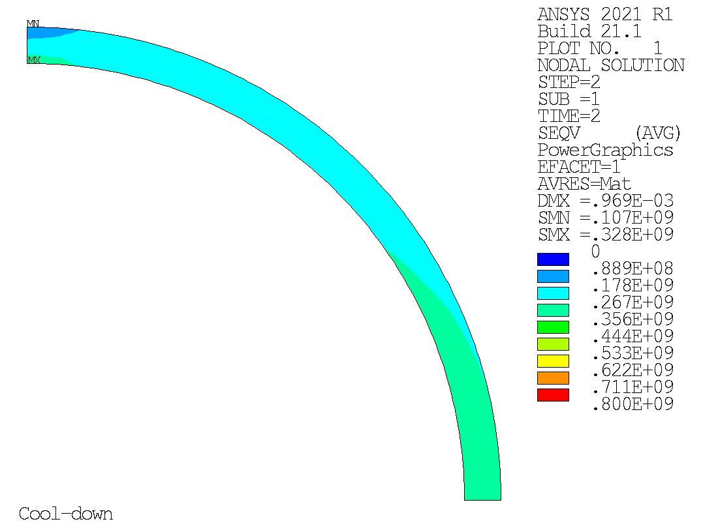
Mechanical Analysis
Von-Mises
Von-Mises
Hoop Stress
D. Araujo

Slide 19
Mechanical Analysis
14 T operation
Stress on coils: 135 MPa on corners, other else < 100 MPa
> 30% engineering margin on the peak of stress regions.
Von-Mises
D. Araujo

Slide 20
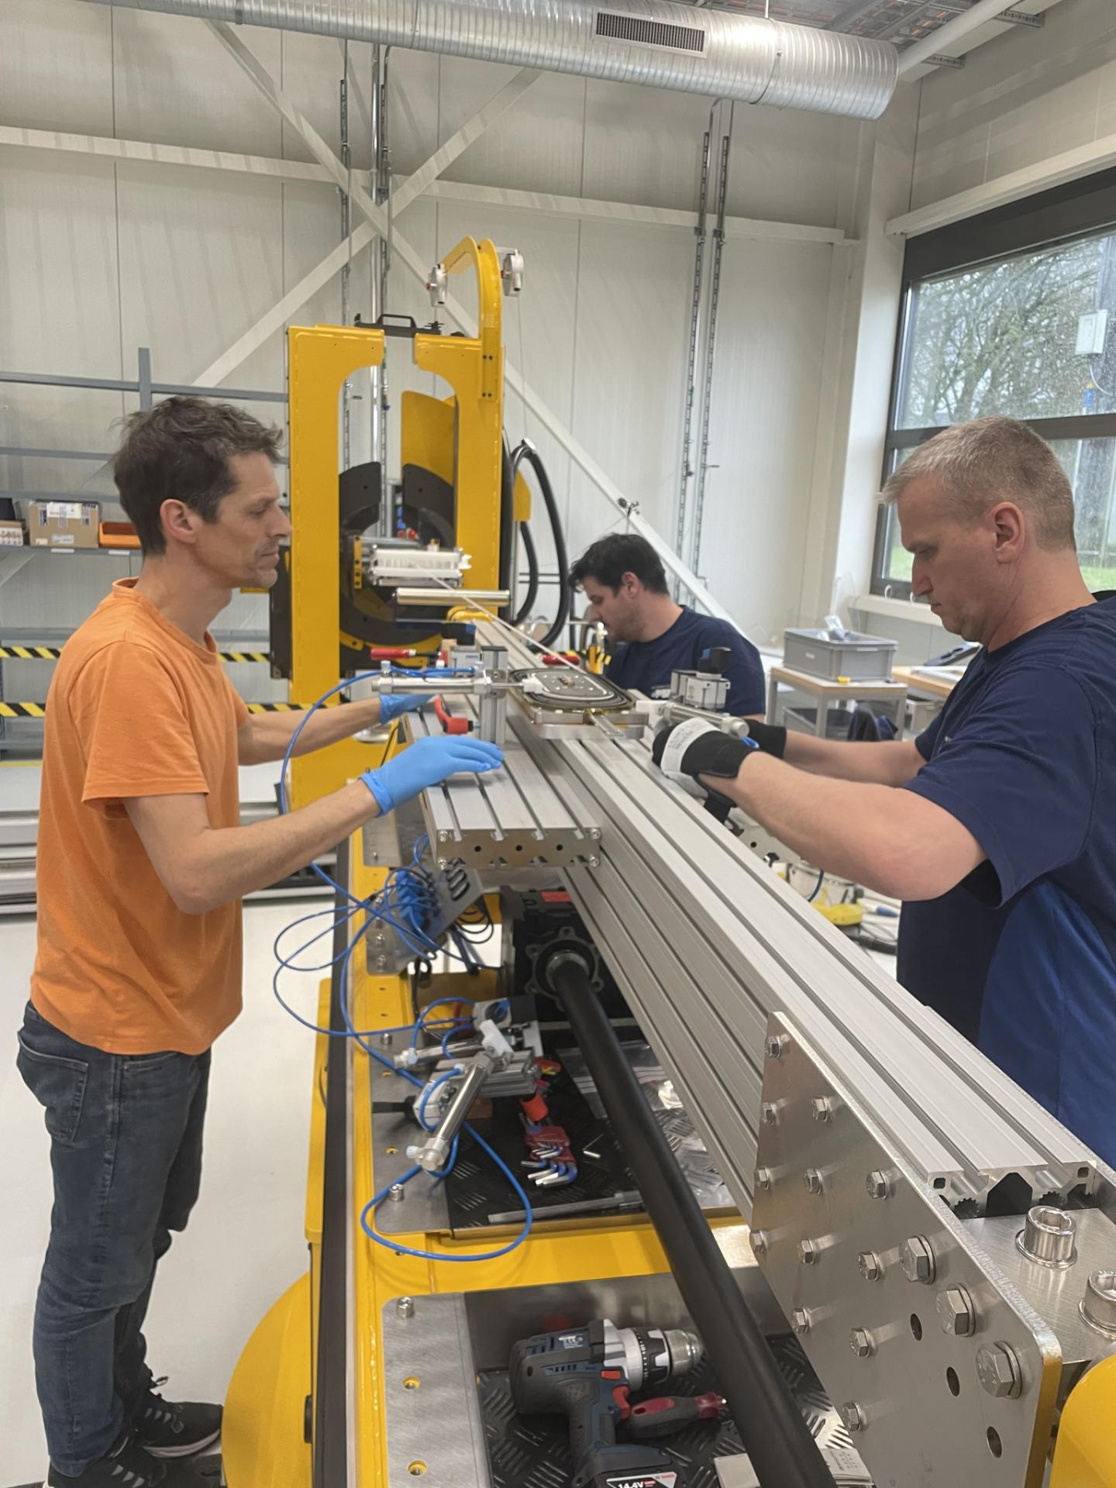
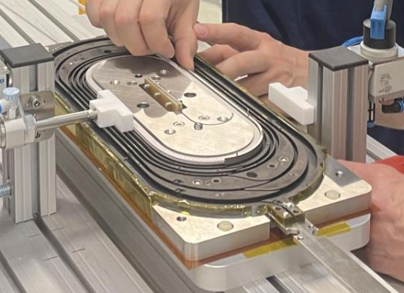
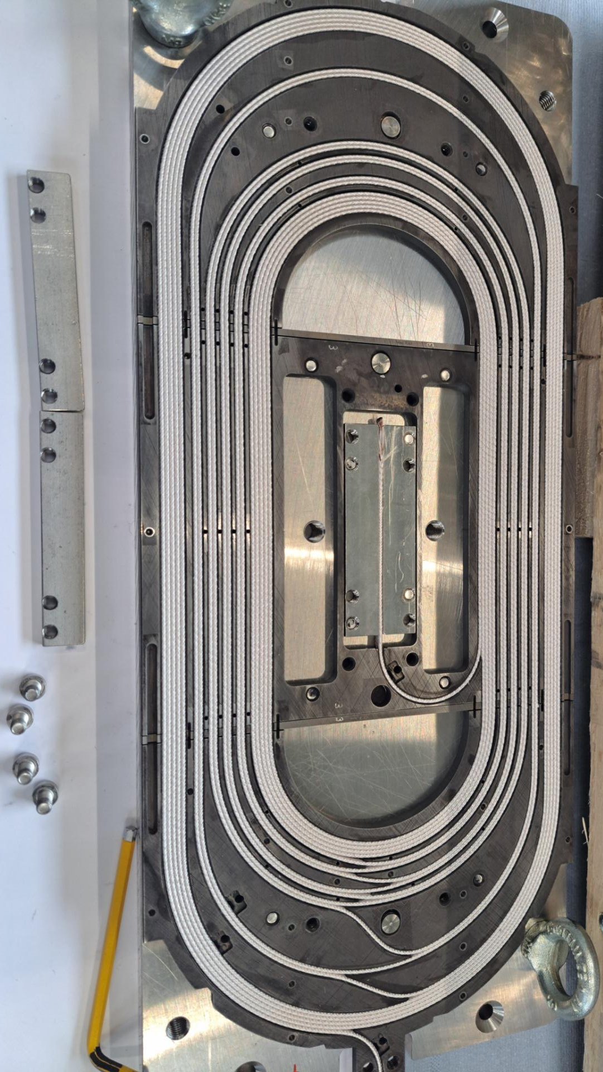
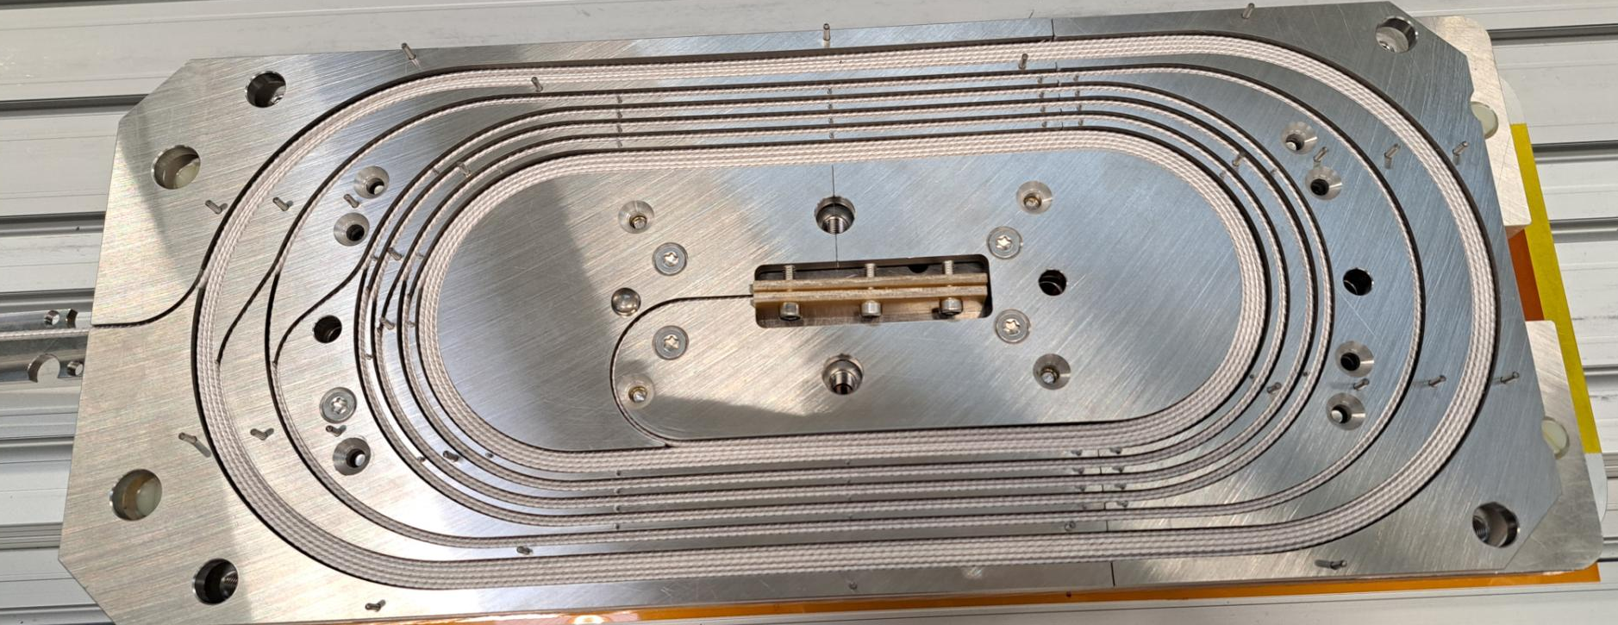
Subscale – Winding
spool
After 1st coil block
rib
former
Rotating beam
Before pushing down
After pushing down

Slide 21
D. M. Araujo

Slide 22
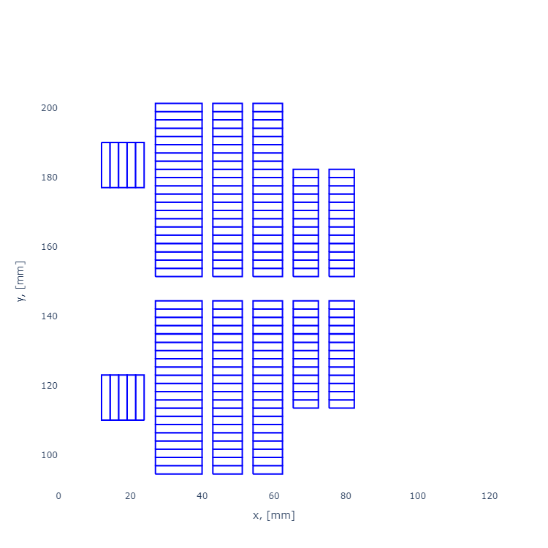
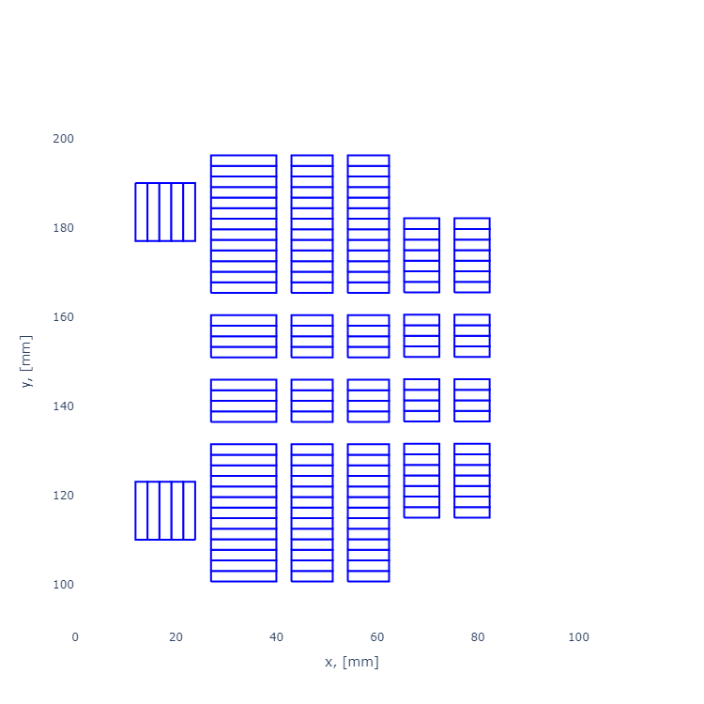
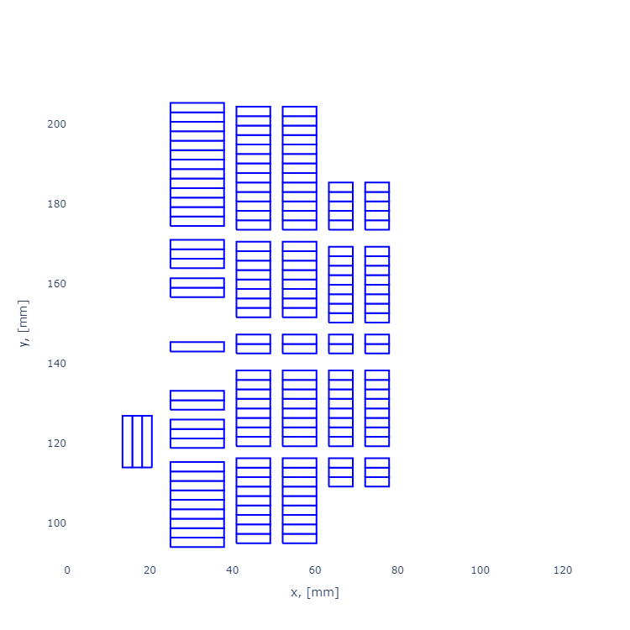
Magnetic Design
Let’s consider two typical common-coils turns distribution, with racetracks on the top and bottom of apertures for field quality correction (a and b). C shows a third design without racetracks / clover-leaf coils, with an additional common-coil on the hard-way bend direction.
a: racetracks / clover-leaf coils and wide blocks
b: racetracks / clover-leaf coils and thin blocks
c: only common-coils and thin blocks
Stress-management with spars, but high vertical load
Stress-management with spars and ribs
Asymmetric design

