Slide 1
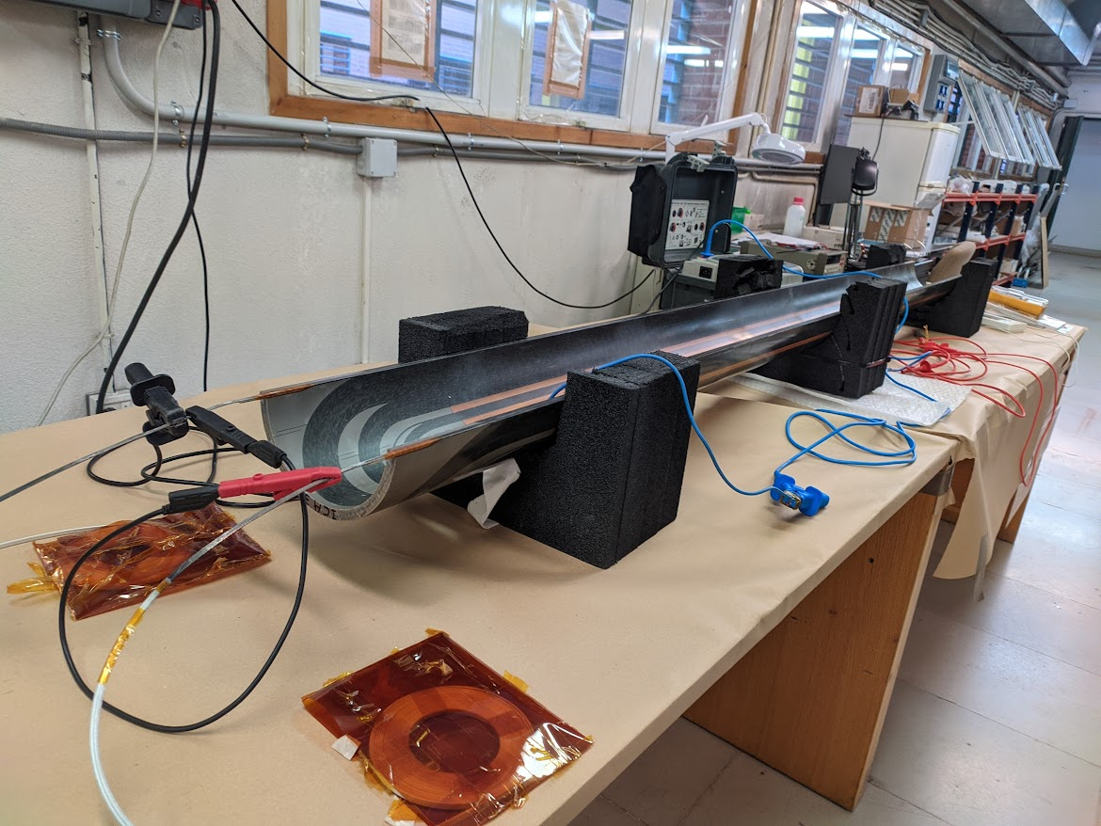
Electrical Tests on MCBXF Coils
M. Domínguez, F. Toral (CIEMAT)

Slide 2
Outline
Before starting the tests
DC Resistance test
Insulation test
Impedance test: frequency sweep

Slide 3
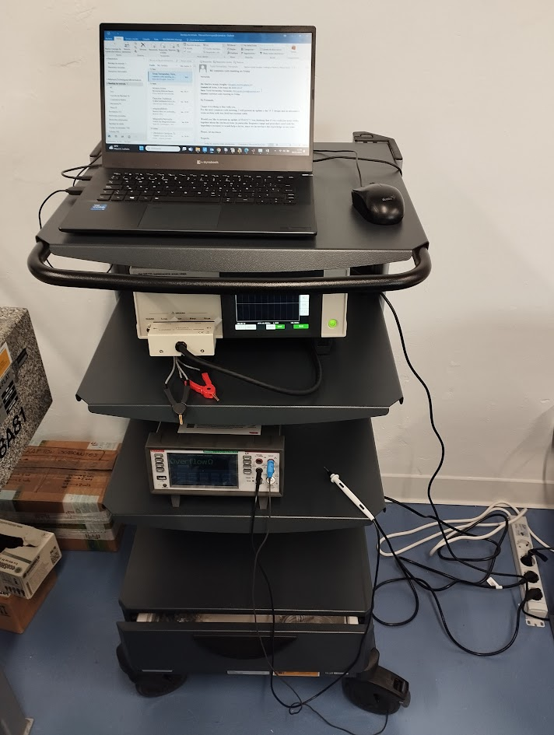
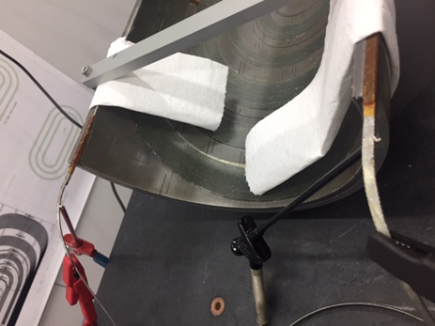
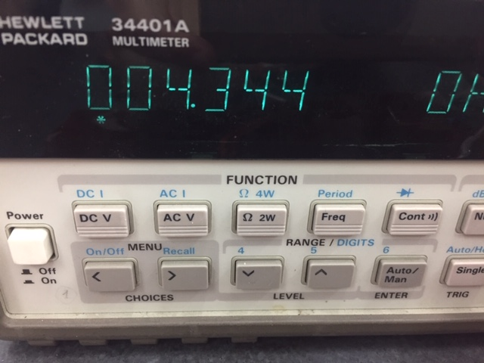
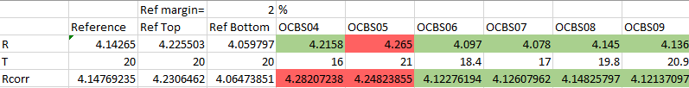
Electrical Tests
Before starting the tests:
  Coils should be thermally stabilized: 6h at 22±2 degrees
  Celsius and RH < 60%
  Measuring equipment switched on one hour in advance
  Coil current leads should be kept away from each other
  and properly insulated to avoid undesired electrical contacts
RDC: DC resistance test
  4-wire R measurement usually enough
  For very low R, a current source should be used (usually 1A)

Slide 4
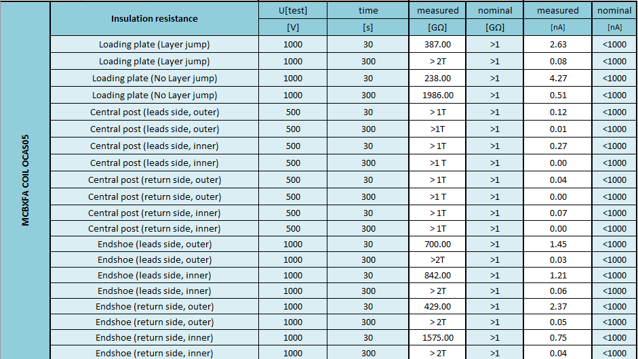
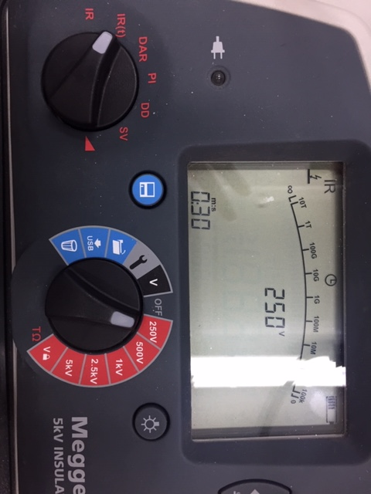
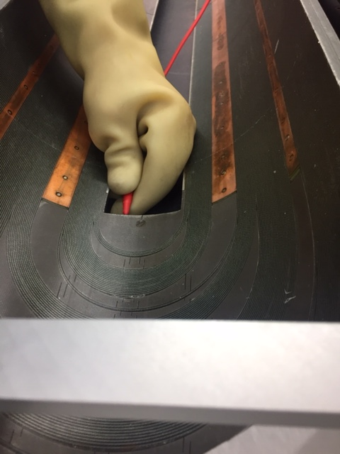
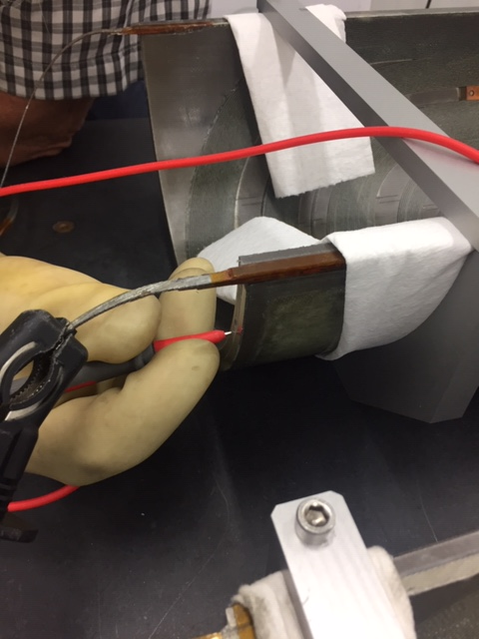
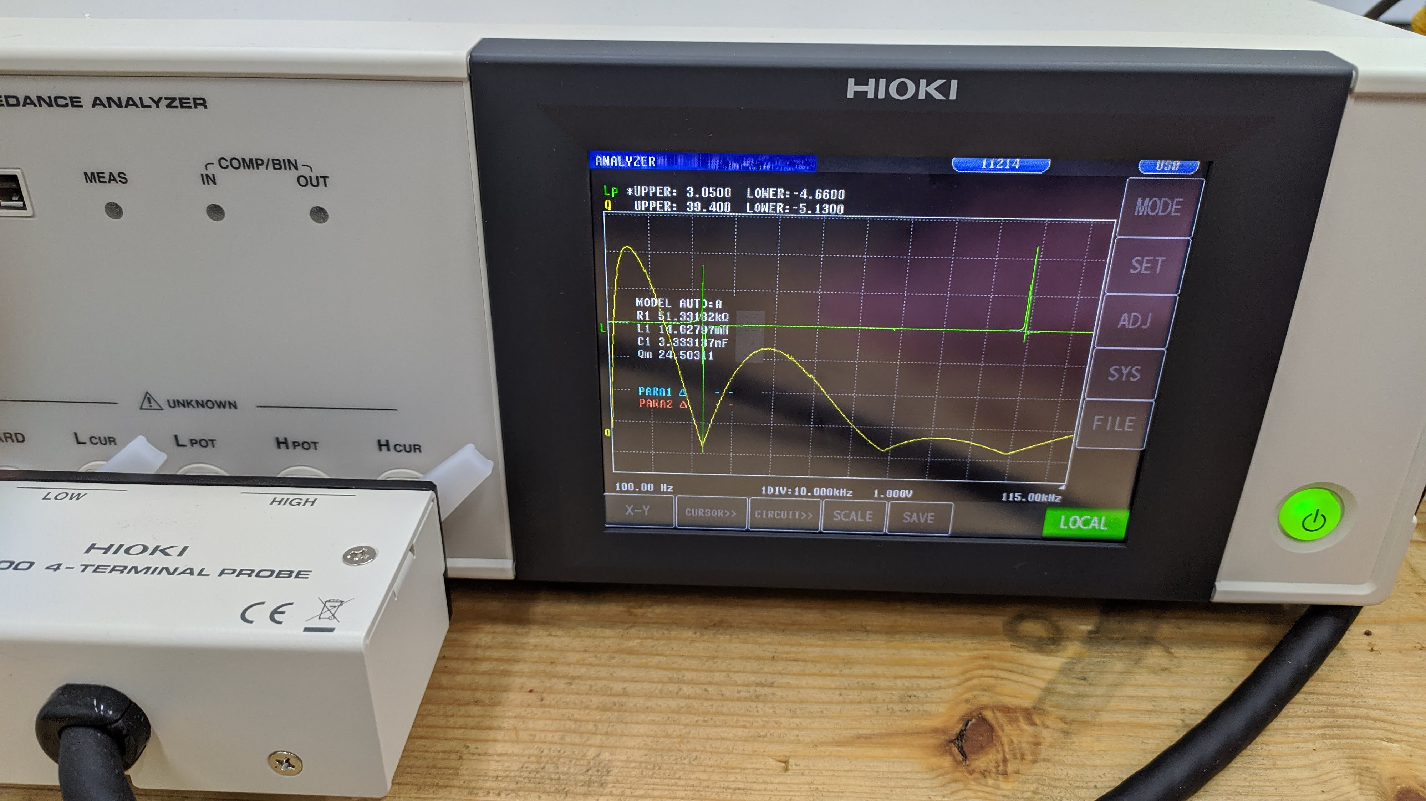
Electrical Tests
Insulation
  HV test: Megger. With MCBXF up to 1000V
  Test all the accessible metallic parts versus the coil to assure a correct insulation
  30 seconds (Leakage + Polarization currents) and 300 seconds (Leakage current) tests
Impedance measurements
  Impedance Analyser Hioki IM3570
  We apply a frequency sweep (variable frequency
  sinusoidal signal) from 100 Hz to 100 KHz
  Maximum voltage 5V peak to peak…
  …and few mA: extremely safe test!
  Objective: find the resonant frequencies
  Measured parameters: L and Q (Quality factor)

Slide 5

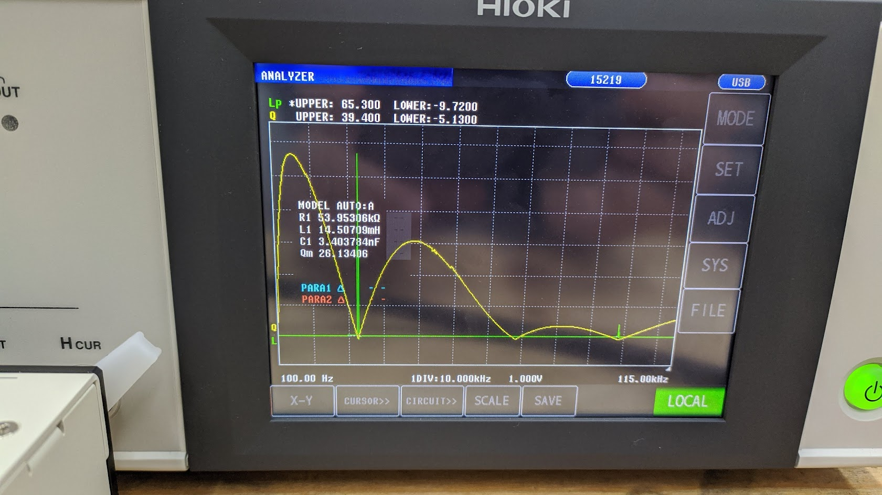
Electrical Tests
Why are the resonance peaks so important?
  The peaks are very narrow, happening at a very specific frequency, any little change in the coil characteristics will change them in a perceptible way
  “This is a coil… There should be only L!!!!”
  The ideal coil does not exist, so we have indeed several C’s: capacitance to ground, inter-turn capacitance, inter-layer capacitance, etc. This is why we can see several resonance peaks
  “Those C’s should be negligible!!!!”
  That is only true at very low frequencies. At high frequencies they can even have a higher value than the actual L
  How do we find them?
    L parameter (green): Zero crossing
    Q parameter (yellow): graph minimums
    (reaches zero). Much easier to detect

Slide 6
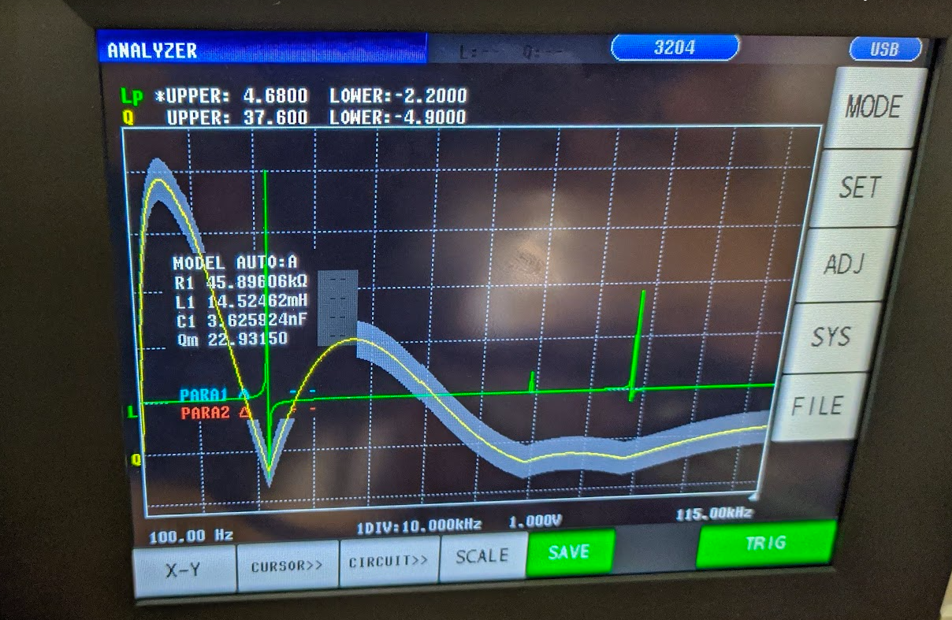
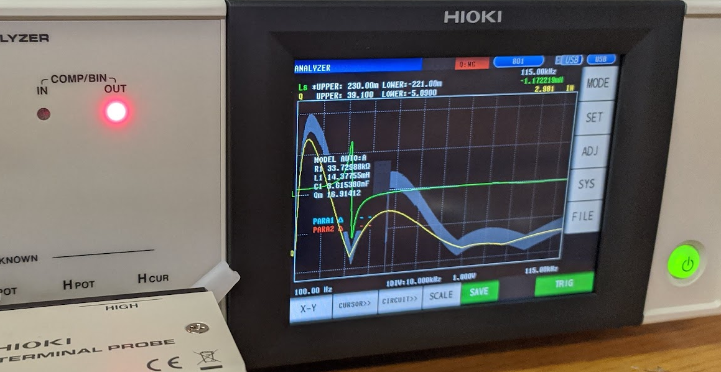
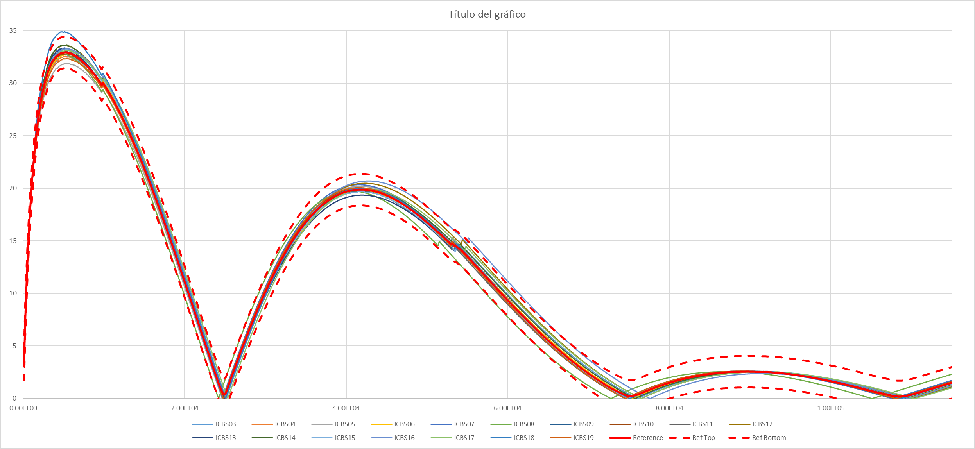
Electrical Tests
The quality factor (Q) of a coil is very sensitive to an inter-turn short circuit:
This is mainly a comparative test. Database with reference and window margin to compare results
Sound coil
Short-circuited coil

Slide 7
Thank you for your attention!

