Slide 1



ENTSO-E Research, Development, and Innovation Committee (RDIC) WG5 (Digitalization) Meeting
Welcome to CERN
European Network of Transmission System Operators for Electricity
Enrico Chesta
12/09/24

Slide 2
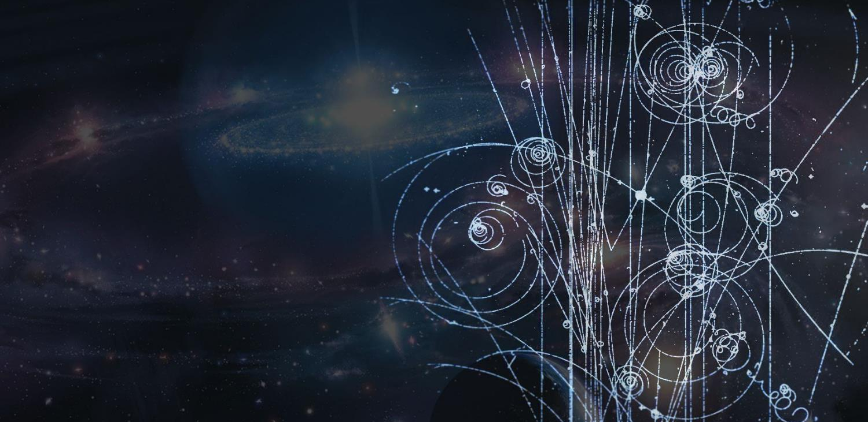
A (short) introduction to CERN

Slide 3
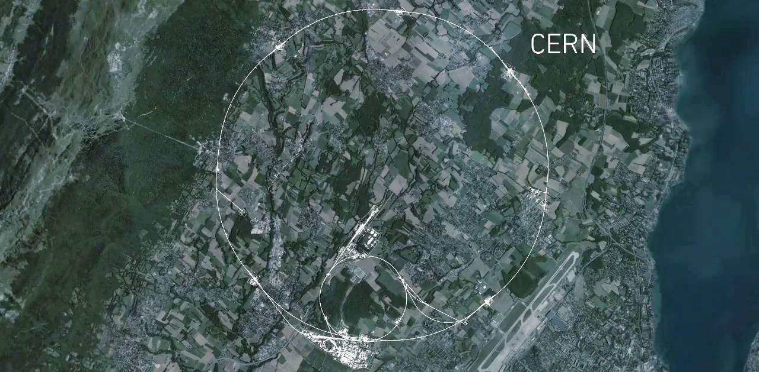
CERN at a glance...
CMS
ALICE
ATLAS
LHCb
Notes:
This is a map of the complex of main accelerators of CERN.
The dotted line is the French-Swiss border.
The 2 main CERN sites are Meyrin and Prévessin (as big, but not as built nor populated)
The PS is the tiny 600m ring on the Meyrin site, the SPS goes accross the border and the LHC takes all the space between Geneva airport and the Jura (dark green on the left).
The 4 red dots represent where the 4 detectors are located.

Slide 4
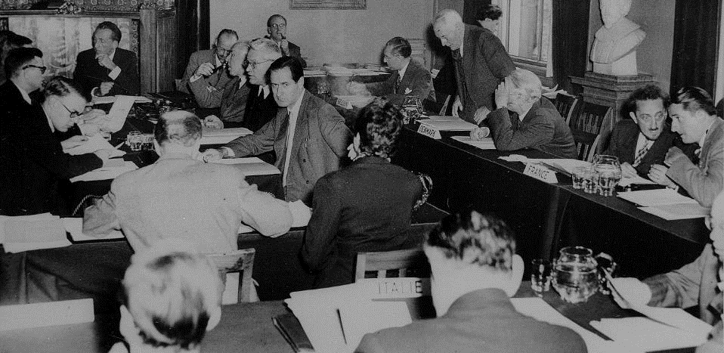



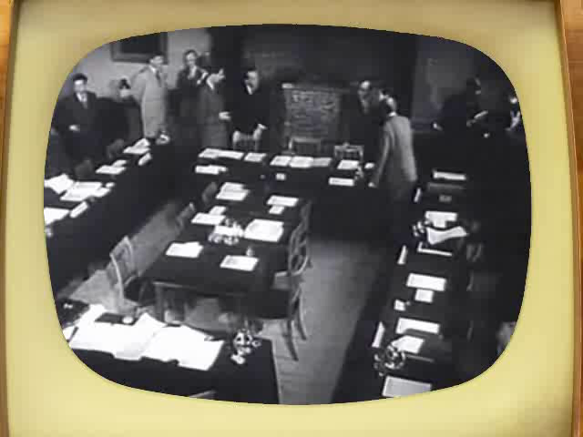
What does « CERN » stand for?
1952
Notes:
Ask the audience what they think «CERN» acronym stands for before showing the answer.
After WW II, fundamental research in Europe was not leading anymore.
Many scientists were flying away to the United States.
In order to stop this movement, eminent scientists gathered in meetings to setup a structure to continue fundamental research in physics in Europe.
They were gathered as a «Council» which means there were just holding meetings and they did not (yet) had a lab or led experiments.
The images are from Amsterdam meeting in 1953 when the CERN convention was signed.

Slide 5
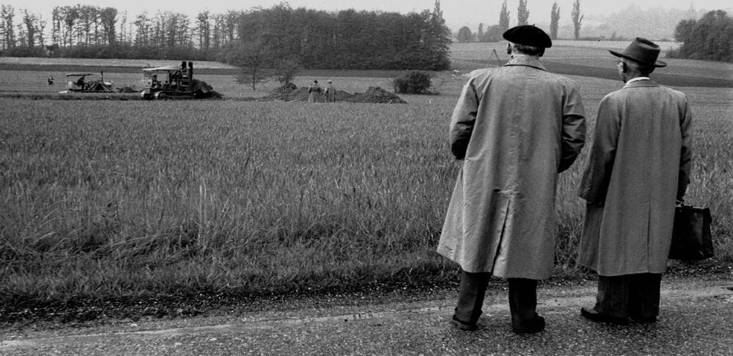

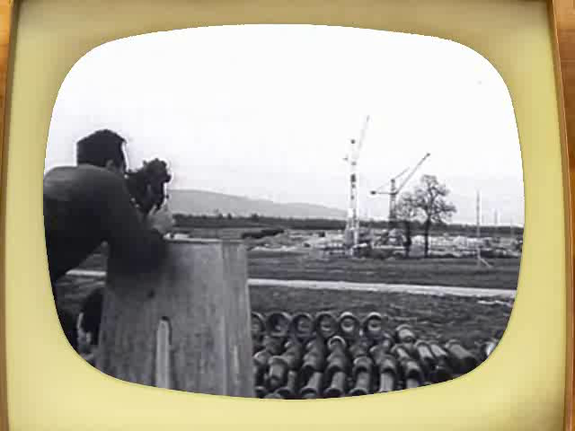
What does « CERN » stand for?
1954
Notes:
It is decided to build the «European Organization for Nuclear Research». It comes into existence in 1954.
Geneva is chosen for its central location, the neutrality of Switzerland, the International visibility.
International Organization format was chosed to guarantee neutrality and independance.
The Organization, unlike the Council, has labs and has research activties.
But as the Organization is still «led» by a Council, the CERN acronym was kept.

Slide 6

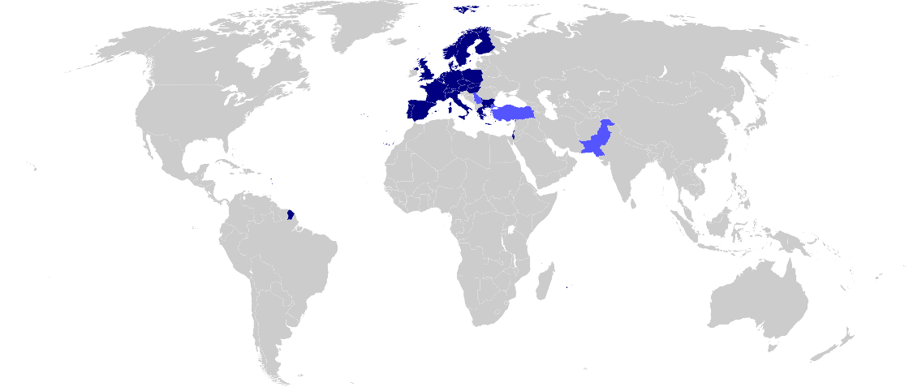

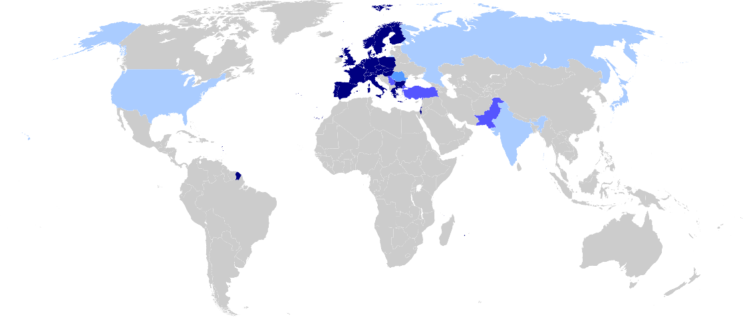
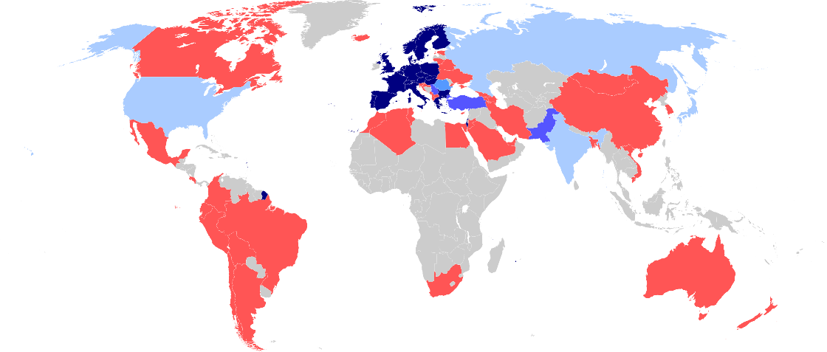

A world collaboration
24 members
10 associates
Observers
Cooperation agreements
Scientific contacts
Member States:
Austria, Belgium, Bulgaria, Czech Republic, Denmark, Estonia, Finland, France, Germany, Greece, Hungary, Israel, Italy, Netherlands, Norway, Poland, Portugal, Romania, Serbia, Slovakia, Spain, Sweden, Switzerland and United Kingdom.
Associate Member States in the pre-stage to Membership:
Cyprus, Slovenia.
Associate Member States:
Brazil, Croatia, India, Latvia, Lithuania, Pakistan, Turkey and Ukraine.
Notes:
Even though the «E» in CERN stands for European, CERN became a WORLD actor in the particle physics community.
In fact, half of the world particle physicists ARE connected with CERN at some point. No other scientific domain has reached this level of integration.

Slide 7
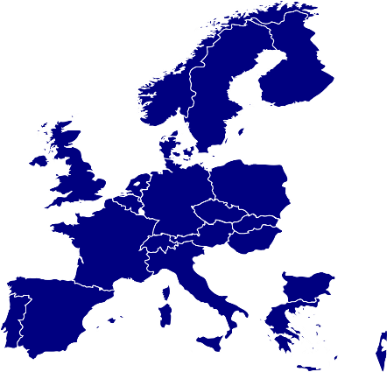






Budget
Germany
20.27%
France
15.39%
United Kingdom
13.88%
Italy
11.48%
Spain
8.28%
ca 1 Bn CHF
Netherlands
4.60%
Switzerland
3.64%
Belgium
2.78%
Poland
2.66%
Sweden
2.61%
Norway
2.55%
Austria
2.22%
Denmark
1.76%
Greece
1.64%
Finland
1.39%
Portugal
1.20%
Israel
1.19%
Czech Republic
1.03%
Hungary
0.65%
LHC
Slovakia
0.50%
Bulgaria
0.28%
(2015 data)
Notes:
First, CERN is funded by 21 Members States.
Mostly European ones. But since 2008 any country in the world can apply for membership, either full or associate.
Israel is the last country which has joined CERN as full Member in 2014.
These countries give ca 1 Bn CHF (this is the budget of a mid-sized University) per year.
This money allows CERN to fulfill its mission: provide and support the needed infrastructure for scientits to make experiments.
That covers: equipment, transport, maintenance, factoring, paying people and… build accelerators.
That does no cover the research cost itself (see collaboration on next slide).
The money is paid by each country pro rata their GDP (Gross Domestic Product).
Therefore Germany which contributes to 20.27% makes the «relative» SAME effort than Bulgaria which contributes for 0.28%.
Of course, in important decisions, Germany will «weight» 20%, and Bulgaria only 0.28%
The decision treshold for important decisions is 75% of the budget represented in the vote.
The big 4 countries (DE, FR, UK, IT) only account for a bit more than 60%. They need the support of smaller countries and cannot impose their views.

Slide 8










How many persons?
+15’000!
2’500 staff
600 fellows &
apprentices
500 students
11’000 users
2’000 external
companies
Notes:
CERN employs «only» 2500 persons. In which there are «only» 70 research physicists (you can ask the audience if they can guess this).
As Fellows and Apprentices are here for a first employement experiences.
The number of students can vary from 300 to 600 depending of the time of the year. It’s mostly university students.
The core population of CERN is made of about 11’000 «users», called like that because they are here to «use» CERN’s facilities.
They are NOT employed by CERN and come in the frame of the collaborations.
They are not all the time at CERN. Some spend 5% of their time at CERN (a few days a year), some spend 100% of their time. It really depends on their function in the collaboration, on the need for them to be on site, or, on the other hand, the possibility for them to work remotely.
Given the size for CERN’s population, many services are externalized (mail, transport, restaurants, etc) to firms.

Slide 9
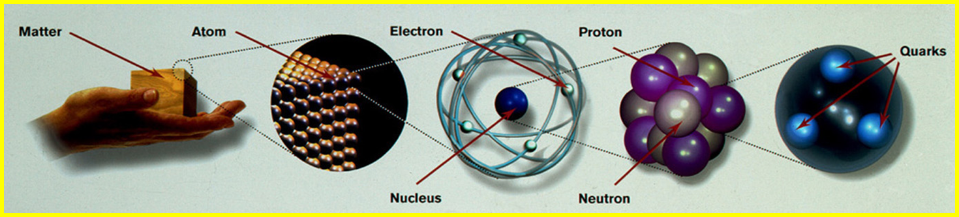
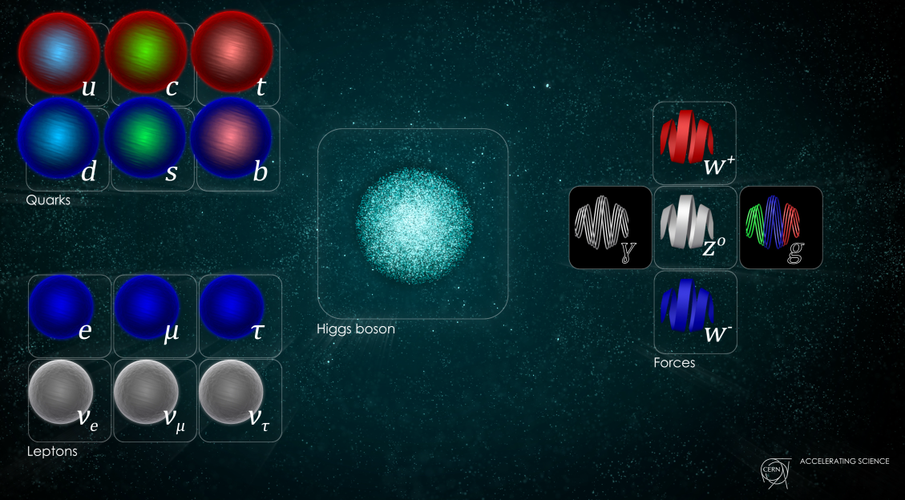
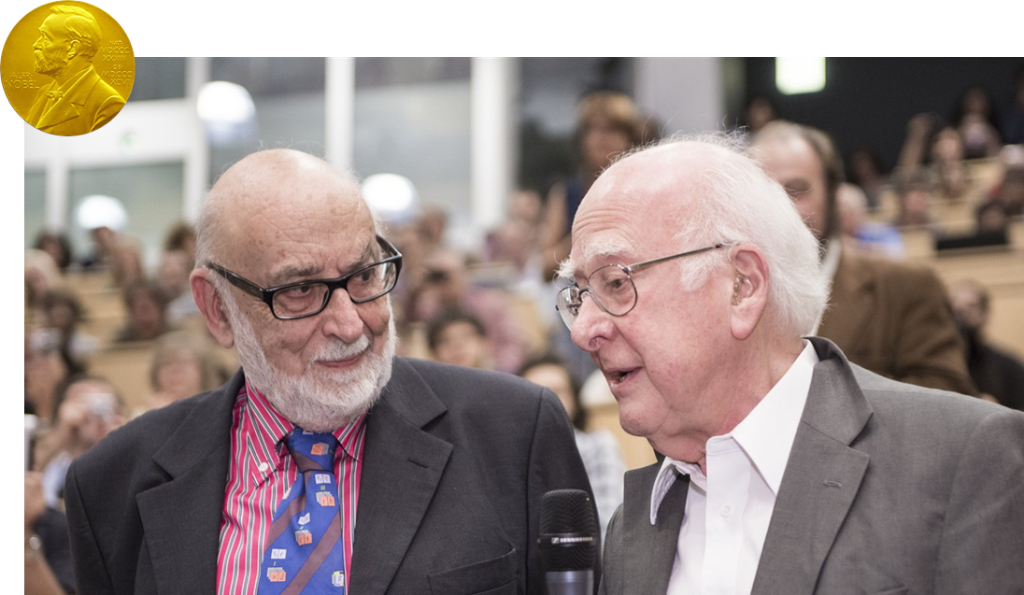
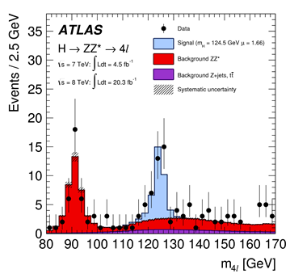
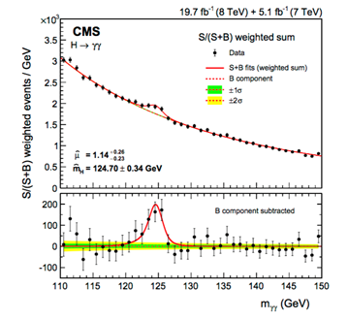
CERN main mission: fundamental physics

Slide 10
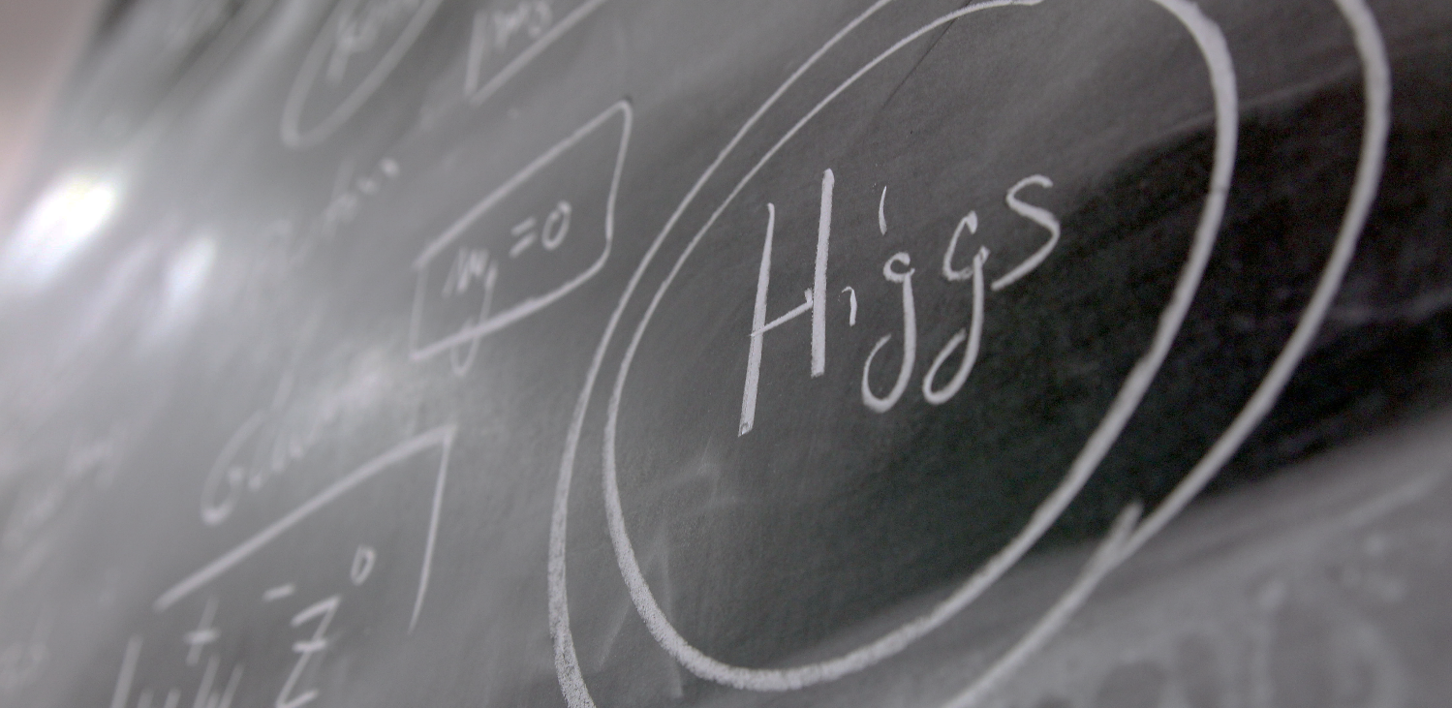
Answering questions…
What lays beyond the Standard Model?
Notes:
CERN also helped proving certain theories like the existence of the «Higgs Boson».
This particle is responsible for giving its mass to all other particles. It is very important in the standard model.
It was predicted in 1964 by 2 Belgian physicists (François Englert and Robert Brout), then by the Scottish physicist (Peter Higgs) and others later.
If took 48 years to have the experiments (ATLAS and CMS) which proved its existence. The discovery was announced at CERN on 4th July 2012.
This discovery led François Englert and Peter Higgs (only surviving of the 3)to be rewarded by a Nobel Prize in 2013.

Slide 11
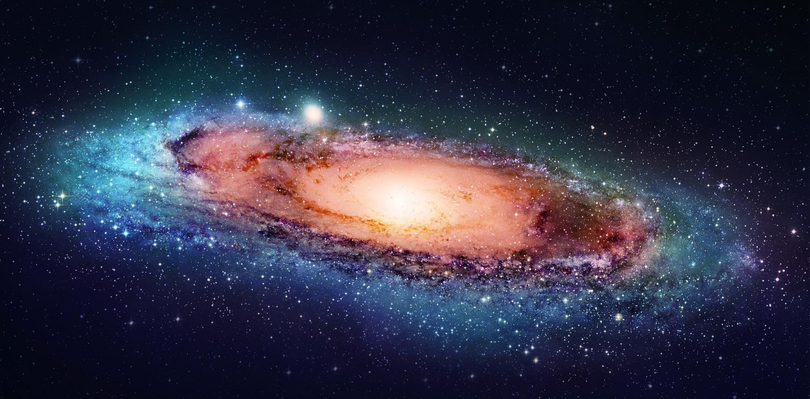
Answering questions…
What is dark matter?
Notes:
But we have many more questions unanswered.
For example when we look at galaxies far away, and at their rotation speed, the estimated mass of the visible matter (stars, planets, clouds of gas etc) is not sufficient to «keep it together». At the speed it rotates, this galaxy should split away.
And the worrying thing is that is seems we are missing 95% of the needed mass…
What is 95% of the universe’s mass made of? Dark matter? Dark energy? There are many theories again (Supersymetry amongst others). CERN may help finding out more about it.

Slide 12
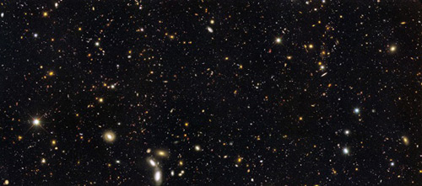
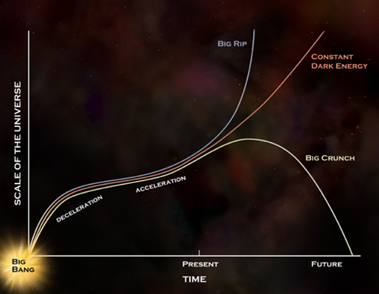
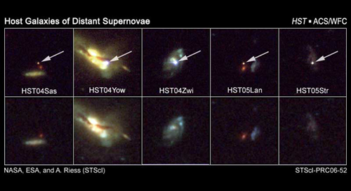
Answering questions…
What is dark energy?

Slide 13
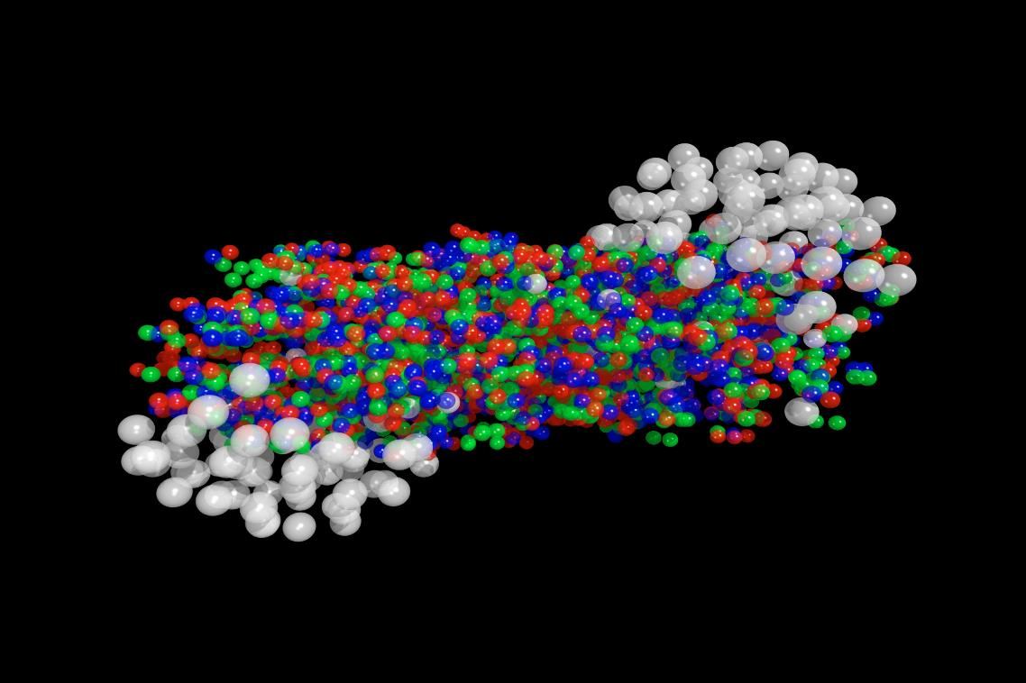
Answering questions…
What happened short after the Big Bang?
Notes:
One last question CERN is trying to answer: theorists believe that at the very early moments of the Universe, quarks were not yet «gluing» together thanks to the Gluons. There was a primordial «soup» of particles called the «Quark-gluon plasma».
CERN’s ALICE experiment tried to reproduce droplets of this state of matter for very short time and observe it.
This will help us understand the way the Universe evovled and why it is as it is now.

Slide 14
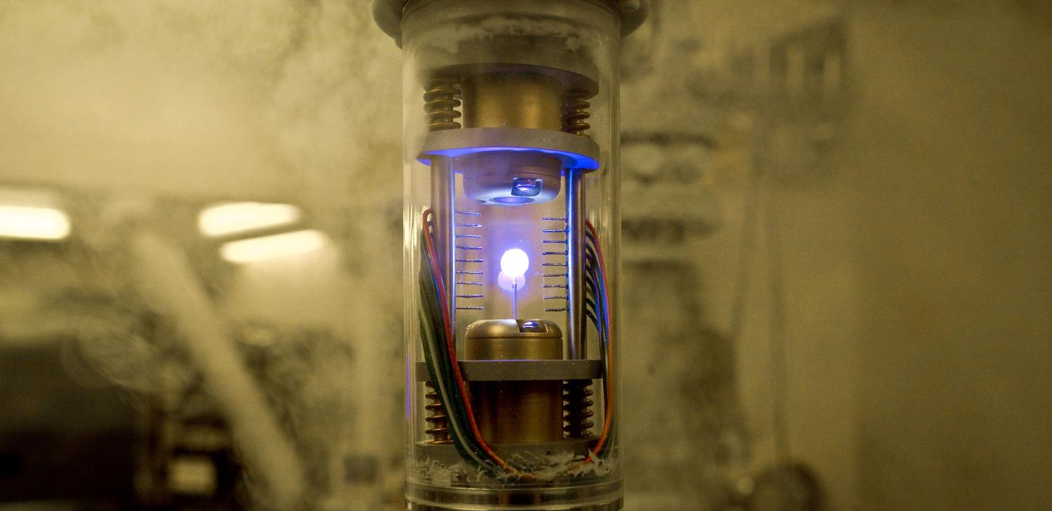
Answering questions…
Where has antimatter gone ?
Notes:
Theorists believe that at the moment of the Big Bang, a theory telling that all universe is an expansion of a tiny space of pure energy which was transformed into matter, as many particles than antiparticles were created. It is also believed that the first instants of the universe was a gigantic anihilation of partcles and their counter anti-particles which were just created. But it seems that out of 1 billion particle-antiparticle anihilation, 1 particle survived… And that what makes the current Universe… apparently made only of matter. Why matter has won over antimatter? Are we sure there is no antimatter left from the Big Bang?
CERN is looking at that question with various experiments amongst which:
AD (Antimatter Decelerator) creates anti atoms and slows them down to eventually trap them (the image here is the one from Angels and Demons movie, our trap is bigger, sexiers and consumes much more energy)
AMS is an experiment on the International Space Station which looks for traces of primordial antimatter from space. It needs to be there outside of the Earth’s atmosphere where many particle collisions occur and produce briefly anti-particles. The AMS Control Centre is located at CERN and receives signals from the experiment.

Slide 15
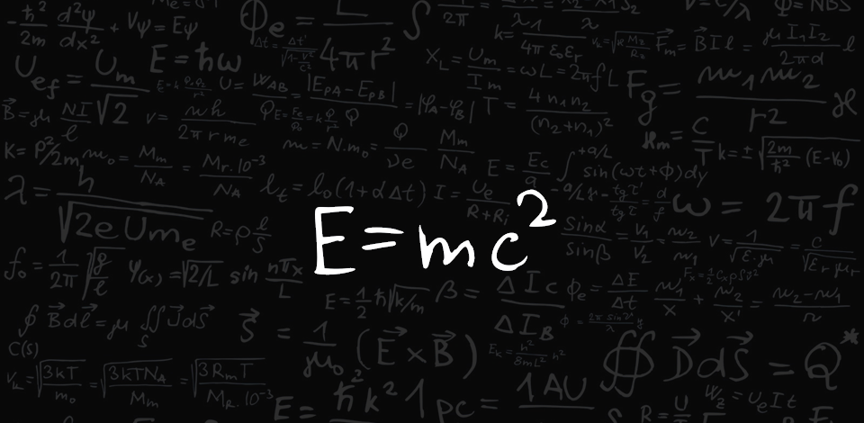
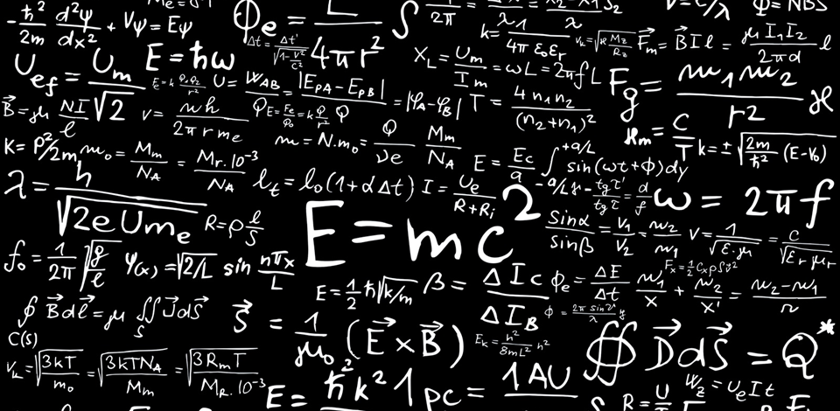

Transforming energy into matter, i.e. …
Notes:
In fact we are only applying the most famous physics formula: «E=mc2».
This formula tells us one thing: energy (E) can be transformed into (=) matter (m).
So why have you never noticed the production of other fruits when smashing 2 apples at very high speed? It’s because the «c2» in the formula. «c» stands for the speed of light (300’000 km/s in the vacuum). If you square it, that makes a very big number. And an equation is a kind of scale with 2 plates on both sides of the «=» sign. If you put «c2» on one plate, then you need a lot of «E» on the other plate to reach balance. If you take large objects like apples, no chance you will reach the level of «E» needed. We will never be able to assign our apples enough energy.
That is why we use smaller objects. The smaller the object to be smashed the easier it is to assign it a «relative» high level of energy. And that is why at CERN we do not have the «Large Apple Collider» but we have the «Large Hadron Collider». We will accelerate hadrons (protons and neutron), the components of the nucleus at an incredible level of energy.

Slide 16

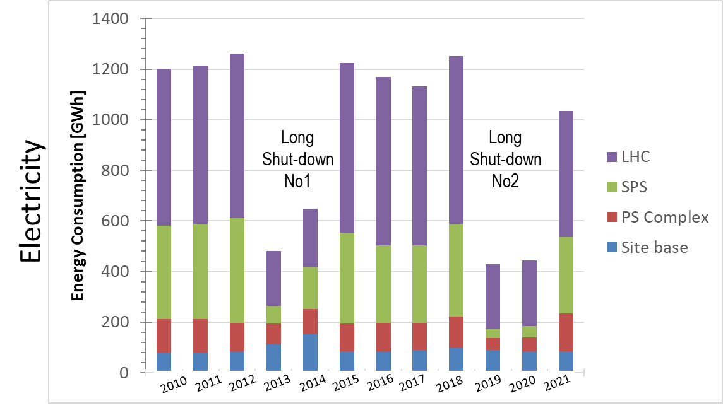
… Transforming energy into data
CERN Energy Consumption
CERN Data Production
Yearly average
Fuel: 4 GWh, 0.3 %
Gas: 67 GWh, 5.2%
Electricity: 1'220 GWh, 94.5%
1EB=10⁹GB
16
Notes:
The LHC produces 600 million collisions every second in each detector, which generates approximately one petabyte of data per second. None of today’s computing systems are capable of recording such rates. Hence sophisticated selection systems are used for a first fast electronic pre-selection, only passing one out of 10 000 events. Tens of thousands of processor cores then select 1% of the remaining events. Even after such a drastic data reduction, the four big experiments, ALICE, ATLAS, CMS and LHCb, together need to store over 25 petabytes per year. The LHC data are aggregated in the CERN Data Centre, where initial data reconstruction is performed, and a copy is archived to long-term tape storage. Another copy is sent to several large scale data centres around the world. Subsequently hundreds of thousands of computers from around the world come into action: harnessed in a distributed computing service, they form the Worldwide LHC Computing Grid (WLCG), which provides the resources to store, distribute, and process the LHC data. WLCG combines the power of more than 170 collaborating centres in 36 countries around the world, which are linked to CERN. Every day WLCG processes more than 1.5 million ‘jobs’, corresponding to a single computer running for more than 600 years.

Slide 17
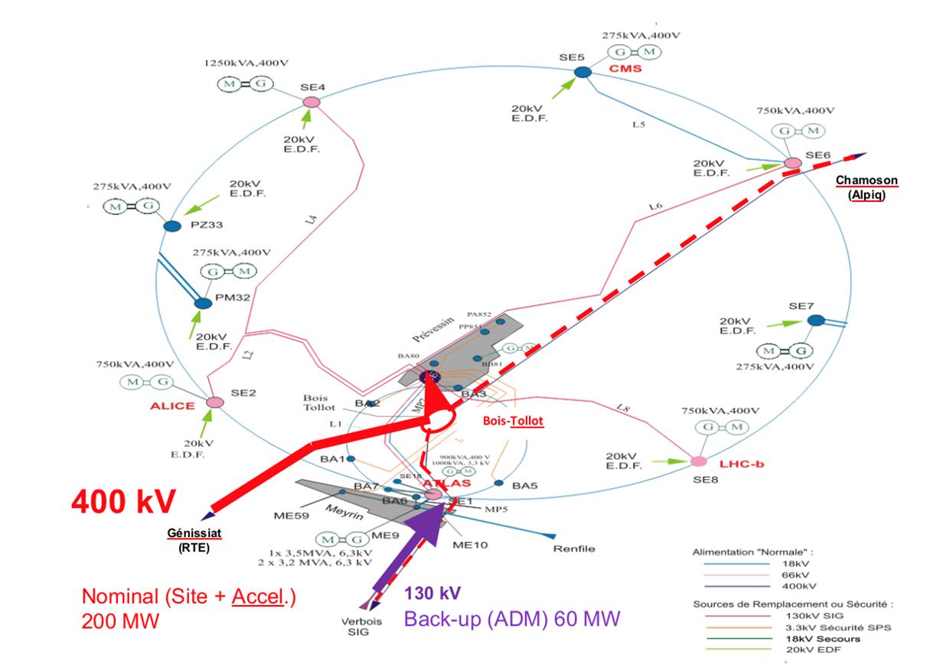
Electrical distribution at CERN
Main feeding point from a 400kV line (interconnection F-CH)
Back-up from 130kV
(limited capacity)

Slide 18

CERN data processing and storage

Slide 19
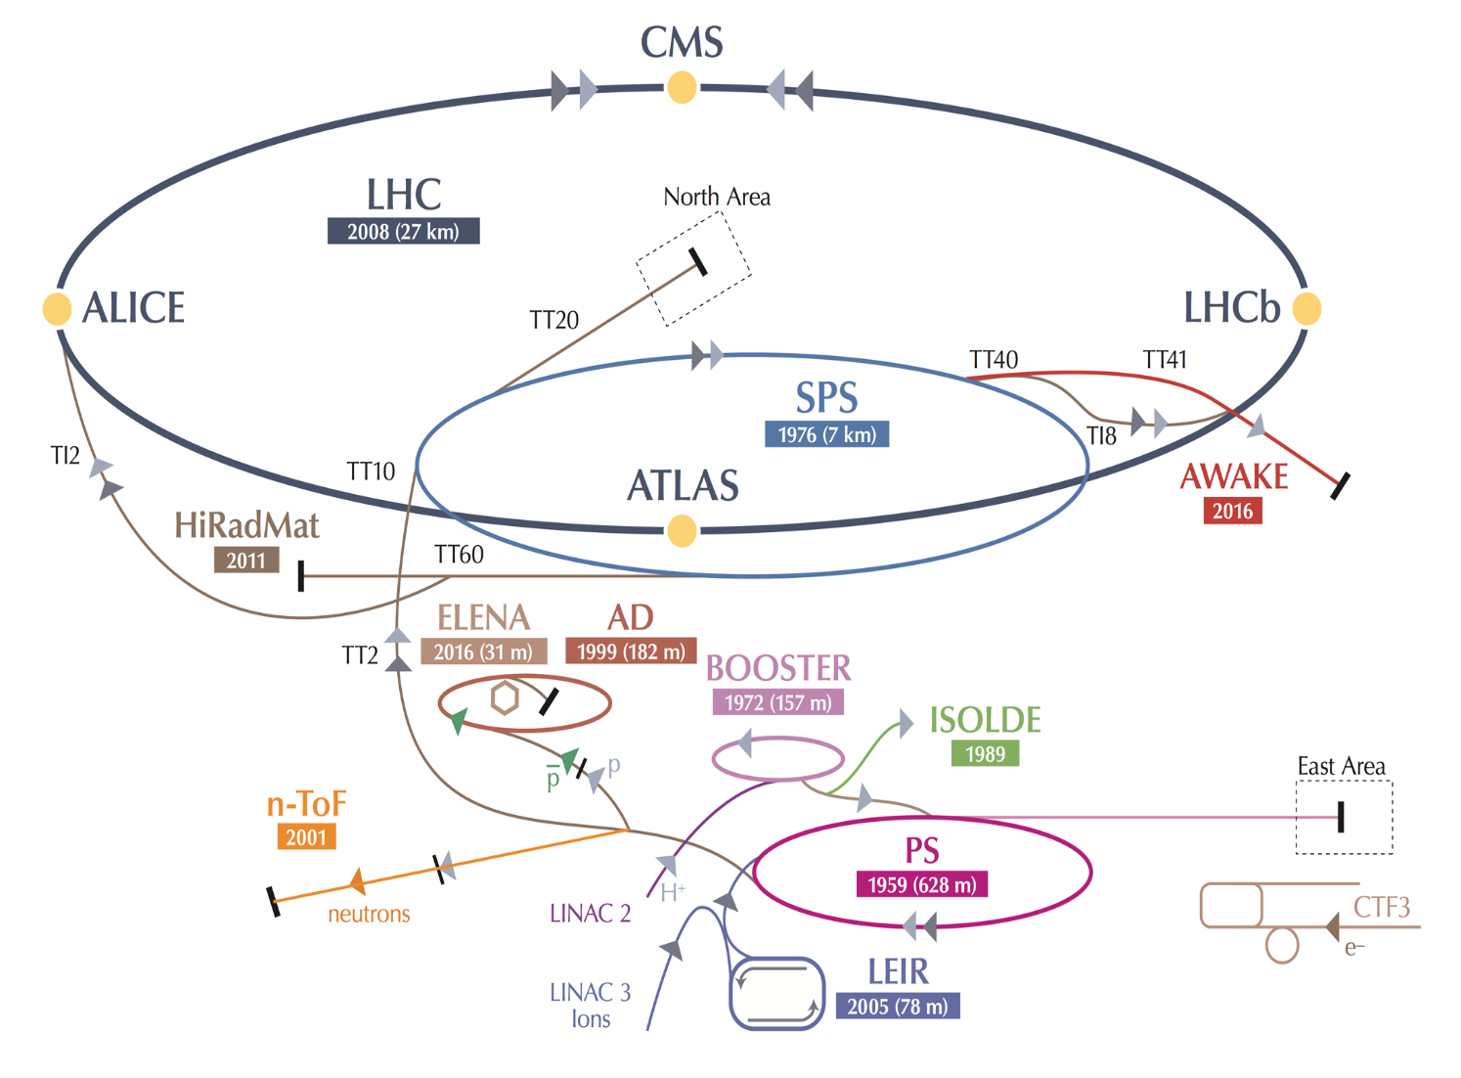
Full accelerator chain and experimental capabilities
AD: Antiproton Decelerator for antimatter studies
AWAKE: proton-induced plasma wakefield acceleration
CAST, OSQAR: axions
CLOUD: impact of cosmic rays on aeorosols and clouds → implications on climate
COMPASS: hadron structure and spectroscopy
ISOLDE: radioactive nuclei facility
NA61/Shine: ions and neutrino targets
NA62: rare kaon decays
NA63: radiation processes in strong EM fields
NA64: search for dark photons
Neutrino Platform: ν detector R&D for experiments in US,Japan
n-TOF: n-induced cross-sections
UA9: crystal collimation

Slide 20
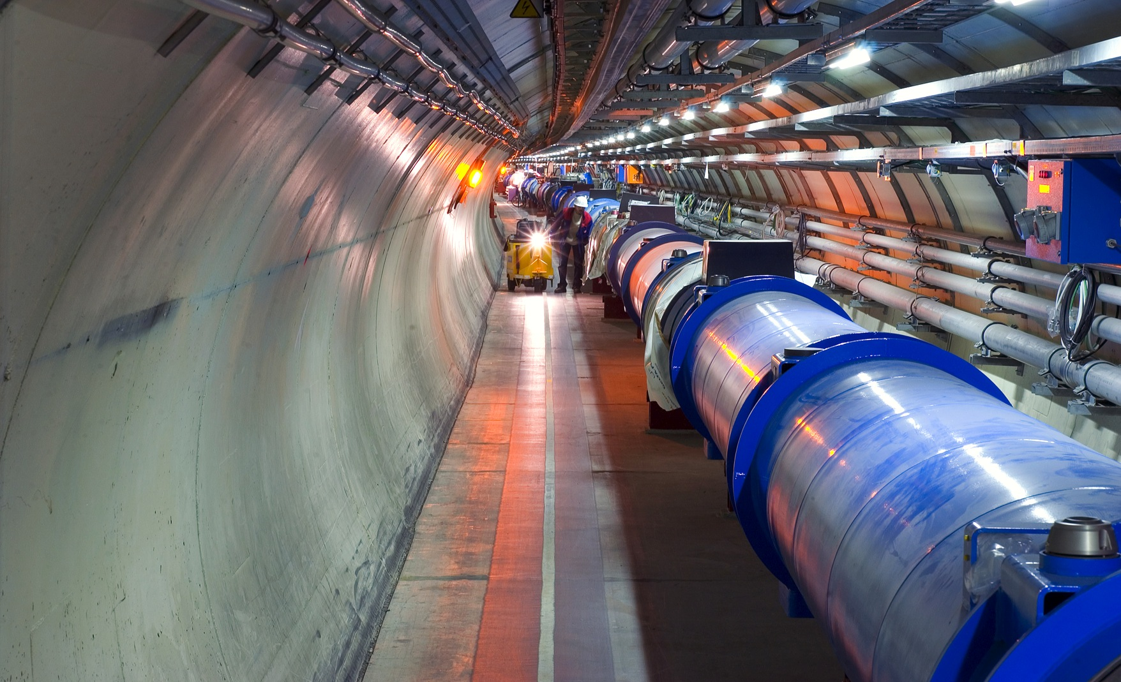
Accelerating particles: the LHC
Accelerator:
1232 high-tech superconducting magnets
magnet operation temperature: 1.9 K (-271 ⁰C)
  → LHC is one of the coldest place in the universe
number of protons per beam: 200000 billions
number of turns of the 27 km ring per second: 11000
number of beam-beam collisions per second: 40 millions
collision temperature: 10¹⁶ K

Slide 21
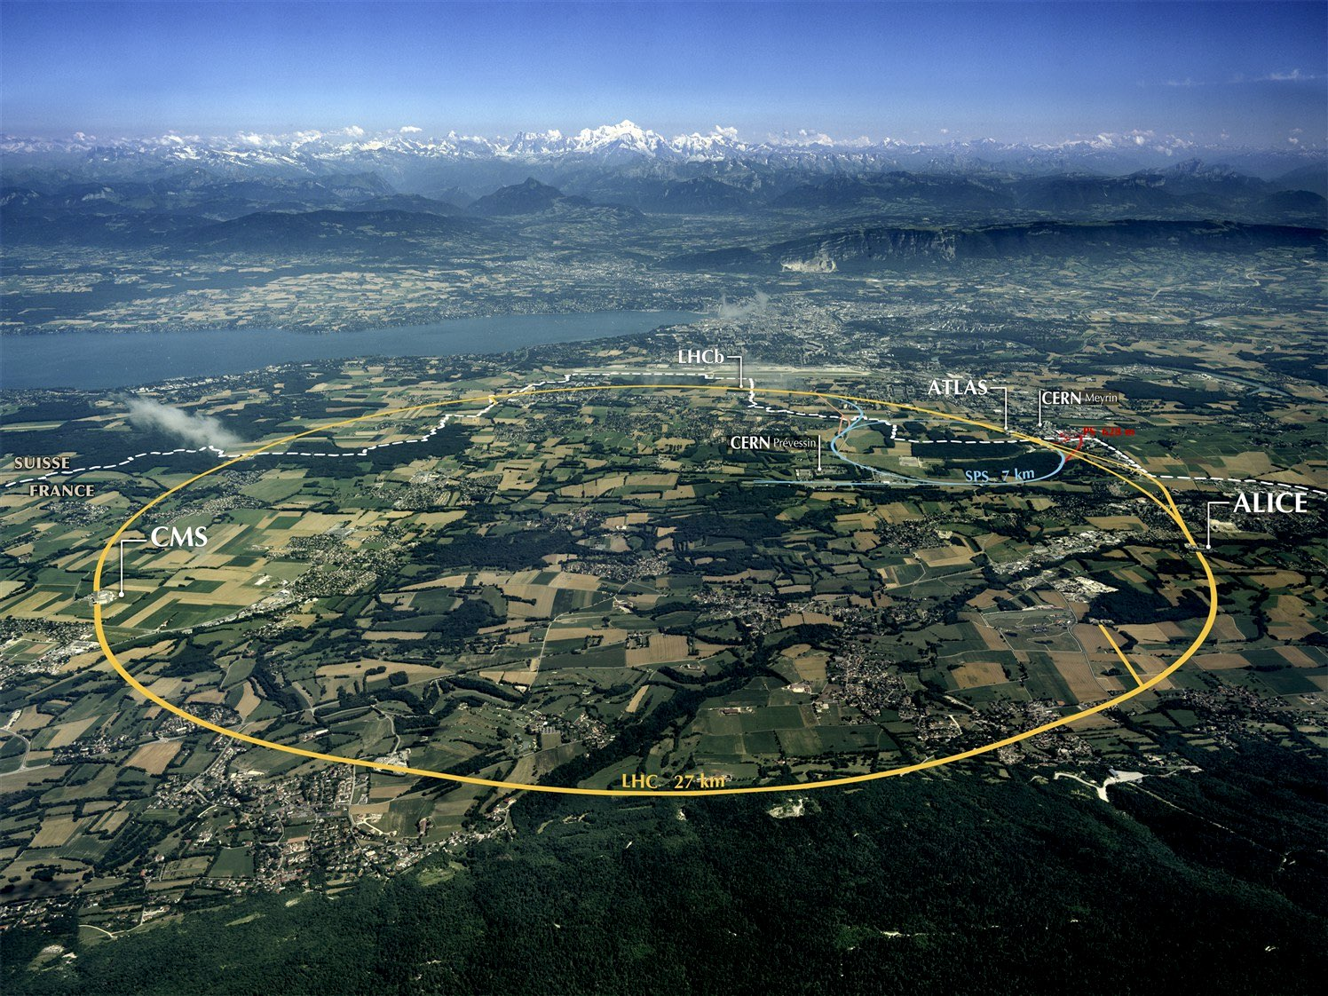
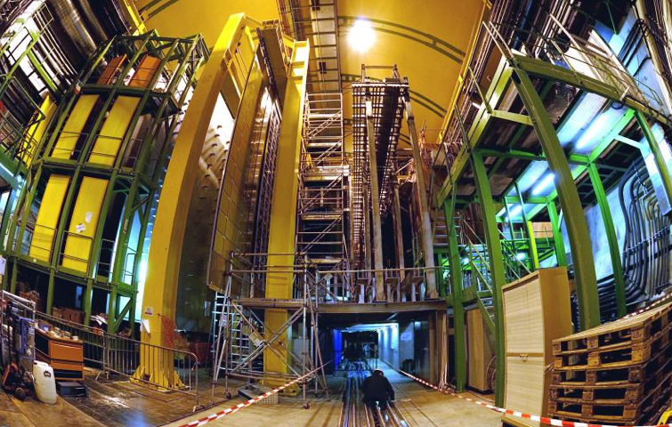


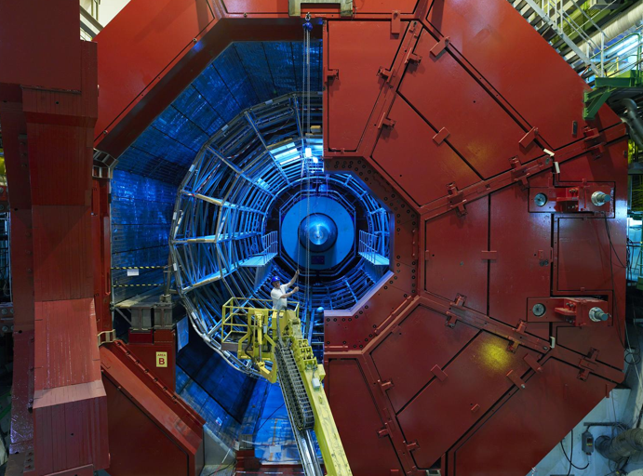

LHCb
CMS
ATLAS
ALICE
LHC ring:
27 km circumference

Slide 22
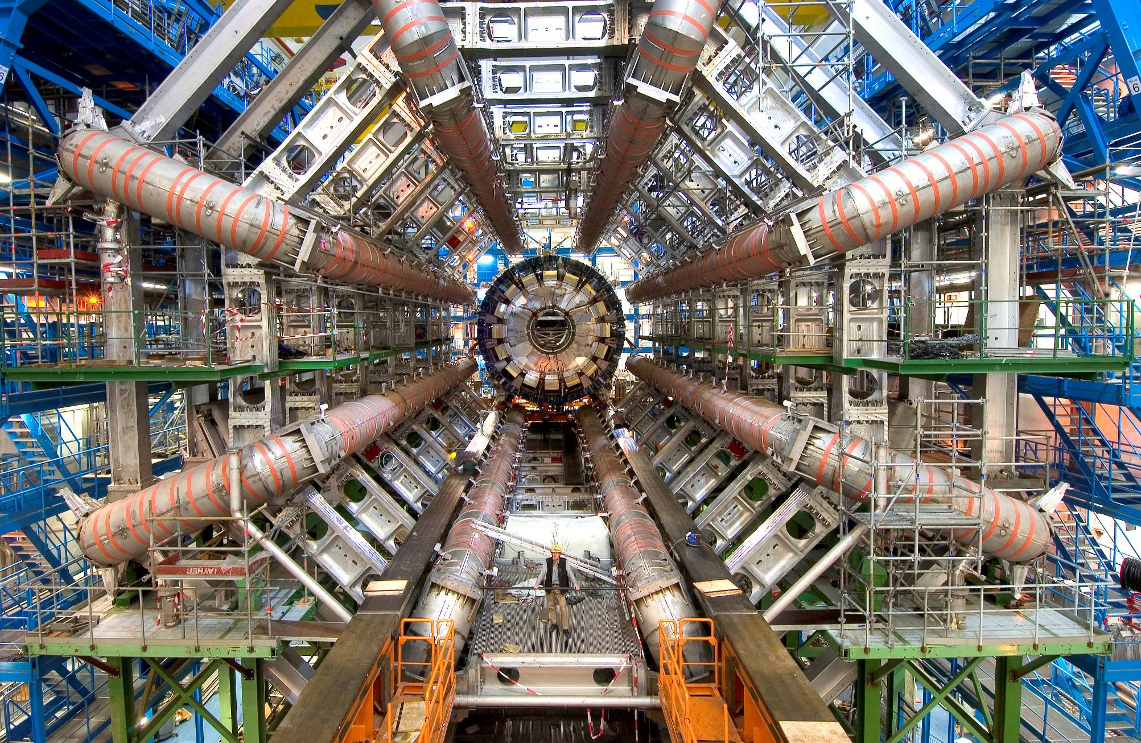
Detecting particles
Detectors:
size of ATLAS: ~ half Notre Dame cathedral
weight of CMS experiment: 13000 tons (more than Eiffel Tower)
number of detector sensitive elements: 100 millions
cables needed to bring signals from detector to control room: 3000 km
data in 1 year per experiment: ~10 PB (20 million DVD; more than YouTube, Twitter)

Slide 23
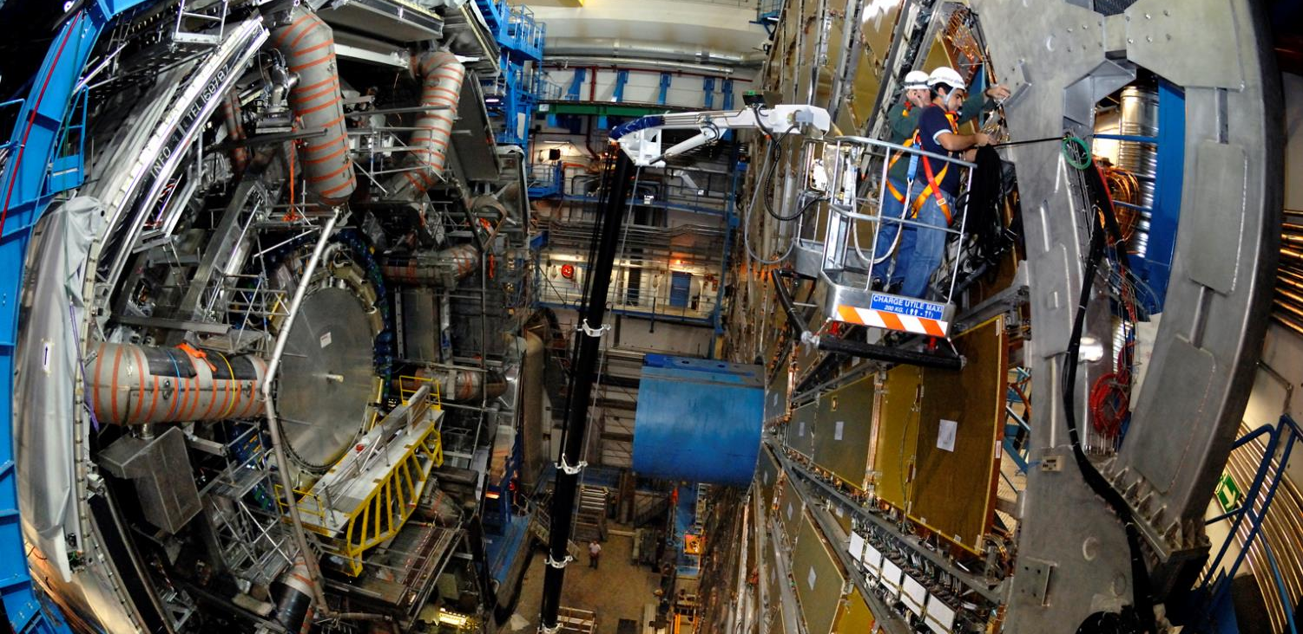
ATLAS
Notes:
Here is a real picture of ATLAS.
Noticed the man at the bottom?
ATLAS is a multi-purpose experiment looking for the Higgs Boson (which it has found in 2012), dark matter candidates etc.
It gathers 3000 physicists from 174 universities and institutes in 38 countries.

Slide 24
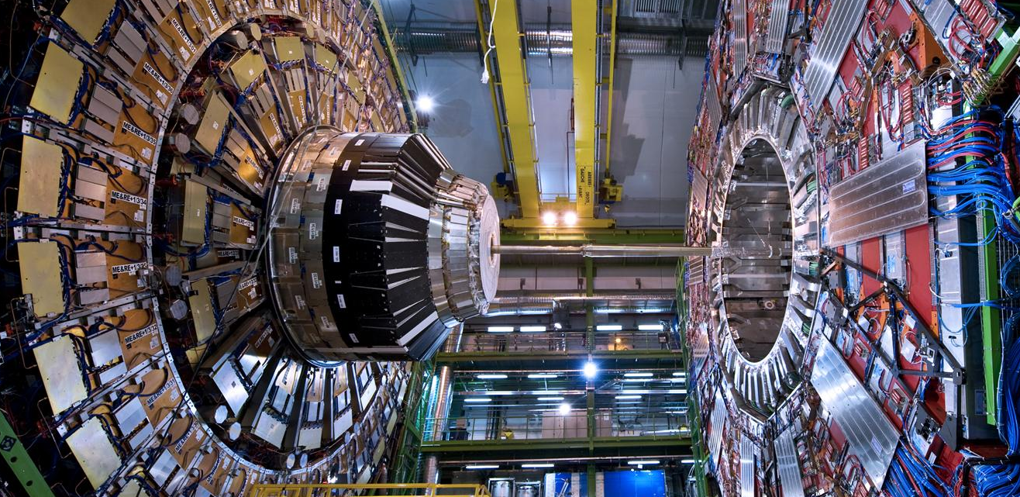
CMS
Notes:
Here is a CMS.
Like ATLAS, this is another multi-purpose experiment. It also discovered the Higgs Boson in 2012.
The C in CMS stands for Compact. Even though it does not look compact to most of you, this experiment is twice as small as ATLAS but twice as heavy: 2 times the Eiffel Tower (14’000 tonnes)!
It gathers 2600 physicists from 182 universities and institutes in 42 countries.

Slide 25
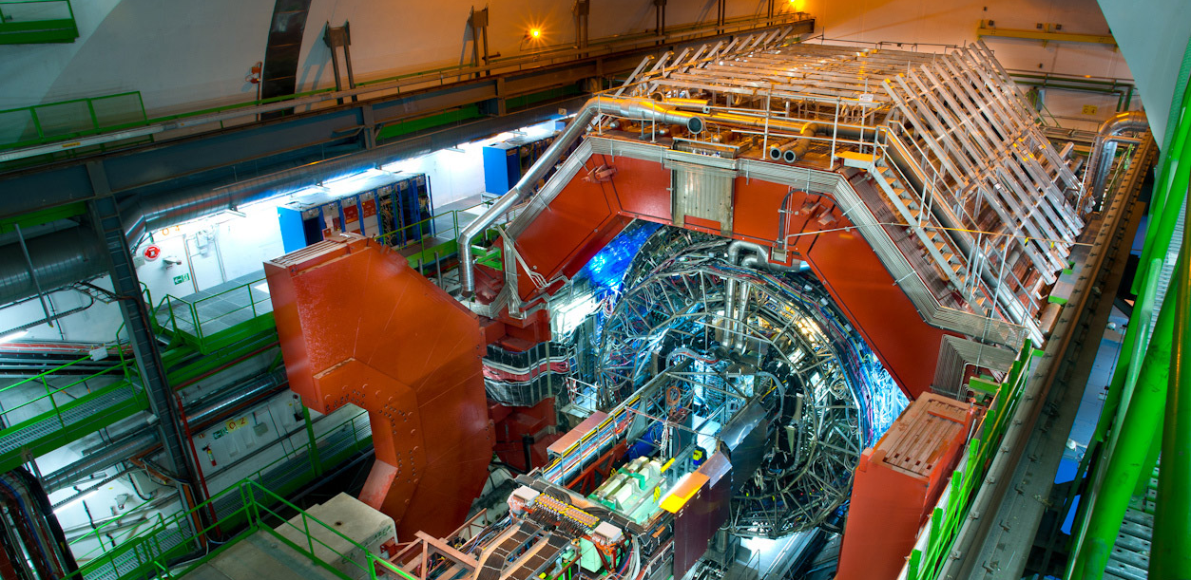
ALICE
Notes:
Here is a ALICE.
This experiment looks more particularly at the creation of the «Quark Gluon Plasma» state of matter which existed moments after the Big Bang.
For that it wait for the beams of Lead Nuclei which occur about 10% of the beamtime of the LHC.
It gathers 1500 physicists from 154 universities and institutes in 37 countries.

Slide 26
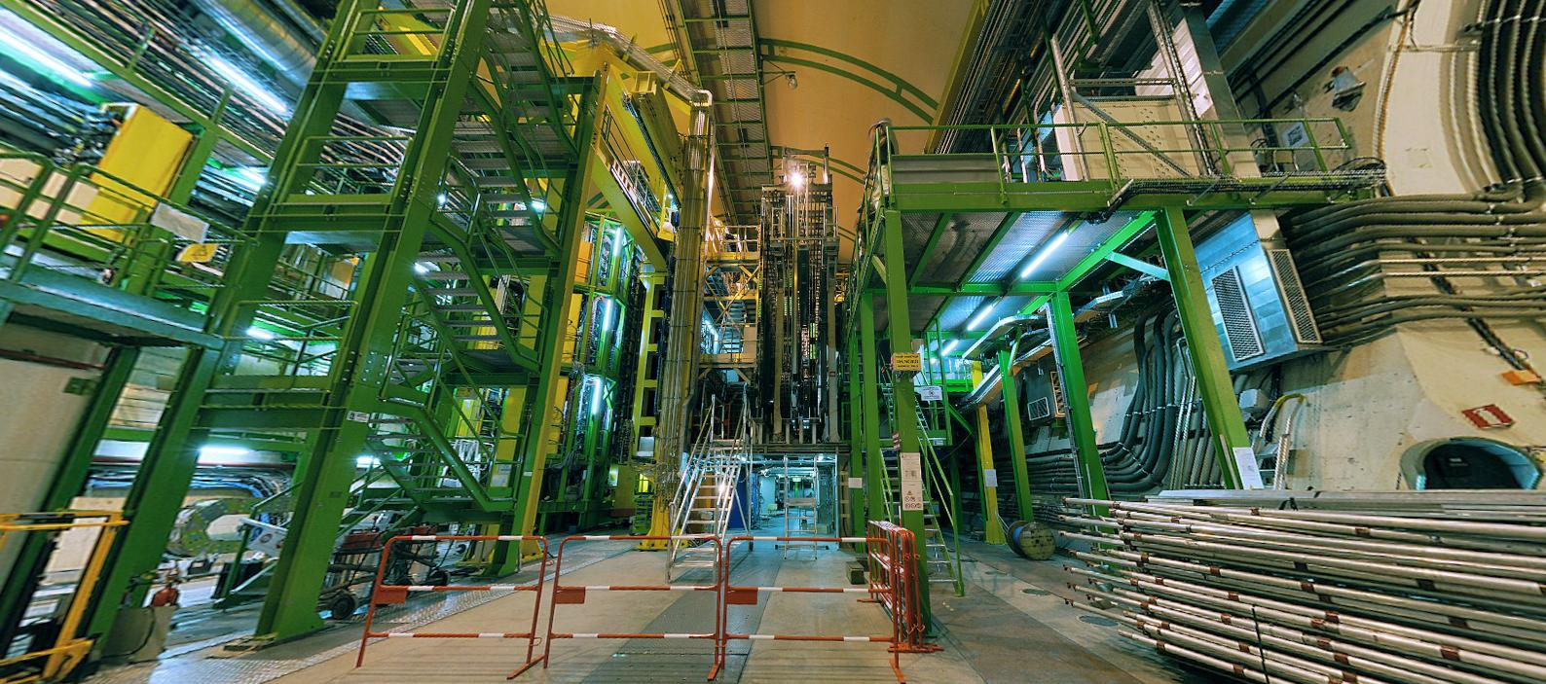
LHCb
Notes:
And the final experiment on the LHC is LHCb. Is is name after the «b» quark which it studies.
In fact LHCb studies the behaviour difference between the b quark and the anti-b quark.
It tries to find difference in the symmetry which may account for the lack of antimatter in the Universe.
It gathers 800 physicists from 69 universities and institutes in 17 countries.

Slide 27
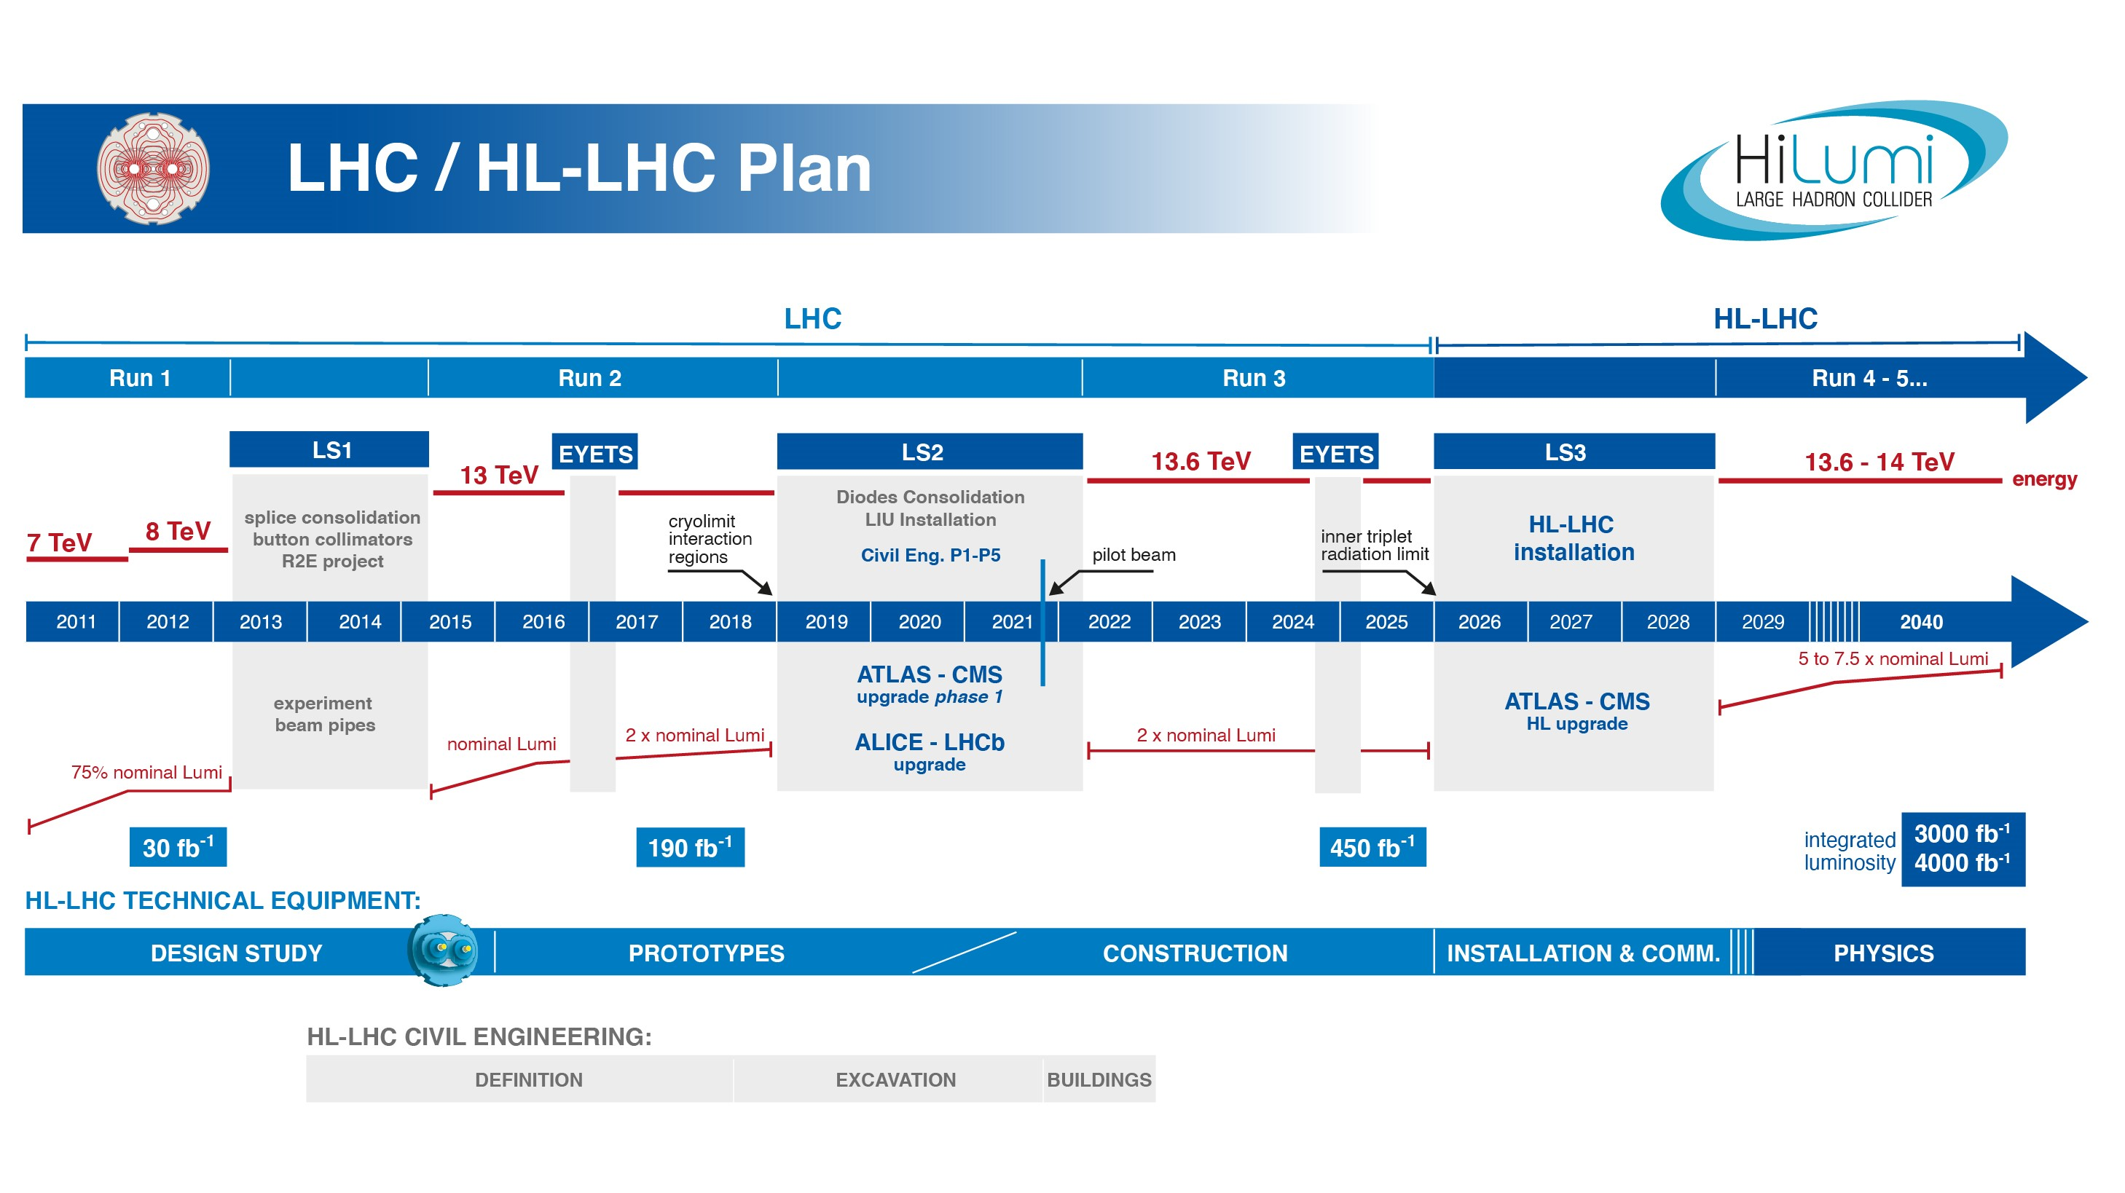
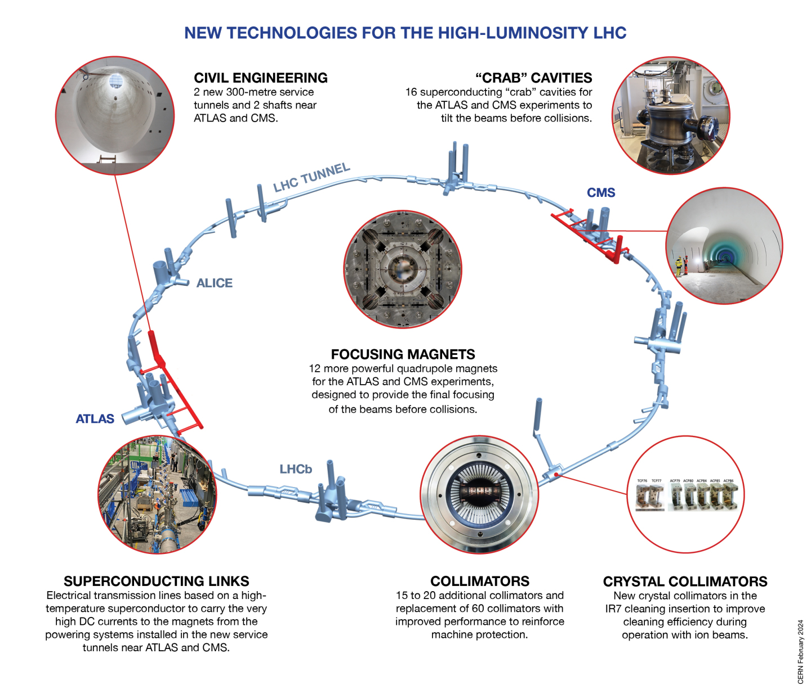
Medium term future: HL-LHC
The High-Luminosity LHC will increase the number of collisions by a factor of between 5 and 7.5 with respect to the nominal LHC design and will produce more than 250 inverse femtobarns of data per year (1fb⁻¹ of integrated luminosity equates to 100 million million collisions)

Slide 28
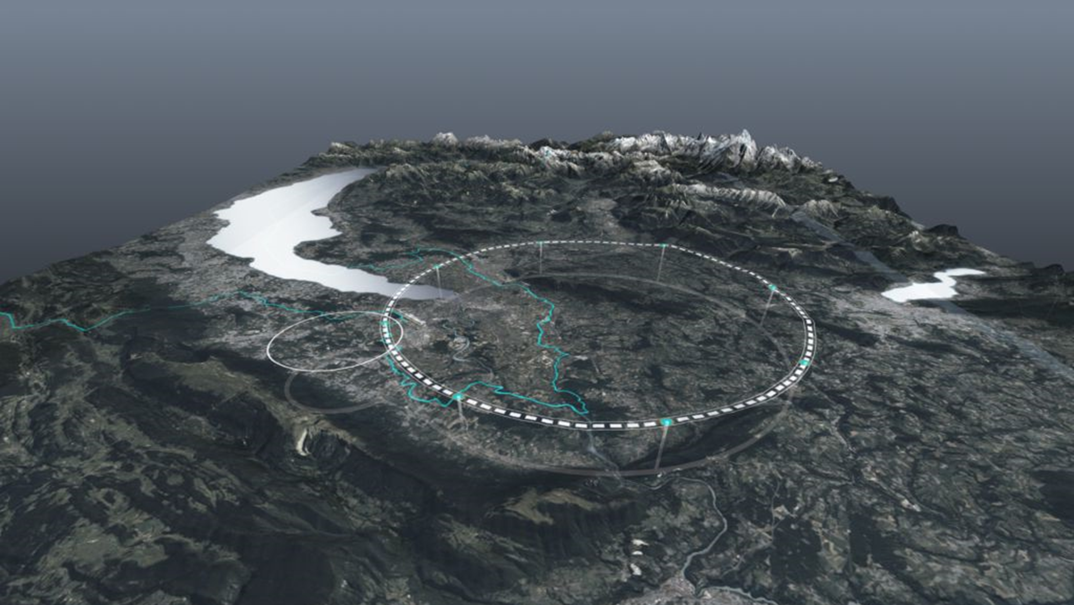
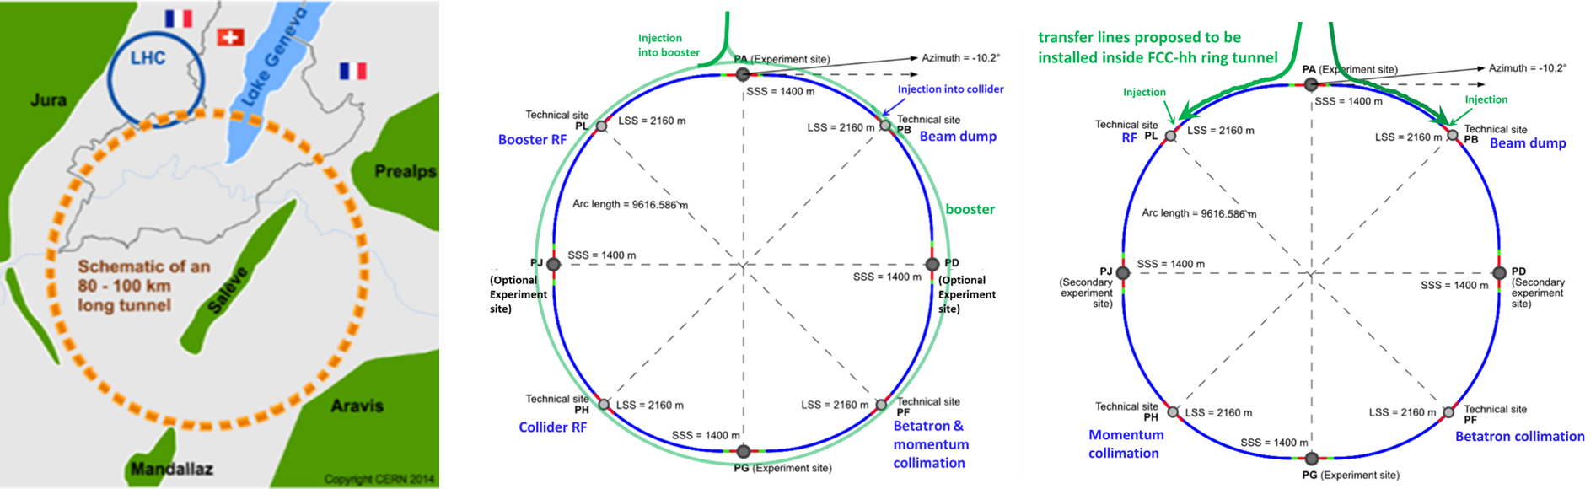
Long term future: FCC-ee and FCC-hh

Slide 29
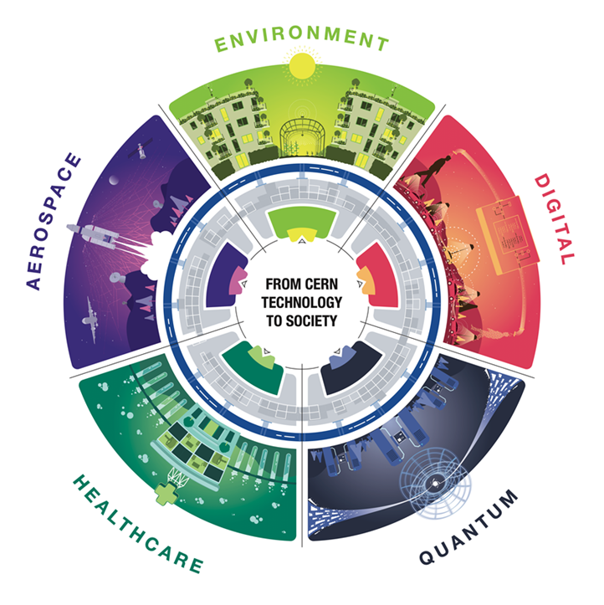
How can CERN have an impact
beyond fundamental physics?

Slide 30
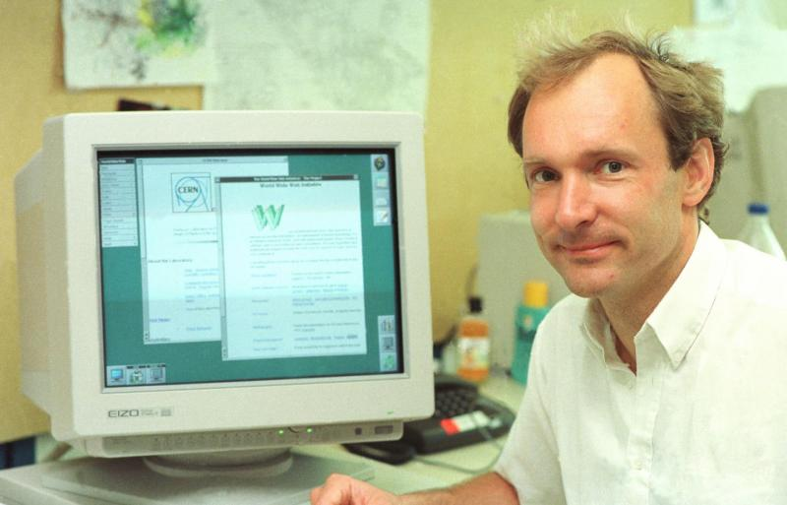
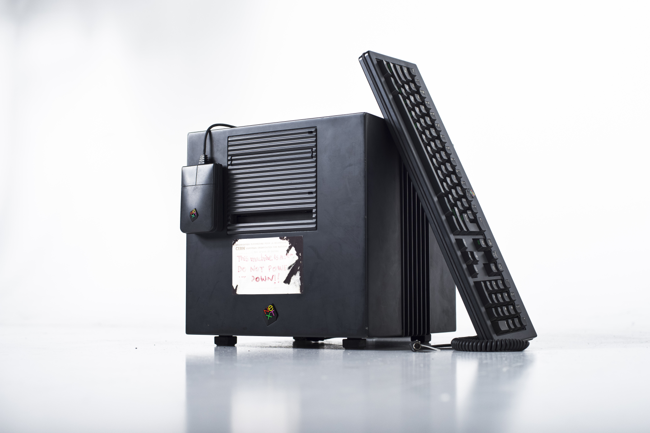
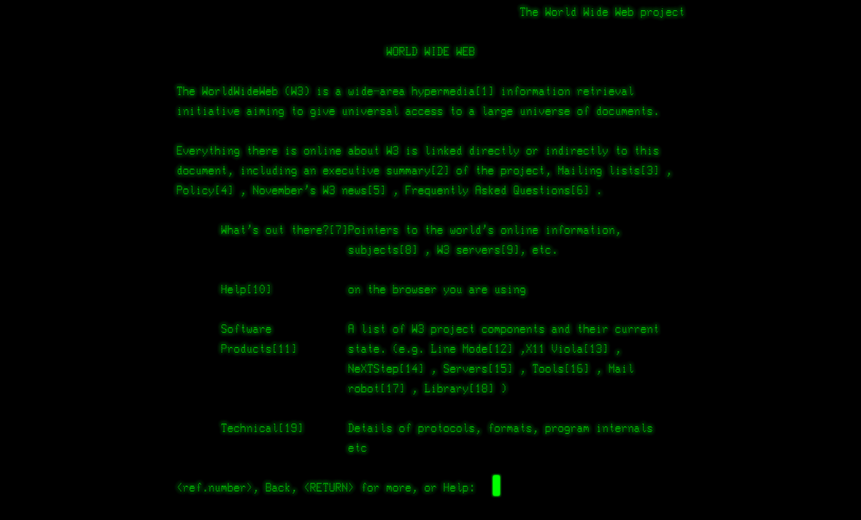
Where the World Wide Web was born

Slide 31

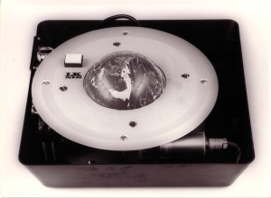
Not always a trivial process…
First «Touch-Screen»
First «Mouse»

Slide 32
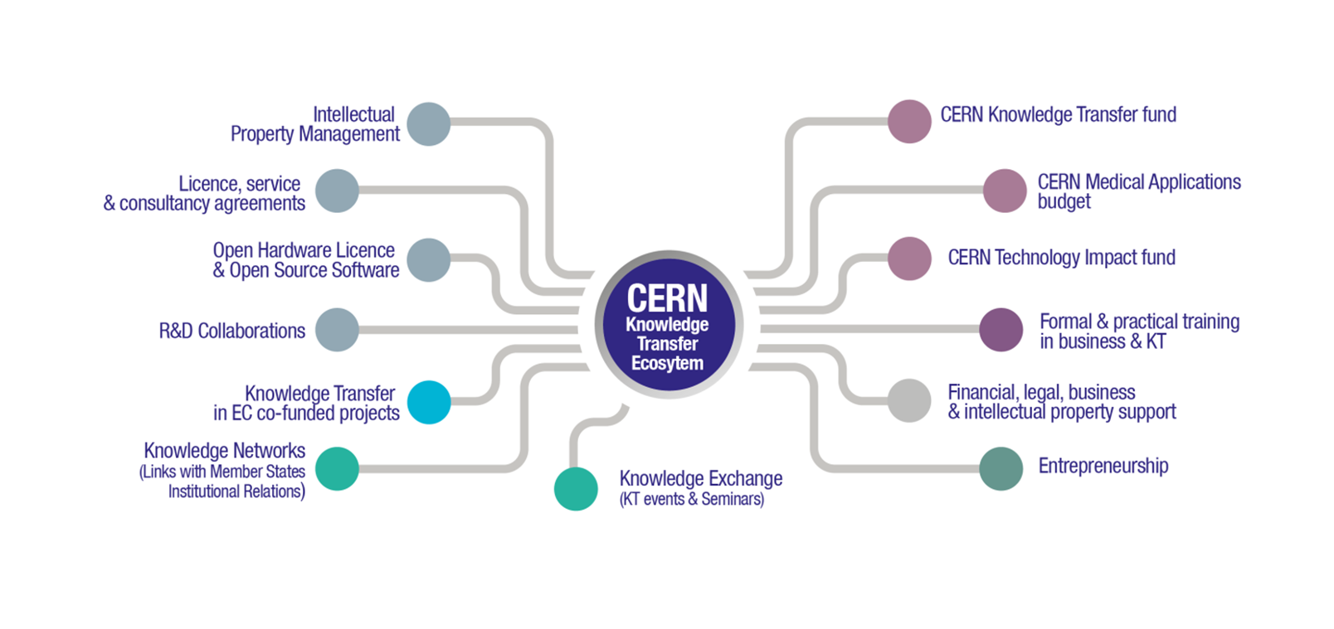
CERN – Knowledge Transfer Ecosystem

Slide 33
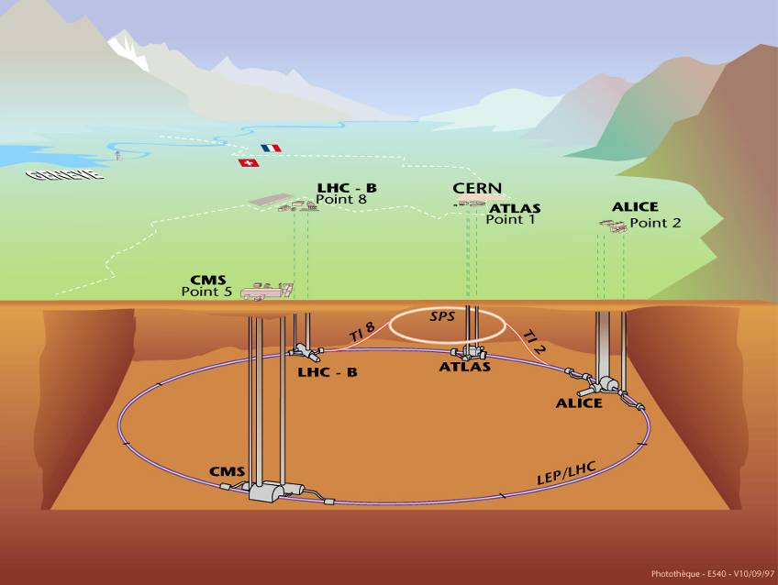

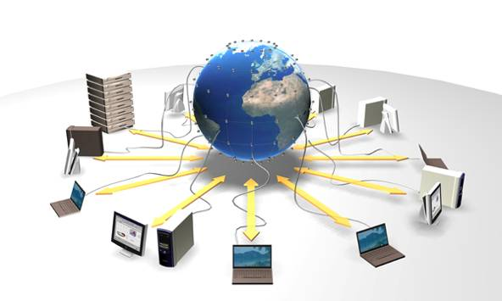
Key competences in cutting edge technologies for extreme environments
Accelerating
particle beams
Detecting
particles
Large-scale computing (Grid)

Slide 34
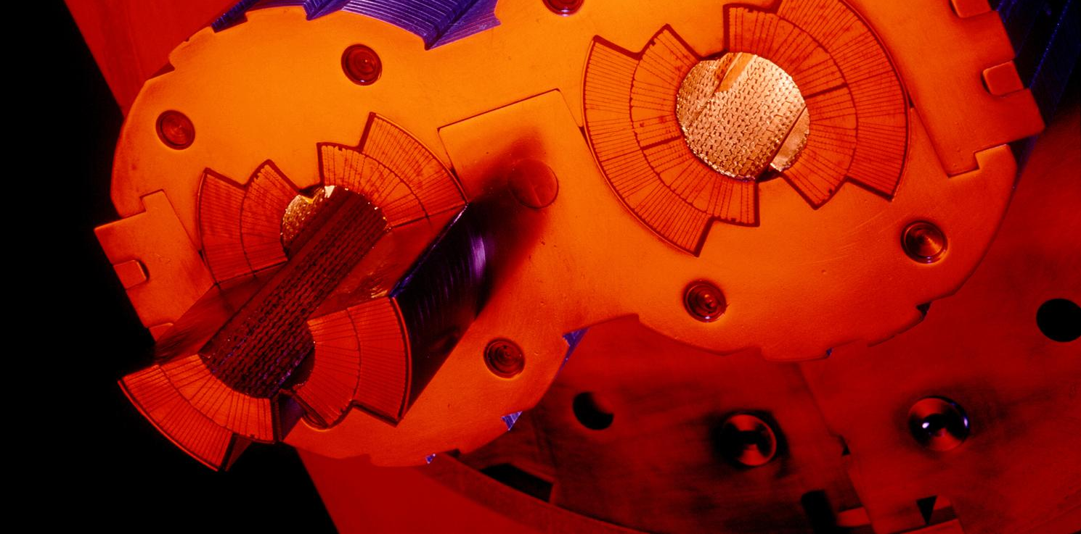
Very high vacuum
Notes:
These 2 pipes need to be as empty as possible (otherwise protons would hit air molecules all the time).
Thanks to turbo-molecular pumps and other technologies, we reach a vacuum of 10^-13 atmosphere in the centre of the pipes: this is 10 times emptiers than on the surface of the Moon or as empty as in the solar system.
The magnetic field which curves the beam, is provided by the coils surrounding the pipes. As each beam holds as much energy as in a high-speed train, the magnets must deliver a tremendous magnetic field of 9 T (tesla). This equates to 200’000 times the magnetic field of Earth (ca 45 micro tesla)
For that, each of the small electric cableyou see around the vacuum pipes (1mm by 10mm section) a current of 11’000 amperes (in comparison in your home there is a current of about 20 amperes in the wires).

Slide 35
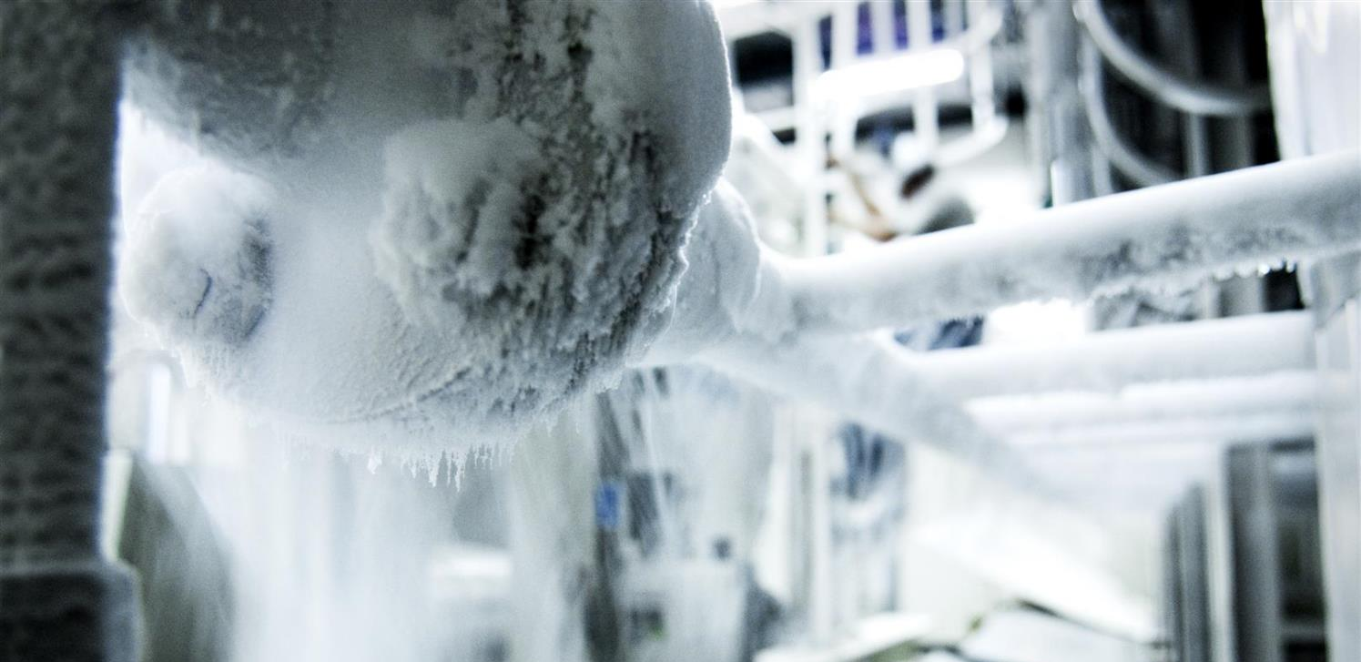
Extreme temperatures
Notes:
That’s why we need to cool down the cables to the lowest temperature possible.
We have to reach -271°C (or 1.9° kelvin, which is 1.9° above the absolute zero).
At that temperature, the cables made of Niobium Titanium (NbTi) are «superconducting», it means they don’t heat up anymore as they have no electric resistance.
LHC is colder than the vast majority of the Universe whose average temperature is 2.725° kelvin (if you look for a «cool» place to work, CERN is a good one)
This is possible thanks to cryogenic facilities using 120 tonnes or 700’000 litres of Helium!

Slide 36

Radiations
Notes:
And the final experiment on the LHC is LHCb. Is is name after the «b» quark which it studies.
In fact LHCb studies the behaviour difference between the b quark and the anti-b quark.
It tries to find difference in the symmetry which may account for the lack of antimatter in the Universe.
It gathers 800 physicists from 69 universities and institutes in 17 countries.

Slide 37

Big data
Notes:
All these detectors will generate loads of data… about 1 PB (petabyte = million of gigabyte per… SECOND!)
Impossible to store so much data. Anyway not needed.
The event the experiments are trying to create and observe are very rare.
That’s why we make so many collisions but we keep only the interesting ones.
Therefore next to each detector is a «trigger», a kind of filter made of various layers (first electronic, then computers) which will select and keep only 1 collision out of a million average.
In the end will still generate dozens of Petabytes of data each year. We need about 200’000 computer CPUs to analyze this data.
As CERN has only about 100’000 CPUS we share the date over more than 100 computer centre over the planet (usually located in the physics institutes participating to the LHC collaboration). This is the Computing Grid, a gigantic planetary computer and hard drive!

Slide 38









Medical Applications
Particle accelerators for hadron therapy
Particle detectors for medical imaging
Computing for simulations and medical data management and analysis
Photons
Protons

Slide 39

Aeropace Applications

Slide 40


Environmental Applications

Slide 41

Highest Priority CERN Poles of Competence in Environmental Applications

Slide 42


Slide 43
CERN contributions to the agenda
White Rabbit
SCADA Modular
Digital Twins
Web Energy

Slide 44







Thanks for your attention!
https://kt.cern/
https://knowledgetransfer.web.cern.ch/news/news/knowledge-sharing/statnett-and-cern-collaborate-embrace-innovative-energy

