Slide 1

ENTSO-E
Thursday Wrap-up

Slide 2
Today
Dinner: 19:00 in Café Papon (Geneva)
  40 minutes by tram: take the #18 up to Place de Neuve
  Some of us are going together right now => let’s meet in front of the CERN Hotel in 10mn or directly at the restaurant

Slide 3
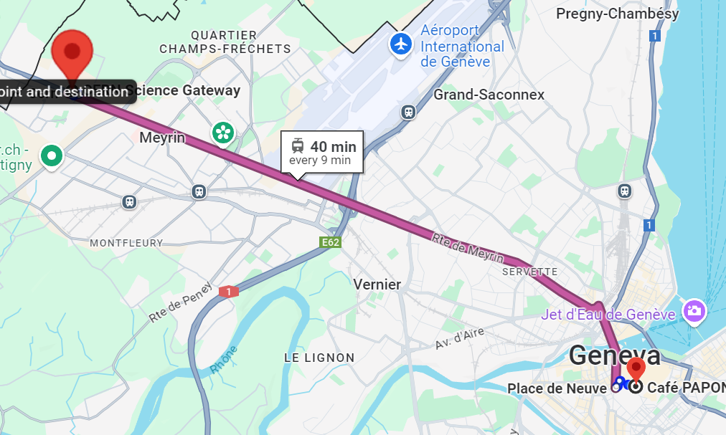
Dinner transportation

Slide 4
Tomorrow
Meeting point: 8:30 on the parking of the Science Gateway. Going by bus – Be on time!
Lunch vouchers – Do not lose yours!
Return: Back at 15:30 at the same place.
  Need to leave earlier? Tell us now!
  Looking for something to do after? Feel free to visit the exhibitions in the Science Gateway, and the shop ☺

Slide 5
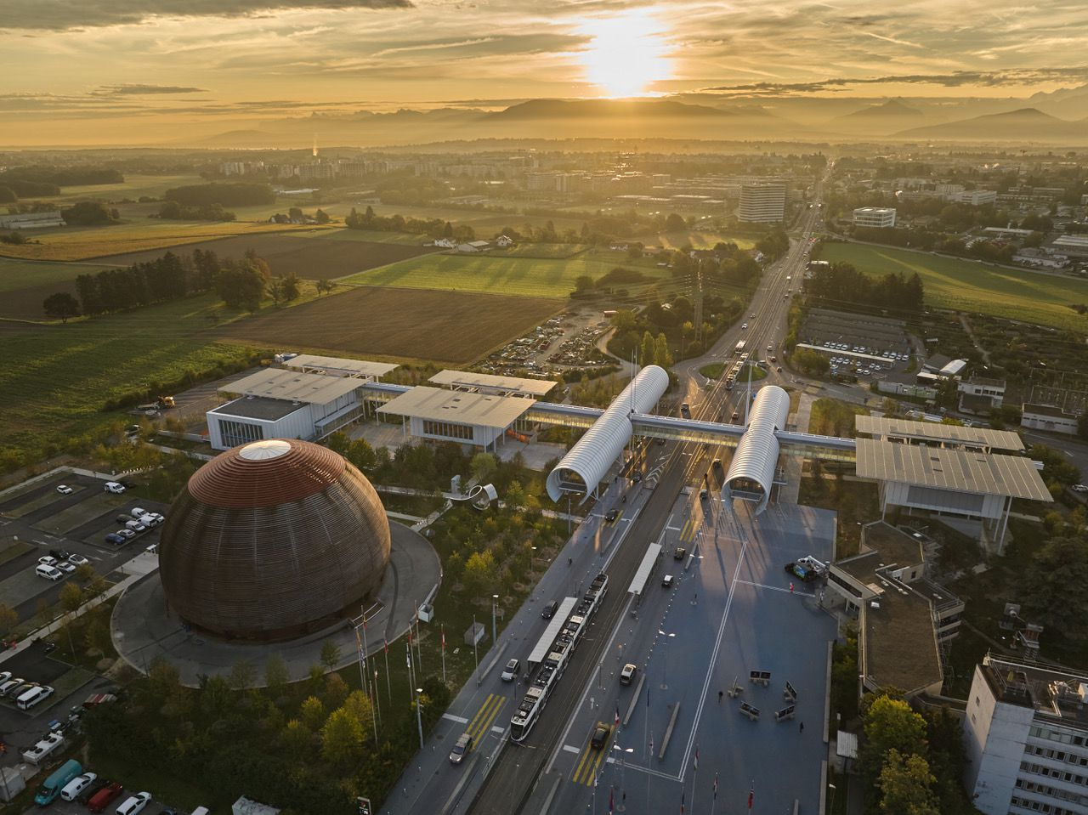
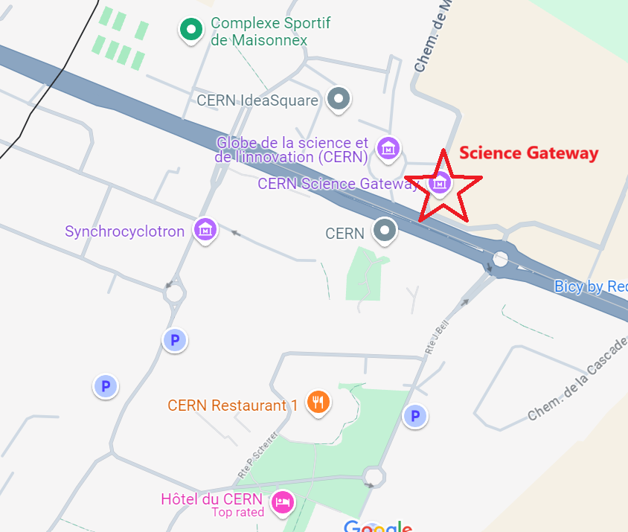
Science Gateway
PARKING

Slide 6
No | Subject | Period | Duration | Presenter | Location
0 | Transportation to Prevessin site (by bus) | 08:30 - 09:00 | 30 min | - | Science Gateway
1. | ENTSO-E WG5 Update including internal - external developments (DESAP, RDI Roadmap and Technopedia) | 09:00 - 09:30 | 30 min | Anna, Siddhesh | 774/2-058 (CERN)
2 | Presentation from CERN – Modular SCADA | 09:30 - 10:00 | 30 min | Piotr Golonka | 774/2-058 (CERN)
Coffee Break (15 min) |  |  |  |  | CERN
3 | Visit: CERN Control Centre (CCC) | 10:15 – 10:45 | 30 min |  | CERN
4 | Presentation from CERN – Digital Twin | 10:45 - 11:00 | 15 min | Oscar Sacristan de Frutos | 774/2-058 (CERN)
5 | WG5 Session: TF VIS | 11:00 - 12:30 | 90 min | Ralf, Dennis | 774/2-058 (CERN)
6 | Presentation from CERN – Web Energy | 12:30 – 12:45 | 15 min | Anargyros Kiourkos | 774/2-058 (CERN)
Lunch Break (60min) | Lunch Break (60min) |  |  |  | R3
7 | WG5 Session: TF WAMS Whitepaper on PMU implementation guidelines Next steps within TF WAMS workstream | 13:45 - 14:15 | 30 min | Matija, Anna | 774/2-058 (CERN)
8 | Summary & Closing of Day 2 (Next WG5 Meetings, AOB) | 14:15 - 14:45 | 30 min | Anna, Kjell-Peter, Siddhesh, et. al | 774/2-058 (CERN)
9 | Group Photo | 14:45 - 15:00
10 | Bus Transportation back to Meyrin Site | 15:00 - 15:20 |  |  | Science Gateway

Slide 7
Questions?
Remind me to give you your vouchers if I haven’t done so yet….

