Slide 1
Monitoring & Forecasting CERN’s
Energy Consumption
Challenges & Opportunities
A.Kiourkos
2024-09-13
ENTSO-E

Slide 2

Agenda
CERN’s Electrical Network
Energy consumption at CERN
Energy Monitoring
Forecasting
Anomaly detection
On-going works

Slide 3
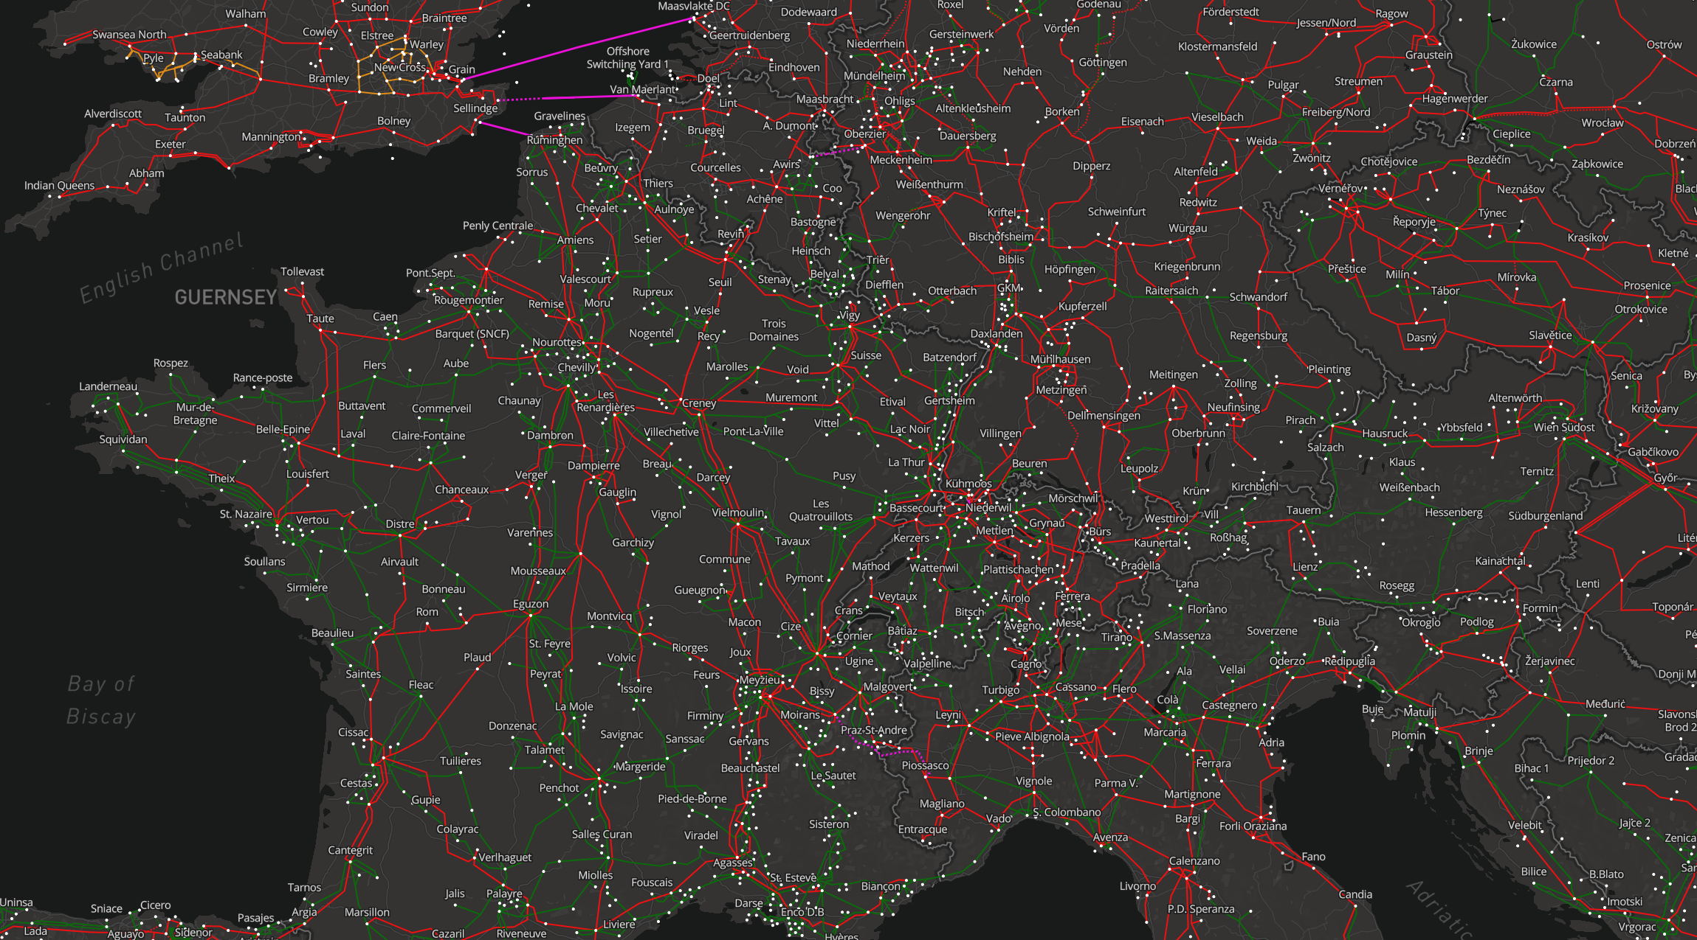
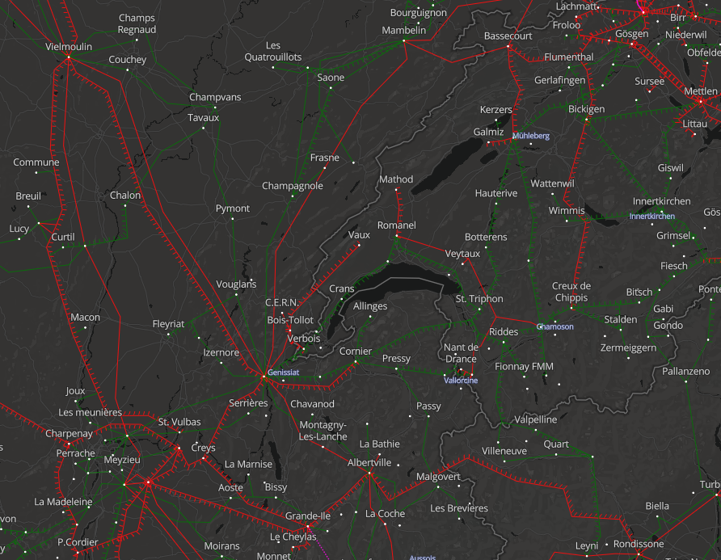
400 kV
220 kV

Slide 4
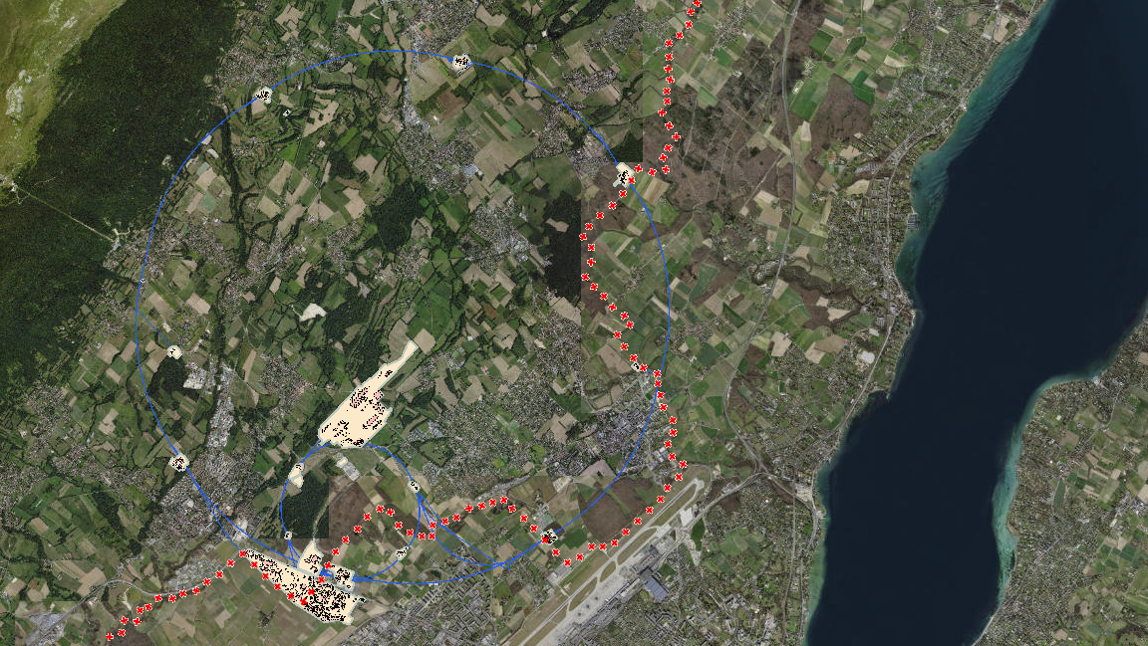
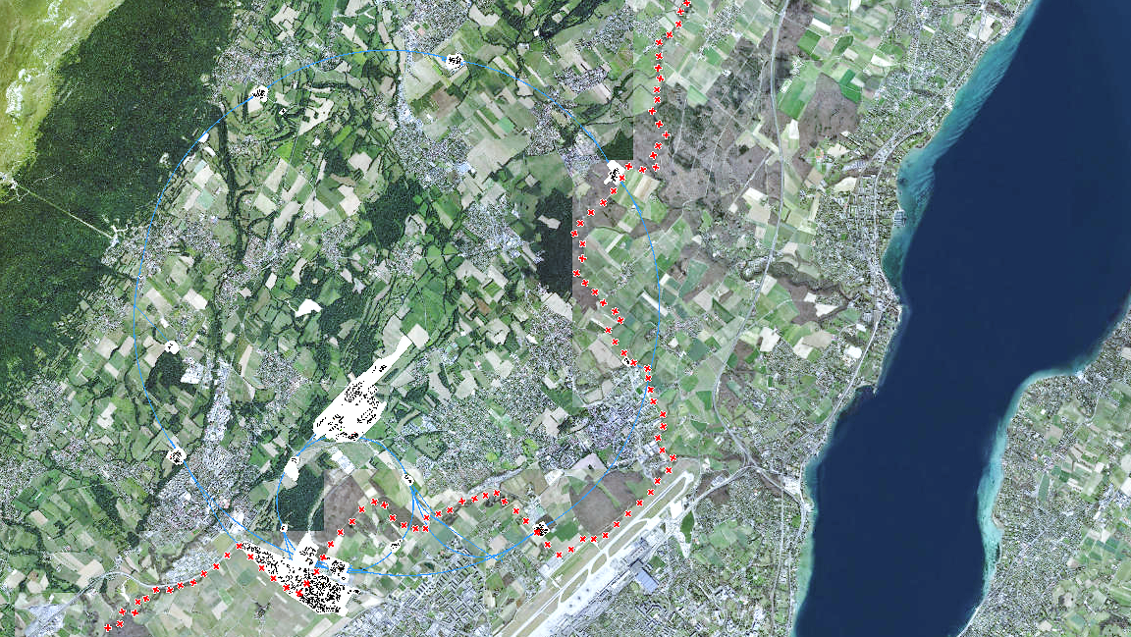


ROMANEL
CHAMOSON
RTE/Swissgrid 400 kV lines
RTE Bois-Tollot 400 kV substation
BE1 400/66/18 kV substation
BE2 400/66 kV substation
66 kV lines
66/18 kV substation
18 kV lines
18 kV substation
SIG 132 kV line
ME10 130/18 kV substation
ENEDIS 20 kV suppliles
B.T.
BE1
BE2
BE1
BE2
B.T.
GENISSIAT
VERBOIS

Slide 5
Energy consumption @ CERN
High-energy physics is energy-intensive…. 😊
Magnets
RF Cavities
Cooling systems
  Cryogenics
  Cooling and Ventilation
Data Centers
General Infrastructure
Canton of Geneva
CERN
1.2 GWh
~ 1/3

Slide 6
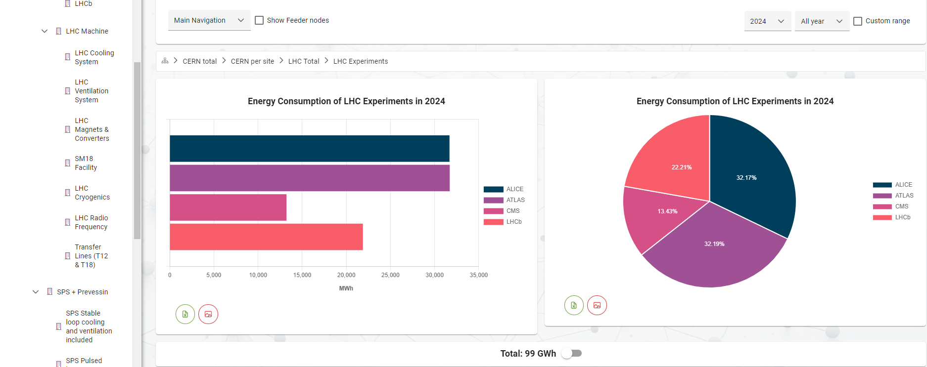
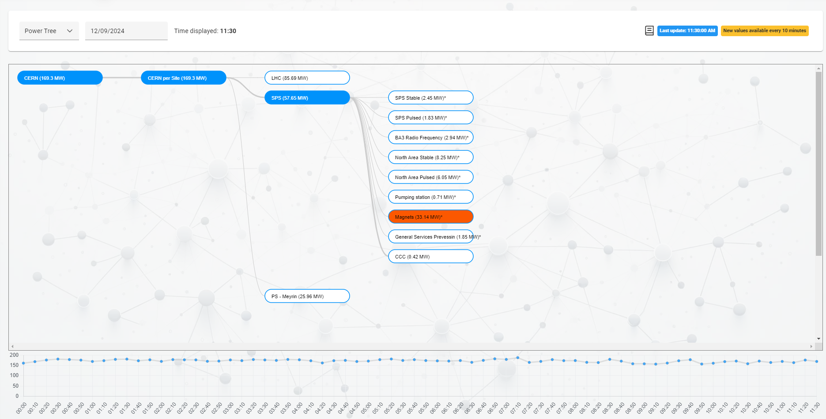
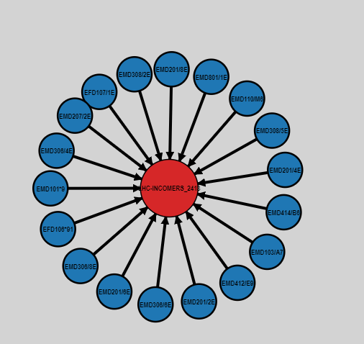
Web Energy
Energy Management System developed @ CERN.
Records and monitors energy consumption.
Forecasts energy consumption.
Detects anomalies.
Facilitates the management of the electricity contract.
Provides users with visibility into energy consumption.
Contains the experience of CERN’s energy management team.

Slide 7
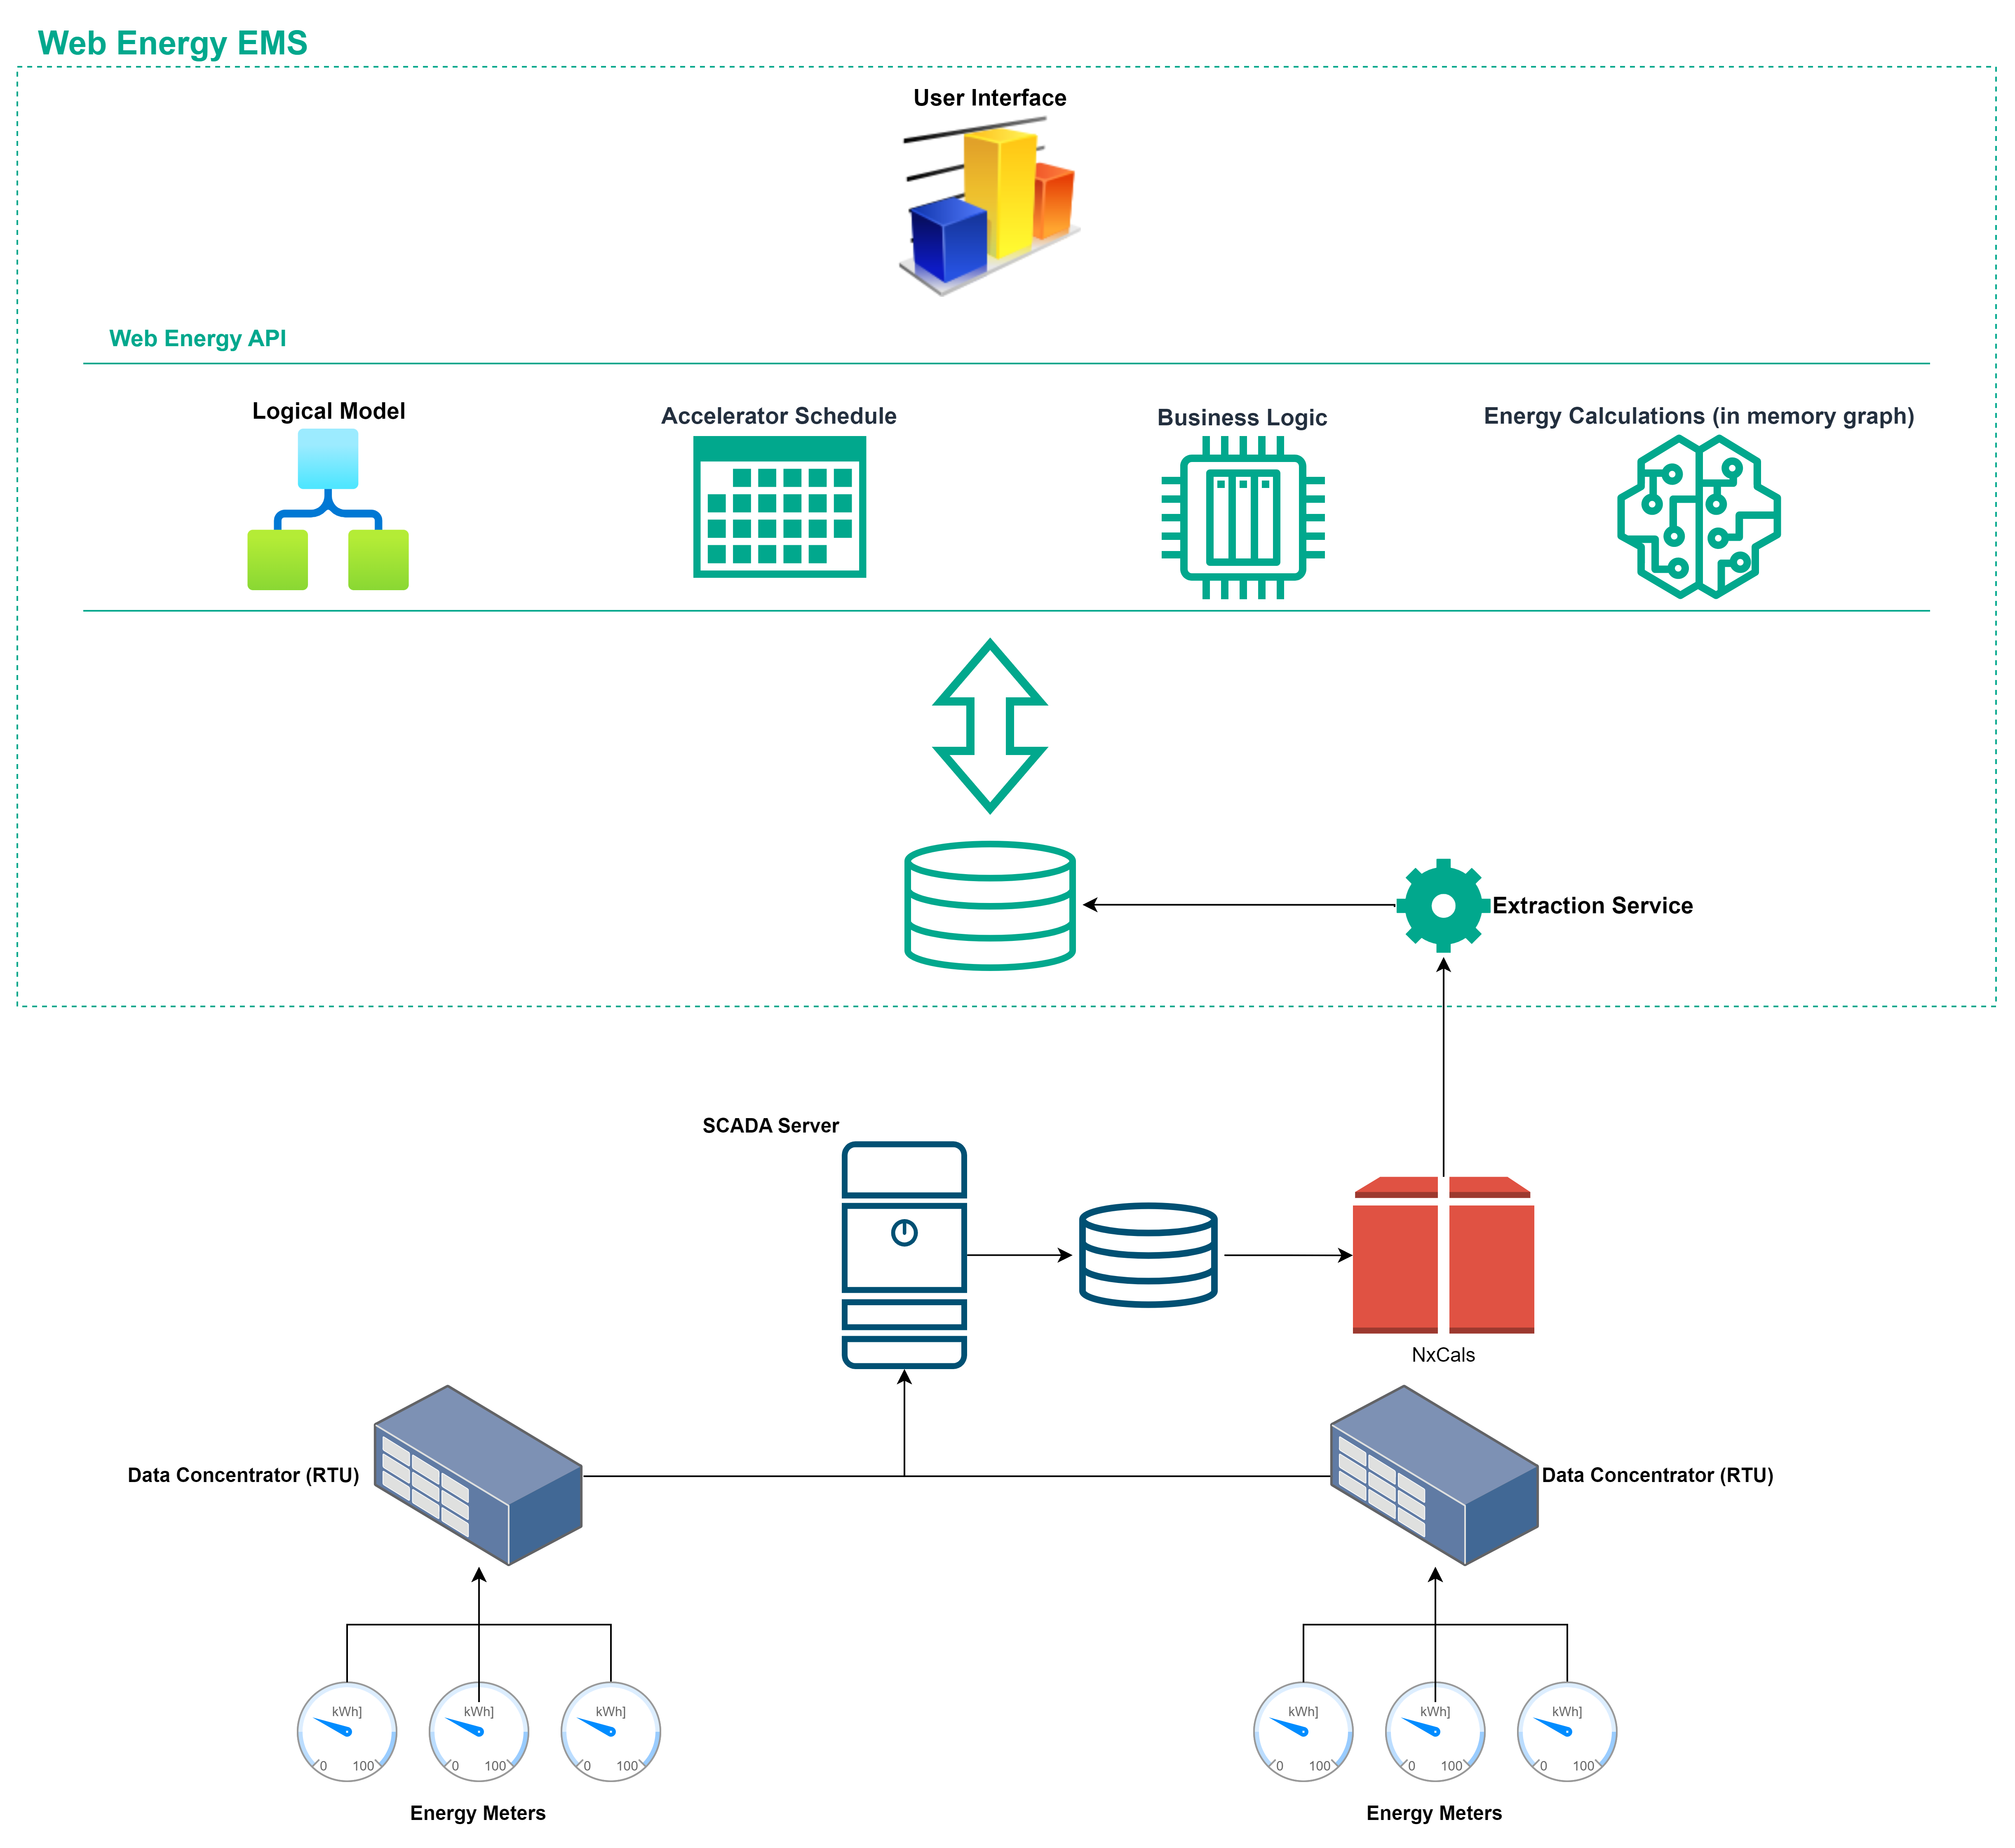
Architecture
Cloud native architecture.
Various data sources.
Flexible & scalable.
Import-export of data using open formats.
Based on open-source technologies.

Slide 8
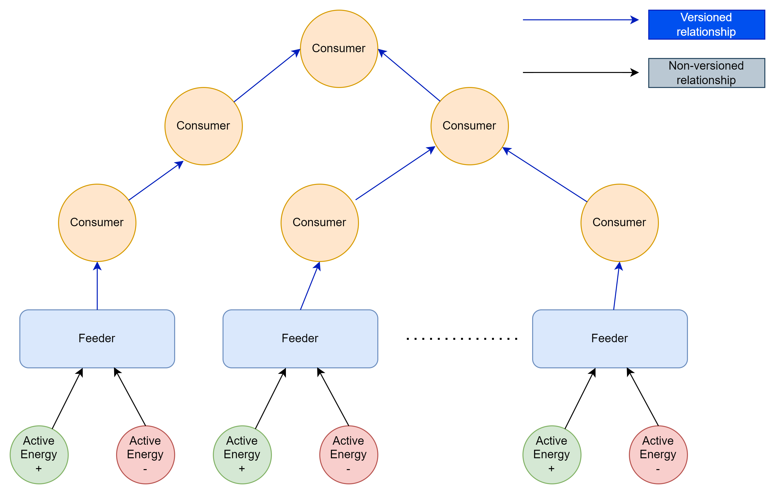
Data Model & Versioning

Slide 9
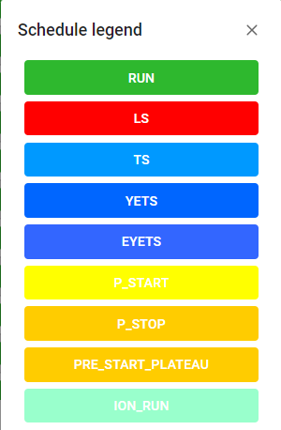
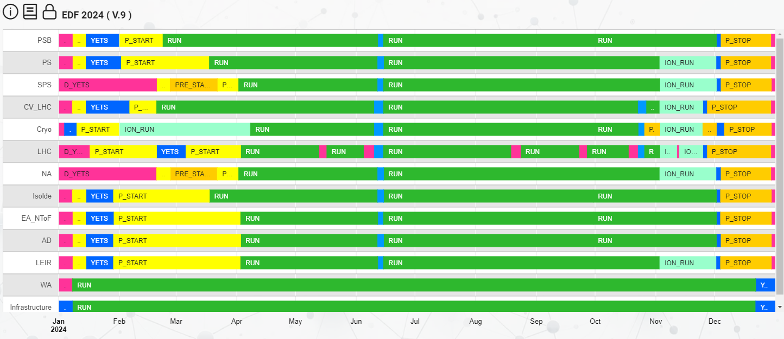
Forecasting

Slide 10
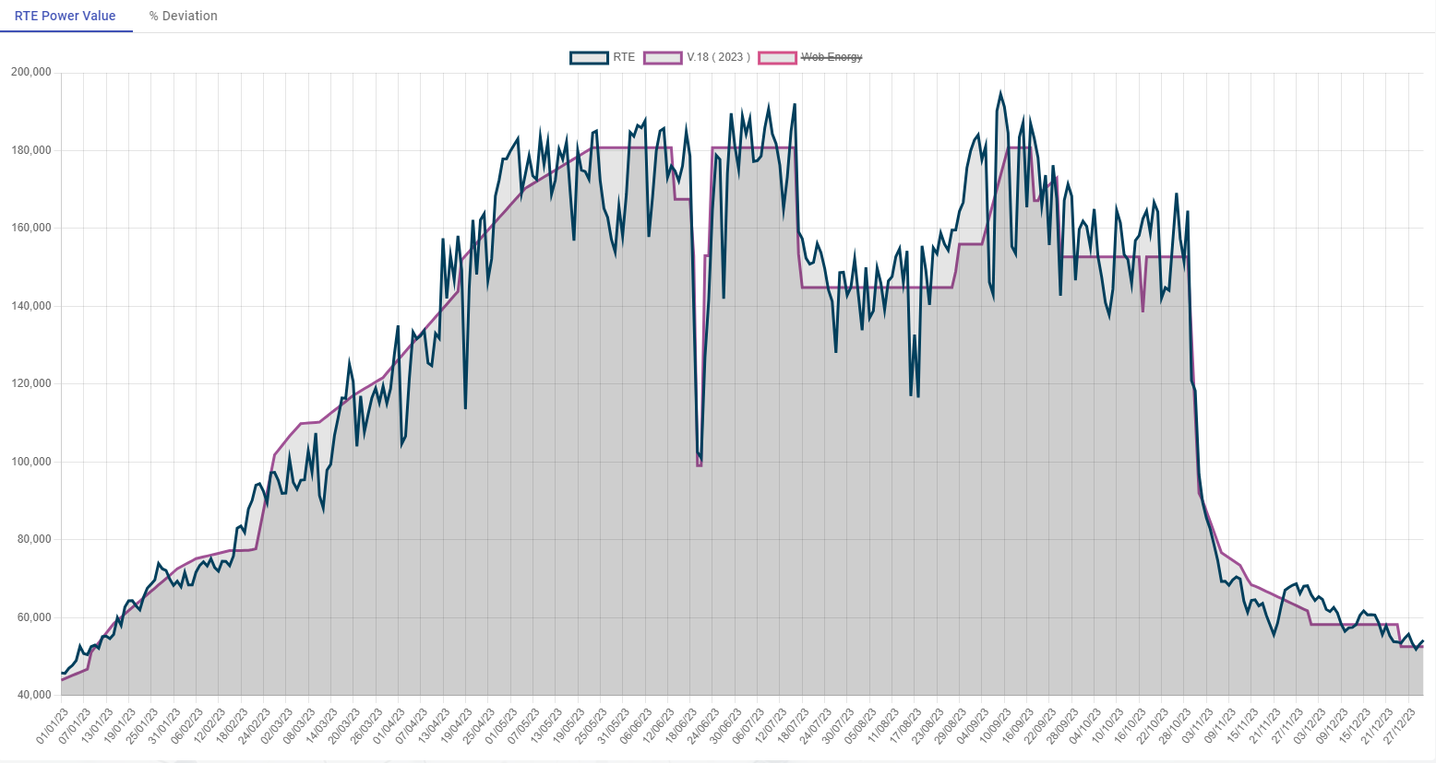
Forecasting

Slide 11
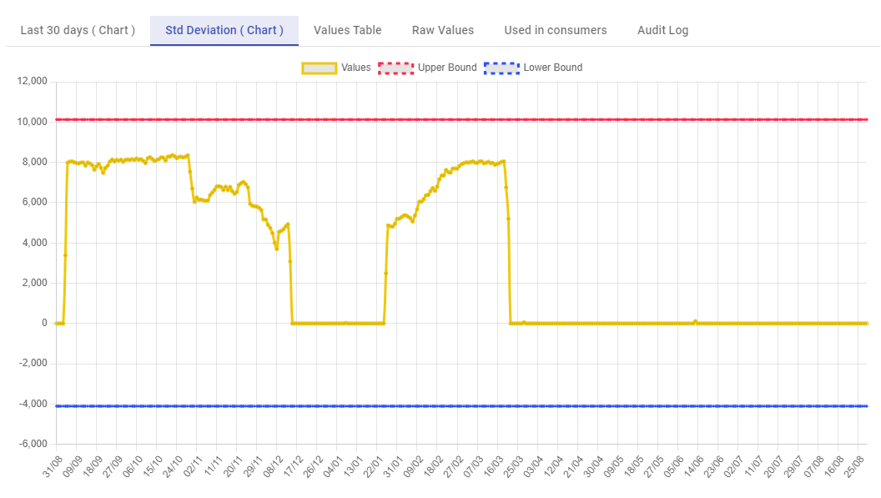
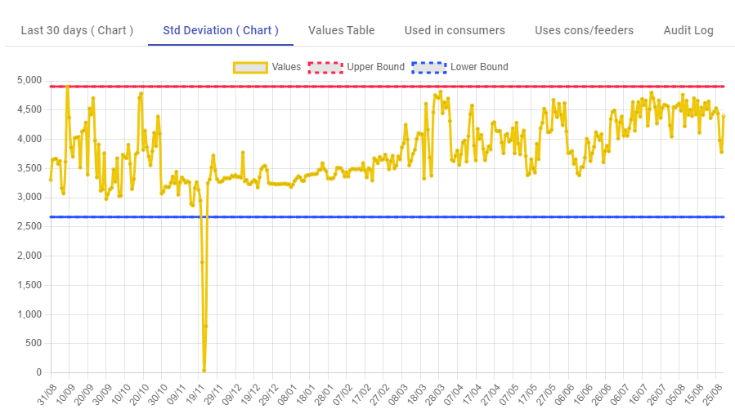
Anomaly Detection

Slide 12
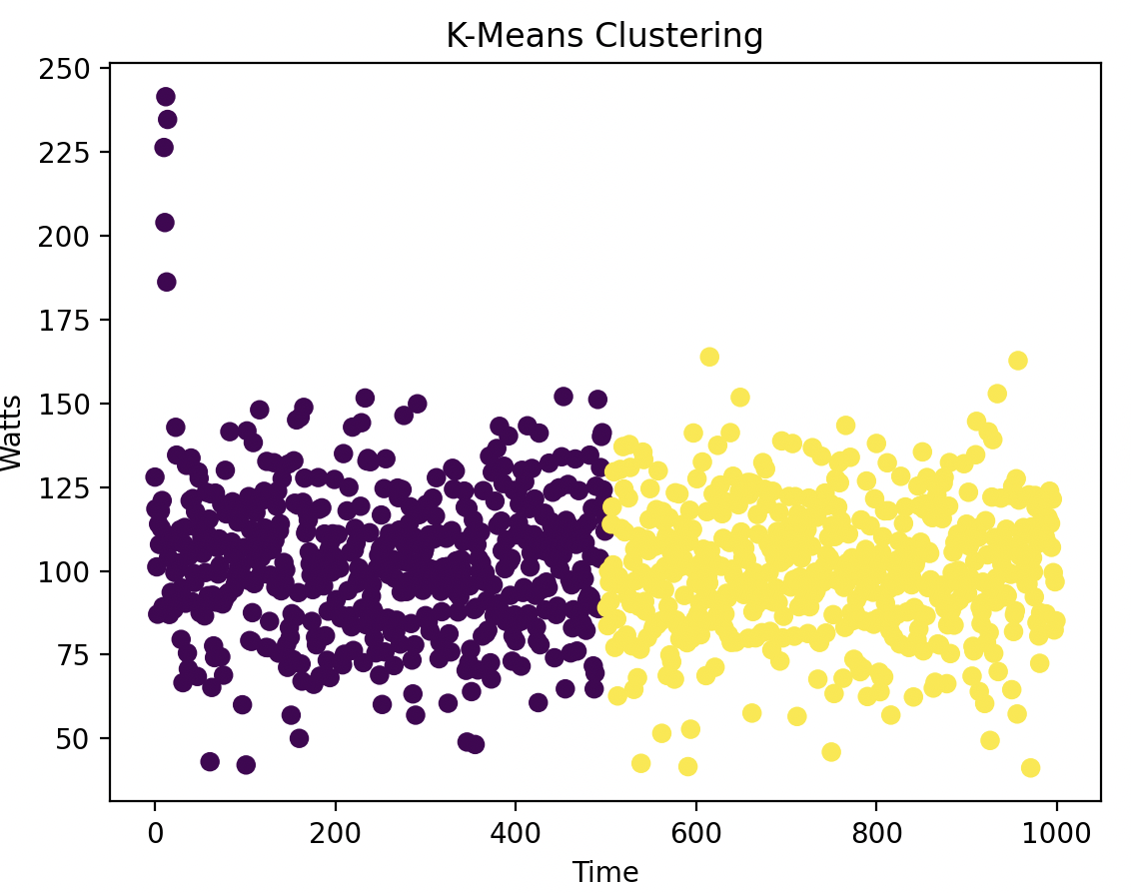
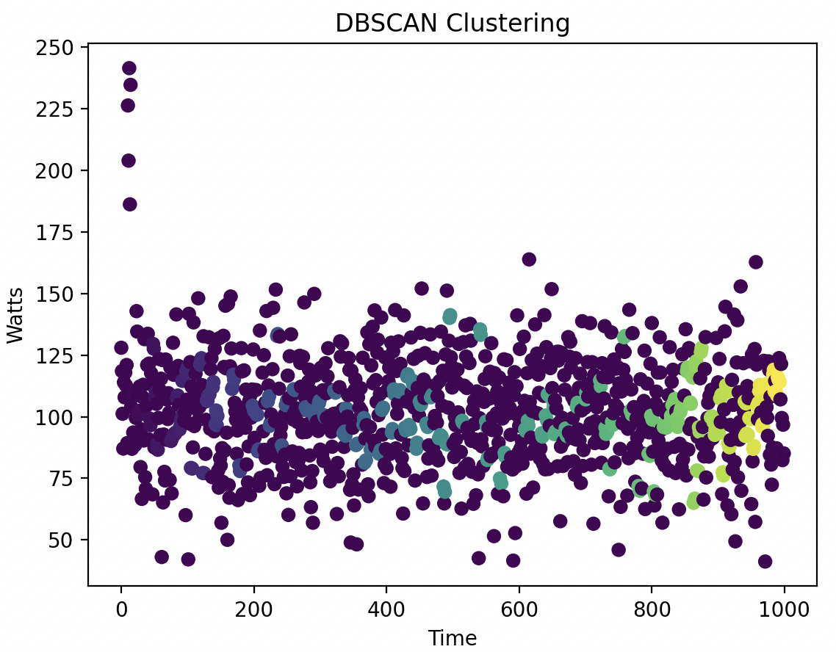
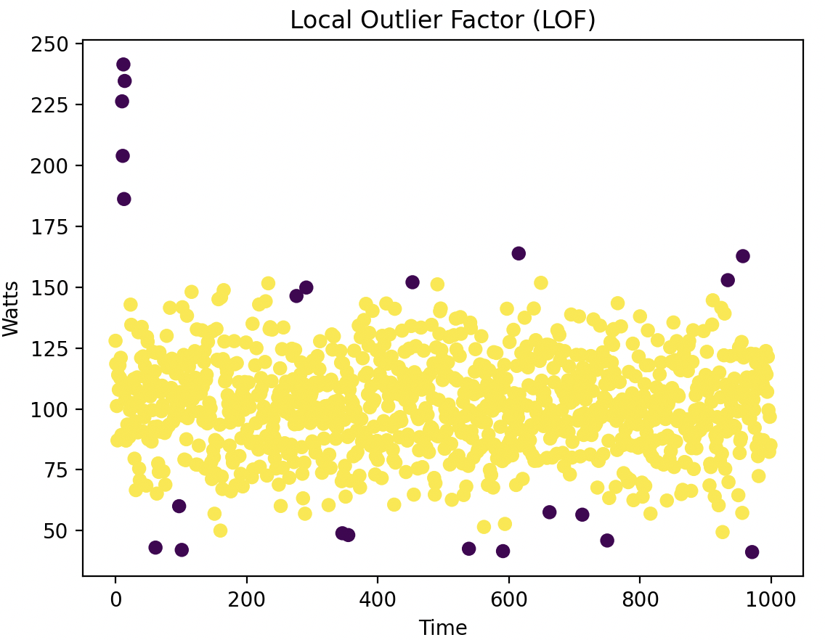
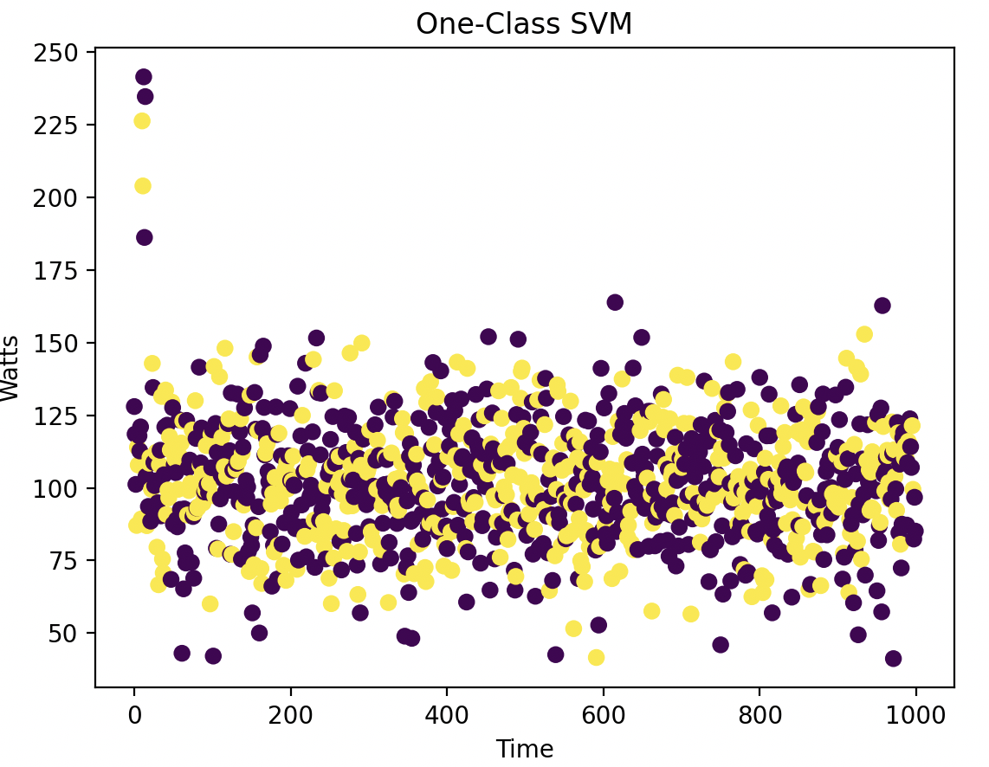
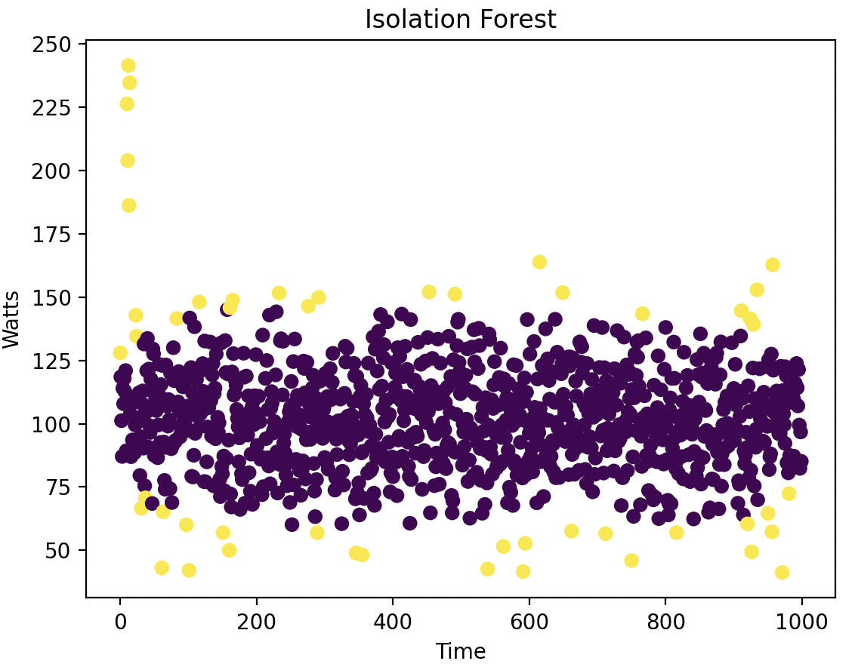
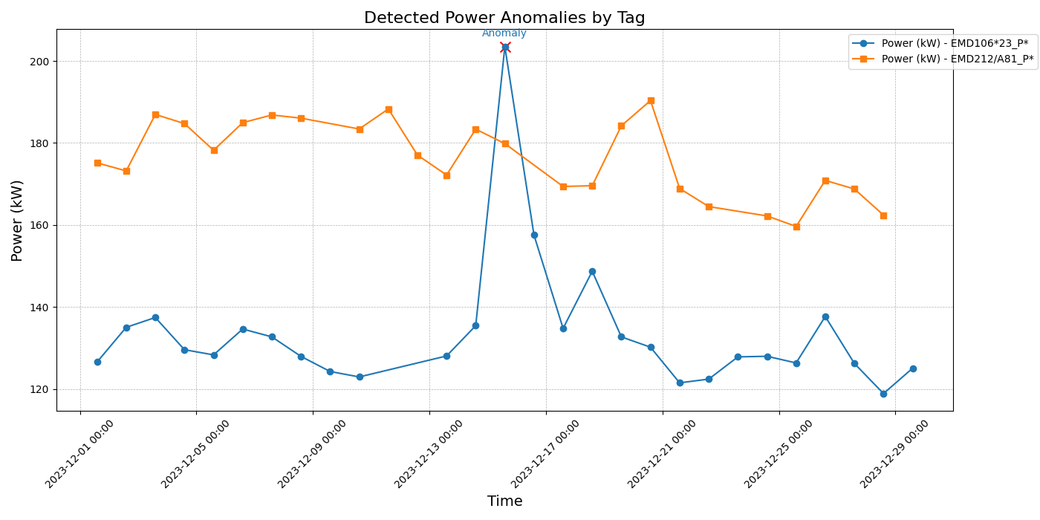
Anomaly Detection

Slide 13
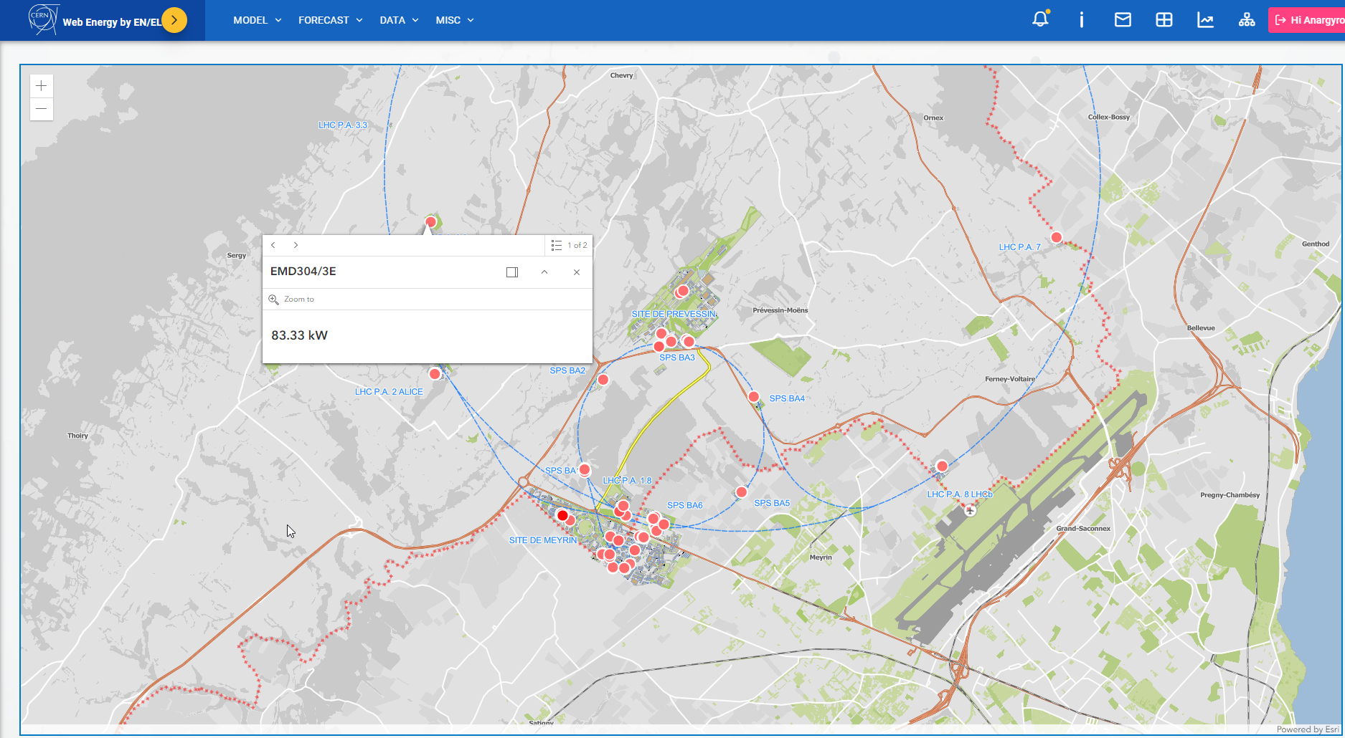
On-going works – GIS Integration

Slide 14





On-going works
Gas and Water monitoring.
KPIs according to ISO 50001.
Short term forecasting and analysis using AI.
Advanced reporting capabilities
Customizable dashboards

Slide 15
Questions?
akiourko@cern.ch

