Slide 1
LEAN MAIL OFFICE WORKSHOP
LEAN MAIL OFFICE TEAM
05/06/2024

Slide 2
Mail Office activities
Sorting of coming mails from french and swiss posts : approx 300 mails per day
Delivery of mail – 6 rounds in Meyrin and Prevessin + 1 for the LHC points (when needed)
Outgoing mail collection, franking and sending around 1’300 per month
Around 2’400 inbox in total on CERN sites
Invoices and pension fund mails sorting every morning
Mass mailing preparation and sending around 3’000 per month
Preparation of shipment by express mail (documents only) requested through Snow
Diplomatic documents transportation twice a week (7-8 requests per week)
Snow requests handling

Slide 3
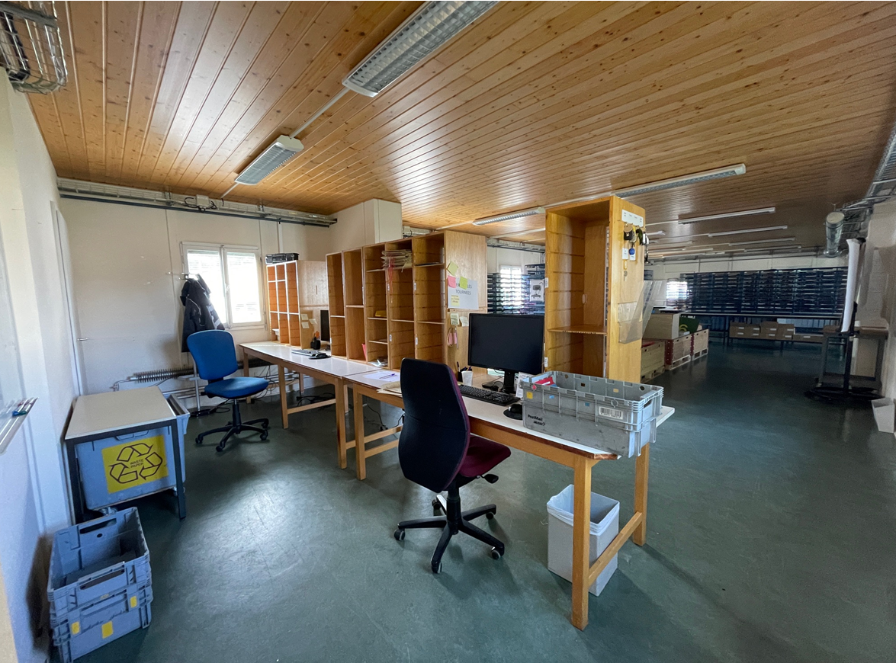
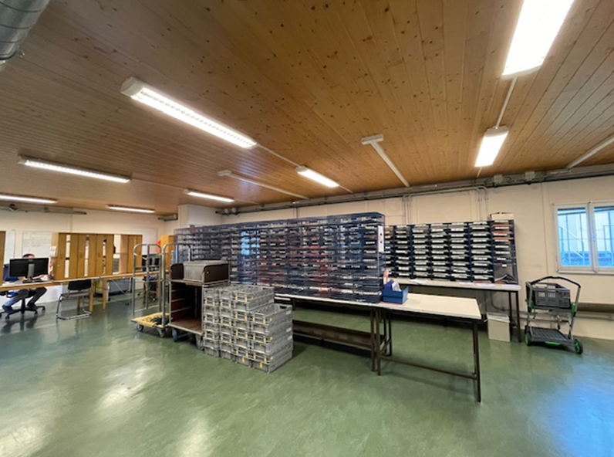
Mail Office activities
1st sorting → per round
2nd sorting → per distribution point (per building – per floor – per office)

Slide 4
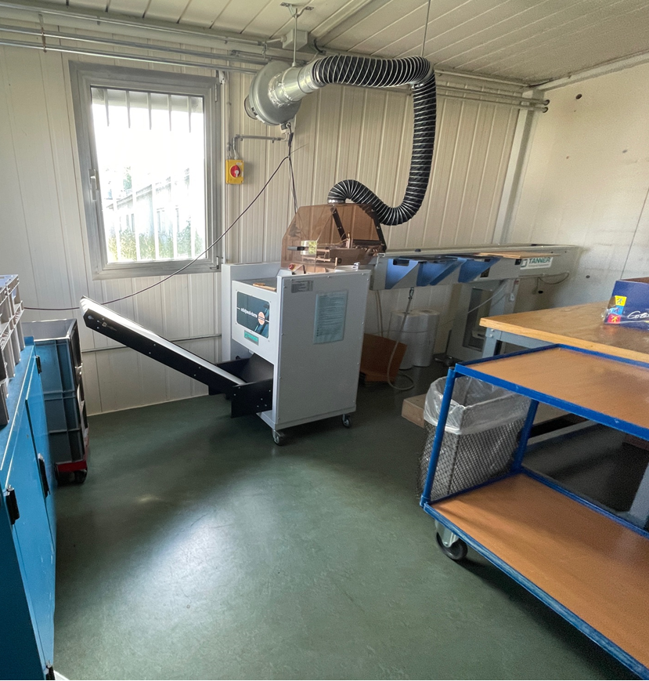
Mail Office activities
Mass mailing preparation area

Slide 5
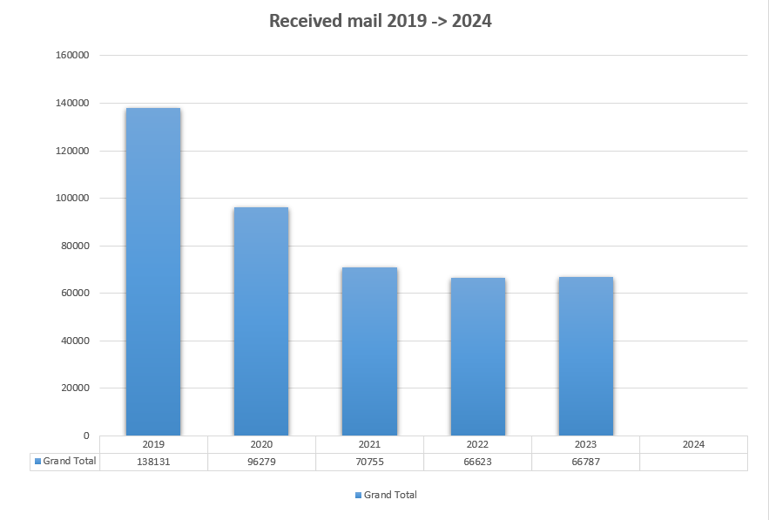

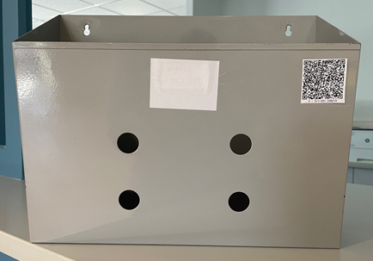
Background
Background:
50 % mail reduction following COVID period
Rounds schedule difficult to identify for users even if information is sent by email (secretary) or available on the SCE website
Rounds not well balanced (ex. B.40 & B.42 already in an extended round)
2,5 FTE per day to do all the rounds + mass mailing + Snow tickets handling + express mail + outgoing mails franking + diplomatic rounds
Lot of distribution points never delivered (movement = MUDA for the team)
Difficulty for the team to scan the QR codes on Inbox

Slide 6
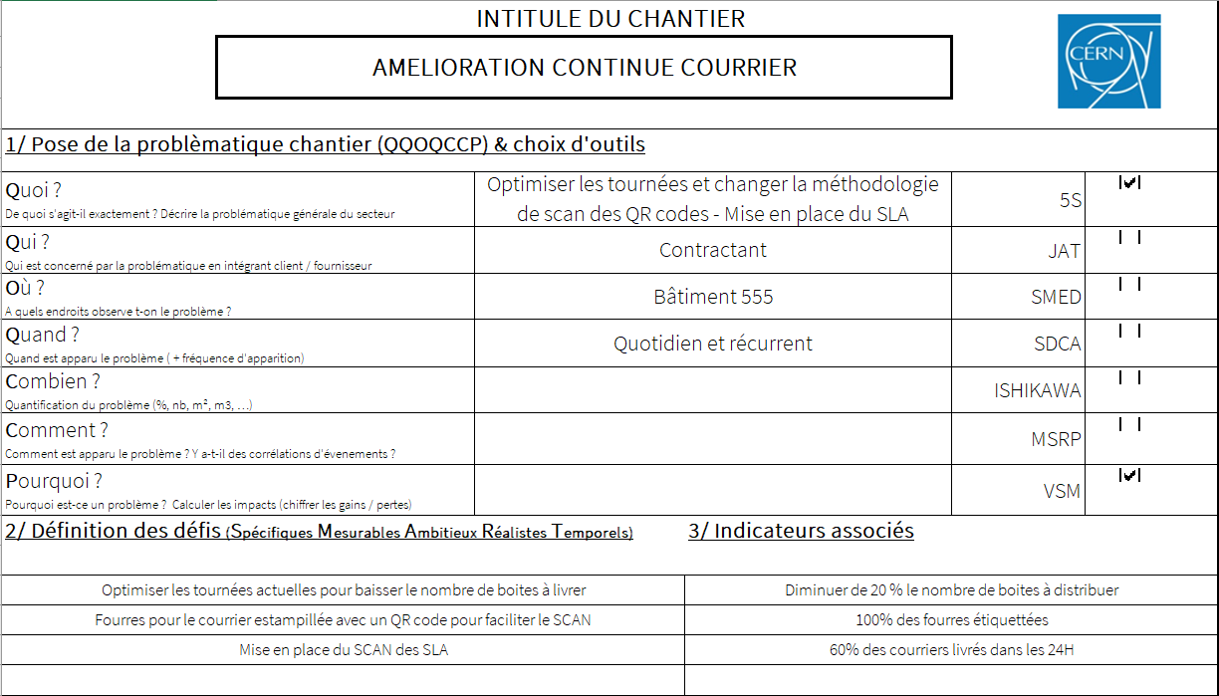
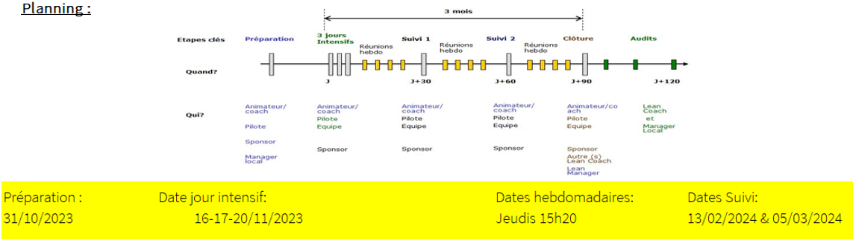
Preparation day : Challenges – KPI - Planning
Chosen KPIs:
Number of inbox decreased at each step
Participation rate

Slide 7
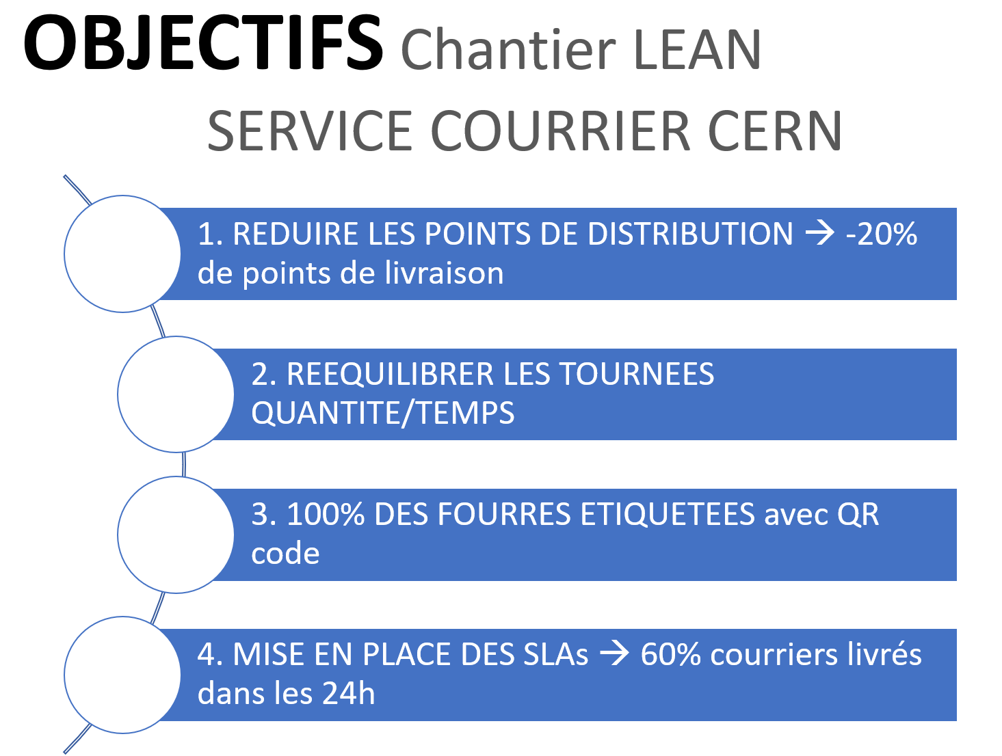
Validated Objectives

Slide 8
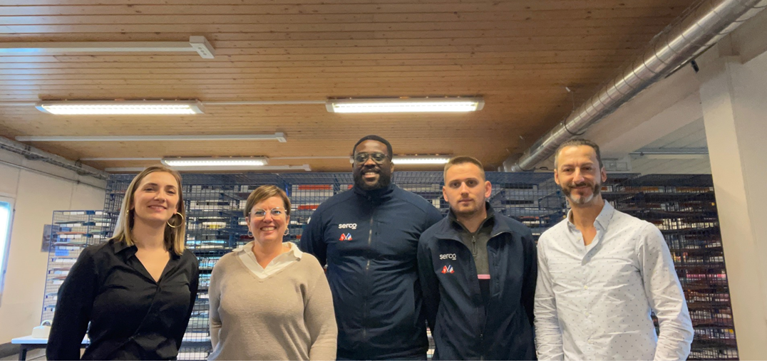
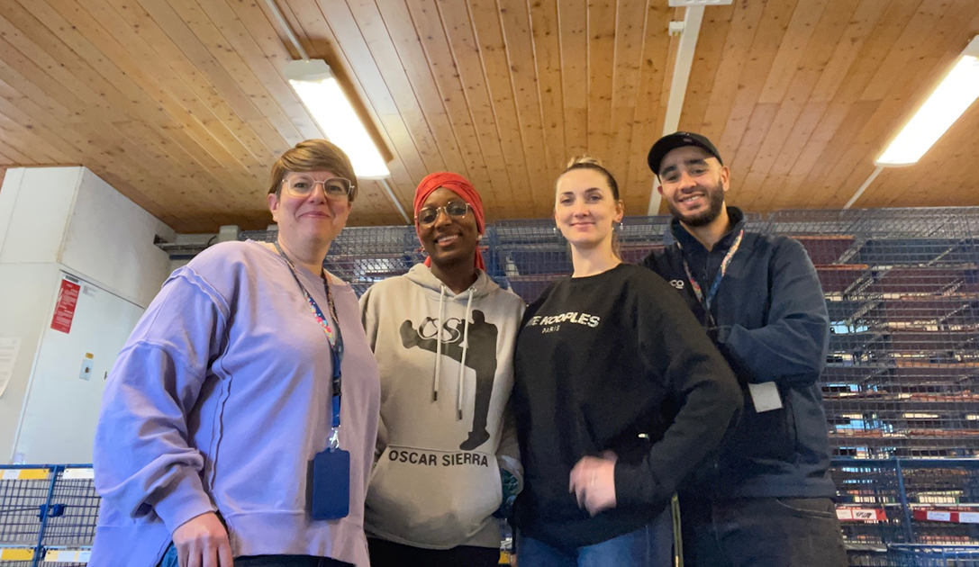
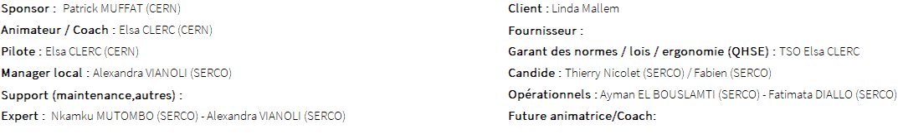
Team
1st team
2nd team

Slide 9
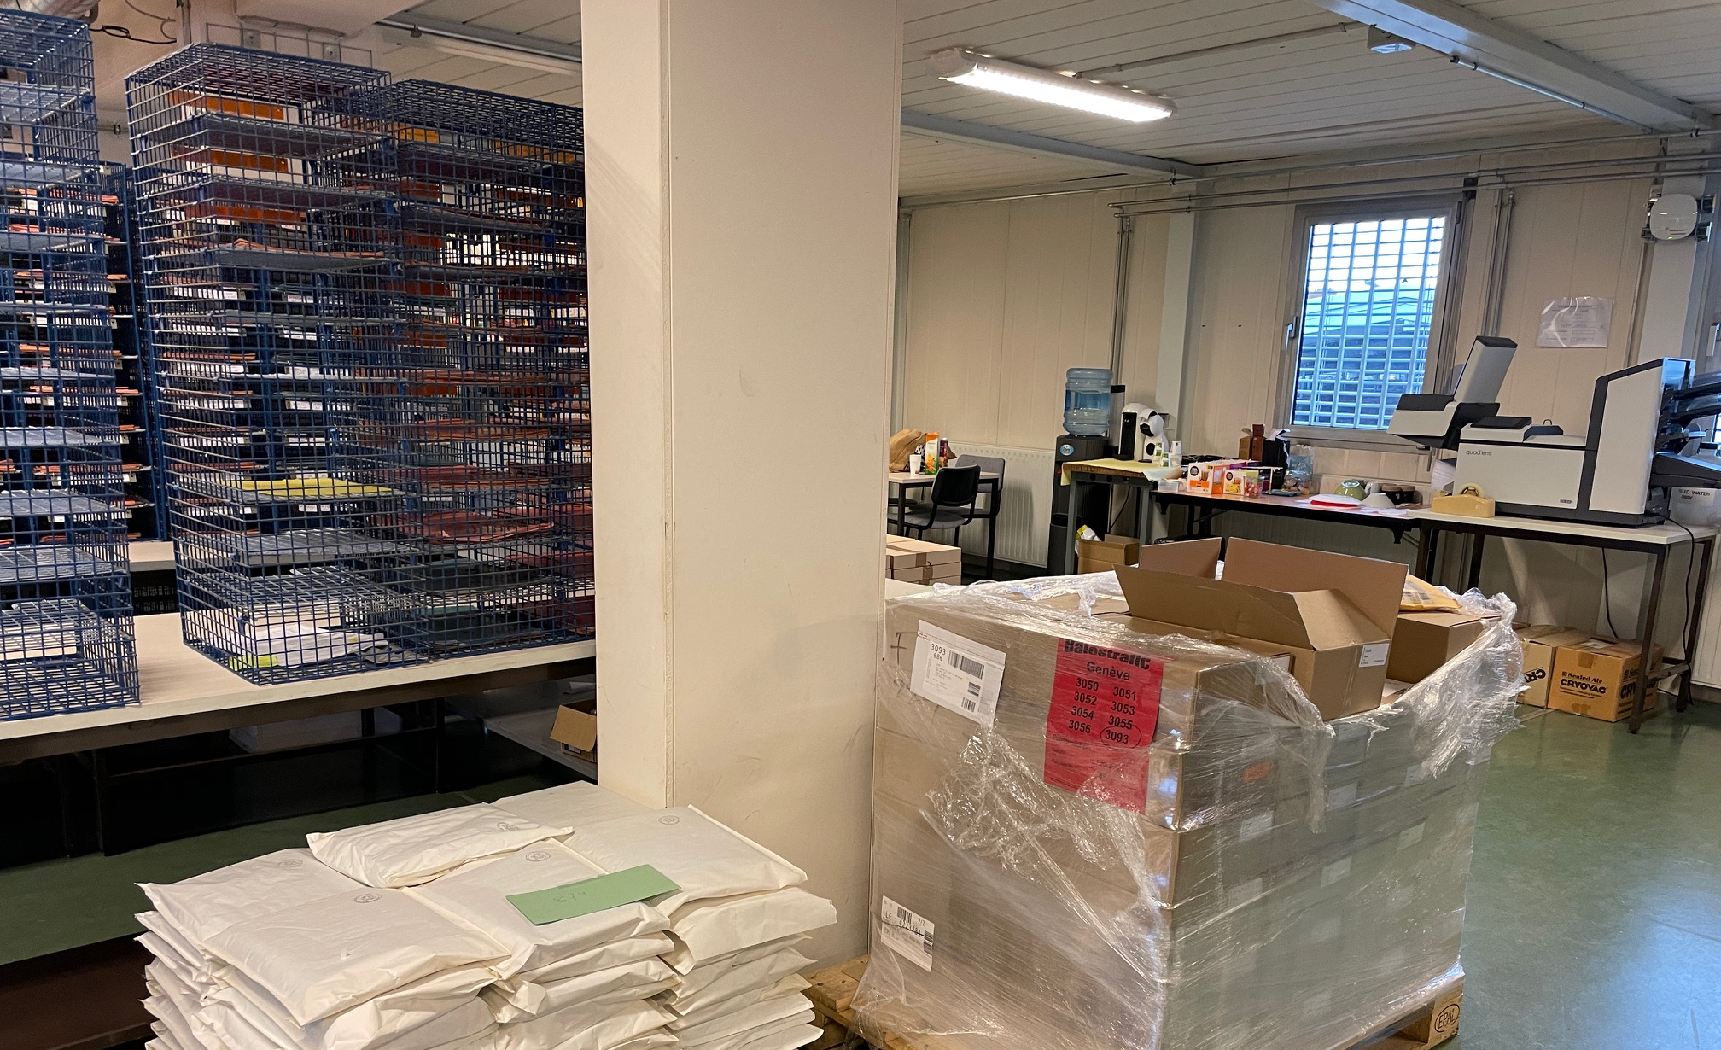
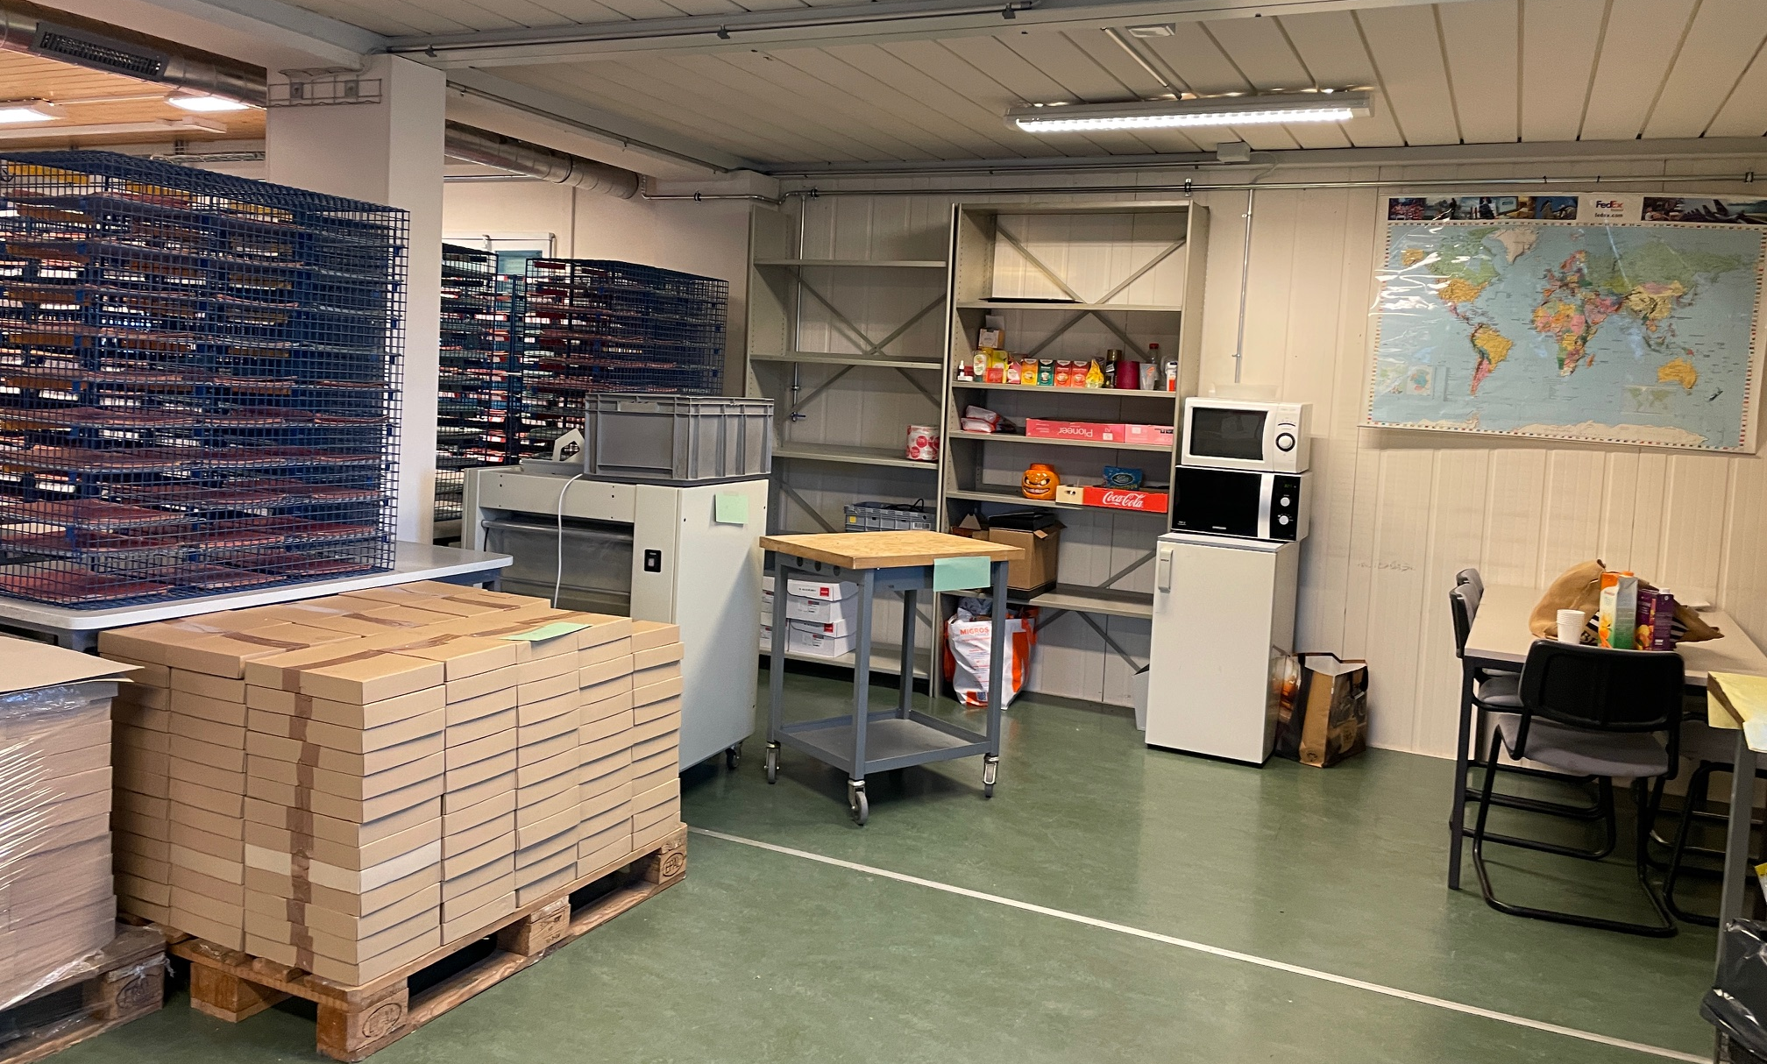
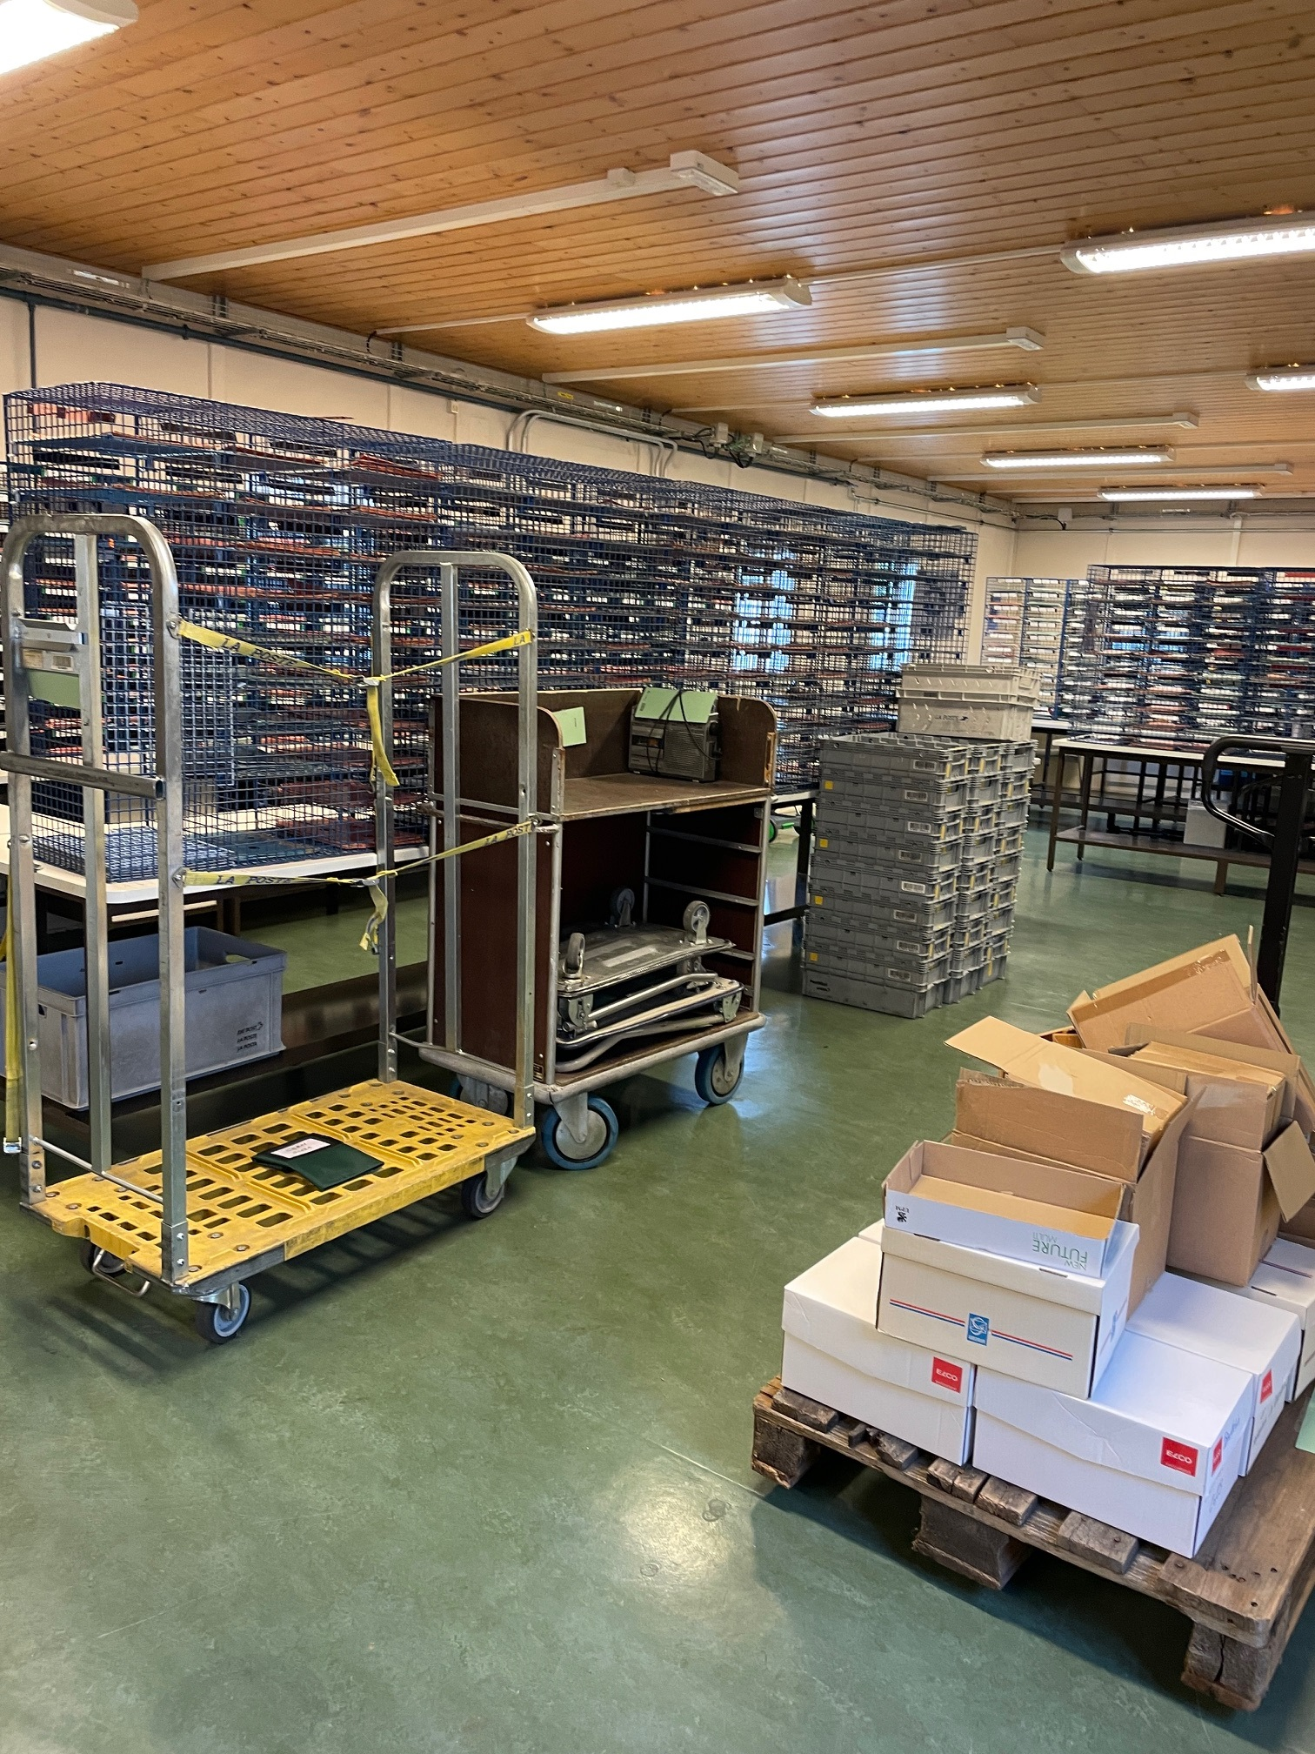
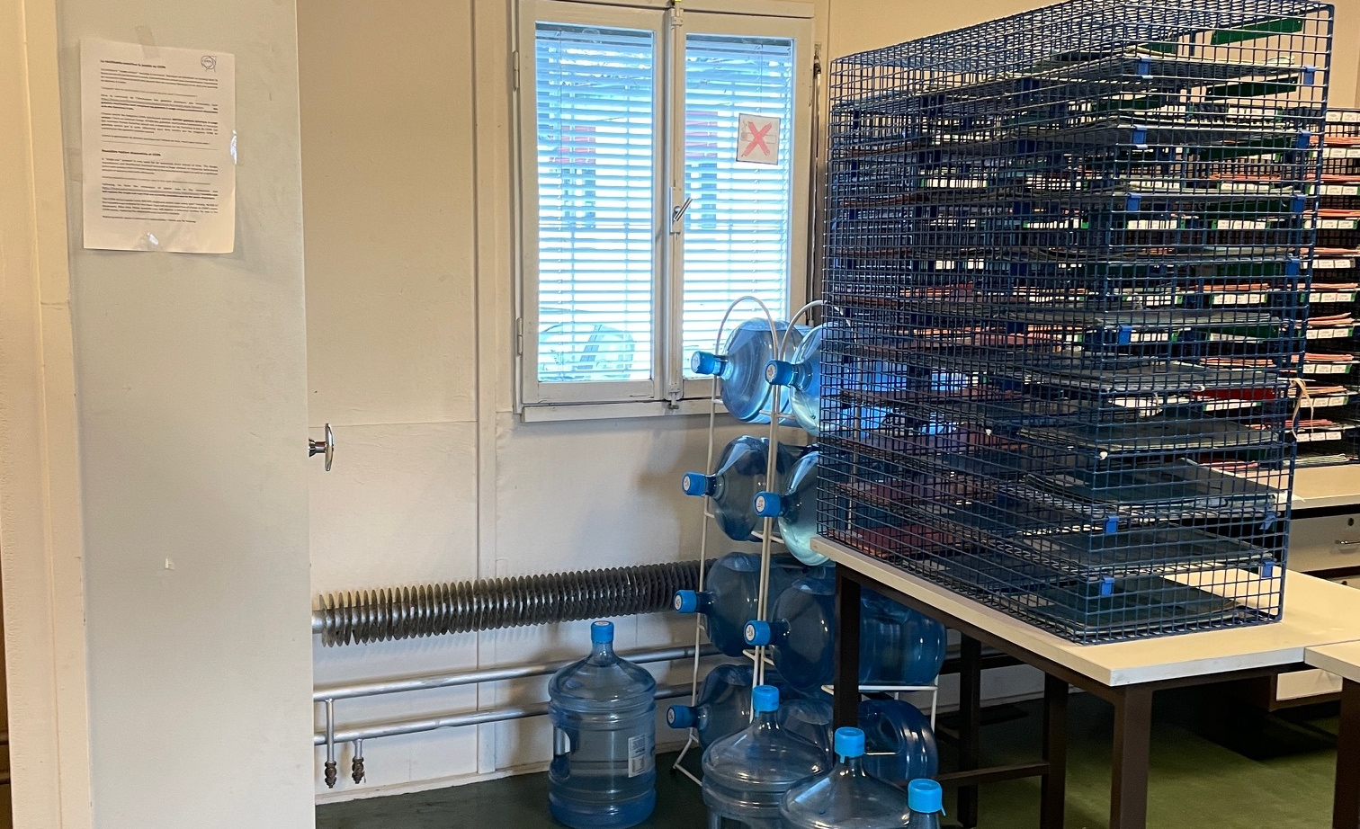
Before workshop
Pictures taken before LEAN workshop
Many objects kept “in case of”
Cluttered work area

Slide 10
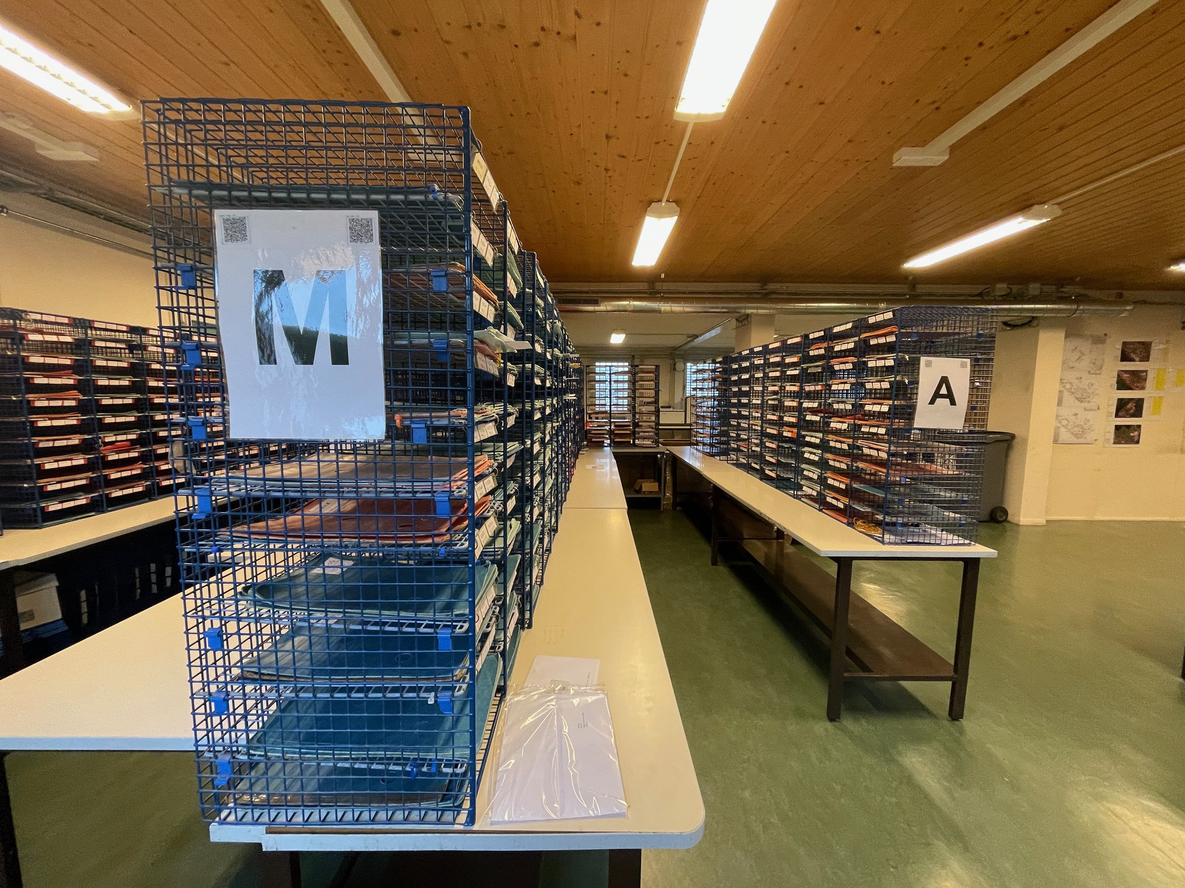
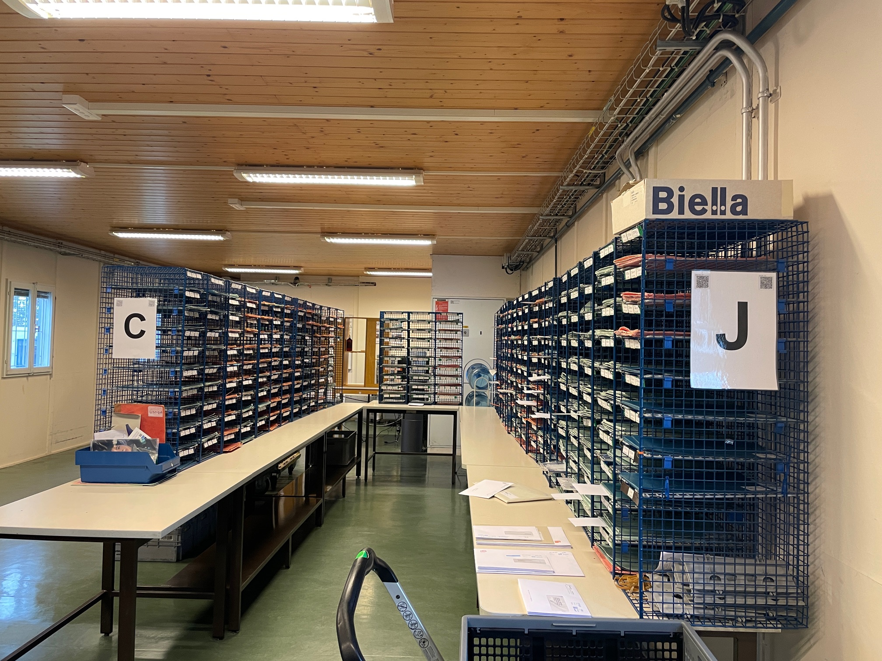
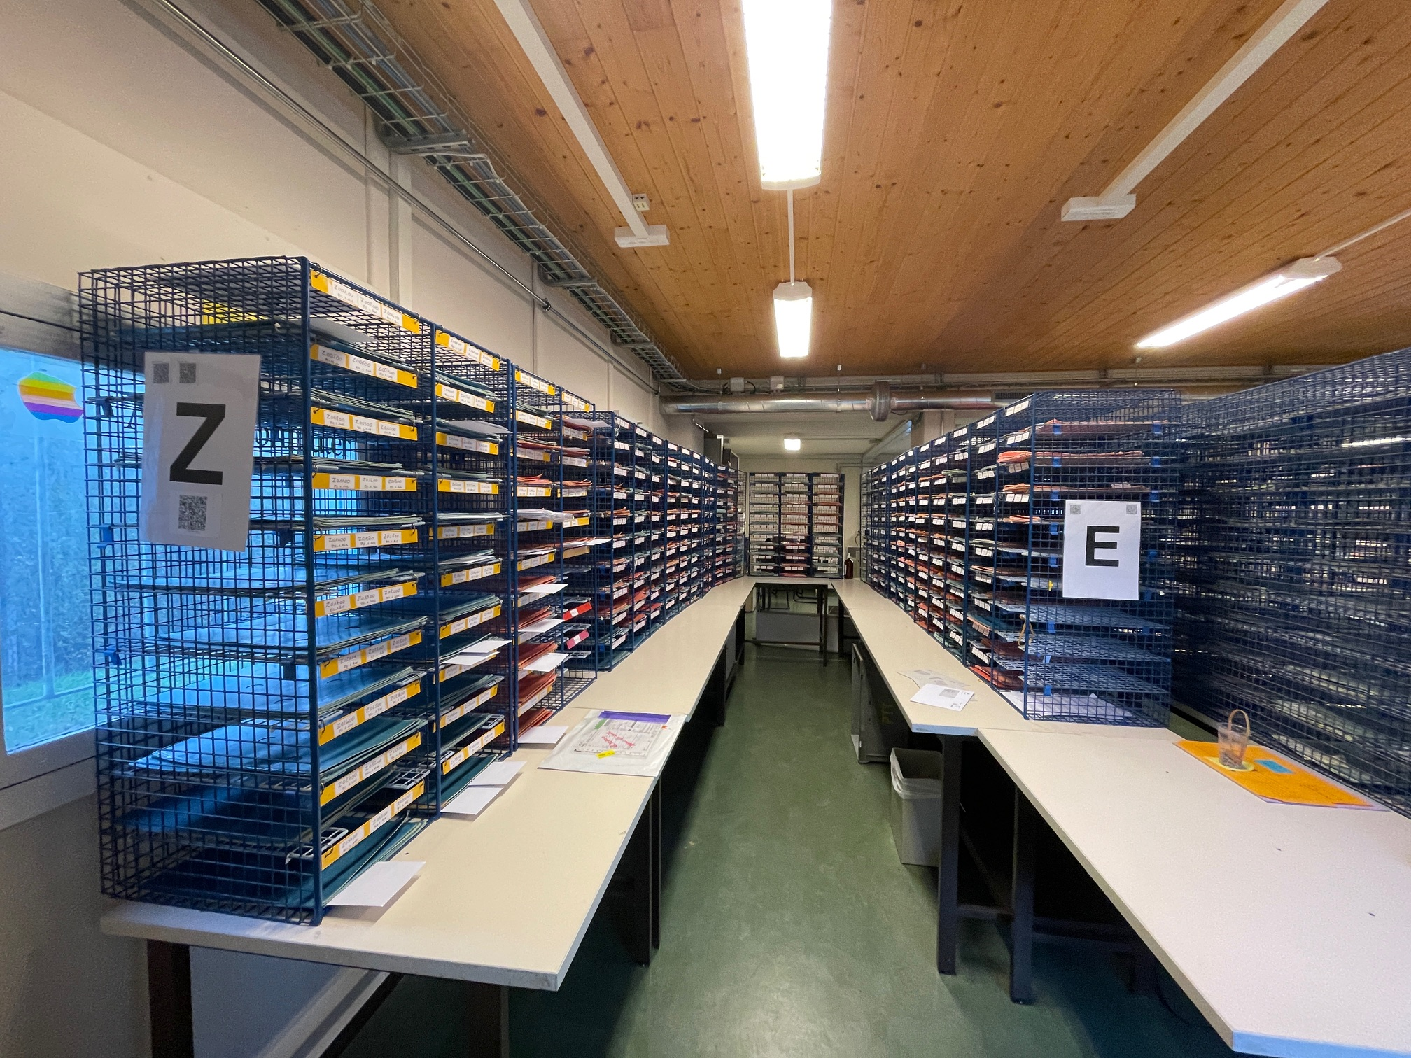
Before workshop
Pictures taken before LEAN workshop of sorting per distribution point area

Slide 11
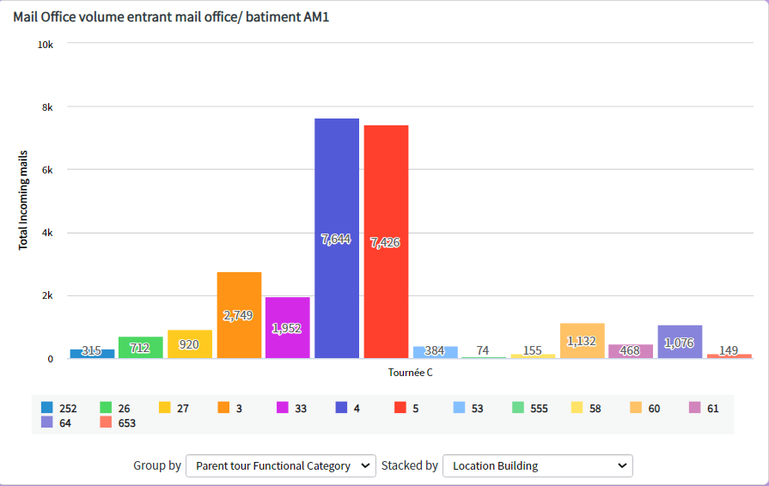
Data collection
Data collection :
Thanks to Snow application for mail distribution tracking the quantity of mail delivered per building/inbox was easy
It allowed us to target buildings where the distribution could be changed

Slide 12
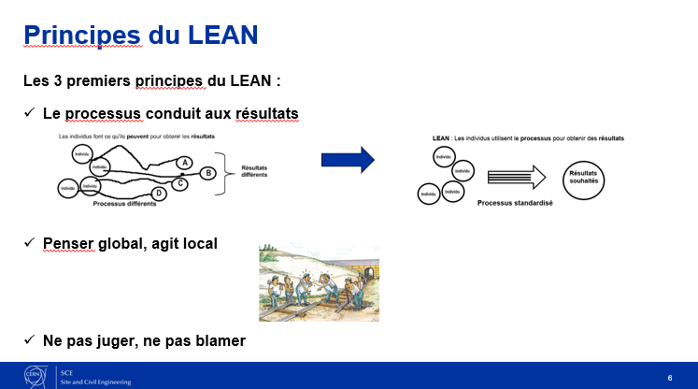
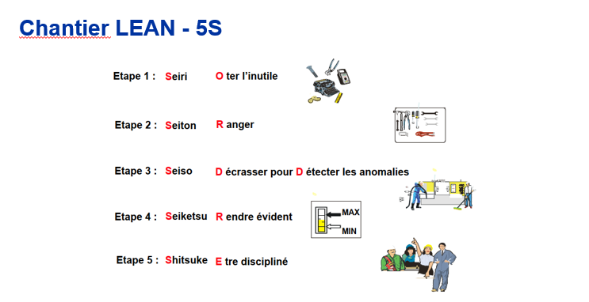

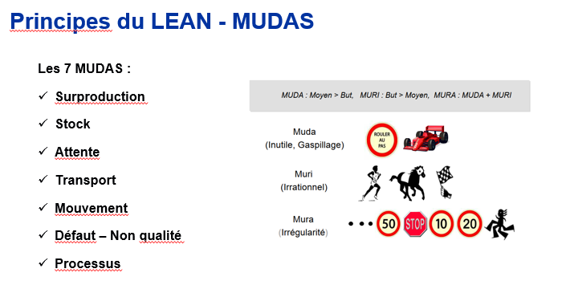
Training – Used LEAN process 5S & MSRP

Slide 13
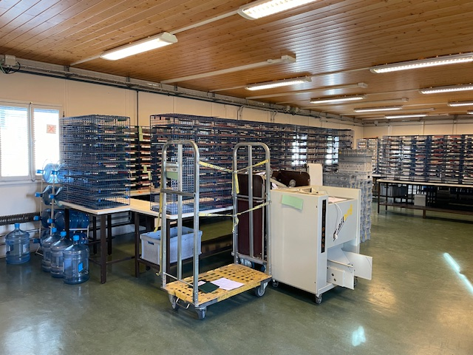
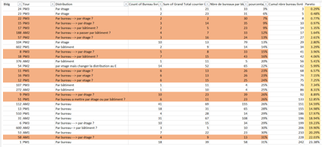
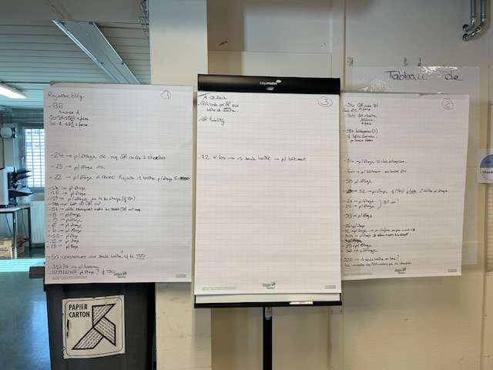
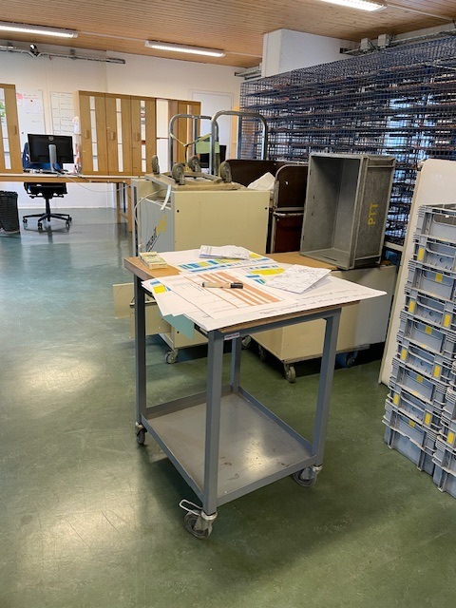
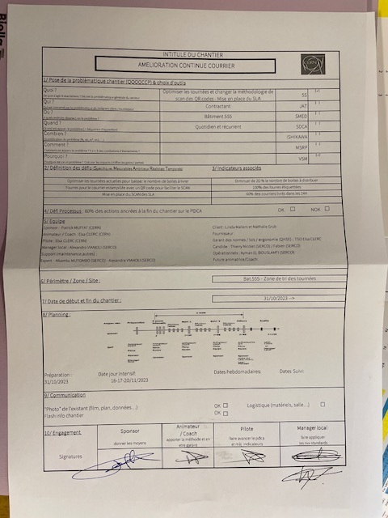
Intensive days
Intensive days:
LEAN training - 5S - Brainstorming

Slide 14
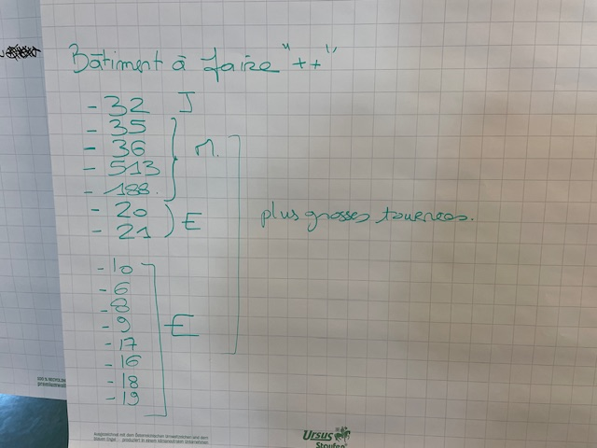
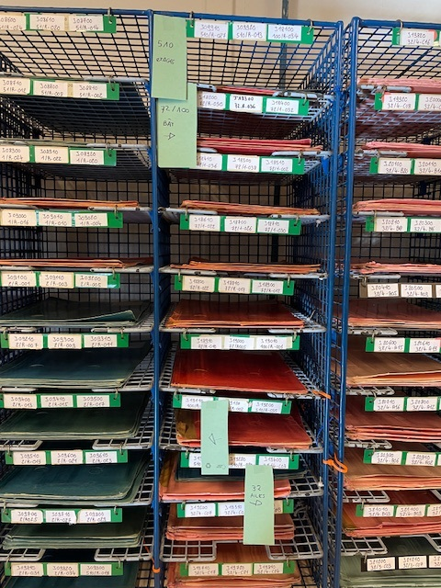
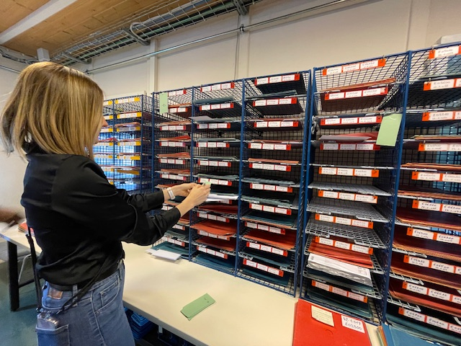
Intensive days
Following brainstorming:
Prototype done in order to visualize the future improvement

Slide 15
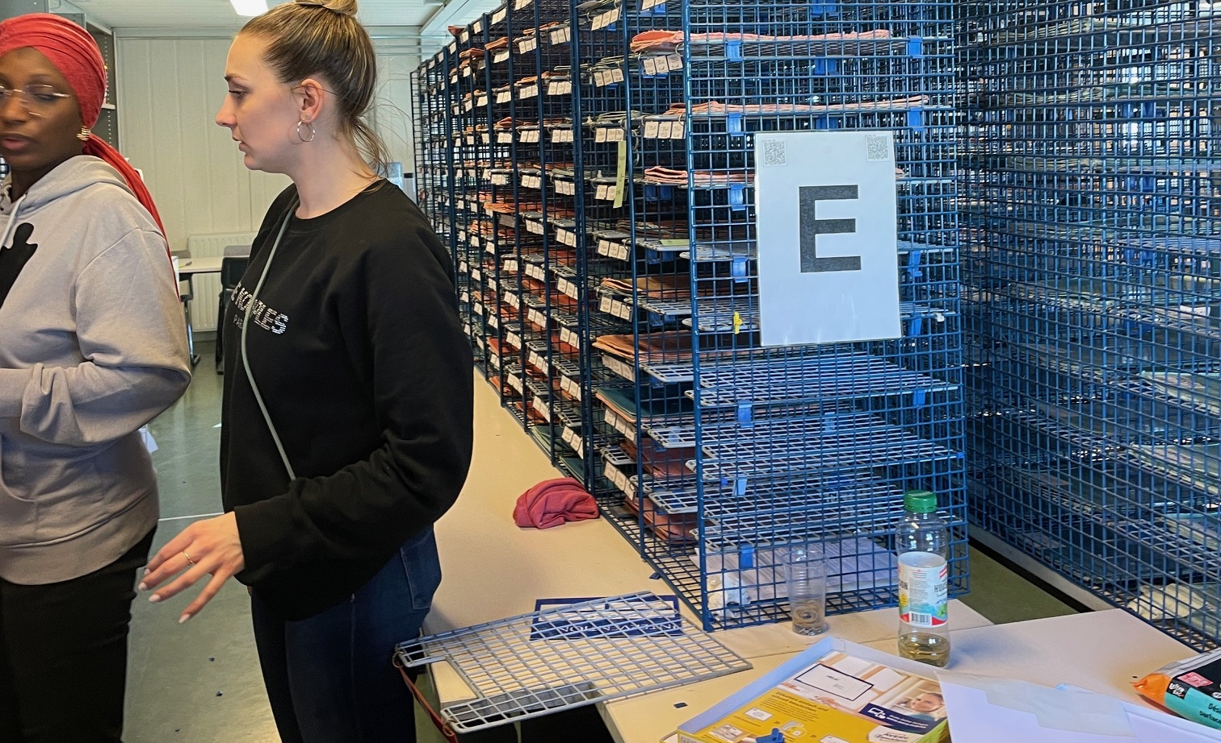
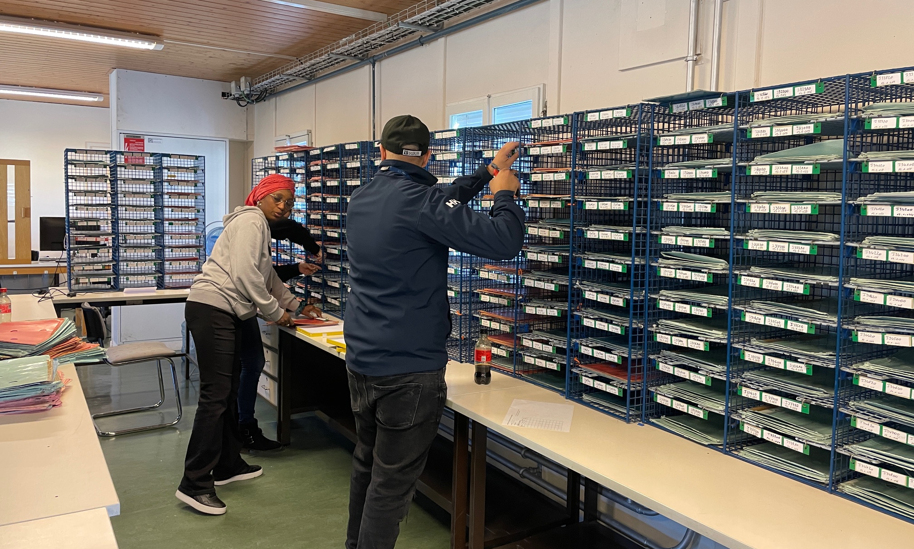
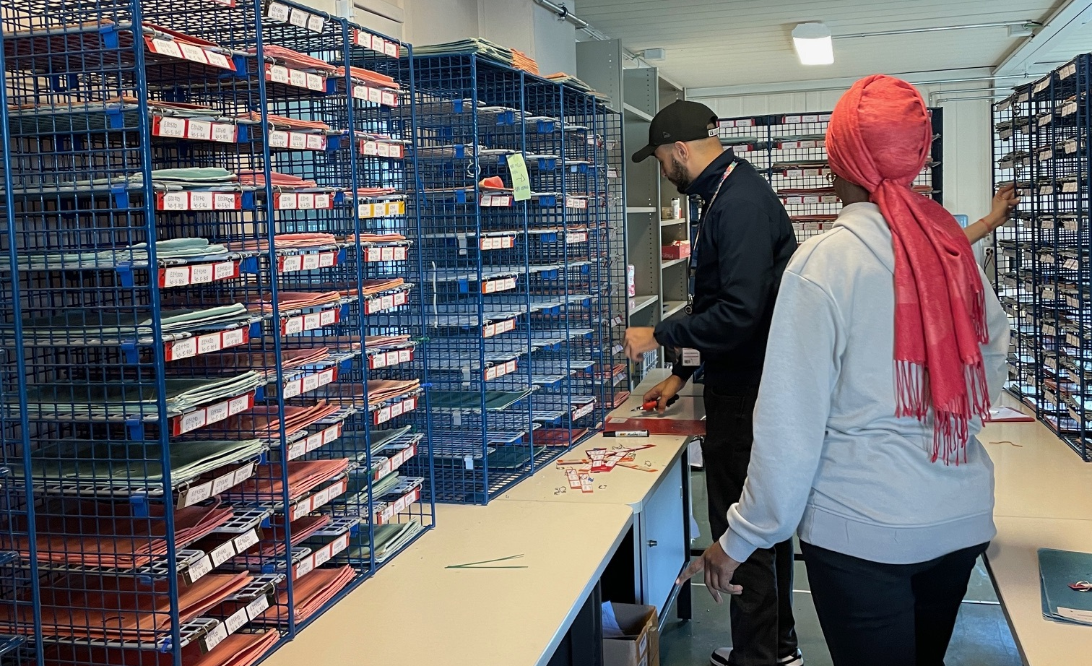
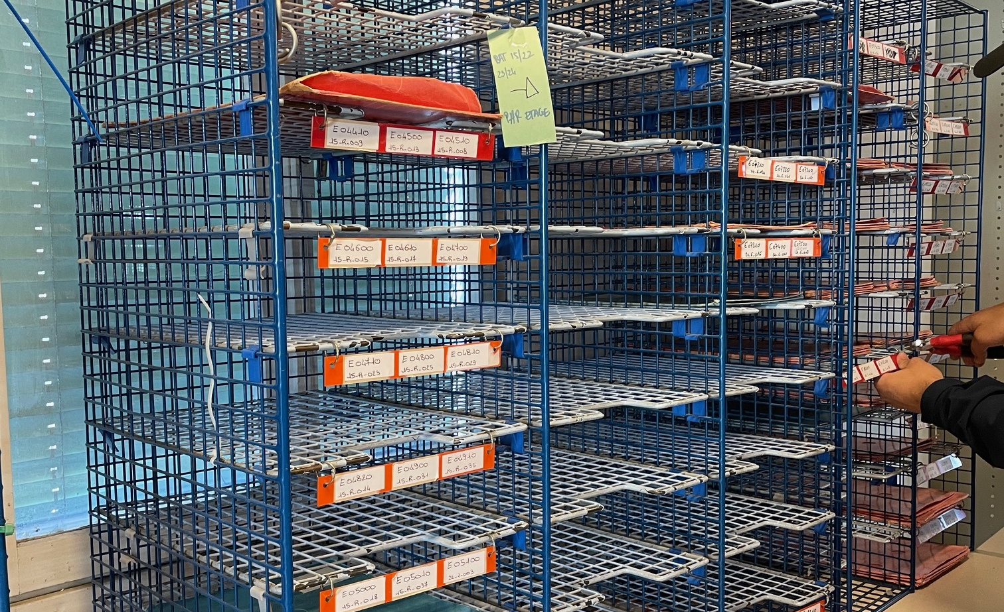
Follow-up days
2 type of rounds are tested following the prototype
One solution has been adopted by the whole team

Slide 16
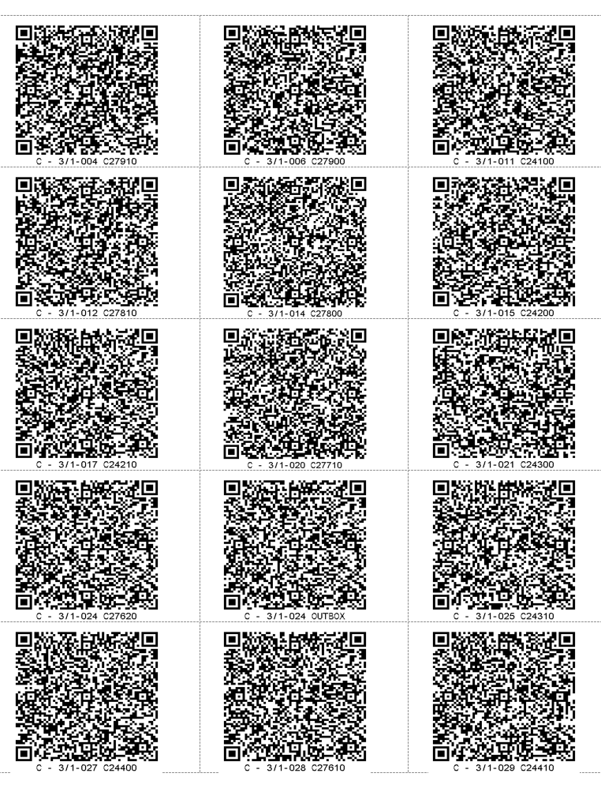
Follow-up days
New QR codes creation for Snow application

Slide 17
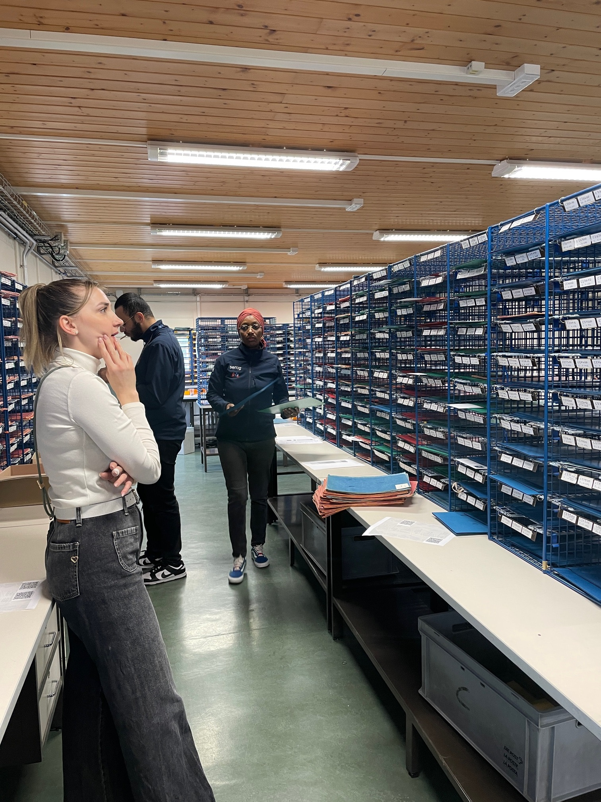
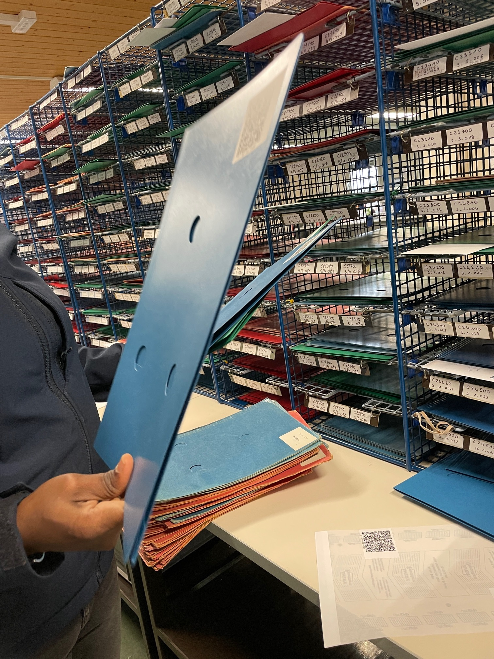
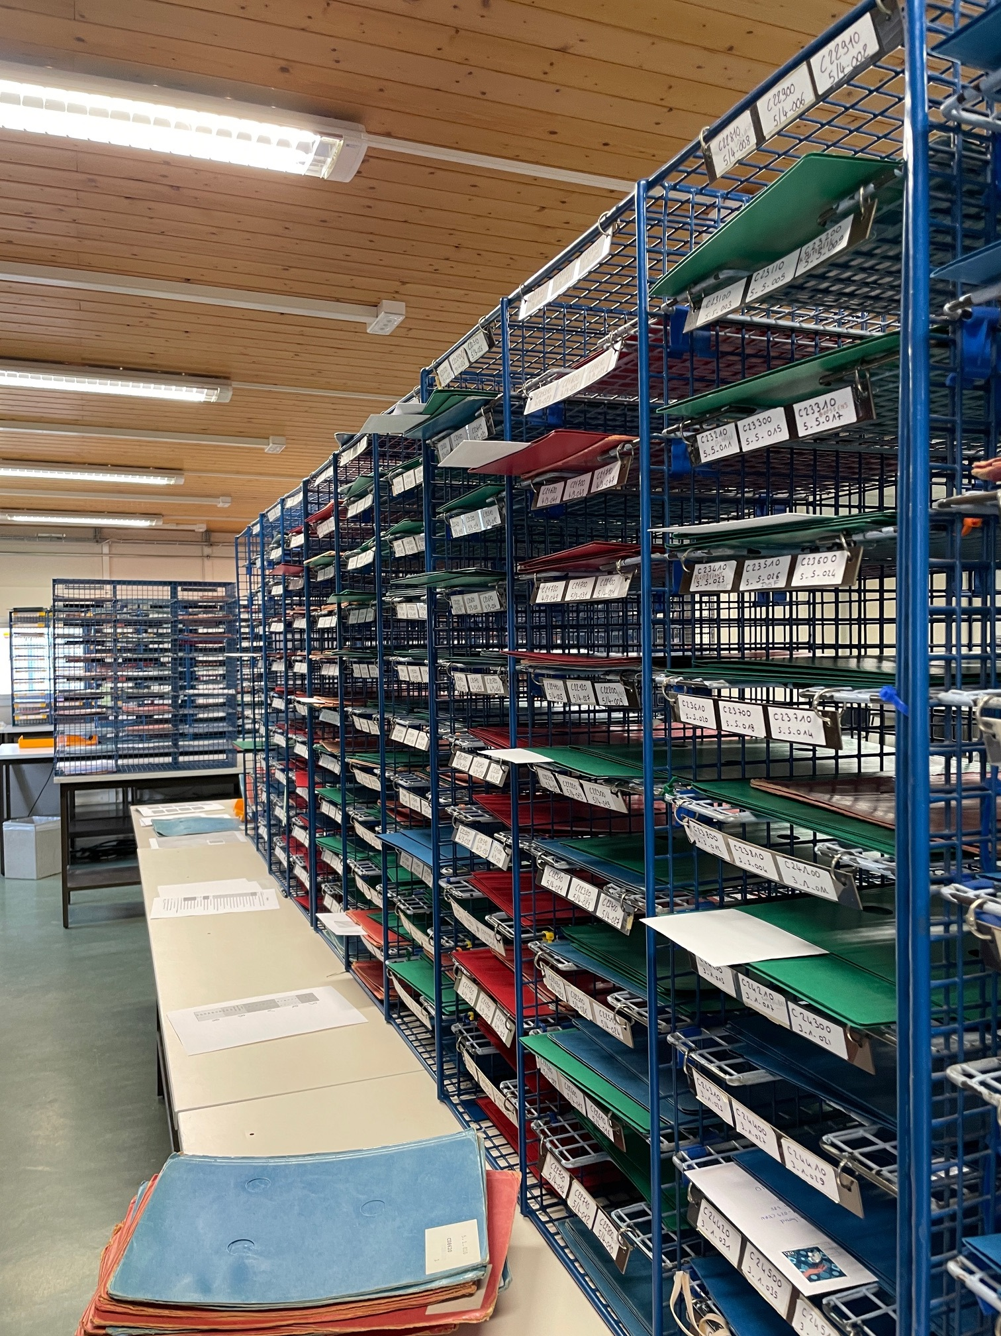
Follow-up days
Labelling of folders and sorting mailbox organization
AIS update

Slide 18
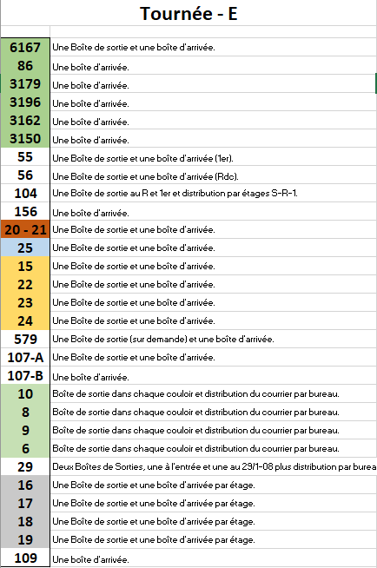
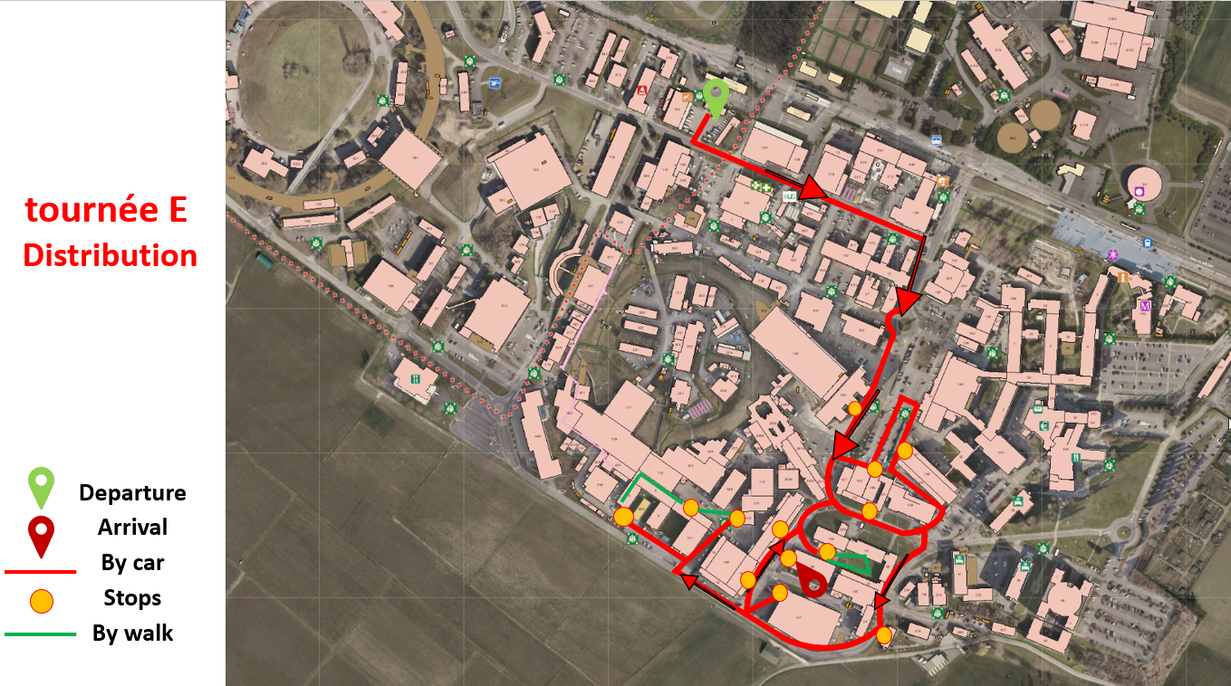
New standards - examples
New standards for the round sorting for new arrivals
New maps for each round

Slide 19
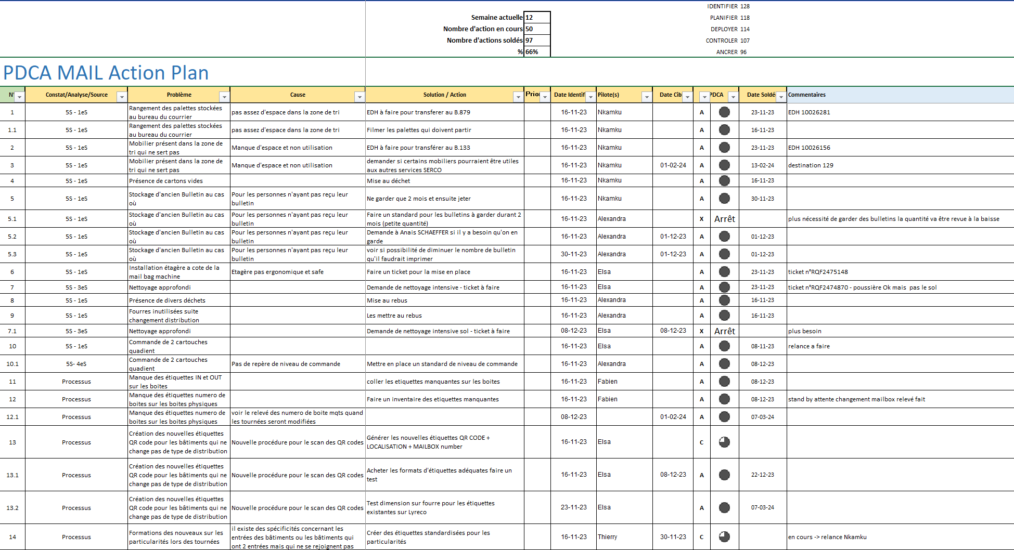
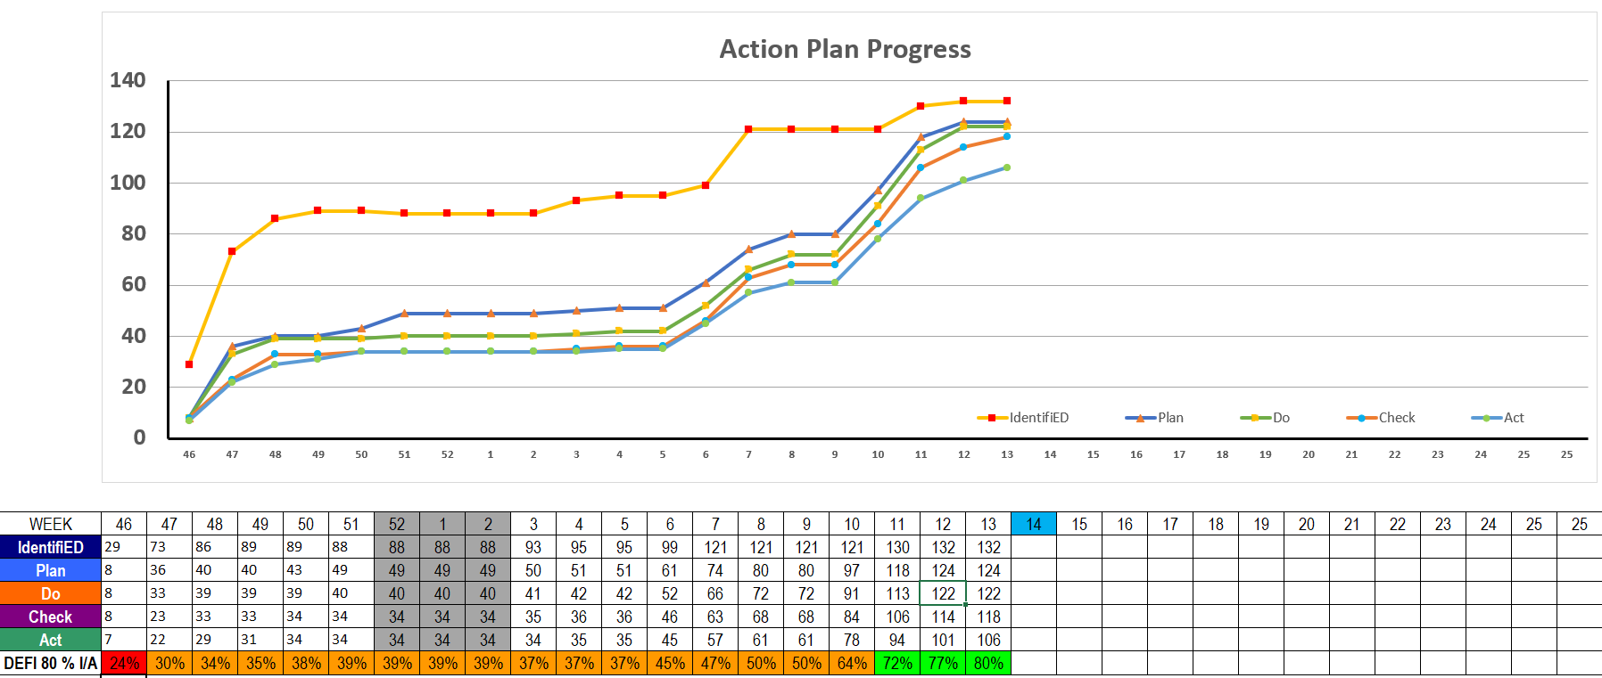
PDCA follow-up

Slide 20
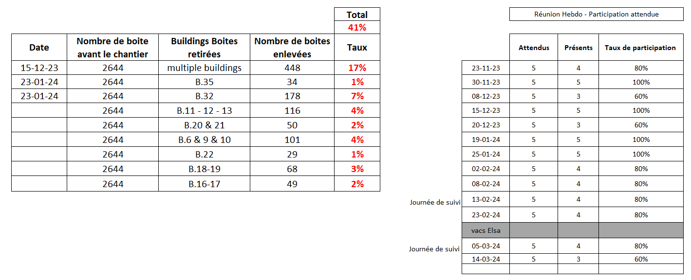
KPI Follow-up

Slide 21
RESULTS
5 rounds instead of 6
2 or 3 times a week
Reorganisation of the sorting area
41 % decrease
100 % QR code labelled

Slide 22
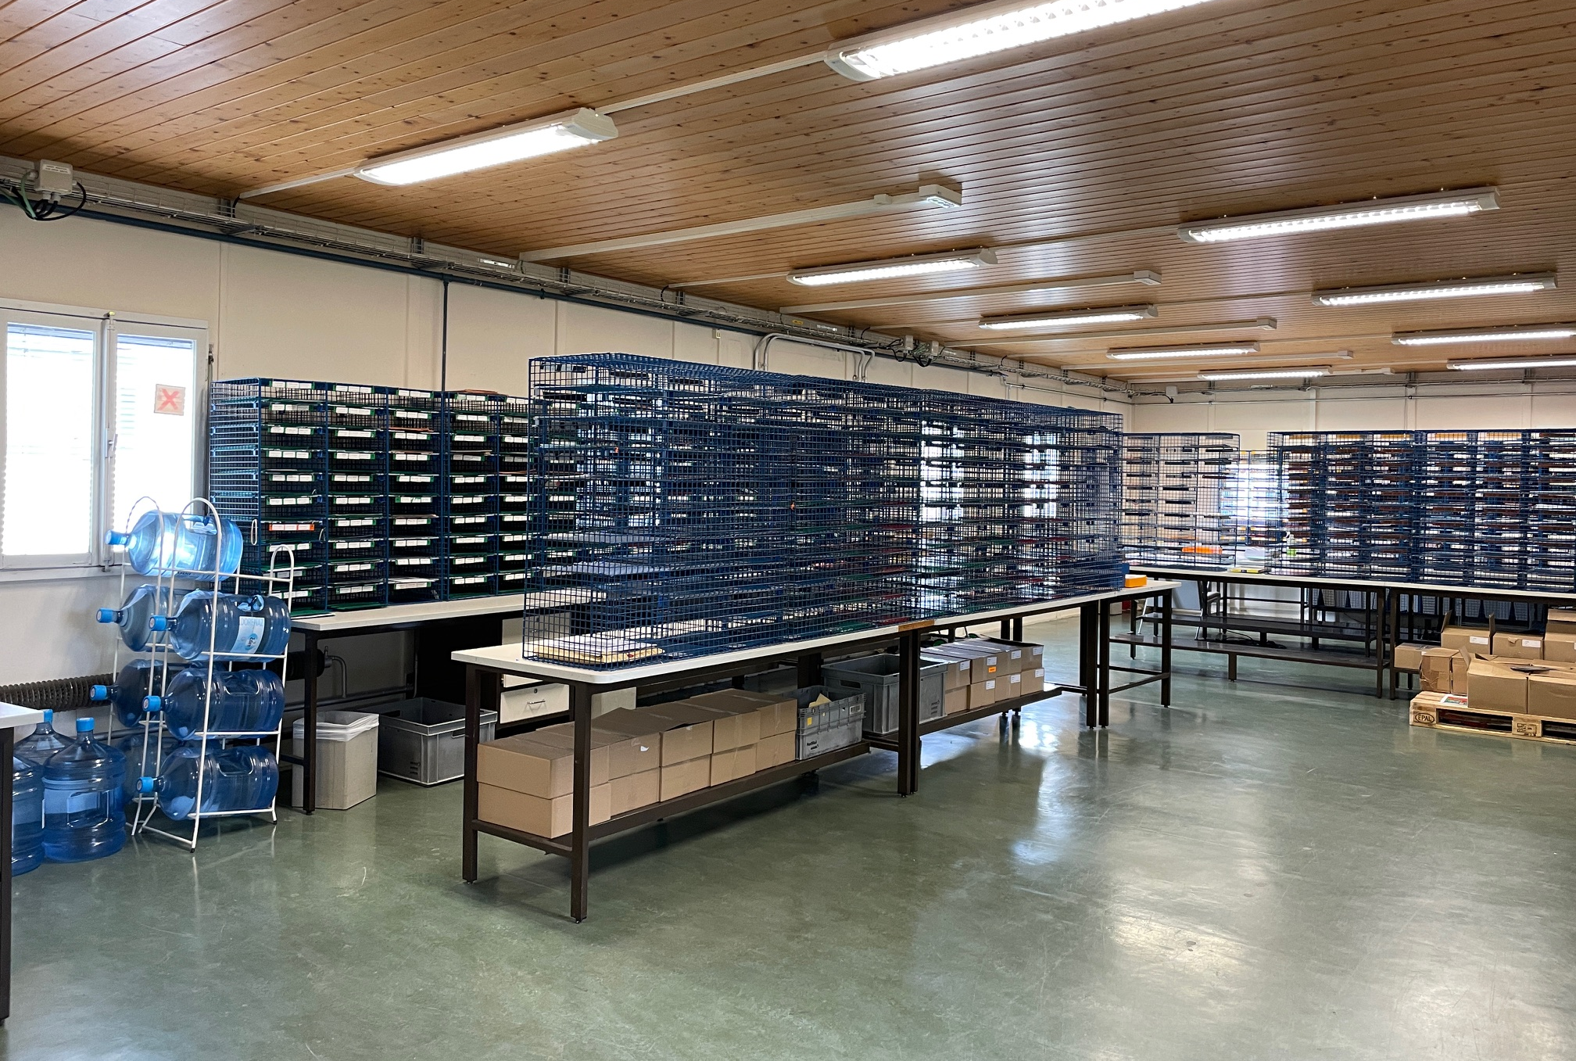
GEMBA FINAL
BEFORE
AFTER

Slide 23
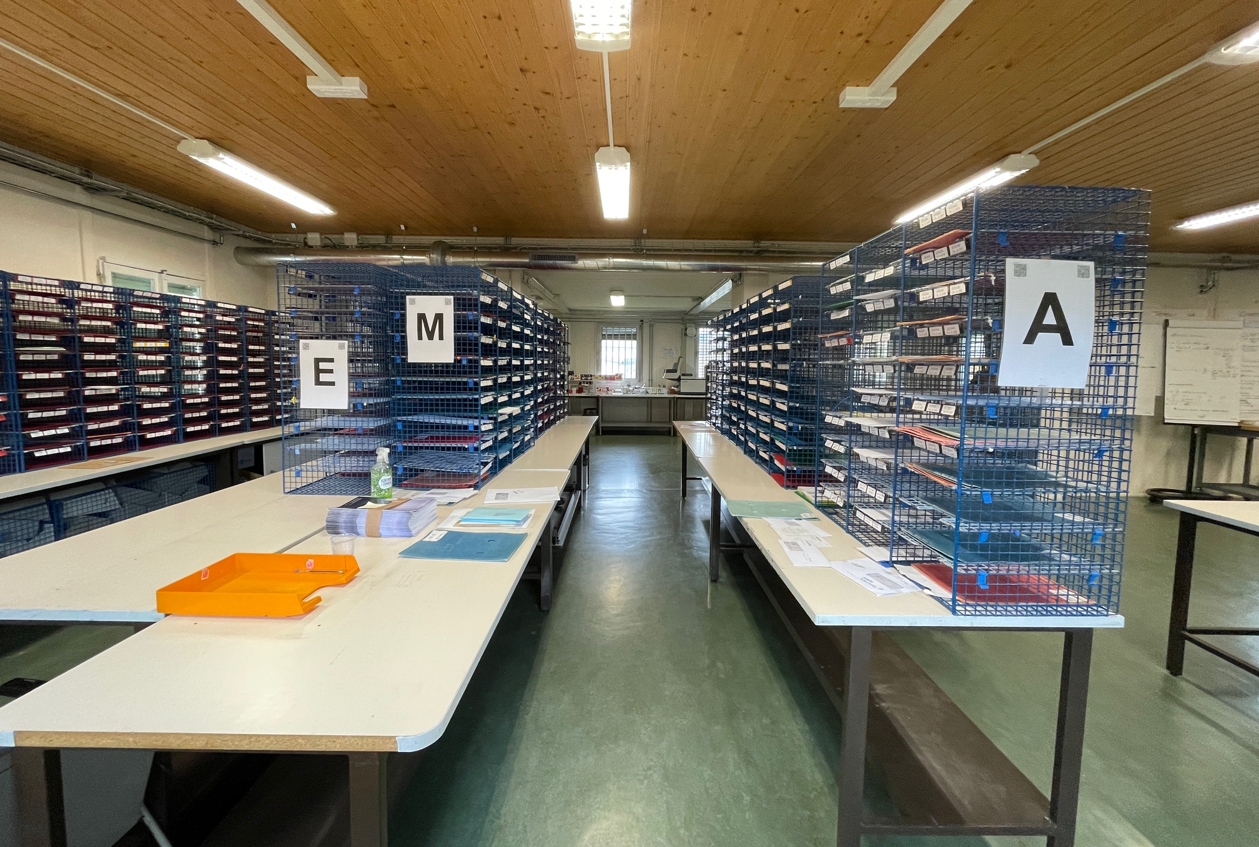
GEMBA Round M & former round A
BEFORE
AFTER

Slide 24
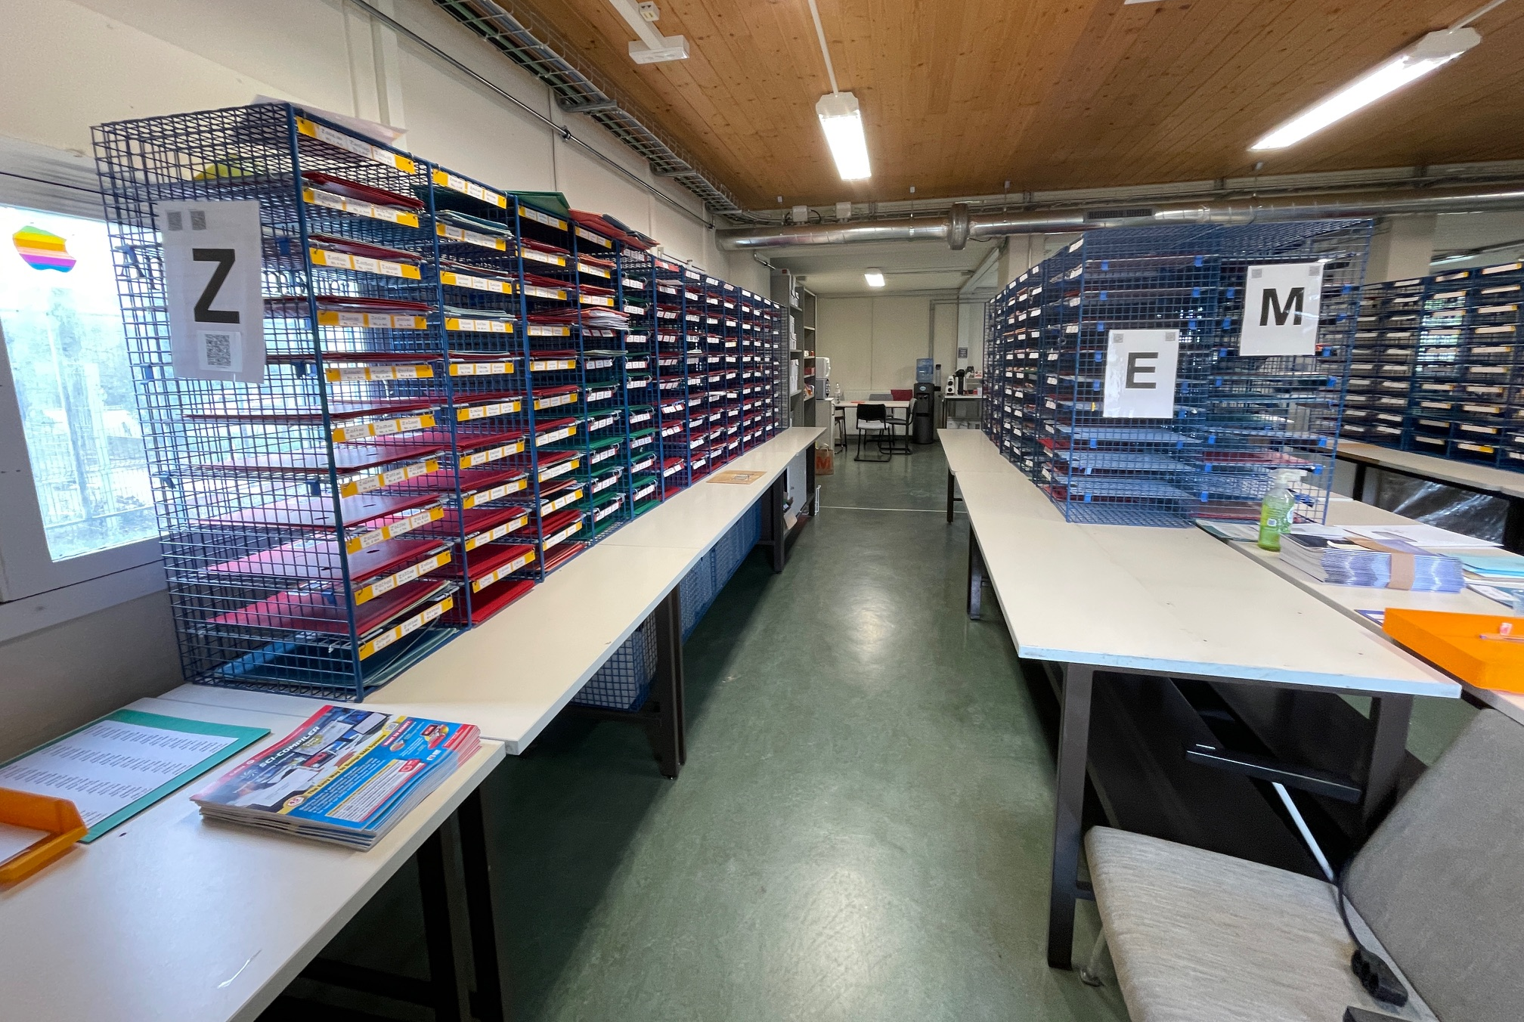
GEMBA Round Z & E
BEFORE
AFTER

Slide 25
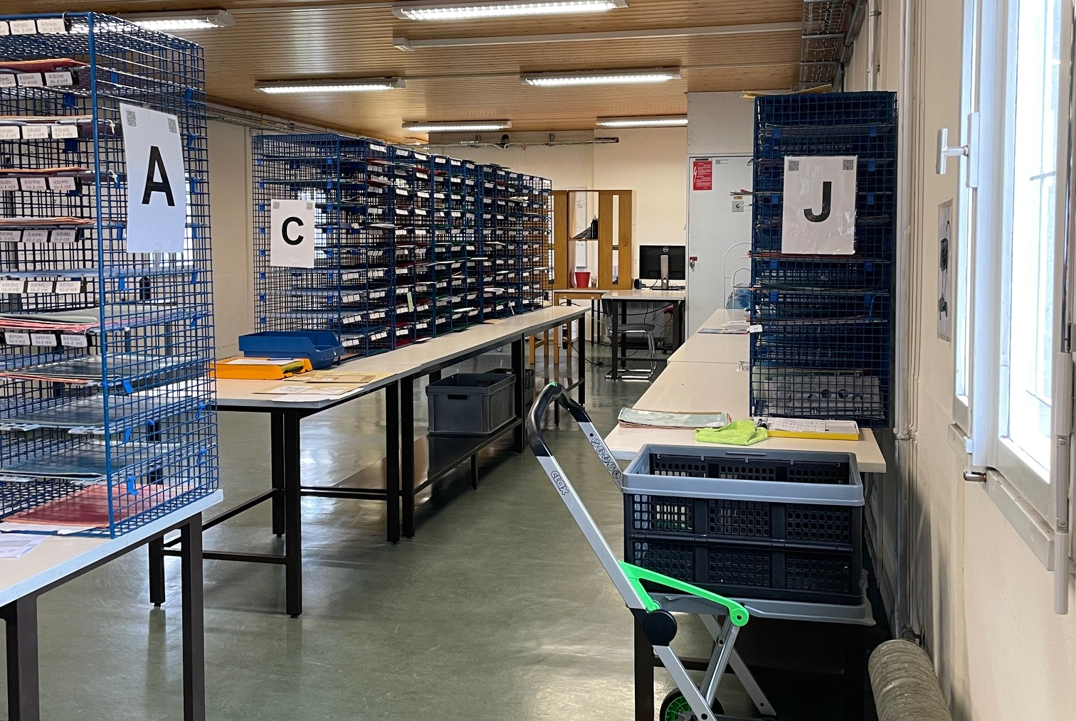
GEMBA Rounds J & C
BEFORE
AFTER

Slide 26


