Slide 1
Science Communication,
Education and Outreach at CERN
Chetna Krishna
CERN Communications Officer

Slide 2
“Science is not finished until it is communicated.”
Sir Mark Walport

Slide 3
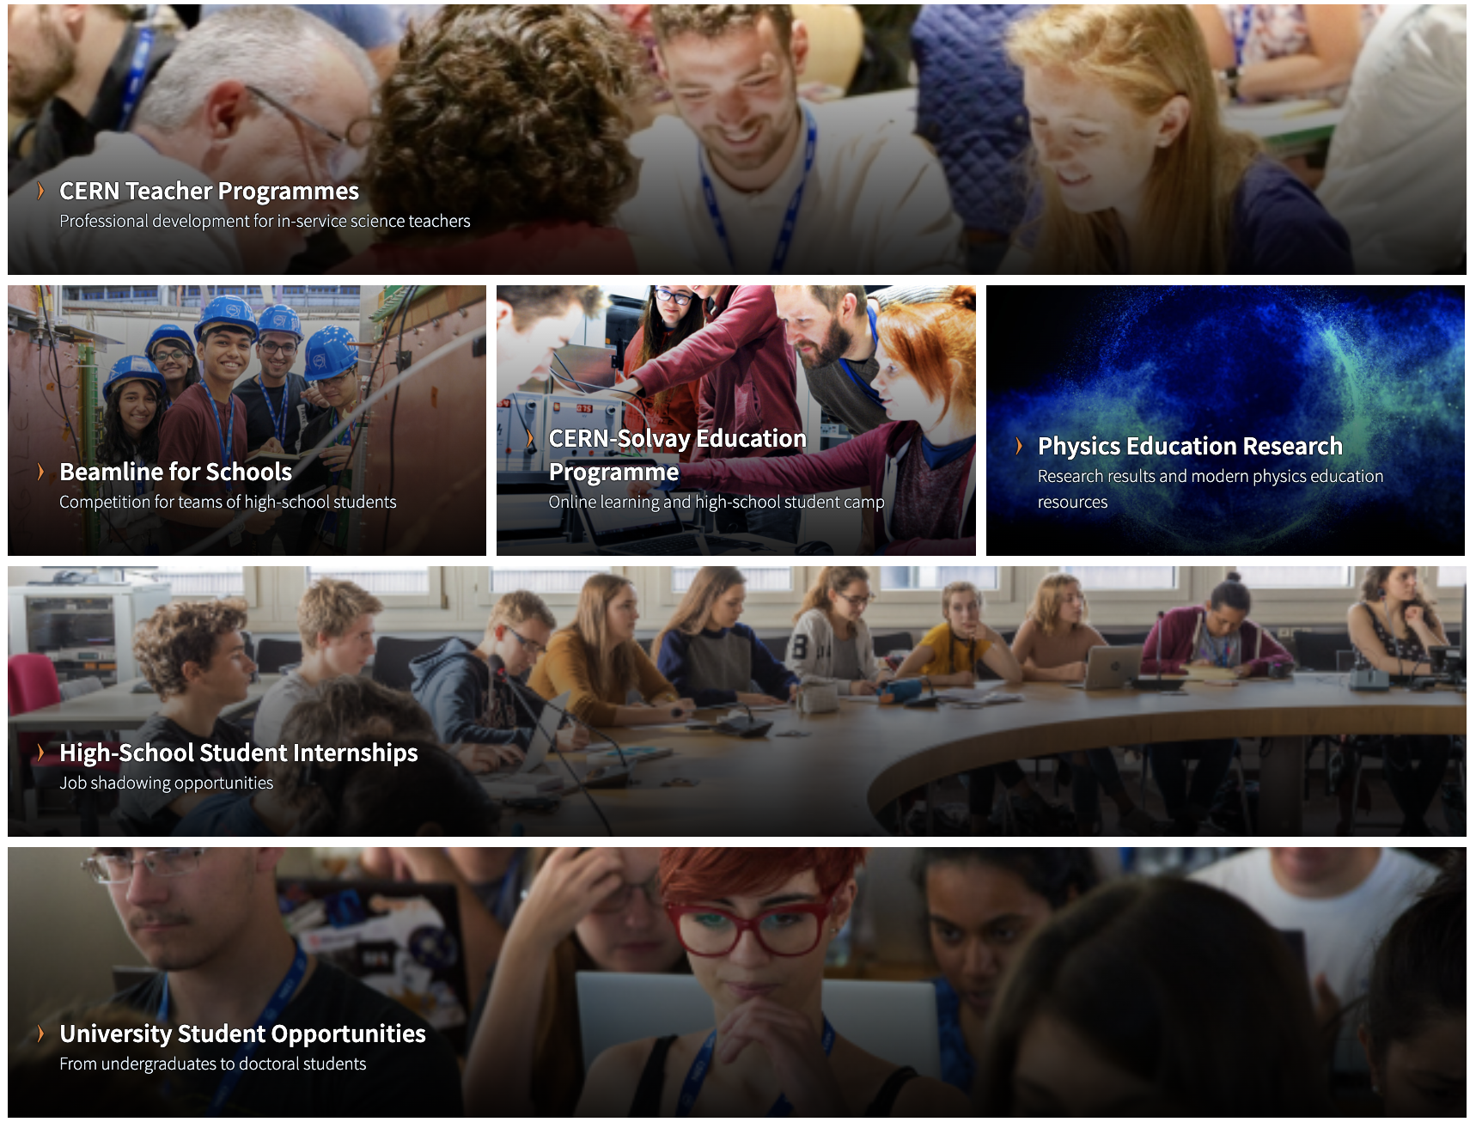
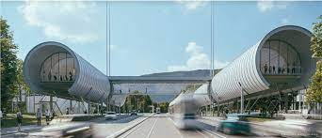
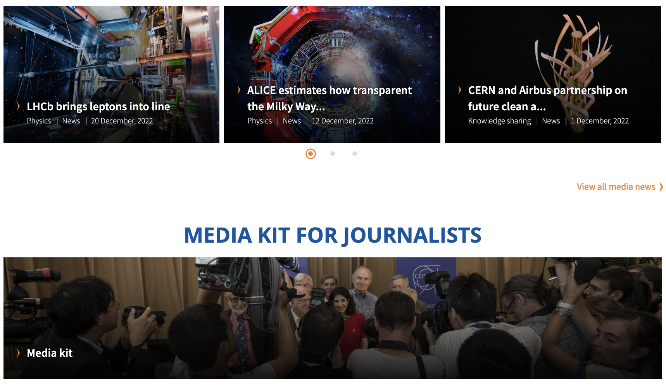
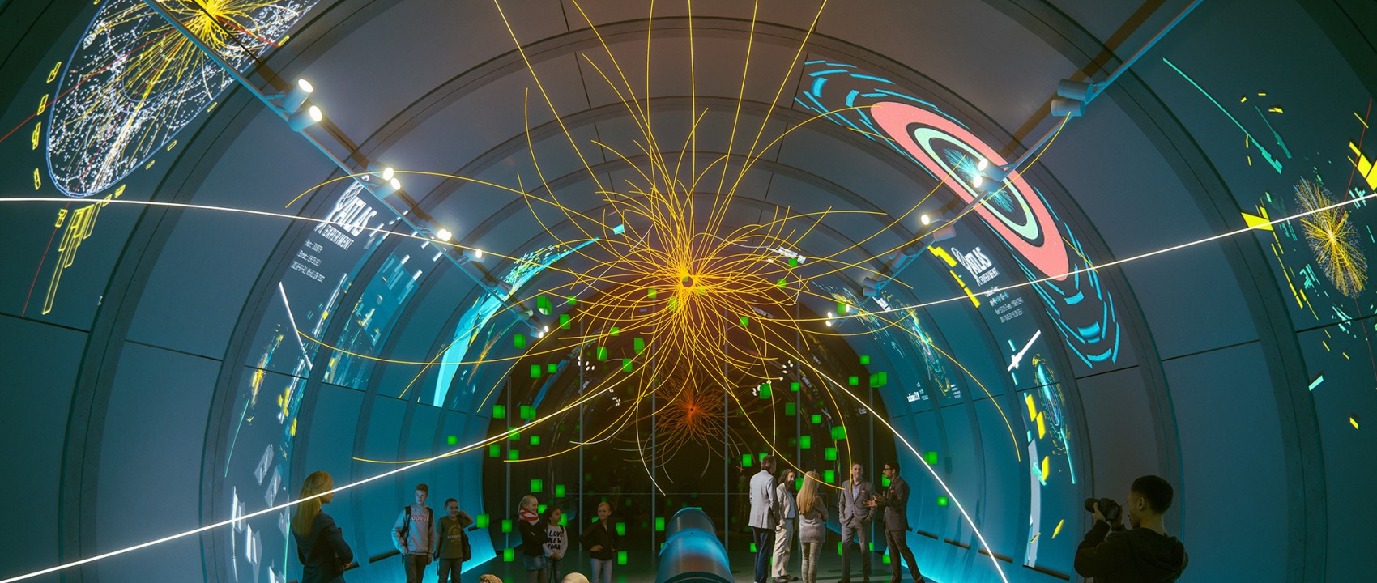
What’s the difference?
Science exhibition and shows
for e.g., CERN’s new facility Science Gateway
🔗Education.cern
Communications
Education
Internal and external communications
(Writing, press office, video production)
Outreach
Chetna Krishna | @chit_chet_

Slide 4
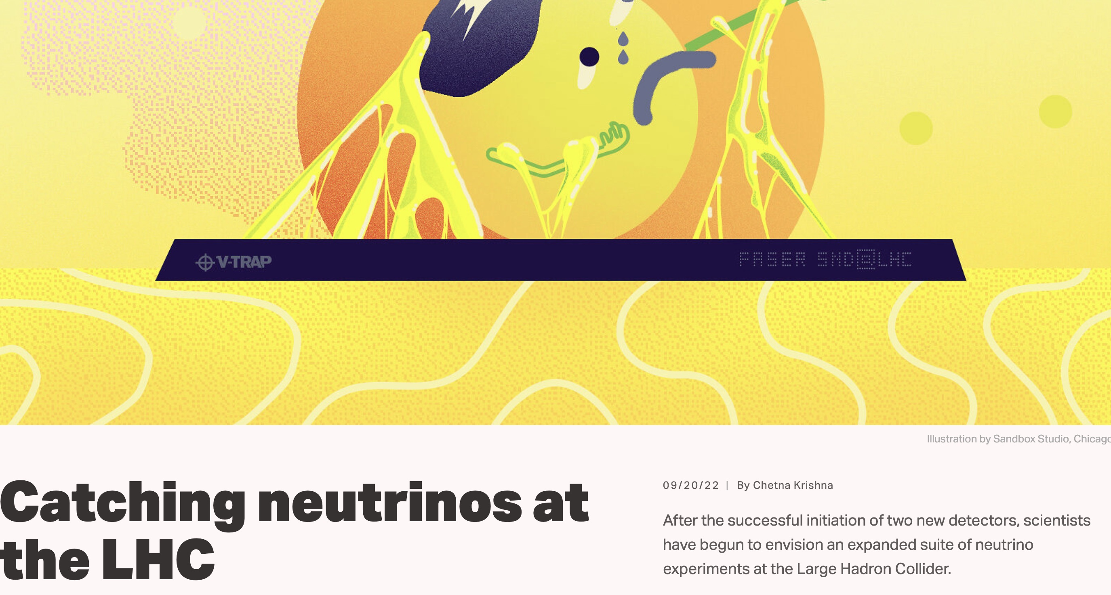
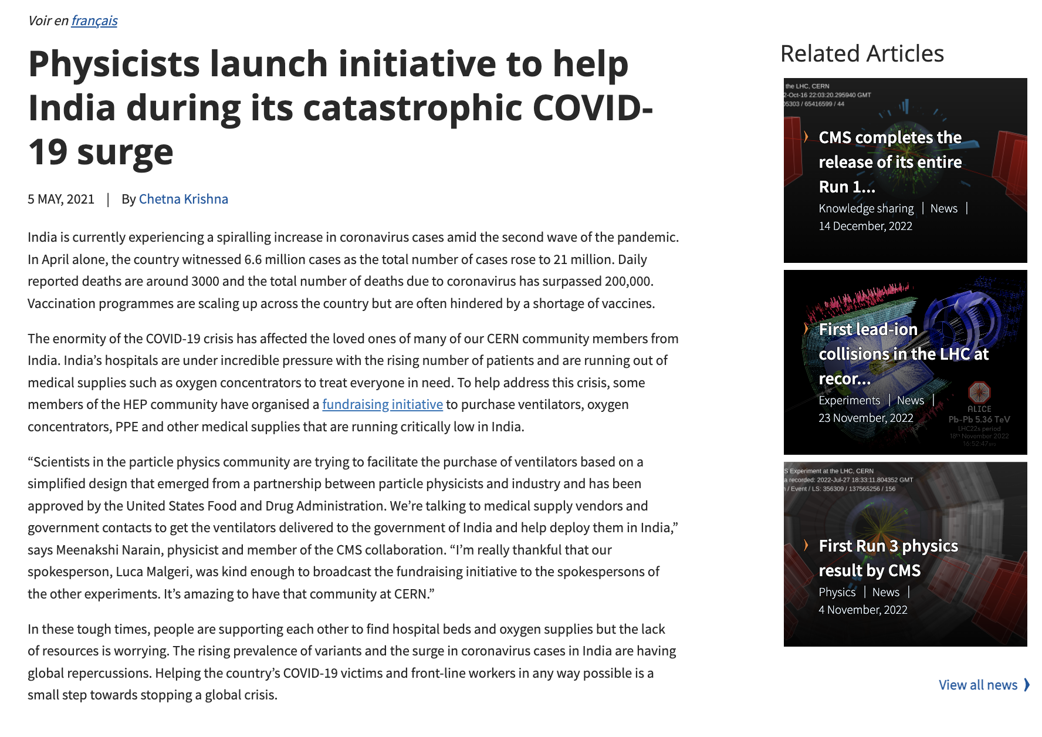
I’m a science writer!
Chasing science stories and discoveries
And other news for societal impact

Slide 5



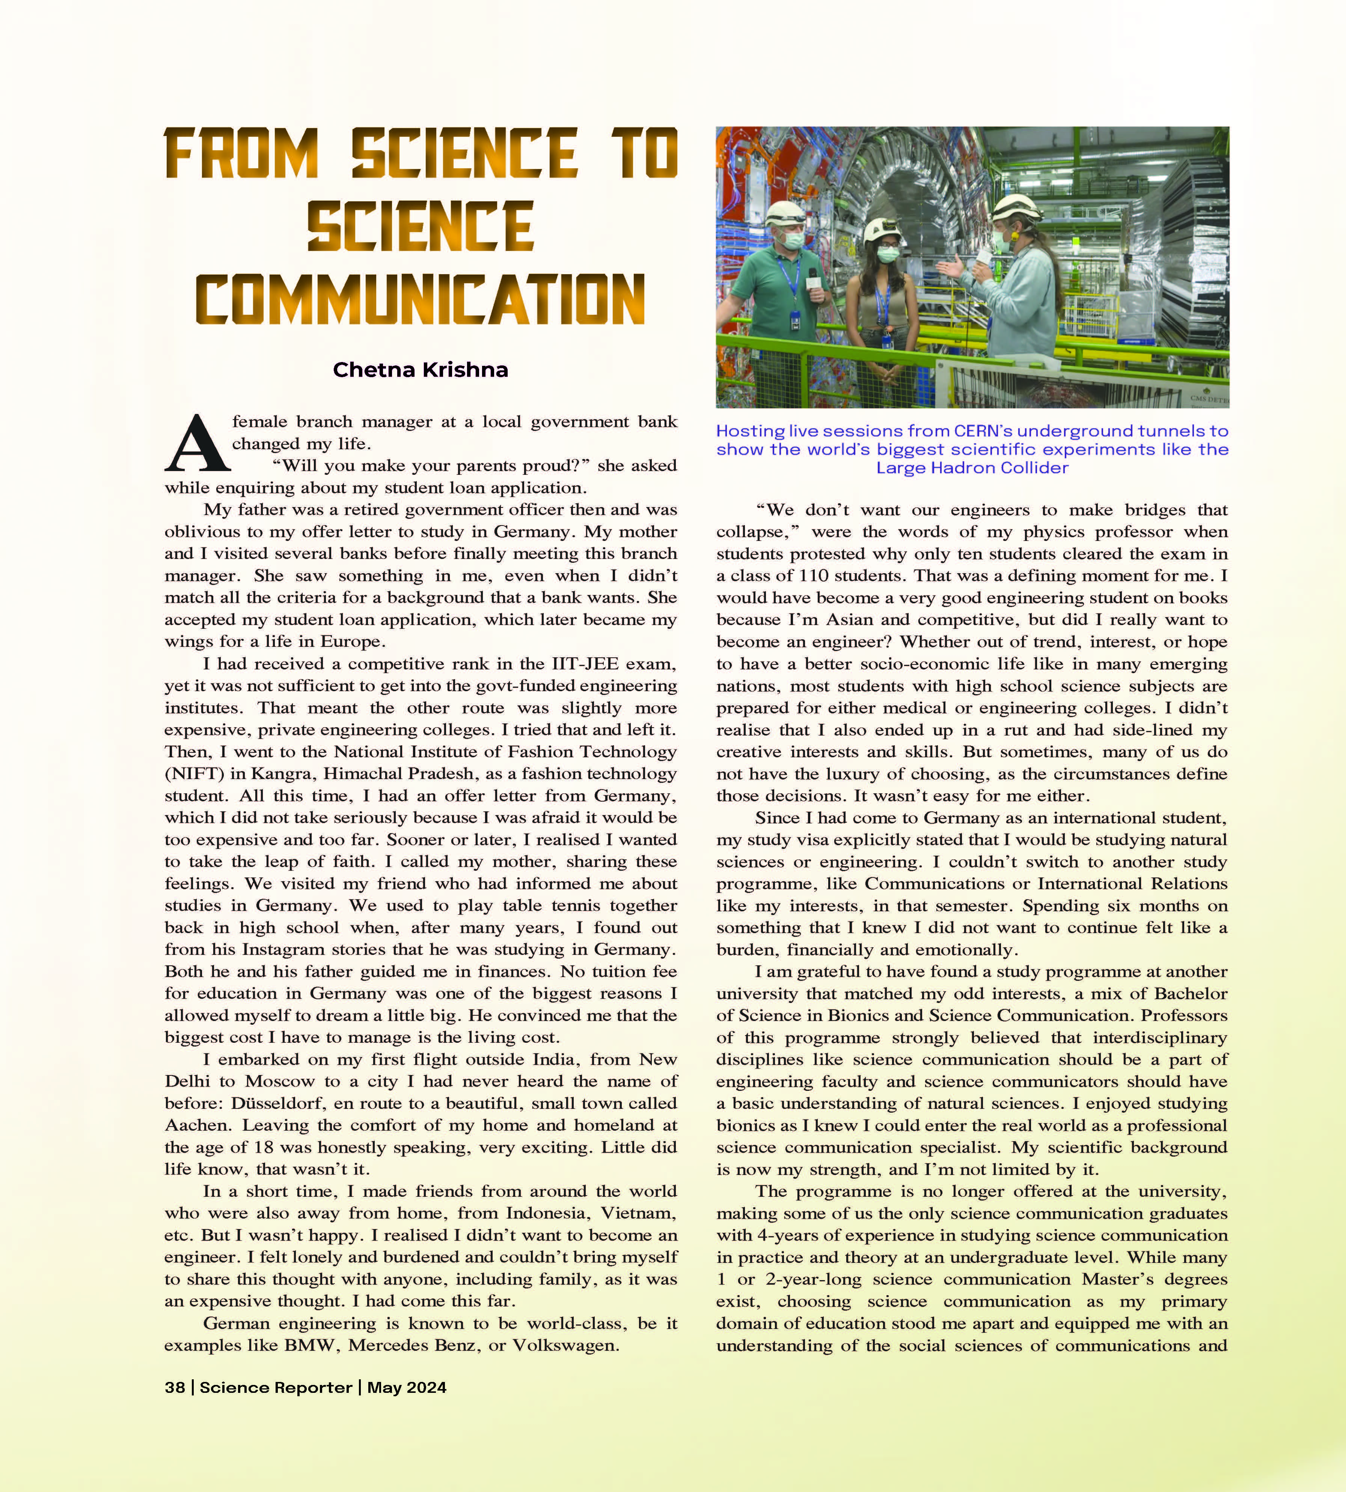
Can you name any science books or magazines?

Slide 6
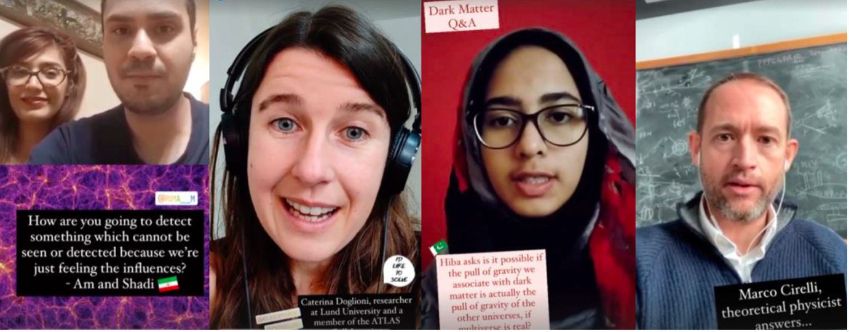
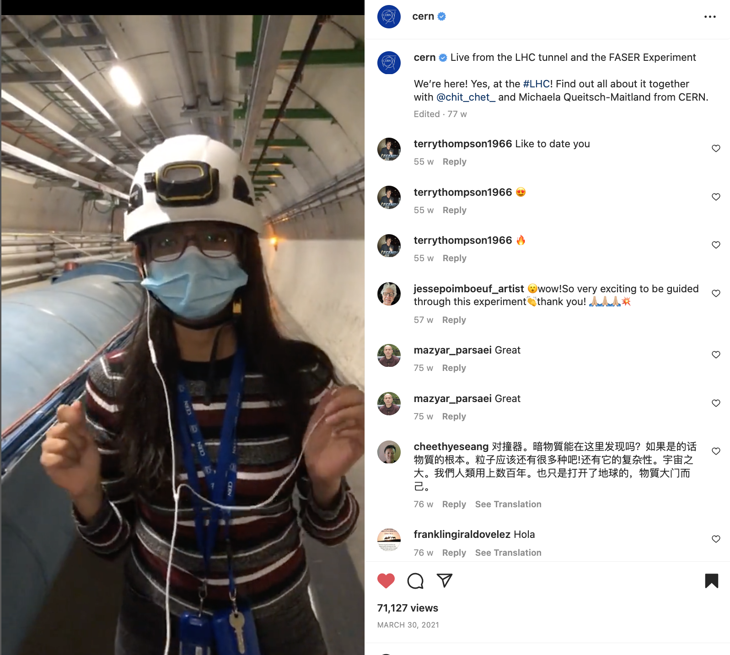
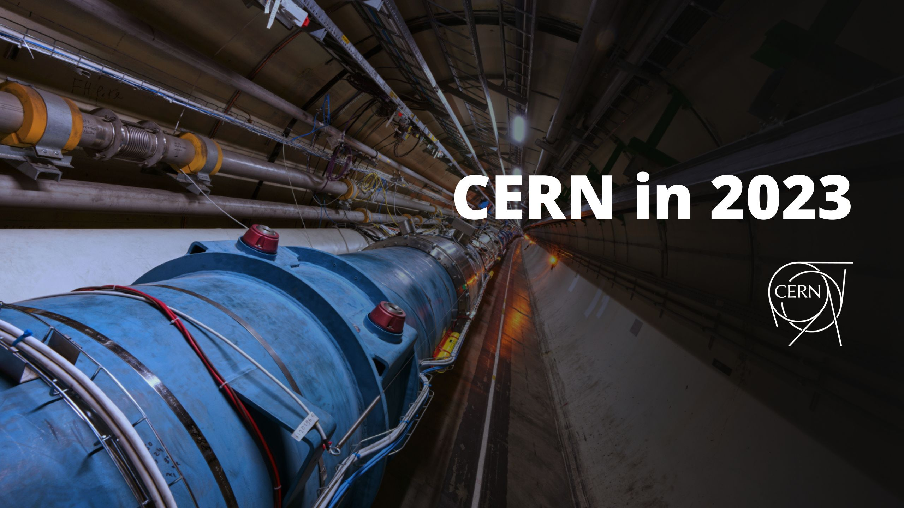
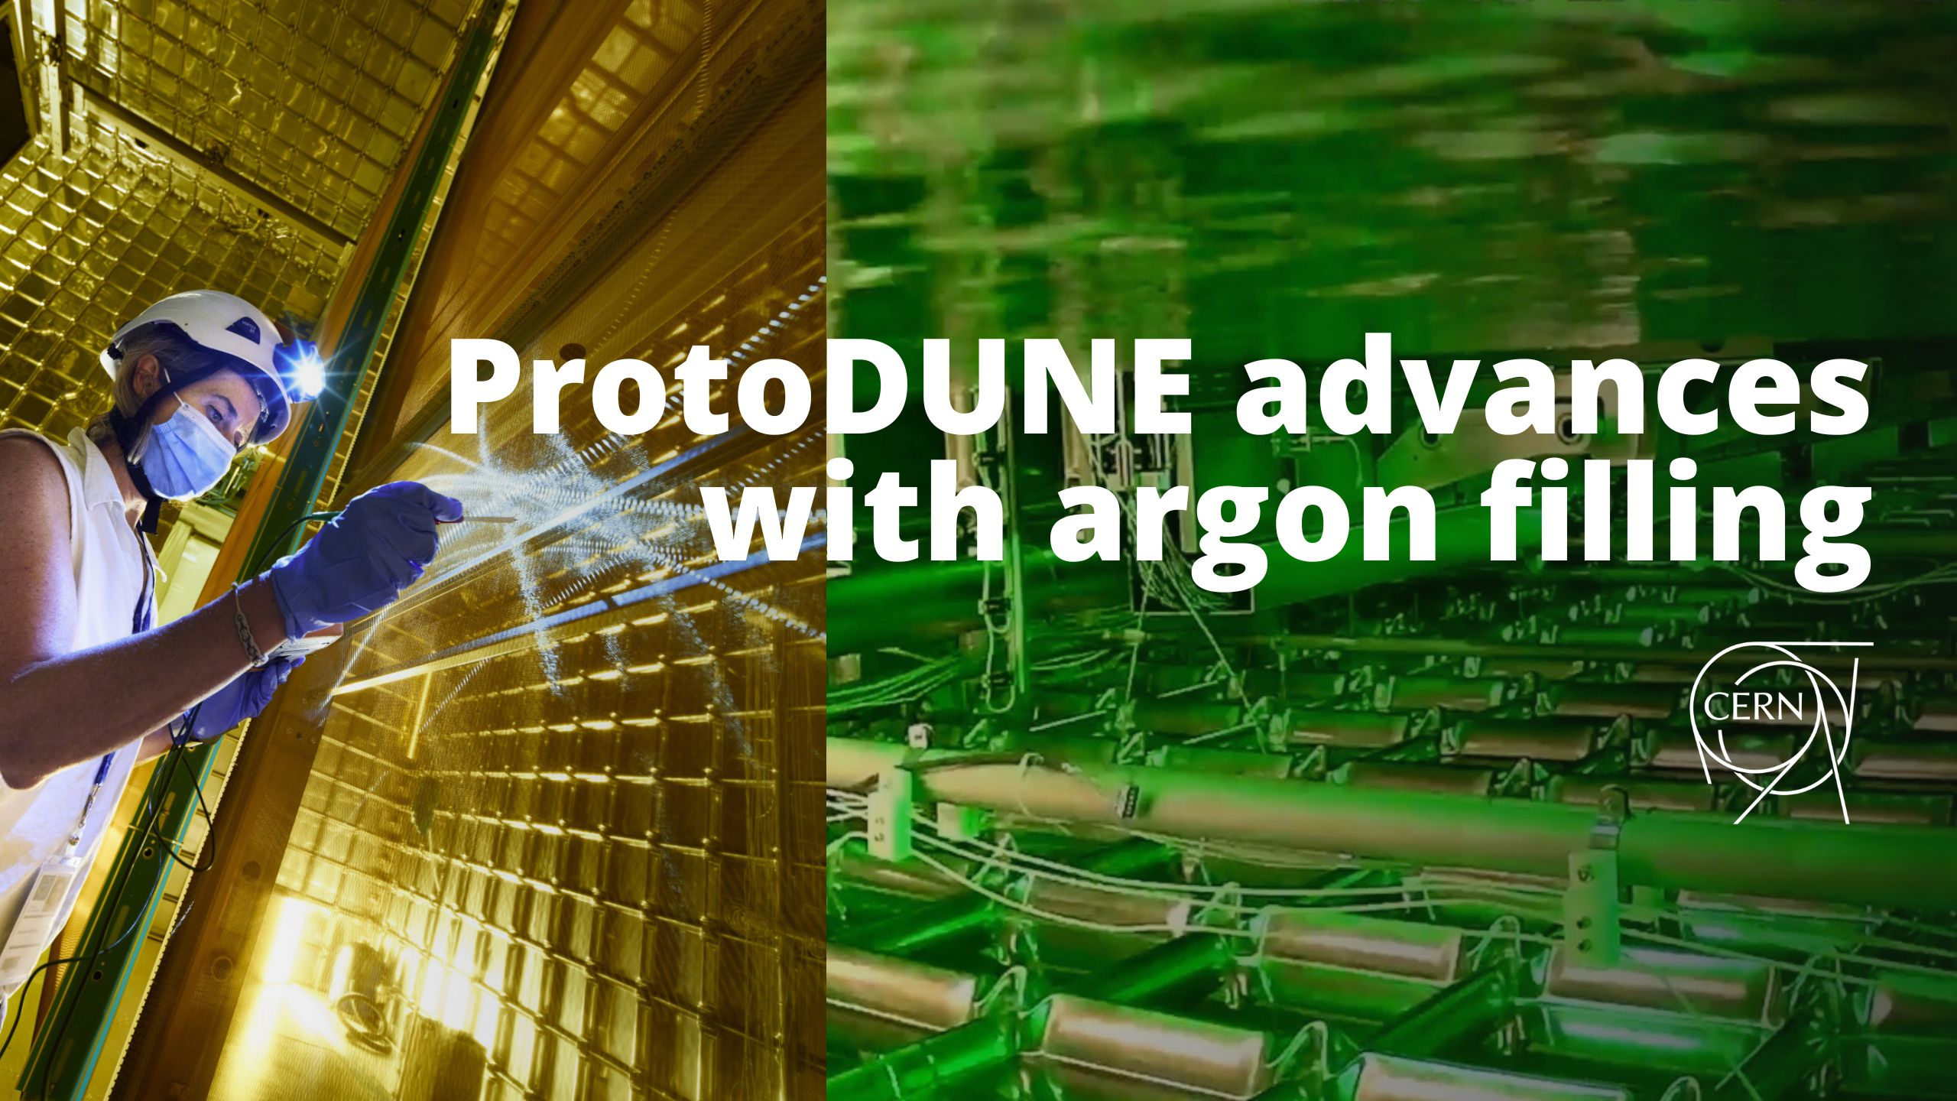
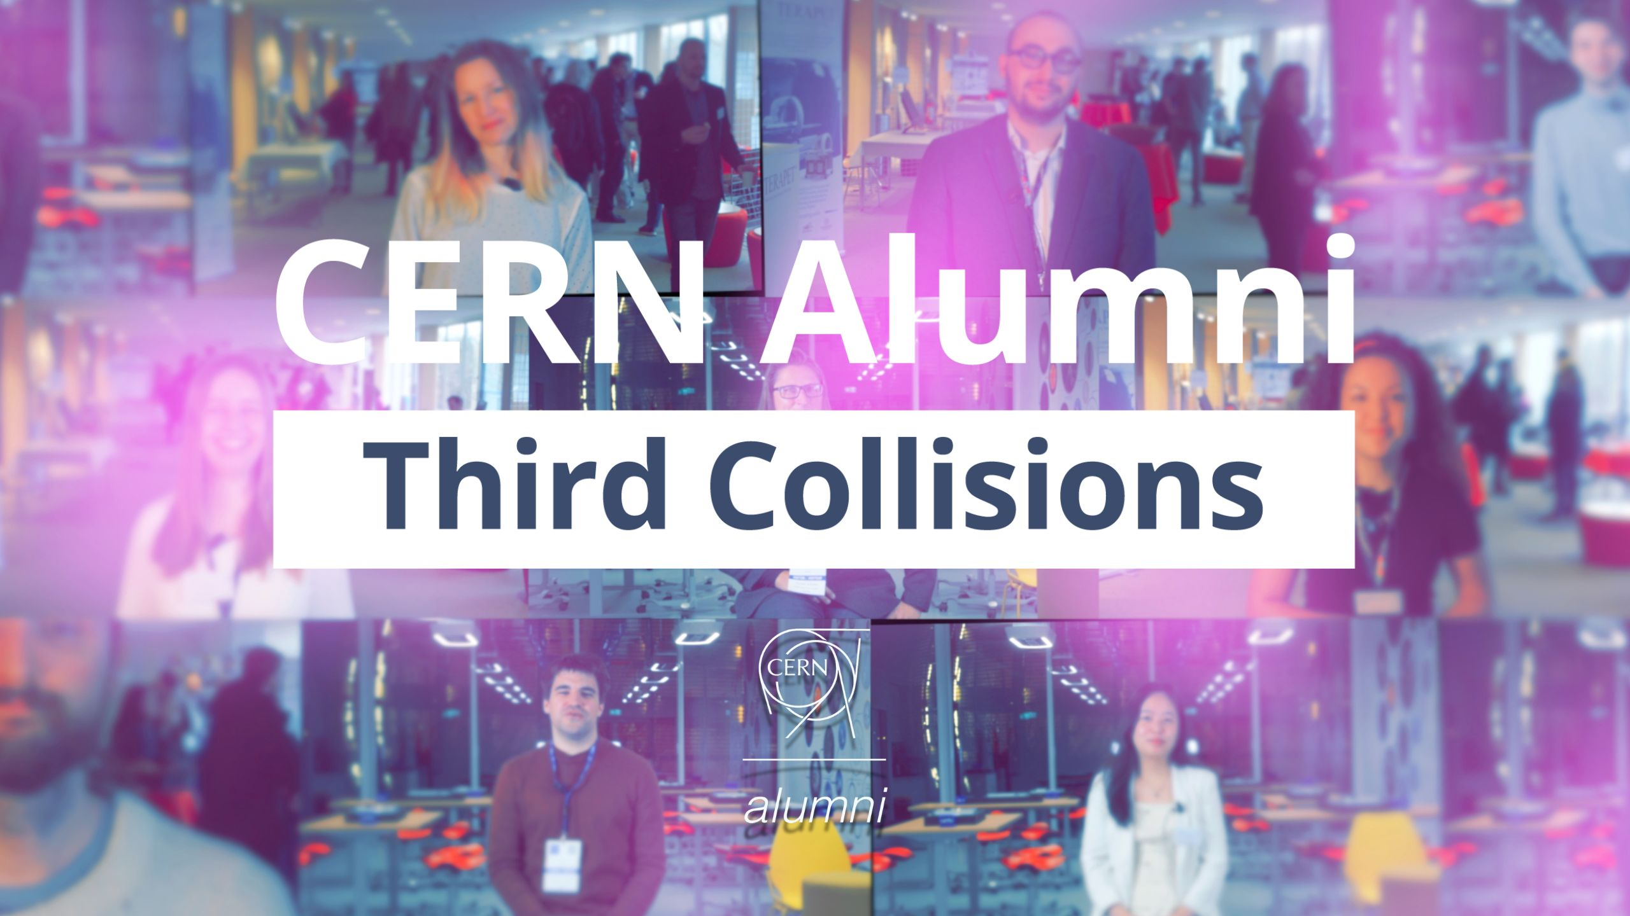
Mostly a storyteller
Livestreams from CERN facilities

Slide 7



We have prepared a short introduction for you on how to use the CERN template
This part edit by "Insert > Header and Footer”

Slide 8

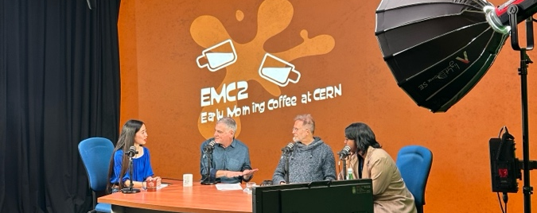
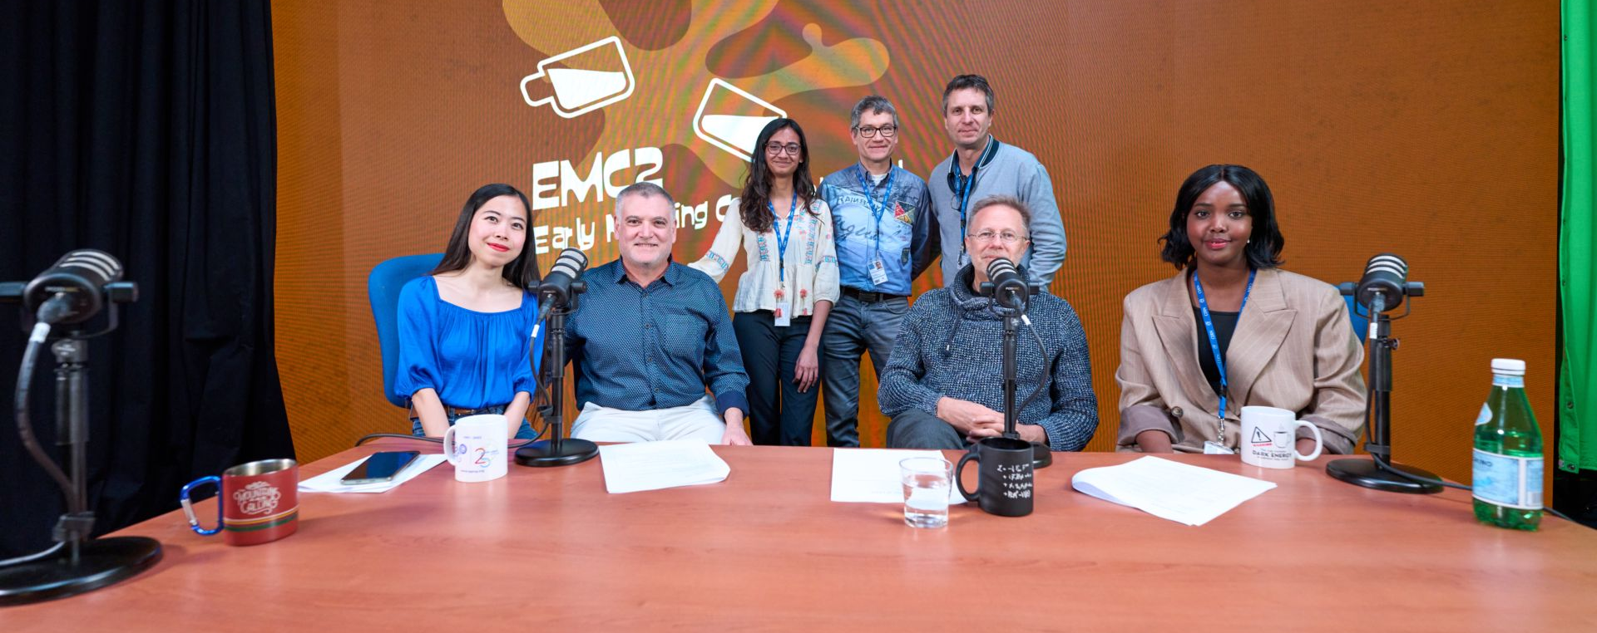
Episodes in making
Episode 1
Meet the crew
Episode 2
Chetna Krishna | @chit_chet_

Slide 9
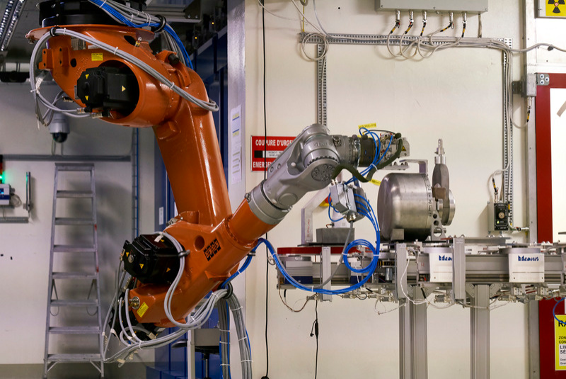
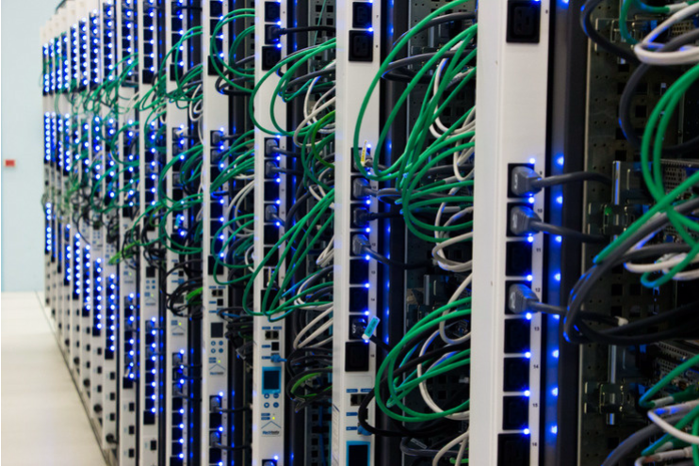
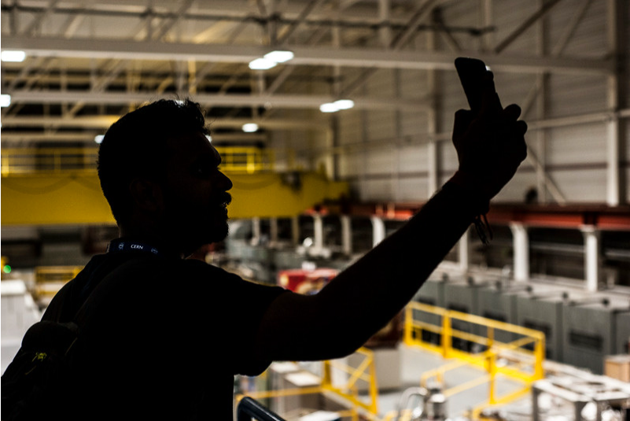
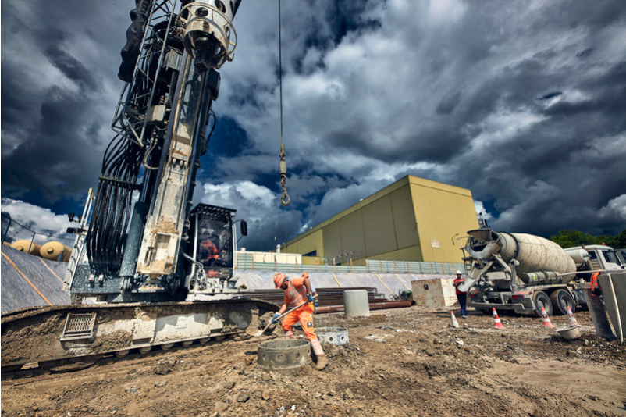
It takes a village..
ROBOTICS
COMPUTING
COMMUNICATIONS
RADIO FREQUENCY
MECHANICAL ENGINEERING
VACUUM AND CRYOGENICS
MATERIALS SCIENCE
ELECTRICAL ENGINEERING
ELECTRONICS
CIVIL ENGINEERING

Slide 10
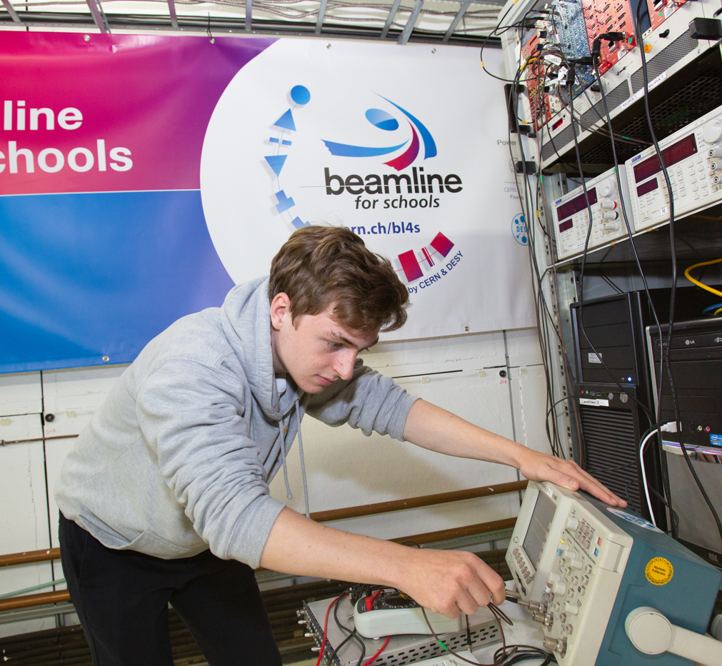
Careers at CERN
Technical, Administrative Student Programmes
Beamline for Schools competition
A 14-month programme for university students
2023 edition: international competition for high-school students
Short-term internships and job shadowing
Users, doctoral students and
many other positions!
For school and university students
🔗careers.cern

Slide 11
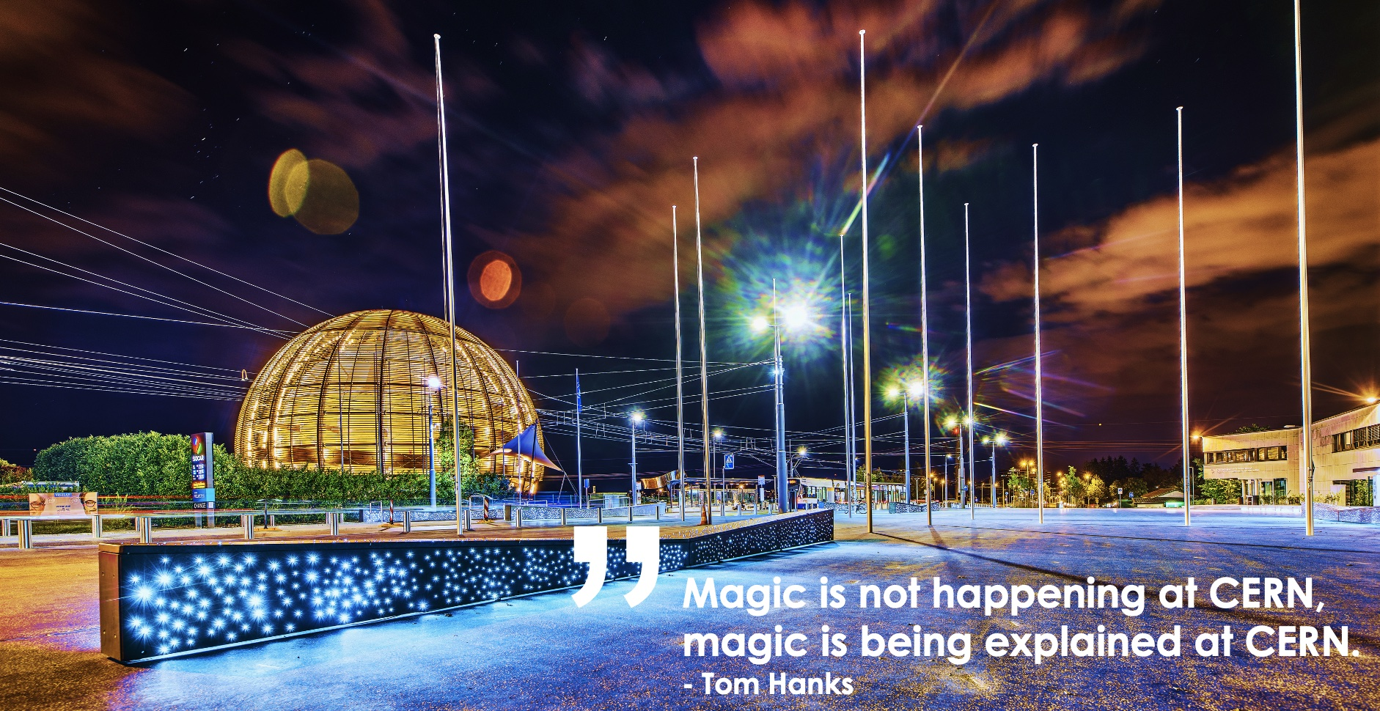


Questions?
/@chit_chet_
/chetnaatcern
”
Magic is not happening at CERN,
magic is being explained at CERN.
- Tom Hanks

