Slide 1
Status of MBRD series production
S. Farinon INFN - Genova
A. Bersani, B. Caiffi, A. Pampaloni
Zoom Meeting – May 22nd, 2024
https://indico.cern.ch/event/1416554/

Slide 2
SUMMARY
Status of coil production
Protrusion of SS protection sheets
Status of MBRD1
Status of MBRD2
Status of MBRD3
Schedule

Slide 3
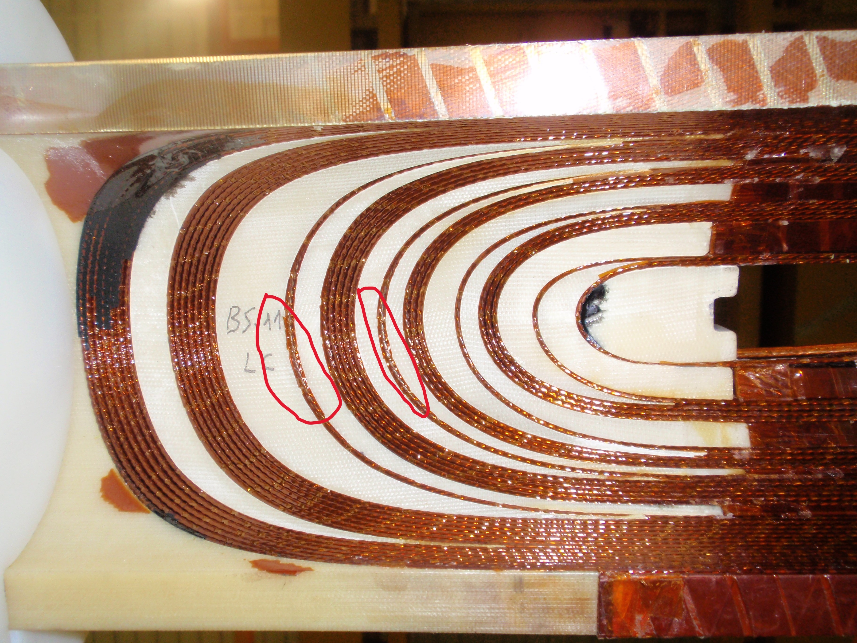
Status of coil production
The winding and curing of all the 24 coils has been completed.
There are 2 issues:
  Insulation damage at the coil ends
    During curing, the coil is pressed against
    the mandrel at 90 MPa, which can damage
    the turn insulation in some areas.
    ASG developed a process to restore the
    insulation in both collared and single coils
    (approved by CERN/INFN).
    The repair has already been performed on
    MBRD2 at CERN, but still needs to be
    applied to MBRD1 and to the coils that have
    not yet been collared.
Inner side of the coil
(https://edms.cern.ch/ui/file/3088308/1.0/28837_1_MBRD_TURN_INSULATION_RESTORING.pdf)

Slide 4
Single coil status
Type A Coils
  AS-03: No issues to report.
  AS-08: Requires two repairs: one on the CS and one on the NCS, located on the first turn adjacent to the filler.
  AS-09: No issues to report.
  AS-10: One point on the NCS needs further investigation to determine if it is dirt or insulation damage (the coil needs to be rotated). Everything is OK on the CS.
  AS-11: Requires a repair on the first turn adjacent to the first filler on the CS. Everything is OK on the NCS.
  AS-12: Requires a repair on the first turn adjacent to the first filler on the CS. Everything is OK on the NCS.
Type B Coils
  BS-03: No issues to report.
  BS-05: Requires a repair on the first turn adjacent to the first filler on the NCS. No issues to report on the CS.
  BS-09: Requires a repair on the second turn adjacent to the first filler on the NCS. No issues to report on the CS.
  BS-10: No issues to report.
  BS-11: Requires a repair on the CS and two repairs on the NCS.
  BS-12: No issues to report.

Slide 5
Status of coil production
The winding and curing of all the 24 coils has been completed.
There are 2 issues:
  Insulation damage in the coil ends
  Excess coil dimension in 4 coils
    The issue is that we do not have the necessary margin with the available shimming sheets to accommodate the largest coils while maintaining the nominal field quality.
    Our initial proposal to the beam dynamics team was to couple the coils in such a way that all issues would be confined to the last magnet, which would be tagged as a spare.
    However, this proposal was not accepted. We are now developing a new proposal that distributes the issues among the magnets to ensure they are as similar as possible. It will be ready in 2 weeks from now.
collared apertures
single coils

Slide 6
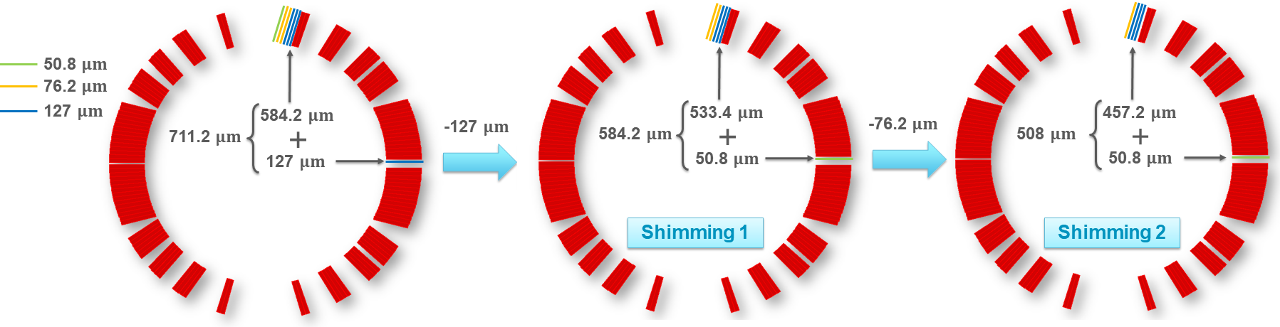
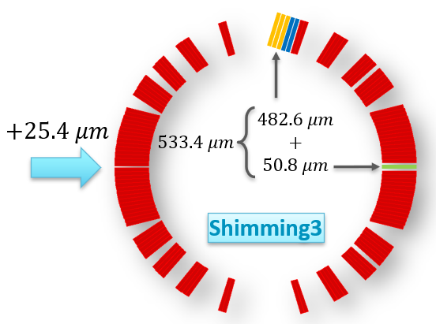
SHIMMING SCHEMES

Slide 7
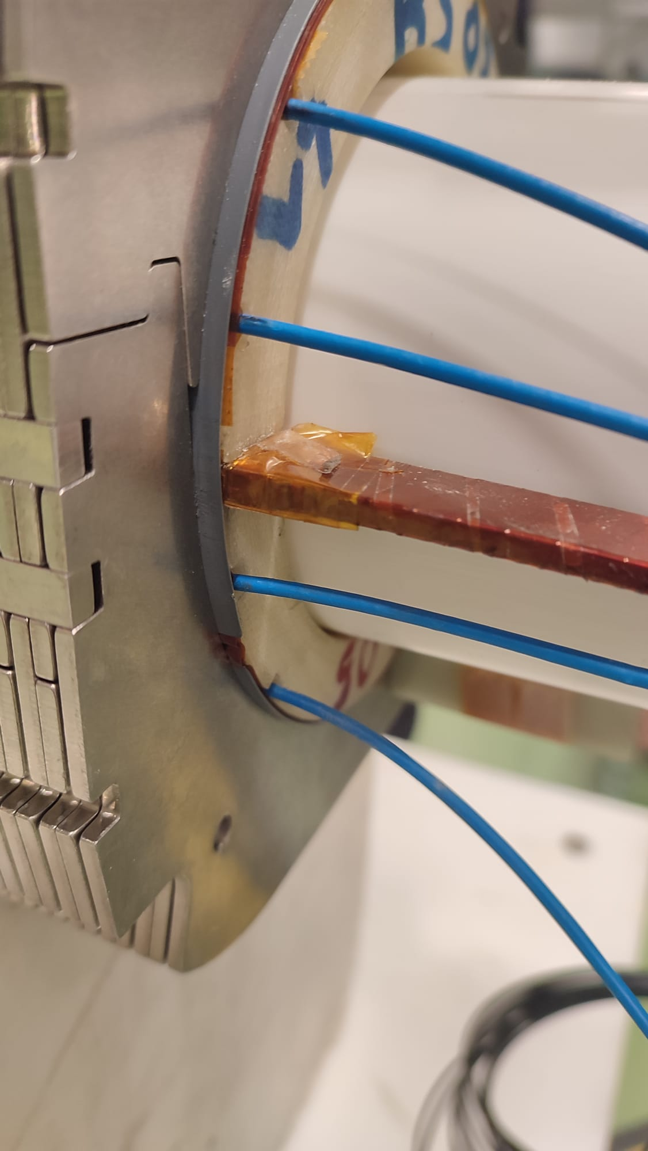
Protruding SS protection sheets
This issue, which has affected all collared apertures, was initially detected on MBRD1.
The root cause consists in the fact that, according to the drawings, the SS protection sheets are as long as the coils.
Due to the inherent difficulty of precisely controlling their position, this protrusion occurs in almost all apertures, leading to the encountered problems.

Slide 8
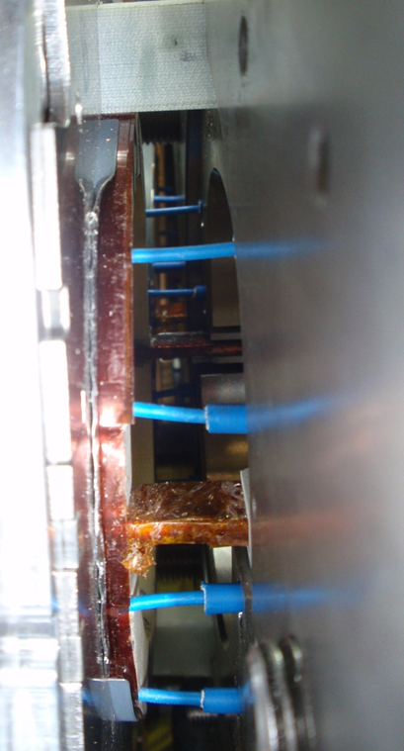
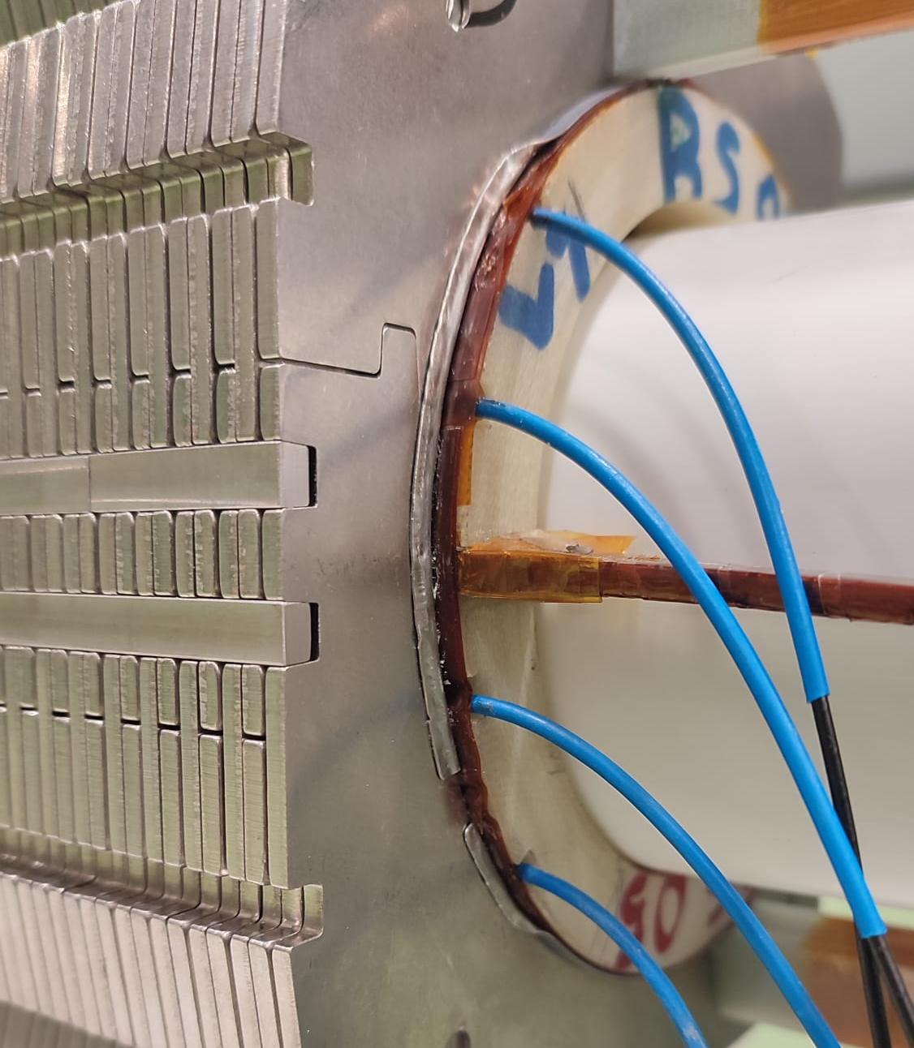
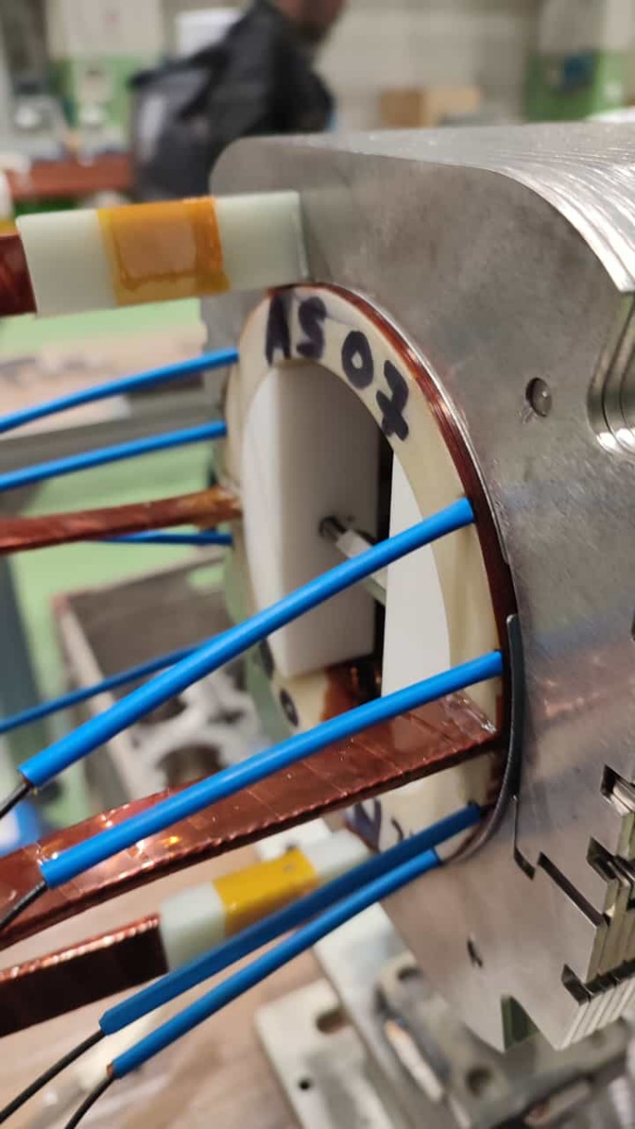
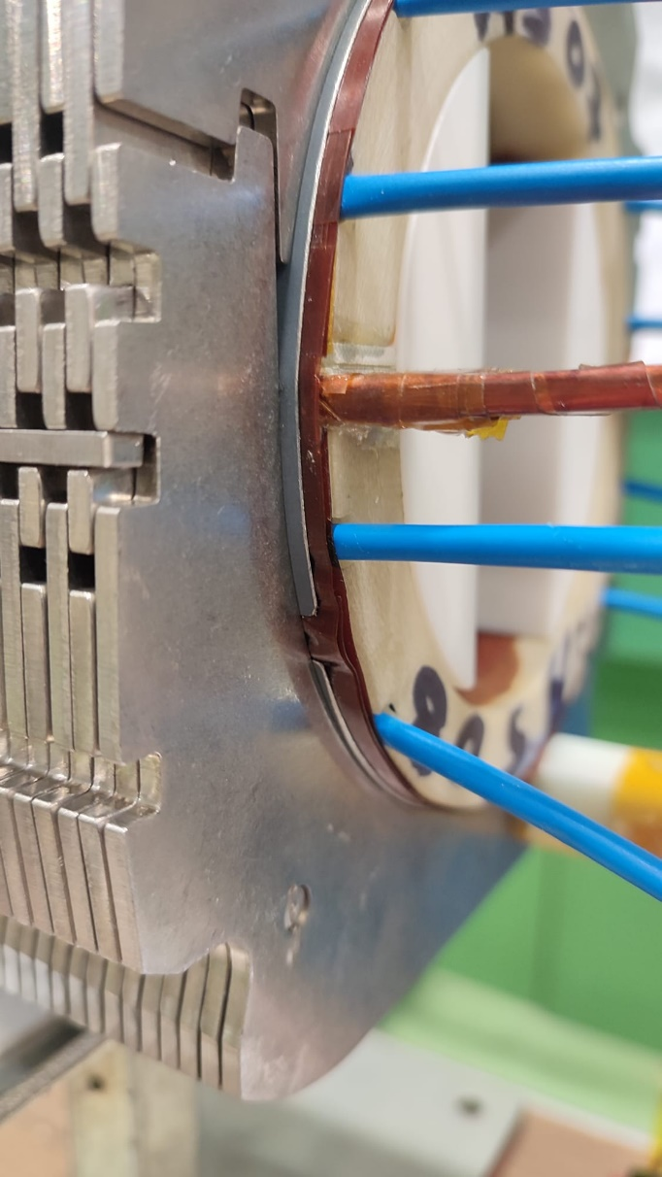
Protruding SS protection sheets: accepted solution
In assembled apertures & magnets:
  The SS protection sheets have been bent toward the collars
In apertures yet to be collared:
  The length of the SS sheet positioned on
  the coil end will be reduced by 2.5±0.5 mm using a rotating rasp abrasion method.
  It is expected that this action will completely solve the issue of protrusion.
  However, there is a possibility that the SS sheet might end up slightly recessed under the last collar: this is not expected to cause any issues.

Slide 9
MBRD1 status
MBRD1 arrived at CERN in October 2023 (with partial loading of the longitudinal tie rods).
In December 2023, with INFN staff, the tie rods were successfully loaded to their nominal load.
Subsequent electrical tests at high voltage (3.1 kV) revealed a short circuit to ground in QH Y112.
  Since no electrical tests were planned upon receipt, it's impossible to determine whether the short occurred during transportation or during the loading of the tie rods.
  The revised acceptance procedure now includes high-voltage electrical tests upon receipt.
CERN technicians attempted to locate the source of the issue using endoscopy but, in the end, it was decided to disassemble the end plate.

Slide 10
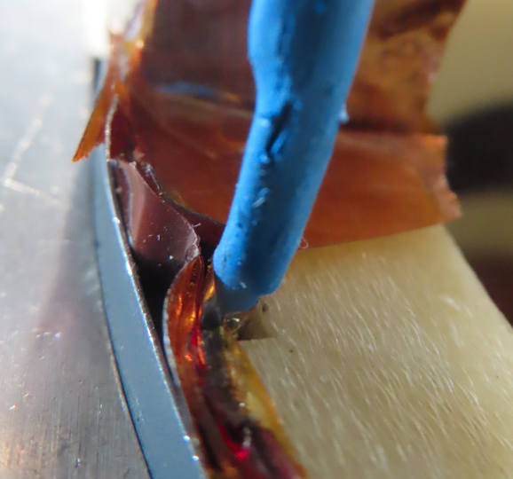
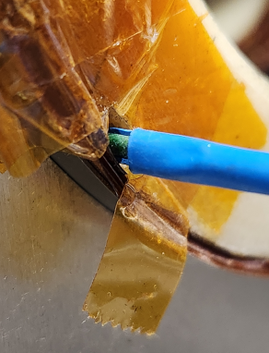
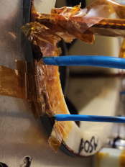
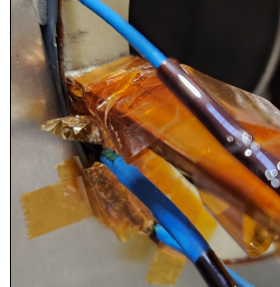
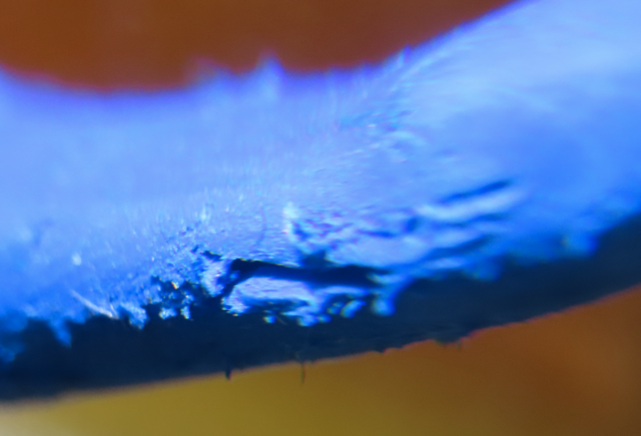
MBRD1 status
The anomaly at QH Y112 wasn’t traced by ASG, and we're still waiting for an explanation from them.
A local electrical test at 3.1 kV was performed between YT112 and an aluminum sheet enclosing the wire. The investigation
precisely identified the defect's location at the repaired
section with the polyimide tape.

Slide 11
MBRD1 status
Corrective actions:
  MBRD1 has been temporarily reassembled for transportation back to ASG, a decision made by ASG.
    However, this transportation process experienced some delays due to customs documentation, and it is now scheduled for next week, specifically May 28th, 2024.
  MBRD1 will be repaired with the highest priority.
    The repair process will involve several steps, including bending of the SS protection sheets, reassembling of the end plate, repairing of the stabilizer brazing, splicing, and attaching VTs according to CERN's procedural guidance.
    According to the current schedule, its delivery to CERN is expected in June 2024.

Slide 12
MBRD2 status
MBRD2 arrived at CERN in April 2024.
Following the findings on MBRD1, in ASG the tie rods were loaded up to nominal load.
  Upon reception at CERN, about 50% of this load was lost (most likely due to vibrations during transportation) and had to be restored.
SS protection sheets were bent in ASG.
MBRD2 successfully passed all reception tests and was accepted.
It will be the first MBRD magnet to be assembled in the cold mass.

Slide 13
MBRD3 status
MBRD3 will consist of apertures:
  VS-05 which includes AS-05 and BS-07 coils, coupled with shimming scheme 2.
    This aperture has been collared without any issues.
  VS-06 which includes AS-07 and BS-08 coils, coupled with shimming scheme 3.
    This aperture encountered two issues:
      A short QH vs coil AS-07, which led to the replacement of QH with a new one, followed by recollaring of the aperture.
      A short coil BS-08 vs ground.

Slide 14
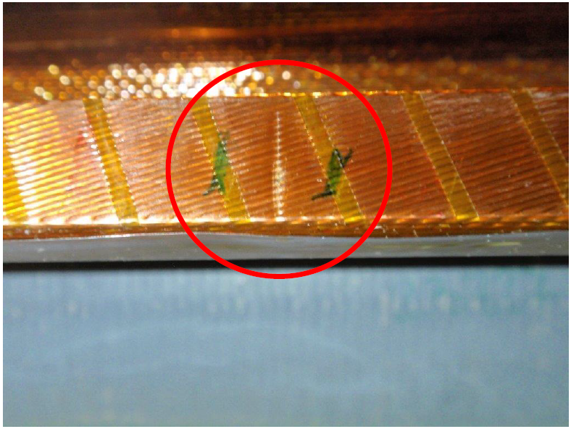
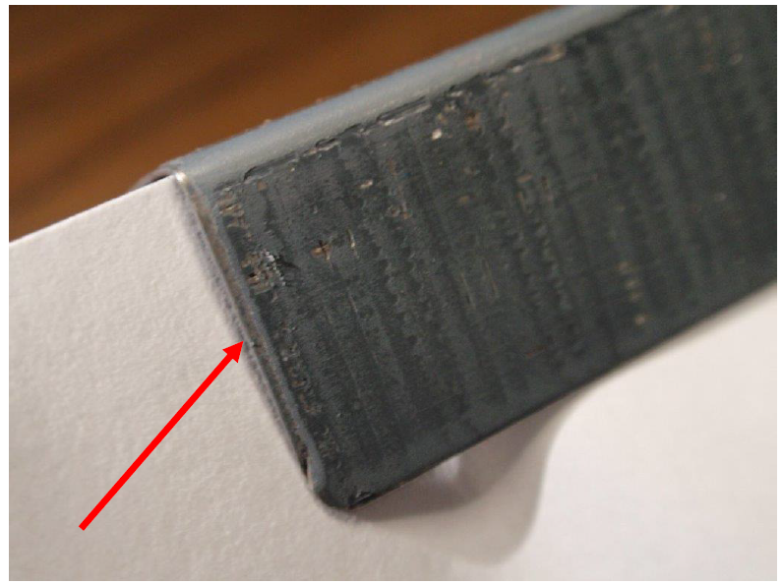
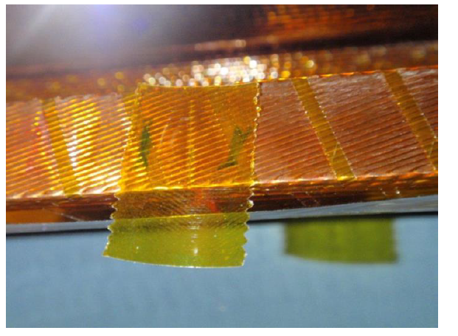
Short coil BS-08 vs ground
The cause of this issue was the unforeseen overlapping of two adjacent coil protection sheets side by side.
This overlapping resulted in an increase in thickness, which under pressure led to damage to all the ground insulation layers (no damage to the conductor strands).
Accepted repair proposal includes the replacement of damaged GI and QH and the local application of a single layer of polyimide adhesive tape (20 mm in width and 0.05 mm in thickness).

Slide 15
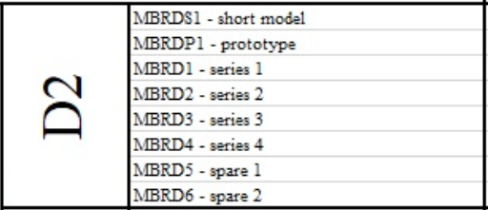
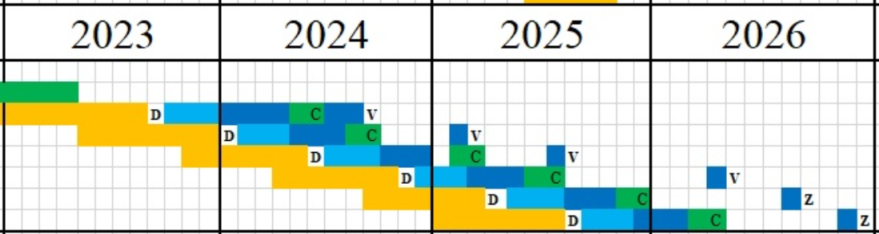
Schedule
ASG delivery schedule:
  MBRD1 June 2024
  MBRD3 September 2024
  MBRD4 January 2025
  MBRD5 May 2025
  MBRD6 September 2025

Slide 16
THANKS FOR THE ATTENTION

