Slide 1




Update on D2 correctors
Yingzhe Wang

Slide 2



Progress of series production
 | Coil name |  | Winding method | Location | Coil stand-alone performance (4.2 K) |  | Magnet performance at 4.2 K
MCBRD01 | AP1 | MCBRD_CB01 | Wet wind | CERN | 530 A |  | Both apertures reached ultimate current 422 A, and passed 4-hour stability test
 | AP2 | MCBRD_CB03 | Direct wind |  | 410 A
MCBRD_CB02 |  |  | Direct wind | CERN | Failed to reach the design current
MCBRD02 | AP2 | MCBRD_CB04 | Wet wind | CERN | 422 A |  | Both apertures reached ultimate current 422 A, and passed 4*1 hour stability test
 | AP1 | MCBRD_CB06 | Wet wind |  | 530 A
MCBRD_CB05，07，08 |  |  | Wet wind | IHEP
MCBRD03 | AP2 | MCBRD_CB09 | Direct wind with new channel size | CERN | 530 A |  | Both apertures reached ultimate current 422 A, and passed stability test
 | AP1 | MCBRD_CB12 | Direct wind with new channel size |  | 526 A (25 quenches)
MCBRD_CB14 |  |  | Direct wind with new channel size | BAMA | 530 A (30+34 quenches), put in quarantine
MCBRD04 | AP2 | MCBRD_CB13 | Direct wind with new channel size | CERN | 530 A (20+33 quenches) |  | Both apertures reached ultimate current 422 A, and passed stability test
 | AP1 | MCBRD_CB17 | Direct wind with new channel size |  | 524 A (47 quenches)
MCBRD_CB10, 11, 15, 16 |  |  | Shipped to CERN for fabrication
MCBRD05 | AP1 | MCBRD_CB18 | Direct wind with new channel size | IMP | 532 A (42 quenches) |  | Assembled in April, test in June
 | AP2 | MCBRD_CB19 | Direct wind with new channel size |  | 530A (68 quenches)
MCBRD06 | MCBRD_CB20 |  | Direct wind with new channel size | IHEP | 530A (68 quenches) | 2nd test after thermal cycle is ongoing | Assemble in July, test in August
 | MCBRD_CB21 |  | Direct wind with new channel size | IHEP | 500 A (81quenches)
MCBRD07 | MCBRD_CB22 |  | Direct wind with new channel size | IHEP | Waiting for stand-alone test |  | Assemble in October , test in November
 | MCBRD_CB23 |  | Direct wind with new channel size | IHEP | Waiting for stand-alone test
MCBRD08 | MCBRD_CB24 |  | Direct wind with new channel size | BAMA | Waiting for VPI |  | Assemble in January 2025 , test in February 2025
 | MCBRD_CB25 |  | Direct wind with new channel size | - | Fabrication in June
MCBRD09 | MCBRD_CB26 |  | Direct wind with new channel size | - | Fabrication in August |  | Assemble in April 2025 , test in May 2025
 | MCBRD_CB27 |  | Direct wind with new channel size | - | Fabrication in October
MCBRD10 | MCBRD_CB28 |  | Direct wind with new channel size | - | Fabrication in December |  | Assemble in July 2025 , test in August 2025
 | MCBRD_CB29 |  | Direct wind with new channel size | - | Fabrication in February, 2025

Slide 3
Time table for MCBRD05-10
 |  | 2024 |  |  |  |  |  |  |  | 2025
 |  | May | Jun. | Jul. | Aug. | Sept. | Oct. | Nov. | Dec. | Jan. | Feb. | Mar. | Apr. | May | Jun. | Jul. | Aug. | Sept. | Oct. | Nov. | Dec.
MCBRD05 | Magnet Test
 | Magnet Delivery
MCBRD06 | Stand-alone test
 | Magnet Assembly
 | Magnet Test
 | Magnet Delivery
MCBRD07 | Stand-alone test
 | Magnet Assembly
 | Magnet Test
 | Magnet Delivery
MCBRD08 | Apertures fabrication
 | Stand-alone test
 | Magnet Assembly
 | Magnet Test
 | Magnet Delivery
MCBRD09 | Apertures fabrication
 | Stand-alone test
 | Magnet Assembly
 | Magnet Test
 | Magnet Delivery
MCBRD010 | Apertures fabrication
 | Stand-alone test
 | Magnet Assembly
 | Magnet Test
 | Magnet Delivery

Slide 4
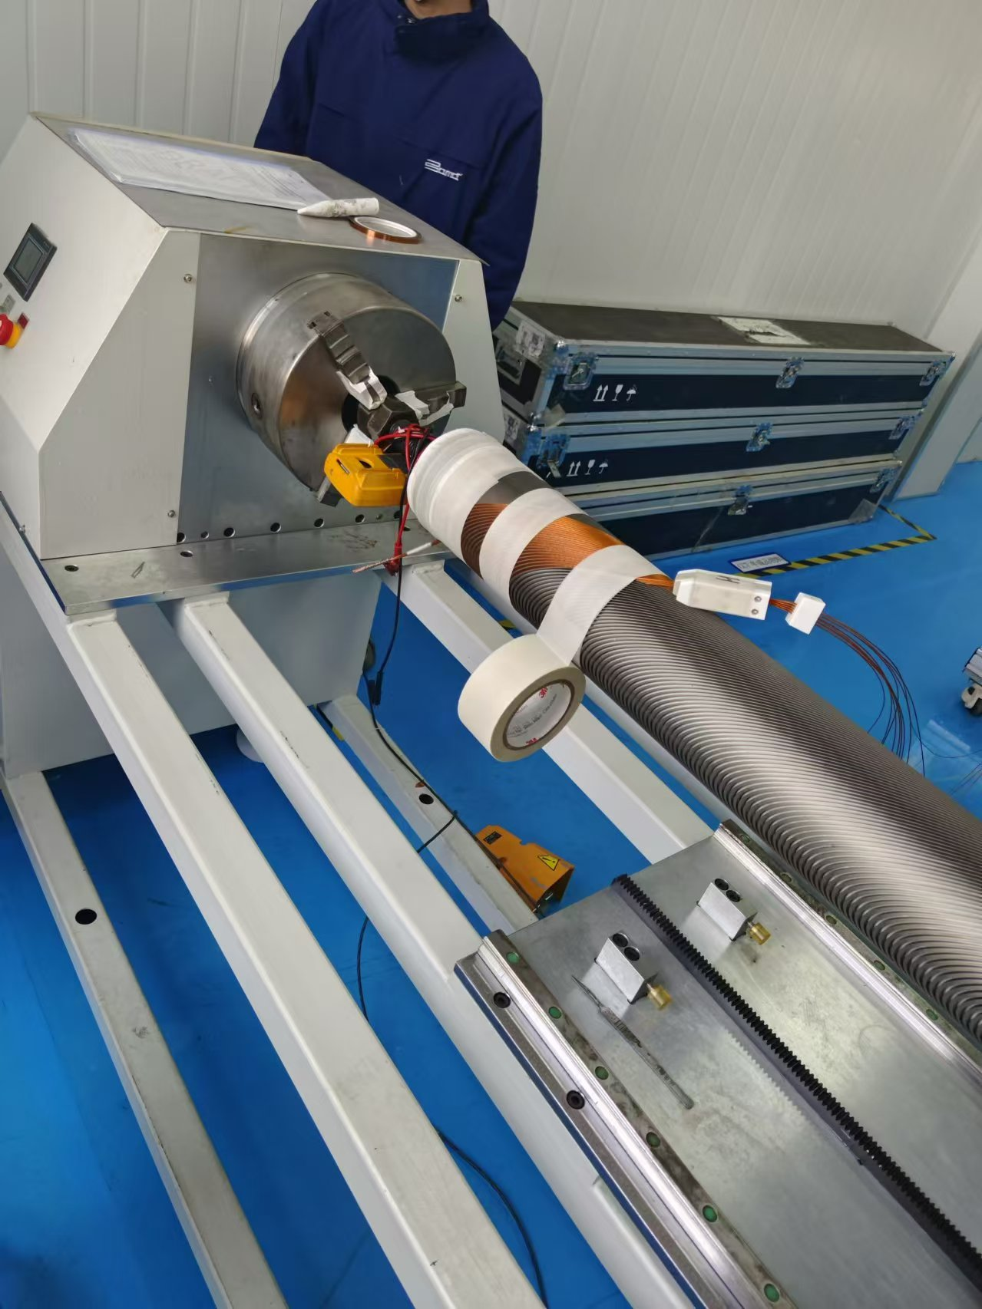
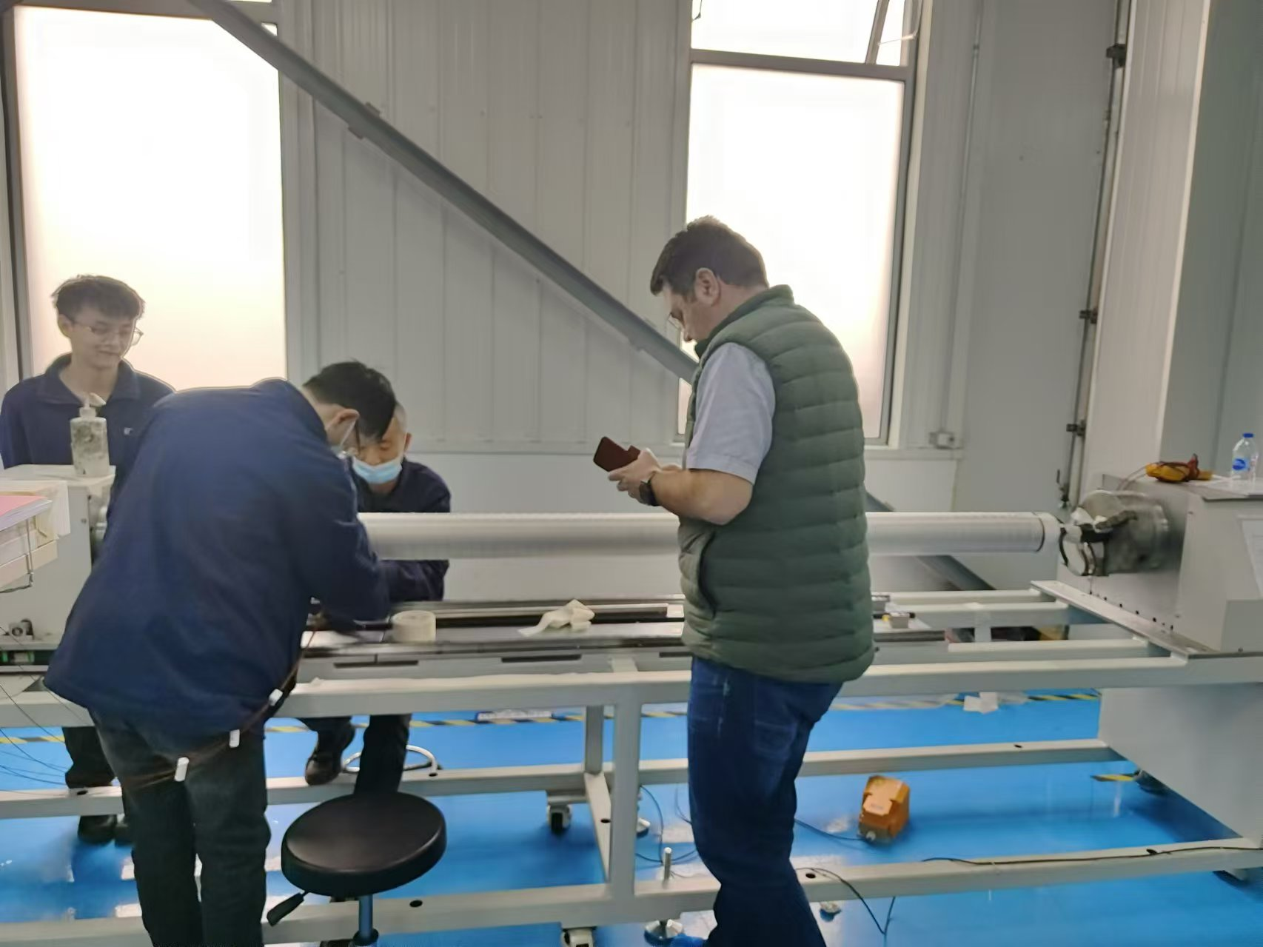
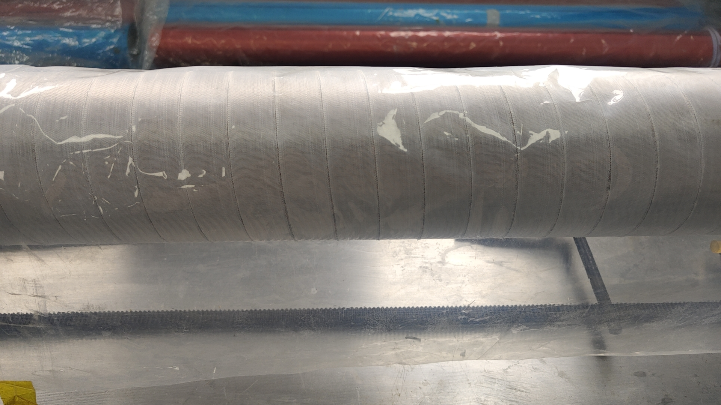
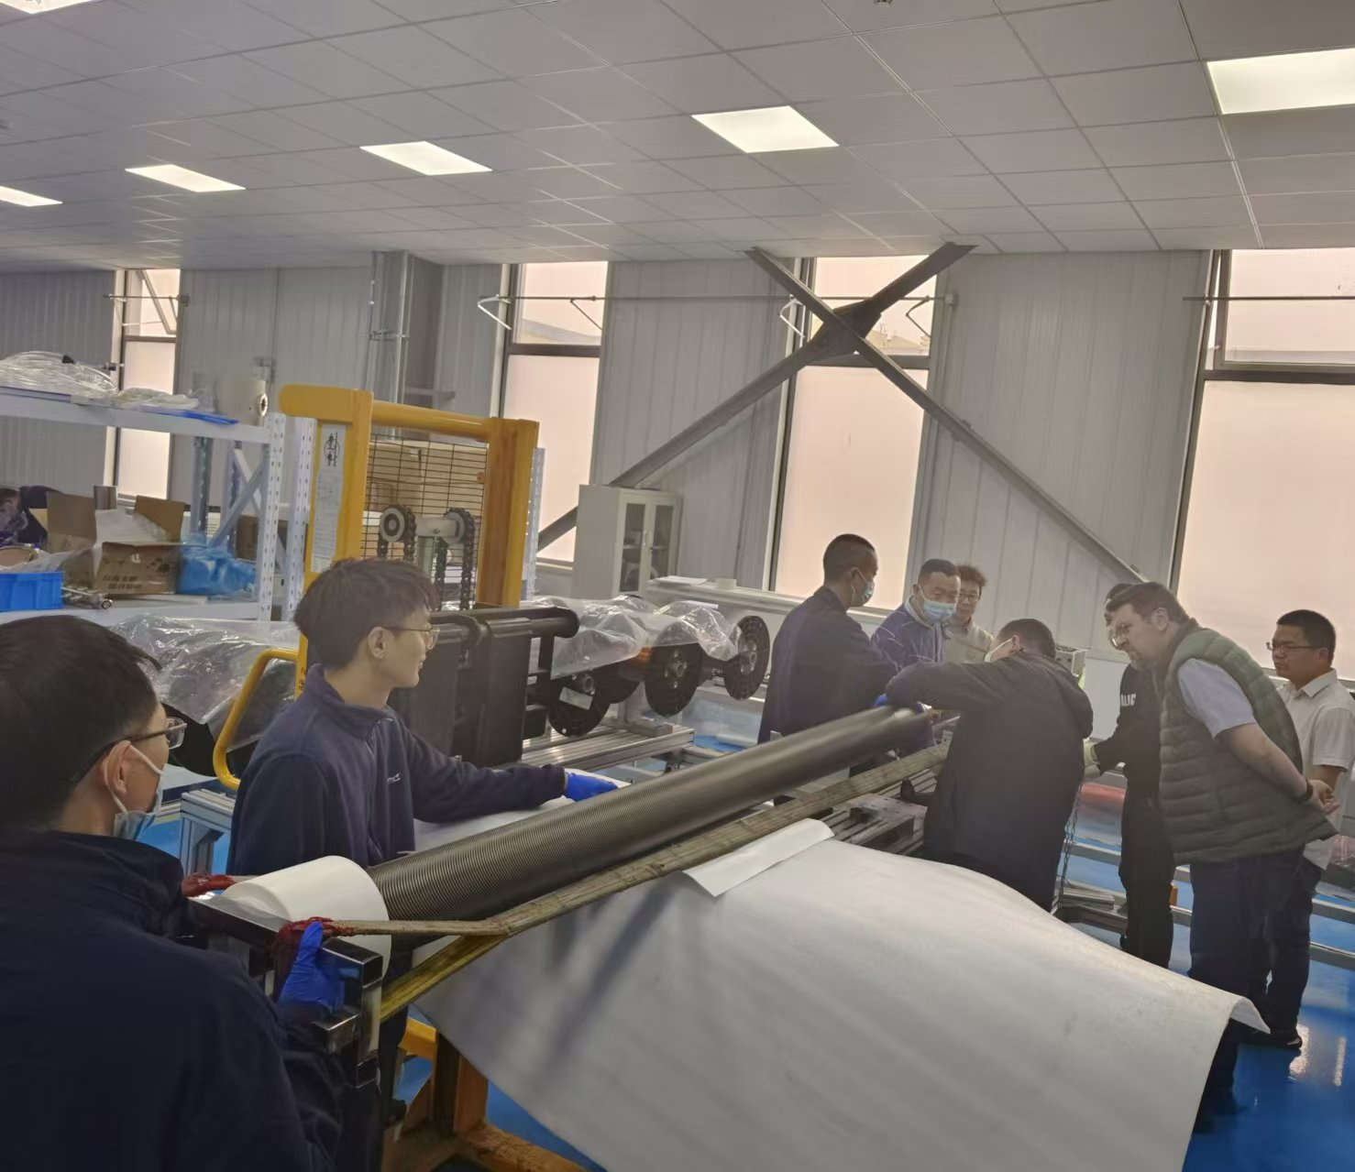
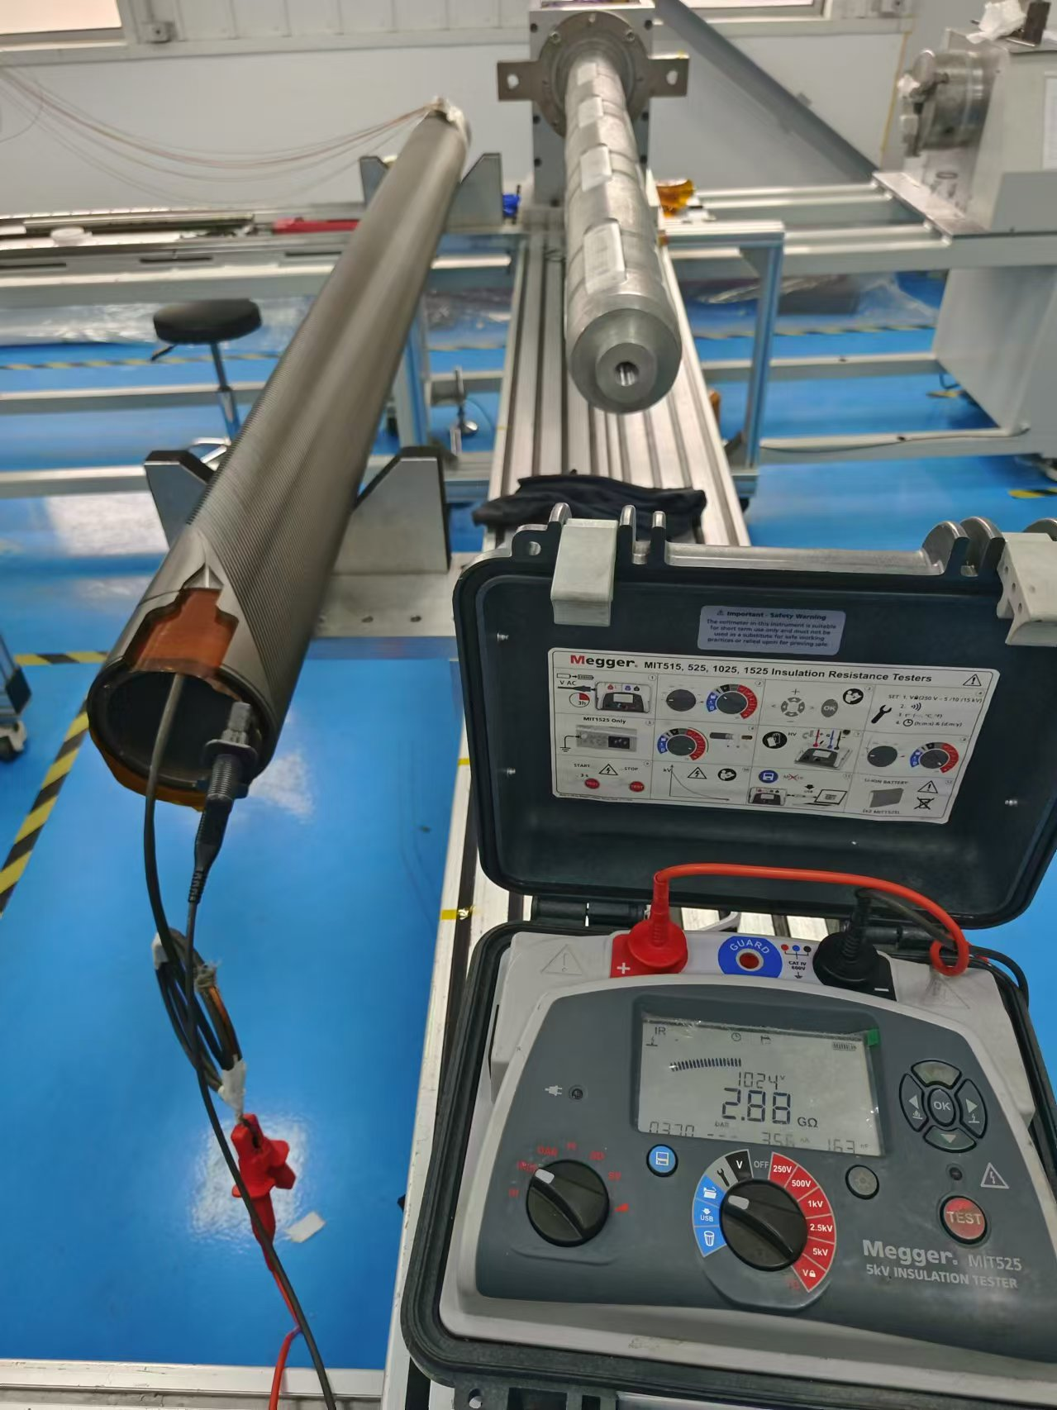
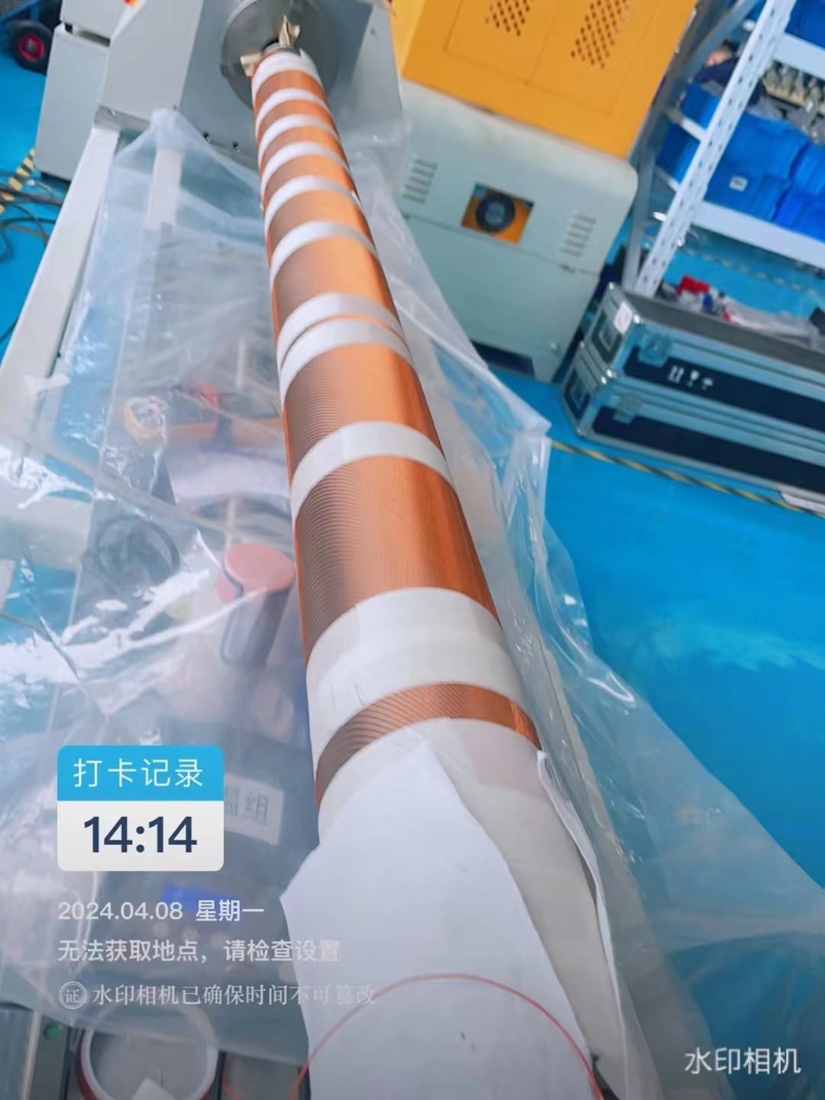
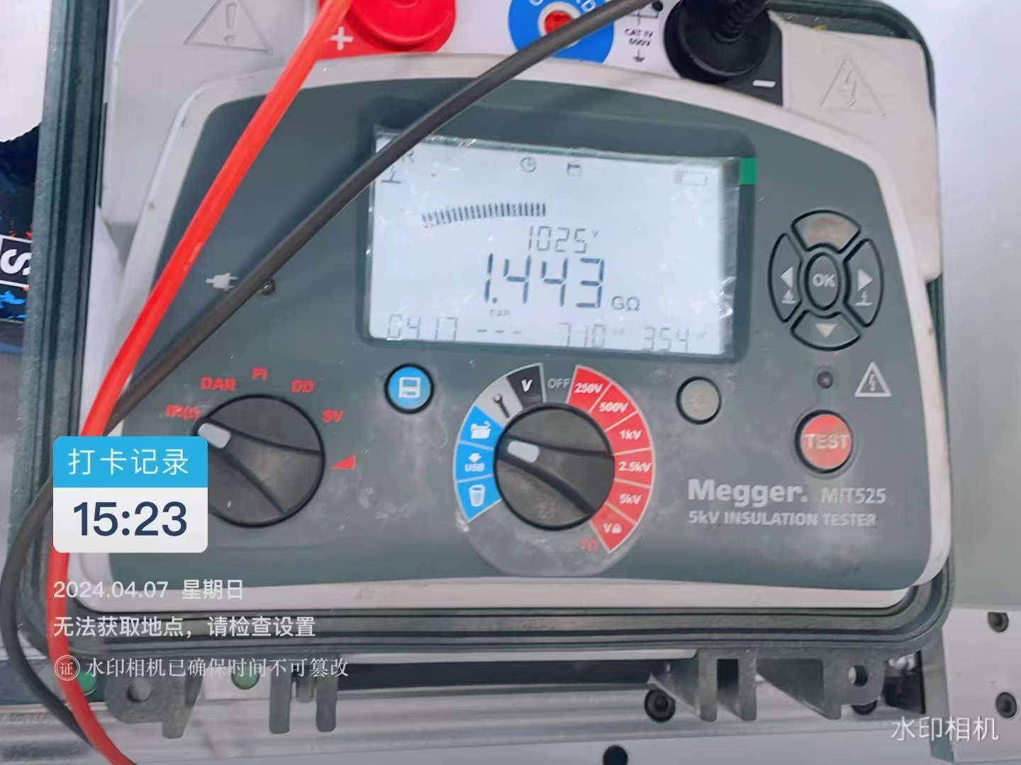
Manufacture of CB24

Slide 5
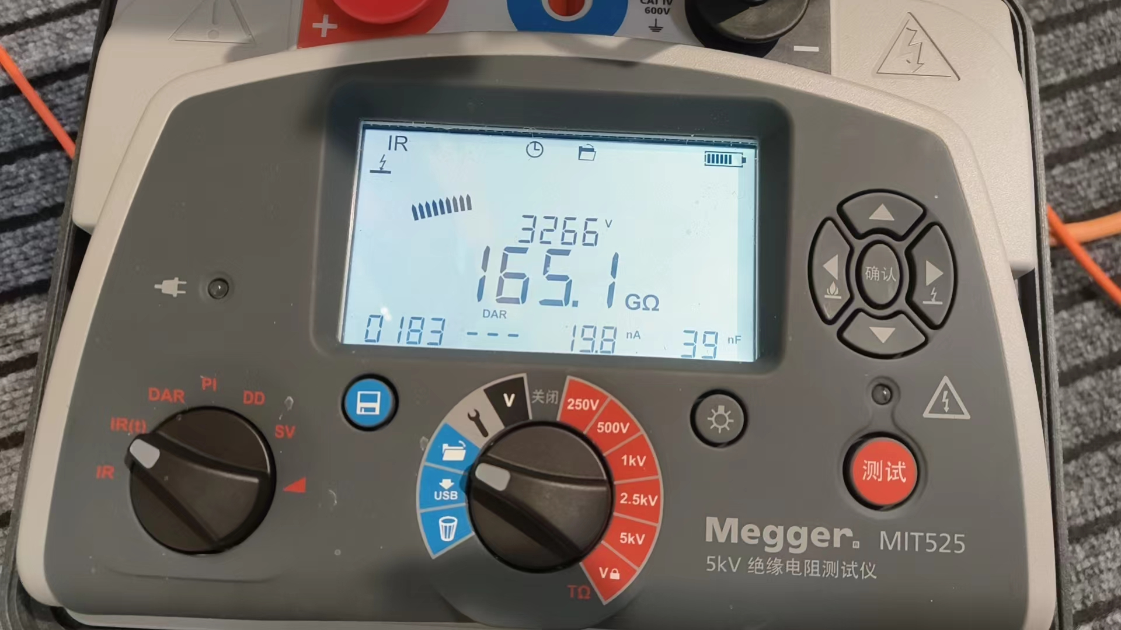
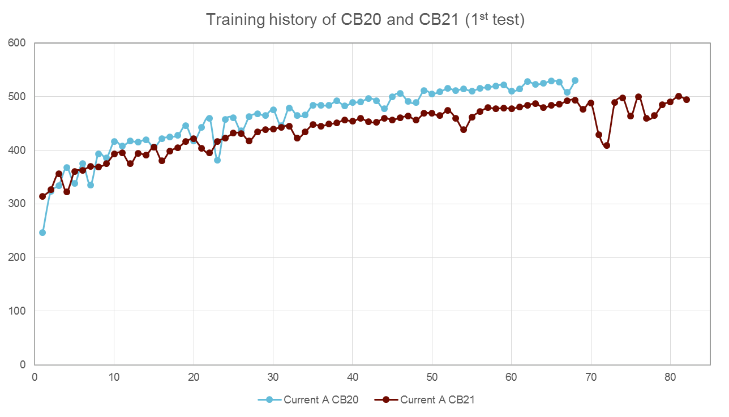
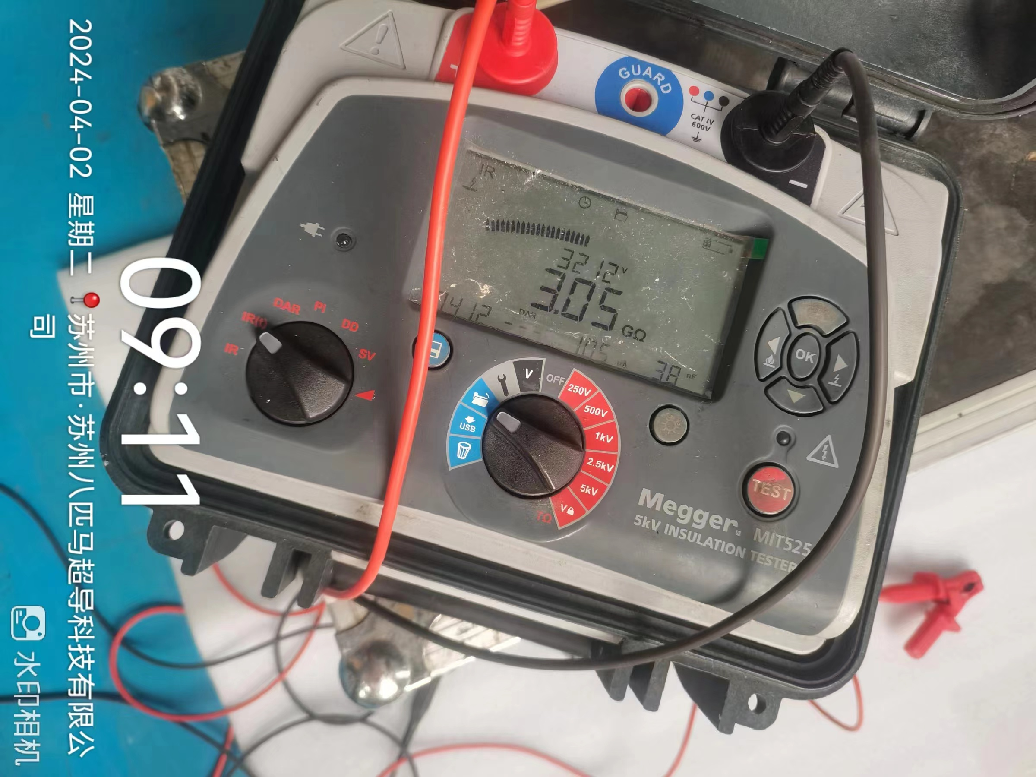
Stand-alone test of CB20, CB21
CB20
CB21

Slide 6
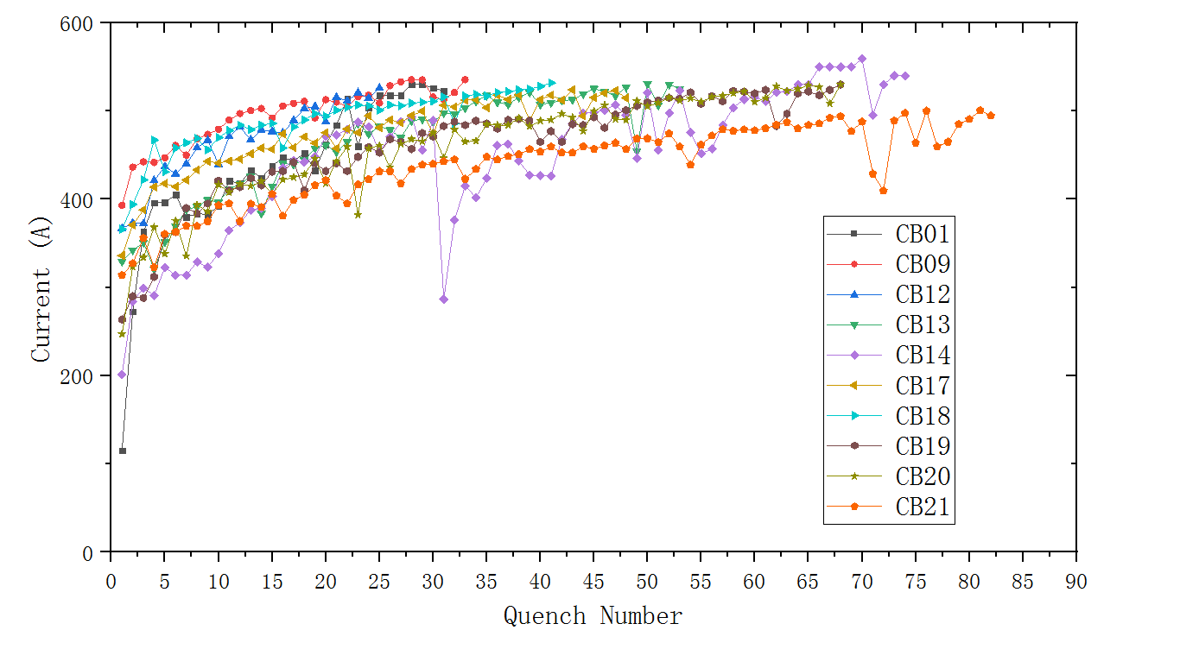
Stand-alone test of All Apertures

Slide 7
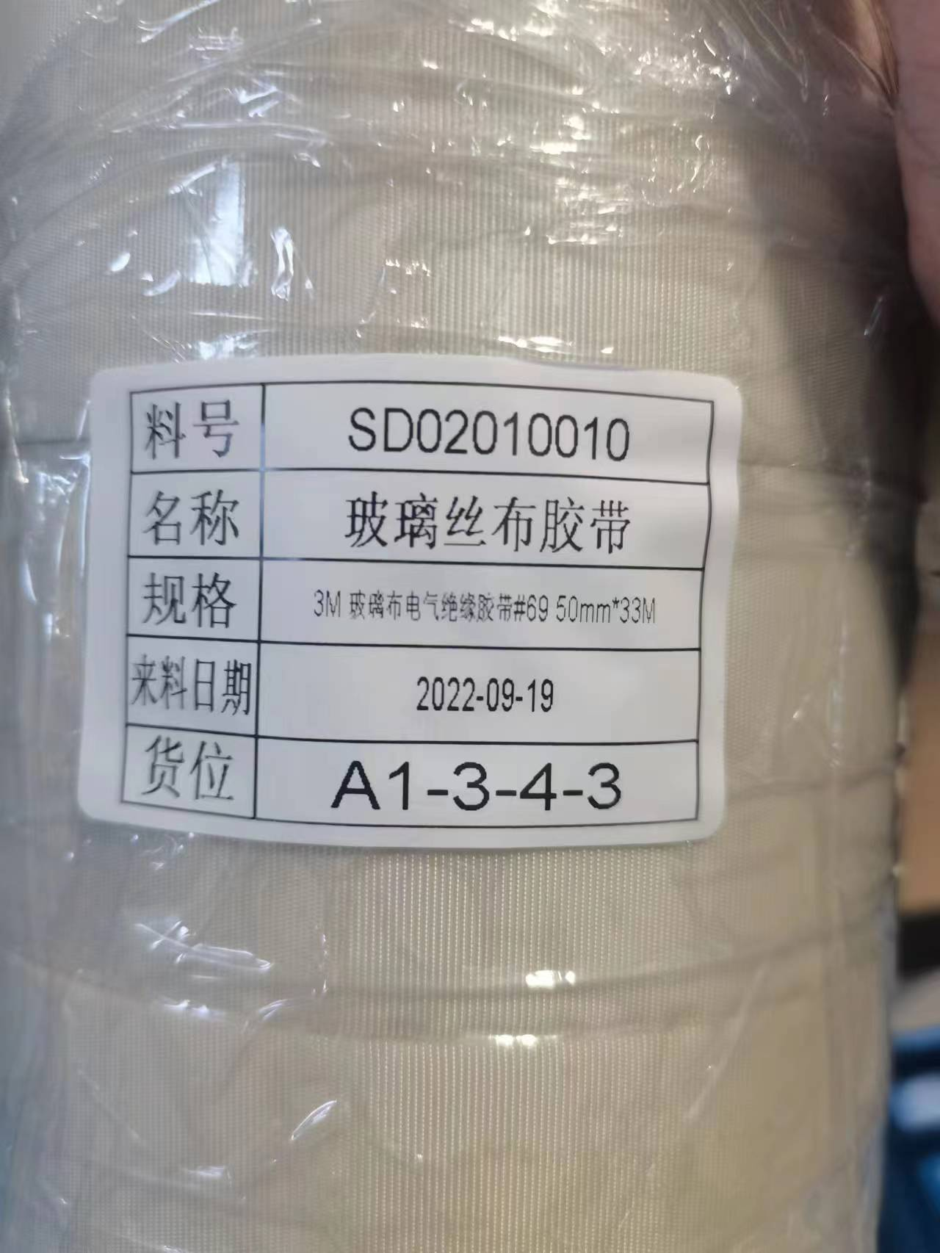
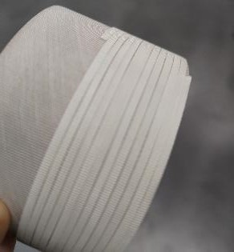
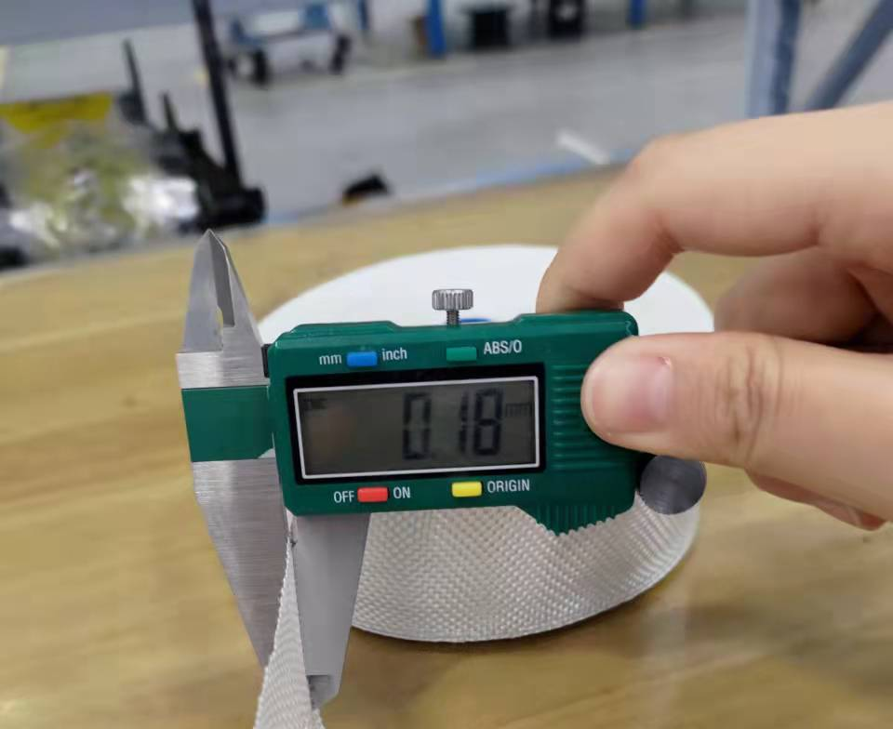
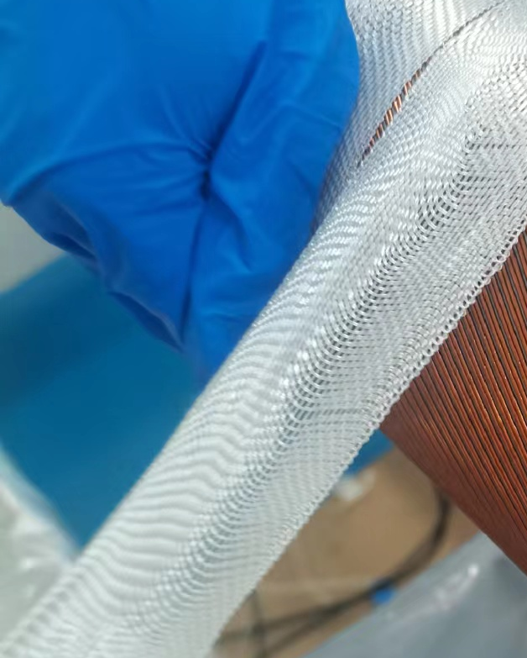
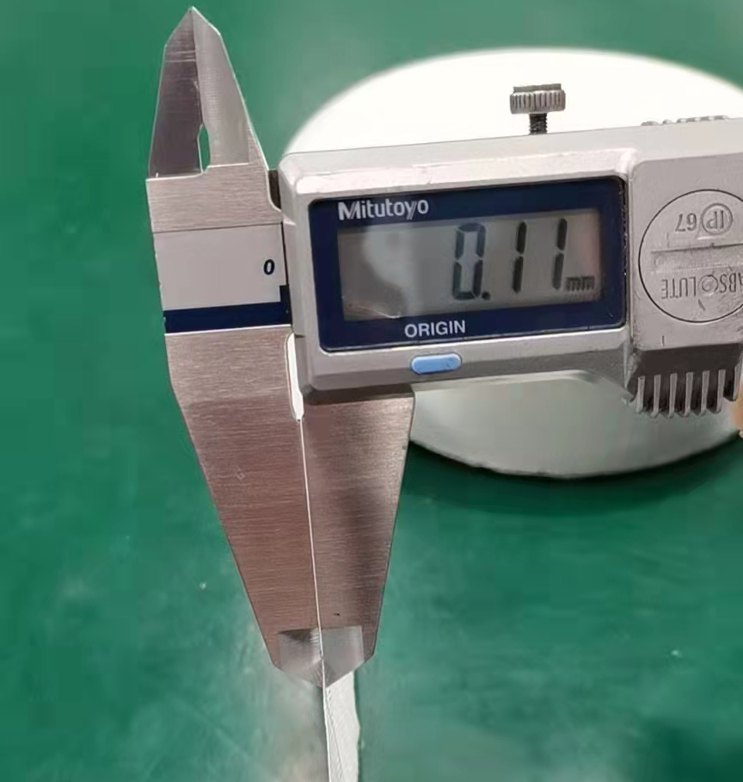
Stand-alone test of All Apertures
 | groove depth | layers of GF tape on the bottom | inner former |  | outer former |  | injection time | Quench number
 |  |  | GF size | overlap | GF size | overlap
CB09 | 5.2 | 2*0.14 | 0.18*50 | √ | 0.18*50 | √ | 3h | 33
CB12 | 4.9±0.1 | 2*0.14 | 0.18*50 | √ | 0.18*50 | √ | 5-6h | 25(526A)
CB13 | 4.9±0.1 | 2*0.14 | 0.18*50 | √ | 0.18*50 | √ | 5-6h | 52
CB14 | 4.9±0.1 | 2*0.14 | 0.18*50 | √ | 0.18*50 | √ | 5-6h | 64(de-training)
CB17 | 4.9±0.1 | 2*0.14 | 0.18*50 | √ | 0.18*50 | √ | 5-6h | 48
CB18 | 4.9±0.1 | 2*0.14 | 0.18*50 | √ | 0.18*50 | √ | 5-6h | 41
CB19 | 4.9±0.1 | 2*0.14 | 0.18*50 | √ | 0.11*20 | √ | 5-6h | 68
CB20 | 4.9±0.1 | 2*0.14 | 0.11*20 | √ | 0.11*20 | √ | 3h | 68 | 2nd test after thermal cycle is ongoing
CB21 | 4.9±0.1 | 2*0.14 | 0.18*50 | √ | 0.18*50 | √ | 6-7h | 81(500A)
CB22 | 4.9±0.1 | 2*0.14 | 0.11*20 | √ | 0.11*20 | √ | 6-7h | -
CB23 | 4.9±0.1 | 2*0.14 | 0.11*20 | √ | 0.11*20 | √ | 5-6h | -
CB24 | 4.9±0.1 | 2*0.14 | 0.11*20 | × | 0.11*20 | × | - | -
0.18*50
0.11*20

Slide 8
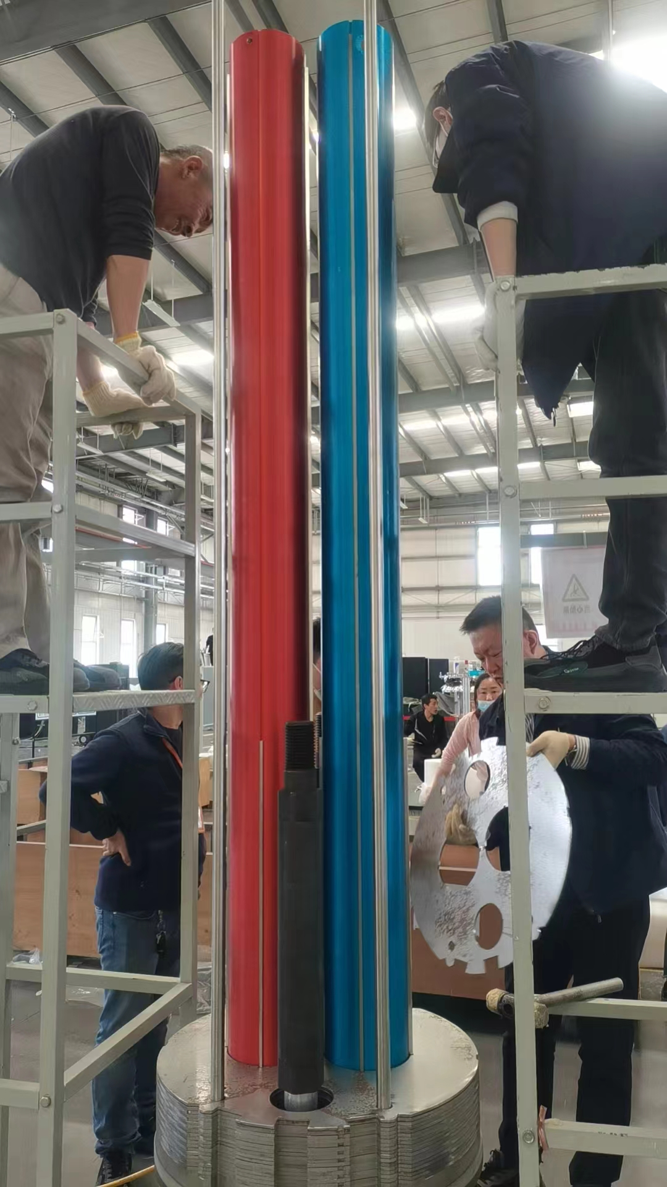
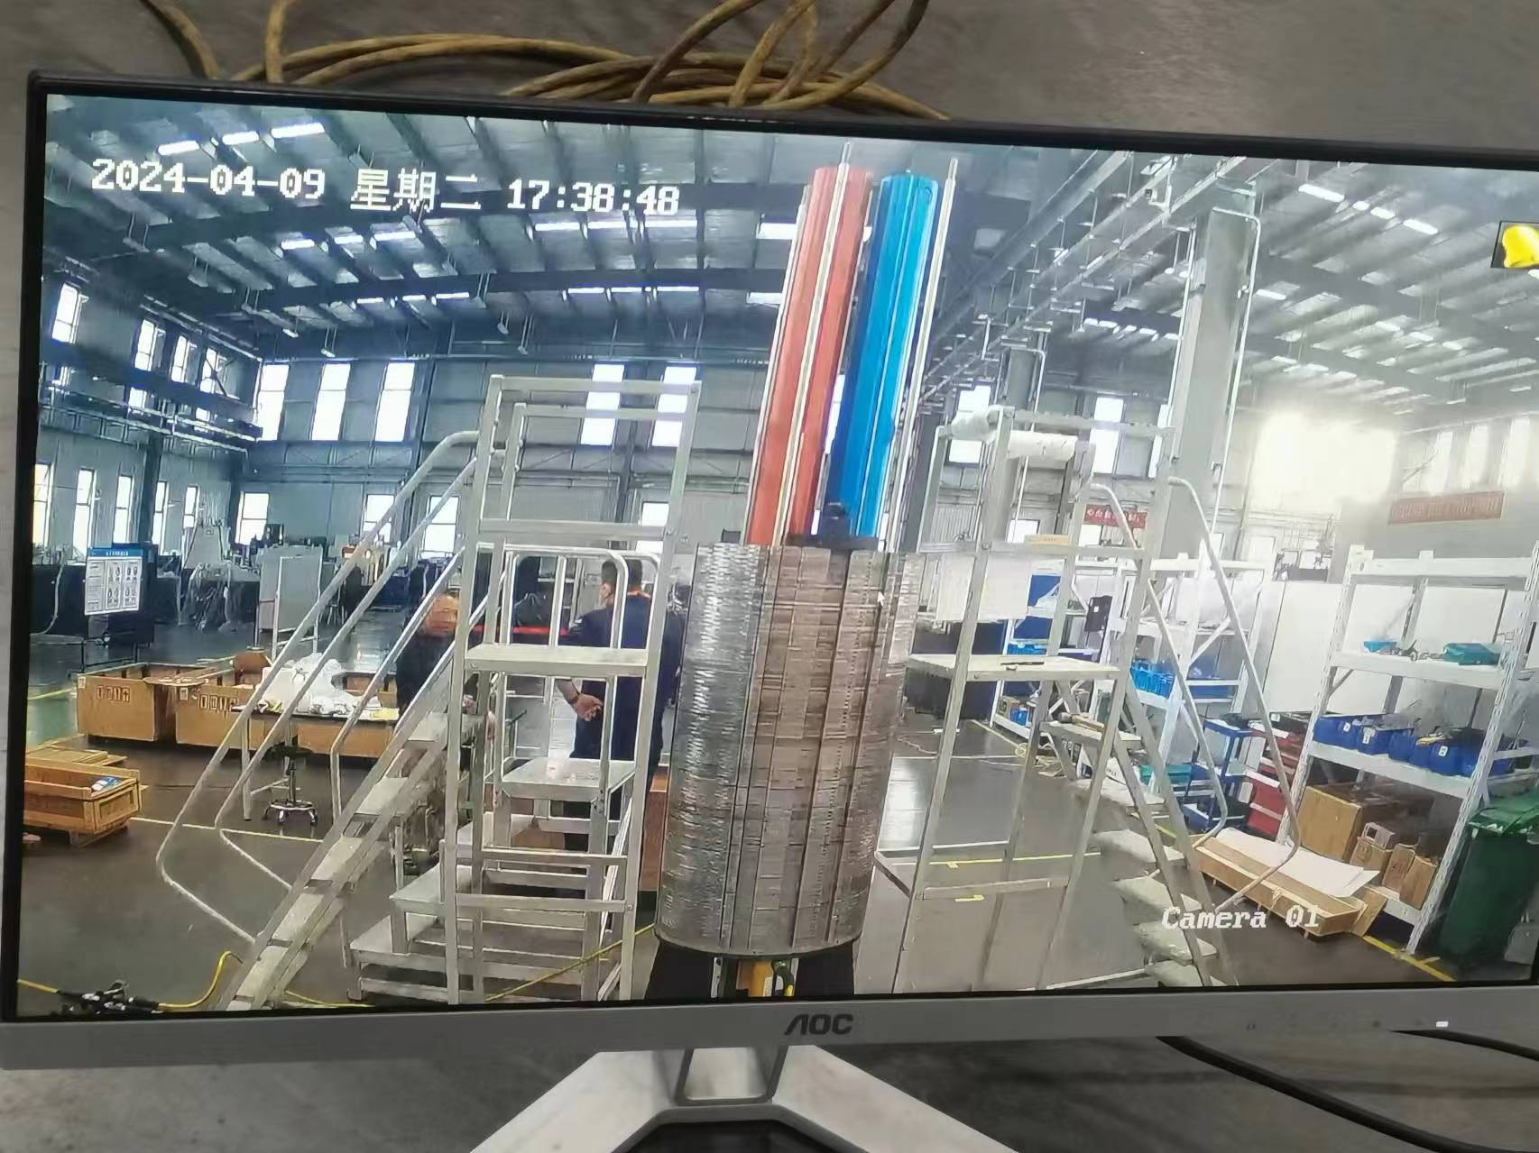
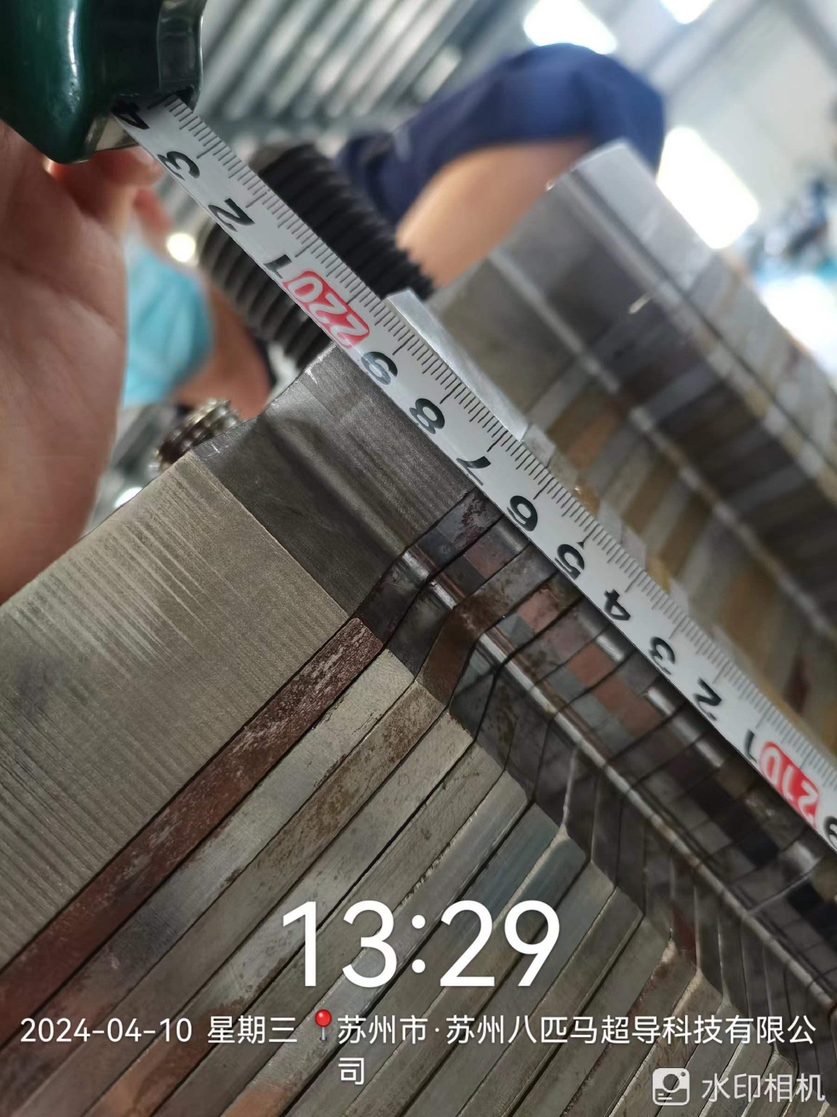
Assemble of MCBRD05
End plate to end plate: 2197mm;
Next step: magnetic measurement;
assemble the Ultem pieces.

Slide 9
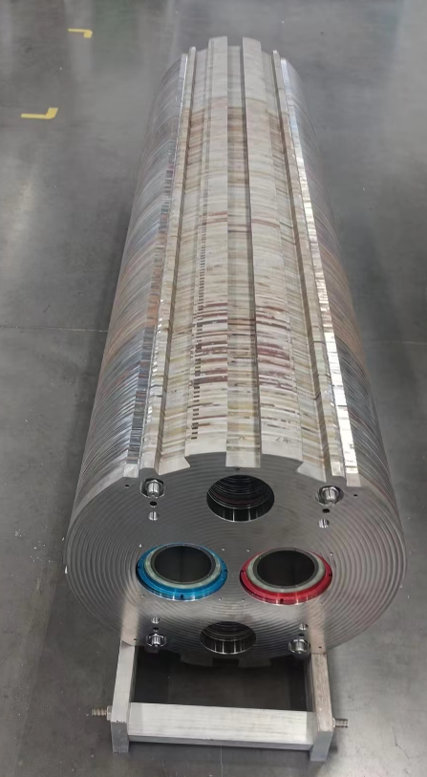
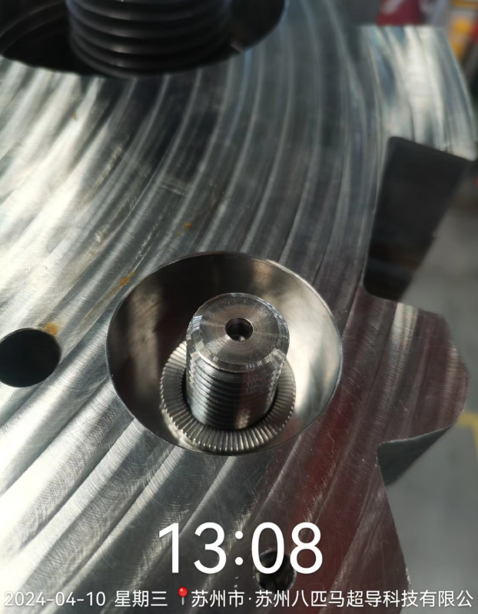
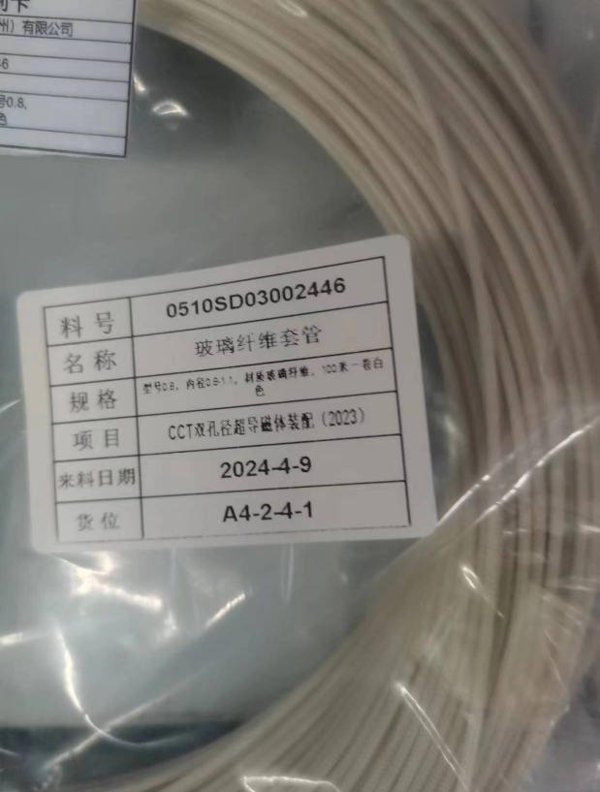
Assemble of MCBRD05
Nord-lock washer
GF sleeve for VTap wire, A1, B10；inner diameter-0.8-1.1mm

Slide 10
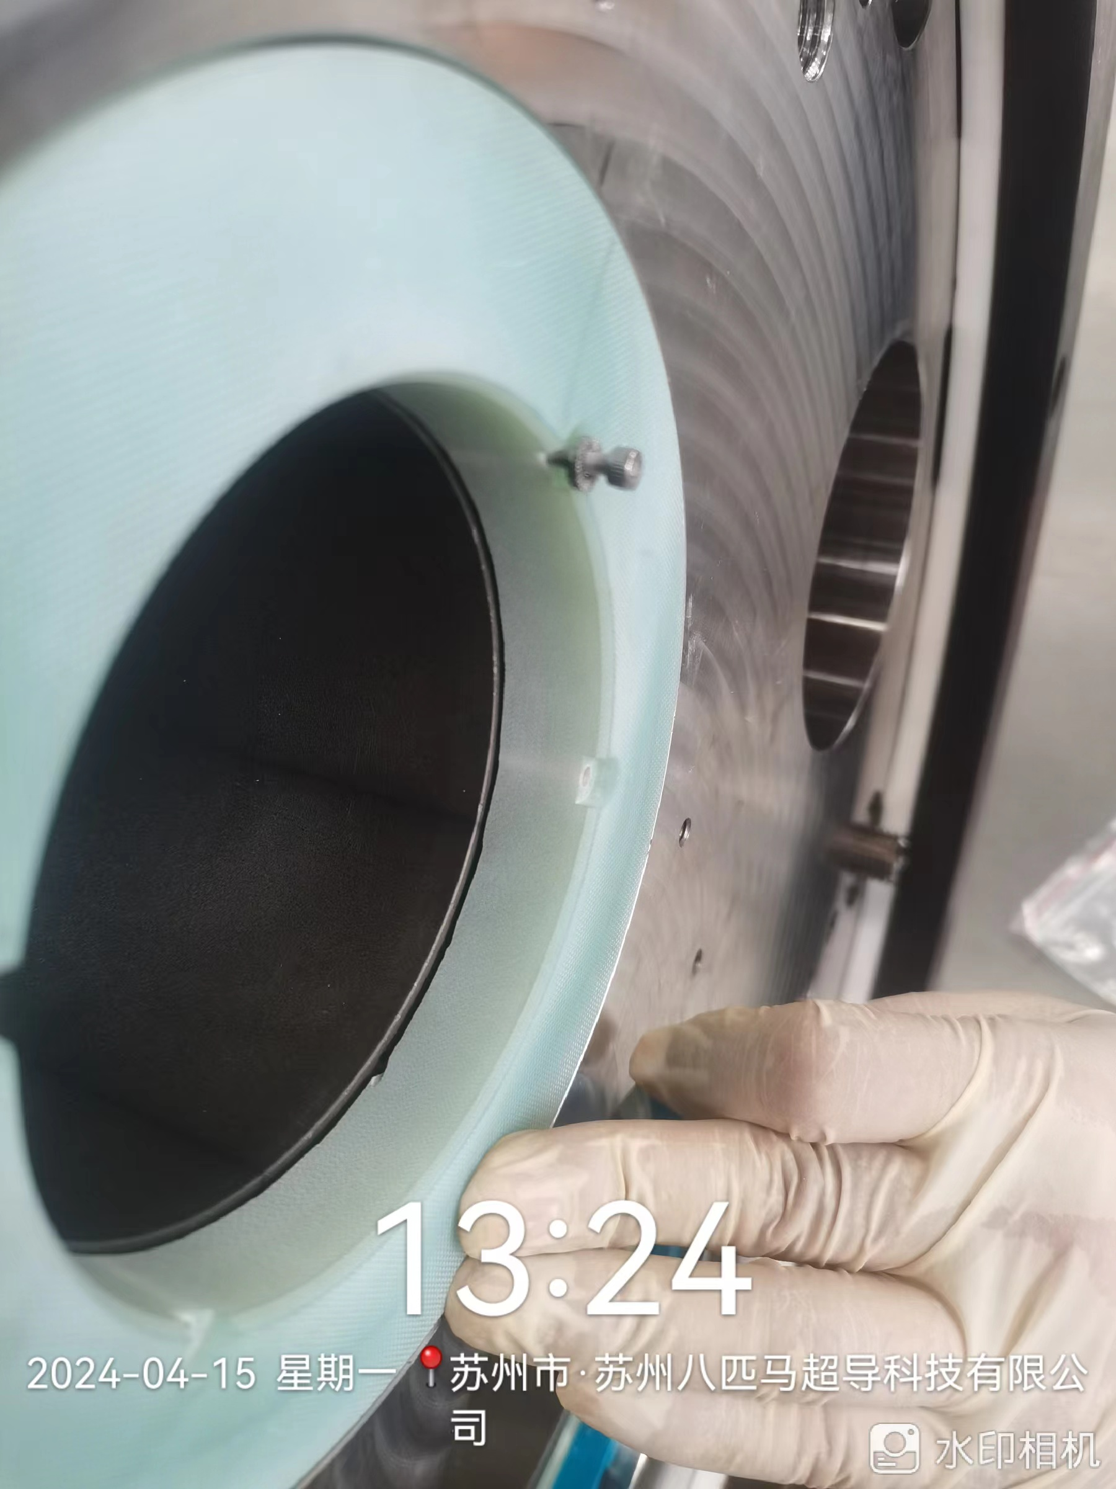
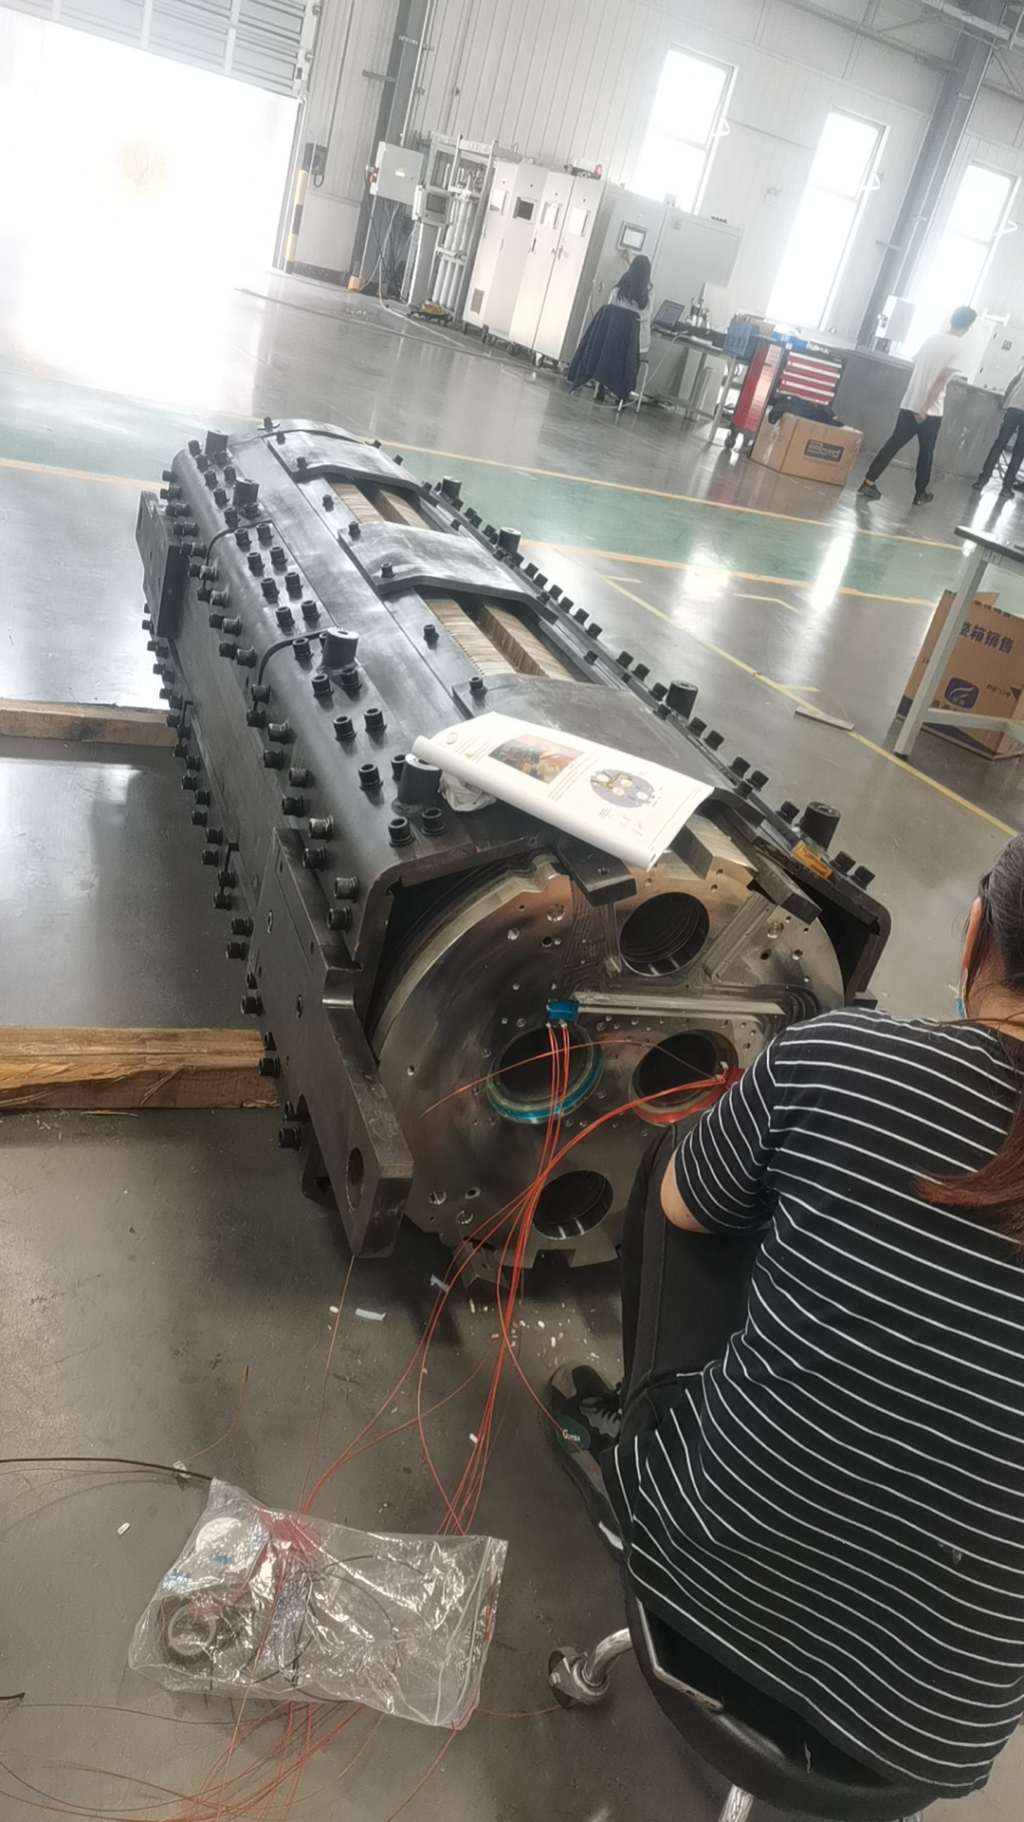
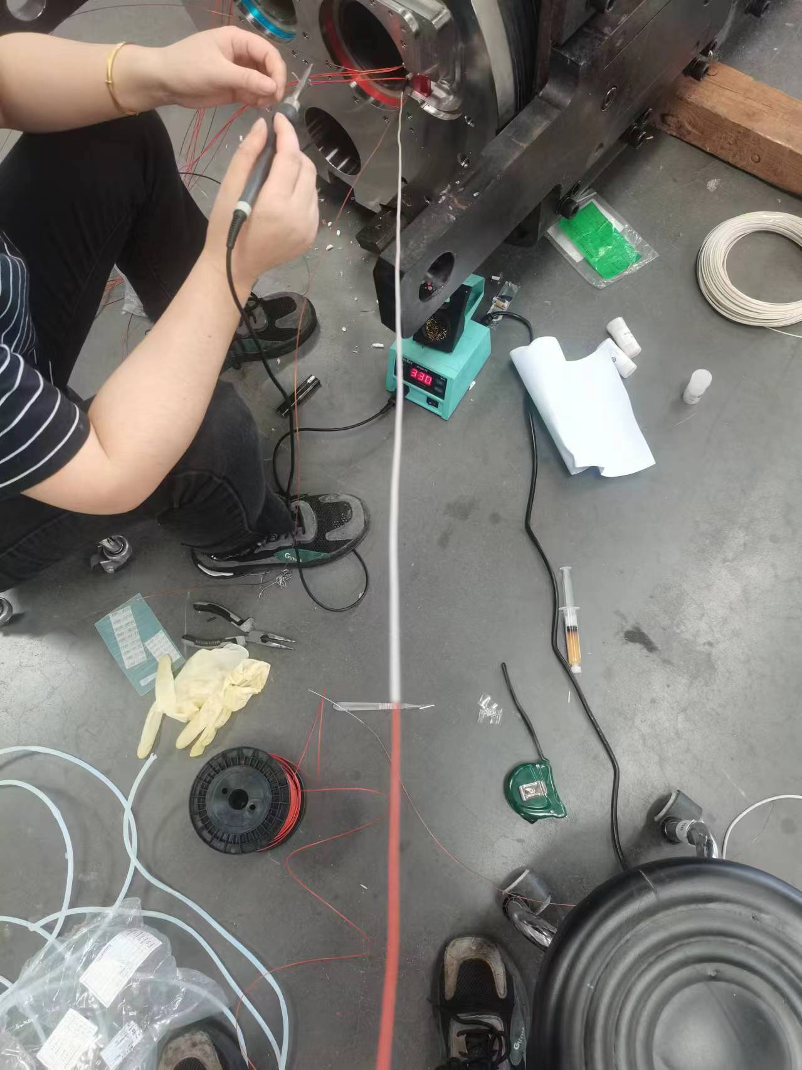
Assemble of MCBRD05
Nord-lock washer
GF sleeve

Slide 11
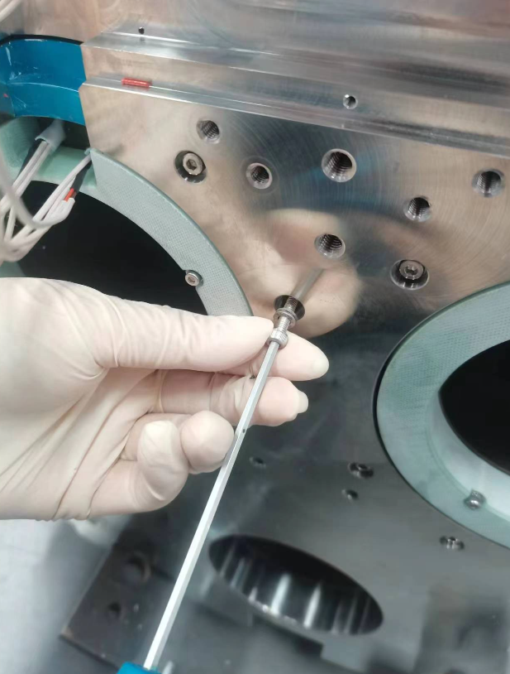
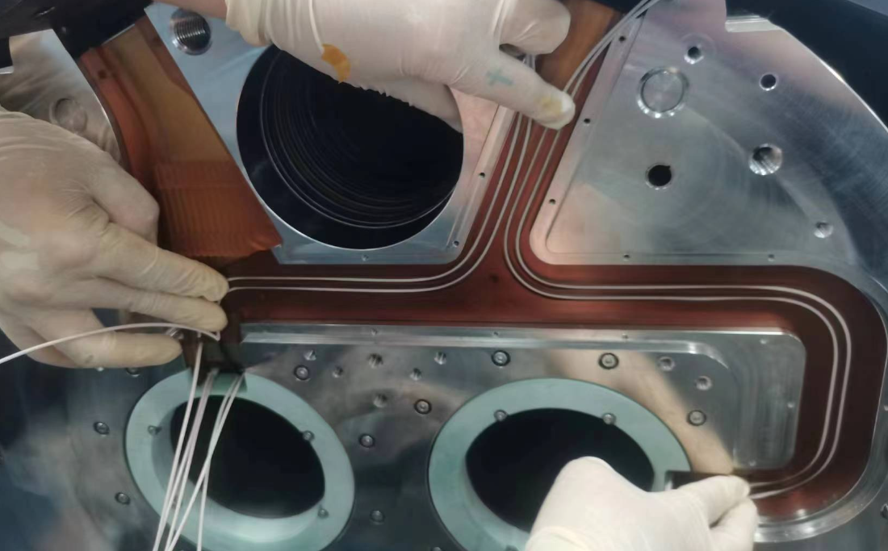
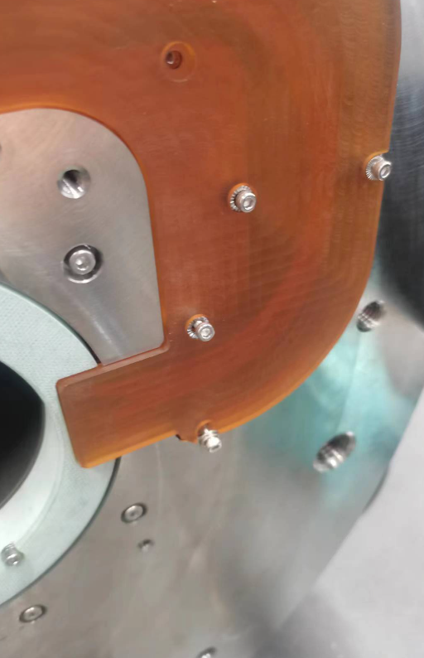
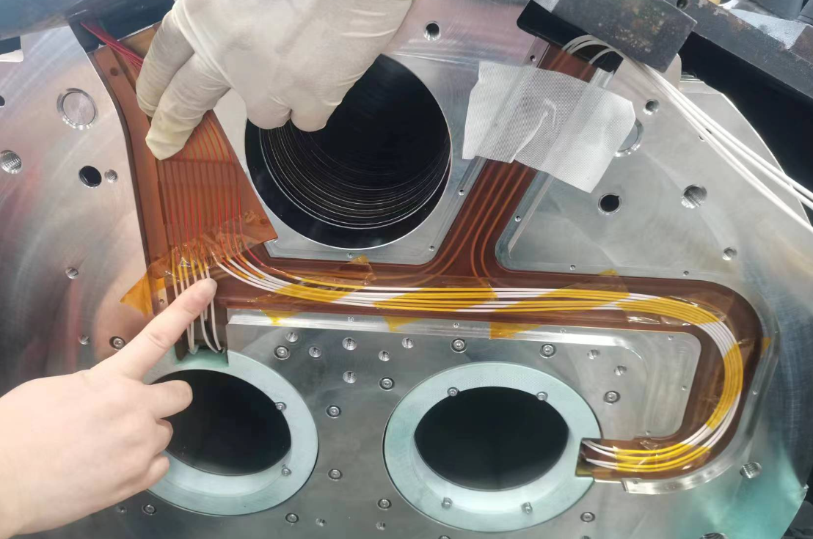
Assemble of MCBRD05
nord-lock washer
current leads
vTap

Slide 12
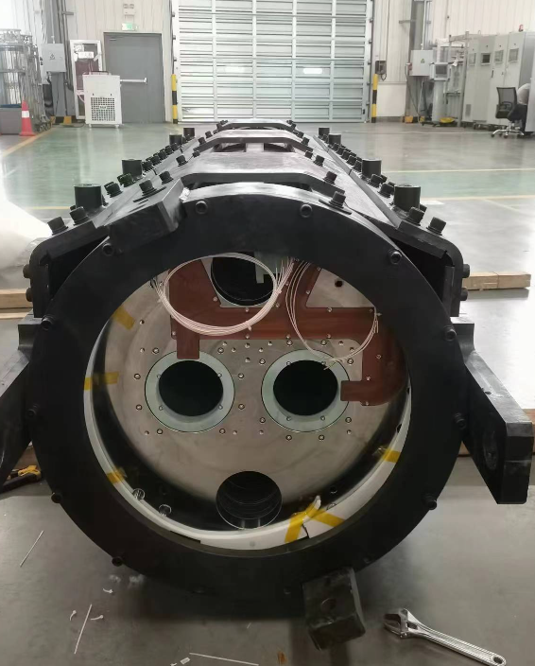
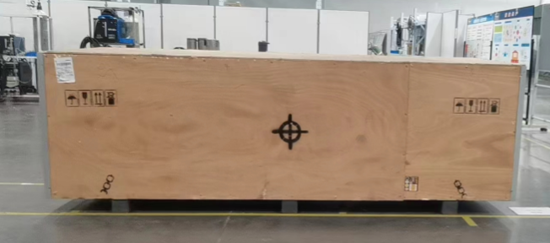
Assemble of MCBRD05
Packaging of MCBRD05

Slide 13
Summary
4 series CCT magnets have been fabricated and shipped to CERN. All of them reached the ultimate current and passed the field quality test.
MCBRD05 has finished assemble and test of MCBRD05 will be started in June, 2024.
Apertures of MCBRD06 (CB20, CB21) have finished fabrication and stand-alone test is ongoing.
Apertures for MCBRD07 (CB22, CB23) have finished fabrication.
Production rate for the rest of series magnets: every 3 month per magnet
Components for 2 CCT magnets have been shipped to CERN from IHEP, to verify the performance with components from China and CERN fabrication process.

