Slide 1
1
General Information
Frank Zimmermann
FCC-ee Optics Design Meeting #186th & 57th FCCIS WP2.2 meeting, 29 May 2024

Slide 2

FCC Week Registration Status – US
https://fccweek2024.web.cern.ch/
319 on site participants including 113 from USA
Affiliation | Count
US-Oak Ridge National Laboratory | 1
US-Other | 1
US-Princeton University | 2
US-Purdue University | 1
US-SLAC National Accelerator Center | 1
US-SLAC National Accelerator Laboratory | 17
US-SLAC, Stanford University | 1
US-Stanford National Accelerator Laboratory | 1
US-Stangenes Industries, Inc. | 2
US-Stony Brook University | 1
US-The University of New Mexico | 1
US-U.S. National Science Foundation | 1
US-UC Berkeley | 1
US-UC Davis | 3
US-UC Irvine | 1
US-UC Santa Cruz | 7
US-University of Arizona | 1
US-University of Maryland | 1
US-University of Maryland at College Park | 1
US-University of Michigan | 1
US-University of Minnesota | 1
US-University of Oregon | 2
US-University of Tennessee | 1
US-Wayne State University | 1
Affiliation | Count
US-Applied Physics Stanford University | 1
US-Applied Superconductivity Center, Florida State University | 1
US-Argonne National Laboratory | 3
US-Baylor University | 1
US-Brigham Young University | 1
US-Brookhaven National Laboratory | 18
US-California Institute of Technology | 2
US-Columbia University | 1
US-Cornell University | 2
US-Cornell University and Brookhaven Nat. Lab. | 1
US-DOE, The Department of Energy of the United States of America | 6
US-Euclid Techlabs LLC and US - Argonne National Laboratory | 1
US-Fermi National Accelerator Laboratory | 8
US-Florida State University | 1
US-GMW Associates | 1
US-Jefferson Lab | 3
US-Lawrence Berkeley National Laboratory | 9
US-Massachusetts Institute of Technology | 2

Slide 3
FCC Week Registration Status – on-site participants
Country | Count
Austria | 4
Canada | 1
CERN | 125
Chile | 1
Czech Republic | 1
Denmark | 1
France | 15
Germany | 13
Italy | 15
Japan | 3
Latvia | 1
Poland | 2
Switzerland | 16
Taiwan | 2
United Kingdom | 6
USA | 113
Registration status as of 26 May 2024 9:30 PM.
Student helpers not included

Slide 4
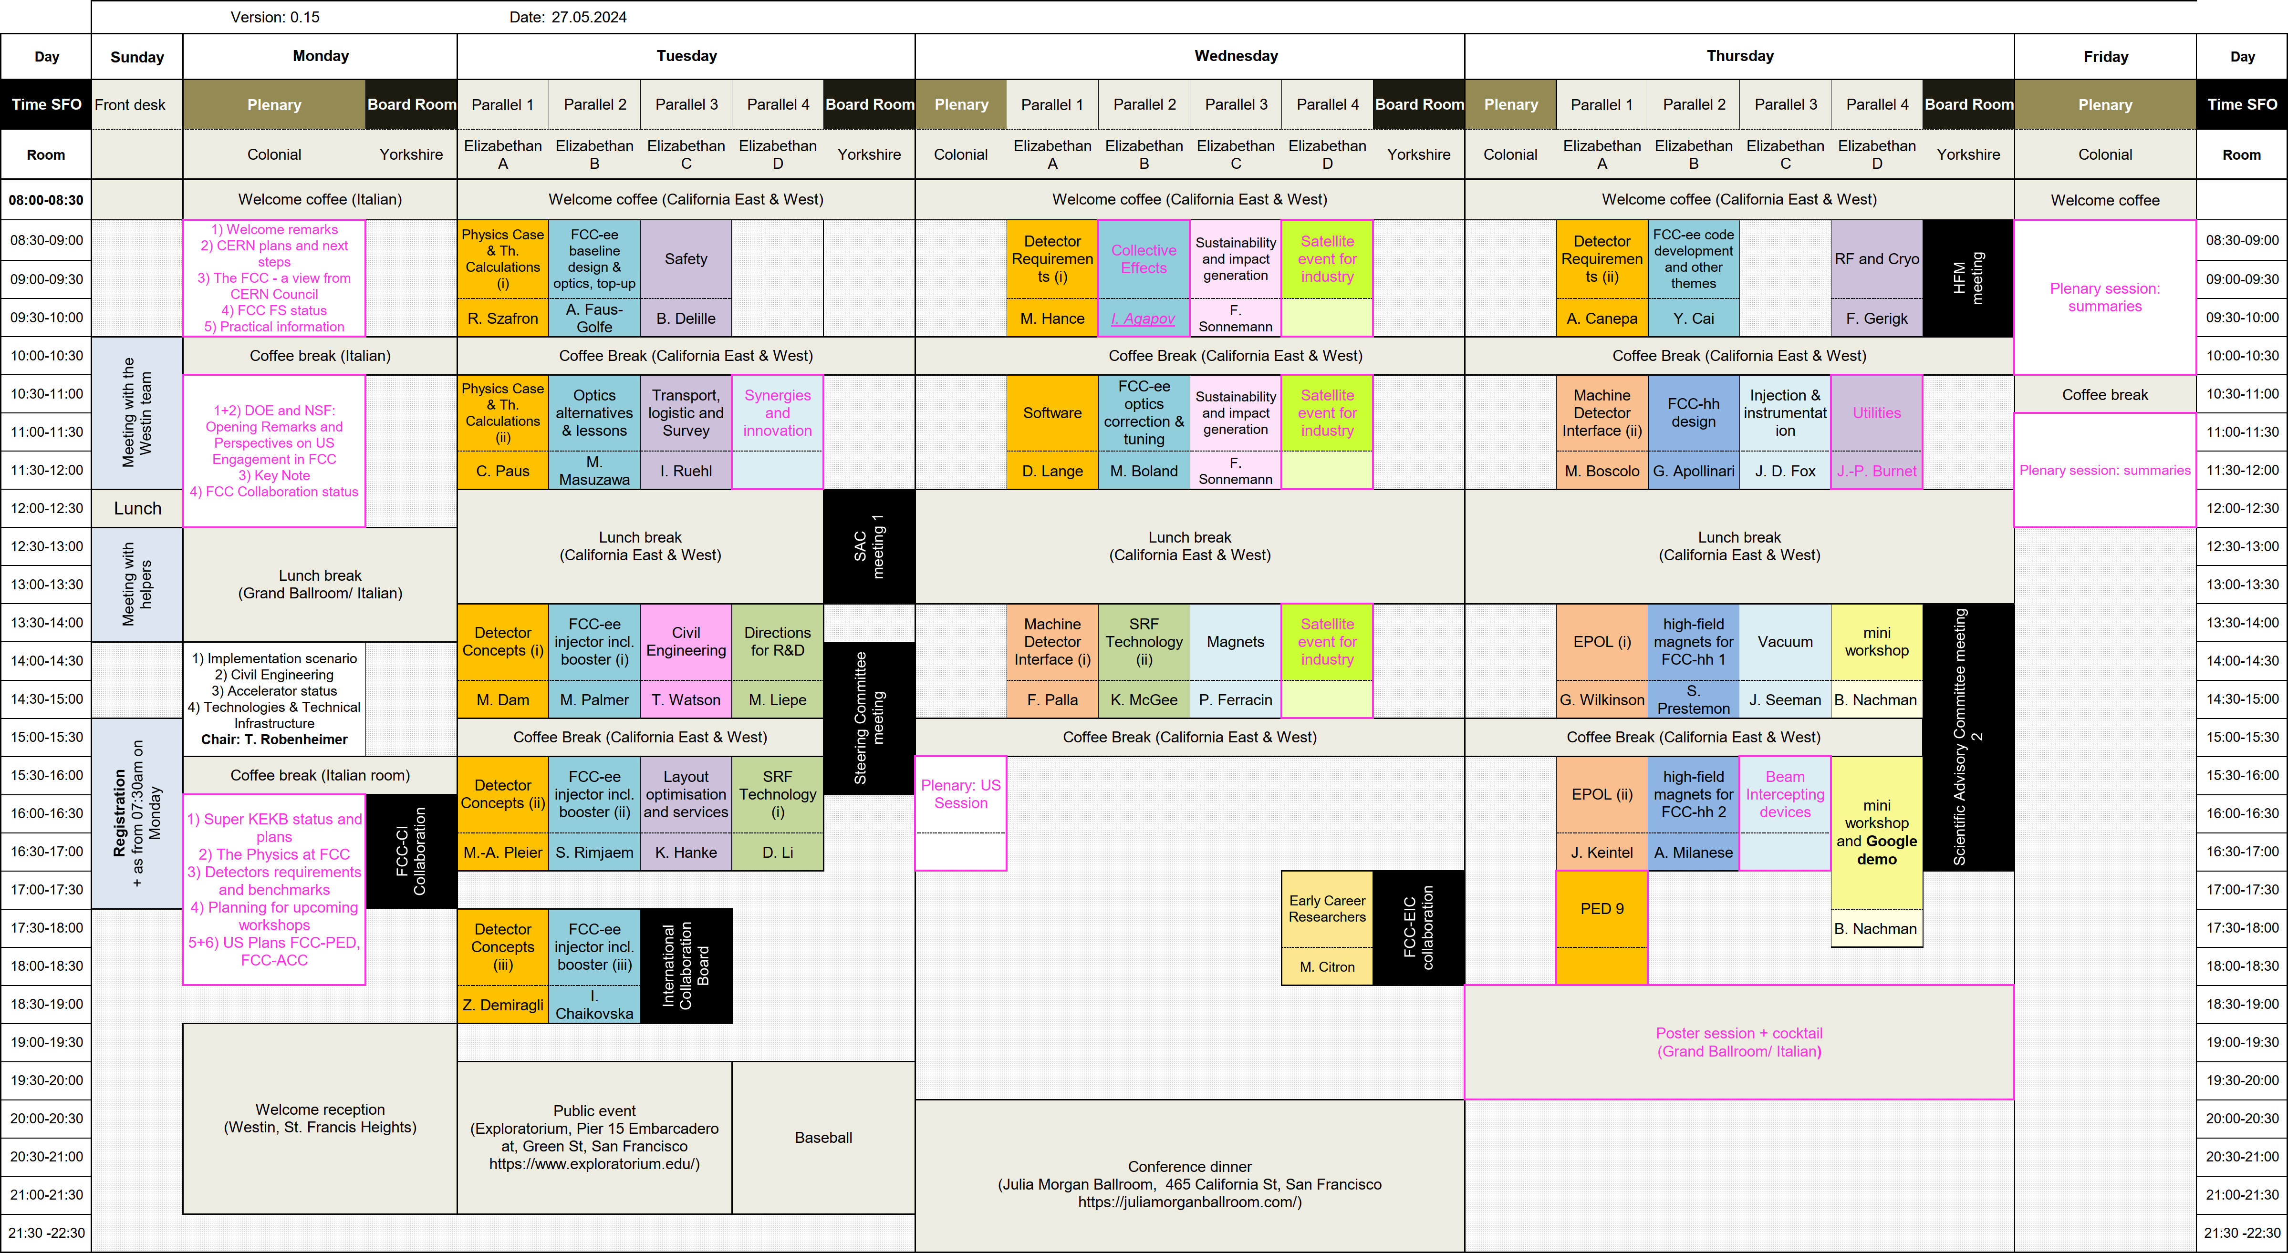
FCC Week Programme
https://fccweek2024.web.cern.ch/

Slide 5
FCC Week 2024 – Invitation Status for Speakers and Chairs
Speakers: we’ve sent out 195 invitations –
of which 70% are confirmed.
The table on the right summarizes the invited chairpersons for the parallel sessions.
Activity | Session | Chair_name | Chair_confirmed
ACC Tech. D. | Beam Intercepting devices | Giulio Stancari | Yes
 | Injection & instrumentation | John Fox | Yes
 | Magnets | Paolo Ferracin | Yes
 | Synergies and innovation |  | Declined
 | Vacuum | John Seeman | Yes
Civil Eng. | Civil Engineering | Tim Watson | Yes
ECR | ECR session | Matthew Citron | Yes
FCC-ee ACC | Collective Effects | Ilya Agapov | No answer
 | FCC-ee baseline design & optics, top-up | Angeles Faus-Golfe | Yes
 | FCC-ee code development and other themes | Yunhai Cai | Yes
 | FCC-ee injector incl. booster (i) | Mark Palmer | Yes
 | FCC-ee injector incl. booster (ii) | Sakhorn Rimjaem | Yes
 | FCC-ee injector incl. booster (iii) | Iryna Chaikovska | Yes
 | FCC-ee optics correction & tuning | Mark Boland | Yes
 | Optics alternatives & lessons | Mika Masuzawa | Yes
FCC-hh | FCC-hh design | Giorgio Apollinari | Yes
 | HFM 1 | Soren Prestemon | Yes
 | HFM 2 | Attilio Milanese | Yes
FCCIS WP3/4 | Sustainability and impact generation (1+2) | F. Sonnemann | Yes
PED | Detector Concepts (1) | Mogens Dam | Yes
 | Detector Concepts (2) | Marc-Andre Pleier | Yes
 | Detector Concepts (3) | Zeynep Demiragli | Yes
 | Detector Requirements (1) | Michael Hance | Yes
 | Detector Requirements (2) | Anadi Canepa | Yes
 | Physics Case and Theoretical Calculations (1) | Robert Szafron | Yes
 | Physics Case and Theoretical Calculations (2) | Christoph Paus | Yes
 | Software | David Lange | Yes
PED/ACC | EPOL (i) | Guy Wilkinson | Yes
 | EPOL (ii) | J. Keintzel | Yes
 | Machine Detector Interface (i) | Fabrizio Palla | Yes
 | Machine Detector Interface (ii) | Manuela Boscolo | Yes
SRF | Directions for R&D | Matthias Liepe | Yes
 | Technology, first session | Derun Li | Yes
 | Technology, second session | Kellen McGee | Yes
Tech. Inf. | Layout optimisation and services | Klaus Hanke | Yes
 | RF and Cryogenics | Frank Gerigk | Yes
 | Safety | Benoît Delille | Yes
 | Transport, logistic and Survey | Ingo Ruehl | Yes
 | Utilities | Jean-Paul Burnet | Yes

Slide 6
FCC Week 2024 – Poster Status
33 poster abstracts received – highlighted in blue: abstracts related to the accelerator
Title | Speakers (affiliation)
Investigation of low gain avalanche detectors exposed to proton fluences beyond 10^15 n_eq/cm^2 and gamma dose up to 2.2 MGy | Josef Daniel Sorenson (University of New Mexico (US))
Integrated Carbon Fiber Composite Structures for Future HEP Detectors | Sushrut Rajendra Karmarkar (Purdue University (US))
FCC Analyses cheat sheet | Juraj Smiesko (CERN)
The Development of Silicon Carbide Low Gain Avalanche Detector | Tao Yang
FCC-ee tuning studies with pyAT | Elaf Musa (DESY)
The air-cooling system for the IDEA Vertex Detecor at FCC-ee: thermal performance and vibrational effects | Giorgio Baldinelli (University of Perugia)
Structural Optimization of Future Circular Collider Interaction Region Support Structure | Francesco Fransesini (INFN e Laboratori Nazionali di Frascati (IT))
Material Budget of the FCC-ee IR | Giulia Nigrelli
Optics Design of the Solenoid Compensation Scheme at FCC-ee | Andrea Ciarma (INFN e Laboratori Nazionali di Frascati (IT))
A next generation, integrated community toolset for the modeling of colliders | Jean-Luc Vay
Operational Considerations for Laser Control of the FCC Bunch Intensity | Spencer Gessner (SLAC)
Enhancing positron sources for future colliders through conical converter targets | Nicolas Vallis (PSI/EPFL)
Diagnostics for the FCC-ee positron source test facility at PSI | Nicolas Vallis (PSI/EPFL)
Lepton injection and extraction system at FCCee | Sen Yue
FCC-ee sensitivity to SUSY through precision Z-boson measurements | Kevin Langhoff (UC Berkeley)
The e+ e- -> Z H process in the Standard Model Effective Field Theory beyond Leading Order | Konstantin Asteriadis
ALLEGRO detector concept for FCC-ee | Jana Faltova (Charles University (CZ))

Slide 7
FCC Week 2024 – Poster Status continued
Title | Speakers (affiliation)
Heavy Neutral Leptons Search in a Realistic Neutrino Oscillation Model at FCC-ee | Xunwu Zuo (KIT - Karlsruhe Institute of Technology (DE))
Exploring New Physics with the Optical Dump at LUXE and Prospects for Future Facilities | Ivo Schulthess (Deutsches Elektronen-Synchrotron DESY)
Overview of and Challenges for the FCC-ee Fast Pulsed Beam Transfer Systems | Giorgia Favia (CERN)
Exploring the supersymmetry through gauginos with FCC-hh | So Chigusa
Using Generative AI to Explore the Limits of Jet Tagging | Nishank Nilesh Gite (Lawrence Berkeley National Lab. (US))
End-to-end ML-based reconstruction | Gregor Krzmanc (ETH Zürich)
Key4hep cheatsheet | Juraj Smiesko (CERN)
Autoencoder Style Neural Networks for Estimation and Control with Unknown Time Varying Parameters | Alan Williams
Recent results on dual readout crystal EM calorimetry | Sara Nabili (University of Maryland (US))
Status and Perspectives for FCC-ee Detector Background Studies | Andrea Ciarma (INFN e Laboratori Nazionali di Frascati (IT))
Full simulation of IDEA muon system | Mahmoud Ali (FCC)
A Straw Tracker for the FCC-ee | Junjie Zhu (University of Michigan (US))
High radiation resistance LGAD designs | Simone Michele Mazza (University of California,Santa Cruz (US))
The OBELIX sensor for the Belle II VTX Upgrade | Christoph Schwanda (Austrian Academy of Sciences (AT))
A Triplet Track Trigger Case Study for FCC-hh: Enhancing the Measurement of Di-Higgs Production and Higgs Self-Coupling | Tamasi Kar (Heidelberg University (DE))
Constraining CP-odd contributions in the Higgs-strahlung process at FCC-ee using kinematic observables | Nicholas Pinto (Johns Hopkins University (US))

Slide 8
FCC Week Plan & Preparation Status – Monday Plenaries
From | To | Duration | Presentation title | Speaker’s name
08:30 | 08:50 | 20 | Welcome remarks | SLAC&LBNL Directors
08:50 | 09:20 | 30 | CERN plans and next steps | Fabiola Gianotti
09:20 | 09:40 | 20 | The FCC - a view from CERN Council | Eliezer Rabinovici
09:40 | 10:10 | 30 | FCC FS Status | Michael Benedikt
10:10 | 10:20 | 10 | Practical information about the conference | Julia Gonski
10:20 | 10:50 | 30 | Coffee break
10:50 | 11:00 | 10 | DOE Remarks & Perspectives on US FCC Engagement | Regina Rameika
11:00 | 11:10 | 10 | NSF Remarks & Perspectives on US FCC Engagement | Jim Shank
11:10 | 12:10 | 60 | Keynote | JoAnne Hewett
12:10 | 12:30 | 20 | FCC collaboration status | Philippe Chomaz
12:30 | 14:00 | 90 | Lunch break
14:00 | 14:20 | 20 | Implementation scenario | Johannes Gutleber
14:20 | 14:40 | 20 | Civil Engineering | Timothy Watson
14:40 | 15:10 | 30 | FCC Accelerator status | Frank Zimmermann
15:10 | 15:40 | 30 | FCC technologies & TI | Jean-Paul Burnet
15:40 | 16:10 |  | Coffee break
16:10 | 16:40 | 30 | Super KEKB status and plans | Mika Masuzawa
16:40 | 17:10 | 30 | The Physics at FCC-ee | Zoltan Ligeti
17:10 | 17:35 | 25 | Detectors requirements & benchmarks | Junji Zhu
17:35 | 18:00 | 25 | ECFA R&D (DRDs)… MoU’s, upcoming workshops | Didier Contardo
18:00 | 18:20 | 20 | US Plans FCC-PED | Tbd
18:20 | 18:40 | 20 | US Plans FCC-Accelerator | tbd

Slide 9
FCC Week Plan & Preparation Status – Satellite Meetings
Monday 15:30-17:00 FCC-Cornell U. meeting (Lead. F. Peauger)
Tuesday 12:00-13:30 SAC meeting #1
Tuesday 14:00-16:00 ISC meeting
Tuesday 17:30-19:00 ICB meeting
Wednesday 17:00 – 18:30 FCC-EIC collaboration meeting (Lead S. Nagaitsev)
Thursday 8:30 – 10:00 HFM meeting (Lead S. Prestemon)
Thursday 13:30-17:00 SAC meeting #2
Friday afternoon visit and colloquium at SLAC
------
SAC invited by M. Benedikt and A. Parker
ISC invited by F. Gianotti
ICB still to be invited / informed

Slide 10
German strategy meeting in Bonn, 22-24 May ‘24 – feedback
https://indico.desy.de/event/44074/
FCC participants included: Christophe Grojean, Johannes Gutleber Frank Gerigk, Bernhard Auchmann
Assessments / summaries obtained from Christophe and from Johannes
BMBF statement at start of the workshop caused a stir in the US (P5 members) and Europe (France etc.)
Goal of the workshop: to understand if and how the German community would like to contribute to the FCC and toi FCC-ee in particular.
Three official statements summarising the opinions of the participants, are being prepared:
1. A new collider after HL-LHC is needed to address fundamental open questions;
2. FCC-ee is the priority and the German community should actively engage;
3. The remaining financial and geopolitical uncertainties must be addressed.

Slide 11
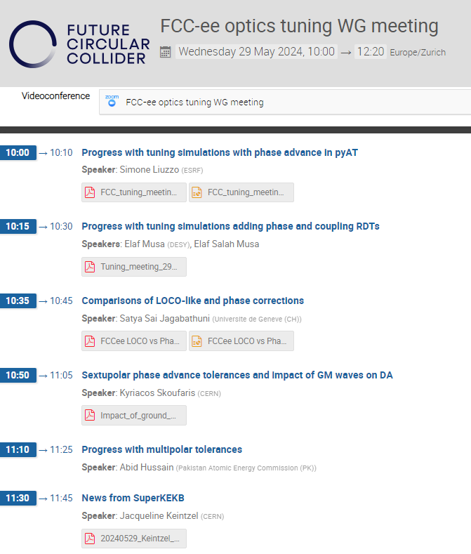
FCC Optics Tuning Meeting this morning
https://indico.cern.ch/event/1421227/

