Slide 1
RFQ2 Discussion
L. Millar
SY-RF-MKS
RFQ2 Meeting – 16/05/2024

Slide 2

Recap
Building 2002:
The RFQ was tuned.
Leak test (Ridge 2 was removed, vacuum port attachments added). The following gaskets were replaced: Tuners T2A2, T7, T4 A4, Antennas T1A1, T17A9, T20A12.
RFQ frequency checked with the antennas, a decrease of 33.41 kHz was observed (corresponds to ~5° in temperature or moving a single tuner by 1.76mm).
Building 152:
RFQ transported to building 152 and placed on the final support. No further frequency change since building 2002.
RFQ was moved to high-power test location. Pumps, the final ridge 2, and the window were installed. The cavity was placed under vacuum.
Measurements performed with WG-Coax coupler indicate that Q₀ is higher, f₀ is even lower, and the field profile is out of spec compared to when it was in bdg. 2002.
Survey measurements were performed (results shared previously).

Slide 3
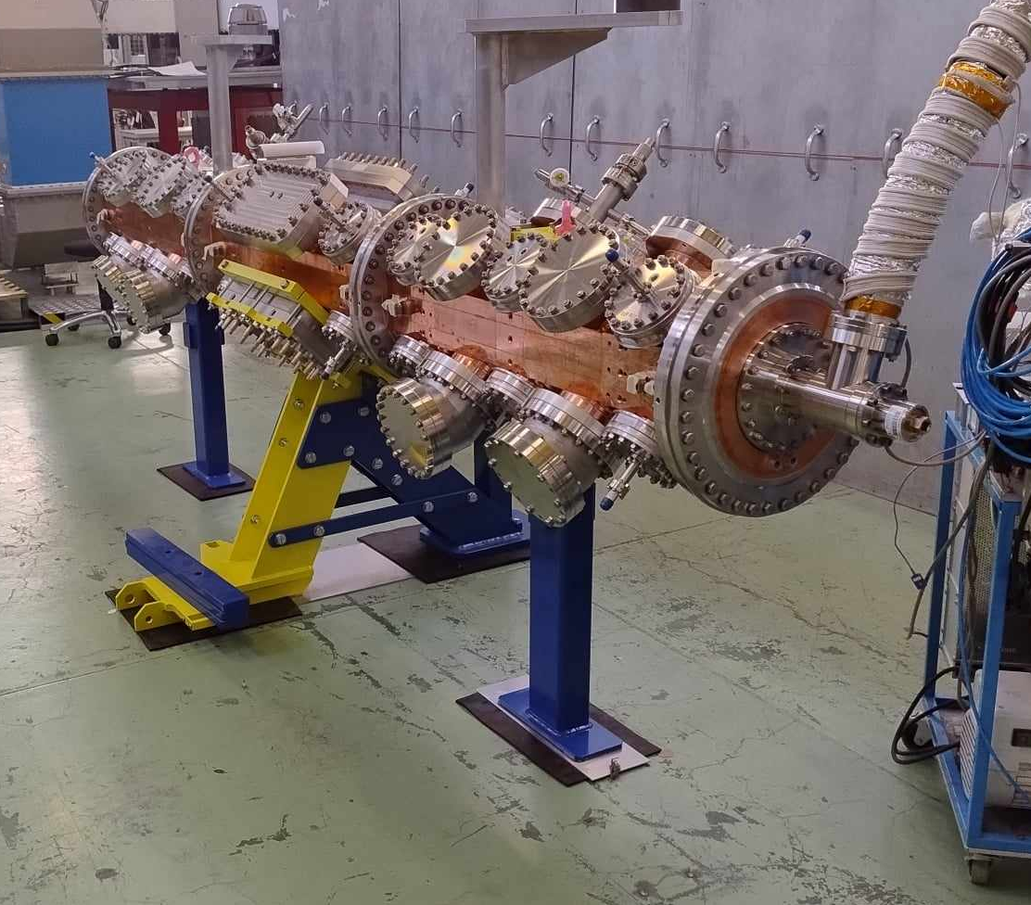
Since last time…
Building 152:
Simulations performed to determine the deformation which can be expected due to vacuum.
Flanges on vacuum ports removed – No change.
Endplate removed – No change.
Additional support installed in high-power test position.
RFQ moved to test area floor.
RFQ moved back to high-power test position.

Slide 4
Effect of Vacuum

Slide 5
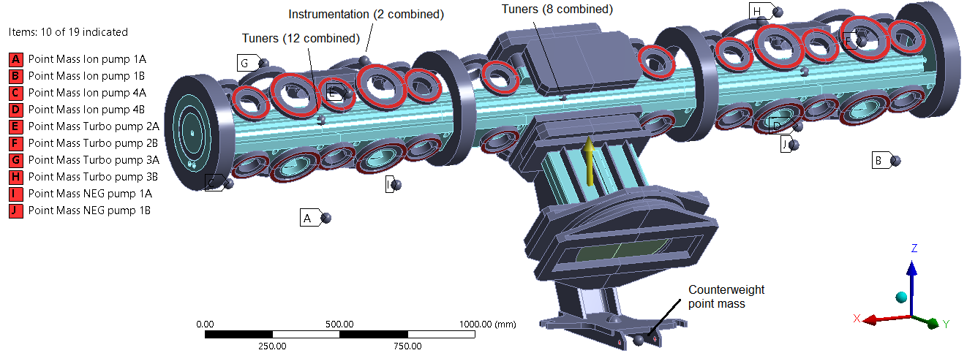
Results of Deformation study
Preliminary mechanical simulations performed. There is a lot of information, to summarise:
Simulations indicate that when placed under vacuum a ~1µm level decrease in the distance between opposing vanes is present, peaking at ~3.8µm locally in the central segment (by design, the average distance between opposing vanes is 6.6mm).

Slide 6
Frequency Evolution

Slide 7
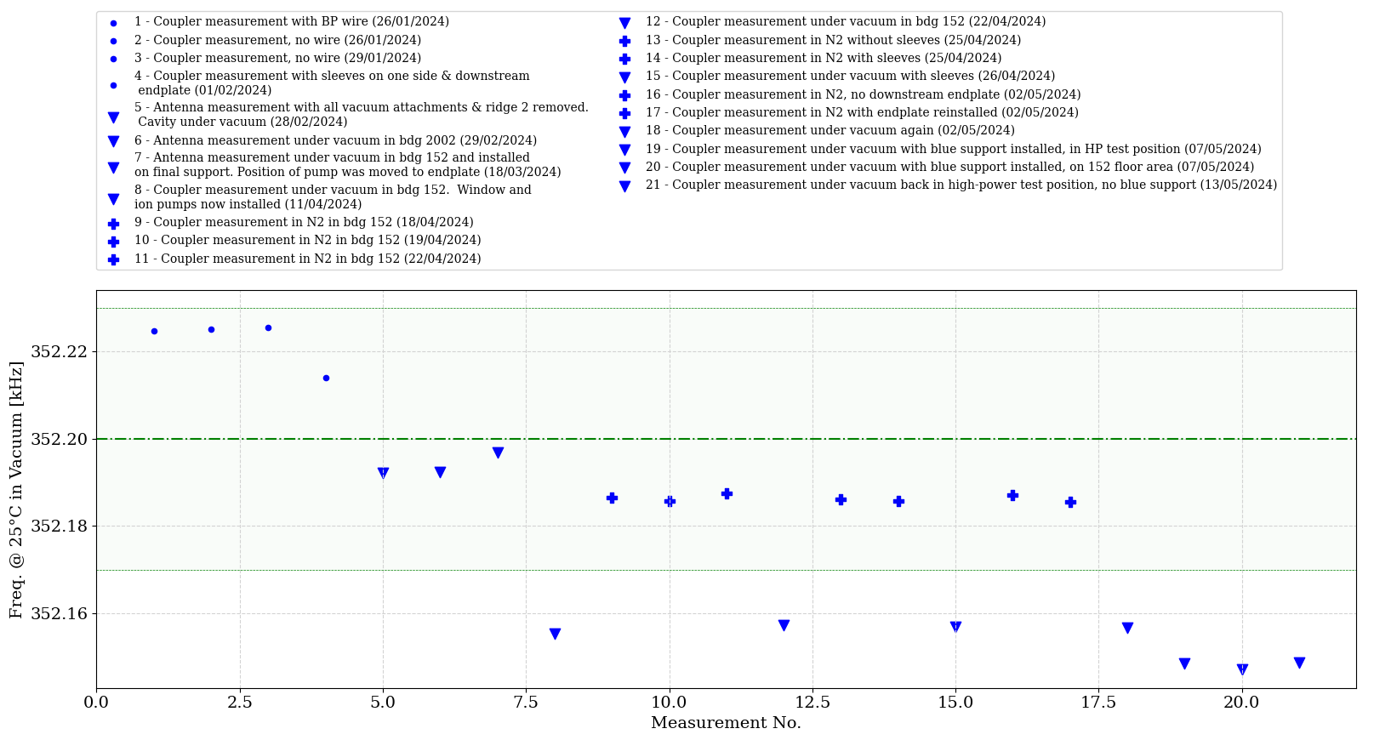
Frequency Evolution
Installing the blue support on the flange opposite the power coupler seems to have reduced the frequency by ~7 kHz.
Notes:
Full spreadsheet updated regularly and available on CERNbox (also contains notes for each measurement, e.g., the status of the cavity, its support, vacuum system): https://cernbox.cern.ch/s/GH50jWEpJYe4MzL

Slide 8
Field Profile Evolution
(from bdg. 2002 to bdg. 152)

Slide 9
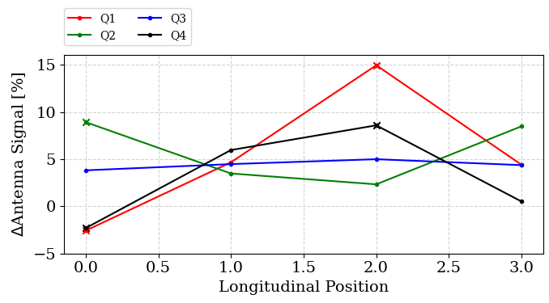
Antenna Change - 2002 to 152
Change from building 2002 to building 152 (point 1 to 8 on slide 7). Note, gaskets were replaced on A1, A2, A4, A9, A12 (plotted with x). Throughout the manipulations, Q and f0 remained virtually unchanged.

Slide 10
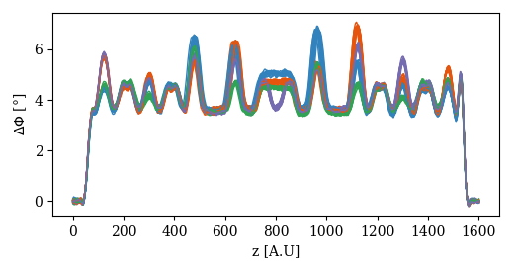
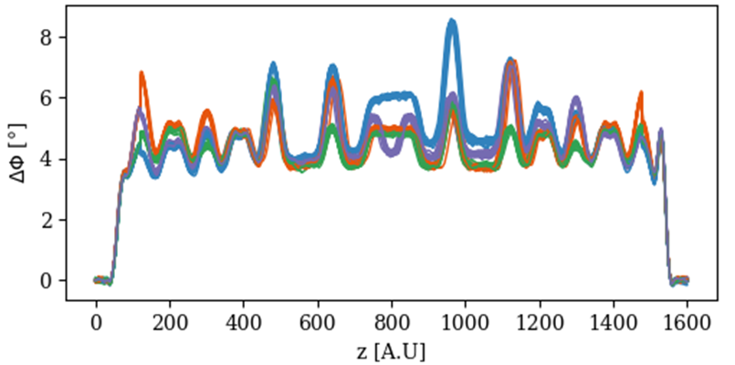
Field Profile - 2002 to 152
Building 152, after transport and addition of final ridge 2, window, etc.
Building 2002, after final tuning.

Slide 11
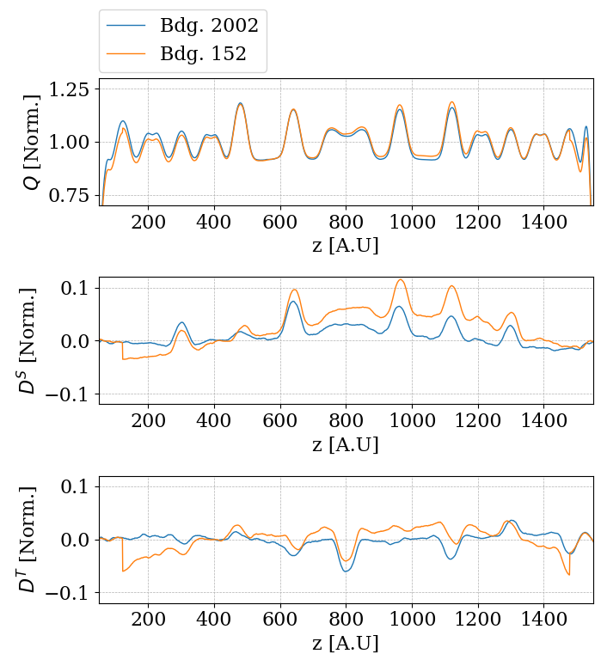
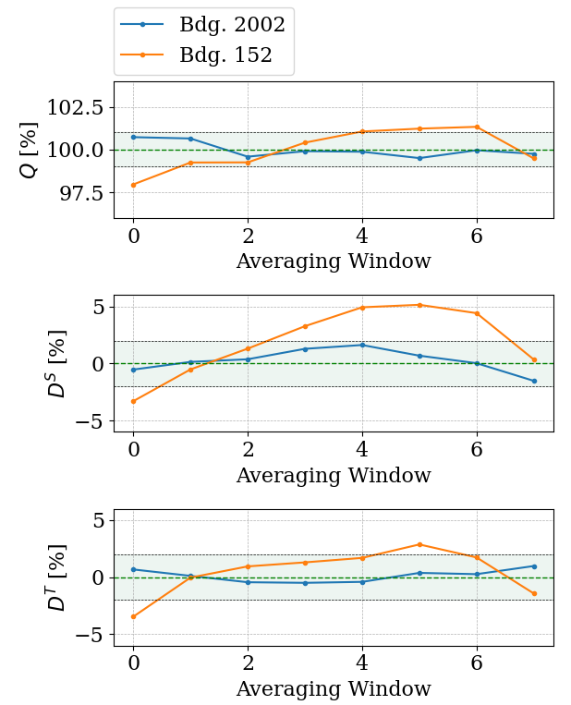
Field Profile - 2002 to 152

Slide 12
Field Profile Evolution (25/04/24 – 26/04/24)

Slide 13
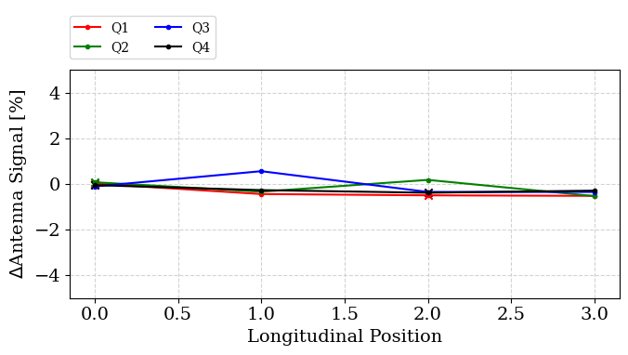
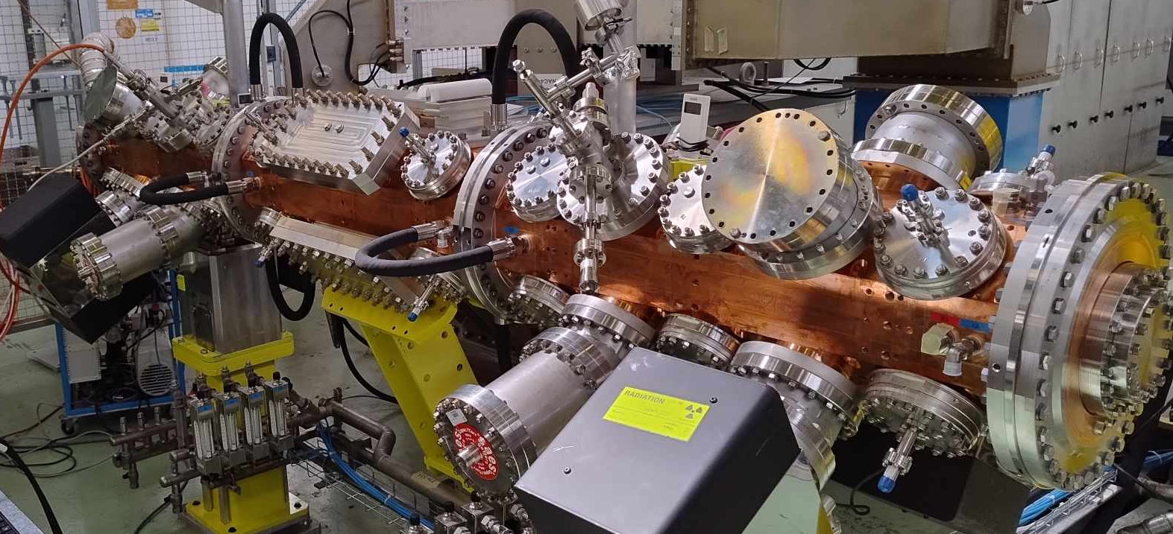
Antenna Change - adding sleeves on 25/04/24
Addition of sleeves on the top of the cavity 25/04 – 26/04 (point 12 to 14 on slide 7).
Conclusion: Changes from venting are small (~1% or less), much less than those observed when moving the RFQ from building 2002 to building 152. The added sleeves have a negligible effect.

Slide 14
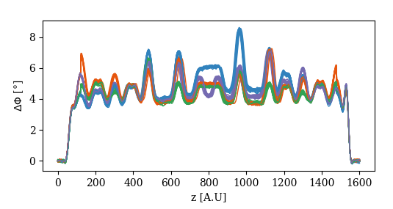
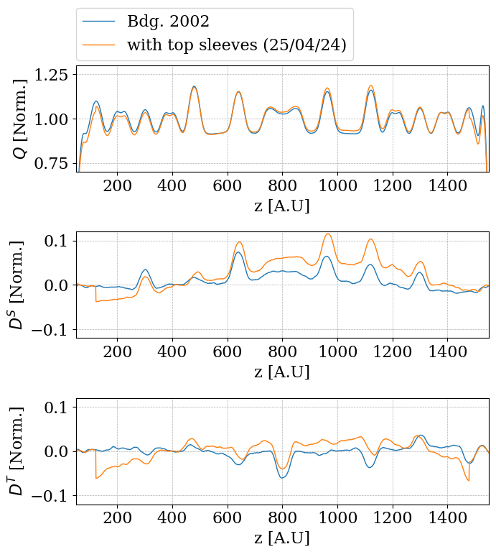
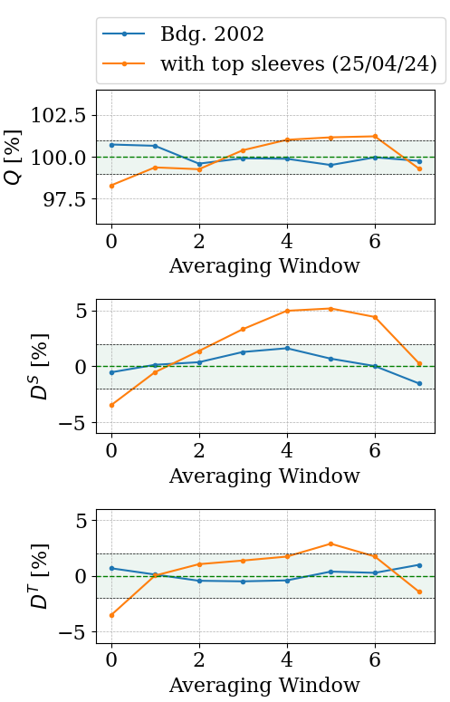
Calculated Field Profile – with sleeves on 25/04/24

Slide 15
Field Profile Evolution (07/05/24 – 13/05/24)

Slide 16
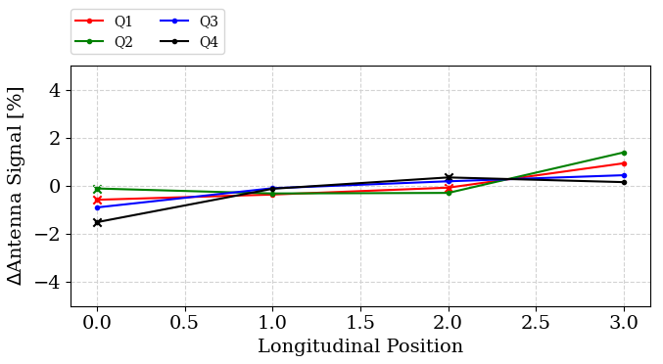
Antenna Change - 07/05/24 with support in test position
Effect of installation the blue central support (point 18 to 19 on slide 7).
Installed while cavity was still in high-power test area.

Slide 17
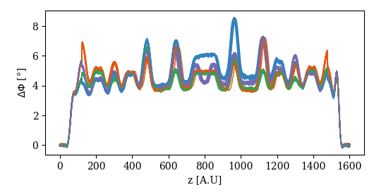
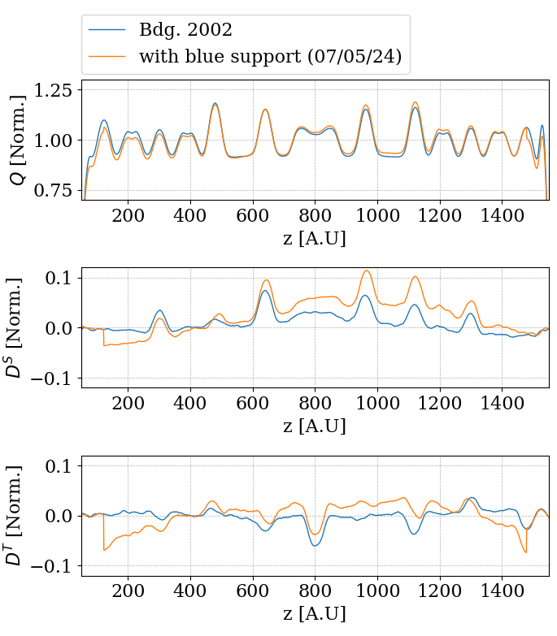
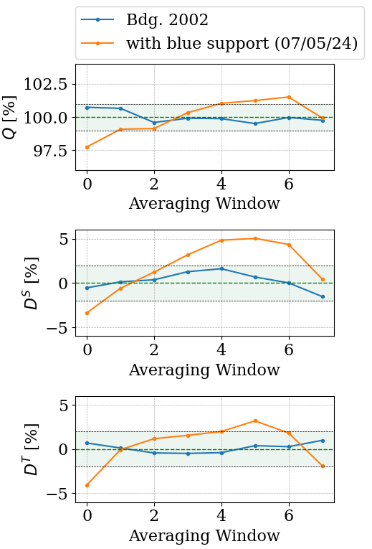
Calculated Field Profile - 07/05/24 with support in test position

Slide 18
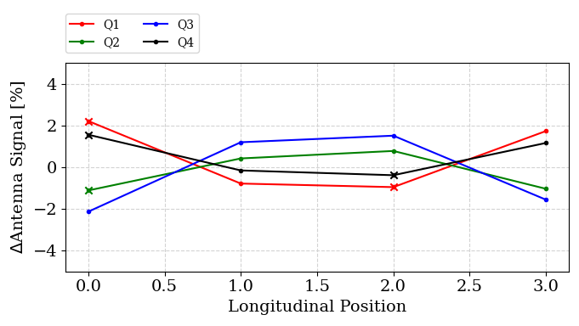
Antenna Change - 07/05/24 with support on floor
Effect of moving the cavity to the floor (point 19 to 20 on slide 7).

Slide 19
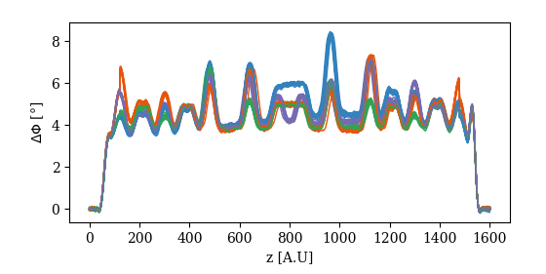
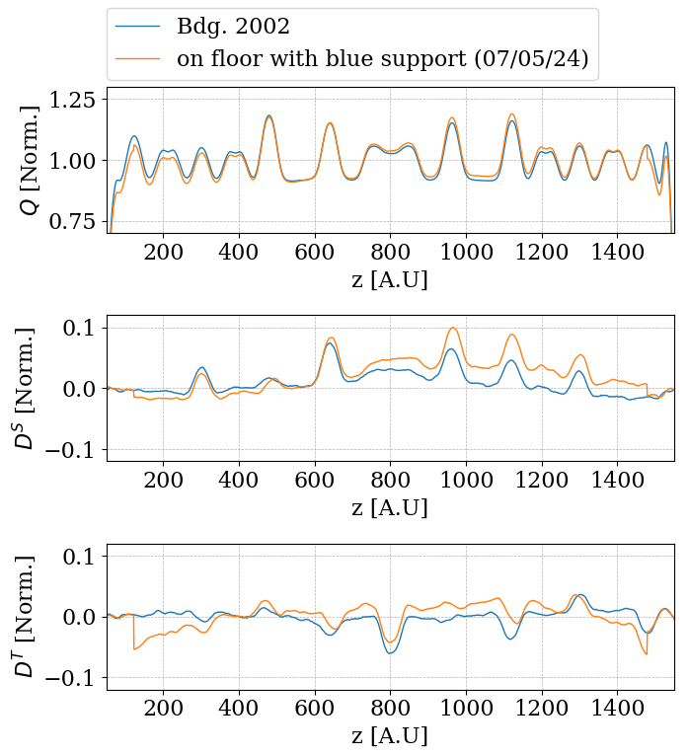
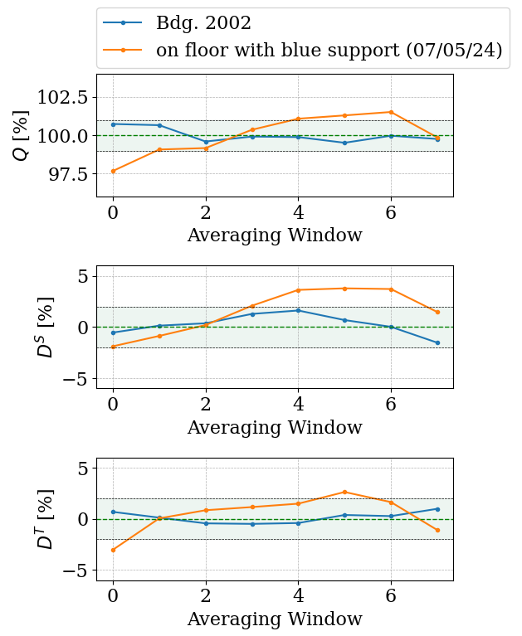
Calculated Field Profile - 07/05/24 with support on floor

Slide 20
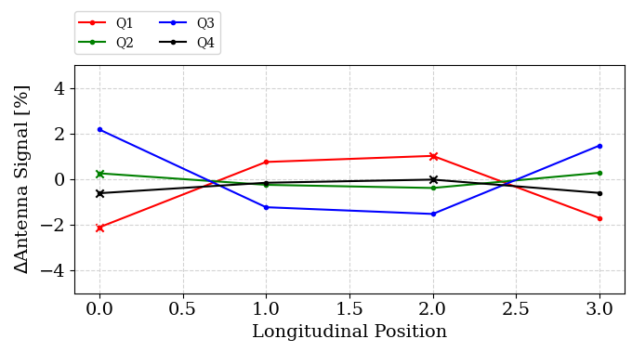
Antenna Change - 13/05/24 with support in test position
Effect of moving the cavity back to the test position (point 20 to 21 on slide 7).

Slide 21
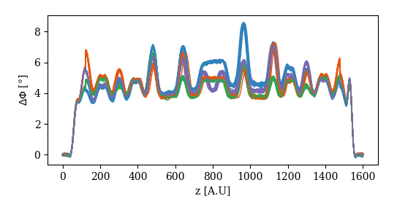
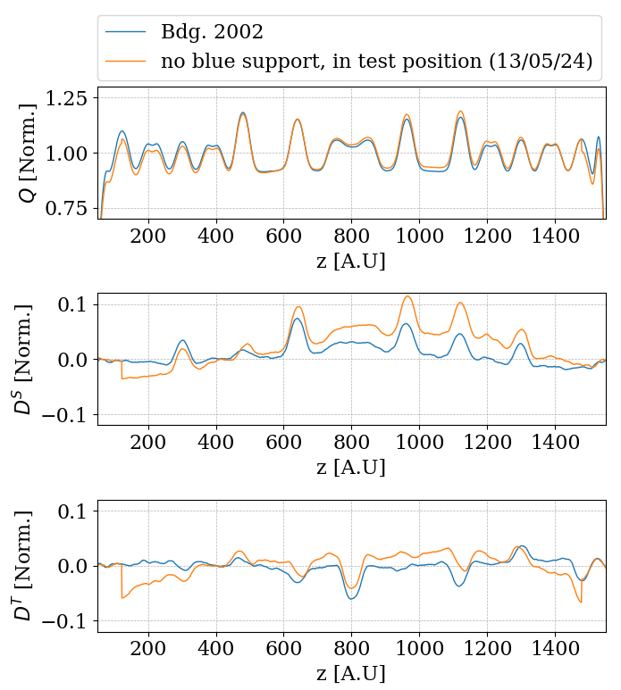
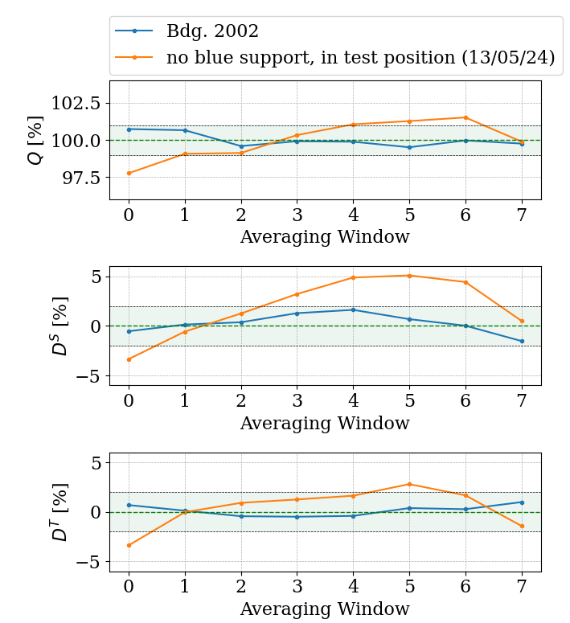
Calculated Field Profile - 13/05/24 with support in test position

Slide 22
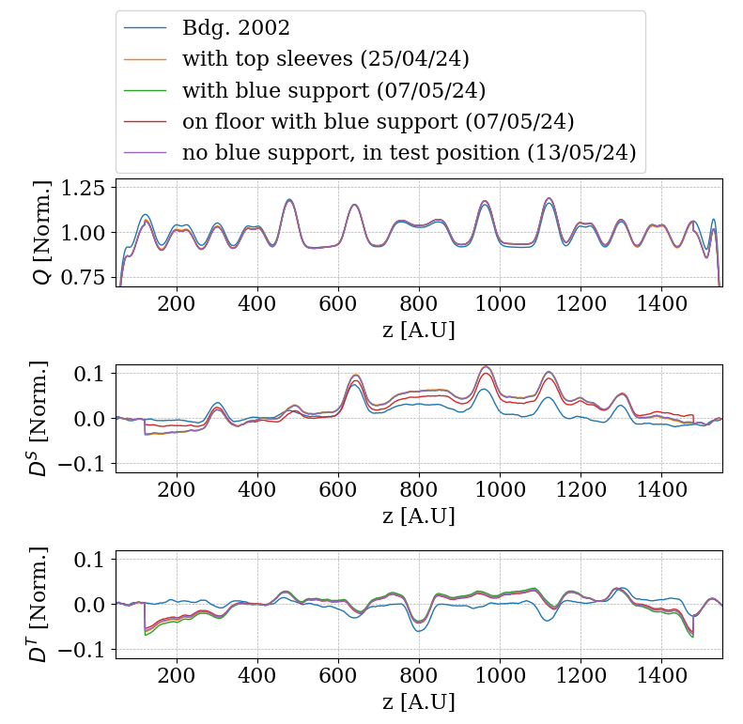
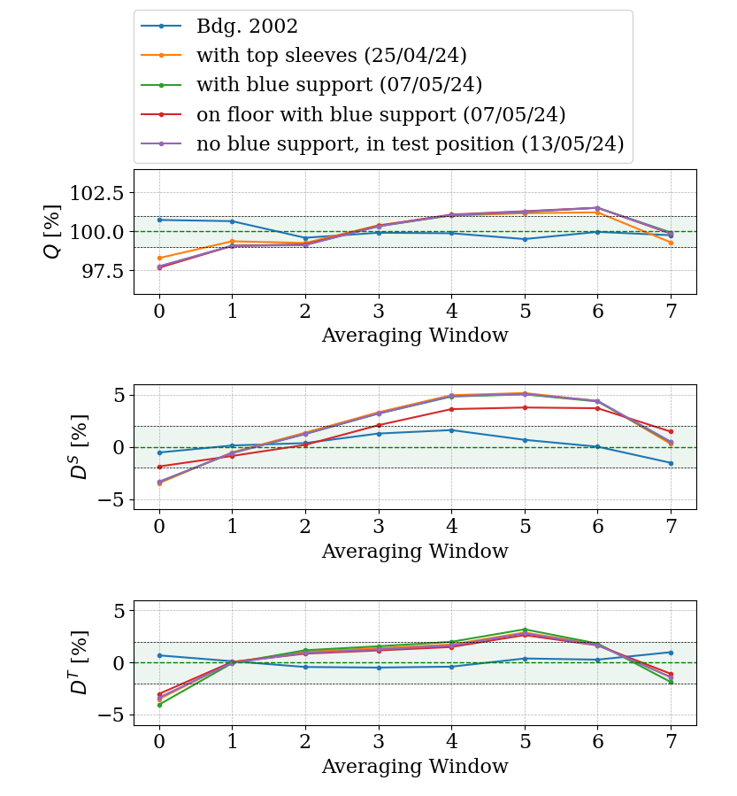
Summary (25/04/24 – 13/05/24)

