Slide 1
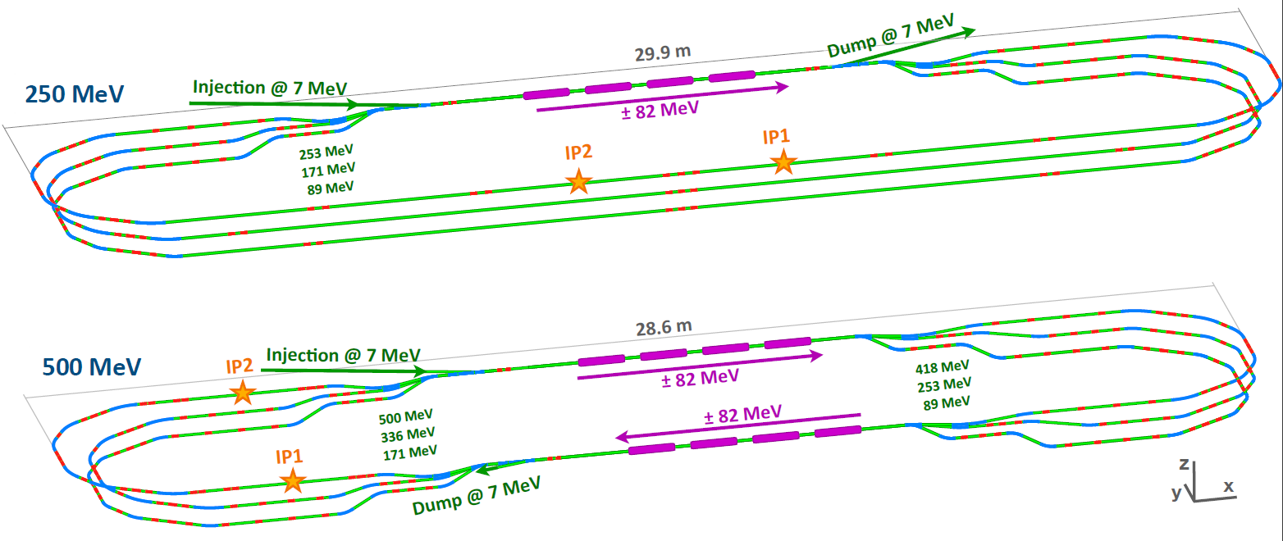
PERLE Collaboration Meeting
Longitudinal beam dynamics on PERLE 250 MeV
Julien Michaud, IJCLab

Slide 2
Contents
1st order tuning of PERLE
Longitudinal matching – general case
First application on PERLE

Slide 3
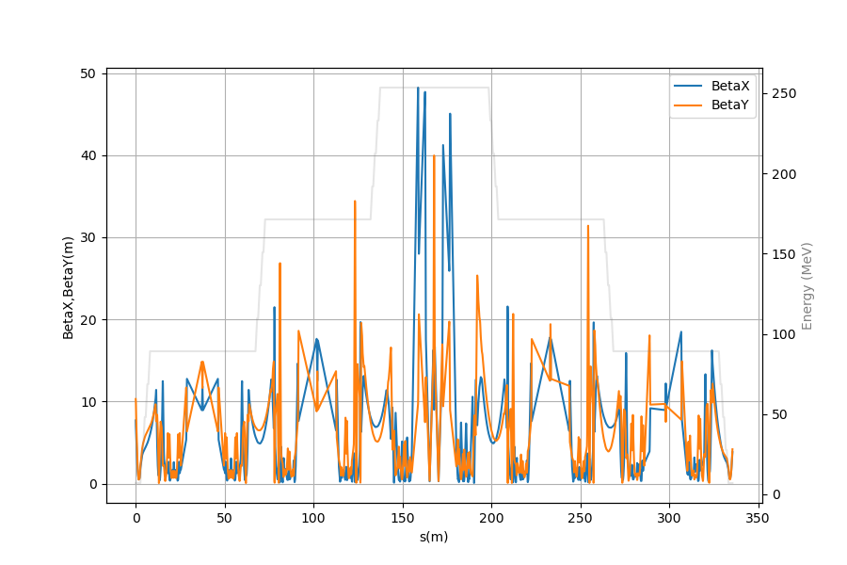
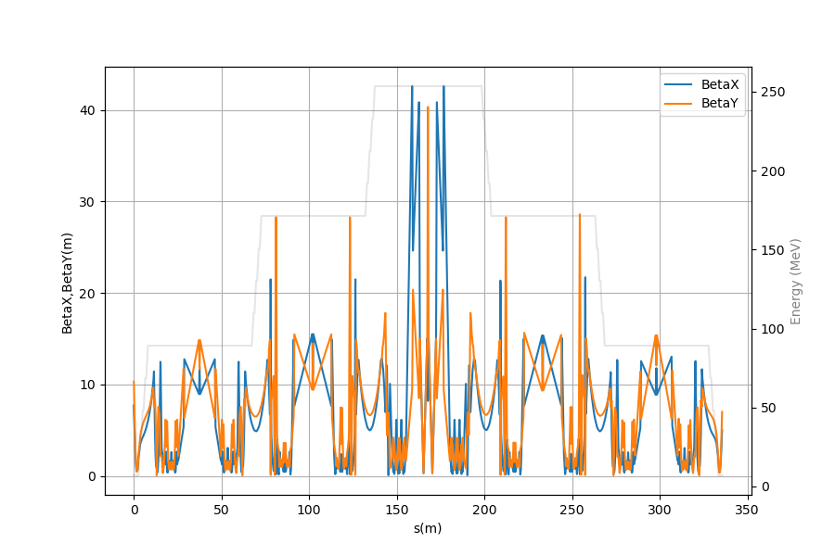
1st order tracking – BMAD [1]
Lattice imported from MADX file, with a few changes :
  Transverse dynamics in LINACS
  Higher order fringe fields
250MeV version
Lattice have been rematched for BMAD (500MeV and 250MeV versions)

Slide 4
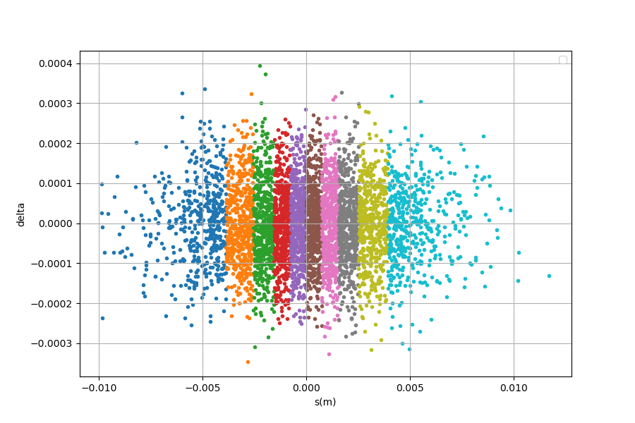
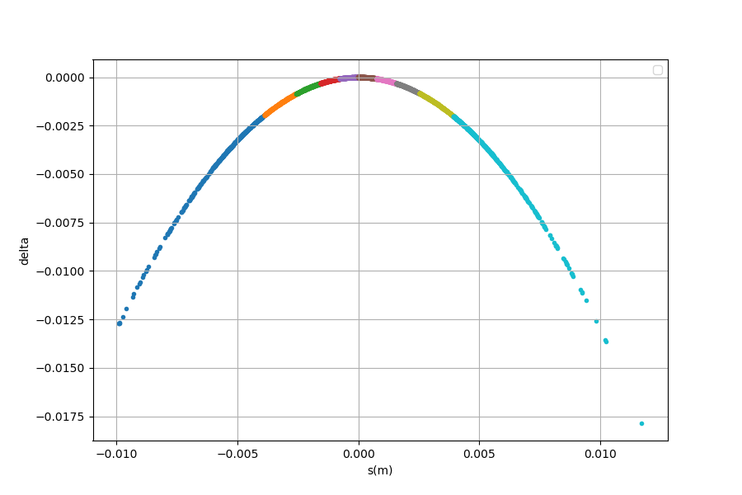
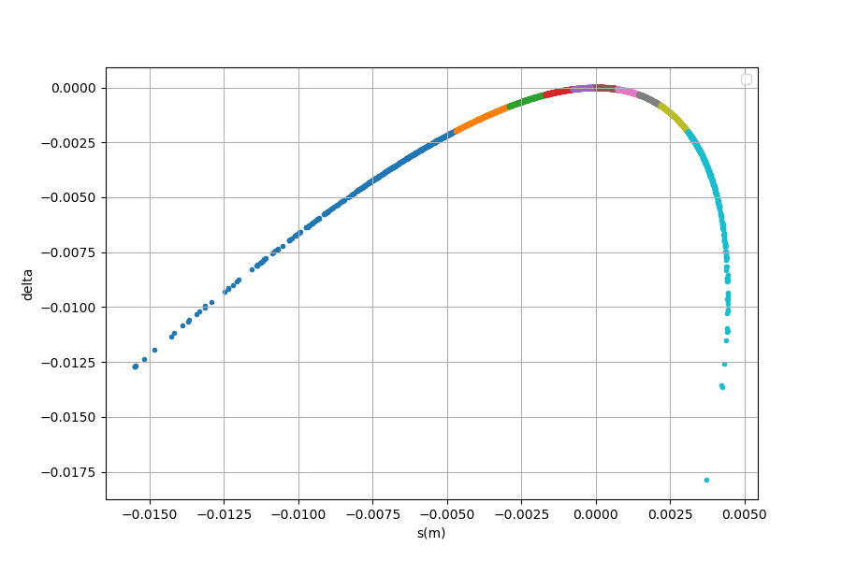
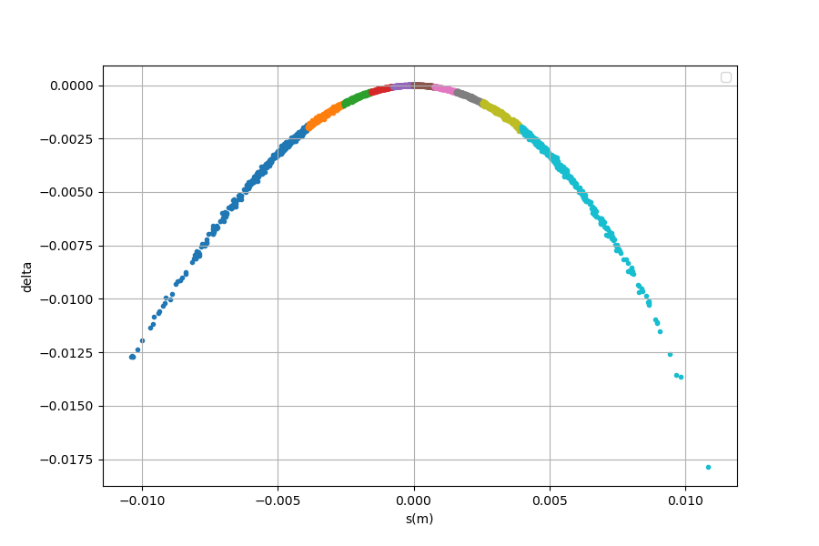
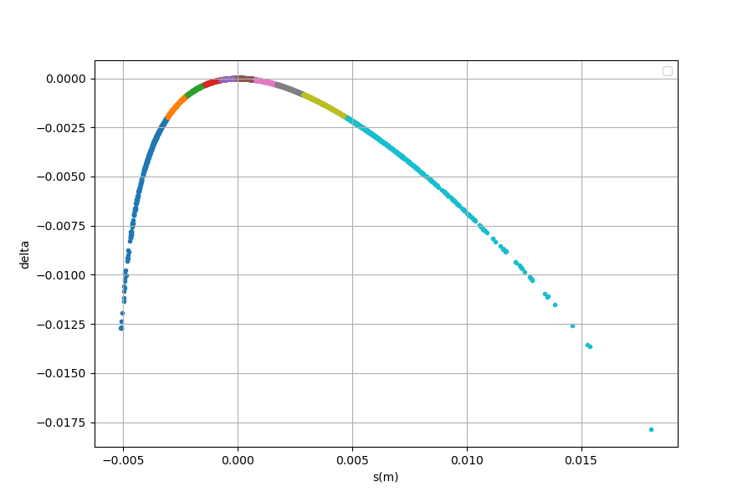

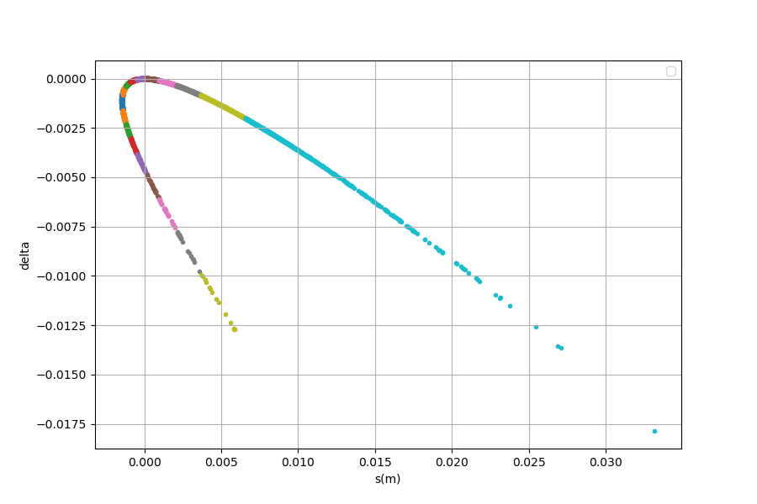
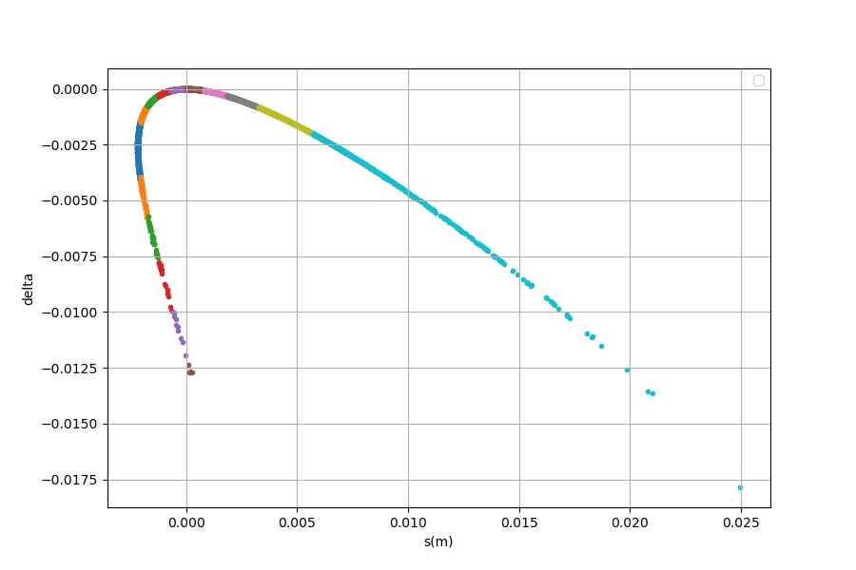
Stacking effect on 250 MeV lattice
Injection
Post-linac
Spreader
Middle arc1
End arc 1
Str section
Arc 2
Merger
The lack of 1 spreader/recombiner creates an asymetry in longitudinal phase space → now corrected with $R_{56}$terms

Slide 5
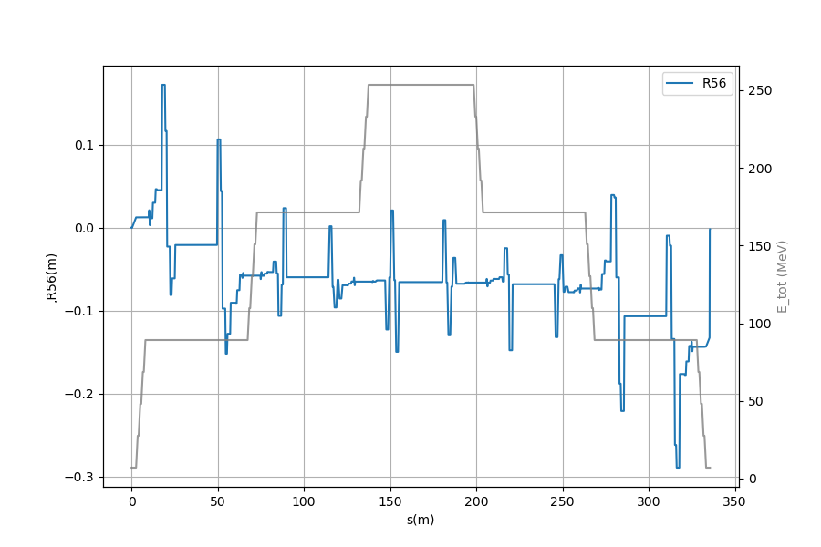
Linear matching
Twiss parameters
1st order bunch compression
Objectives :
Symetry accel/decel
Minimum beta in spreaders
Dispersion closed
Trajectories are longer in dipoles for different energies
Ends up with bunch length changes
Term M56 must be cancelled at the end of arcs
Especially true in 250MeV lattice (lack of spreader/recombiner in straight section)

Slide 6
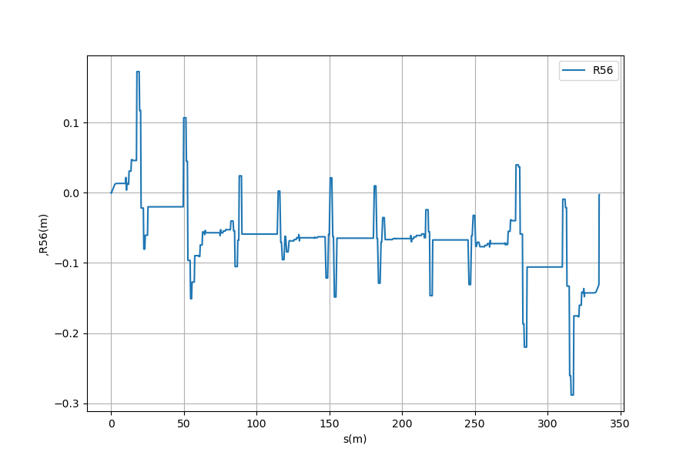
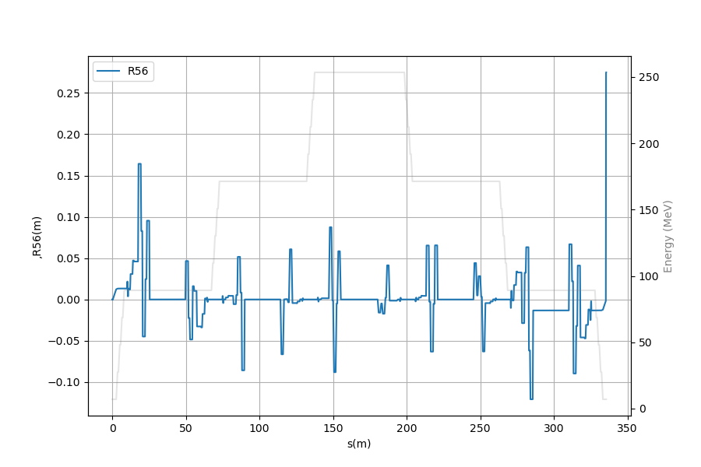
Momentum compaction (R56 term)
Match R56 = 0 on :
  End arc1
  End merger 1
  End arc3
  …
Additional conditions:
Disp x & y =0 (end arcs)
Disp’ x & y = 0 (end arcs)
Alpha x & y = 0 (center arcs)
Alpha x & y = 0 (center strs)
Not closed for 250 MeV lattice (no recombiner after 1st arc)
Need to cancel at injection

Slide 7
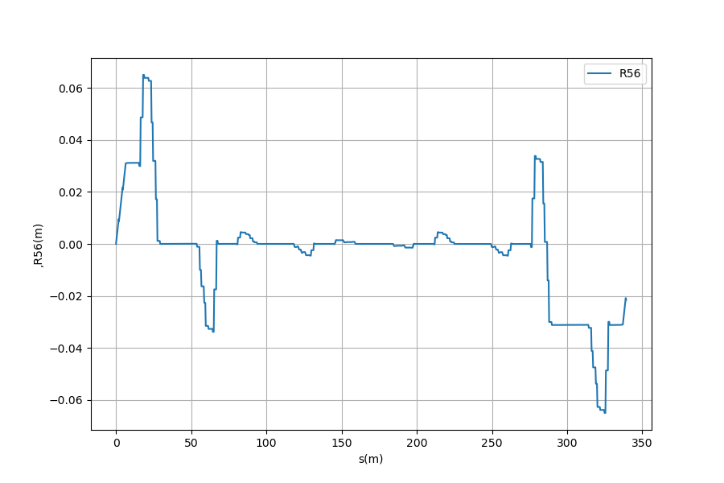
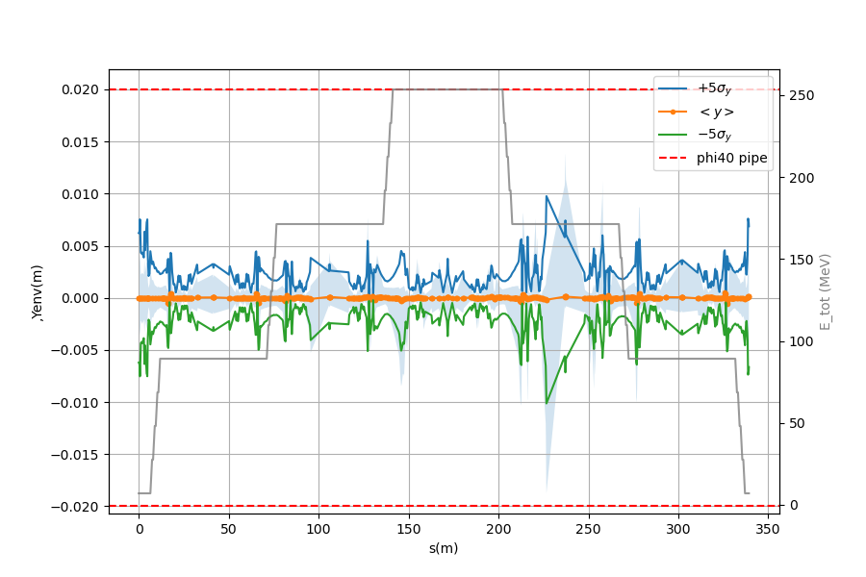
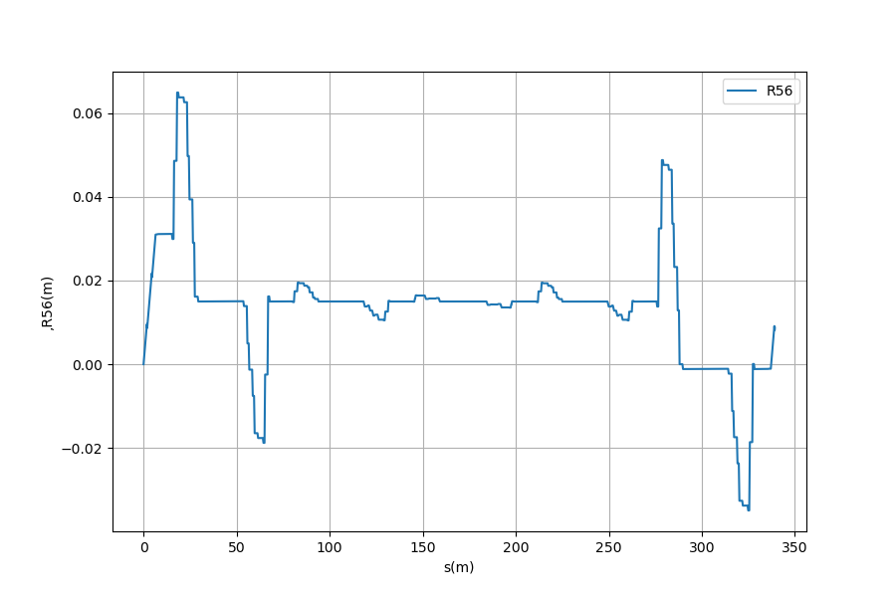
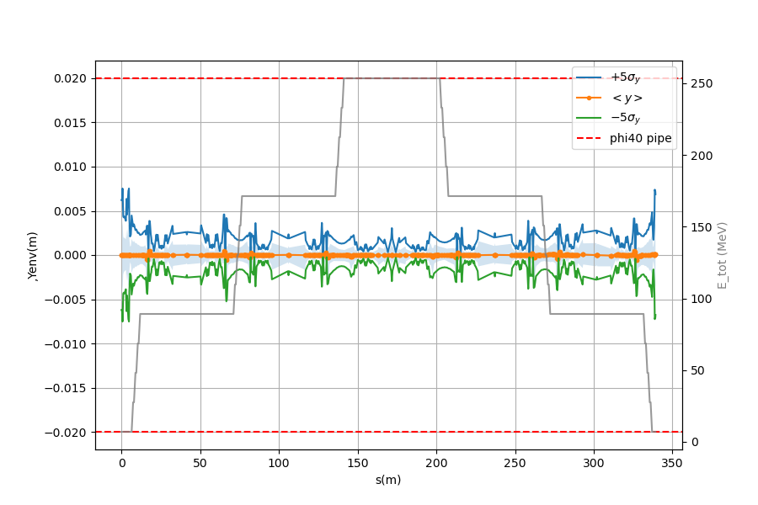

A more stable solution
In fact, the best solution (most stable) is around $R_{56}\sim 0,014$
  This corresponds to the half of the merger contribution to $R_{56}$
R56 = 0,0 m
R56 = 0,015 m
(half increase from merger)

Slide 8
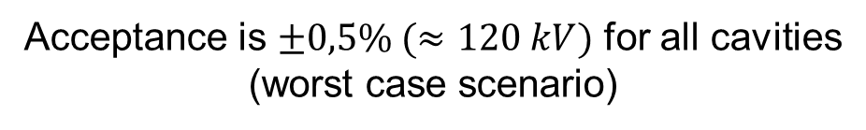
Sensitivity to Voltage (energy) variations : worst case scenario (4 cavities detuned)
Acceptance is $±0,5\% (≈120 kV)$ for all cavities (worst case scenario)

Slide 9
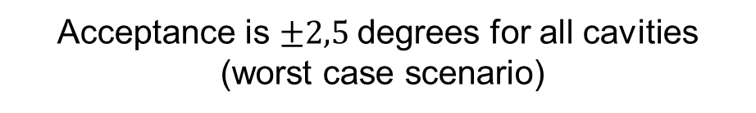
Sensitivity to phase variations : worst case scenario (4 cavities detuned)
Acceptance is $±2,5$degrees for all cavities
(worst case scenario)

Slide 10
Contents
1st order tuning of PERLE
Longitudinal matching – general case
First application on PERLE

Slide 11




Longitudinal match of PERLE
Longitudinal match is important to control the bunch longitudinal phase space over the 6-passes of PERLE
In particular :
  For FELs : bunch current maximized at IP ➔ compressive match
  For colliders : energy spread minimized at IP ➔ energy spread minimizing match
Usually, two modes can be considered :
  With synchrotron radiation
  Without synchrotron radiation
$${ E}_{loss_SR} =8,85E^{−5}⋅E^{4}(GeV)/ρ_{0}$$
For PERLE : $E_{loss_SR}≈1$ keV (negligible)
Finally, two types of ERL exists :
  Separate transport ERLs : different arcs for decell and accell (possible with 2 linacs)
  Common transport ERLs : same arcs for recirculation
IP_FP
[2]
PERLE 250 MeV : interaction points

Slide 12
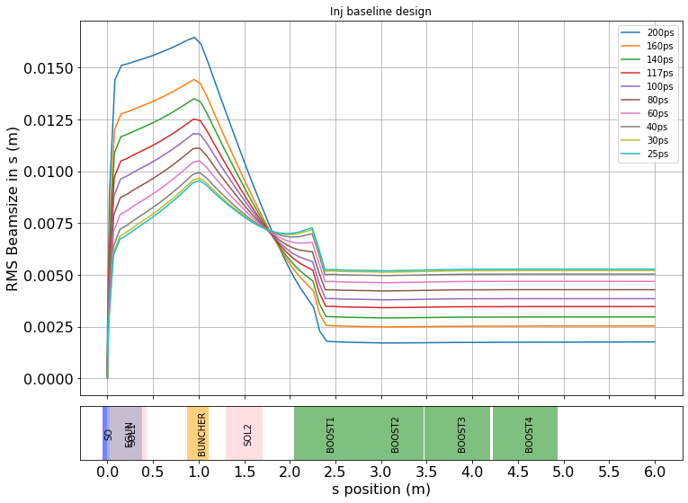
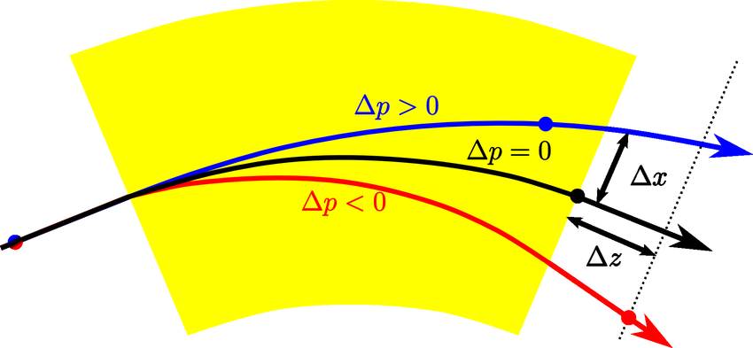
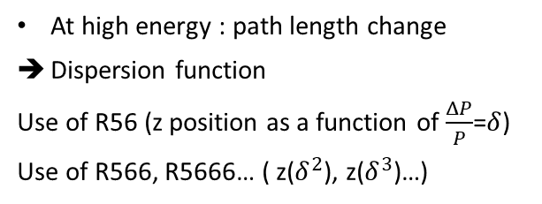
Longitudinal match
1. Control of the bunch size
At low energy : velocity change
Buncher
This is the case for the injector @ 250keV
And also a little bit in the merger @ 7MeV
At high energy : path length change
Dispersion function
Use of R56 (z position as a function of $\frac{ΔP}{P}$=$δ$)
Use of R566, R5666… ( z($δ^{2}$), z($δ^{3}$)…)
Arcs are the most sensitive to these effects
Almost totally negligible in the ERL !

Slide 13
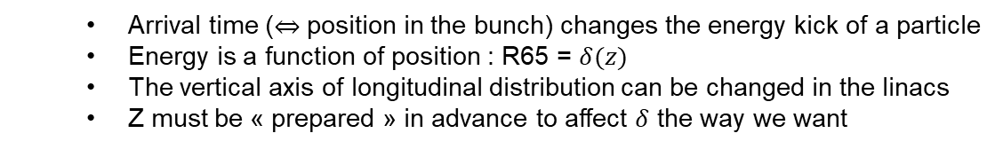
Longitudinal match
2. Control of the energy spread
  Arrival time ($⇔$ position in the bunch) changes the energy kick of a particle
  Energy is a function of position : R65 = $δ(z)$
  The vertical axis of longitudinal distribution can be changed in the linacs
  Z must be « prepared » in advance to affect $δ$ the way we want

Slide 14
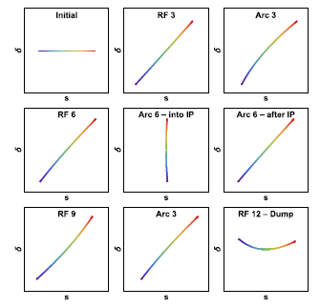
Methodology
The bunch energy distribution can be developped as taylor expansion :
$$δ_{0}\left(s\right)=δ_{0}^{′}s+δ_{0}^{′′}s^{2}+δ_{0}^{′′′}s^{3}$$
Example of bunch compression
$1^{st}$ order
$2^{nd}$ order
$3^{rd}$ order
Then, we use the following variables to manipulate this distribution :
  Phases of the LINAC(s)
  R56 : longitudinal dispersion
  R566 : second order longitudinal dispersion
  R5666 : third order longitudinal dispersion

Slide 15
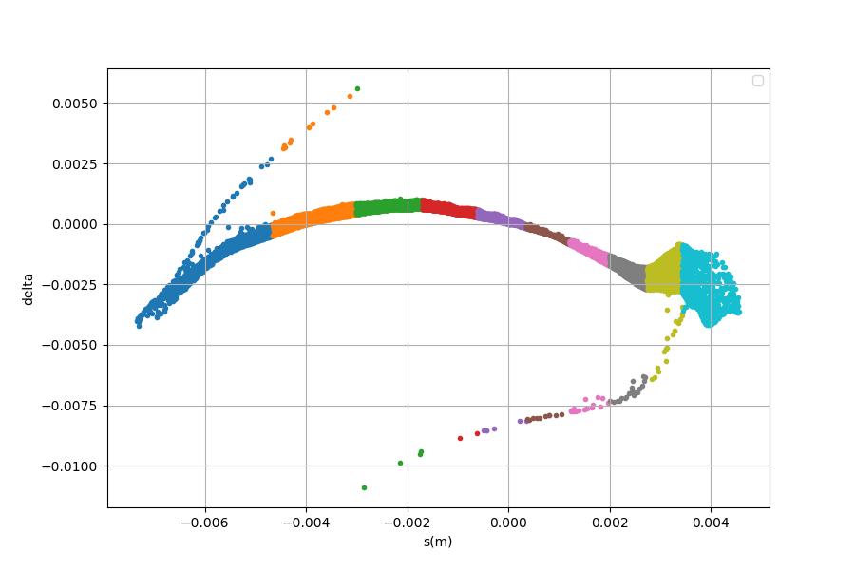
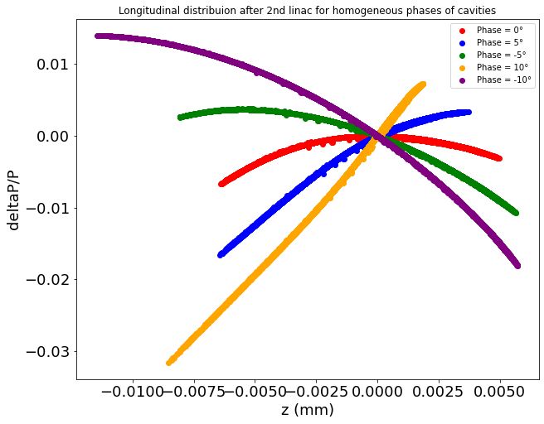
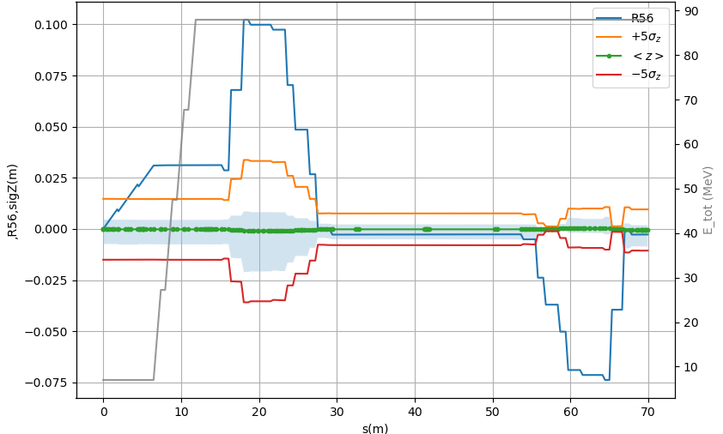



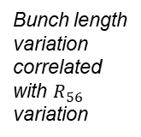


Manipulation of longitudinal phase space
Phases in the cavities can be used to linearize the longitudinal distribution
$φ_{0}=10°$ : fully linear
$φ_{0}=5°$ : start linearizing (~debunching)
$φ_{0}=0°$ : parabolic shape (on crest)
$φ_{0}=−5°$ : start linearizing (~bunching)
$φ_{0}=−10°$ : almost linear
Initial longitudinal distribution at the exit of the booster
After linac
Bunch length variation correlated with $R_{56}$ variation
$R_{56}$ (and higher order) can be used for bunch compression :

Slide 16

Contents
Base tuning of PERLE
Longitudinal matching – general case
First applications on PERLE
(very)

Slide 17
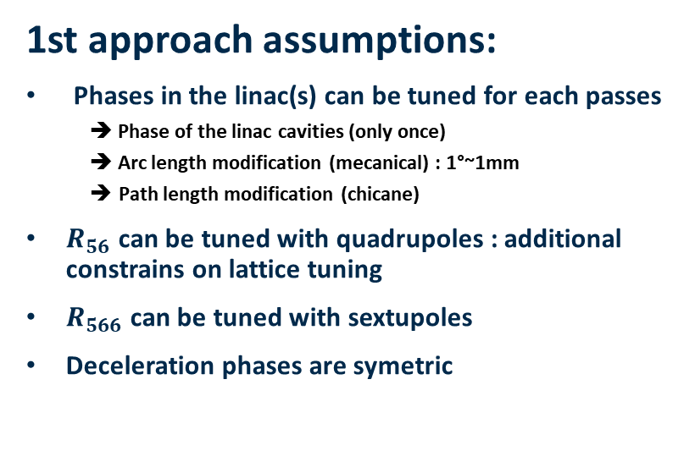
Preliminary : first applications on PERLE
1st approach assumptions:
Phases in the linac(s) can be tuned for each passes
  ➔ Phase of the linac cavities (only once)
  ➔ Arc length modification (mecanical) : 1°~1mm
  Path length modification (chicane)
$R_{56}$ can be tuned with quadrupoles : additional constrains on lattice tuning
$R_{566}$ can be tuned with sextupoles
Deceleration phases are symetric
For this first approach, I am using taylor elements at the end of the arcs to add artificial $R_{56}$and $R_{566}$ ➔ new additional objectives for next lattice matching

Slide 18
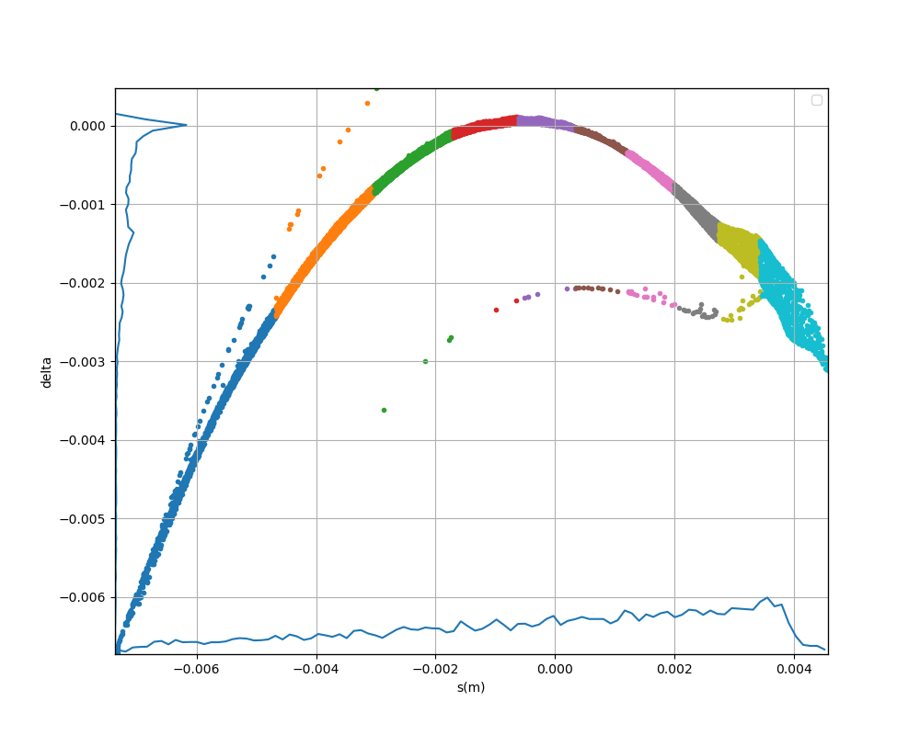


Example of bunch compression
Bunch longitudinal distribution at IP-FP :
$$σ_{z}=3mm$$
$$σ_{δ}=1,2e^{−3}$$

Slide 19
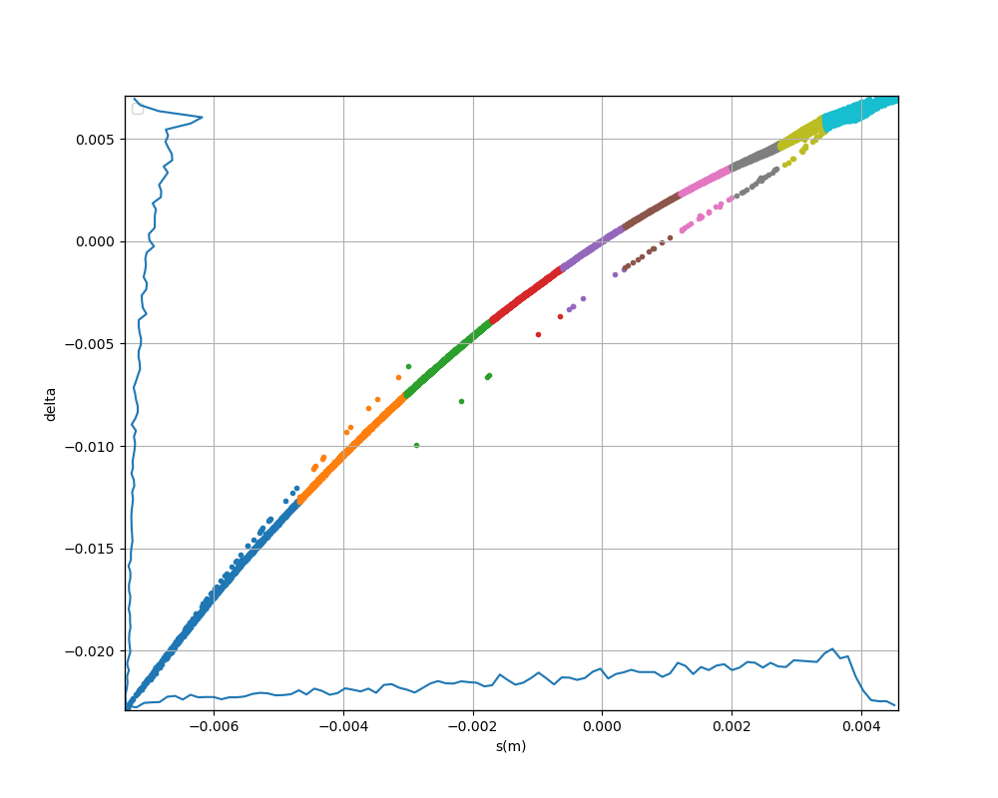


Example of bunch compression
Linearization with the phase of the linac
Apply phase to linearize
$$σ_{z}=3mm$$
$$σ_{z}\sim 3mm$$
$$σ_{δ}=1,2e^{−3}$$
$$φ_{0}=10°$$

Slide 20
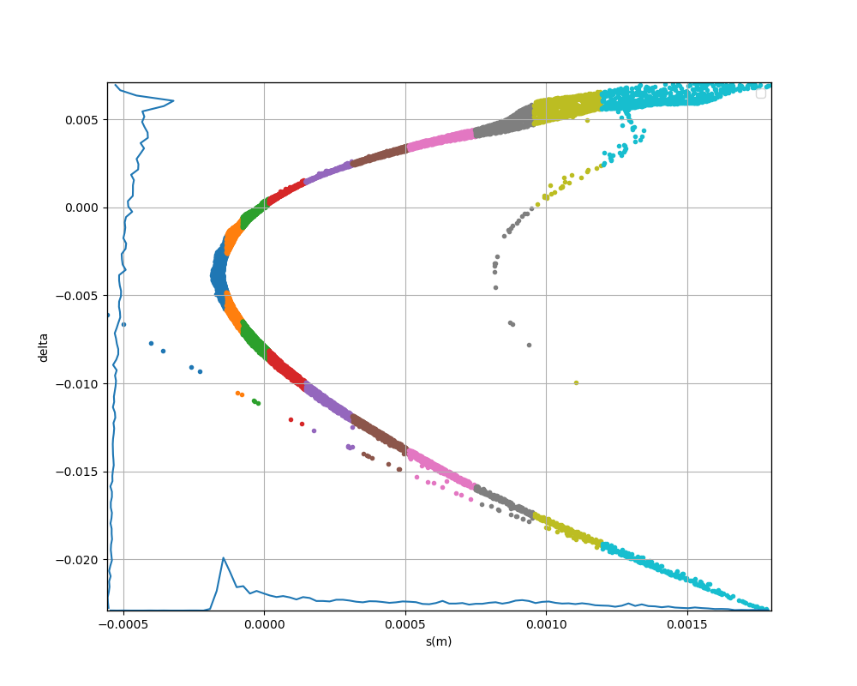



Example of bunch compression
Bunch compression with R56
Apply R56 to compress
$$σ_{z}\sim 3mm$$
$$σ_{z}=0,51mm$$
$$R_{56}=−0,4$$

Slide 21
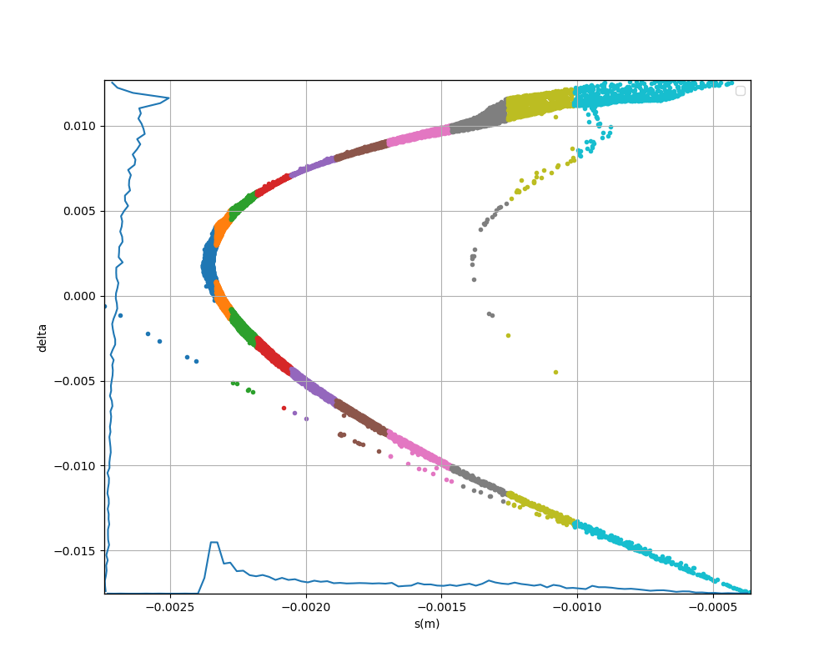
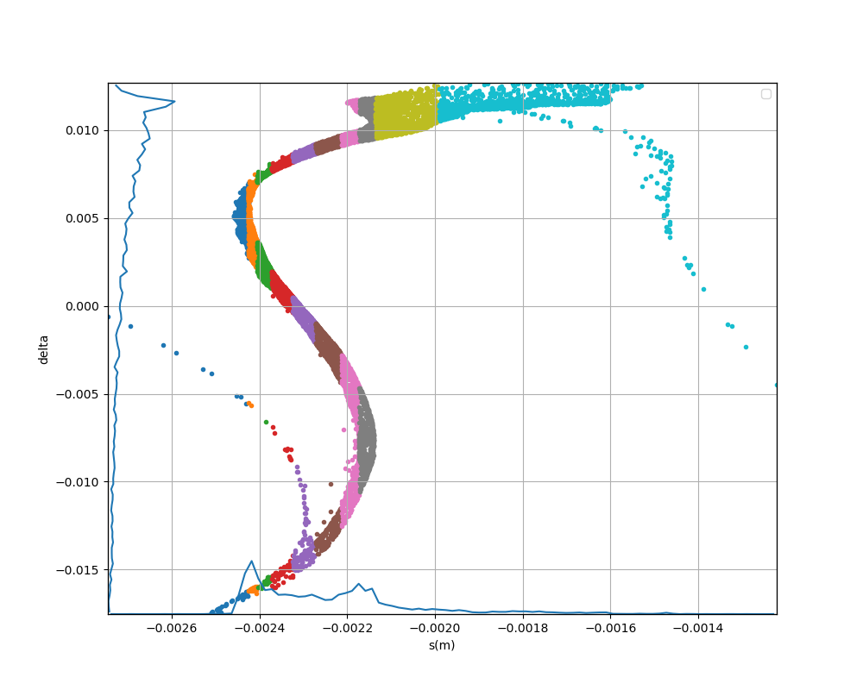




Example of bunch compression
Higher order compression with R566
Apply R566 to compress
again
$$σ_{z}=0,51mm$$
$$σ_{z}=0,189mm$$
$$R_{566}=−7$$
$$σ_{δ}=7,2e^{−3}$$
Bunch compressed from 3mm to 0,2mm (factor 15 compression). Energy spread dilated by factor 6.

Slide 22
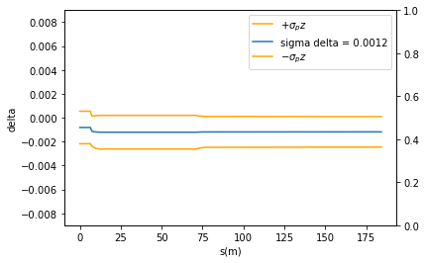
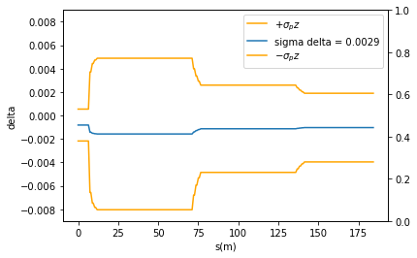
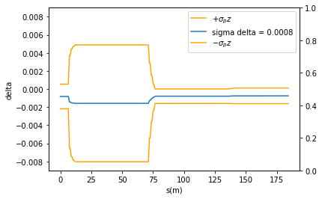
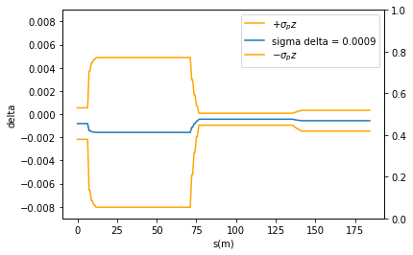







Example of energy spread minimization (not optimal)
Tuning both phases and $R_{56},R_{566}$ can compress energy spread :
No compression
$$φ_{1}=7°$$
$$φ_{1}=7°$$
$$φ_{2}=−11°$$
$$R_{56}=−0,05$$
$$R_{56}=−0,05$$
$$φ_{1}=7°$$
$$φ_{1}=7°$$
$$φ_{3}=−2$$
$$φ_{2}=−11°$$
$$φ_{2}=−11°$$
$$R_{566}=−8$$
$$R_{566}=−8$$
$$R_{56}=−0,8$$
$$R_{566}=−7$$
Energy spread compressed by factor ~3

Slide 23
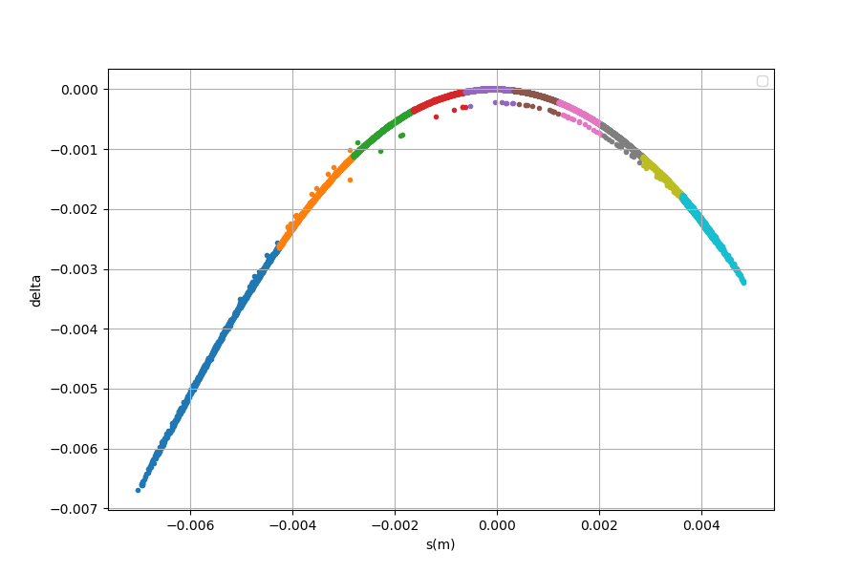
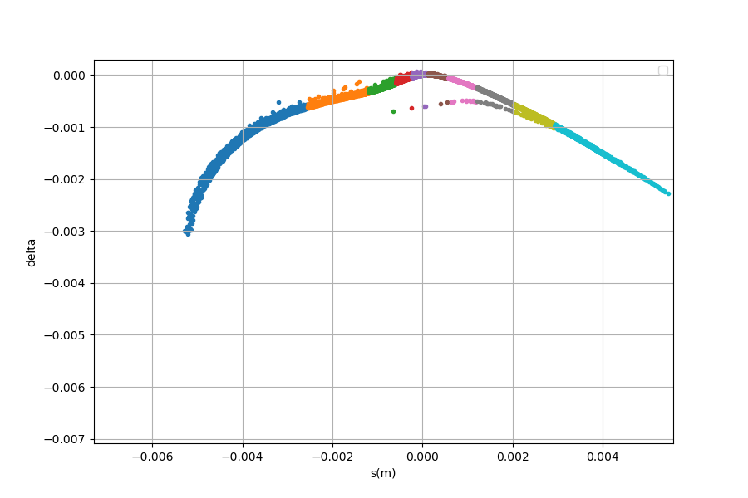
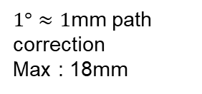




Overall better shape for experiments
No longitudinal match
With energy spread compression
$$σ_{z}=2,9e^{−3}$$
$$σ_{z}=2,1e^{−3}$$
$$σ_{δ}=1,3e^{−3}$$
$$σ_{δ}=5,1e^{−4}$$
 | R56 | R566 | Phase
Pass 1 | -0,05 | -8 | 7
Pass 2 | -0,8 | -8 | -11
Pass 3 |  |  | -2
→ 0,6 MeV
$1°≈1$mm path correction
Max : 18mm
→ 1,5 MeV
→ 0,05 MeV

Slide 24
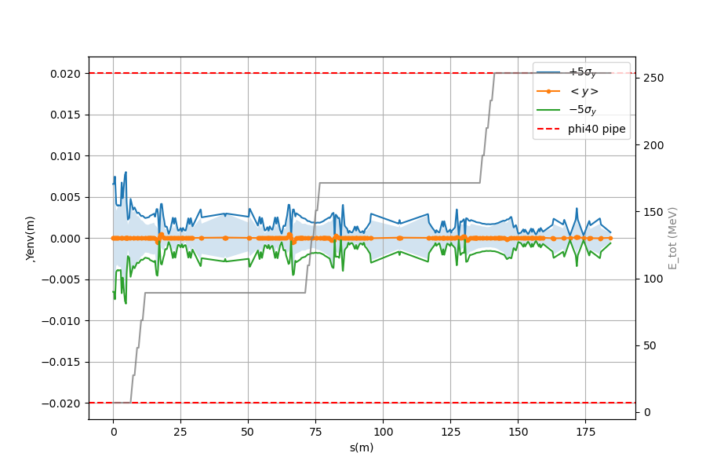
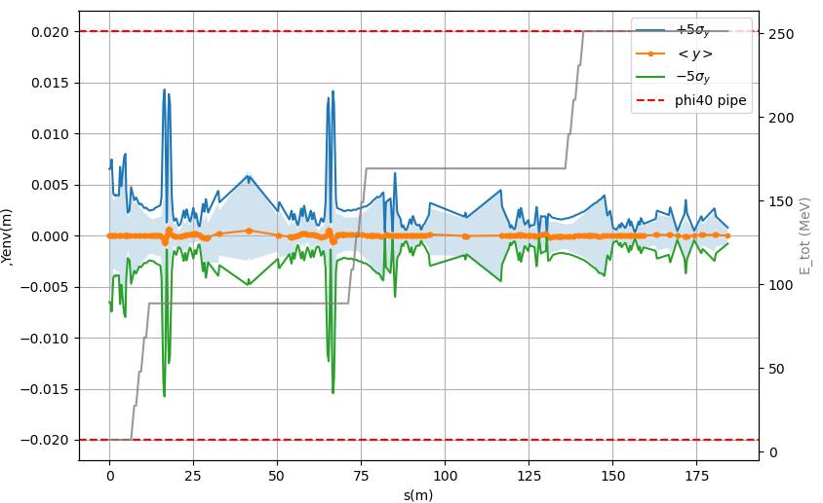



Stability of the solution
No $\frac{ΔP}{P}$ compression
With $\frac{ΔP}{P}$ compression
$5σ$ envelops get closer to beam pipe
Lattice is symetric
(/!\ deceleration phases to check)

Slide 25
Thank you for listening !
Special thanks to: A. Bogacz, A. Fomin, L. Perrot, R. Abukeshek, C. Guyot,
R. Roux, F. Bouly, C. Monaghan, W. Kaabi, A. Stocchi and all the PERLE collaboration
References :
[1] D. Sagan, "Bmad: A Relativistic Charged Particle Simulation Library" Nuc. Instrum. & Methods Phys. Res. A, 558, pp 356-59 (2006)
[2] Segurana, Gustavo & Bailey, Ian & Williams, Peter. (2022). Construction of self-consistent longitudinal matches in multipass energy recovery linacs. Physical Review Accelerators and Beams. 25. 10.1103/PhysRevAccelBeams.25.021003.

Slide 26
PERLE experiments
SCRIT : deltaP/P = 2.4e-4 @300MeV

Slide 27


Example of bunch compression
Symetrise the distribution
Change voltage for symetry reasons
$$σ_{z}=0,51mm$$
$$V_{err}=152keV$$

Slide 28
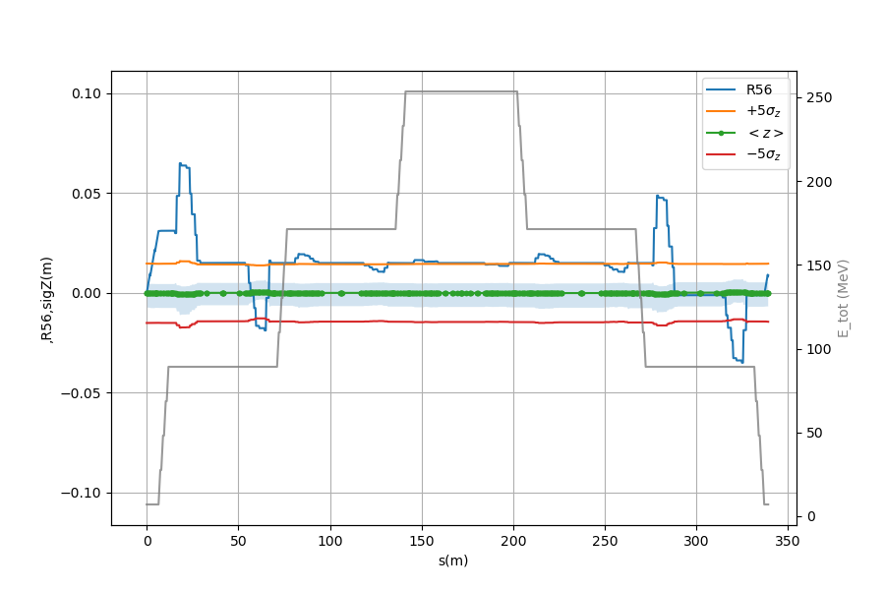
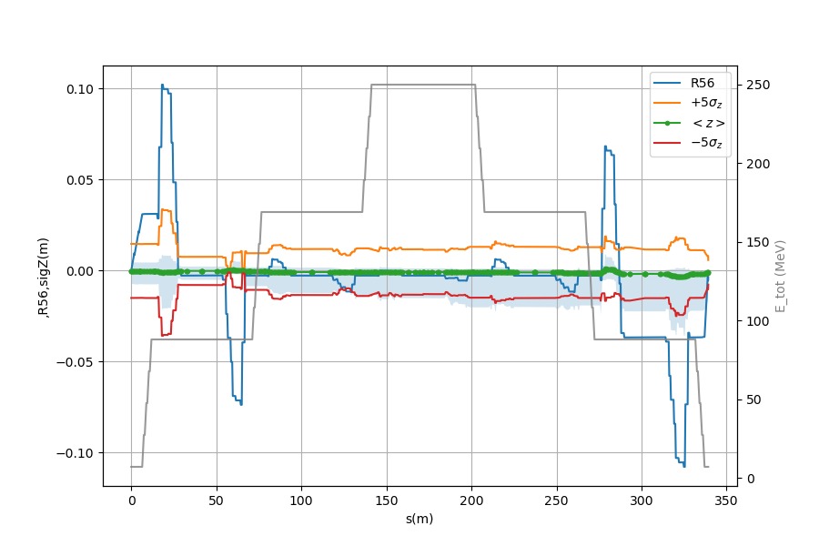

Slide 29
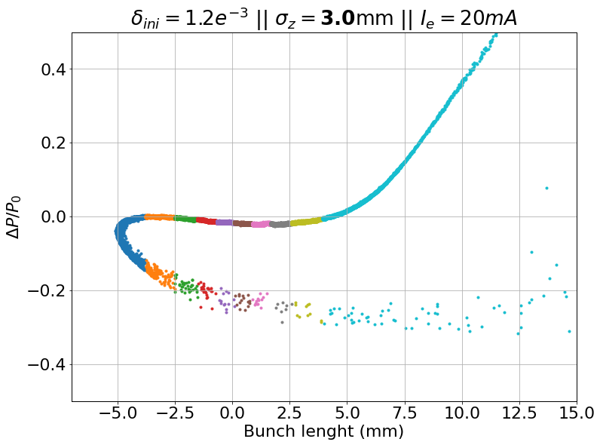
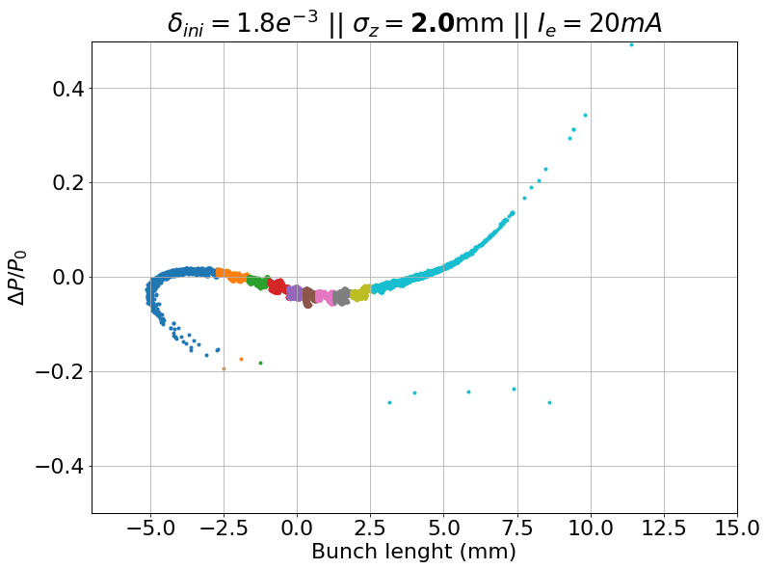
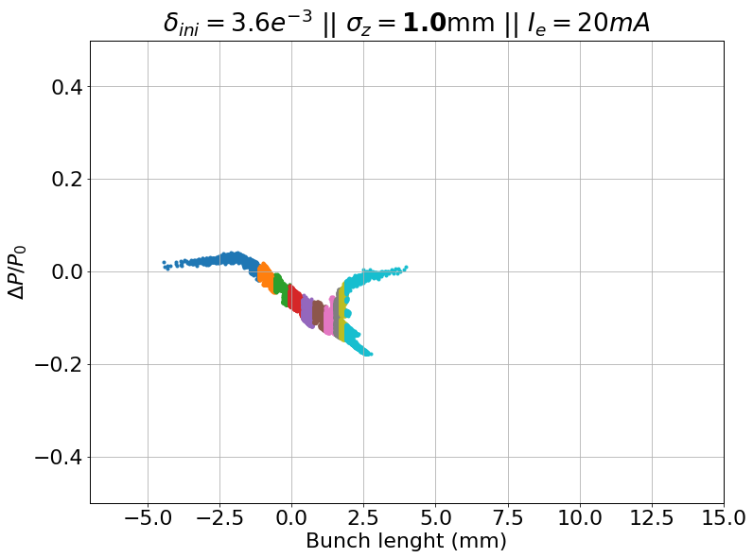
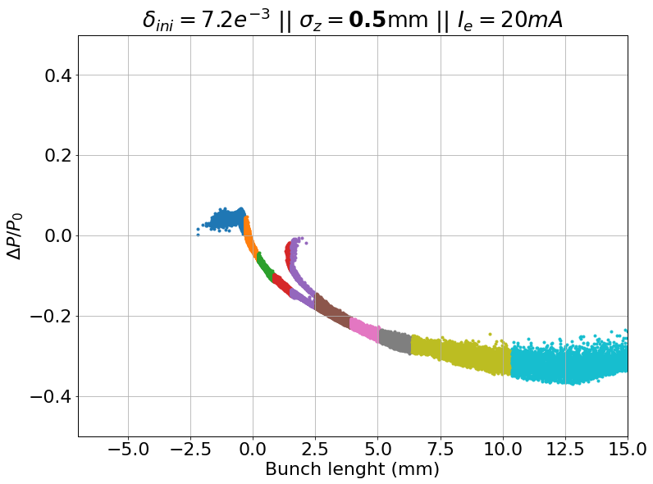
RF curvature VS CSR
3 mm
bunch length
2 mm
bunch length
1 mm
bunch length
0,5 mm
bunch length
Lost : 1%
Lost : 0%
Lost : 0%
Lost : 13%
RF curvature dominated
CSR dominated
Need to specify an optimum bunch length for simulations and injector
1,4mm optimal value from K. Andre simulations

Slide 30
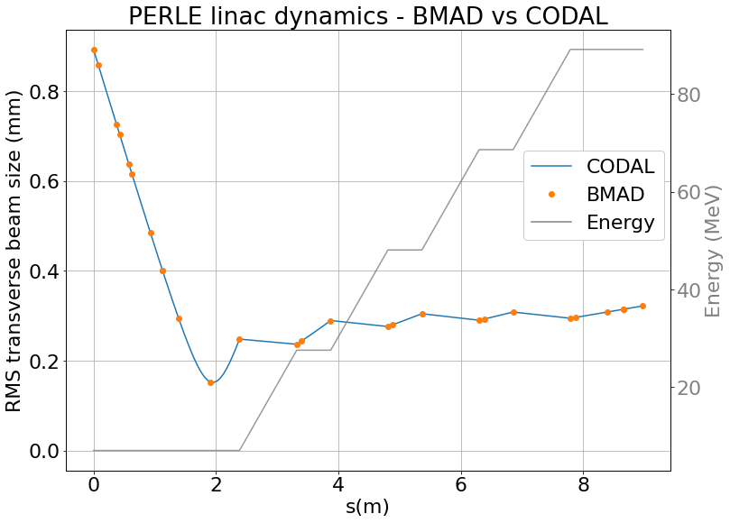

RF cavities benchmarking
Transverse position
Transverse divergence
BMAD crosschecked with CODAL and ASTRA (see Coline’s talk)
Energy
Transverse envelope
Longitudinal and transverse emittance distributions
Equations (CODAL&BMAD)
from the same publication [2]
[2] Rosenzweig, J, and Serafini, L. 1994. "Transverse particle motion in radio-frequency linear accelerators". United States

Slide 31

Check for CSR

Slide 32

Transverse raw acceptance
CSR : OFF
$Δx$= 0,06mm
$Δ_{px}$= 0,06
Aperture check : $φ40$
$$ε_{y}=ε_{z}=0,0 mm.mrad$$

Slide 33

Transverse raw acceptance
CSR : OFF
$Δx$= 0,06mm
$Δ_{px}$= 0,06
Aperture check : $φ40$
$$ε_{y}=ε_{z}=0,0 mm.mrad$$

Slide 34


Longitudinal raw acceptance
CSR : OFF
$Δz$= 40mm
$Δ_{pz}$= 1
Aperture check : $φ40$
$$ε_{x}=ε_{y}=0,0 mm.mrad$$
INJECTION
DUMP

Slide 35







Optimization objectives
What needs to be tuned :
What can we play on :
Twiss functions stable over all linacs
Merger output :
initial twiss functions
$$3σ_{y,x}<2,2 mm$$
- K1 gradient of quads in spreader
(7 quads families)
$$D_{y}=D_{y}^{′}=0$$
$$β_{start}=β_{end}$$
$$α_{center}=0$$
- K1 gradient of quads in arcs
(11 quads families)
$$D_{x}={D′}_{x}=0$$
$$M_{56}=0$$

Slide 36








Collective effects benchmarking
Initial distribution : 3x2D gaussian distribution at the beginning of the first linac
Tracking : from first linac to dump
PLACET2 (K. Andre)
BMAD

Slide 37



Effect of CSR on the beam
If we slice a bunch in longitudinal bins, we can observe a change in energy of each bin.
This is linked to the z position of the bin wrt the coherent SR wavelength.
This effect, mixed with dispersion, causes transverse shifts of the particles in the dipoles.
$$Δx \sim η_{x}δ , Δx^{′}\sim η_{x}^{′}δ …$$
For PERLE,
for 1 dipole :
$$δ\sim 3e^{−4} ;η_{x} \sim 0,1 ;η_{x}^{′}\sim 0,5⇒Δx \sim 0,03mm ;Δx^{′}\sim 0,1mrad$$
Not cancelled, even if dispersion closed, because energy spread introduced within the arc

Slide 38



PERLE beam dynamics
Lattice stable with no losses in nominal mode (5 $σ$ beam safe from vacuum chamber)
First results of misalignment corrections studies
Beam 5$σ$ transverse envelop over the 6 passes of PERLE
Simulation of 100 beam orbits along the 1st pass of PERLE (blue) and corrections (orange)
Also under study :
Injector beam dynamics optimization (C. Monaghan)
Longitudinal match (talk J. Michaud)
Beam losses through halo formation
➔ talk Rasha Abukeshek

