Slide 1

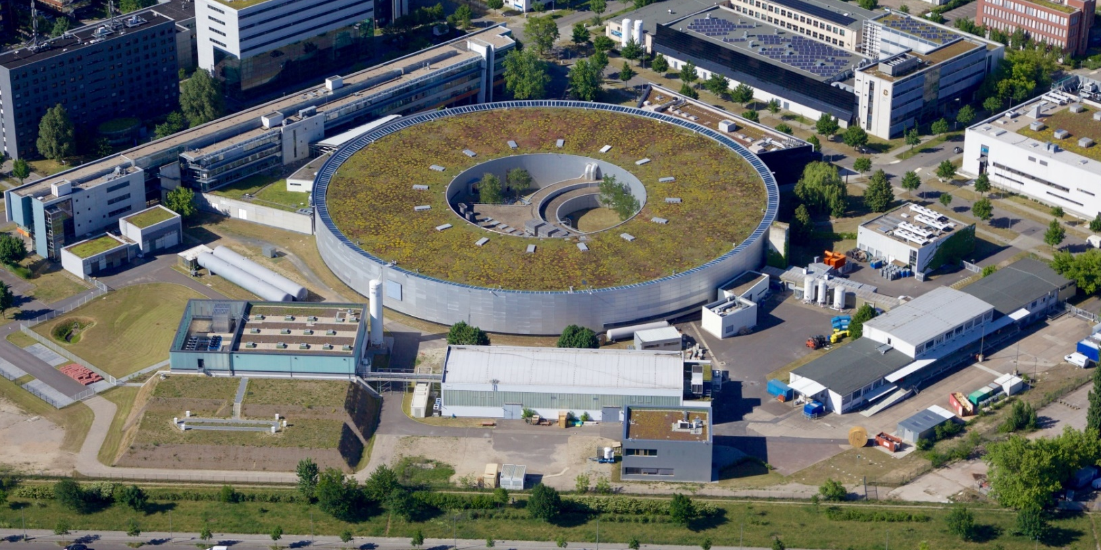

Status of bERLINPro’s Injector
PERLE Collaboration Meeting
16/09/24,
CERN
A. Neumann for the bERLinPro team @SEALAB
BESSY II
Status
bERLinPro
For the LDG
bERLinPro Beam Countdown
28d
21h
19m
35s
36s
37s
38s
39s
40s
41s
42s
43s
44s
45s
46s
47s
48s
49s
50s
51s
52s

Slide 2
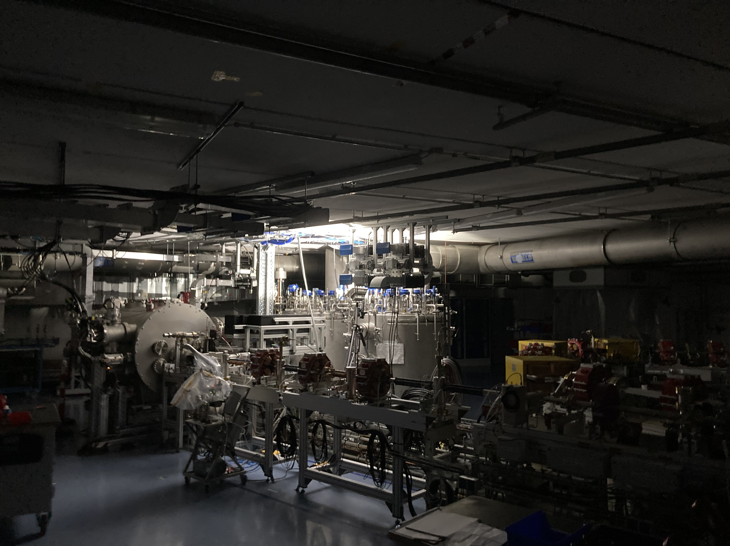
2024, an exiting autumn and Winter are ahead of us
Reminder: What was bERLinPro meant for and how far
is it assembled and financed?
Current status of the facility
2024: Finally the year of first beam?
  Milestones:
  Final setup of the injector beamline
  First cooldown and RF tests
2024: Beam commissioning plan, a first insight
The injector awakens

Slide 3
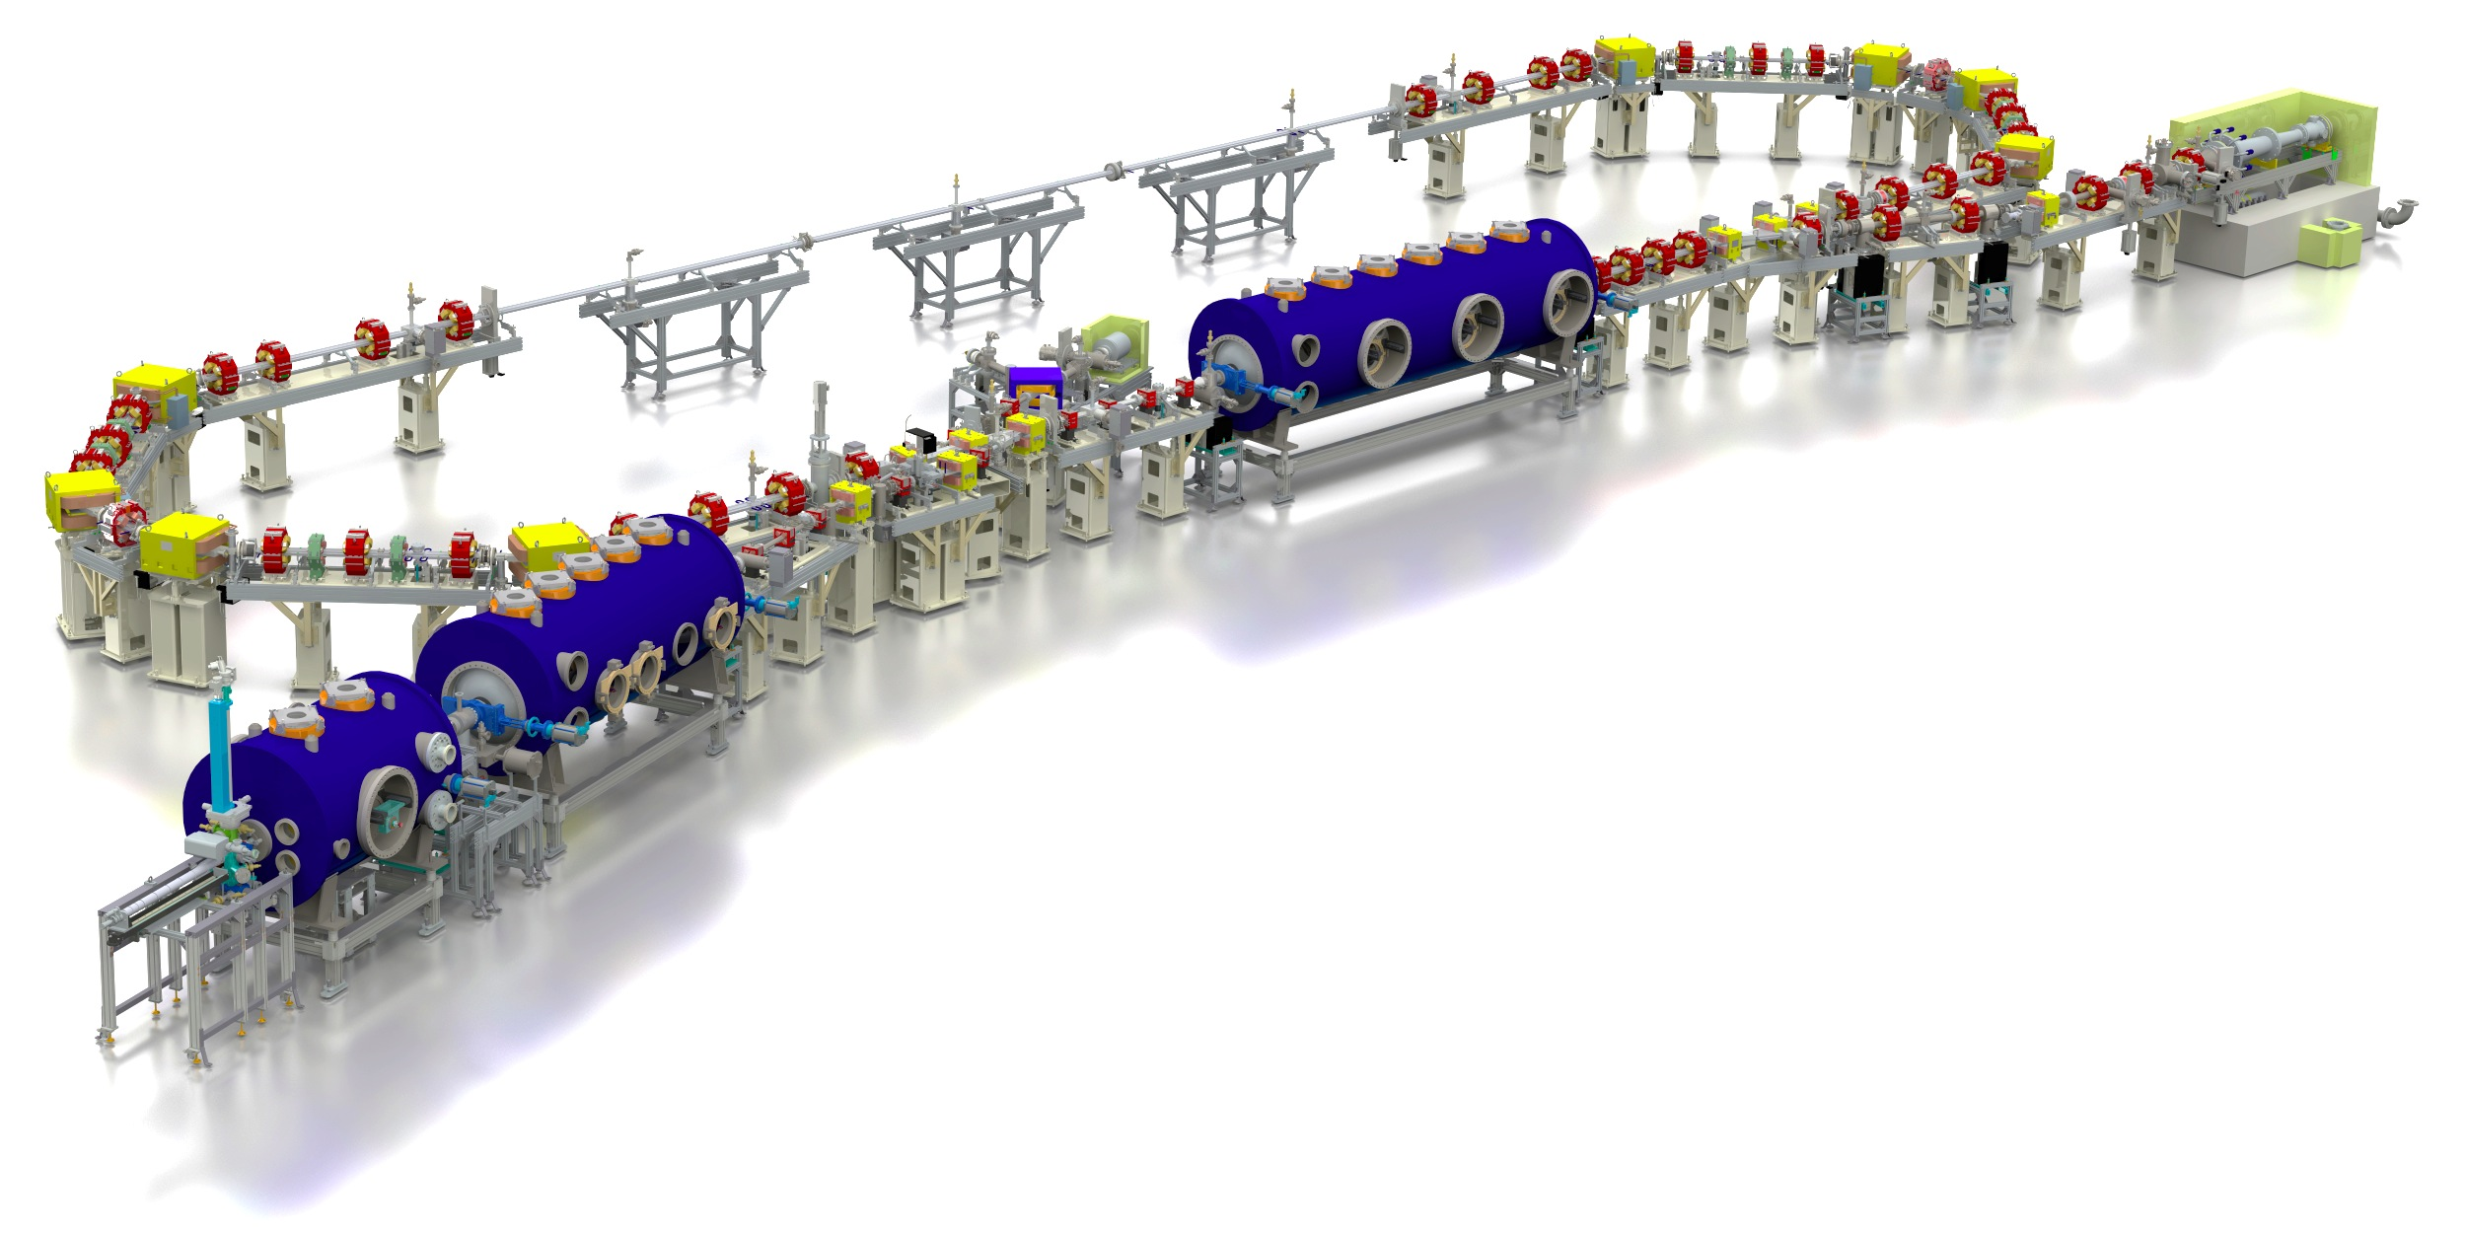
Evolution of bERLinPro
History
From 4th generation light source prototype (2011), via generic high intensity ERL prototype
(2012-2020) towards application driven facility (today)
Single turn high intensity ERL
5 MW beam power
650 kW injector beam power
test and
diagnostic line
beam dump
6.5 MeV, 100 mA
= 650 kW
linac module
3 x 7 cell SRF cavities
44 MeV
merger
dogleg
Parameter | bERLinPro
Beam energy recirculator (MeV) | 50
Beam current ERL mode (mA) | 100
Frequency RF and Laser (GHz) | 1.3
Normalized emittance (mm mrad) | 1 (< 0.6 in simulations)
Bunch length (ps) | < 2 (ERL mode), 100 fs @ 10 mA
Beam losses | << 10⁻⁵ @ 100 mA
modified Cornell booster
3 x 2 cell SRF cavities
4.5 MeV
srf-gun
1.4 cell SRF cavities
1.5-2.3 MeV, single SC solenoid,
Important aspects:
Injector beam quality at high
current/bunch charge
Beam loss control and monitoring
→ Radiation protection
Beam break-up in main Linac
Longitudinal control of beams for
recovery process (low power margin)

Slide 4
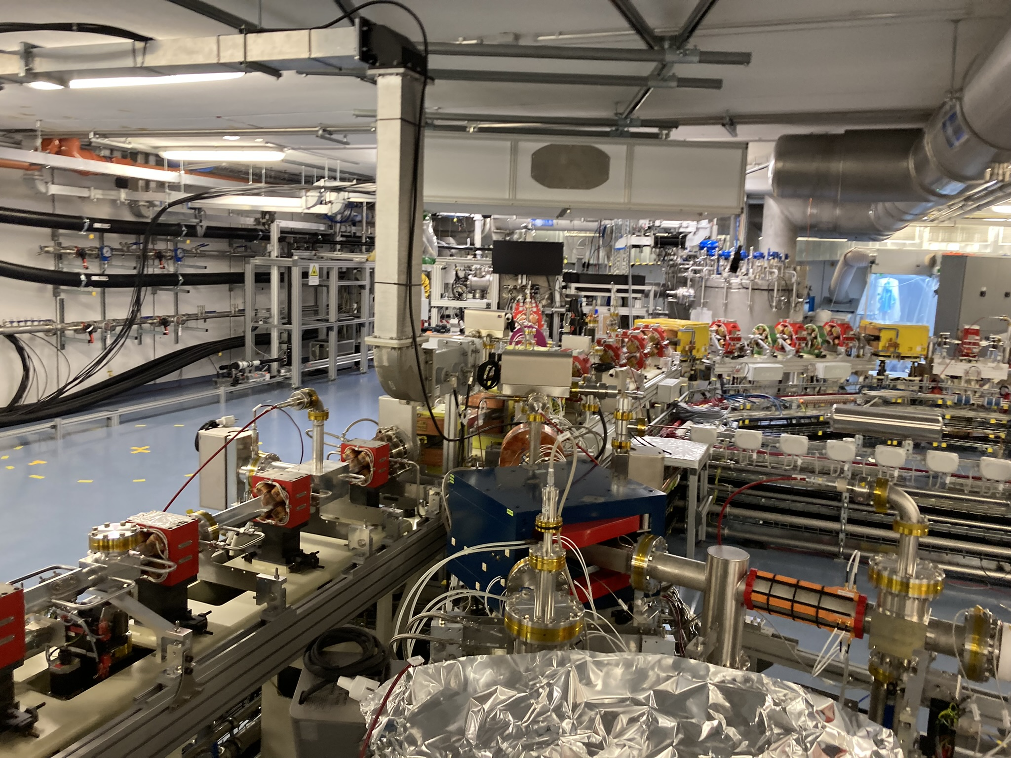
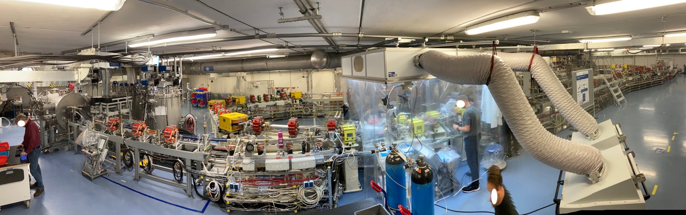
Stages at bERLinPro
Operations concept
Presently installed facility
BEAM
Installed: 10-mA SRF gun + merger + recirculation + dump
Installed: Proof-of-principle UED experiment
Funded: Booster module. Produced but assembly required
Not funded: LINAC module
Not funded: 100-mA class photoinjector
CW photoinjector studies < 10 mA
Long-pulse injector studies < 100 mA
High-power beam studies (“long pulse”)
High-power energy recovery
Energy-efficient RF operation

Slide 5
Stages at bERLinPro
Operations concept
Presently installed facility
Applications
Short pulse, low emittance
Low charge
High power beam
UED Exp.
Waste Water
Make use of injector’s flexibility for beam parameter range
→ Cover in parallel ERL relevant beam studies
Installed: 10-mA SRF gun + merger + recirculation + dump
Installed: Proof-of-principle UED experiment
Planned: Waste water treatment demonstrator
Funded: Booster module. Produced but assembly required
Not funded: LINAC module
Not funded: 100-mA class photoinjector
CW photoinjector studies < 10 mA
Long-pulse injector studies < 100 mA
High-power beam studies (“long pulse”)
High-power energy recovery
Energy-efficient RF operation

Slide 6
Stages at bERLinPro
Operations concept
Presently funded facility
Applications
UED Exp.
Waste Water
Installed: 10-mA SRF gun + merger + recirculation + dump
Installed: Proof-of-principle UED experiment
Planned: Waster water treatment demonstrator
Funded: Booster module. Produced but assembly required
Not funded: LINAC module
Not funded: 100-mA class photoinjector
CW photoinjector studies < 10 mA
Long-pulse injector studies < 100 mA
High-power beam studies (“long pulse”)
High-power energy recovery
Energy-efficient RF operation

Slide 7
Stages at bERLinPro
Operations concept
Full program (partially funded)
Applications
UED Exp.
Waste Water
Installed: 10-mA SRF gun + merger + recirculation + dump
Installed: Proof-of-principle UED experiment
Planned: Waste water treatment demonstrator
Funded: Booster module. Produced but assembly required
Not funded: LINAC module
Not funded: 100-mA class photoinjector
CW photoinjector studies < 10 mA
Long-pulse injector studies < 100 mA
High-power beam studies (“long pulse”)
High-power energy recovery
Energy-efficient RF operation

Slide 8
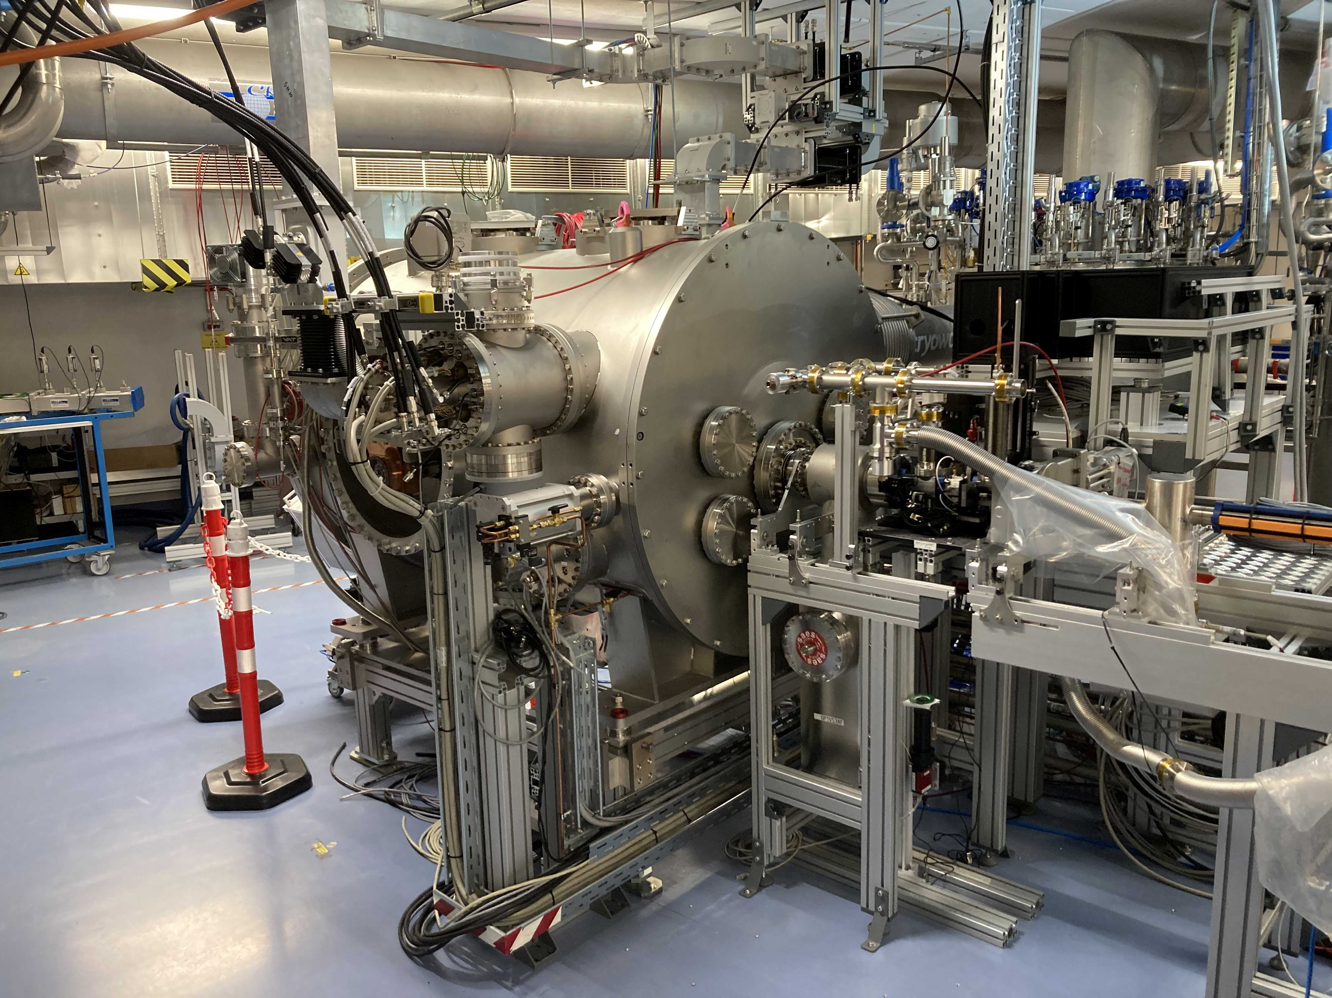
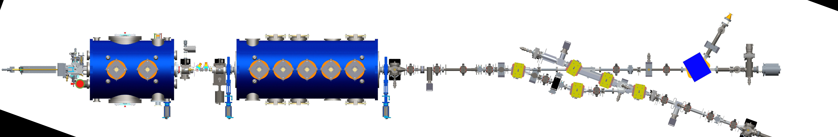
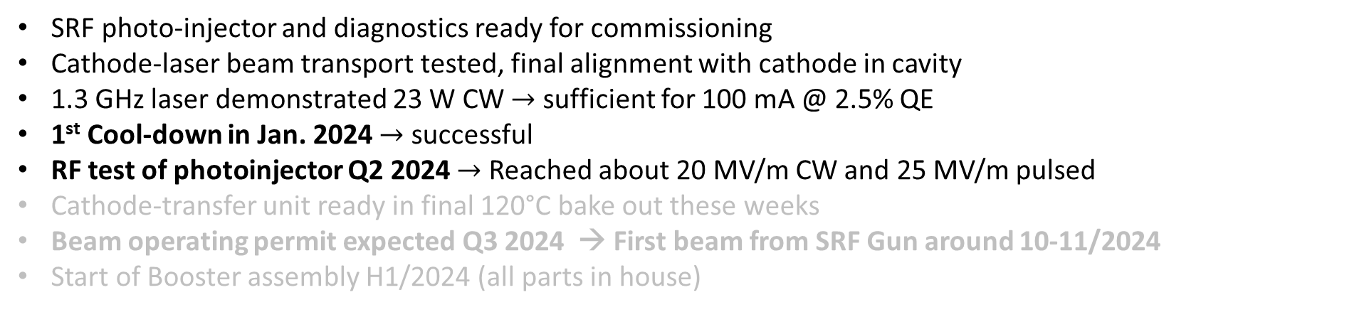
Status of bERLinPro@SEALAB
status
Injector installation at present
Beam diagnostics
Cathode
transfer
system
SRF gun
SRF booster
Merger section
“1st meter” diagnostics +
Laser window for laser-beam transport
Recirculator
SRF photo-injector and diagnostics ready for commissioning
Cathode-laser beam transport tested, final alignment with cathode in cavity
1.3 GHz laser demonstrated 23 W CW $→$ sufficient for 100 mA @ 2.5% QE
1st Cool-down in Jan. 2024 $→$ successful
RF test of photoinjector Q2 2024 $→$ Reached about 20 MV/m CW and 25 MV/m pulsed
Cathode-transfer unit ready in final 120°C bake out these weeks
Beam operating permit expected Q3 2024 → First beam from SRF Gun around 10-11/2024
Start of Booster assembly H1/2024 (all parts in house)
Six+ month delay due to severe HZB cyber attack

Slide 9
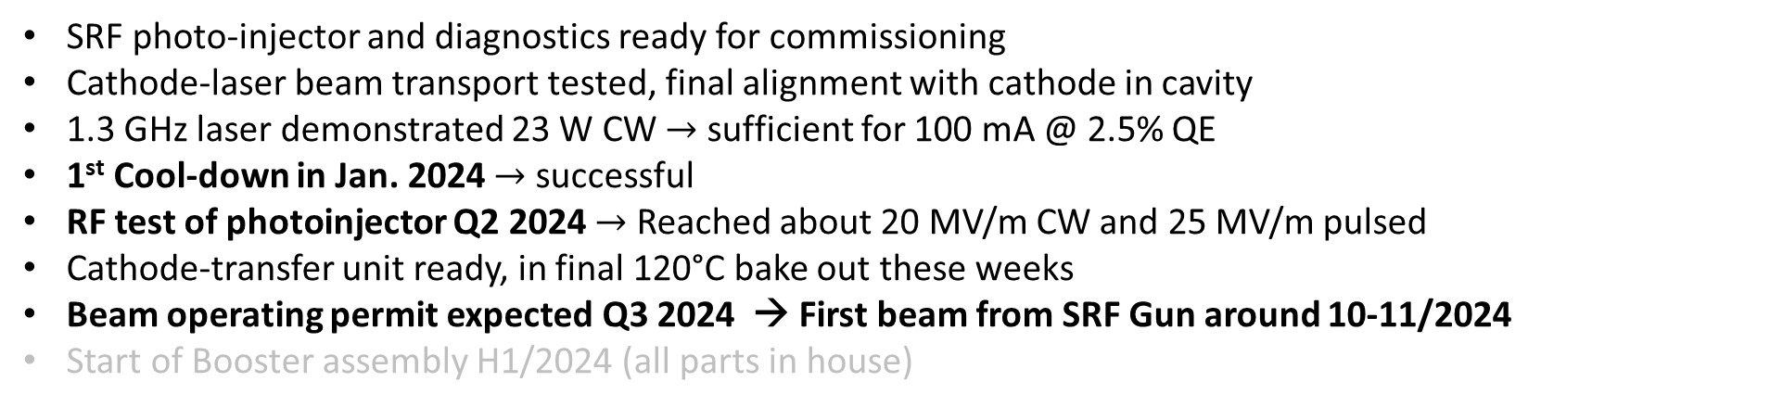
Status of bERLinPro@SEALAB
status
Injector installation at present
Beam diagnostics
Cathode
transfer
system
SRF gun
SRF booster
Merger section
“1st meter” diagnostics +
Laser window for laser-beam transport
Recirculator
SRF photo-injector and diagnostics ready for commissioning
Cathode-laser beam transport tested, final alignment with cathode in cavity
1.3 GHz laser demonstrated 23 W CW $→$ sufficient for 100 mA @ 2.5% QE
1st Cool-down in Jan. 2024 $→$ successful
RF test of photoinjector Q2 2024 $→$ Reached about 20 MV/m CW and 25 MV/m pulsed
Cathode-transfer unit ready, in final 120°C bake out these weeks
Beam operating permit expected Q3 2024 → First beam from SRF Gun around 10-11/2024
Start of Booster assembly H1/2024 (all parts in house)
Six+ month delay due to severe HZB cyber attack

Slide 10
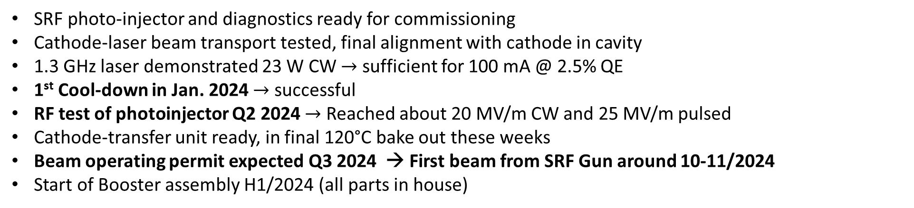
Status of bERLinPro@SEALAB
status
Injector installation at present
Beam diagnostics
Cathode
transfer
system
SRF gun
SRF booster
Merger section
“1st meter” diagnostics +
Laser window for laser-beam transport
Recirculator
SRF photo-injector and diagnostics ready for commissioning
Cathode-laser beam transport tested, final alignment with cathode in cavity
1.3 GHz laser demonstrated 23 W CW $→$ sufficient for 100 mA @ 2.5% QE
1st Cool-down in Jan. 2024 $→$ successful
RF test of photoinjector Q2 2024 $→$ Reached about 20 MV/m CW and 25 MV/m pulsed
Cathode-transfer unit ready, in final 120°C bake out these weeks
Beam operating permit expected Q3 2024 → First beam from SRF Gun around 10-11/2024
Start of Booster assembly H1/2024 (all parts in house)
Six+ month delay due to severe HZB cyber attack

Slide 11
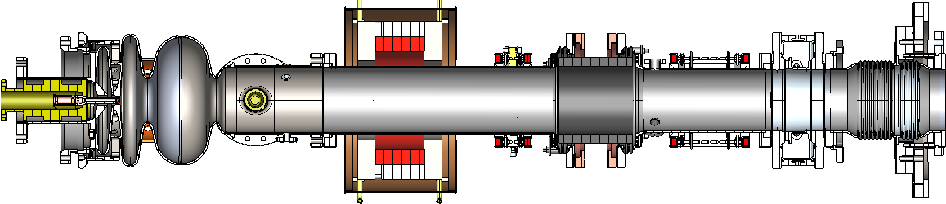
Reminder: The SRF Gun
Blade-tuner with
four piezos
Transition to warm beamline
Twin CW-modified
TTF-III coupler (≤20 kW)
Cathode insert + Petrov filter
Steerer magnets
Choke-cell
Half-cell
Full-cell
SiC HOM beampipe absorber (80 K)
SC- solienoid (4K)
1.4xλ/2 cell shape (1.8K)

Slide 12
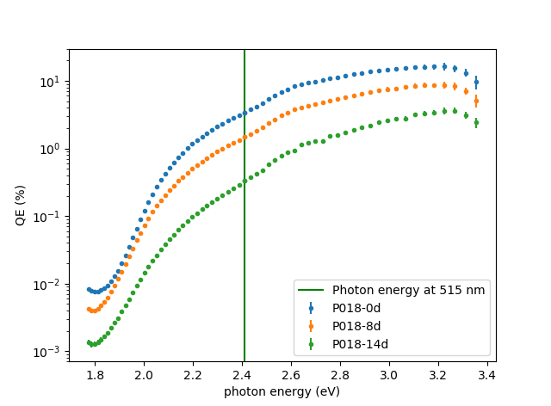
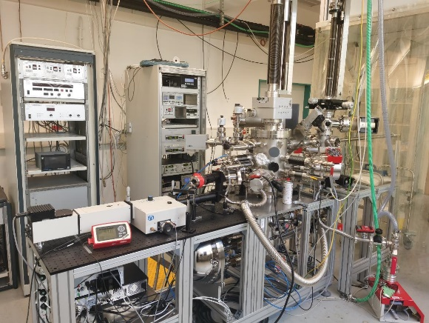
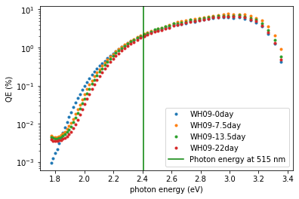



Cathodes: Na-K-Sb vs. Cs-K-Sb
Investigations into Na-K-Sb as more temperature robust alternative to Cs-K-Sb (baseline cathode)
Photocathode Preparation & Analysis System
Sepctral Response Na-K-Sb (WH09)
Spectral response Cs-K-Sb (P18)
Cathode for
commissioning
Remember:
Best so far 16.8% at
515 nm (specs 1%)
Time after deposition | Na-K-Sb (WH09) QE @ 515 nm | Cs-K-Sb (P18) QE @ 515 nm
0 days | 2.0% | 3.4 %
8 days | 2.4% | 1.5 %
14 days | 2.2% | 0.3 %
22 days | 2.0% | -
High QE photocathodes for SEALAB photoinjector:
Explore multi-alkali Cs- and Na-K-Sb systems, from theoretical modeling (DFG fund), growth and characterization, towards operation in a SRF gun.
Complete infrastructure: growth and characterization system, UHV transport vessels, access to materials science lab EMIL at HZB, collaboration with theory.
Lifetime/Robustness
J. Kühn, S. Mistry, C. Wang, J. Dube, C. Cocchi, R. Schier, H. Sassnick, et al.

Slide 13
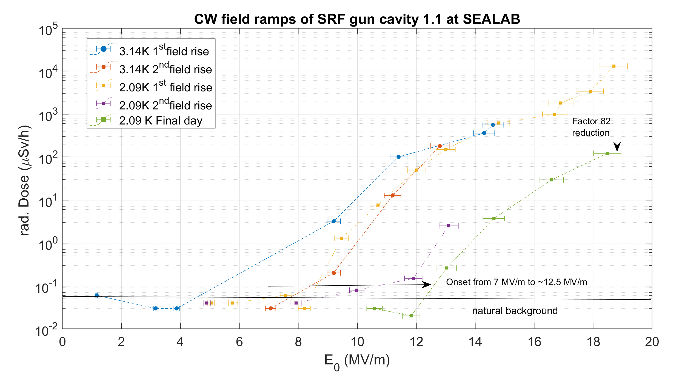
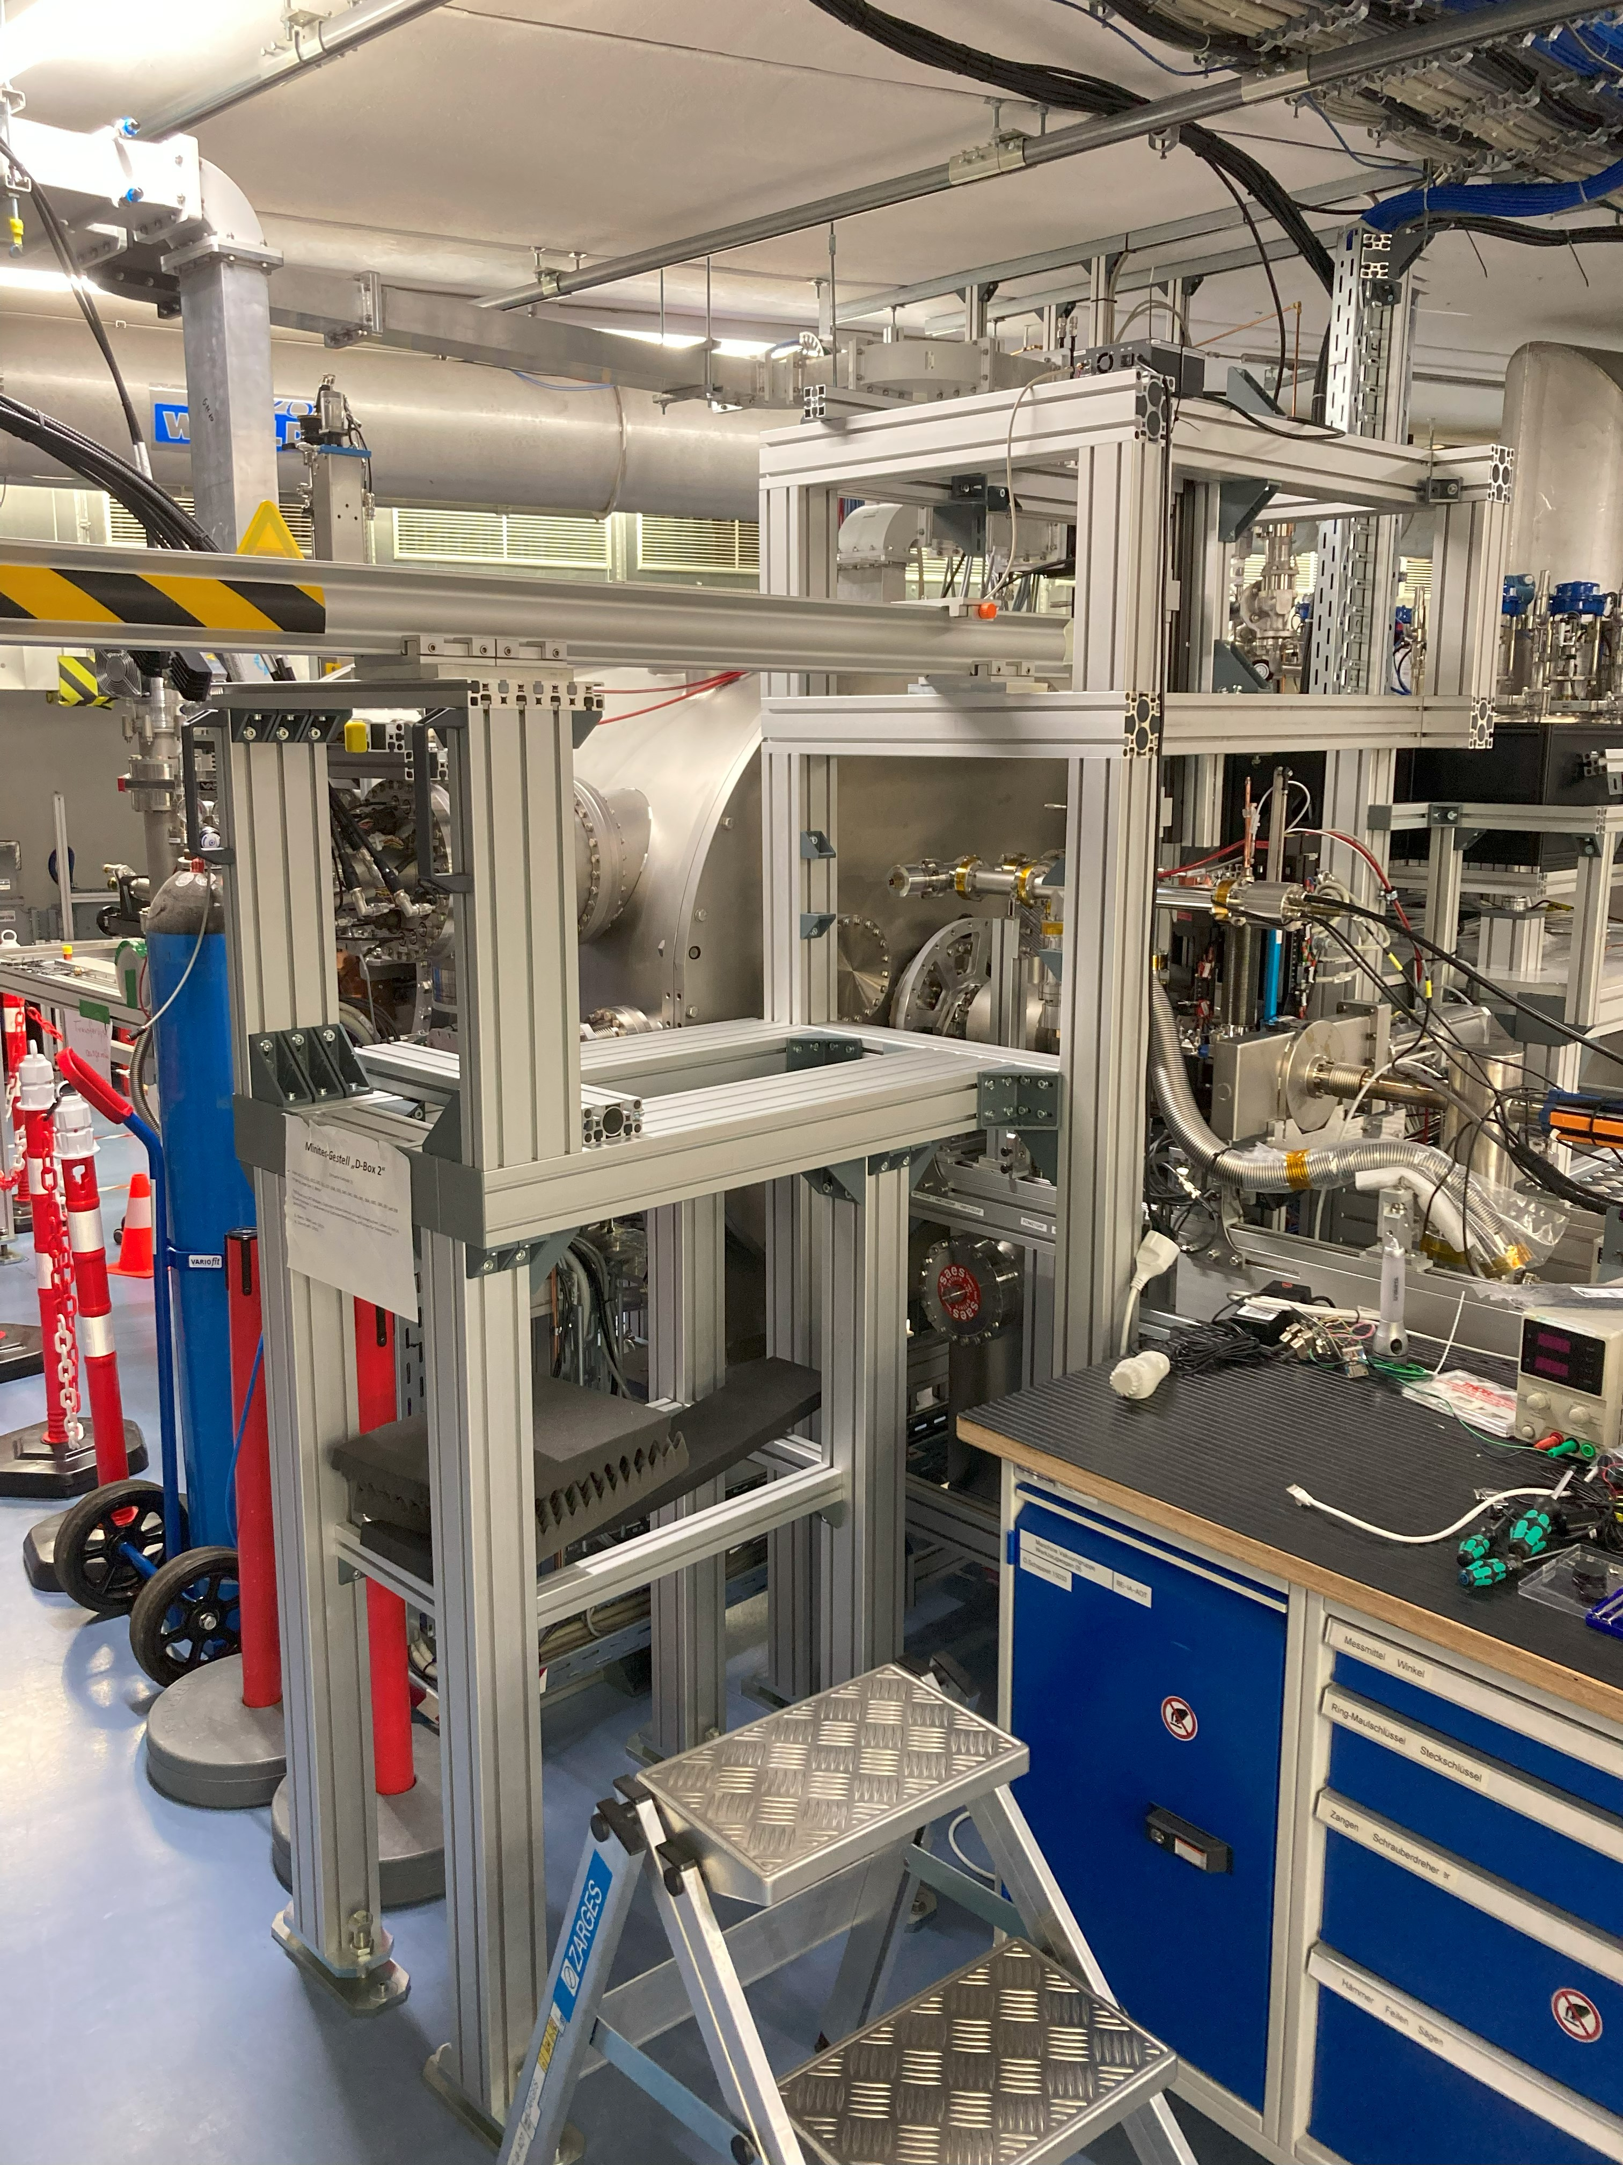
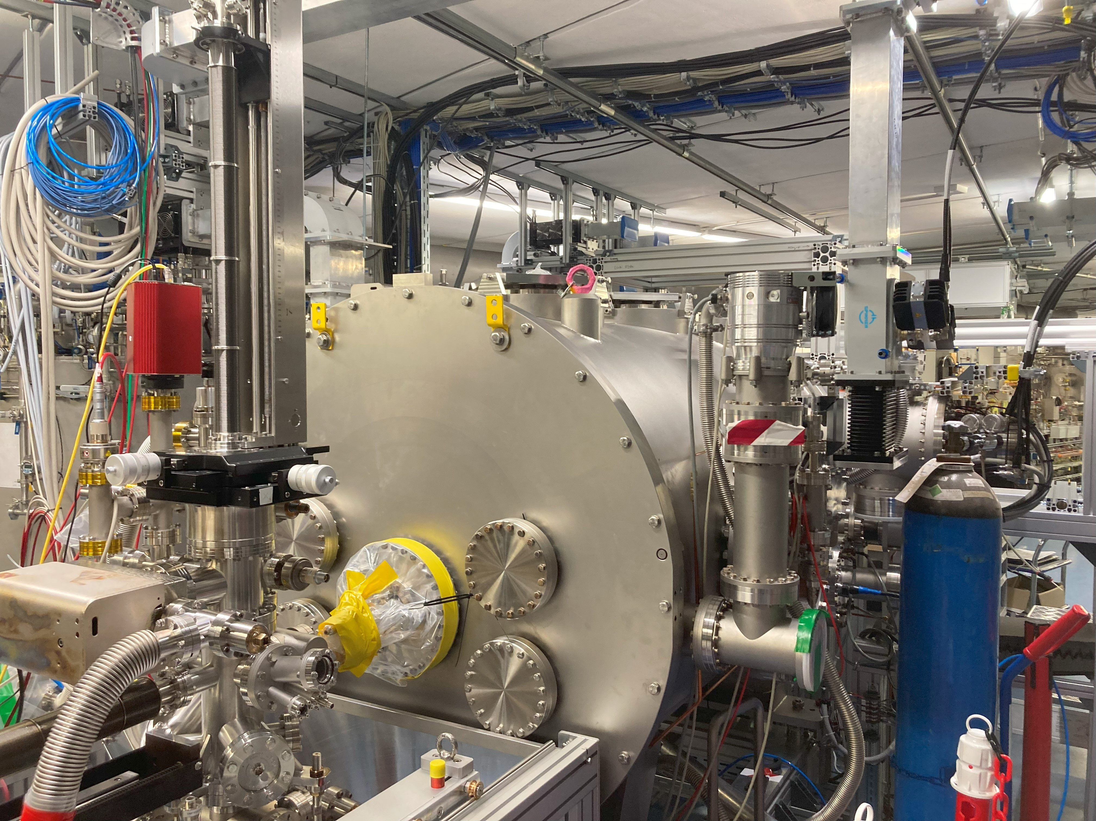
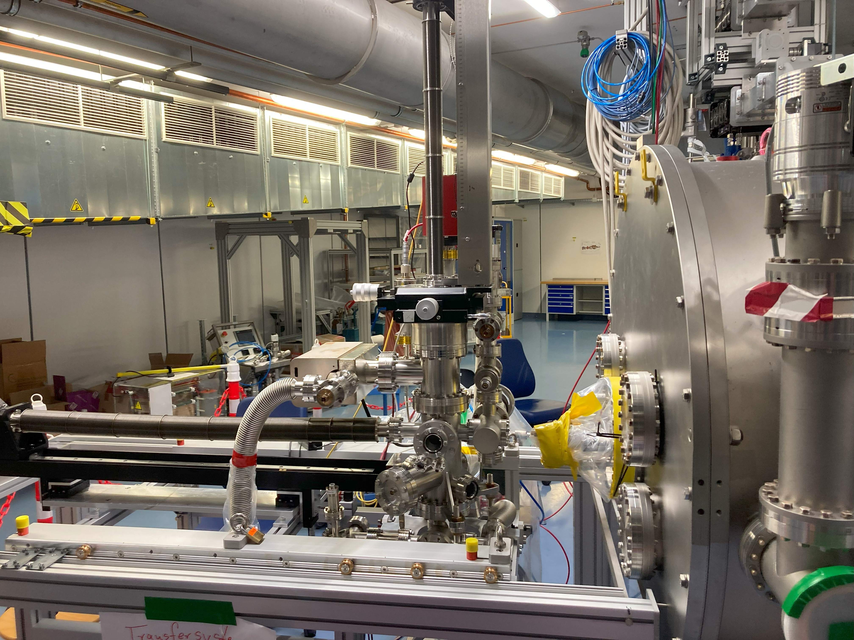
1st RF test at bERLinPro
Current status
Successful RF test, beam energies up to 2.1 MeV
→ there is room for progress
Field emission was present, but continuously being
processed by RF
Laser system, diagnostics, beam transport optics,
beam loss monitoring (several systems) installed
and ready
Cathode transfer system in final bake out
Still RF processing
during ramp

Slide 14
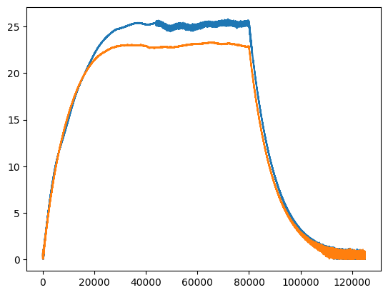
Pulsed processing: Examples
Pulsed processing
RF processing at 1 Hz repetition rate
Pulse length 30 and 100 ms
Processing event at 14:35, 14th of
May: Vacuum in 1st meter 2e-8 mbar
→ Above threshold for closing
gate valve in module, no alarm handler
→ Processing continued not
noticing this event
→ Explains also absence of any dark
current measurement by Faraday Cup
After event higher level pulsing showed
this ripple effect, stopped and took
last CW curve
Reached: CW 20 MV/m, 25 MV/m pulsed
E₀ (MV/m)
100 ms
Time (a.u.)
Beam energies between 1.7 to 2.1 MeV in reach

Slide 15
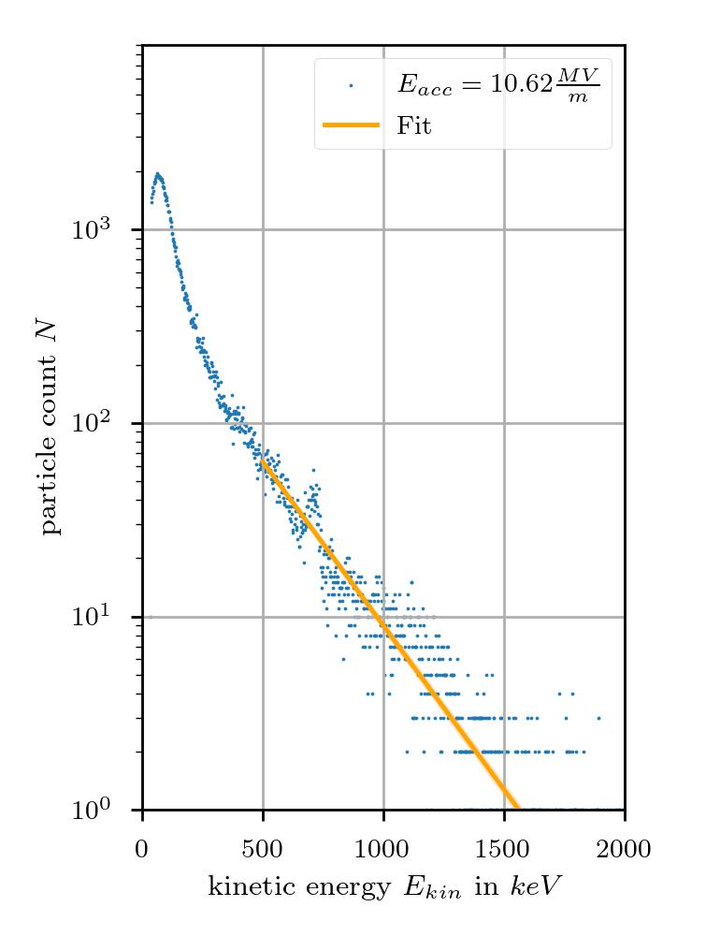
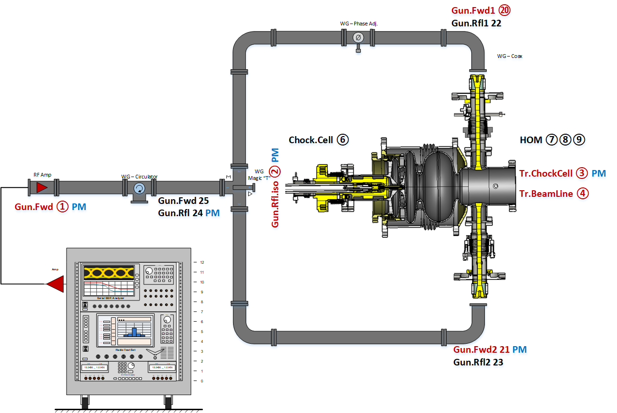
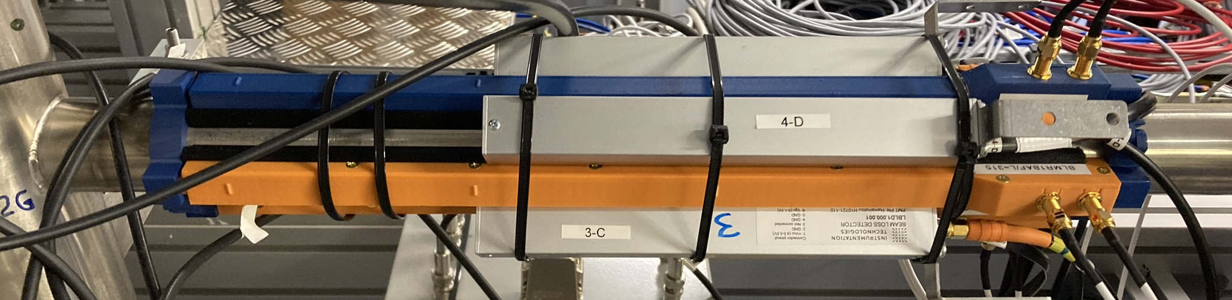
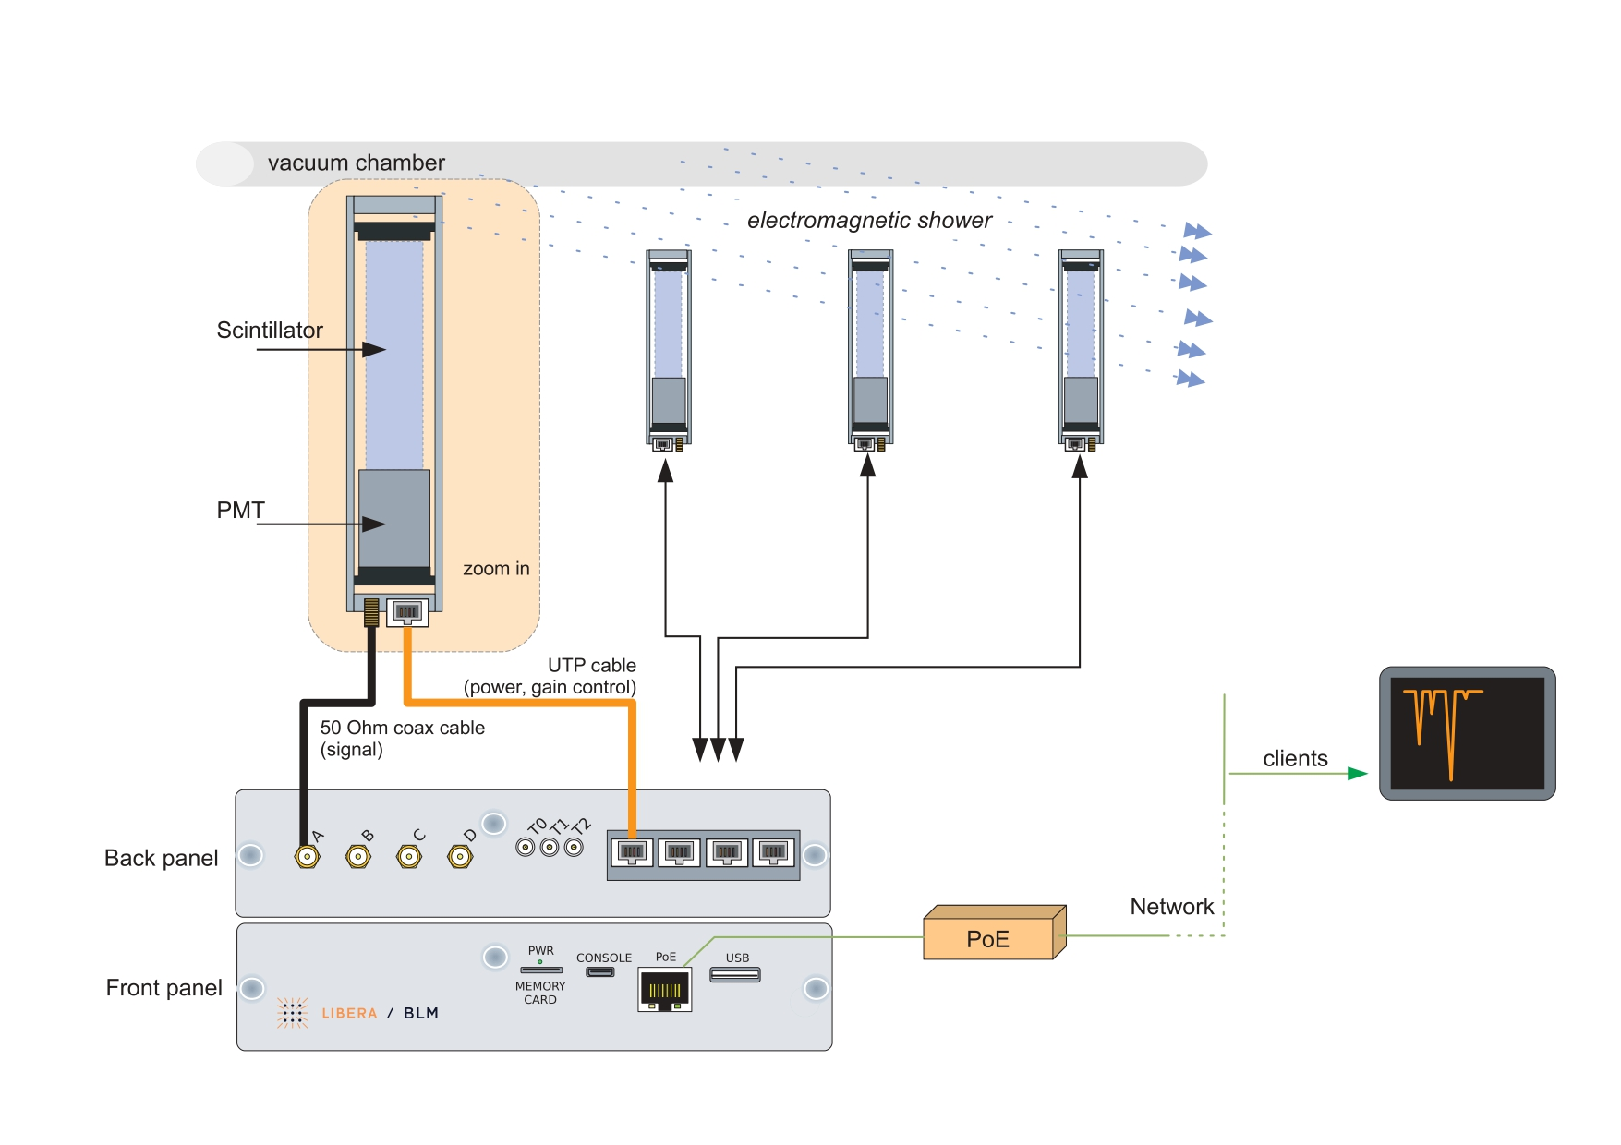
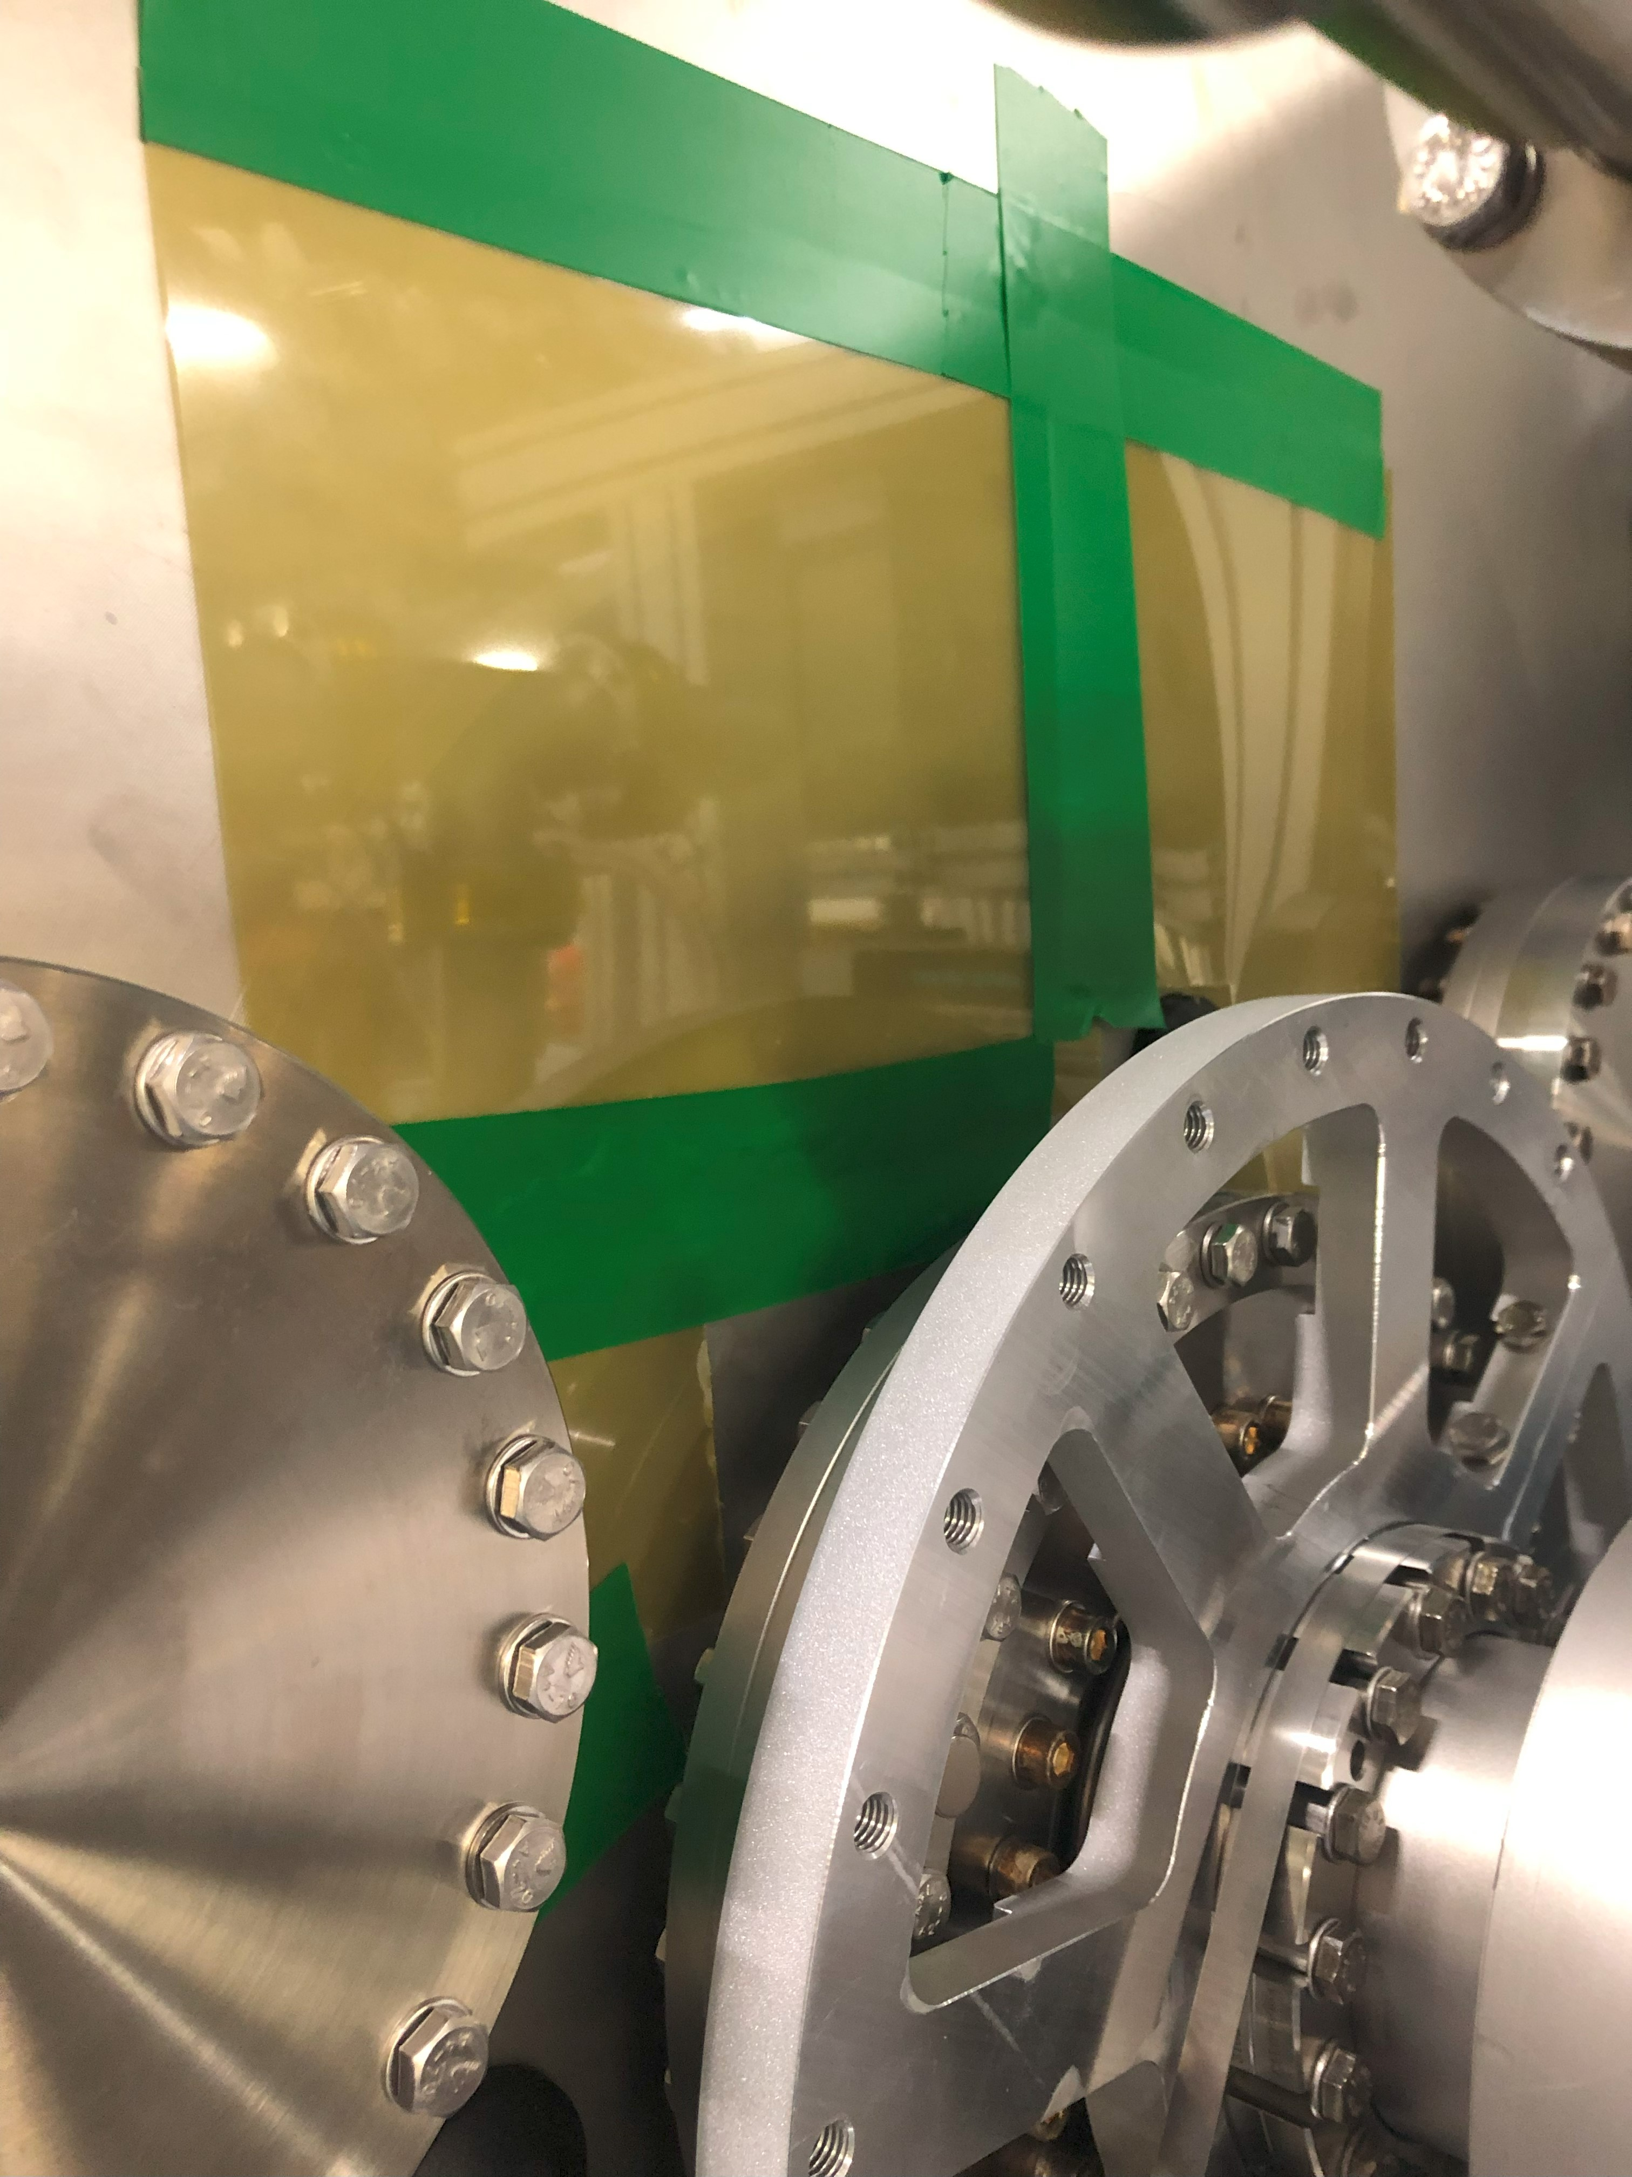
First Commissioning steps
commissioning
2nd RF test w/o cathode:
  Demonstrate achievable field level with final installations of
  all beam vacuum systems
  Measure dark current: Level, on-set field, energy range, determine source
  → Test beam loss monitoring system (PIN diodes, PMT based systems, Radiation
  sensitive films, Faraday Cup, foil monitor)
  Determine field stability: Setup LLRF control system, twin coupler operation
  → Measure SRF cavity parameter for control: LF detuning, microphonics…
Courtesy
Eric May, HZB
Twin coupling scheme,
Pic courtesy A. Ushakov, HZB
https://www.i-tech.si/products/libera-blm/
Gafchromic RTQA2
on Gun cryostat

Slide 16
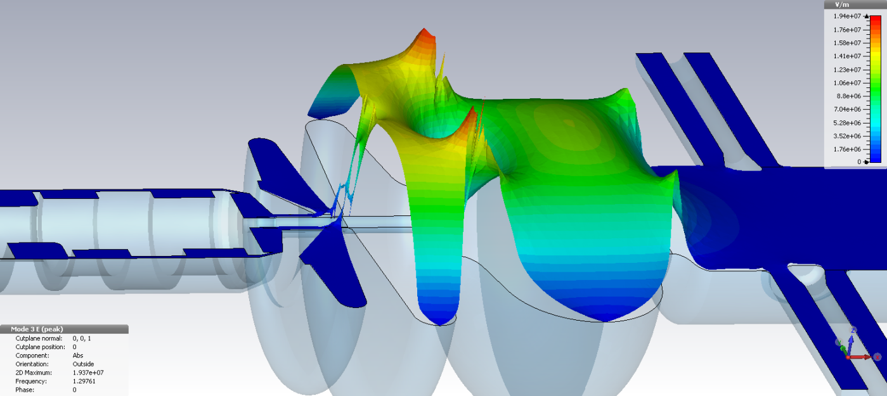
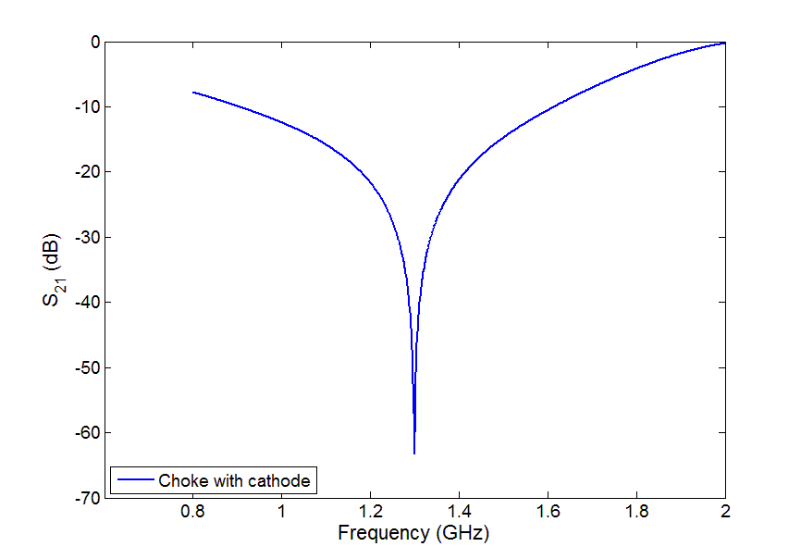

First Commissioning steps
commissioning
2nd RF test with cathode:
  Demonstrate achievable field level with uncoated cathode → Measure position of cathode
  w.r.t. backwall: Impact on dark current, beam focusing, emission phase → Longitudinal and transverse
  beam dynamics……..training of cathode transfer into SRF gun
  Measure dark current: Level, on-set field, energy range, determine source
  → How to handle co-propagating dark current, how to separate further down-stream?
  Determine impact on cathode inserted on RF heating of cathode → adjust position
  Multipacting observed? DC bias as countermeasure → Impacts low field beam dynamics
  Measure eventually microphonics by cathode insert
$$E_{emitt}=E_{cath}∙\sin\left(φ_{emitt}\right)$$
E_{emitt}: Beam emittance
E_{max}: Beam energy
E_{cath}: Beam emittance and level
of dark current, eventually
multipacting
→ High current ERL issue:
Balance Beam quality vs. dark current
beam losses all within power limit
by high power operation
E_{max}
E_{cath}
E_{peak}
„E_{choke}“

Slide 17
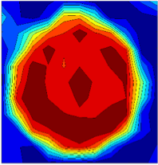
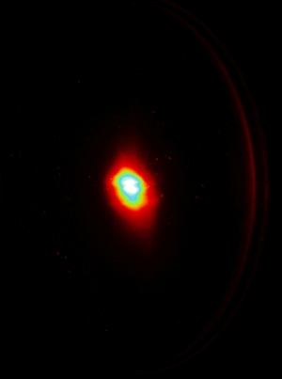
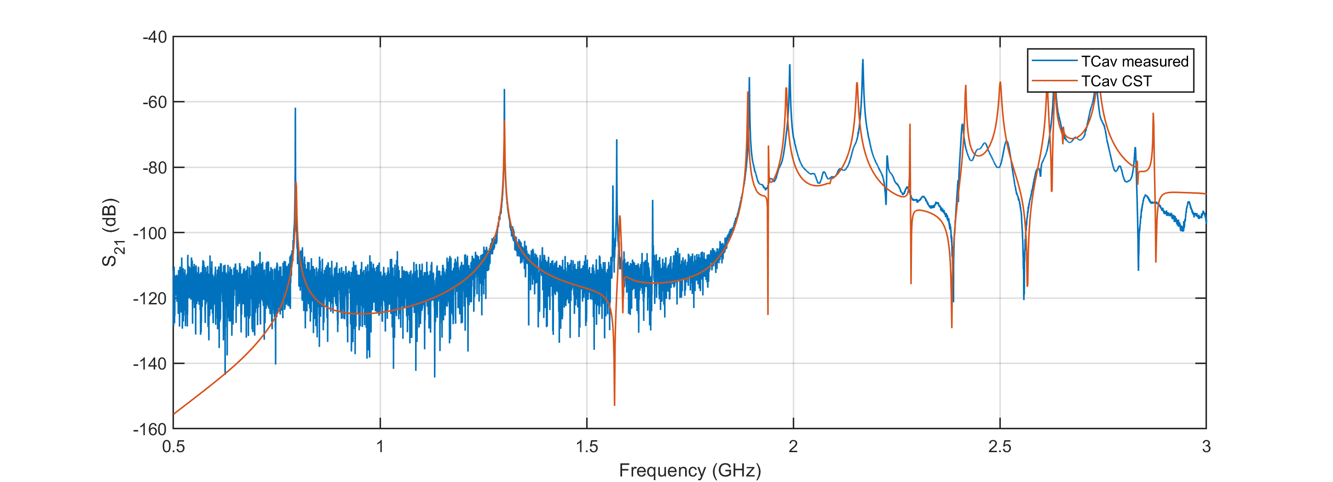
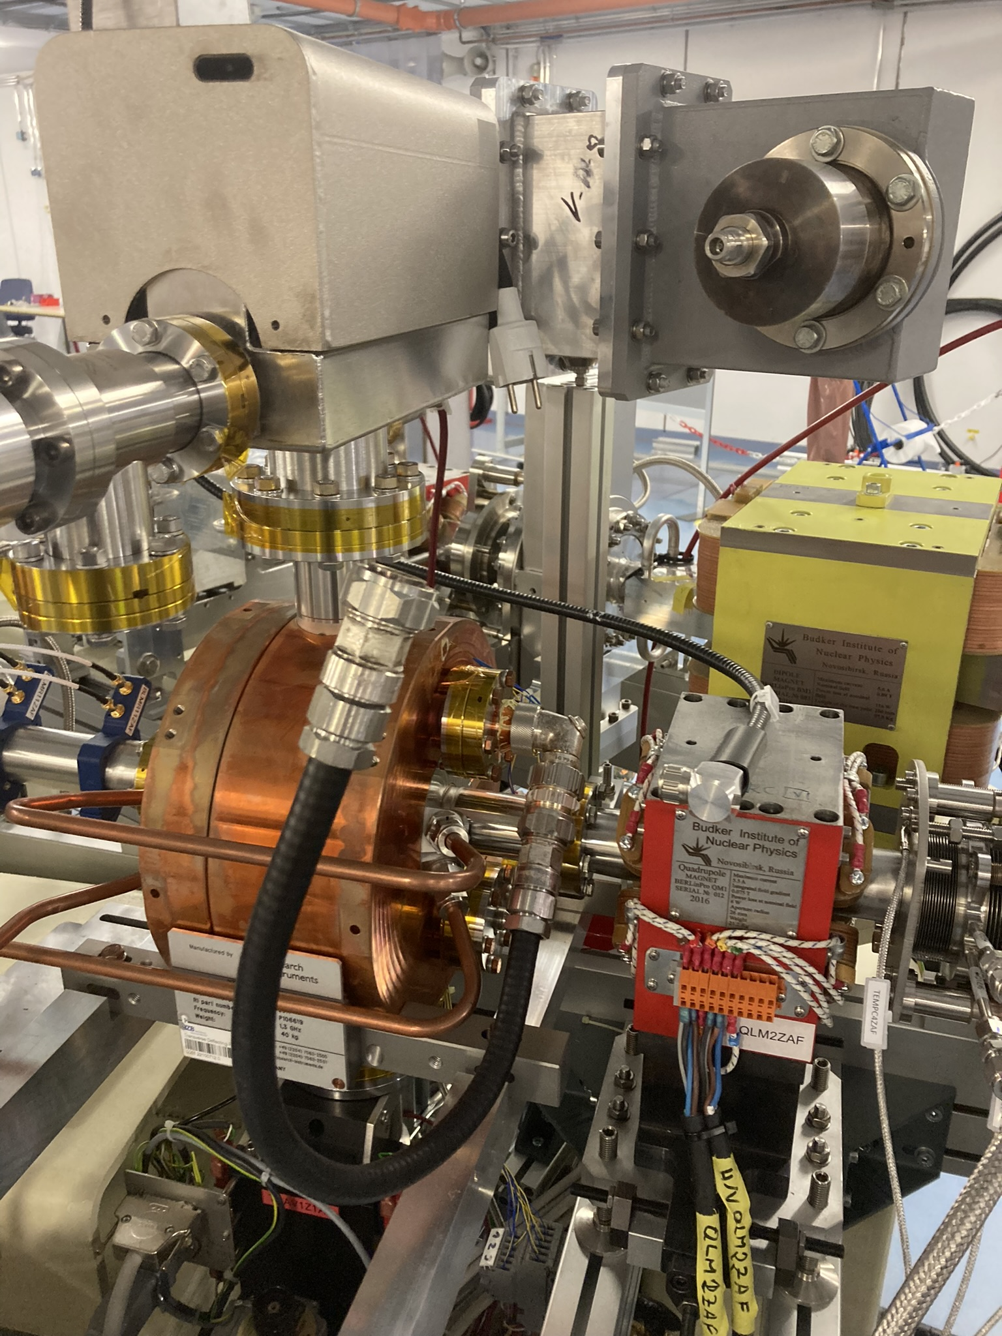
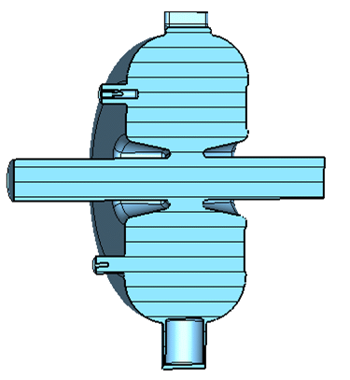
First Commissioning steps
commissioning
Cathode operation:
  Characterisation of cathode: Measure first beam, cathode quantum efficiency, QE maps
  → Cathode lifetime QE(t)
  Measure dark current: Level, on-set field, energy range, determine source
  → How to handle co-propagating dark current, how to separate further down-stream?
  Measure multi-parameter beam phase space:
    Beam based alignment of machine (Solenoid, steerer)
    Beam emittance vs. field level, emission phase, cathode position, pulse length, etc…
    Longitudinal beam phase space: Bunch length studies, short beam studies (TCav)
  Impact of field stability on beam parameter: Jitter studies, beam based feedback
J. Kühn et al., IPAC 18
Cu cathode QE map
Tcav: see Linac 18
G. Kourkafas et al.
A. Neumann et al., IPAC 11
First beam from fully SRF gun with lead cathode

Slide 18
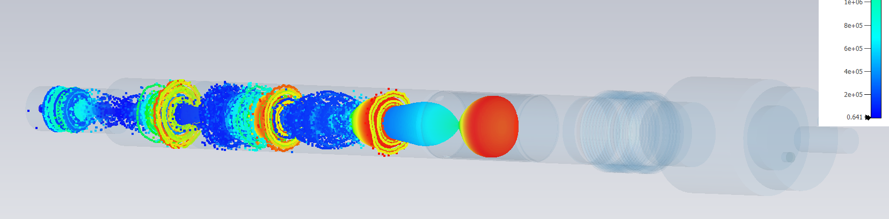
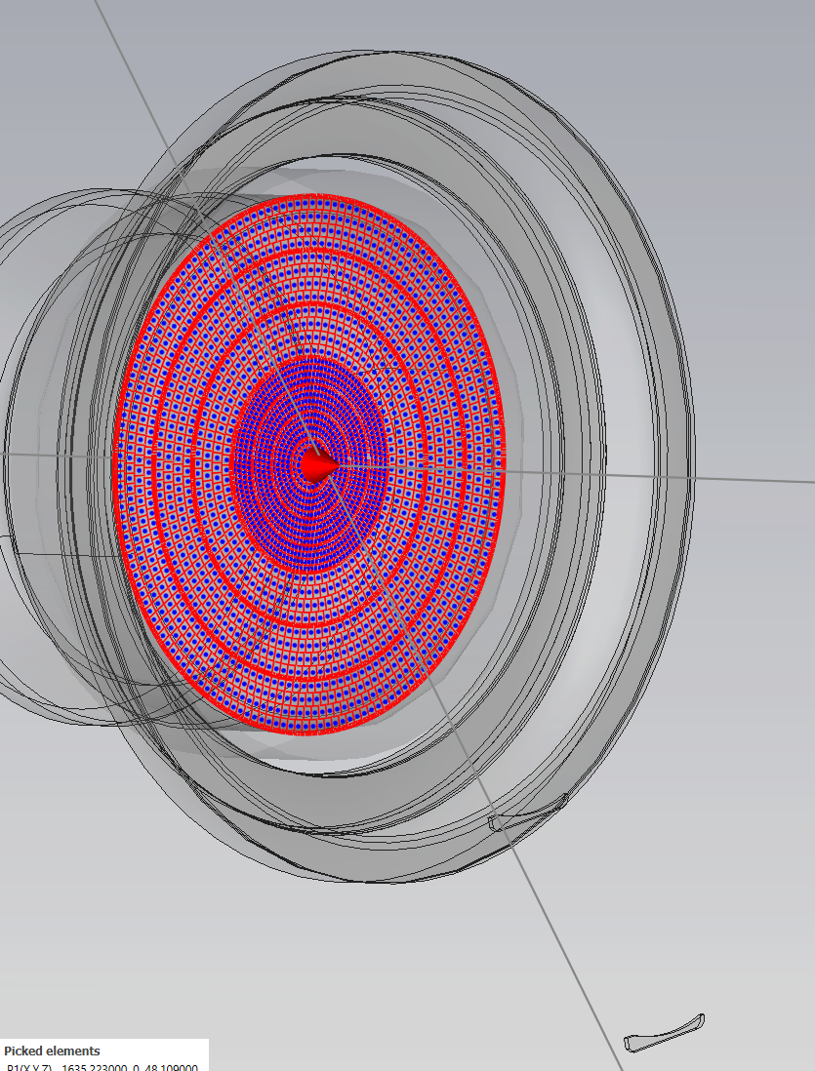
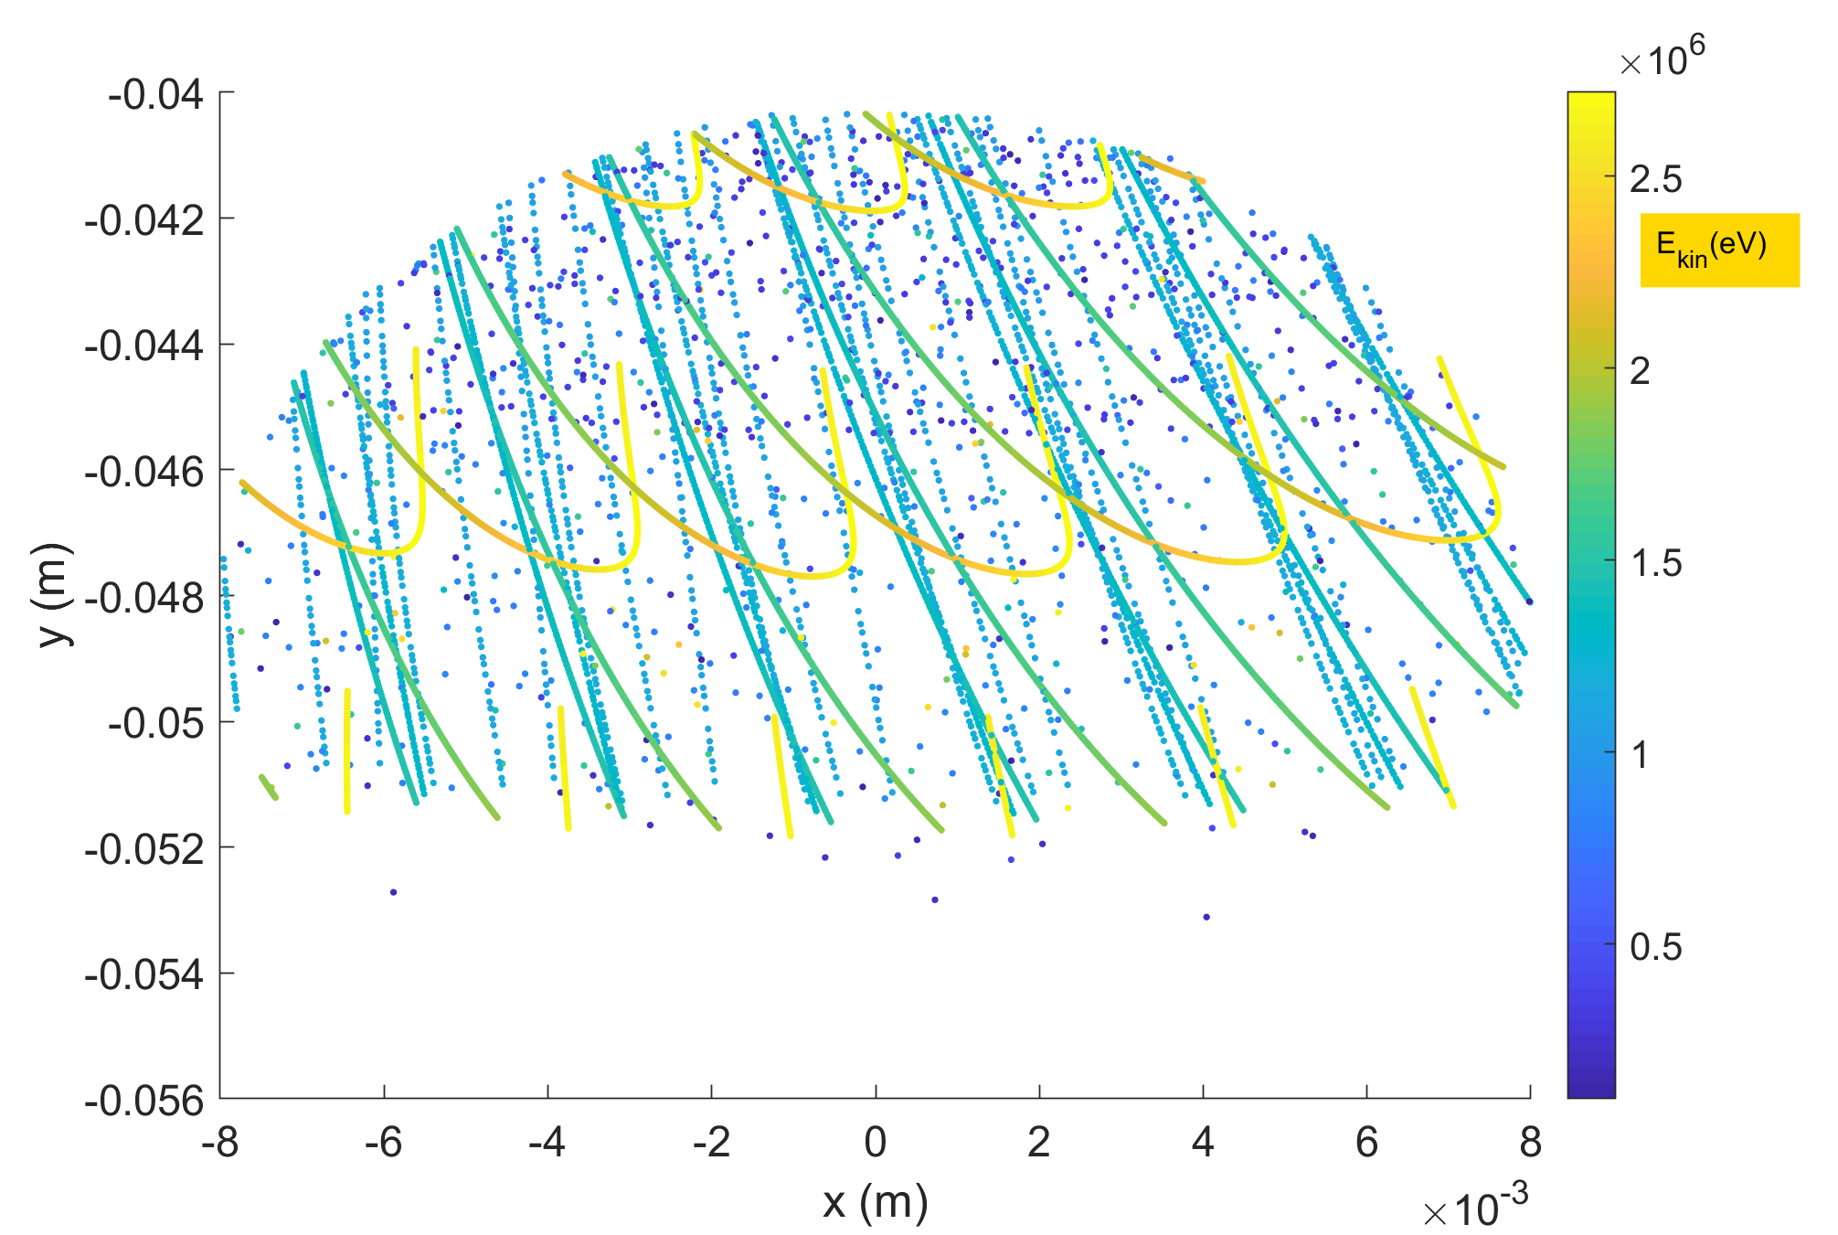
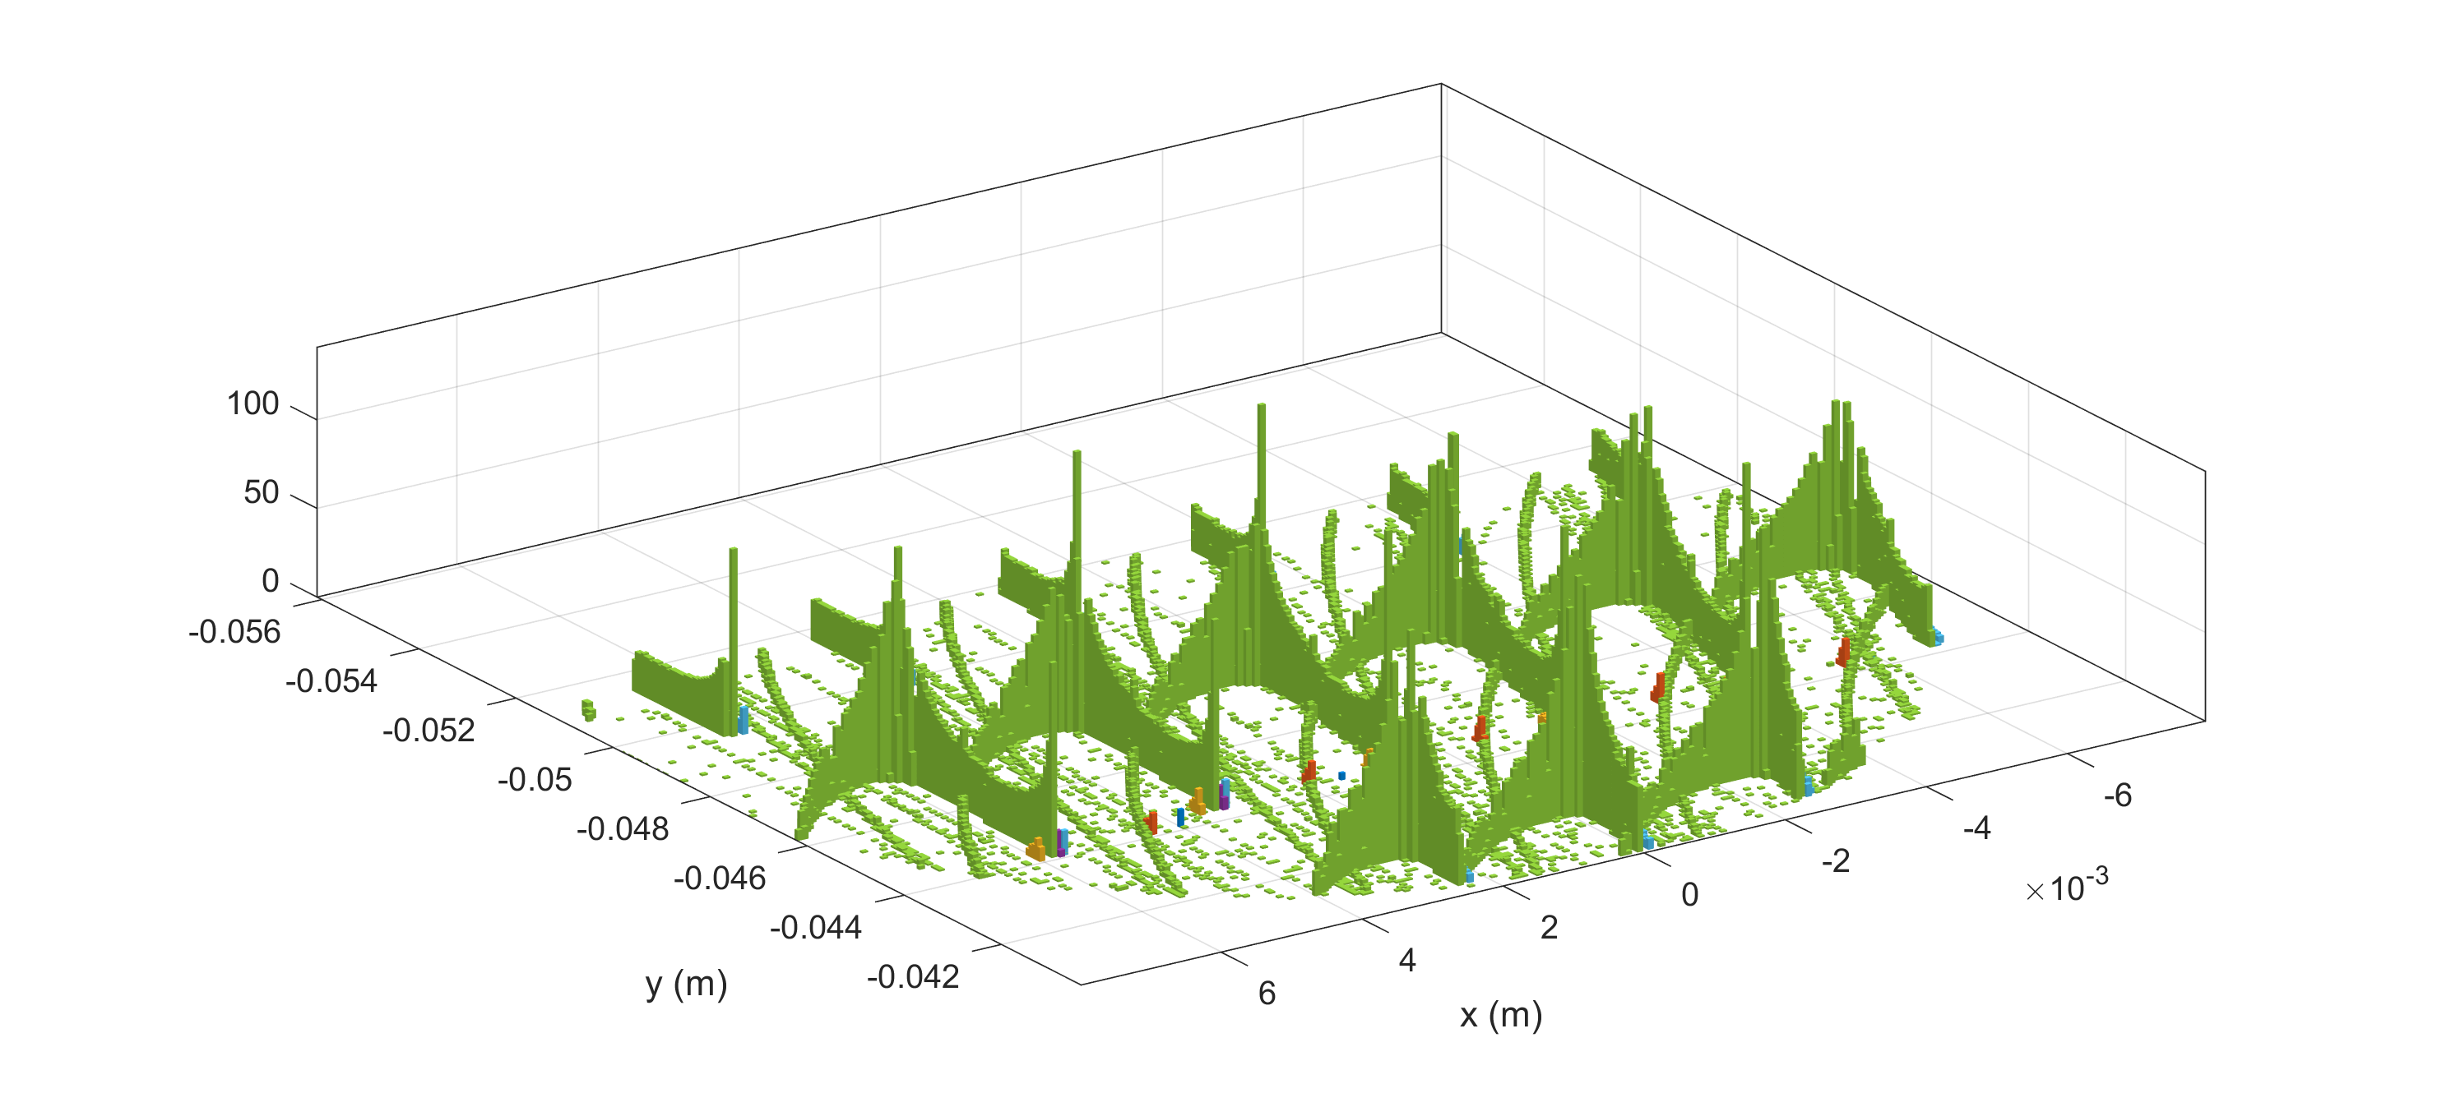
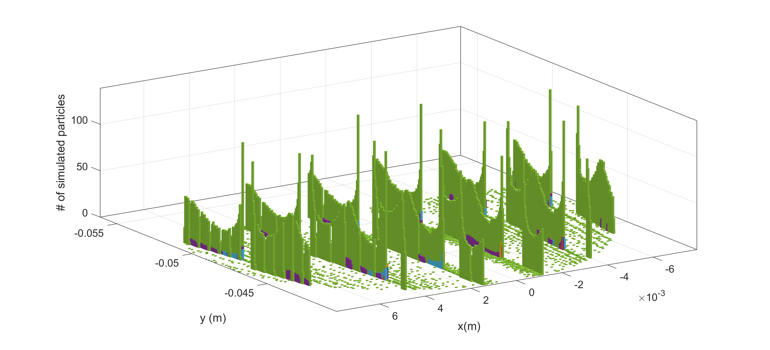
Field emission by cathode on laser windows
Does it harm?
Some parameters: E0=20 MV/m, elevated field in half cell, Solenoid off, 37 mT, 75 mT
Focusing by RF and solenoid field
1st meter
Cavity
Solenoid=75 mT (here)
Segmented emission
Fowler-Nordheim field emission model
Laser window
Solenoid off
Solenoid 37 mT

Slide 19

bERLinPro@SEALAB injector studies
Topics to study
Parameter | Injector / UED | ERL
Beam energy (MeV) | 6.5 – 10 / 2 | 50
Max. average current (mA) | 10 / 0.0025 | 100
Bunch charge (pC) | 0.05 – 400 | 77
RF Frequency (MHz) | 1300 | 1300
Norm. Emittance (mm mrad) | 0.6 / 0.03 | 1 (0.6)
RMS bunch length (ps) | 0.02 – 2 | 2 (0.1)
Medium-power gun (20kW) / booster program
Explore full parameter space of SRF injector @ I_{b} < 10 mA
100 mA can be potentially studied in long-pulse* regime
Bunch charge up to 0.5 nC with a high QE cathode
Proof of cathode exchange concept, test of more robust
cathode materials: Replace Cs by Na
Studies of beam loss scenarios by dark current or
beam halo formation by bunch tails
Propagation of beam and unwanted beam from injector to dump
Beam loss monitoring and machine protection concepts
High dynamic range diagnostic concepts for low-current start-up to high-power operation (< µA $→$ mA $→$100 mA*)
Beam arrival time and jitter studies
Digital twins, ML+AI assisted control methods
Funded: SRF gun/booster ops & UED mode
Not funded: 100-mA CW gun cavity + couplers + LINAC module (existing design)

Slide 20
A coarse 2024 schedule
2024
RF operation permit
January
February
March
April
May
June
Cooldown 2K
RF test 2K
Dry run injector
LLRF ready
High power RF ready
Cryo ready
Module diagnostics
PSI operational
TCav ready
Readiness cathode transfer
system, cathode laser
Beamline magnets, steerer magnets
Diagnostics: FOMs, Faraday Cups
Camera tools, beam loss monitoring
Control system fully implemented for
needed devices, MPS functional
Setup Laser
Setup transfer system
Check for beam condition:
FOMS, magnets,…
Final fixes,
tests and repairs
July
August
September
October
November
December
Beam operation permit
Beam operation injector

Slide 21
















Merci!
If there is time left, questions are welcome or contact me at
Axel.Neumann at helmholtz-berlin.de
Thanks and acknowledgements to all partners, who contributed to this project
Funding: Bundesministerium für Bildung & Forschung
Bundesland Berlin, Helmholtz Gemeinschaft

