Slide 1









Photogun and photocathode preparation
for the PERLE project
M. Baylac (LPSC), on behalf of the collaboration

Slide 2
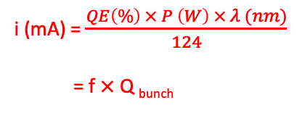

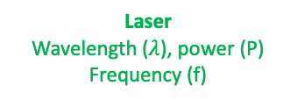
Principle of DC photogun
Electrons produced by photoemission
  photocathode optically pumped by wavelength-adapted laser light and held at a constant HV
Ultra high vacuum environment (10⁻¹¹ mbar, or better)
Cathode at high voltage (DC)
Anode (ground or low bias)
Q _{bunch}
Electron current (average) :
e-
i (mA) = $\frac{QE\left(\%\right) × P \left(W\right) × λ (nm)}{124}$
= f $×$ Q _{bunch}
Photocathode
P
laser
f
Quantum efficiency (QE)
nb of e- emitted per incident photon
depends on material, wavelength ($λ$)
decreases with surface degradation
Laser
Wavelength ($λ$), power (P)
Frequency (f)
M. Baylac, B. Militsyn, LHeC/FCCeh/PERLE workshop, Orsay, October 26-28, 2022

Slide 3
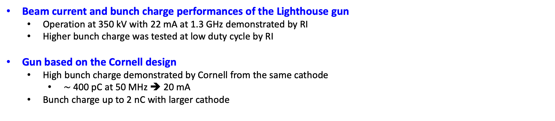
Photogun for PERLE
Project initiated with the gun from ALICE (STFC)
Since 2023, collaboration agreement between IN2P3 and Research Instruments (RI) for photoinjector R&D
    Hardware of Lighthouse project (terminated) transfered to IJCLab for PERLE
      photogun, HV system and photocathode preparation facility
    Commissionned and validated at high repetition rate, lower bunch charge at RI
Beam current and bunch charge performances of the Lighthouse gun
  Operation at 350 kV with 22 mA at 1.3 GHz demonstrated by RI
  Higher bunch charge was tested at low duty cycle by RI
  Gun based on the Cornell design
  High bunch charge demonstrated by Cornell from the same cathode
    $\sim$400 pC at 50 MHz ➔ 20 mA
  Bunch charge up to 2 nC with larger cathode
      Test of a DC-photogun Injector for the Lighthouse facility, G. Blokesch et al, doi: 10.18429/JACoW-IPAC2023-TUPA020
Operational experience with nanocoulomb bunch charges in the Cornell photoinjector, A. Bartnik et al, Phys. Rev. ST Accel. Beams 18, 083401

Slide 4

Specifications
Electron beam requirements for PERLE
  Q _{bunch} = 500 pC
  Repetition rate : 40 MHz
  High DC voltage to extract high bunch charge
    350 kV
  Multi-alkali antimonide photocathode (CsK₂Sb)
    Well suited for high current : typical QE $\sim 1\%$(green light) considering degradation
  Load-lock configuration
    Loading of photocathodes without full gun bake for fast exchange
Laser power
  5 W (on the photocathode) of green light (500-550 nm)
  Excellent vacuum level for good operational lifetime
    $\sim$10⁻¹¹ mbar or better
  Anode bias to limit QE degradation
  I= 20 mA

Slide 5
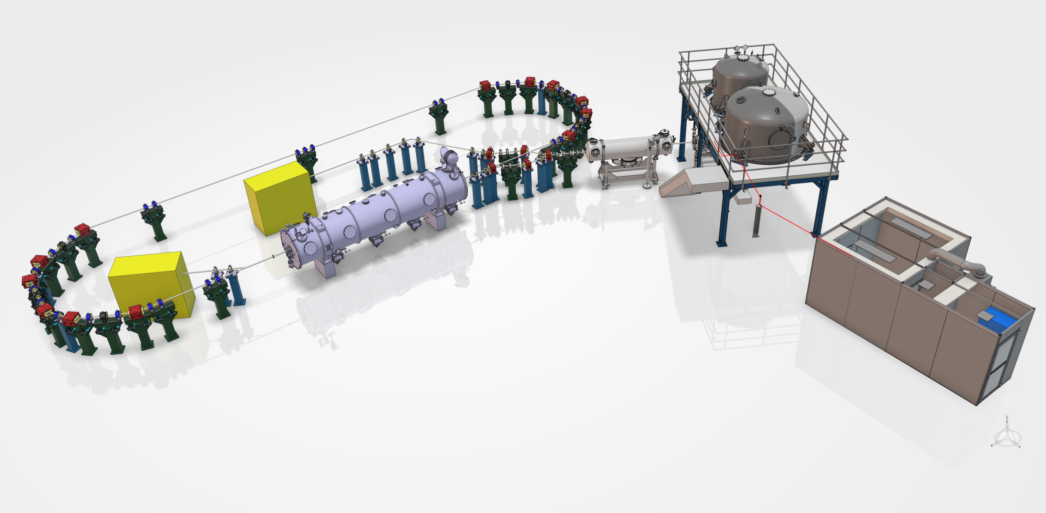
PERLE, 1 loop configuration
HV platform
Booster
∼25 m
Injector
(20 mA, 7 MeV)
dump
Linac
(89 MeV, 802 MHz)
PERLE at 250 MeV
Laser room
PERLE at 89 MeV (1 loop)

Slide 6
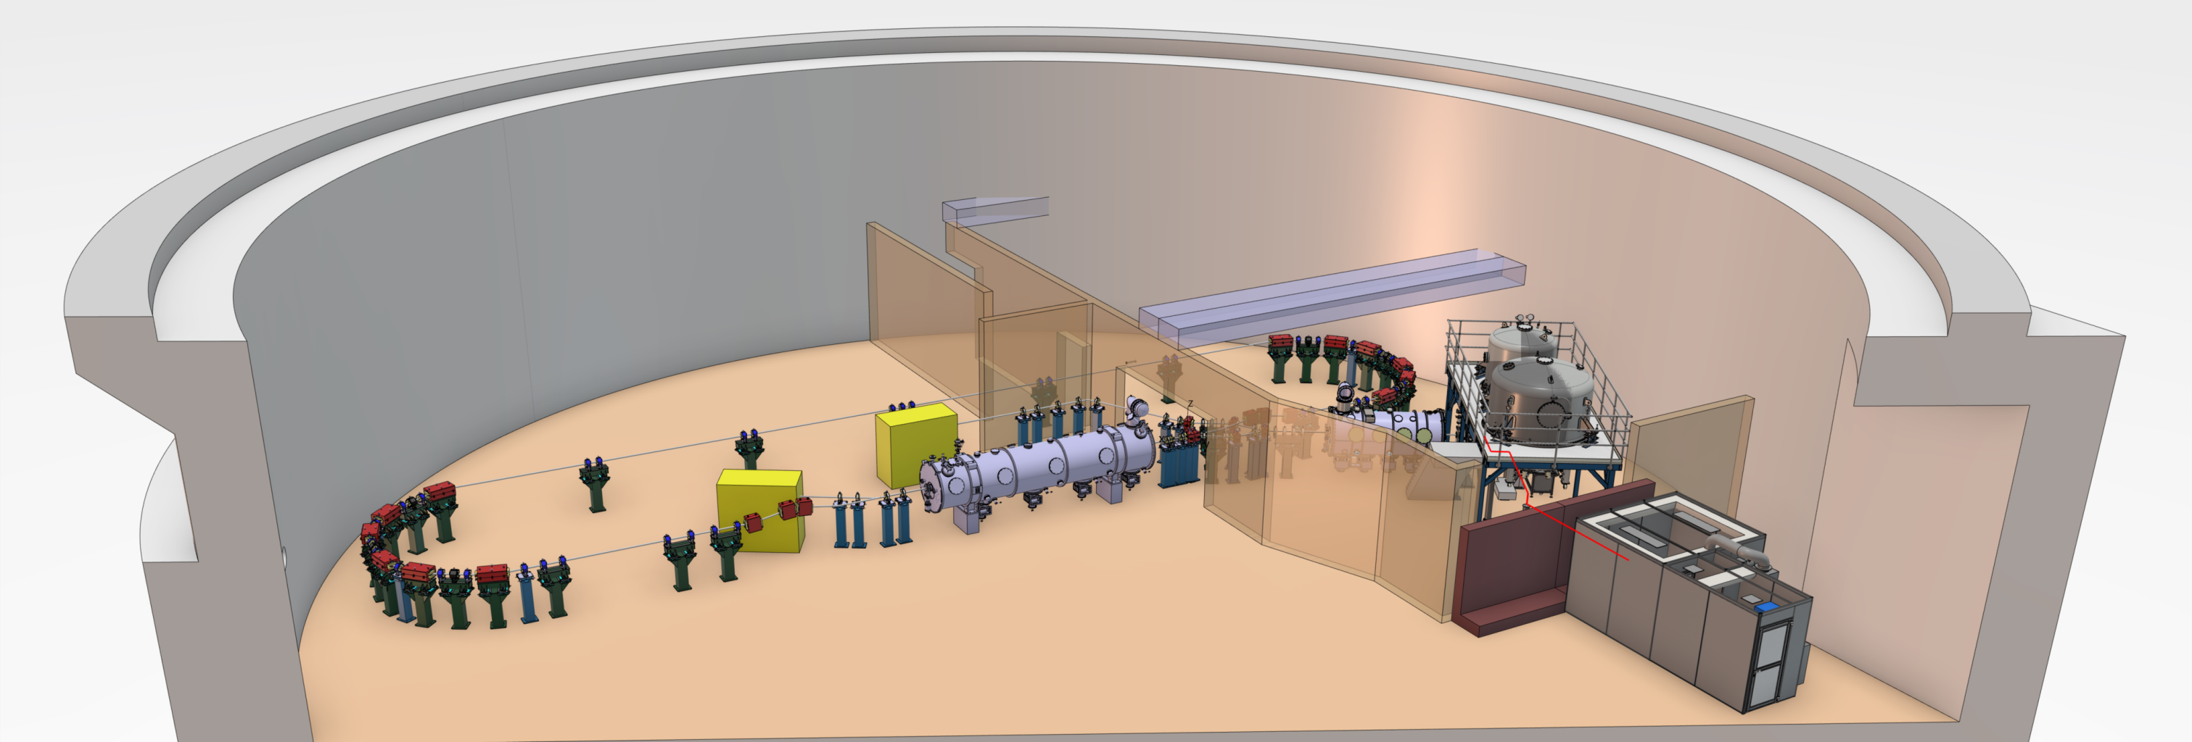
Layout in the igloo bunker
HV platform
Laser room
  1 loop configuration at IJCLab, Orsay

Slide 7
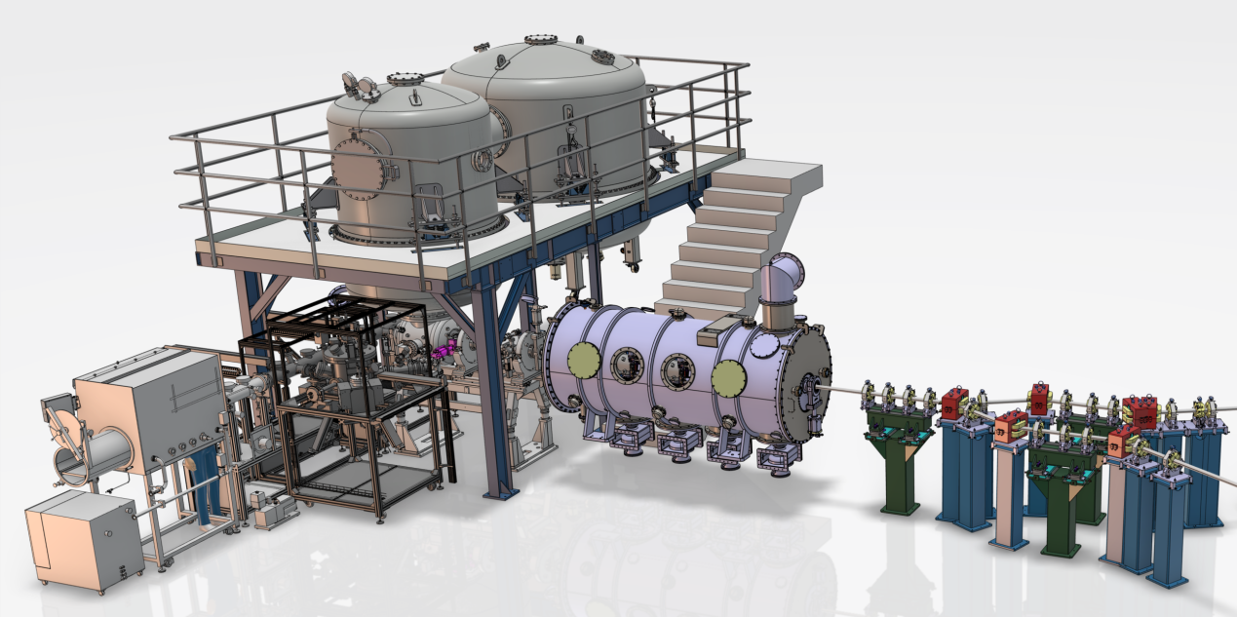
Injector layout
HV system
Photogun
PERLE at 89 MeV (1 turn)
Photocathode Preparation Facility (PPF)

Slide 8
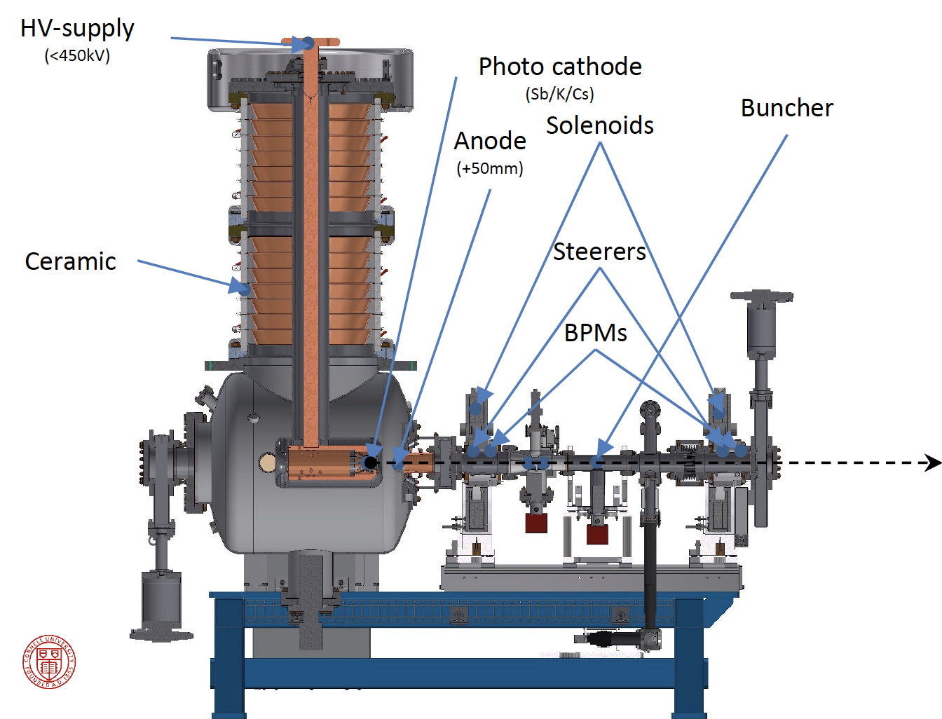
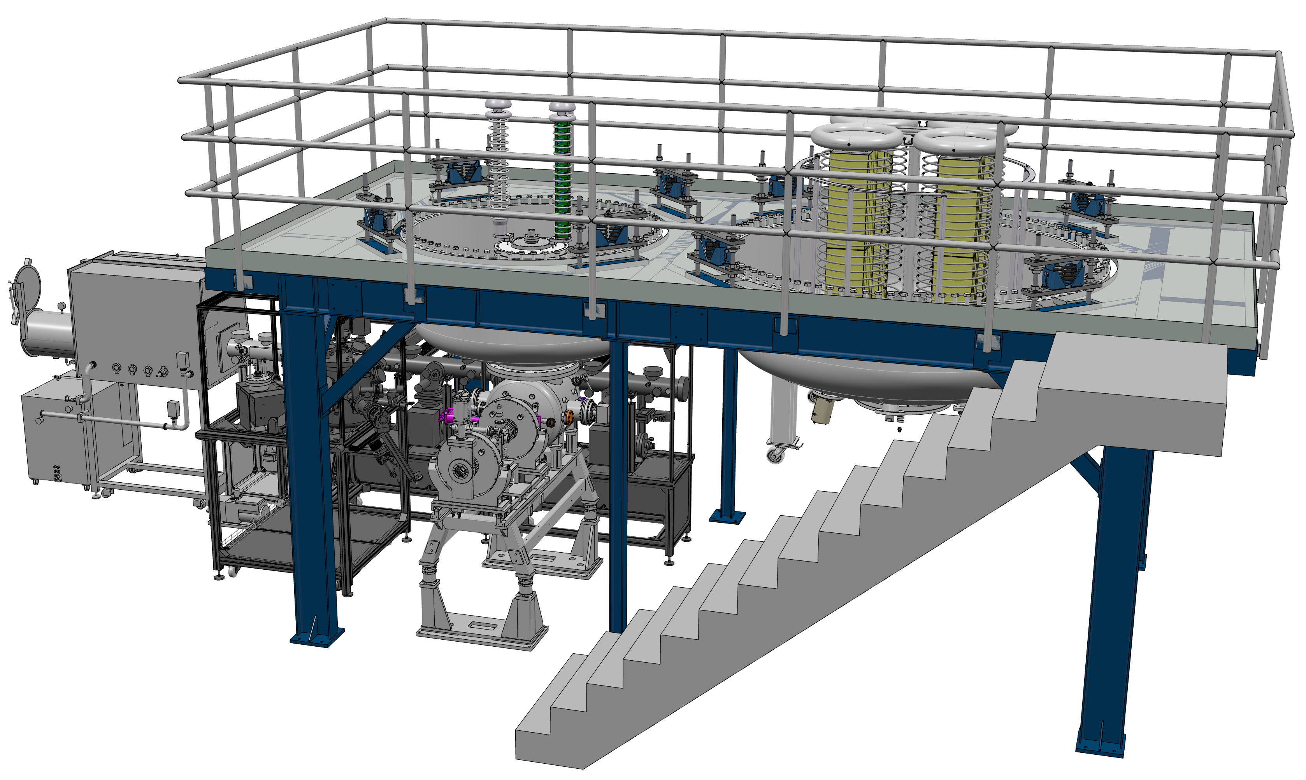

Photogun layout

Slide 9
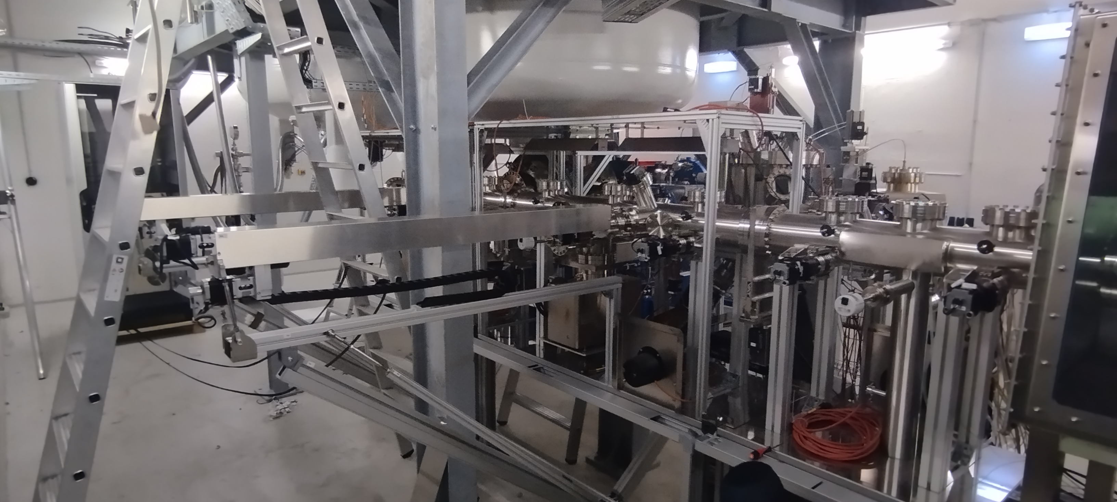
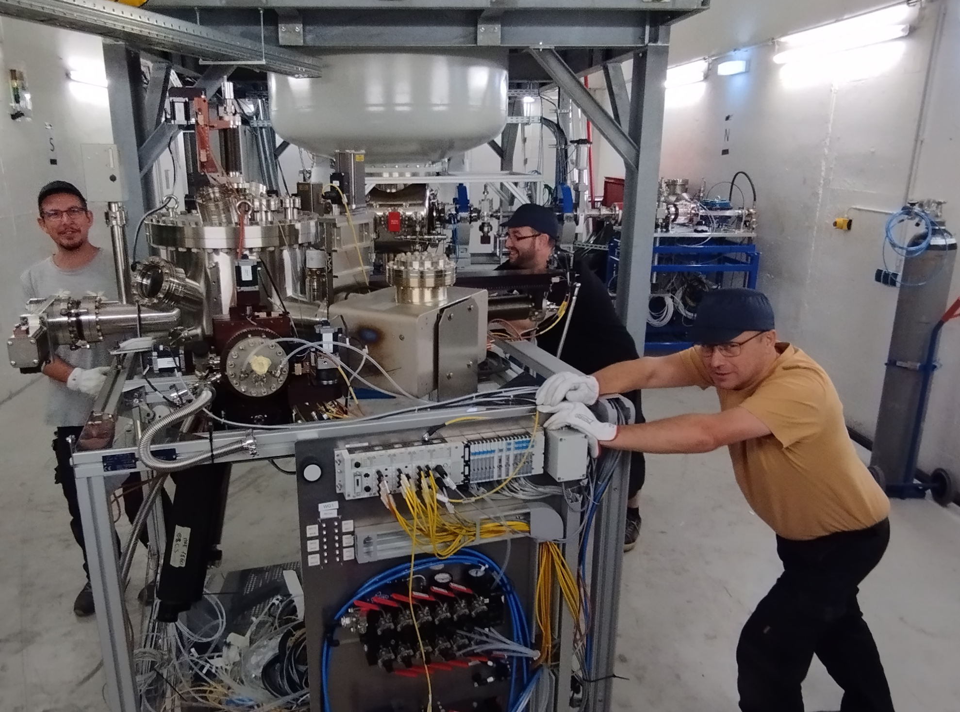
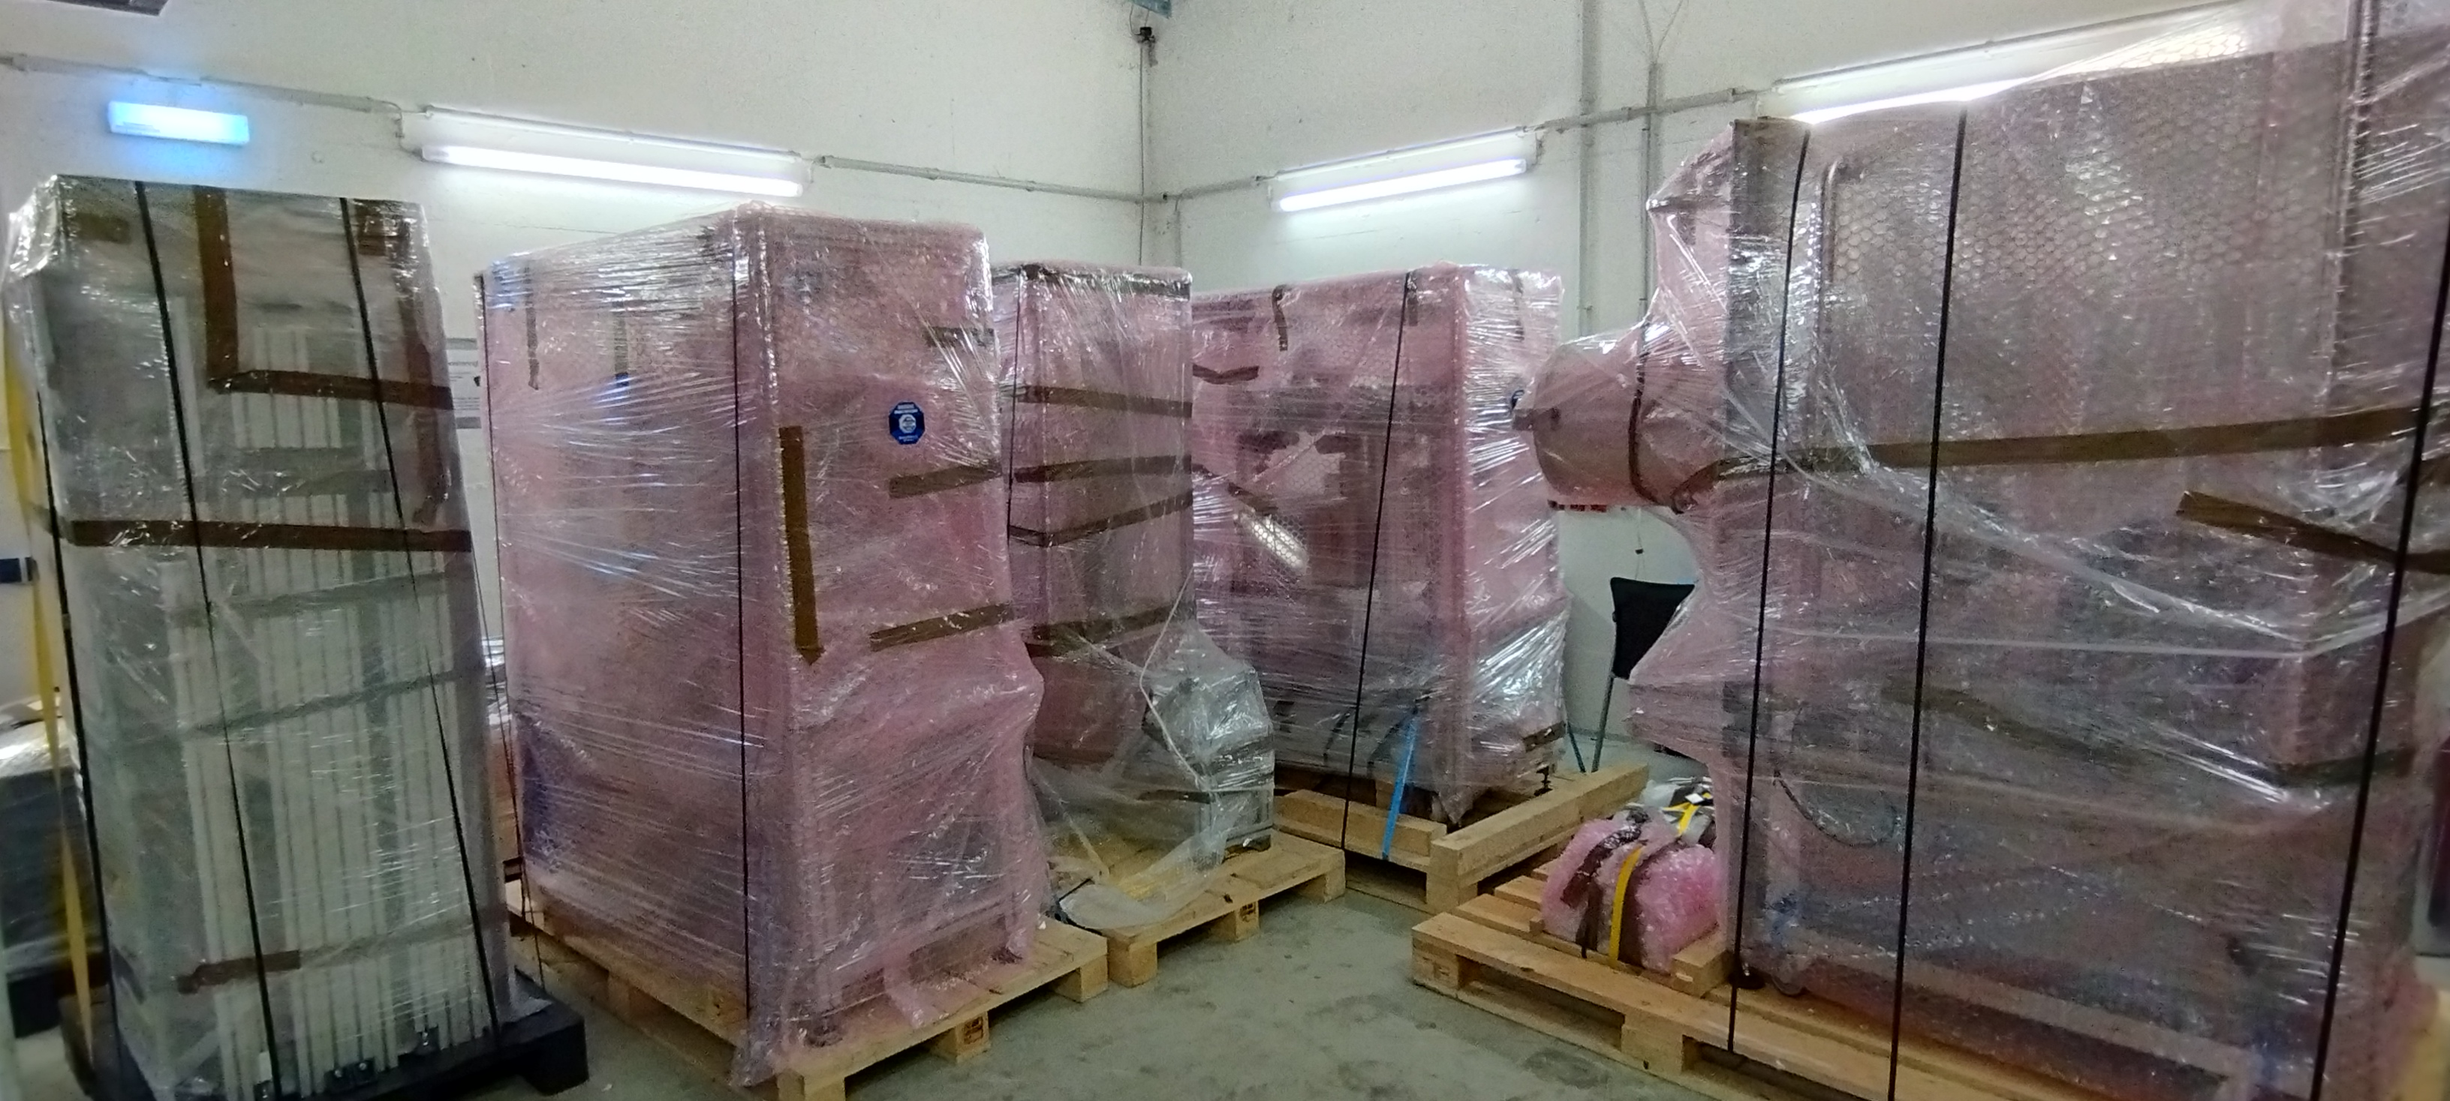
Dismantling of the PPF
September 2023

Slide 10
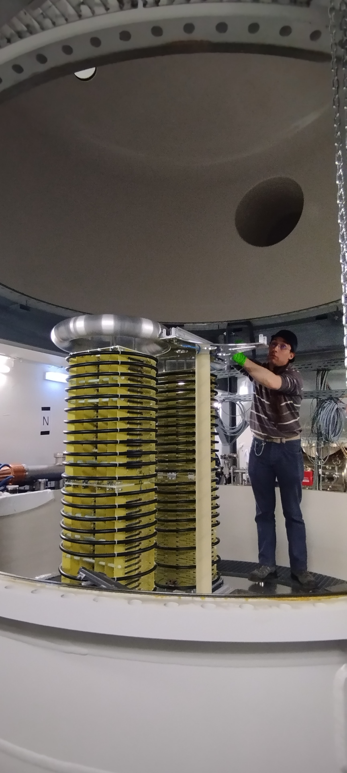
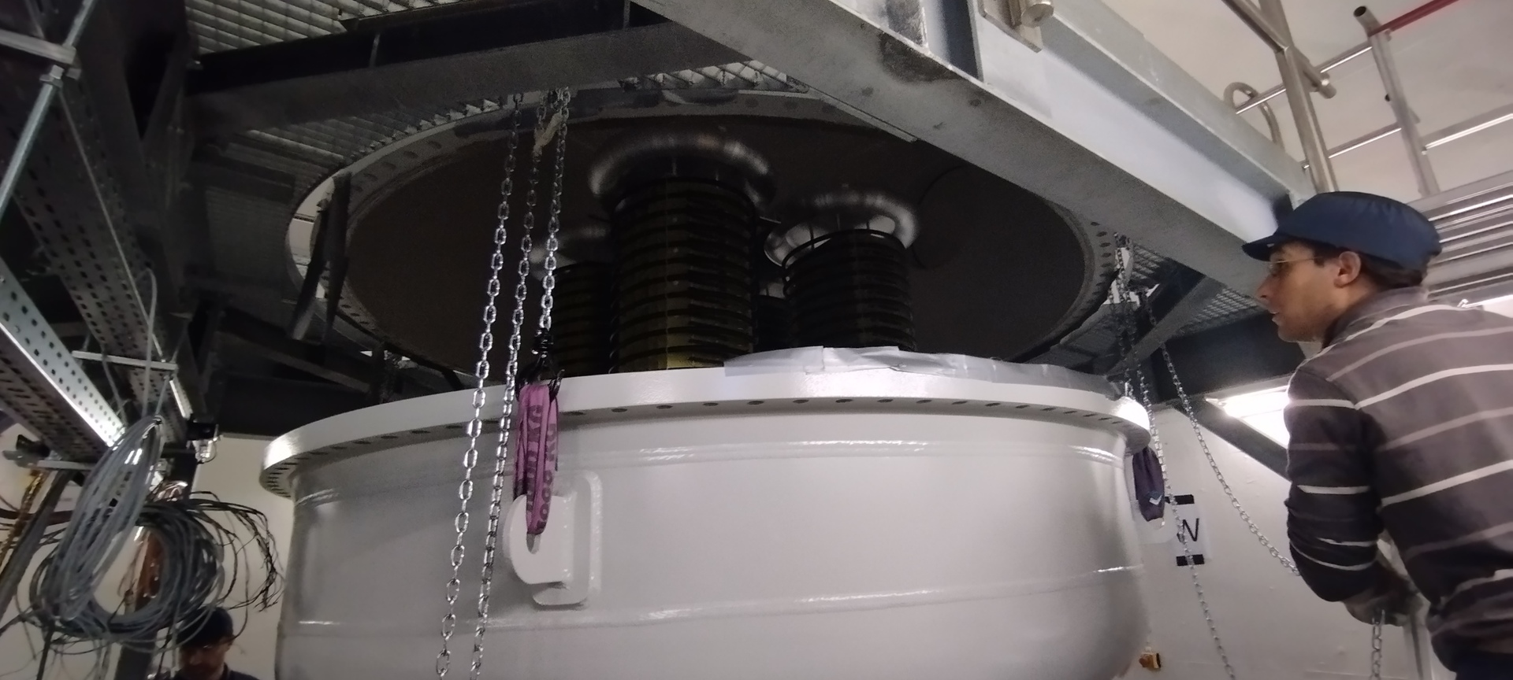
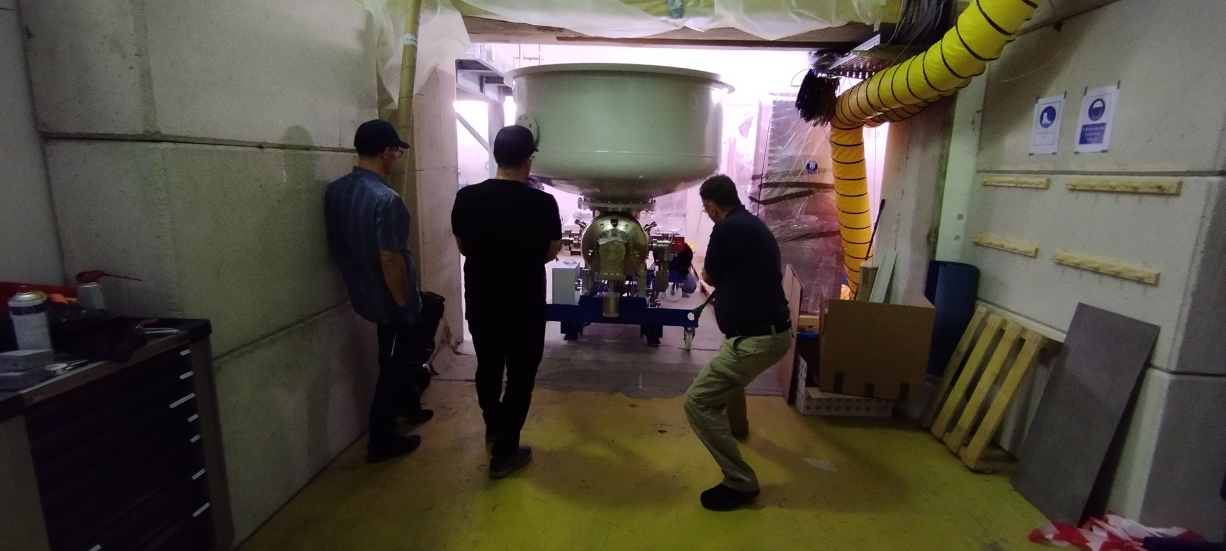
Dismantling HV system
November 2023

Slide 11
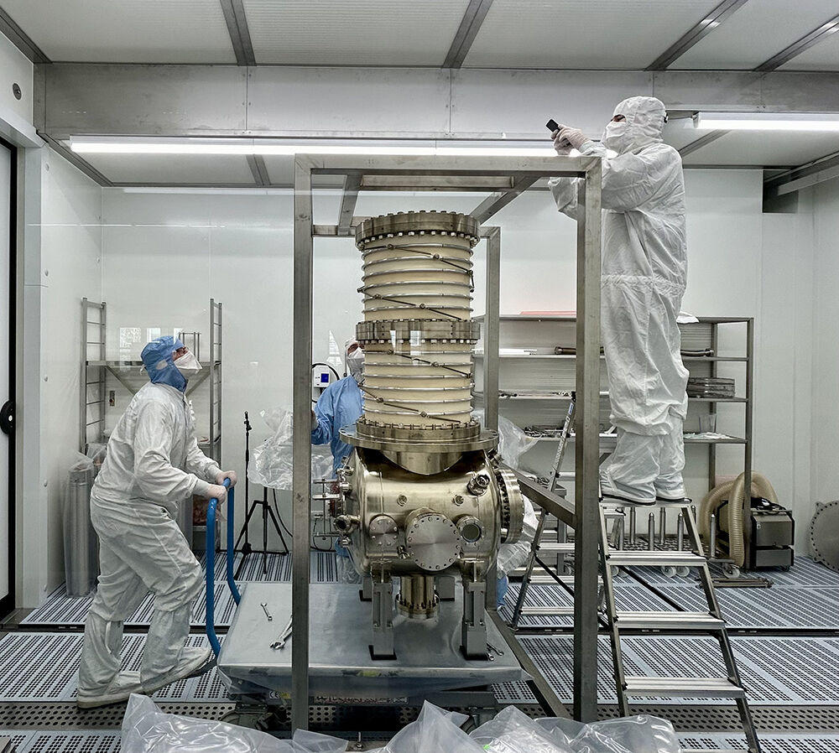
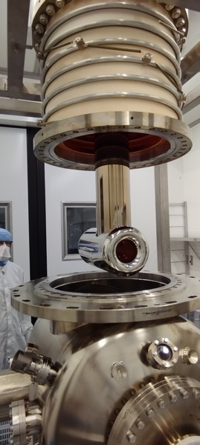
Photogun disassembly in RI clean room
January 24

Slide 12
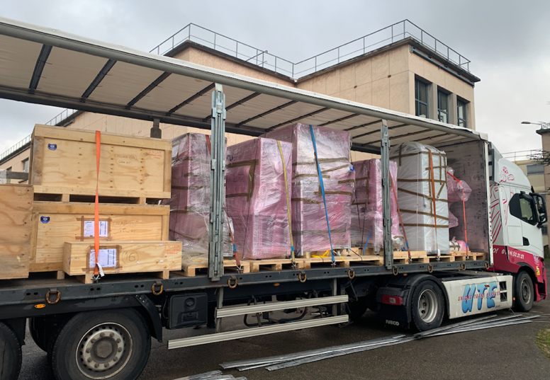
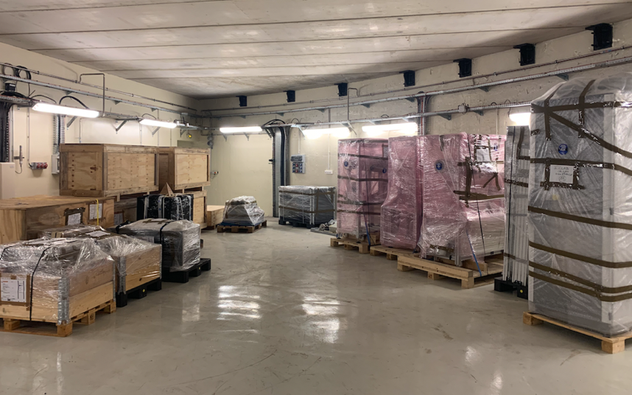
Transfer to IJCLab
All equipment received by end of January 24

Slide 13
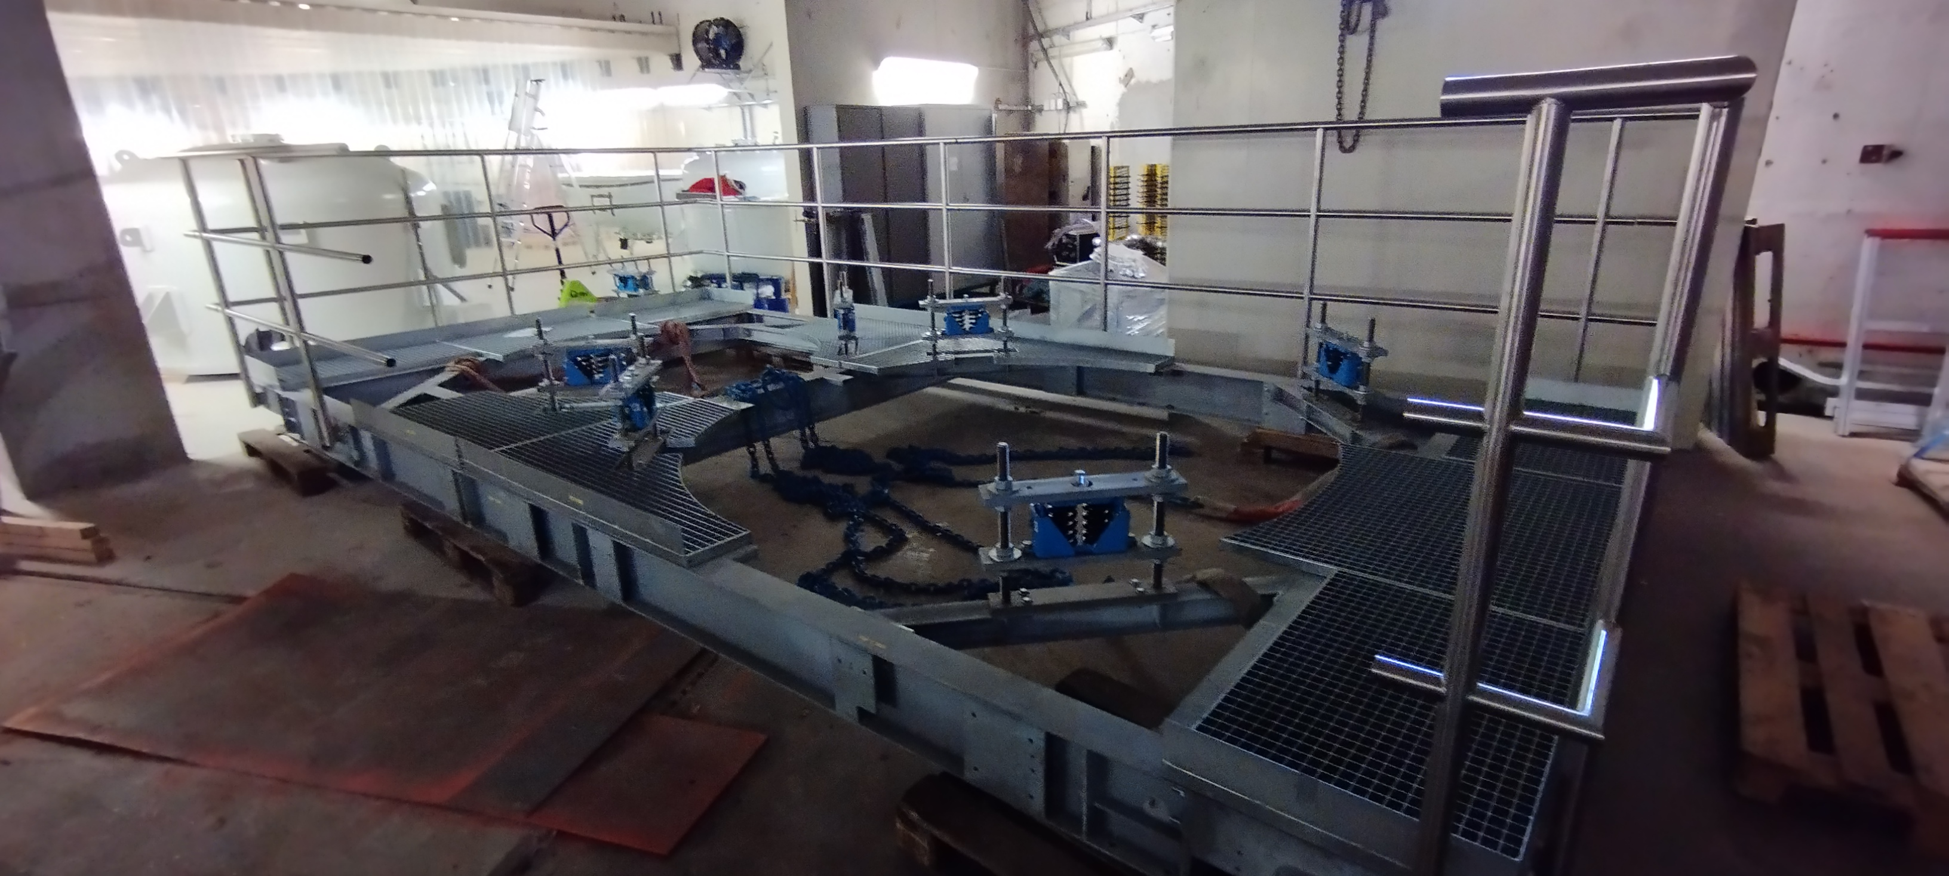
HV platform re-assembly
feb 24

Slide 14
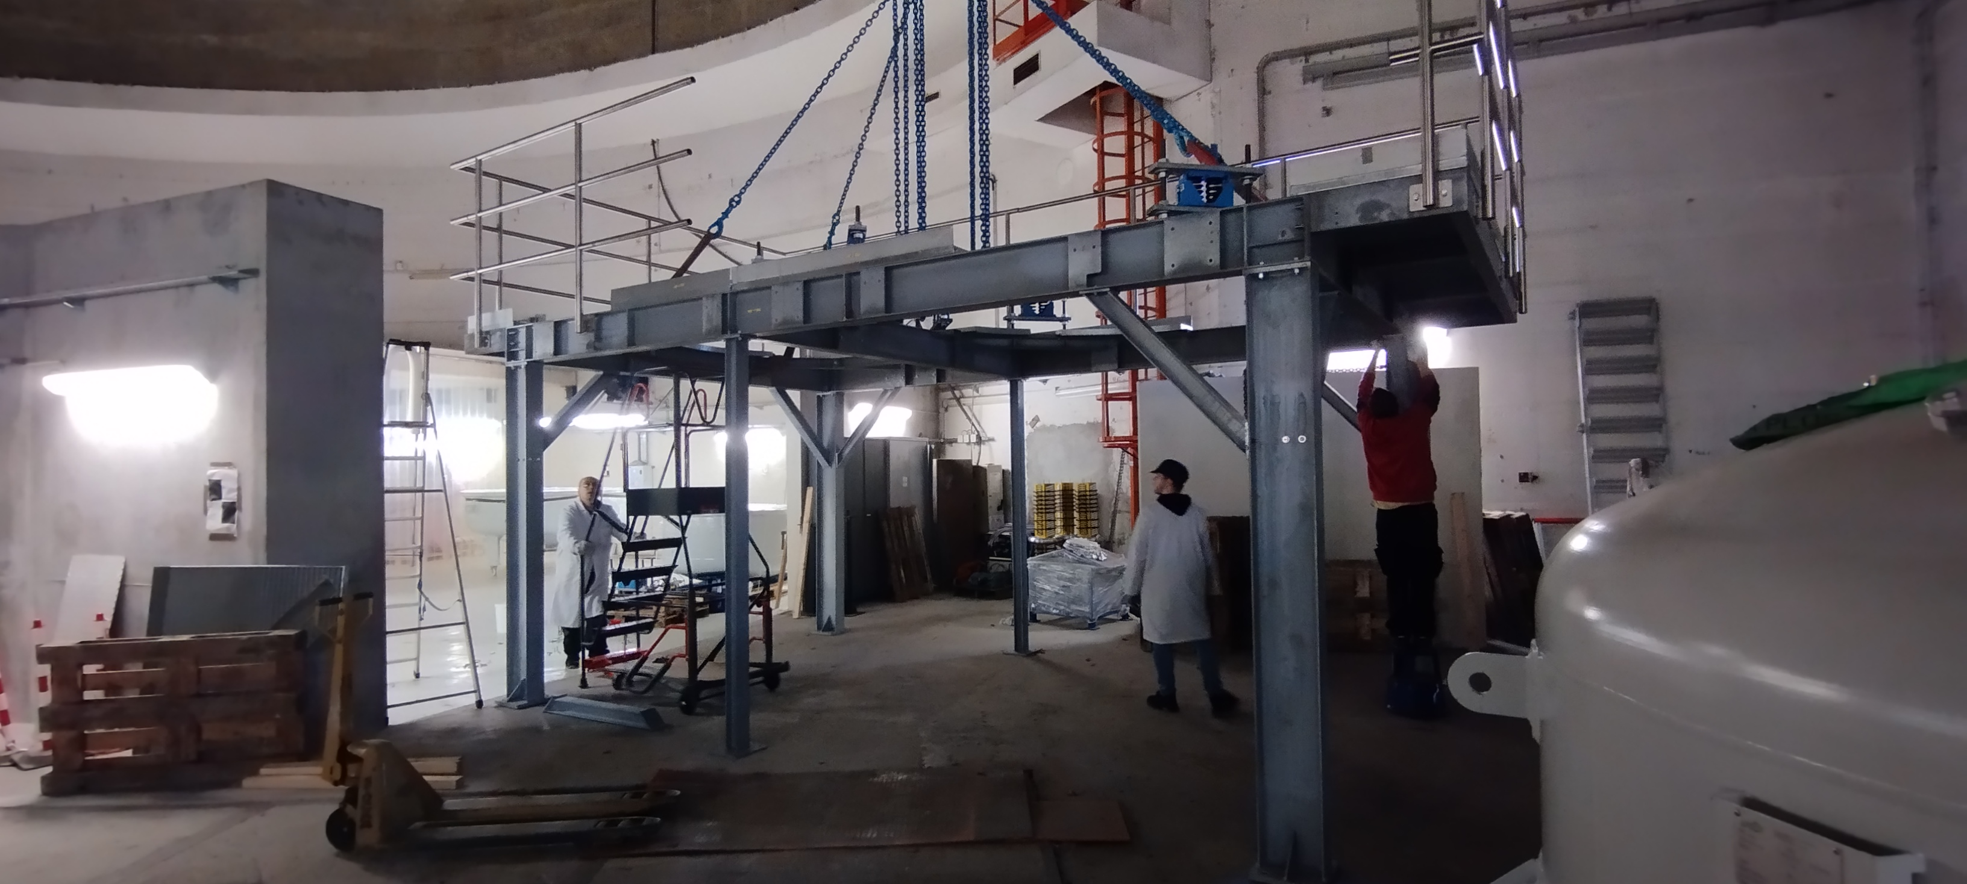
HV platform re-assembled
March 24

Slide 15
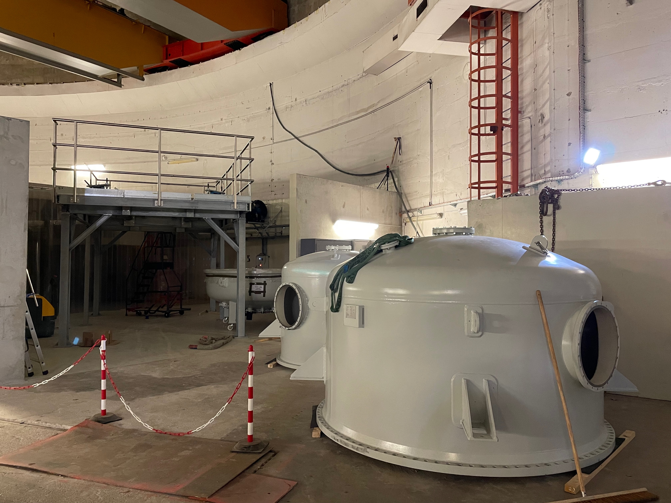
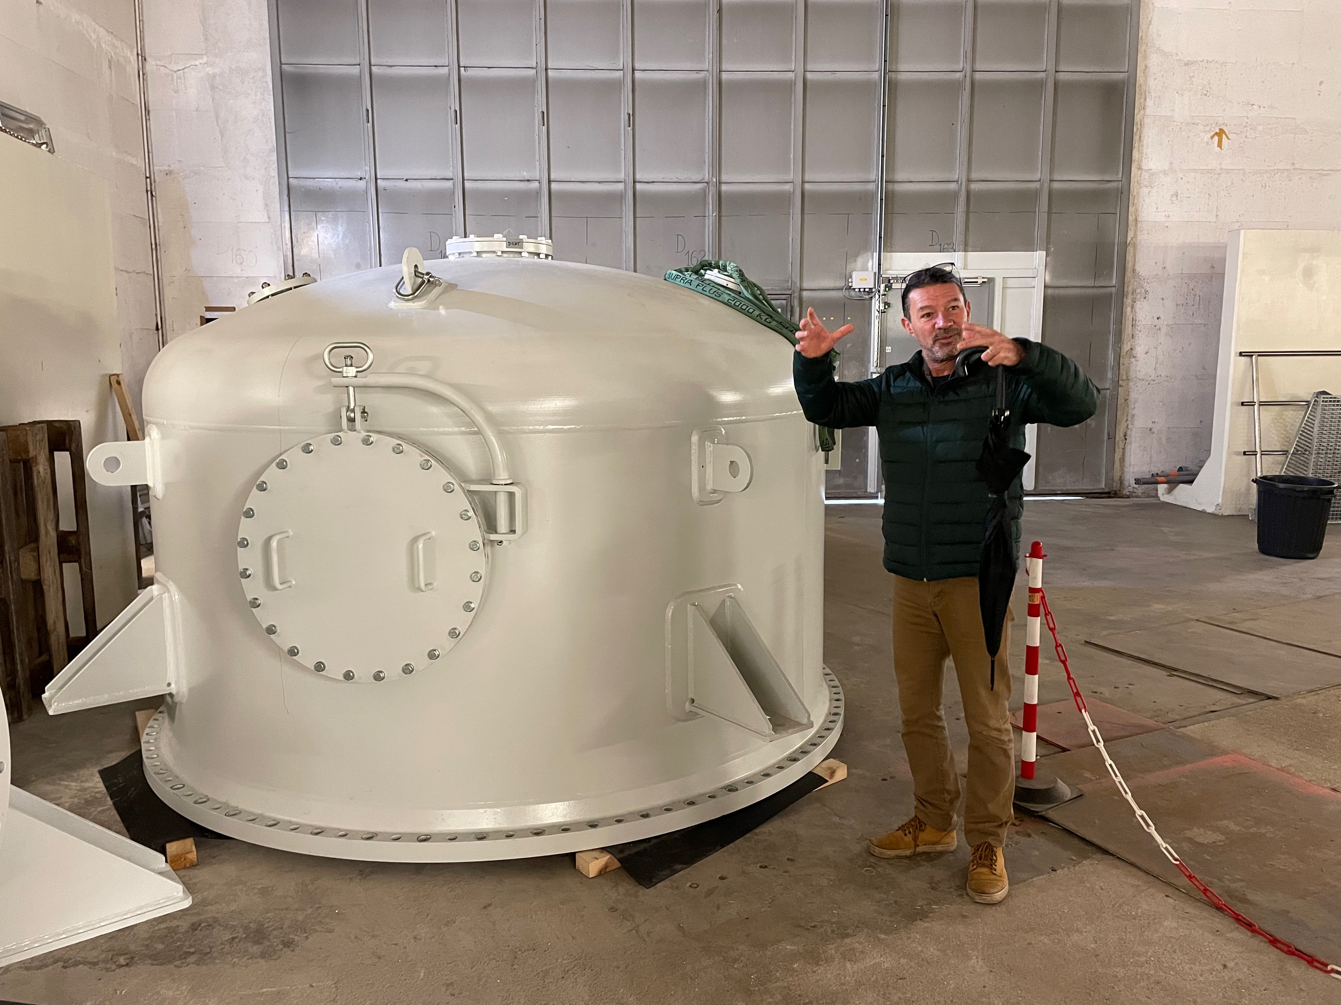
HV vessels
May 24

Slide 16
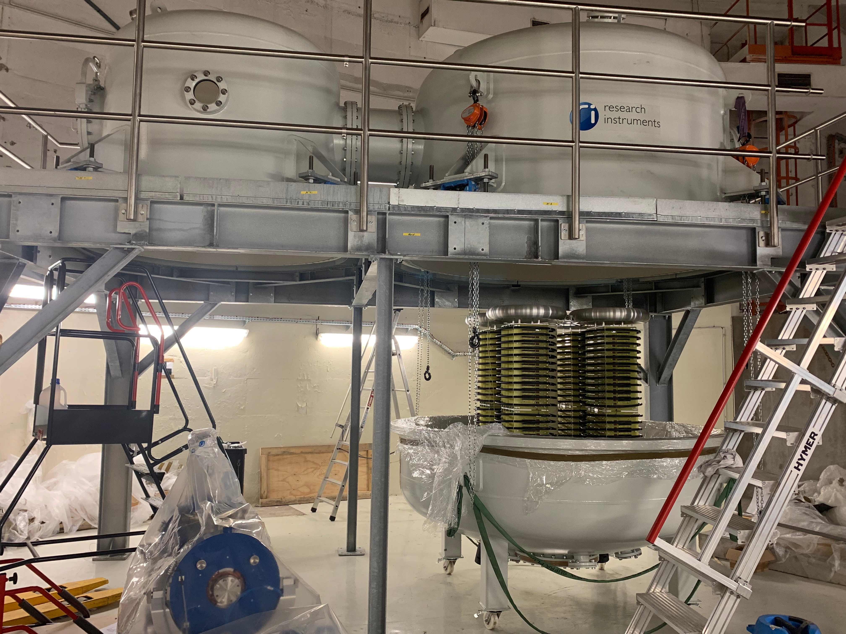
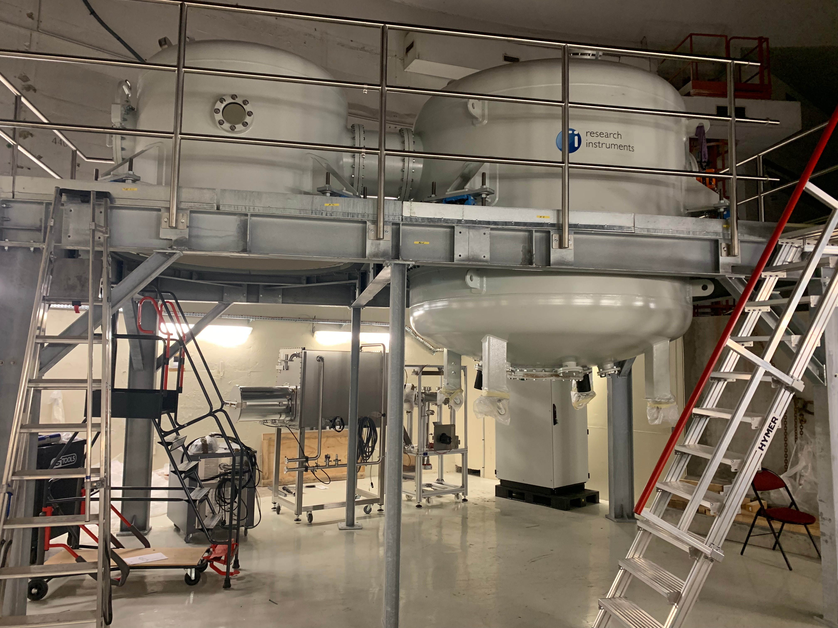
HV system
August 24

Slide 17
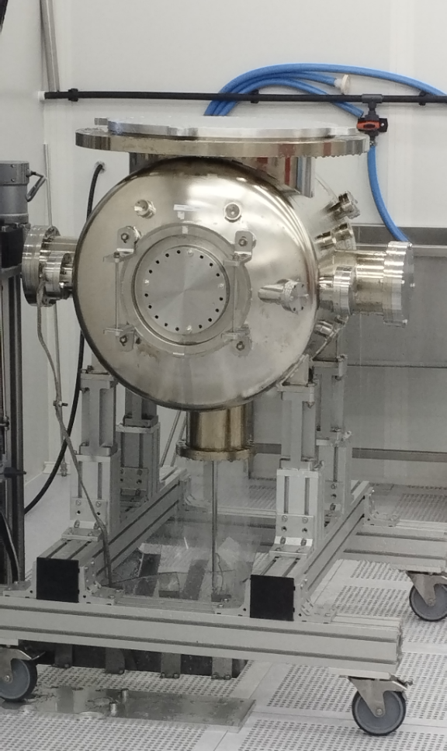
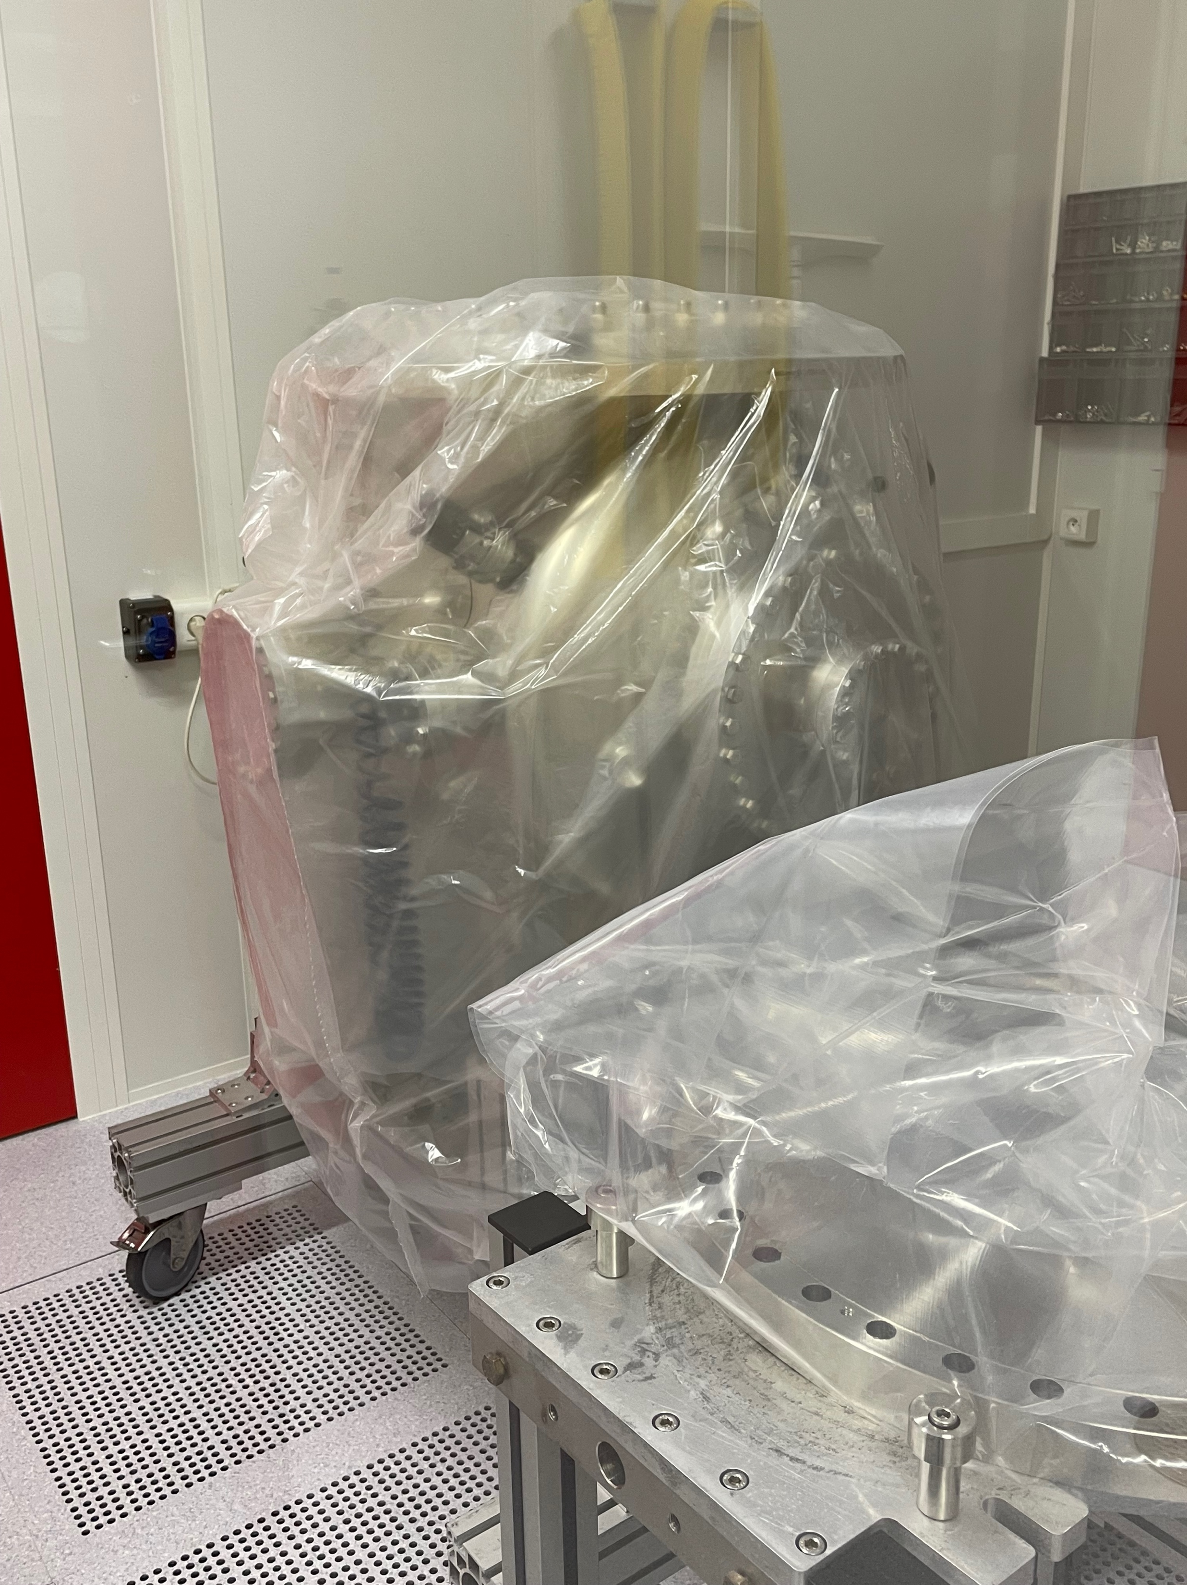
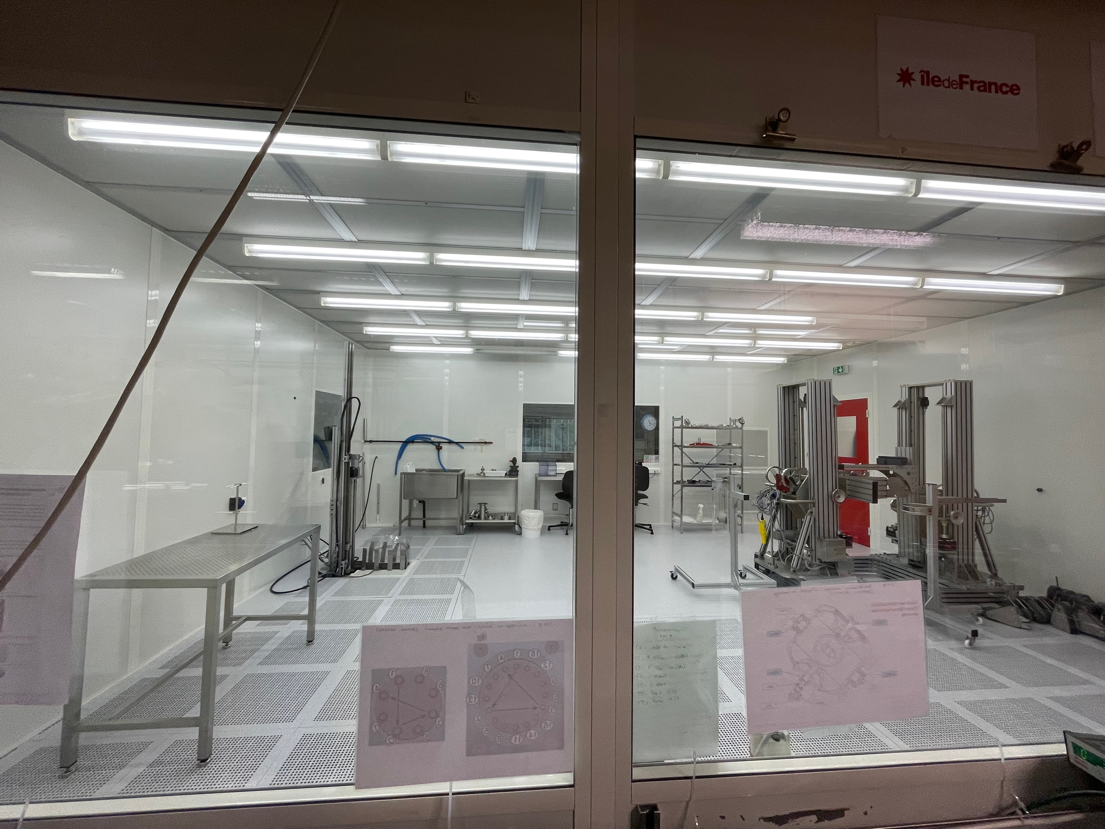
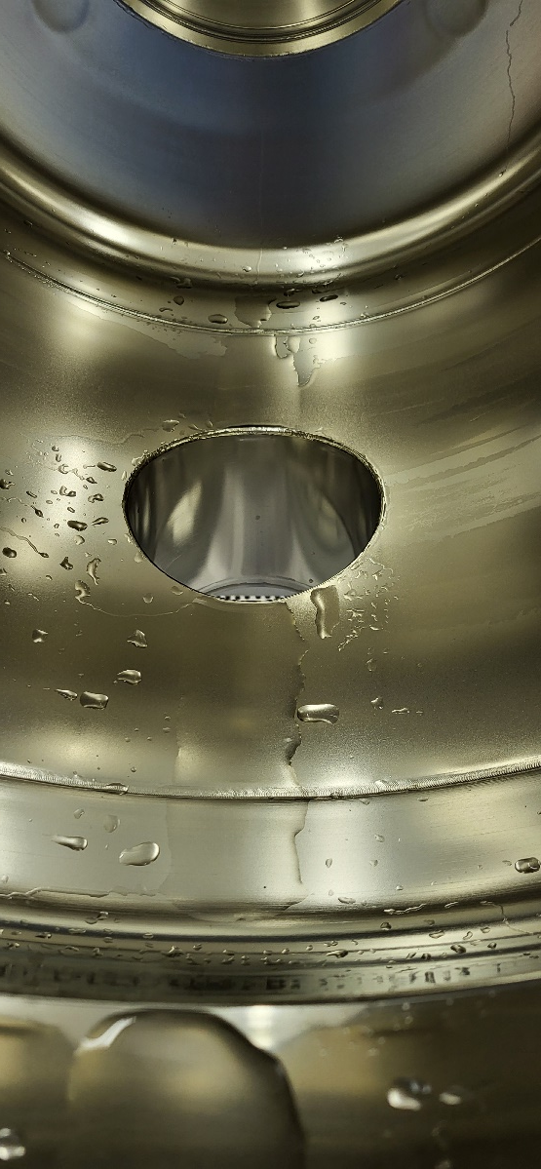
Vacuum chamber
Gun chamber opened in IJCLab cleanroom
Upon opening of the chamber, black residu which we could not remove
Process of High Pressure Rinsing (HPR) was performed in clean room
  ➔ Chamber cleaned
July 24

Slide 18
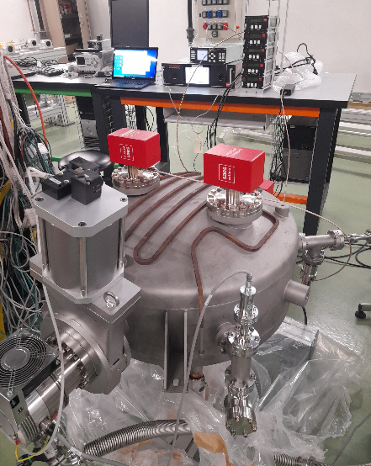
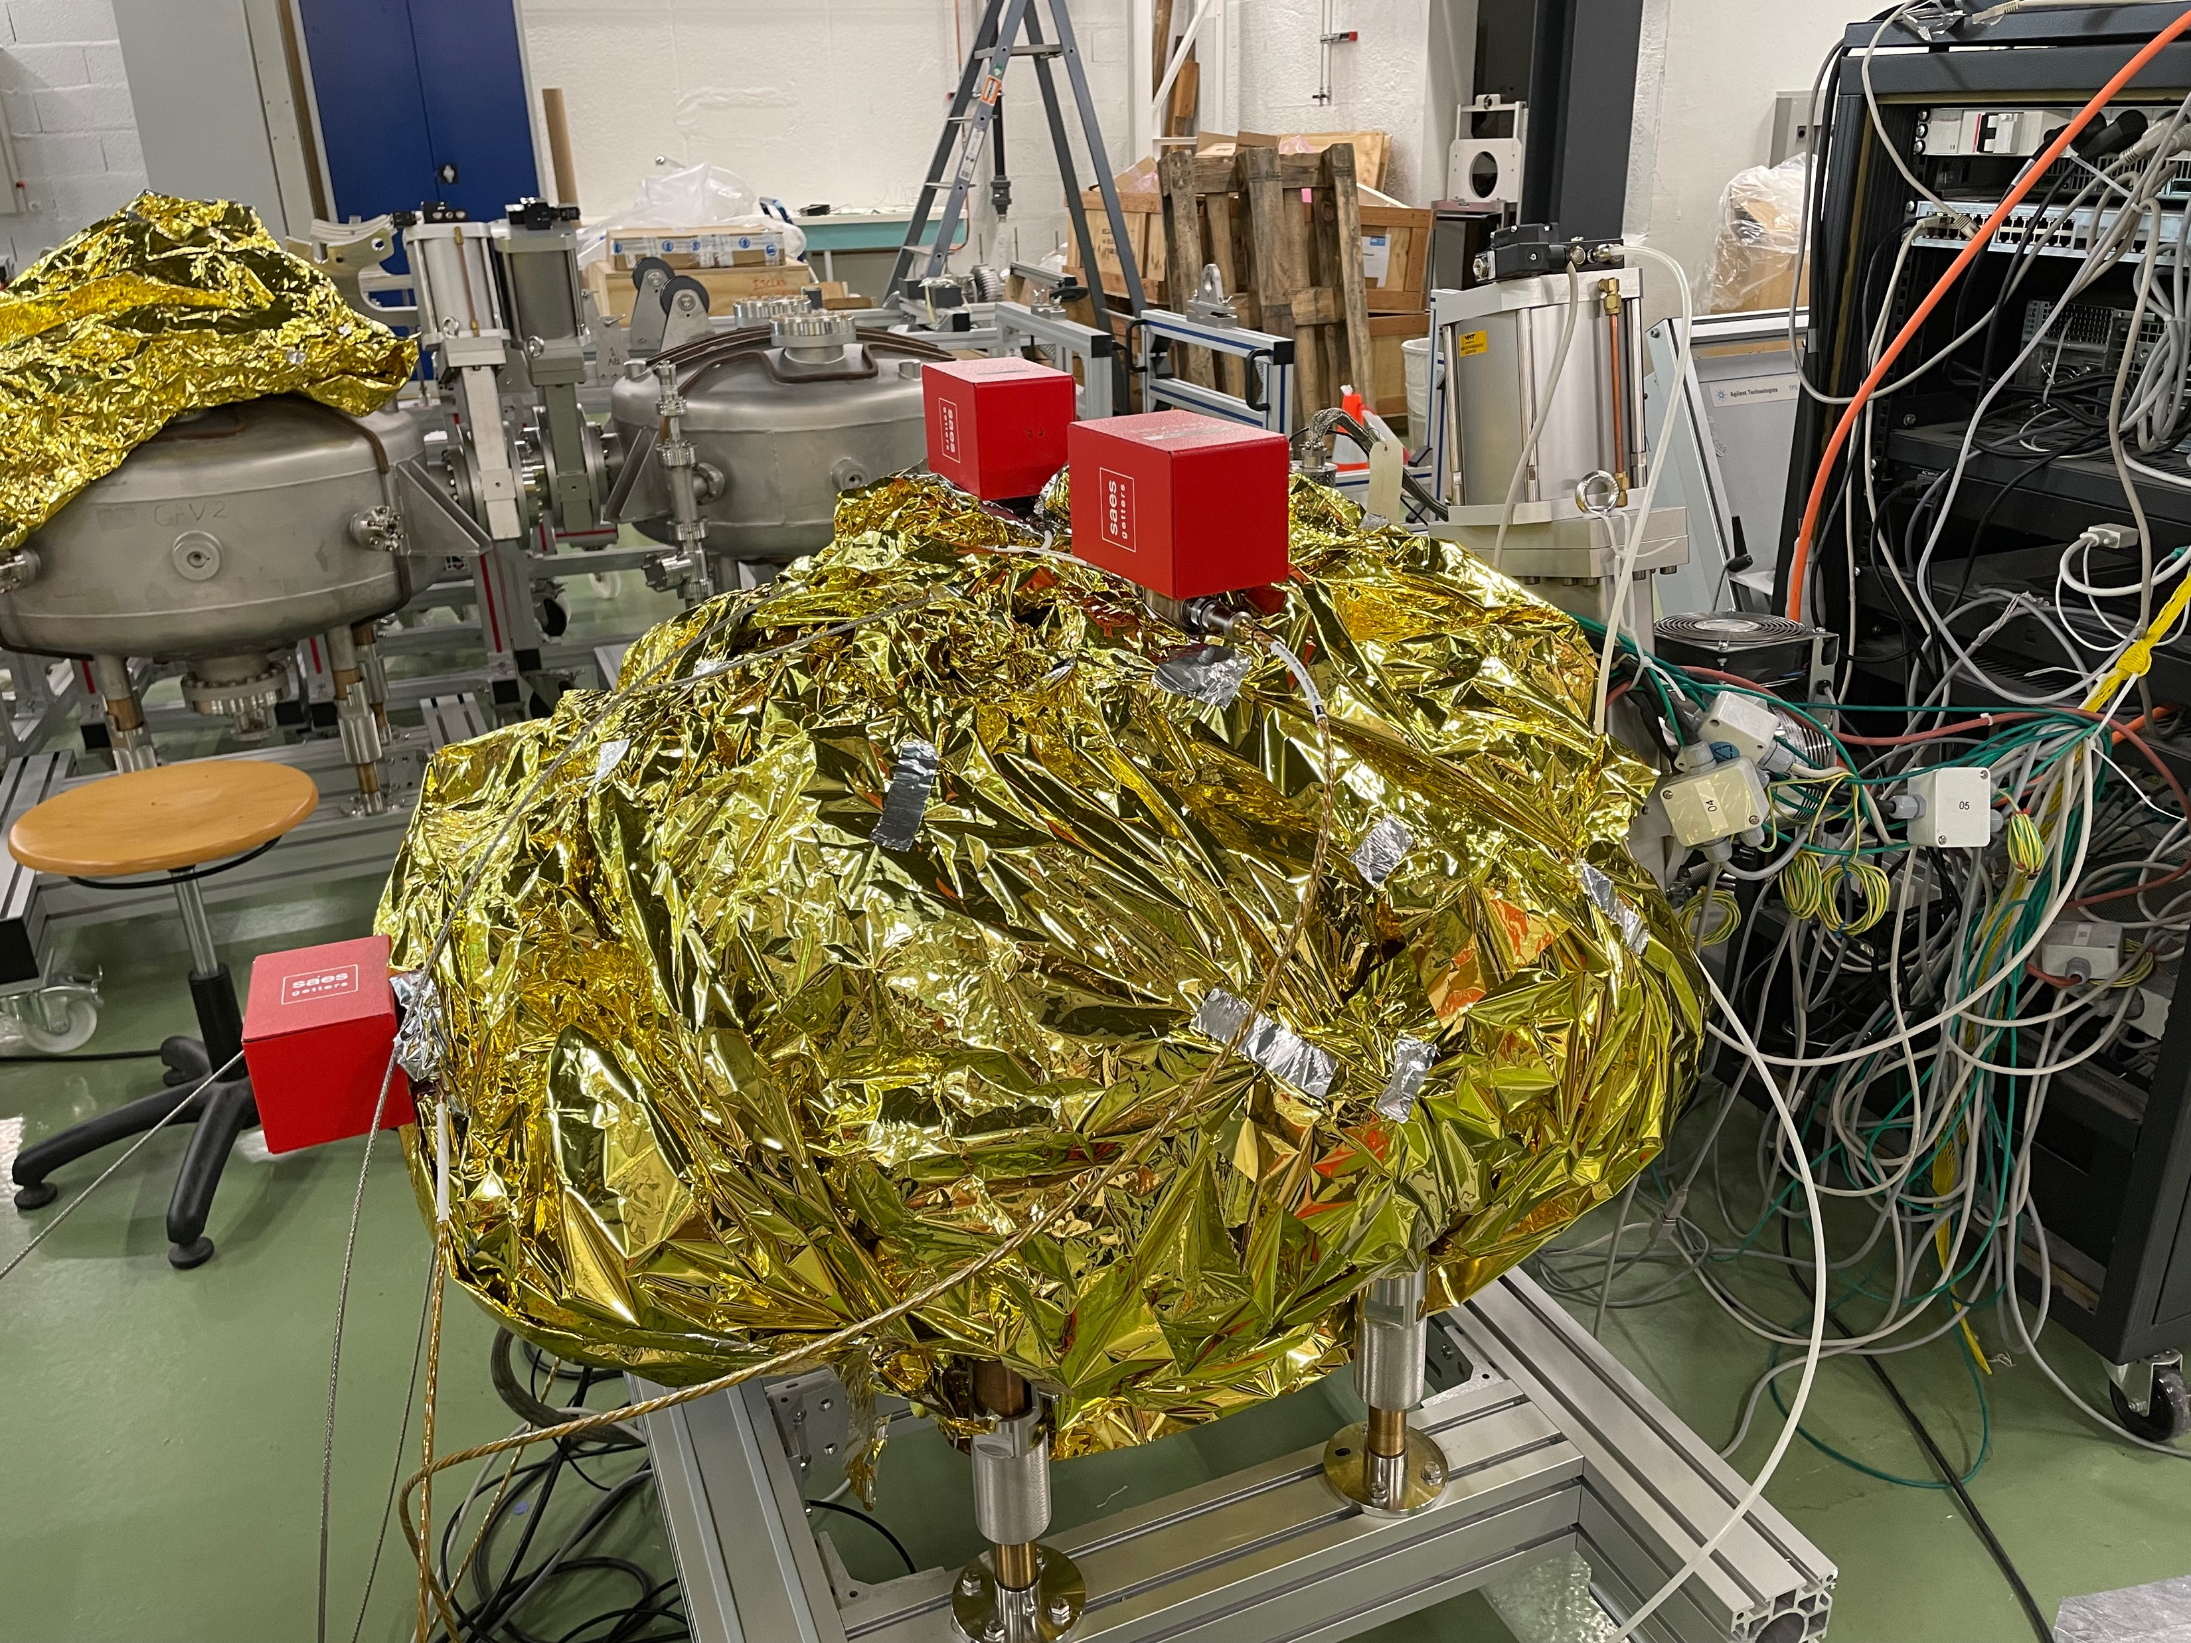
Vacuum pumps
Combined ionic and NEG pumps (NexTorr) under test
  The 3 gun pumps mounted on a test chamber
  Test, activation underway, with evalutation of pumping speed
PI NX01 ON
PI NX01 OFF
fermeture vanne enceinte/PTM1
ouverture vanne enceinte/ PTM1
PI NX02 ON
PI NX01 ON
PI NX02 ON
PI NX01 ON
PI NX02 OFF
September 24
PI NX01 OFF

Slide 19
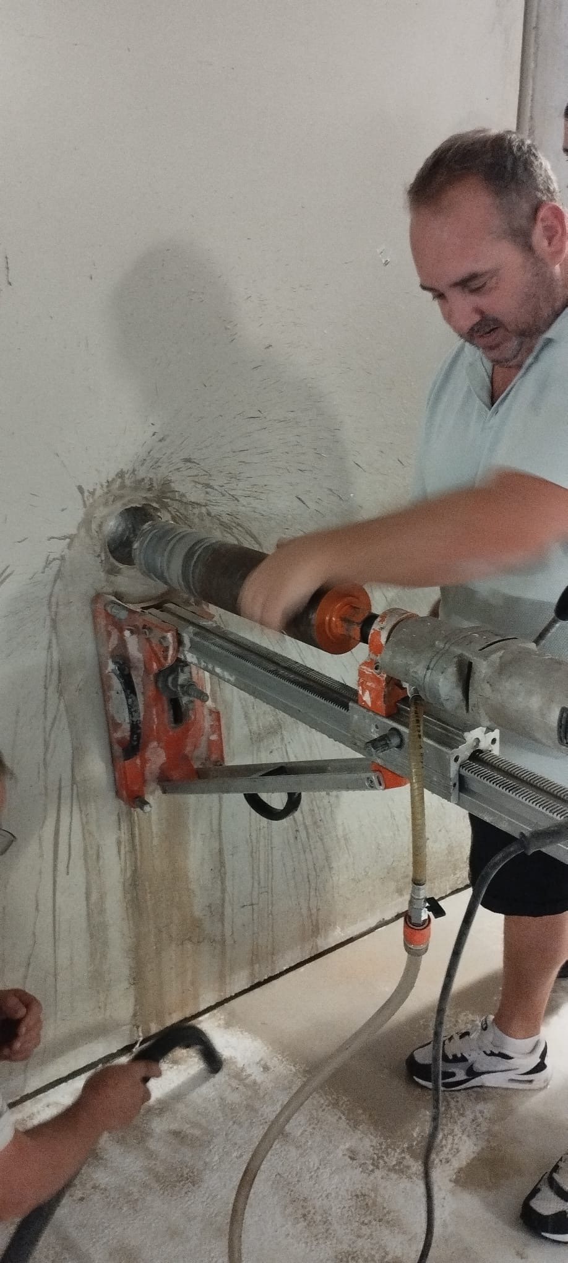
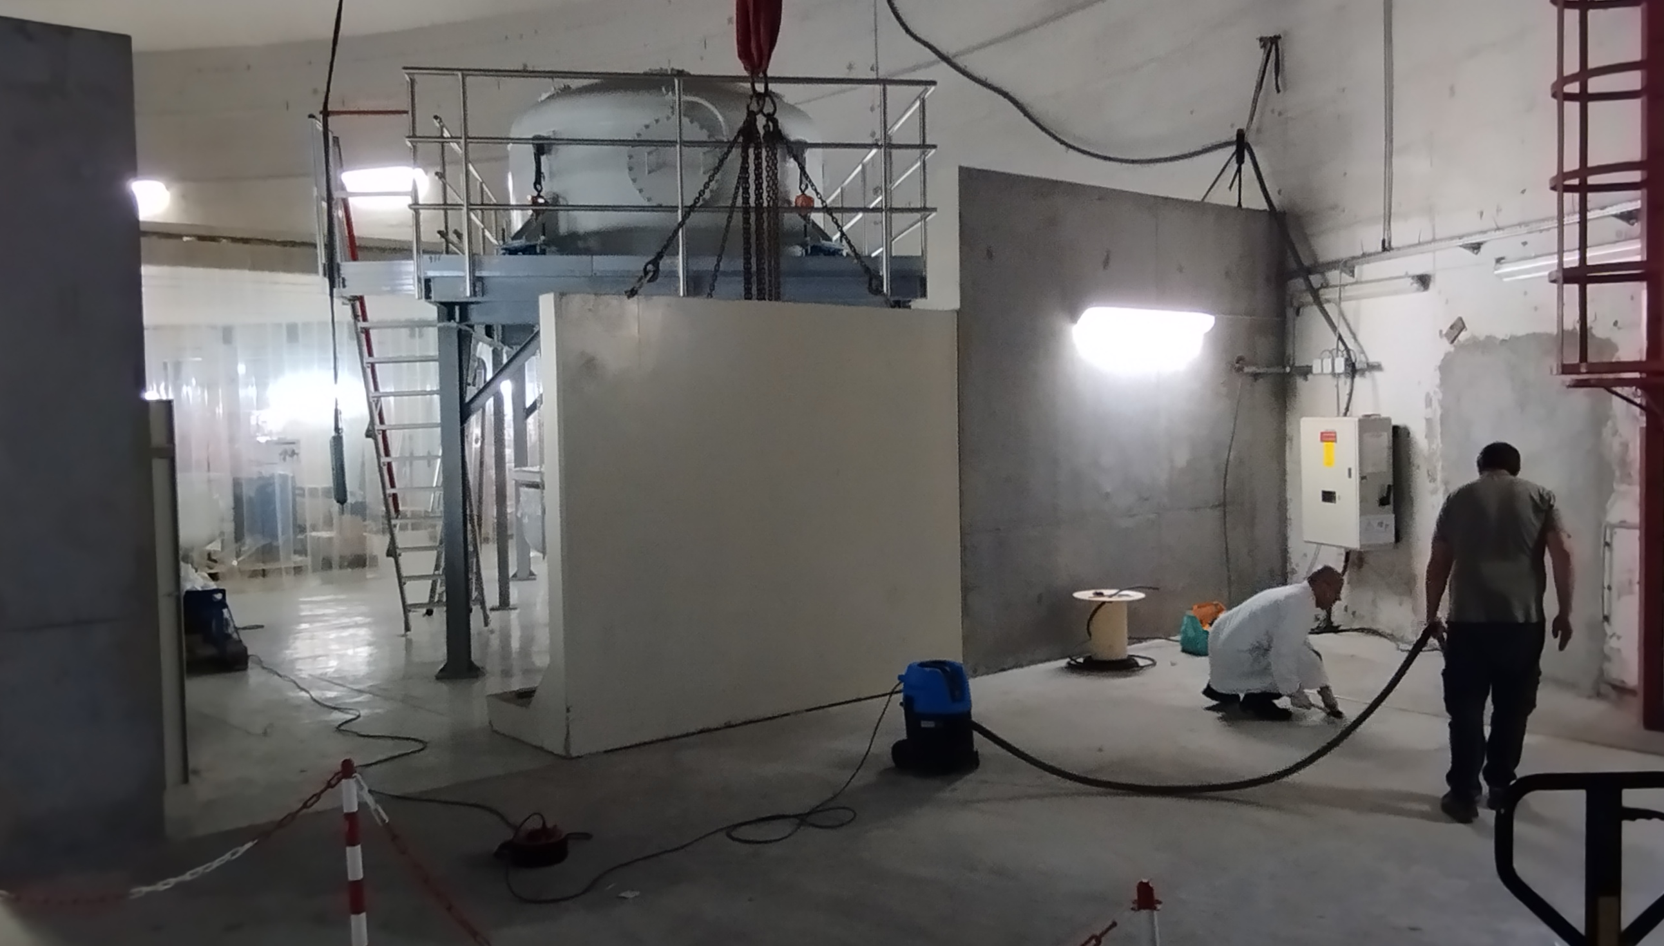
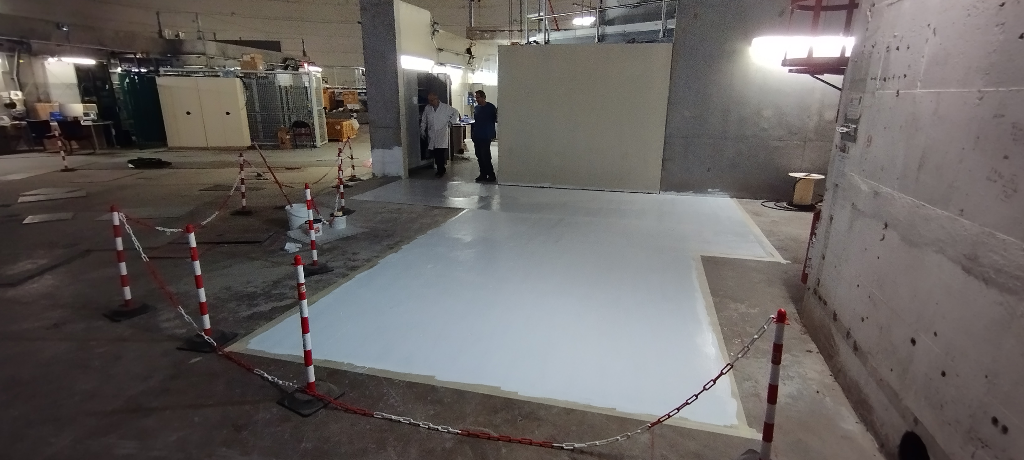
Laser room preparation
Shielding set in place
Hole for laser drilled
Floor prepared
July-sep 24

Slide 20
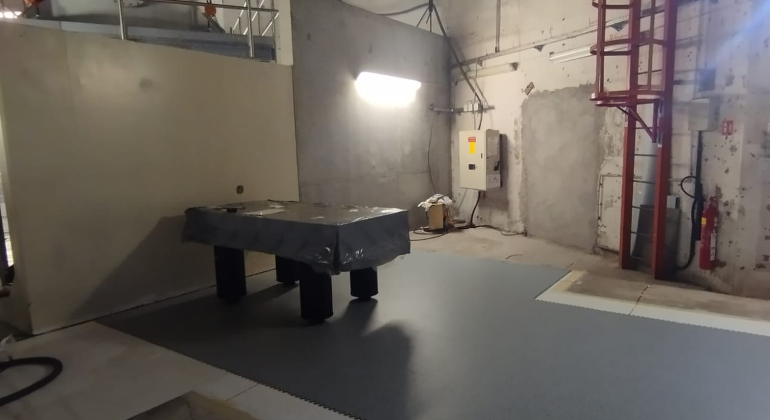
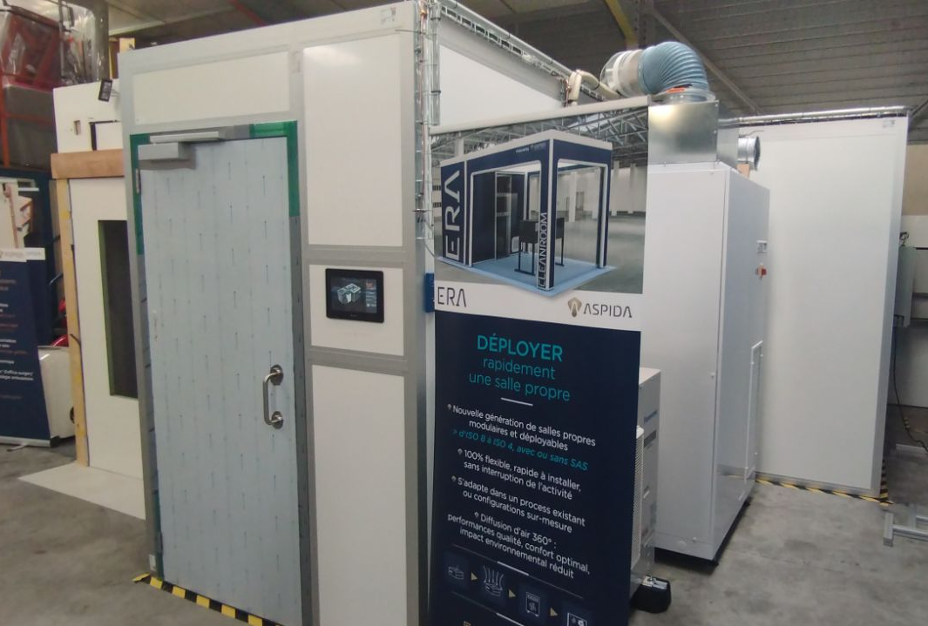
Laser room
Optical table installed
Delivery of the clean room end of September
To be delivered at Orsay

Slide 21
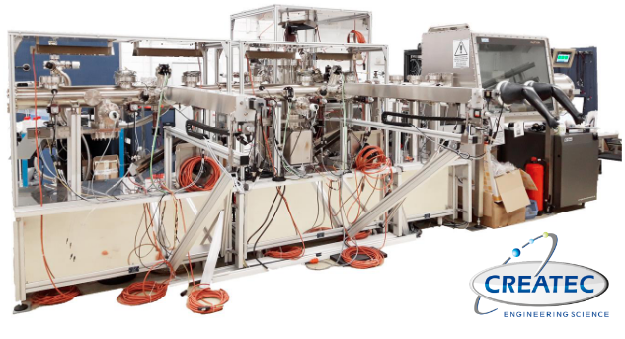
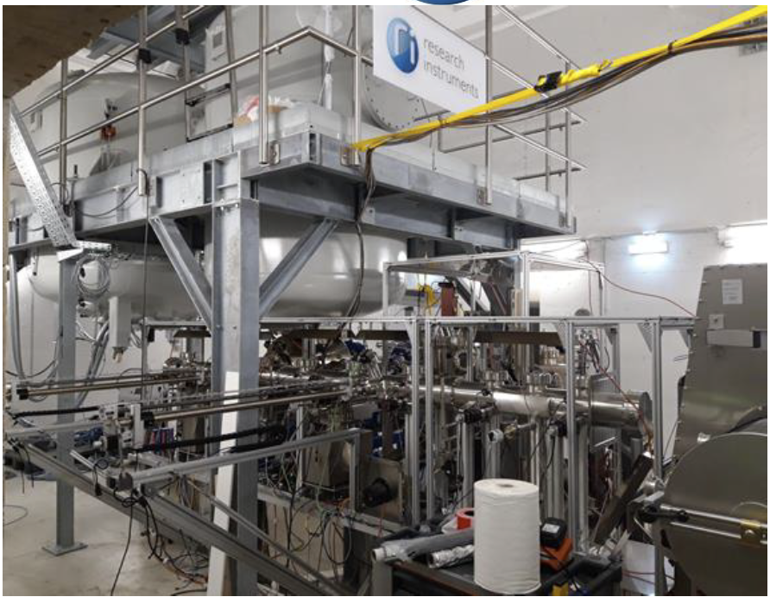
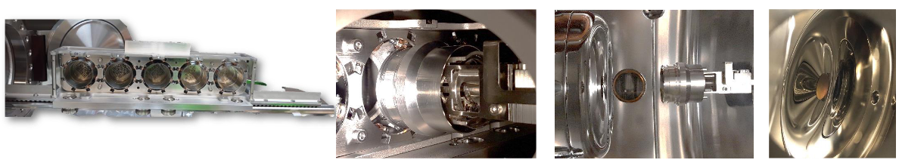
Photocathode preparation
Photocathode preparation facility (PPF) for deposition and transfer to the gun
  Glovebox and load lock
  Trolley for 5 pucks (2’’ in diameter)
  MBE chamber (thermal effusion cells)
  2 automated modules to grab and transfer the puck

Slide 22
Photocathodes
Multi-alkali antimonide photocathode (CsK2Sb)
PPF operated by RI (before its transfer to Orsay), results were presented at EWPAA2022, Milano
  10 photocathodes of CsK₂Sb produced, with high and repeatable QE (>4%)
  Re-assembly to be done at Orsay before photocathode preparation can be carried out
  Collaboration under discussion with STFC, INFN-Milano and JLab
  CsK₂Sb photocathodes for applications in an industrial accelerator, V. Kumper et al, EWPAA 2022, Milano

Slide 23
Planning
  Re-assembly of the photogun under way
    Gun chamber underway
    Vacuum pumps under test
    Mobile clean room to assemble the gun and the ceramics in the igloo to be delivered end of September
Laser system
  Laser room to be installed end of September
  Laser to be installed in the laser room and transport to the gun to be done
Photocathode preparation facility (PPF)
  To be assembled and commissionned
  Postdoc starting October 1st to work on the PPF
  Alignement of the PPF to the gun is critical ➔ to be performed by the manufacturer of the PPF (January 25)
Permit from the french Nuclear Safety Authority (ASN) being modified (from ALICE gun scenario)
  Required for HV > 30 kV
  Expected around April-May 2025
  Control system, diagnostics and safety interlock to be developped
  Commissioning expected within 12-18 months (ERL4ALL milestone)

Slide 24
Thanks for your attention
In memoriam of Max Klein

Slide 25
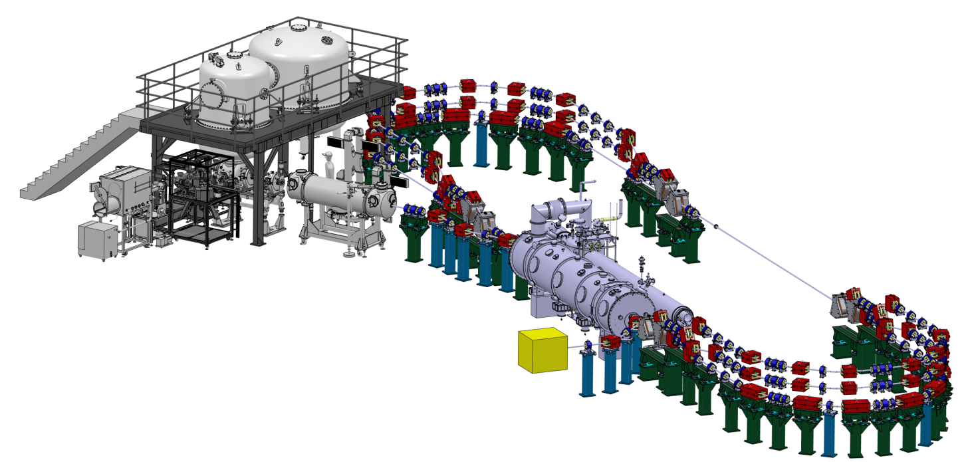
Full layout PERLE at 250 MeV
Spreader and recombiner : vertical switch of beams at different energies
3 isochronous recirculation arcs
for beams at different energies
Injector : 20 mA, 7 MeV
Linac cryomodule (82 MeV) :
4 five-cell cavities

Slide 26

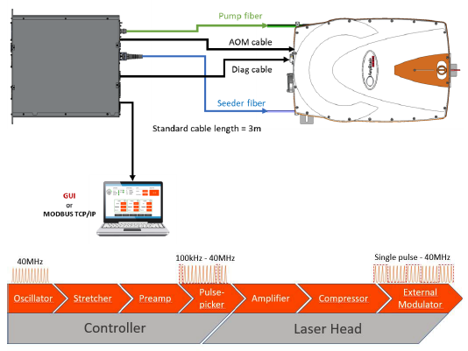
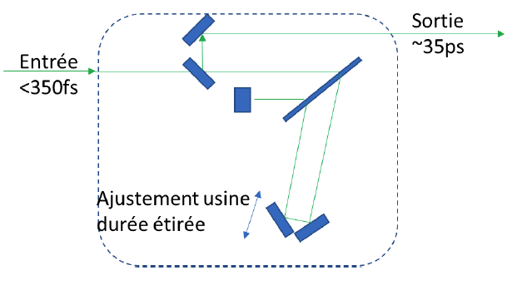
Laser purchased
Procurement placed in December 2022 for 1st part of the laser system
  Initial purchase limited (no synchronization, 10 W)
  Vendor : Amplitude (France)
  SATSUMA HP with frequency doubling and stretcher module, based on Chirped Pulse Amplification (CPA)
  - diode-pumped ultrafast oscillator to generate the pulse train ultrafast
  - stretcher to temporally expand the pulses in the pulse train < 350 fs ➔ 30-50 ps
  - frequency doubling module : 1030 nm ➔ 515 nm
  - diode-pumped fiber power amplifier
  - compressor to recompress the amplified pulses to their minimum duration
  - external modulator used as an optical switch
Delivery expected in October 2023

