Slide 1

Towards ordering the cavities
CNRS/IN2P3/IJCLab
Akira Miyazaki, Patricia Duchesne, Gilles Olivier, Sebastien Blivet, Guillaume Olry

Slide 2
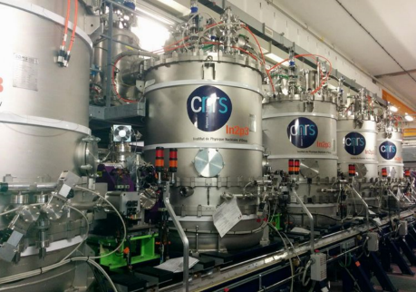
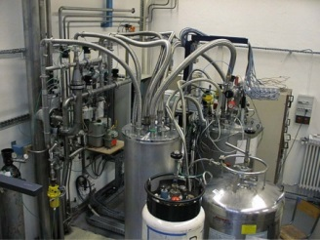
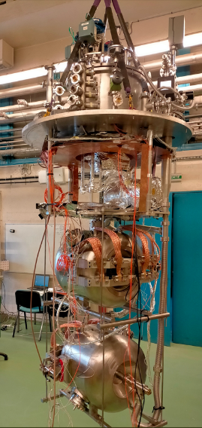



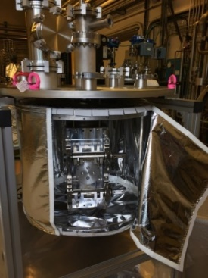
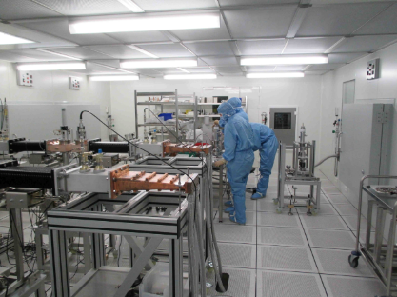
Introduction : History summary and series production
Prototyping Phase
Series production
R&D
Calibration Station (2000)
Clean-room for cryomodule (2007)
Vertical cryostat (CV800)
Chemical facility (2008)
Furnace (2016)
Klystron (2017)
He Liquefier (2008)
Upgrade CV800 (2018)
New Assembly Hall (2020)
Spiral2 : Integration and test of 7 cryomodules
ESS : - preparation & testing of cavities, couplers and tuners
- Integration of 14 cryomodules
LHC
SPIRAL2
SPIRAL2
ESS
ESS
EURISOL
MAX
MYRTE
MYRRHA
MYRRHA
LHC : Calibration of all Cernox thermal sensors (> 6000 units)
TTF3
EU-XFEL
PIP2
PIP2
1995
2000
2005
2010
2015
2020
2025
PIP-II : Testing of 33 Spoke cavities
First cryogenic test of a Spoke resonator in Europe (2002)
First cryogenic test of a cryomodule at Supratech (2007)
Supratech Platform is officially recognized by IN2P3 (2017)
Creation of IJCLab, merging of equipment from LAL and IPNO in Supratech (2020)
Supratech Platform is created (2004)
MYRRHA : - preparation & testing of 60 couplers and tuners
EU-XFEL : Preparation and power testing of 800 couplers

Slide 3
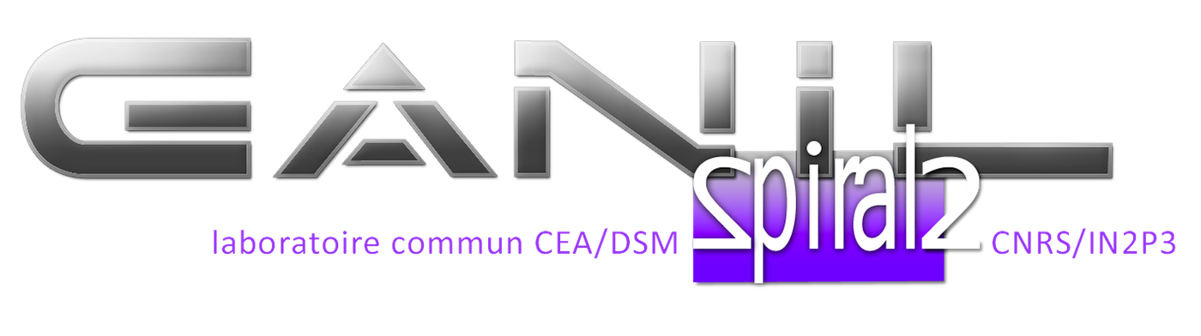

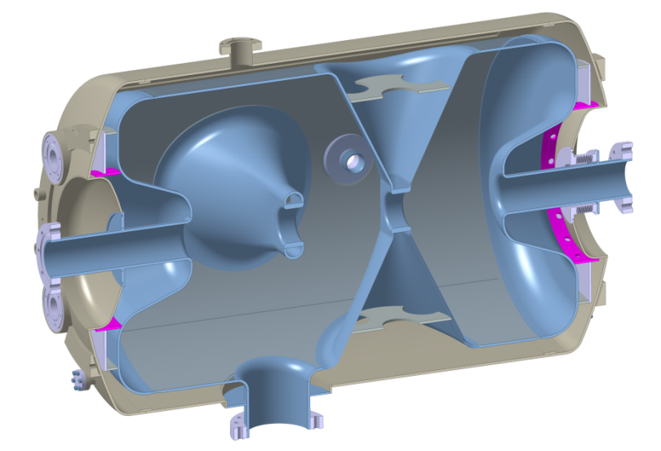
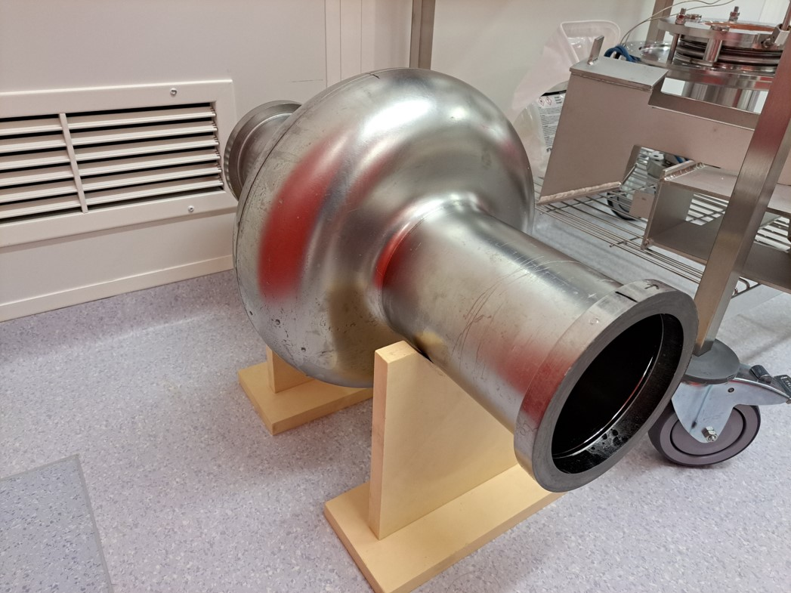
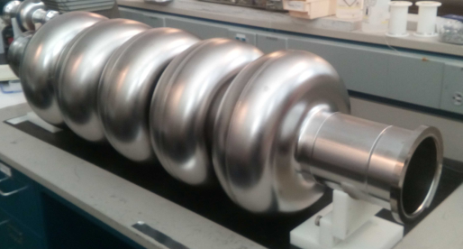
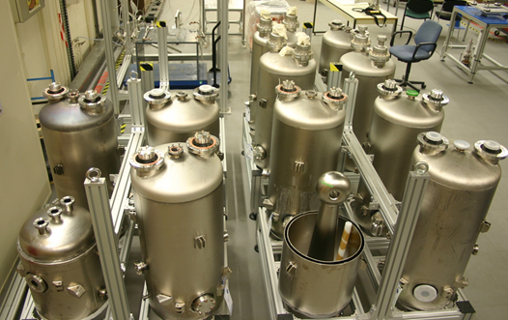

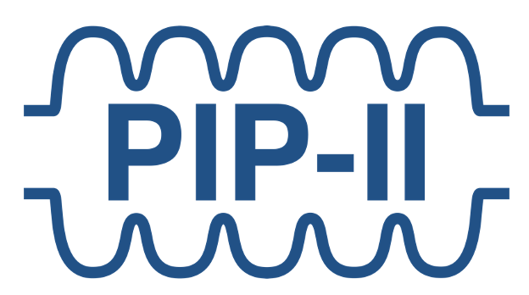
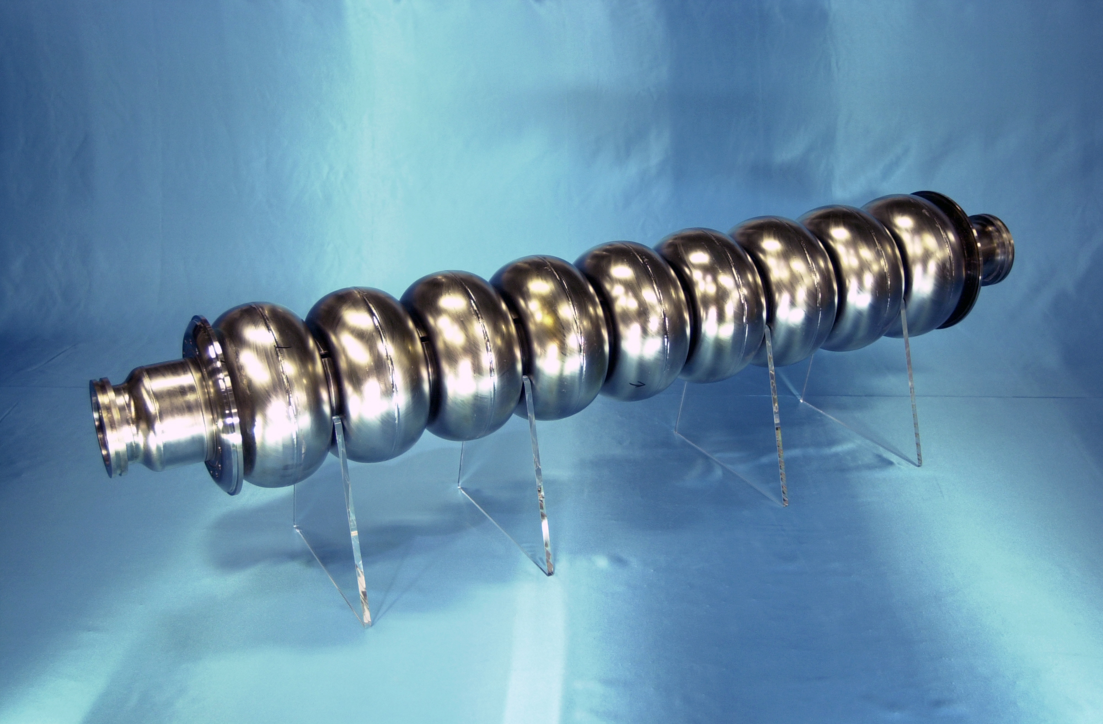
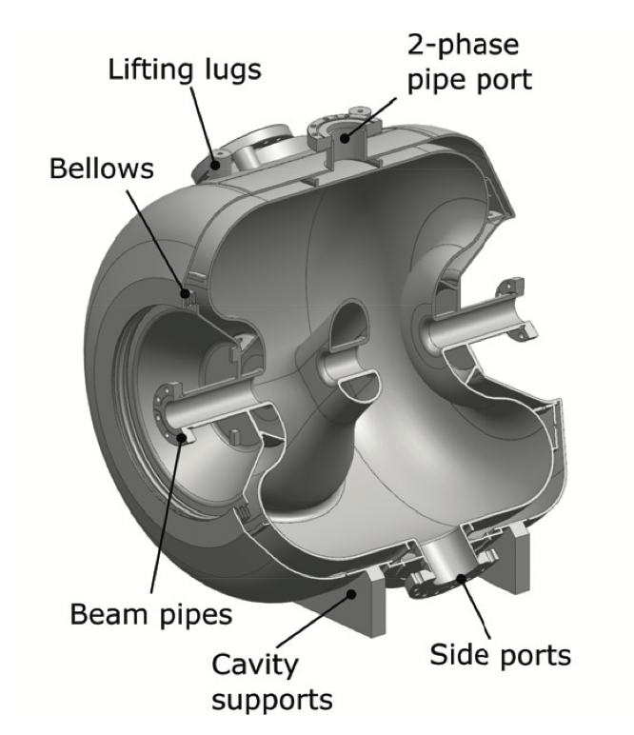
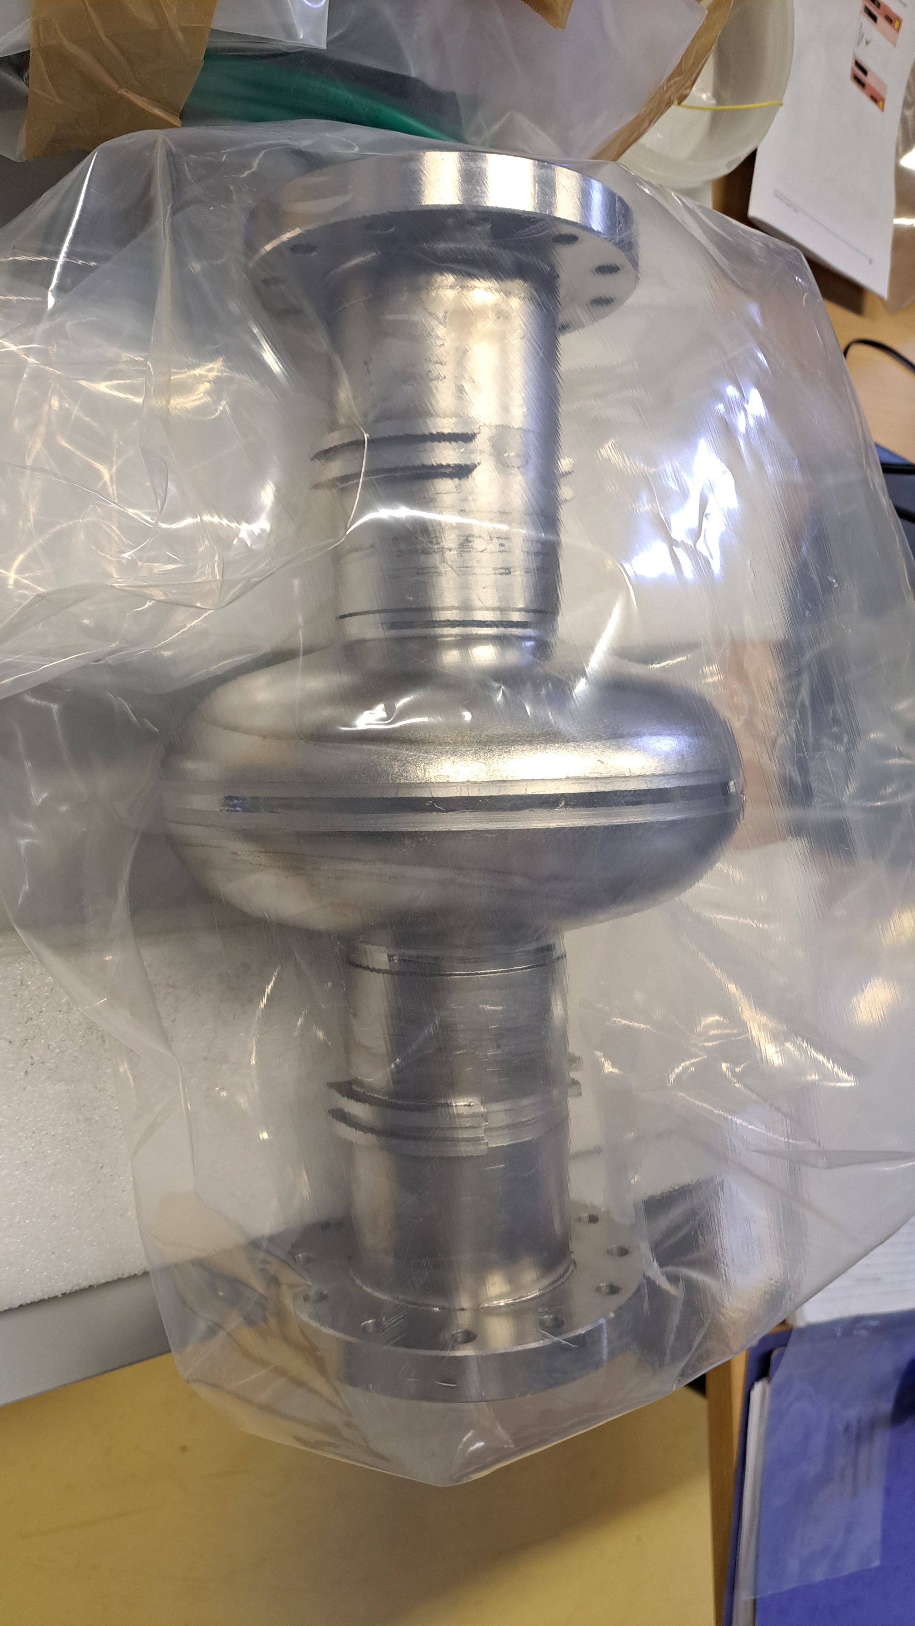
Low-β cavities for protons & heavy ions→ collider cavities
FCC/PERLE cavities (800 MHz)
352 MHz
88 MHz
ILC cavities (1.3 GHz)
352 MHz
325 MHz

Slide 4
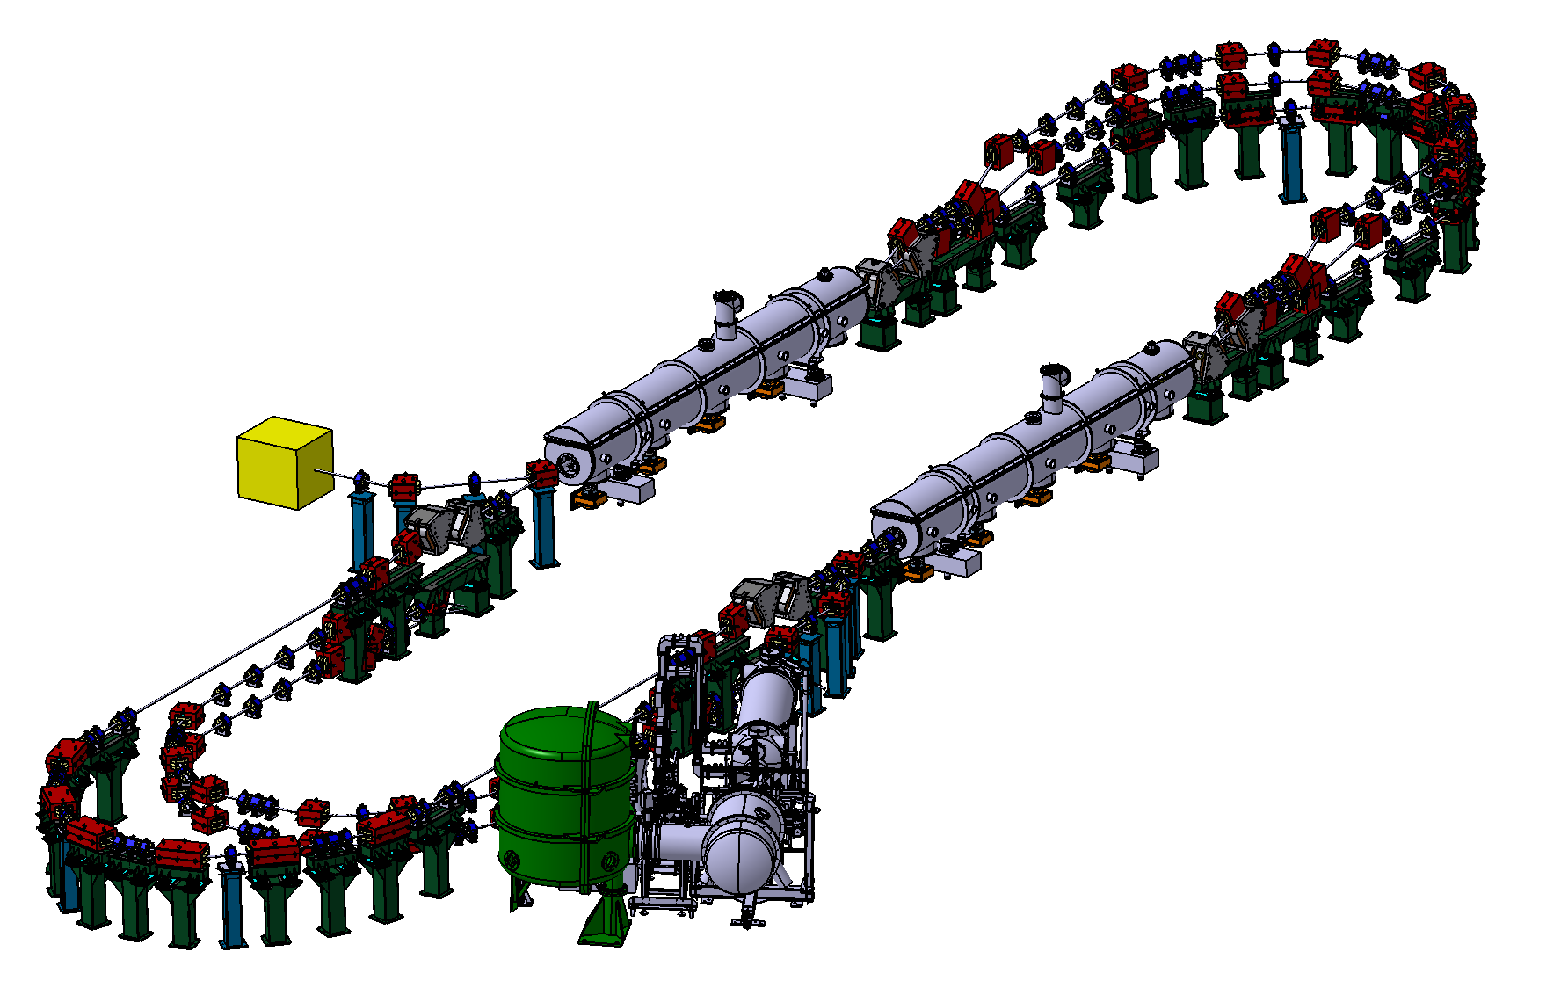
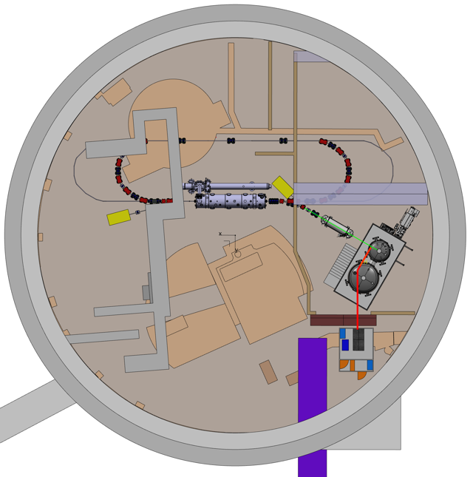
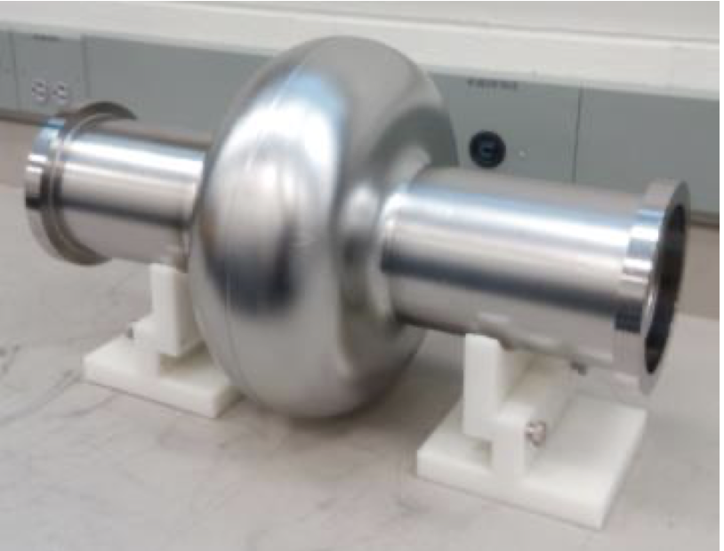
PERLE project at IN2P3/IJCLab and cavities
Ultimate goal of PERLE: first multi-turn ERL designed to operate at 10 MW (20 mA, 87→250→500 MeV)
A hub to explore a broad range of accelerator phenomena and to validate technical choices improving accelerators for future energy and intensity frontier machines
Target Parameter | Unit | Value
Injection energy | MeV | 7
Electron beam energy | MeV | 250 / 500
Average beam current | mA | 20
Bunch charge | pC | 500
Duty factor |  | CW
Main Linac
Beam Dump
800 MHz 5-cell SC cavity x 4
(22 MV/m)
Injector Linac
800 MHz 1-cell SC cavity x 4
(9.2 MV/m)

Slide 5
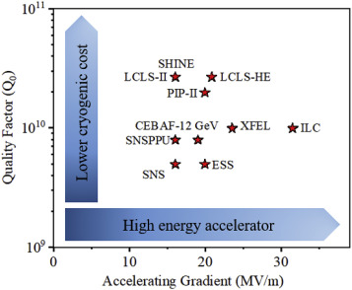
R &D targets
For FCC/PERLE
Duty cycle =100%
FCC/PERLE
Extremely high-Q at relatively high gradient in large cavities (800 MHz)
For ILC250
P. Dhakal “Nitrogen doping and infusion in SRF cavities: A review” Phys Open 5 100034 2020
Duty cycle <1%
Extremely high gradient with relatively high-Q in a large # of cavities (~8000)

Slide 6
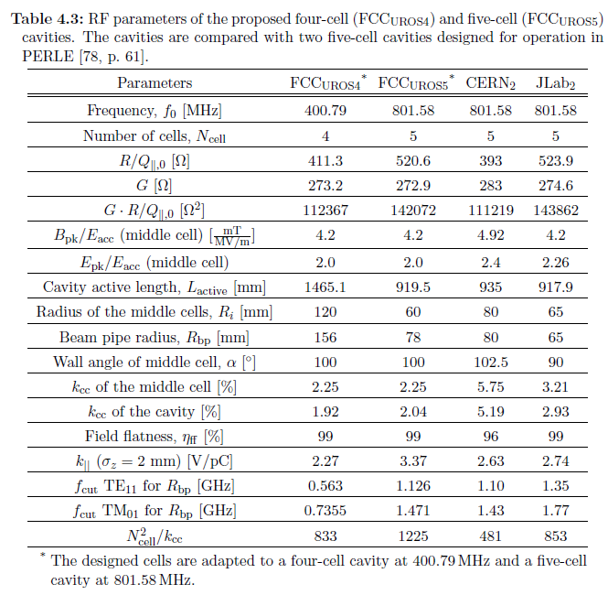
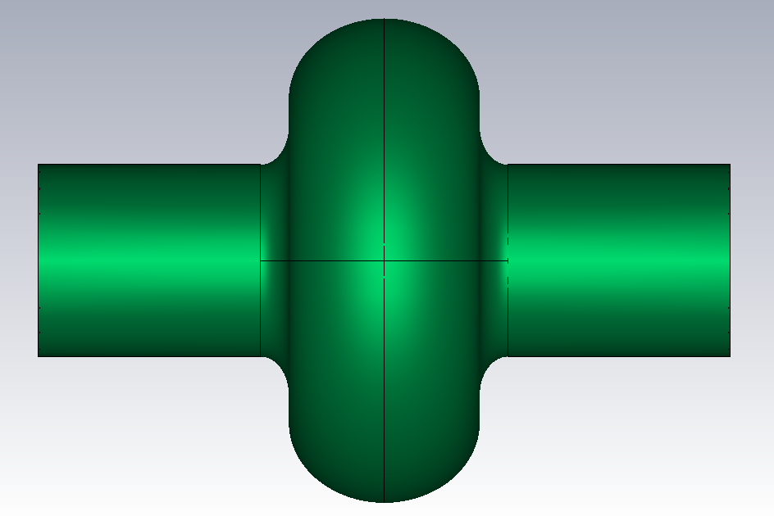
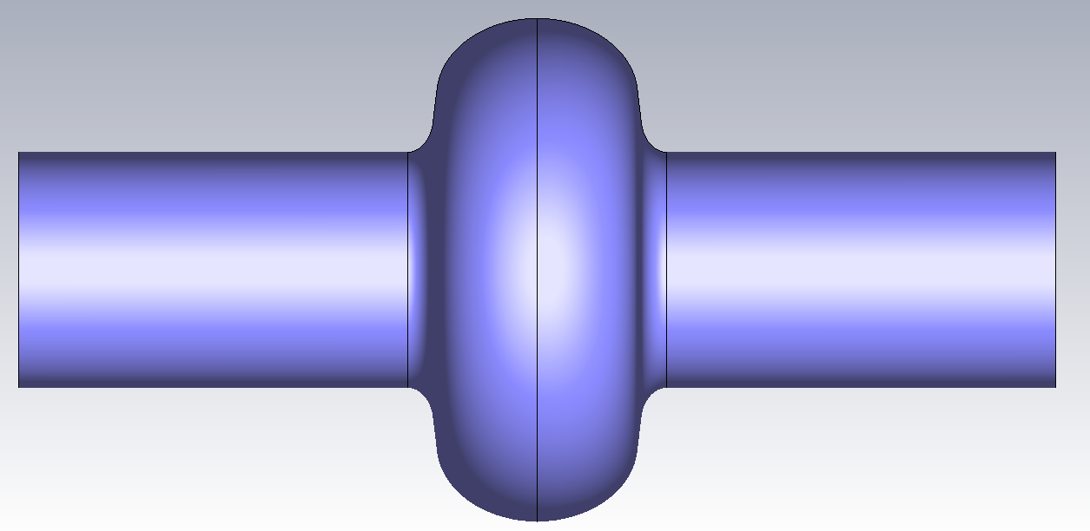
FCC/PERLE RF design: different strategy to eliminate HOMs
JLab
Trapped mode in 5-cells damped with HOM couplers
HOM couplers tested with Cu prototype cavity
FCC_{UROS5}
HOMs extracted through beam pipe → Beam Line Coupler or Absorber
Simulation only
Shahnam’s PhD thesis

Slide 7
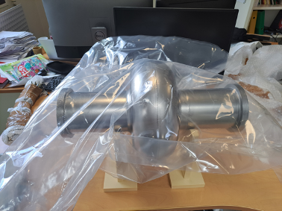
Strategy for successful cavity preparation
On my desk ☺
JLAB prototype 1-cell @ IJCLAB
  Mid-T baked by JLAB → no improvement
  Deep groove (1 mm) in welding found by FNAL
  repair?
JLAB prototype 5-cell @ FNAL
  Determine the best recipe for PERLE/FCC
  1st test showed bad Q₀ and Q-slope
  Light EP and another test without mid-T bake
FCC prototype 1-cell from CERN
  One cavity will be provided by CERN (mid 2025)
Public tender for PERLE cavities (JLAB RF design): end of 2024
  1-cell bare cavity for the validation process in the vendor (end 2025)
  4 x 5-cell jacketed cavities for the accelerators (no spare, no prototype!)
  Recipes need to be determined during the fabrication process without R&D!

Slide 8
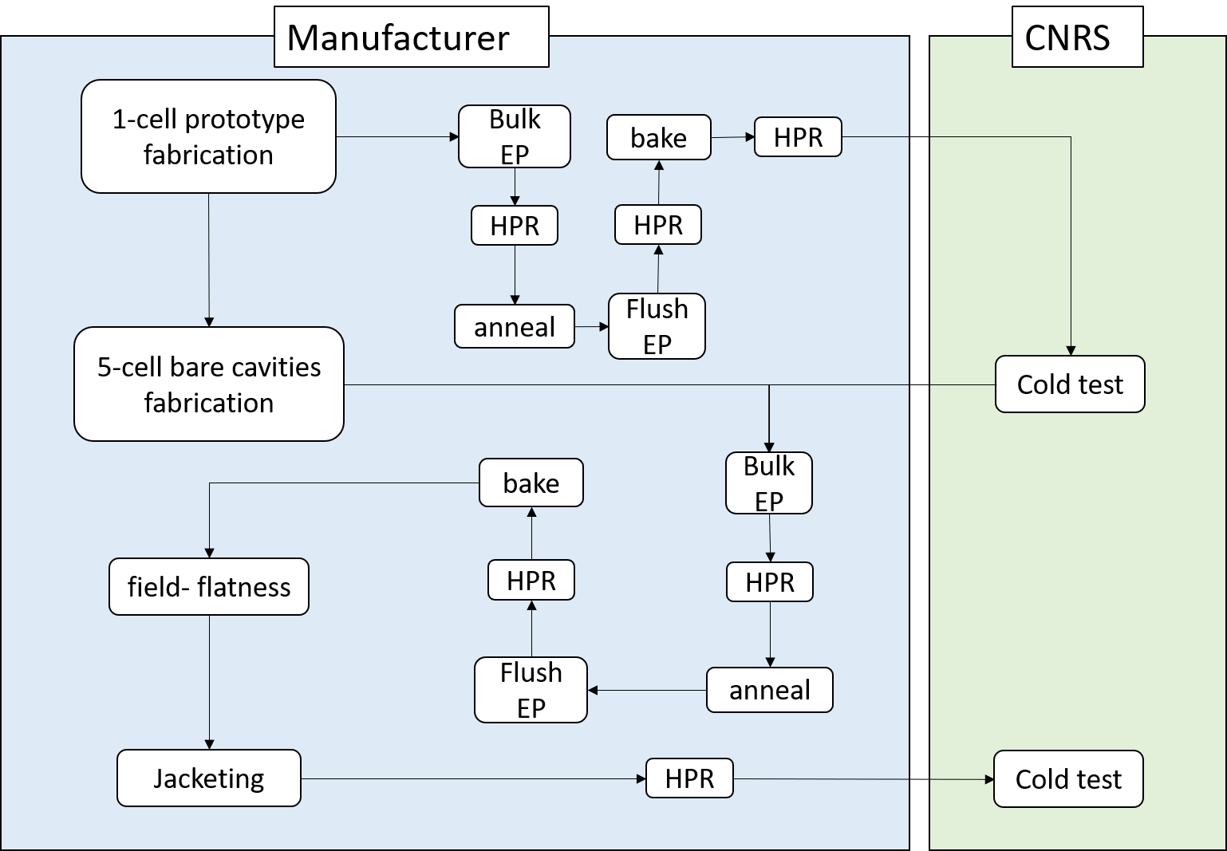
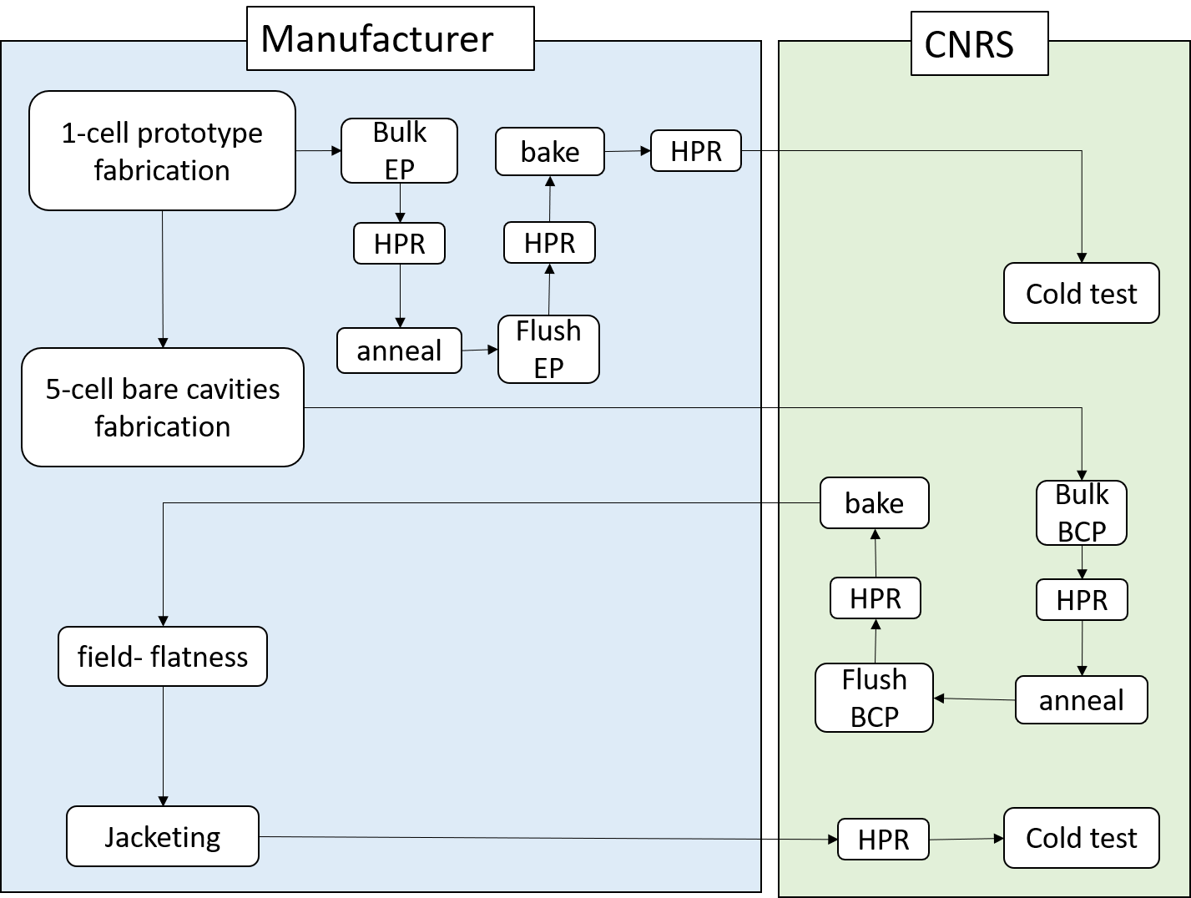
Fabrication and preparation of the cavities
Plan A: EP + heat treatment
Plan B: BCP + heat treatment
Risk in increasing costs
Risk in lower performance
Validate EP process and its cost with the 1st single cell prototype

Slide 9
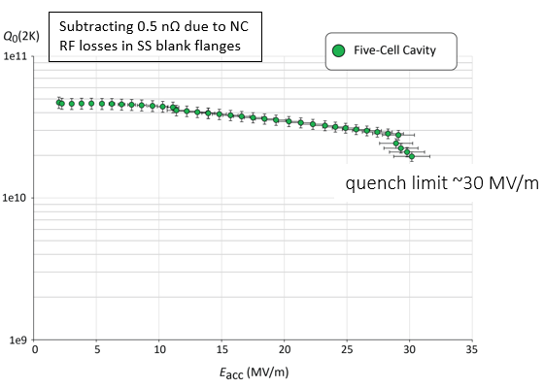
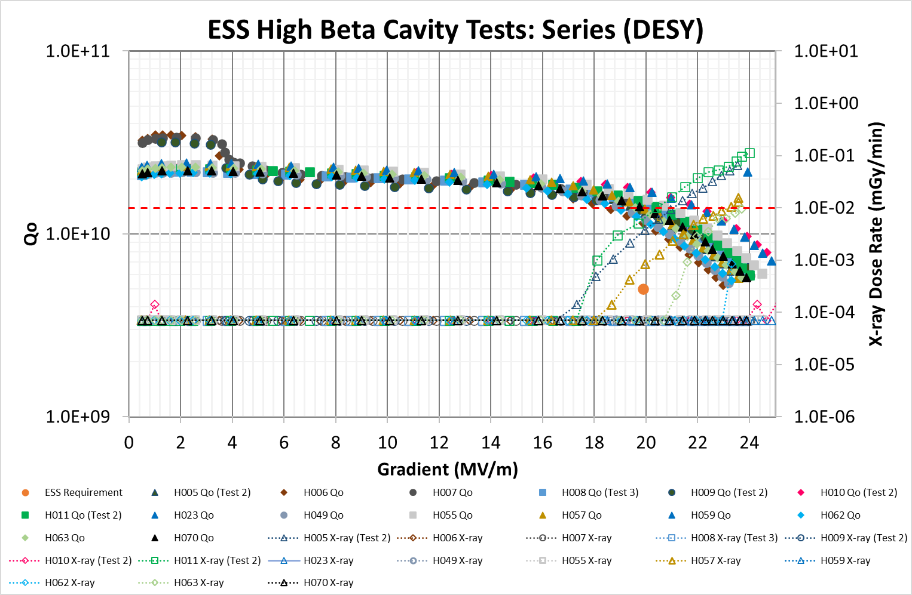
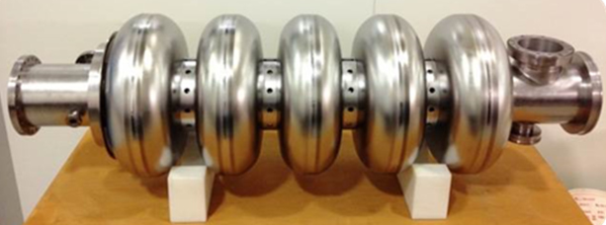
Experiences from JLAB prototype vs series ESS cavities
704 MHz
JLab
P.A. Smith et al SRF2017
800 MHz
Step | Amount
Bulk BCP | 200 um
800C annealing | 3 hours
Final EP | 30 um
120C baking | 12 hours
We will not reach PERLE specification with the ESS standard recipe
No safety margin from JLAB recipe
→ More advanced recipe!
Step | Amount
Bulk BCP | 90+110 um
600C annealing | 10 hours
Final BCP | 20 um

Slide 10
List of the advanced recipes
P. Dhakal “Nitrogen doping and infusion in SRF cavities: A review” Phys Open 5 100034 2020
P. Sha et al. Appl. Sci. 12, 546 (2022)

Slide 11
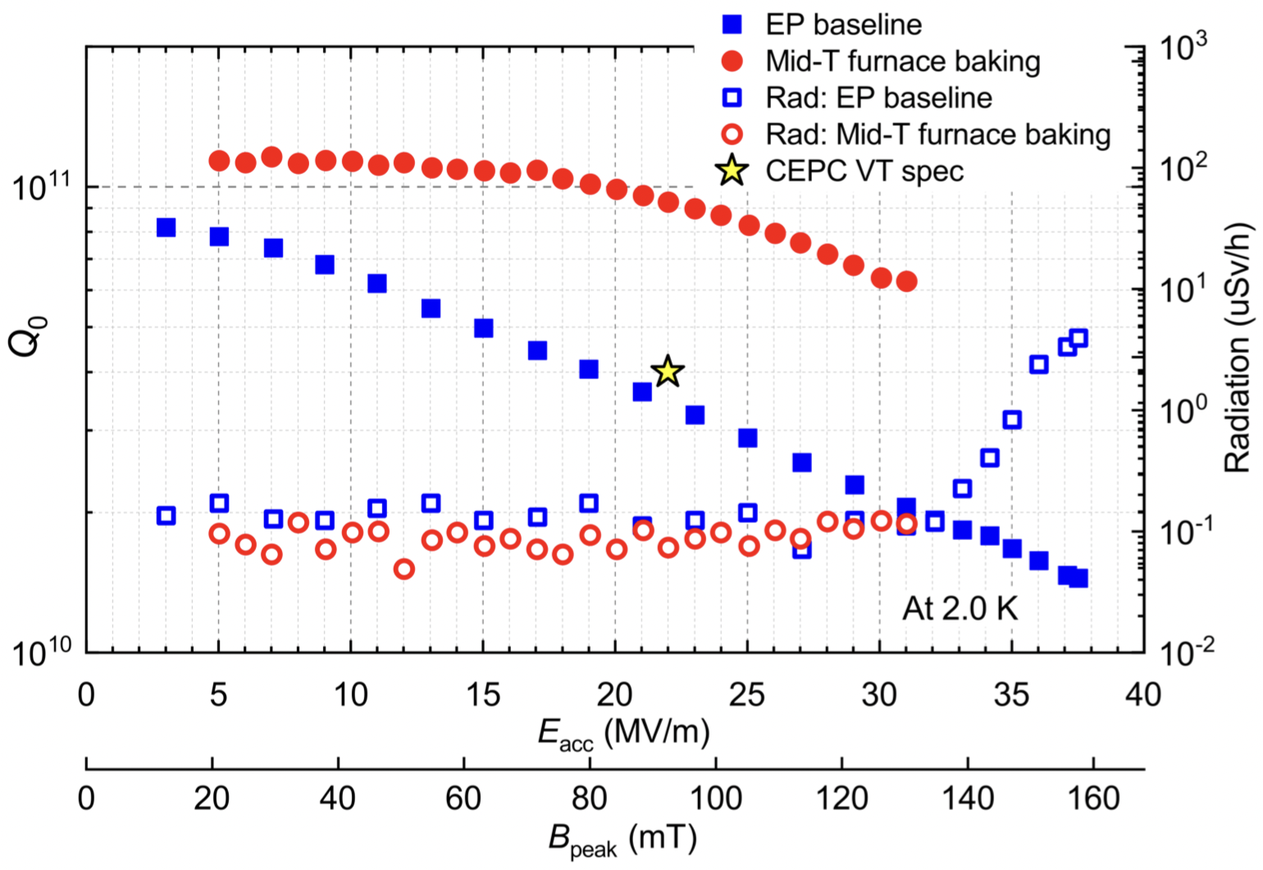
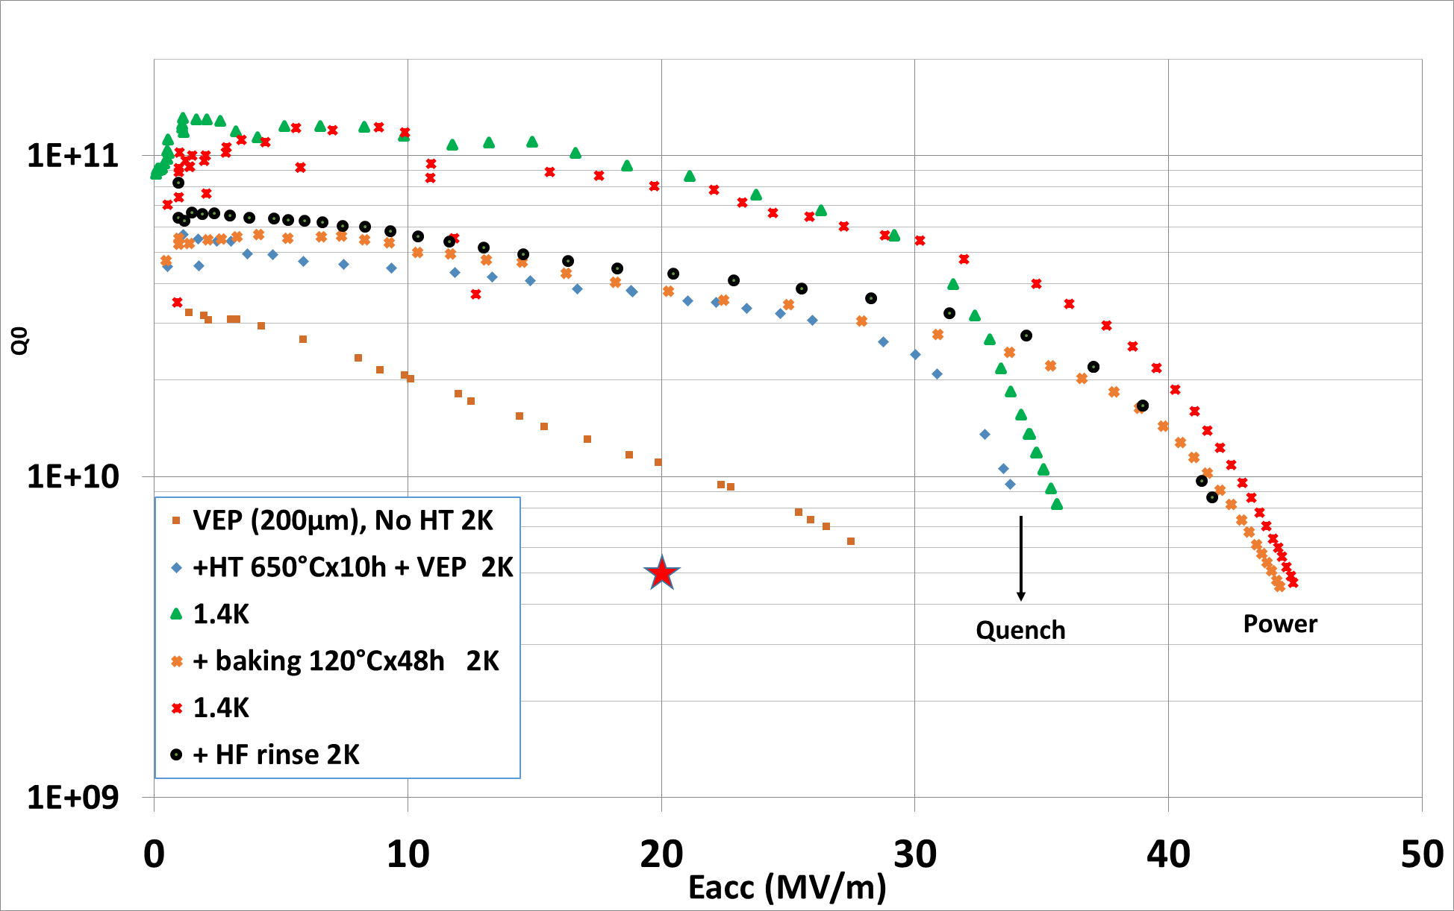
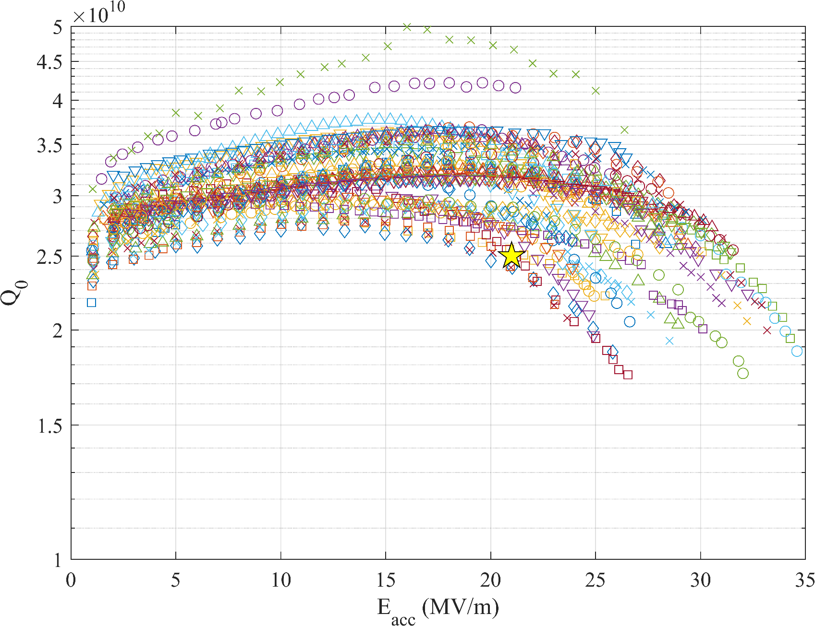
high-Q / high-G cavities in the world
300C baking @ IHEP
120C baking @ CEA-Saclay
2N0 doping at 800C @ LCLSII
P. Sha et al. Appl. Sci. 12, 546 (2022)
704 MHz
650 MHz
1.3 GHz
F. Eozenou et al TTC high-Q/high-G WG Sep 2022 LINAC22 THPOGE23
J. Maniscalco TTC high-G/high-Q WG meeting 09/08/2022
300C baking or N-doping seems like the best option for FCC/PERLE
120C or 2-step baking for higher gradient → ILC
Clean vacuum baking furnace is key in this research domain

Slide 12
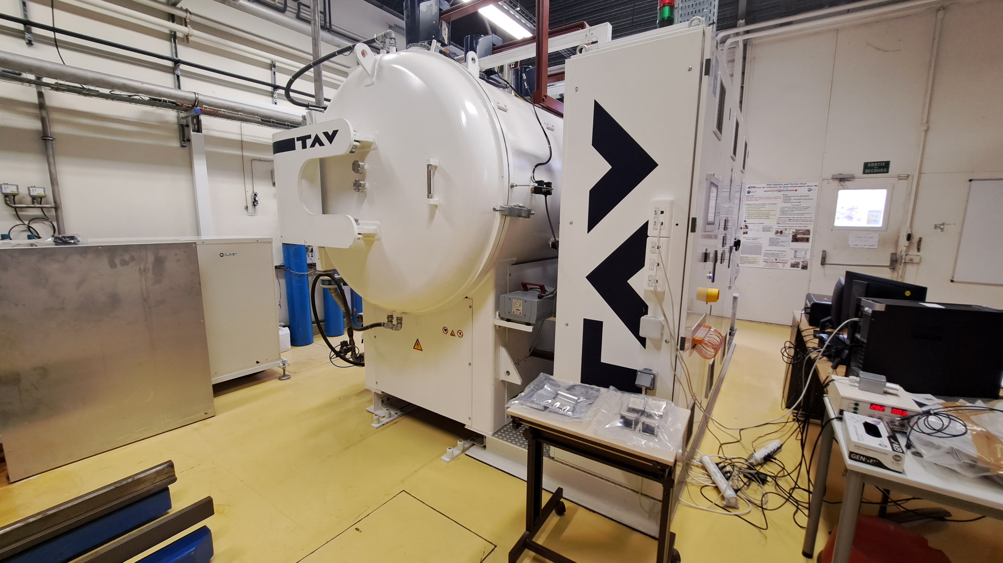
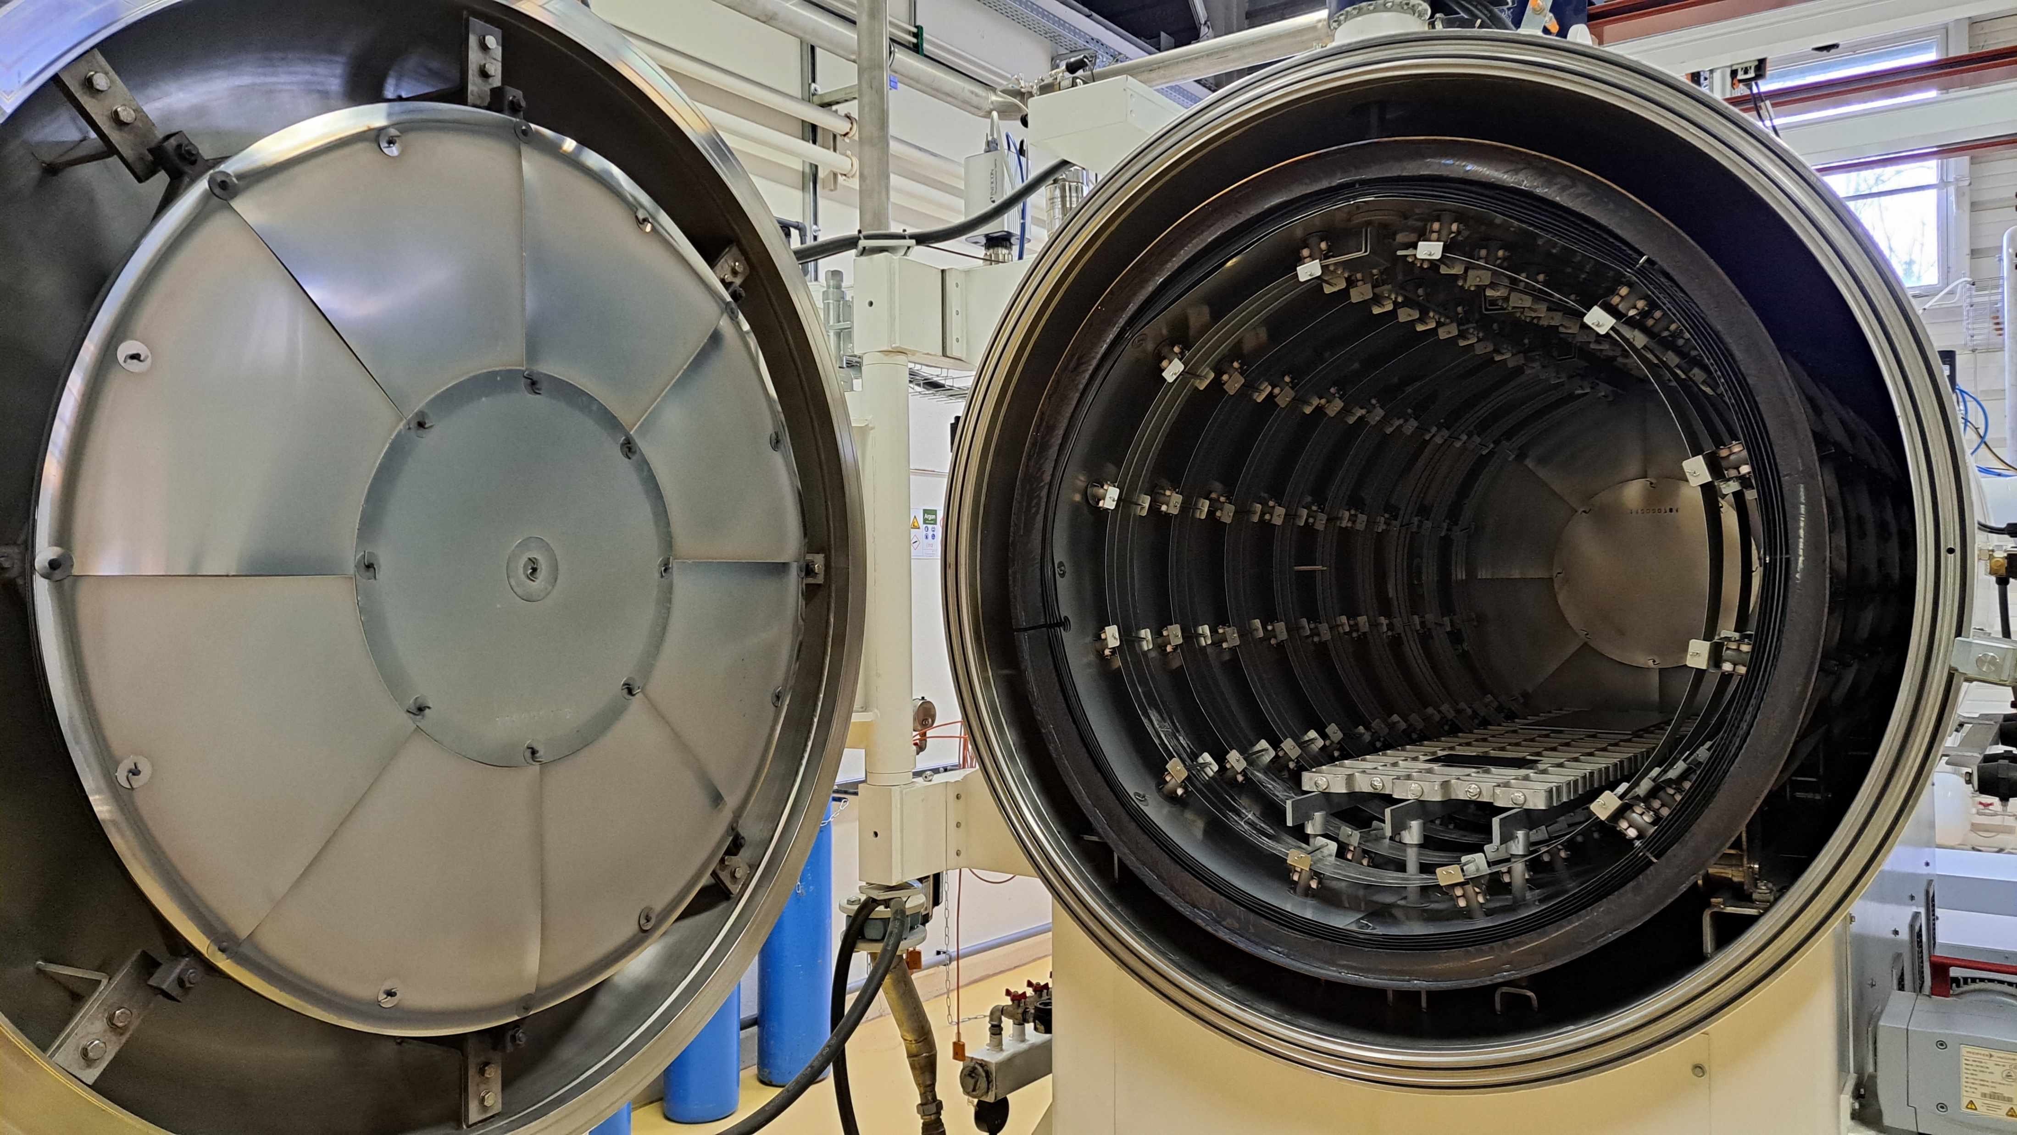
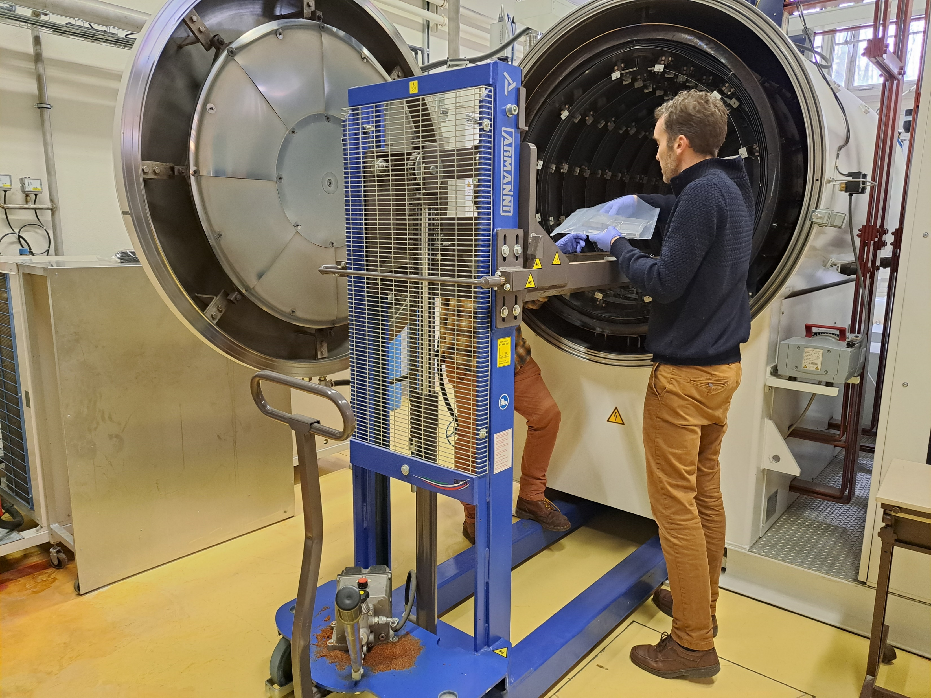
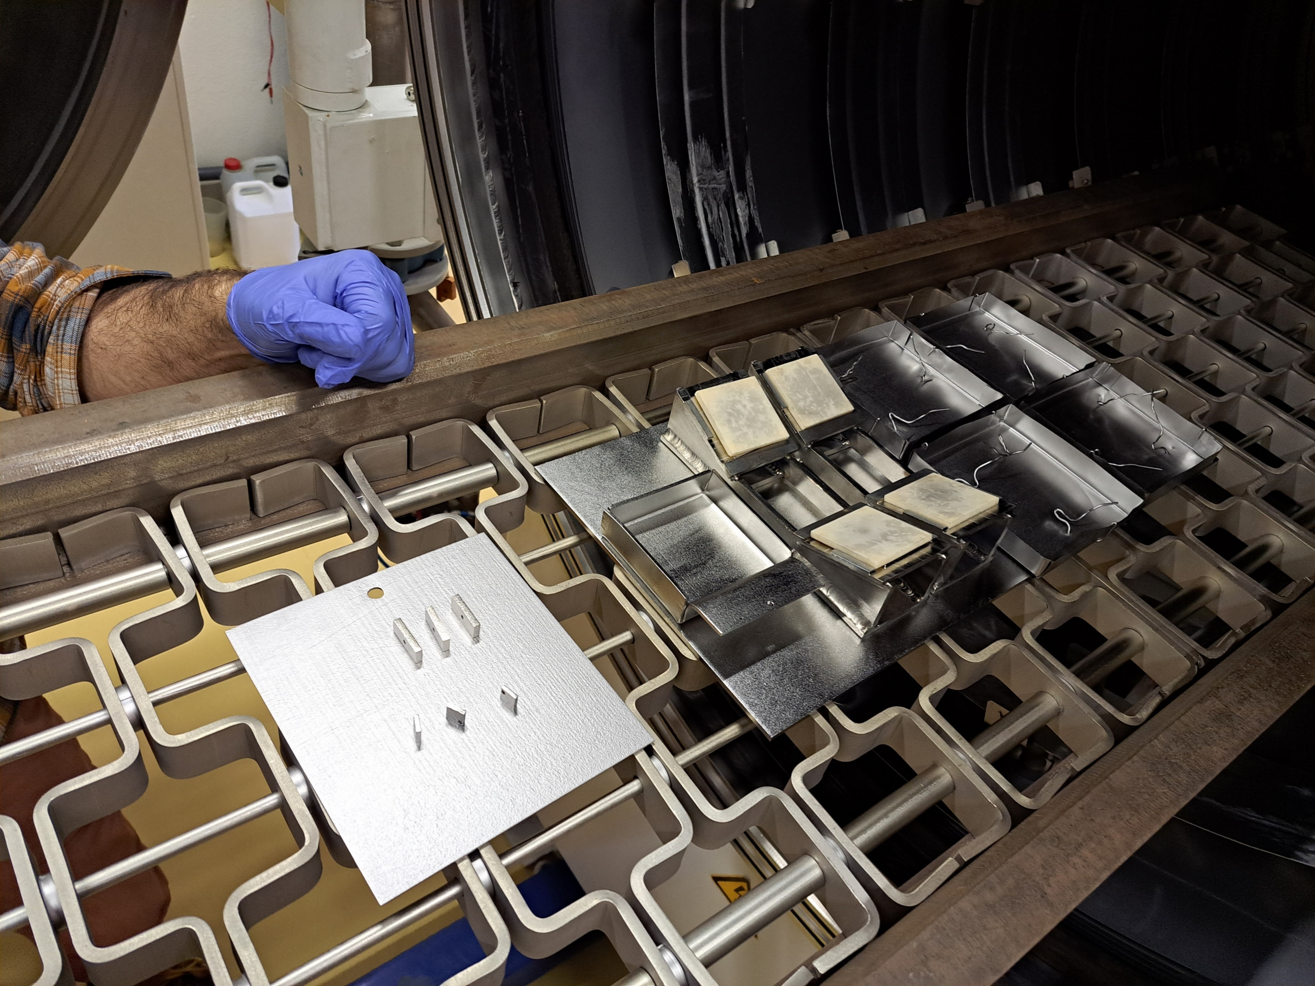
Clean vacuum furnace at IJCLab: same as the one in ZANON
M. Fouaidy et al., IEEE Transactions on Applied Superconductivity, vol. 28, no. 4, pp. 1-6 (2018)
Vacuum furnace originally used for 600C annealing of ESS spoke cavities
A cryogenic pump, pure Ar for purging etc
Never used for advanced heat treatment (mid-T bake)
Annealing at 800C with samples to see contaminations

Slide 13
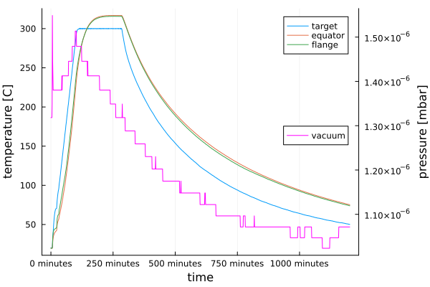
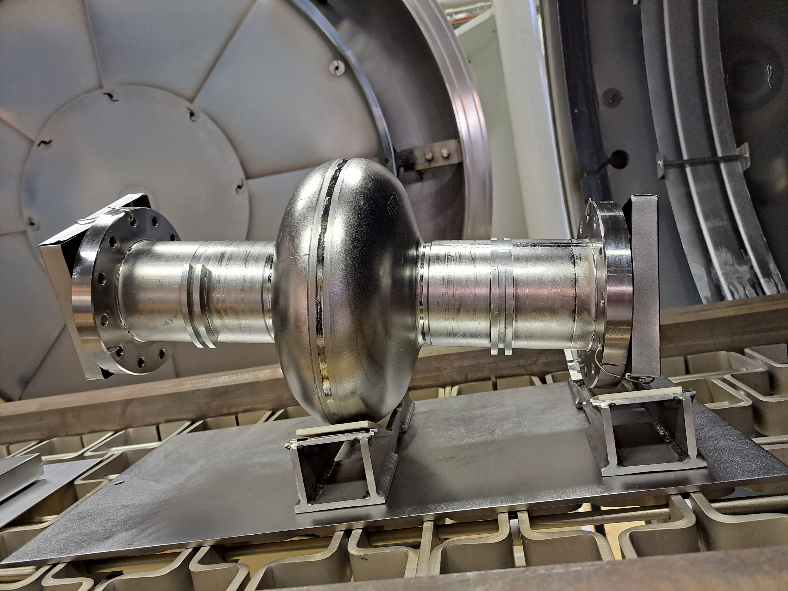
300C baking of DESY 1.3 GHz cavity in IN2P3/IJCLab
April 3 2024
Large volume → ultimate vacuum reach is not as good as KEK
Offset between target (300C) and cavity (316C)
No clean room around
  Same as JLAB → Lid + plastic bag prepared in a clean room
  FNAL and KEK have a clean room in front
Very first mid-T bake in France
13

Slide 14
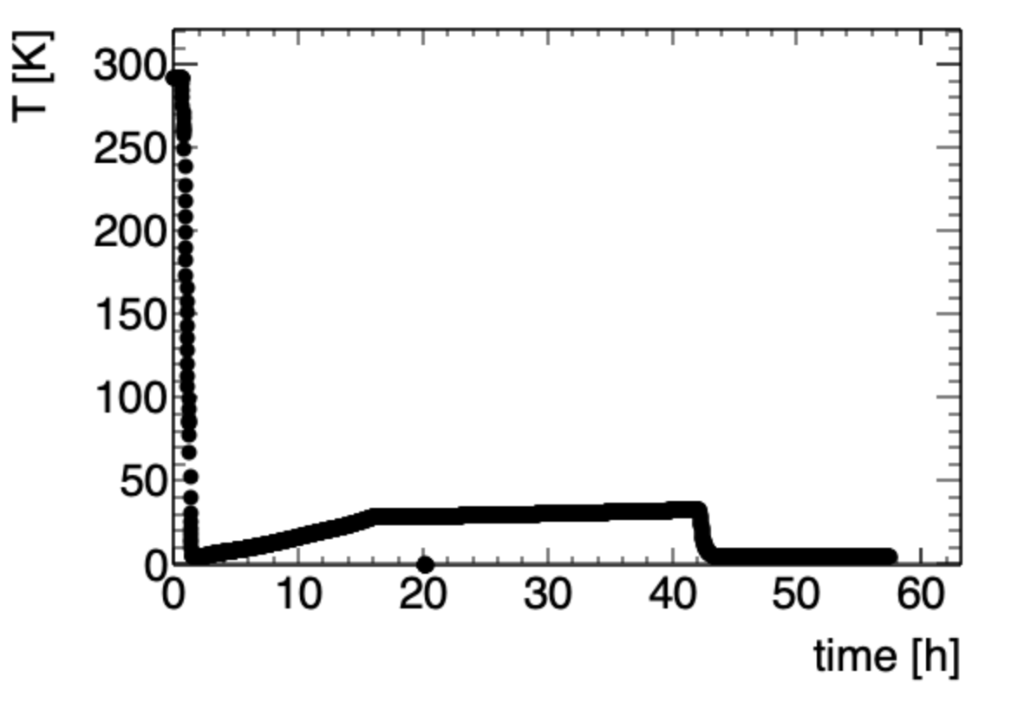
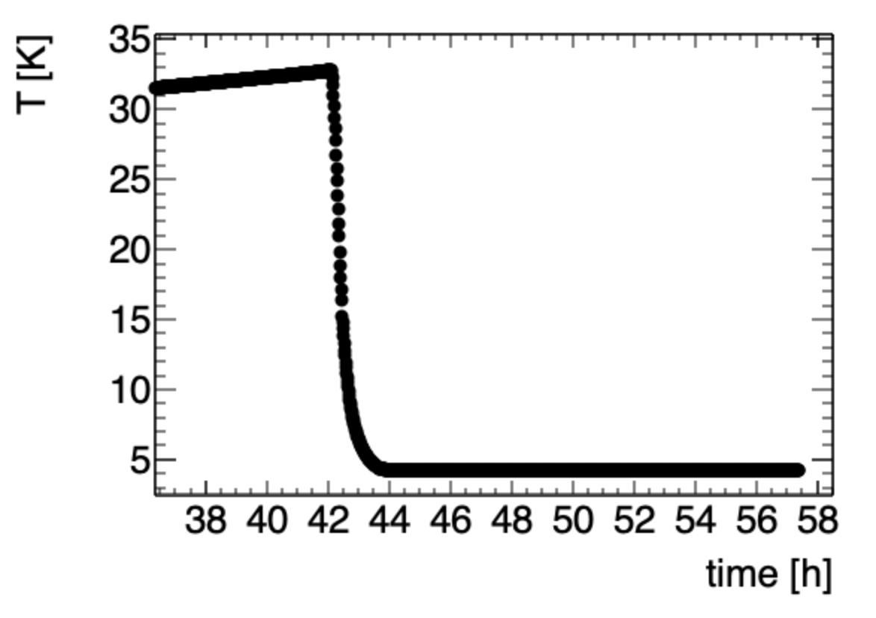
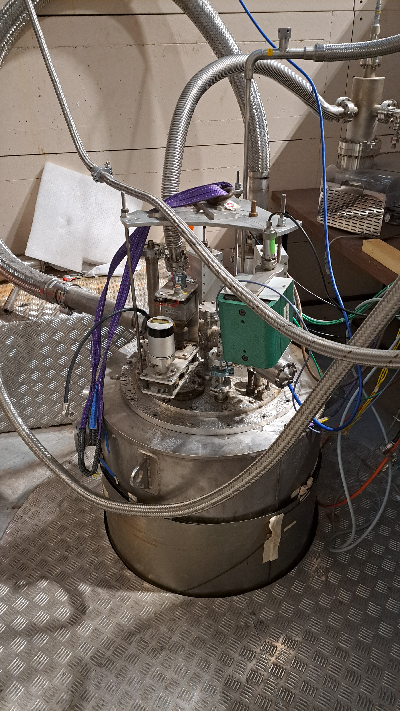

1st test is always far from ideal (CV1 at CEA Saclay on June 18 2024)
No info in $|ΔT|$
1st cooling down after long shutdown
T-sensor at the bottom broken

Slide 15
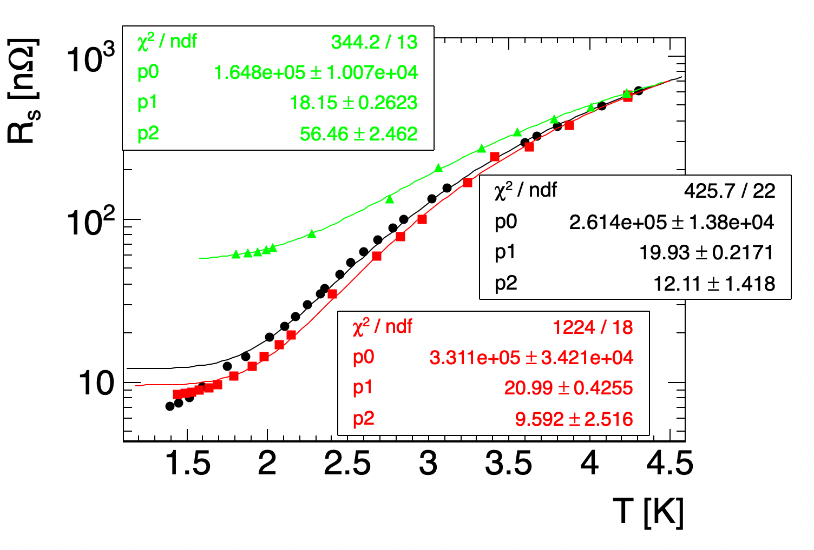
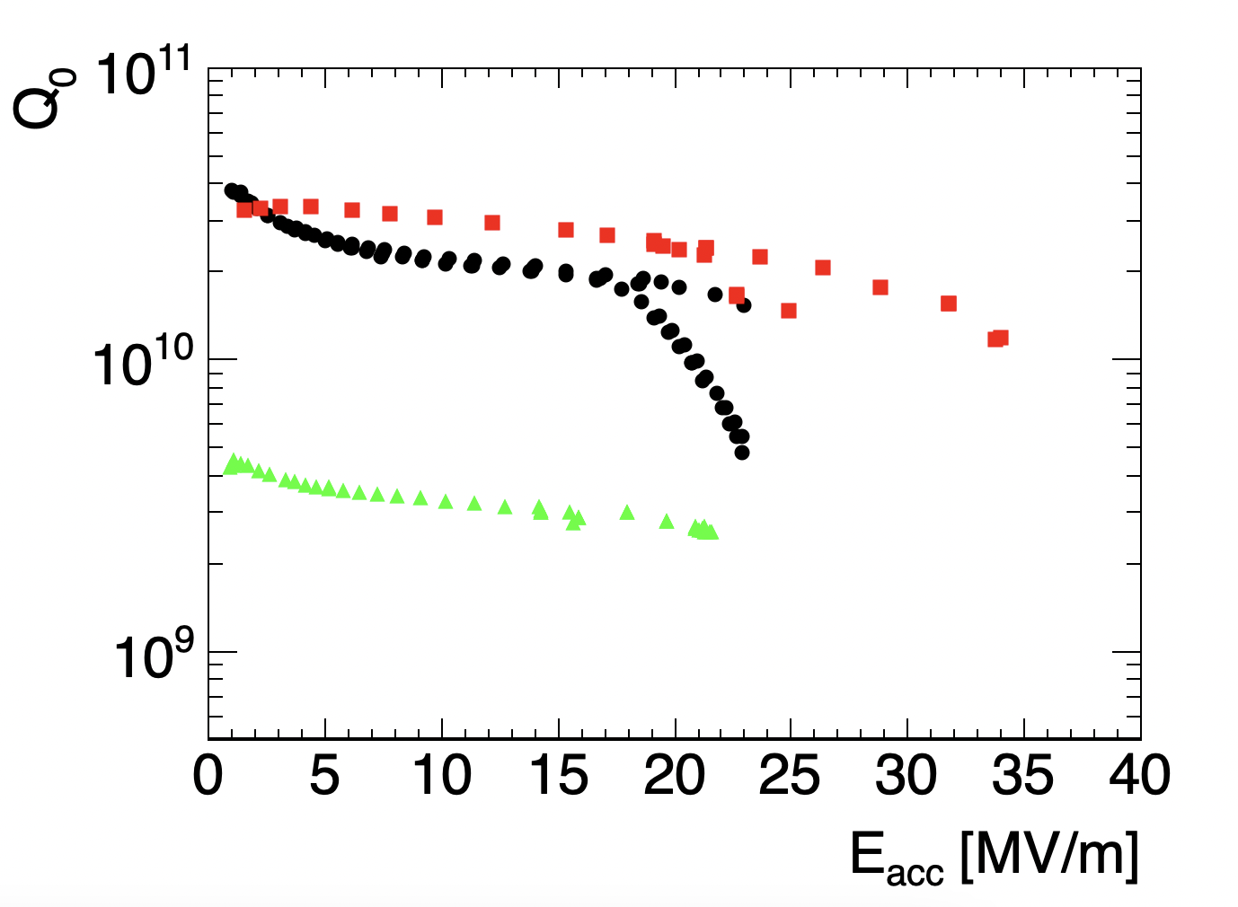

1st test results
At 1 MV/m
2022 2nd EP + 650C @1.4 K
2022 1st EP
2024 mid-T bake
2022 1st EP @ 1.4 K
2022 2nd EP + 650C
2024 mid-T bake at 2 K
$$R_{s}(T)=\frac{p_{0}}{T}\exp\left(−\frac{p_{1}}{T}\right)+p_{2}$$
The mid-T baked cavity showed significantly high residual resistance $ΔR_{res}>46 nΩ$
→ Is it due to contamination of furnace/cavity or magnetic field effect?

Slide 16
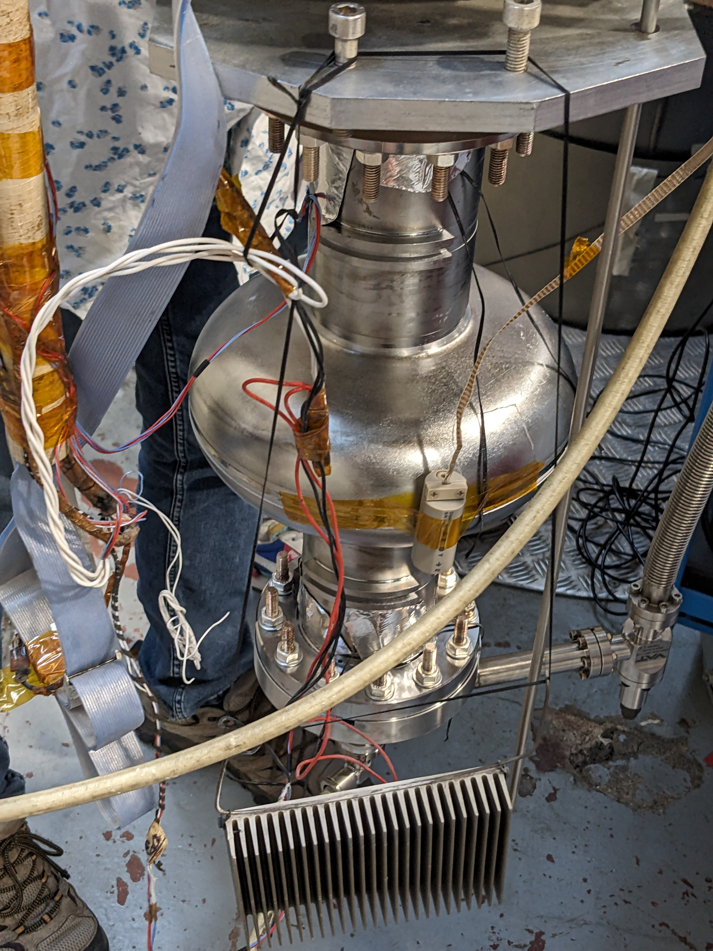
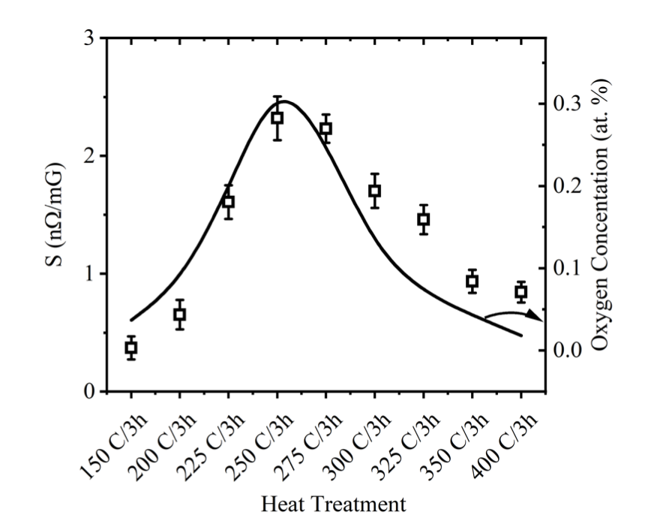
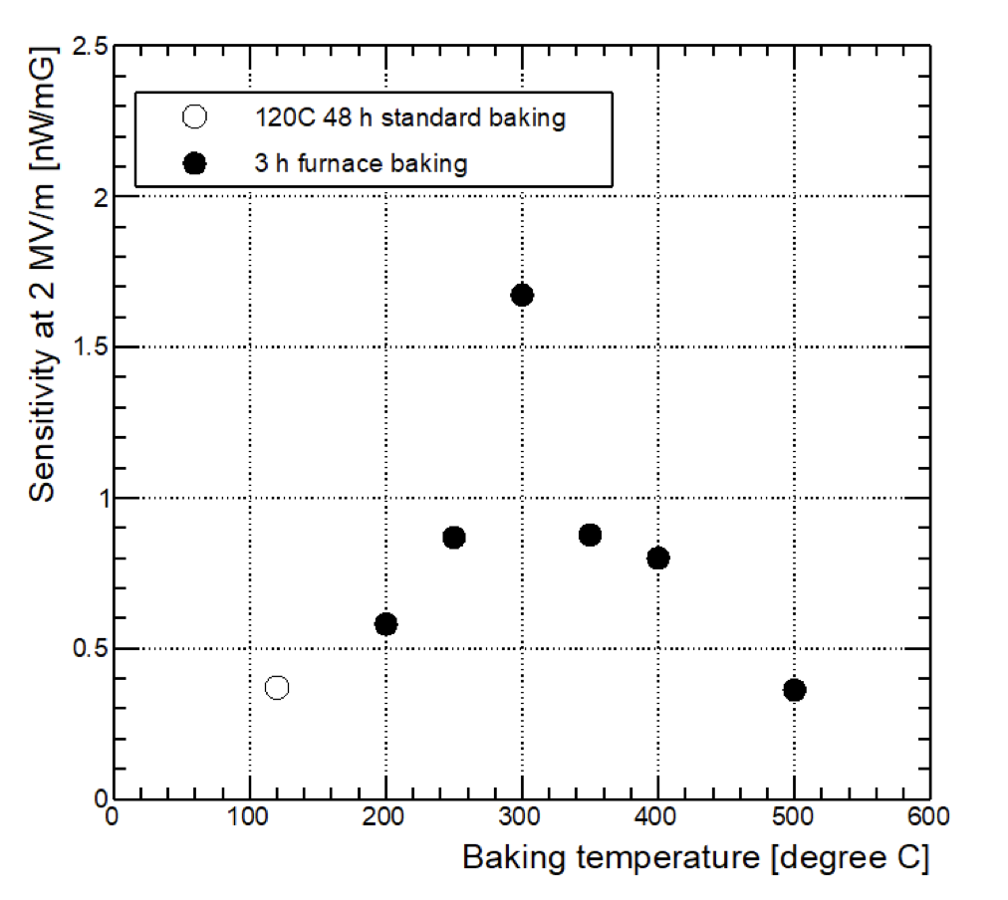
Magnetic field sensitivity (1.3 GHz cavities)
JLab
KEK
$$H_{ext}\sim 25 mG=2.5 μT$$
$$S\sim 2 {nΩ}/{mG}$$
Not optimized for mid-T!
$$→ΔR_{res}\sim SH_{ext}=50 nΩ$$

Slide 17
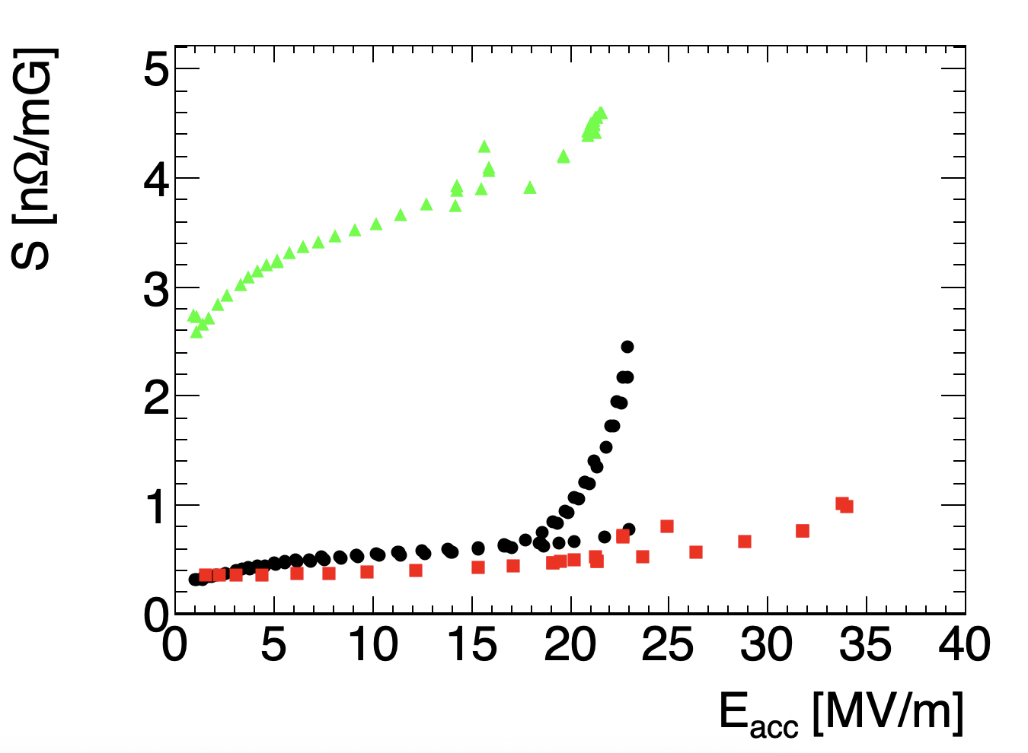
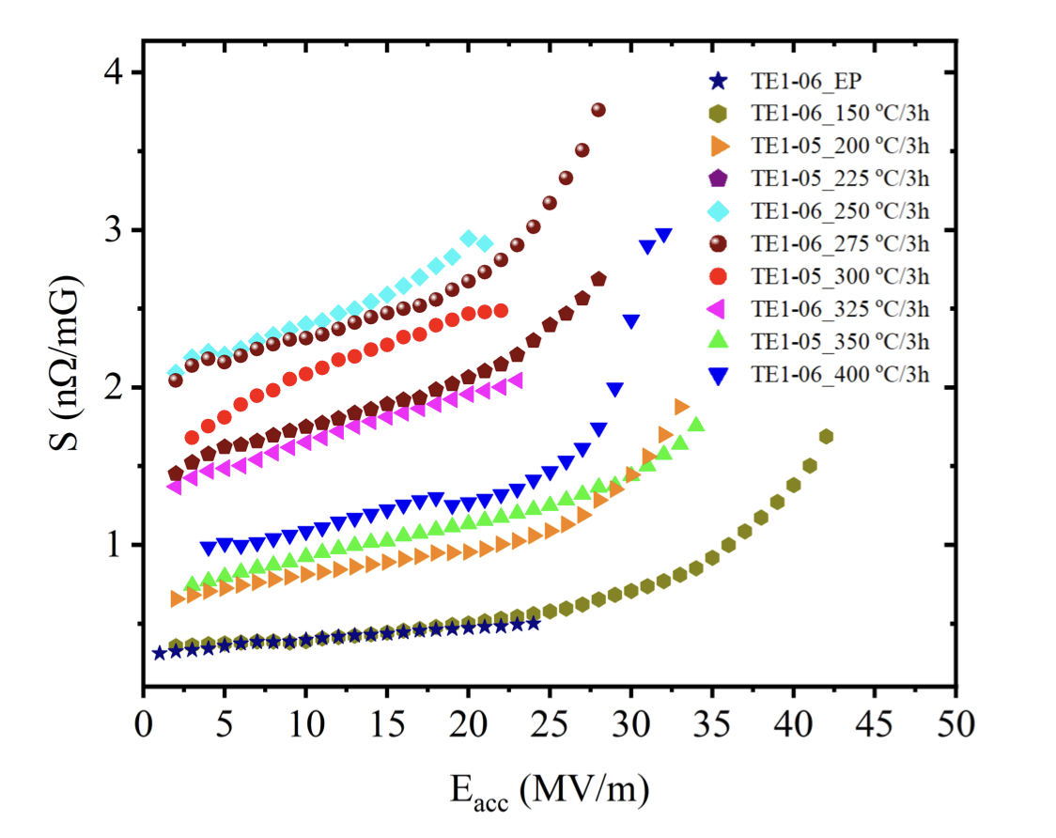
Compare to JLAB result at 2 K: 25 mG case
2024 mid-T bake at 2 K
2022 1st EP @ 1.4 K
2022 2nd EP + 650C @1.4 K
We could explain the degradation of Q due to non-optimized magnetic shield and high sensitivity to trapped flux in mid-T baked cavities
→ Improving magnetic shield and installing magnetic field at CEA!

Slide 18
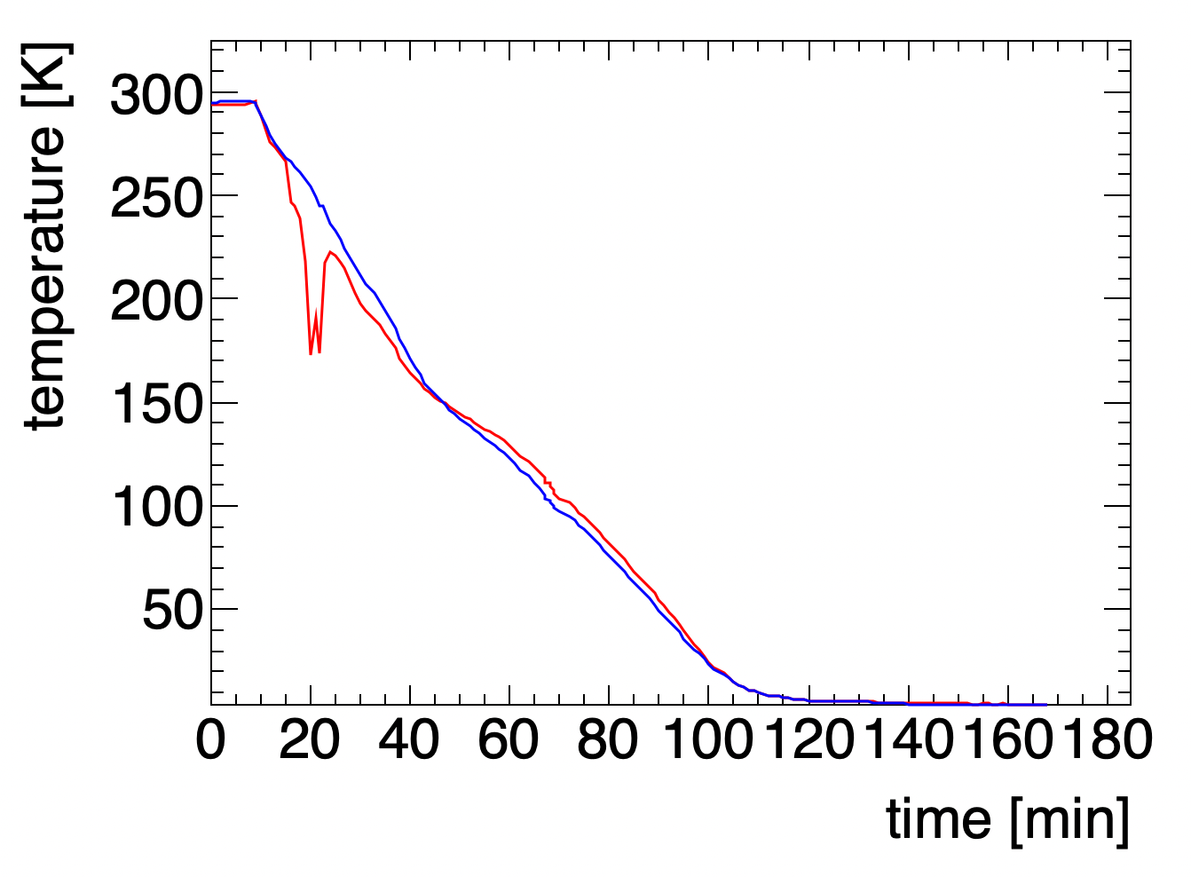
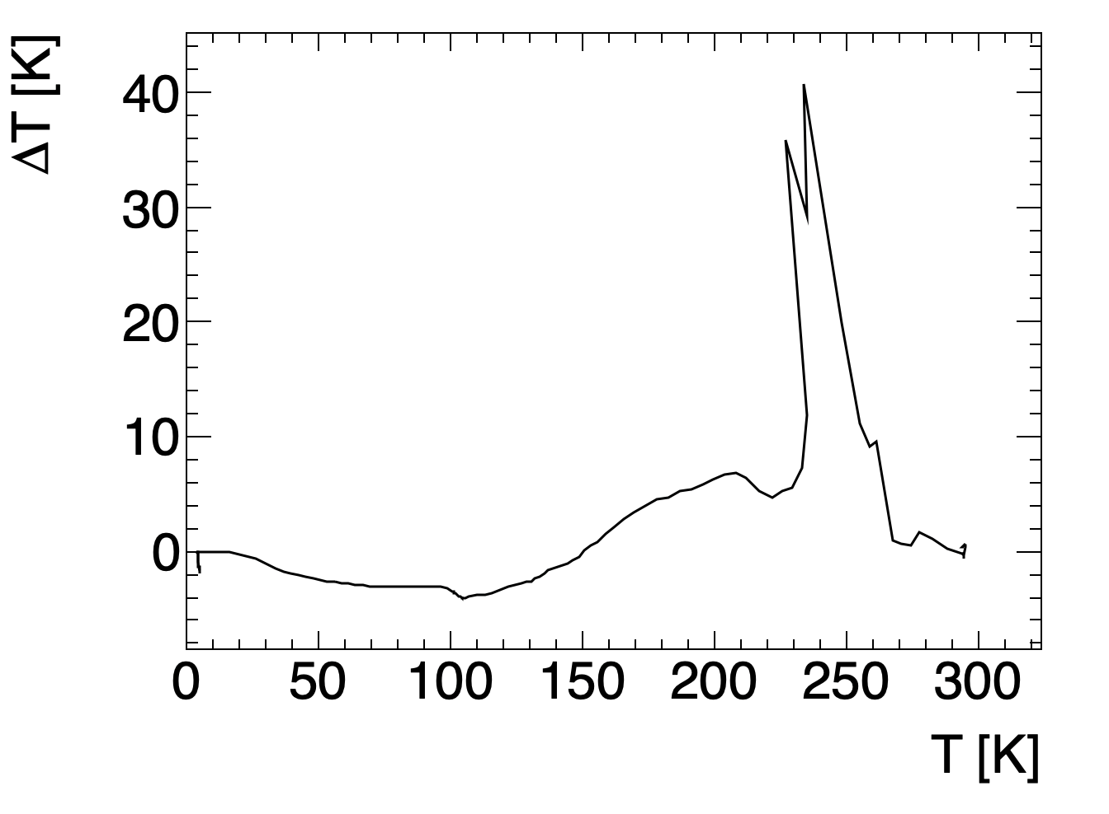
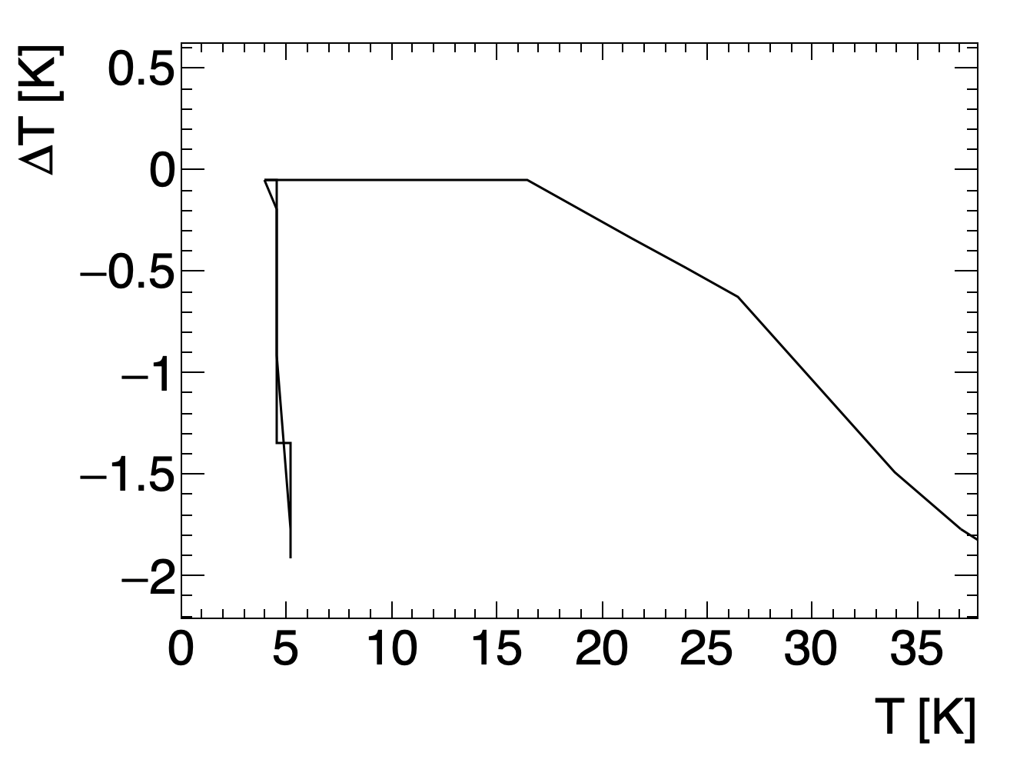
2n cooling down: temperature sensors were OK (July 18 2024)
Cavity bottom
Cavity top
800C & 600C annealed 1.3 GHz cavity with $ΔT=0$ at $T_{c}=9.25 K$
→ No flux expulsion is expected

Slide 19
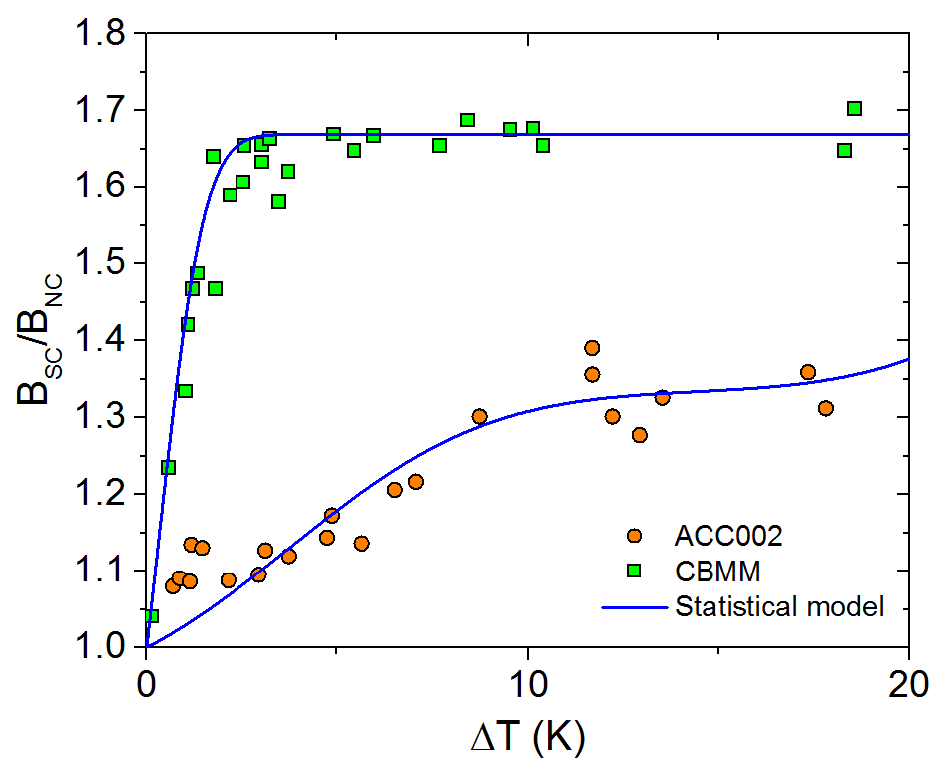
Flux expulsion is mandatory for mid-T bake or N-doped cavities
$$y$$
900C annealing
$$f_{T}=SΔT=−φ_{0}{∂H_{c1}}/{∂T}⋅ΔT$$
$$g(x)$$
$$f$$
Lower $\left\langle J_{c}\right\rangle$
$$f$$
$$x$$
Meissner State
Mixed State
800C annealing
$$f_{p}=\left|{ \overline{J}}_{c}×n{\overline{Φ}}_{0}\right|=J_{c}B$$
M. Checchin TTC topical workshop 2017
Balance between thermodynamic force $f_{T}$ and pinning force $f_{p}$ in the mixed state
Higher thermal gradient → higher expulsion efficiency
→ Cooling down with higher thermal gradient is a standard receipt in LCLS-II at SLAC

Slide 20

Surface resistance at low field during cooling down
The very high residual resistance of the last measurement after mid-T bake was due to the bad ambient magnetic field
The magnetic field expulsion is still not perfect
KEK cryostat for final check
FJPPN “ERL collaboration”

Slide 21


Q vs E and Rs vs E
20 MV/m seems like a quench limit after the mid-T bake at 316C
Maybe a small anti-Q-slope was observed
Before mid-T bake data was taken at 1.4 K

Slide 22




3rd test at KEK (1st week of October) being prepared
Our results so far
316C baking, no perfect magnetic field
1.4 K
2.0 K
→ Extremely interesting to test this cavity at KEK

Slide 23
Risk management of 5-cell 800 MHz cavities
The 1st constraint is budget
  We prepared public tender based on quotations from the vendors
  Niobium materials is under procurement; very expensive!
  Cavity fabrication + preparation will be soon published; super expensive!
Within the budget, we need to take a risk
  Mid-T baking is the most promising way to achieve the potential performance of PERLE
  However, magnetic field environment and flux expulsion capability will be known at the very end inside the cryomodule (deliverable of iSAS) → out of spec. can be the practical answer
  Backup 1: reset the surface with light BCP → ESS spec: 17 MV/m Q₀=10¹⁰ → 200 MeV instead of 250 MeV
  Backup 2: reset the surface with light EP → jacket is the obstacle
EP is still under discussion
  Cold EP can achieve x100 better surface roughness than BCP→ Knowledge transfer was done from FNAL to a vendor with 650 MHz cavity → No technical issue
  Budget is the constraint!
  No EP → BCP at IJCLab → ESS spec or trying mid-T bake after BCP (R&D subject)
HOM damping scheme
  HOM couplers were validated with copper cavities (Carmelo’s PhD thesis)
  Risk in niobium coupler antennas → hyper expensive; challenging to cool down
  FCC’s scheme (no HOM couplers) is not yet validated → too late for the iSAS public tender
  Backup (?)

Slide 24




Booster cavities: low gradient requirement: new proposal
$E_{acc}=9.2$ MV/m & Single cell 800 MHz → Nb₃Sn/Nb at 4 K is realistic!
PIPII 650 MHz in Fermilab!
Courtesy:
Sam Posen
M. Seidel iSAS workshop 2023
S.Claudet et al, CERN 2013
Timeline: 4 years → 800 MHz single cell prototype for Nb3Sn test after mid-T bake
Nb3Sn booster + mid-T bake ERF → the most advanced SRF accelerator project!
Crylcooler is probably too ambitious at this moment

Slide 25
Conclusions
IJCLab has been a world-leading laboratory of SRF cavities for proton / heavy ion linear accelerators
  R&D of Spiral2, ESS, MYRRHA, PIPII cavities are coming to the final phase
  Contributions to collider projects has been in beam dynamics and nanobeams (ATF), RF couplers (Eu-XFEL), temperature sensors (LHC), etc
Risk management is the critical issue in the iSAS/PERLE cavity procurement
  Very ambitious specification (however not impossible according to the literature)
  No sufficient R&D: time and money → international collaboration to complement it
  Limited budget (or too expensive cavities) → several options to mitigate the risks
Advanced heat treatment is the key R&D subject
  IJCLab is equipped with a clean vacuum furnace originally used for the ESS spoke cavity project
  Mid-T baking for super high-Q
  1st mid-T baked results in 1.3 GHz cavity → studies on-going
Future prospects (end 2024 – beginning 2025)
  3rd test at STF in KEK (October) with flux expulsion
  Repairing JLAB 800 MHz prototype cavity
  Procurement of Nb materials and cavities
Collaborations
  Collaboration with INFN-LASA / CEA Saclay via iSAS
  ERL collaboration with KEK via FJPPL
  FCC: collaboration with CERN/FNAL
  PERLE: collaboration with CERN/JLAB
  Potential collaboration with iHEP

