Slide 1
Power couplers design for PERLE
Eric.Montesinos@cern.ch on behalf of all colleagues involved in SPL and FCC FPCs at CERN, and elsewhere all around the world

Slide 2
Content
SPL, a bit of history
SPL Two FPC designs
  Plug & play WG
  Test box
  Construction
  First tests
  Devil is in the details
  A long experience with eth collaborations
  Test mitigation plan
SPL 3.0 design
HL-LHC Crab FPC
FCC simulations stage
iSAS FPC
  Design and prototyping
  Conditioning of the FPCs
  Some definition clarification
  PERLE FPC timeline
Conclusion
Glossary
ERL Energy Recovery Linac
FCC Future Circular Collider
FPC Fundamental Power Coupler
HL-LHC High Luminosity - Large Hadron Collider
iSAS innovate for Sustainable Accelerating System
PERLE Powerful ERL for Experiment
SPL Superconducting Proton Linac
SW Standing Wave
TW Travelling Wave
WG Waveguide

Slide 3
A bit of History
2000
2005
2010
2015
2020
2025
2000, Conceptual Design of the SPL, a high-power Superconducting H- Linac at CERN
    The conceptual design of a superconducting H– linear accelerator at CERN for a beam energy of 2.2 GeV and a power of 4 MW is presented. Using most of the superconducting RF cavities available after the decommissioning of LEP, it operates at 352 MHz and delivers 1016 protons per second, in 2.2 ms bursts with a repetition rate of 75 Hz. In conjunction with an accumulator and a compressor, it is designed to be the proton driver of a neutrino factory at CERN. At an early stage, it will upgrade the performance of the PS complex by replacing Linac2 and the PS Booster, by injecting protons directly into the PS. The brilliance of the LHC beam will thus be tripled. The present ISOLDE facility can be supplied with five times more beam current than today, and a new-generation radioactive ion beam facility receiving up to 100 µA beam current could also be accommodated. More generally, the PS beam intensity will be substantially increased at all energies, with a direct benefit for fixed target physics and especially neutrino physics based on pion decay

Slide 4
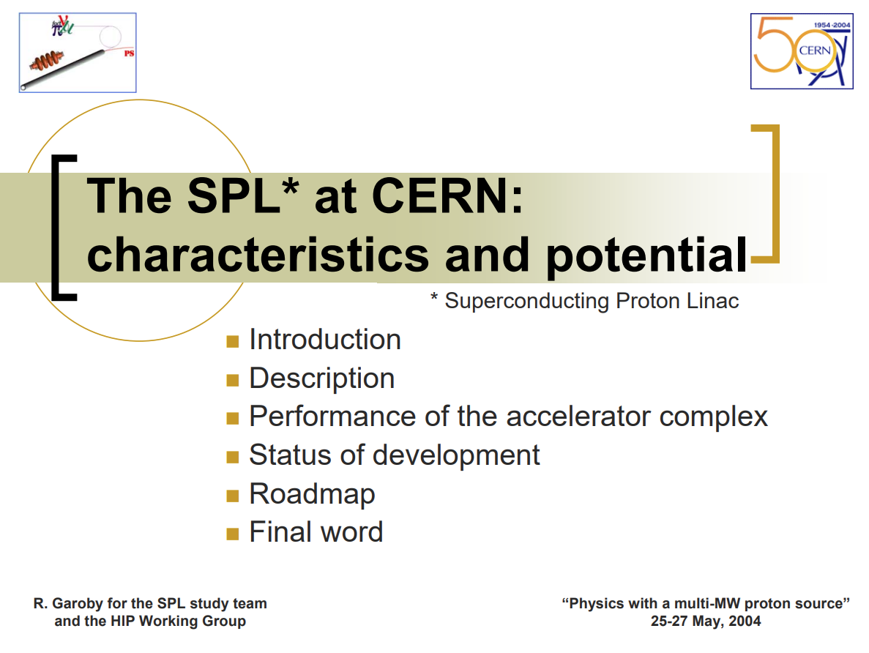
A bit of History
2000
2005
2010
2015
2020
2025
2004, Workshop on PHYSICS WITH A MULTI-MW PROTON SOURCE , CERN, Geneva, May 25-27
The SPL at CERN: characteristics and potential
  The workshop ‘Physics with a multi-Megawatt (MMW) Proton Source’ was held at CERN on 25-27 May 2004. It was organized by the ECFA/BENE working groups for future neutrino facilities in Europe and by the EURISOL nuclear physics community to explore the physics opportunities offered by a new high intensity proton accelerator. It confirmed the important synergies that exist between these communities. This document summarises the main design choices for the accelerators and experiments involved, the physics possibilities and the most critical R&D that will be necessary. A preliminary baseline road map is delineated.

Slide 5
A bit of History
2000
2005
2010
2015
2020
2025
2008
  First SPL Collaboration meeting
2009
Proposal of four possible designs
2010
  Design review with worldwide coupler experts
  ANL-APS: Ali Nassiri
  DESY: Wolf-dietrich Moeller
  Fermilab: Mark Champion & Sergey Kazakov
  Jlab: Mircea Stirbet
  Two designs validated
Technical Choices
Single window coupler
Fixed coupler
With a Double Walled Tube
Mounted in clean room with its double walled tube
Vertically below the cavity and will be a support for the cavity (first time worldwide)
With a HV DC biasing capacitor
Air cooled
RF Characteristics
f₀ | 704.4 MHz
Power levels | 1000 kW pulsed 0.4 + 1.2 + 0.4 = 2.0 ms 50 Hz (20 ms) 100 kW average
Cavity design gradient | 19-25 MV/m
Q_{ext} of input coupler | 1.2 x 10⁶
Input line Ø | 100 / 43.5 mm = 50 Ω (from the cavity design)
Waveguides | WR 1150

Slide 6
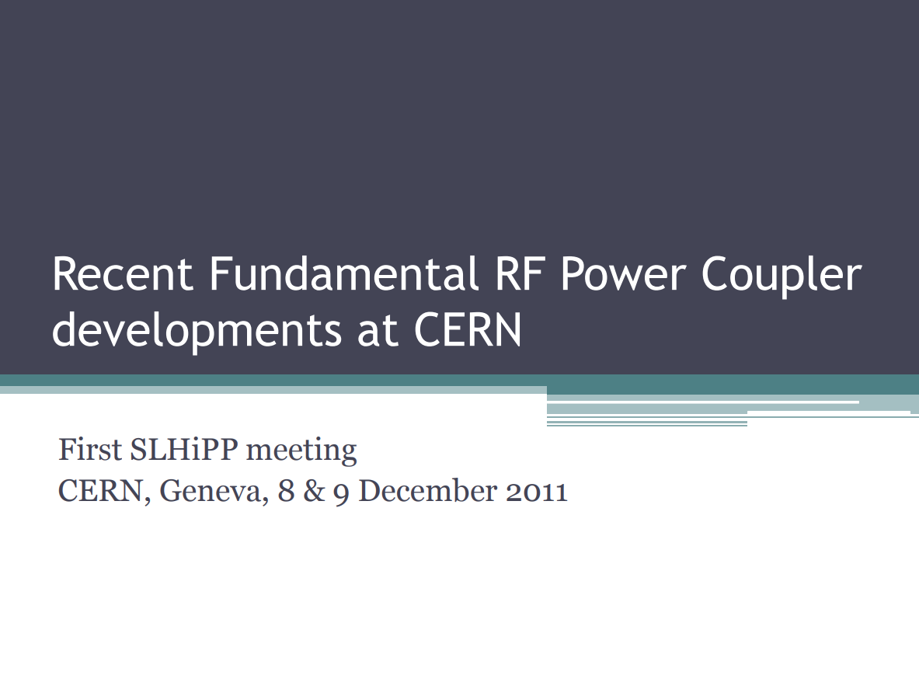
A bit of History
2000
2005
2010
2015
2020
2025
2011, Conceptual SPL RF Main Power Coupler design
    The existing complex of accelerators at CERN is capable to provide the Large Hadron Collider (LHC) with the beam required to reach its nominal characteristics. Higher performance injectors will however be necessary to exceed this limit and maximize the physics reach of the LHC. As a first step, the construction of a new 160 MeV H- linac (Linac4) has started, and the study of a 4 GeV Superconducting Proton Linac (SPL) is being pursued. The SPL project aims to test a first four cavities with full power.

Slide 7
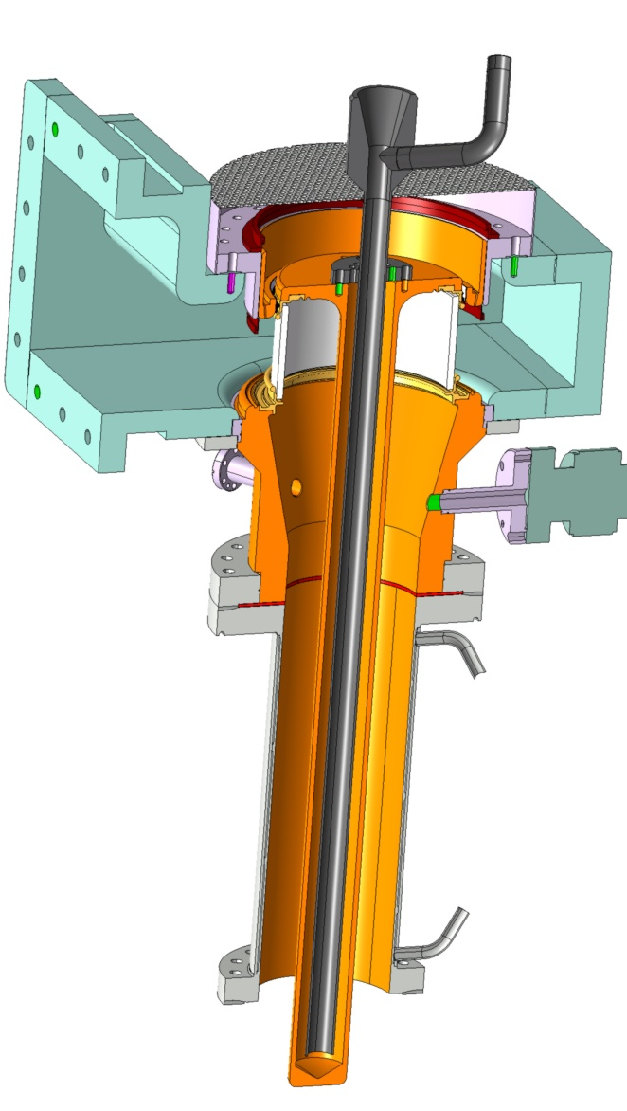
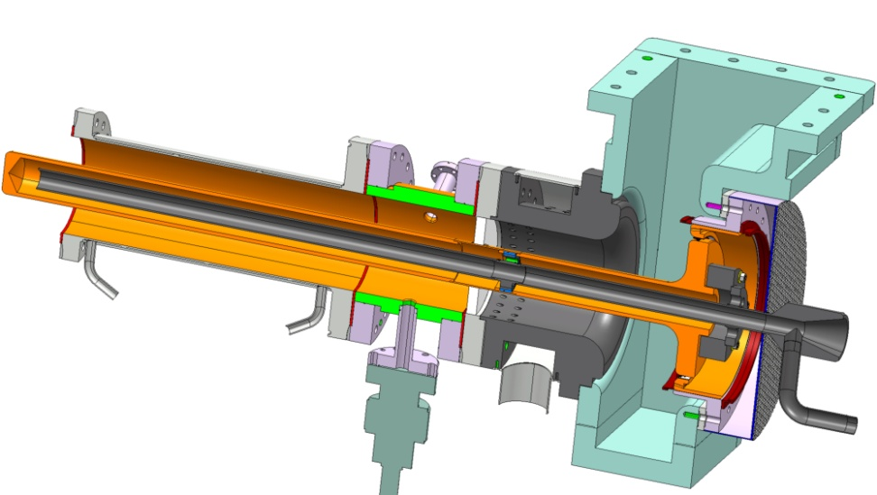
Two FPC designs
Both designs
will have the same
  Double walled tube
  Matching waveguide without doorknob
  Contacts ring including DC capacitor
  Interface to
  cryomodule flange &
  RF + vacuum gasket
Planar disk window coupler
Coaxial cylindrical (LHC) window coupler

Slide 8
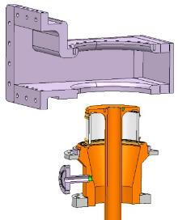

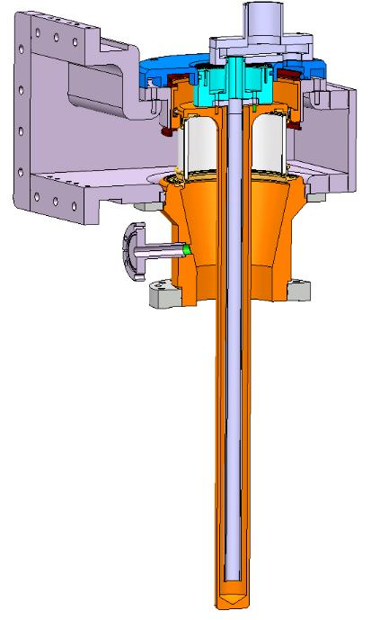
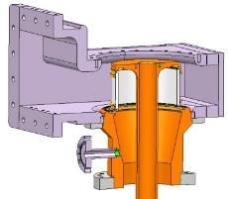
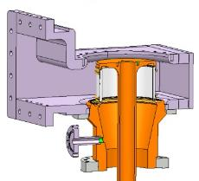
Plug & Play waveguide concept
1
2
3
4
‘Plug and Play’ waveguide with matching step and DC capacitor included
Connect the monobloc waveguide to the body line
  Insert the contacts ring, without stress given to the ceramic
  Final assembly of air-cooling system
1
2
3
4

Slide 9
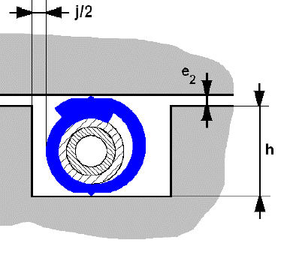
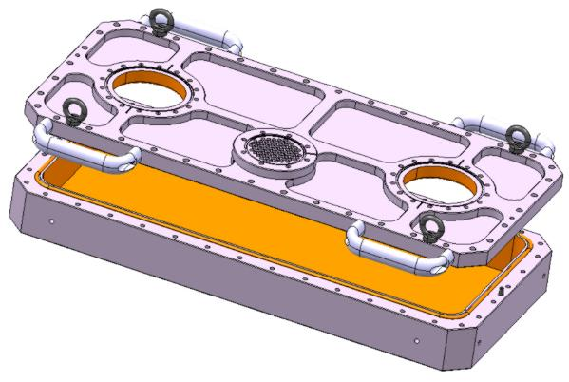
Test box
SPL helicoflex gasket
specially designed to avoid any dust going into the box
Easier (not easy) copper sputtering, self supporting shape
Use of a specially designed for SPL test boxes helicoflex seal
In June 2011, the four test boxes were assembled in DESY clean room, thanks to DESY colleagues who have done a very good job
SPL test box
Upper cover with all flanges machined from a plain 3D forged Stainless Steel block

Slide 10
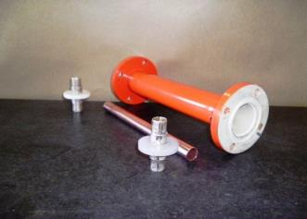
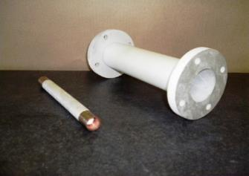
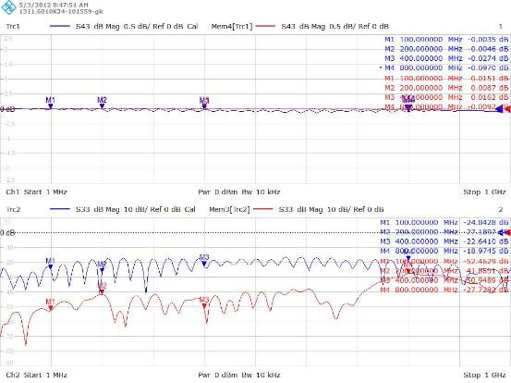
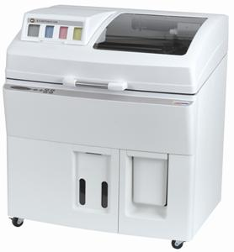
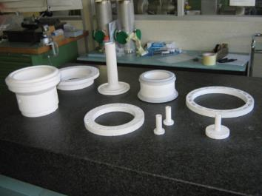
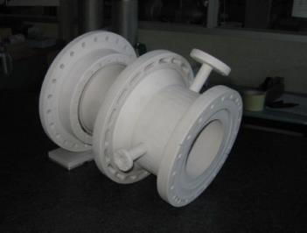
Construction
2000
2005
2010
2015
2020
2025
2011
3D printing & Construction
  Thanks to SPL R&D program we demonstrated that 3D printing can be used with an accuracy of 0.2 mm which allows a cheaper mechanical check compared to conventional machining
  With the correct metallic paint, it can also be used for LLRF checks at a quite cheaper cost compared to the cost of true items
Conventional machining
3D printed painted
S21 = -0.03 dB
S21 = -0.01 dB
S11 = -25 dB
S11 = -40 dB

Slide 11
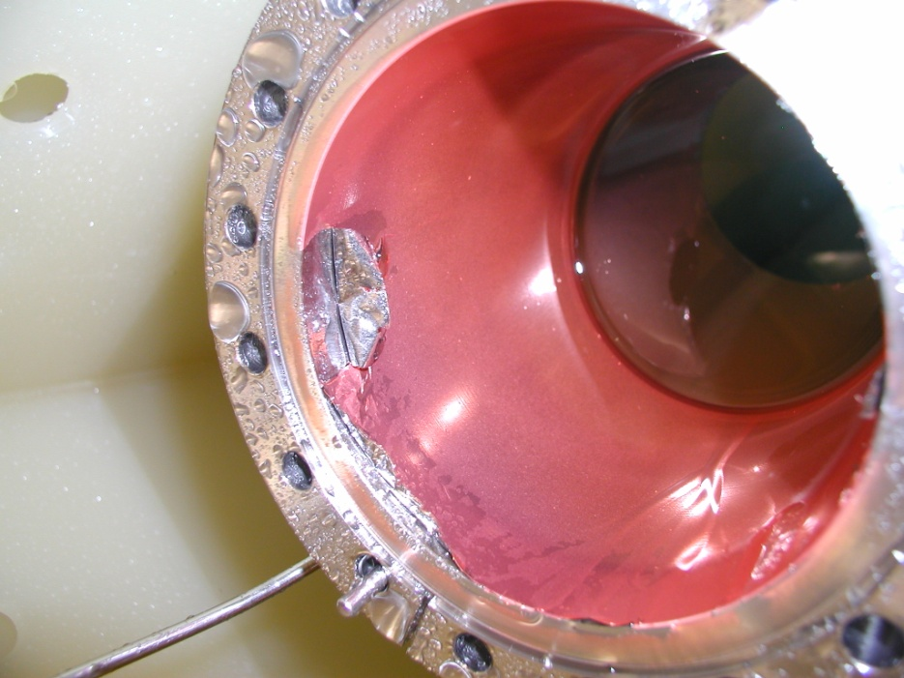
Construction
2000
2005
2010
2015
2020
2025
2012
Copper peeling on Double walled Tube (DT)
  Double Walled Tube copper coating peeled off during cleaning before installation in clean room at DESY premises
We identified the trouble as being at cern, coating process was wrongly modified
We had to remove all first coatings and to restart from scratch

Slide 12
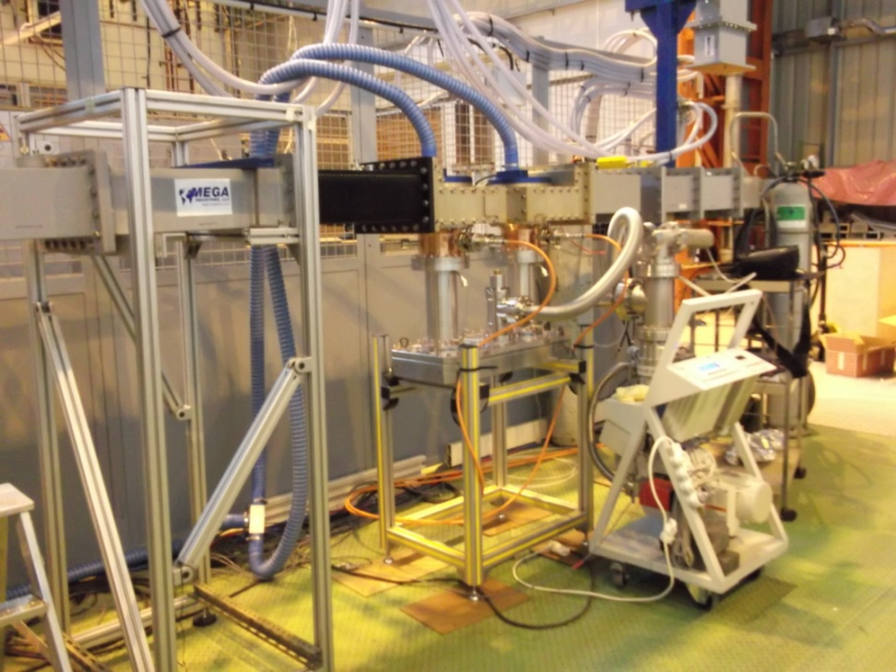
First tests
2000
2005
2010
2015
2020
2025
2013
TW test was ok
High peak power difficulties in SW tests
Arcing regarding some reflected power phases
Not found with simulations
At the peak power value limit
Test box cavity with two couplers
face to face
  After a bake out at 150 °C along 24 hours
  connected to a RF power load or a movable short for TW and SW conditioning process
Cylindrical windows tests
TW : 1000 kW - 2 ms / 25 Hz
SW : 550 kW - 500 µs - 8 Hz
Disk windows tests
TW : 1000 kW - 2 ms / 25 Hz
SW : 1000 kW - 1.5 ms / 4 Hz

Slide 13
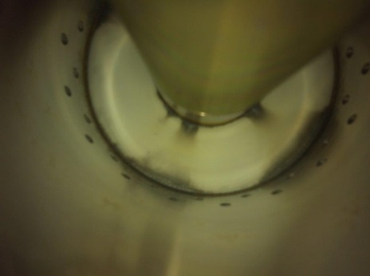
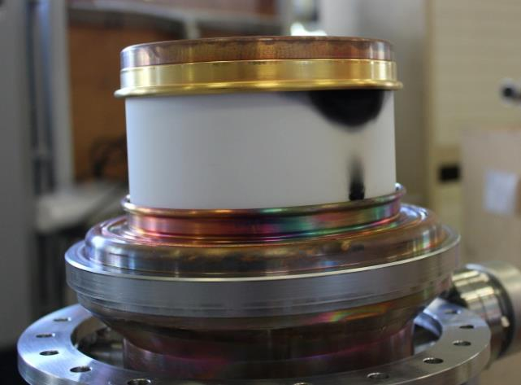
The devil is in the details (1)
2013
TW test was ok
High peak power difficulties in SW tests
Arcing regarding some reflected power phases
Not shown during simulations
At the peak power value limit
Black deposit
Gold & Copper from upper collar
Copper from lower collar

Slide 14
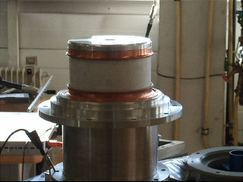
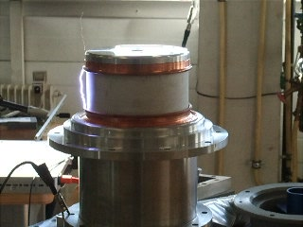
Arcing along ceramic on the air side
As these ceramics are part of the matching system, it is not so easy to calculate the RF peak power limit
Arcing with 44 kVDC
applied between copper collars
(rounded shape to increase high voltage RF swing capability)
This is equivalent to 1 MW SW for most of the phases but limits to 600 kW SW for some phases

Slide 15
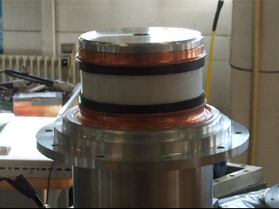
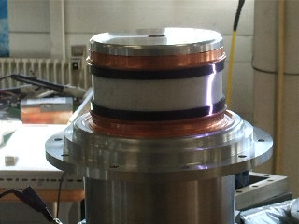
Arcing along ceramic on the air side
Despite two ‘plastic protection’ added, now arcing with 72 kVDC
applied between copper collars
This is equivalent to 1 MW SW for most of the phases but still limits to 650 kW SW for some phases

Slide 16
Arcing along ceramic on the air side
Despite two ‘plastic protection’ added, now arcing with 72 kVDC
applied between copper collars
This is equivalent to 1 MW SW for most of the phases but still limits to 650 kW SW for some phases

Slide 17
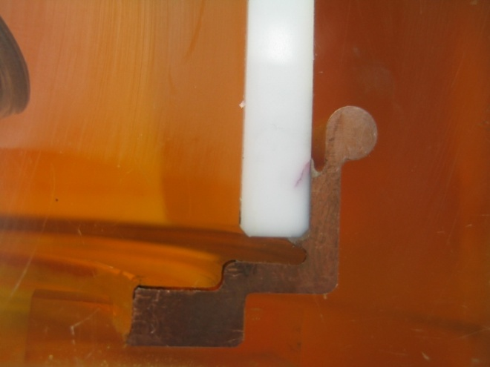
The devil is in the details (1)
The ‘antenna’ made by the metalization and the brazing shape, close to the ceramic, considerably reduces the voltage capability of the design
This was not shown during simulations because, even if we would have thought about it (that was not the case) the meshing would have been too small in this area

Slide 18
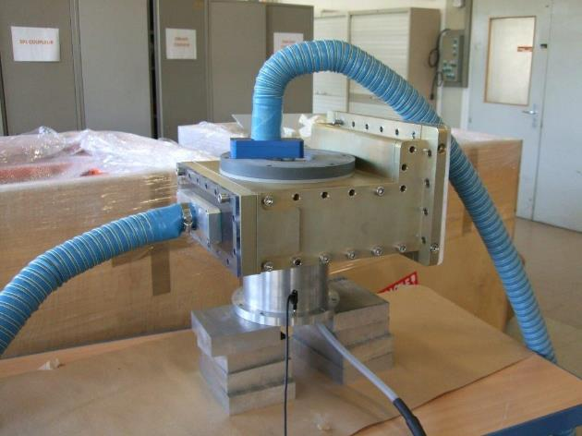
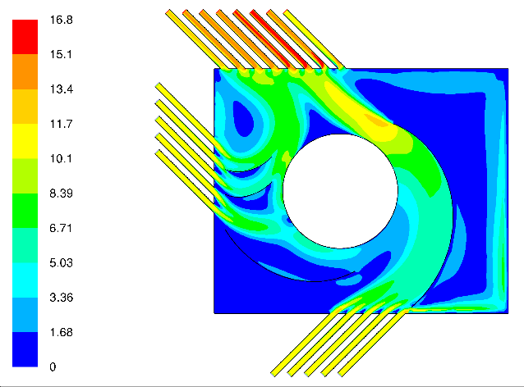
Improved air cooling to help to reduce the arcing
Another way to improve the peak voltage capability, we improved the air cooling to remove ionized air as quickly as possible

Slide 19
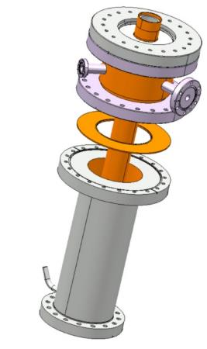
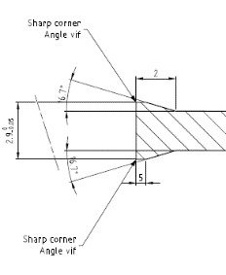
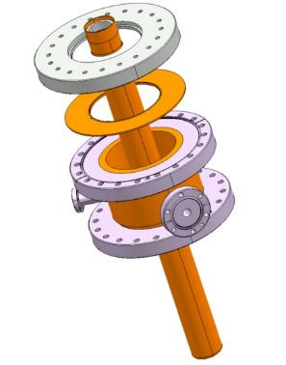
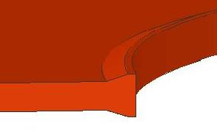
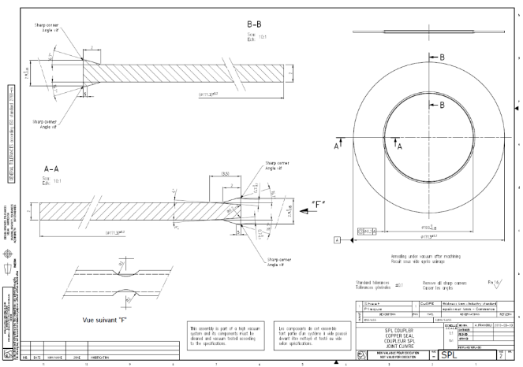
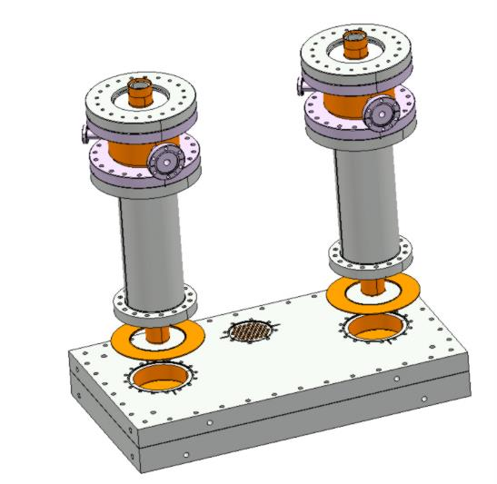
The devil is in the details (2)
During the FPC review we were advised to use special nuts and bolts
(DESY type CuNi1Si, CuNi2Si, CuNi1.5Si0.5 and CuNi3Si)
We lost a lot of time before we understood these items are not strong enough to correctly tighten our all-in-one RF & vacuum seal
Indeed, DESY vacuum seal and CERN vacuum seal are very different
It has cost us a lot of clean room time…

Slide 20
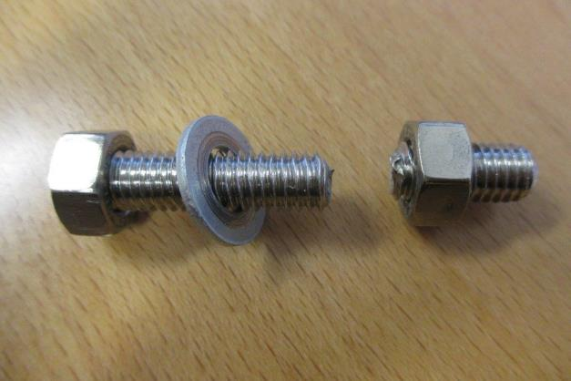
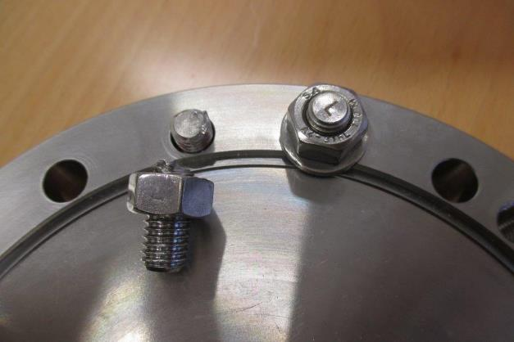
The devil is in the details (2)
During the FPC review we were advised to use special nuts and bolts
(DESY type CuNi1Si, CuNi2Si, CuNi1.5Si0.5 and CuNi3Si)
We lost a lot of time before we understood these items are not strong enough to correctly tighten our all-in-one RF & vacuum seal
Indeed, DESY vacuum seal and CERN vacuum seal are very different
It has cost us a lot of clean room time…

Slide 21
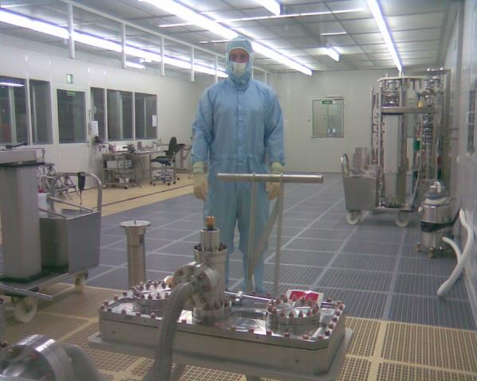
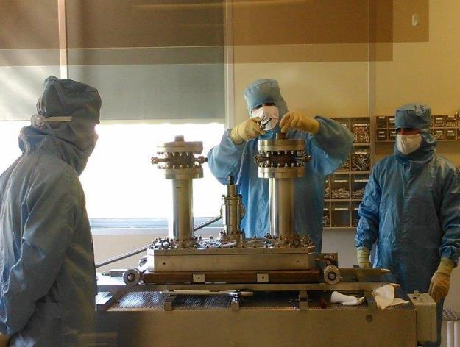
A long experience with collaborations
Another very important aspect of the SPL project was that quite some operations were done at several places
A good preparation and communication were mandatory to ensure the success
Each of the actors having their own experience, we learnt a lost from each others
A lot of preparation and specialized peoplepower were required
Test boxes successfully assembled
in DESY clean room, June 2011
Special thanks to DESY team
SPL couplers assembly on test box
in CEA Saclay clean room
Special thanks to CEA team

Slide 22
Test mitigation test plan
We intended to continue to work on the peak power limitation, however, as we had to deliver FPCs to SPL project on due time, we decided to modify the initial test program considering all the difficulties we faced
The new test program remained fully compatible with SM18 tests program
May 2014, we completed the tests of the second pair of couplers
Test Repetition rate 50 Hz | Initial kW | New (compromise) kW
TW | 1000 | 1000
SW 100 µs | 1000 | 1000
SW 200 µs | 1000 | 500
SW 500 µs | 1000 | 250
SW 1 ms | 1000 | 250
SW 2 ms | 1000 | 250

Slide 23
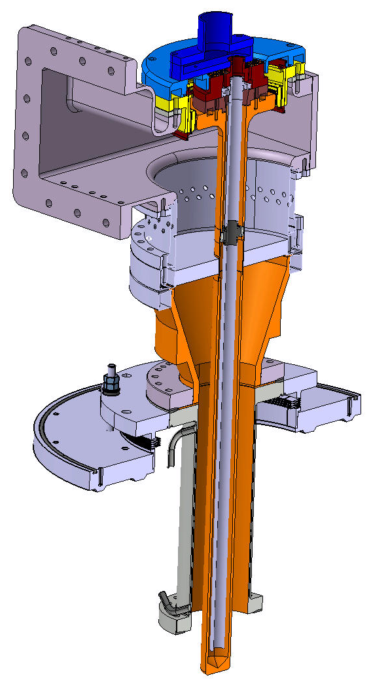
FPC SPL 3.0
Taking into consideration all the lessons we learnt with the first couplers, we designed a new coupler that will be able to operate at much higher power levels
We increased the size of the coaxial line on the vacuum side with a pseudo-conical line and a larger ceramic window to be less sensible to arcing on the air side
The goal was to sustain 2 MW peak @ 704 MHz full reflection and 10 % duty cycle (SPL 2 ms - 50 Hz and ESS 4 ms – 28 Hz)

Slide 24
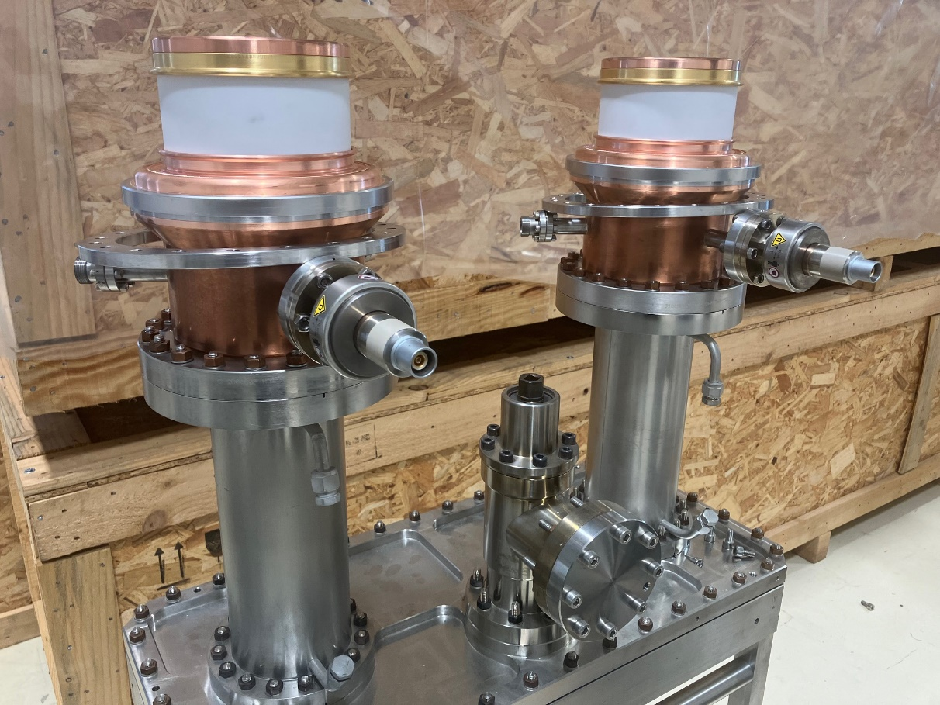
SPL couplers as per 2024
The SPL project was stopped in 2015
Since the SPL project was stopped, the four SPL FPCs that have been fully tested are stored under vacuum assembled onto their test boxes
Four couplers are done
(two cylindrical windows and two disk windows)

Slide 25
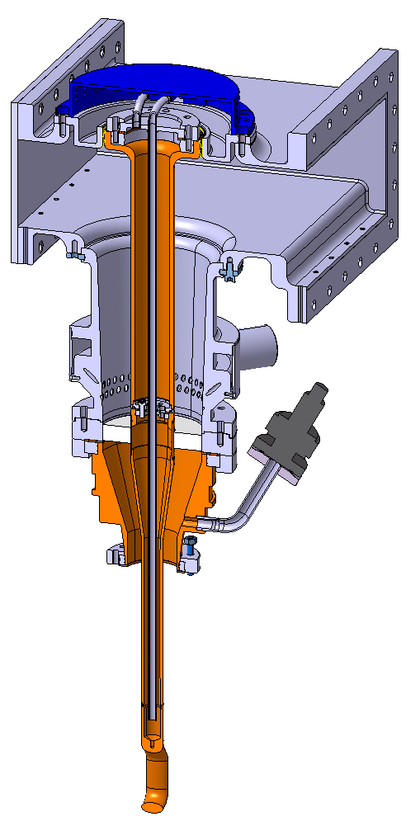
HL-LHC Crab FPC
The HL-LHC Crab FPC project started after we completed the first tests with the SPL couplers
We took advantage of all lessons learnt, and we designed the Crab couplers based on the SPL 3.0 design
One can notice the similarities (and the differences)
With the same ceramic diameter, we matched this coupler to 400 MHz
This is all about the distance to the WG short circuit and the WG step
This coupler has been tested up to 80 kW CW TW & SW all phases without any trouble

Slide 26
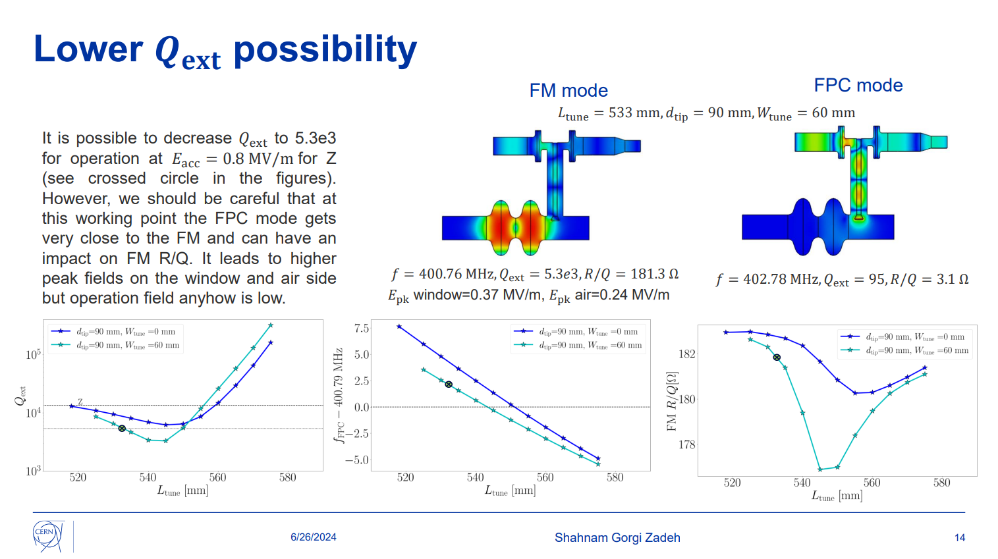
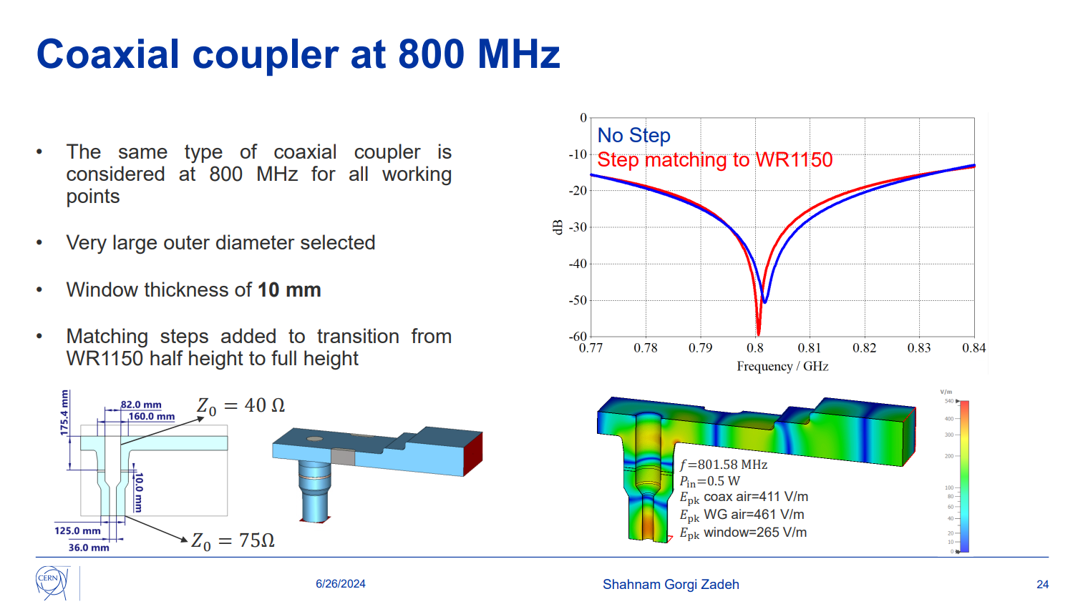
FCC FPC
We are still at the stage of RF simulations but we will test two versions of the couplers
  At 400 MHz, one (or two) plain disk window located in the WG, assembled in a second step clean room assembly
  At 800 MHz, a coaxial disk window located in the coaxial line close to the beam axis, assembled with the initial clean room step
Courtesy Shahnam Gorgi Zadeh (CERN)

Slide 27

ISAS FPC
WP4.3.1 Design and prototyping RF couplers
  Optimization of the RF design for CW, 800MHz, 50kW SW to 200kW TW range and cooling strategies of the couplers to save energy
  Optimization of the fabrication of prototypes and RF conditioning
  IJCLAB
  Mechanical adaptation of SPL FPC to PERLE Cryomodule
  (includes coupling element)
  CERN
  Fabrication of 4 FPC
Parameter | Specification PERLE FPC
Number of couplers | 4
RF Power Coupler Window | Disc ceramic with TiOx coating on vacuum side
Frequency | 801,6 MHz
Maximal power | 50 kW To hold the 100% reflected maximal power (ideally 200 kW CW in TW)
Duty cycle | CW
Max. reflection coefficient S₁₁ | <- 20 dB
Q_{ext} optimal (at cold temperature) | tbd by IJC Lab, 2 cavity bandwidth considered 100 Hz, Qext = 8 10⁶ 150 Hz, Qext = 5.34 10⁶
Tolerance range | tbd≤ Q_{ext} ≤ tbd (by IJC Lab)

Slide 28
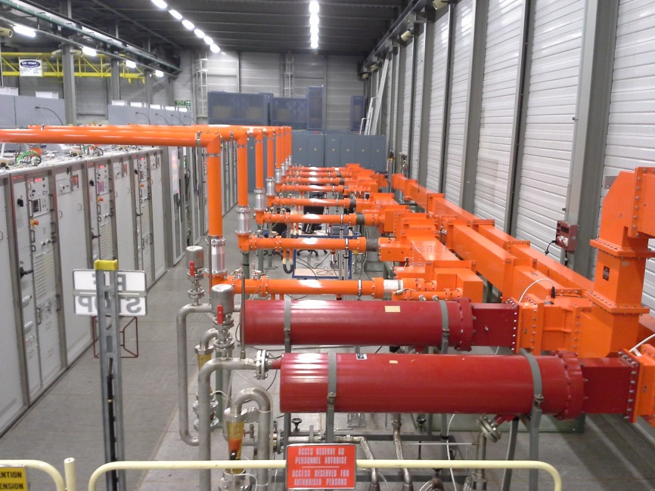
ISAS FPC
WP4.3.2 Conditioning of the RF couplers
  RF conditioning at CERN
  Test bench at 800MHz, 50kW, CW amplifier provided by CERN (IOT)
  (including test box)
  CERN
  Preparation and RF conditioning
  The FPC test box can be connected to a single IOT, or it can be connected before the power load, the only restriction in that case is that it must be done during YETS or LS
Cost for the RF couplers fabrication and test 400k€

Slide 29
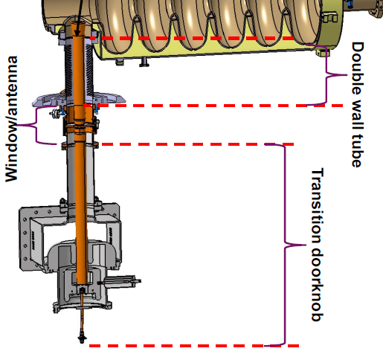
ISAS FPC
CERN CM
CEA CM
Some definitions to be clarified, under way
  At CERN, we do consider the Double Walled Tube (DT) as part of the cryomodule
  At CEA, it is part of the coupler
  So when defining the scope, the ‘Coupler’ was not understood the same way
  CEA provided a design, and CERN will integrate it, to the maximum possible, into the PERLE project as part of the FCC studies, as we need it there as well
CEA FPC
CERN FPC

Slide 30
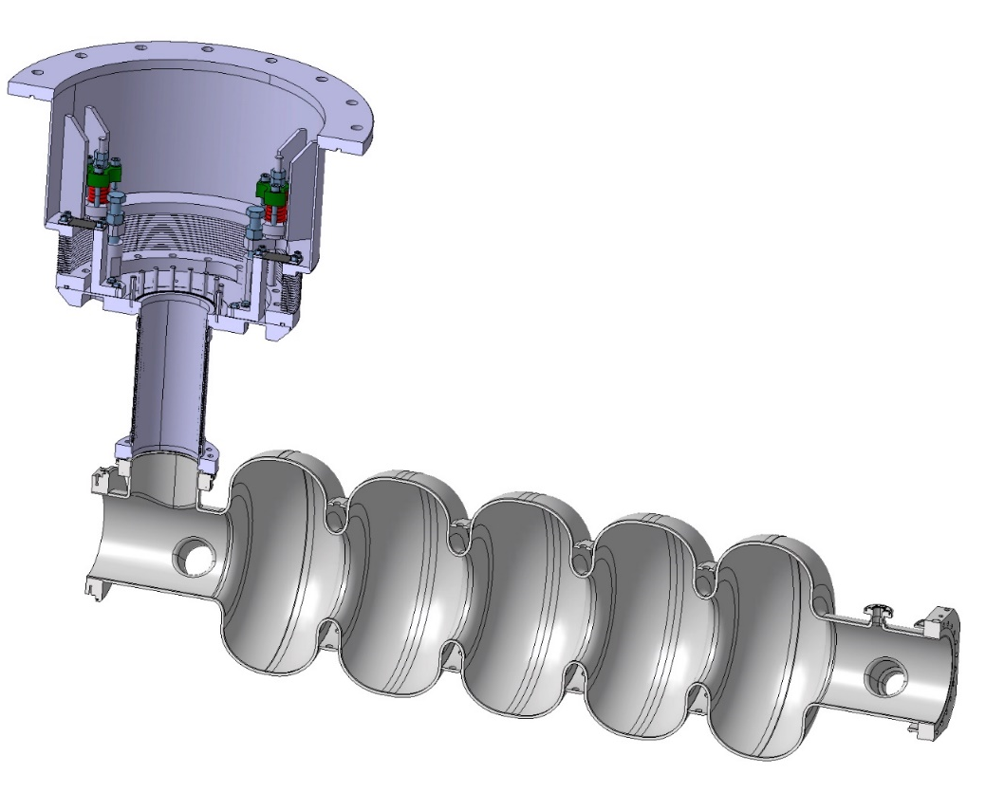
ISAS FPC
Some definitions to be clarified, under way
  At CERN, we do consider the Double Walled Tube (DT) as part of the cryomodule
  At CEA, it is part of the coupler
  So when defining the scope, the ‘Coupler’ was not understood the same way
  CEA provided a design, and CERN will integrate it, to the maximum possible, into the PERLE project as part of the FCC studies, as we need it there as well

Slide 31
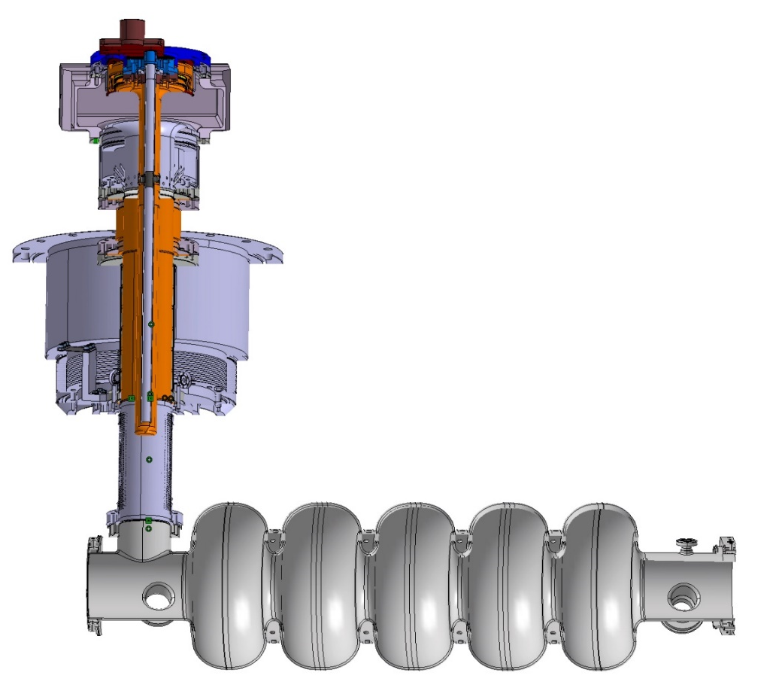
ISAS FPC
Some definitions to be clarified, under way
  At CERN, we do consider the Double Walled Tube (DT) as part of the cryomodule
  At CEA, it is part of the coupler
  So when defining the scope, the ‘Coupler’ was not understood the same way
  CEA provided a design, and CERN will integrate it, to the maximum possible, into the PERLE project as part of the FCC studies, as we need it there as well
Compensation barometric (IJCLab)

Slide 32
Perle FPC project Timeline
2024
today
2025
2026
2027
2028
  M1 Design report of FPC coupler
  1st July 2025
  M3 Intermediary general rapport 1st February 2026
Keep in mind that Devil is in the details, and quite some details still have to be worked out…
  M6 Engineering report of the fabrication of FPCs 1st June 2026
  M7 Test report of FPC couplers 1st December 2026
As we are not starting from scratch, looks reasonably achievable
  D2 RF coupler test Report on RF test of 800-MHz FPC at 50 kW by CERN 1st June 2027

Slide 33


Conclusion
SPL was a fantastic project with respect to FPCs
It allowed to design couplers that were the basis of the design of the Crab FPCs
We clearly see a possibility to adapt the SPL FPCs such that they fulfil PERLE FPCs requirements
There is clearly a possible synergy with PERLE FPCs and FPCs that will have to be designed for FCC study

Slide 34
Simplicity is the ultimate sophistication
Leonardo Da Vinci (500+ years ago)
They did not know it was impossible, so they did it
Mark Twain

