Slide 1
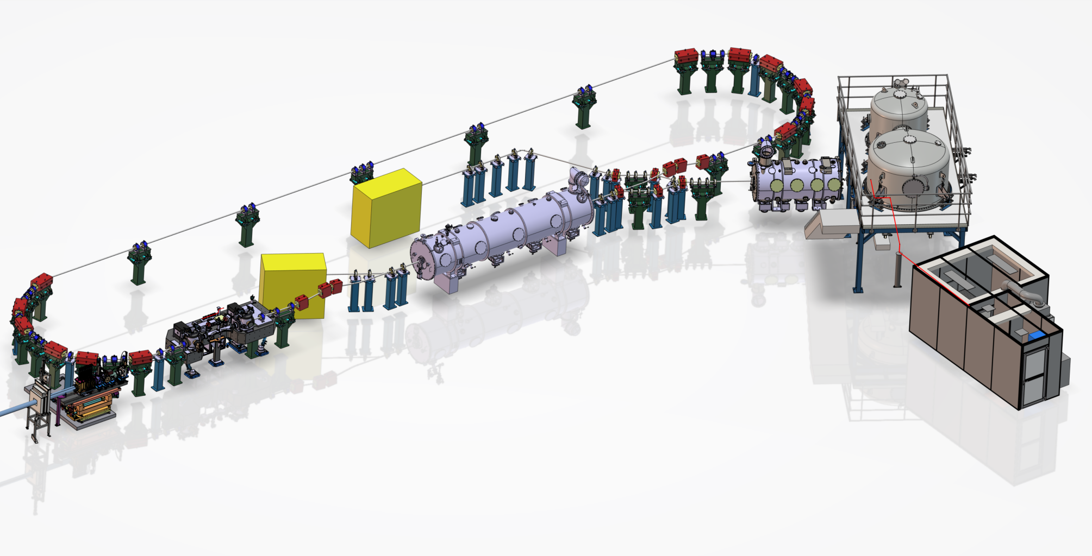
LLRF and RF power prospects for PERLE
Christophe Joly (CNRS/IN2P3/IJCLab)
On behalf of the PERLE collaboration

Slide 2
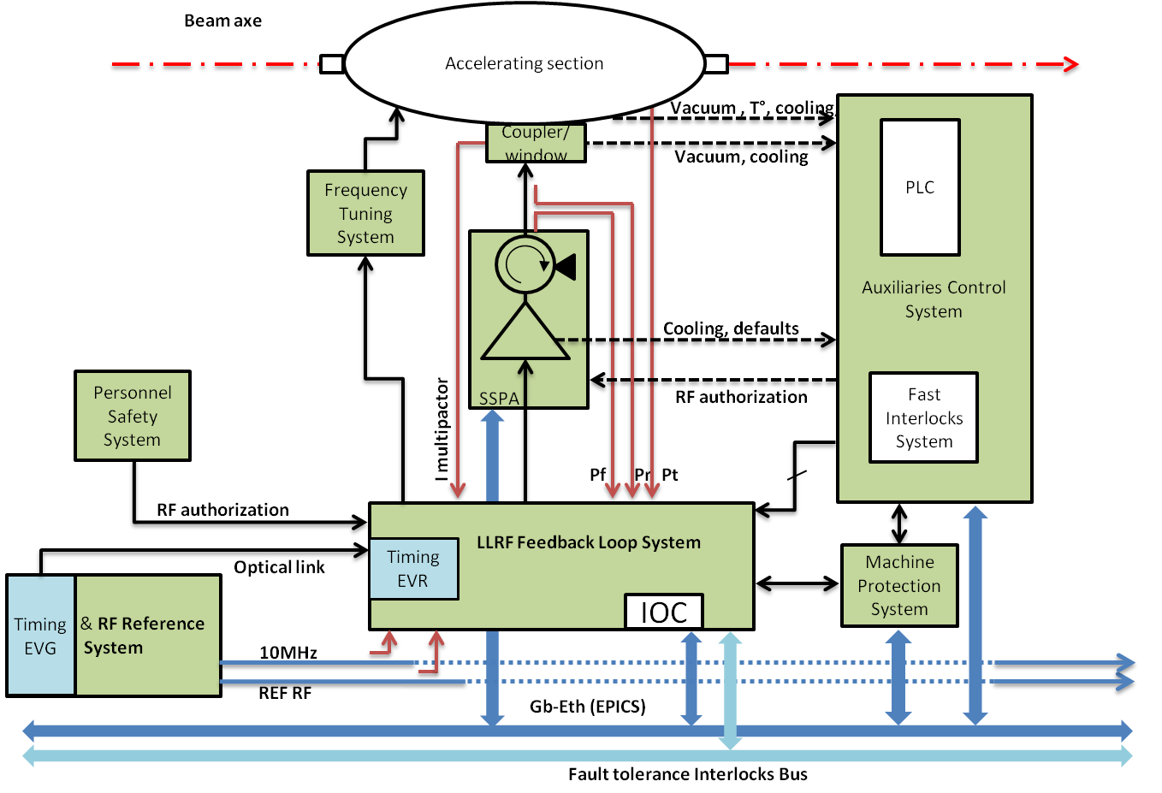
LLRF and RF power prospects: Contents
Accelerating cavity
Master Oscillator
Accelerator Phase Reference generation/distr.
Synchronization (LLRF, Diagnostics,…)
MPS
RF powers Sources
Field bus

Slide 3
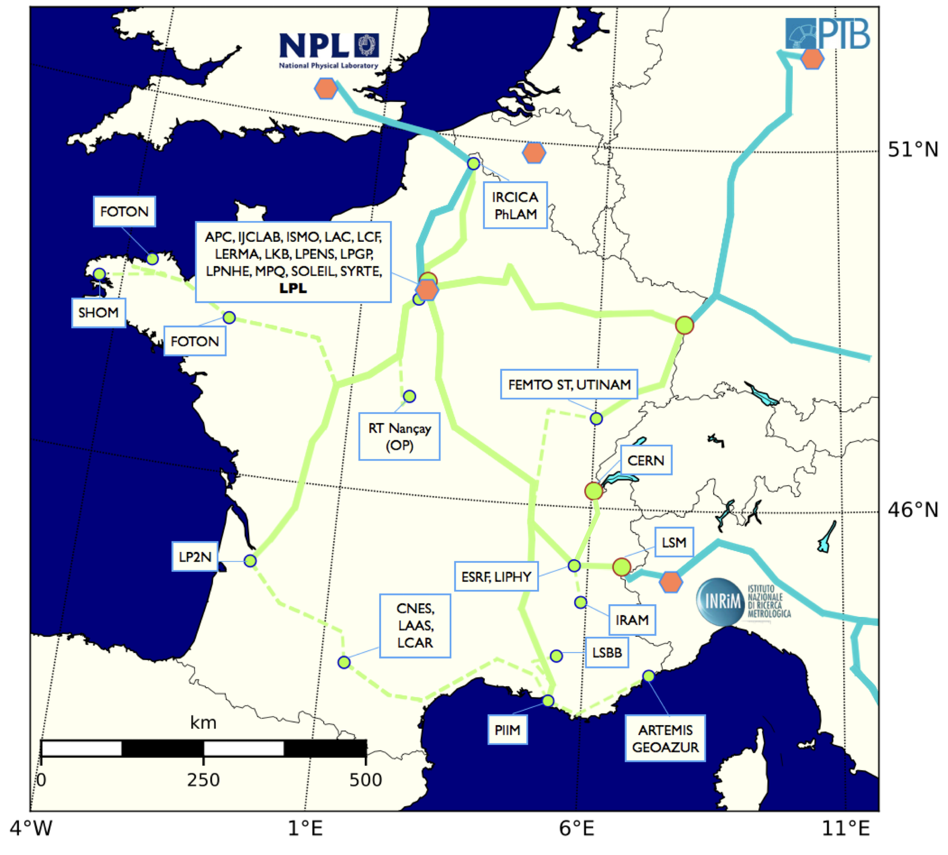
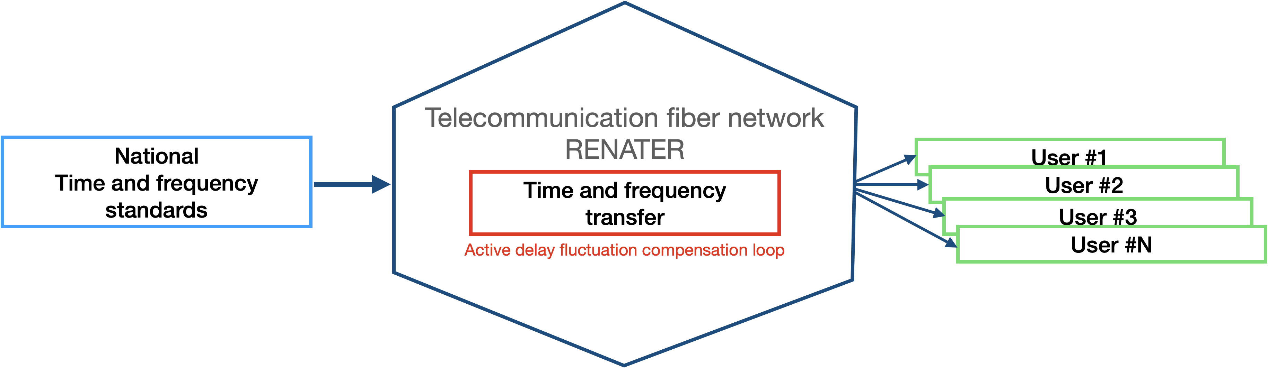
LLRF and RF power prospects : MO
REFIMEVE : Network Metrological fiber with European vocation
Concept : Dissemination of time-frequency references by optical fiber
Responsibilities : LPL & SYRTE for deployment and optical reference
IJCLab & SYRTE for timing
MO /timing references will provide to PERLE using National Standards
from SYRTE via the RENATER fiber network and using enhanced White Rabbit protocol

Slide 4

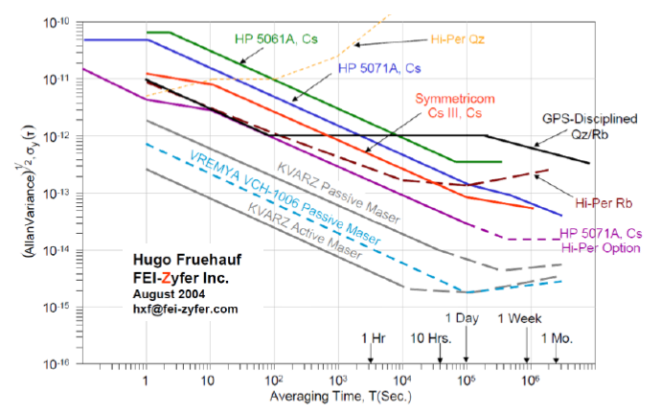
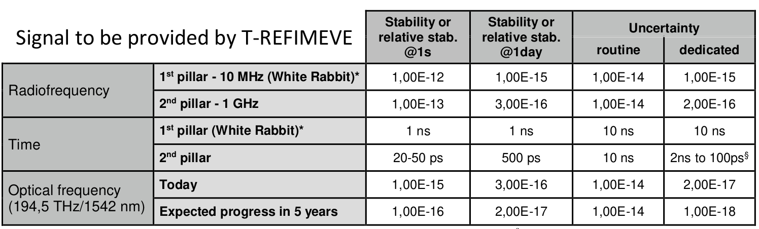
Long term stability comparison :MO
Typical use for MO : GPS + rubidium + PLLs
Standard references used allow to obtain
a high stability compared to the classical
industrial solution
Industrial systems (graph by FEI-Zyfer Inc )

Slide 5

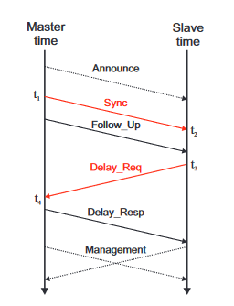
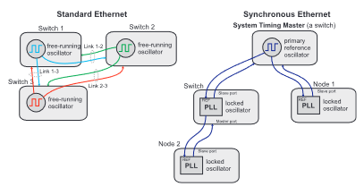
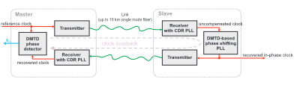
LLRF and RF power prospects : White Rabbit
The WR network is an extension of Ethernet which uses the Precision Time Protocol (PTP),
Synchronous mode (Syn-E) and precise Phase Measurements to synchronise the entire network with a phase (delay ) compensation ( deterministic routing latency).
https://white-rabbit.web.cern.ch/
Synchronous Ethernet
for clocks hierarchy and locked PLL
Distribution via the swicthes
Precision Time Protocol (PTP)
for delay compensation
Precise Phase Measurement thanks to
DDMTD Phase tracking (Digital Dual Mixer Domain)
Pictures form the article “The white Rabbit project”, CERN 2013

Slide 6



LLRF and RF power prospects : Enhanced White Rabbit
Collaboration
With improvements of CERN’s WR developments and use of the IPBUS from LPSC for configuration
125km by fiber link
fiber link
Courtesy D. Charlet
Enhanced White Rabbit thanks to IDROGEN AMC Board developments

Slide 7
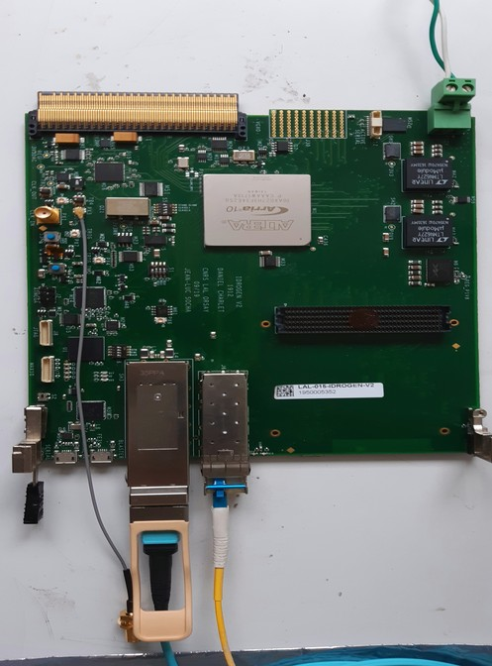
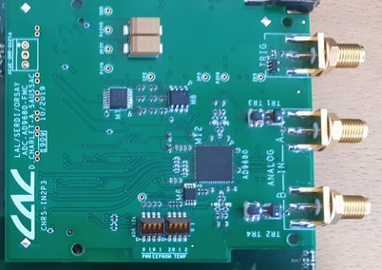
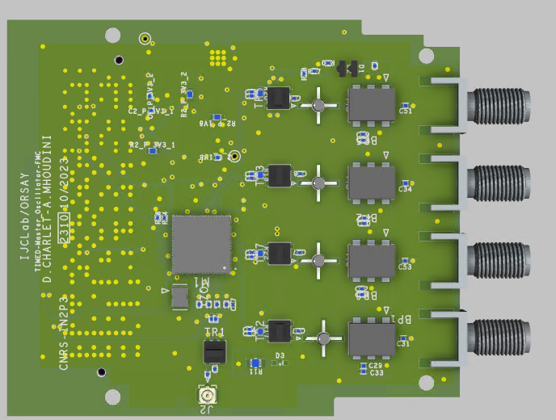
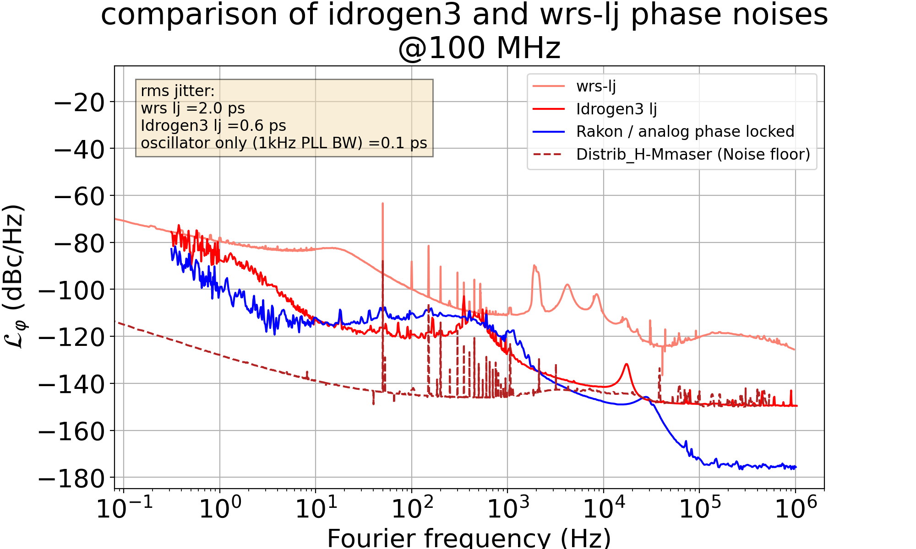
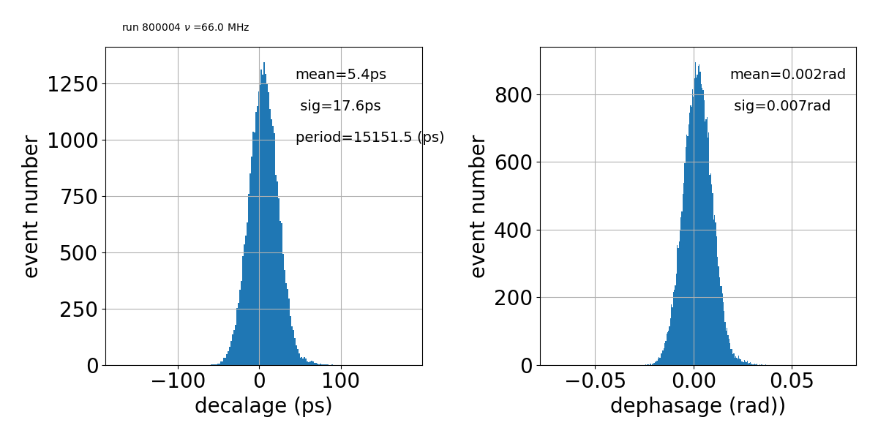
LLRF and RF power prospects : AMC IDROGEN
WR implementation
FMC_AD9680_500MSPS
FMC_REF_GEN_SI536X
IDROGEN board
FMC Slot
VITA57.1 (FMC), ADC 9680, 2 channels, 14 bits
500 MSPS, JESD204B, 2GHz analog bandwidth
Bandwidth 500 MHz to 1.5GHz
Synchro & timing by WR
  4 single ended outputs clock
  10kHz to 2.75GHz range
  Using SI536X PLL with Ultra Low jitter (<55 fs)
  Currently in manufacturing phase
IDROGEN boards synchronized by WR and
66MHz signal DAQ on one ADC channel of each board
Preliminary results
soon
Preliminary results
Measurements made at SYRTE by P.-E. Pottie

Slide 8
LLRF and RF power prospects : Timing Distribution
REFGEN FMC is manufacturing
Tests planned before end of this year.
Timing disciplined by WR distribution µRTM (TBD)
Local
Distribution
Of reference

Slide 9
LLRF and RF power prospects :RFPA
Parameters | Buncher | Elliptical 1-cell Cavities | Elliptical 5-cells Cavities
Frequency [MHz] | 801.58 | 801.58 | 801.58
Beta | 0.8048 | 1 | 1
Q0 | 2.55E4 | 1E10 min | ≥ 3E10 aim ↗ for reducing losses
r/Q [Ω] | 247.7 | 109.25 | 524
QL[Required] | 1.27E4 | 8.59E5 | 5.34E6
Bandwidth [Hz] | 62949 | 933 | 150 aim ↘ for reducing RF power needs
Filling time [µs] | 2.53 | 170 | 1061
Eacc [MV/m] | 1.4 | 10 | 22.33
Lacc [m] | 0.126 | 0.187 | 0.918
Nb of cavities | 1 | 4 | 4
Min Power needed | 5kW | 38kW | 40 kW
Power requirements | 10kW | 50kW | 50kW
Cryogenics power
ERL Efficiency
Depending on
the FRT R&D
See F. Bouly presentation

Slide 10
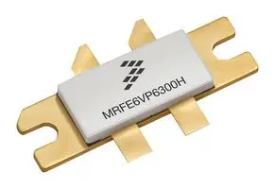
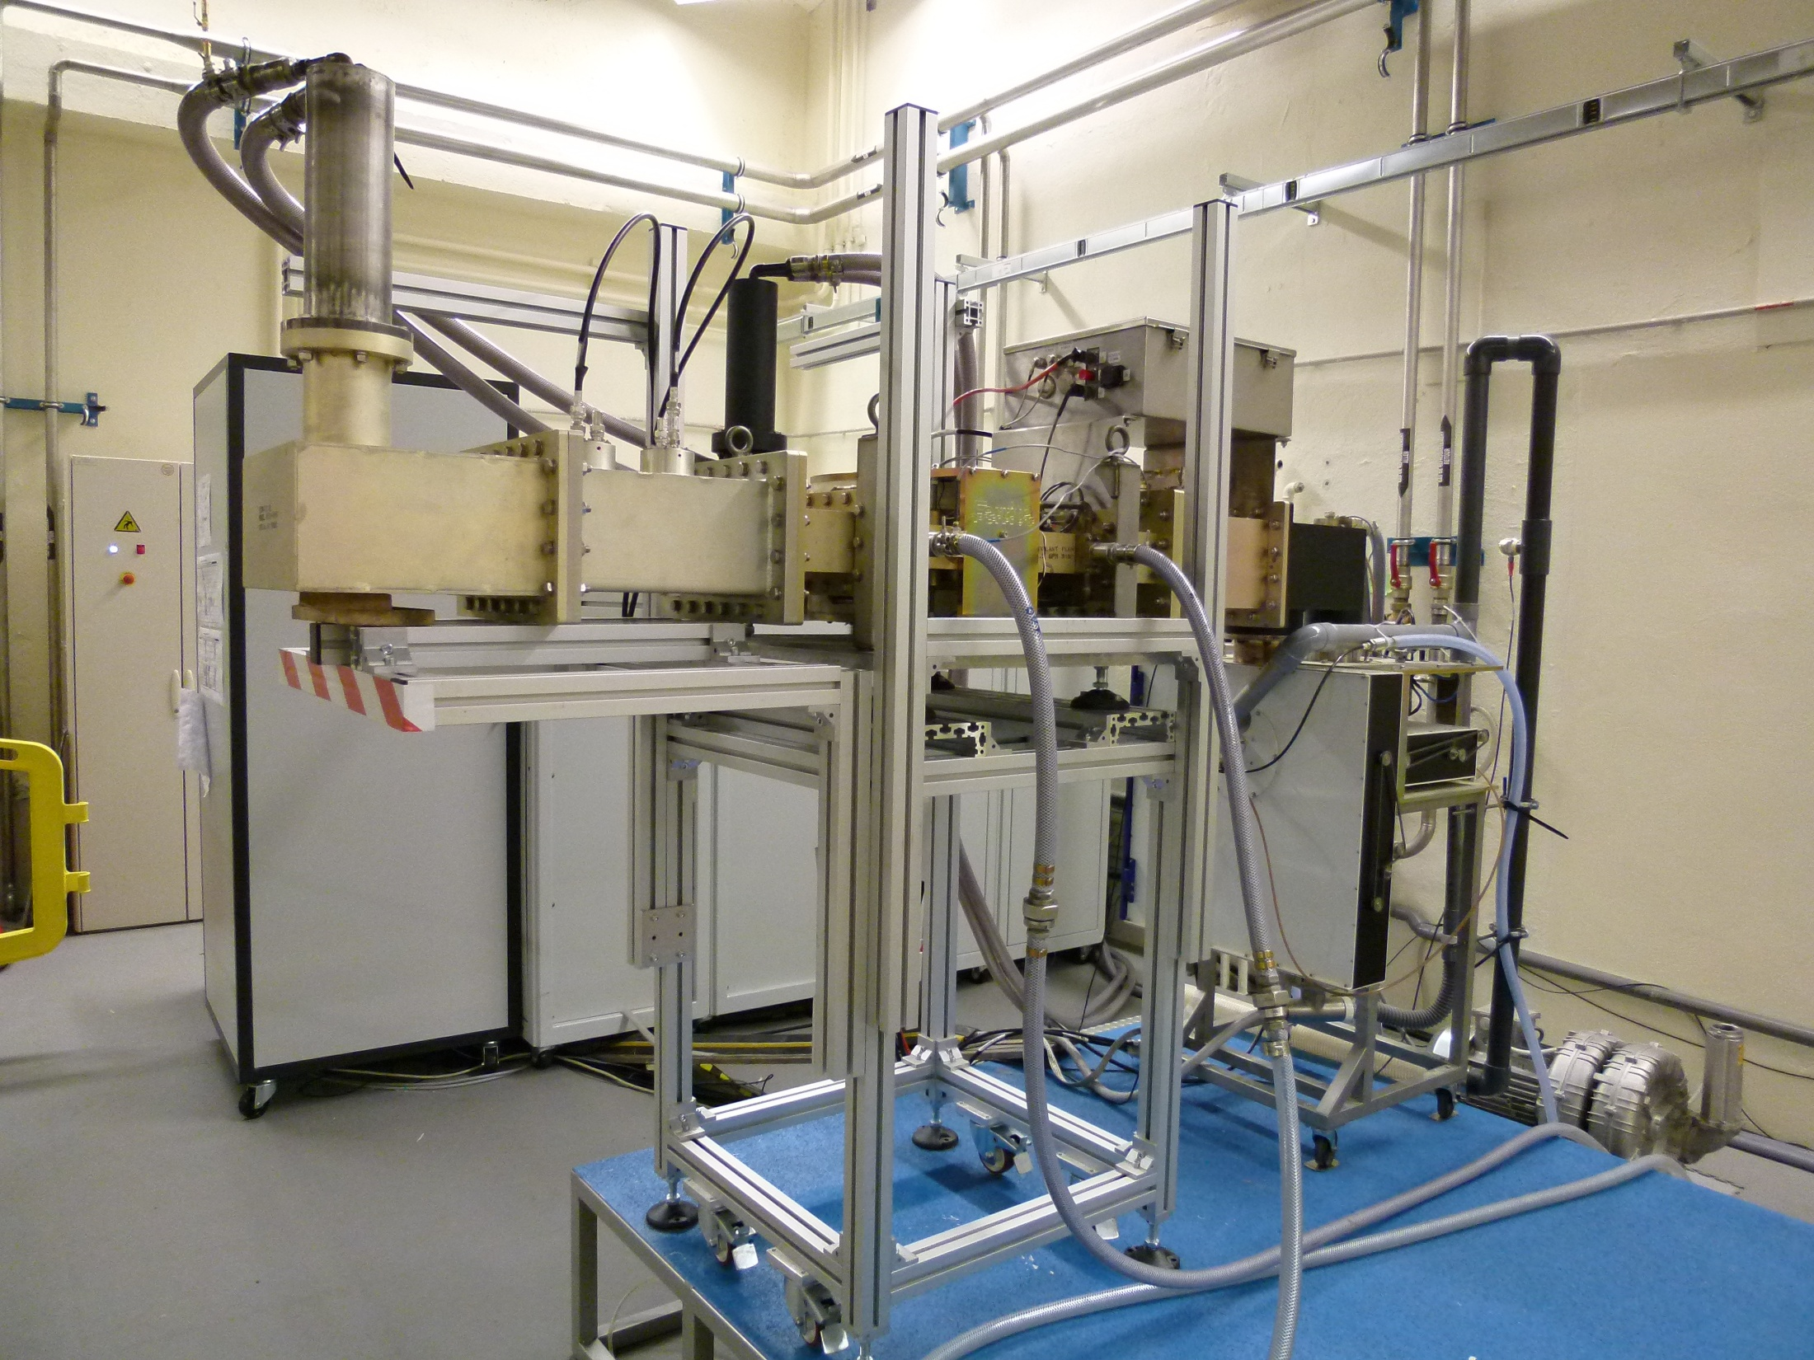
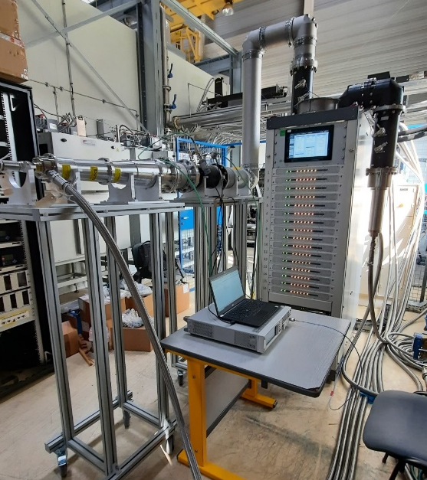
LLRF and RF power prospects : RFPA
Basic premise is : one RF power amplifier by cavity and lower RF power needed
IOT (Inductive Output Tube)
footprint
High efficiency 60 % to 70%
RF power more 50kW @801.58MHz
High reliability
PW and CW operation ( 10µs@1Hz and more to CW)
RF power SSA (Solid State Amplifier)
CW LDMOS Transistors limited in the 800MHz range
High efficiency ~50%
RF power more 50kW @801.58MHz , modular
High reliability
PW and CW operation ( 10µs@1Hz and more to CW)
drain1
drain2
Common
source
gate1
gate2
Ex : SSA 80kW @352MHz
(MYRRHA, IBA) IJCLab
Ex :IOT 80kW @700MHz IJCLab
CERN R&D project for HiLumi @400MHz and FCC@800MHz
At least, two firms interested

Slide 11
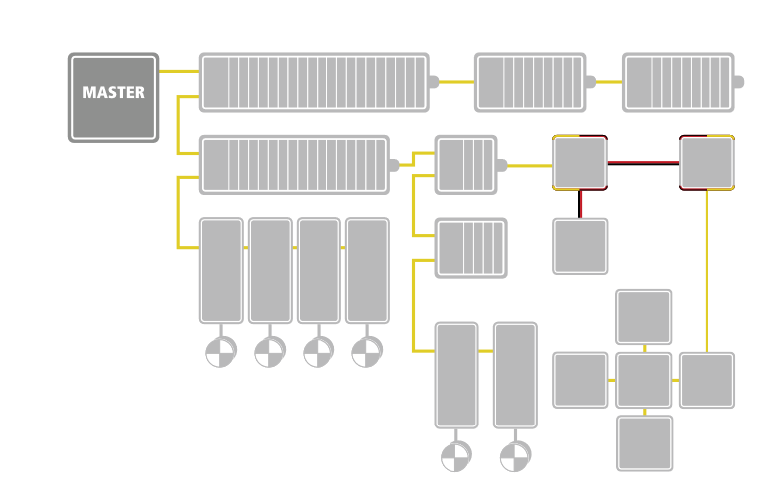
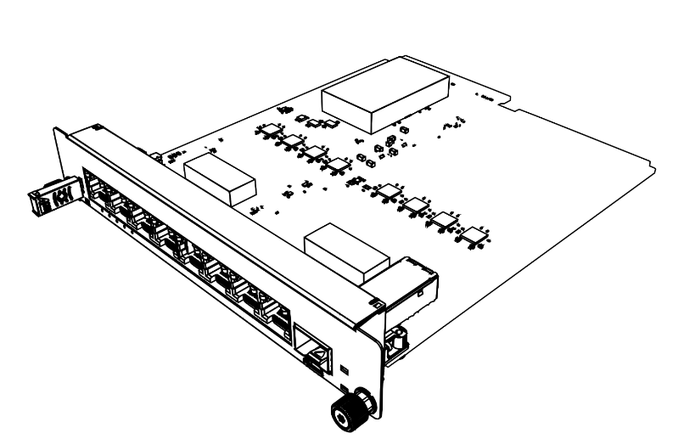
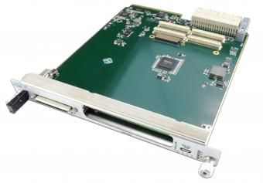
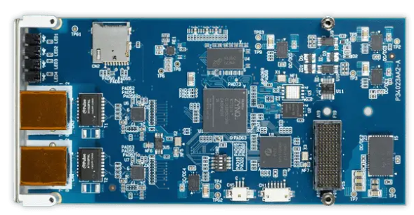
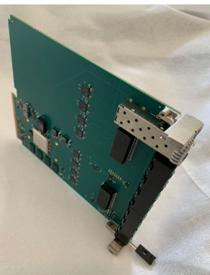
LLRF and RF power prospects : MPS
Ethernet for Control Automation Technology (ECAT) → Ethernet Field Bus
ECAT is real time down to the I/O level
No underlying sub-systems any more
Update time depending of the type and number of IO
Module Exiting for PLC, MTCA, etc.
MPS BerlinPro, VME based using ECAT: Overall reaction time ~5µs incl. cable lengths, cascades,RS485↔TTL conversions and FPGA processing.
Flexible topology: line, tree, start or daisy-chain
(picture from ETtherCAT Technology Group (ETG) brochure
MTCA based MASTER
MCTA based SLAVE
AMC105 by Vadatech company associated to
An adXMC1573 XMC module by Advanet company
NAT-AMC-ZYNQUP-ECAT by NAT company, jointed
developments with XFEL.
Xilinx ZynqUP MPSoC (FPGA with ARM Cortex-A53/-R5 cores)
Scalable number of EtherCAT slaves in MTCA
1x SFP as GPIO of FPGA (LVDS or single-ended I/O) at front panel
8x 100Mbit Ethernet via RJ45 to EtherCAT network at front panel
GbE, PCIe x1, and TCLKA-D towards the backplane
Xilinx Zynq® (FPGA + ARM® Cortex®-A9)
2x 100MBits Ethernet Ports via RJ45 to ECAT
network at front panel
https://www.ethercat.org/download/documents/EtherCAT_Introduction_EN.pdf
See https://accelconf.web.cern.ch/erl2019/talks/frcoxbs04_talk.pdf
See https://accelconf.web.cern.ch/ICALEPCS2017/papers/tupha148.pdf
see https://conference-indico.kek.jp/event/153/contributions/2780/attachments/1913/2277/mtca2021-erd_P1-211027.pdf

Slide 12
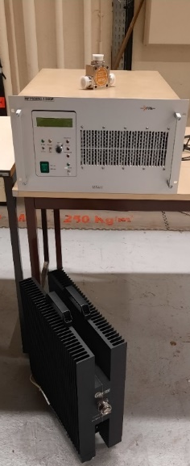
LLRF and RF power prospects: Summary
Two technologies for the RF power : IOT new generation or/and Solid State amplifier with RF modules redundancy
Depending of the FRT and CTS performances ( R&D in progress within the framework of iSAS project)
To pursue and develop collaboration and technical discussions.
Use of the improved WR nodes for the MO distribution and Timing
pursue of the R&D with IN2P3 support
Many HW, FW and SW developments still needed
Use of the ECAT for the MPS implying to start the global MPS design for validating this approach
Global C&C architecture needed
With an objective of a strong integration in the format MTCA.4
First RF power components for different tests bench are delivered :
  1 KW CW amplifier operating in the 800MHz range
  1.5 kW circulator (Amplifier protection)
  1.5kW load
  Planned to be used with superconducting cavity ( Q0 qualification, LLRF tests, …)

Slide 13

LLRF and RF power prospects
Thank you for your attention
And special tanks to : Daniel Charlet and the IDROGEN Developments team
IJCLab
      Hardware : Daniel Charlet
      Firmware : Eric Plaige, Antoine Back, Cédric Esnault, D.Charlet
      Software : Monique Taurigna, Chafik Cheikali, A.Back, Christelle Soulet
      Test : Cédric Esnault, Daniel Charlet
Paris Observatory
  SYRTE
    Clock expertise and qualification : Paul-Eric Pottie
    Hardware : Michel lours
  Obs Nancay
    Firmware : Cédric Viou

Slide 14
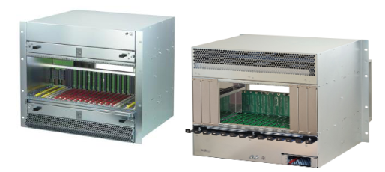
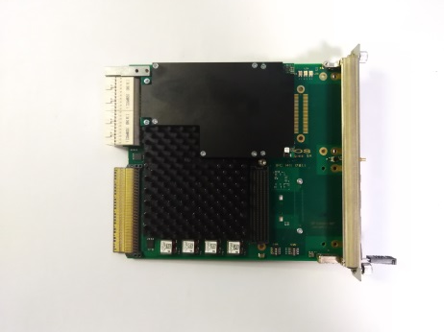
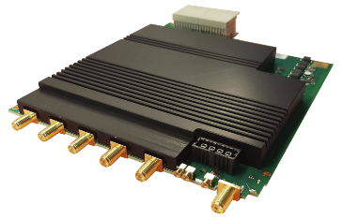
LLRF and RF power prospects: MTCA.4
MTCA.4 rack
Front
Rear
AMC IFC1420
µRTM RDC1470

Slide 15
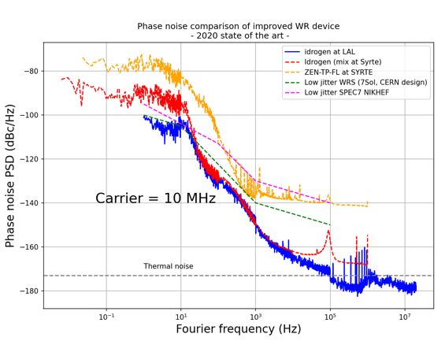

LLRF and RF power prospects : Enhanced WR
Courtesy D. Charlet
Collaboration with Paris Observatory Laboratory
  Goal 1 : ~ 1ps
  Goal 2 : < 100fs
Soft PLL modification
    Decreases the response time of software PLL : µP frequency upgrading
    Gain integrator optimization : Kp, Ki dynamically connfigurable
Increased PLL bandwidth of the GM Local oscillator
Components upgrading
    VCXO selection
    Increased internal Frequency (PLL number reduction)
Modification of WR principle
  phase modulation and demodulation of an ultra-stable optical carrier
  Replacement of message protocol by timecode
  Phase measurement in optic
  Link asymmetry mitigation
  Time calibration at the pps level

Slide 16
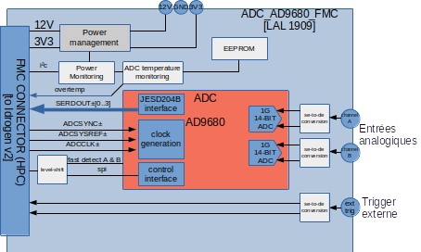

FMC_AD9680_500MSPS
Courtesy D. Charlet
The motivation of the development of a new mezzanine instead of an off-the-shelf ADC mezzanine :
  includes : its own PLL.
  ADC clock source : External clock
Mezzanine main features :
  VITA57.1 (FMC), ADC 9680, 2 channels, 14 bits
  500 MSPS, JESD204B, 2GHz analog bandwidth
  External trigger in
Bandwidth 500 MHz to 1.5GHz
Synchro & timing by WR
Data transfer 2x 10G Ethernet
Configuration by IPBus 10G

Slide 17
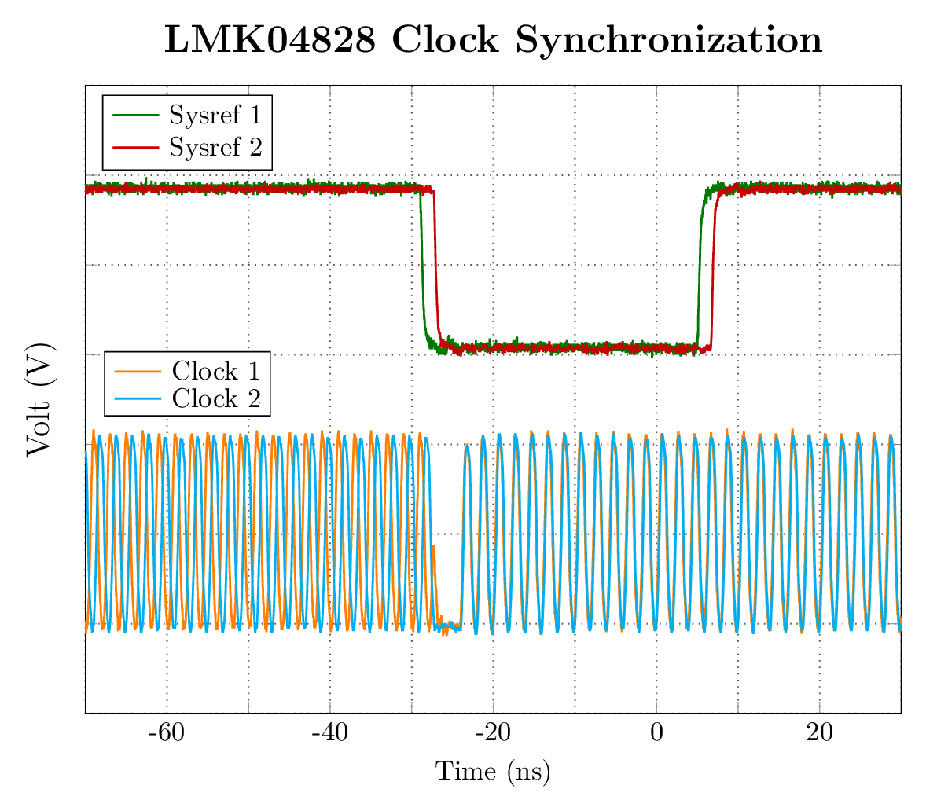
FMC ADC_9680: Synchronization
2 IDROGEN boards synchronize by WR
PLL : LMK04828
ADC data transfert : JESD204B class 1
500MHz Clock
Phase alignment by PPS
LM04828
SYSREF
ADC9680
Clock
SYSREF Clock SYNC
FPGA
PPS
Courtesy D. Charlet

Slide 18
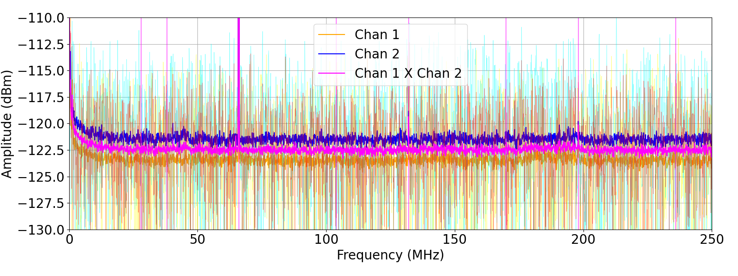
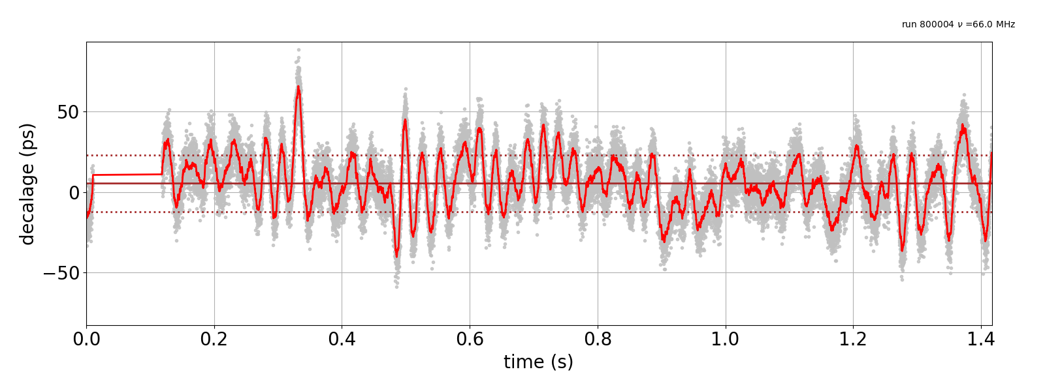
FMC ADC_9680: Synchronization
2 IDROGEN boards synchronize by WR
Same RF signal (66MHz) split on boards
FFT 16K point
Cross correlation
10km distance

