Slide 1
PERLE
-
Cryogenics
P. DUTHIL (IJCLab/CNRS)
(on behalf of the PERLE’s team)
September 17th 2024

Slide 2
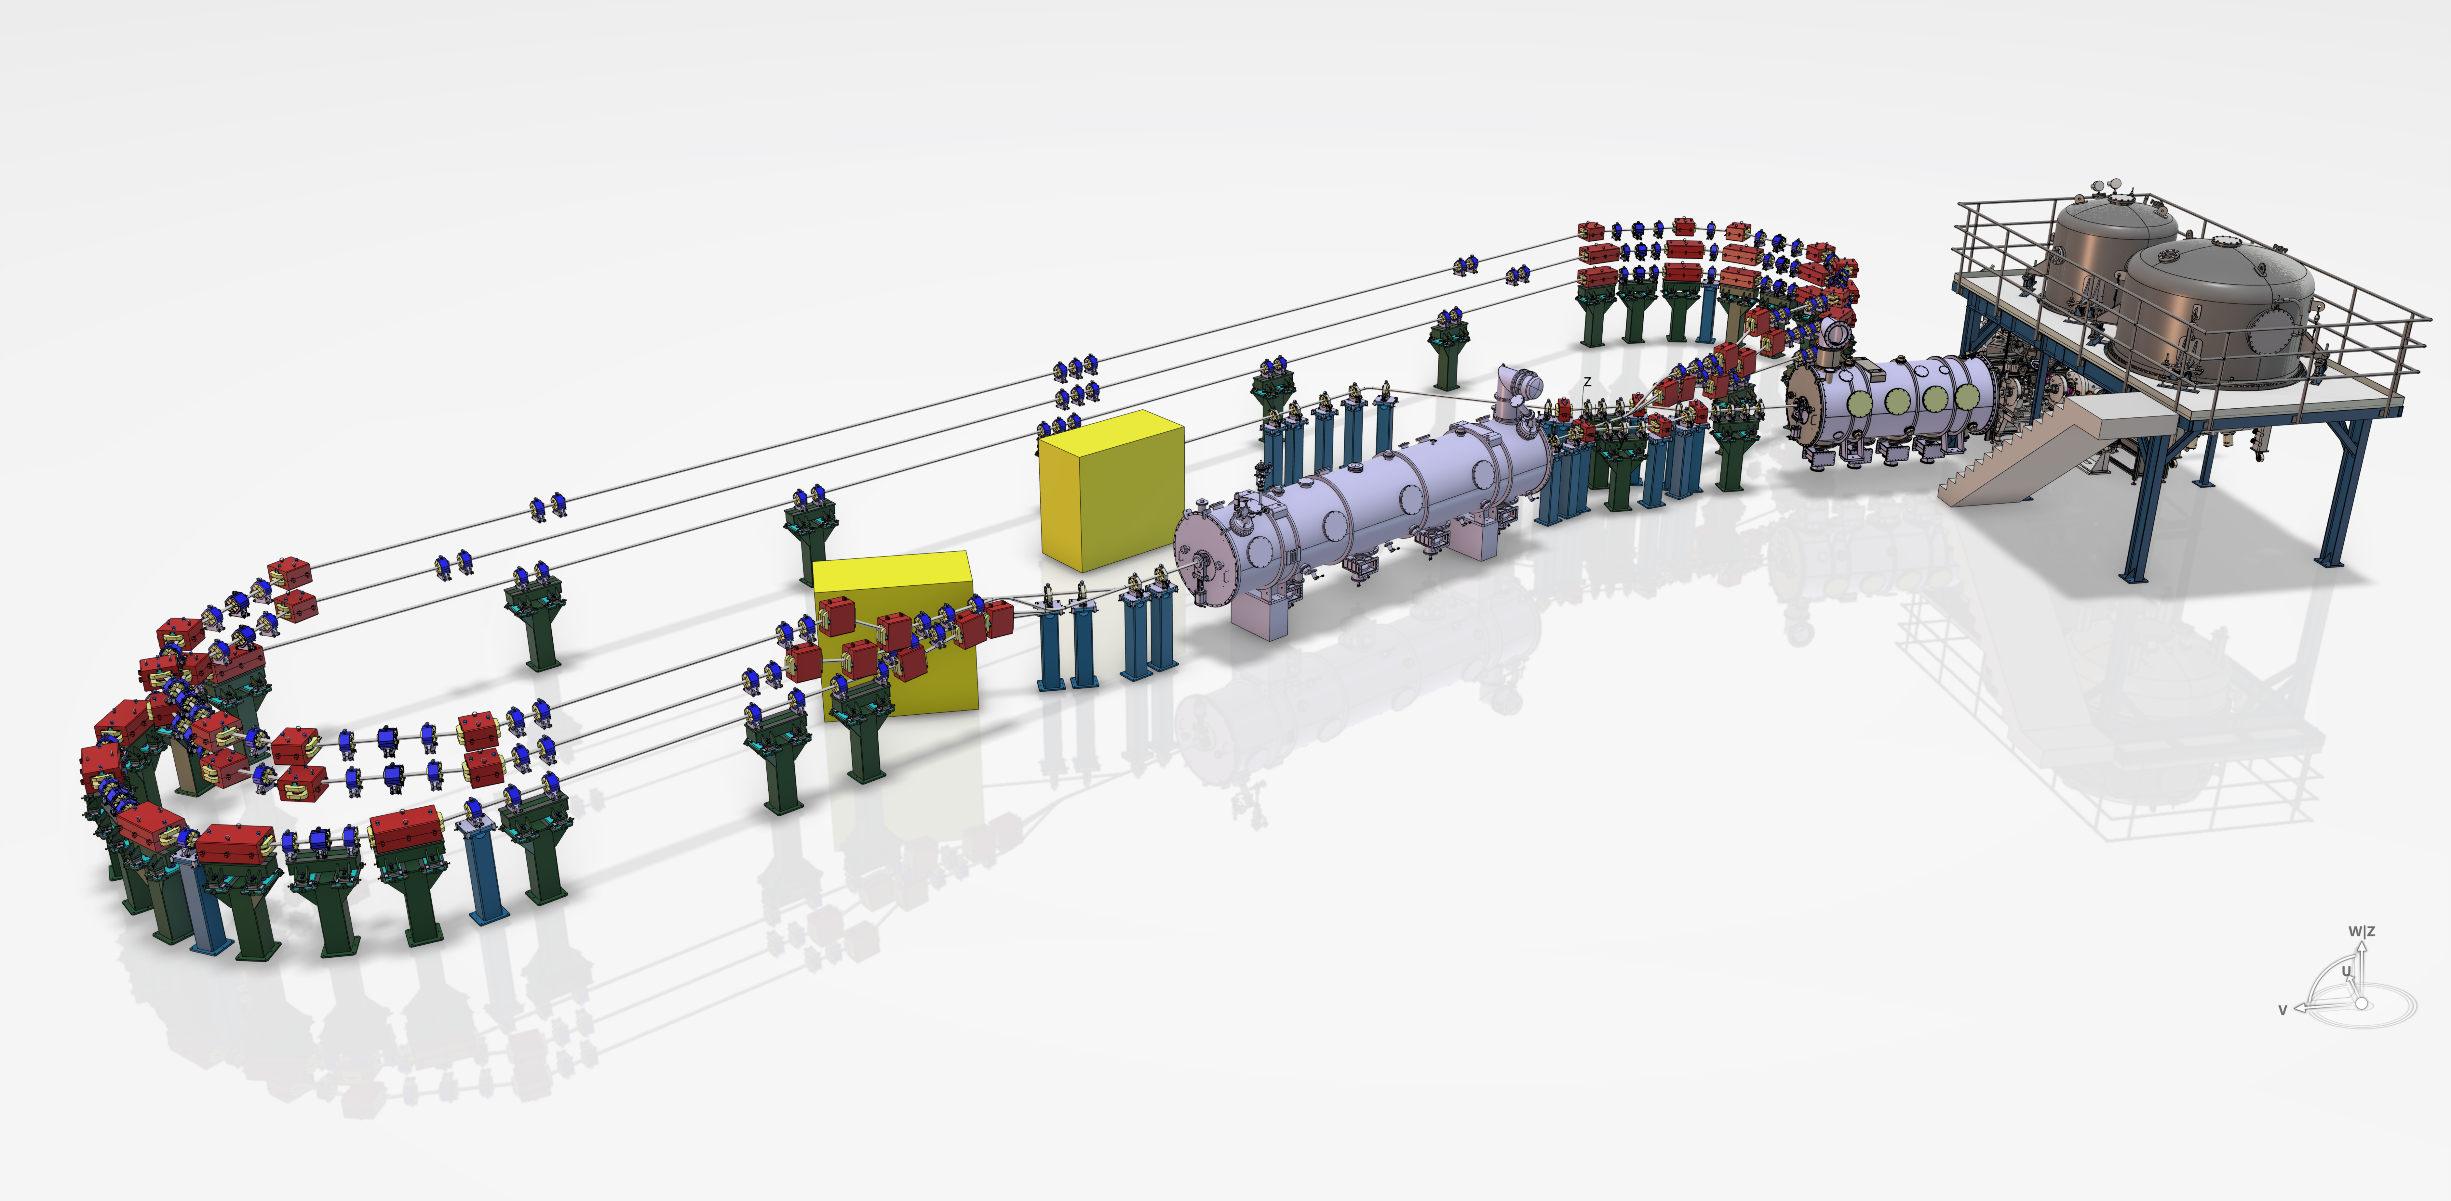

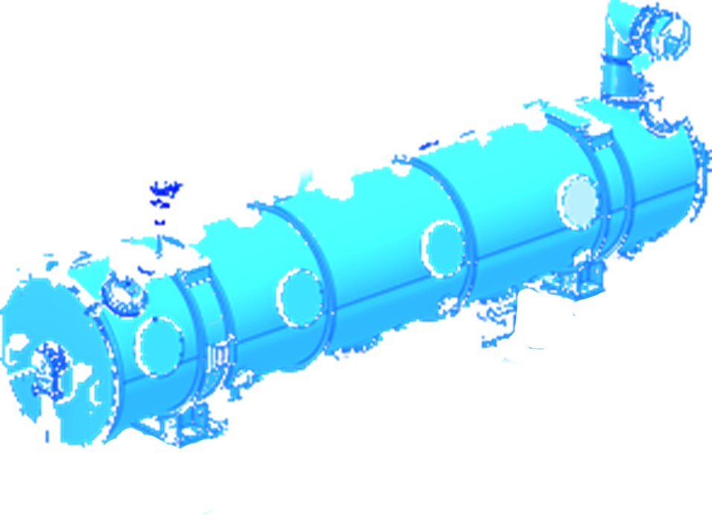
Scope of Cryogenics
What to cool?
Booster
Cryomodule
PERLE ERL

Slide 3
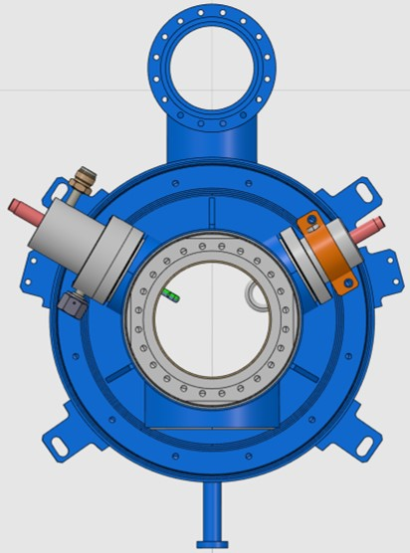
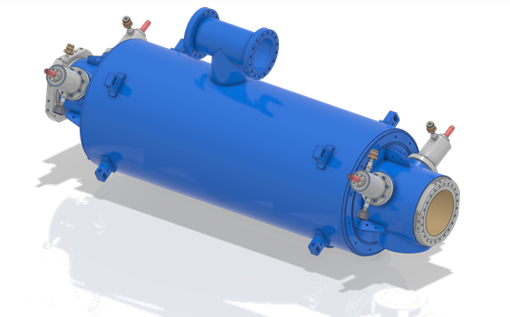
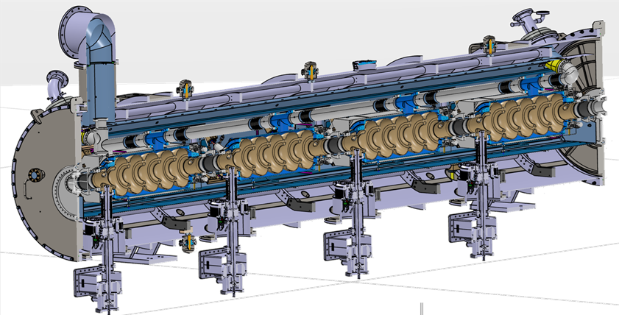

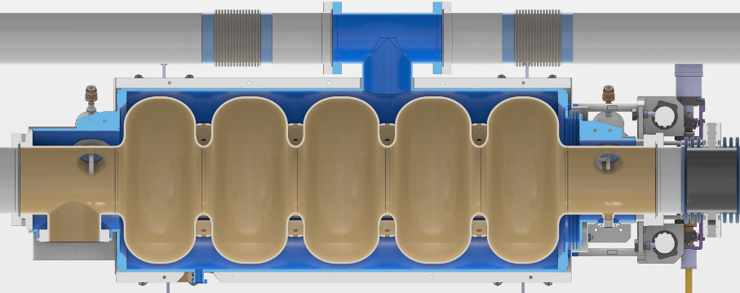
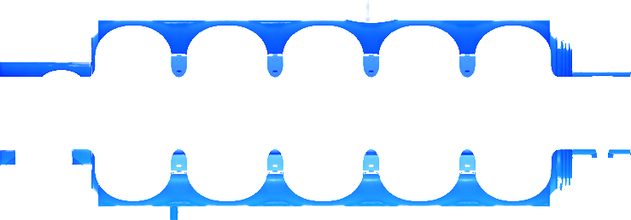
Scope of Cryogenics
What to cool?
  The PERLE cryomodule
    4x 5-cells SRF cavities
- Cavity: 48 kg of bulk niobium
- Helium tank:
  Tank: 37.7 kg of Ti grade 2
  Flanges: 3.7 kg of Nb-Ti
- Cryogenic vessel : V_{LHe}=32.8 L
Mechanical aspects:
Ø=368 mm
1300 mm
Max. Allowable Working Pressure PS=1.5 bar(g)
(art. 4.3 of Pressure Equipment Directive 2014/68/EU)
Bi-phase pipe
(Ø=95.5 mm)
He vap. pumping
T=2 K; P=31 mbar
Some RF features | IJCLab series
Frequency | 801.58 MHz
E_{acc} | 22 MV/m
L_{acc} = (n.β.λ/2) | 0.936 m
Q₀ | 3·10¹⁰
R/Q₀ @β=1 | 521 Ω
P_{RF_diss_cav} | 27 W @ T=2 K per cavity
LHe II
Niobium cavity
LHe II Subatmospheric saturating bath

Slide 4
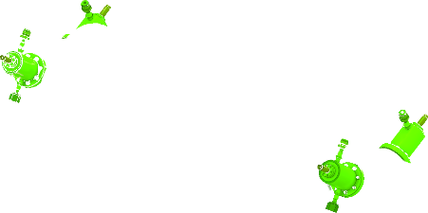

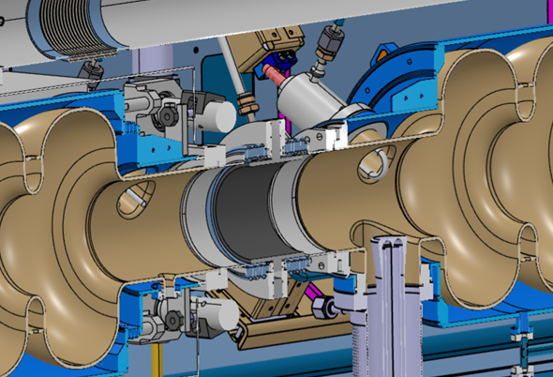
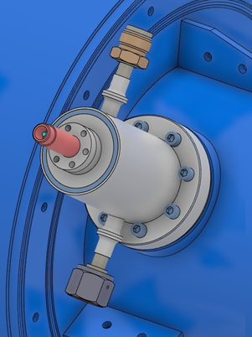
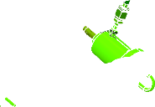
Scope of Cryogenics
What to cool?
  The PERLE cryomodule
    4x4x HOM couplers
See C. BARBAGALLO’s talk
4 HOM couplers per cavity
Cryogenic goals:
Remove heat induced by RF loading
Intercept heat flowing along the cables
Active cooling with LHe II TBC:
Probe design ⇒ LHe II cooling TBC
Hook design ⇒ LHe II cooling TBC
DQW design ⇒ LHe II cooling needed
(mech. and thermal designs ongoing)
P_{cooling}~ 0.04 W per HOM coupler @ T=2 K

Slide 5


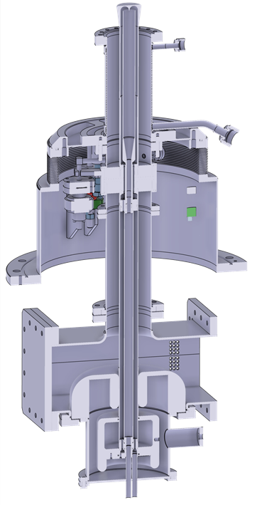
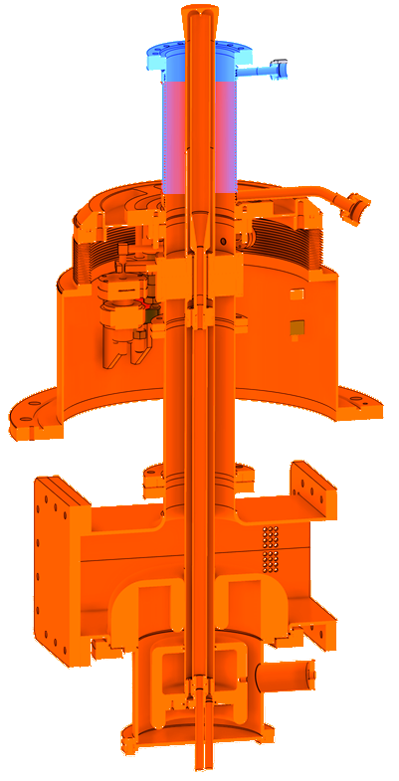

Scope of Cryogenics
What to cool?
  The PERLE cryomodule
    4x RF power couplers double walls
Double wall
(supercritical helium flowing in channels)
See E. MONTESINO’s talk
RF power coupler
Supercritical helium
(T=5 K, P=3 bar)
Cavity interface -
Supercritical helium
T=300 K, P=3 bar
Cryogenic goals:
Intercept heat flowing from room environment (diffusion + radiation)
Remove heat from RF dissipation along the double wall
Cooling mass flow rate: 0.2 g/s per coupler
(maximum preliminary estimate)
MB ESS RF power coupler

Slide 6


Scope of Cryogenics
What to cool?
  The PERLE cryomodule
    5x HOMS Beam Line Absorbers
      3 between the 4 SRF cavities
      (and 2 warm at the end of the cryomodule)
See C. BARBAGALLO’s talk
Foreseen (TBC):
- Main cooling: supercritical helium at T~60 K, 12.5 bara
- Heat intercept: supercritical heat at 5 K, 3 bara
Cryogenic goal: extract heat induced by RF dissipation (HOMs damping)
P_{cooling}: ~200 W @ 60 K now considered for 5 absorbers
(⇒ to be evaluated; R&D ongoing)

Slide 7
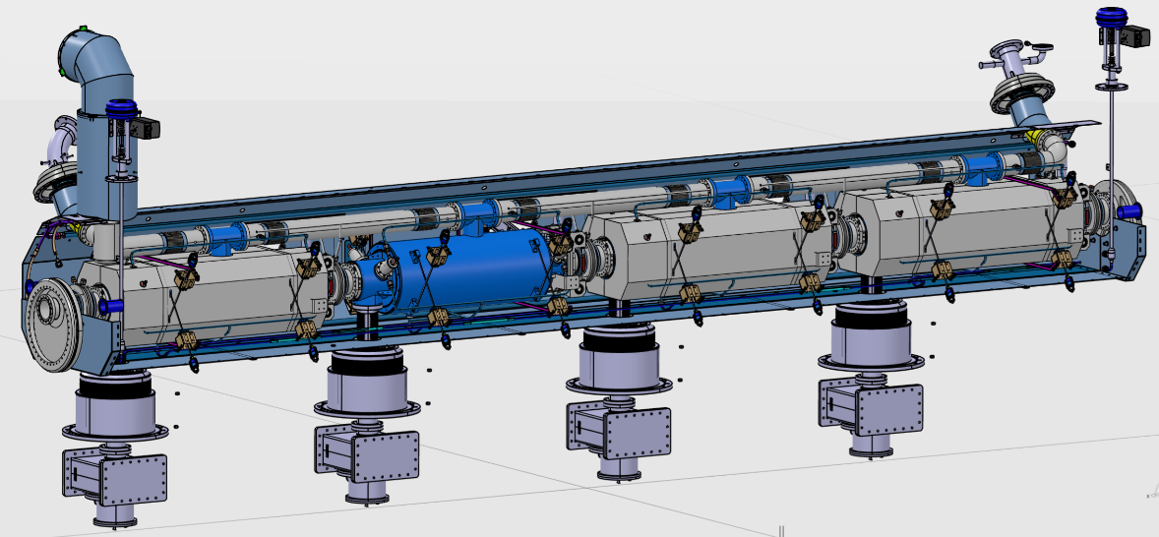

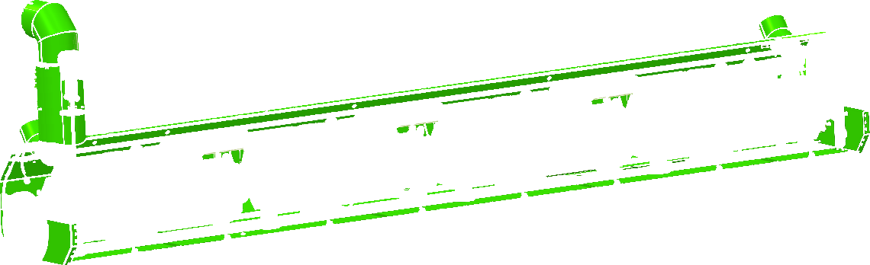
Scope of Cryogenics
What to cool?
  The PERLE cryomodule
    1x Thermal shield
Cryogenic goals:
Reduce the heat which is radiated from the room environment to the cold mass
Intercept heat diffusing along cables, supports, etc.
Cooled with supercritical helium
(T~60 K, P=12.5 bar)
P_{cooling}: ~260 W @ 50 K
(based on ESS cryomodule measurements)

Slide 8
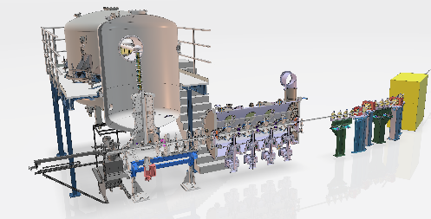
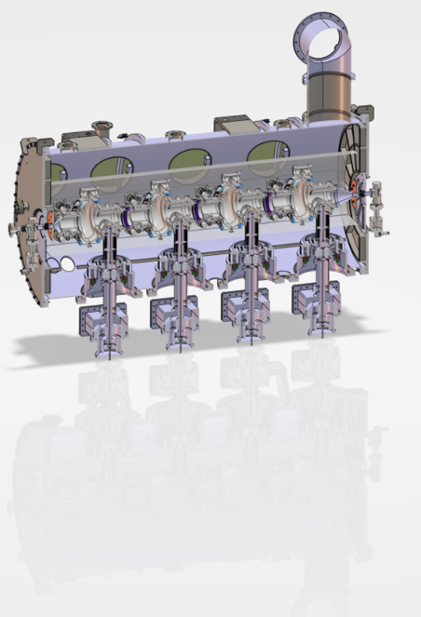
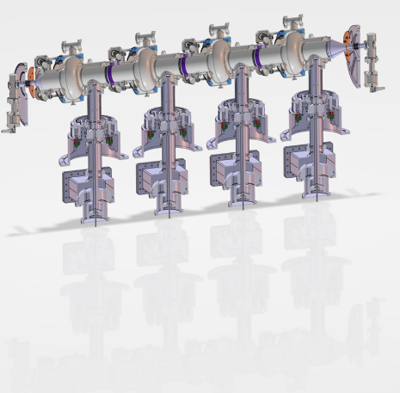
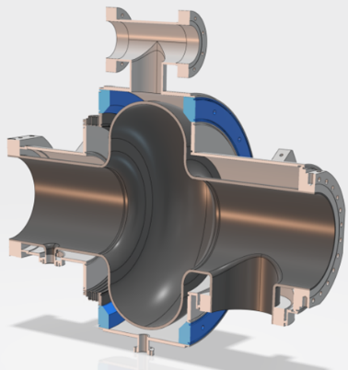
Scope of Cryogenics
What to cool?
  The PERLE SRF booster
    String of cavities:
      4x SRF single-cell cavities @ 2 K with superfluid helium
      No HOM coupler
      4x RF power couplers with supercritical helium at 3 bara and from 5 to 300 K
    1x thermal shield with supercritical helium at 12.5 bara and at ~60 K
Injection line
See R. ROUX’s and G. OLRY’s talks
- Cavity: 12.4 kg of bulk niobium
- Helium tank: 23.4 kg of Ti grade 2
- Cryogenic vessel: V_{LHe}=7.7 L

Slide 9
Scope of Cryogenics
How much to cool? Preliminary heat loads budget
ERL PERLE | Q @ 2 K | Q @ 60-70 K | LHe 5-300 K
 | (W) | (W) | (g/s)
Cryomodule
4x SRF cavity @Q0=3e10 | 108
Cryomodule static | 25
16x HOM Rfdyn | 0.64
16x HOM static | 0.64
4x RF power coupler | 1.5 |  | 0.8
Absorbers
Thermal shield + heat intercepts |  | 260
Booster
4x SRF cavity @Q0=1e10 | 12
Cryostat static | 25
4x RF power coupler | 1.5 |  | 0.8
Thermal shield + heat intercepts |  | 175
2x Valve Boxes | 15 | 50
2x Cryolines | 15 | 30
Beam losses | 10
TOTAL | 210 | 515 | 1.6

Slide 10
Scope of Cryogenics
How much to cool? Preliminary heat loads budget
  PERLE ERL:
  LINAC pattern:
1st loop : 89MeV
2nd loop : 171 MeV
3rd loop : 253 MeV
7MeV
Source
Booster
Cryomodule
Expérience
Dump
Cryogenics:
Pcryo 2 K: 210 W
Pcryo 60-70 K: 515 W
LHe: 1.6 g/s
Pelec: 200 kW
7MeV
89MeV
171 MeV
253 MeV
Source
Booster
Cryomodule 1
Cryomodule 2
Cryomodule 3
Expérience
Dump
Cryogenics:
Pcryo 2 K: 515 W
Pcryo 60-70 K: 1 720 W
LHe: 3.2 g/s
Pelec: 462 kW

Slide 11
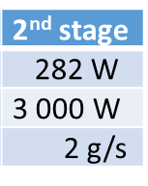
Scope of Cryogenics
How to cool?
  Currently: decommissioning of the BESSY VSR (Variable pulse length Storage Ring) refrigeration system located in Helmholtz-Zentrum Berlin (HZB)
  Cooperation agreement between HZB and IJClab set up for the transfer of the cryogenic refrigeration system to IJCLab by end of 2026 for PERLE operations
  This cryogenic refrigeration system
    includes:
      A Linde refrigerator: based on the refrigerator of CMTF at Fermilab, but 2 K production part is separated (in a distribution box)
      A distribution box (or valve box) producing superfluid helium
      A cryogenic transfer line (~30 m long) containing several cryogenic circuits
      Additional components: cycle compressors, helium pumping system, etc. (transfer to IJCLab is to be confirmed)
    specified and designed in two stages (steps): stage 1 = low power and stage 2 = high power refrigeration
    1st stage was installed in 2020
    1st stage was commissioned in 2022 (almost completely)
  NDA between IJCLab and Linde is being set up to ease communication on technical aspects
Temperature level Heat load | 1st stage
1.8 K (evaporation at 16.4 mbara) | 186 W
60 K (warming from 45 to 80 K at ~12.5 bara) | 1 300 W
4.5 K (liquefaction at 1.25 bara) | 2 g/s
eq. 207 W @ 2K
(210 W for PERLE’s heat budget; no margin)
515 W for PERLE estimates
~1.6 g/s for PERLE estimates

Slide 12
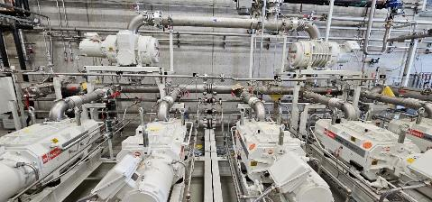
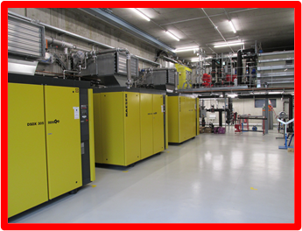
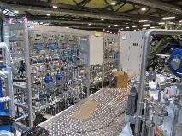
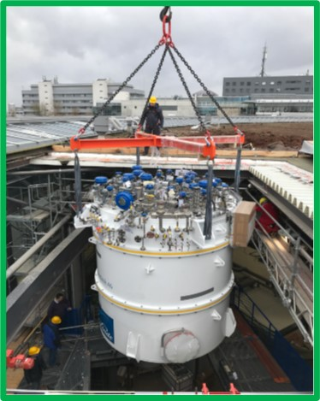
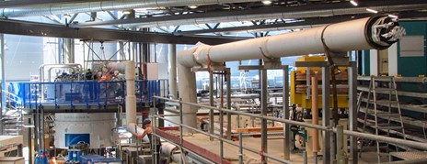
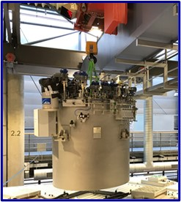
Perspectives
How to cool?
Cycle compressor
Low pressure pumping stations
LN₂
Cold box
(cryogenic refrigerator)
LHe
Cryogenic transfer line
5 K, 3 bara
Distribution box
(Valve box)
1.8 K
1.8 K

Slide 13
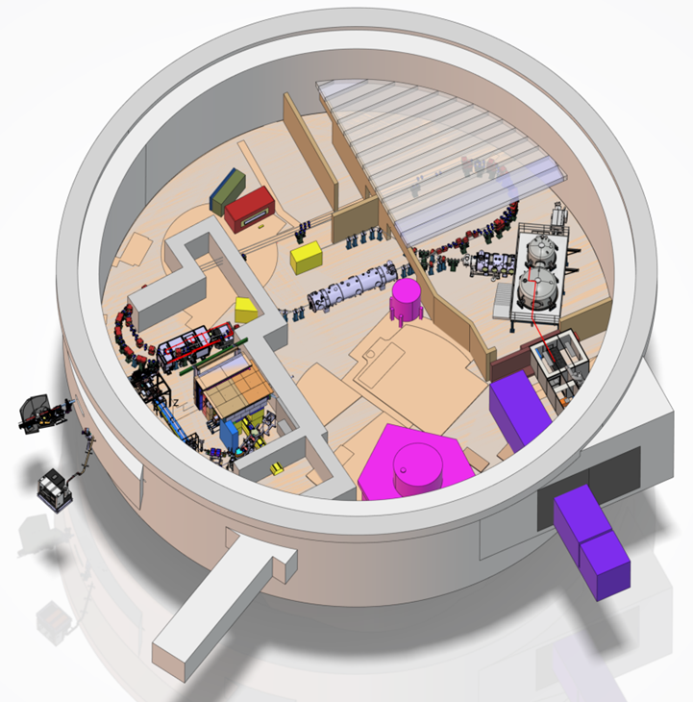
Conclusion & Perspectives
Intense design work on the booster and cryomodule is currently ongoing
    cooling concepts for HOM couplers to be choosen
    more accurate numbers to be provided for heat loads
Conceptual design of the cryogenic distribution system
  Includes: transfer lines and distribution boxes
  ⇒ ongoing and expected to be finalized by mid 2025
Opened questions:
  Cooling concept for BLAs in the cryomodule?
  Is fast cooling needed for cryomodules cavities?
  Refrigeration stage 2: needed, how, when, what cost?
Siting studies began to integrate cryogenic systems
(and related subsystems)
  HZB’s in-kind integration into PERLE’s pattern
  Prepare a financial application for the support
  of cryogenic infrastructures
  Prepare the 2nd stage phase

Slide 14
Thank you for your attention
Special thanks to:
Sébastien BLIVET
Sylvain BRAULT
Patricia DUCHESNE
Gille OLIVIER

